Slide 1
Web Interactions Https - Html - Javascript
arnaud.nauwynck@gmail.com

Slide 2
Outline
Https → Load Html + Js + Css + Json + *
Js → Call Http : SPA, Rest + Json
Html → execute Js <script>
Html → trigger events to Js
Js → Query/Update Html DOM
Js Frameworks, MVC, Bindings

Slide 3
Outline
Https → Load Html + Js + Css + Json + *
Js → Call Http : SPA, Rest + Json
Html → execute Js <script>
Html → trigger events to Js
Js → Query/Update Html DOM
Js Frameworks, MVC, Bindings

Slide 4



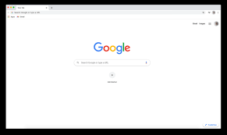
Web Browser = Http Client Web Site = Http Server
Http Server
DNS hostname: www.google.com
Port : 8443
Protocol: Http + TLS
Resource path: some-path
Url: https://www.google.com:8443/some-path
Your PC
mydesktop.home
192.168.0.1
http Request
http Response

Slide 5
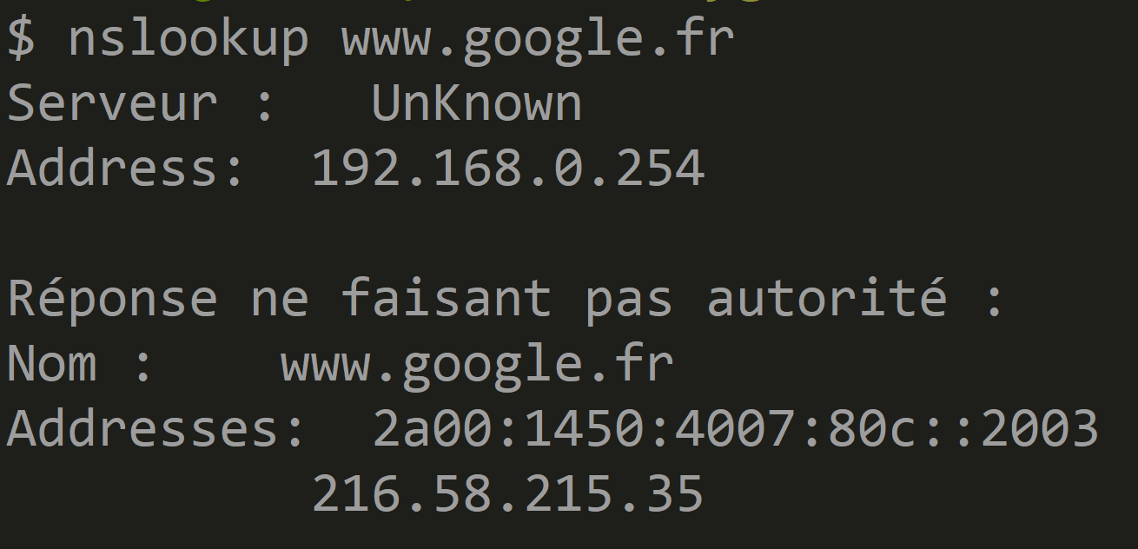
Https://<<hostname.domain>>:<<port>>
Step 1 : resolve hostname.domain to TCP-IP Address

Slide 6
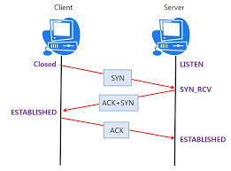
Open TCP-IP Socket
Step 2 : open TCP-IP Socket = SYN, SYN+ACK, ACK

Slide 7
What is a TCP-IP Socket ? (1/3)
a virtual bi-direction stream
write
read
write
read
OS User Mode (Apps)
OS Kernel
Network

Slide 8
What is a TCP-IP Socket ? (2/3)
a virtual bi-direction stream
identified by 4 ids : (IP-source, Port-Source, IP-dest, Port-Dest)
write
read
write
read
OS User Mode (Apps)
send IP Packets
(IP1:port1, IP2:port2)
(IP1:port1, IP2:port2)
OS Kernel
Network
receive IP Packets

Slide 9
What is a TCP-IP Socket ? (3/3)
a virtual bi-direction stream
identified by 4 ids : (IP-source, Port-Source, IP-dest, Port-Dest)
with client/server states = buffers + "sequence numbers" (read/write)
write
read
write
read
OS User Mode (Apps)
send IP Packets
OS Kernel
Network
receive IP Packets

Slide 10
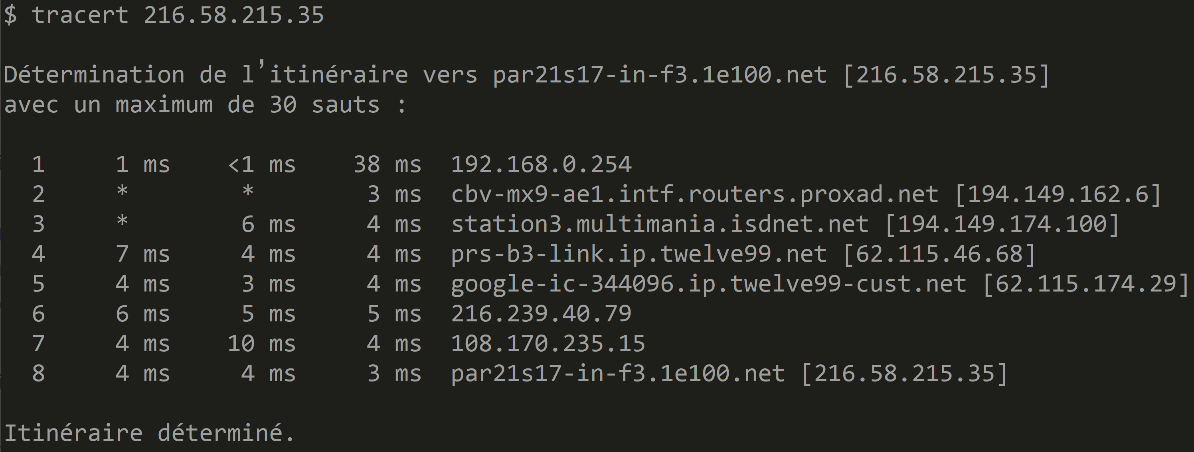
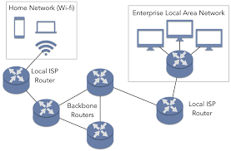
Traceroute ?
ANNEXE

Slide 11
HTTPS = Request-Response Text Protocol over TCP-IP (+TLS)
https Request
encrypted text Request
(over TLS)
open TLS socket
write request
Request
in TCP-IP Packet(s)
Response
from TCP-IP Packet(s)
read text response
close
decrypt text Response
(over TLS)
https Response

Slide 12
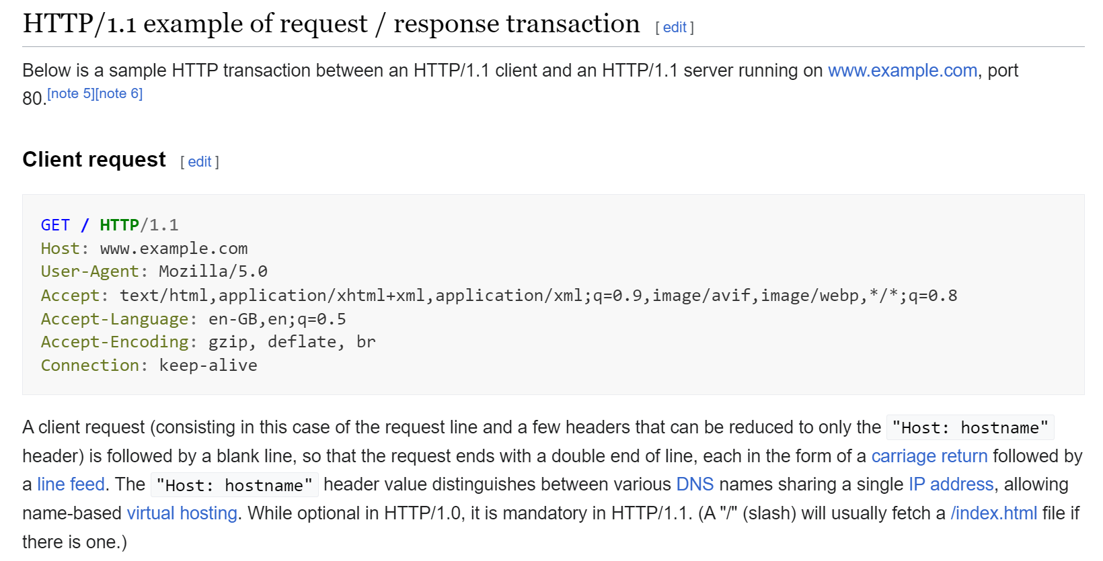
Http Request (GET, POST, PUT, ..)
https://en.wikipedia.org/wiki/HTTP

Slide 13
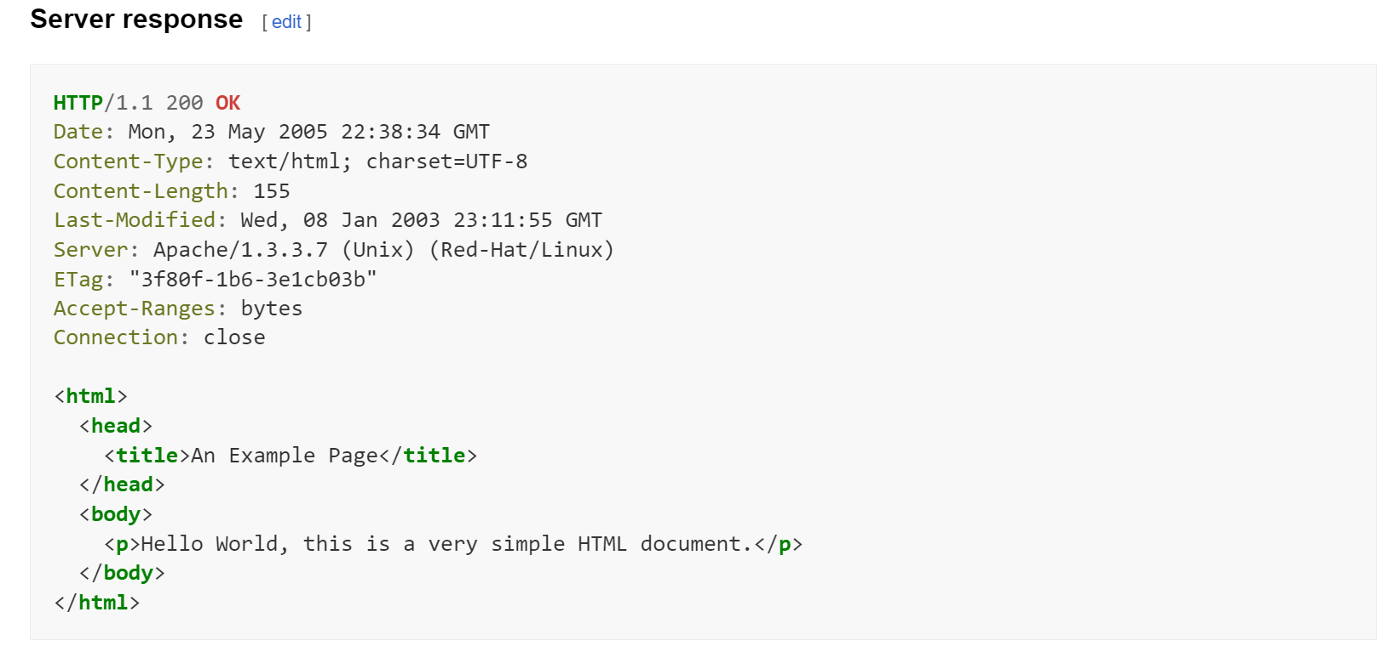
Http Response (200, 300, 400, 500 ...)
https://en.wikipedia.org/wiki/HTTP

Slide 14
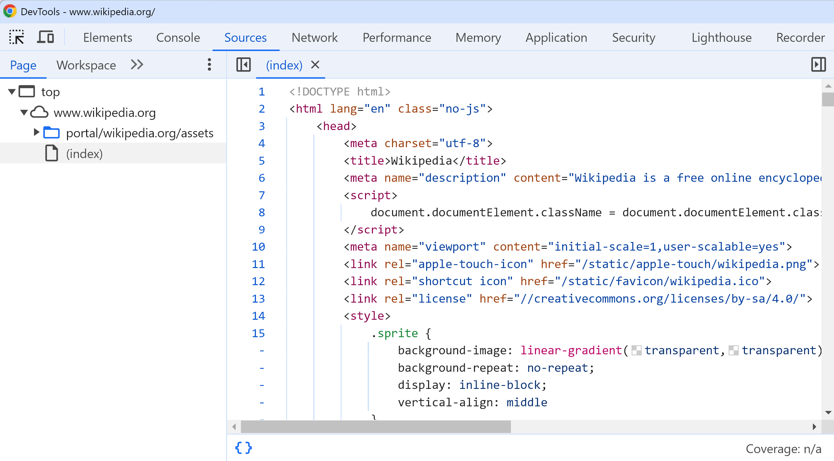
Loading Html Page

Slide 15
Can you GET/POST ONLY Html from Https ?
Http Requests have 2 parts:
part 1 in text:
line 1 = VERB (GET/PUT/POST..) + path
line 2, 3, ..N = http header name=value
separator line : "."
part 2 in any format (byte[])

Slide 16
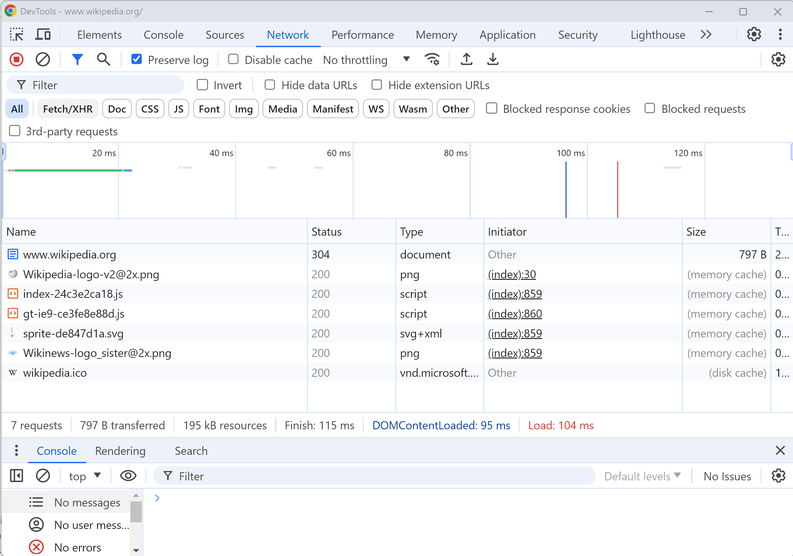
loading a page (N Requests: html, png, js, svg, css..)
example:
https://www.wikipedia.org/

Slide 17
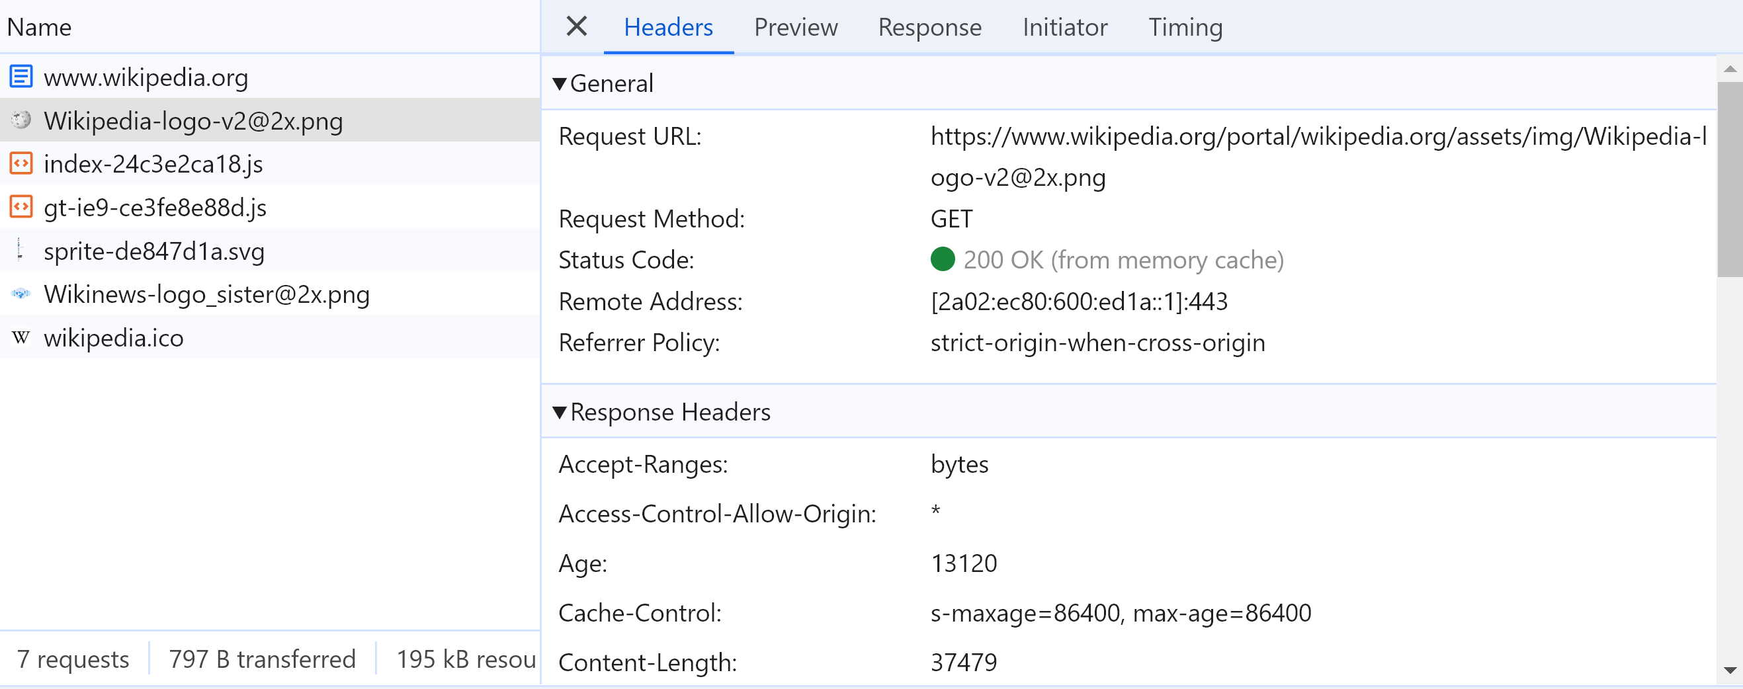
Content-Length
How can Http knows the full binary content response, then close the socket ?
... By using a Http Header "Content-Length"

Slide 18
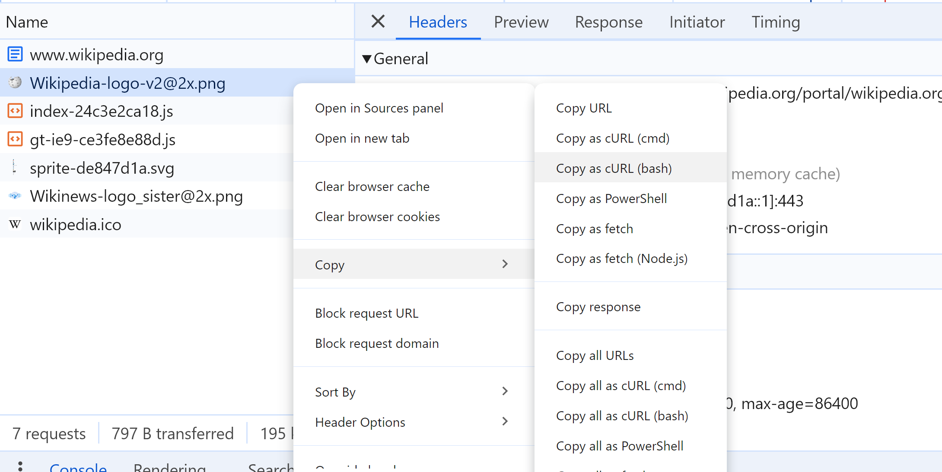
Copy Request/Response from Browser
Often usefull to reproduce Http request manually from "Postman", or "Curl"

Slide 19
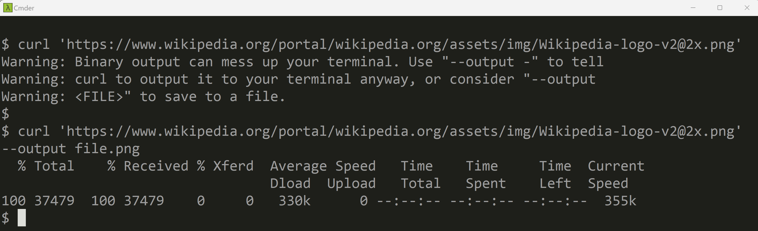
Http Request using Shell Command "curl" (with "-v" for verbose, "--output -" for binary)

Slide 20
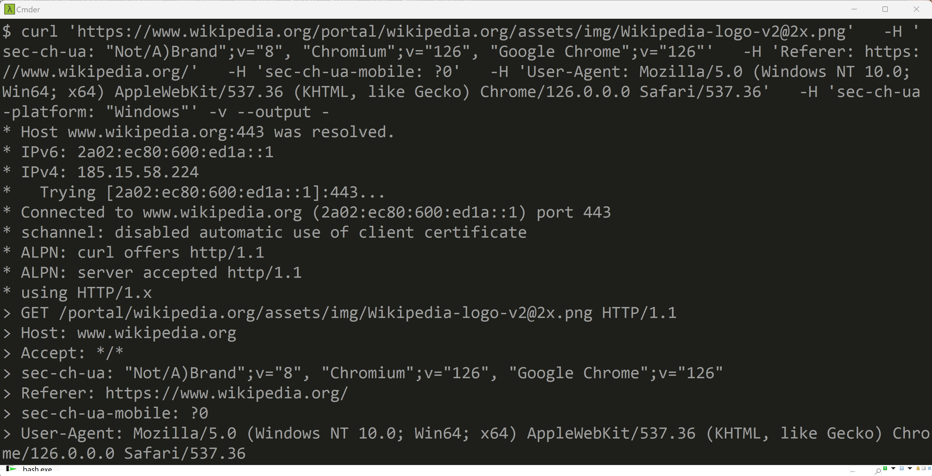
"curl" with "-v" for verbose part 1/3: connection "*" + sent ">" Http headers
connection
sent
http headers

Slide 21
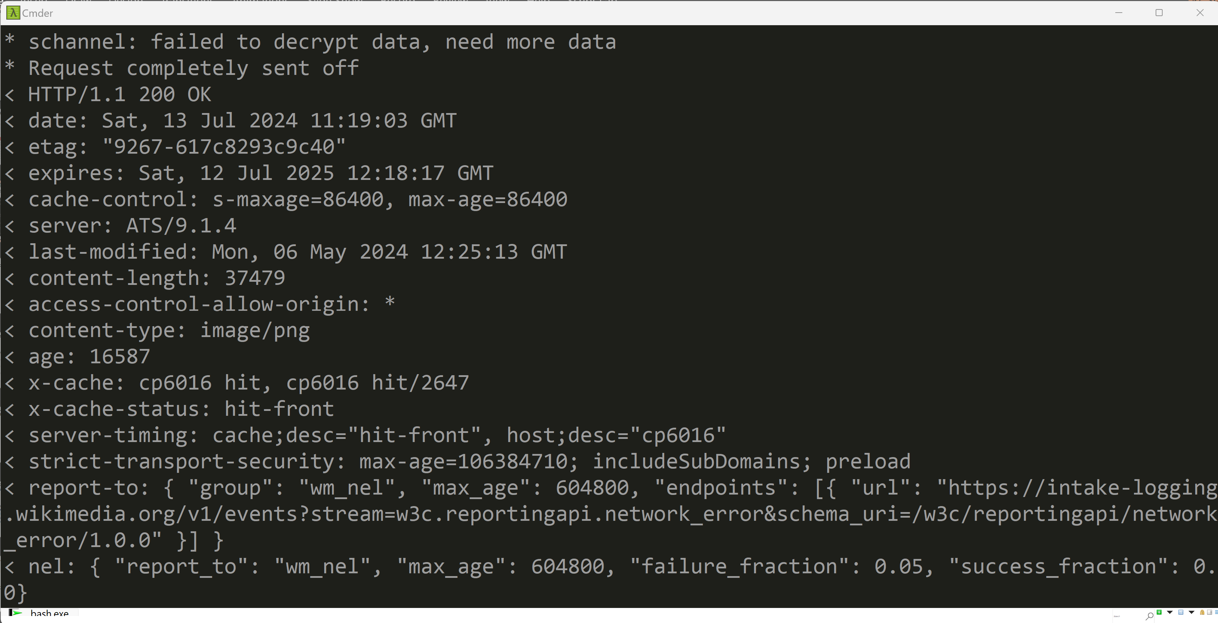
"curl" with "-v" for verbose part 2/3: "<" received http headers
received
http headers

Slide 22
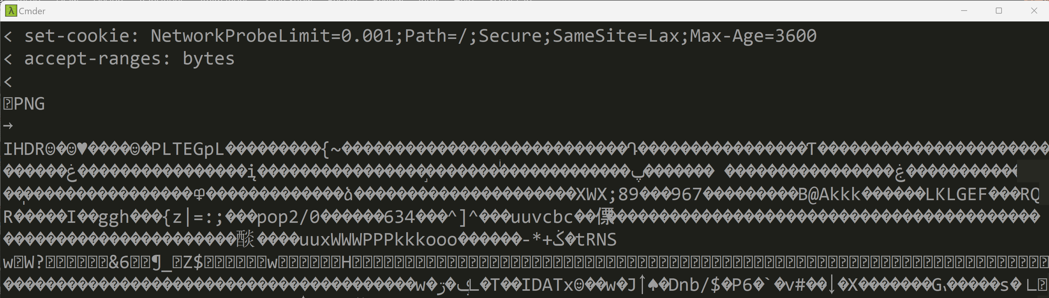
curl with "-v" for verbose part 3/3: received body
empty line
separator
received
body
(binary)

Slide 23
Outline
Https → Load Html + Js + Css + Json + *
Js → Call Http : SPA, Rest + Json
Html → execute Js <script>
Html → trigger events to Js
Js → Query/Update Html DOM
Js Frameworks, MVC, Bindings

Slide 24
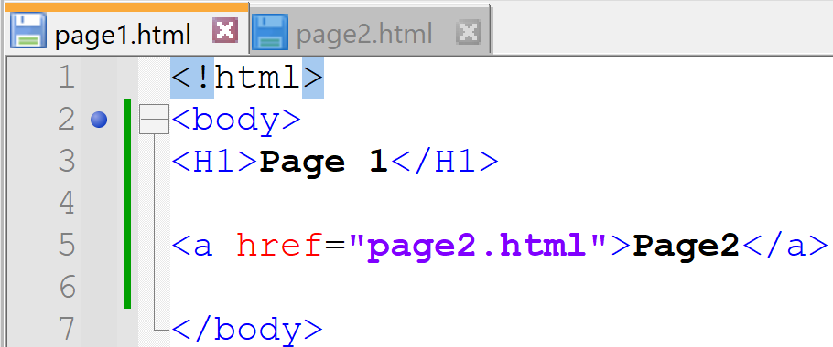
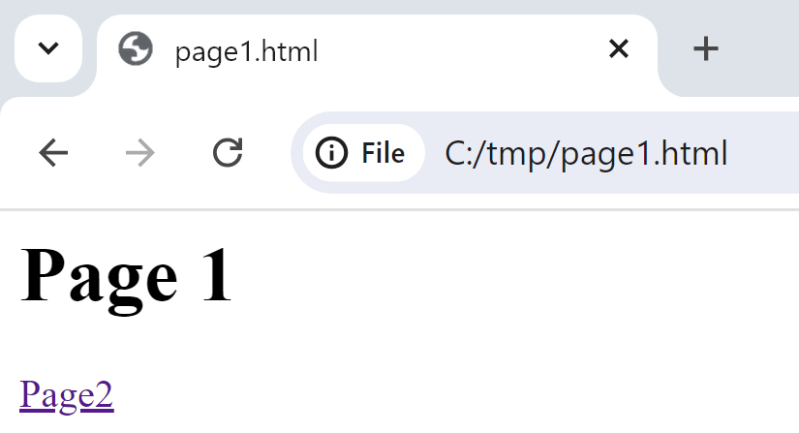
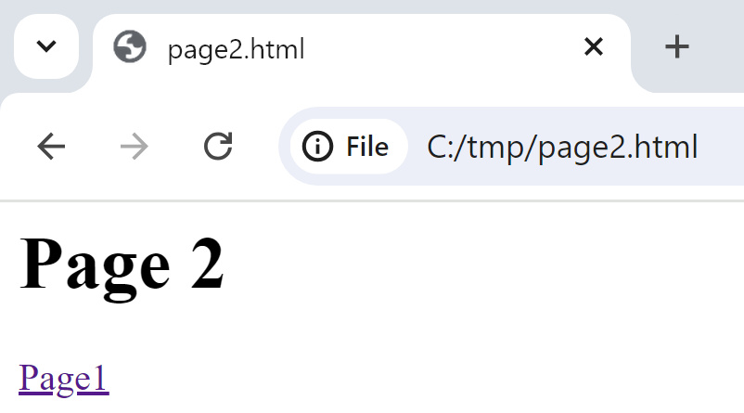
Old Ways to Change Pages 1/ change page with <a href="page.html>

Slide 25




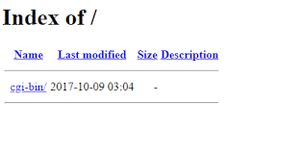





Old Ways to Change Refreshed Pages 2/ server-side generate pages
/htdocs / cgi-bin / *.sh
*.SP
Personal Home
Page
(not a decent langage)

Slide 26


Java Servlet & Jsp (html in java / java in pseudo-html )
= plain old java code printing « html » text
void toHtml(ServletOutputStream out) {
if (cond) {
out.print("<div> <span \"attr\"=\"v1\"> ..");
} else {
out.print("<div> <span \"attr\"=\"v2\"> ..");
}
out.print( new Date() );
}
= pseudo html/xml/markup code containing java
<% if (cond) { %>
<div><span "attr"="v1"> .. </span></div>
<% } else { %>
<div><span "attr"="v1"> .. </span></div>
<% } %>
<%= new Date() %>

Slide 27
Click <href> … RE-Loading new html page
Web Browser
/Page1.html
http GET /page1.html
<script>app1.js</script>
Free old page memory
http GET /page1.js
app1.js
Parse js
+ execute function init() {.. }
+ parse css + render html
http GET /page1.css
http GET /page1-image2.png
Dynamic Server Pages Server
CLICK on <href url=« /page2 »></href>
http GET /page2
/Page2
http GET /page2.js (or shared cached)
(re)Parse js
+ RE execute function init() {.. }
+ (re)parse css + RE render html
REPLACE page
with
new page
http GET /page2.css (or shared cached)
http GET /page2-image2.png (or shared cache)

Slide 28
Not only a Developper problem… Html+Js+CSS re-Rendering slowness + Network + .. for reloading pages links
SLOW … SLOW ….
NETWORK Bandwidth CONSUMING
+ Network Latency
+ CPU CONSUMING

Slide 29
Solution to Multiple Pages Application Problems ? caching + optims + workarounds … ? => SPA = Single Page Application !!

Slide 30
SPA = Single Page Application … still dynamic, still Multiple Rest Json requests
Web Browser
/Page1.html
http GET /page1.html
<script>app1.js</script>
http GET /page1.js
app1.js
Parse js
+ execute function init() {.. }
+ parse css + render html
http GET /page1.css
http GET /page1-image2.png
Web Server
CLICK on <button (click)=« callFunction() » >
http POST /api/restEndpoint1 {json}
REPLACE add/remote/update some <div>
Within SAME page
response {json}
http POST /api/restEndpoint2 {json}
response {json}

Slide 31
http API Server (cf Rest Api)
Terminology: Http Api Server
http request GET/POST/PUT/DELETE
On resource /{dynamicEntityPath}/{id}?{query}
Request body {json}
http Api Client
Http Api Server
response body {json}
Mostly *.json or *.xml !!!
Maybe also few (static) pages *.html,*.js,*.css

Slide 32
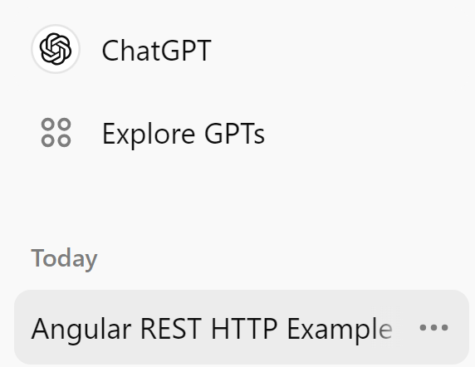
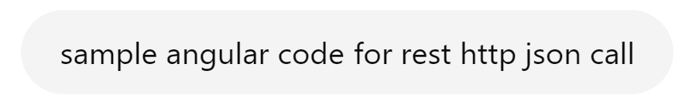
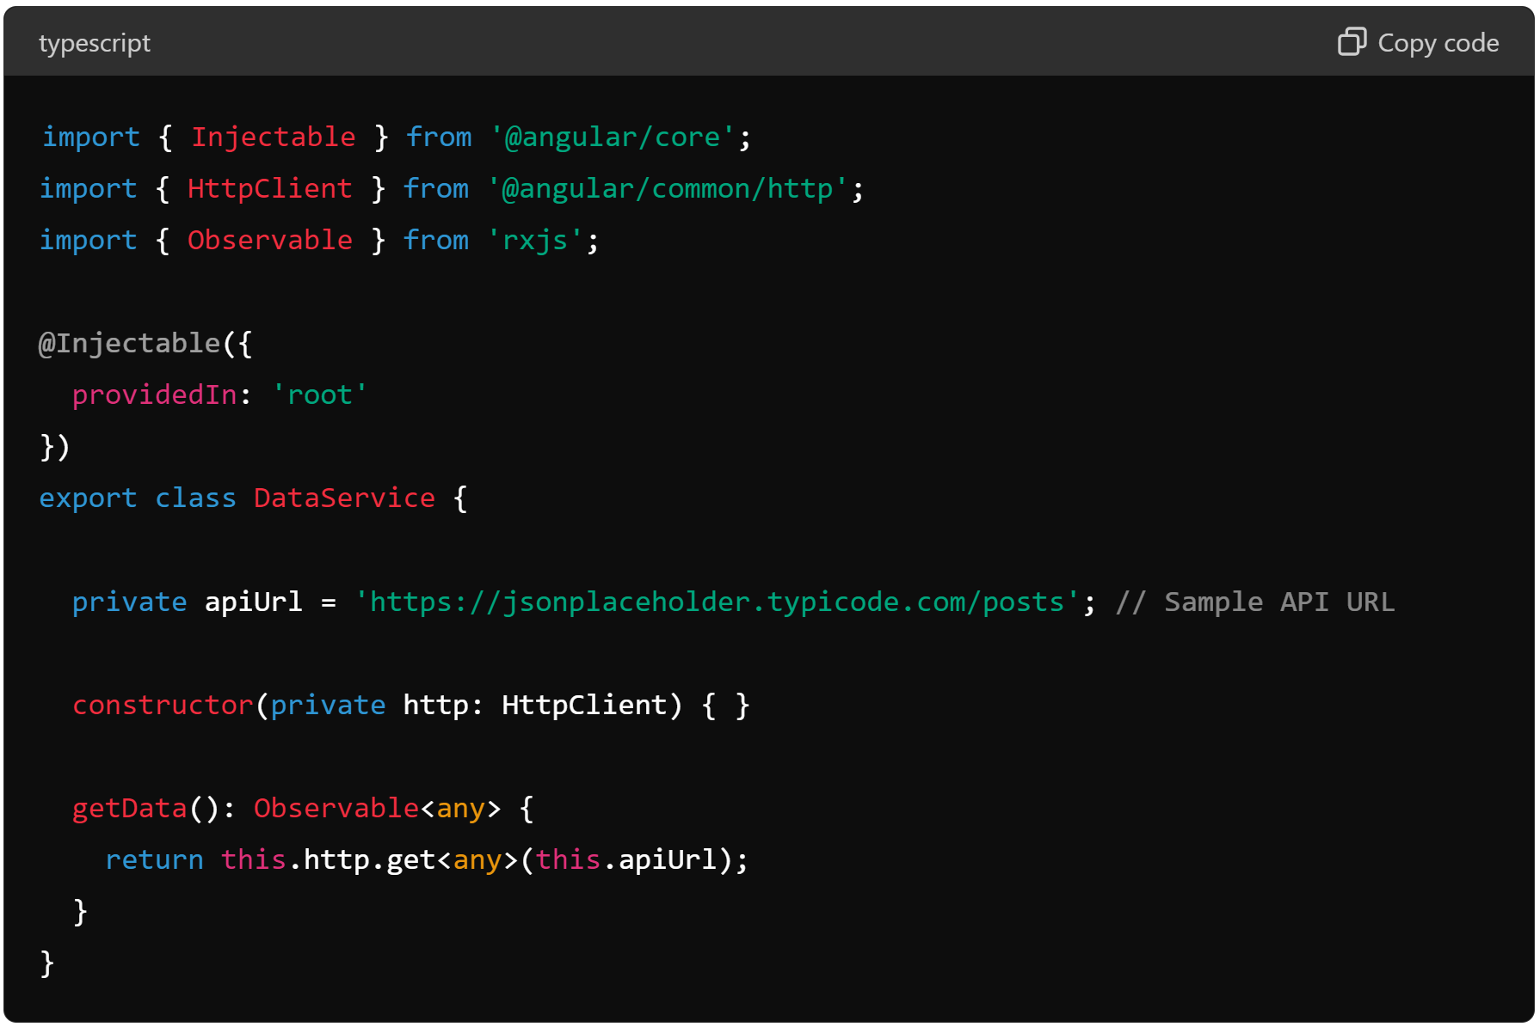
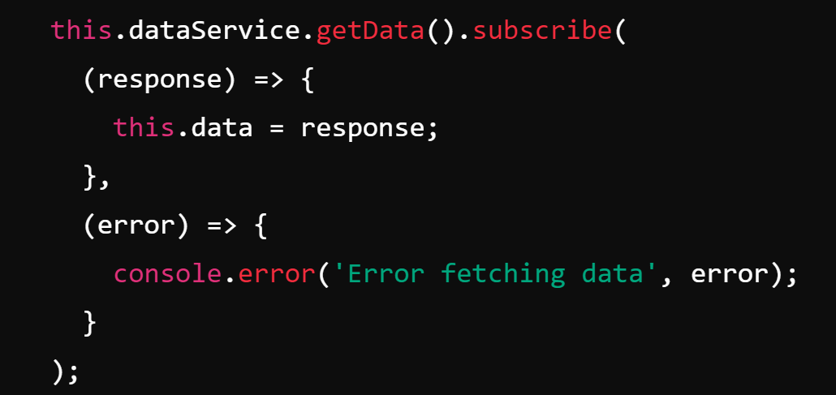
Sample Angular Code for Rest Http+Json Request

Slide 34
Request as "Blocking" (Low-Level) Code / SystemCalls
Code (ex: java)
System Calls
Socket s = // new Socket(...)
SSLSocketFactory.getDefault().createSocket(..)
s.connect(...)
OutputStream out = s.outputStream()
out.write("GET / HTTP 1.0\n")
out.flush()
InputStream in = s.inputStream()
byte[] buffer = new byte[4096]
int readCount = in.read(buffer)
s.close()
connect()
write()
flush()
all blocking calls
( thread/process
suspended to wait )
read()
close()

Slide 35
In the Browser (Javascript Web Spec) ... only 1 "event loop" main Thread
JavaScript API from the Web Browser
implement ONLY
High-Level
NON-Blocking calls
(with Callbacks or Promises)

Slide 36
Callback for Async
function asyncFunc( input, resultCallback ) {
...
}
yourApp() {
asyncFunc(..., resultCallback ); // <= return immediatly,
// and will call later: resultCallback( ...someResult )
... // next... called before resultCallback
}
function resultCallback( res ) {
...
}

Slide 37
Promises for Async
function asyncFunc( input ) { // return Promise
...
}
yourApp() {
var promise = asyncFunc(...); // <= return immediatly, will put result in promise later
promise.then(resultCallback);
... // next... called before resultCallback
}
function resultCallback( res ) {
...
}

Slide 38
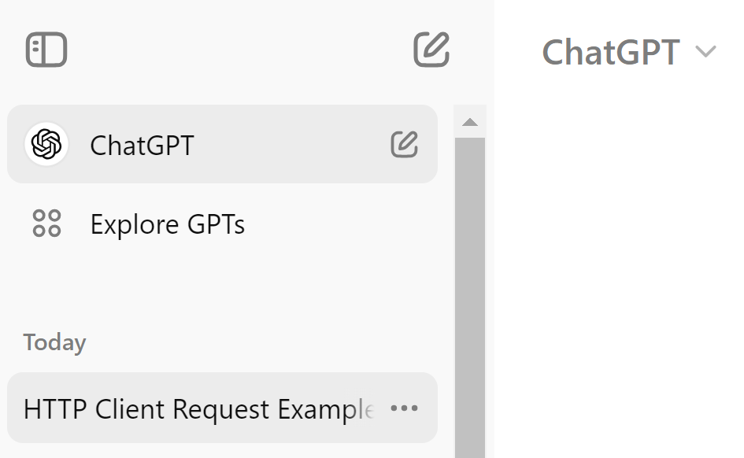
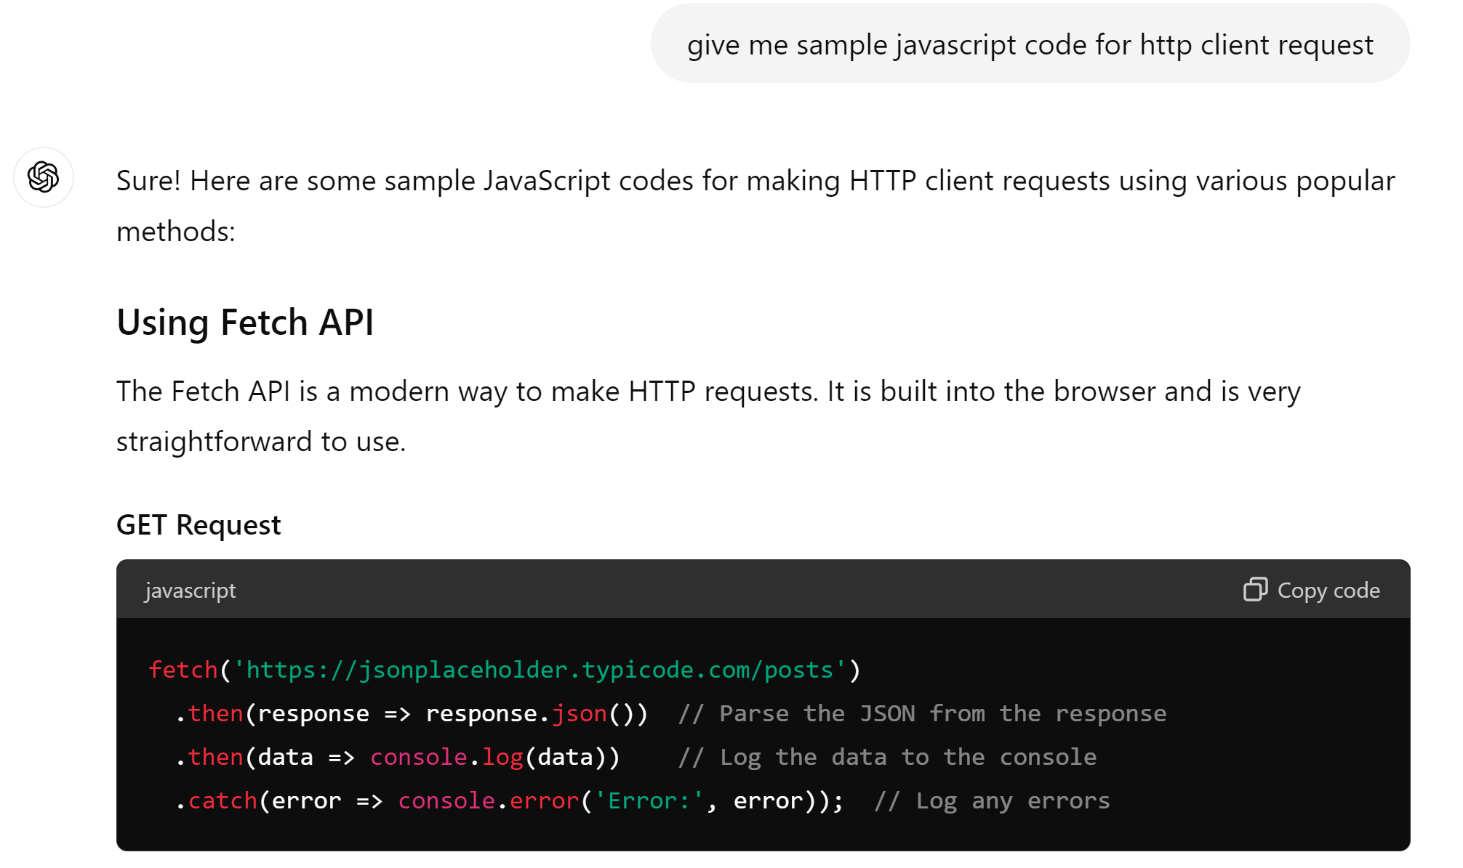
Http Request as Async (=Non-Blocking) Code

Slide 39
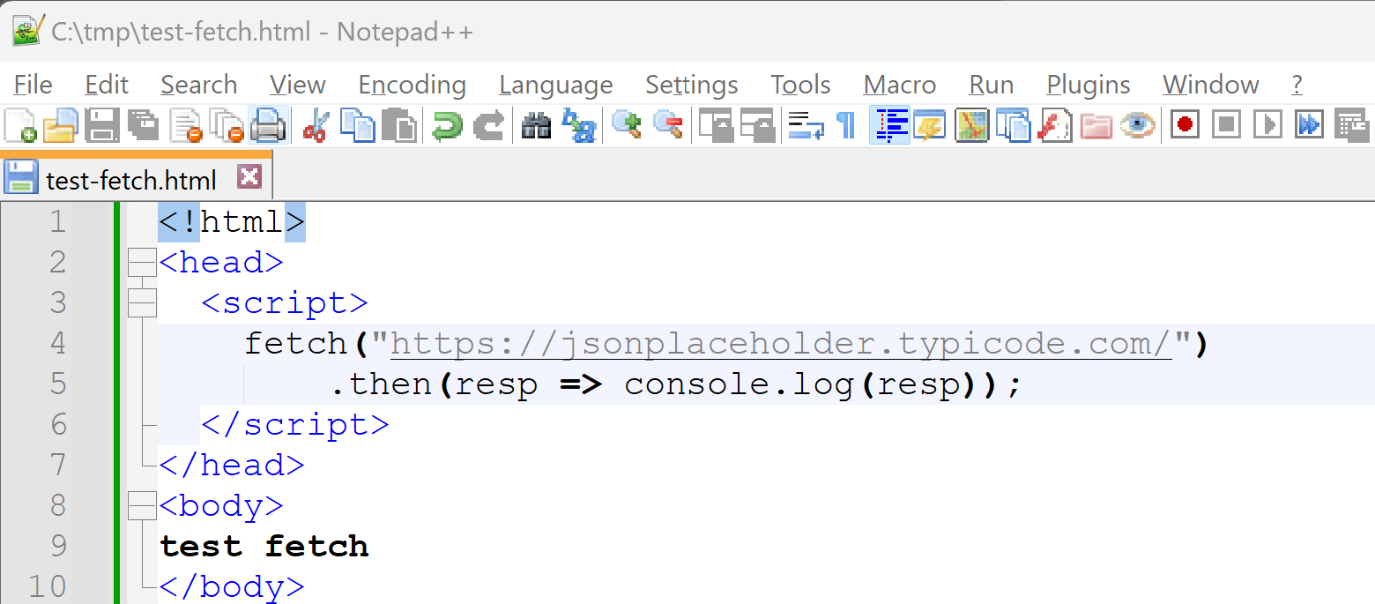
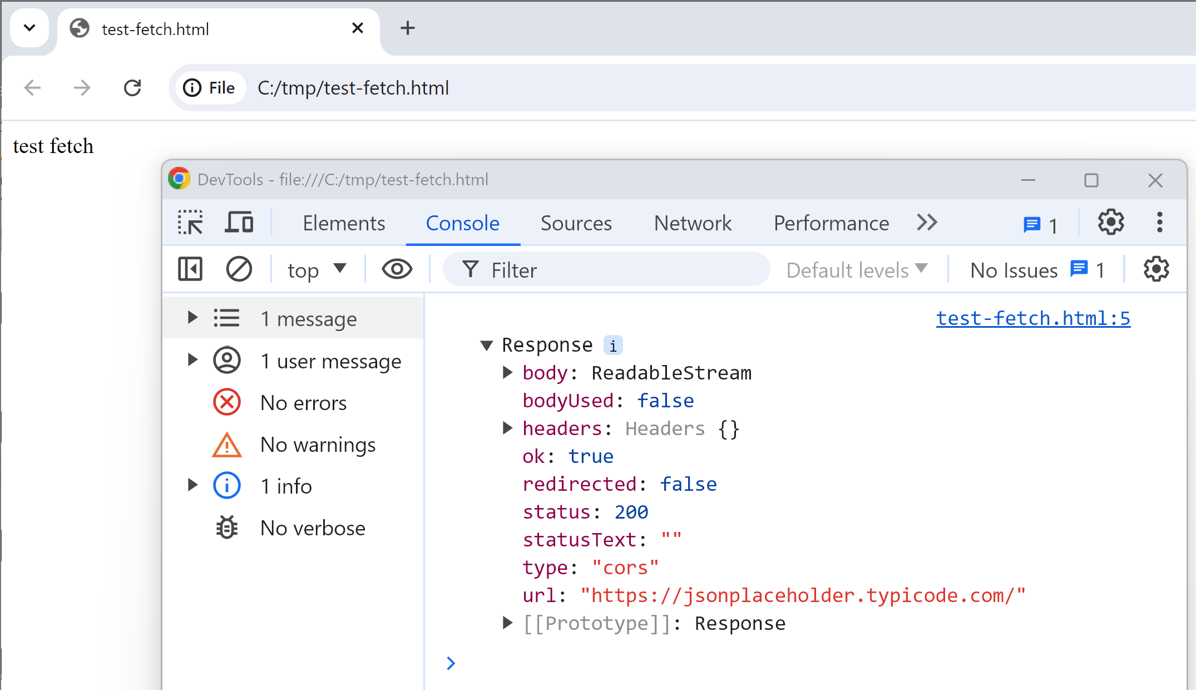
test-fetch.html
(1/3) Edit Html code, save file
(2/3) open browser
(3/3) Open DevTools (F12)
open Console

Slide 40
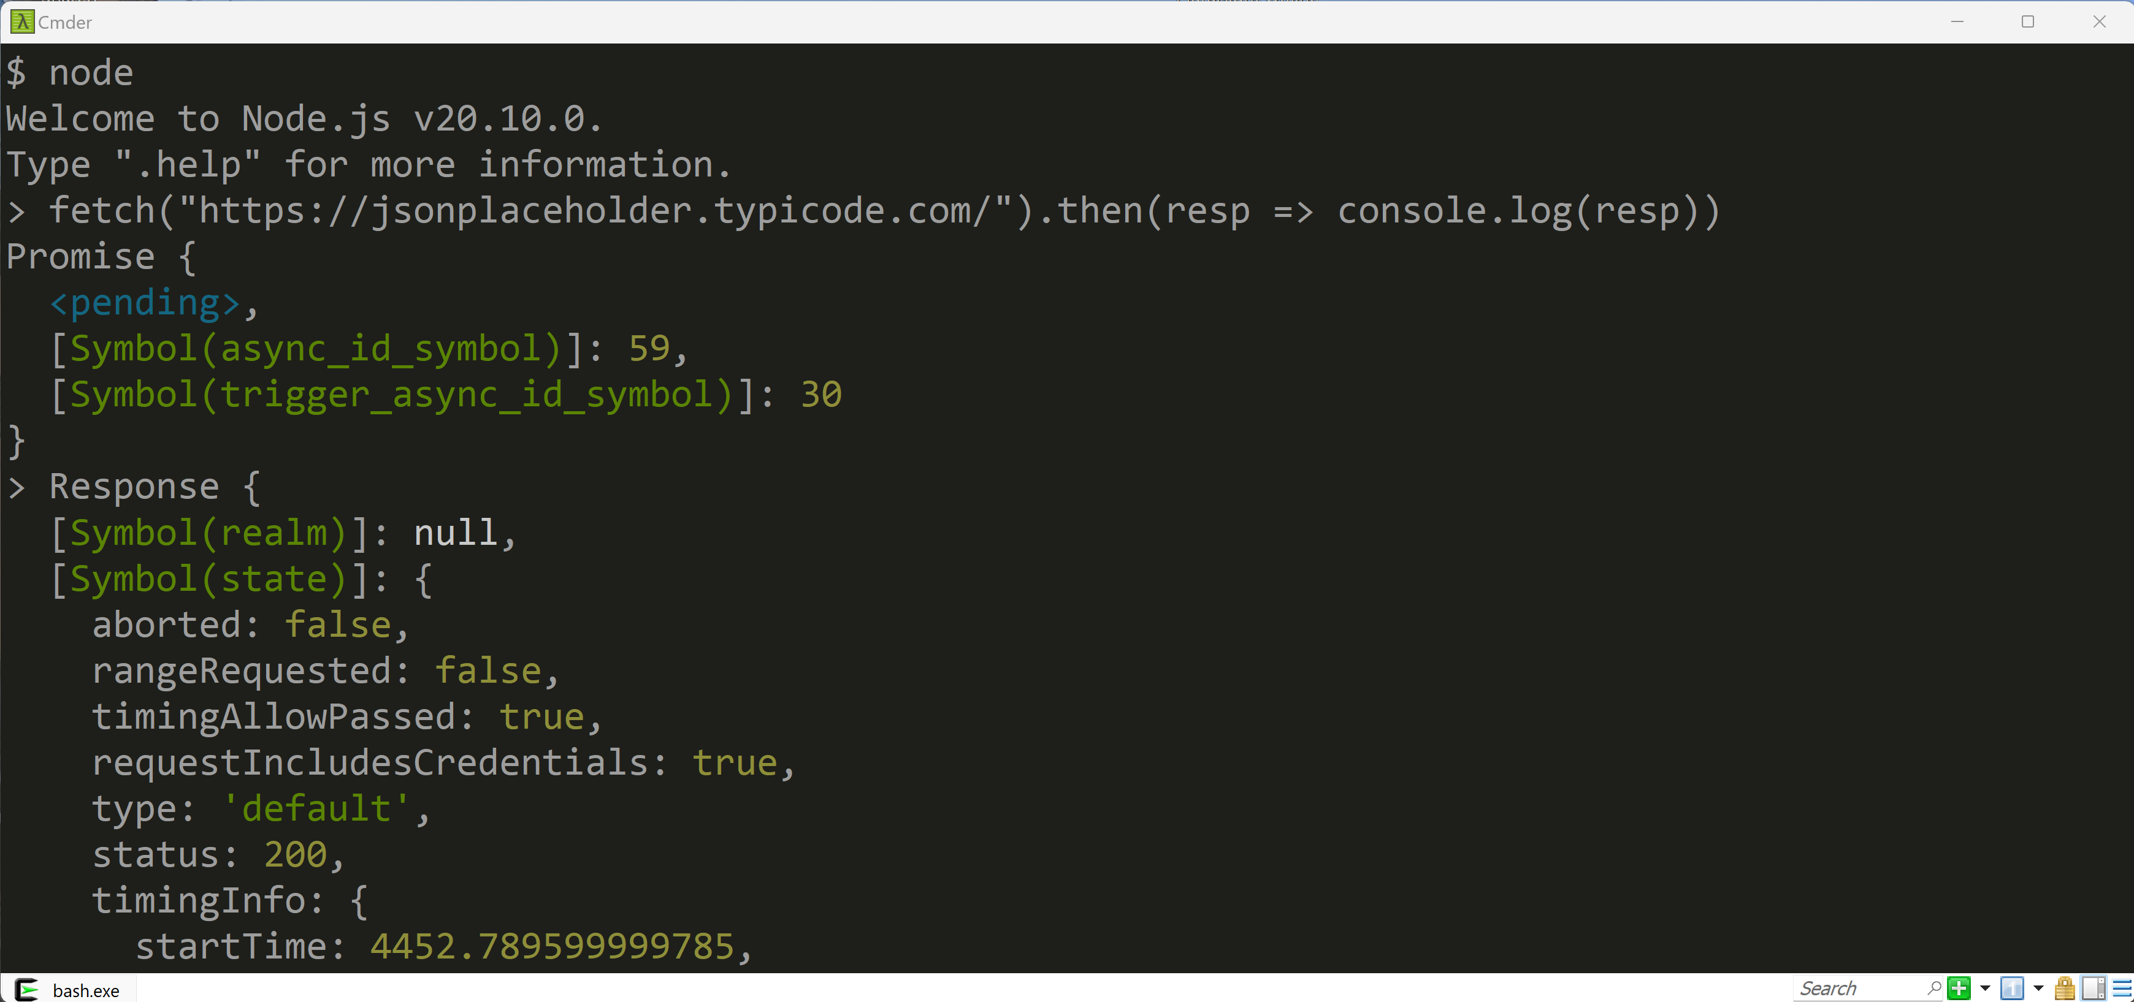
using NodeJS (same Javascript interpreter V8 as Chrome/Edge)

Slide 41
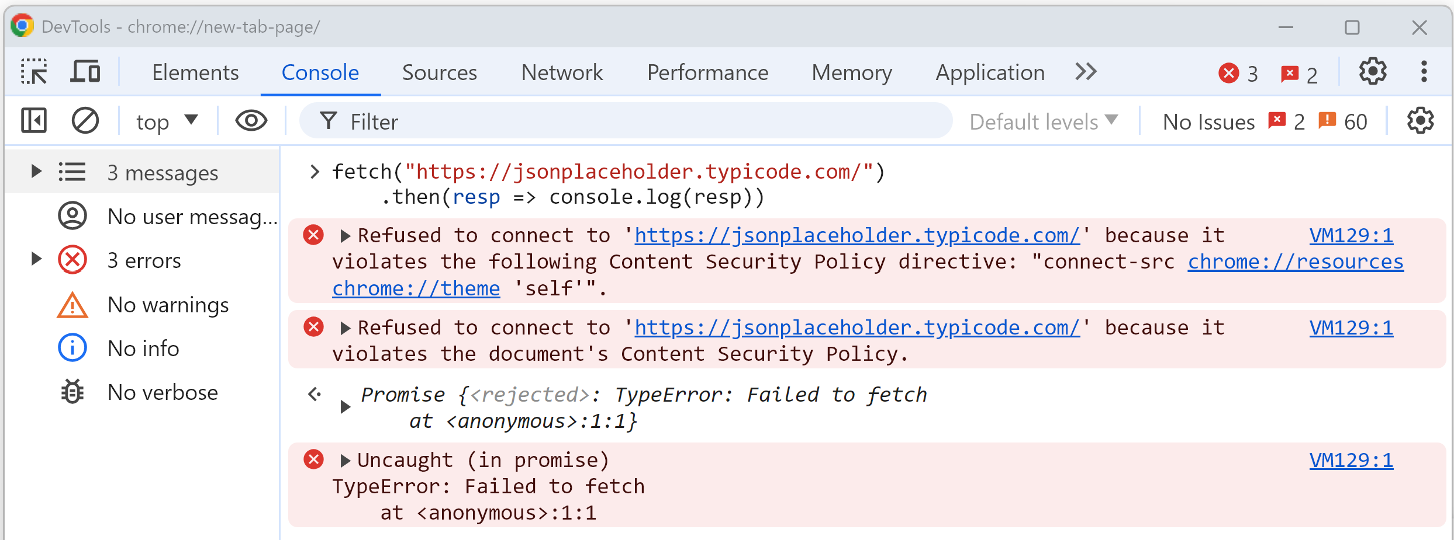
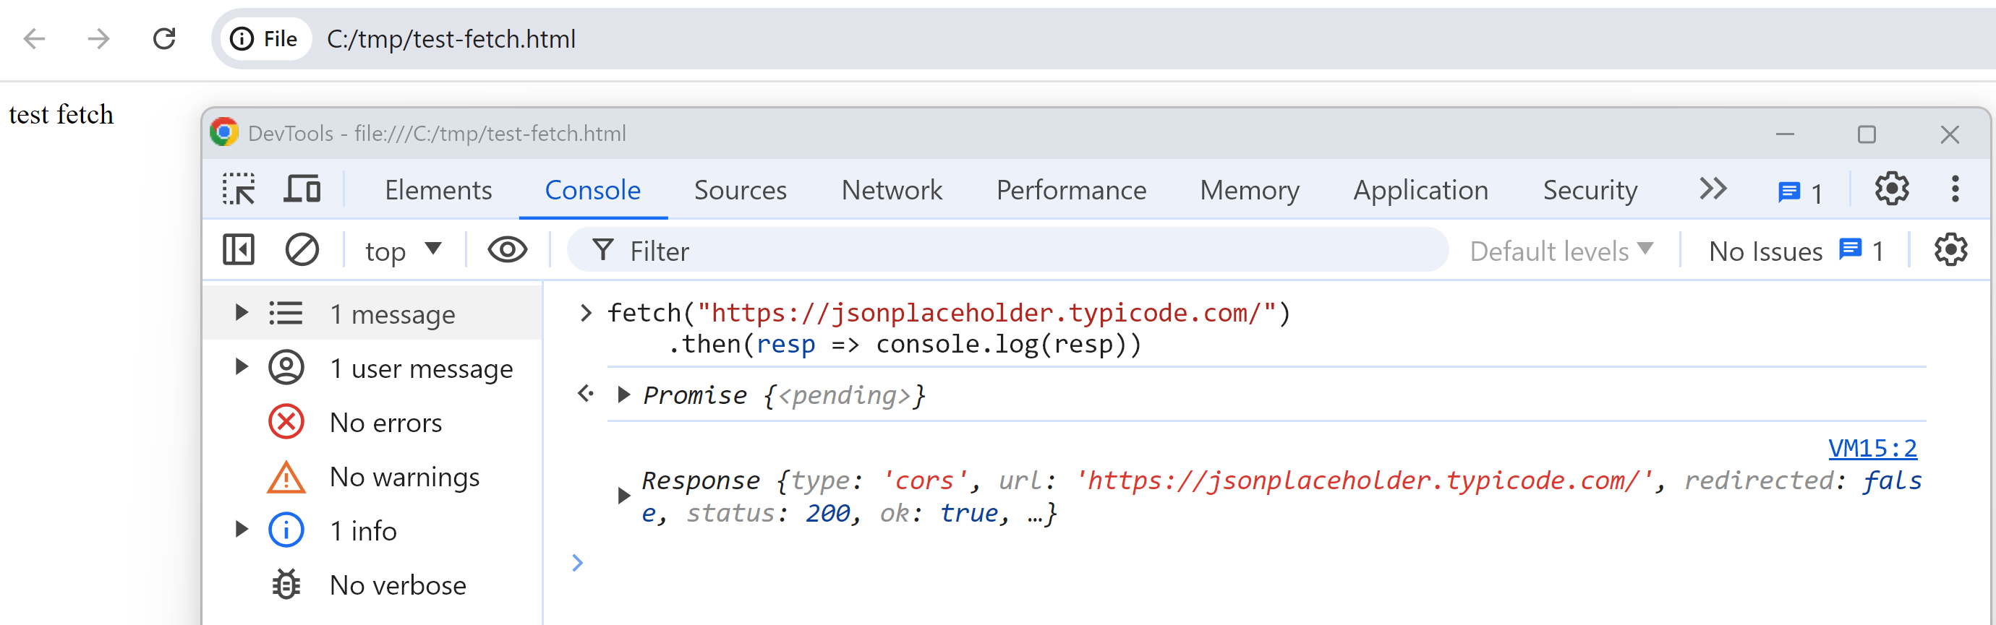
fetch() from DevTool Console... Fail "CORS"
ANNEXE
Fail "CORS" from
website
OK from file://

Slide 44
Outline
Https → Load Html + Js + Css + Json + *
Js → Call Http : SPA, Rest + Json
Html → execute Js <script>
Html → trigger events to Js
Js → Query/Update Html DOM
Js Frameworks, MVC, Bindings

Slide 47
Outline
Https → Load Html + Js + Css + Json + *
Js → Call Http : SPA, Rest + Json
Html → execute Js <script>
Html → trigger events to Js
Js → Query/Update Html DOM
Js Frameworks, MVC, Bindings

Slide 50
Outline
Https → Load Html + Js + Css + Json + *
Js → Call Http : SPA, Rest + Json
Html → execute Js <script>
Html → trigger events to Js
Js → Query/Update Html DOM
Js Frameworks, MVC, Bindings

Slide 53
Outline
Https → Load Html + Js + Css + Json + *
Js → Call Http : SPA, Rest + Json
Html → execute Js <script>
Html → trigger events to Js
Js → Query/Update Html DOM
Js Frameworks, MVC, Bindings

