Slide 1
Workshop Kubernetes + Helm + K9s practice on Harbor Install(s)
( vs Docker-Compose )
arnaud.nauwynck@gmail.com

Slide 2
Outline
Discover Harbor
Install…
1/ using « install.sh » => Docker Compose
OR Alternatives, using Kubernetes + Helm
2/ using Linux|WSL (Shell Cmdline) -> Kind -> Helm
OR Alternative
3/ using Podman (GUI) -> Kind -> Helm
- Discover K8s internals (deployment,service,pod,ingress,..)
+ use K9s, and port-forward / exec shell

Slide 3
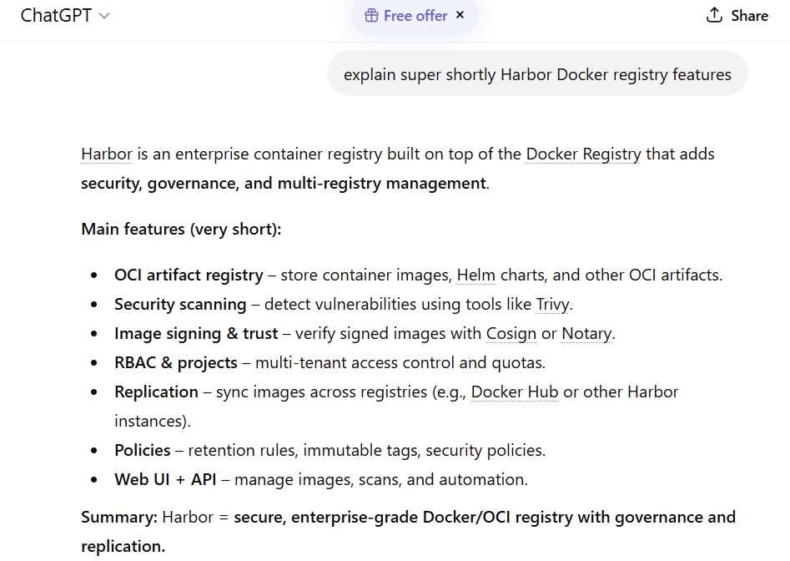
Discover Harbor

Slide 4
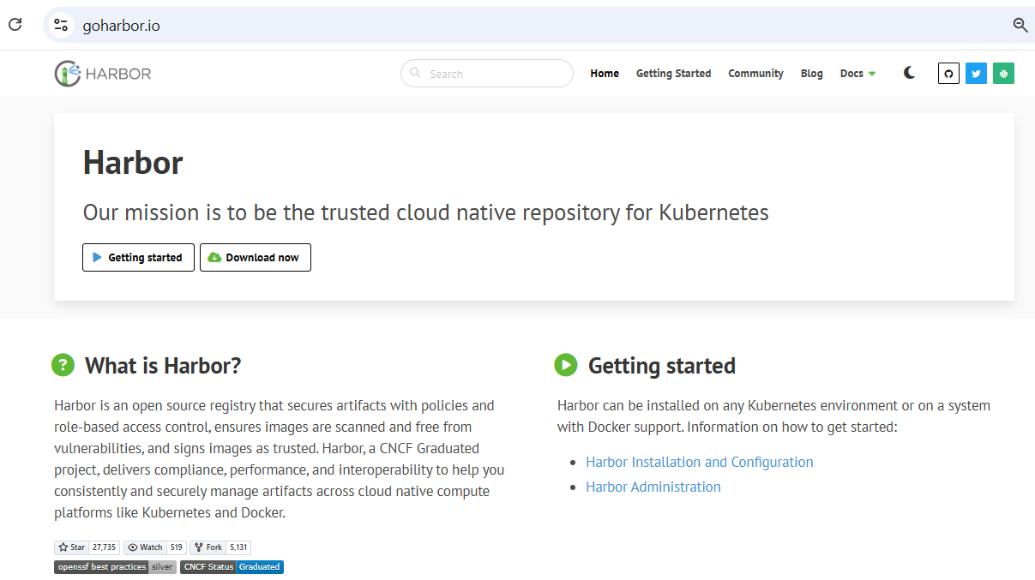
Discover Harbor (web site) https://https://goharbor.io/

Slide 5
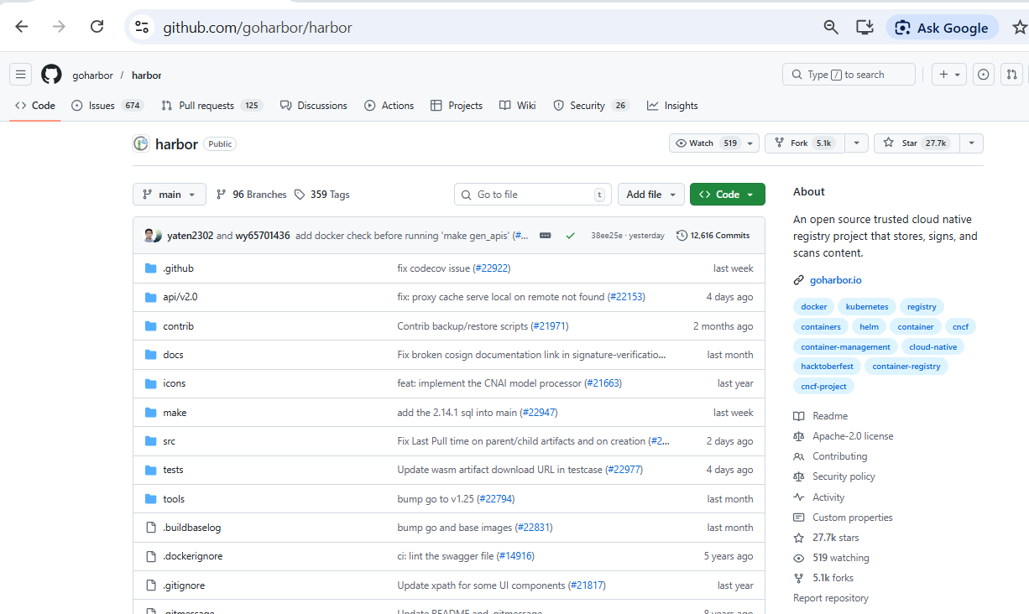
Discover Harbor (source code) https://github.com/goharbor/harbor

Slide 6
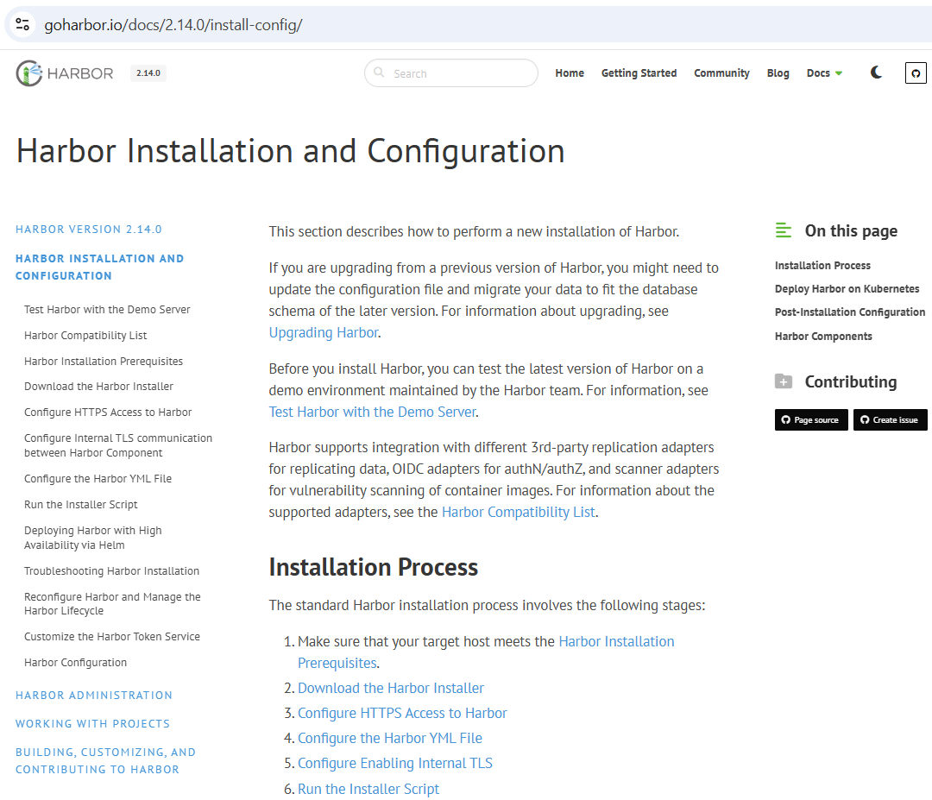
https://https://goharbor.io/ Getting Started

Slide 7
3 officials Ways to install:
1/ Local Offline Installer (=> Docker Compose)
2/ Local Online Installer (=> Docker Compose)
3/ K8s + Helm
This Workshop recommmends alternative 3/: using Helm
We also show 2/ … as failover, in case you are blocked on 3/

Slide 8
Why Installing Harbor?
Because
It focus on Docker images managment and Vulnerabilities
It organizes Team read-write permissions for Docker Images pull/push.
used in production in many companies
Internally, it is using standard Kubernetes architecture
It offers easy/standard deployment solution for kubernetes, with Helm
It is a very complex app, not a « Hello world »
You can not read/understand all… this is on-purpose !
You will struggle at deploying it… this is on-purpose !
A good occasion to learn internals of Kubernetes !

Slide 9
Spoiler Alert: Modern Install
= easy commands in 3 lines
helm repo add harbor https://helm.goharbor.io
helm repo update
helm install my-harbor harbor/harbor

Slide 10

In theory …. That’s All Folks
But In practice …
A Long (difficult) journey for your kubernetes baptism
Pre-Requisites = Install Kube cluster + Tools (Helm + Kubectl + K9s)
Then Debug…

Slide 11
a little detour into the past
… Installing the old style
Download huge tar.gz file
Unzip
Copy + edit configuration files
Generate TLS (https) certificates
Launch « sudo ./install.sh »
fix shell scripts
Discover Result, Debug …

Slide 12
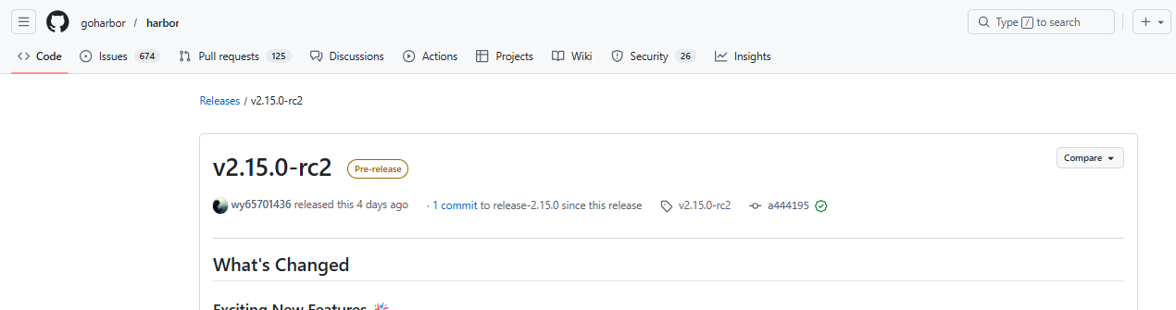
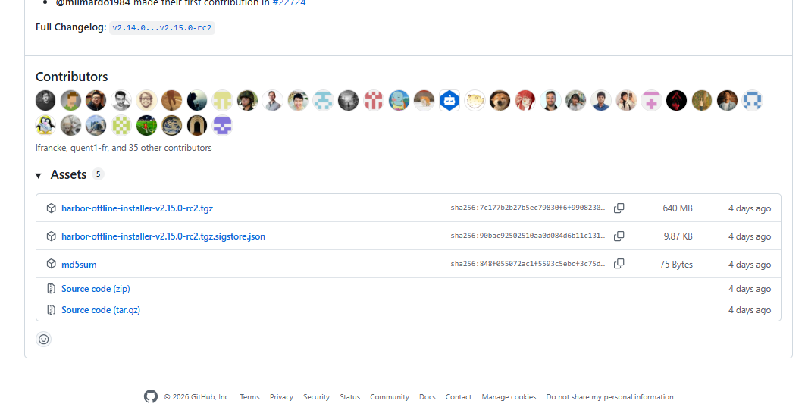
Using Releases - Installer https://github.com/goharbor/harbor/releases

Slide 13
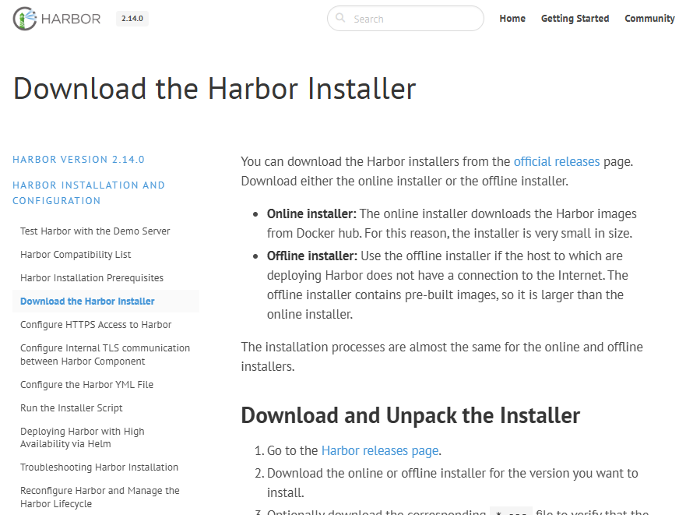
Donwload Online/Offline Installer https://goharbor.io/docs/2.14.0/install-config/download-installer/

Slide 14
Linux/Wsl Install.sh
wsl
wget https://github.com/goharbor/harbor/releases/download/v2.13.5/harbor-online-installer-v2.13.5.tgz
tar zxf harbor*.tgz
cd harbor
cp harbor.yml.tmpl harbor.yml
vi harbor.yml

Slide 15
Generate OpenSSL Certificate
openssl req -x509 -sha256 -days 4000 -nodes -newkey rsa:2048 -subj "/CN=demo.local/C=FR" -keyout rootCA.key -out rootCA.crt

Slide 16
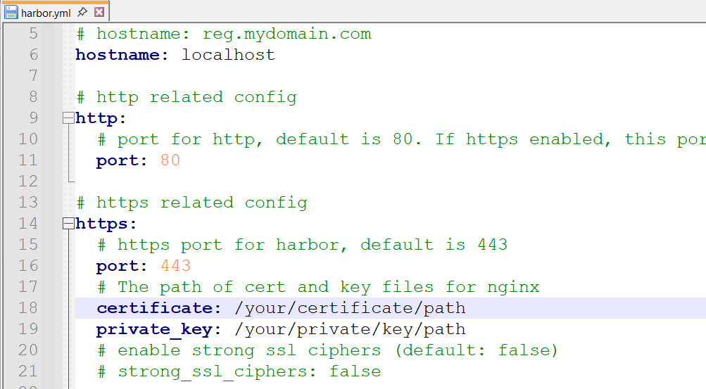
Edit file harbor.yml
hostname: localhost
https:
certificate: <<YOUR-PATH>>/rootCA.key
private_key: <<YOUR-PATH>>/rootCA.crt

Slide 17
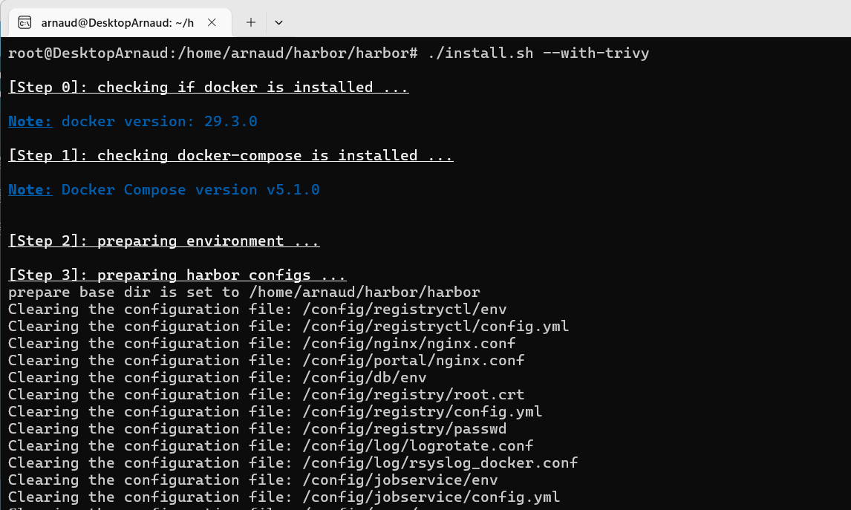
sudo ./install.sh --with-trivy
Notice…. Does not work when using your account!!!
Need run as root?!?!! « sudo ./install.sh »

Slide 18
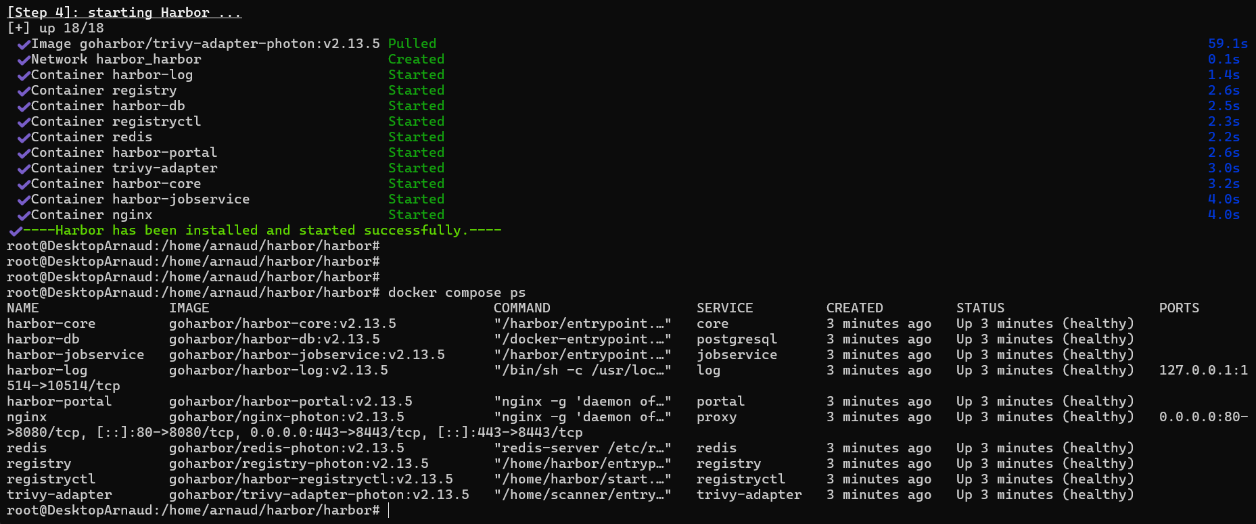
Install => docker compose up -d

Slide 19
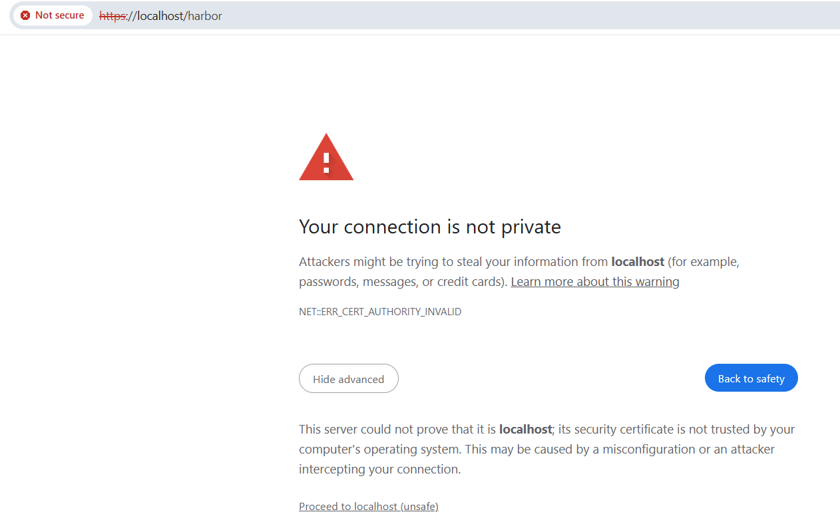
https://localhost:443/harbor
Proceed Unsafe (self-signed certificate)

Slide 20
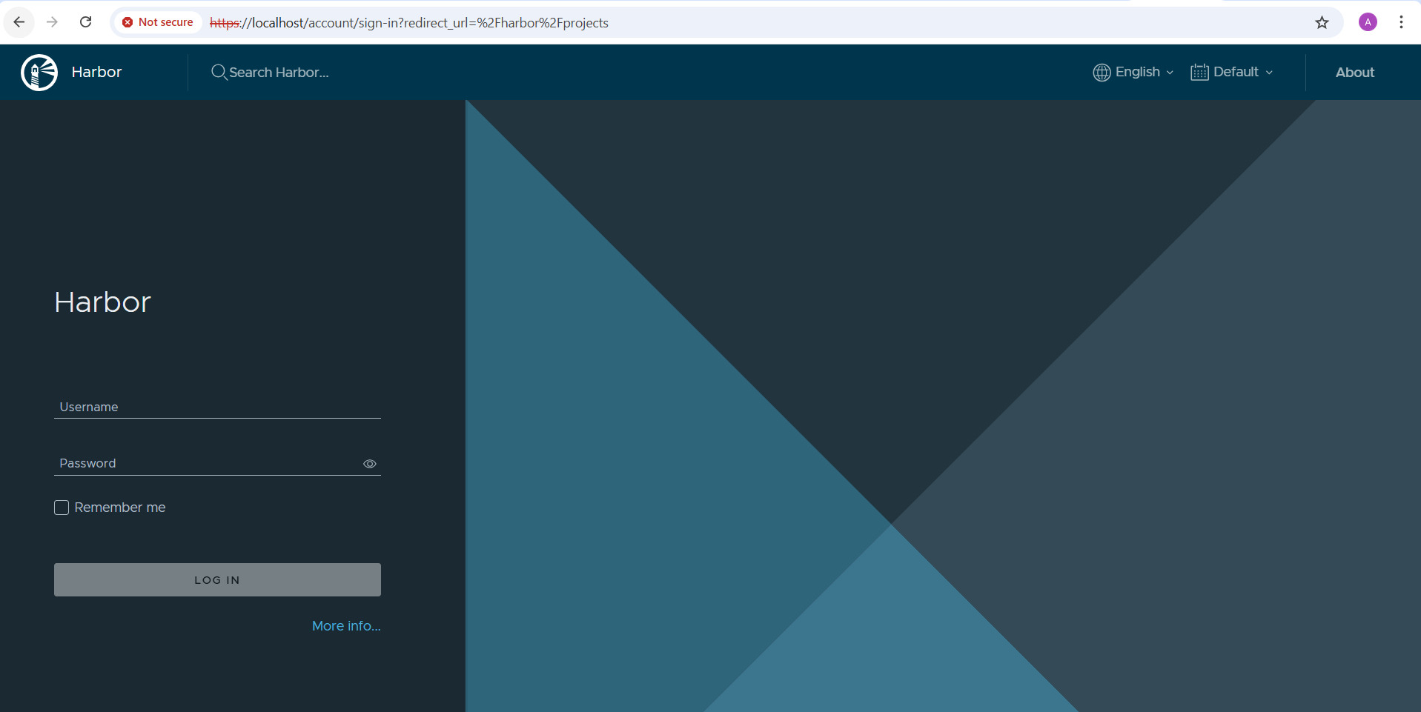
Login: admin / Harbor12345

Slide 21
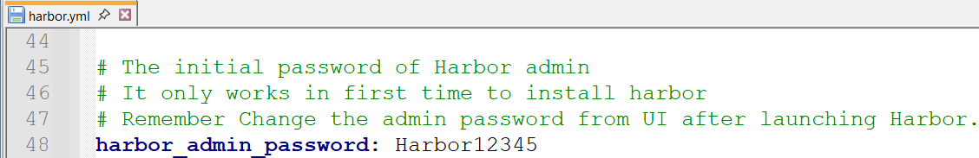
See Config « admin » / « Harbor12345 »

Slide 22
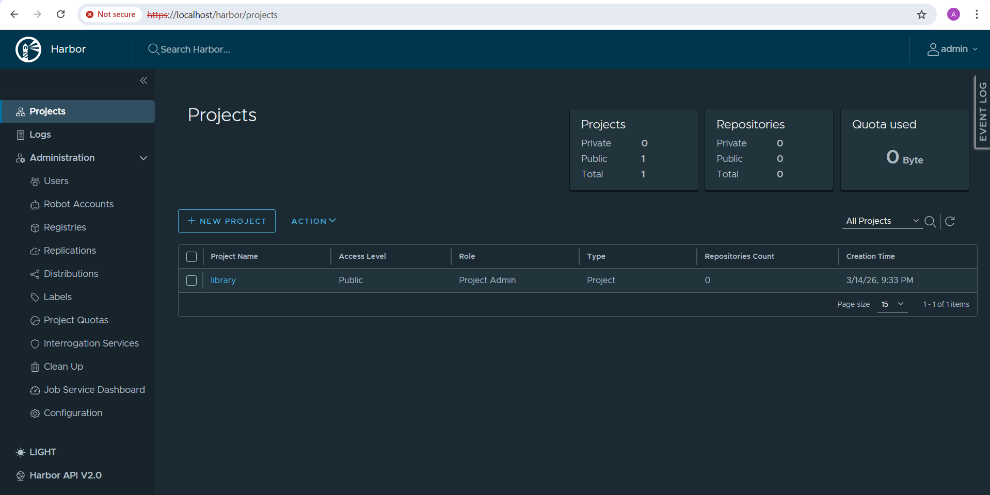
It Works !

Slide 23
But How Deceptive !!
only plain-old legacy Shell + « Docker-Compose »
unmanaged solution, that nobody uses in real PROD !!
(no cluster / not distributed / not scalable
/ no monitoring / no auto-restart / no auto-scaling up&down / … )
And nothing new, no Kubernetes !

Slide 24
Better Install
Using Kubernetes + Helm using Linux | Windows WSL > Kind
… with teminal Shell command lines
(see also next alternative, using Podman GUI)

Slide 25
Linux vs « WSL » … Kubernetes « Kind » ?
Docker run almost « natively » under Linux
On windows => either use
- « WSL » = Windows Sub-system for Linux (=> like SSH + real Linux VM)
- DockerDesktop for Windows… paid solution, NOT used much in companies
- Podman
Kubernetes can run « natively » under linux, but may be difficult to install
example of packaged solutions: « minikube », « k3s », « kind », …
« Kind » = « Kubernetes In Docker »

Slide 26
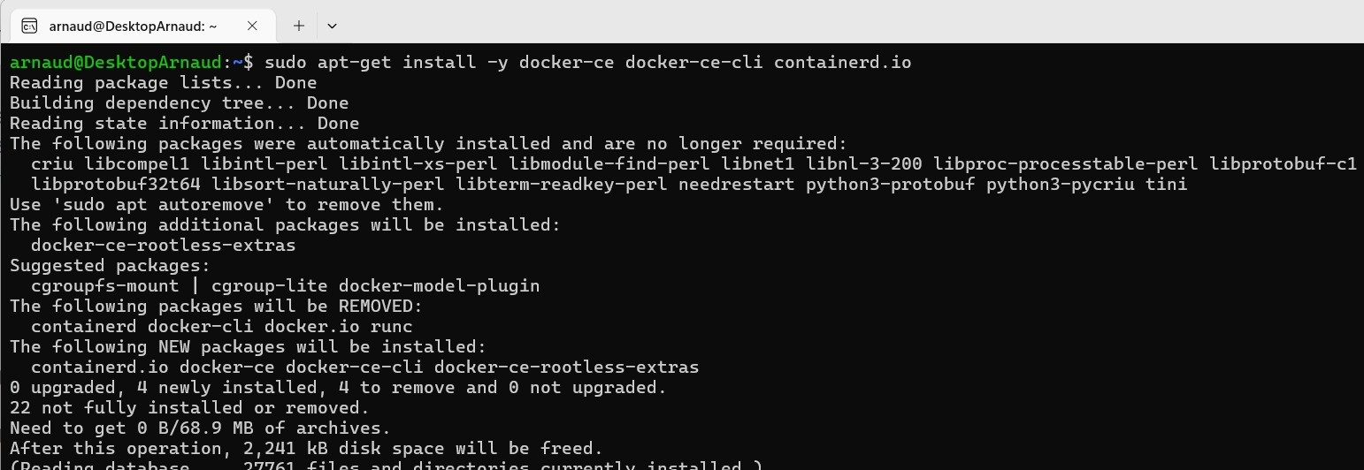
Windows > WSL > Docker
Linux > Docker
sudo apt install -y docker-ce docker-ce-cli containerd.io

Slide 27
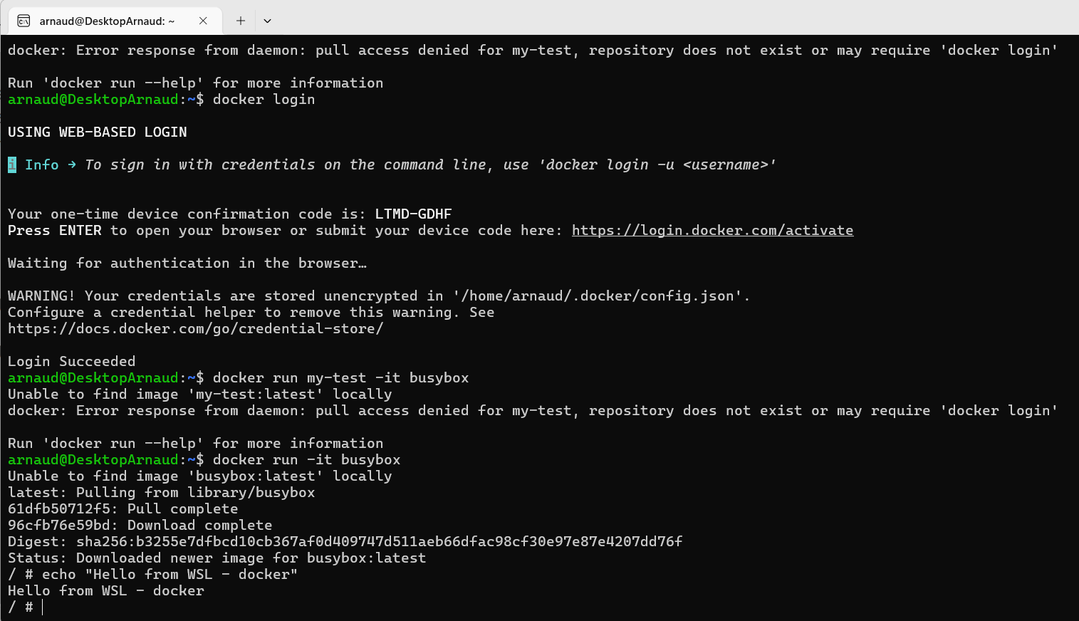
WSL > test Docker
docker ps -a
docker login
docker run -it busybox

Slide 28
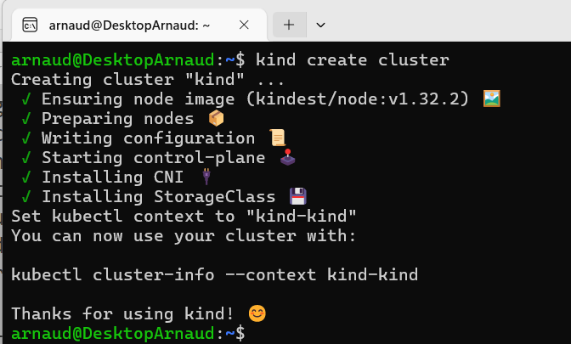
(WSL | Linux) > sudo apt-get install kind kubectl kind create cluster
sudo apt-get install kind kubectl
kind create cluster

Slide 29
Having « Too Many Open Files » … ??
podman machine ssh
ulimit –a
ulimit –n 4096

Slide 30
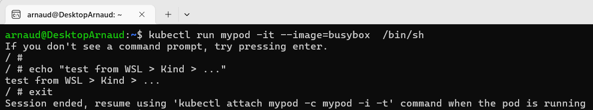
Test Kubectl
kubectl config get-contexts
kubectl get pod
kubectl run mypod -it --image=busybox /bin/sh
kubectl delete pod mypod

Slide 31
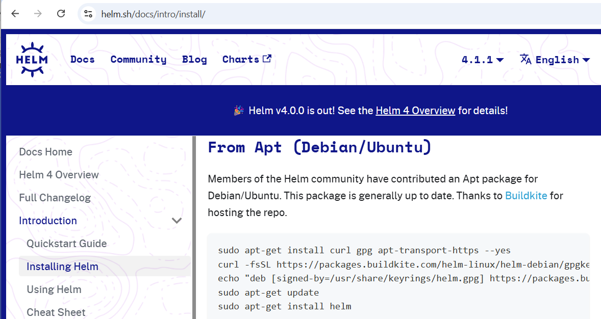
Install Helm https://helm.sh/docs/intro/install/
sudo apt-get install curl gpg apt-transport-https --yes
curl -fsSL https://packages.buildkite.com/helm-linux/helm-debian/gpgkey | gpg --dearmor | sudo tee /usr/share/keyrings/helm.gpg > /dev/null
echo "deb [signed-by=/usr/share/keyrings/helm.gpg] https://packages.buildkite.com/helm-linux/helm-debian/any/ any main" | sudo tee /etc/apt/sources.list.d/helm-stable-debian.list
sudo apt-get update
sudo apt-get install helm

Slide 32
Alternative for WSL (+ Kind)
… Using Podman (+ Kind)

Slide 33
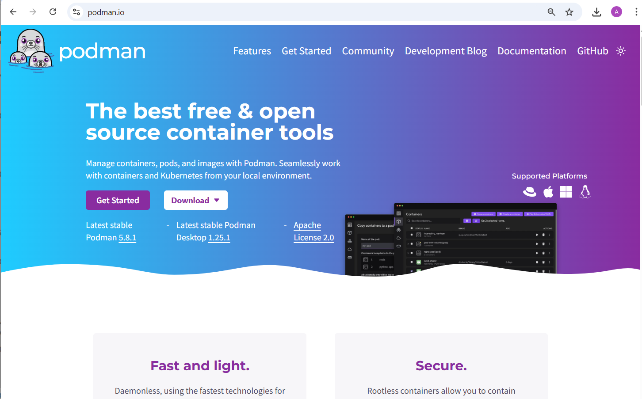
Install Podman https://podman.io

Slide 34
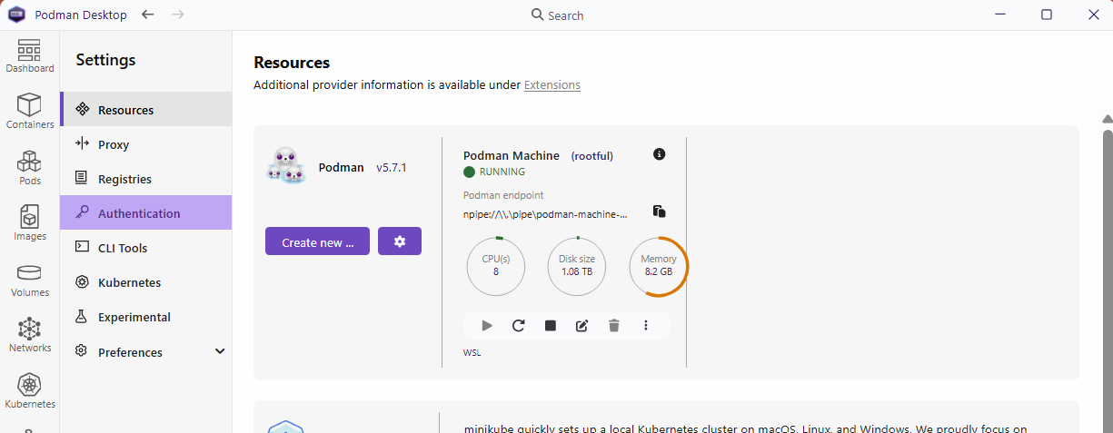
Podman > Create « Podman Machine »

Slide 35
alias docker=podman
« podman.exe » is a simple executable file
… that is backward compatible with ~all Docker commands
In your ${HOME}/.profile or ${HOME}.bashr, you can even use
alias docker=podman
podman ps
podman run …
podman kill ${container}
…
docker ps
docker run …
docker kill ${container}
…

Slide 36
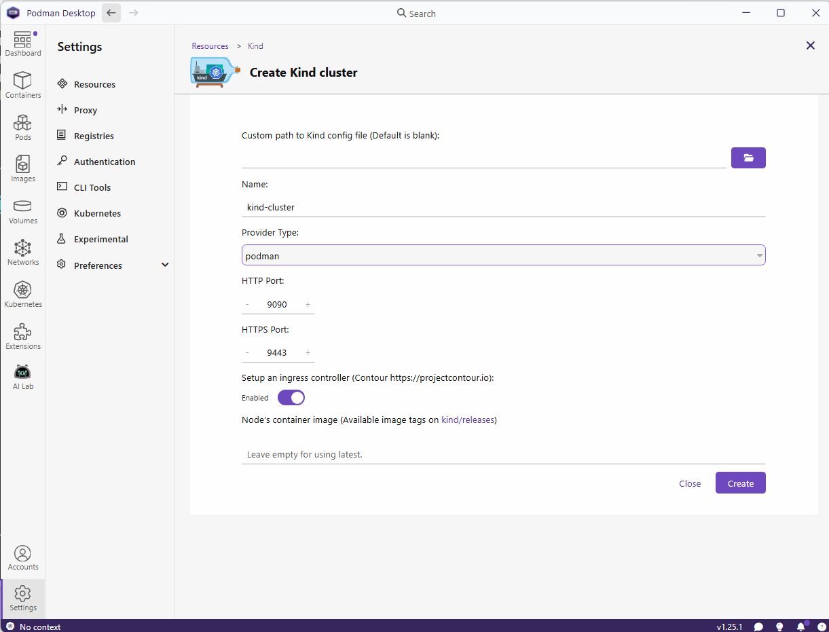
Step 2: Podman > Create Kind cluster

Slide 37
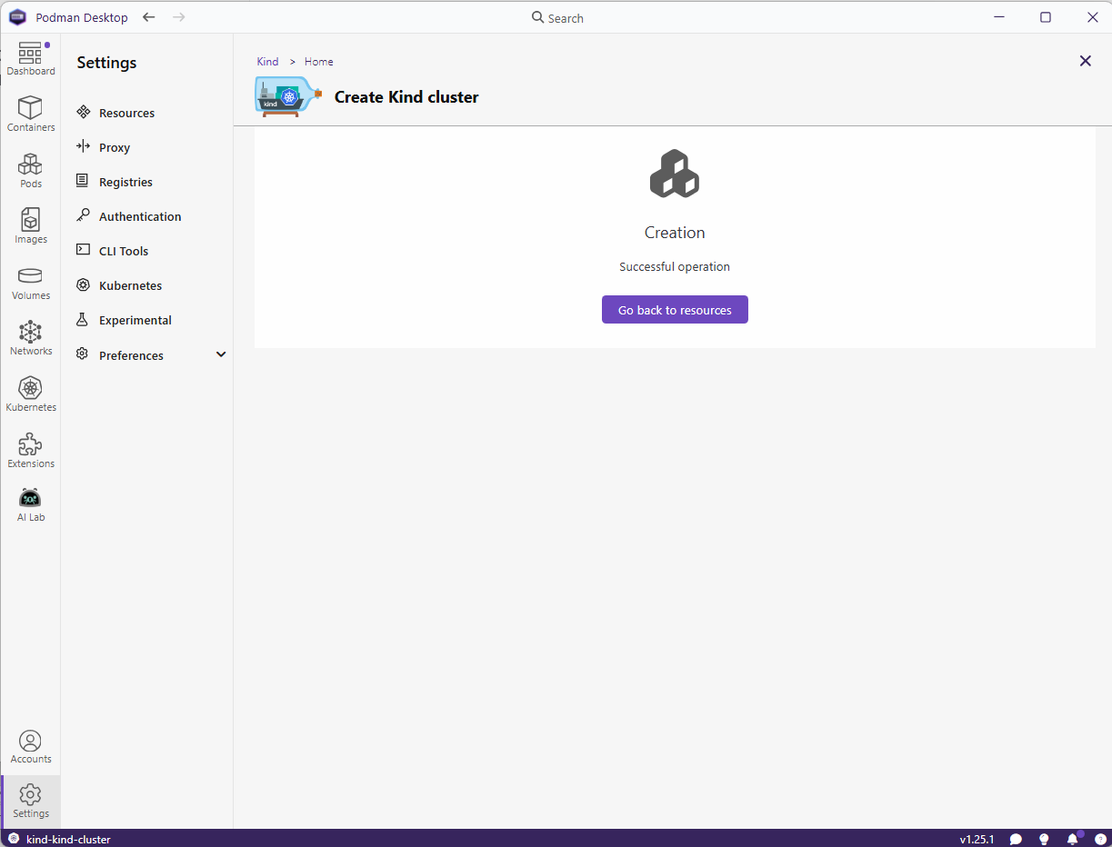
Wait ~3 minutes

Slide 38
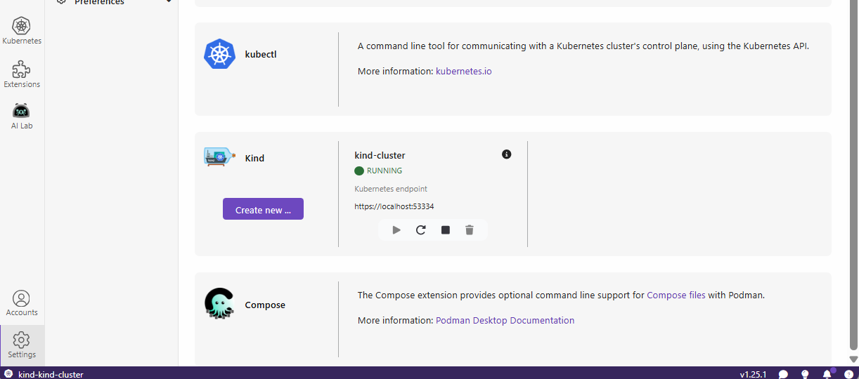
Podman Settings > Kind > RUNNING

Slide 39
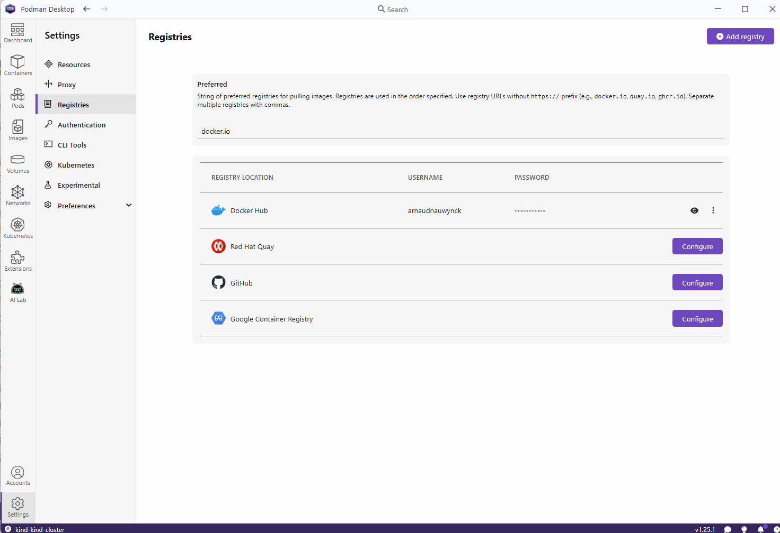
Configure podman with your Dockerhub account

Slide 40
Installing Harbor using K8s + Helm

Slide 41
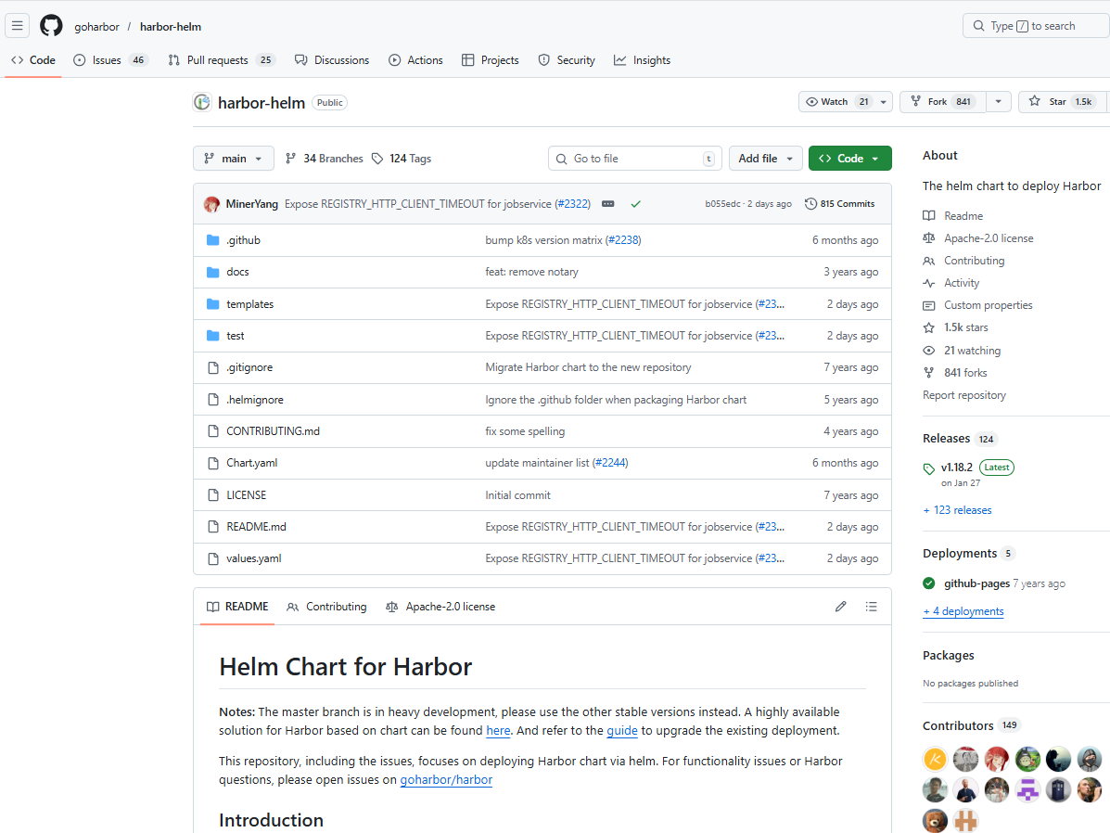
Helm Chart for Harbor https://github.com/goharbor/harbor-helm

Slide 42
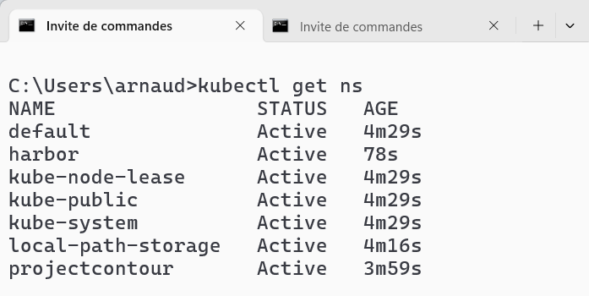
(optional) Kubectl create namespace
kubectl create ns harbor
kubectl get ns

Slide 43
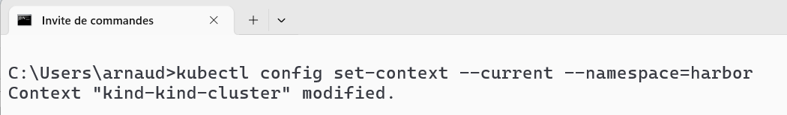
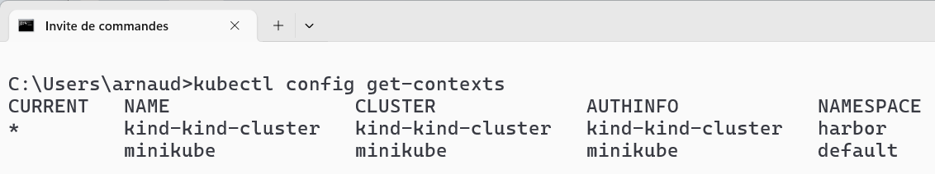
(optional) Kubeconfig… set default namespace
Every kubectl commands must add option « -n harbor » to set namespace !
kubectl config set-context --current --namespace=harbor
kubectl config get-contexts

Slide 44
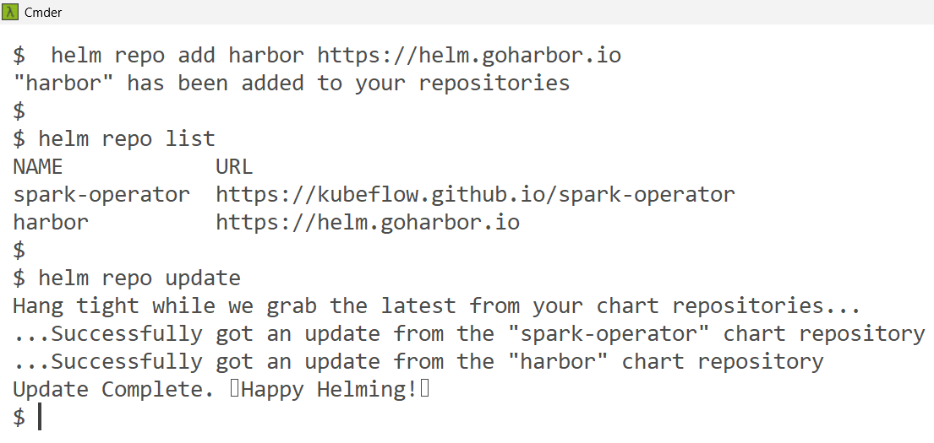
in Terminal: helm repo add
helm repo add harbor https://helm.goharbor.io
helm repo update
helm repo list

Slide 45
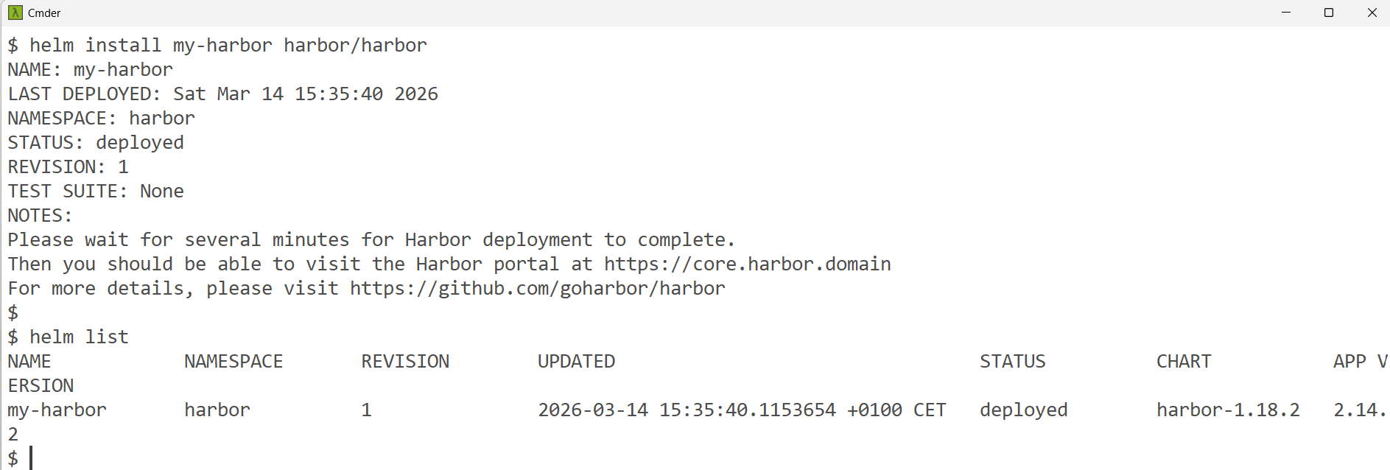
Helm install
helm install my-harbor harbor/harbor
helm list

Slide 46
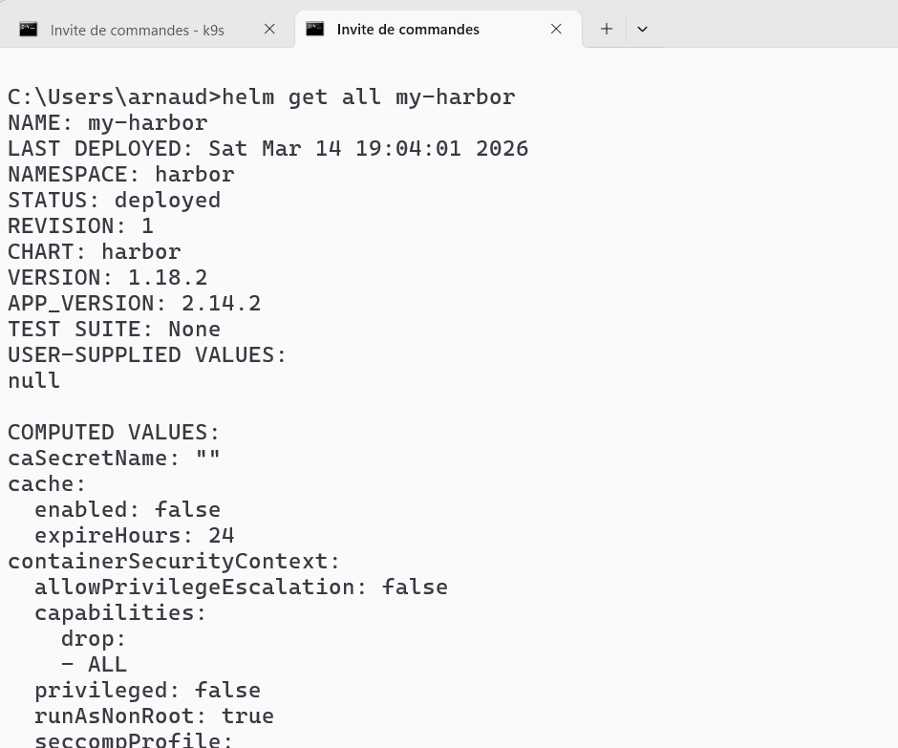
Helm get all ( helm install --dry-run)
helm get all my-harbor > my-harbor.yaml

Slide 47
Kubectl … WAIT ~5 minutes (Image Pull)….
kubectl get all
kubectl get pod
… Wait pod « ContainerCreating »
kubectl get deployment
… Wait READY 0/1
kubectl get event -w

Slide 48
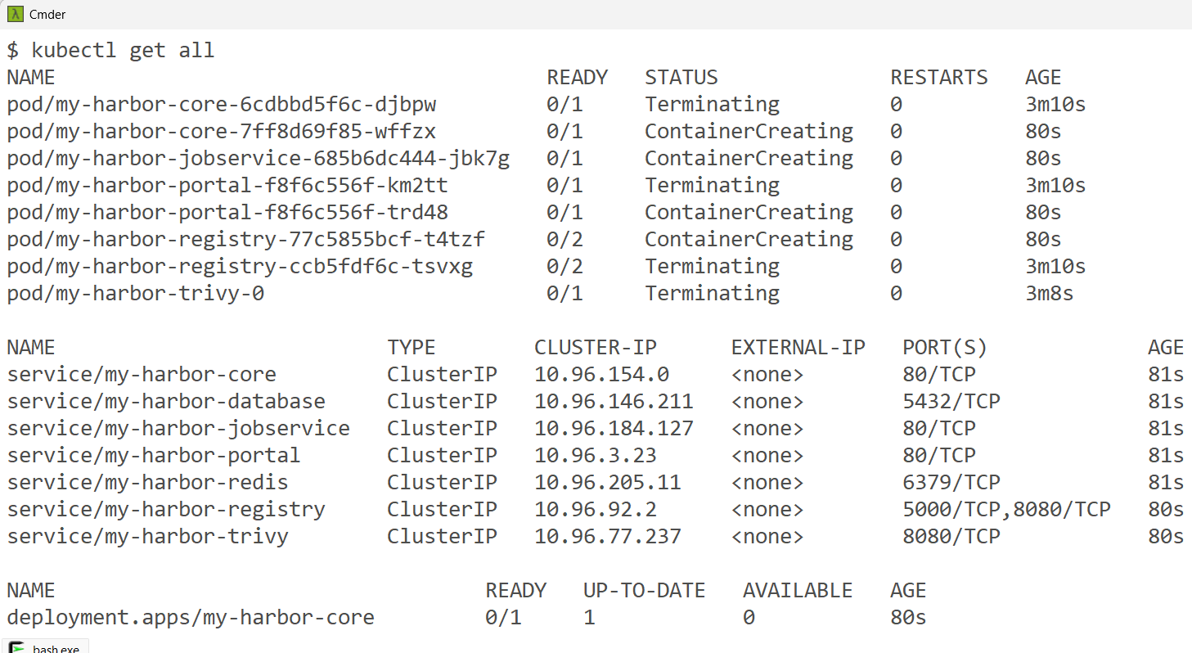
Check… kubectl get all
kubectl get all

Slide 49
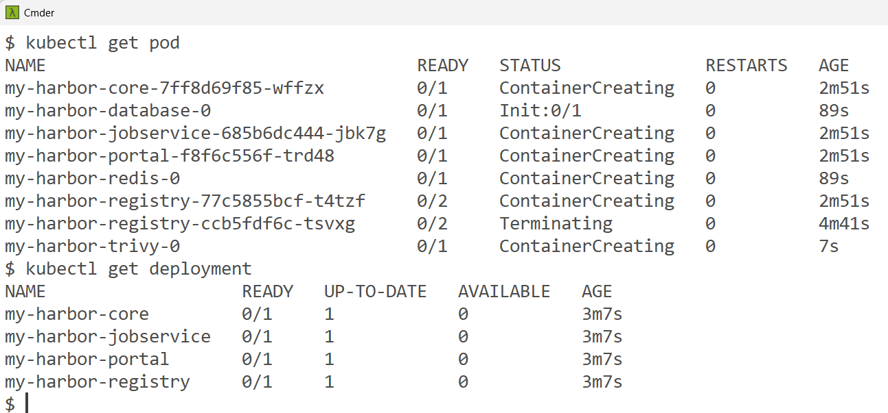
… WAIT ~5 minutes …
kubectl get pod
kubectl get deployment

Slide 50
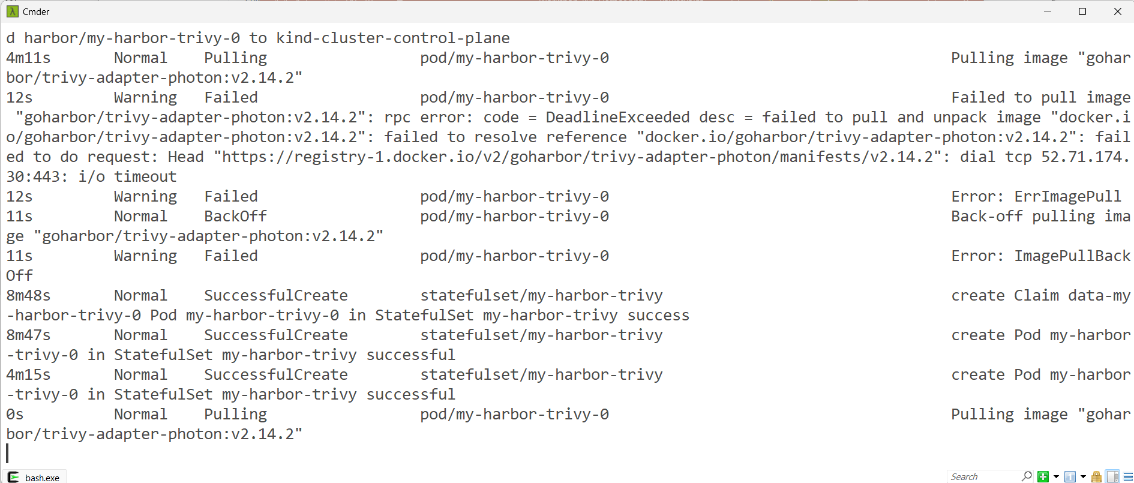
WAIT ~5 minutes…
kubectl get event -w

Slide 51
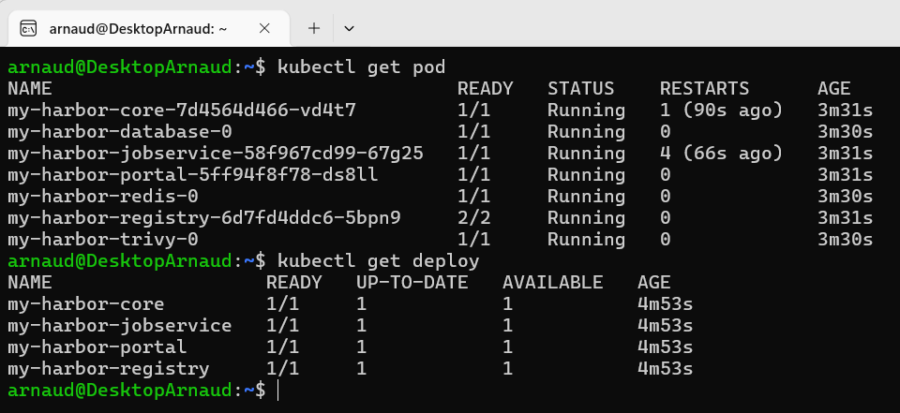
All pods RUNNING , Deployment 1/1 READY

Slide 52
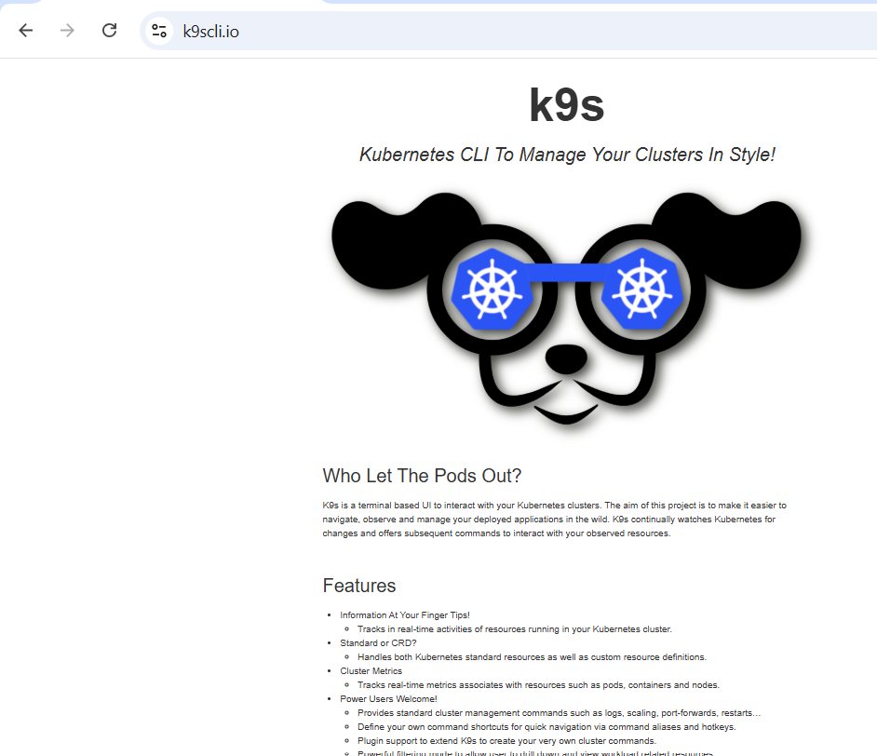
Still Waiting … Install K9s (command line) https://k9scli.io/

Slide 53
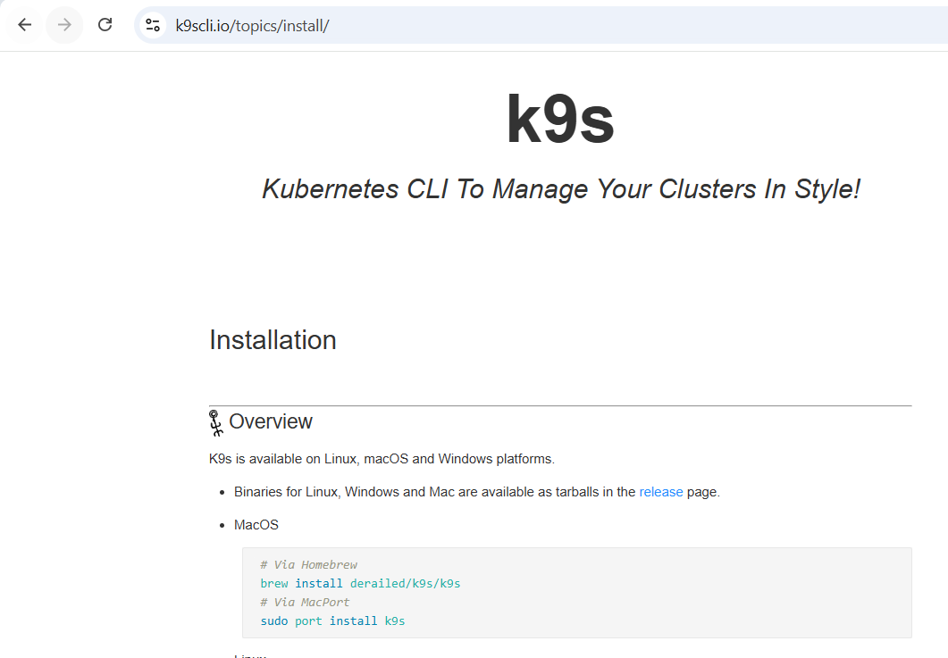
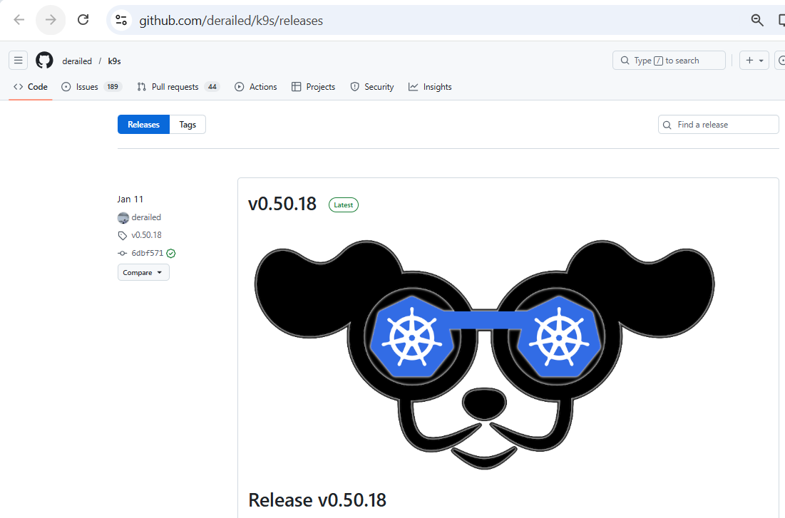
Install K9S on Windows

Slide 54
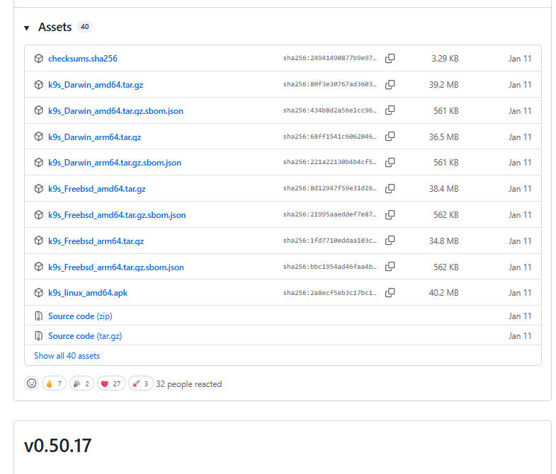
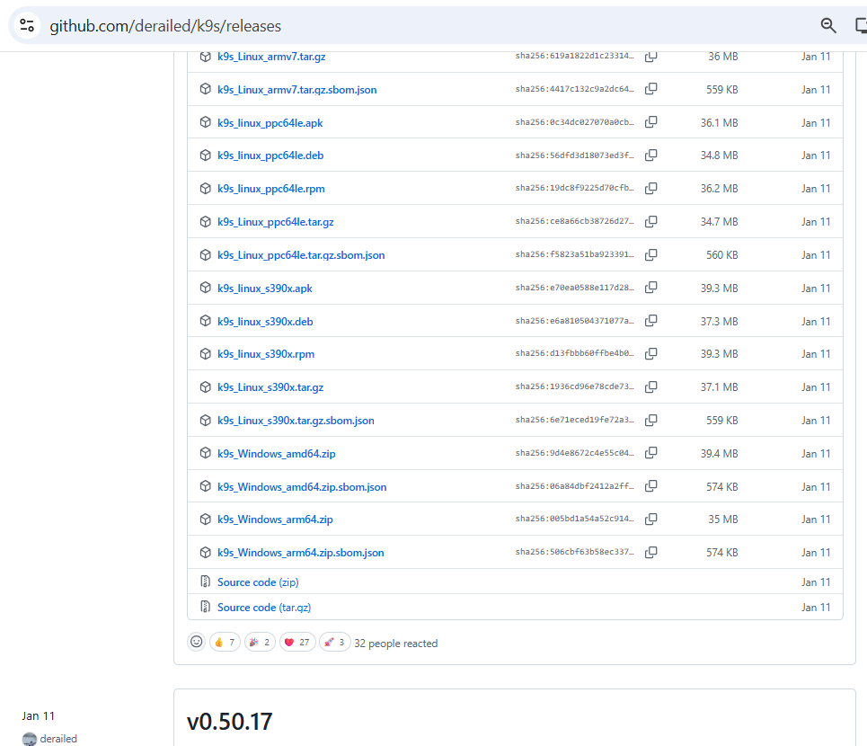
Install K9S on Windows

Slide 55
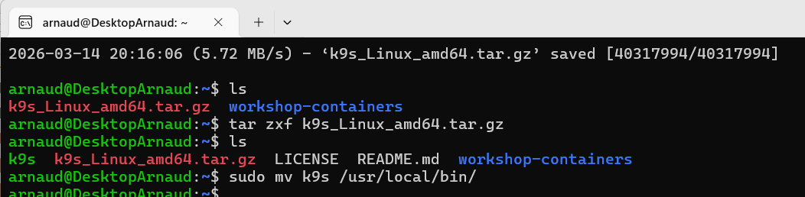
(On Linux) … Install k9s
wget https://github.com/derailed/k9s/releases/download/v0.50.18/k9s_Linux_amd64.tar.gz
tar zxf k9s_Linux_amd64.tar.gz
sudo mv k9s /usr/local/bin/

Slide 56
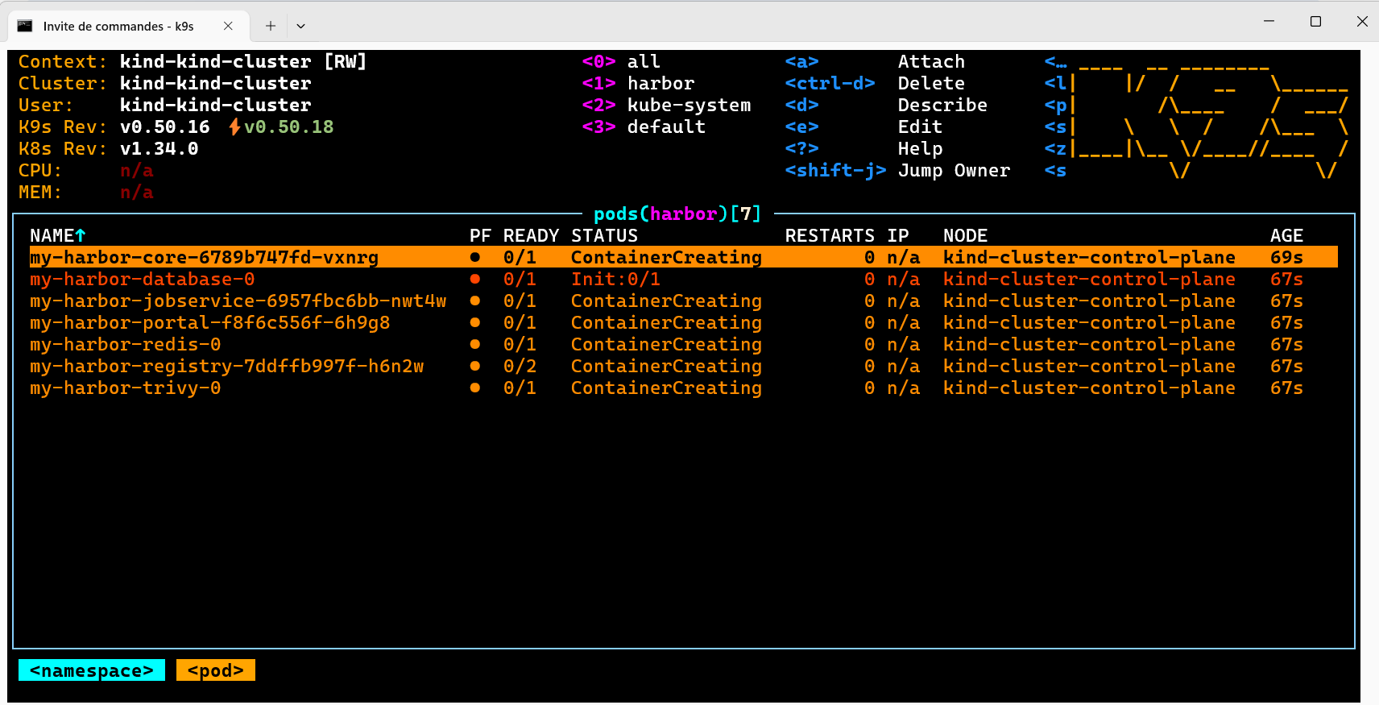
In terminal, type « K9s »

Slide 57
Helm Installed + Installed Tools « k9s »
…
Now Struggle with K8s internals understand / connect to « http://host:port »

Slide 58
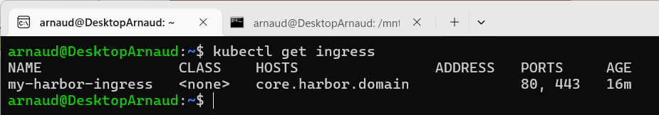
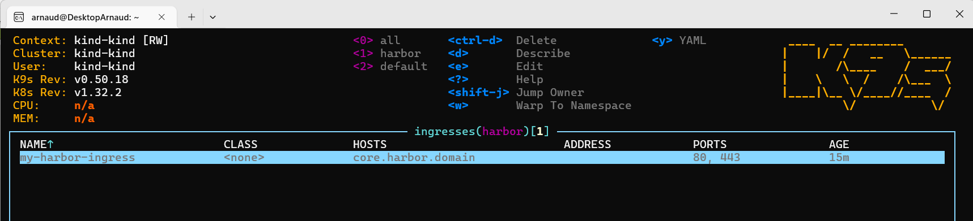
kubectl get ingress
kubectl get ingress
k9s
<ESCAPE> :ingress <ENTER>

Slide 59
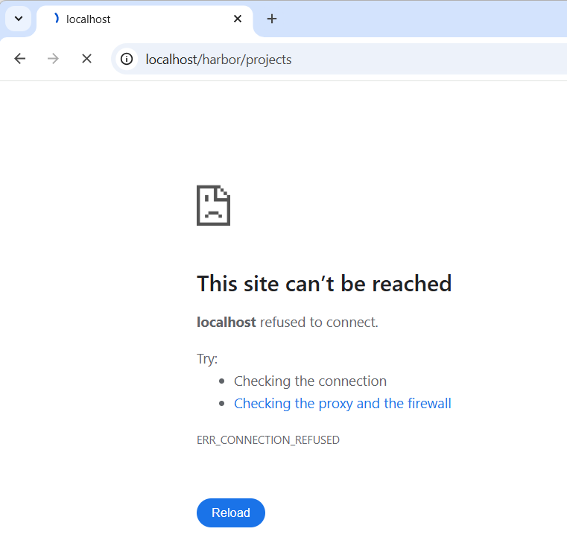
http://localhost:80/harbor
=> Connection Refused (= bad port number)

Slide 60

From Podman … Port 8080 on Localhost ??
Give 404 Page Not Found ?!

Slide 61
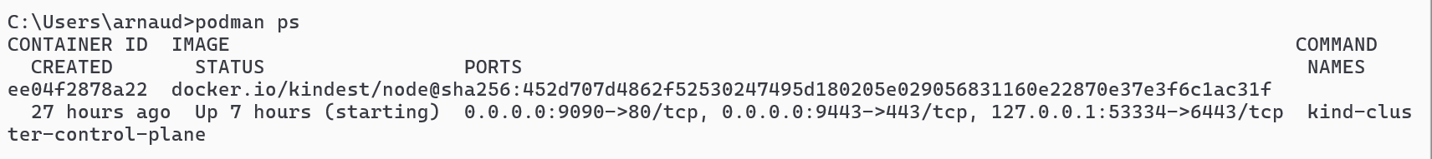
Podman machine … doing mapping of port ! localhost:9090 -> podman machine 80 (http) localhost:9443 -> podman machine 443 (https)
podman ps

Slide 62
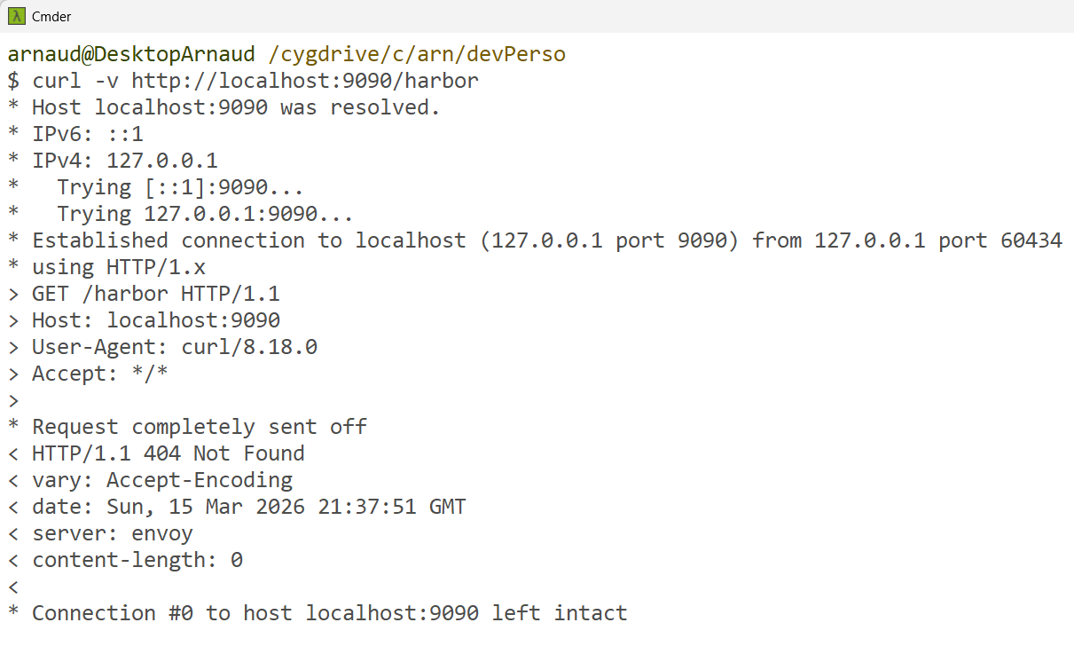
Curl http://localhost:9090/
=> request with http Header for virtual Host=« localhost:9090»

Slide 63
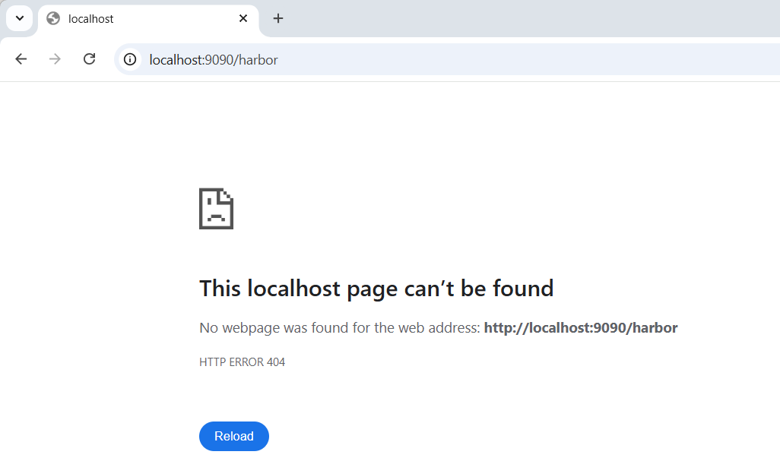
http://localhost:9090/ … 404 NOT_FOUND

Slide 64
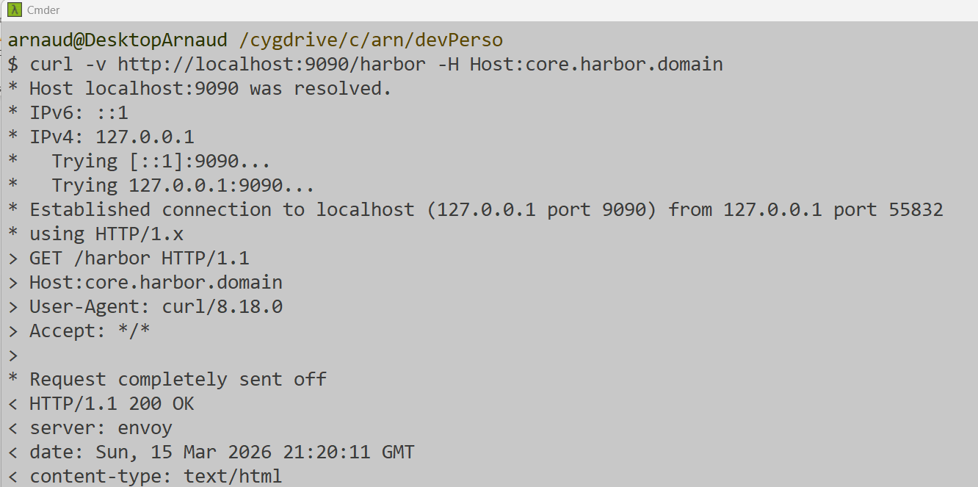
Using curl http://localhost:9090
+ forcing http Header for virtual Host « core.harbor.domain »
curl -v http://localhost:9090/harbor -H Host:core.harbor.domain

Slide 65

Using curl https://localhost:9443
+ forcing http Header for virtual Host « core.harbor.domain »
curl -vv -k https://localhost:9443/ -H Host:core.harbor.domain
???? Does not work ????

Slide 66


DNS Hostname « core.harbor.domain »
… expecting localhost IP
Solution 1/ …. Force Windows to resolve « core.habor.domain » to 127.0.0.1 (=localhost)
launch Notepad as «Admin» !!
Edit file « C:\Windows\System32\drivers\etc\hosts»

Slide 67

Edit as Admin C:\Windows\System32\drivers\etc\hosts
Add line
127.0.0.1 core.harbor.domain

Slide 68

Check nslookup?? curl
nslookup does not work?? But curl: OK

Slide 69

http://core.harbor.domain:9090/
It works !!! … redirected to login page

Slide 70

Other possibility… change ingress yaml to expose on hostname: localhost
K9s
<ESCAPE> :ing <e> (=edit)
In editor (notepad), change
host: localhost
Then save / close
This is HACK... Should change param value in Helm
+ do «helm upgrade»

Slide 71
Other Work-Around Alternative for Host:Port
… using Port-Forward !

Slide 72

Find service « portal » … exposing port 8080
k9s
:svc <ENTER> /portal <ENTER>
Equivalent: kubectl get svc

Slide 73

Service details
:svc /portal <ENTER>
<y> (=yaml)
<c> (=copy)
Equivalent: kubectl get svc my-harboor-portal –o yaml

Slide 74

Find pod exposing the « portal » web app
Either from service, type <ENTER>
Or
:pod <ENTER> /portal <ENTER>

Slide 75


Port-Forward 8080:8080
<shift-F> (=port-forward)
<tab> (=8080)
<tab> (=8080)
<ENTER> (=OK)

Slide 76

Port Forward Activated
Once done, you see « PF » = « Port-Forward »)

Slide 77


Port-Forward: Activated <-> Stopped if stopping k9s !

Slide 78
Equivalent command: kubectl port-forward
kubectl port-forward my-harbor-portal 8080:8080

Slide 79

http://localhost:8080/harbor

Slide 80

Guessing Login / Password… in k8s secret
Reminder: « admin » / « Harbor12345 » as seen in install.sh via harbor.yml config file
kubectl get secret
kubectl get secret my-harbor-core –o yaml

Slide 81

Secret … encoded in base64 !
echo -n SGFyYm9yMTIzNDU= | base64 -d
kubectl get secret my-harbor-core -o json | jq -r '.data.HARBOR_ADMIN_PASSWORD'
kubectl get secret my-harbor-core -o json | jq -r '.data.HARBOR_ADMIN_PASSWORD' | base64 -i -d

Slide 82

It Works!

Slide 83

K9s pod logs
K9s :pod /portal
<ENTER> (container => child logs)
<ESCAPE> (logs => parent container)

Slide 84

kubectl logs ${pod} [–c ${container}] [-f]

Slide 85


Executing Shell inside Pod
K9s :pod /portal
<s> (=shell)
Equivalent kubectl:
kubectl exec -it my-harbor-portal /bin/sh

Slide 86

Questions?

