Slide 1
Harbor Screenshots
arnaud.nauwynck@gmail.com

Slide 2
Outline
Discover Harbor
Harbor Screenshots

Slide 3
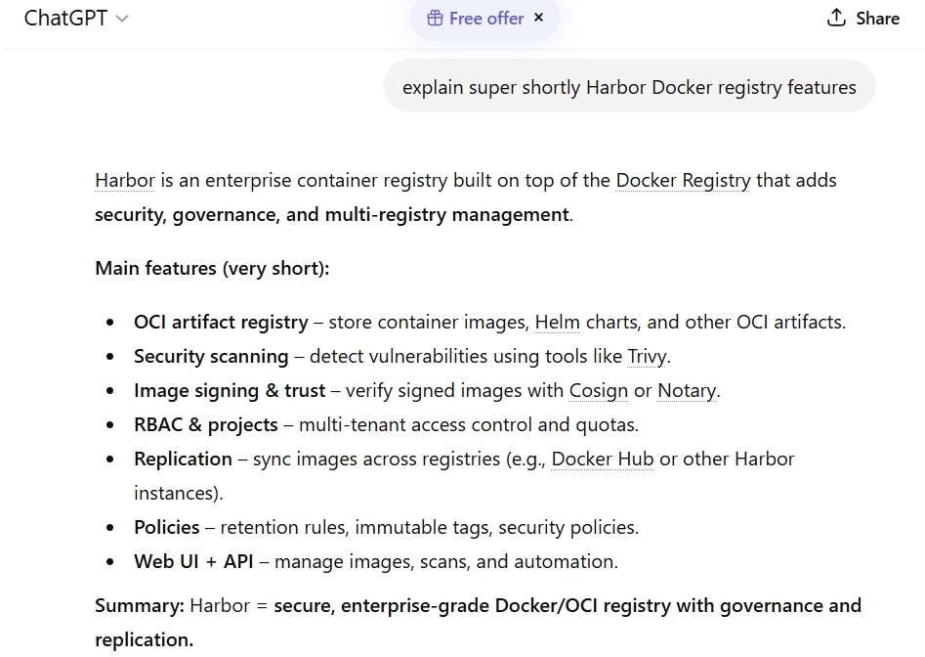
Discover Harbor

Slide 4
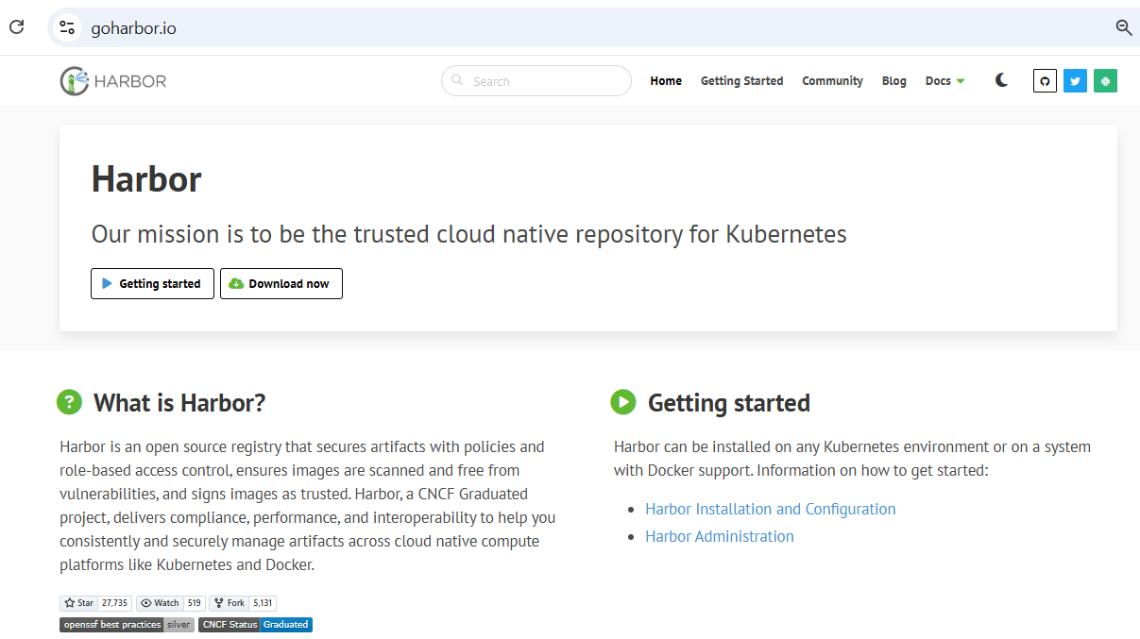
Discover Harbor (web site) https://https://goharbor.io/

Slide 5
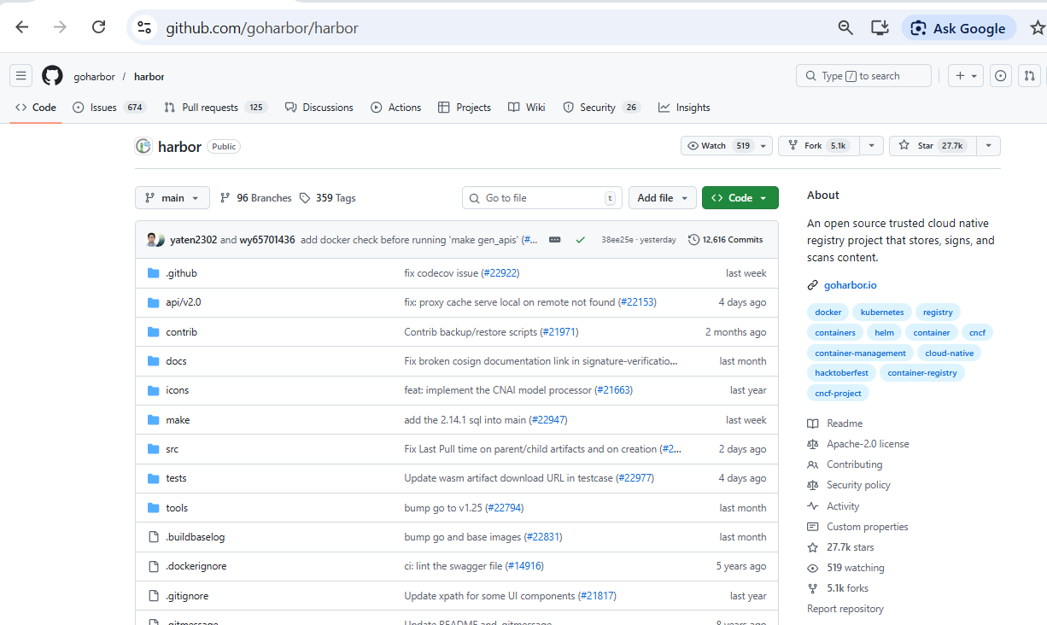
Discover Harbor (source code) https://github.com/goharbor/harbor

Slide 6
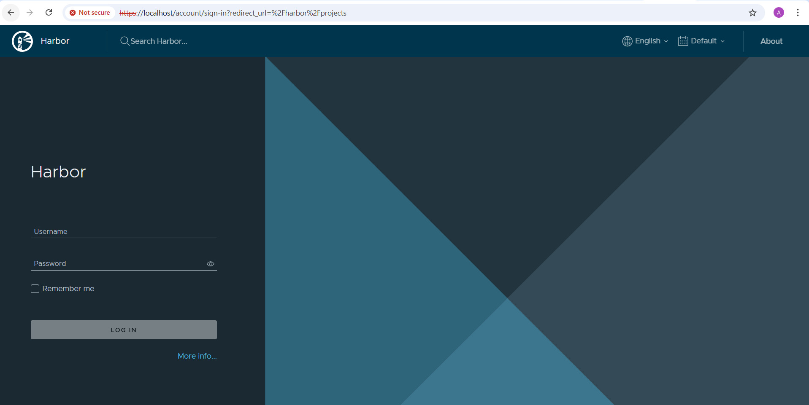
Login (defaut: « admin » / « Harbor12345 »)

Slide 7
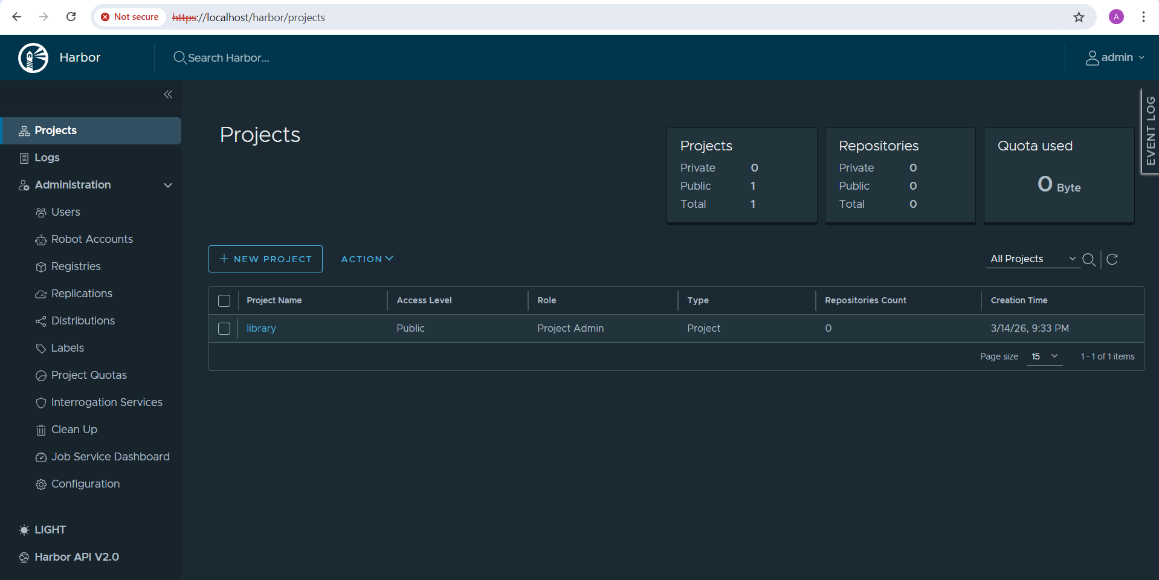
Home Page: Projects

Slide 8
Harbor Model: Projet > Repository > Image
Project = belongs to a list of member Users (= to a team)
contains
Repositories = logical name of Image that are pushed
contains
Docker Image tags/versions/sha
has Scanned result, contains Vulnerabilities

Slide 9
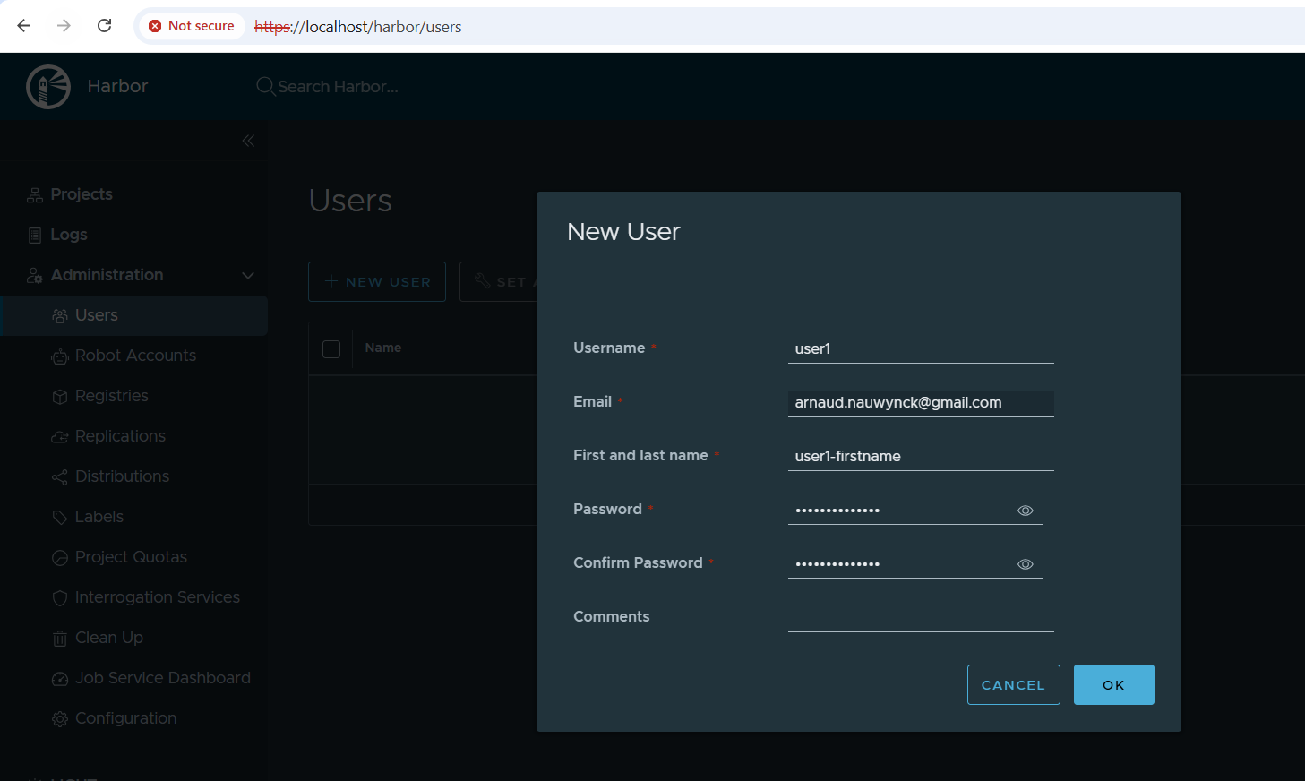
New User « user1 »

Slide 10
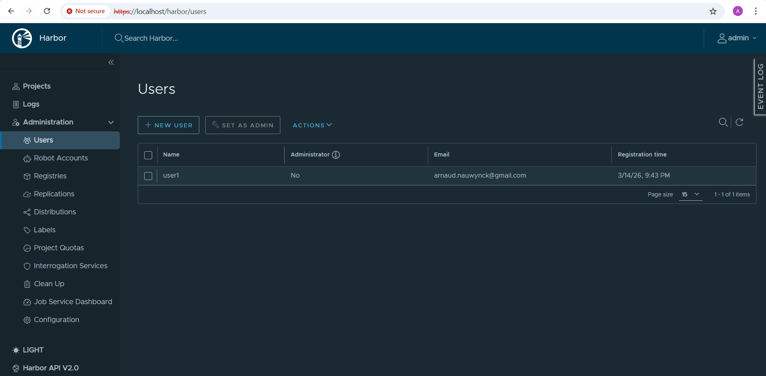
Users

Slide 11
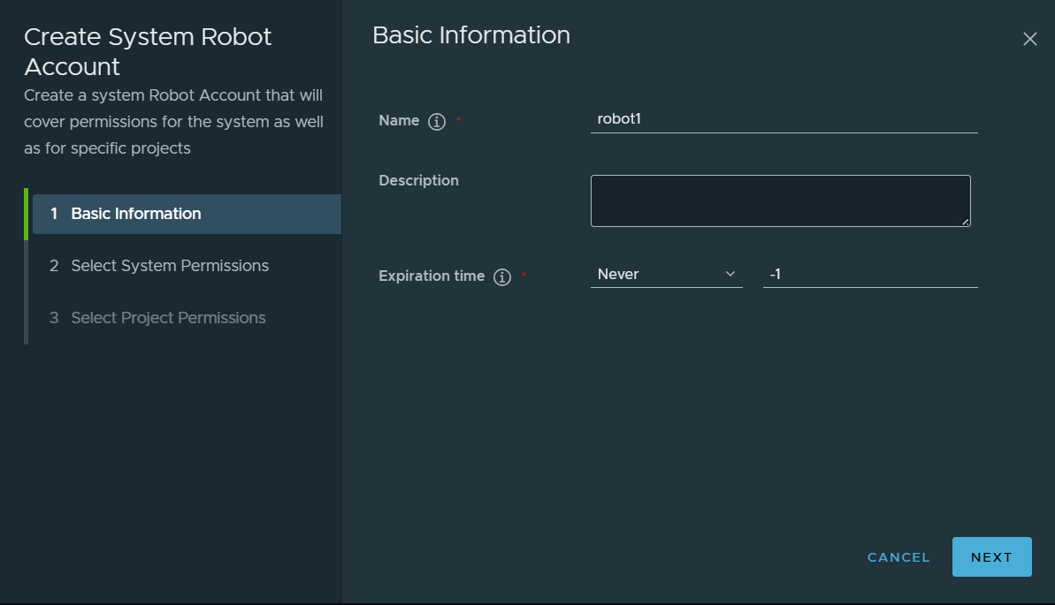
New Robot Account

Slide 12
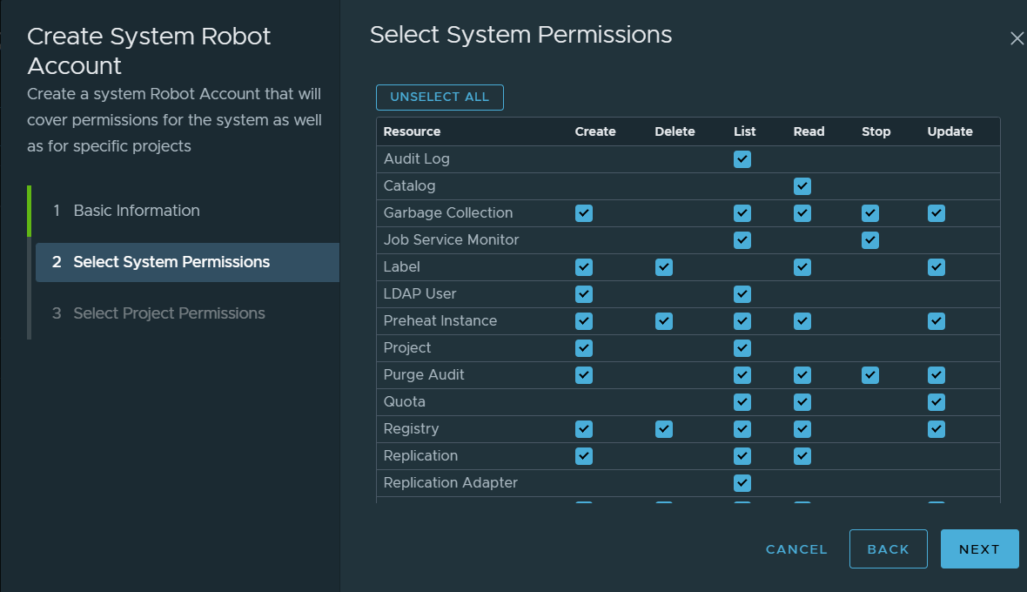
Robot Account – System Permissions

Slide 13
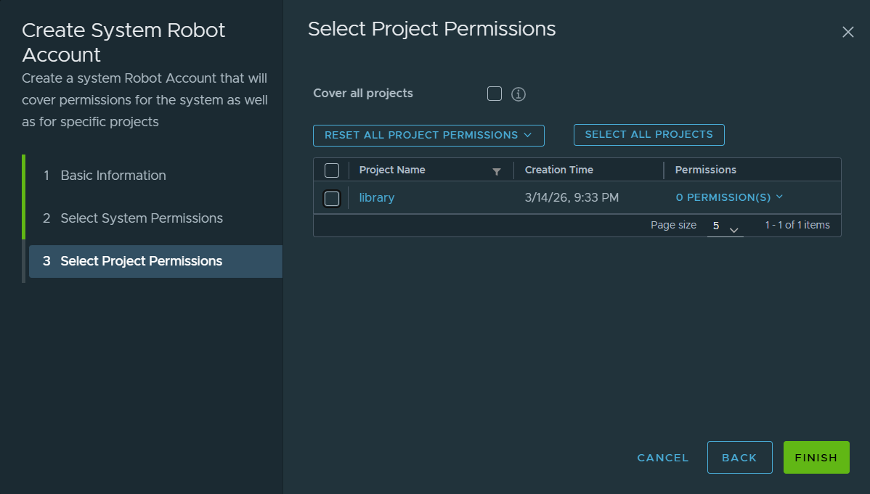
Robot Account – Project Permissions

Slide 14
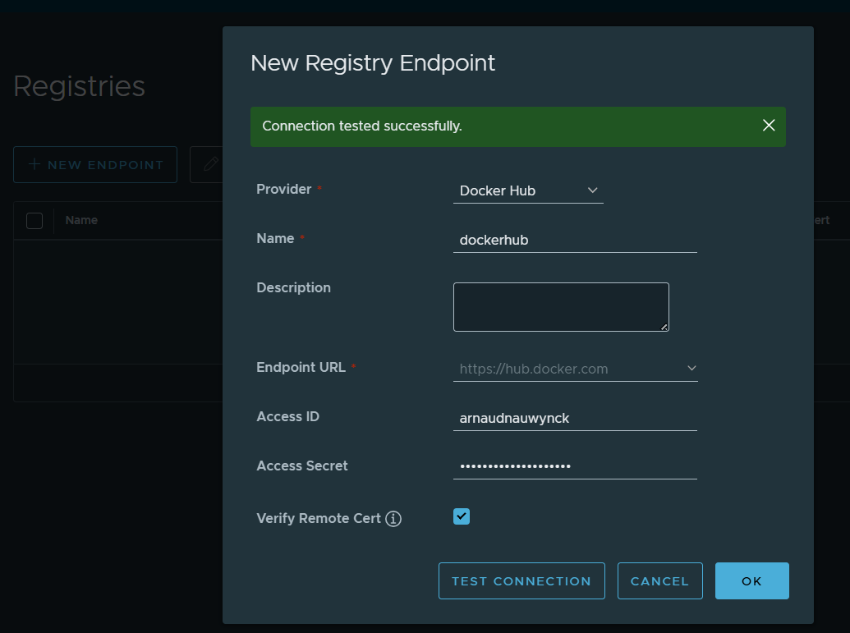
Registries

Slide 15
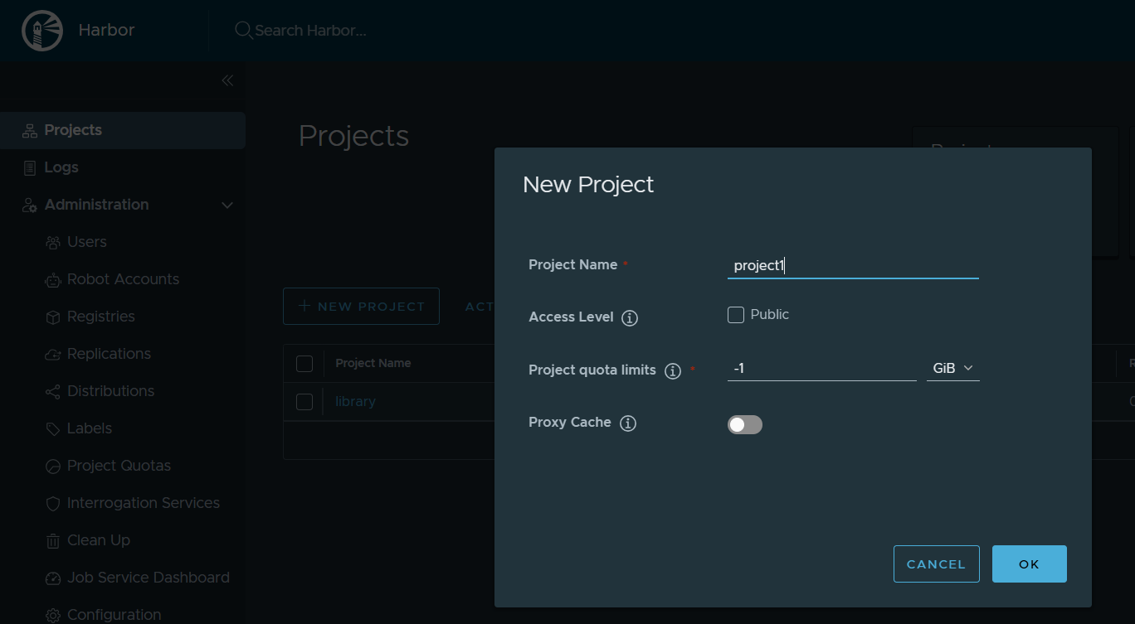
Projects

Slide 16
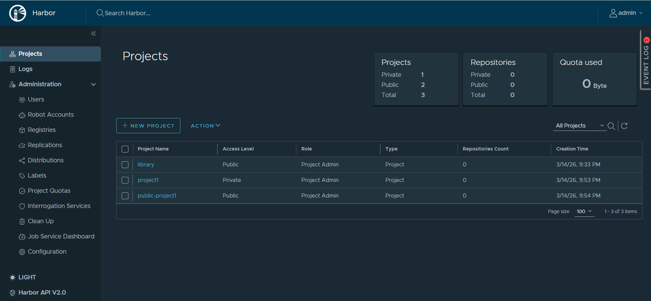
Projects List (Private+Public)

Slide 17
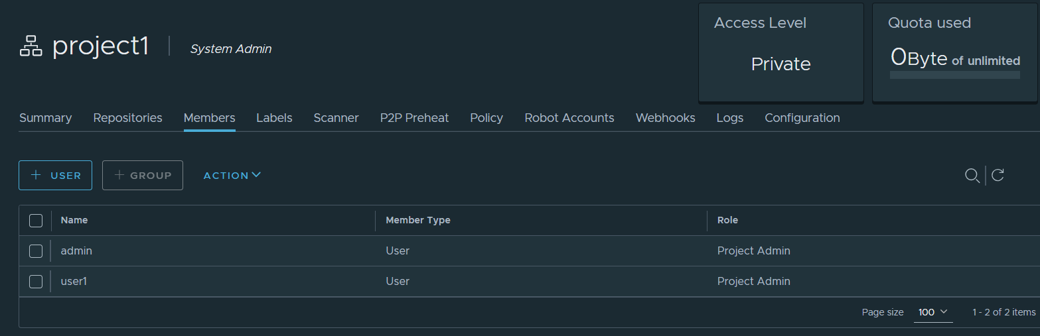
Project - Members

Slide 18
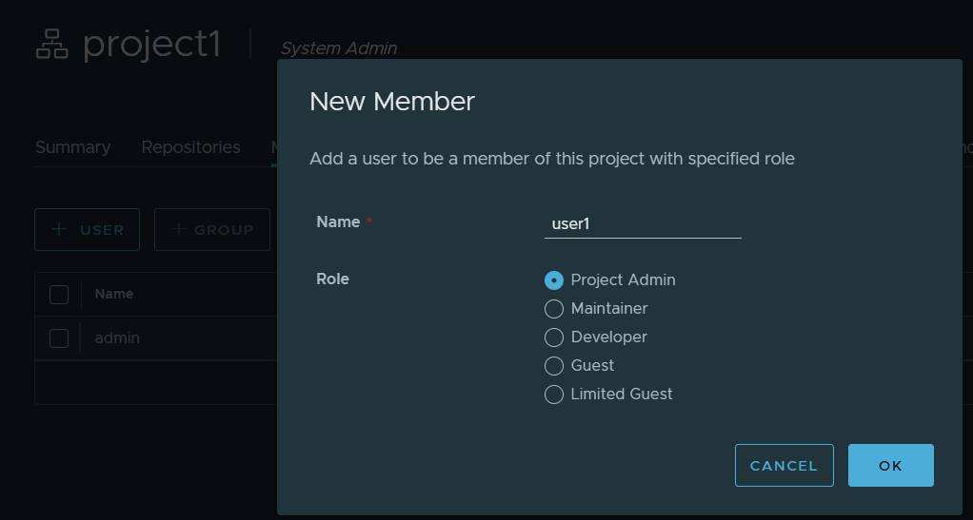
Project – Add Member

Slide 19
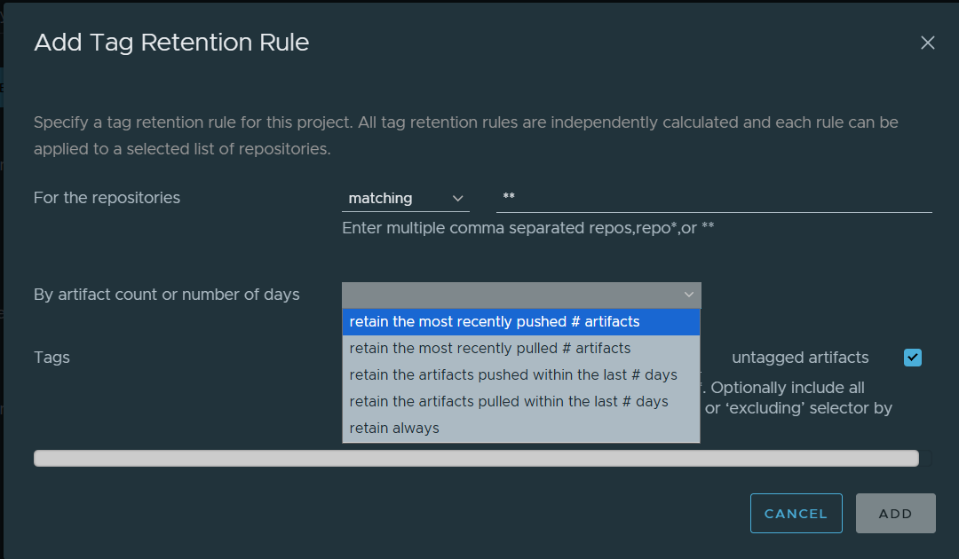
Project – Add Retention Rule

Slide 20
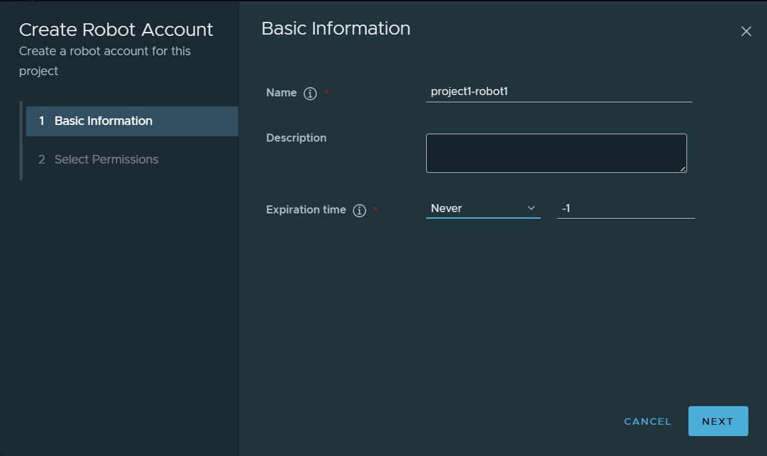
Project – Create Robot Account

Slide 21
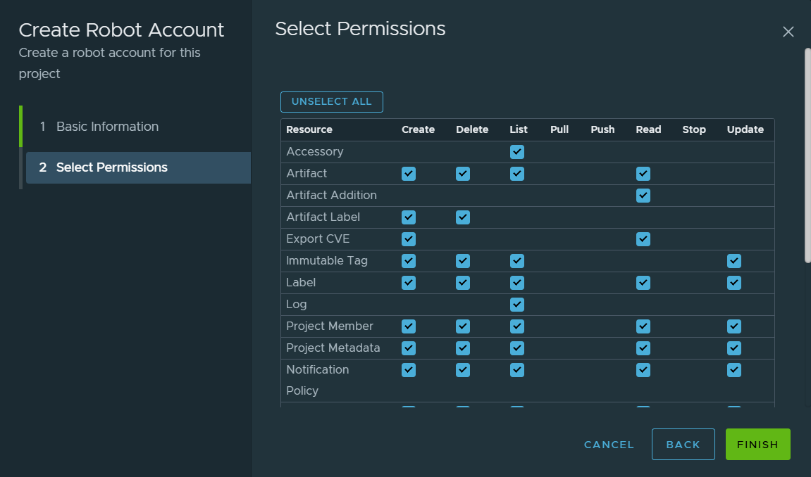
Project – Robot Account Permissions

Slide 22
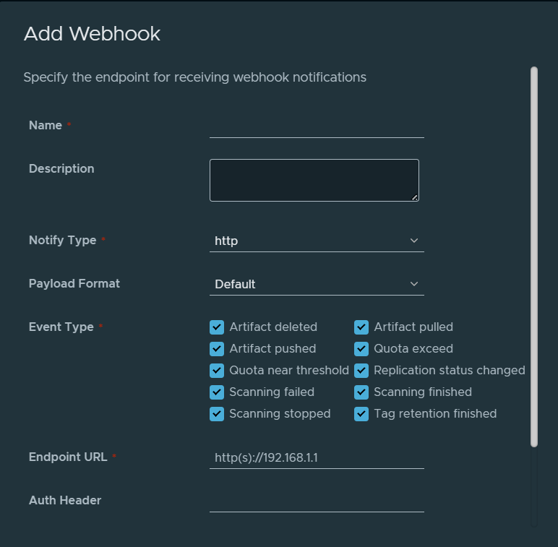
Project - Add Webhook

Slide 23
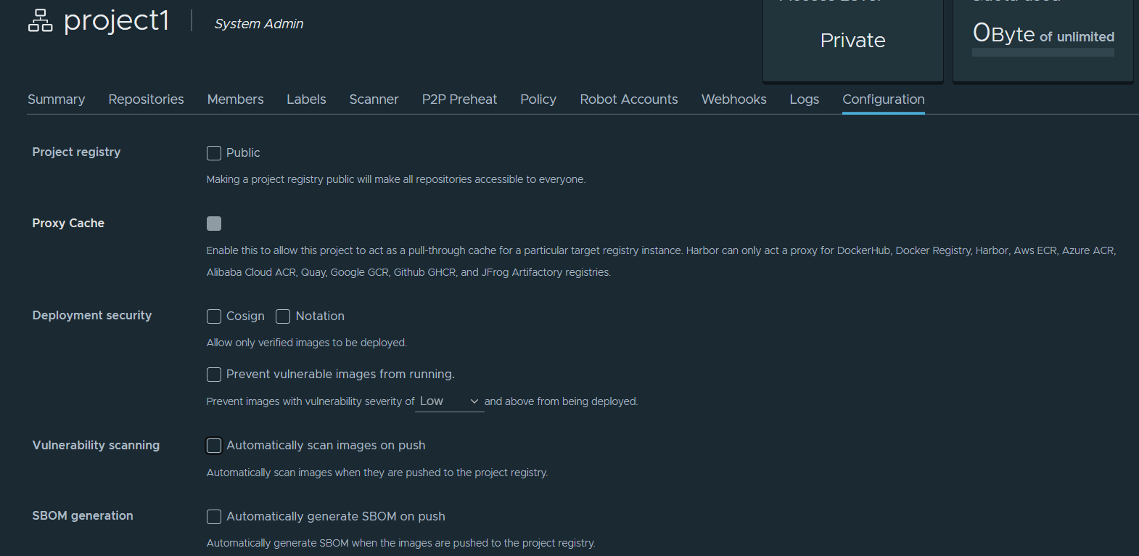
Project – Configuration (1/2)

Slide 24
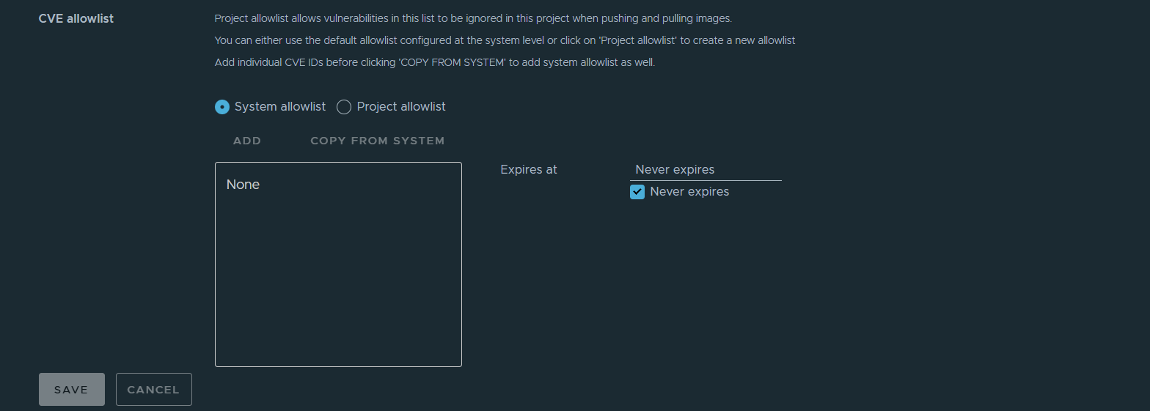
Project – Configuration (2/2)

Slide 25
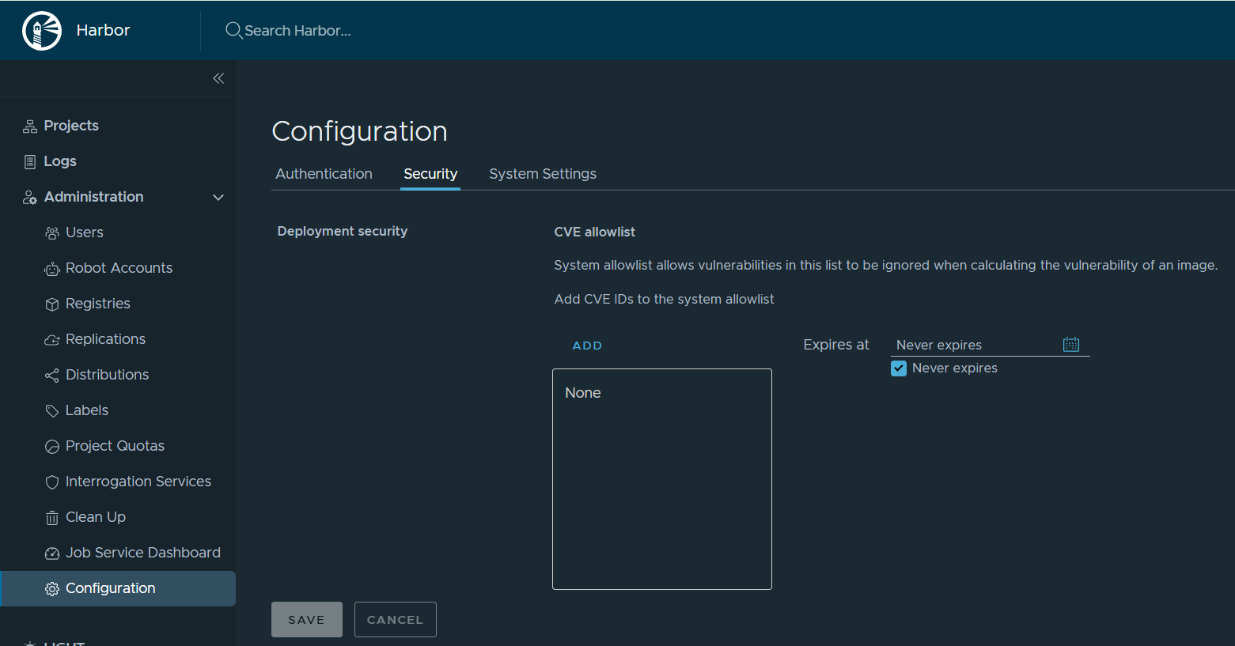
Configuration (global) – CVE allowlist

Slide 26
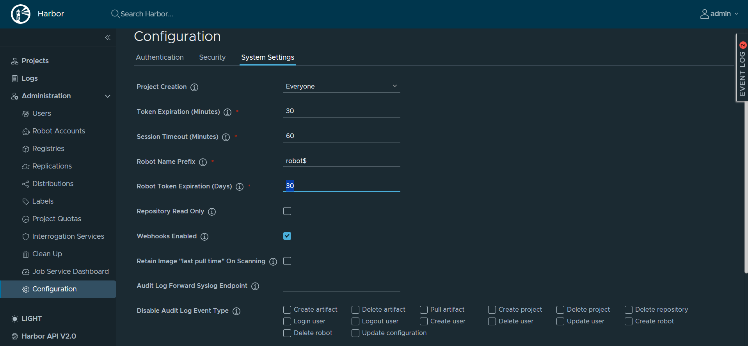
Configuration

Slide 27
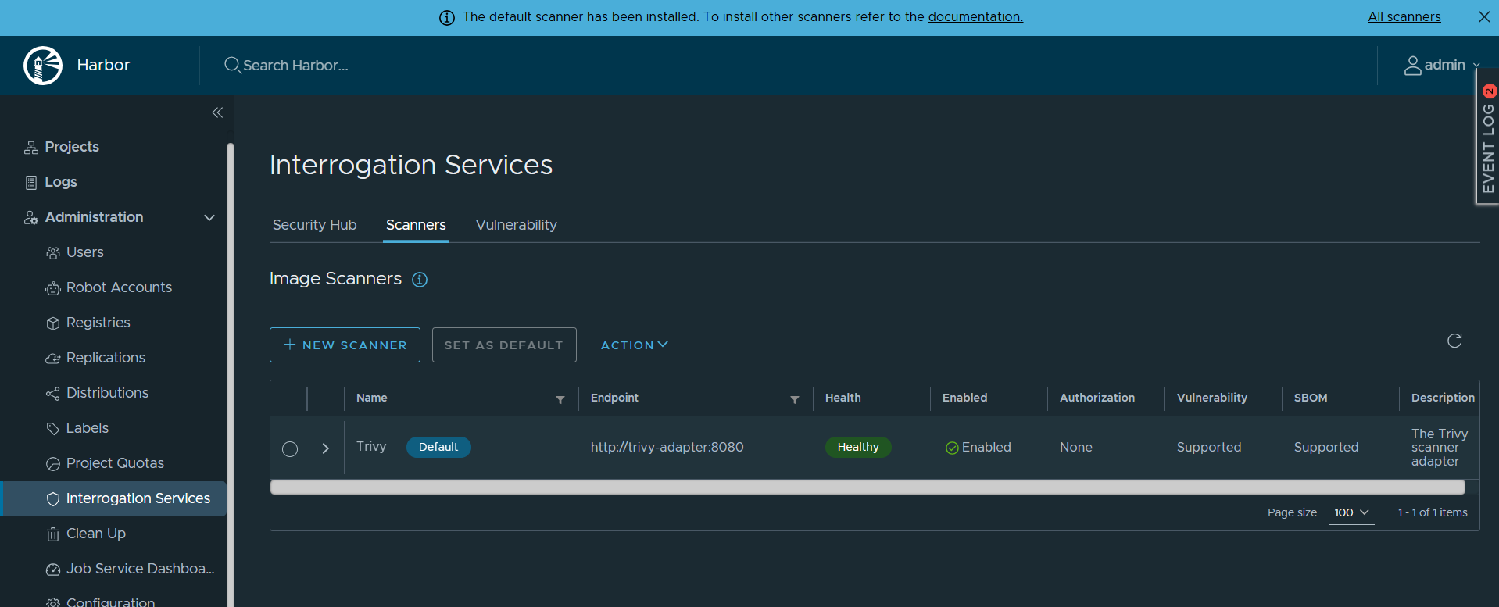
Interrogation Services (=> Trivy)
NOTICE installation: sudo ./installer.sh --with-trivy

Slide 28
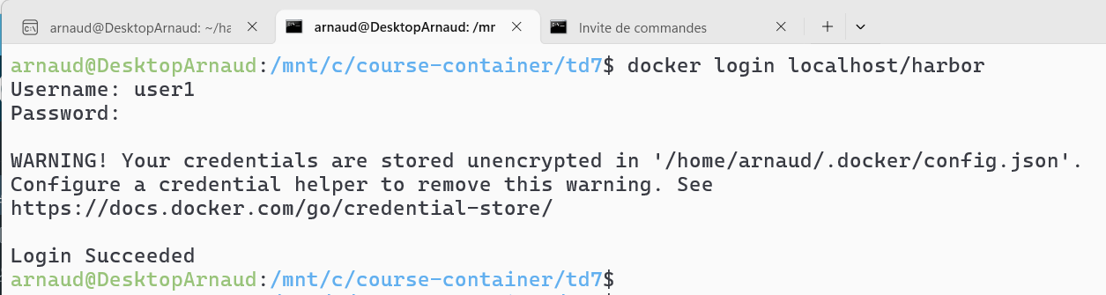
Test pushing / Pulling Image to Docker

