Slide 1
Architecture Design Part 2 : Model & Service
arnaud.nauwynck@gmail.com
Entity - Model vs Service
SOLID principles for business logic code
This document:
http://github.com/arnaud-nauwynck/Presentations/java/ Architecture-Design-part2-Model.pdf

Slide 2
Outline
Entities problems : FLAT , Anemmic classes
Model to the rescue ?
Organize code with SOLID principle
Services

Slide 3
Reminder Part 1 : Entity classes

Slide 4
Entity Restrictions
1/ Entities FIT the database Tables design
2/ Restrictions from JPA / Relational model
2bis/ NO complex (table join) classes hierarchy
3/ Lifecycle managed by Transaction
4/ NOT suited to put business logic code (SOLID principle)
4bis/ Only POJO getters/setters
… DTO + Service (+ Model?) to the rescue

Slide 5
Focus on (Persistence) Data vs Behavior
An Entity is unique via its « ID »
And completely defined via all its state data
Not focusing (yet) on behavior methods on Entity
Assume only Getter/Setters
+ Add/Remove relations to other Entities
Behavior will be handle by Service classes or corresponding Model class

Slide 6
POJO Entity class : weakness for Smart Code « Anemic » classes
@Entity
@Getter @Setter // POJO with lombok
Class XEntity {
@Id @GeneratedValue
private long id;
private int field1, field2, field3, field4;
private String field5, field6, field7;
private Date field8, field9, field10;
}
Class looks full of fields/data
May save lot of « things »
Only getter/setters – No methods
No business logic / behavior

Slide 7
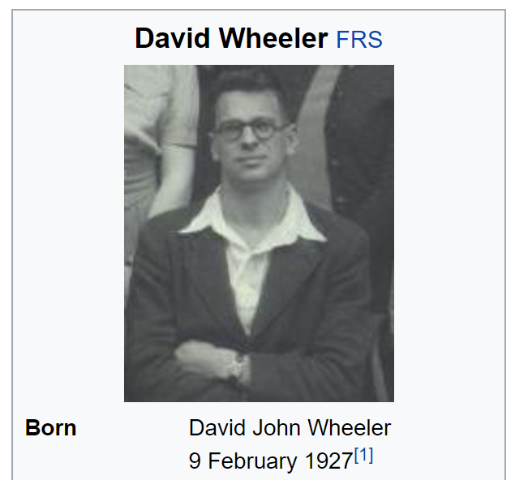
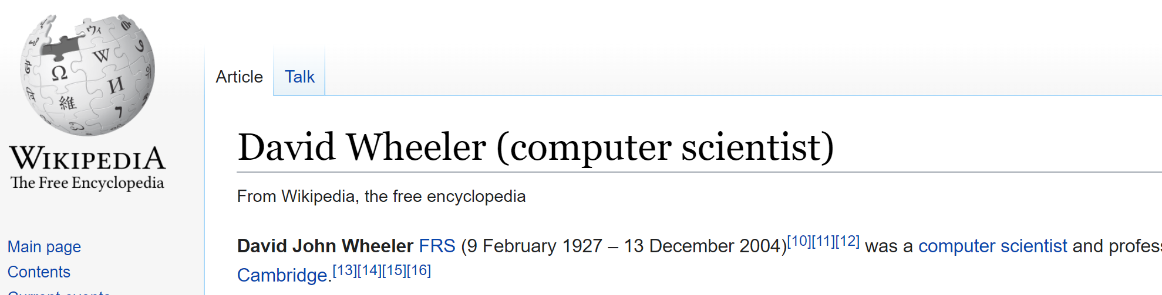
« The » Computer Science Theorem
“ All problems in computer science
can be solved
by another level of indirection,
except for the problem of too many layers of indirection.”

Slide 8
Model always needed / usefull for Entity ?
If you ask question
then you know the answer

Slide 9
Model … indirection to Entity
Model is an indirection to Entity
& (Entity) “problems can be solved by another level of indirection”
=> Possibility that Model indirection solve some Entity problem
For simple « CRUD » … There is absolutly NO problem
… except that « Model » defines too many additional level of indirection
Adding Model indirection level falls in the rule of “too many layers of indirection”

Slide 10
Flat / Object-Oriented classes hierarchy
Start simple …
NO interface
NO « diamond » inheritance NO sub-class without new fields
NOT focusing on « behaviour » … focusing only on « data »
Favor delegation: « has » rather than inheritance: « is »
XEntity
Id: IdType
field1: Type
…
SubAXEntity
SubBXEntity
fieldForSubAX: Type
…
fieldForSubXB: Type
…
SubCBXEntity
fieldForSubXB: Type
…

Slide 11
Object-Oriented for Code <-> Flat for DB
XModel
Id: IdType
field1: Type
…
FlatXEntity
FlatXTable
Data Copy
Id: IdType
type: EnumXType;
field1: Type
fieldForSubA: Type;
fieldForSubB: Type;
SubBXModel
or
SubAXModel
fieldForSubAX: Type
…
fieldForSubXB: Type
…
Adapter Wrapper
SubBXModelAdapter
getFieldForSubXB() {
return entity.fieldForSubB; }

Slide 12
Typical mismatch between Finantial Instrument Models <-> Optimized Database
Flat Tables
EquityTradeEntity
Transaction
Unified
Trade model
ForexTradeEntity
TradeLeg
1..*
Math modelisation
of derivatives pricing
OTCTradeEntity
1
Instrument
Currency
ListedProduct
Forward
Sum
Future
Equity
Comodity
All specific to trading markets,
optimized for db access…
not object-oriented
Scaled
Option

Slide 13
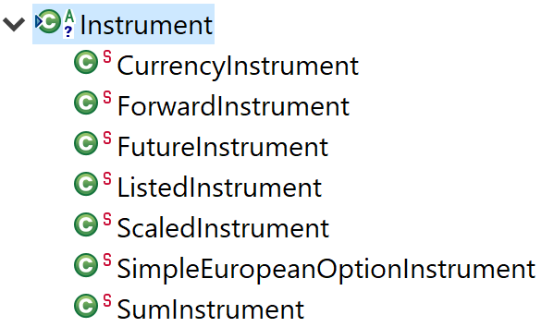
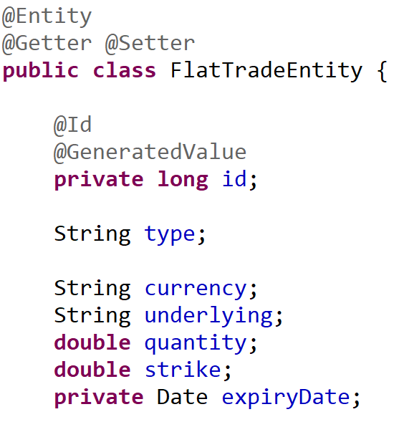
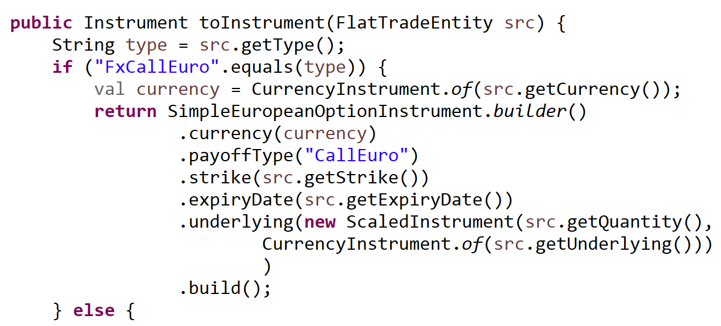
Typical Flat to Tree Converter (Pricing Finance )

Slide 14
Model Adapter design-pattern
interface Model {
int getField();
int setField(int field);
}
class ModelAdapter implements Model {
private Entity entityDelegate;
@Override
public int getField() {
return entityDelegate.getField();
}
@Override
public void setField(int p) {
entityDelegate.setField(p);
}
}
Model
Entity
1
delegate
ModelAdapter

Slide 15
Copy / Adapter out-of-sync / updates to Entity ?
Thread
entity = em.findBy(..)
modelAdapter = new ModelAdapter(entity)
modelCopy = new ModelCopy(
entity.getField1, entity.getField2,…)
entity updates
modelAdapter updates
Entity == modeAdapter still in SYNC
!= modelCopy (values diverged)
modelCopy updates
Resynchronize modelCopy changes to Entity ??
Flush update entity to DB

Slide 16
Read-Only Model : simpler
interface ReadOnlyModel {
int getField();
// NO setter
}
class ReadOnlyModelAdapter implements Model {
private Entity entityDelegate;
@Override
public int getField() {
return entityDelegate.getField();
}
}

Slide 17
Model using Immutable Copy + Converter (Builder pattern)
interface Model {
int getField();
// NO setter
}
@Builder // lombok
@Getter
class ImmutableModel implements Model {
public final int field1;
public final int field2;
public final int field3;
}
// Builder class generated from Lombok
public static class Builder {
public int field1;
public Builder field1(int p) {
this.field = p;
return this;
}
… field2, field3, …
ImmutableModel build() {
return new ImmutableModel(field1, field2, field3);
}
}
// usage
public ImmutableModel copyEntityToModel(Entity src) {
return ImmutableModel.builder() .field1(src.getField1())
.field2(src.getField2())
.field3(src.getField3())
.build();
}

Slide 18
Unmodifiable (wrapper) vs Immutable (copy) see java.util.UnmodifiableList / guava ImmutableList
Underlying object can be changed outside
Unsafe code can get content, then update
UnmodifiableList extends List …. Type are compatible
Confusing: All methods set/add/clear are declared … but throw RuntimeException
Same method for List & UnmodifiableList
Safe code. Final fields copy
Optimized layout for list 1,2,3…
Type are NOT compatible
Only read-only methods declared
different methods for Immutable
(incompatible type signatures)

Slide 19
Decision Diagram to use Model
NO: Same flatness
FlatModel
Useless indirection
copy/wrapper code
Risk of missed updates
NO value added !!
Id: IdType
field1: Type
…
FlatEntity
Id: IdType
field1: Type
…
Indirection For
Object-Oriented?
Possibly OK/Difficult
Need to use Model Wrapper
With bi-directional updates to Entity
NO:
update
AbstractModel
Use model as
Read-Only?
Yes
// Abstract method
OK, can use model
Immutable copy (ValueObject)

Slide 20
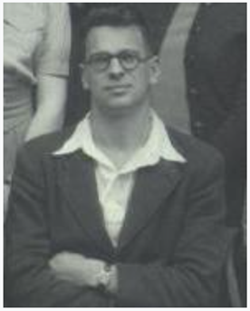
Pb => 1 More Indirection to Model « Visitor » Design-Pattern
Annexe
Model
Visitor
abstract
accept(Visitor v);
abstract
caseA(Amodel x);
caseB(Bmodel x);
caseC(Cmodel x);
caseD(Dmodel x);
« Magic » dispatches
class X extends Model {
@Override
accept(Visitor v) {
v.caseX(this);
}
}
AModel
BModel
CModel
DModel
Func1VisitorImpl
Func2VisitorImpl
@Override
caseA(Amodel x){..}
caseB(Bmodel x){..}
caseC(Cmodel x){..}
caseD(Dmodel x){..}
Func3VisitorImpl
@Override
caseA(Amodel x){..}
caseB(Bmodel x){..}
caseC(Cmodel x){..}
caseD(Dmodel x){..}
@Override
caseA(Amodel x){..}
caseB(Bmodel x){..}
caseC(Cmodel x){..}
caseD(Dmodel x){..}
extensibility
- Fixed classes hierarchy
- Simple code (no behavior)
- Extensible behaviors via visitor
- Independant behavior classes
- SOLID principle

Slide 21
Still Pb => 1 + 1 More Indirections to Model « Adapter » + « Factory » + « Registry » Patterns « Double dispatch »
Annexe
Model
Registry
T adapt(Class<T> c)
{ registry.findFactory
+ create.. }
Factory<T> findAdapterFactory( Class<T> f, Class<C> onClassOrSuper) {..}
register(
Class<C> c,
Class<T> t,
Factory<T> f) { ..}
IInterface1
IInterface2
IInterface3
AModel
BModel
extensibility
A1AdapterFactory
B1AdapterFactory
extensibility
(abstract) Factory<T>
abstract
T createAdapter(C onObject);
A1Adapter
B1Adapter
A2AdapterFactory
A2Adapter
extensibility

Slide 22
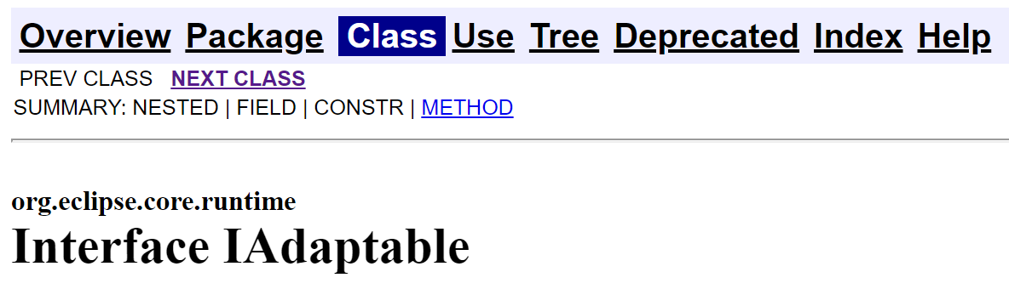
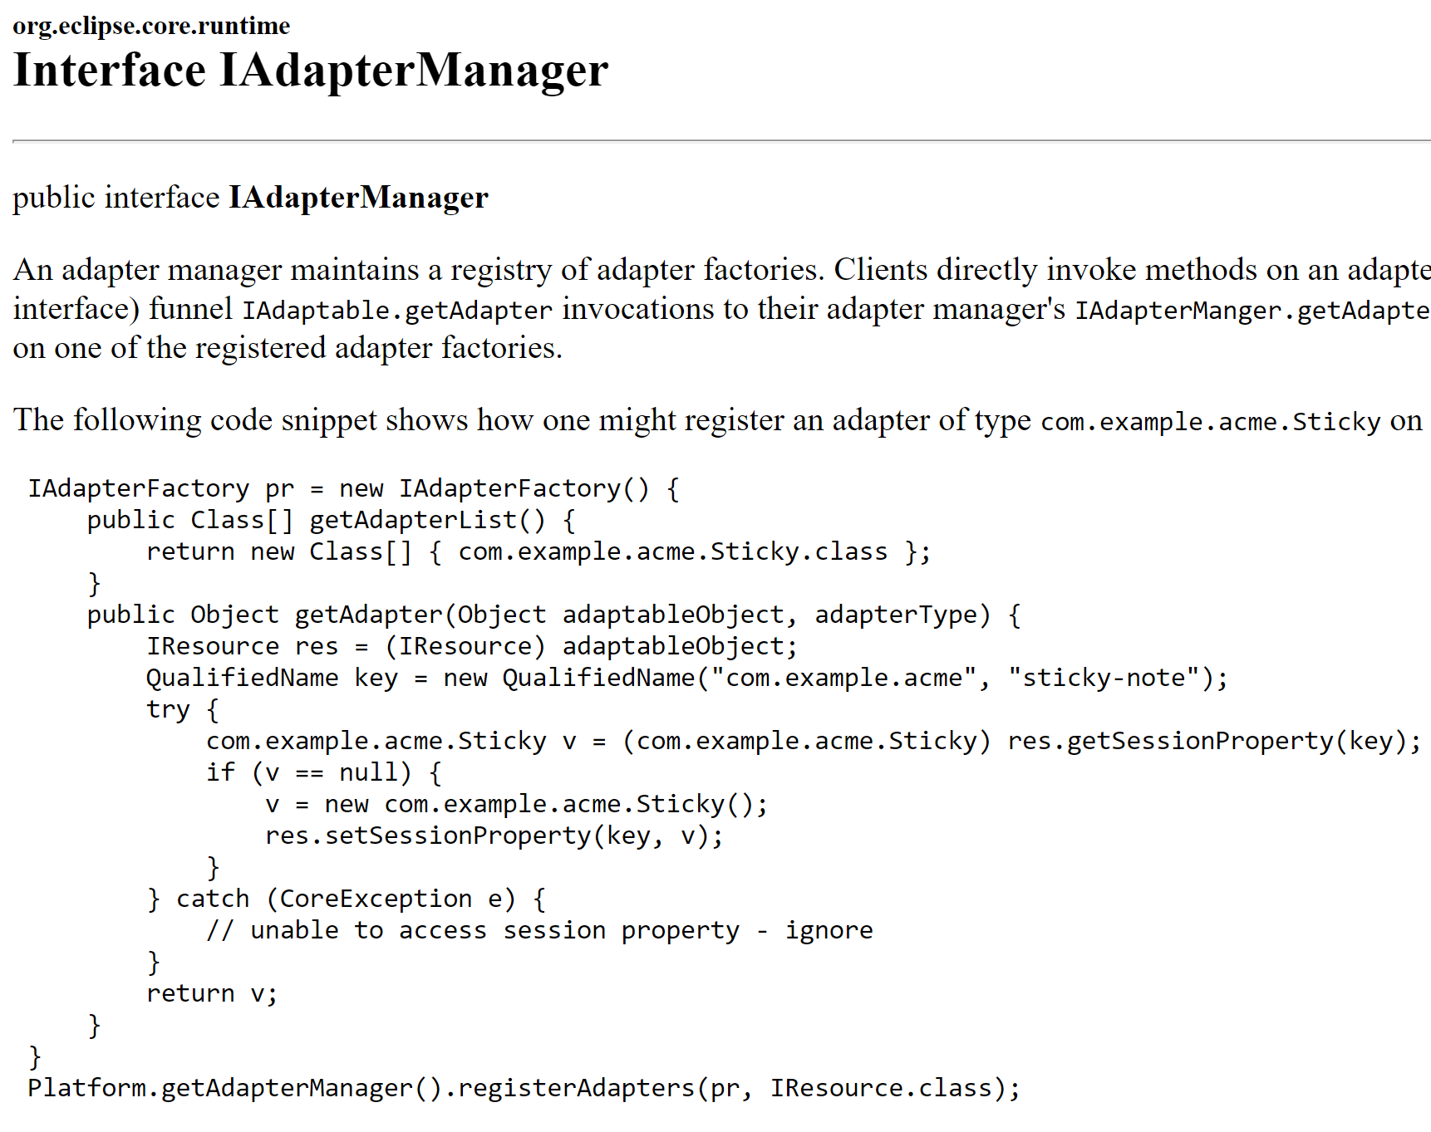
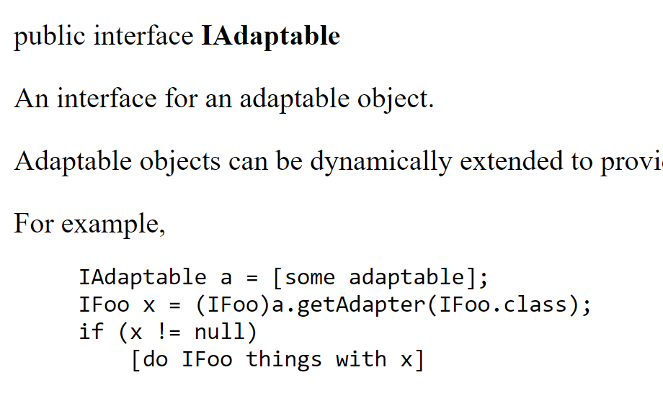
See org/eclipse/core/runtime/IAdaptable.java Eclipse Platform « core » Framework + Plugins Extensions
Annexe

Slide 23
Restriction on Model Adapter class … same lifecycle as Entity anyway

Slide 24
Entity : Lifecycle managed by Session (Transaction)
Level1Cache
(=Session )
Read-Write, single-thread
Thread
Begin transaction
@Transactional
method () {
XA (Transaction)
e1 = em.save(new Entity())
e2 = e1.getField()
e3List = repo.findBy(..)
end transaction
} // implicit try-catch-finally
prepareXA => flush Entity changes
Commit XA => commit JDBC
Entity lifecycle ends with XA commit/rollback

Slide 25
Use Entity outside of Transaction ? RuntimeException
// not transactional
// no open-session-in-view
class Controller {
@Autowired FooXAService service;
public void foo() {
FooEntity e = service.foo();
e.getField(); // => Exception !!!
}
}
@Transactional
class FooXAService {
public void foo() {
FooEntity e = findBy …();
return e;
} // <= INVALID e outside XA
}

Slide 26
Copy Entity data to Transfer before Commit
Thread
Session
Begin transaction
@Transactional
method () {
XA (Transaction)
e = repo.findBy(..)
Dto res = new DTO()
// copy dto entity
res.setField1( e.getField1() );
return res;
end transaction
} // implicit try-catch-finally
Entity lifecycle ends with XA commit/rollback
DTO have no lifecycle ends (only GC to free)

Slide 27
Do not confuse Model with DTO .. or DTO with Model
Model = better Object-Oriented modelisation
DTO = Data Transfer Object
= an outgoing serializable POJO class to output DATA

Slide 28
Relations (Graph) between Entity restrict to kernel « domain »
Lifecycle managed by
JPA Transaction
Domain (self-contained package)
XEntity
YEntity
ZEntity
FooEntity
Any Class
Lifecycle bigger than JPA Transaction

Slide 29
Entity – Model … same managed Lyfecycle
model (self-contained package)
Lifecycle managed by
JPA Transaction
Domain (self-contained package)
OK to Create Model from Entity
(model contain NO extra data)
YModel
XEntity
OK to point to Entity
(same lifecycle than Entity)
YEntity
ZEntity
FooEntity
Any Class
Lifecycle bigger than JPA Transaction

Slide 30
DTO - Entity – Model – Service … different managed Lyfecycle
model (self-contained package)
Lifecycle managed by
JPA Transaction
Domain (self-contained package)
OK to Create Model from Entity
(model contain NO extra data)
YModel
XEntity
OK to point to Entity
(same lifecycle than Entity)
YEntity
ZEntity
dtos (self-contained package)
NO CYCLIC dependencies
NO managed Lifecycle(only GC)
FooEntity
service (self-contained package)
Lifecycle managed by spring
ApplicationContext
XDTO
Service1
YDTO
Any Class
Lifecycle bigger
than JPA Transaction
Service2
ZDTO
Component1

Slide 31
Adding business logics in Model class
Example: save « Order » on e-commerce site
OrderModel
Send e-mail confirmation to user
Product Catalog
Compute VAT
Manage Stocks
Recommandations
Delivery
Billing
Special Offers

Slide 32
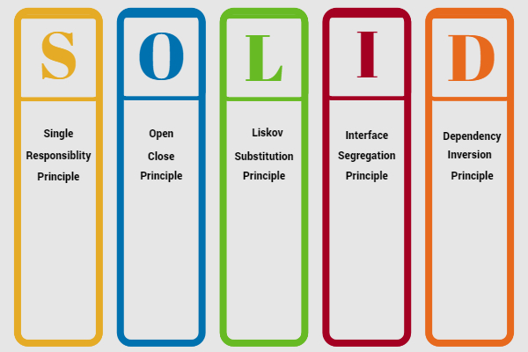
« solid » principles

Slide 33
In Solid … S = SINGLE
A class should do only 1 thing,
given by its naming convention.
Delegate all other things to other classes

Slide 34
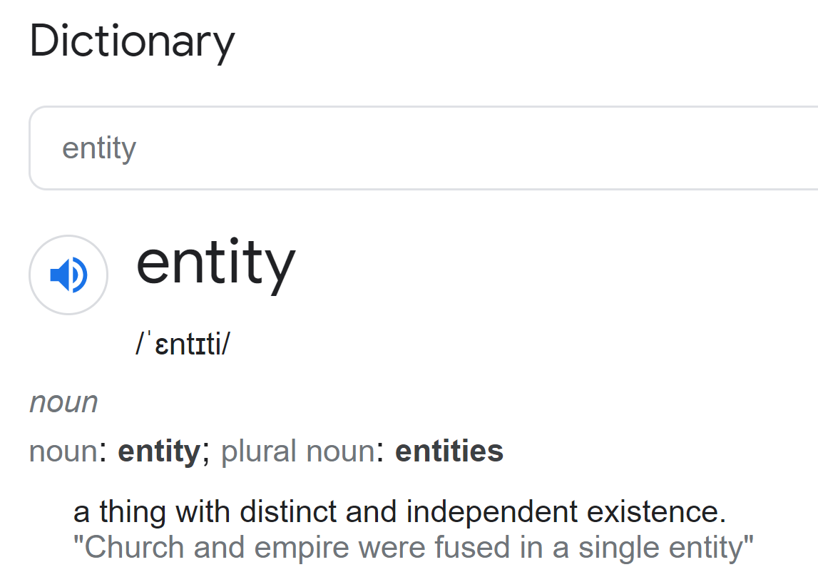
English Definition « Entity »

Slide 35
Single » principle of SOLID for Entity:
Store some data for a given @ID
Entity should be simple POJO with NO code

Slide 36
Remark Note: zoom « Entity » definition
Annexe
An Entity is a « thing »
Could be whatever make sense
with distinct
They have a UNIQUE « ID » (primary key)
To distinct between objects
and independent
May contains group of dependent data/field/values/parts
but entities are independent of each others
existence
Entity have a lifecycle.
They exist after you create and name them with ID.

Slide 37
Remark Note: Entity versus « Aggregate » (Trees of data)
Annexe
Technically, these are « entities »
There can have references to each-other
But exist independently.
Technically, these are « NOT entities »
Then all are dependent of the « Aggregate starting at X»
X
XEntity
x_id
x_id
1
Y Part (Inside X)
YEntity
yOffset
*
y_id
1
ZEntity
Z Part (Inside Y)
z_id
*
zOffset
Entities with « cascade delete » rule:
When deleting « X » => all child are deleted
Y and Z can not be created-without /detached-from X

Slide 38
Put « methods » in SOLID classes
… In « Models » or « Services » SOLID classes ?
Is it necessary to have a « model(isation) » ?
Why not a simple service

Slide 39
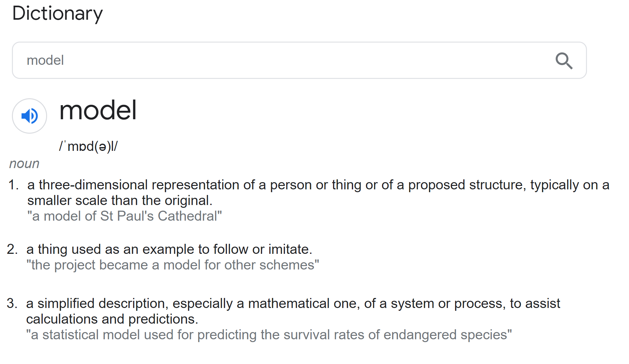
Model … put more abstraction on perfection representation

Slide 40
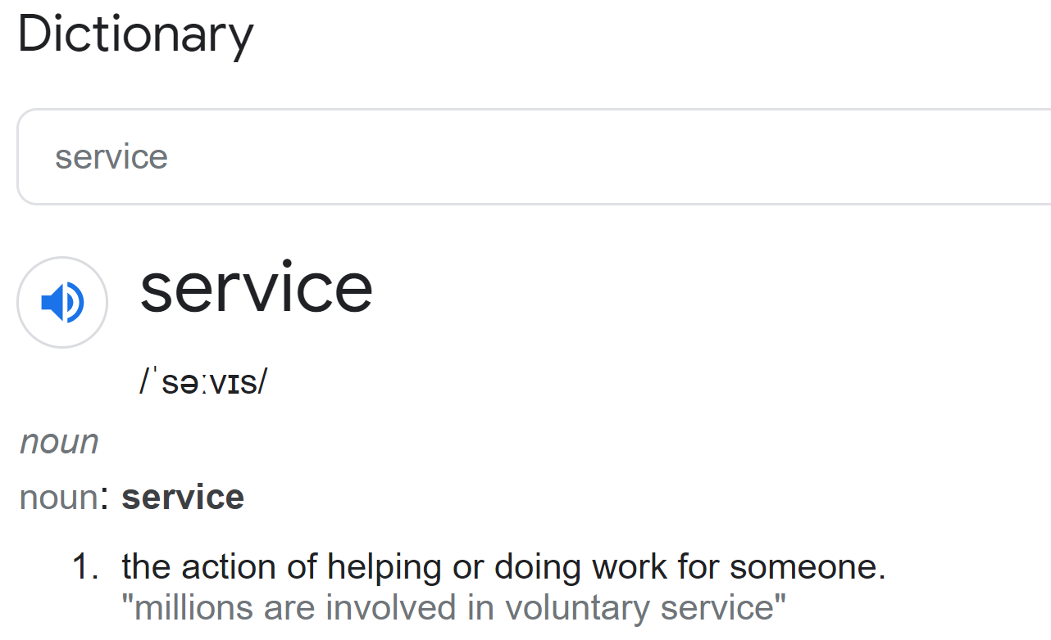
Service … where action are done

Slide 41
Move behaviors methods in N x « Services »
OrderEntity
Side-Effects
to persist
someAction( … )
BillingEntity
BillingService
computeVATForOrder(OrderEntity p) {
return … VAT;
}
createBillingForOrder(OrderEntity p) {
…
}
updateBillingAfterPayment(OrderEntity p,
PaymentEntity payment) {
..
}
Return value
( no persist)
response as DTO / Entity refs
BillingActionResult

Slide 42
Entity/Model (Statefull) vs Service (Stateless)
DB
@Entity
Statefull
DTO
ValueObject
Model
Not persisted
Stateless
@Service
POJO
No Code
Business Logic
Code { … }

Slide 43
Entity = persist DATA + STATE between actions Actions = may have side-effects, code in Service Service = fully Stateless
Entity
Audit
Action Changes
Entity
Side-Effects
to persist
Entity
PERSISTED
DATA
ActionInput
Entity
Entity
Service
STATELESS
Service
(code only)
algebraicCompute(..) { .. }
sideEffectAction(){ .. }
Return value
( no persist)
NON- PERSISTENT
DATA
response as DTO / Entity refs
ActionResult

Slide 44
Service Methods Dichotomy Side-Effect ..or.. NO-Side-Effect
May prepare pre-conditions
+ computations ahead
( algebraic sub-part)
… then side-effects part
Unit test on side-effects
All side-effects
must be atomically saved
( ACID transactions).
Method should not be
re-executed
(or rollback XA)
Yes
Does method
Have
Side-Effect ?
No
Method is purely algebraic:
y = f(x)
Can be recomputed at any time
multi-threaded, etc…
Simple to Unit test

Slide 45
Where Complexity is
Complexity ++++++
Yes
( concurrency, locks, update,
XA, ...)
Does method
Have
Side-Effect ?
Complexity ++
Yes
( possible race conditions,
threading, caching ..)
mutable
params?
No
Complexity 0.0
No
( pure algebraic, repeatable)

Slide 46
algebraic Part / side-effect part on « Essential vs Accidental Complexity »
Essential complexity
Juridic declaration by state.
Example: pay VAT
« vat : 5% of raw added value for {x,y,..} product »
Deploy On Kubernetes
In Cloud
Using Caching Technologies
Choose JDK + compile
Choose JRE + Linux version
Choose memory jvm args
Optim for threads / thousand connections
Choose Algorithm:
to find vatRatio by Product Type…
computeThenSave(ProductType p, BigDecimal rawValue) {
// Hibernate vatRepo.findByProductType(..)
Choose storage in Oracle DB
Save result
Model as Pure algebraic
Math formula is « essential »
Some formulation more complexes
Vat = vatRatio(ex:5%) * rawValue
Total = rawValue + Vat
… round to cents
Choose imperative langage (java)
Choose Data-structure:
« float », « double » (rounding errors)
« BigDecimal »
Accidental complexity
From mandatory choices
+ extra choices

Slide 47
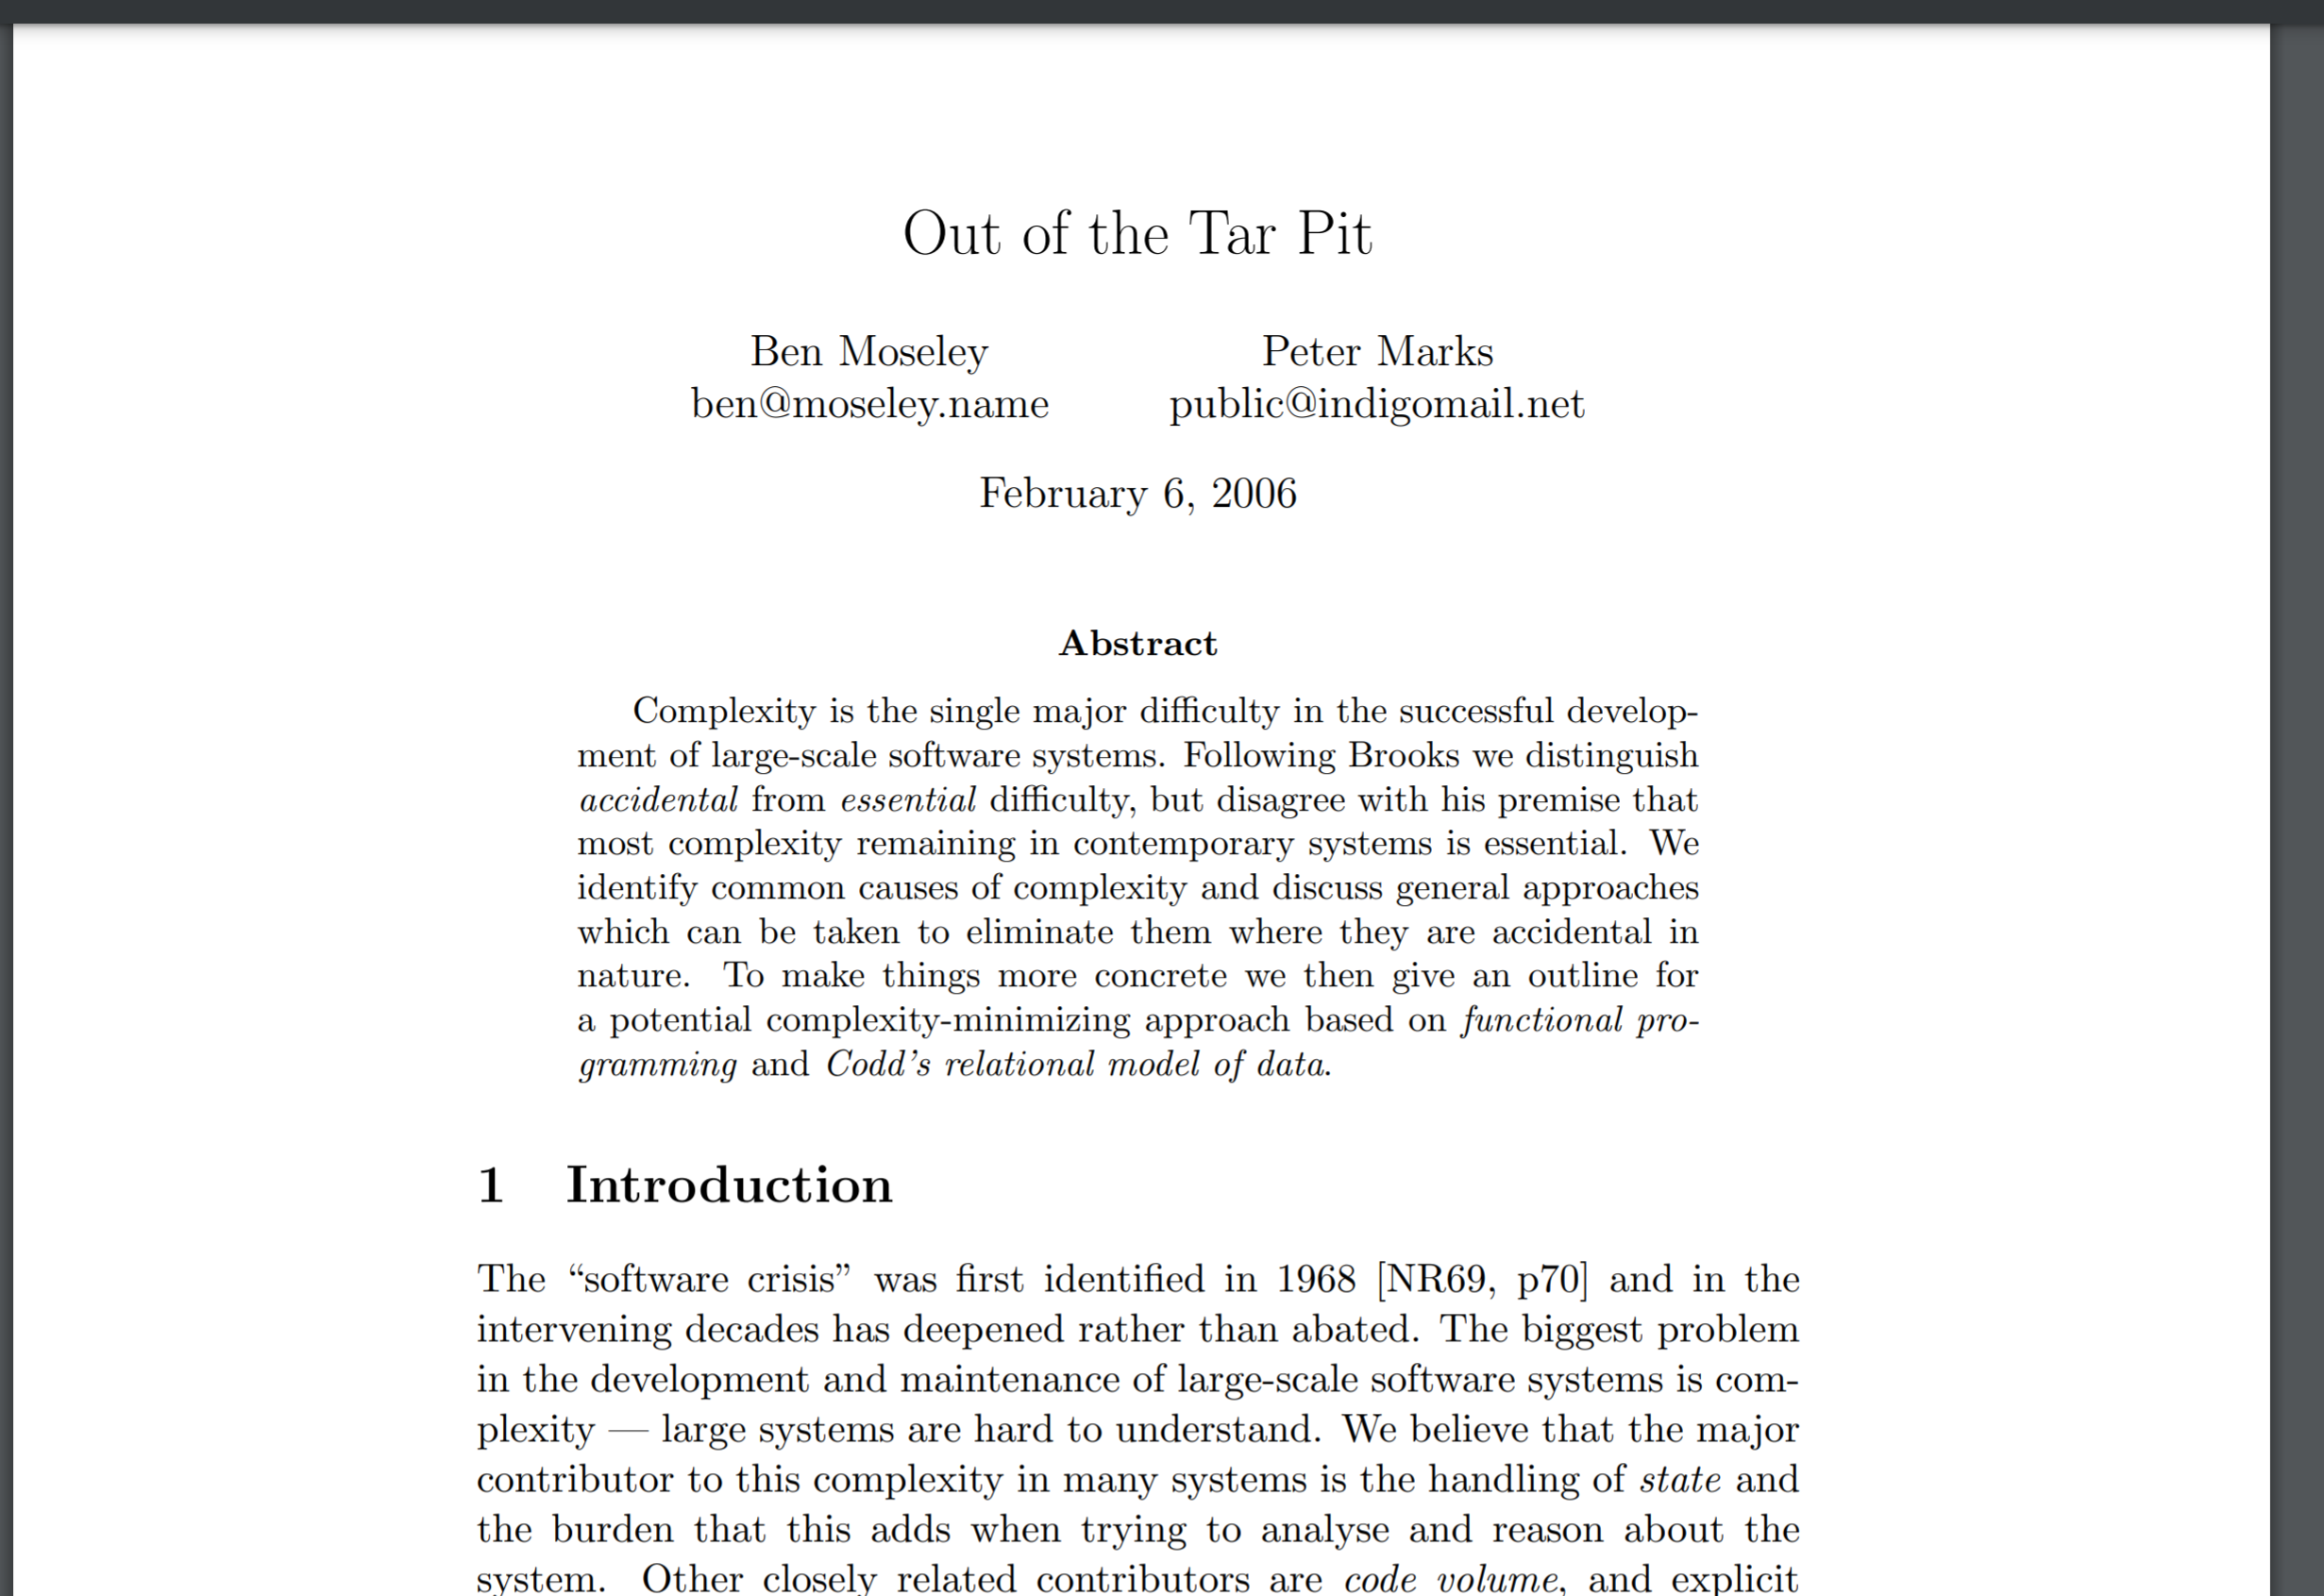
http://curtclifton.net/papers/MoseleyMarks06a.pdf

Slide 48
Algebraic Service Methods : may use declarative / functional / math code on Immutable Value Objects
Convert entity to immutable model
Using getters only + constructors/builder only
ComputeService
function
result
function
input
Entity
Immutable
ValueObject
Immutable
ValueObject
// y = f(x) …x,y: values
algebraicCompute(..) { .. }
Query
ExprEvaluationService
Expression
Rule
Function

Slide 49
Side-Effect Service Methods : may use imperative code or Workflow engine or Rule Inference engine
NEW DUMP States
of all entities
After « action »
DUMP States
of all entities
Before « action »
Service
Create
Update
Delete
…interpret some data
as workflows state
Find « Trigger condition»
so execute some actions

Slide 50
Model / Service / Workflow Code / Rule Engine Code
Still need service…
Often: NO object-oriented
specific needs (no dynamic methods)
… simpler to use « static methods»
How to split SOLID principles ?
services?
Visitor design pattern ?
Adapter pattern ?
Dynamic dispatch Adapters+Factory (eclipse-like fwk)
Still need Service
To prepare « WorflowContext »
by extracting Entity
IDEM …
Still need Service
To prepare « RuleContext »
by extracting Entity
Once preparation is done…
Worflow is often TOO simple
So better done in Service itself
Only very complex business workflow
Need? accidental complexity
of JBPM / Camunda / Activiti…
In practice: < 1% of business cases?
Need? accidental complexity
of Drules / JRules…
In practice: < 1/100000 of cases?

Slide 51
Choose the best Paradigm / Solution
Declarative >> Imperative
Example 1 : maven, bazel, makefile >> better than>> ant, shell scripts, graddle custom codes
Example 2: deploy on Kubernetes >>better than>> deploy using SSH custom restarts shell, or Docker Swarm
Example 3 : provisionning using Puppet,Ansible,Terraform >>simpler than>> shell, code or custom workflow engines
Choose Langage & Tool
Example: use algebraic tool for math, generate automated code from declaration
NO Silver Bullet
Do not use JBPM, or Drules if it is NOT absolutely adapted/necessary

Slide 52
Conclusion
Try to reduce software complexity
Respect naming conventions
Respect proven correct architectures
Use SOLID principles on classes
Read books
Do no create too many additionnal Layer of indirections in your architecture ( Interface + Command classes + Copies + Model + DAO/Repositories … )

