Slide 1
Java Langage & JRE Internal Basics
This document:
https://github.com/Arnaud-Nauwynck/presentations/blob/main/java/Java-Langage-JRE-Internal-Basics.pdf

Slide 2
Outline
Overview compile – runtime chain
Compiler basics: grammar, parser to AST
Declaration-Statement-Expression
Bytecode, stack
Langage Class Symbol resolution
Class.forName() / ClassLoader
First reference, Hot swap code
Method Symbol resolution + call
Invokestatic, invokespecial
Invokevirtual
Invokeinterface
invokedynamic

Slide 3
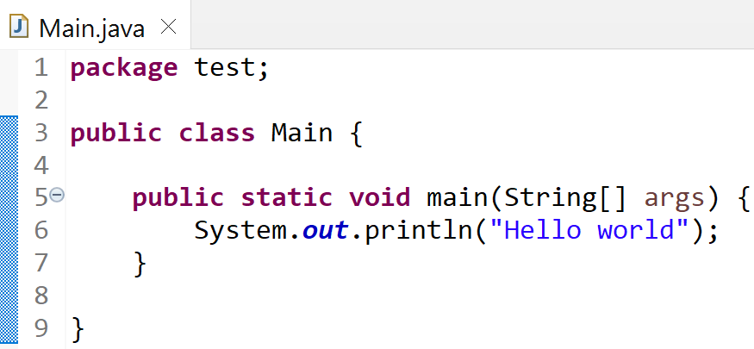
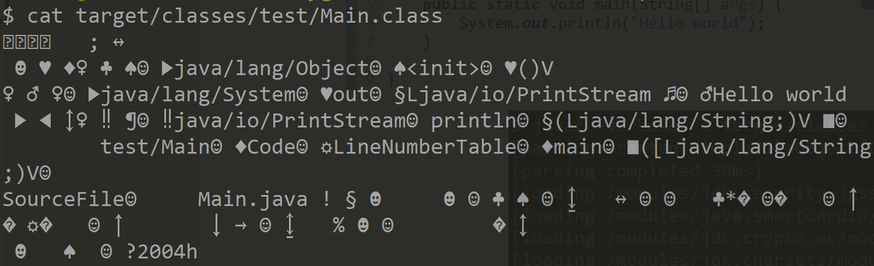
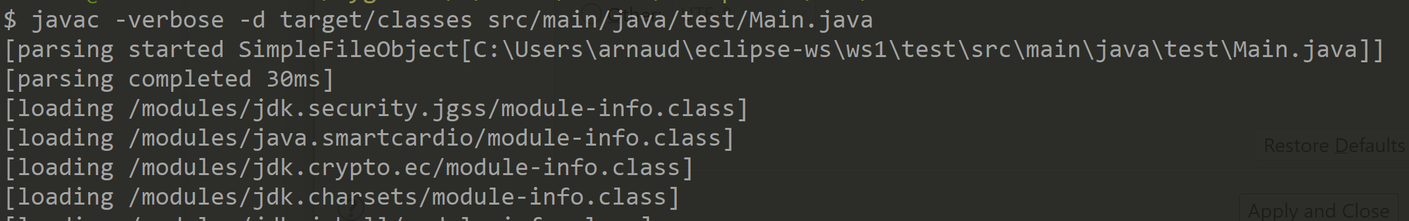

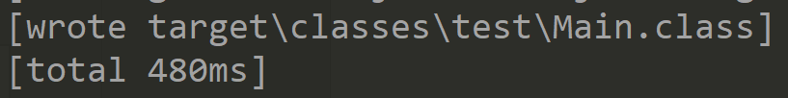
Compile steps
UTF-8 files
src/main/java/*.java
Bytecode (binary) files
target/classes/*.class
Zip file
target/*.jar
javac
jar
mvn package

Slide 4
Javac .. steps
*.java
Bytecode generator
Read char(s)
lexer
parser
builder
Token(s)
Grammar rules
shift-reduce
Tree
( AST )
Resolved
Typed Tree
Attributed Tree
( AAST )
Bytecode
AAST =
Attributed Abstract Syntaxic Tree
Stack Operator
CST = Concrete Syntaxic Tree
AST = Abstract Syntaxic Tree
contain « ; » and parenthesis « () »
Example:
push 1
push x
fadd
push 3.1
dmult
*
Type: double
*
« (1 + x) * 3.1 »
+
3.1
Type: float
+
3.1
1
x
Type: int
1
x

Slide 5
Javac .. steps
parser
builder
1 grammar Rule ~ 1 AST sub-class
Grammar rules
shift-reduce
Tree
( AST )
detect (Reduce) grammar rule
=> expr = new AstSubClass( subExpr1, ..subExprN)
CompilationUnit
Public class « Main »
ClassDeclaration
Public static void « main(String[] args) »
MethodDeclaration
{.. ; .. ; }
StatementBlock
ExpressionStatement
ApplyExpr
lhs: « System.out »
params: [« Hello world» ]
« . »
FieldAccess
MethodSymbol
StringLiteral
« println(String)»
«Hello world»
ClassSymbol
FieldSymbol
« java.lang.System »
« out»

