Slide 1
ANNEXES

Slide 2
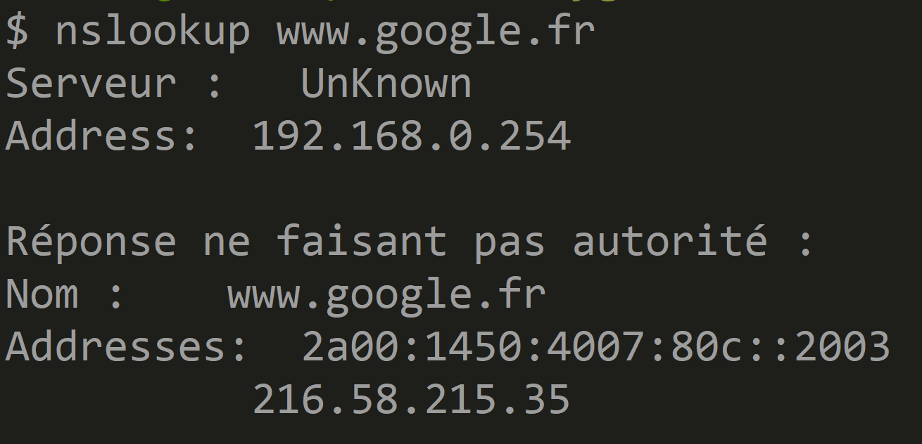
Https://<<hostname.domain>>:<<port>>
ANNEXE
Step 1 : resolve hostname.domain to TCP-IP Address

Slide 3
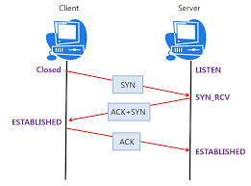
Open TCP-IP Socket
ANNEXE
Step 2 : open TCP-IP Socket = SYN, SYN+ACK, ACK

Slide 4
What is a TCP-IP Socket ? (1/3)
ANNEXE
a virtual bi-direction stream
write
read
write
read
OS User Mode (Apps)
OS Kernel
Network

Slide 5
What is a TCP-IP Socket ? (2/3)
ANNEXE
a virtual bi-direction stream
identified by 4 ids : (IP-source, Port-Source, IP-dest, Port-Dest)
write
read
write
read
OS User Mode (Apps)
send IP Packets
(IP1:port1, IP2:port2)
(IP1:port1, IP2:port2)
OS Kernel
Network
receive IP Packets

Slide 6
What is a TCP-IP Socket ? (3/3)
ANNEXE
a virtual bi-direction stream
identified by 4 ids : (IP-source, Port-Source, IP-dest, Port-Dest)
with client/server states = buffers + "sequence numbers" (read/write)
write
read
write
read
OS User Mode (Apps)
send IP Packets
OS Kernel
Network
receive IP Packets

Slide 7
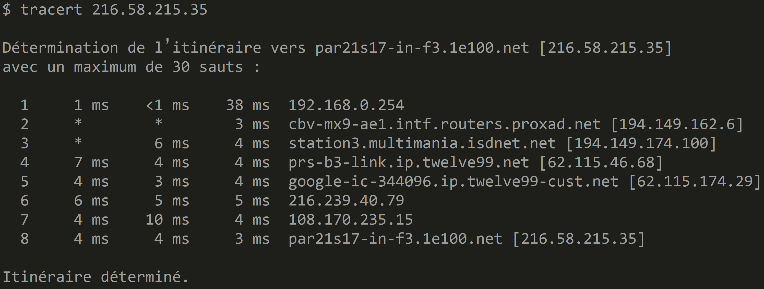
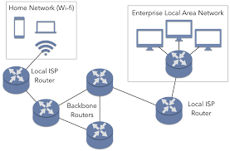
Traceroute ?
ANNEXE

Slide 8
HTTPS = Request-Response Text Protocol over TCP-IP (+TLS)
https Request
encrypted text Request
(over TLS)
open TLS socket
write request
Request
in TCP-IP Packet(s)
Response
from TCP-IP Packet(s)
read text response
close
decrypt text Response
(over TLS)
https Response

Slide 9
