Slide 1
Architecture Design Part 3 : DTO
arnaud.nauwynck@gmail.com
Entity – DTO, external APIs, Protocol Marshalling
This document:
http://github.com/arnaud-nauwynck/Presentations/java/ Architecture-Design-part3-DTO.pdf

Slide 2
External Protocol … Marshalling/Unmarshalling to Internal Langage
Receive messages from external
Input Channel
(= Connection,Queue or others?)
Message Request
Unmarshalling: Message -> Object
Object
Application code
Server-side « Skeleton » implementation
Object
Marshalling: Object -> Message
send response to external
Output Channel
(= Connection,Queue or others?)
Message Response

Slide 3
Message Encoding : Text / Binary
explained
<xml? schema:=« ..xsd » namespace=« ns1:….. » >
<a> <ns1:b> some value</ns1:b> </a>
verbose
+++ most powerfull
+++ Self-explained / extensible
--- most verbose
<xml?> <a> <b> some value</b> </a>
JSON: { « a »: { « b »: « some value » } }
Simplest
Compromise for Web
CSV: a.b; \n
some value
compressed
opaque
Obscure
+++ compressed encoding
+++ efficient int32, long64, float32, ..
CPU representation
Binary: 0101010101101010101010

Slide 4
Schema … Code-Generator
<?xml>
xsd schema
Text
(No code generator)
{ json}
?? No standard
( json-schema,OpenApi,Swagger)
CSV
Header line … Tabular, Not tree
Binary
+ code generator per-langage
Corba,RPC,XRD,..
.idl
Avro
.avsc : Avro-Schema (in json)
Thrift
.idl : Thrift Schema
Protobuf,gRPC
.proto : Protobuf Schema

Slide 5
Schema: Fixed / support version upgrade
Backward-compatibility is mandatory
Still evolutivity possible ? Better if true
PAST
PRESENT
FUTURE
Future = unknown
Only 1 knwon fact = things will change
…will be possible to keep today vX.Y.Z?
V0
5 years ago
v1
V2
experimental

Slide 6
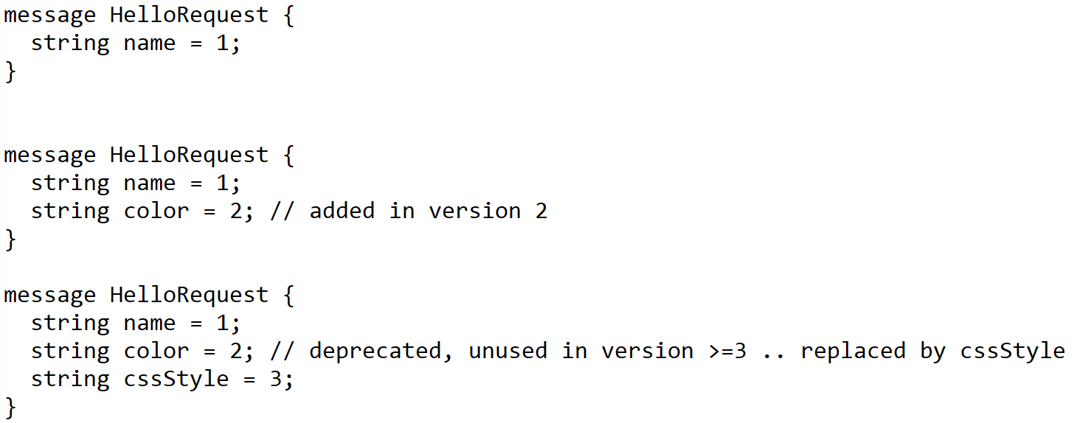
Dynamic Schema: Protobuf, gRPC compiled Versioned Fields
In schema, all field are numbered (unique ID)

Slide 7

Dynamic Messages, Schema-compatible
Build:
generate
client-v0.exe
.proto
messages from v0 .proto format
In Messages
« Map<FieldVersion, Value> »
all Field ids + values encoded
Small extra cost
… Great compatibility
1: « Hello »
client-v1.exe
.proto~1
message from v1 .proto format
1: « Hello », 2: « blue »
client-v2.exe
.proto~2
message from v2 .proto format
1: « Hello », 3: « { color: blue }»

Slide 8
Reading « Future » Message / Backward Client … Ignore Unknown Fields
.proto~2
.proto~1
client-v2.exe
client-v2.exe
write
message from v2 .proto format
read
1: « Hello », 3: « { color: blue }»
1: « Hello »
Ignore unknown field « 3 »

Slide 9
Schema Registry
write
read
schemaURL= « ….. Schema vX.Y.Z»
Payload= 01010101101101010101
Schema v0 = {…}
Schema cache
(immutable by ID)
Schema v1 = {…}
Schema cache
(immutable by ID)
Schema v2 = {…}

Slide 10
Schema Contained in Messages
Data Payload
« Hello », { color: blue }
Examples :
Metadata schema:
« { name: String, color: String } »
MetaData
(overhead)
Kafka Messages, Pulsar Messages
Avro Message, Avro Data-File
PARQUET File
for ULTRA compression of millions of rows (dictionnary, incremental, filter..)
java.io.Serializable
Contains serialVersionUID + fully-qualified Names + field name / types
Use « Kryo » instead of « java.io. » for typed / schema-less messages ! (better performances )

Slide 11
Http Json Request <-> Java Object method
http Server Thread (Tomcat, Netty, ..)
DispatcherServlet.handle( httpServletRequest, httpServletResponse)
http 2.0 VERB /path
header=value
.
{ json body }
Socket.read
{json}
Unmarshalling: JSON -> Java Object
(RequestBody -> method param)
java Object
http / TCP-IP Socket
Application code called by introspection
@RequestMapping
Output method(Input..) { …}
Java Object
Marshalling: Java Object -> JSON
(method return -> ResponseBody)
Socket.write
http 200
header=value
.
{ json body }
{json}

Slide 12
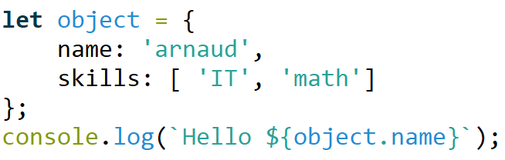
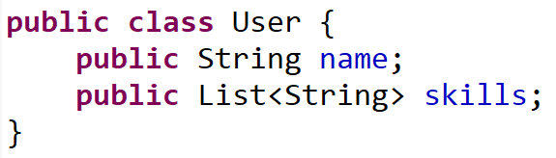
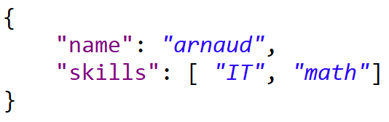




JavaScript <-> Json (JavaScript Object Notation) <-> Java
Script (untyped interpreter)
DATA format (no schema)
Langage (typed)
Web Front-End
Network
encoding
Back-end

Slide 13








http JSON : Open & DeFacto Standard for Portability, Simplicity, Frameworks
Web Front-End
API Front-End (app-to-app)
Network
connection+encoding
Back-end

Slide 14
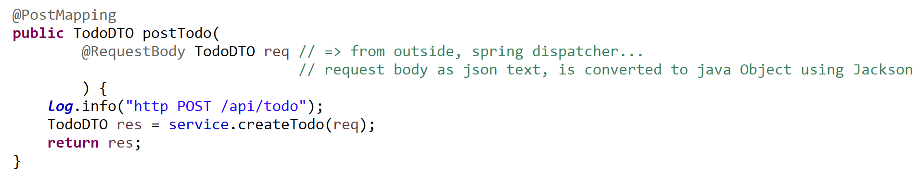
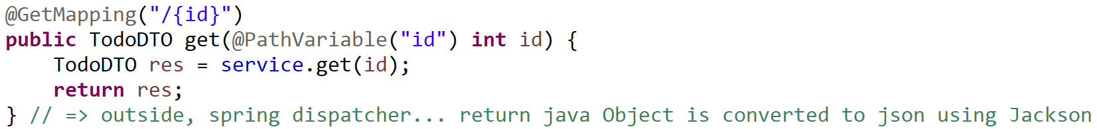
Http Request <-> Spring Java Mappings @RequestMapping, @{Get|Post|..}Mapping, @RequestBody ..

Slide 15
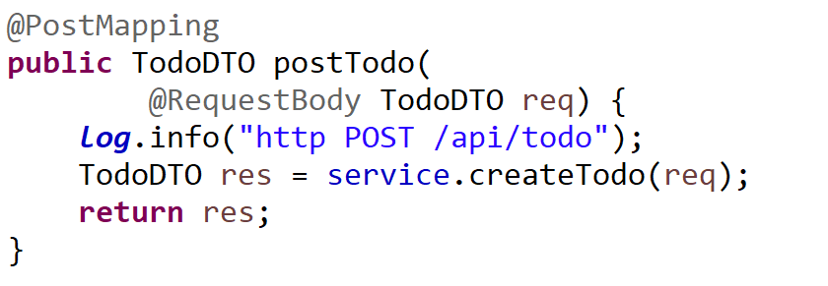
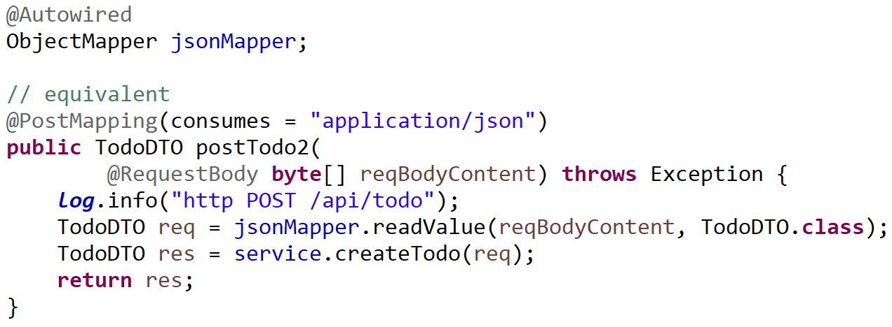
Equivalent Explicit Json Unmarshalling

Slide 16
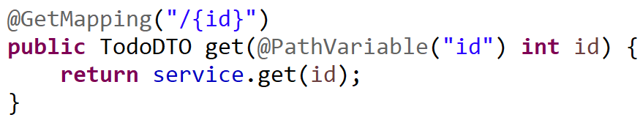
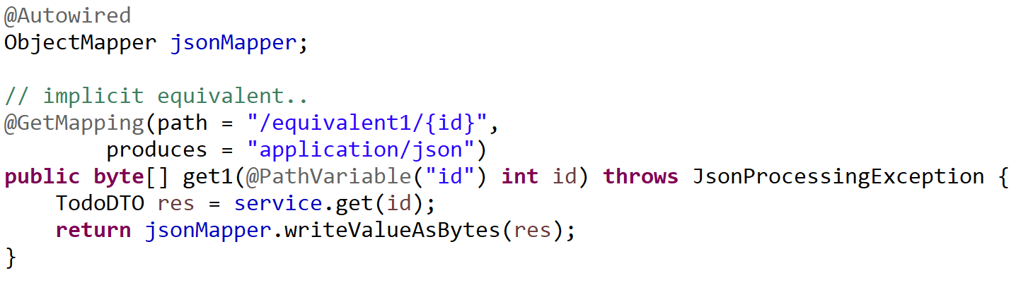
Equivalent Explicit Json Marshalling

Slide 17
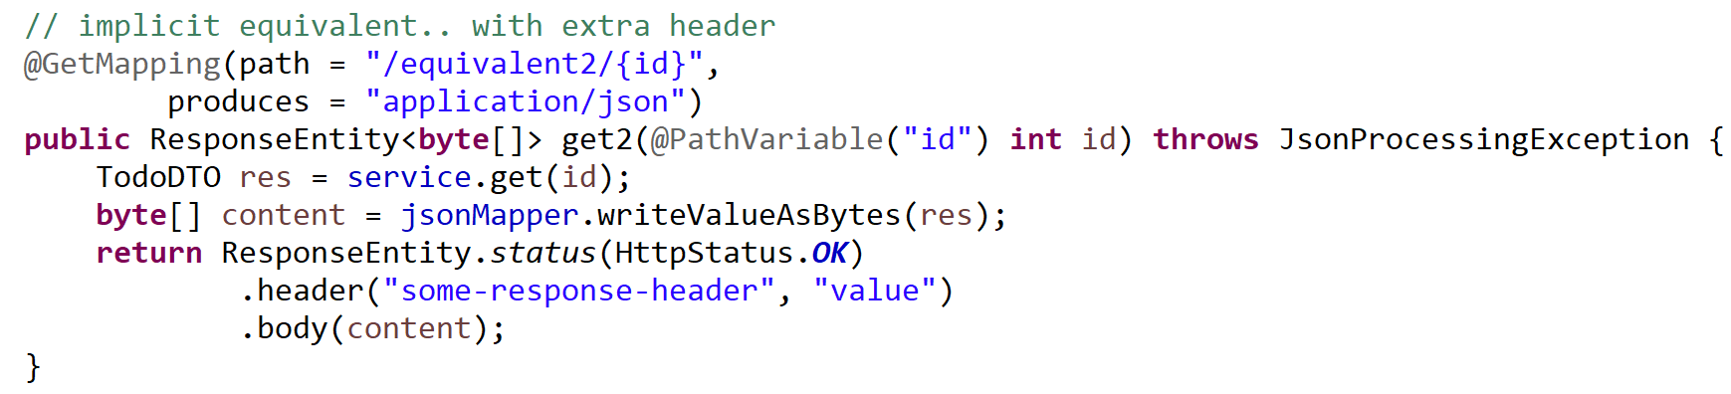
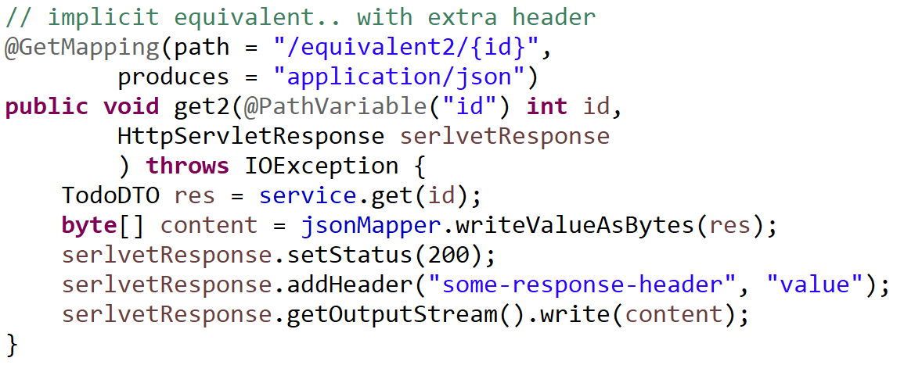
Explicit Equivalent, with http Status + Headers

Slide 18
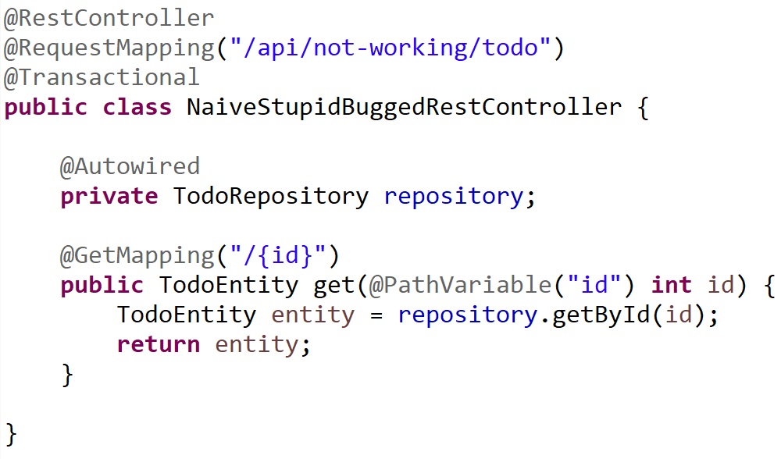
Naive (Not working) @Entity to JSON
Entity class maybe
not JSON compatible
Entity object invalid
After transaction commit
(managed lifecycle)

Slide 19
Why Not using 1 class Entity = DTO ?
1/ internal database is PRIVATE, implementation specific
!= external API is publicly specified
2/ Decoupling helps evolutivity
3/ Mandatory for complex Entities graph
with cyclic dependencies parent-child (@ManyToOne(mappedBy..) )
4/ several DTO classes/APIs for a single Entity class
5/ Do not use HACKS like @JsonIgnore… (see 1/, 2/, 3/, 4/ )

Slide 20
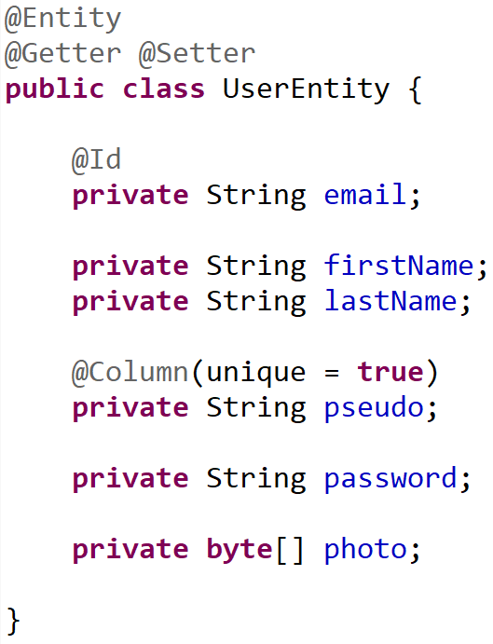
Example Entity class .. Do not export all
Personnal data
Do not publish
Critical Security data
never publish !!
( Except for owner )
High volume data
export only explicitly demanded

Slide 21
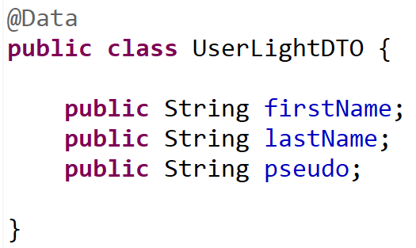
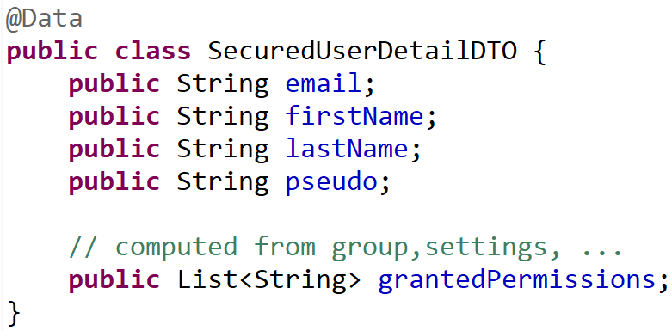
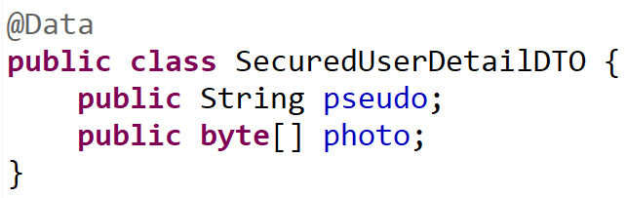
1 Entity class <-> Several specific DTO classes
Default mapping
Owner personal view
Public detailed view (high data volume)

Slide 22
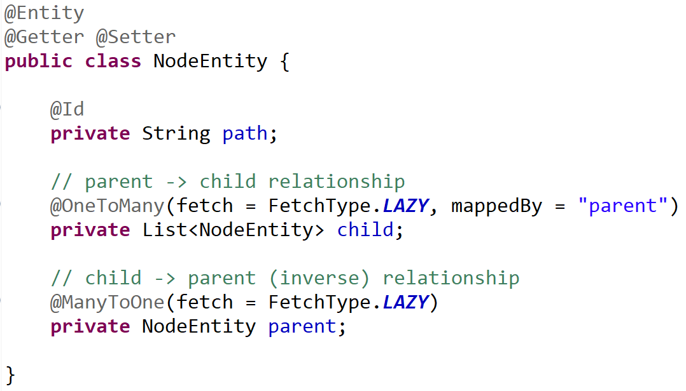
Entity -> Projection DTOs = « Cutting » relations
0..1 parent
NodeEntity
* child
Projection Parent->Children (recursive)
TreeNodeDTO
* child
Projection Child->Parent (recursive)
AncestorNodeDTO
0..1 parent

Slide 23
Reminder Part 2 … Entity lifecycle in Session

Slide 24
Entity : Lifecycle managed by Session (Transaction)
Level1Cache
(=Session )
Read-Write, single-thread
Thread
Begin transaction
@Transactional
method () {
XA (Transaction)
e1 = em.save(new Entity())
e2 = e1.getField()
e3List = repo.findBy(..)
end transaction
} // implicit try-catch-finally
prepareXA => flush Entity changes
Commit XA => commit JDBC
Entity lifecycle ends with XA commit/rollback

Slide 25
Copy Entity data to Transfer before Commit
Thread
Session
Begin transaction
@Transactional
method () {
XA (Transaction)
e = repo.findBy(..)
Dto res = new DTO()
// copy dto entity
res.setField1( e.getField1() );
return res;
end transaction
} // implicit try-catch-finally
Entity lifecycle ends with XA commit/rollback
DTO have no lifecycle ends (only GC to free)

Slide 26
2 Rules : a/ use DTOs != Entities b/ use RestController != (Transactional) Service
Thread
@RestController @RequestMapping
{
Api input checks
@Transactional @Service
{
JPA queries (find entity) / fill from dto
Functional code
entities
Entity to dto
}
dtos
Api output result
}

Slide 27
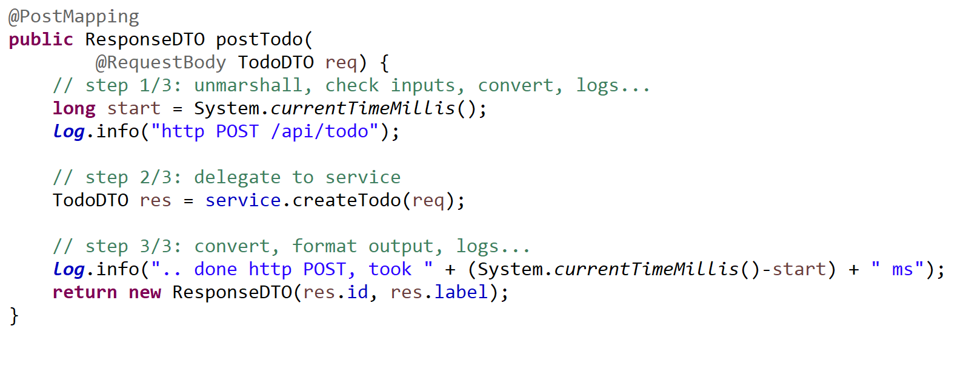
Controller Method Pattern { unmarshal / delegate / marshall }

Slide 28
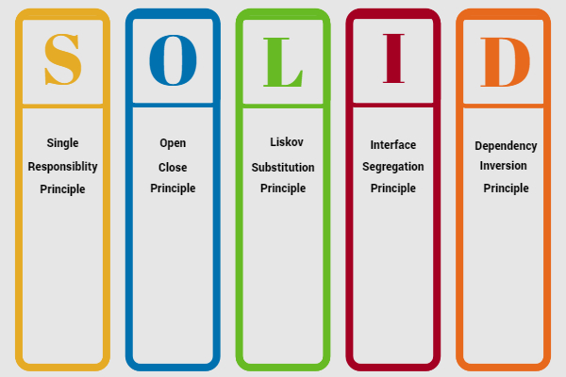
« solid » principles

Slide 29
SOLID RestController …. S = Single
A RestController does only 1 thing :
controls (maps) http Rest requests to Java methods
… delegate all others things to injected Service

Slide 30
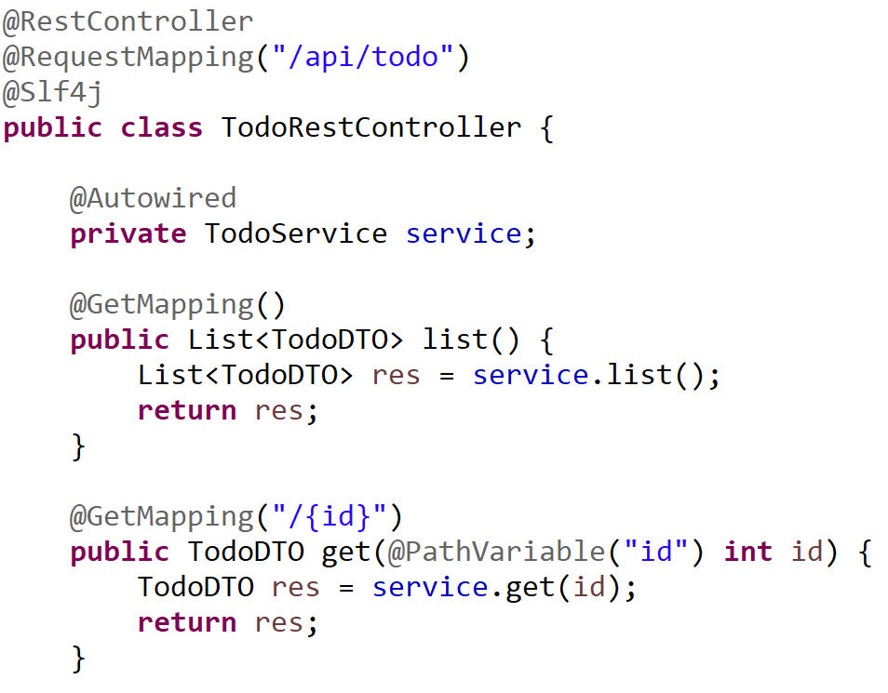
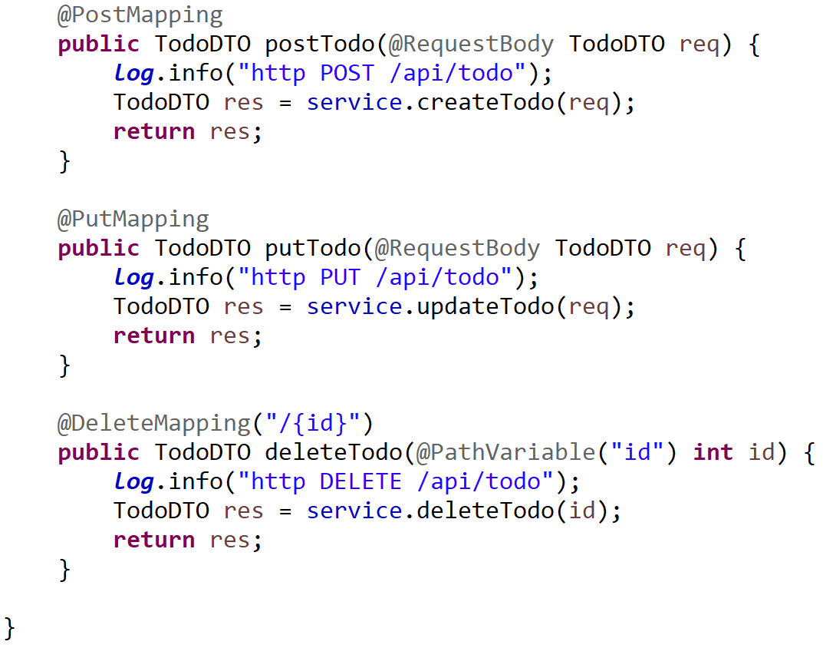
Typical CRUD Rest Controller

Slide 31
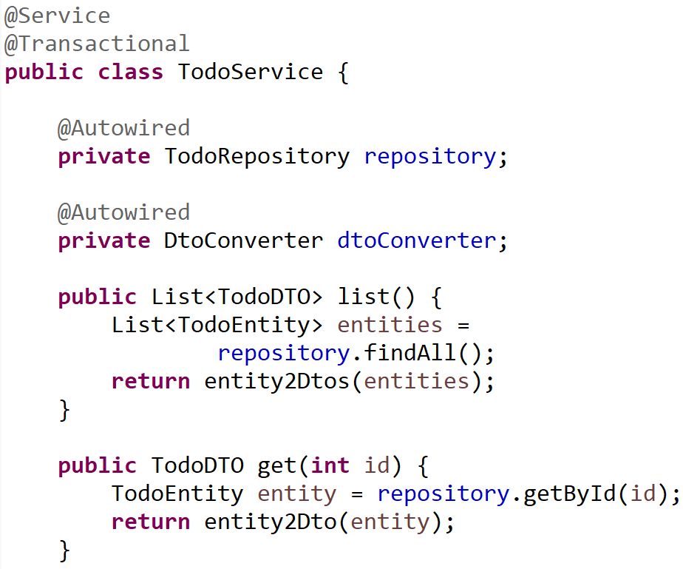
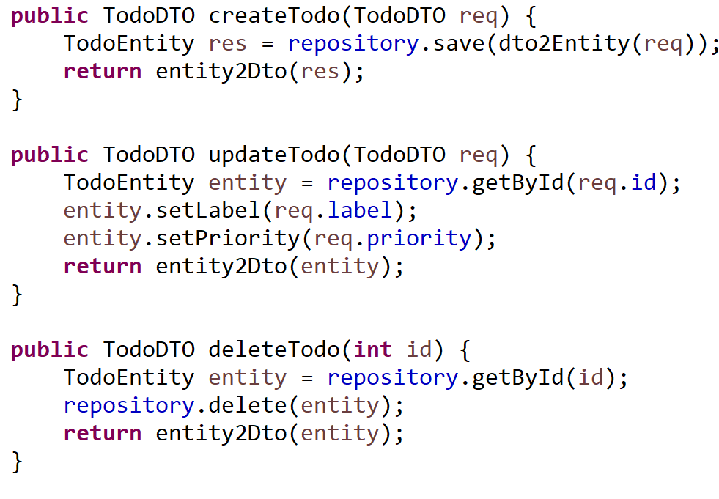
Typical CRUD Transactional Service (1/2)

Slide 32
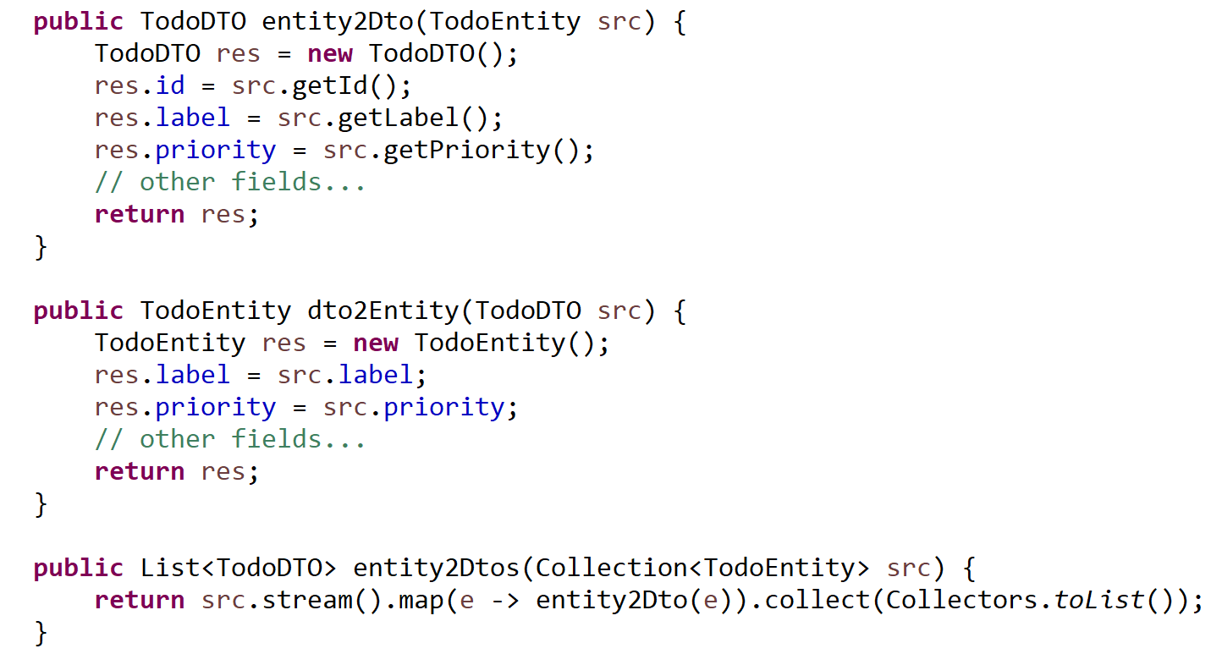
Typical CRUD Service (2/2) entity2Dto / dto2Entity

Slide 33
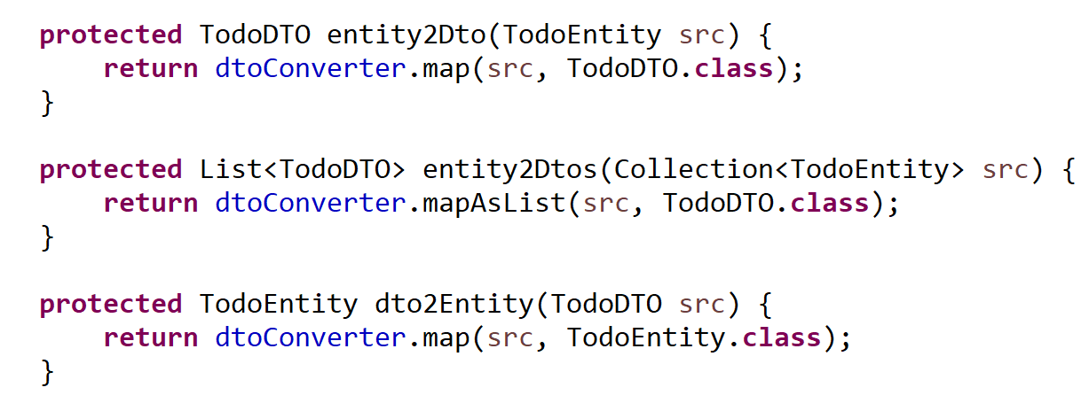
entity2Dto / dto2Entity using generic signature and « .class »

Slide 34
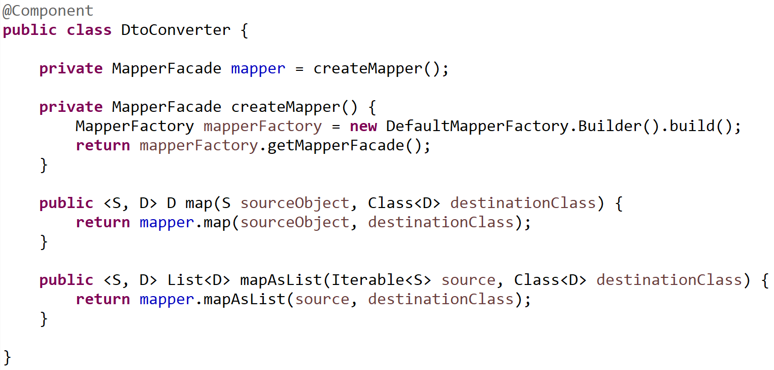
using Orika MapperFacade

