Slide 1
Theory and Practice of Security & Privacy Part 5 Security of Data
arnaud.nauwynck@gmail.com

Slide 2
Notice: Security of System <--> Security of Data
if System is unsecure => then Data on it is unsecure
general security concerns on System ... see previous course : Part 4
specific concerns on "Security of Data" ... this course : Part 5

Slide 4
Access to PC Hard Disk => can read/write 010010101
Reminder
Rule # 1 = Encrypt Disks
encryption key (in BIOS ? should be secured)

Slide 5
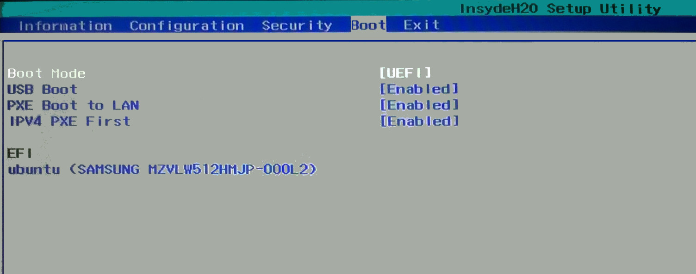
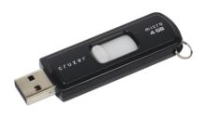
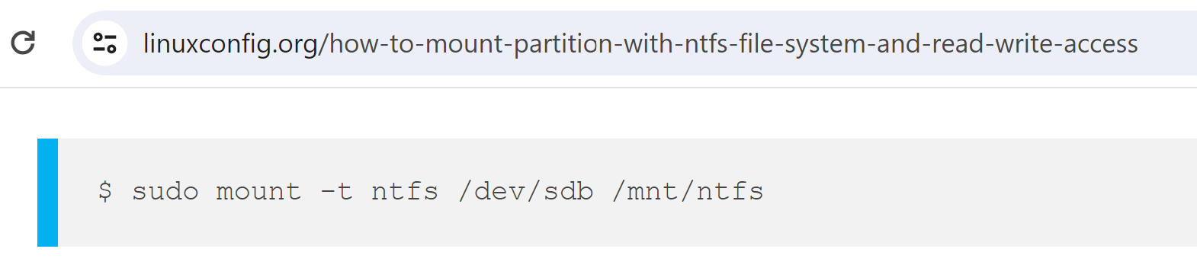
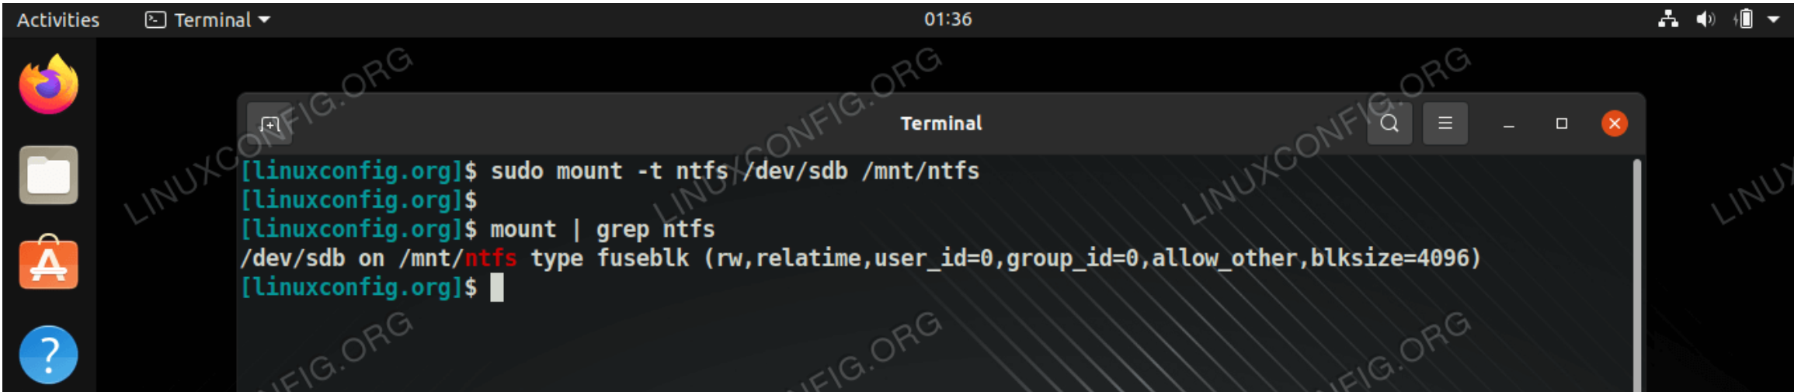
Un-Encrypted Disk? can we (do you need to) Boot ?
Reminder

Slide 6
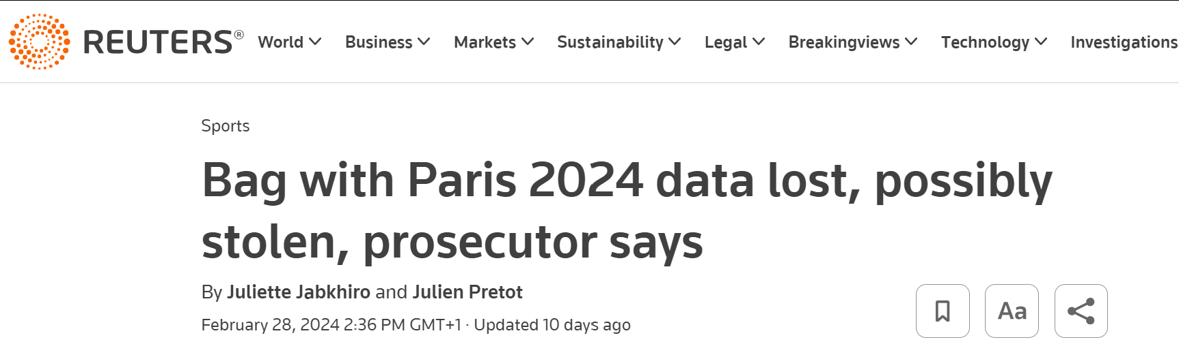
Un-encrypted Disk : risk for Data stolen Anecdote as of 2024-02
"if" stolen Pc (Disk) was encrypted => "no" issue (only "lost")
but was it ?

Slide 7
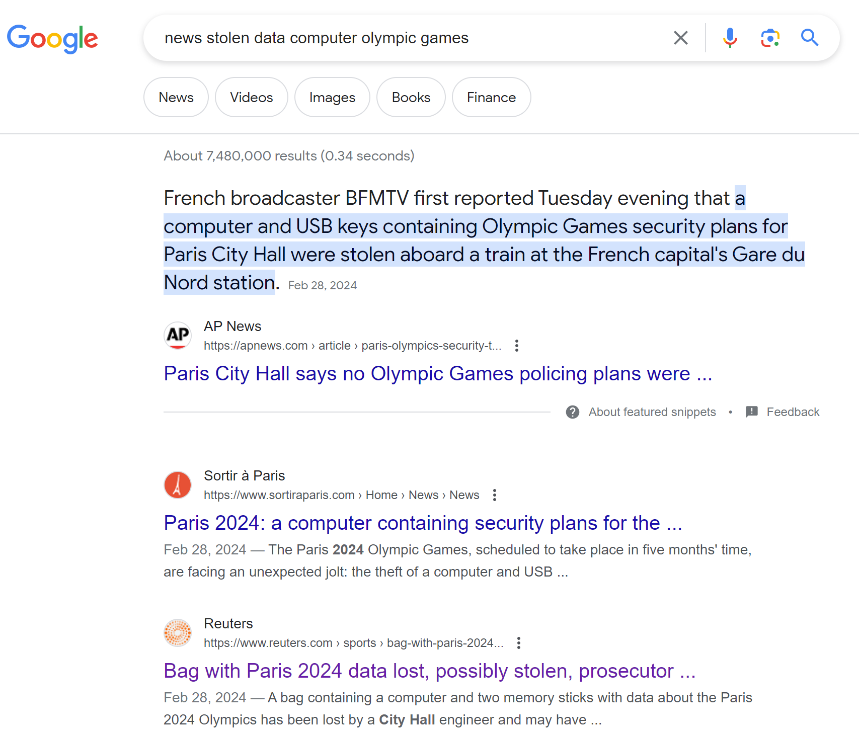
7 millions search results

Slide 8
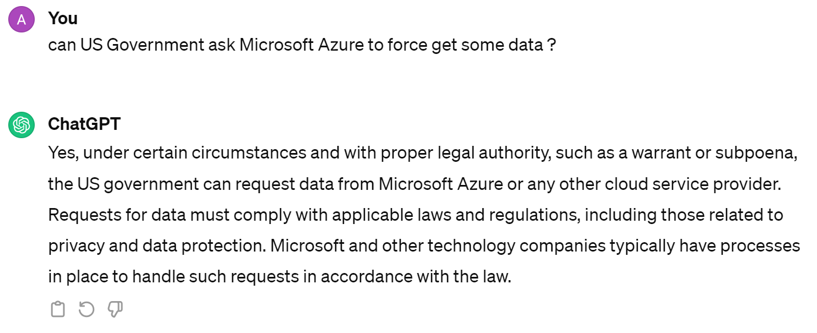
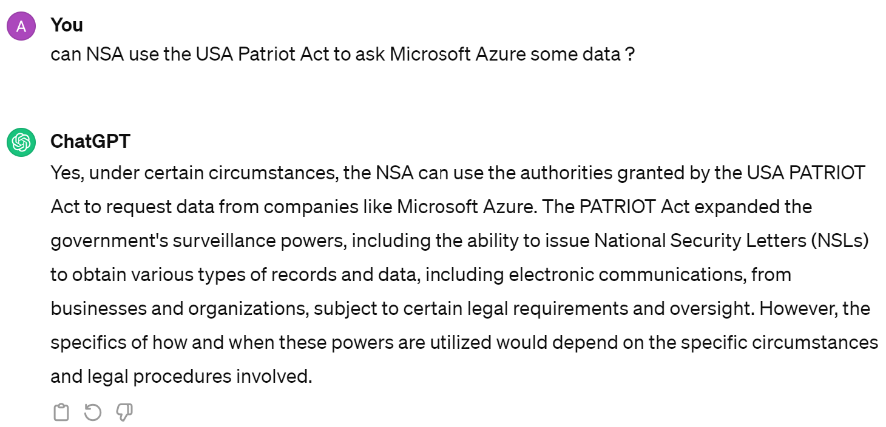
Security of Data on Public Cloud Provider ? Privacy ?
Security != Privacy

Slide 9
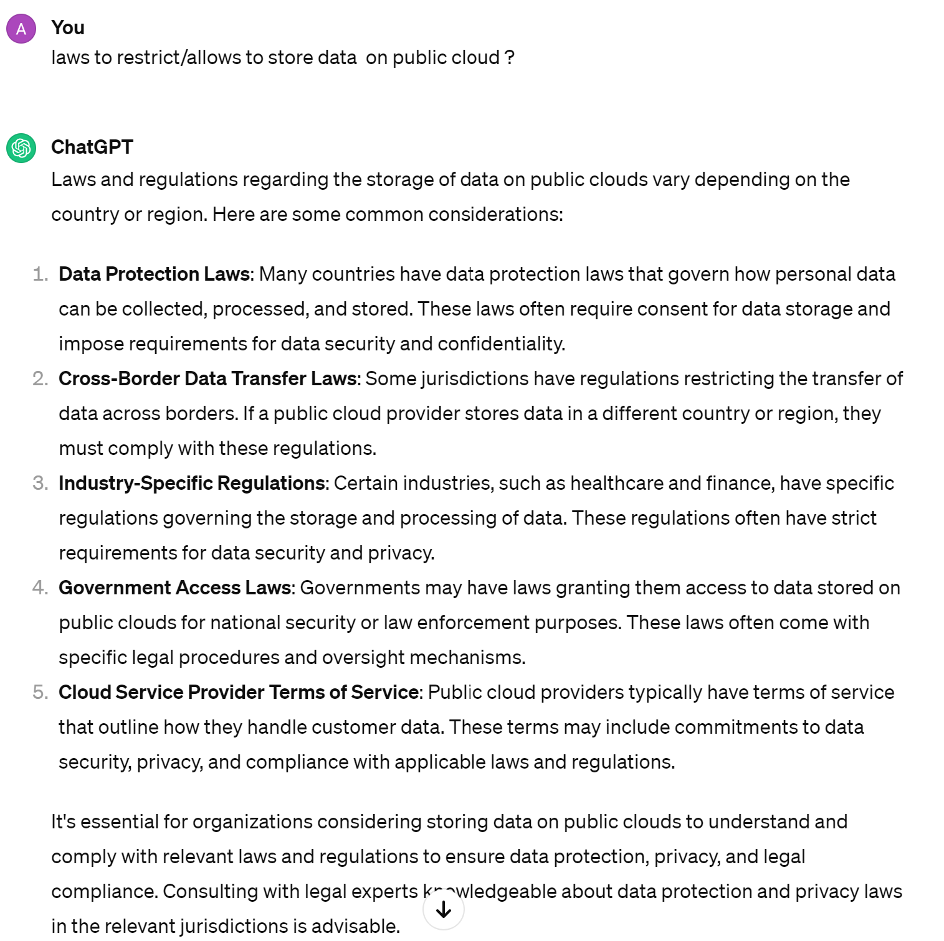
Lows to restrict/allow Data on Public Cloud

Slide 10
Data Across Border
How to practically check ?
Choose your "Region"
Trust
Example: Bank in Europe on Azure
=> choose Azure West-Europe, or Azure North Europe, ..
How to be sure "NO data" is sent to US ?

Slide 11
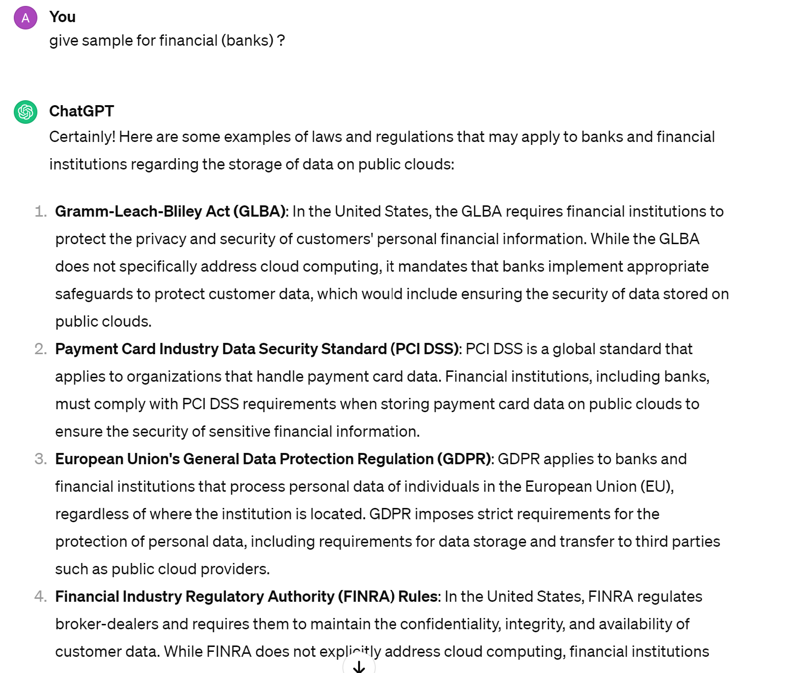
Laws ..

Slide 12
Fears, Customers, .. Data Classification C0,C1,C2 Eligibility to Cloud
Most companies classify their data with classification levels
example:
C0 = public data (ex: official CAC40 closing price yesterday)
C1 = internal data (ex: organigram of employees
C2 = private data (ex: trade with client, password)
C3 = ultra confidential data
example of program to cloud:
fears => up to C1
trust => C2

Slide 13


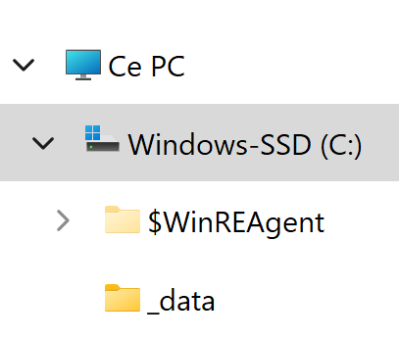
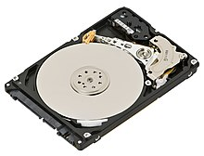
Encrypt Files vs Encrypt FileSystem
.exe
.exe
tmp copy
used by App
clear text
clear text
clear text
clear text
System call "write()"
System call "read()"
explicit encrypt
$ openssl enc file.txt ..
explicit decrypt
$ openssl enc file.txt ..
write
=> on the fly encrypt
read
=> on the fly decrypt
SALT_x$ %1!4xA6
9érP5°w
explicit copy
<opaque>
01010101

Slide 14
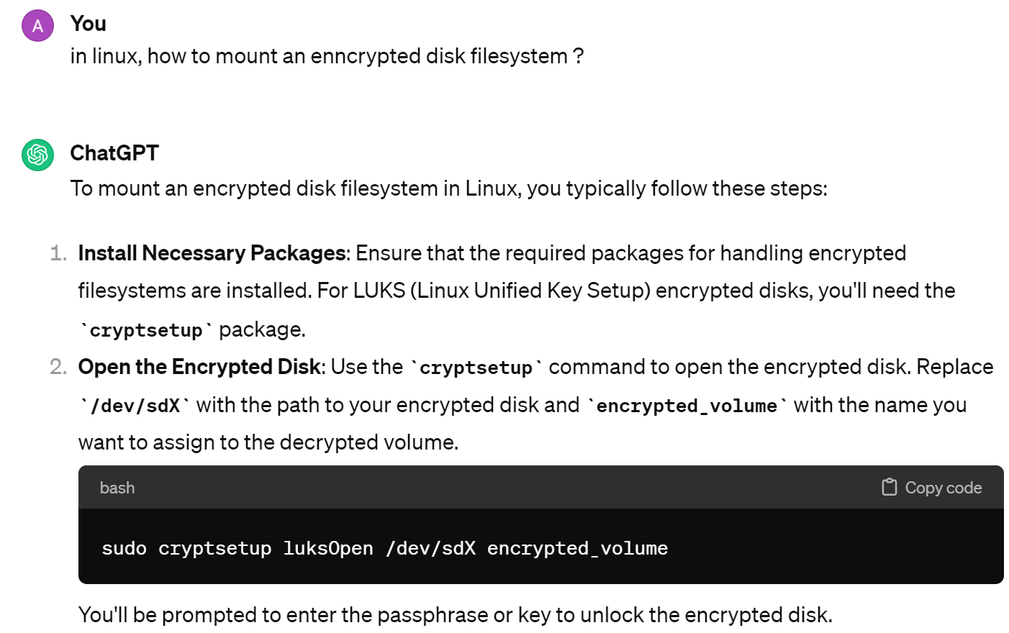
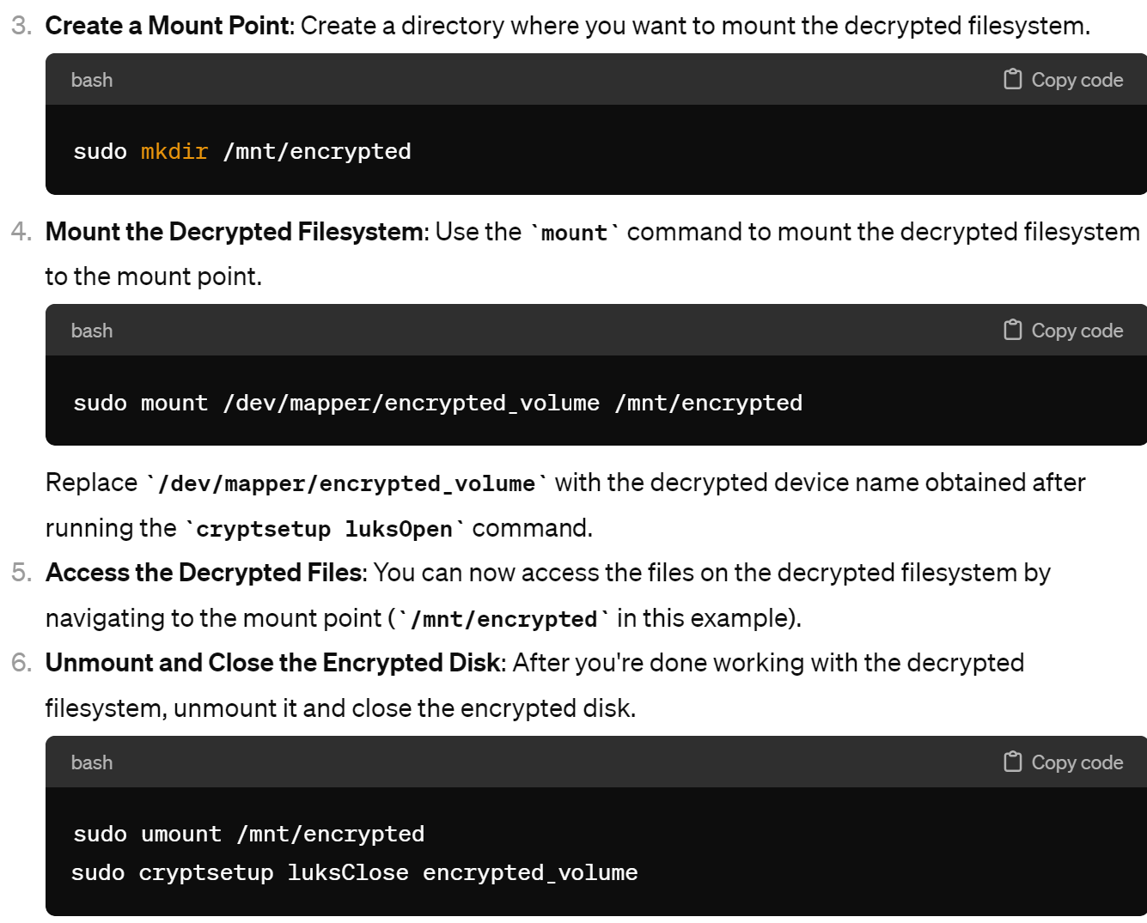
Mounting Encrypted FileSystem ex on Linux : LUKS (Linux Unified Key Setup)

Slide 15
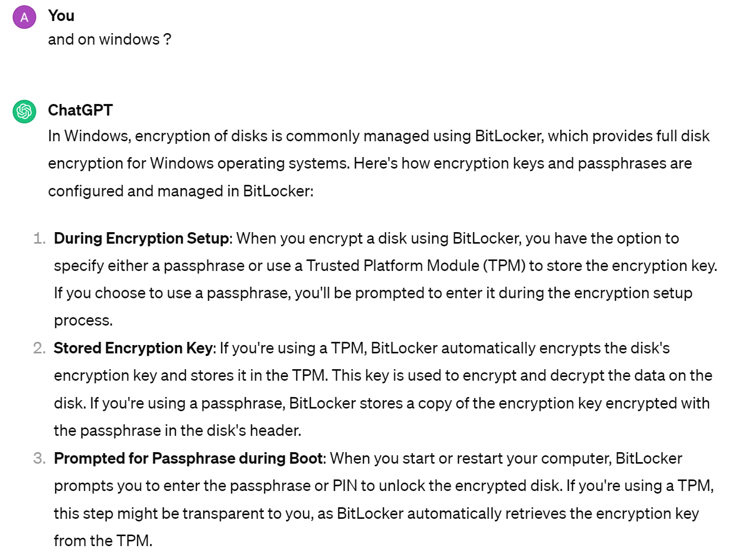
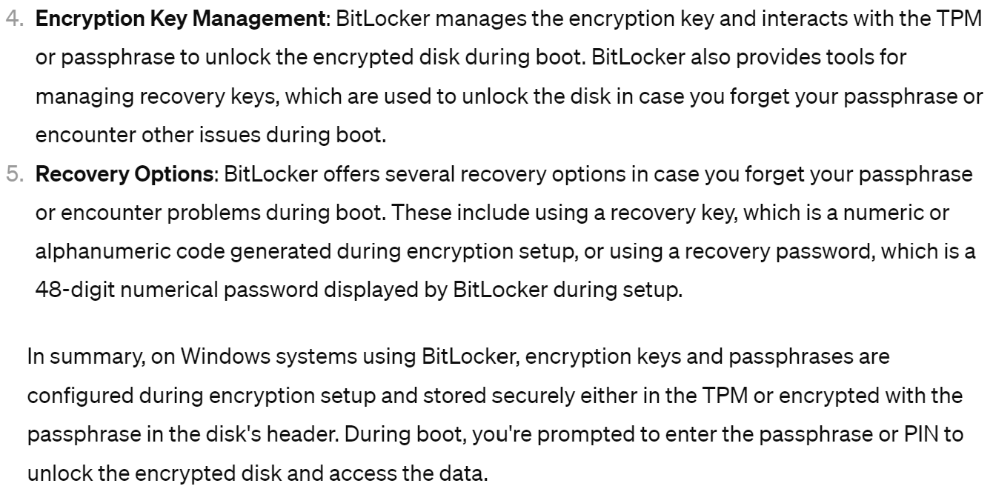
on Windows

Slide 16
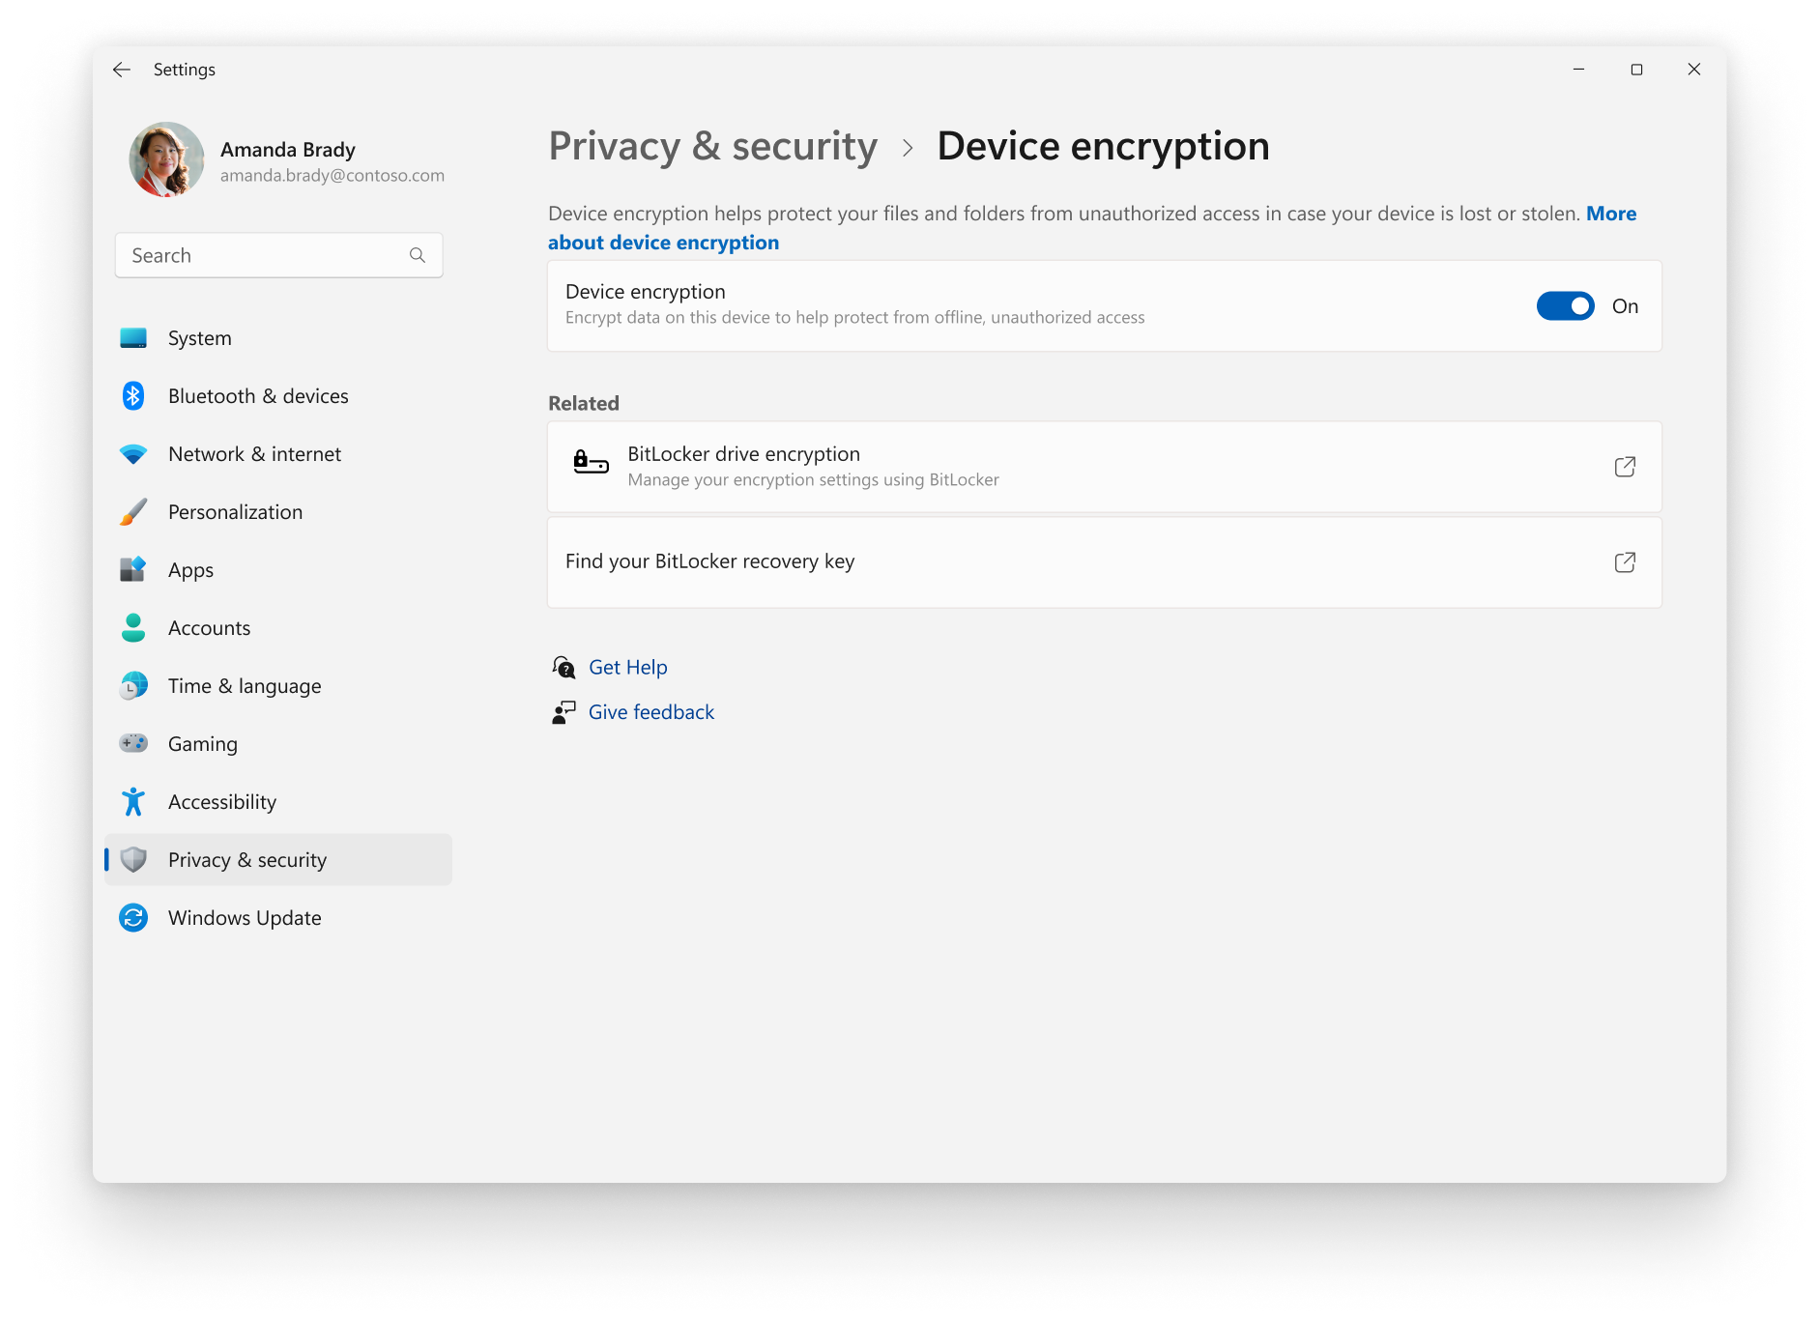
Windows BitLocker

Slide 17
Data Access Authorization

Slide 18
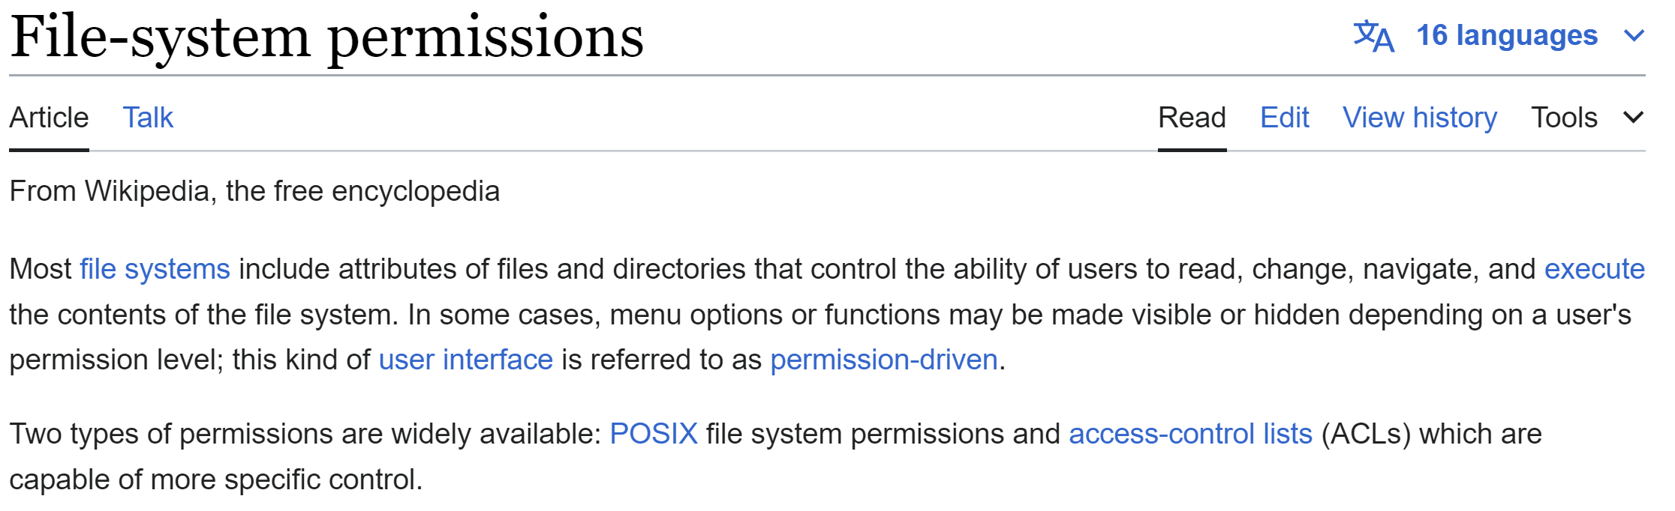
File System Permission POSIX (umask) & ACL (Access-Control List)

Slide 19
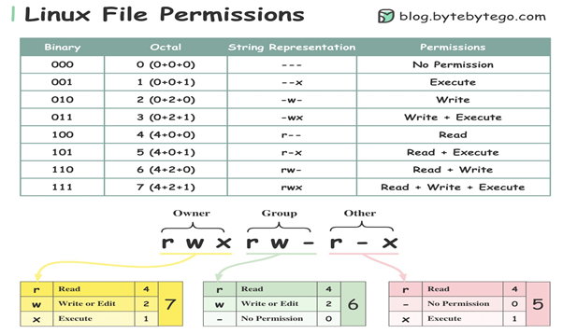
$ chmod go-rwx

