Slide 1
Installing Jupyter Notebook for Spark
Arnaud.nauwynck@gmail.com

Slide 2
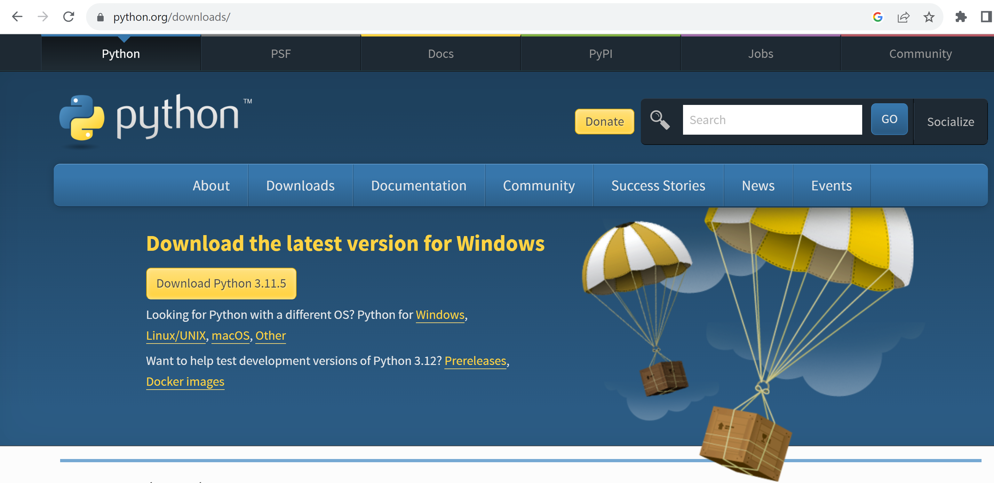
Step 1 : install python (simplest method, not using AnaConda)

Slide 3
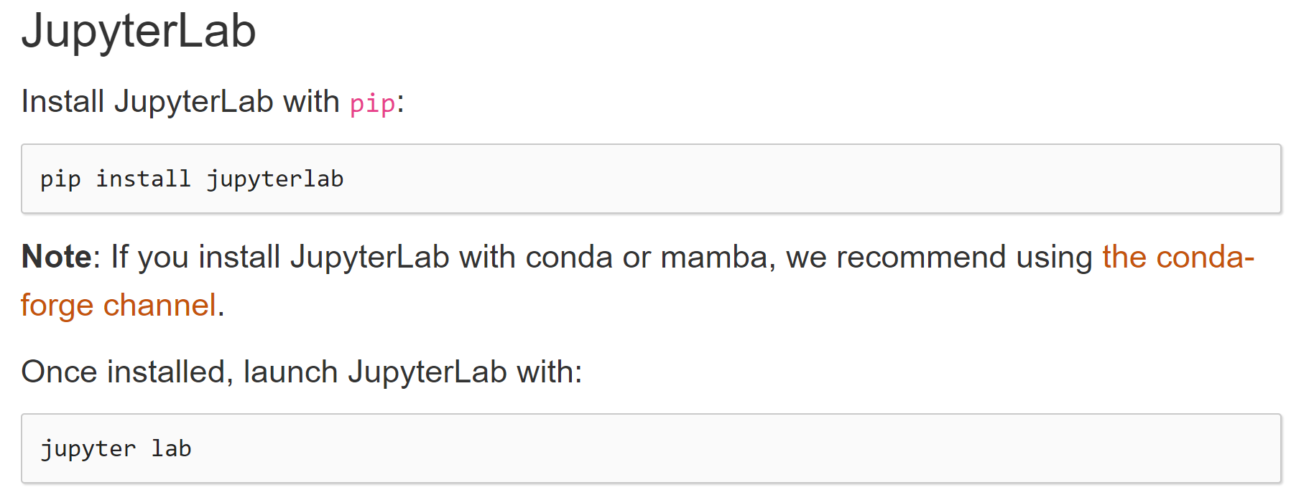
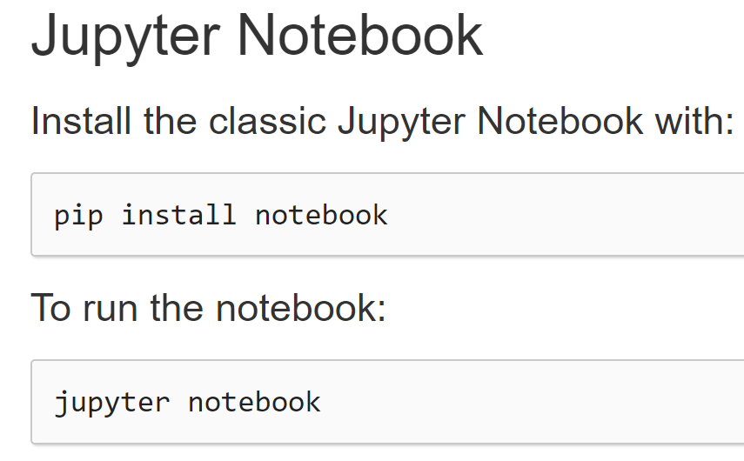
Step 2 : install jupyter
Choose class Jupyter Notebook… OK

Slide 4
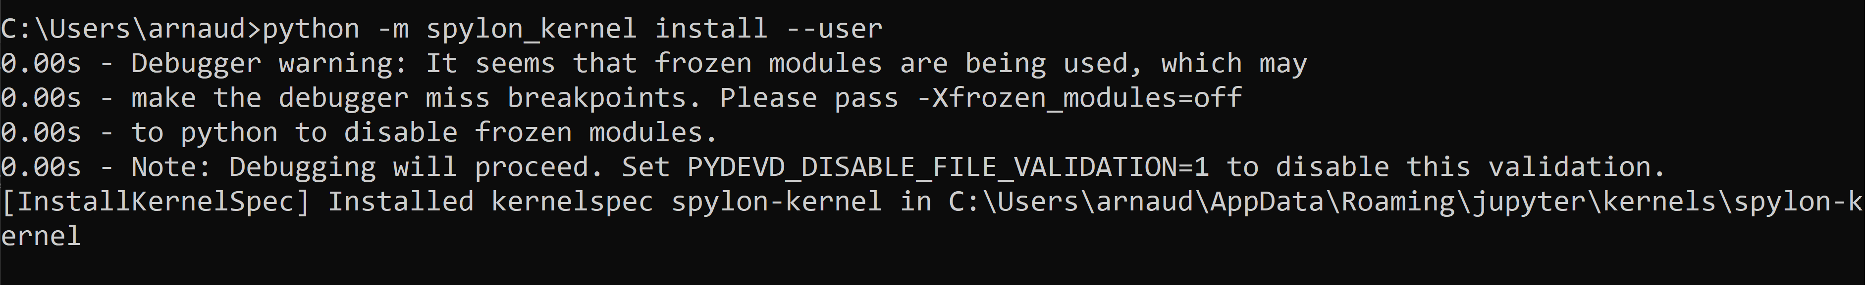
Step 3 : install jupyter spylon_kernel (for using Spark with Scala langage)
python –m spylon_kernel install --user
(or pip install spylon_kernel –user )

Slide 5
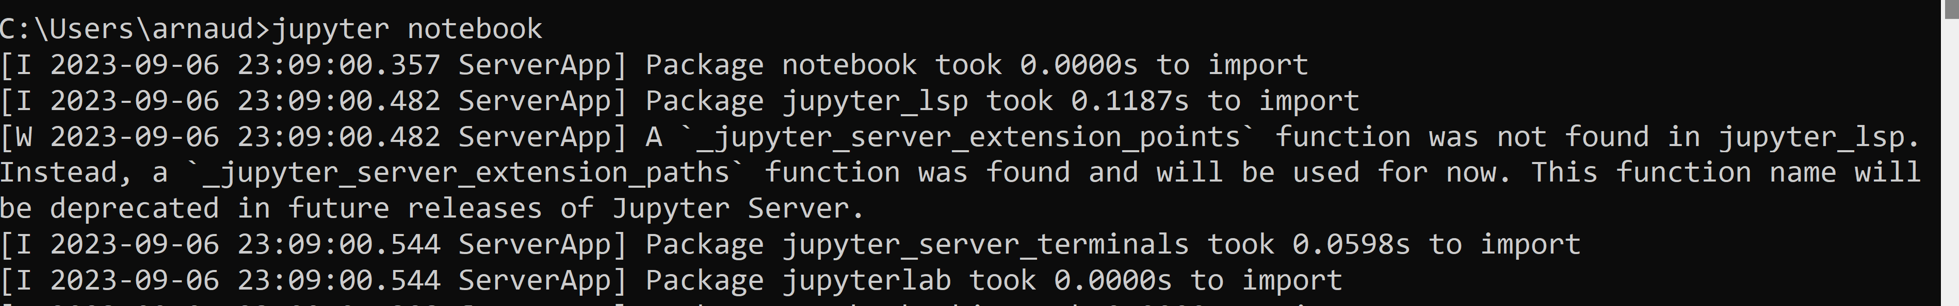
Star Jupyter Notebook
jupyter notebook
[[truncated logs …. Also contains errors?? ]]

Slide 6
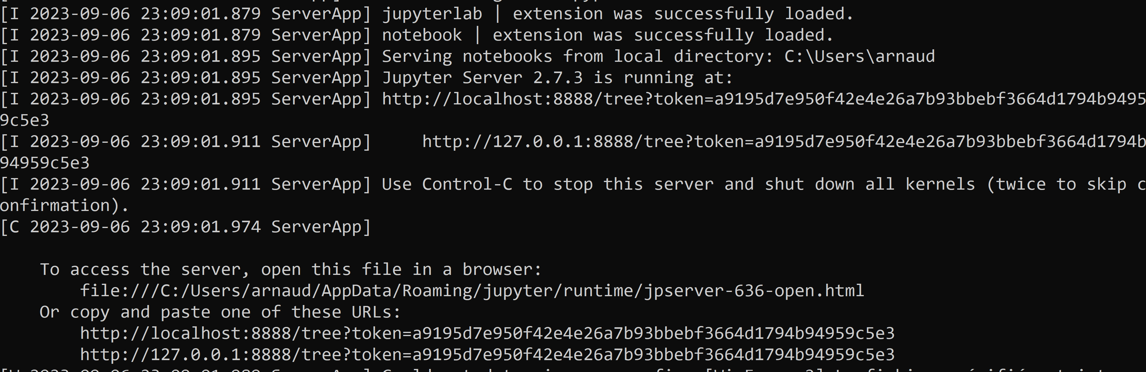
Jupyter Notebook ..

Slide 7
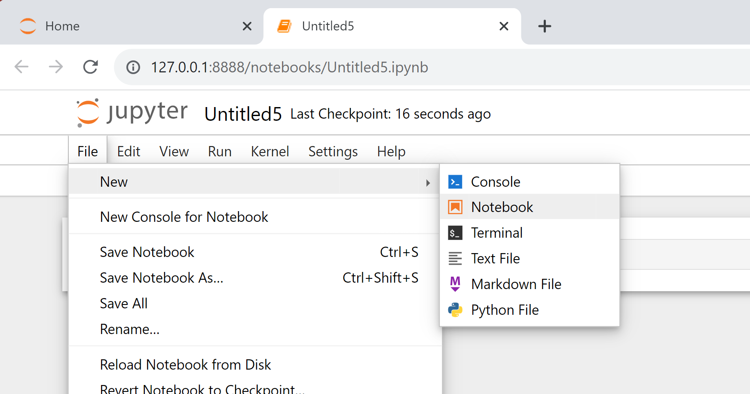
Creating a new notebook

Slide 8
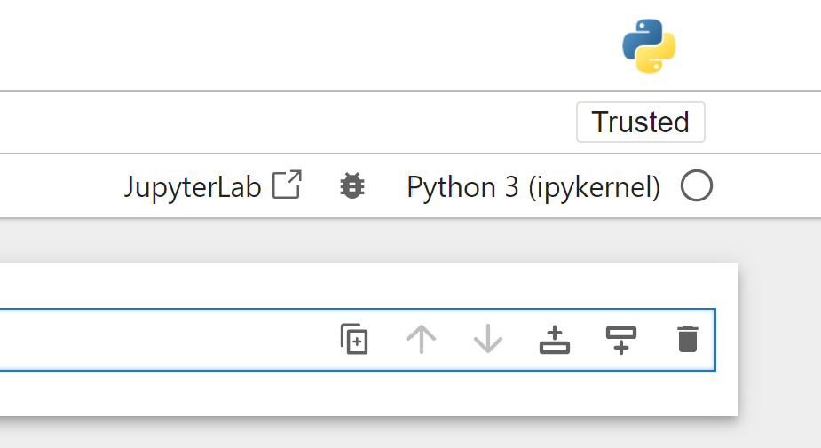
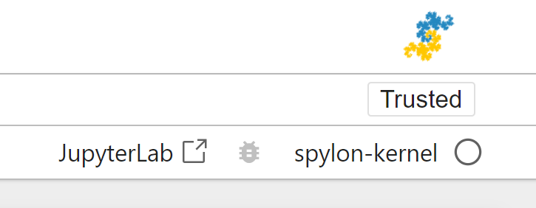
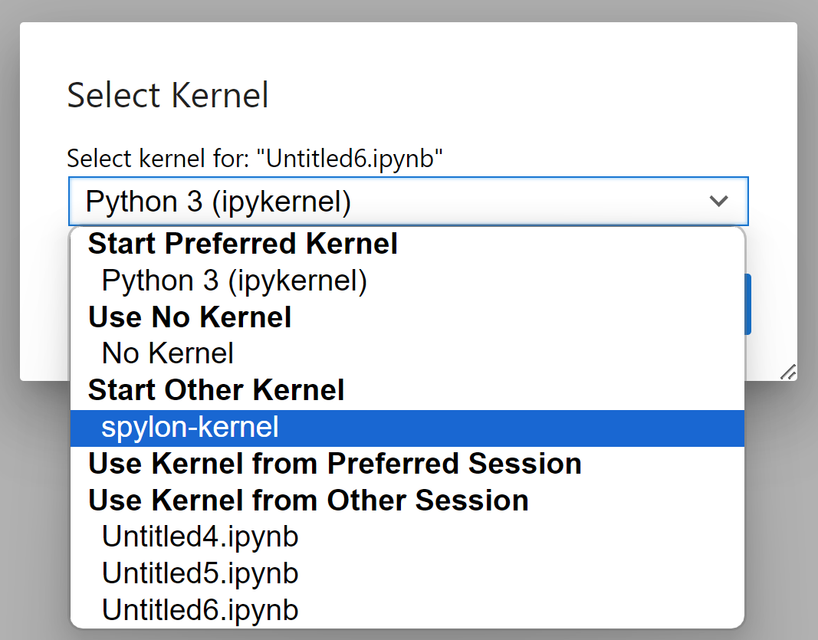
Step 3 … testing spylon

Slide 9
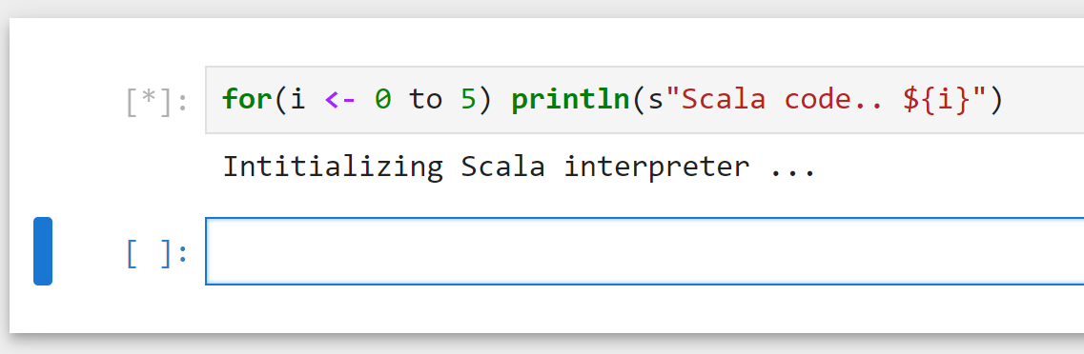
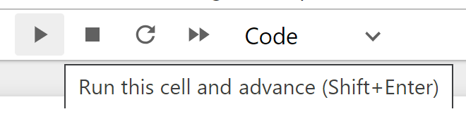
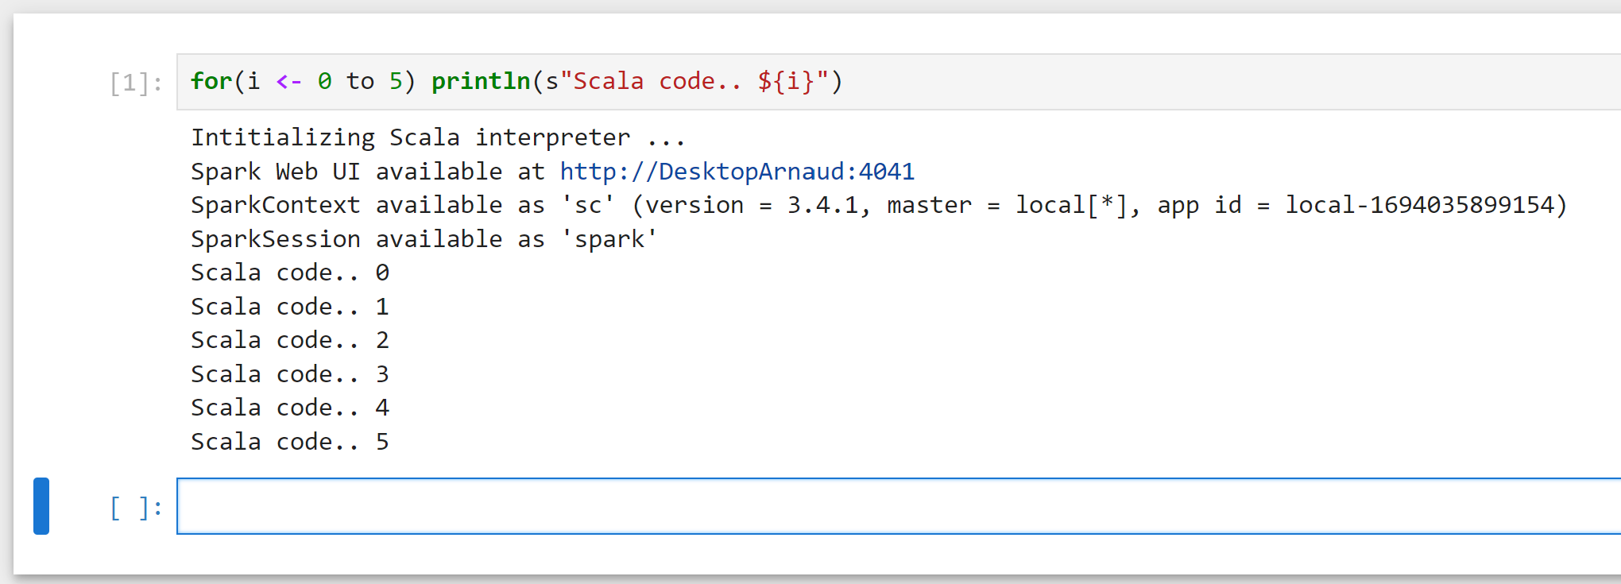
Step 3 … Testing Spylon .. Write Scala
Type SCALA code … Shift+Enter
Get Spark process (Scala interpreter)

Slide 10
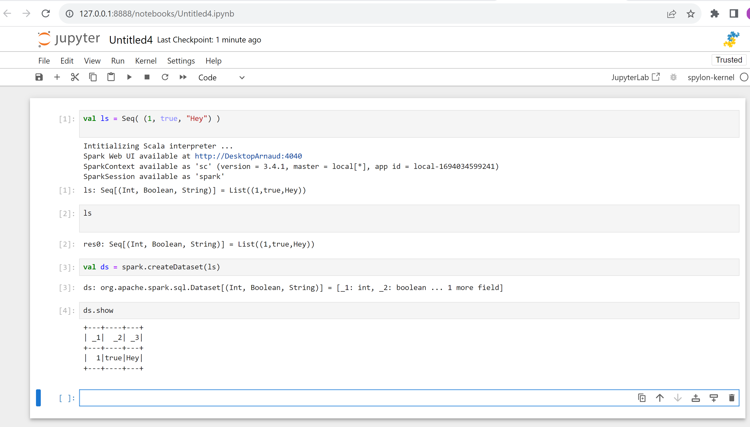
Step 3 … Testing Spylon .. Write Scala

Slide 11
Step 4 : install kernel for pyspark… (for using PySpark with Python langage)

