Slide 1
Comparisons
NoSql Databases vs
Standard OLTP Databases
Esilv 2025
Arnaud.nauwynck@gmail.com

Slide 2
Overview
Standard in OLTP :
  ACID
  Read isolation (read consistent, mvcc)
  Sql SELECT + INSERT, UPDATE, DELETE
  Transaction WAL Files
  Modifying Binary files
  Using B-Trees, and Indexes
  Fast lookup by rowid/addresses in file blocks
NOT Anymore in NoSql Databases !!
  Commit, using « _temporary/* » directories?
  Read isolation ?
  Overwrite Files… delete + re-create new
  No Indexes
  …

Slide 3

« Si tu as besoin de quelque chose, appelle moi, je te dirais comment t’en passer »
« If you need anything, call me,
I'll tell you how to do without it. »

Slide 4
ACID
A = Atomic
C = Consistent
I = Isolated
D = Durable

Slide 5
ACID, A = Atomic
Atomic = All (commit) or Nothing (rollback)

Slide 6
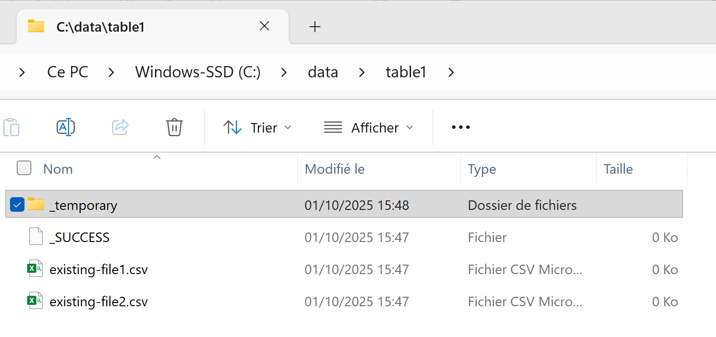
Using « _temporary » dirs

Slide 7
Hidden files & Dirs: starting with « _ » or « . »
Example of hidden files:
« _SUCCESS » empty marker file for Hadoop for success end of task
« .file1.csv.crc » «SHA-256 » checksum file, for detecting corrupted data files
Example of hidden directories
« _temporary / » during task, then removed at end

Slide 8
Slow Write to Hidden temporary directory… OK then « atomic ?» delete all OLD files
+ rename all NEW files
# step 1…50 : Remove ALL OLD …
rm existing-file1.csv;
rm existing-file2.csv;
..
rm existing-file50.csv;
/ table1 /
+ existing-file1.csv
+ existing-file2.csv
…
+ existing-file50.csv
/_temporary /
+ new-file1.csv
+ new-file2.csv
…
+ new-file200.csv
# step 51…250 : Rename ALL NEW …
mv _temporary/new-file1.csv ./new-file1.csv;
mv _temporary/new-file2.csv ./new-file2.csv;
..
mv _temporary/new-file200.csv ./ new-file200.csv;

Slide 9
Is It really Atomic ?
Example at SG, we have some huge spark-jobs
The « Atomic » renaming of files takes too long => Timeout / Failure inside the « commit » !?
There might be still some « _temporary » remaining dir, partially some new files added …. And all old files deleted
The commit is SO LONG … you may read partially « uncommitted » files, but not all

Slide 10
ACID, C = Consistent
val dataset = spark.read.load(« /table1 »)
dataset.count(); // => OK, first read success
…
… then processing for 20 minutes …
…
// … then actual read again the expected same files !
dataset.count();
// ➔ throw new FileNotFoundException(« …File ‘file1’ does not exist »);
// another process running
val newDataset = …
newDataset.write.save(« /table1 »);
Spark does not even return
the « new refreshed » result
…it just fails

Slide 11
ACID, I = Isolated
it is not Atomic, nor Consistent … it is also not Isolated
In particular, spark tries to be ACID, but per directory
… Suppose you are writting to several partitions (1 partition = 1 directory in Hive MetaStore)
You may see some committed partitions (so partially committed task result), but not others
Even from different writer processes

