Slide 1
GDPR Principles
arnaud.nauwynck@gmail.com

Slide 2
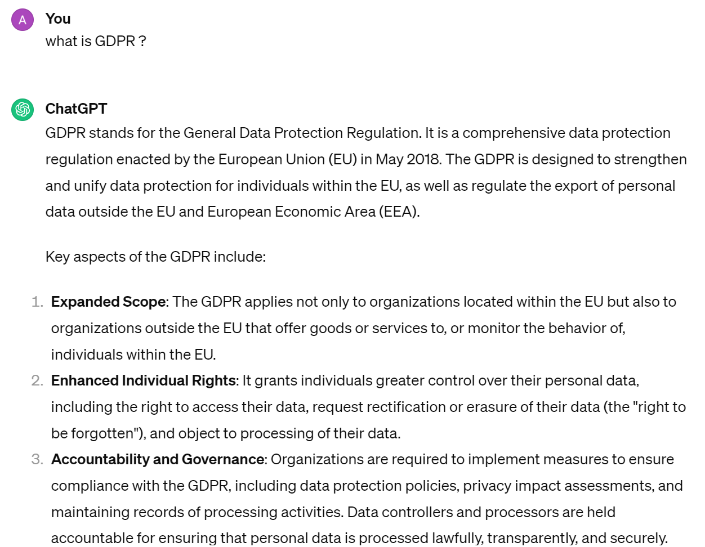
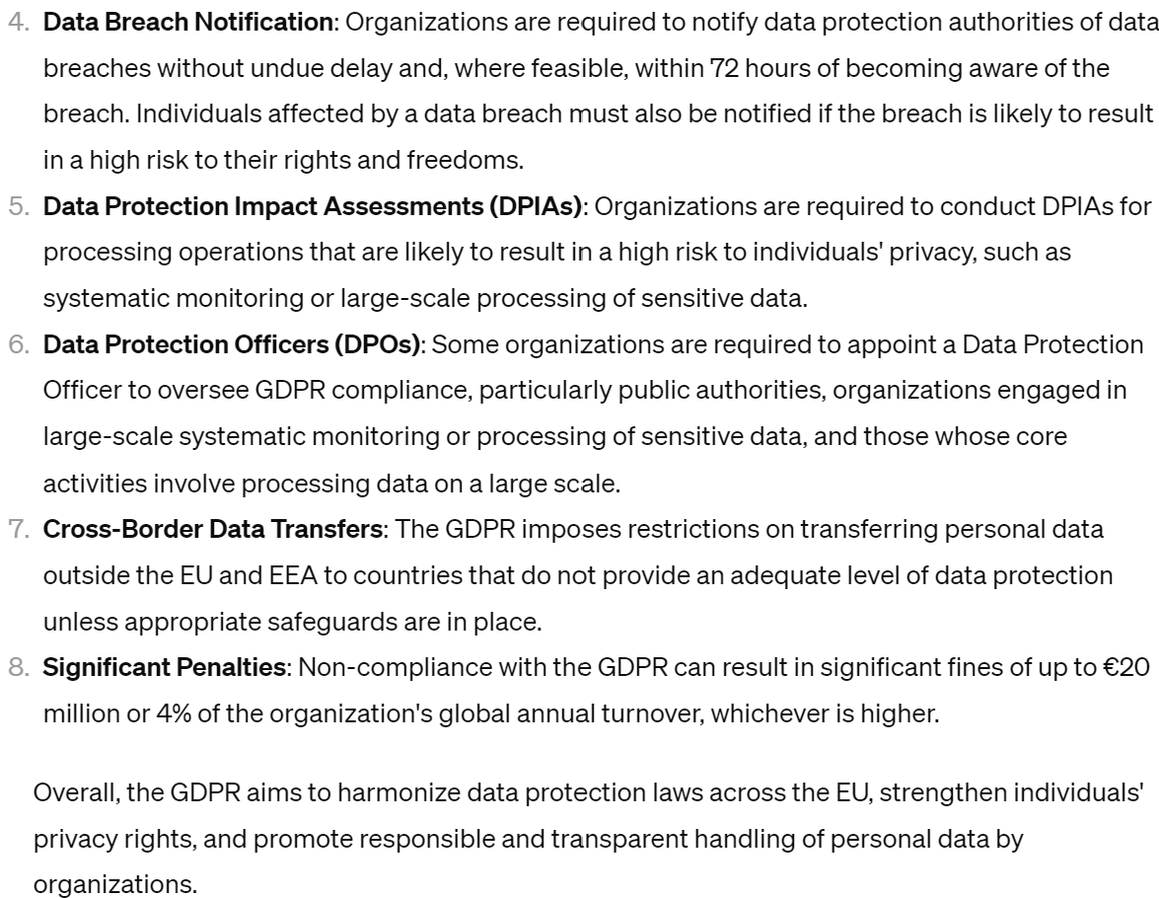
What is GDPR

Slide 3
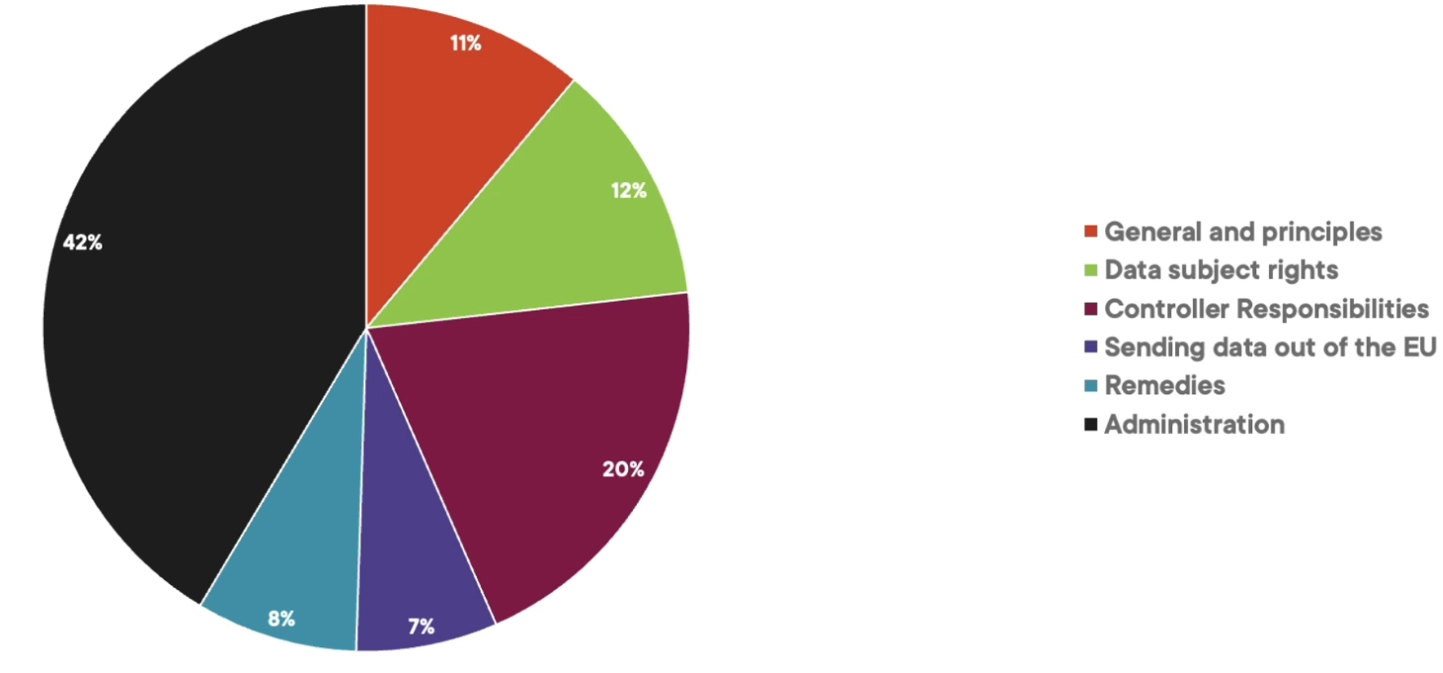
99 articles !

Slide 4
Terms
Data Subjects = living individuals in EU
Data Controller = giving order to process data
Data Processor = processing the data as specified by controller (ex: cloud provider)

Slide 5
Principle 1 : OK to use data
Using Data is legal, fair and expected
BUT living individual also have freedom rights,
including rights for their personnal data
So balance both

Slide 6
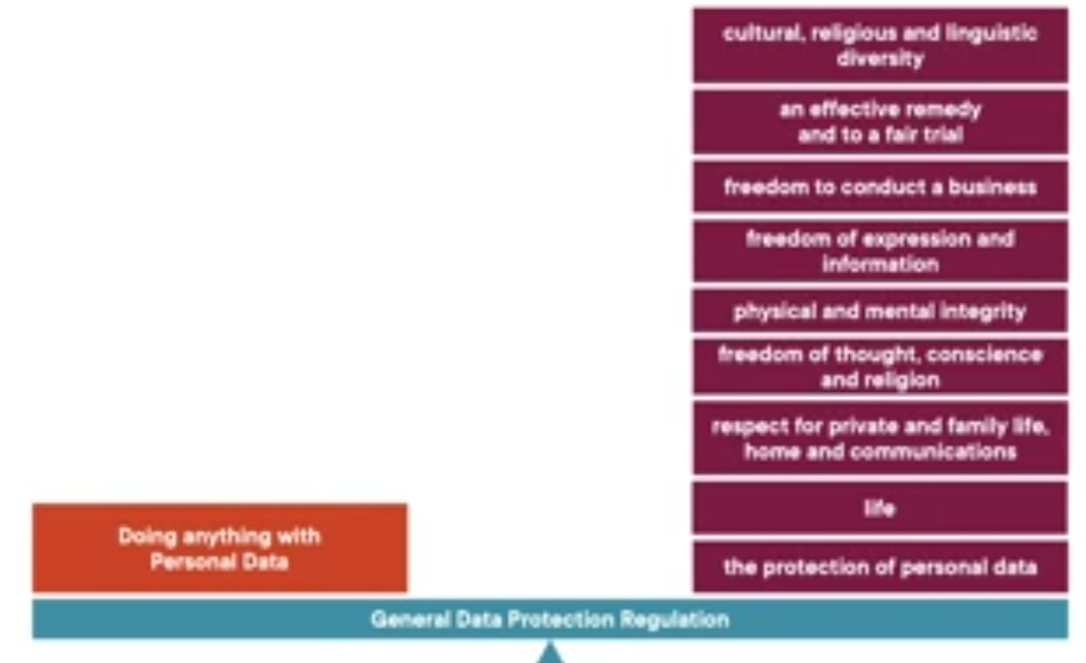
Balance

Slide 7
Restriction Principles
Only collect for specific purpose
Only necessary data (not more)
Data must be accurate
Delete when finish
Secure (measure risk for end-users)
Be accountable

Slide 8
Lawfull, Fair, Transparent
Transparent: tell people what you're doing with data
Fair: balance people rights with interrest of organisation with processing data
Lawfull : process for one of 6 specified reasons :
consent
contract
legal obligation
vital interrest
official
legitimate interrests

Slide 9
Special Category Data
Discrimation
Biometric
Health
Sexual orientation
Processing Special Data? ... if
explicit consent, employment, vital interest, public interest, public health,
what an organisation does

Slide 10
Purpose Limitation
do not collect anything "just in case"
use data for the purpose you declare it, nothing more

Slide 11
Minimalist Data Needs
strictly minimal for what is necessary for the processing
use pseudonimisation (reversible, ~index)
or anonymisation (irreversible, ~random)

Slide 12
Accurate
Data must be accurate, and up to date
Users can ask for review / corrections

Slide 13
Purge / Expire Data : Time Limit
retention for business / legal need ... ask
then automatically delete data after

Slide 14
Integrity and Confidentiality
process securely for the end-users
protect against unauthorized, unlawfull processing
warn for data loss, damage
( the CIA triad )

Slide 15
Accountability
The Data Controller (cf next) is responsible for respecting the principles
and must demonstrate compliance, collaborate with authority

Slide 16
Must Provide
Who is the Data Controller ?
and who is the DPO
Purpose and legal basis
Legitimate interrest
Other recipient
International Transfers (ex: public cloud?)

Slide 17
Must Provide (... next)
Retention period
Statement of Right
Notification of the right to complain
Special rights if consent used
Whether obligated to provide data
Use of automated decision-making

Slide 18
Right To Know
Article 13 : right to know before giving your personnal data
Article 14: right to know when a controller get personnal data
from elsewhere

Slide 19
Right to Correct/Delete/Stop
Article 15 : right to know(copy) the data
Article 16 : right to correct if inacurate
Article 17: delete if possible
Article 18 : stop doing that with data
... with 1 month delay max, and free

Slide 20
Governance Obligations
Article 24 : Accountability and governance
Article 25 : Protection by design
Article 30 : Records of Processing Activity (Audit)
Article 31 : Cooperate with Regulators

Slide 21
Accountability
things must be understood, organized,
with written policies,
folllowed by the organization structure

Slide 22
Protection By Default & By Design
minimize Data
audit every field :
do you really need each field, each line ?
if yes, could it be pseudonimized / anonymized ?
minimize Data security Access to required minimum
Who needs to see it ?
keep audit of who has read/write access

Slide 23
Secure proportionally to Risk of end-users
take into account
- state of the art security
- cost
- risk
- impacts
.. in the context of end-users risk x impacts

Slide 24
Record of Processing Activities
keep audit of :
What data is processed,
pupose and legal basis
Retention periods, security measures
can be requested by the regulator
( not required id "occasional" or very small organizations)

Slide 25
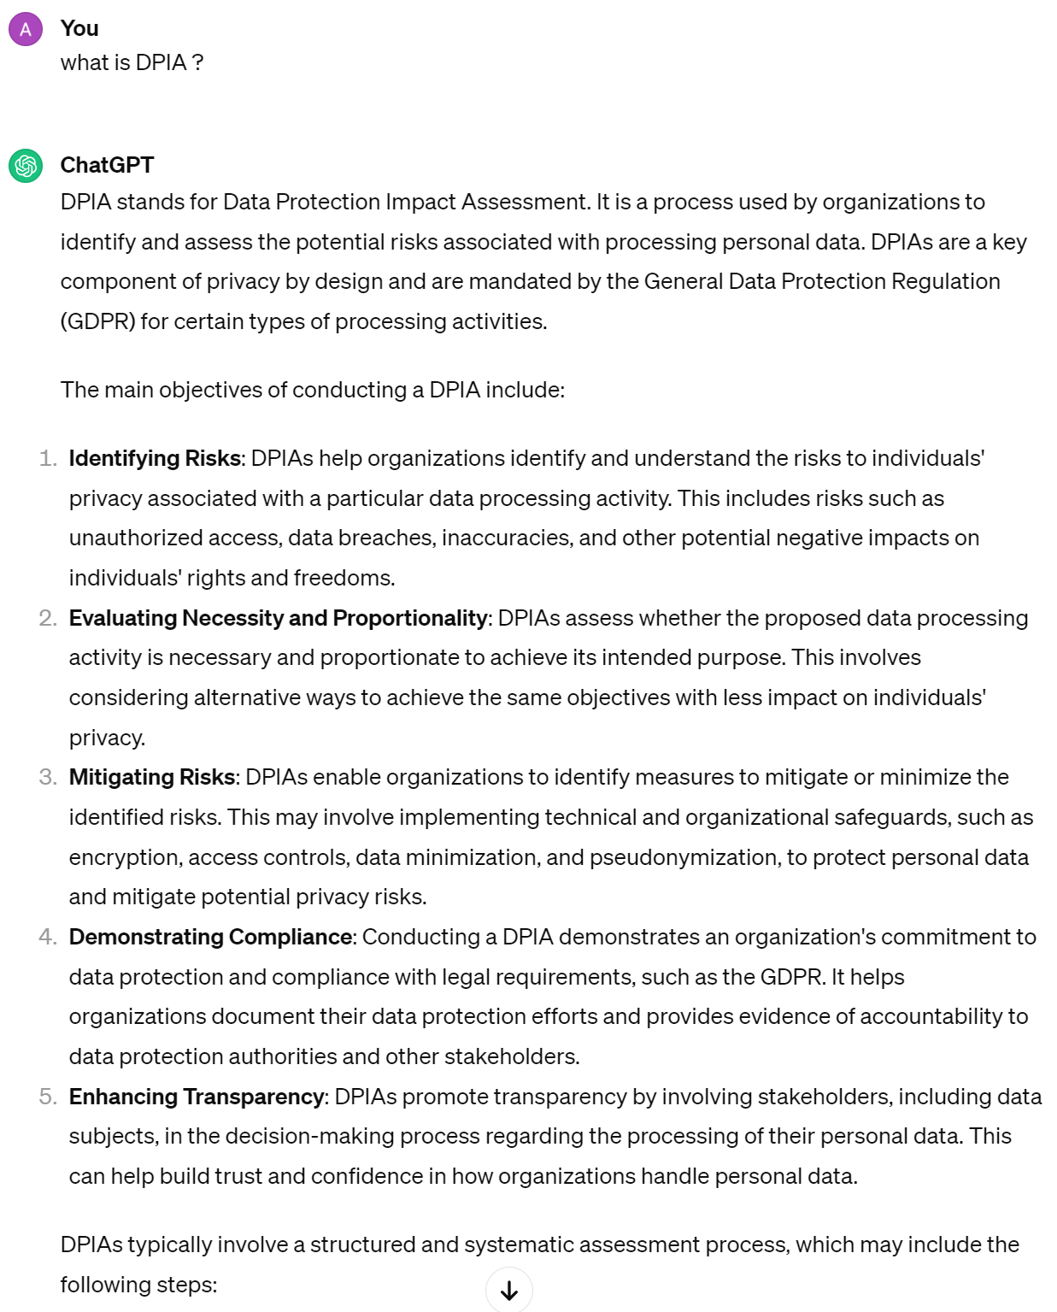
DPIA (Data Protection Impact Assessment)

Slide 26
DPIA ... Mandatory if
processing and profiling that causes significant effect
large scale special category data (health, ..)
Public area monitoring

Slide 27
Data Controller | Processor
Data Processor = an entity that processes personal data on behalf of a Controller
(third party / supplier / outsourcer / cloud provider )
Data Controller = an entity that determine a processing of a personnal data

Slide 28
Data { Controller |Processor }
Article 28 : Controller must manage Processors
Article 29 : Processors must do nothing else
must be contract / scope of service
sub-processors? must be agreed by Controller
Processor must help Controller/Data Subjects for obligations/rights

Slide 29
Do what you Say
Article 32:
You are responsible that
everybody does what is says with the data he has access to

Slide 30
DPO : Data Protection Officer
Article 37 : you must name a (competent) DPO
Article 38 : DPO has rights and responsibilities
Article 39 : a DPO has specific tasks

Slide 31
Security
Article 32 : appropriate technical & organizatinoal security
Article 33 : notify Regulator (72H) if personal data breach
Article 34: Notify data subjects if personal data breach

Slide 32
Risk
Impact (for end-users)
1=minor ex: disclosure of info
2=low ex: disclosure of special category data
3=medium ex:theft of identity
4=high ex: irretrieval control of sensitive data
5=critical ex: life changing
Probability
1=unlikely
2=possible
..
5=certain
Number
of Subjects

Slide 33
Questions

