Slide 1
Hands-On 1 - Design Patterns
February 2023
arnaud.nauwynck@gmail.com
This document: https://github.com/Arnaud-Nauwynck/presentations /tree/main/java/TP-design-patterns/handson-1-design-patterns.pptx

Slide 2
Outline
The goal of this Hands-On is to recognize and model as UML Classes
many Design Patterns in the « FileSystem » ( = File + Directories)
Composite,
Prototype,
Proxy,
Adapter,
Bridge,
Decorator,
Strategy,
Abstract Factory,
Command
Visitor,
…

Slide 3
Exercise 1 : complete UML links for classes diagram of a basic FileSystem
RootFileSystem
INode
Directory
File
Directory: are composed of sub-directories and Files
File contains bytes
Both File and Directory are INodes
The root filesystem starts at « / » dir

Slide 4
Exercise 2: Design pattern used for « Directory » ?
a/ Explain
b/ give the general structure of the « composite » Design-Pattern
c/ give other examples

Slide 5
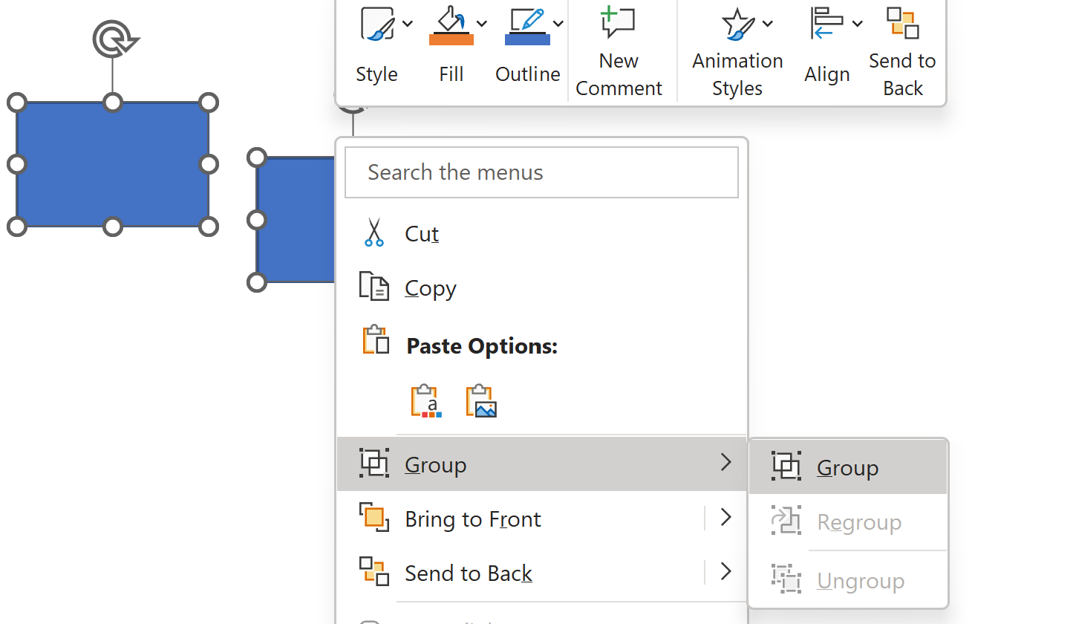
Exercise 3 : Can you recognize same pattern in a graphic drawing app (PowerPoint)
a/ give UML classes for a minimal graphic app supporting: Line, Rectangle, Text
b/ can you recursively « group » elements of type « group », rotate them ?

Slide 6
Exercise 4 : Copy&Paste .. Pattern=?
Every objects (File or Directory) can be copy&paste,
Therefore duplicating the full content of it
The file act as a « ?? Name of pattern ??» for creating another same file

Slide 7
Exercise 5 : complete more links
INode
Directory
File
SymbolicLink
DataINode
On Linux, you can create 2 types of links
$ ln a b → « hard link » : Inode counter is incremented for existing file « a », now also visible as « b » … delete « a » => « b » still exists with content of previous file
$ ln –s a b → « symbolic link »
…. Delete « a » => « b » points to non-existing file name
Notice there is NO « Link » class, only « SymbolicLink » class … but there is a new class « DataINode »

Slide 8
Exercise 6 : explain design-pattern for « Symbolic Link » class

Slide 9
Exercise 7 : give other examples of « Proxy » design pattern in network
a/ DNS name vs Ipv4 address, Ipv6 address
b/ http proxy (cache)
Model both examples as UML classes

Slide 10
Exercise 8 : explain design-pattern for « File» - « INodeData » class
Hint.. Bridge / Adapter / ..
AClass -> AImpl

Slide 11
Exercise 9 : complete links … explain Pattern
RootFileSystem
INode
FileSystemType
Directory
File
Device
Mount
Partition
On unix, you can « mount » a partition of a disk(block device) as a directory , knowing its FileSystemType (ext3, betterfs, ntfs, ..) $ su root
# mount –t ext2 /dev/hda1 /mnt/mydisk-partition1
# mount –t ext3 /dev/hda2 /mnt/mydisk-partition2 # mount => show all current mounts
# cat /etc/fstab => show all mounts at boot

Slide 12
Exercise 10 : model UML classes for unix « NFS » (Network File System)
NFS Directory??
NFSClient library
NFSServer
Open TCP socket (IP,port)
… to call NFS requests
NFS FileSystem ???
NFS FileSystemType??
NFS Device ??

Slide 13
Exercise 11 : linux « char device »
INode
Device
Directory
File
CharDevice
BlockDevice
On linux, there are also « char device », in addition to « block device »
« char device » can get serial data, from a « mouse », a network interface, a keyboard, …
You can query linux mouse via « cat /dev/mouse » …
Model those classes

Slide 14
Exercise 12 : linux loopback device
Model UML class for loopback device
On linux, if you have a file (of 650Mo), with file format « iso9660 »
It can be seen as a « CD-ROM », and mounted
mkdir /mnt/iso
sudo mount -o loop /path/to/my-iso-image.iso /mnt/iso

Slide 15
Exercise 13 : linux « /proc » FileSystem
Model UML class for /proc special files
On linux, many system information can be read on virtual files of the « /proc » (and « /sys » )
filesystems
$ ps
=> list processes
… internally implemented as something equivalent to « ls /proc »
Getting details of process « $pid » can be obtained using
$ ls –l /proc/$pid/fd # list open files for process
$ cat /proc/$pid/xxx

Slide 16
Exercise 14 : Namespaces .. « Chroot »
Model as UML classes
On linux, you can « chroot » a process,
for security reasons, it is sandboxed, and can not get out of his « jail »
It is widely used for containers
…In fact, there is 1 « root » directory per « filesystem» namespace
There can be several namespaces

Slide 17
Exercise 15 : Namespaces .. Docker Containers support
Model as UML classes
A « process » points to several namespaces
When forking, a child process inherits all from its parent namespaces
Namespace for FileSystem
Namespace for IP,
Namespace for Processes
Namespace for Users
..
In kubernetes, all containers in the same pod share the same namespace..

Slide 18
Exercise 16 : File Explorer ClickHandler model as UML classes … recognize patterns « Decorator », « Chain Of Responsibility», « Strategy », else ?
When you double-click on a file with suffix « .exe » => it executes
with suffix « .pdf », « .doc », « .pptx », « .html » …. => it opens an application with suffix « .tar », « .gz » => it proposes you to uncompress with suffix « .tar.gz » => it proposes you to uncompress, and then to extract in a new dir with suffix « .zip » => it proposes you to extract in a new dir zip files behave like a directory.. You can browse in it

Slide 19
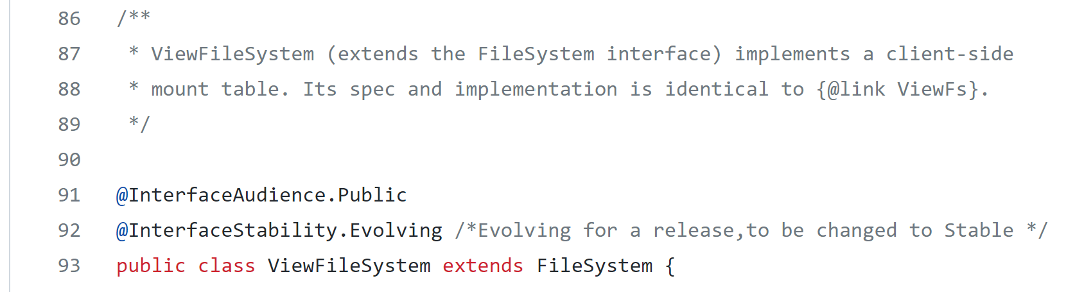
Exercise 17 : FileSystem class in Hadoop. which patterns do you recognize ?
org.apache.hadoop. FileSystem
https://github.com/apache/hadoop/blob/trunk/ hadoop-common-project/hadoop-common/ src/main/java/org/apache/hadoop/fs/viewfs/ViewFileSystem.java
ViewFileSystem
Dir
child
MountViewDir

Slide 20
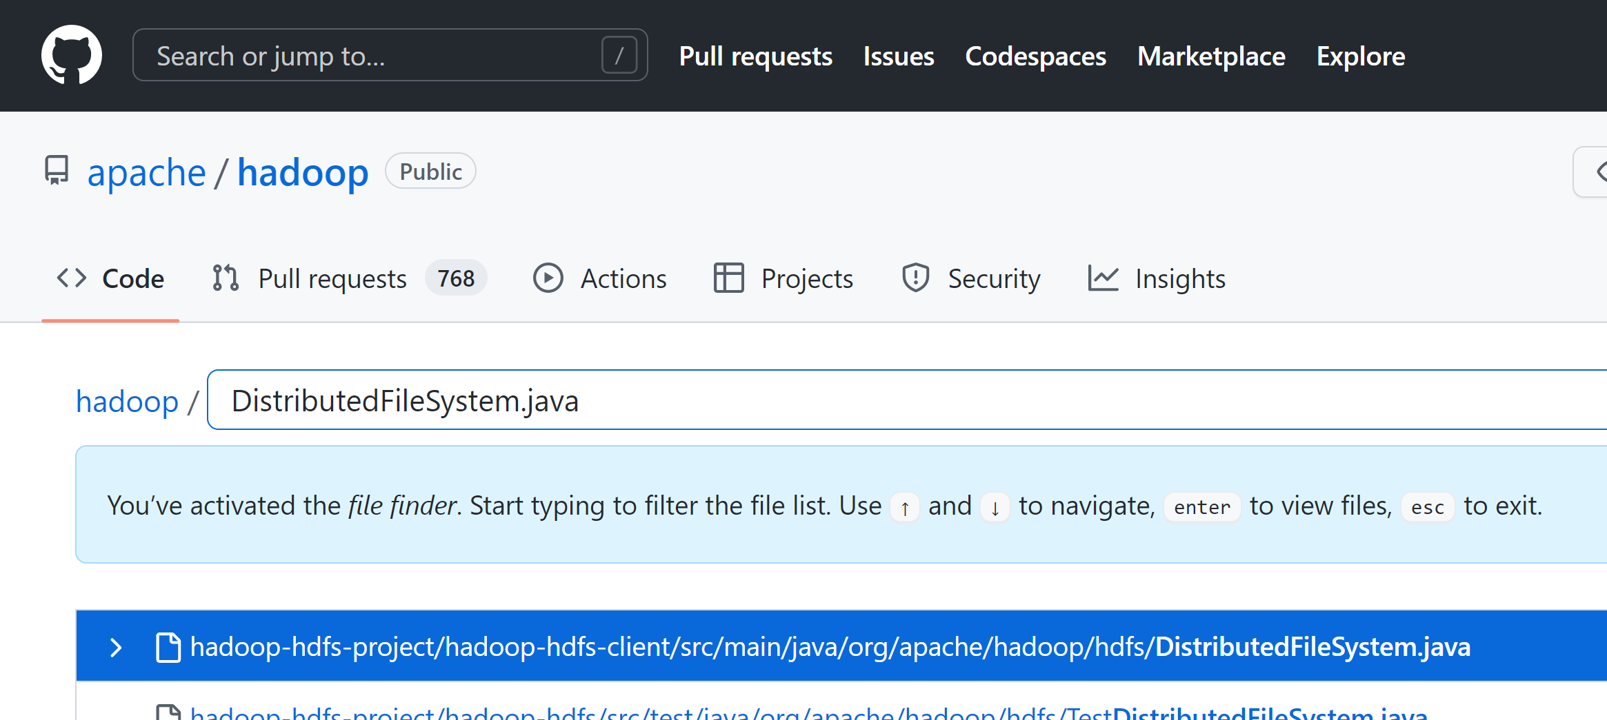
Exercise 18 : FileSystem class in Hadoop. which patterns do you recognize ?
org.apache.hadoop. FileSystem
https://github.com/apache/hadoop/
DistributedFileSystem
(HDFS)
HadoopOutputStream
HadoopInputStream
new
new
DistributedOutputStream
DistributedInputStream

Slide 21
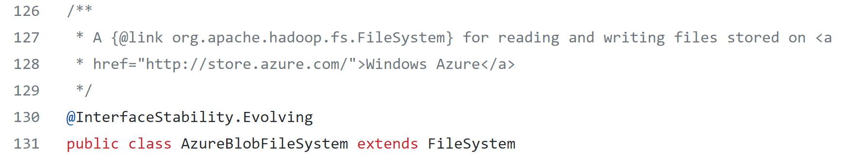
Exercise 19 : FileSystem class in Hadoop. which patterns do you recognize ?
Path
org.apache.hadoop. FileSystem
Azure Blob Client
HttpClient
AzureFileClient
OkHttpHttpClient
AzureBlobFileSystem
(abfs)
NettyHttpClient
https://github.com/apache/hadoop/ blob/trunk/hadoop-tools/hadoop-azure/src/main/java/
org/apache/hadoop/fs/azurebfs/AzureBlobFileSystem.java
Azure FileOutputStream
Azure FileInputStream

Slide 22
Exercise …
Implements in Java
abstract class INodeDTO {.. }
class FileDTO extends INodeDTO { … }
class DirDTO extends INodeDTO { … }
Etc…
So as to describe some filesystem data using POJO classes
(to be serializable on Json, to get data over a http web page )

Slide 23
Exercise …
Implement the builder of DTO using real java.io.File
Implement a Factory
Implements the Visitor design pattern
Other ideas ?

