Slide 1
Continuous Integration
Présentation IUT Agile Mai 2014
#iutagile http://iutagile.com
arnaud.nauwynck@gmail.com
This document:
http://arnaud.nauwynck.free.fr/IUT-Agile-2014-ContinuousInt.pdf

Slide 2
Summary
What is Continuous Integration ?
Presentation of Tools Ecosystem
Live Demo with...
  Test Driven (TDD) perspective
  Most important Tools
  Focusing on Java
  In 1h30 !!! Fasten Seat Belts ….

Slide 3
Who I Am
IT Passionate
IT Architect since ~7 years
Working at SGCIB – Lyxor, Paris - La Défense
Doing Archi, Dev, Tools, DevOps... on Java/C#
Prof at IUT ~ 15 days/year

Slide 4
Continuous + Integration
In French : “Intégration Continue” …
2 Math terms … with precise semantics
2 “common” terms
In Computer science ??
= Automated Build,Test & Deployment … Tools

Slide 5
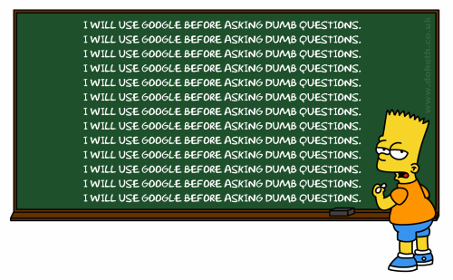
What is “Continuous Integration” ?

Slide 6
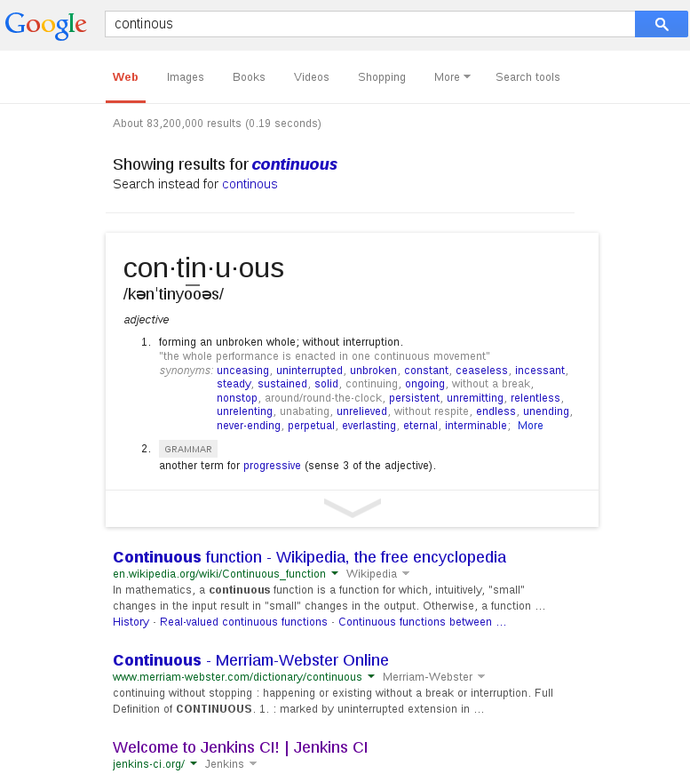
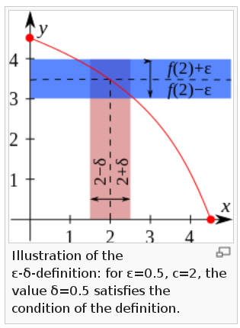
“Continuous” Google rank #3
= Jenkins
http://en.wikipedia.org/wiki/Continuous_function

Slide 7
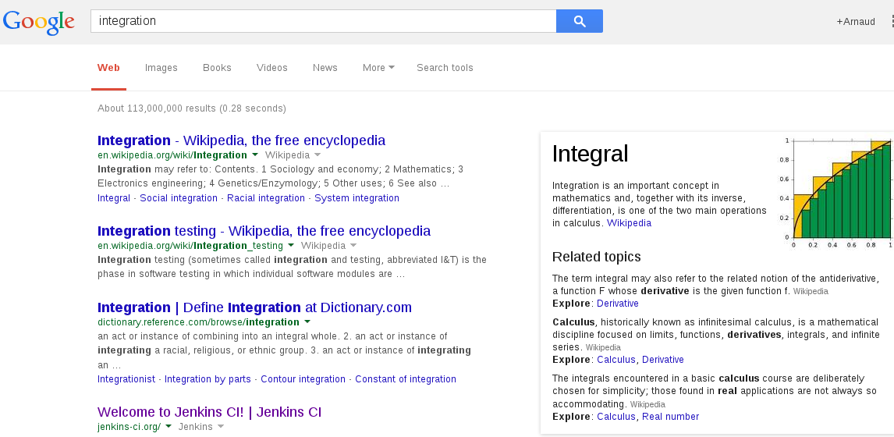
“Integration” Google rank #4
= Jenkins !

Slide 8
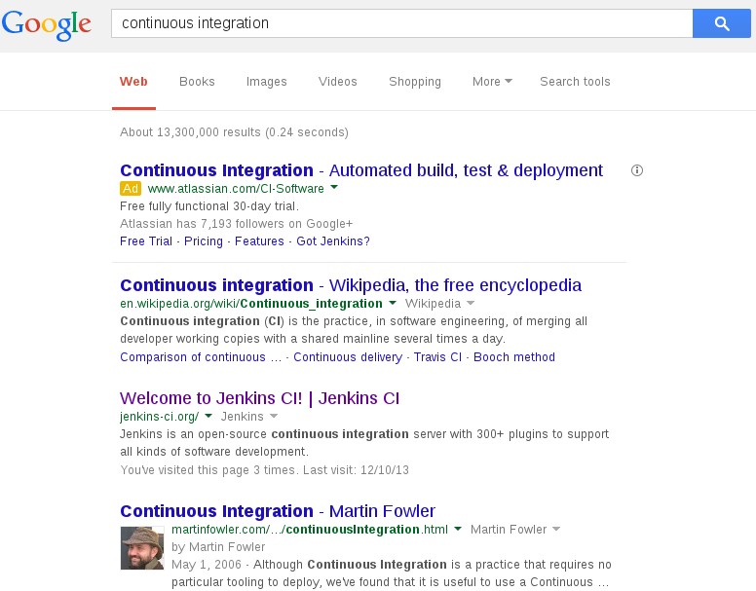
“Continuous Integration ” Google
Commercial
#1
Theory
#2
Practise
#3

Slide 9
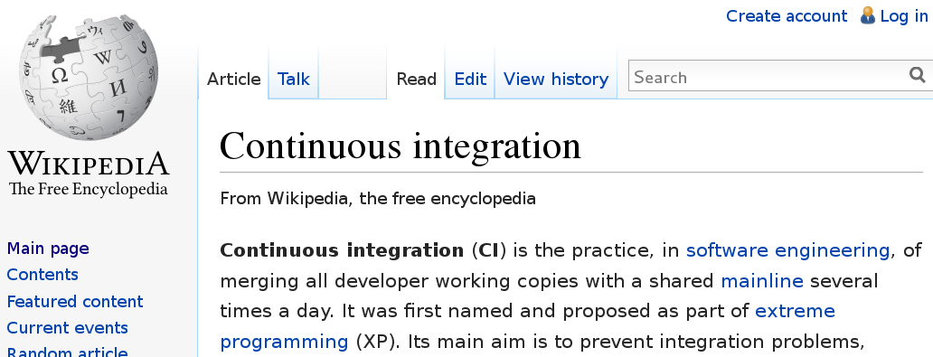
Wikipedia

Slide 10
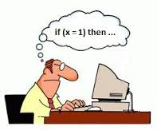



Merge Work - */Day - Mainline - Test
Code
Mainline
Automated
Build + Test
Test
Test
Test
Test

Slide 11

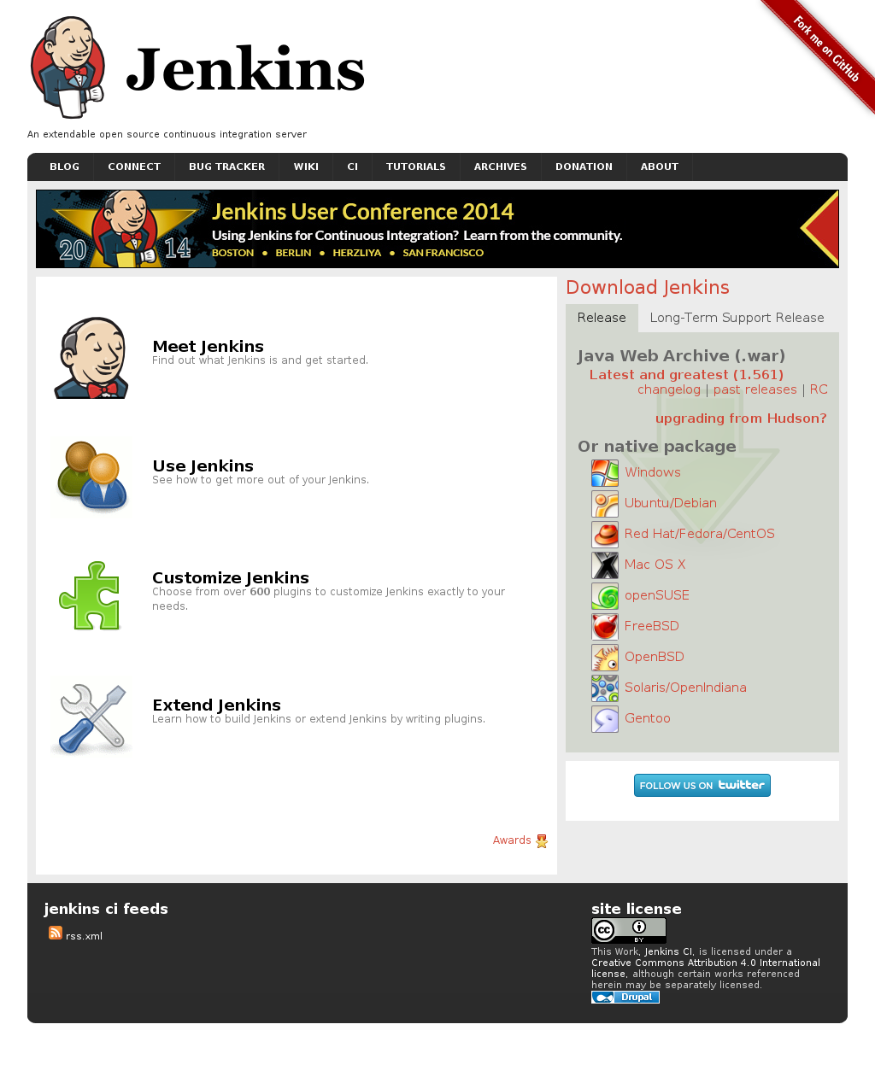
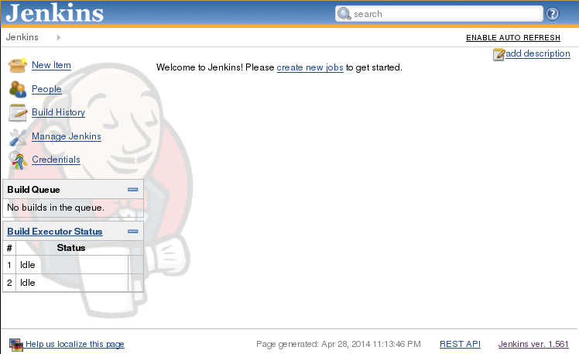
Meet Jenkins
http://jenkins-ci.org
http://localhost:8080/jenkins

Slide 12
Meet Jenkins
http://jenkins-ci.org
http://localhost:8080/jenkins

Slide 13
What
http://jenkins-ci.org
“An extendable open source continuous integration server”
Get Project Source Code
Build Project Output
Archive Build results,
Test reports,
Emails ...

Slide 14


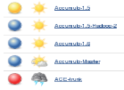
How
“An extendable open source continuous integration server”
Jobs & Plugins
Get Project Source Code
Trigger
from SVN, GIT,
Or other events
Build Project Output
Export Build results
Html, reports,
Emails ...
Launch “builds”
Processes (maven, ant, .cmd, graddle, ...)

Slide 15

Get Hands Dirty
Start as
- tomcat
- standalone jar
Tomcat/bin/statup.sh
java -jar jenkins.war
Check log OK
http://localhost:8080
Demo
Open Browser

Slide 16
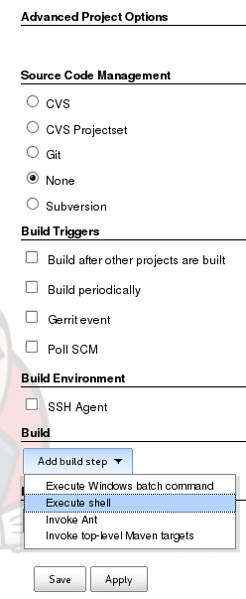
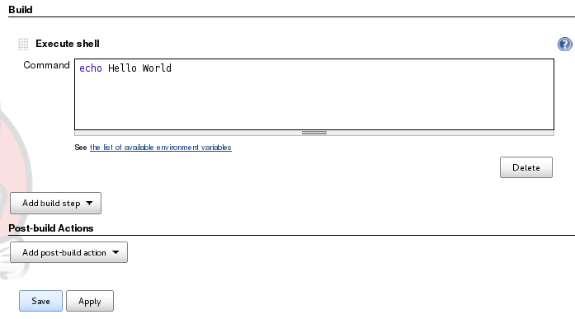
Jenkins “Hello World”
Get Hands Dirty
- Add Build Step “Execute Shell”
- Enter shell text
echo Hello World
- click SAVE
Demo

Slide 17
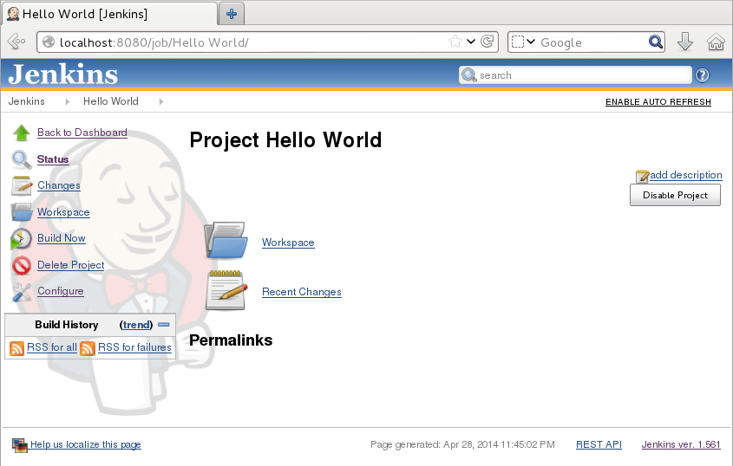
Jenkins > Job
Demo

Slide 18
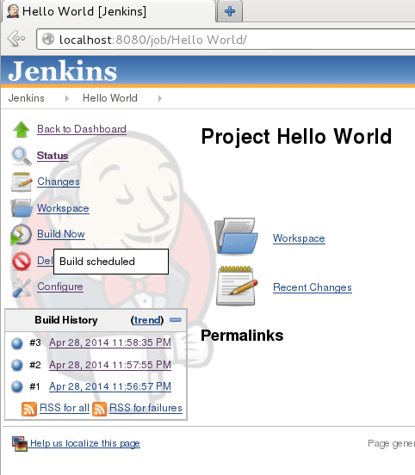
Build Now (3/3)
Build = instance of launching a Job
Demo

Slide 19
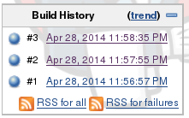
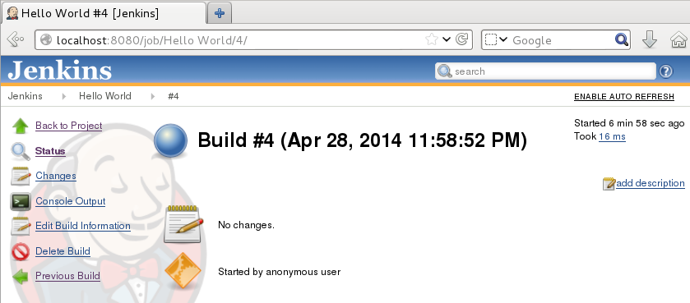
Jenkins > Job > Build #
Demo

Slide 20
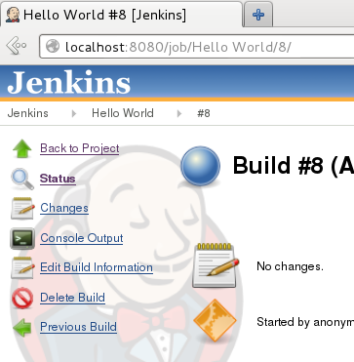
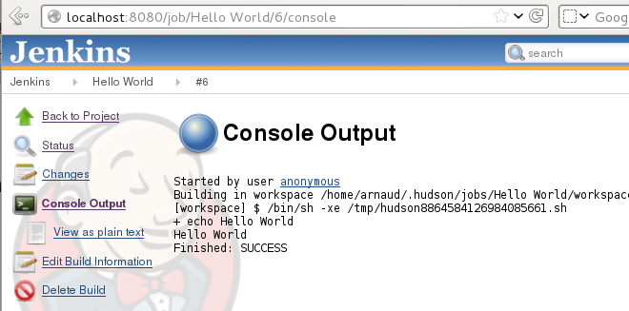
> Job > Build # > Console
Demo

Slide 21
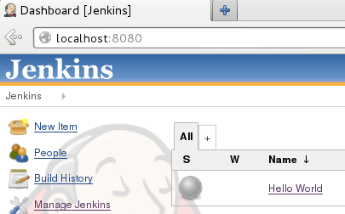
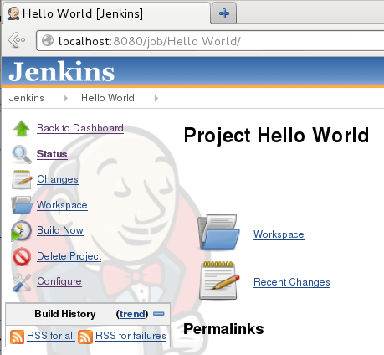
Navigation
Dashboard > Job > Build > Result
URL = Navigation Toolbar = Navigation into jenkins object
Demo

Slide 22
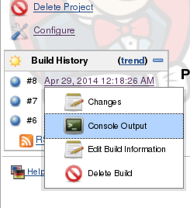
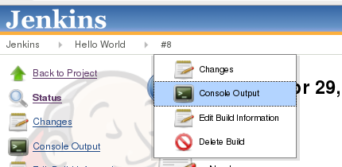
Contextual Action / Menu
From Object / Action Menu
Directly From Context Menu
Demo

Slide 23
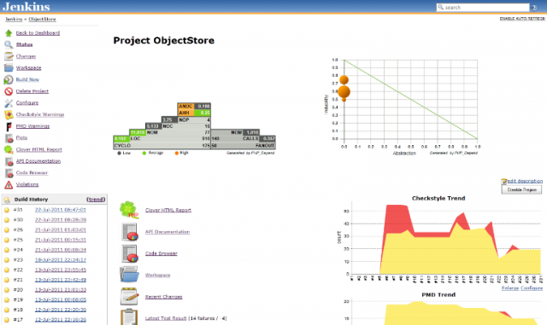


Is That All ? Is It Used ?
NOT just a CRON !!!
Plugins => Huge Value Added
… on reports
… Integration of MANY Tools
Build History => Reports, Stats, Trends, ...
De Factor Standard – in Industry & Open-Source
Ultra Active

Slide 24

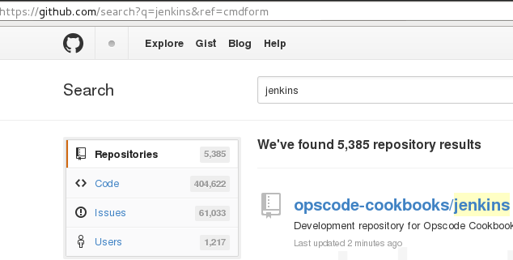

How Much Extensible
Configurable ?
Cf http://jenkins-ci.org
600 Plugins !
Configurable + extensible
https://github.com/jenkinsci
5385 GitHub Repos

Slide 25
















Tools Ecosystem / Plugins
Gerrit
Jetty, Weblo, Jboss, ...
CheckStyle
FindBugs
Cobertura

Slide 26




Don't Panic...

Slide 27



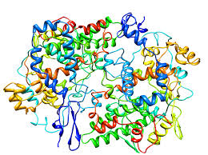



First Review It … Several Ways

Slide 28
CORE Interconnected Tools

Slide 29

Quizz ...
Find Circular Loop ?
Gerrit
Jetty, Weblo, Jboss, ...
CheckStyle
FindBugs
Cobertura

Slide 30
Core Workflow
Dev → Integration → Delivery
Dev
Delivery
Int

Slide 31
Day to Day Development Workflow
1 : Dev
2 : commit & Push
3 : Trigger auto build
4 : build with maven

Slide 32
Divide in Groups ?
Gerrit
Jetty, Weblo, Jboss, ...
CheckStyle
FindBugs
Cobertura

Slide 33
Divide By Run Location / Category
Gerrit
Jetty, Weblo, Jboss, ...
Platform Tools
Independent Tools
Team Work Tools
Change Mgt Tools
CheckStyle
Devops Tools
FindBugs
Cobertura
Run on Local PC
Run on Build Servers
Run ...

Slide 34
Quizz ...
What's Common ?
( & Who are Intruders )
Gerrit
Jetty, Weblo, Jboss, ...
CheckStyle
FindBugs
Cobertura

Slide 35



Render unto Caesar the things...
The intruder were…
But Jgit is here :
And no real equivalent !
(glu, smartfrog??)

Slide 36
Commons Availability ?
Gerrit
Jetty, Weblo, Jboss, ...
CheckStyle
FindBugs
Cobertura

Slide 37
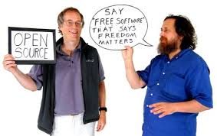


Open Source - Free - $ ...
Except Almost Free:
Free Use for
Open Source Projects
Free with $$ Support
Non free Features
Except:
No Source & Not Free !

Slide 38
Tools / Langage Library ?
Gerrit
Jetty, Weblo, Jboss, ...
CheckStyle
FindBugs
Cobertura

Slide 39
All Tools “Agnostic”
… except these Libraries
From Beginning
(TDD Test)
To End
(IOC, JEE App Server)
2 Java CORE Libraries
MUST-HAVE for Continuous Integration

Slide 40







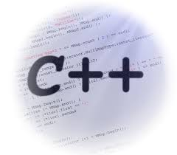

Continuous Integration for Others ?

Slide 41












Translate => C# Micro$oft TM
MS-Project
??
Spring.net ??
MsBuild
PowerShell
??
??
Gendarme
Cf: TFS
OpenCover
NuGet
?

Slide 42
Translate => Generic Name
IDE :
Integrated
Development
Environment
WIKI
Document Database
Issue Tracker
SCM:
Source Code Management
Repository
Automated Test Runner
Code Review Tool
IOC Fwk
Application Servers
Test Framework
Build Script
Framework
Automated
Build Server
Code Style
Checker
DevOps framework
Static
Code Analyzer
Delivery Management
Analysis
Framework
Project Management
Code
Coverage
Artifact Repository
Mutation Testing Analyzer

Slide 43



Pause Before ...

Slide 44





Start Simple, and TDD Test First !
TDD
TDD
TDD
TDD
TDD
Test Driven Development
= Test First … => Test

Slide 45
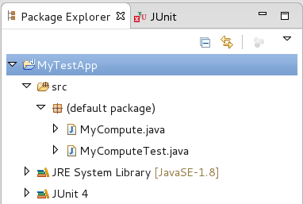
Get Hands Dirty
Create Simple Project ...
import org.junit.Test;
public class MyComputeTest {
private MyCompute tested = new MyCompute();
@Test
public void test_1_0_equal_1() {
// Prepare
int param1 = 1, param2 = 0;
// Perform
int res = tested.compute(param1, param2);
// Post-Check
Assert.assertEquals(1, res);
}
@Test
public void test_1_m1_equal_0() {
// Prepare
int param1 = 1, param2 = -1;
// Perform
int res = tested.compute(param1, param2);
// Post-Check
Assert.assertEquals(0, res);
}
@Test //(expected=IllegalStateException.class)
public void test_1_m2_fail() {
// Prepare
int param1 = 1, param2 = -2;
// Perform
tested.compute(param1, param2);
}
}
Demo
public class MyCompute {
public int compute(int param1, int param2) {
if (param2 == -2) throw new IllegalStateException();
return param1 + ((param2 > 0)? param2 : 0);
}
}

Slide 46

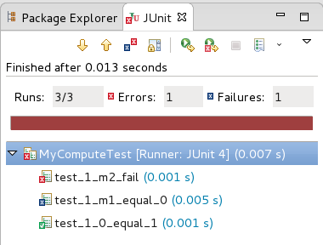
Running Junit Tests
Crashed with Exception
Demo
Test Assertion Failure
expected XX, got YY
Test finished OK

Slide 47
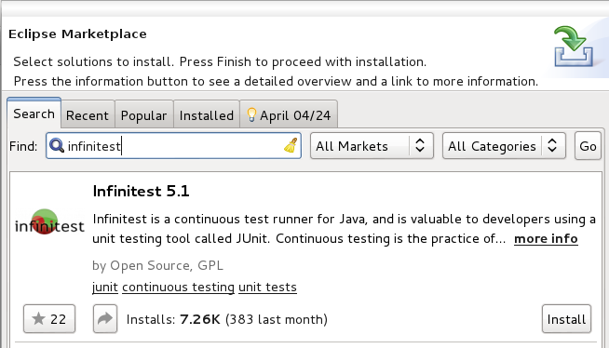




InfiniTest
Background Test Runner
Install
Then Show Running (Bottom Left)
Demo

Slide 48
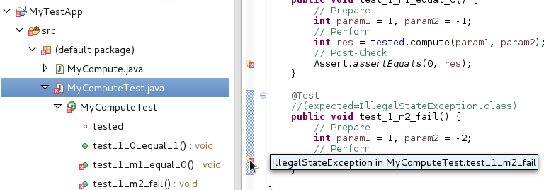
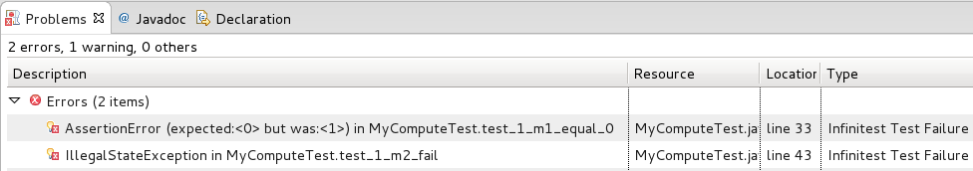
InfiniTest Markers
When Error => Shown as “Compile Error” Marker
Demo

Slide 49
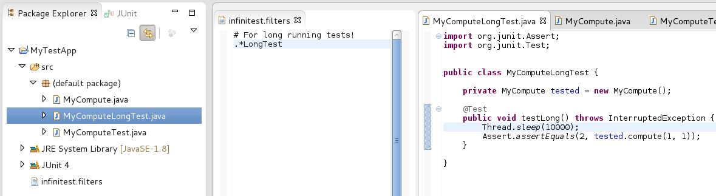
Skipping Slow Tests in InfiniTest
Demo

Slide 50




Victory Celebration Pause
TDD in Eclipse
Develop TDD FAST
on Local PC
in Eclipse + Eclipse Junit + Eclipse InfiniTest
What's next ?
Share on other PC … not having Eclipse ?

Slide 51

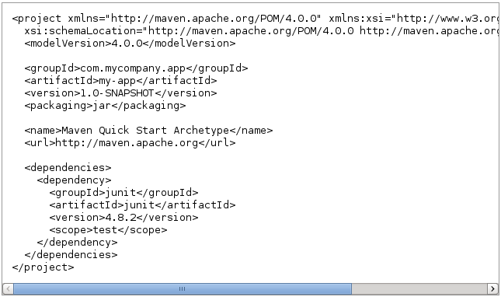
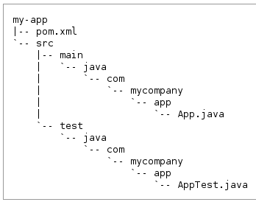
Welcome Maven pom.xml
Repo
Project
POM
Std
Layout

Slide 52
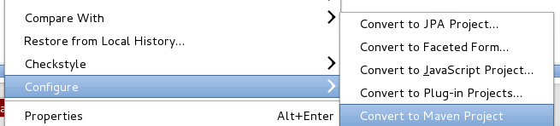
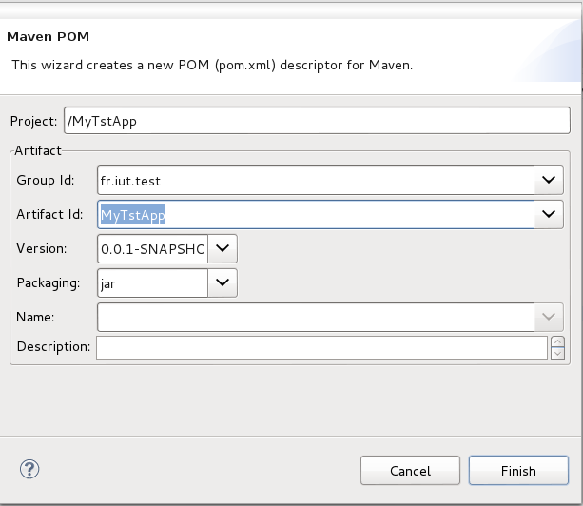
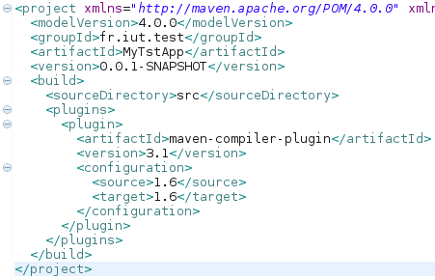
Get Hands Dirty
Convert to Maven - from Eclipse
Demo

Slide 53
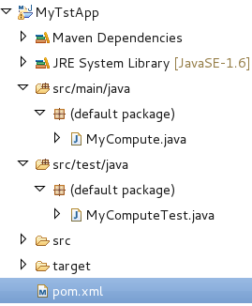
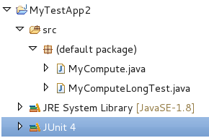
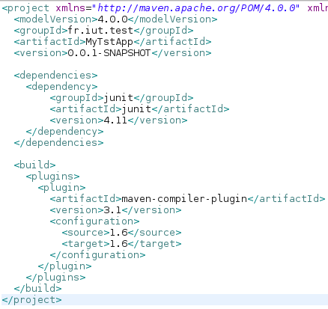
Convert … src/{main,test}/java
+ Junit Dependency

Slide 54
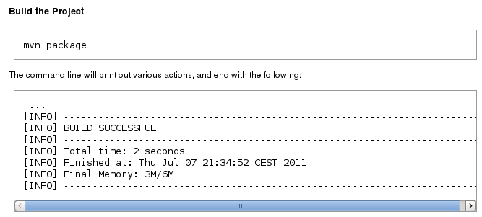
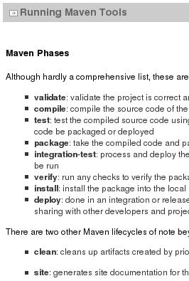
Build With Maven
Demo
Compile + test + jar …
Cf LifeCycle / Plugins Mojo

Slide 55
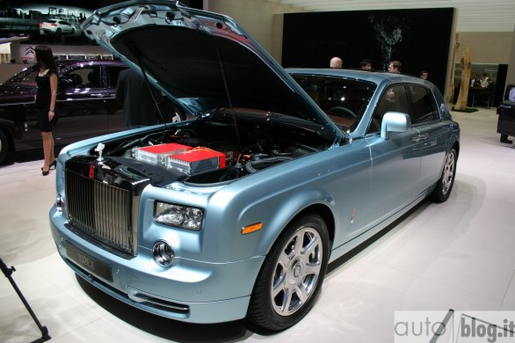
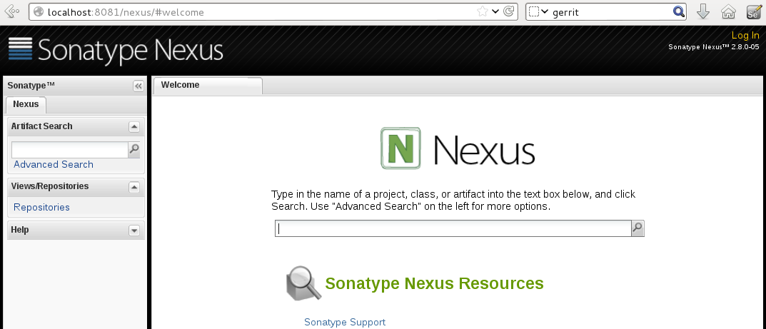
Download Dependencies ?
.. cf Nexus Repository
Maven
Nexus

Slide 56
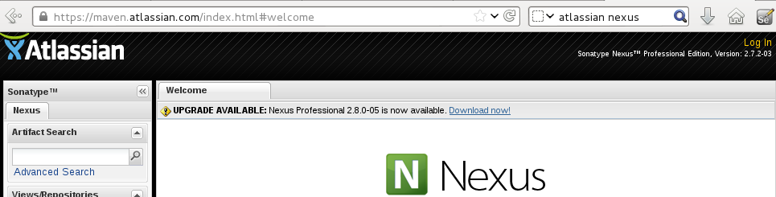
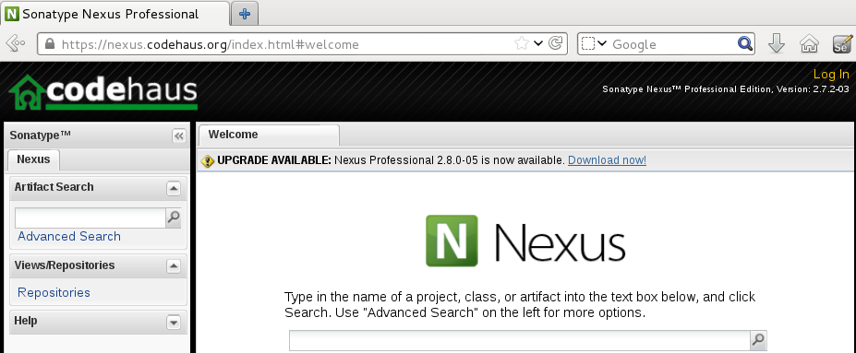
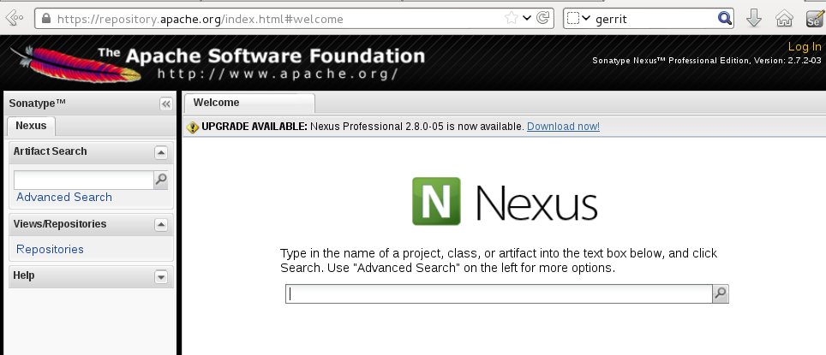
Public Repositories on Internet

Slide 57
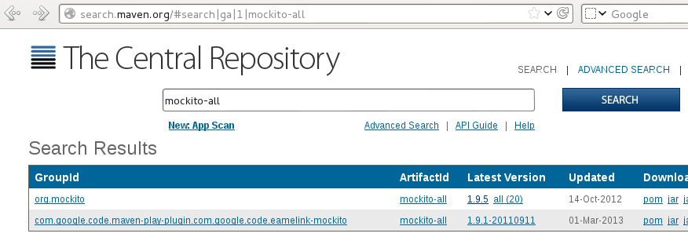
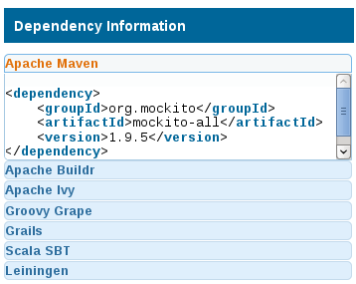

Search Maven Dependency
(Example : Mockito)
1
2
3
Demo
5
4

Slide 58

Add Dependency in Pom.xml
To Download … simply wait eclipse auto-build !!
Demo
Or “mvn install”

Slide 59





Maven
TRULY AWESOME … Industry Standard … MUST-HAVE
But Xml verbose...
Deprecated Alternatives
Compile.sh / compile.bat … with javac + jar, Makefile
ant
For C# … Msbuild +
Other Modern alternatives ?

Slide 60

Build Without Maven ? ...

Slide 61

Victory Celebration Pause
Maven – platform independent build
Questions so far ?

Slide 62
Victory Celebration Pause
Maven – platform independent build
What's next ?
Backup on usb key?
Share / email changes to colleagues ?
Apply changes
Questions so far ?

Slide 63
GIT – Source Code Mgt
Local Dev
Team Dev
Backup on usb key?
Share / email changes to colleagues ?
Apply changes
Git Commit
Git Push
Git Branch/Merge

Slide 64

1 minute GIT Demo
Demo

Slide 65


Start Git Server
1) Copy to ”Bare” repos
2) Start Simplest as possible server = (git:// protocol)
Demo
3) Clone on client

Slide 66



Commit – Push
Pull (fetch+merge)
1) Local commit
2) Push to Git server
Demo
3) Pull from other

Slide 67

Gerrit Code Review
NO Time for Demo Here !!
(Internet Access – OpenID) ??

Slide 68

Victory Celebration Pause
Maven – platform independent build
GIT Source Code Management
Questions so far ?

Slide 69
Victory Celebration Pause
Maven – platform independent build
GIT Source Code Management
What's next ?
Repeat Compile on every Commit
...
...

Slide 70

Local Dev Loop
FAST Part of Continuous Integration
Develop
Build + Test
(Agile Pulse)
Refactor
GIT Commit + Push
Pomodoro & Coffe-Time Break

Slide 71

Slow Parts Hidden ?
And Repetitions ?
GIT Commit + Push
Compile scripts, post-build scripts
Build / Test history
Email, Publish, Reports ...
Deliver To UAT..Prod from my PC

Slide 72

Continuously … 1000x
Type “mvn install” + email
+ archive tests + archive build
+ copy + start/stop... + …

Slide 73
Continuous Integration
Requirements : FASTER outer Loop
Develop
Build + Test
Refactor (Agile Pulse)
Whatever if Automated &
transparent to me ...
Whatever if Automated
& transparent to others

Slide 74

New Jenkins Maven Job
Demo
or..

Slide 75

Create First Job (1/3)
Demo
… fill : SCM + Build Trigger

Slide 76

Job > Conf > SCM
Demo

Slide 77






Job > Conf > Build Trigger
Demo
REQUIRED for automated build on commit ...

Slide 78

Conf > Maven + Steps
Demo

Slide 79


Relaunch Build Now
.. or Trigger on Commit
De
Mo ?

Slide 80


It Works ! Red → Blue
Demo
Build SUCCESS
Build FAILED
Job Disabled (view in dashboard)

Slide 81

Buid Result …
Junit Test Trend
Test added
0 +1
Details...
Test Error
+1 0
Unstable = Build OK... but Test Fail
Stable = Build + Test OK
Test OK
-1 0

Slide 82

Test Result History Details
Test in Failure
Since 6 builds
See in previous build

Slide 83


Test Result
Failure = +1
this build
Failure detail:
Log + assert
+ exception
Age=1 :
Test is NEW Failure

Slide 84




Dashboard Meteo Per Job
Demo
Last
Build
(binary value)
Average
Recent Builds
Range scale = Meteo clouds

Slide 85

Meteo Example
https://hudson.eclipse.org/hudson/
~25 visible
out of ~300

Slide 86

Another Meteo ?
https://builds.apache.org/
~25 visible
out of >= 1000

Slide 87

Victory Celebration Pause
Test
Develop
(Agile Pulse)
Refactor
GIT - Team work
Jenkins Automated Build
Questions So Far ?

Slide 88
Full Victory ??
Test
Develop
(Agile Pulse)
Refactor
GIT - Team work
Jenkins Automated Build
Integration Tests / Real Apps
Deliver to Envs : INT,UAT,TNH,PROD
DevOps / Monitoring

Slide 89

Creating a Real Java Web App
Objective : run a WebApp != HelloWorld
  on tomcat/jetty
  Using Standard Modern techno
  Spring + JPA + Eclipselink (on server-side)
  Whatever on client-side (jspx, GWT, json+Angular)
  Test .. Test … Test
Constraint: <= 3 minutes for Demo time!
Several alternatives … as “Wizards”

Slide 90




A WebApp in LESS Than 3 mn
http://start.spring.io/

Slide 91


ROO - Get Hands Dirty
hint
project --topLevelPackage com.foo
jpa setup --provider HIBERNATE --database HYPERSONIC_IN_MEMORY
entity jpa --class ~.Timer --testAutomatically
field string --fieldName message --notNull
web mvc setup
web mvc all --package ~.web
selenium test –controller ~.web.TimerController
Demo
ZOOM

Slide 92




Launching Roo WebApp
Create
Demo
List
Save .. redirect: View
View, Update, Delete

Slide 93
Forgot TDD Test Promises ?
TDD in Hello World
FAST dev env
maven build
Real WebApp
launched + test .. MANUALLY only !!
What's next ?
Do same with real JEE project... Tomcat,Spring
tackle complexity

Slide 94

Small < Medium < Big Tests
Integration Tests
Small Test : Real Unit Test
… using in memory (Mockito)
Medium Test : Integration Test with White Box
… (no real client / server, ex: Spring Junit)
Integration
Tests
Big Test : Integration Test with Black Box
… using Selenium + REAL server

Slide 95


HTTP Client Integration Test
(Medium test)
Demo

Slide 96

Launching *IT.java
Integration Test from Maven
Integration-test
*IT.java
Demo
Pre-integration-test
= start
Post-integration-test
= stop

Slide 97




Big Test – Real Browser
+ Selenium Record-Replay
Clue 1 … From ROO script
Clue 2 … From WebApp
Demo

Slide 98

Selenium Test
list count
before
Save new
list count
after
Assert +1
Demo

Slide 99



Selenium Test Exported in Java
export
Add dependency
Demo
Refactor test

Slide 100


Results Automated Test
Start + Test + Stop
Launch
Demo

Slide 101

Real Java WebApp
Integration Tests
Victory Celebration
Integration Tests / Real Apps
Questions so far ?

Slide 102
Real Java WebApp
Integration Tests
Victory Celebration
Integration Tests / Real Apps
next ?
Deliver to Envs : INT,UAT,TNH,PROD
DevOps / Monitoring

Slide 103
Workflow Reminder …
Dev → Integration → Delivery
Dev
Delivery
Int

Slide 104
XL Deploy (XebiaLabs (c) )

