Slide 1
Introduction to
BigData – Spark – Processing
Part 2: OnPrem to Cloud
Experience at SG
Arnaud Nauwynck
Oct 2022

Slide 2
Outline
What is BigData ?
  Order of Magnitudes for « Big »
  History
  Evolution of Softwares, Spark
Description of a Datalake
  Content, data feeding
  How it is organized
  Who uses it
Example of Data-Processing
  RAW to LAKE, Reports
Change Storage-Compute, Evolution to Cloud

Slide 3




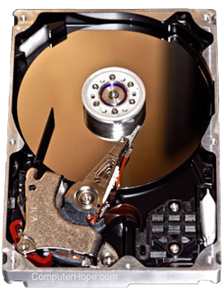

Fundamental Resources
TradeOffs
Network (Bandwith, Latency)
Development price / Run cost
€€€€€€$$$$$
Horyzontal Scale
CPU (HOT, Watts)
Cold Storage
(SLOW)
Storage (~Small)
RAM (FAST .. Expensive)

Slide 4
Historical Needs
Data Locality
Resource WERE Collocated for Speed :
1 Blade = few Disks + few CPU + RAM
PROS:
FAST local access
OS Caching for re-using same files
No need network shuffle when CO-LOCATING program on data
Disk managed by softwares
Easy plug

Slide 5
Software / Hardware Evolutions..
Hard Disks -> SSD Disks (not in OnPrem yet)
HDI,Sata… PCI. disk can now be fast
Example on Microsoft Azure: ONLY SSD Disks
Network bandwidth + Latency … now 1 Gb/s
=> Data Locality is NO MORE a requirement

Slide 6
HDFS FileSystem Full ?
Add more disk ?
At SG … HDFS was reaching dangerously the 80% threshold
Infra Department refuses to add more disks / IT to pay more
Purging data becomes a recurrent task
But not enough!
Several production incidents

Slide 7
HDFS Usage > 80% … SafeMode?
Example Chronology of an incident
Batching HBASE repartioning of Regions
Create intermediate temporary files … more than 40 Tera
In DEV OK.
In Prod … no 40 tera free at that time
DataNode above 80% self evict from cluster for maintenance error
HFS replicate data (of evicted nodes) to other nodes
more DataNodes self evict… Yarn queue is no more able to process batches
40% of computing power! Alert
=> Need purge + restart

Slide 8
HDFS Weakness = the central NameNode
>= 200 Millions of HDFS files
Each file metadata need to be in-memory, in NameNode
(~4k per file)
NameNode process in java, need Heap of >= 50 Go of RAM
Java garbage collector sometimes do « stop-the-world Full GC »
More than 2minute pause => Socket timeout
=> Failover to other NameNode => and again => and again

Slide 9
Not Enough Disk
… Too much/too Expensive « CPU »
Example at SG:
Cost reduction plans… to reduce datacenters
But still HUGE requirement to increase disk !!
Projects pretends they NEVER have enough cpu
BUT in reality … too much CPU/RAM => Wasting is easier than Optimizing
Not even AWARE of consuming / wasting

Slide 10


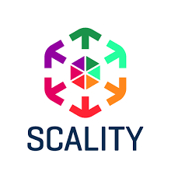
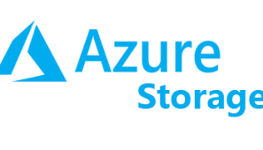
Splitting Storage / Compute
Solutions already existed, but historically not used in BigData Hadoop
Unix Network NFS
Disk SAN
ObjectStorage
(Appliance / API )
Cloud Storage
Example: Databases
For Oracle/PostgresQL/..
Example: Scality
Example:
Historically lot of
confidentiality constraints
… NOW used

Slide 11
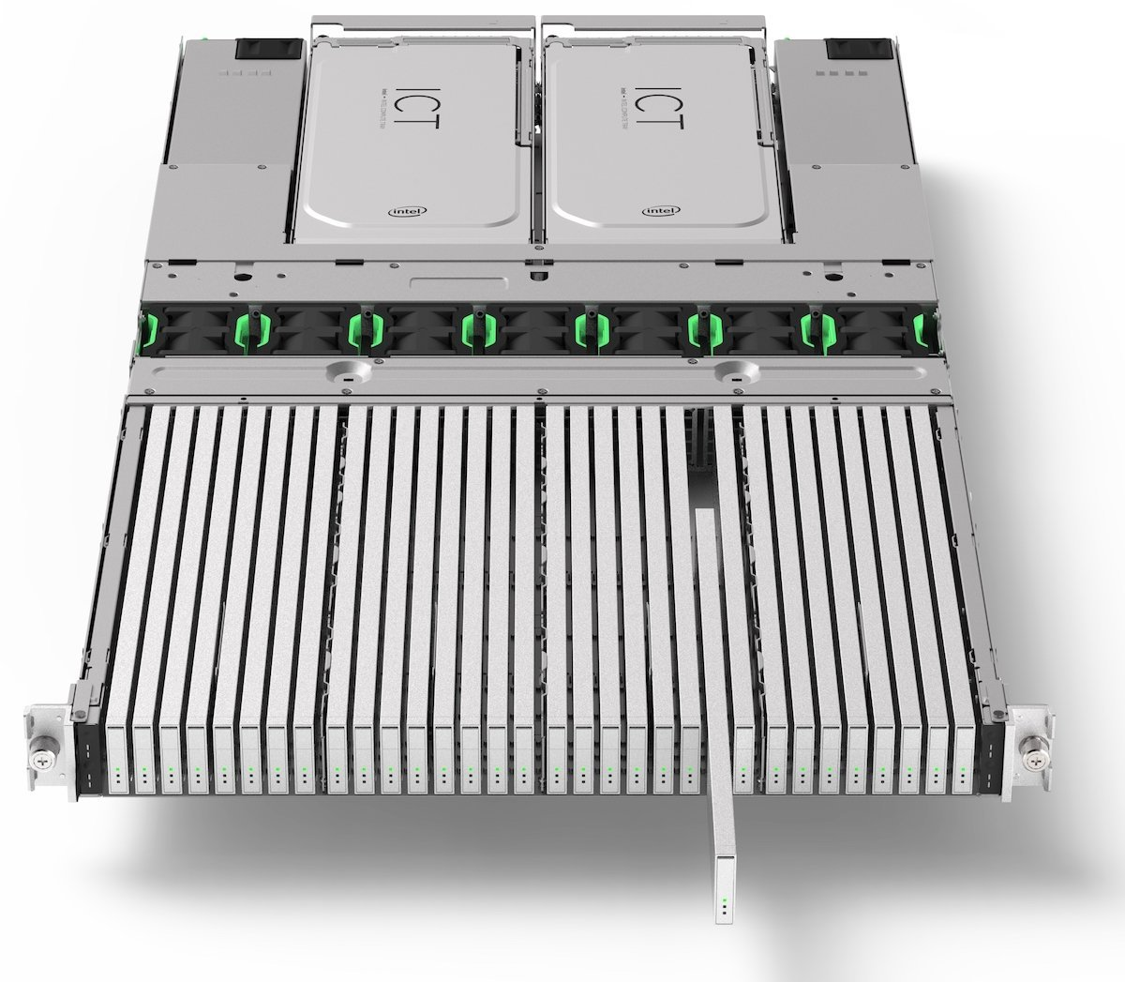
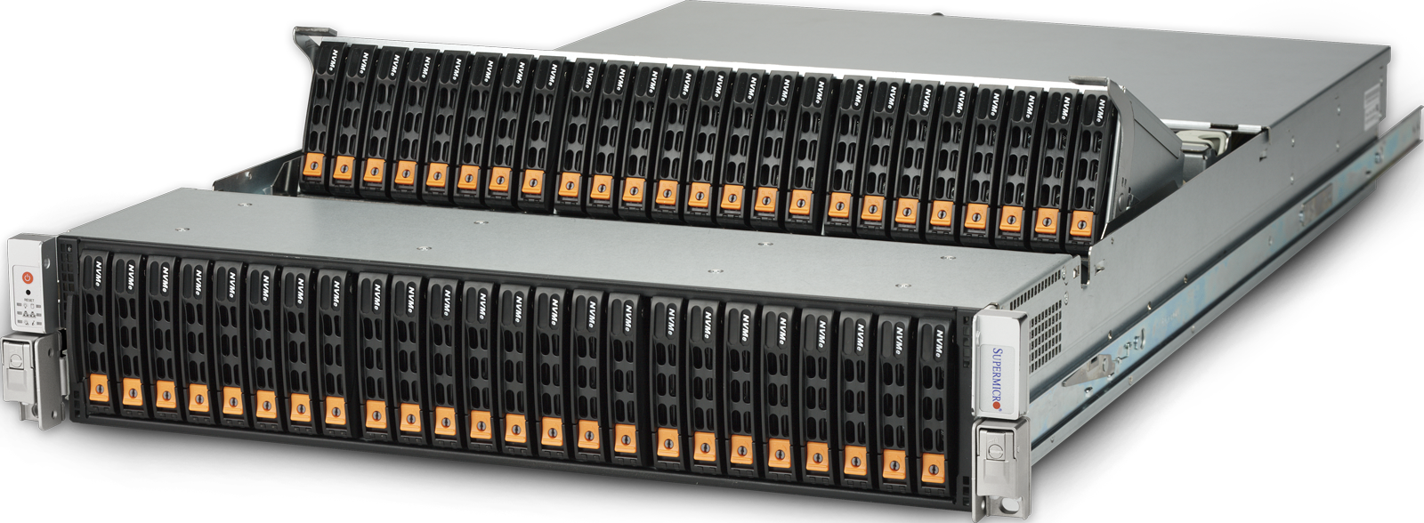
Data Density
48 * HDD disks in 2U blade
32 * SSD (E.1 EDSFF) in 1U blade
… 500 Tera / 1 Peta !! … 200 000 euros

Slide 12
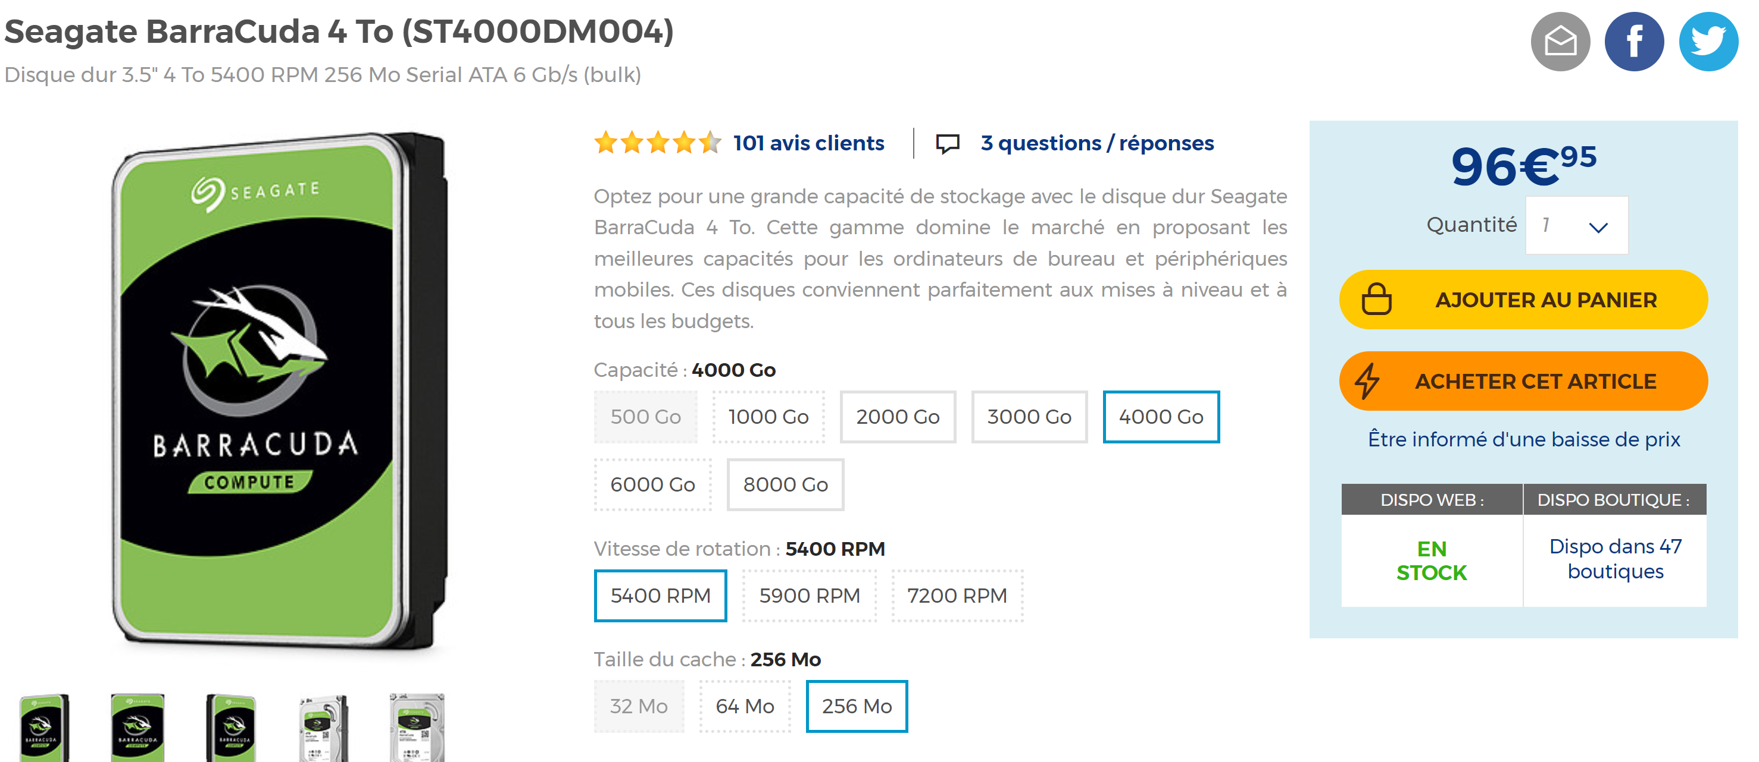
Storage Price
1 Disk 4To = 100 euros
x 10 … 40To
x 3 (replication) = 3000 euros
+ Plug + Maintenance + …
Appliance used …
License cost + Annual billing
.. Cost re-dispatched internally
= 17 000 euros for 40To/Year
Azure Cloud Storage
« Pay as You Go »
+ discount for reservations
= 7000 euros for 40To/Year
+ Costs per Read/Write Operations
+ Network Bandwidth

Slide 13
Migration to Cloud
Azure - AWS - Google
Goals:
Elasticity of Storage
(No more fear of HDFS FileSystem Full)
Elasticity of Compute
(adapt CPU to workload… Pay only what you use)
Clear visibility of cost per Projects / internal refacturation
By-Pass internal IT department
Easier (?) Self-Service API for Provisionning
No More Multi-tenant (no risk of 1 project crashing/consuming whole cluster)
Since 2020 SGCIB is moving its Datalake to Azure

Slide 14
Architecture of Datalake on Clouds
Azure Cloud
Azure Tenant
Intranet LAN
Firewall - Restrictions – BluePrint Rules - ..
HUB Network
/ Socks Proxy
Azure Subscription
(per project)
RAW Storage Account
Dedicated ExpressRoute
VM, AKS, HDI ..
VM, AKS, HDI ..
LAKE Storage Account
VM, AKS, HDI ..
VM, AKS, HDI ..

Slide 15
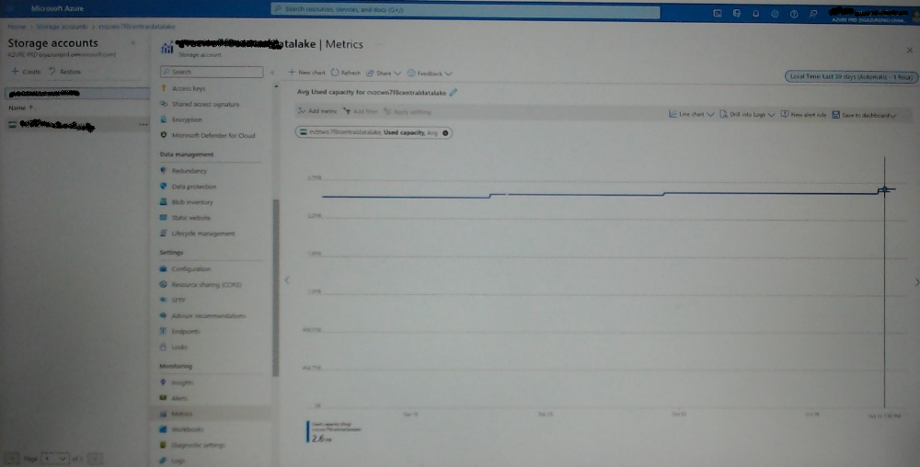
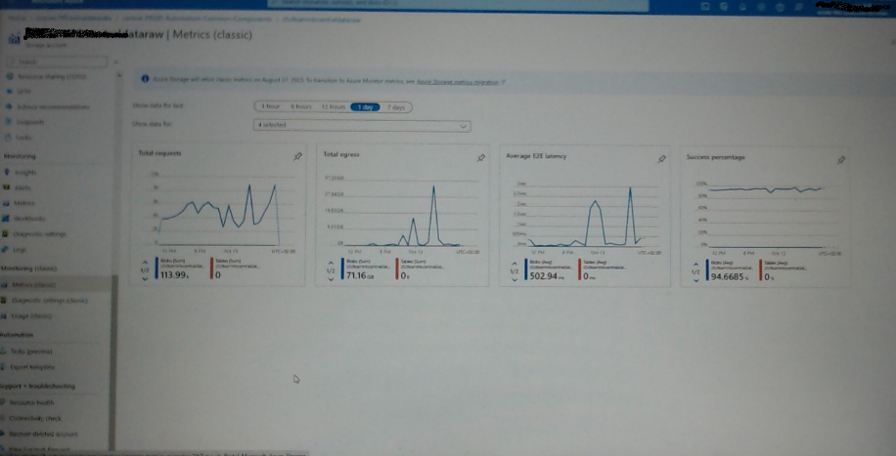
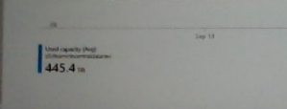
Screenshot Azure Storage
increasing
on last 30 days
2.6 Peta on LAKE …
+ 400 Tera on RAW + APP + …

Slide 16

HDInsight …
= HDP (HortonWorks) on Azure
Same HADOOP Ecosystem : Ambari, Yarn, Oozie, Spark, Zeppelin, …
Kerberos security… with Azure integration (Azure AD)
No More HDFS: No more NameNode maintenance / errors
replaced by « Azure Storage »
Elastic storage - but no more Ranger for permission

Slide 17
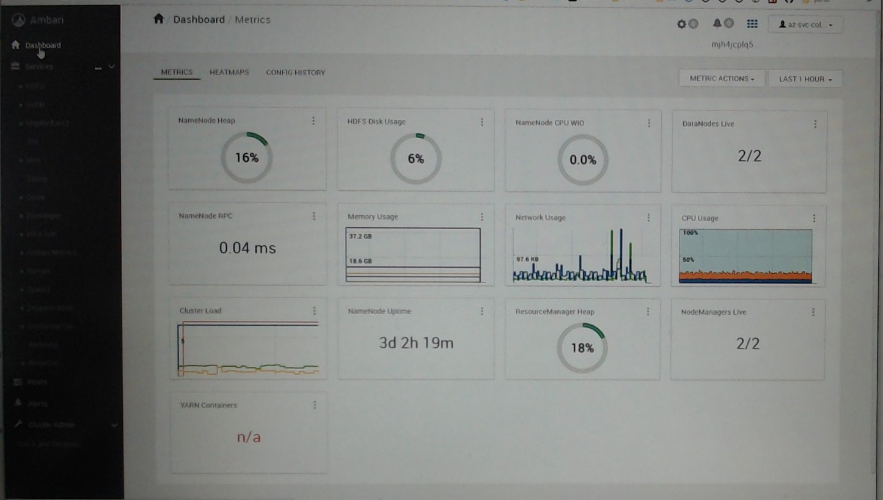
Screenshot HDI Ambari … ~Like OnPrem

Slide 18
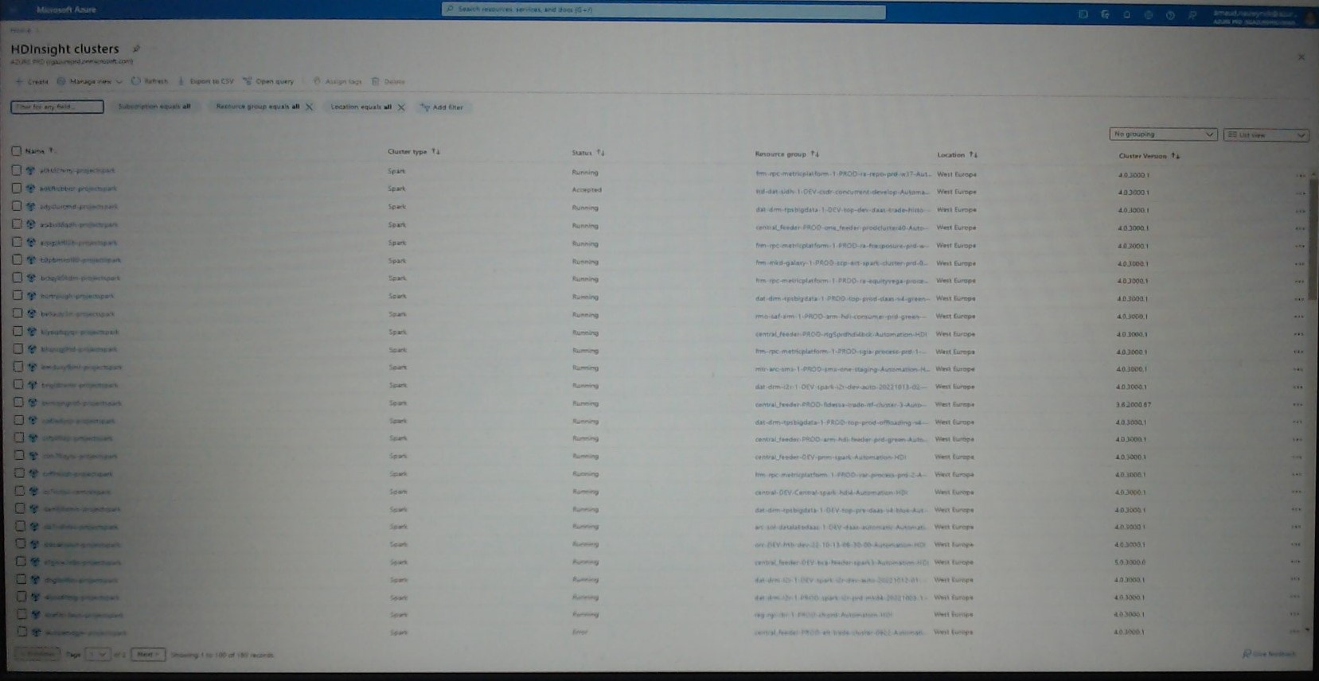
Screenshots
.. Hundreds of HDI

Slide 19
HDInsight Provisioning
After several week/monthes => cluster have errors
Need to stop/restart some services !!
Purge Log files
=> Need Un-provision + Reprovision cluster
+ Cluster are expensive, should be deleted ASAP when not used
Example of Cluster:
2 HeadNodes (mandatory) + 5 x D14 WorkerNodes = 10 000 euros/monthes
Problem: 1 hour to provision, >= 3% of provisionning errors

Slide 20
Azure Services At Scale …
No more unix Root Admin
Problems need Tickets, and can not be resolved internally
Security is THE Obsession … make things more difficult
example: impossible to provision HDInsight cluster without explicit white-listing Ips
Azure Portal / API blocked for security … Internal « sudo » APIs developped
Need to find workarounds
Collaboration with Microsoft… but not enough solutions
Some services do NOT scale as expected
Example: provisionning speed
Azure AD for millions of authentications per hours
File ACLs for billions of checks per hours

Slide 21
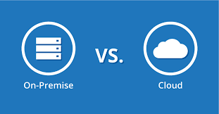
BigData Engineering from OnPrem to Azure
Lot of User permissions/quota management
Development of custom Yarn/Oozie/Ranger tools
1 Huge cluster, used as Multi-tenant (several users)
Used at 100%
Almost Disk-Full
Many report on disk usage / data purges
Clear view of all Running workloads
(1 Ambari screen)
Lot of Network & Security
Development of Provisionning « sudo » tools
NO more multi-tenant system… but LOT of small clusters
Hundred of clusters, each used at 5% !!!
COST COST COST
Necessity to Optimize Performance
( batches too long… 100x slower / too expensive)
No more Disk worry
… data is growing (no more purges?)
NO admin central view
NO Orchestration of workloads

Slide 22




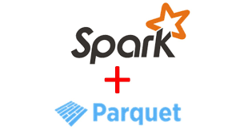

What About Spark in Azure Migration?
COST COST COST
Necessity to Optimize Performance
( batches too long… 100x slower / too expensive)
=> Many projects have
migrated + optimized
+ UDF
+
Optimized Spark
Reduced memory + Cluster sizes

Slide 23
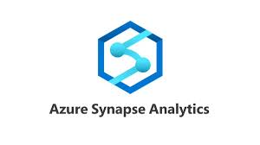

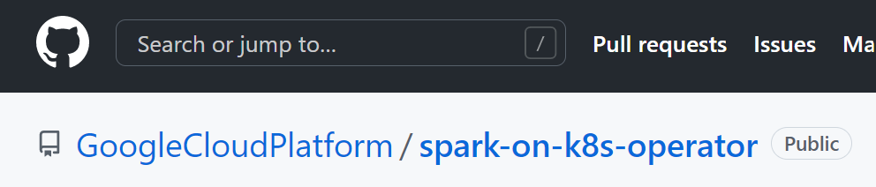

Managed Spark ?
Goals: Autoscaling / « serverless »
Managed by Azure :
Managed via Kubernetes
databricks
AWS : EMR
GCP : BigQuery

Slide 24
Questions?

Slide 25
Take Away
What is BigData ? Horyzontal Scaling
compute: cluster with Tera of RAM used by Spark apps
storage: Petas of Files, in parquet
What is Spark ?
Simple unified Sql/Java engine
for distributed compute (Yarn/Kube)
distributed storage (HDFS/cloud)
What is Processing ?
mostly spark batches
Feeding RAW
Transforming RAW to LAKE
Consuming SQL analytics
Hadoop ecosystem is complex, Spark brings simplicity
Ecosystem is evolving (Cloud, Kubernetes)

