Slide 1
Security - Hands-On 3 springboot credential configuration
(Jasypt, spring cloud, Vault)
Esilv 2025
arnaud.nauwynck@gmail.com

Slide 2
Using Jasypt springboot to encrypt configuration properties

Slide 3
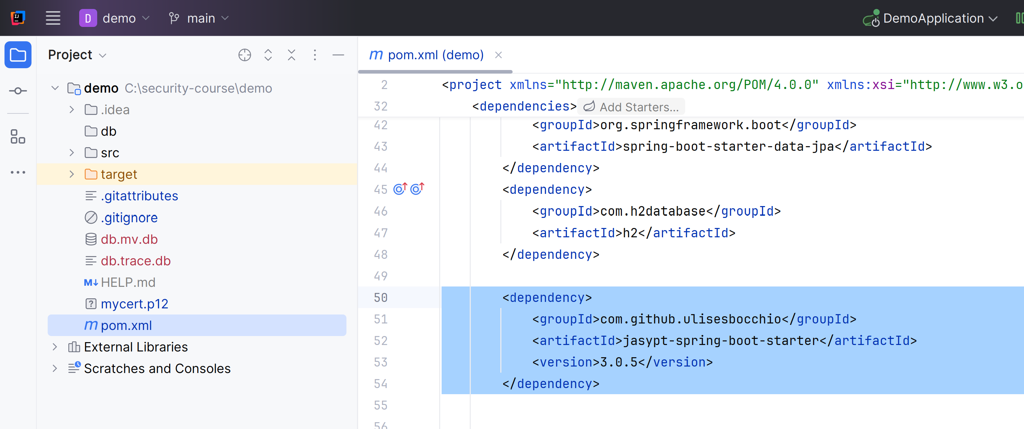

Jasypt [1/7] : adding maven pom.xml dependency
<dependency>
<groupId>com.github.ulisesbocchio</groupId>
<artifactId>jasypt-spring-boot-starter</artifactId>
<version>3.0.5</version>
</dependency>
edit pom.xml, add in <dependencies>..
then click on Refresh maven

Slide 4
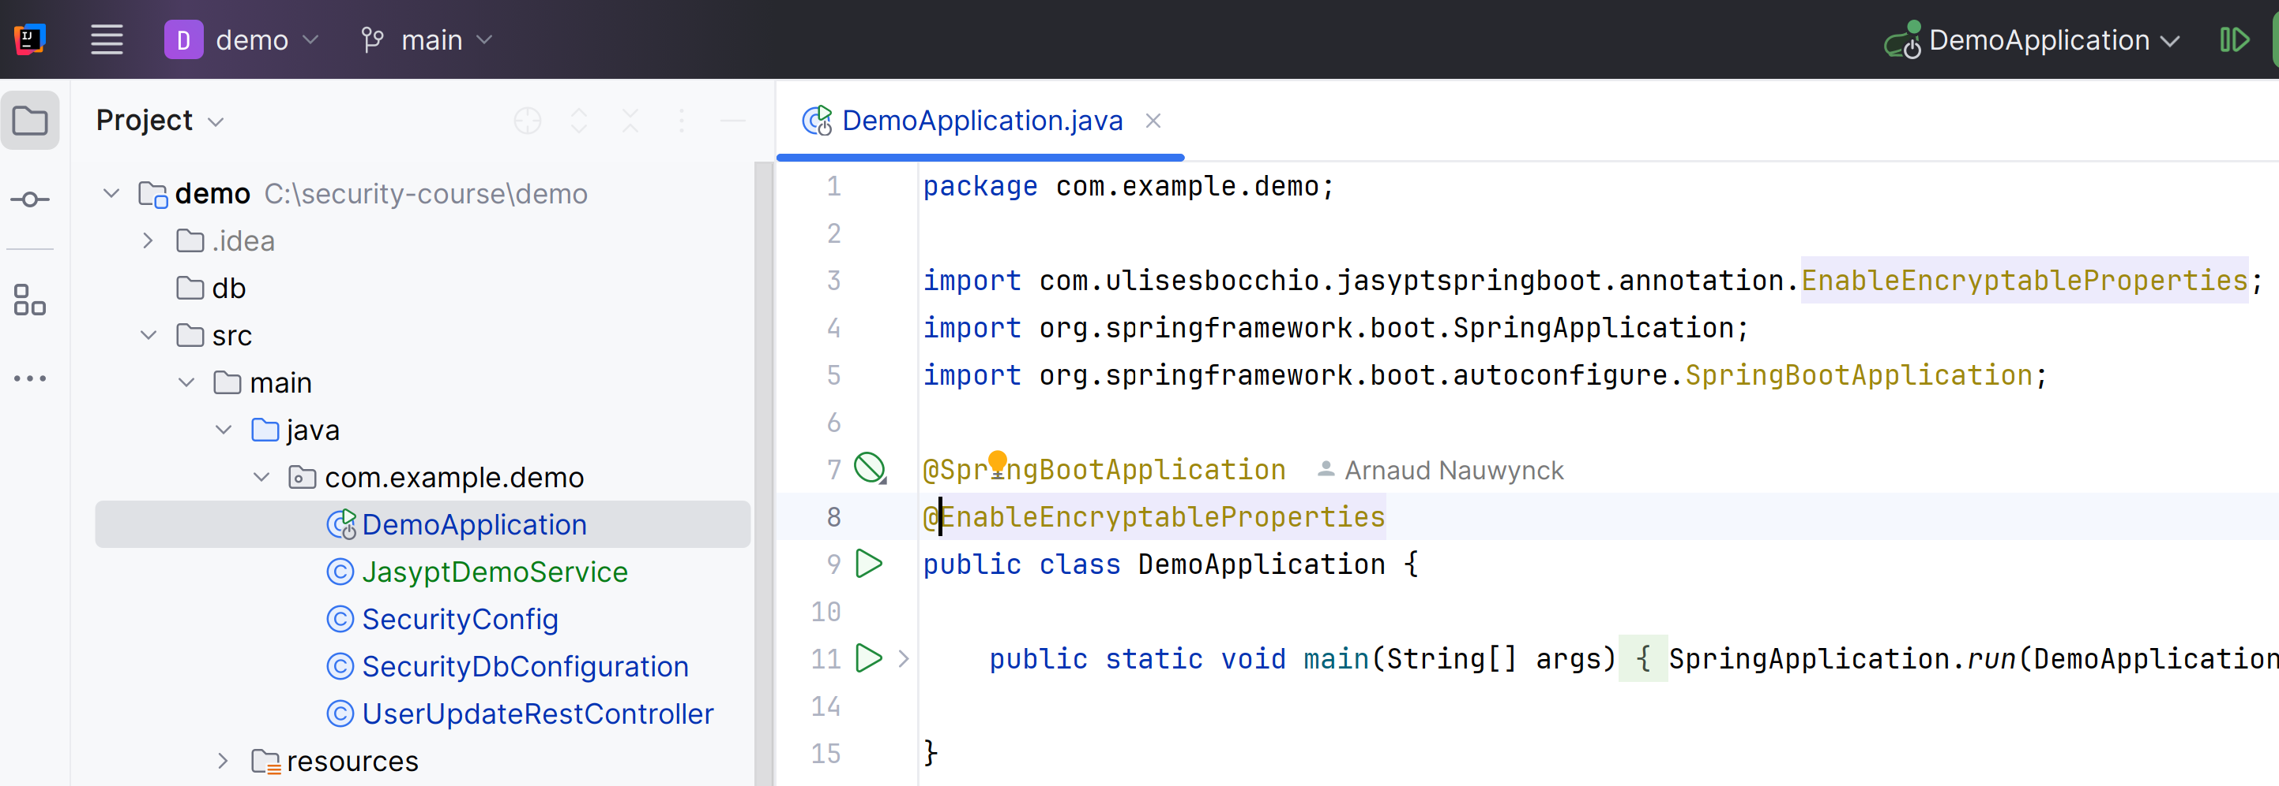
Jasypt [2/7] : Configure App to use EncryptableProperties
add
@EnableEncryptableProperties
to your app (on a the class main @SpringBootApplicatino or on any @Configuration class)

Slide 5
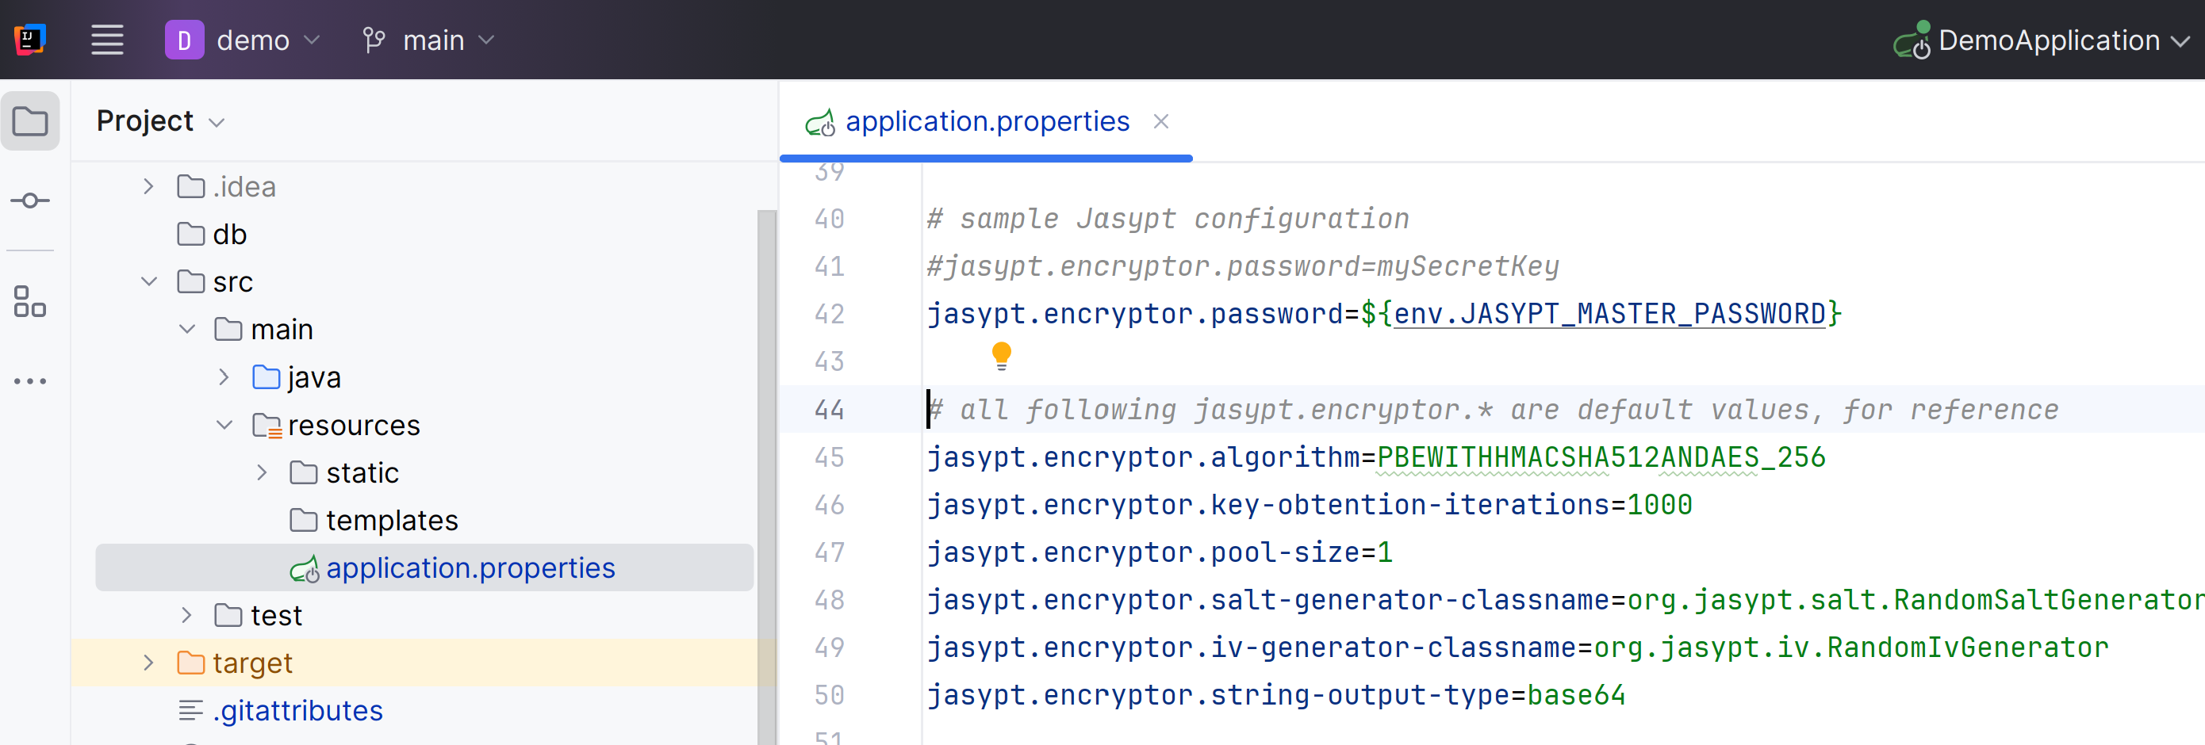
Jasypt [3/7] : default config of Jasypt Encryptor in application.properties
# all following jasypt.encryptor.* are default values, for reference
jasypt.encryptor.algorithm=PBEWITHHMACSHA512ANDAES_256
jasypt.encryptor.key-obtention-iterations=1000
jasypt.encryptor.pool-size=1
jasypt.encryptor.salt-generator-classname=org.jasypt.salt.RandomSaltGenerator
jasypt.encryptor.iv-generator-classname=org.jasypt.iv.RandomIvGenerator
jasypt.encryptor.string-output-type=base64
edit file
src/main/resources/application.properties

Slide 6
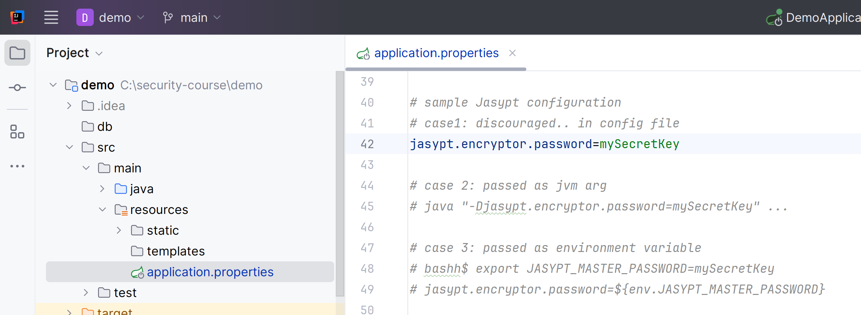
Jasypt [4/7] case 1: simpler
(but not recommended) add jasypt encryptor password in configuration file

Slide 7
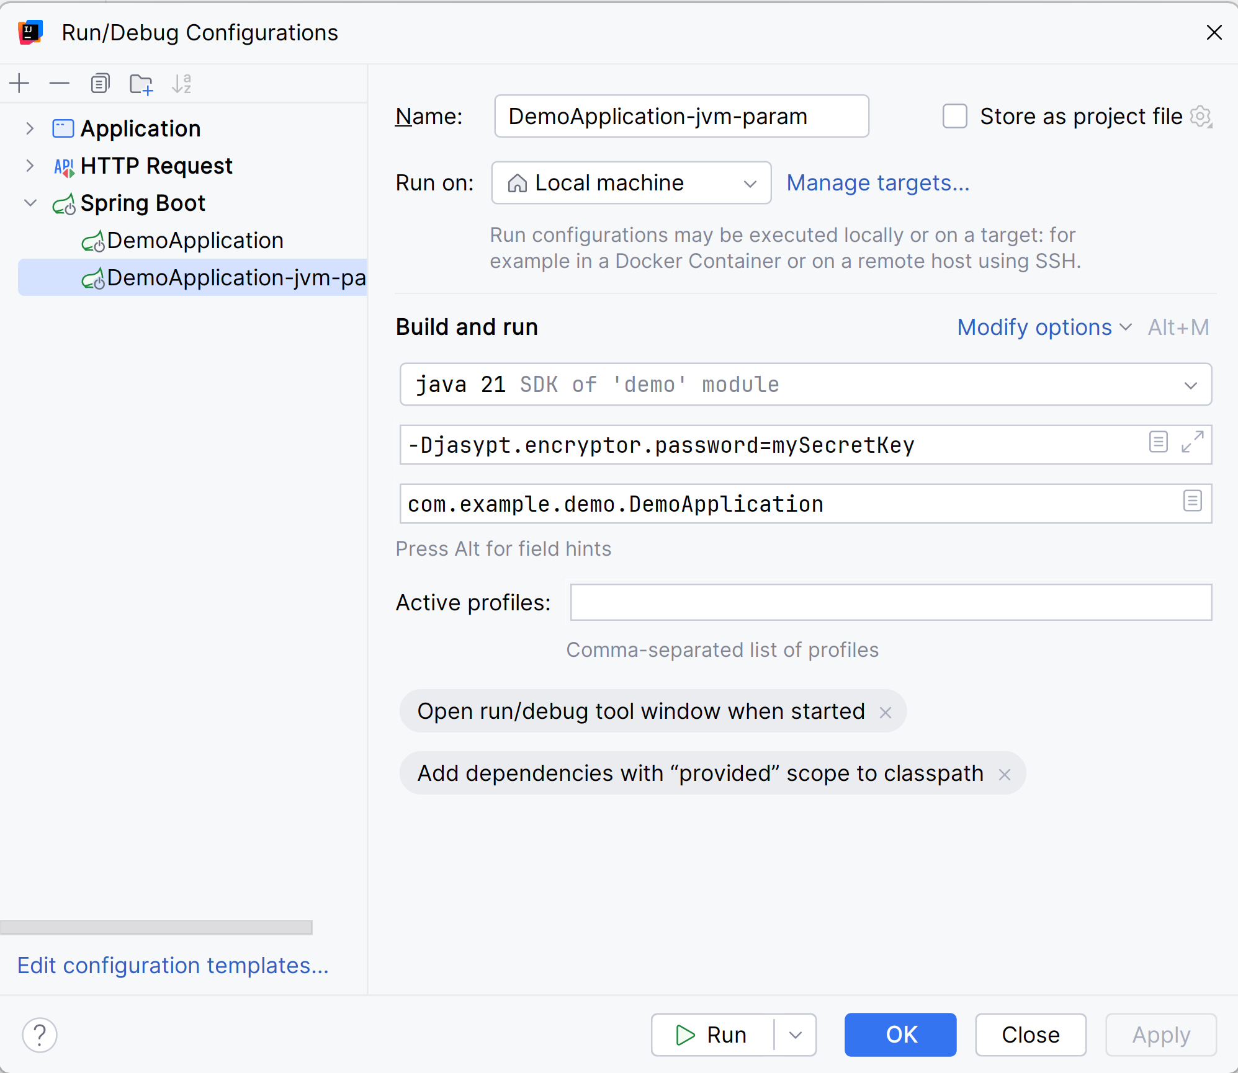
(Optionnal) Jasypt [4/7] case 2: with JVM param
-Djasypt.encryptor.password=...

Slide 8
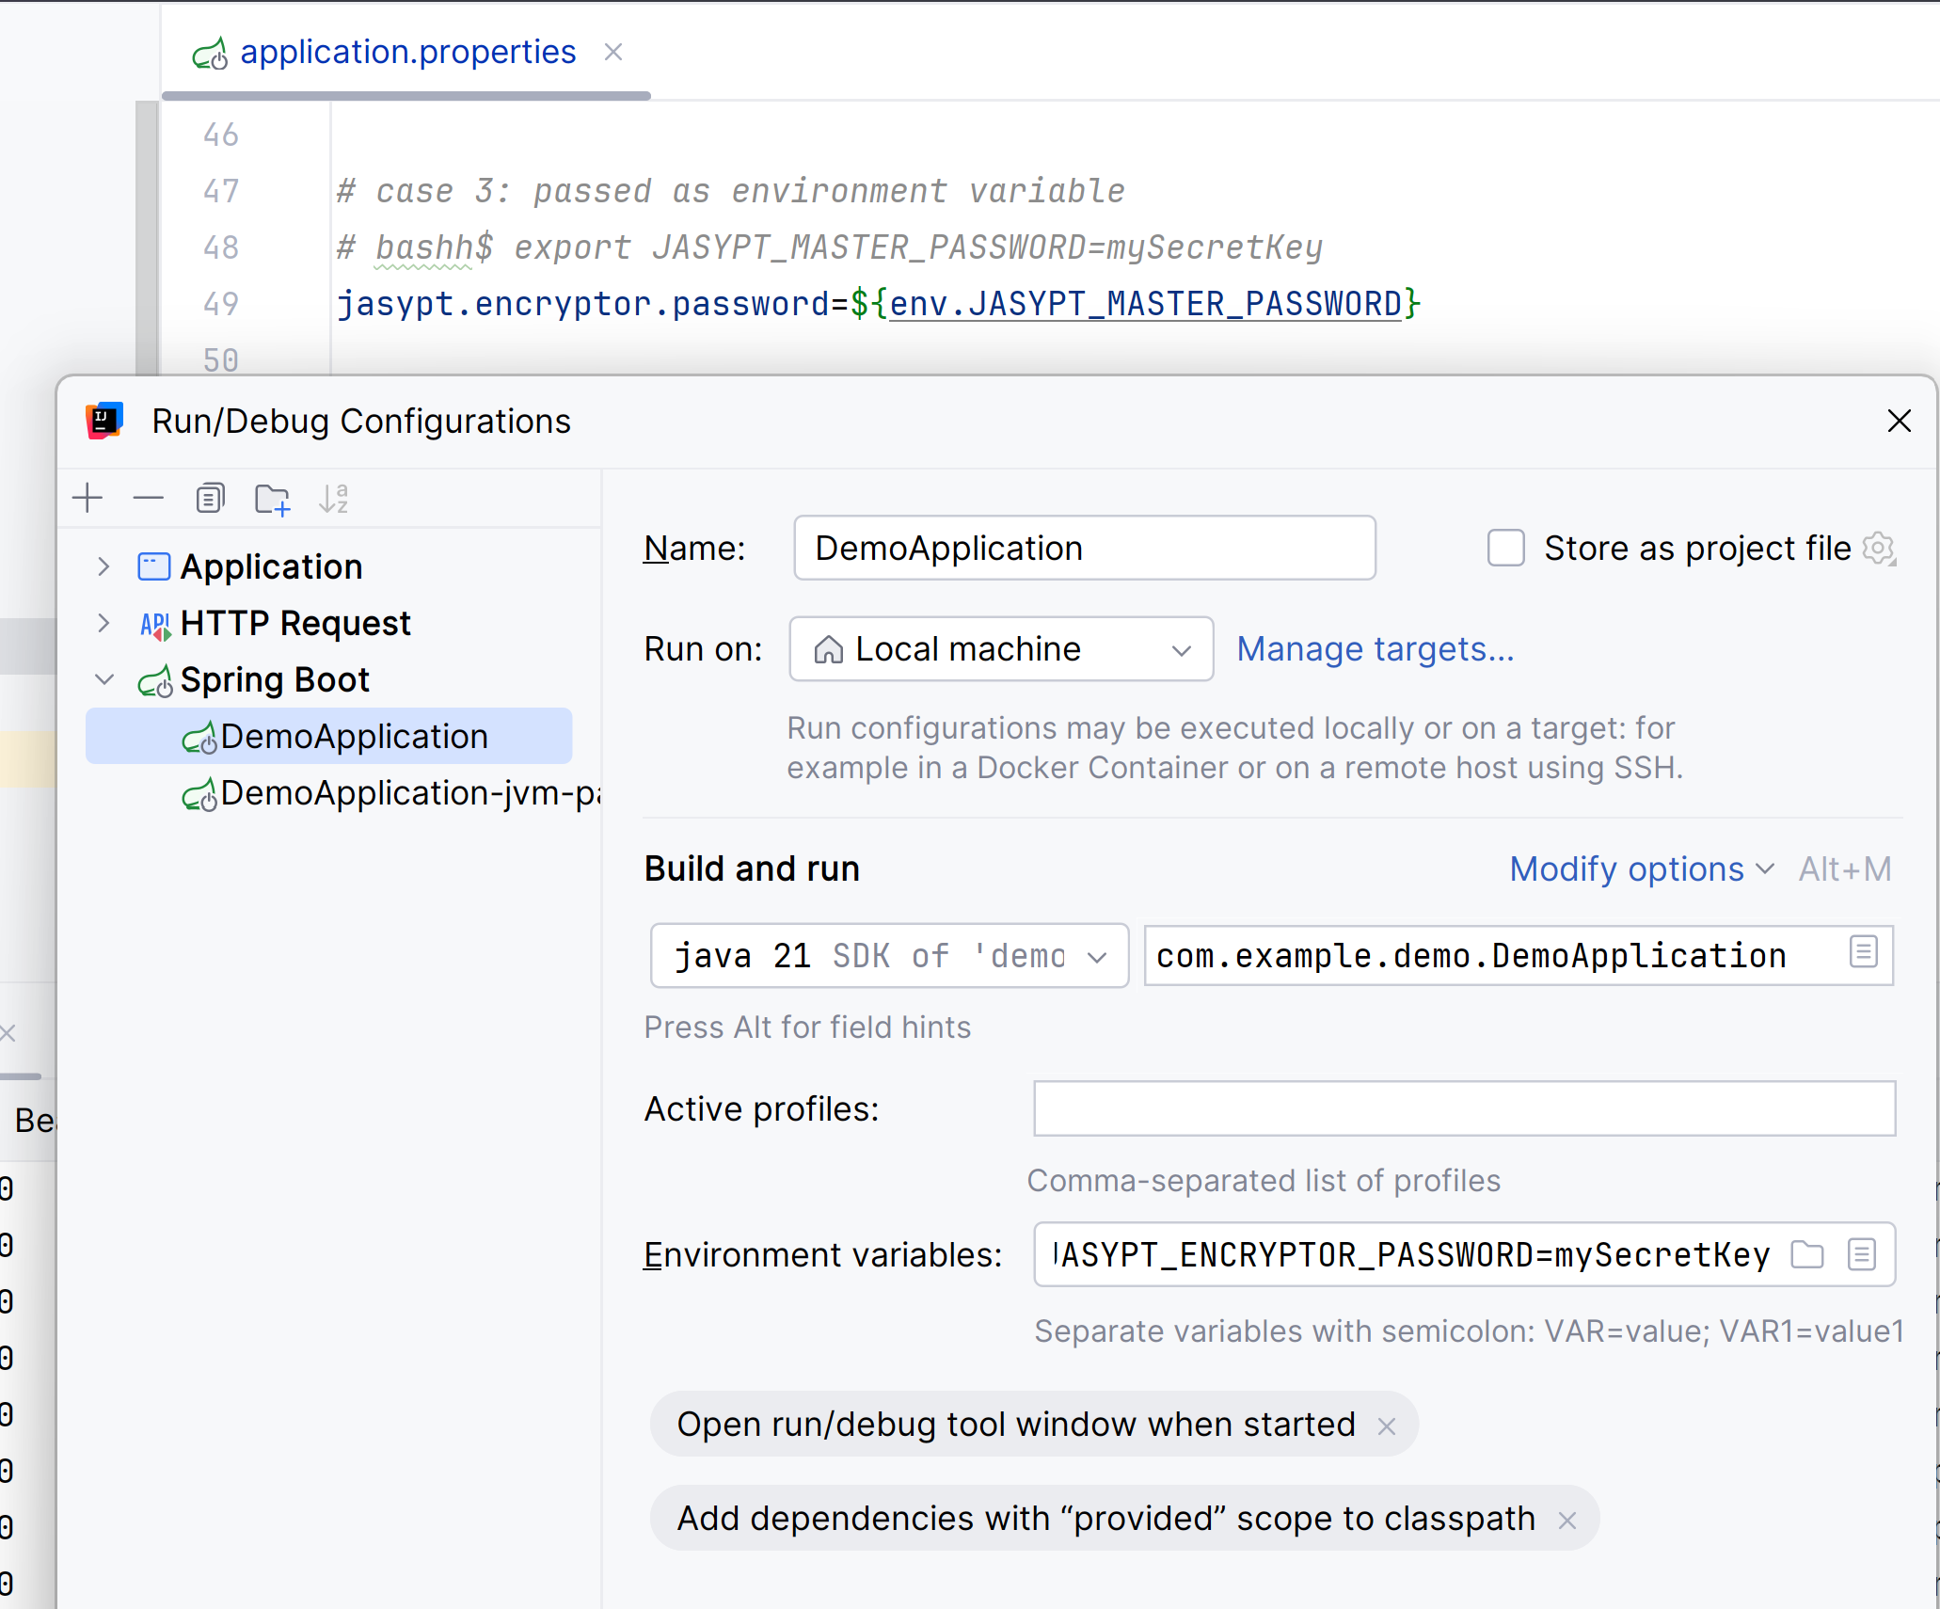
(Optionnal) Jasypt [4/7] case 3: with ENVIRONMENT variable + conf

Slide 9
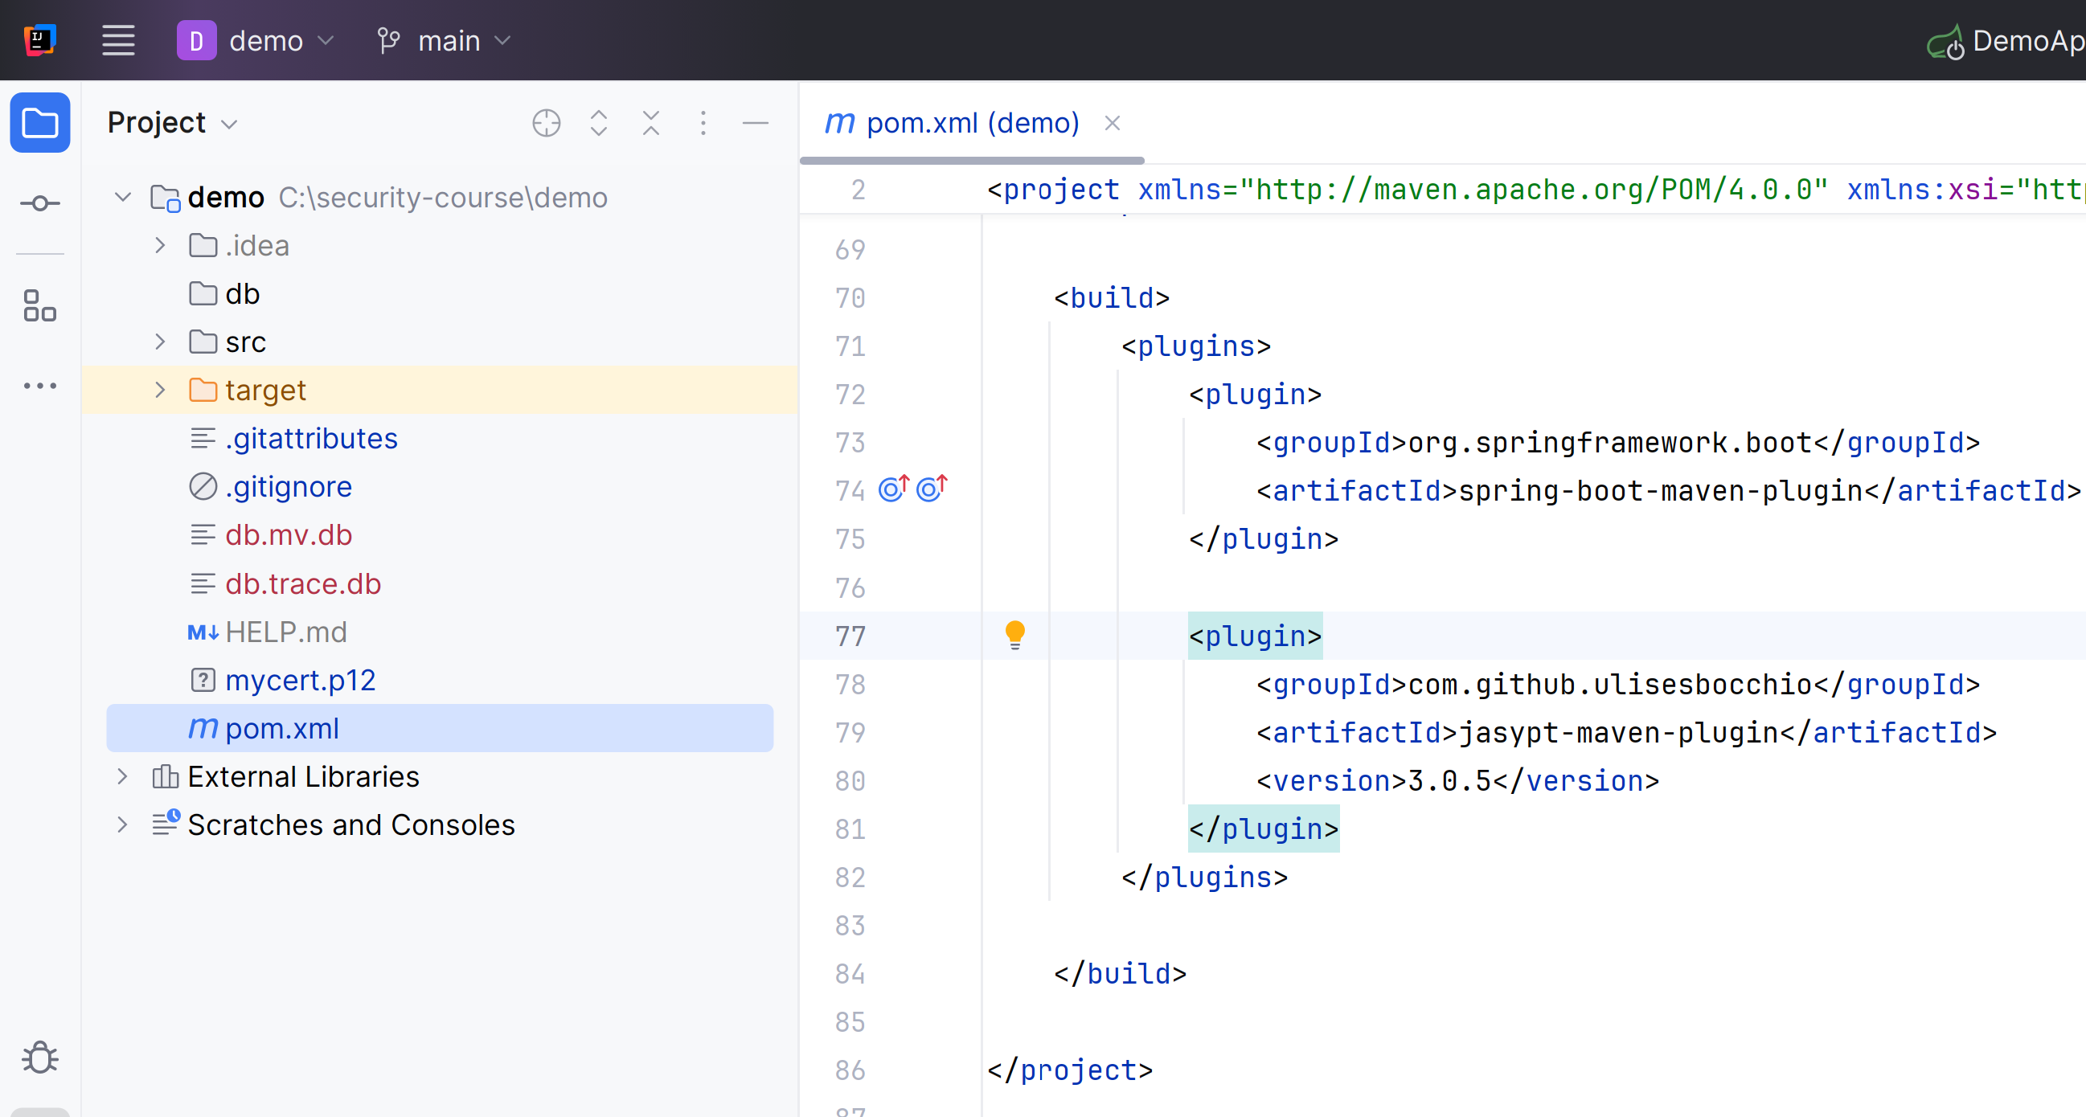
Jasypt [6/7] : compute the encryption of a secret value
<plugin>
<groupId>com.github.ulisesbocchio</groupId>
<artifactId>jasypt-maven-plugin</artifactId>
<version>3.0.5</version>
</plugin>
Could use directly "java -jar jasypt.jar .."
but would need to download manually
=> Simpler to use a maven plugin,
edit file pom.xml <build><plugins> ...

Slide 10
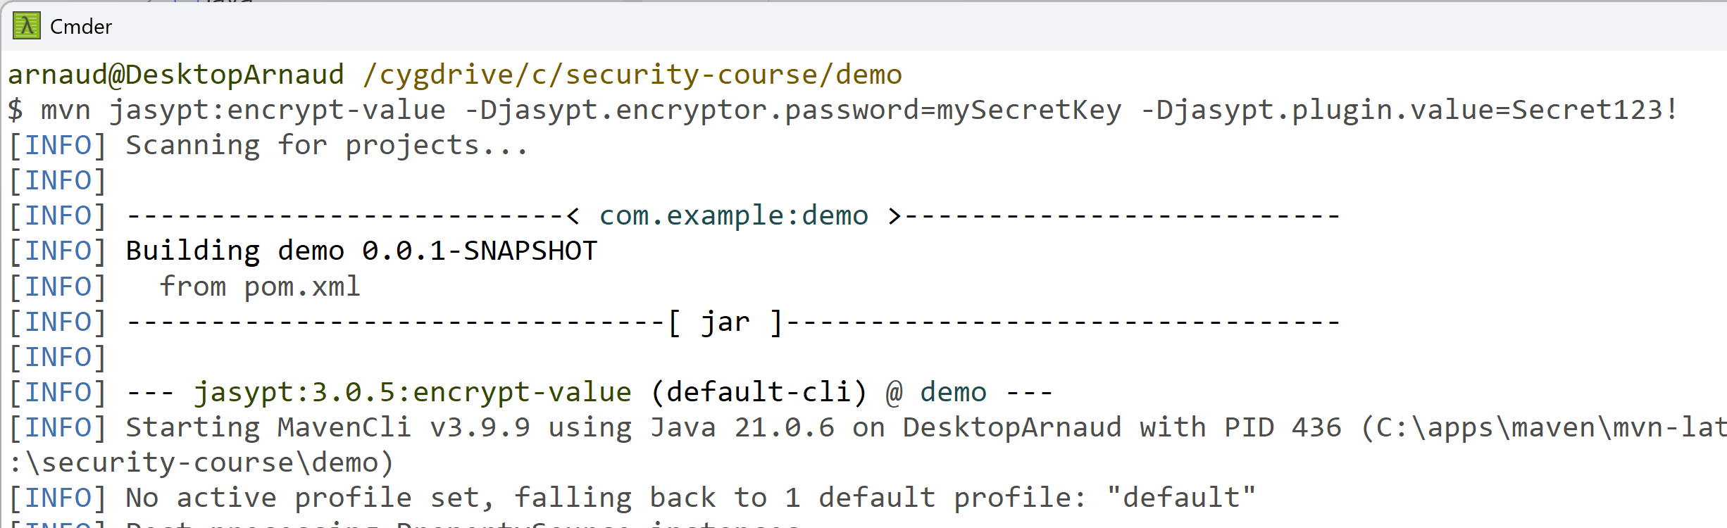
Jasypt [6/7] : compute the encryption of a secret value
open windows 'cmd' ... need to have maven downloaded and in %PATH% environment variable
mvn jasypt:encrypt-value -Djasypt.encryptor.password=mySecretKey -Djasypt.plugin.value=Secret123!

Slide 11
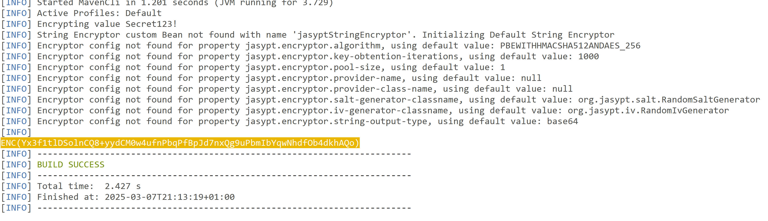
Jasypt [6/7] : compute the encryption of a secret value

Slide 12
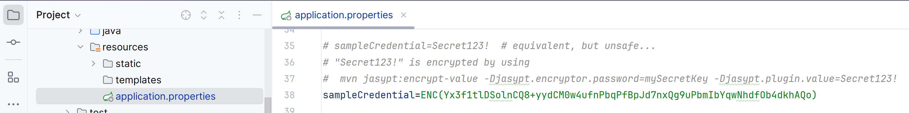
Jasypt [6/7] : add encrypted value in application.properties
edit src/main/resources/application.properties
sampleCredential=ENC(Yx3f1tlDSolnCQ8+yydCM0w4ufnPbqPfBpJd7nxQg9uPbmIbYqwNhdfOb4dkhAQo)
NOTICE: because of random Salting, every re-generation will get a different value

Slide 13
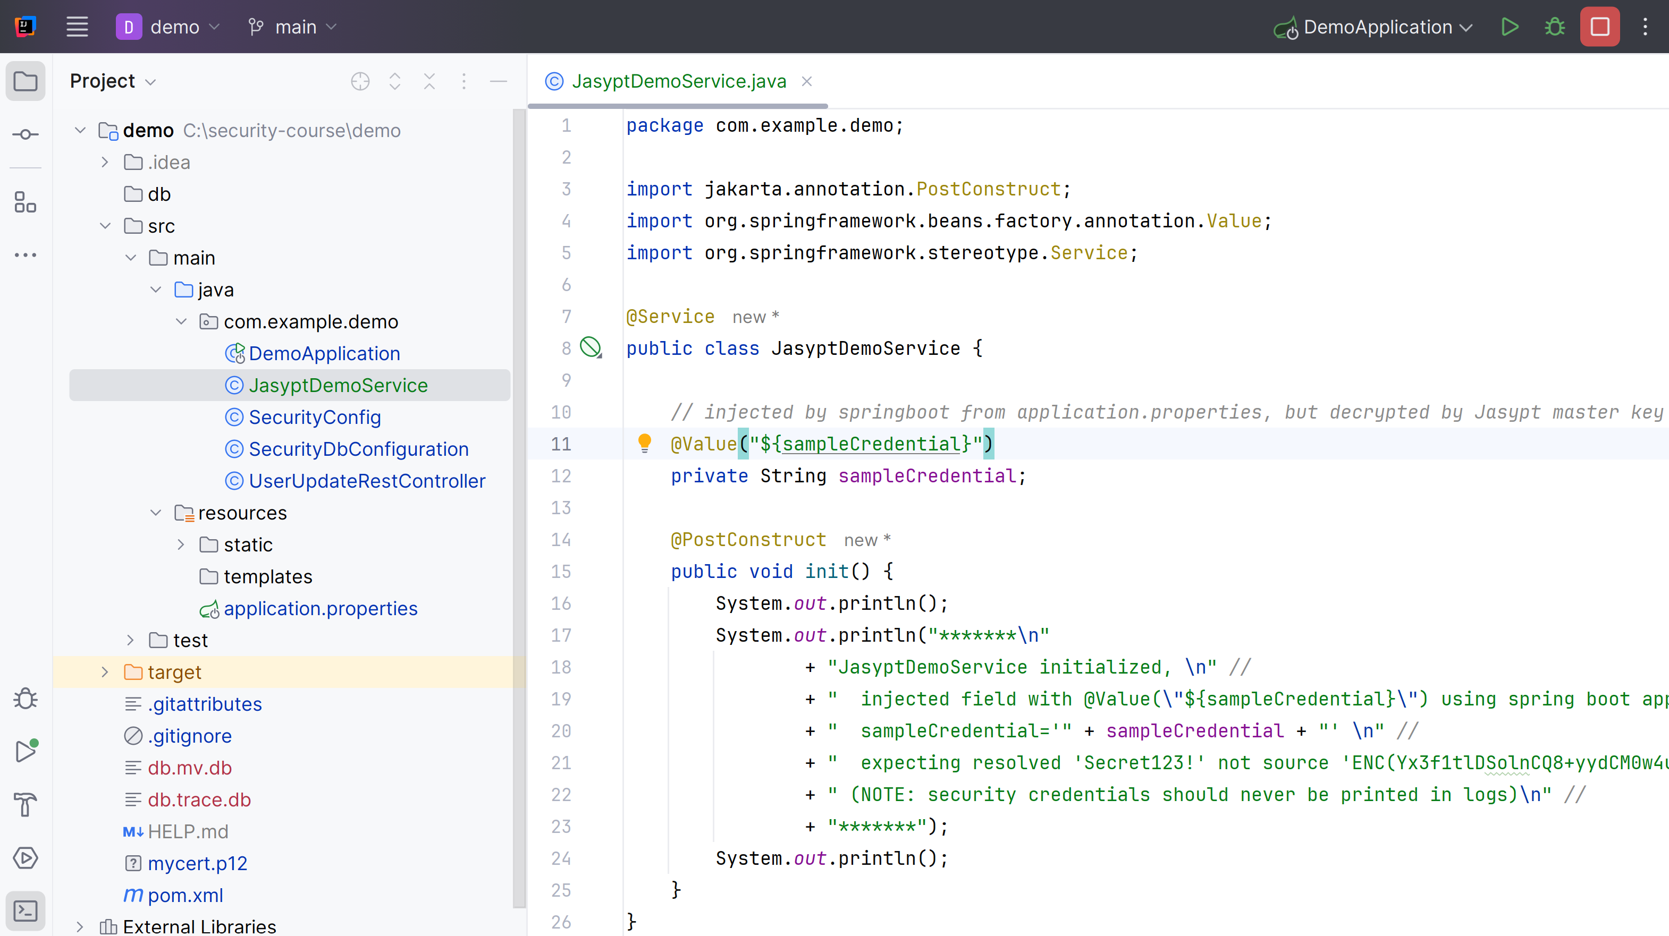
Jasypt [7/7] :use injected value in java code
package com.example.demo;
import jakarta.annotation.PostConstruct;
import org.springframework.beans.factory.annotation.Value;
import org.springframework.stereotype.Service;
@Service
public class JasyptDemoService {
// injected by springboot from application.properties, but decrypted by Jasypt master key
@Value("${sampleCredential}")
private String sampleCredential;
@PostConstruct
public void init() {
System.out.println();
System.out.println("*******\n"
+ "JasyptDemoService initialized, \n" //
+ " injected field with @Value(\"${sampleCredential}\") using spring boot application.properties \n" //
+ " sampleCredential='" + sampleCredential + "' \n" //
+ " expecting resolved 'Secret123!' not source 'ENC(Yx3f1tlDSolnCQ8+yydCM0w4ufnPbqPfBpJd7nxQg9uPbmIbYqwNhdfOb4dkhAQo)' \n" //
+ " (NOTE: security credentials should never be printed in logs)\n" //
+ "*******");
System.out.println();
}
}
add new java class JasyptDemoService

Slide 14
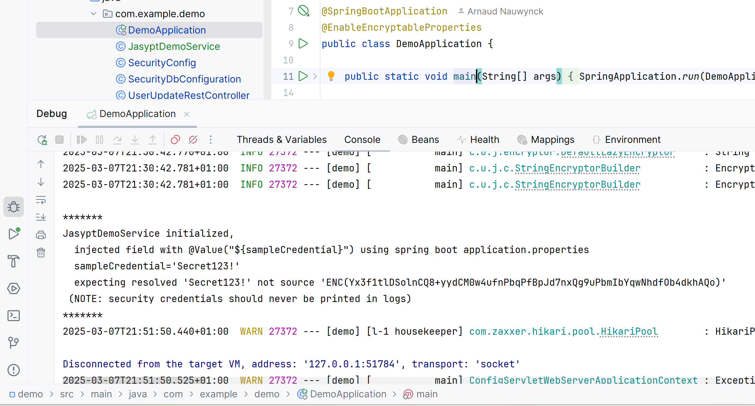
Jasypt [7/7]: Run see startup logs

Slide 15
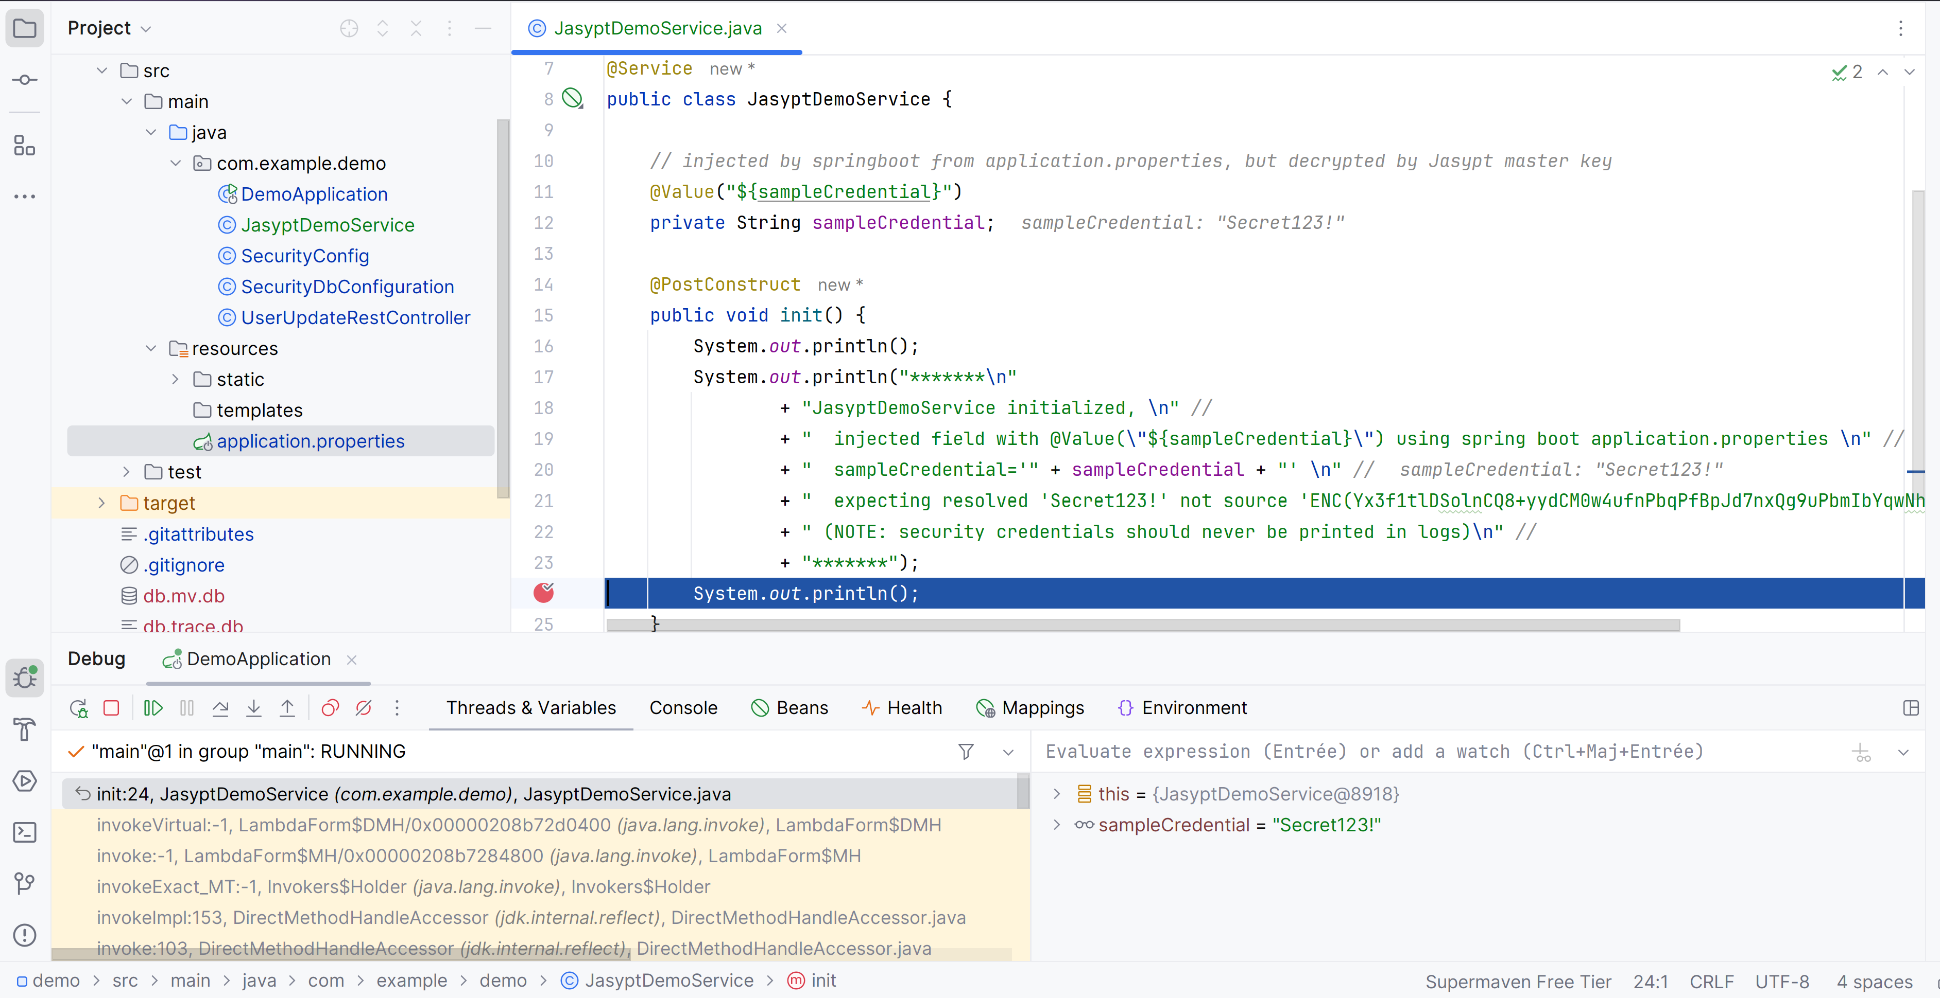
Jasypt [7/7]: Debug with Breakpoint
(debug as you should never print credential in logs!)

Slide 16
Using Hashicorp Vault

Slide 17
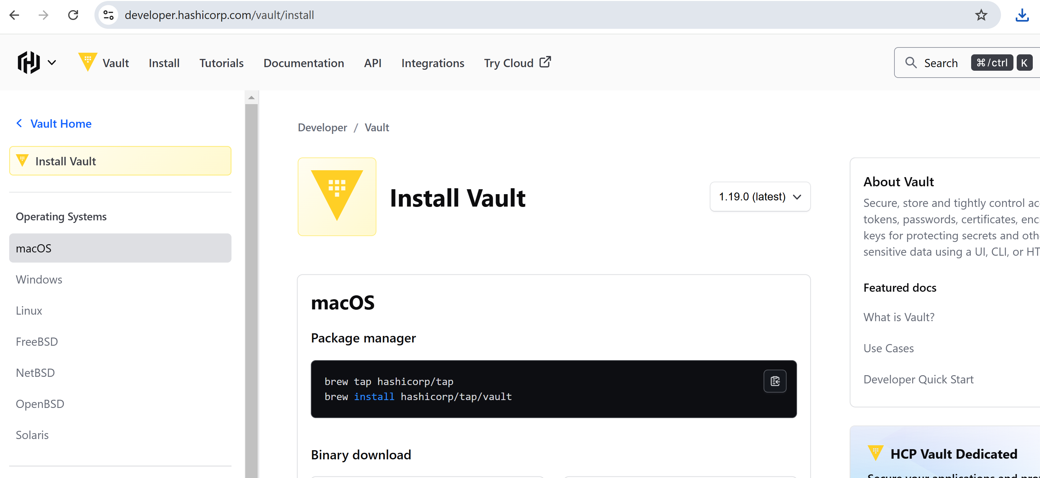
Download + Unzip Hashicorp Vault
https://developer.hashicorp.com/vault/install

Slide 18
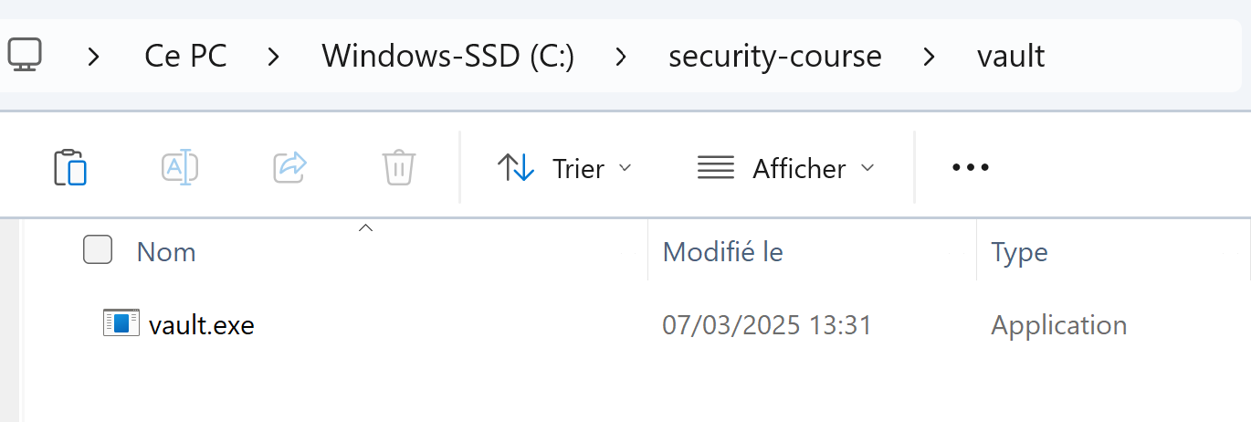
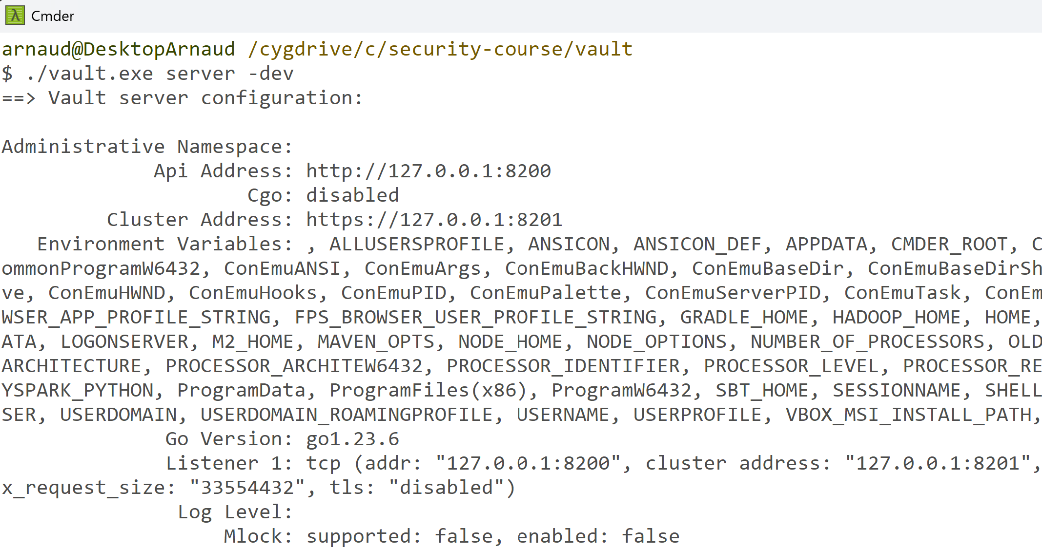
Run in "-dev " mode
C:\security-course\vault> vault.exe server -dev

Slide 19
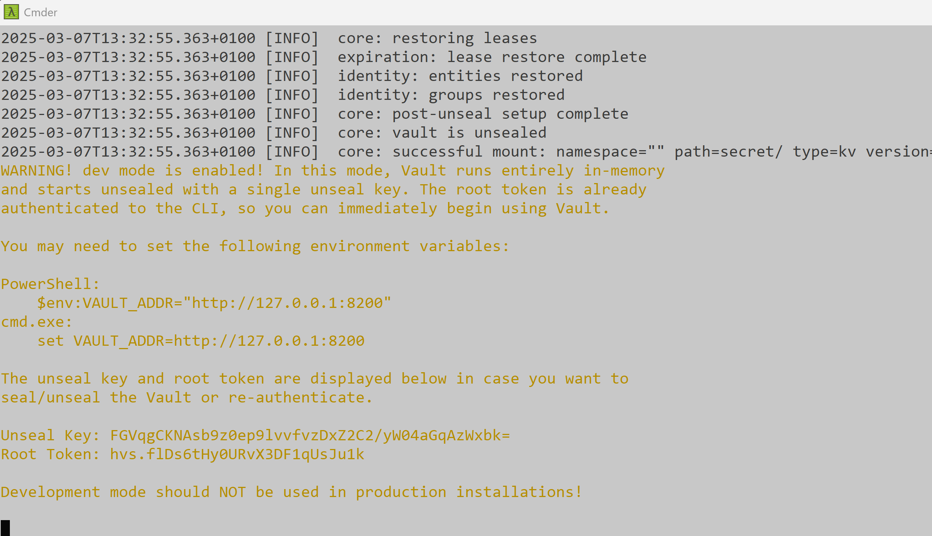
See console log root "token"
( NOTICE: "-dev" = in-memory only, no secrets saved... and token regenerated at startup)

Slide 20
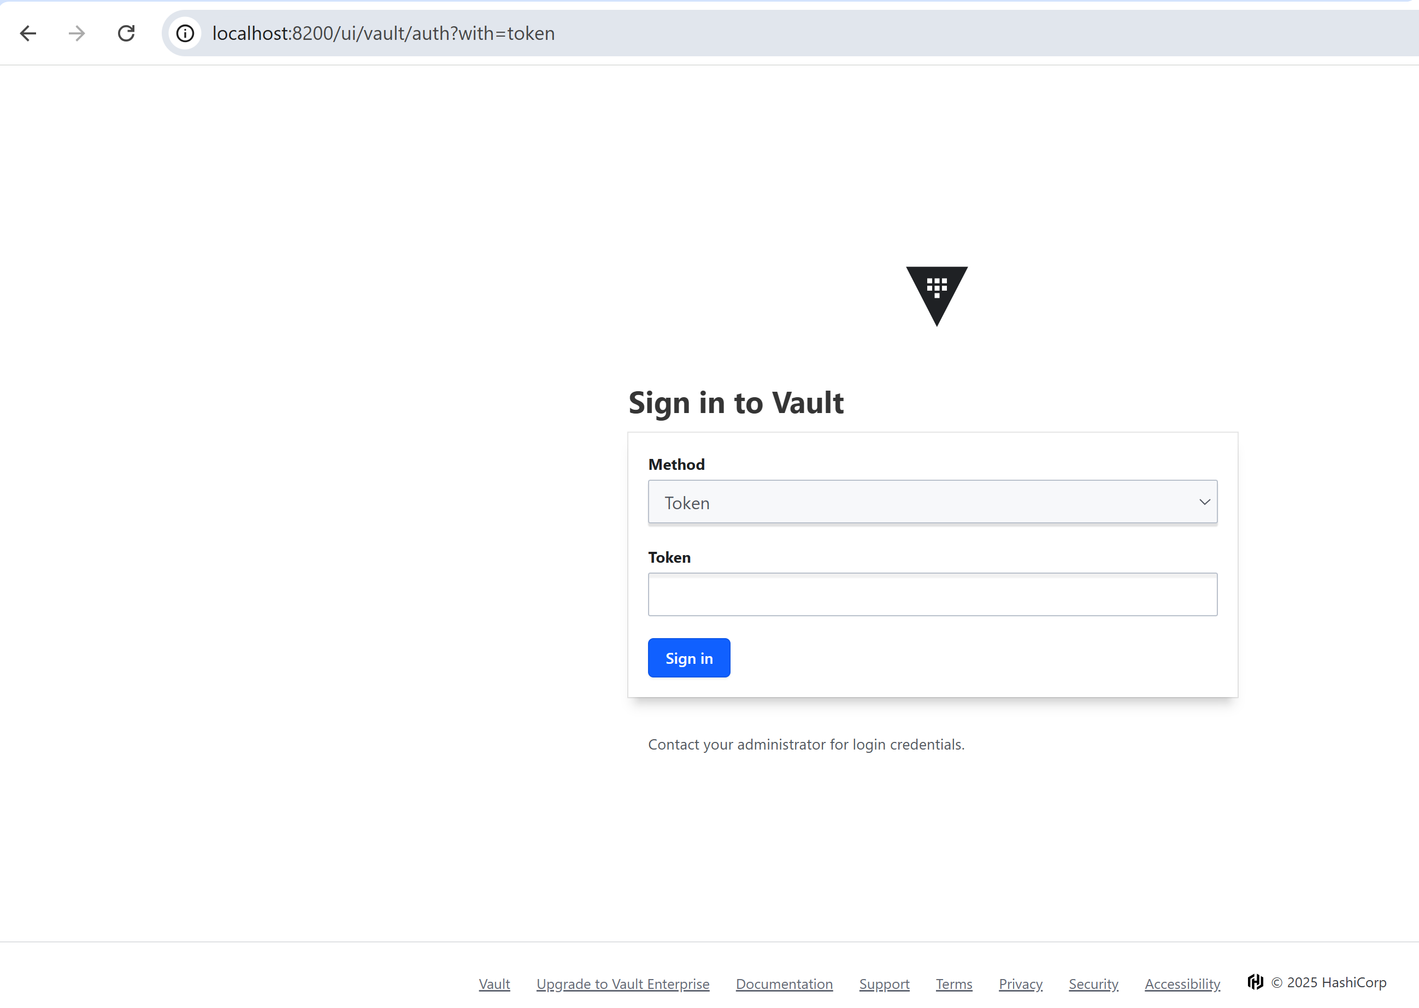
Open Vault Http UI
http://localhost:8200

Slide 21
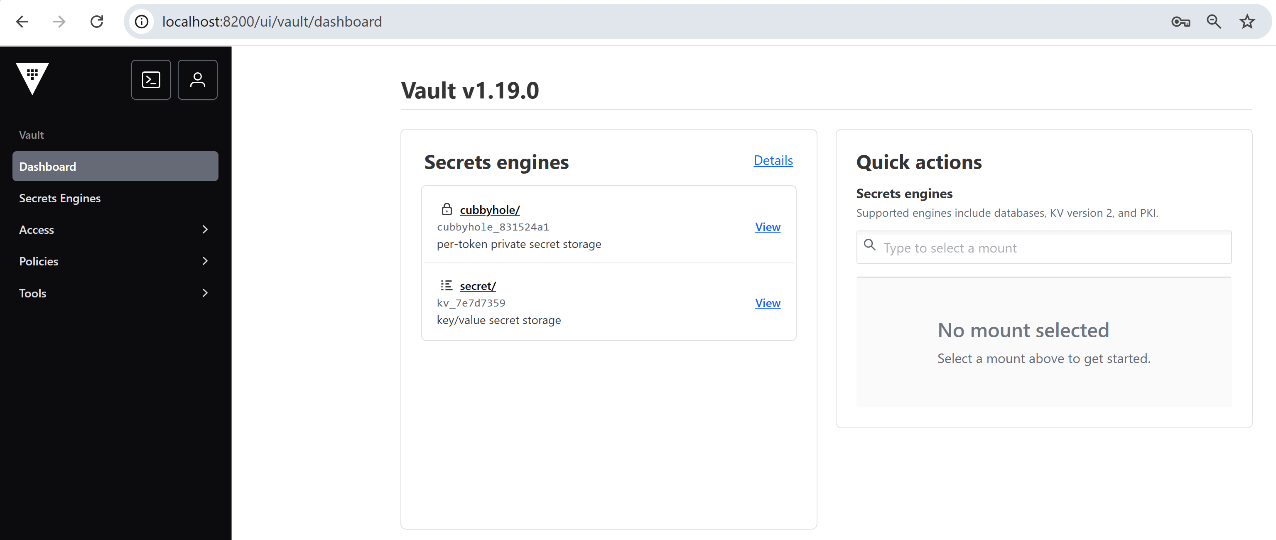
Login... UI Home Page

Slide 22
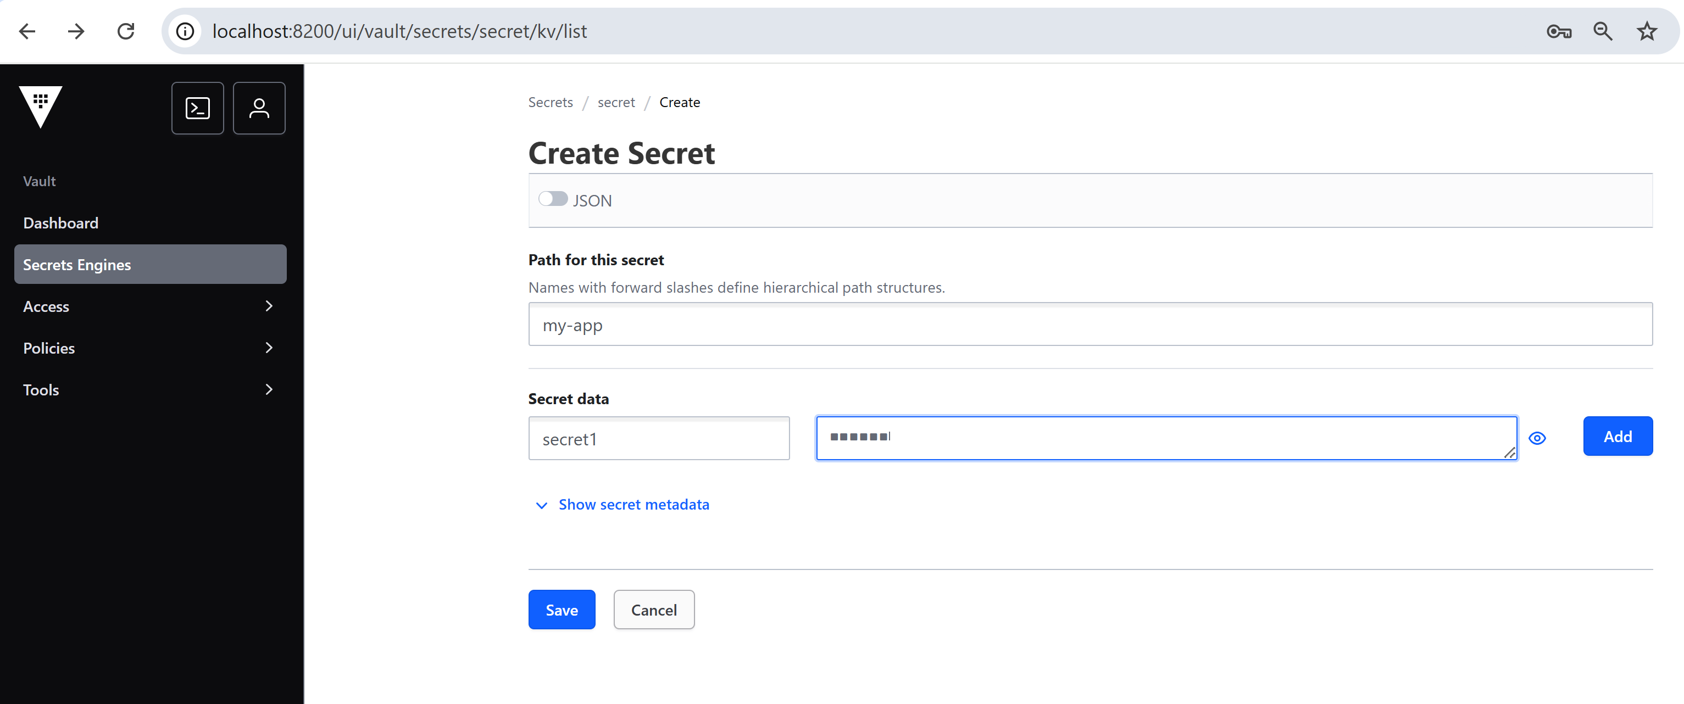
Create a Secret

Slide 23
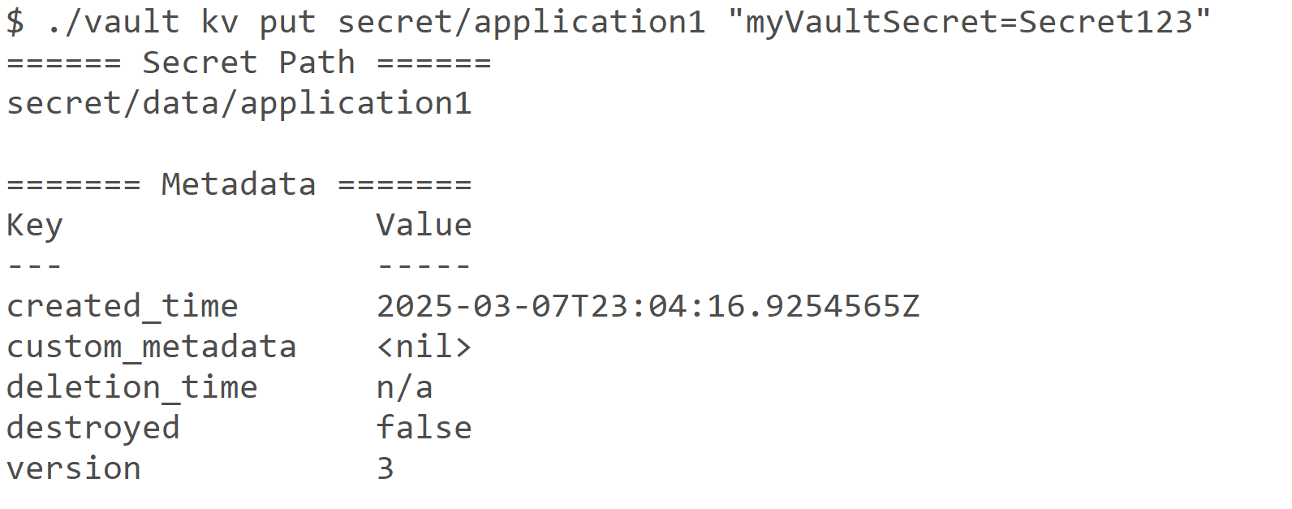
(Optionnal) Creating secret with cmd
./vault kv put secret/application1 "myVaultSecret=Secret123"

Slide 24
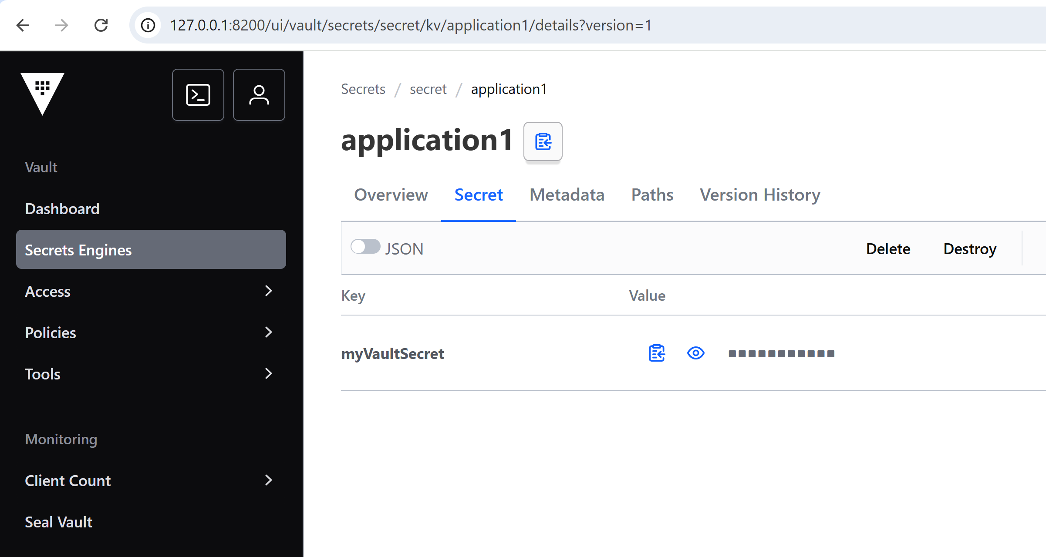
Configured Secret in Vault
path=application1
secretName=myVaultSecret ( secretValue=Secret123 )

Slide 25
Use springboot cloud + Hashicorp Vault to resolve secrets in config

Slide 26
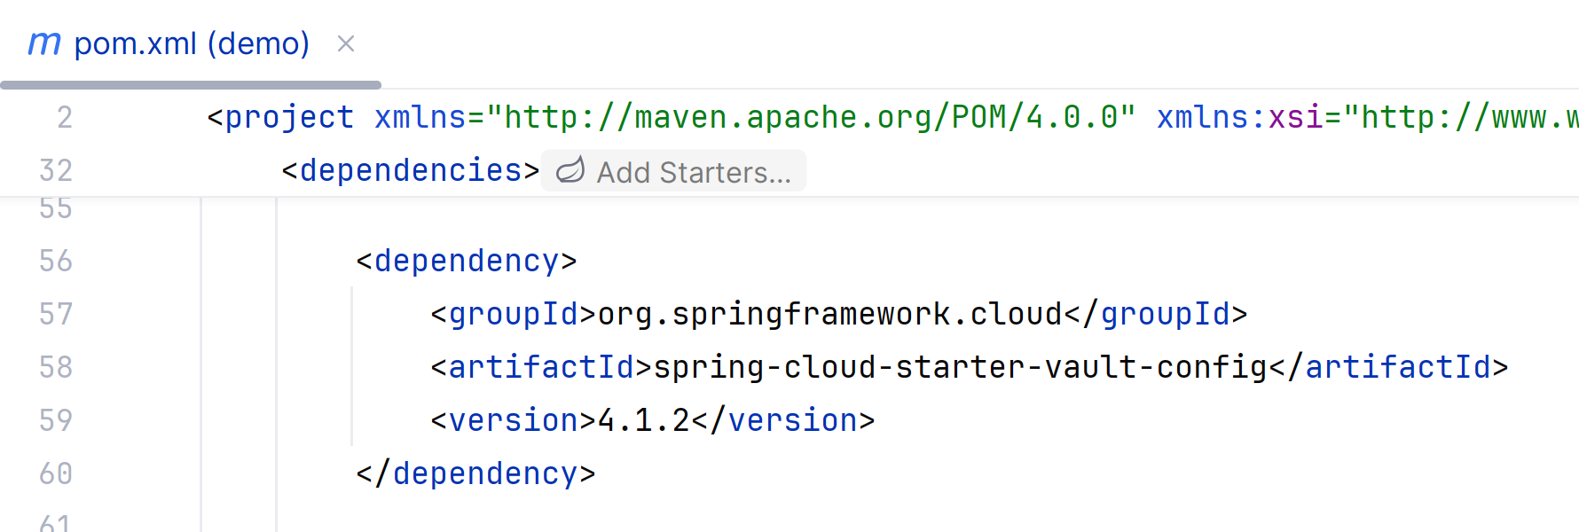
add pom.xml dependency spring-cloud-starter-vault-config
<dependency>
<groupId>org.springframework.cloud</groupId>
<artifactId>spring-cloud-starter-vault-config</artifactId>
<version>4.1.2</version>
</dependency>
edit pom.xml, add <dependencies>...

Slide 27
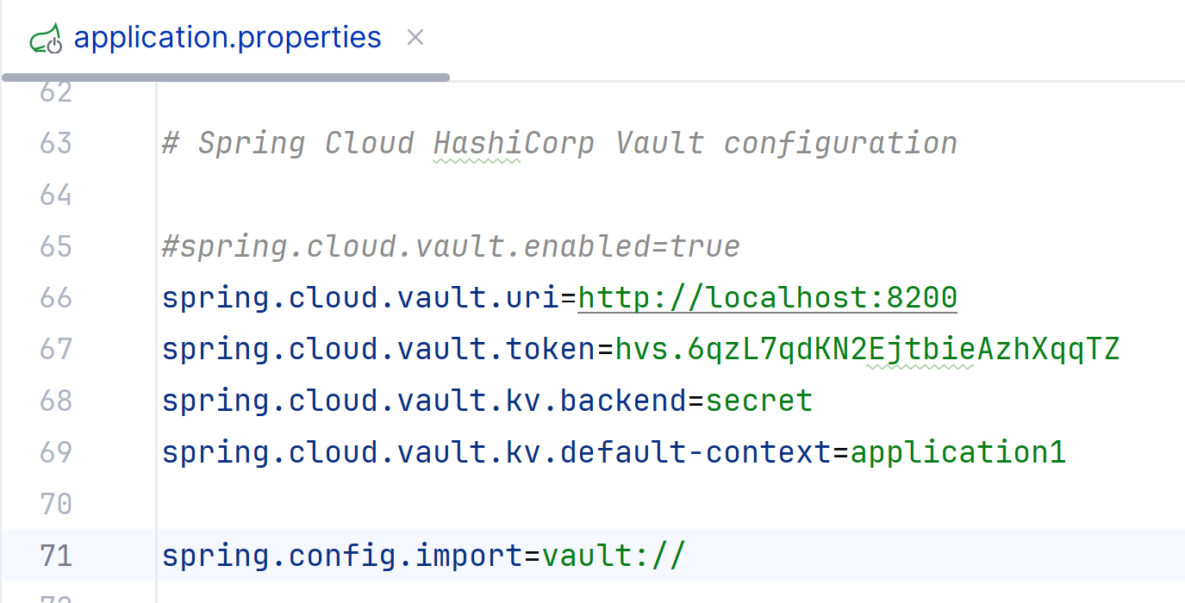
Configure springboot - Vault
# Spring Cloud HashiCorp Vault configuration
spring.cloud.vault.uri=http://localhost:8200
spring.cloud.vault.token=**************your token
spring.cloud.vault.kv.backend=secret
spring.cloud.vault.kv.default-context=application1
spring.config.import=vault://
# myVaultSecret=.. cf overriden injected from Vault 'application1/secret/myVaultSecret'
edit file
src/main/resources/
application.properties

Slide 28
Add Java code to use injected value
@Service
public class VaultDemoService {
// injected by springboot from Vault, via spring-cloud-vault-config
@Value("${myVaultSecret}")
private String myVaultSecret;
@PostConstruct
public void init() {
System.out.println();
System.out.println("*******\n"
+ "VaultDemoService initialized, \n" //
+ " injected field with @Value(\"${myVaultSecret}\") using spring boot via spring-cloud-vault-config \n" //
+ " myVaultSecret='" + myVaultSecret + "' \n" //
+ "*******");
System.out.println();
}
}
edit new java class
VaultDemoService

Slide 29
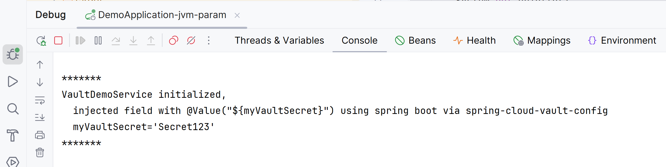
Run/Debug

Slide 30
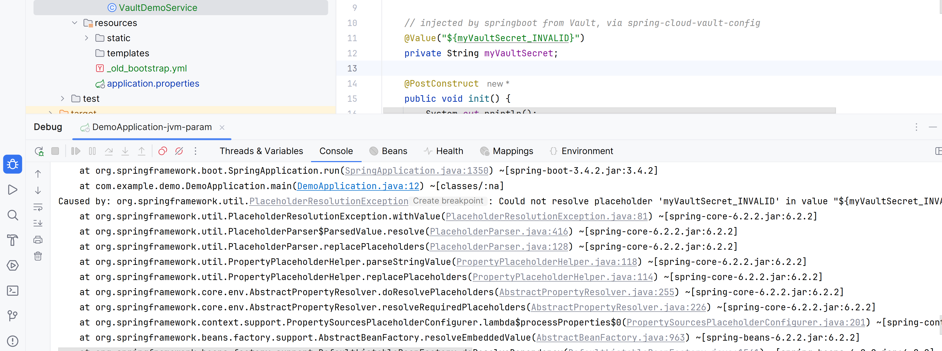
NOTICE... if property (Secret) not found
=> Error at startup

Slide 31
Questions ?

