Slide 1
Security - Hands-On 4
Cryptography
Prime Numbers
Esilv 2026
arnaud.nauwynck@gmail.com

Slide 2
Study on Prime-Number
... java code snippets

Slide 3
Step 1: Create a new Java (Maven) Project
<dependencies>
<dependency>
<groupId>org.projectlombok</groupId>
<artifactId>lombok</artifactId>
<version>1.18.36</version>
<scope>provided</scope>
</dependency>
<dependency>
<artifactId>junit</artifactId>
<groupId>junit</groupId>
<version>4.13.2</version>
<scope>test</scope>
</dependency>
</dependencies>
typical dependencies to use
in pom.xml <dependencies>:

Slide 4
Ex1: Print consecutive powers of a number, modulo a prime number (ex: 101)
display the p first power values modulo P, for each element "i"
( warn to overflow, use modulo after each multiply )
2, 2^2%p, 2^3%p, 2^4%p ... 2^p%p
3, 3^2%p, 3^3%p, 3^4%p ... 3^p%p
...
p-1, (p-1)^2, (p-1)^3, ...(p-1)^p%p

Slide 5
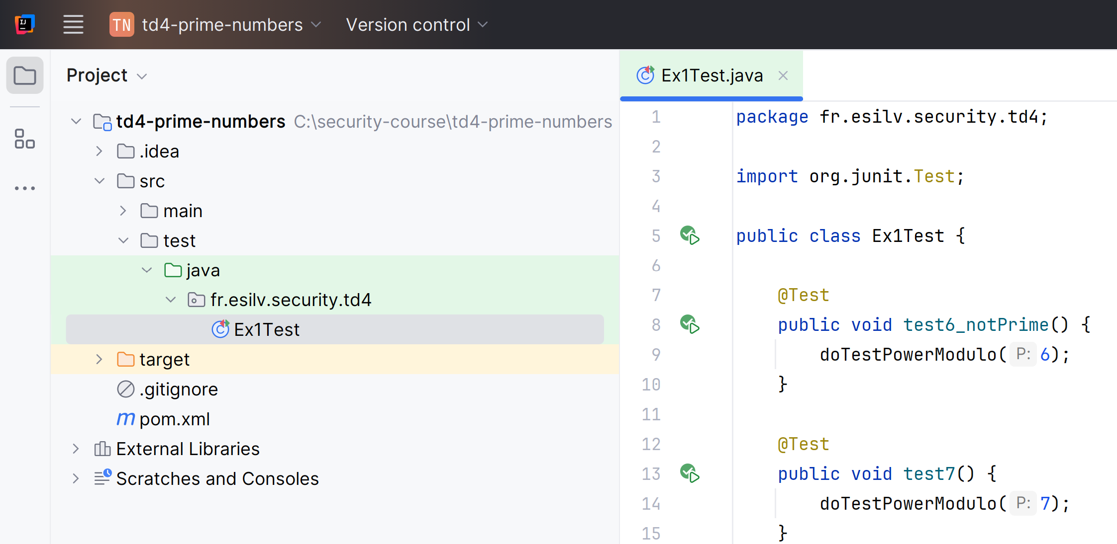
Run several samples as JUnit "@Test" methods for p=7, 11, 13, 17, 101, .. also run for p not prime, ex: 6
package fr.esilv.security.td4;
import org.junit.Test;
public class Ex1Test {
@Test
public void test6_notPrime() {
doTestPowerModulo(6);
}
@Test
public void test7() {
doTestPowerModulo(7);
}
// ... complete code yourself

Slide 6
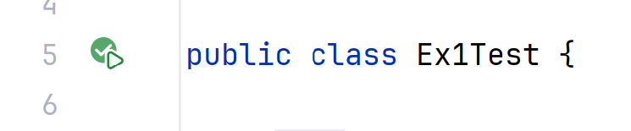
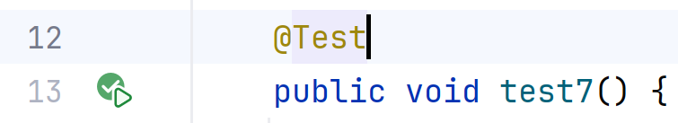
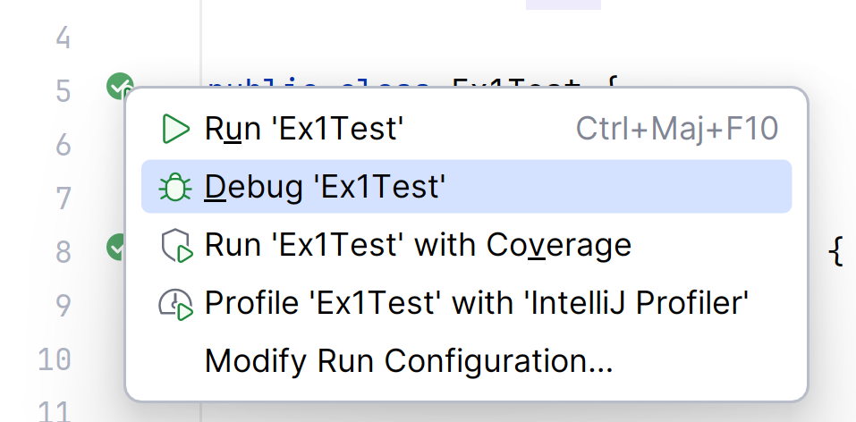
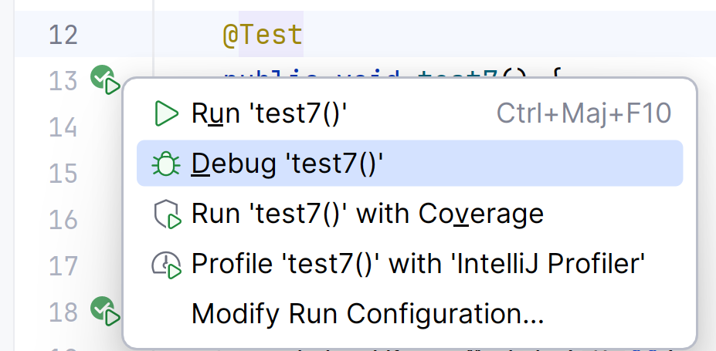
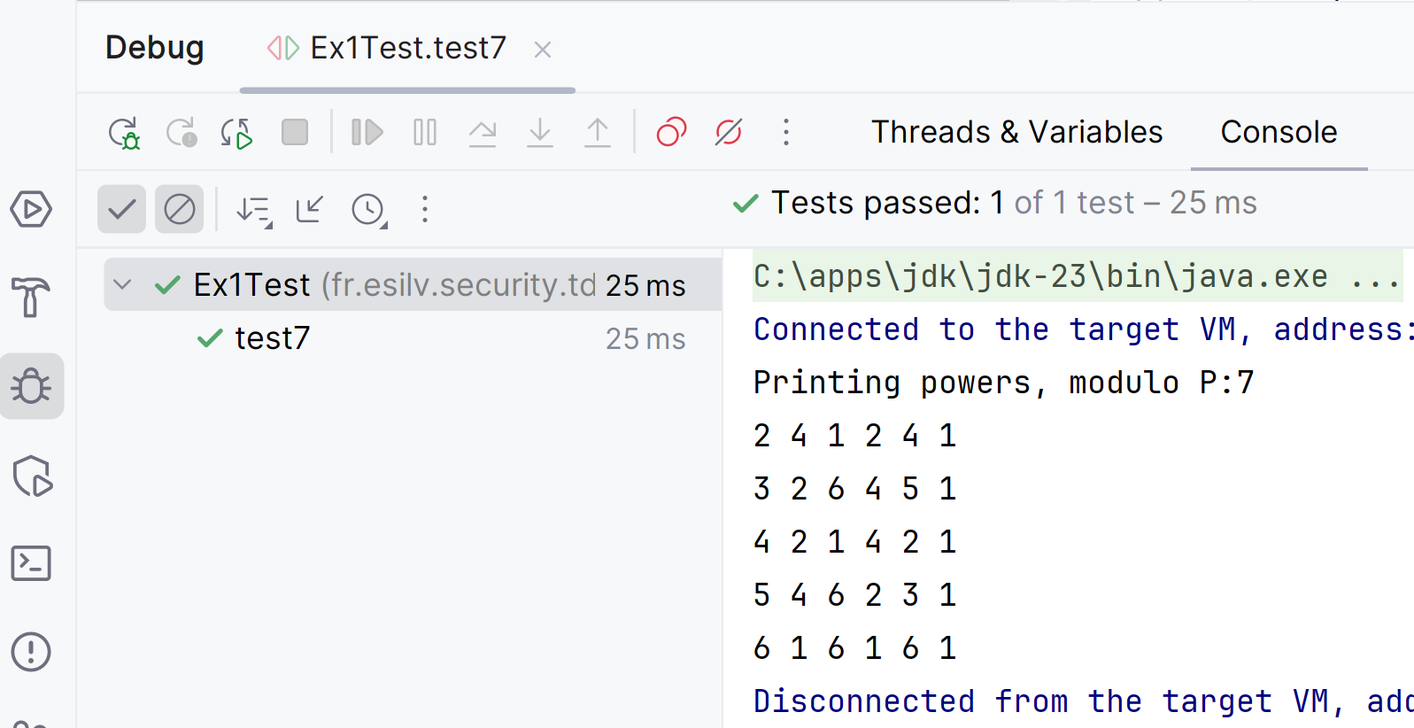
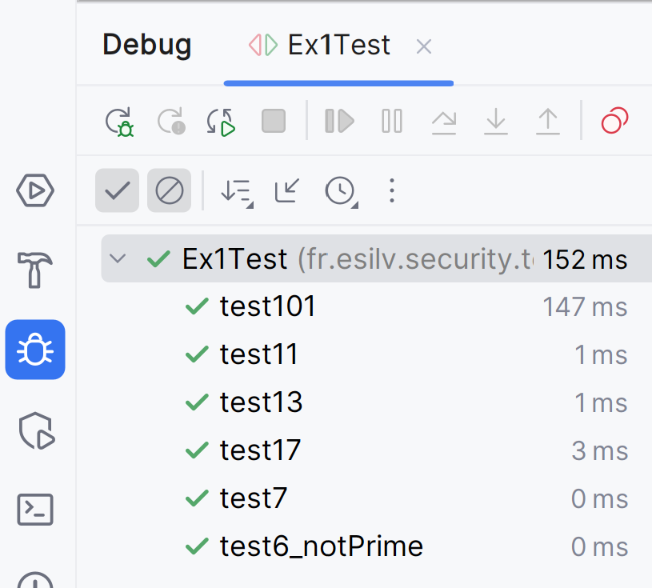
Run/Debug your Test(s)
run all tests within class
run a specific @Test method

Slide 7
Ex 2 : How to efficiently raise number to powers 2, 4, 8, 16 ... ?
Write a Test that raise n ^ 1048576 modulo P
1 048 576 = 1 mega (~1e6) = 1024*1024 = 2^20
How many multiplications and modulos used ?

Slide 8
(Optional) Ex 3: Write code to efficiently raise a number to power N="1000 000 000 000", with modulo "P"
do you need 1 trillions multiplications ?
so how many multiplications?
decompose N in base 2 ( N = a0 + a1 . 2 + a2 2^2 + a3 2^3 + .. ak 2^k )

Slide 9
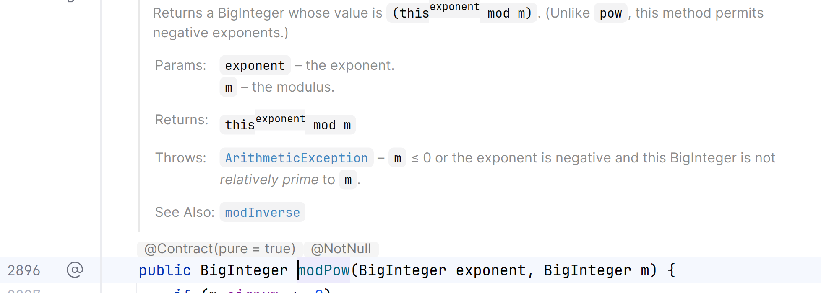
Ex 4 : code to use java BigInteger instead of int/long
cf built-in code "BigInteger.modPow(exponent, modulo)"

Slide 10
(Ex 4) Compute following:
p = 10000000000000000000000000000000000000000000000000000000000000000000000000000001
a = 20000000000000000000000000000000000000000000000000000000000000000000000000000001
m = 30000000000000000000000000000000000000000000000000000000000000000000000000000001
a^p % m

Slide 11
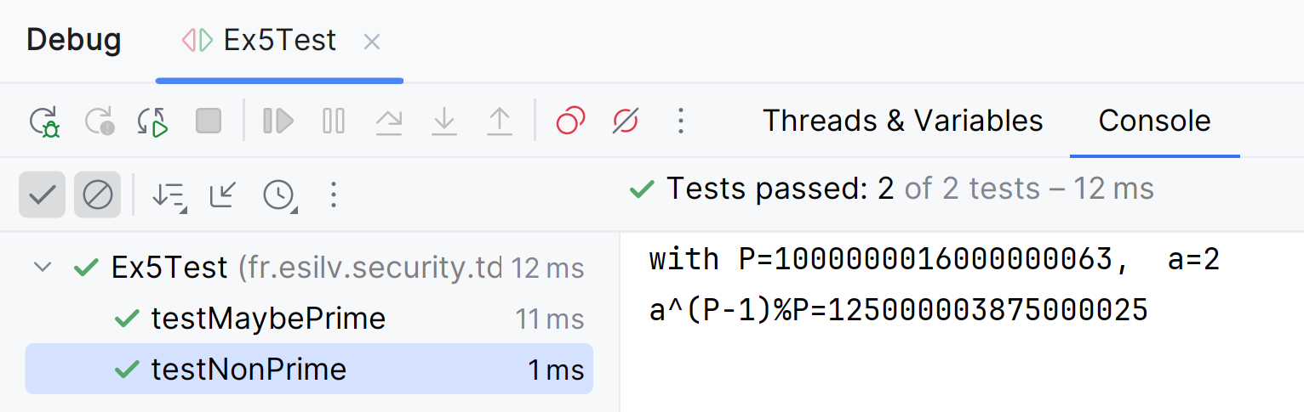
Ex 5: Without iterating to check on divisors, proof that a given "P" is NOT prime
P = 1000000016000000063
Use the Fermat theorem. If P was prime, for all a => "a^(p-1) modulo P = 1";
test with choosen a =2, or a=3, .. or a=random
Use built-in method : BigInteger.modPow(exponent, modulo)
What is the probability that "a^(p-1) modulo P = 1" despite the fact that P were not prime ?

Slide 12
Notice that searching n1,n2 with N=n1*n2 is much more complex...
But when knowing, checking is trivial n1=1000000007 x n2=1000000009

Slide 13
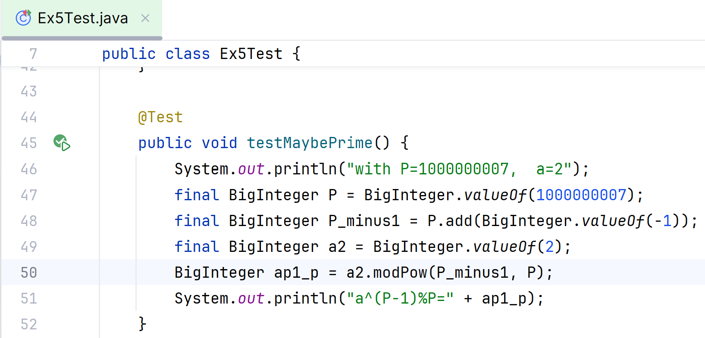
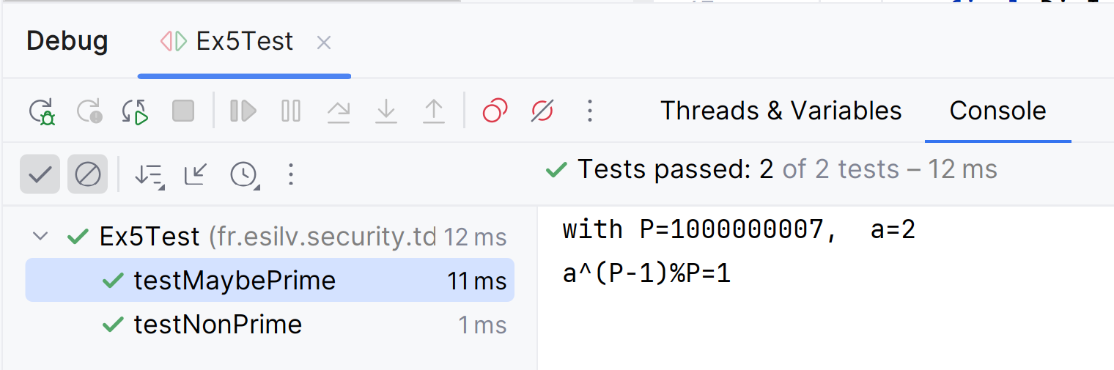
Ex5 : repeat primality test on n1, n2 compute 2^(n1-1) modulo n1

Slide 14
Write the Fermat Primality test, with 5 internal number tries
(also call Miller-Rabin test )
See source java built-in source code: BigInteger.isProbablePrime(certainty)

Slide 15
Ex 5: use java BigInteger.nextProbablePrime() to print the consecutive 1000 primes, after a given N
N = 10000000000000000000000000000000000000000000000000000000000000000000000000000000000000000000000000000000000000000000000000000000000000001
nextPrime?
next nextPrime ?
...
next next ...(1000) next Prime ?

Slide 16
using standard java.security.* package
(class MessageDigest, .. ) compare with bash command line tools

Slide 17
Ex 6: Use Java API to compute "SHA-256" of text (ex: "Hello World") print result in Hexa
@Test
public void testMessageDigest() throws Exception {
byte[] data = "Hello World".getBytes();
doTestSha256(data);
}
public void doTestSha256(byte[] data) throws Exception {
// **** complete code yourself ****
byte[] digest = ****
System.out.println("SHA-256 printed (binary, non asci)");
System.out.println(new String(digest));
String hex = HexFormat.of().formatHex(digest);
System.out.println("SHA-256 printed (hex)");
System.out.println(hex);
}

Slide 18
Ex 7: compare with bash tool
$ echo -n "Hello World" | sha256sum
a591a6d40bf420404a011733cfb7b190d62c65bf0bcda32b57b277d9ad9f146e *-
$ echo "Hello World" | sha256sum
d2a84f4b8b650937ec8f73cd8be2c74add5a911ba64df27458ed8229da804a26 *-
@Test
public void testMessageDigest() throws Exception {
byte[] data = "Hello World".getBytes();
doTestSha256(data);
}
@Test
public void testMessageDigest_newline() throws Exception {
byte[] data = "Hello World\n".getBytes();
doTestSha256(data);
}

Slide 19
Ex 8: Use Java API to encrypt a text then decrypt, with RSA Assymetric algorithm

Slide 20
Ex 9: Use jdk/bin/keytool to generate a PrivateKey

Slide 21
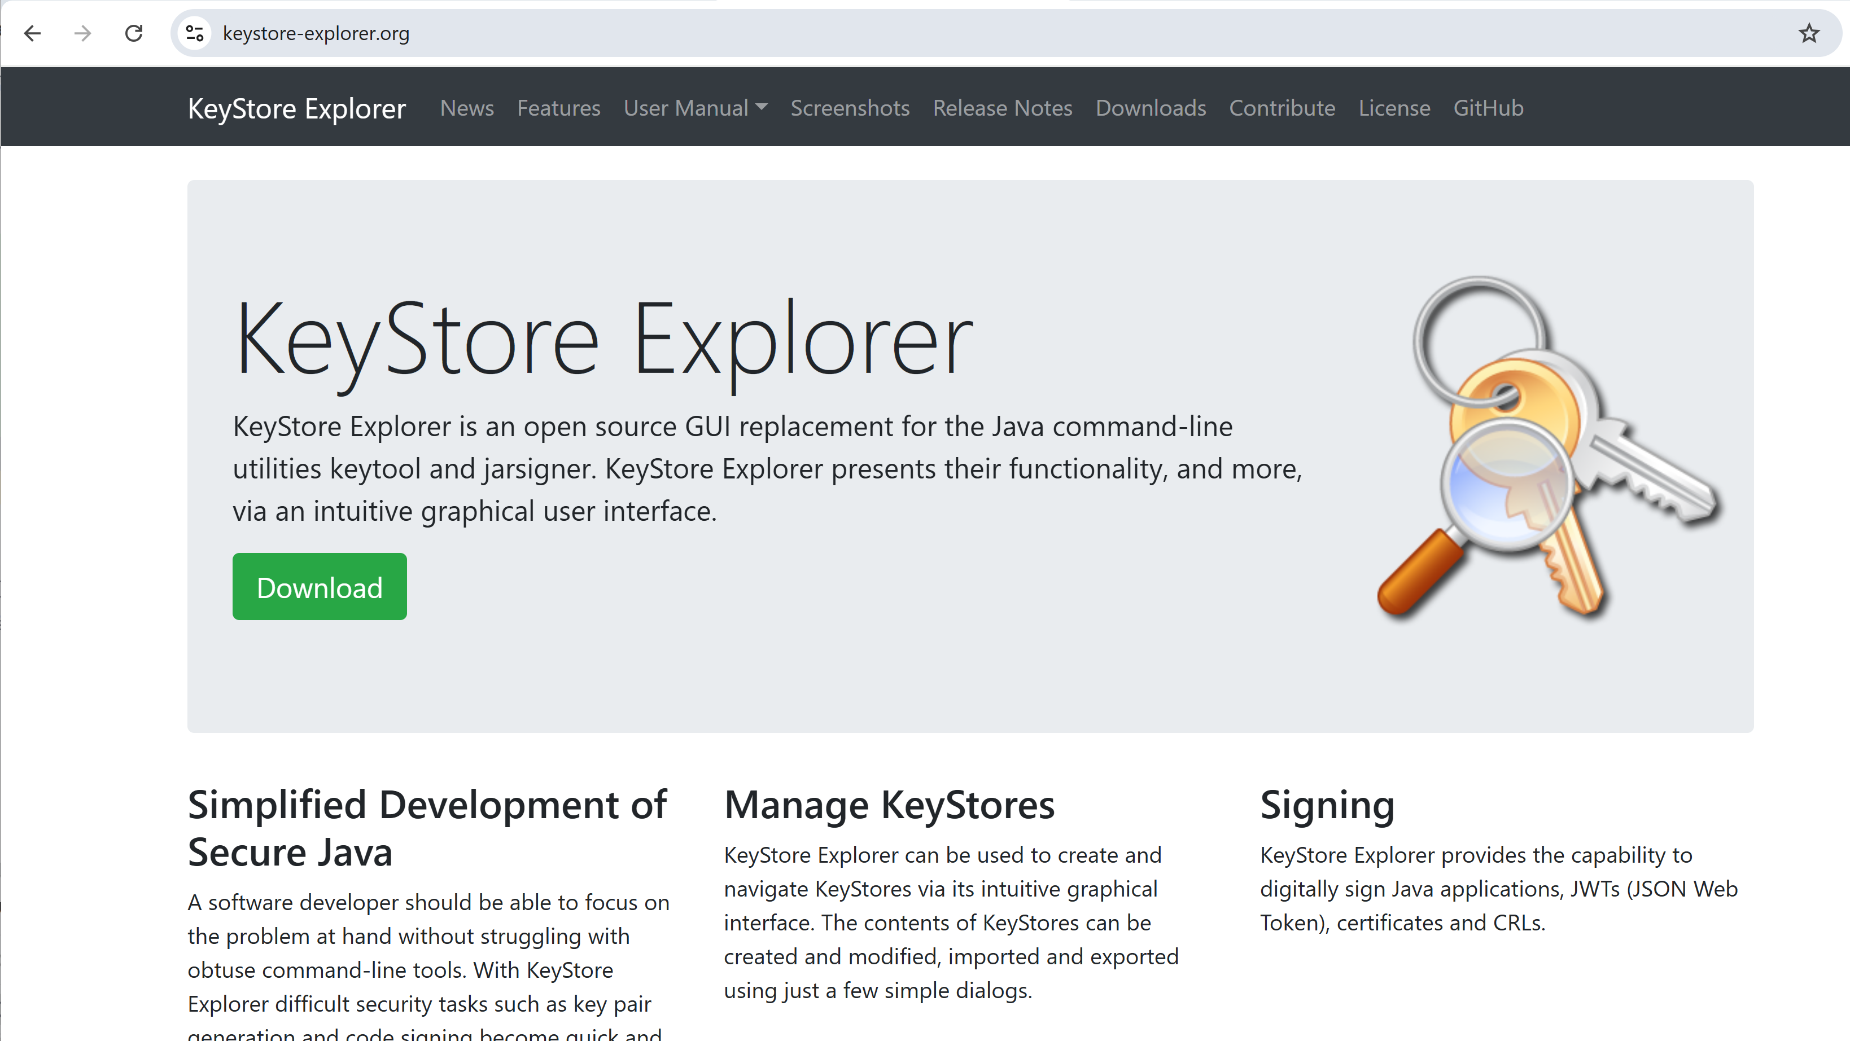
Ex 10: Install java KeyStore Explorer (UI) https://keystore-explorer.org/

Slide 22
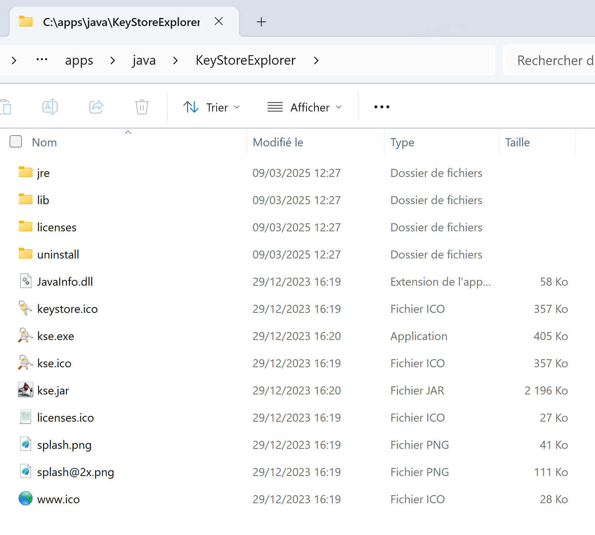
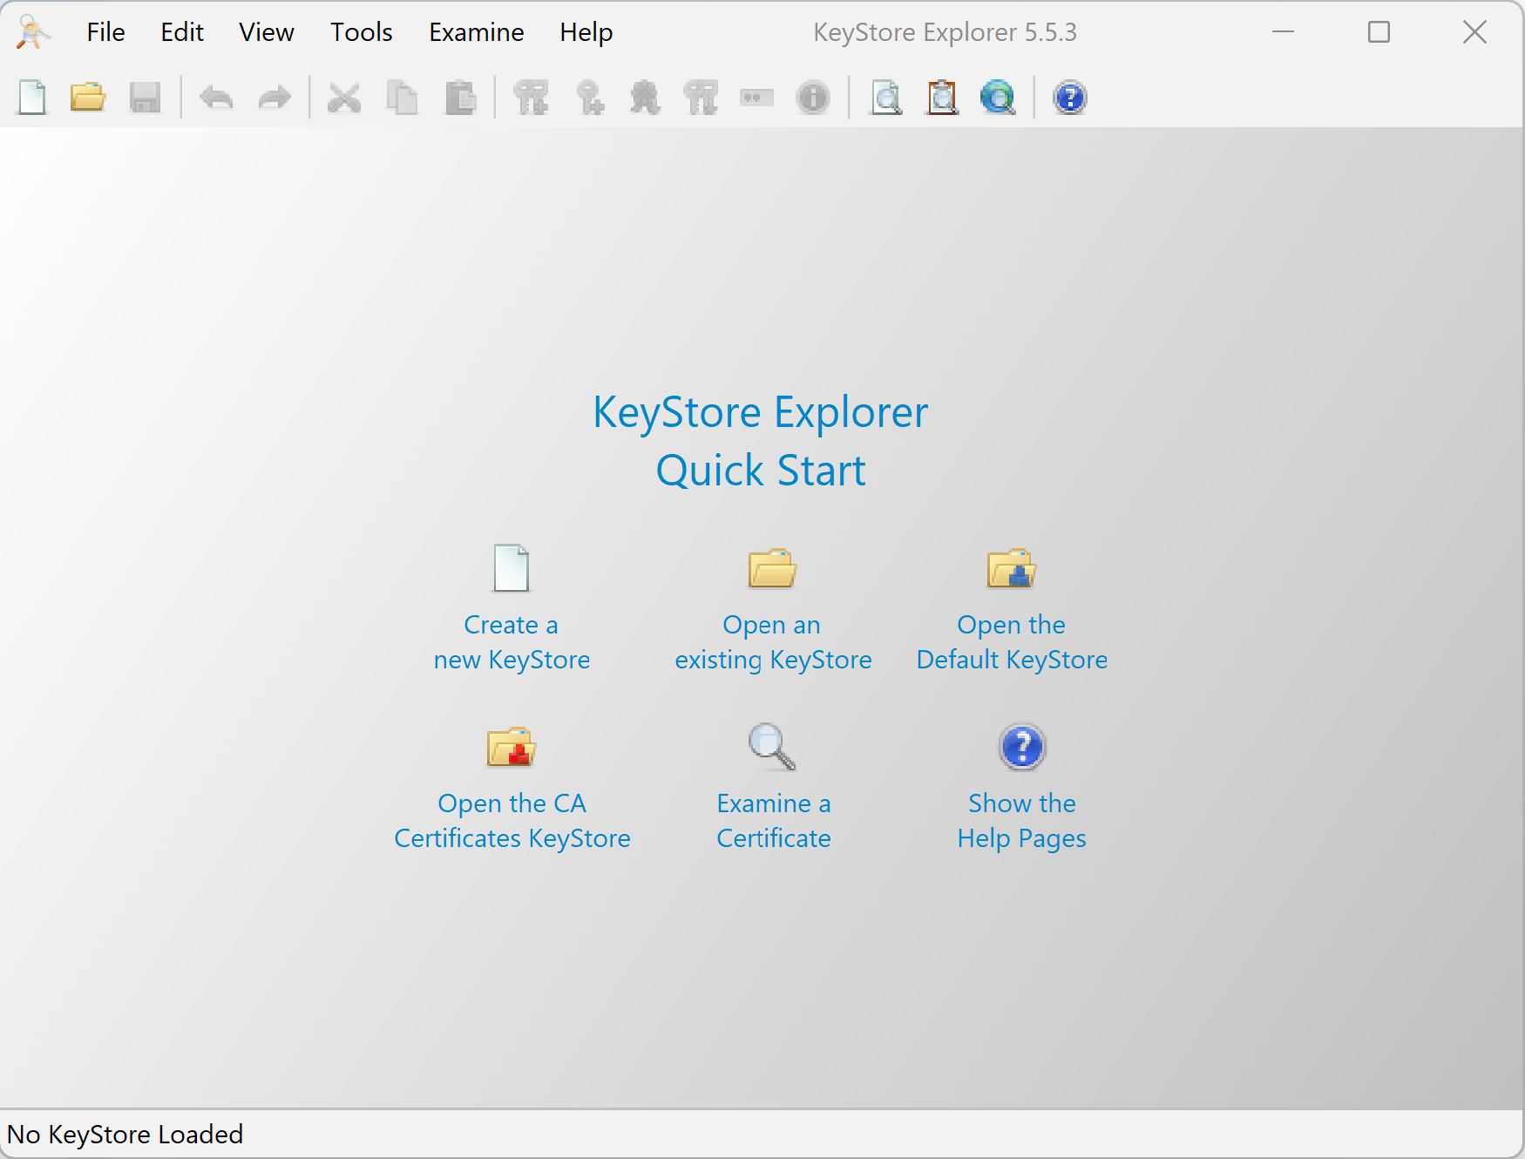
Launch "kse.exe"

Slide 23
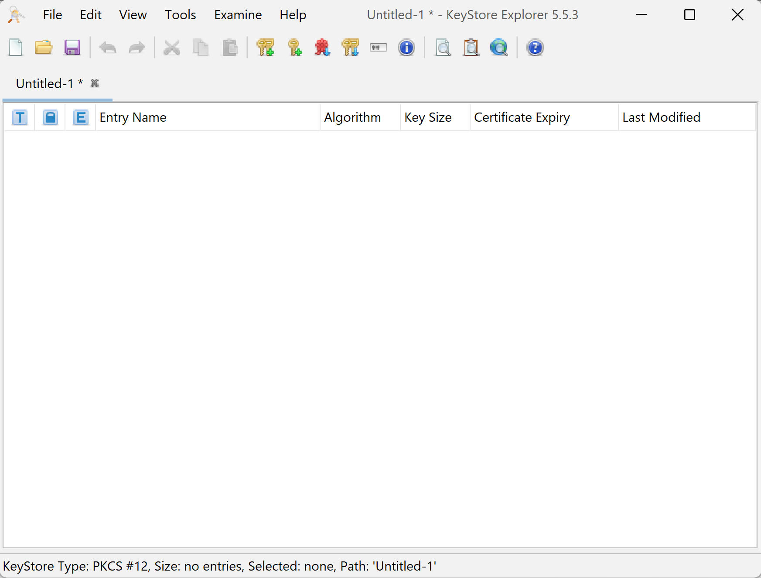
Create a new KeyStore
( or open an existing *.p12 / *.jks file)

Slide 24
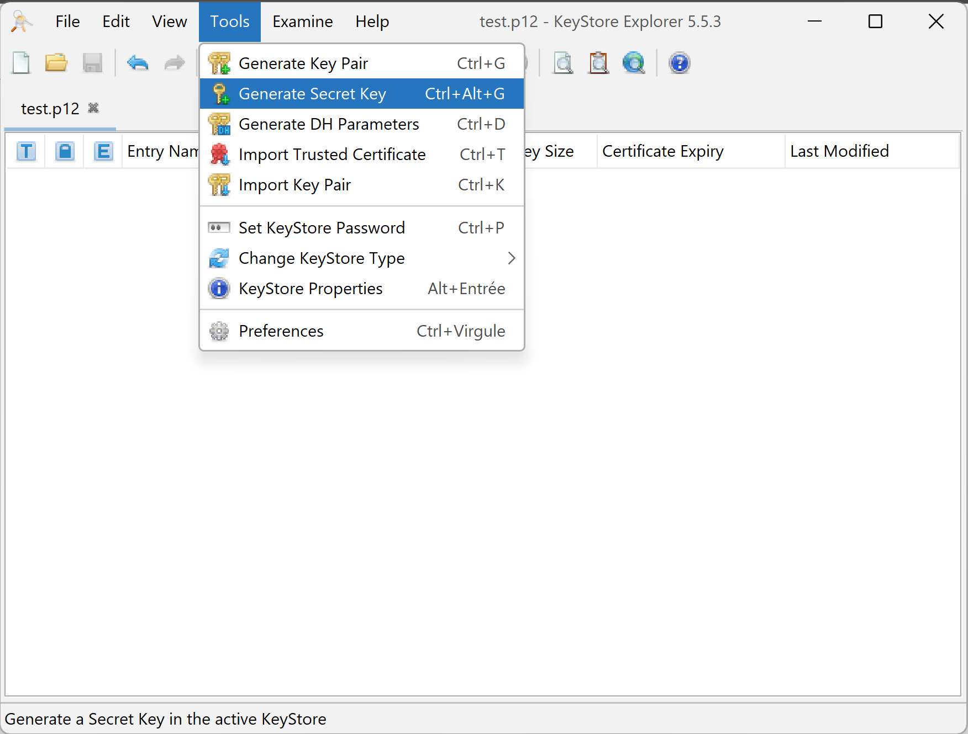
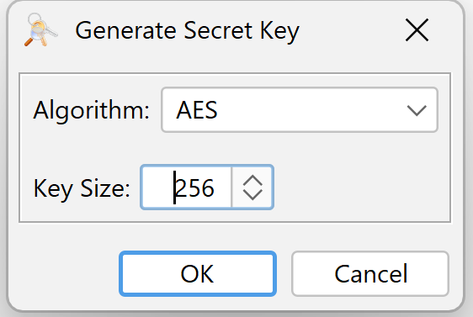
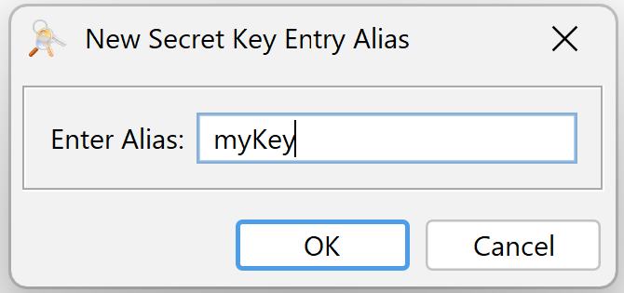
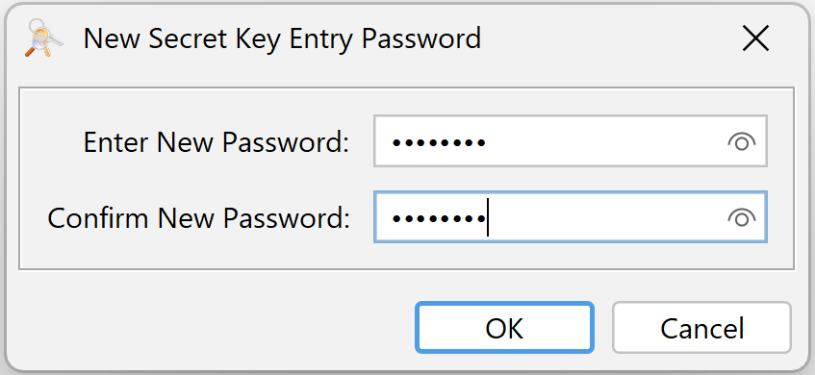
Generate a "Secret Key"

Slide 25
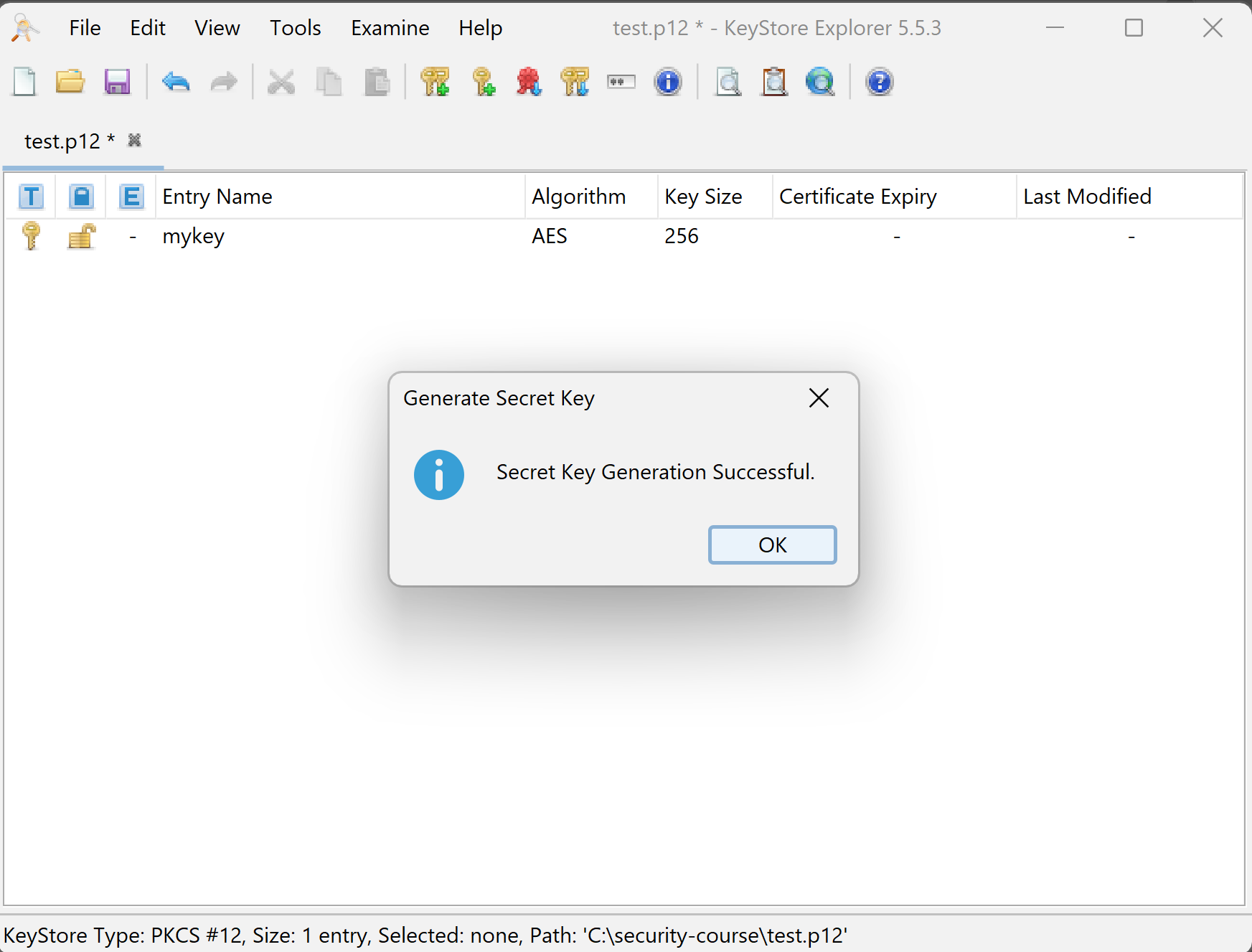
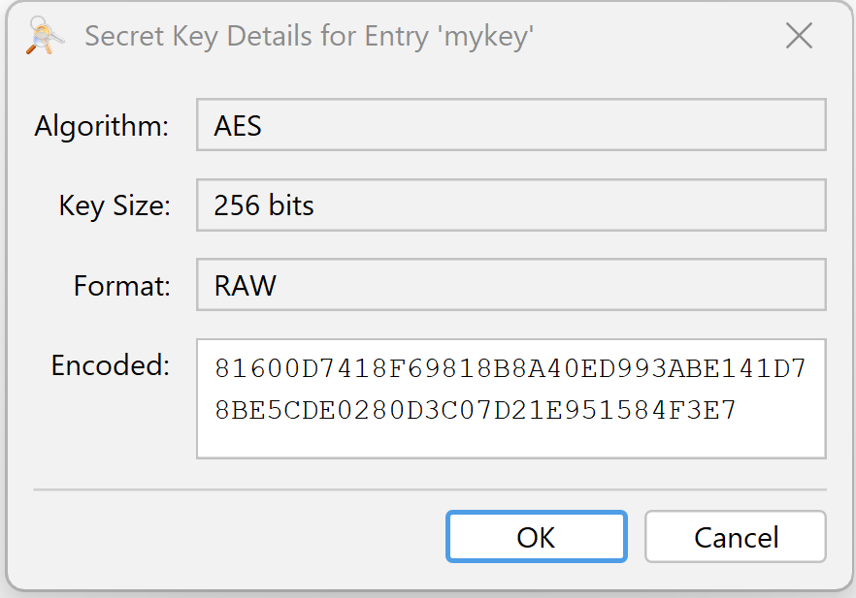
Created AES Key

Slide 26
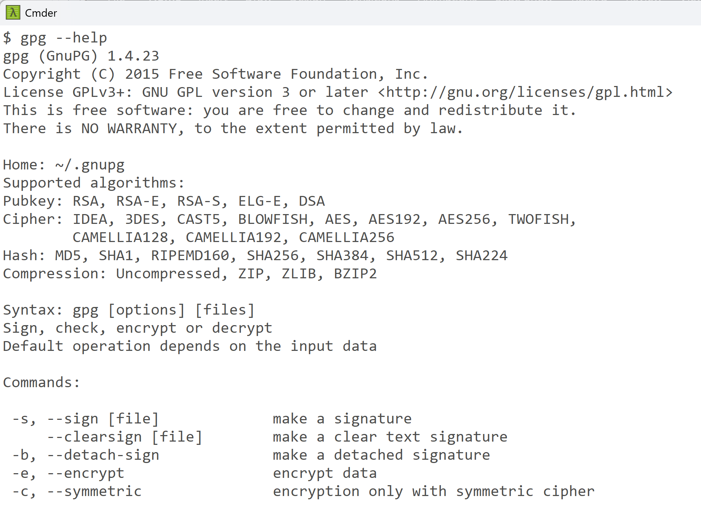
Ex 11: compare with gpg

Slide 27
Ex 12: Use java.security.Cipher and KeyGenerator to encrypt a text then decrypt, with a Symmetric key algorithm
// encrypt then decrypt using symmetric key algorithm AES-256
@Test
public void testEncryptDecrypt() {
String data = "Hello World".getBytes();
String key = "1234567890123456";
String iv = "1234567890123456";
System.out.println("plainText: " + plainText + ", key: " + key + ", iv:" + iv);
// encrypt
byte[] encrypted = encryptAES(data, key, iv);
System.out.println("encrypted: " + encrypted);
// decrypt
String decrypted = decryptAES(encrypted, key, iv);
System.out.println("decrypted: " + decrypted);
}
private byte[] encryptAES(byte[] data, String key, String iv) {
// ***** complete code yourself ******
return null;
}
private String decryptAES(byte[] encrypted, String key, String iv) {
// ***** complete code yourself *****
return null;
}

Slide 28
Ex 13: repeat ex12, but use java class KeyStore to load the key from your keystore file

Slide 29
Question ?

