Slide 1
Additionnal Questions for Hands-on NodeJs + JavaScript + TypeScript … ‘require()’, ‘export / import’
Esilv 2023
arnaud.nauwynck@gmail.com
This document: https://github.com/Arnaud-Nauwynck/presentations/tree/main/web/tp1-questions-nodejs.pdf

Slide 2
Objectives
This Hands-On contains many small questions,
It is a Step-by-Step discovery for nodejs modules & imports
Questions are optionnal and may not be finished during the 3h session.
The main objectives of the session is to get familiar with your IDE
(WebStorm) environment, and be able to browse nodeJs modules.
If you are already familiar with FrontEnd development,
do the questions, you might learn things on nodejs import.

Slide 3
Question 1 : ChatGPT …
This is a up to You to ask ChatGPT things about NodeJs
to learn things you do not understand
Ask him about « require() », « import », « named import », « import * » , « import as », « default export », « CommonJs », « ESM module », etc…
Except for explanations, please do NOT use ChatGPT (or GithubCopilot) during the Hands-On to write Code !

Slide 4
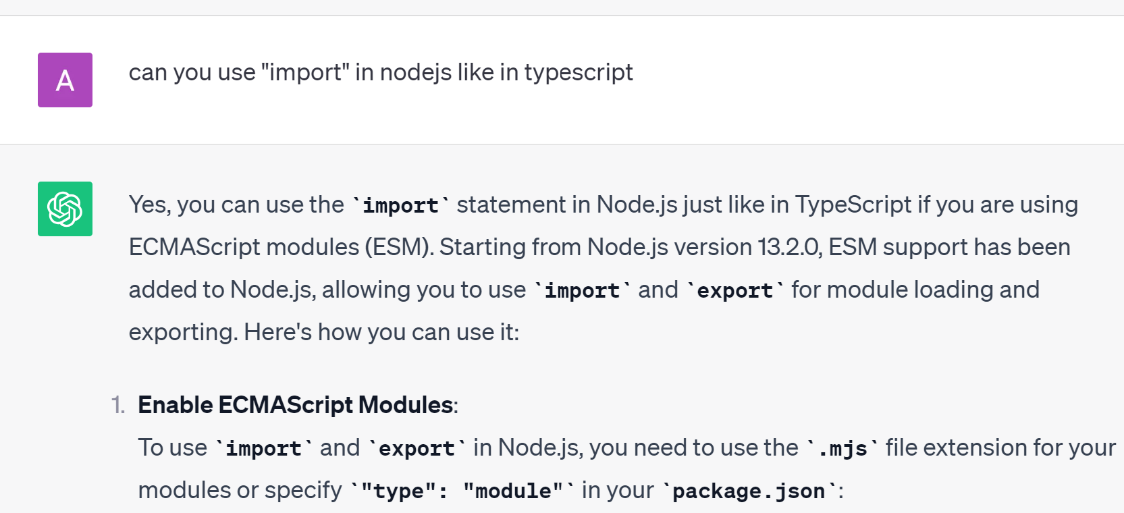
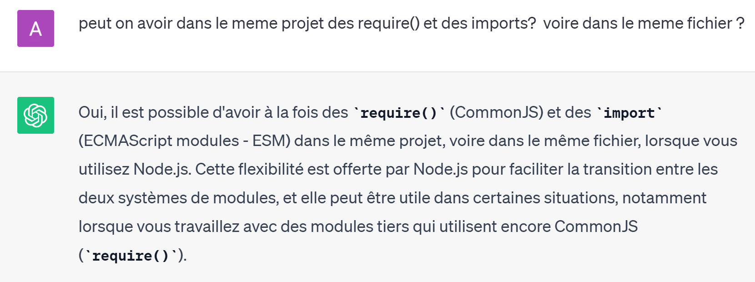
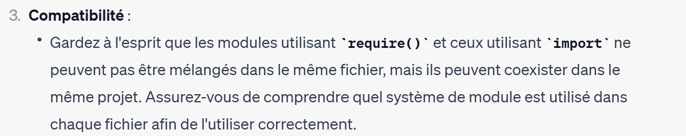
Answer 1… Example
MAIS … 20 lignes plus loin ??!!!! ….
ChatGPT fabule le contraire …

Slide 5
Question 2: use export & require()
Create 2 files
File « q2/A.ts » to export a class named « A », that has a constructor logging a message
File « q2/B.ts » use « require » syntax, like « constant moduleA = require( …. ); » then use class A from moduleA, using « new » to create an object

Slide 6
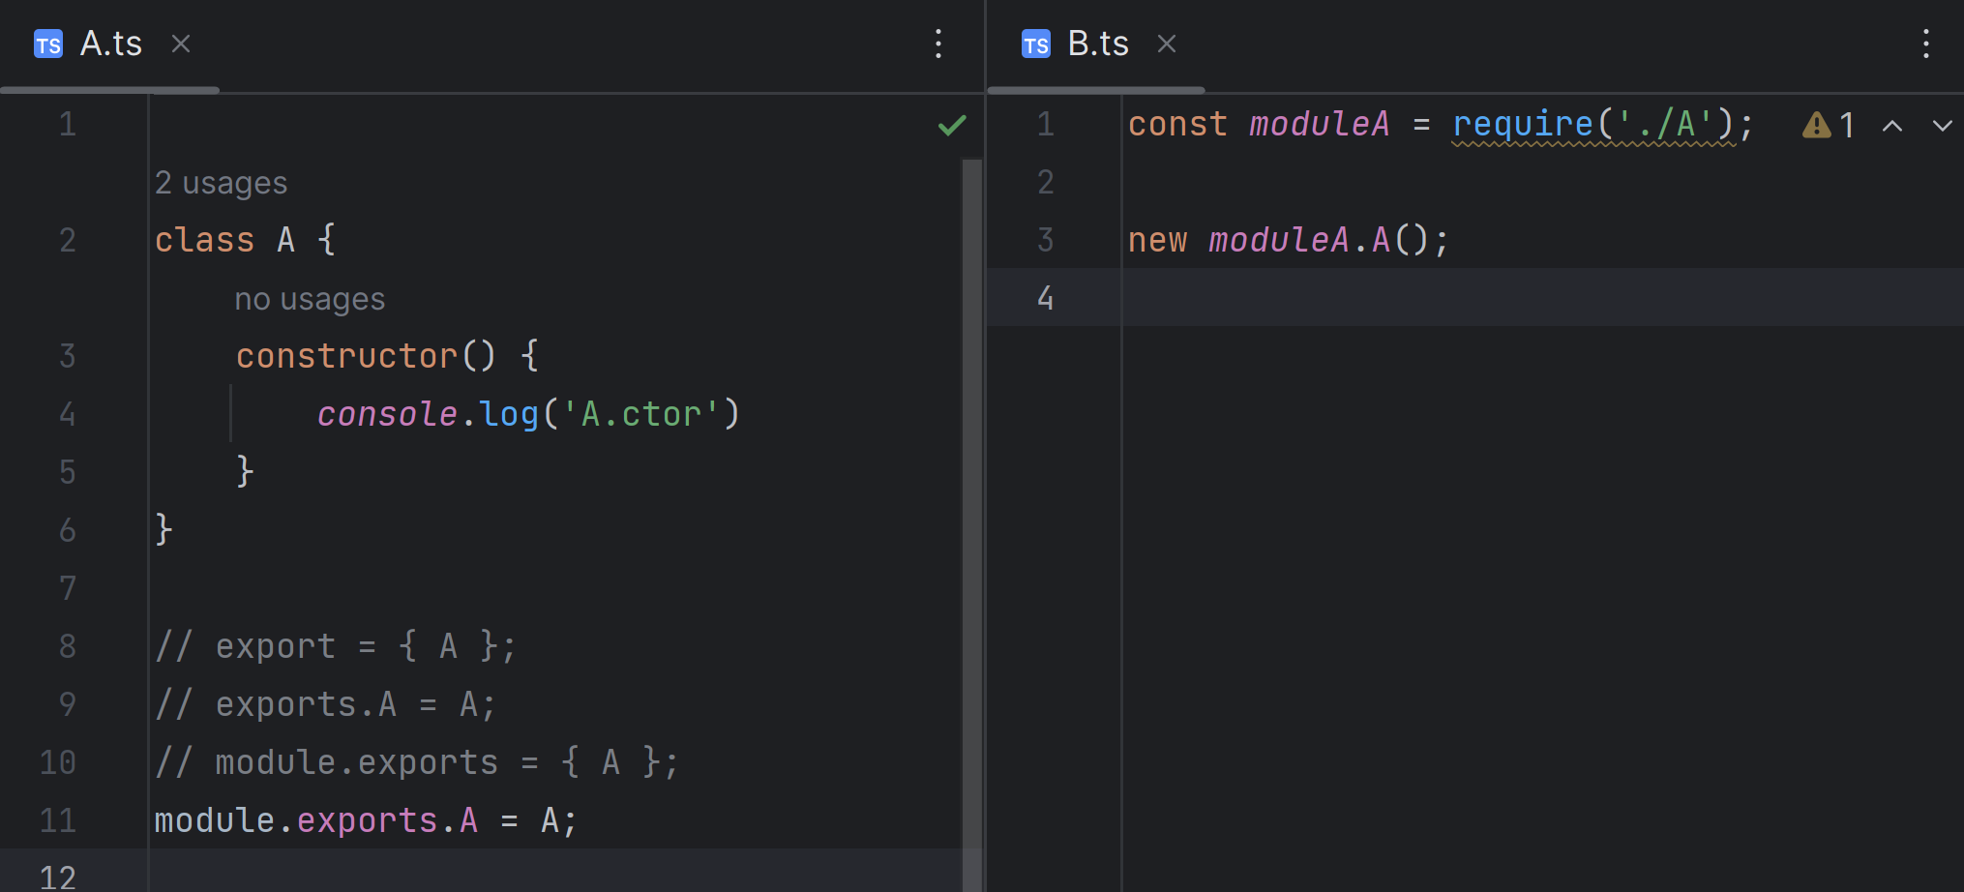
Answer 2 … alternative A/ using module.exports
4 different ways of exporting …

Slide 7
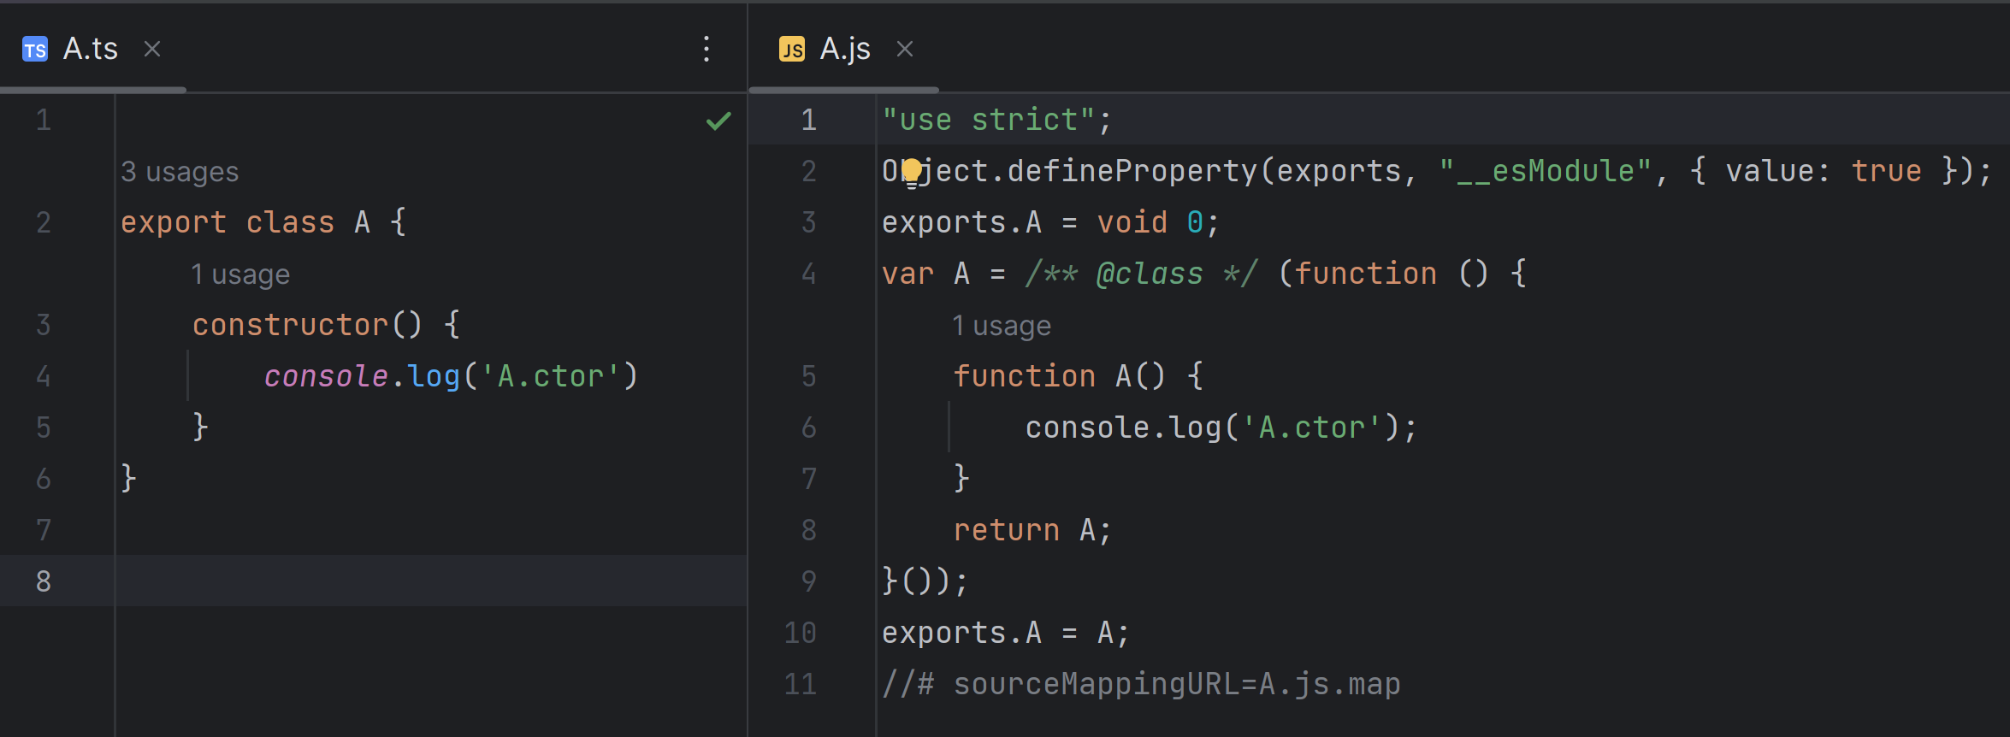
Answer 2 : … Alternative using Typescript syntax
« export class A » in TypeScript => generated as « exports.A = A; » in JS (line 10)
see also strange generated line 2, 3 ..

Slide 8
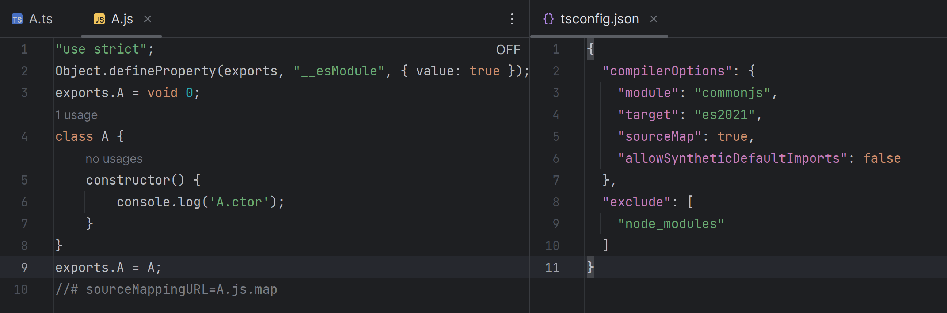
Answer 2: … Notice when target=« es2021 »

Slide 9
Question 3: Run the code in « node »
Run either from command-line,
C:> tsc q2/a.ts C:> node q2/a.js
or Click « Run » in Webstorm IDE
Notice that « *.ts » may not be executed directly, but « *.js » below
Do not forget to create a default tsconfig.json, for { "sourceMap": true }
… It should Run correctly

Slide 10
Question 3 (next)…
Add
console.log(‘moduleA’, moduleA);
Do you see details of moduleA content in console ?
Try to dump the object properties in code
Or else, you need to run the Debugger ! .. See next question 5

Slide 11
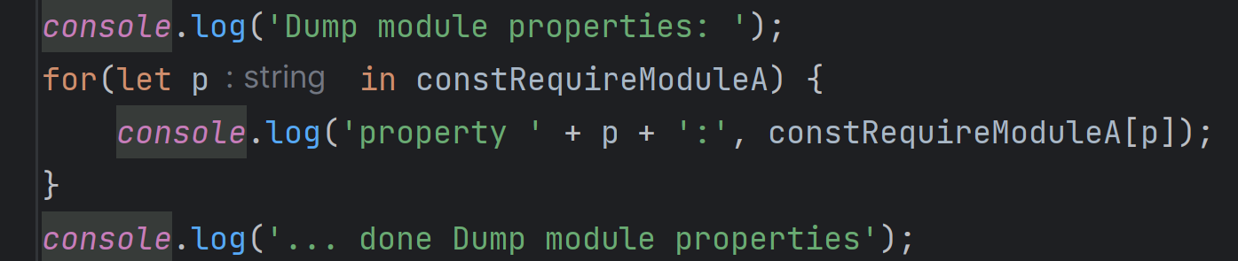
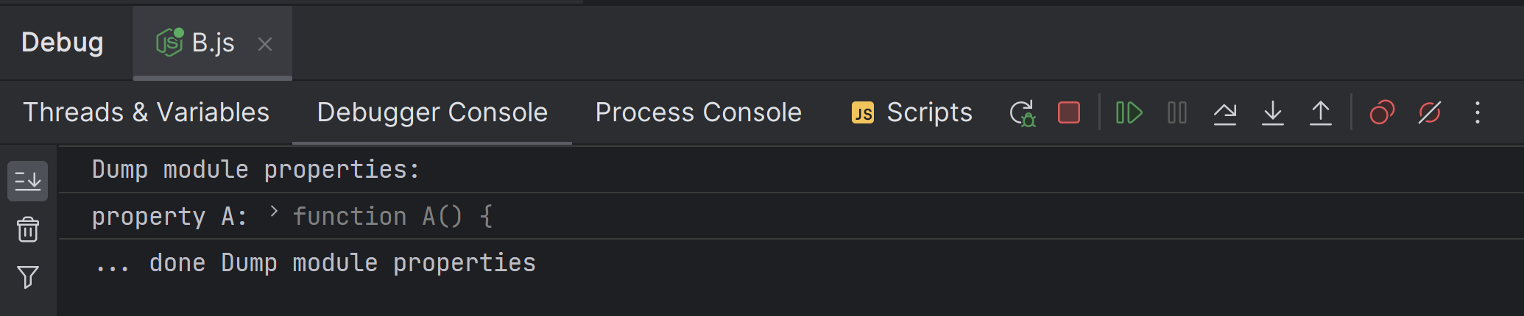
Answer 3: … dump object properties

Slide 12
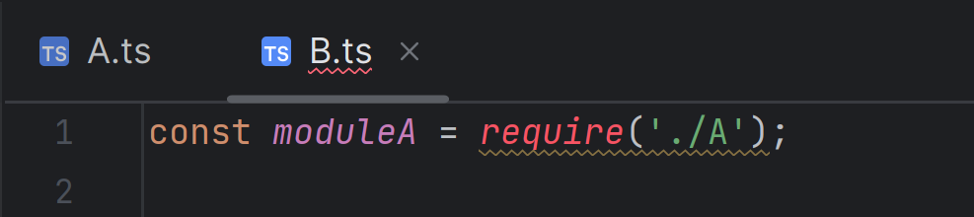
Question 4:
Using WebStorm IDE, the « require()» from Q2 is in RED
… showing a WARNING, ERROR, or missing Node configuration ?
Fix the WARNING as suggested by WebStorm

Slide 13
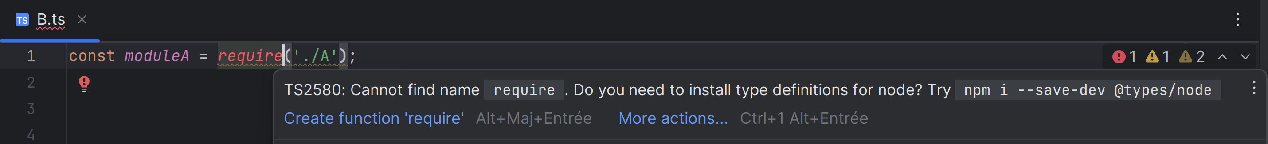
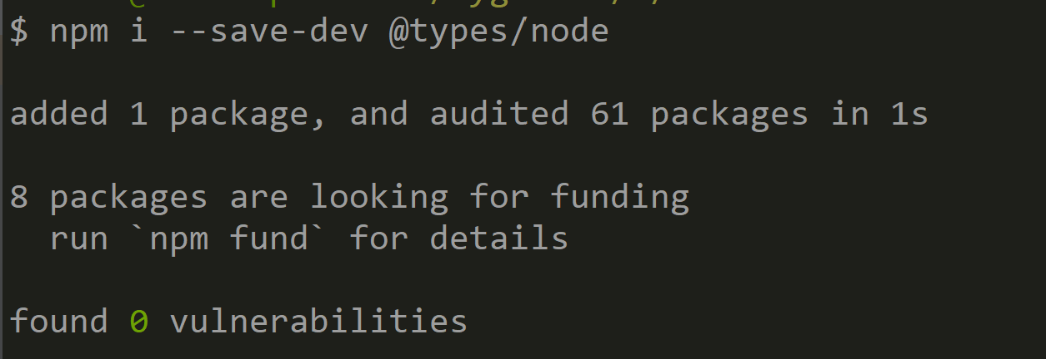
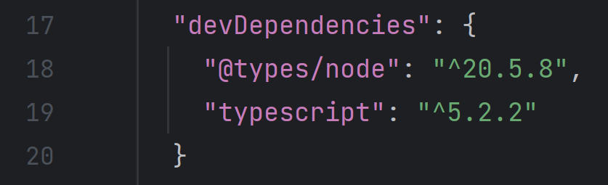
Answer 4 :

Slide 14
Question 5: Debug and inspect value
Re-launch in Debug mode and Put Breakpoint
Inspect content of variable « moduleA »

Slide 15
Question 6 : can you modify the « const » object content ?
Add code
moduleA.dummyField = 1;
Any compile Error in TypeScript?
What about Generated JavaScript ?
Runtime Error ?

Slide 16
Answer 6
TypeScript shows a compiler WARNING / ERROR
But generated JavaScript in « correct »
It run succesfully

Slide 17
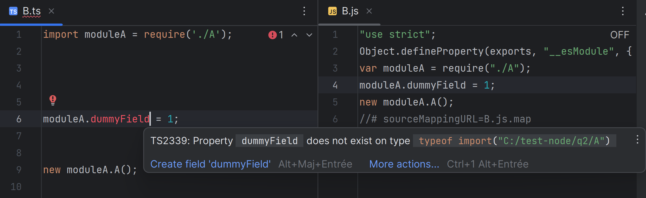
Answer 6
Compile ERROR
No Compile, OK

Slide 18
Question 7: meaning of « const »
What is the meaning of « const » ?
Can you make object immutable ?

Slide 19
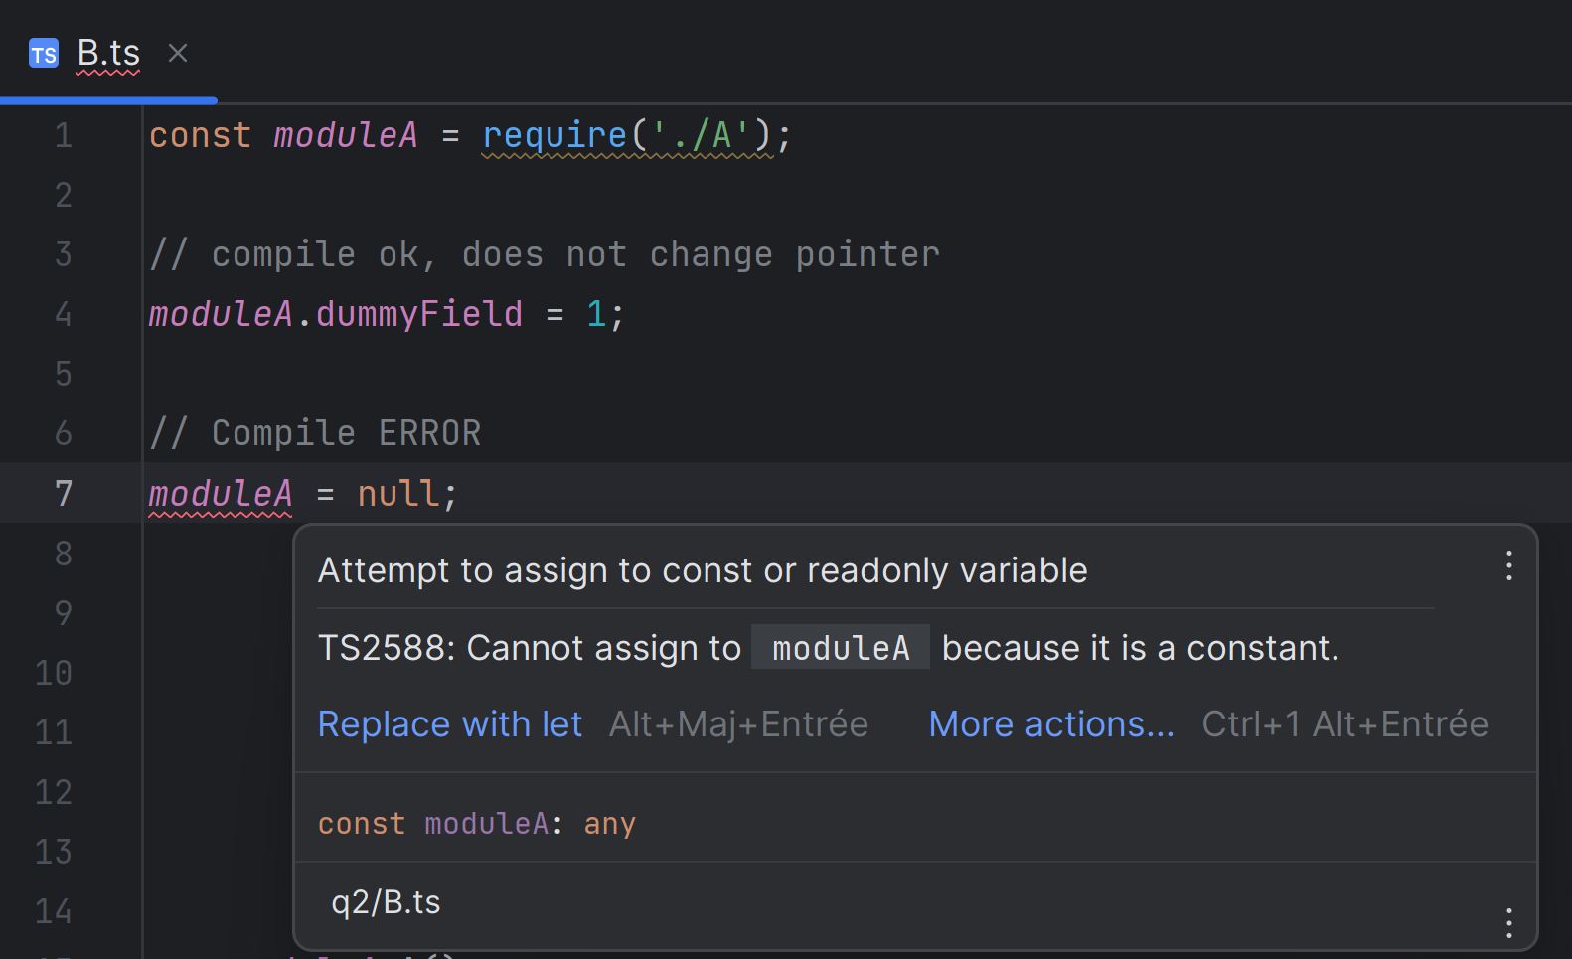
Answer 7
const : the reference (pointer) can not be changed
But the pointed object content can be changed !
You may use Object.freeze()
or redefine all « setter » methods
or use some javascript frameworks

Slide 20
Question 8: meaning of « let » and « var »
Does JavaScript accept accessing unknown(undeclared) variable ?
What is the meaning of « let » and « var » ?
What difference(s) between « let » and « var » ?
Knowing that « var » can be re-declared several times but not « let »,
what would you generally recommend to use ?

Slide 21
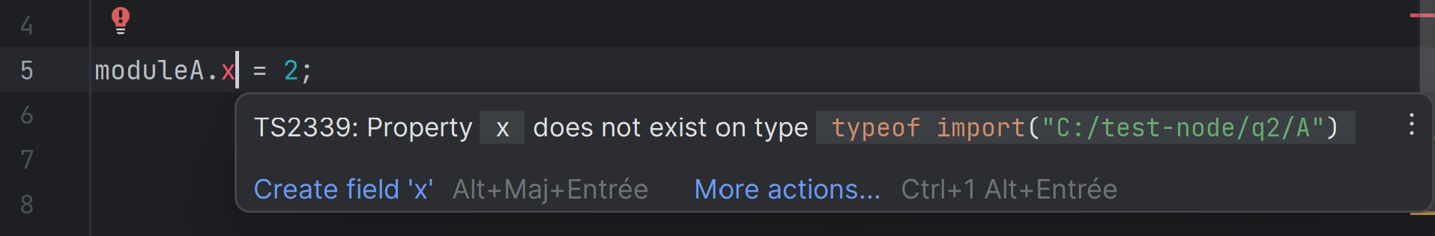
Question 9: property does not exist… but Runtime OK ?
WebStorm shows an ERROR for « property does not exist »
WebStorm suggest adding « // @ts-ignore » .. Try it
Suggest another way in Javascript to assign a property, not causing an error

Slide 22
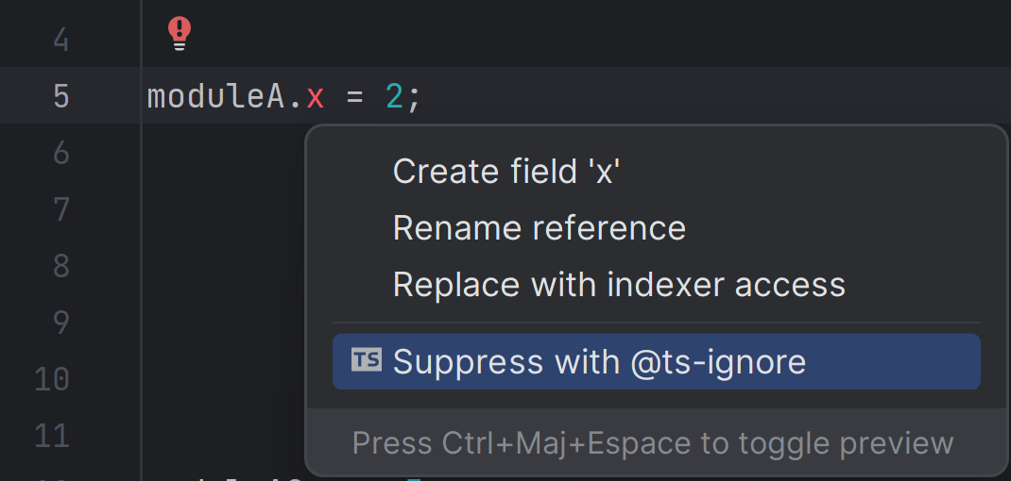
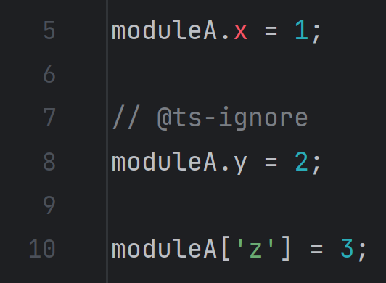
Answer 9
Use property indexed syntax :
obj[‘x’] = value;

Slide 23
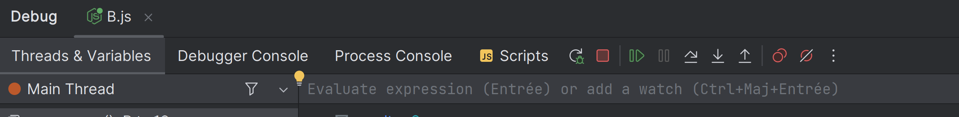
Question 10 : call require() several times… check same object is returned
const moduleA = require(‘./A’);
const moduleA2 = require(‘./A’)
Are they equals… Same content? Or same pointer ?
From Debugger, modify « moduleA » object to add a dummy property
Also modify from moduleA2
.. See if moduleA and moduleA2 are in-sync

Slide 24
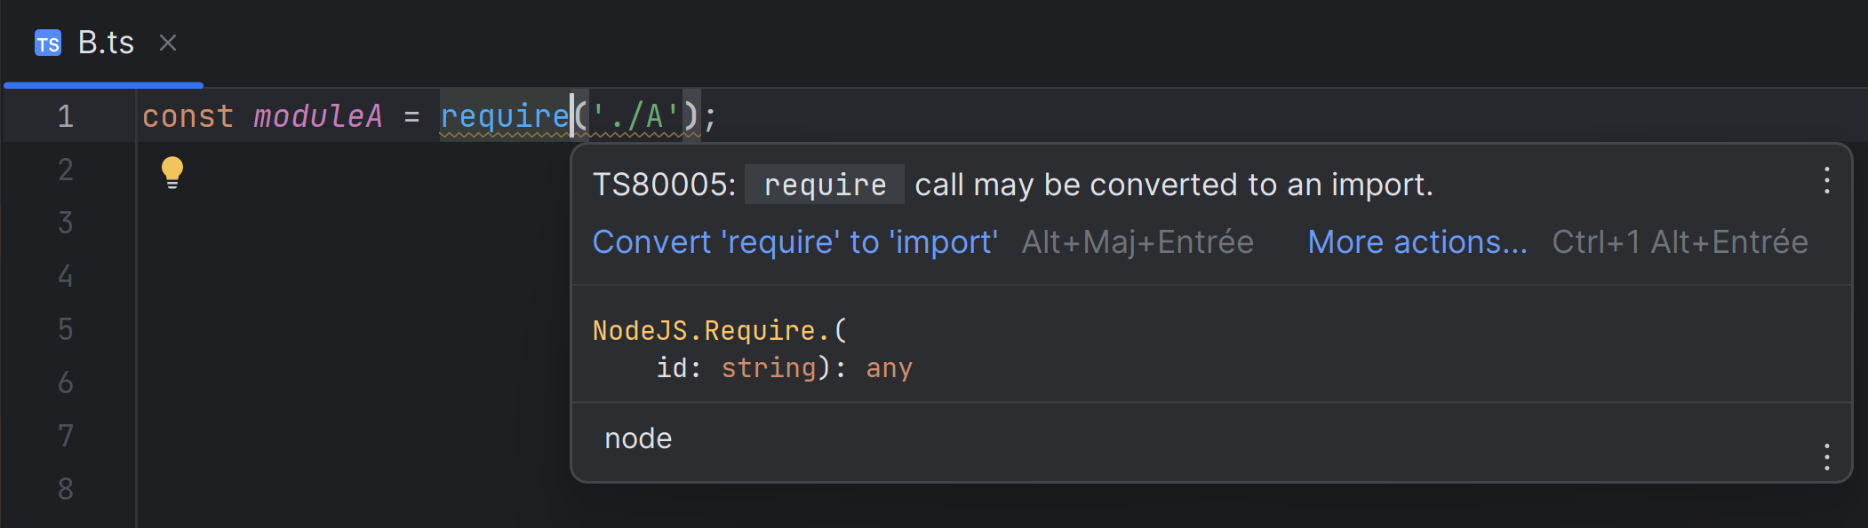
Question 11 : perform WebStorm suggested change convert ‘require’ to ‘import’
What do you get ?
Is is a standard named import like in TypeScript ?

Slide 25
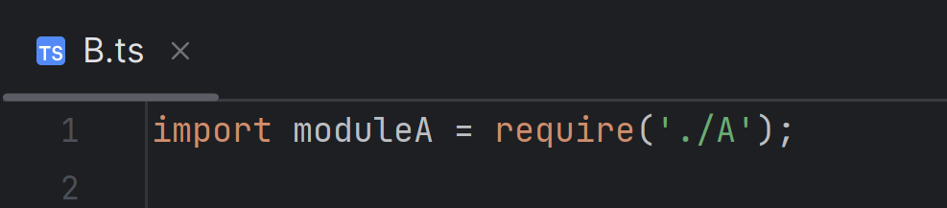
Answer 11 :
You still have to use « new moduleA.A() » …

Slide 26
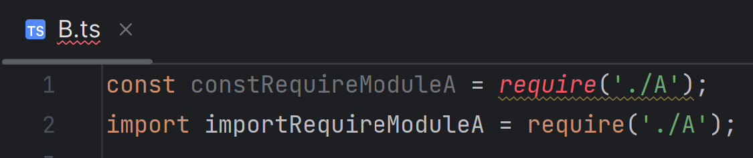
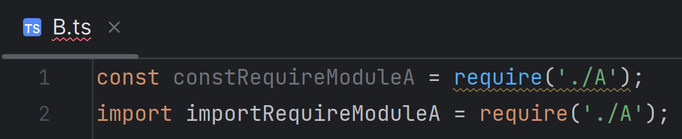
Question 12: Difference in generated JavaScript code ?
Is there any difference in generated Javascript code for both lines ?
Noticed line 1 is in « RED » but line 2 is ok.
After Applying « npm i --save-dev @types/node », you have underline marker on line 1

Slide 27
Question 13: transform to standard {named} import
transform to standard « named import »
as in Angular – TypesScript
Adapt « new A() » code, now simpler
Check re-run code
See generated JavaScript code

Slide 28
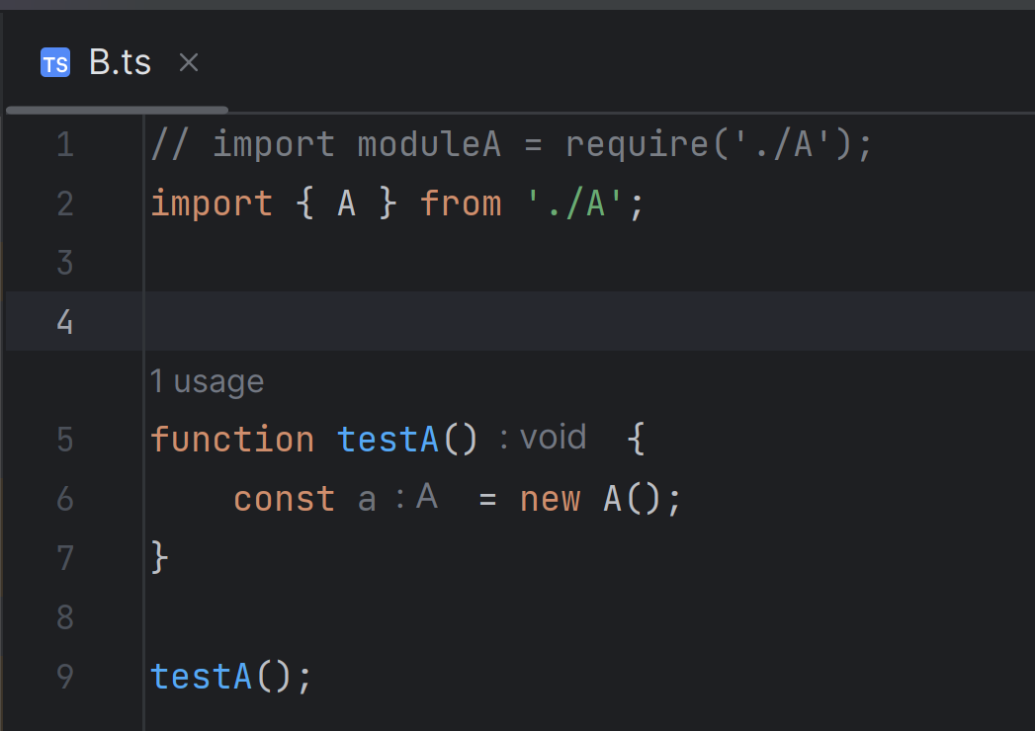
Answer 13 :

Slide 29
Question 14: redo using « import * as » syntax
Redo using « import * as » syntax
See generated JavaScript code, Compare with « =require() »
Optionnaly:
Repeat several times the « import * as », using different names
then add dummy fields moduleA.x= .. and moduleB.y=.. in each.
Explain what should you get in each ?

Slide 30
Question 15 : show generated js code from ts
Compare generated JavaScript codes for corresponding TypeScript :
What is generated for line « import * as moduleA from ‘./A’ » ?
What is generated for line « import { A } from ‘./A’ » ?
What is generated for line « import { A as B } from ‘./A’ » ?
What is generated for lines « new moduleA.A() »? « new A() »? new B() » ?

Slide 31
Question 16: generated names for imports
See from Previous question:
generated code for « import {A} from ‘./A’ » => creates a constant declaration
« const A_1 = require(…); »
What if you add in your code a conflicting declaration ? « const A_1 = ‘something else’; » ?
How is the conflict resolved ?

Slide 32
Question 17: export default … import named
Remember that file A.ts declares only 1 export, so
Create a similar new file « C.ts », which contains a class C … with « export default »
Now you can import with syntax « import C from ‘./C’ »
Notice NO more « { } » , as in « import { A } from ‘./A’ »
What is the generated JavaScript code for « import » and « new C() » ?

Slide 33
Question 18: export default… import with different name
Does it work ?
import D from ‘./C’;
new D();
import * as E from ‘./C’;
new E(); // <= compile error …
What is the correct syntax for creating the object?
import { C } from ‘./C’; // <= compile error .. Don’t use {}

Slide 34
Question 19: import from node_modules
Use import from ‘express’
Notice you do not specify relative path ‘./’
and in particular, do not use ‘../node_modules/express’

Slide 35
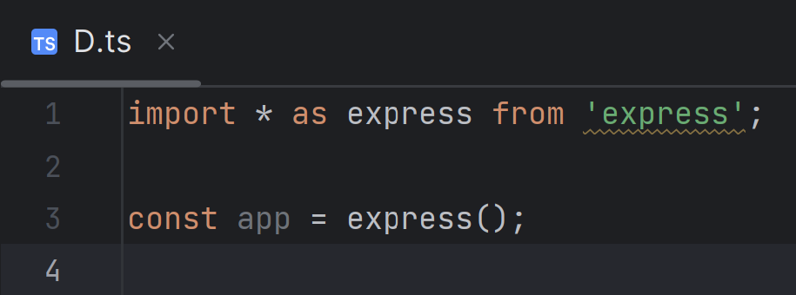
Question 20: Express … imported
What is the type of the imported object ? … so how do you use it?
Check both in Debugger and using suggested @types/express

Slide 36
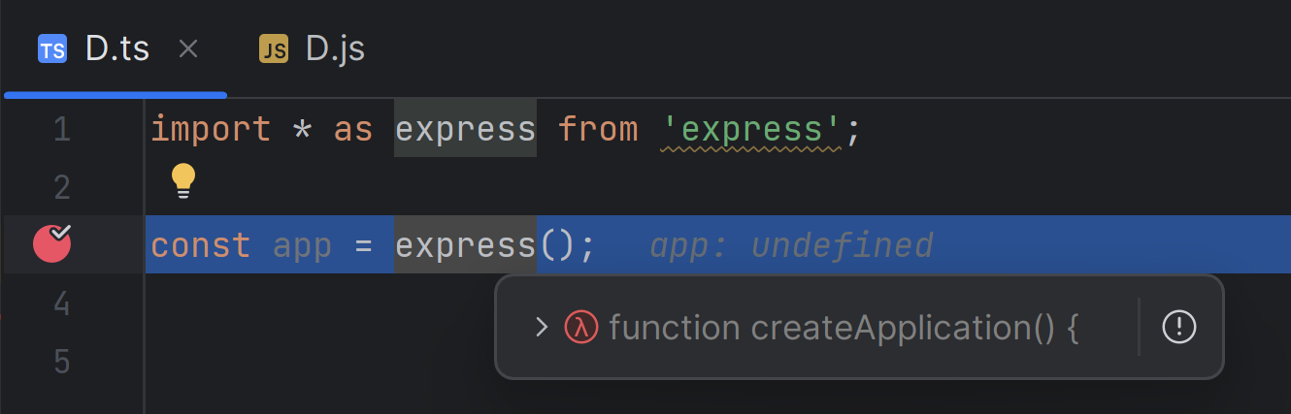
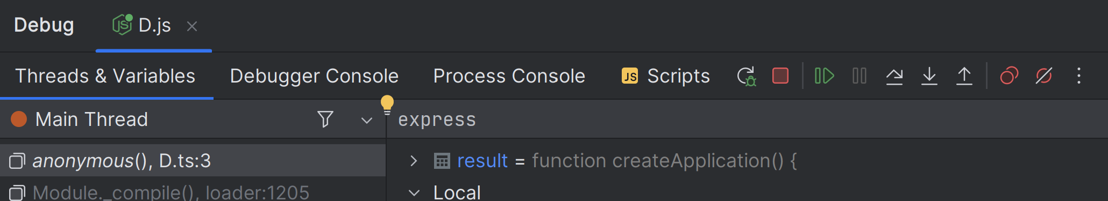
Answer 20 :
Imported « object » is a function !

Slide 37
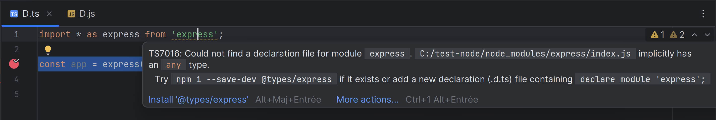
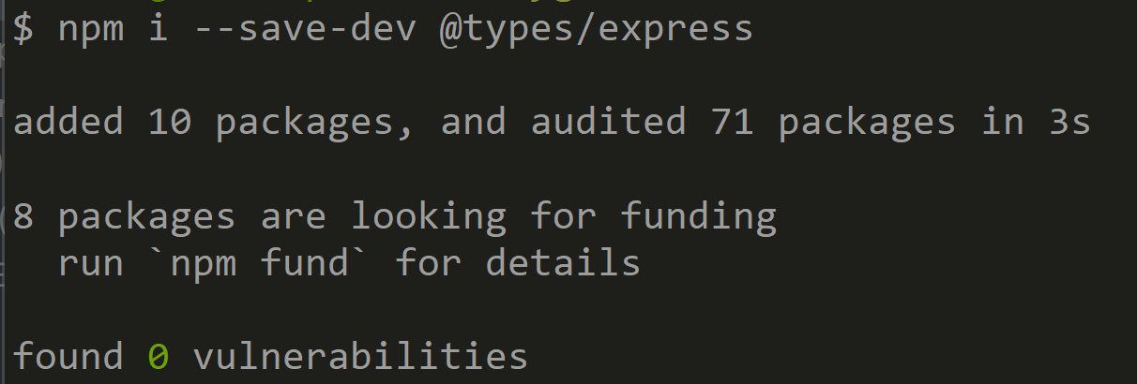
Answer 20 :

Slide 38
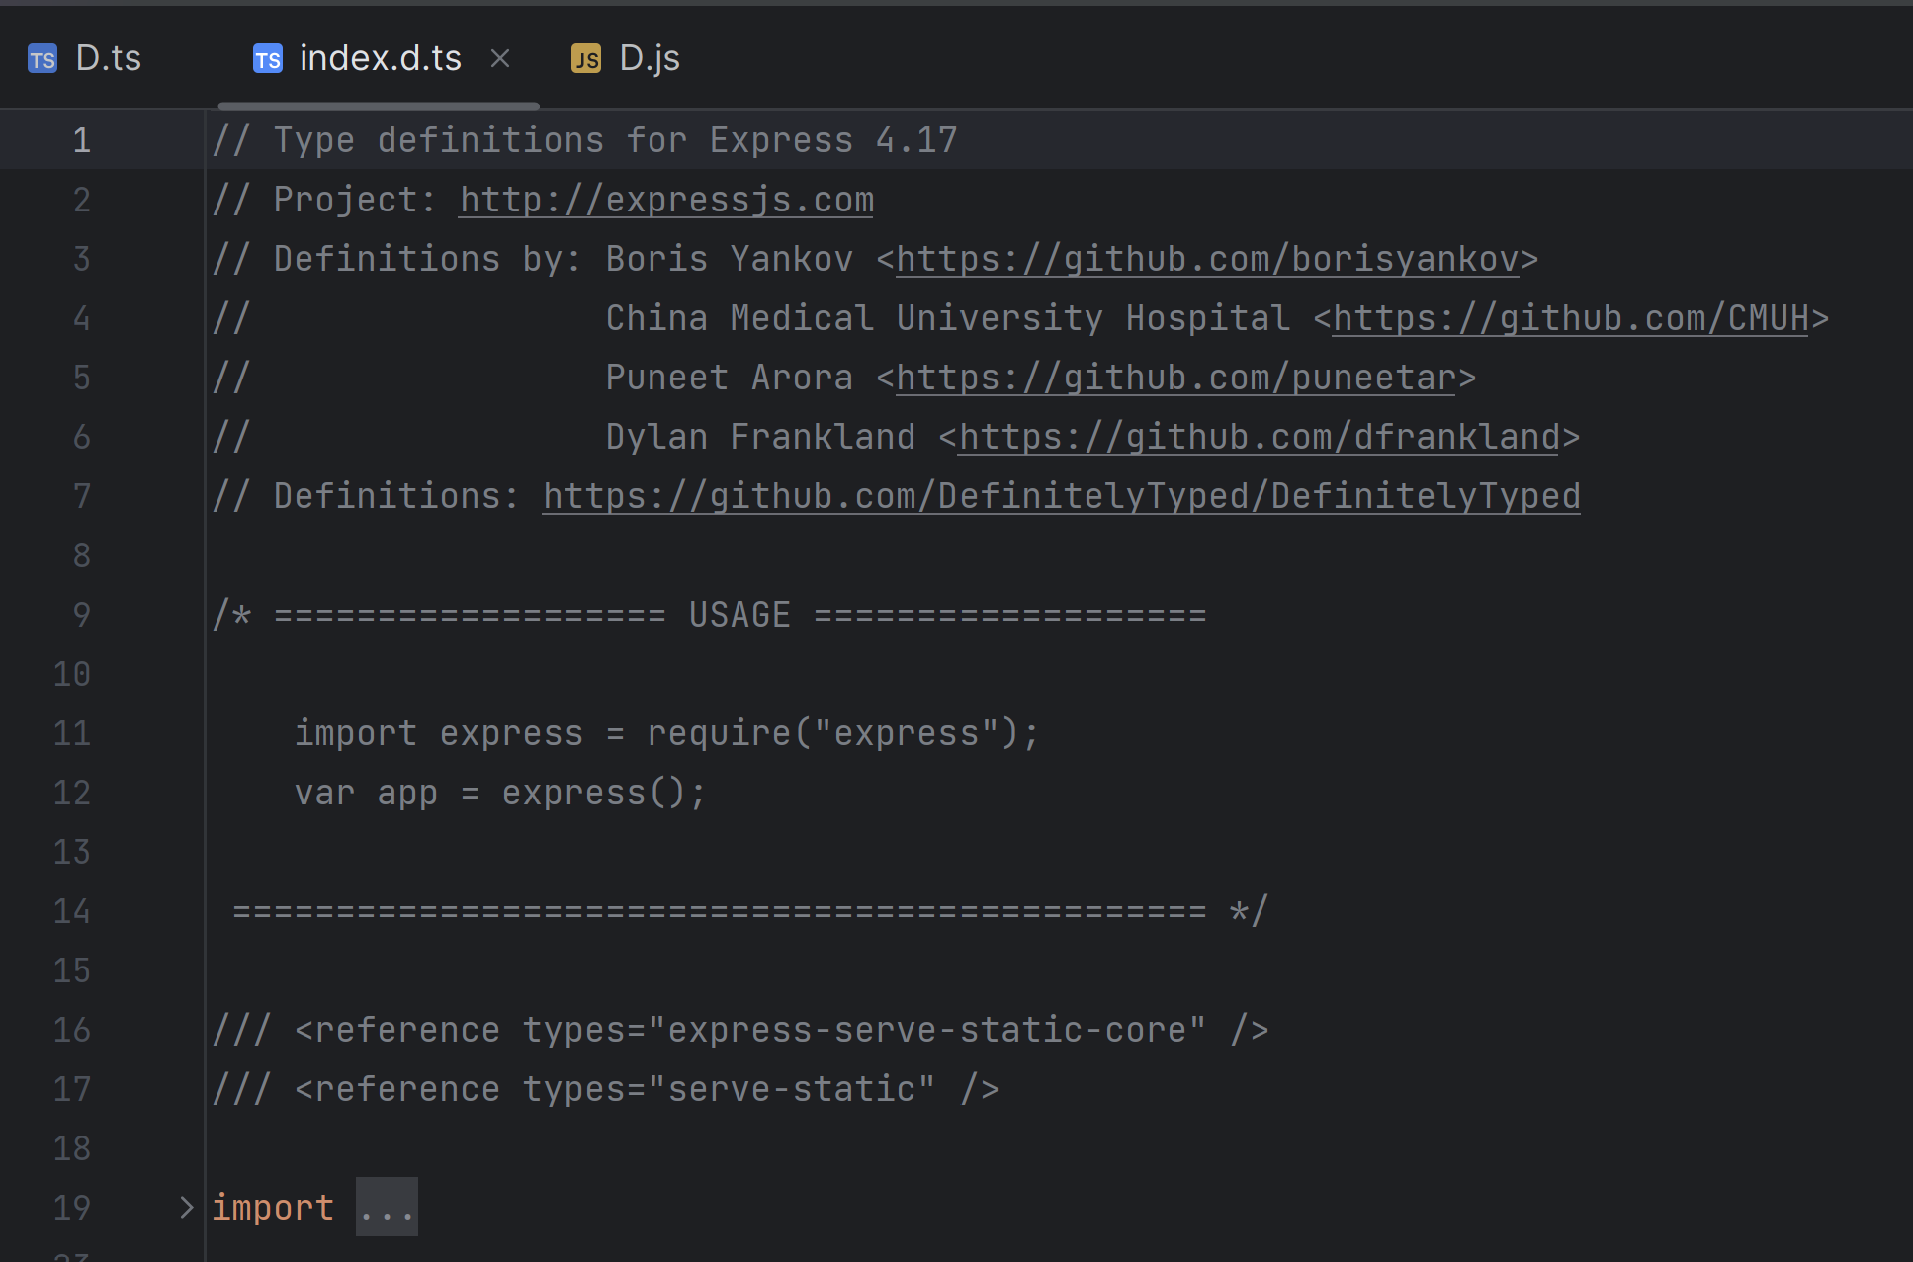
Answer 20 :
Once you have installed « express.t. », you can now browse on import ‘express’ (=> @type/express)

Slide 39
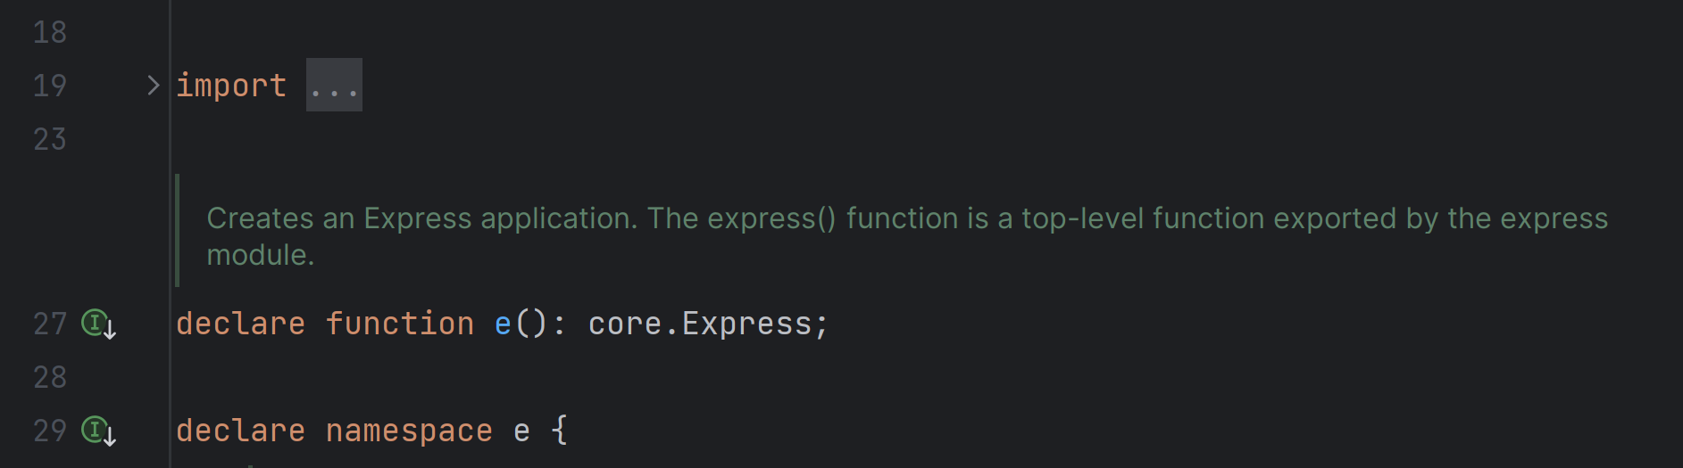

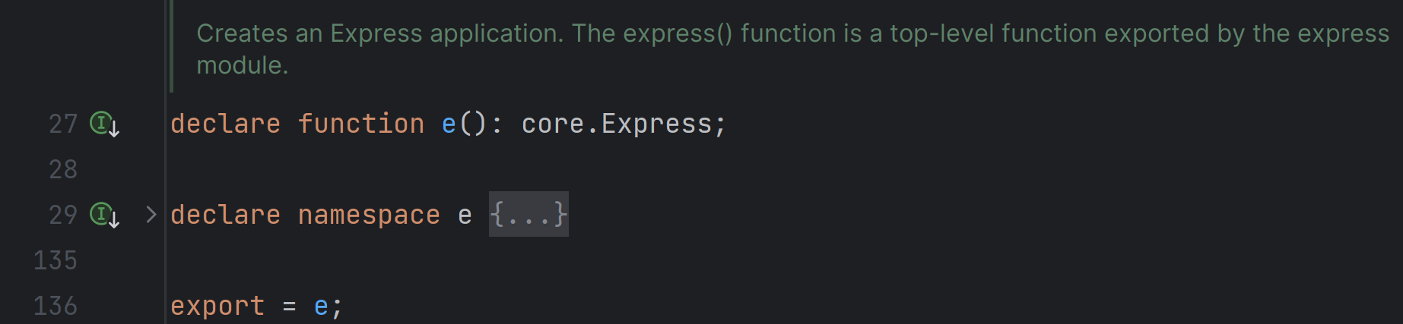
Answer 20 (bis)
Reading first declaration
and last line of file …
You can even shrink the lines
for « namespace e { …. }

Slide 40
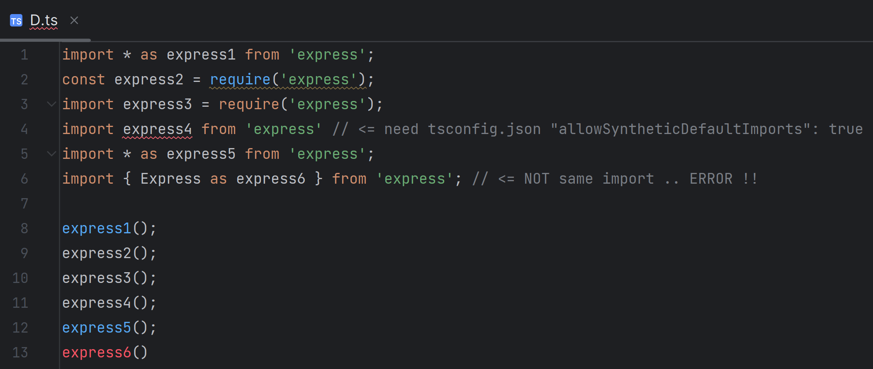
Advanced Remark on Question 20 : exploring alternative syntaxes to import express

Slide 41
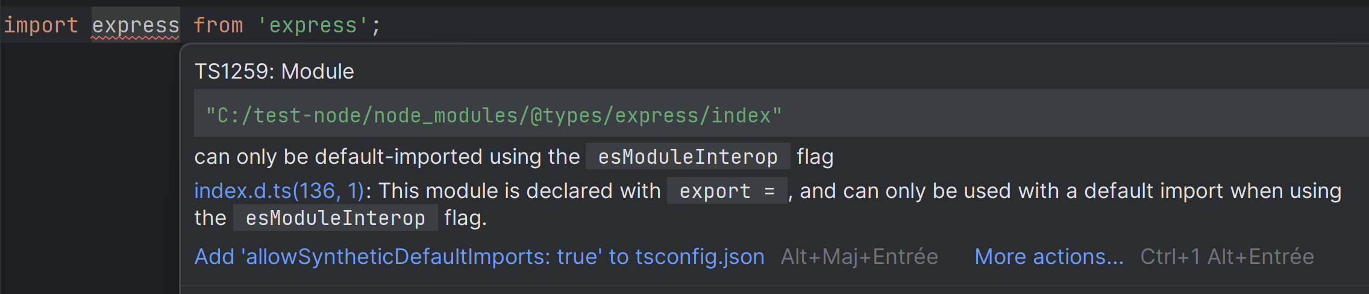
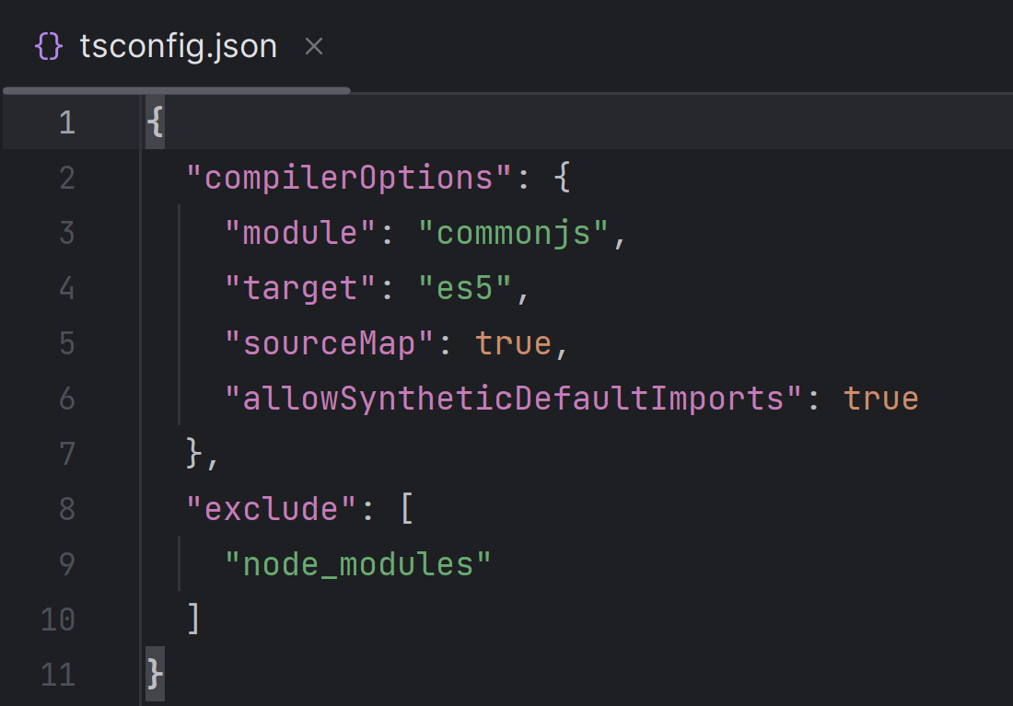
Advanced Remark on Question 20 …

Slide 42
Question 21: re-export from import …
Create a file ‘q2/index.ts’ that re-export all from ‘q2/A’, ‘q2/C’
Check that you can now directly import {A,C} from ‘./q2’
( suffix ‘/index’ is optionnal )

Slide 43
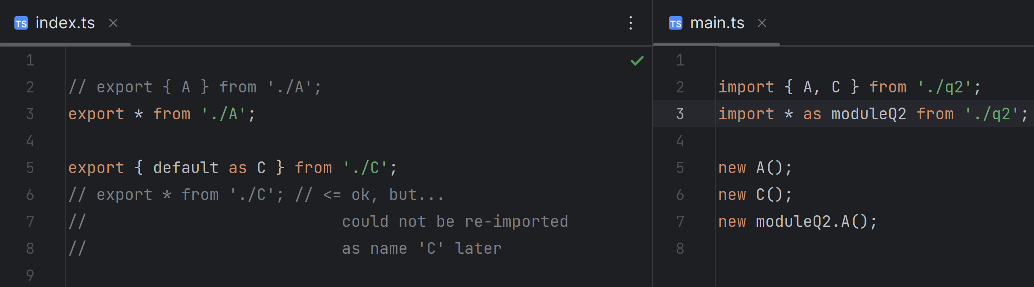
Answer 21 :

Slide 44
Question 22: import from built-in modules
using built-in module ‘fs’, here is a simple program to list all files in a directory
import * as fs from 'fs';
fs.readdir('.', (err, files) => {
files.forEach(f => {
console.log('file: ' + f)
})
});
1/ Execute it
2/ From your IDE, browse into ‘fs’ declaration check you have source code « node_modules/@types/node/fs.d.ts »

Slide 45
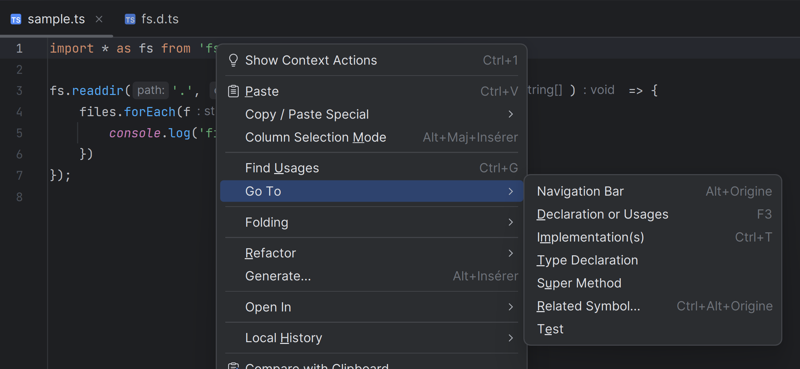
Answer 22

Slide 46
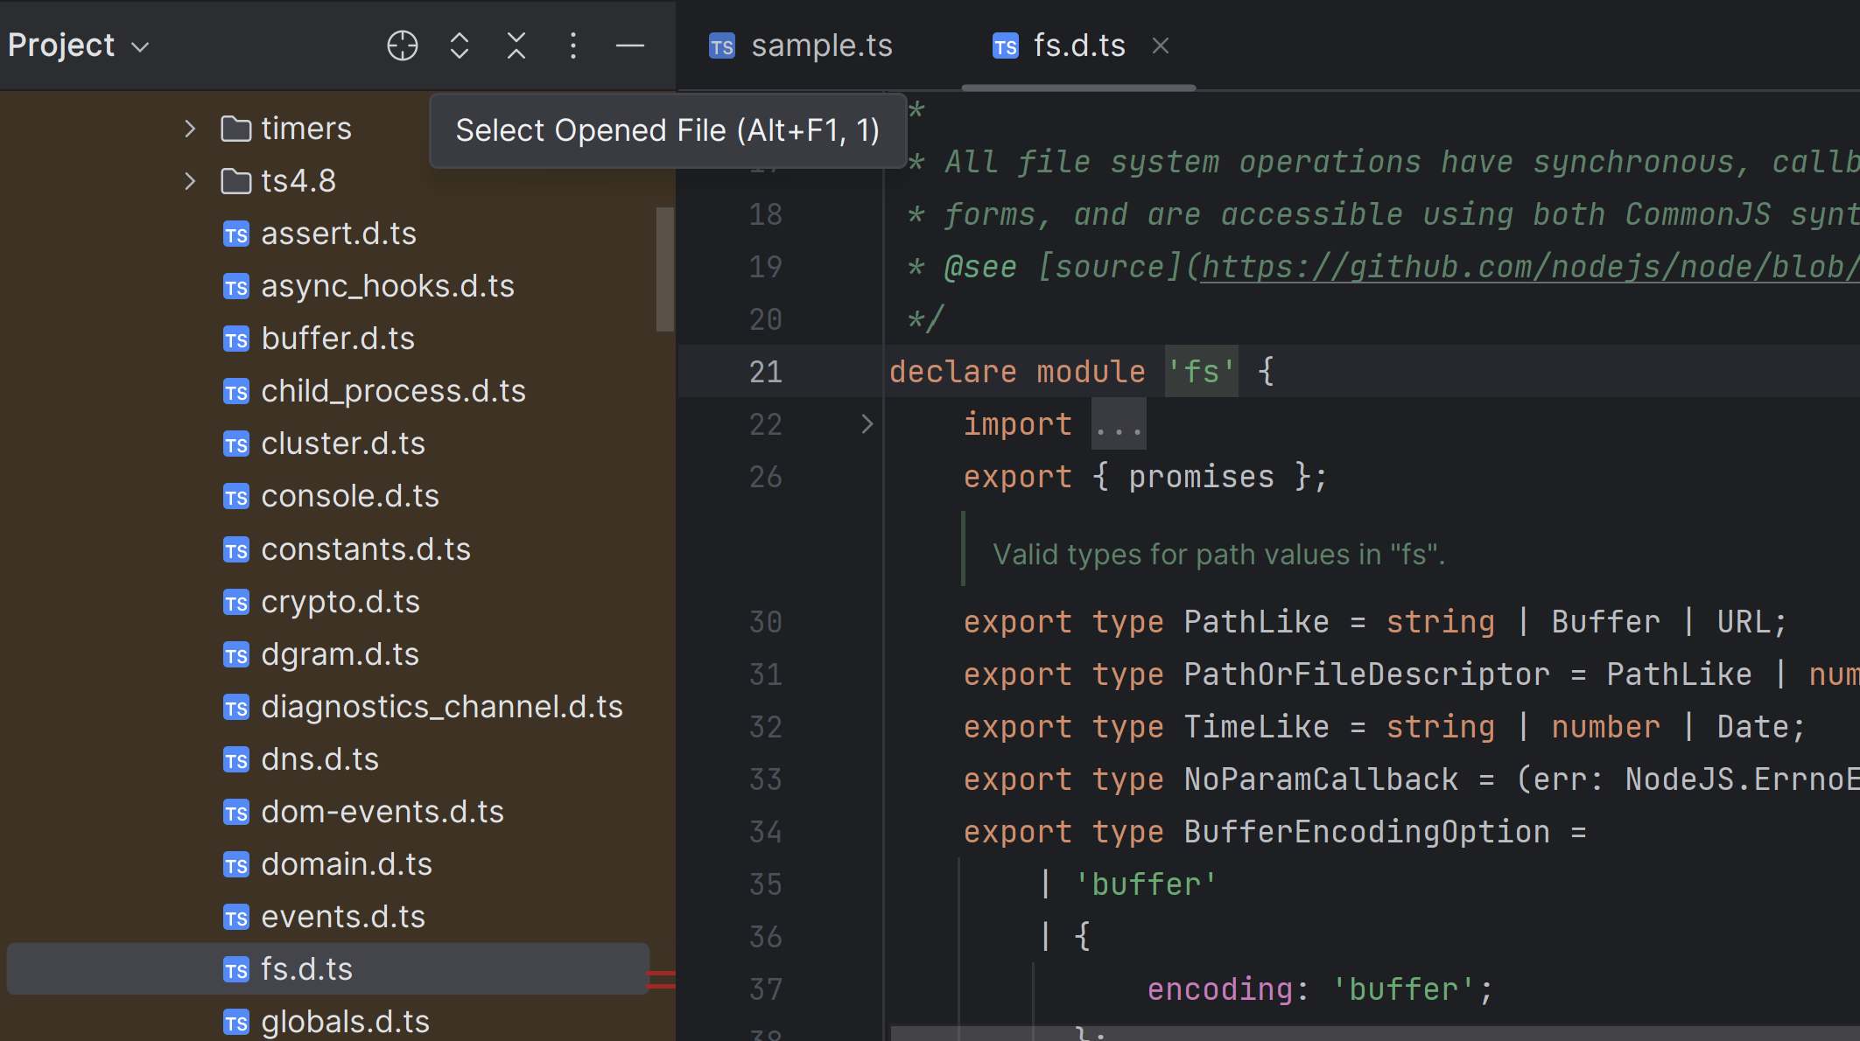
Answer 22 (bis)

Slide 47
Question 23: compare import NodeJs<->Angular… how is the generated JavaScript code in Angular ?
You started with ChatGPT, so Happily finish by ChatGPT !!
Ask him
What is generated javascript code for import in angular typescript ?
Differences between CommonJS, ES6, AMD, SystemJS ?
Whats is Webpack ?
What means EcmaScript compared to JavaScript?
ES6, EcmaScript2015 ?
ES7 … ES12 ? ES2021 ? Esnext ?

Slide 48
Next Steps … Hand-on 2 : build a http Rest Api (Json) in nodejs, using express
define CRUD for a simple collection, use Postman , add OpenApi, use swagger-ui

