Slide 1
course 2024 arnaud-nauwynck@gmail.com
This document: https://github.com/Arnaud-Nauwynck/presentations/pres-bigdata/ 3-failure-and-resiliency-pinciples-distributed-computing
Failures and Resiliency Principles
of Distributed Computing

Slide 2
MTBF
M.T.B.F = Mean Time Between Failure
For HDD ~ 500 000 hours ≥ 50 years
May looks good at home, to save your data
( "Mean" is probabilistic average...
Real errors will occur before )

Slide 3

MTBF « at Scale »
In DataCenter with 10 000 servers x 4 disks
=> 1 failure every 1h 15mn
= 19 failures per day
becomes a recurrent task / job

Slide 4

When Failure(s) Happens ?
=> Program fails ?
=> System fails ?
=> need relaunch manually ?
=> diagnostic hardware/software ?
=> interrupt all, repair ?

Slide 5
Studying « When Failure » 1/5
=> Program fails ?
=> System fails ?
=> need relaunch manually ?
=> diagnostic hardware/software ?
=> interrupt all, repair ?

Slide 6
When Failure..
=> Program fails ?
Individual Component : Obviously FAIL
Distributed Architecture : RESILIENT
resist (hopefully) to (some) failure

Slide 7
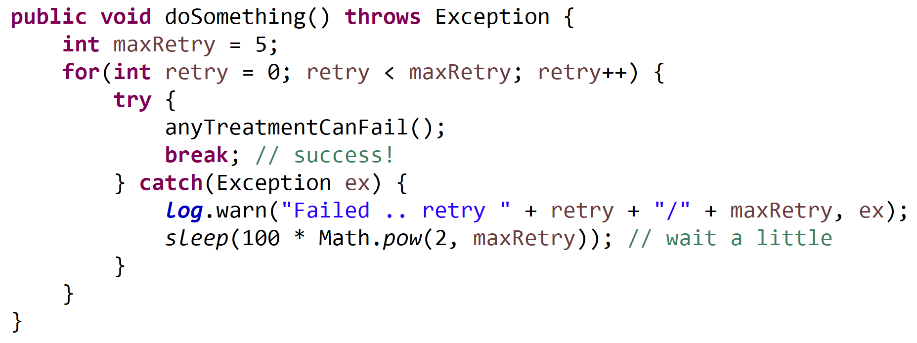
Failure is not « Exceptional » .. is a « normal » path consider it everywhere in code
if (retry+1>=maxRetry) throw ex;

Slide 8
Retrying with a LoadBalancer .. might just work
LoadBalancer
Call (Try 1)
... (Try 1)
Call (Try 2)
... (Try 2)
Dispatch to underlying servers
Using Round-Robin

Slide 9
Server Health Check Temporary evict from RoundRobin Pool
Health Check

Slide 10
Client-Side « LB »
Call (Try 1)
Call (Try 2)
NO « LB »
Need discovery mecanism on client

Slide 11
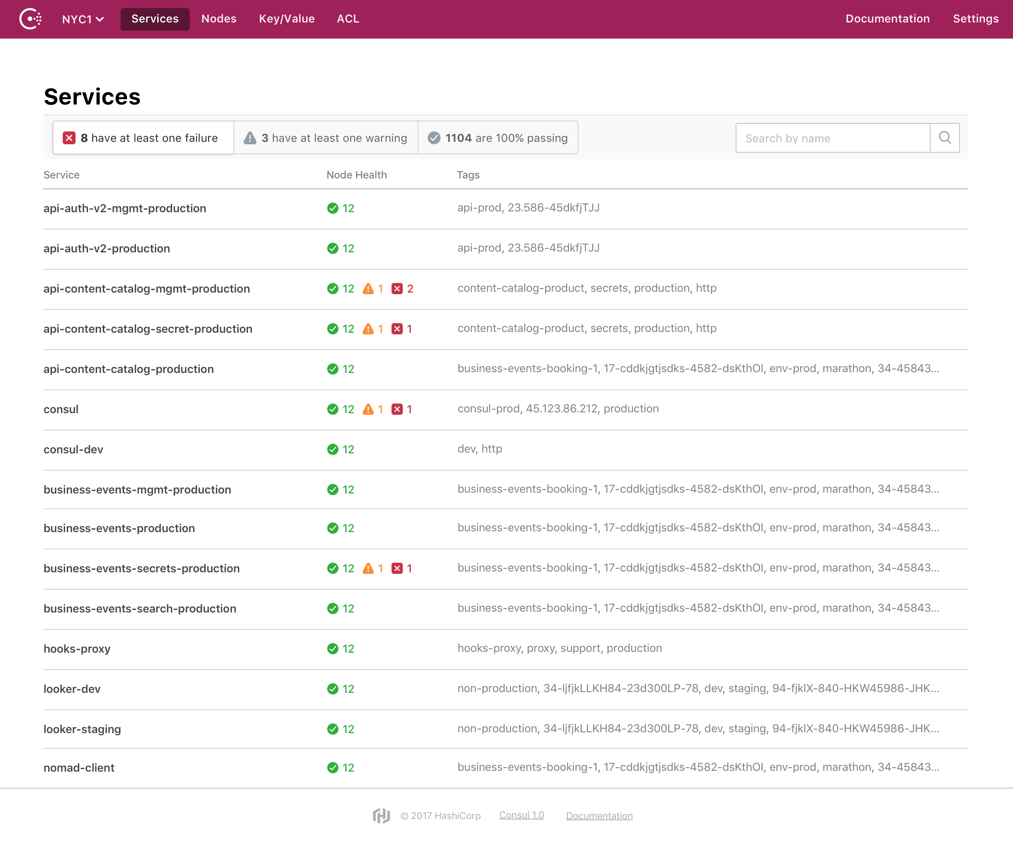
Service >= Nodes Examples of Service Discovery
DNS, ServiceMesh, Zookeeper, Consul.io, HAProxy, Kubernetes, ..
Consul.io Services
Nodes

Slide 12
Studying « When Failure » 2/5
=> Program fails ?
=> System fails ?
=> need relaunch manually ?
=> diagnostic hardware/software ?
=> interrupt all, repair ?

Slide 13
System = Union of independent components
Each component can be killed
… The system must survive each failure

Slide 14

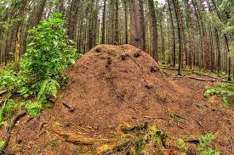


Be Confident in « System »
Walk on a « Ant » ...
… « Anthill » not in danger

Slide 15
How to Check System does not « Fail » ?
Very difficult to « prove » system correctness
Easy to test : « kill and see »
Not an exhaustive test… Repeat + Changes

Slide 16


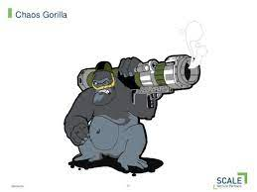

Test Kill with Chaos Engineering
Initiated by Netflix
Goal : Randomly kill Process / VM / Datacenter

Slide 17

SLA : 99.99 Up-time ?
= Daily: 8s
Weekly: 1m 0s
Monthly: 4m 22s
Quarterly: 13m 8s
Yearly: 52m 35s
3 nines : 99.999 = Yearly : 5mn15s
4 nines : 99.9999 = Yearly : 31s

Slide 18
Studying « When Failure » 3/5
=> Program fails ?
=> System fails ?
=> need relaunch manually ?
=> diagnostic hardware/software ?
=> interrupt all, repair ?

Slide 19
When Failure ...
=> need relaunch manually ?
Hard-Coded Launch to specific server.. fail
Auto Distributed: RESILIENT
don’t launch manually on a specific server
Let the system select one

Slide 20
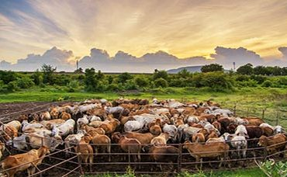
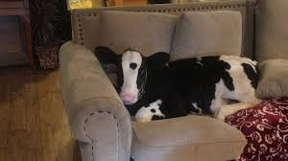
Pet vs Cattle
Pet have id=name
You take extra care of it
Cattle >= 1000 : anonymous
Id=Number, interchangeable

Slide 21
Launching => Scheduling on Allocated Resource
You submit
Something to run
You don’t run yourself
internally, it may
wait/allocate resource
do retries...
Not your concern.

Slide 22
Studying « When Failure » 4/5
=> Program fails ?
=> System fails ?
=> need relaunch manually ?
=> diagnostic hardware/software ?
=> interrupt all, repair ?

Slide 23
When Failure ...
=> diagnostic hardware/software ?
NO ? … difficult anyway
Bugs may exist
BUT failure is « not » a bug

Slide 24
Studying « When Failure » 5/5
=> Program fails ?
=> System fails ?
=> need relaunch manually ?
=> diagnostic hardware/software ?
=> interrupt all, repair ?

Slide 25
When Failure ...
=> interrupt all, repair ?
NO …
Immutable-Infrastructure
Do not edit infra once created
Drop and re-create new VMs

Slide 26

When Failure ...
Hardware HOT-PLUG :
unplug old disk, and plug new one
Without interruption

Slide 27
When Failure ...
Idem for Software :
add/remove servers to cluster
( no hard-coded topology/confs )

Slide 28
Duplicate Failable Component for Fewer System Failure
If a component has 0.01 chance to Fail today
Adding another (independent) component…
=> Probability that 2 fail today = 0.01*0.01 = 0.0001
=> Probability that 3 fail today = 0.01³ = 0.000001 = 1e-6
« If » your system still works with 1 working component out of 2 … better

Slide 29
System ≥ Component If No Correlated / Dispatch / No Spof
Electric power : when fail … all fails (correlated failures)
Need reliable network + dispatching to working components (retry/detect failed ones)
Everything between the components can be a « SPOF »
Network may be a « Single Point Of Failure »
as all forgotten components not redundant

Slide 30
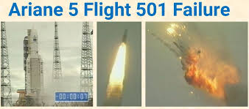
Story of Arianne 501 Duplicated / « Correlated » Errors...
Flight computation performed twice in parallel on 2 isolated hardwares
But using same program…
Both programs throw same «overflow exception » at exact same millis
=> Lessons learned : use 2 hardwares + 2 independent softwares + ..

Slide 31
Single Point Of Failure ?
... (Try 1)
... (Try 1)
Call (Try 1)
Call (Try 2)
... (Try 2)
... (Try 2)
High Availability Servers…
But Shared State / Database .. SPOF

Slide 32
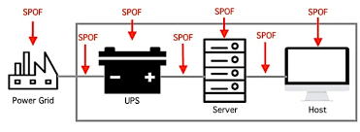
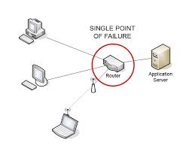
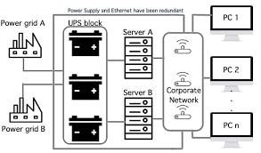
Examples of SPOF

Slide 33
NO SPOF : Duplicate Everything
But how to duplicate a single Source of Truth « Data » ?
Copy => stale data / replication / distributed lock ?

Slide 34
Stateless, Spof, Sharded (easy) vs Statefull (difficult)
Distributed Lock ?
Replication ?
Source of truth ?
Stateless
( or stale Read-Only cached data)
Spof
Sharded… 2 spofs
(ex : id modulo 2)
Horizontal scale : OK
But not replicated
Statefull
Concurrent Distributed Data

Slide 35
« HA » High Availability Active – Standby + Replication
2/ request
To current Leader
Save data
+ replicate
1/ Query
current Leader
Leader Election System
Curr Leader = node1

Slide 36
Transparent Delegate to Active
Forward to active
Save data
+ replicate
Call any server
(round-robin?)
Leader Election System
Curr Leader = node1

Slide 37
Synonym Terms...
Master – Slaves (not polically correct)
Leader – Followers
Active – StandBys
Primary – Secondaries
Main – Replica
MainSite - Disaster Recovery
MainDisk - BackupDisk

Slide 38
Switching from Active to StandBy
Latest saved data
NOT yet replicated
to server 2
Server2 in cold state
Not ready for burst of calls
Data in server 2
NOT ready/online
Data in server 2
NOT replicated (to server1 ?)
Client detect
Failure ?
..switch ?
Leader Election System
Curr Leader = ?
Detect ? Trigger new
Leader Election Phase
..switch / split brain?

Slide 39
Problem with Leaders same as in Political
works only when there is exactly 1 leader
≥ 2 leaders … conflicts / Split-Brains / Network Partitioning
0 Leader … nothing works
Imposters pretend to be Leader
Leader staying leader too long after new election
Slow to organize election
Trust the result of election ?
Who can organize if there is no leader?
Can’t decide election in 50 % / 50 % equality … need an odd number : 3, 5, 7..
There must be at least 50 % participation (no Abstention)
Otherwise both candidates pretend to majority (not absolute majority) with 50 %

Slide 40
Leader fail to « Start Lead » … re-electing too Often ?
Example of Catastrophic scenario :
1/ Server « N » become Leader
2/ It needs huge memory to serve requests
There are too many requests (burst of waiting requests)
3/ « Full GC » occurs, take >=30s , and « stop-the-world »
30s is the default Timeout for socket connection / read response
… During this time, Leader fails to answer to « Health check »
4/ Leader is considered not healthy => not leader any more
=> 5/ Electing another Leader « N+1 » => back to beginning 1/

Slide 41
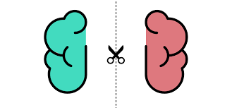
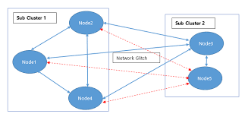
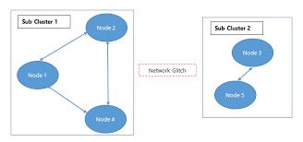
Split Brain / Network Partitionning
1 cluster, 1 master
status=OK
… but network partition happens
2 clusters fully isolated each
Each have 1 master
Each have status=OK
… data diverge, will discover conflict on merge

Slide 42




Quorum of 50 %
candidate1
candidate1
Quorum of >50 % reachs => elect candidate1
candidateX
candidate1
candidate2
NO Quorum of 50 % reachs
=> re-organize new election
( proba=0.5 that 2 of 3 vote for same )
candidate1
Majority but NO Quorum
… high risk of Split-Brain
( all others may vote and you are not aware)
=> wait enough voters (re-organize / accept vote)

Slide 43



Waiting Quorum = system « Not Available »
Waiting Quorum
<= 50 % … means cluster 0 % working

Slide 44
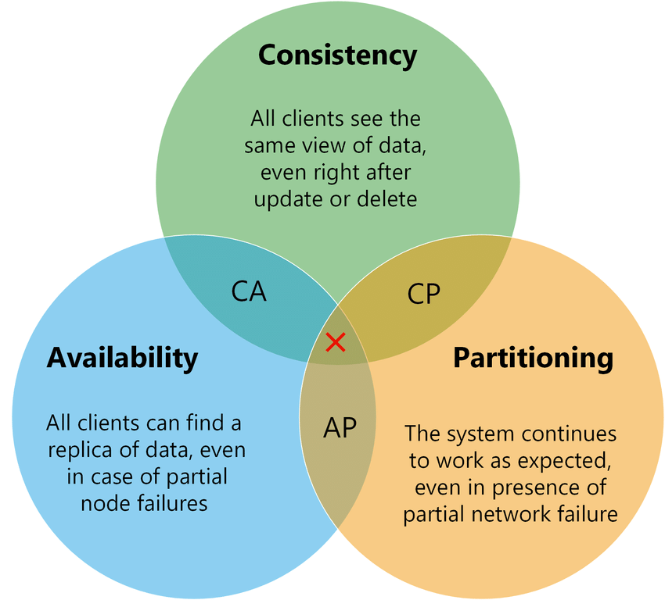
CAP Theorem .. Choose 2 out of 3

Slide 45
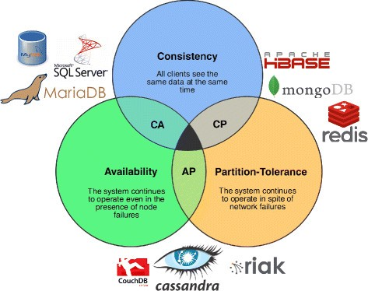
Databases choices
« Eventually Consistent »
.. Means « NOT » always consistent … but ends to be

Slide 46
Distributed Coordination Server(s)
Small subsystem (3,5,7 nodes)
for quorum / election
Storing coordination data
N servers => N+3 connections
Difficult to synchronize data on N servers
N servers => 1/2 * N * (N-1) connections .. too many
Slow to organize election

Slide 47

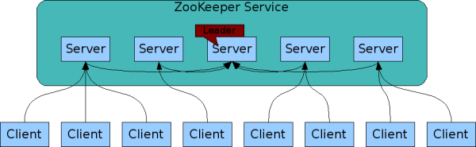
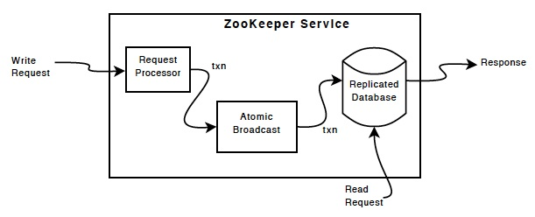
ZooKeeper Because Coordinating Distributed Systems is a Zoo
Zookeeper is CP (Consistent and Partition Tolerant)
Not A (Available)
All writes are serialized to Leader
(exclusive lock)
+ replicated to quorum for committing

Slide 48
ZooKeeper Features
1
Watch
ZNode
child
ConnectionSession
*
1
0..1 parent
EphemeralZNode
(Persistent)ZNode
Zookeeper kernel : « key=value » database, with atomic features
Organized as directories hierarchy, called Znode
With Listening capabilities
And Ephemeral Znode for connections

Slide 49
ZooKeeper
Znode « / »
Znode « /data »
« /prop » = value
Get key..
Set key=value
List key/*
Listen Key
Znode « /servers »
EphemeralZNode « /node1 »
EphemeralZNode « /node2»
Example for service discovery :
Listen « /servers/* »
EphemeralZNode « /node3»

Slide 50

ZooKeeper : for Master Election + Persist Topology/Metadata Infos
Master
? ?
Election
Follower
Follower

Slide 51
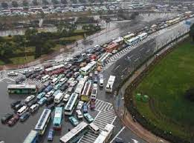
1 Master for All => does not scale
Master treat
all requests
Followers IDDLE
in StandBy Mode
( waste of cpu )

Slide 52
Sharding for Horyzontal Scaling
Sharding = choose responsible server from data Id
( shared rule for clients and servers )
ServerId = Id modulo 3
When Id%3 = 0
Example
id=5
When Id%3 = 1
Hash: 2
When Id%3 = 2

Slide 53
Sharding .. Pros/Cons
Scale very well « linearly » with number of servers
ONLY for request with known « ID »
(not for search / full scan)
Difficult to redimension « N » at runtime… need re-shuffle all data !

Slide 54
1 Master per Shard
Shard 1
Shard 2
Shard N
Node1
master
Node1
Node1
Node2
replica1
master
Shard1 : master on 1
Replica on 3, 4
Node3
replica2
master
Shard2 : master on 3
Replica on 2, 5
Node4
replica3
ShardN : ...
Node5
replica3
replica3

Slide 55



3 Examples & Comparisons for Sharding + Master/Replica

Slide 56

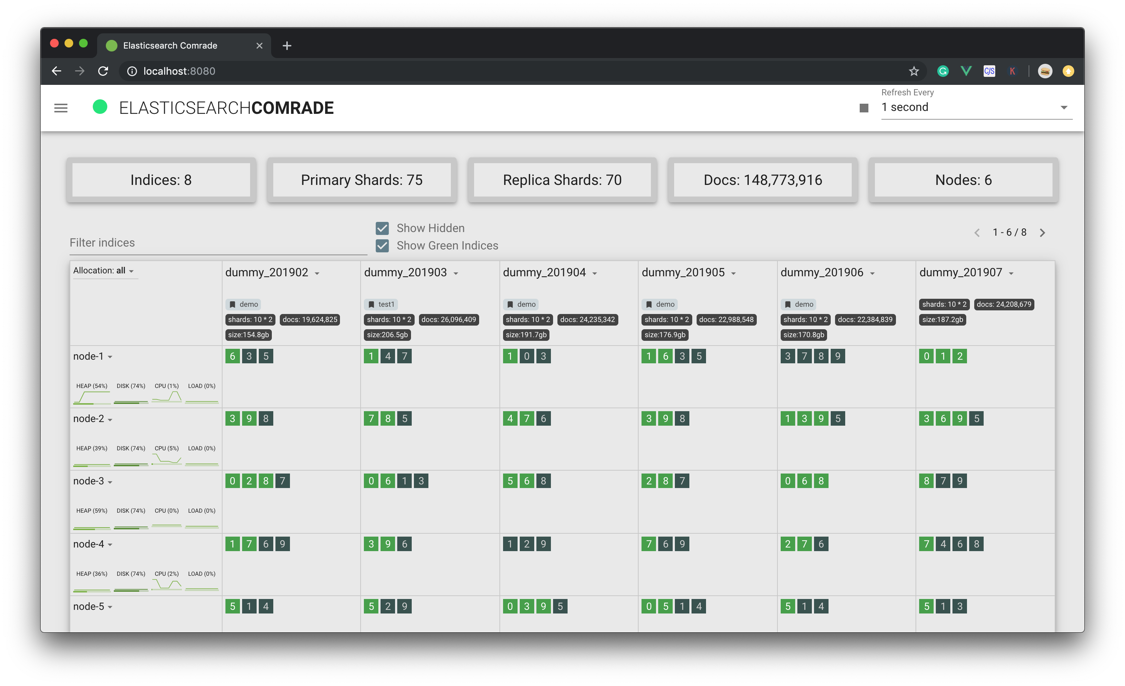
Example 1/3 : ElasticSearch

Slide 57
ElasticSearch … UML model
*
Index
(~table)
1
1
Cluster
*
Shard
Id : 0..N
1
1
1
Shard-Replica
*
Node
*
1
*
*
Document
Id (Immutable)
=> shard id
Document : json text
{ _id : « some-id1 »,
field1 : 123,
field2 : { subField : [ « a » ] }
}

Slide 58
ElasticSearch … Zooming Relations
Horyzontal Sharding (by Id)
Index
(~table)
Replication
1
*
Shard
Id : 0..N
1
Shard-Replica
Node
*
1
*
Assignement to Nodes
Role leader/follower

Slide 59
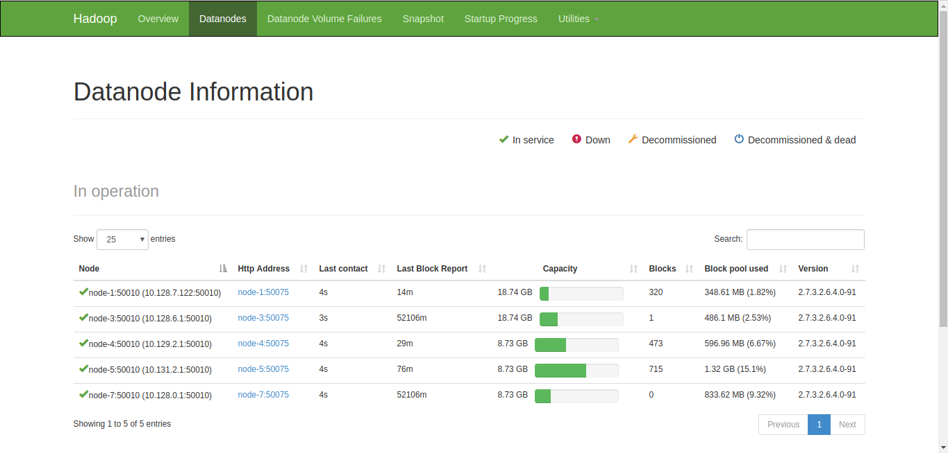
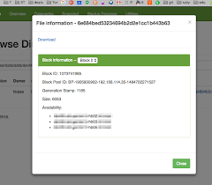
HDFS

Slide 60
HDFS … UML Model
FsEdit
1 (current)
* old
FsImage
INode
*
1 (current)
* old
Directory
SymLink
NameNode
1
File
2
1
Cluster
*
Block
1
*
1
DataNode
*
Block-Replica
1
*
File: binary large object « blob »
= metadata
(owner, group, chmod, acl, ..)
+ list of blocks

Slide 61
HDFS … Zoomin Relations
Horyzontal Sharding
Replication
File
1
*
Block
1
Block-Replica
DataNode
*
1
*
Assignement to Nodes
Role leader/follower

Slide 62
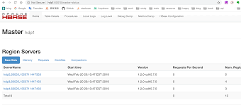
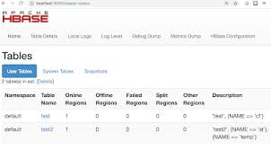
HBase

Slide 63
HBase … UML Model
Row
1
*
CF-Columns
1
*
1
Column-Value
*
1
Namespace
1
ColumnFamily
1
*
*
1
1
Table
1
1
*
Region
[StartKey,
endKey(
*
HBaseMaster
1
Cluster
1
Store
1
*
*
*
1
StoreFile
RegionServer
1
*
Table = Map<byte[],Map<byte[],byte[]>>
RowKey
BlobValue
RowKey
ColumnFamily:Column

Slide 64
HBase … Zooming Relations
Horyzontal Sharding
(by Id)
(by columnFamily)
Replication
Table
1
*
Region
[StartKey,
endKey(
1
1
Store
*
1
*
RegionServer
StoreFile
1
*
Assignement to Nodes
Role leader/follower

Slide 65
Questions ?

