Slide 1
BigData – Spark Hands-On File IO - Parquet TD2 - part 2/2
arnaud.nauwynck@gmail.com
Esilv 2024

Slide 2

Objectives of TD2
1/ read CSV files, convert options
2/ read combine several files
3/ others file format: json, nd-json, xml, text
4/ write to PARQUET files dir repartitionning
5/ Discover PARQUET format optimisations

Slide 3
Exercise 15: (similar to exercise 9) save as parquet, load parquet file
a/ Convert Dataset addresses loaded (.. from CSV files)
into PARQUET files
b/ look at written file
compare file size of csv/ json with Parquet
c/ reload dataset from Parquet file
d/ notice more memory needs during conversion, logs example
WARN MemoryManager: Total allocation exceeds 95,00% ..of heap memory
Scaling row group sizes to 96,54% for 7 writers

Slide 4
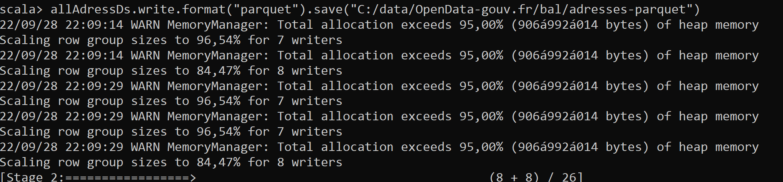
Answer Exercise 15
allAdressDs.write.format("parquet").save("C:/data/OpenData-gouv.fr/bal/adresses-parquet")
More on this later… spark has split into 26 partitions
More on this later… retry with force spark « repartition » to write 1 file
allAdressDs.repartition(1).write.format("parquet").save("C:/data/OpenData-gouv.fr/bal/adresses-parquet1")

Slide 5
Exercise 16 : (similar to exercise 10) analyze written PARQUET files
Repeat the same operation twice, and notice that
1/ you can not specify the file names .. Only an empty directory name !
2/ the file names are generated with a unique UUID part-00{partNumber}-{UUID}-c000.snappy.parquet
3/ during write time… spark write to « _temporary » sub dir, then rename at the end
4/ spark has written several files … If using the full dataset of 3Giga .. Spark write 26 parquet files

Slide 6
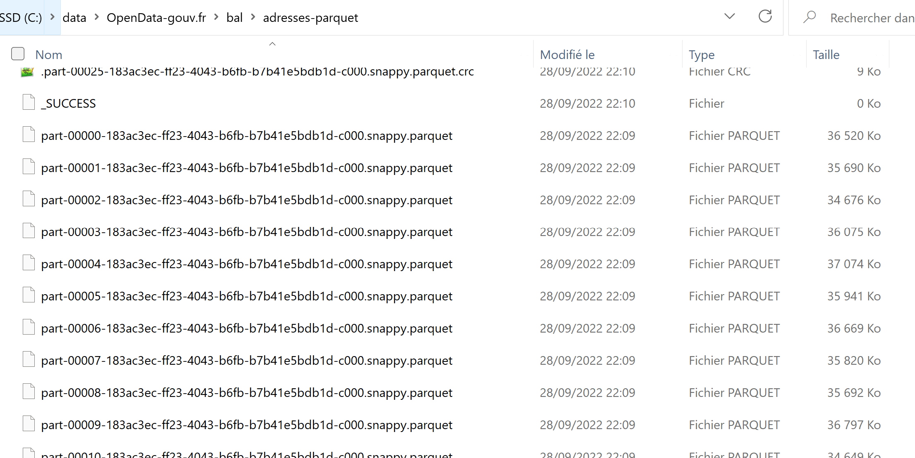
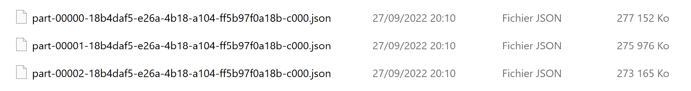
Answer Exercise 16 …
Compare with previous 26 json files …

Slide 7
Answer Exercise 16
Parquet files …. 10x smaller than json files

Slide 8
Objectives of TD2
1/ read CSV files, convert options
2/ read combine several files
3/ others file format: json, nd-json, xml, text
4/ write to PARQUET files dir repartitionning
5/ Discover PARQUET format optimisations

Slide 9
Exercise 17 : use repartition(1) before writing … redo
a/ Use allAdressDs.repartition(1) then write to parquet (choose a new empty directory path)
b/ analyse written file
c/ Explain what it does

Slide 10
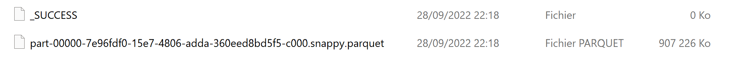
Answer Exercise 17
What is does :
26 partitions
( currently on same « executor » JVM
… but may be distributed)
Shuffle ( currently no network)
1 partition
( currently on same « executor » JVM )

Slide 11
Exercise 18: use .repartition(N) … check N files are written
Redo same as exercise 17, with
.repartition(2) => check 2 files are written .repartition(3) => check 3 files are written
.repartition(4) => check 4 files are written
got the idea ?
Optionnally: Measure performances of writing for each scenario

Slide 12
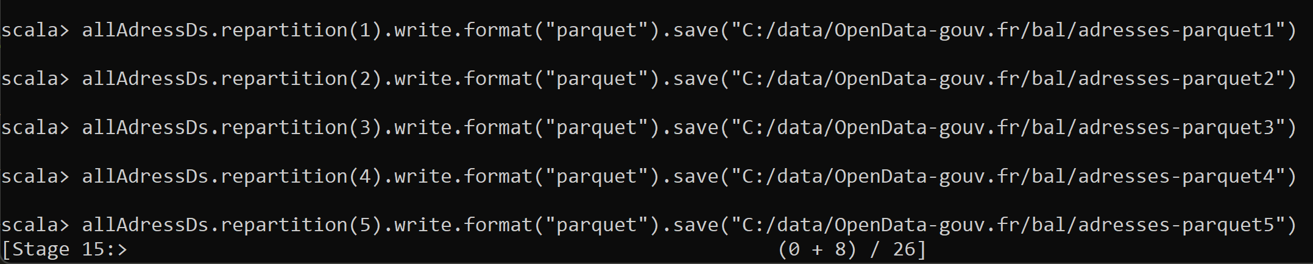
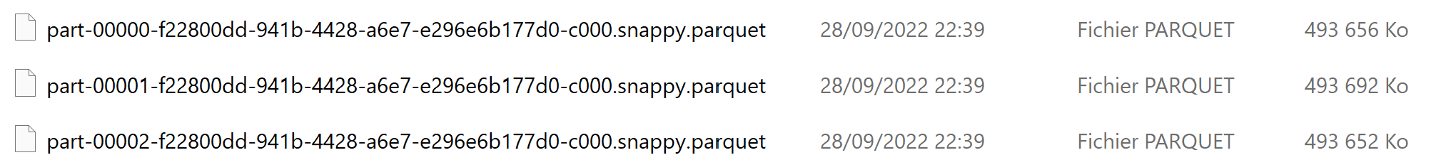
Answer Exercise 18
.repartition(1) => 1 File
.repartition(2) => 2 Files
.repartition(3) => 3 Files
.repartition(N) => N Files

Slide 13
Objectives of TD2
1/ read CSV files, convert options
2/ read combine several files
3/ others file format: json, nd-json, xml, text
4/ write to PARQUET files dir repartitionning
5/ Discover PARQUET format optimisations

Slide 14
Exercise 19
Compare total size of parquet files 1/ file size when using repartition(1)
2/ total file sizes when using repartition(2)
3/ total file sizes when using repartition(3)
(Hint: on cygwin / linux, you can use « du –Sh »
Questions:
a/ check that less files is better
b/ explain why

Slide 15
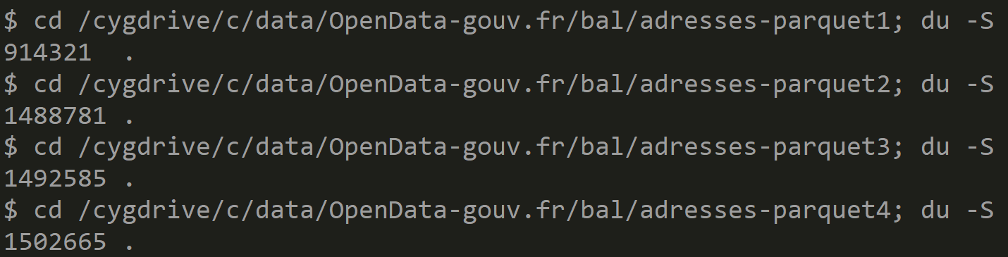
Answer Exercise 19
a/ YES … less file is better 900M < 1.4G < … < 1.5G
b/ because … - Dictionnaries (if any) need not repeat shared values several times - Each parquet file repeat some metadata (schema, etc…) but this is small
- compression works better with more data
- there is less « padding » alignments .. Default to 128M alignments

Slide 16
Exercise 20 : columnar file format
a/ execute 2 different queries on addressDs (from spark.read.parquet …) addressDs.select("commune_nom").distinct().count() addressDs.select(« voie_nom").distinct().count()
b/ Check using Spark UI (http://localhost:4000) that « Input » bytes size is different while reading only 1 or another column (parquet is a « Columnar File format »)
c/ repeat same 2 queries, on dataSet read from csv or json (not a « Columnar file format ») … check in spark UI that the « Input » are same !

Slide 17
Exercise 21 : always use .sortWithinPartition(..) after a .repartition() / before .write() !!
Redo write() … by adding « .sortWithinPartition() »
which columns are good candidates to be sorted in « address » dataset?
Questions
b/ explain why it will improve performances to find addresses
c/ explain why it will also improve Dictionary compression

Slide 18
Exercise 22 : MindMap
Draw a MindMap to summarize
what you did and learn from this TD session
Your MindMap should
start with word « Spark File I/O» in the middle
Then draw star edges to other word chapters and sub-chapters

Slide 19
Exercise 21
partitions
compression
parquet
dictionaries
UUID Files Write Dir
csv
Combine Read dir
Spark File I/O
json
ND-json
PostProcessing
text
Schema
xml ?

Slide 20
Bonus Exercise …
Your friends are still struggling with spark parquet ?
Option 1/ Help your friends
Option 2/ do bonus exercise 22/ on parquet-cli File viewer

Slide 21
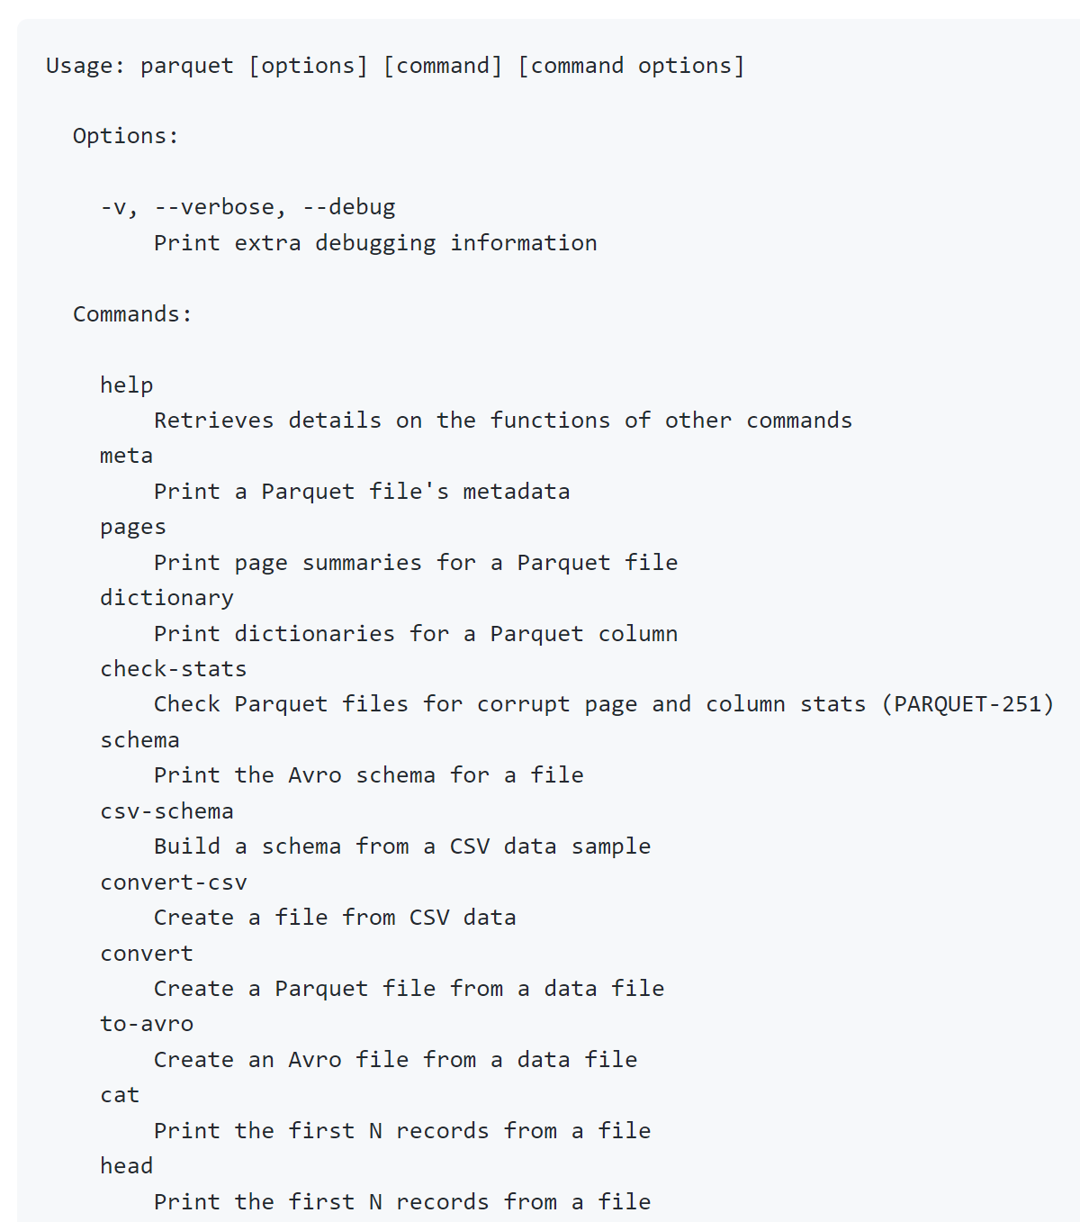
Exercise 22 : use paquet-cli to view internal file Page / ColumnChunk / Dictionaries ..
Checkout tool from official site: https://github.com/apache/parquet-mr/tree/master/parquet-cli ( notice the tool was previously called parquet-tool )
Focus on
parquet « pages »
parquet « dictionary »

Slide 22
Questions ?

Slide 23
Take-Away What You learned ?

Slide 24
Questions ?

Slide 25
Next Steps
More CMs
More TDs
Spark concepts:
SQL
Column Pruning / Partition Pruning / Predicate-Push-Down
DAG, Distribution, Optimizations
Spark Clustering
Java binding, UDF, map
Spark Streaming
…

