Slide 1
Installing Hadoop Standalone with Hadoop-Unit
arnaud.nauwynck@gmail.com
Esilv 2024
this document:
https://github.com/Arnaud-Nauwynck/presentations/tree/main/pres-bigdata

Slide 2
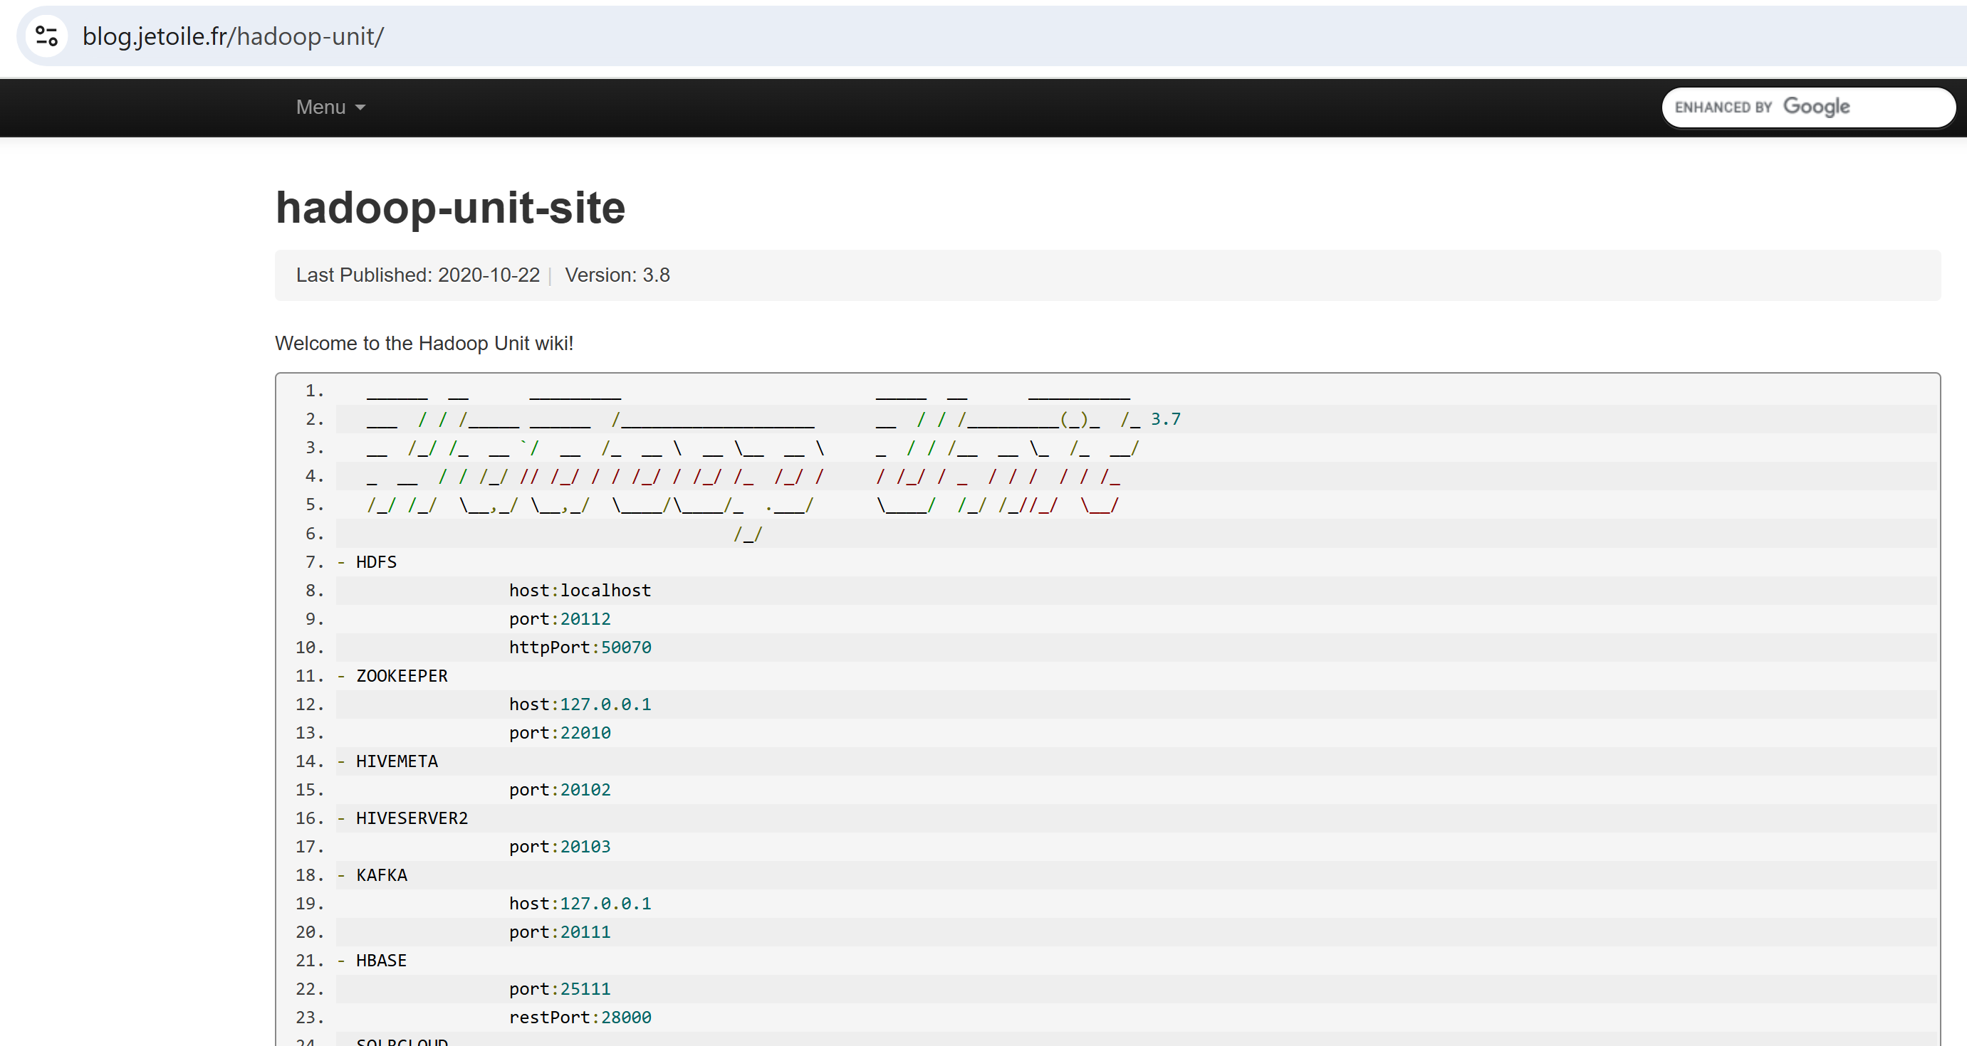
https://blog.jetoile.fr/hadoop-unit/

Slide 3
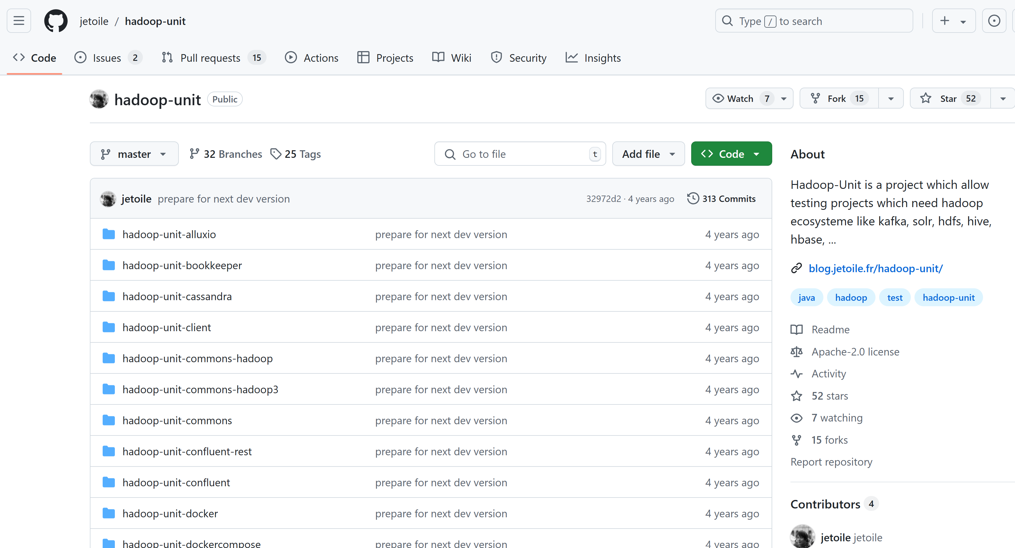
https://github.com/jetoile/hadoop-unit

Slide 4
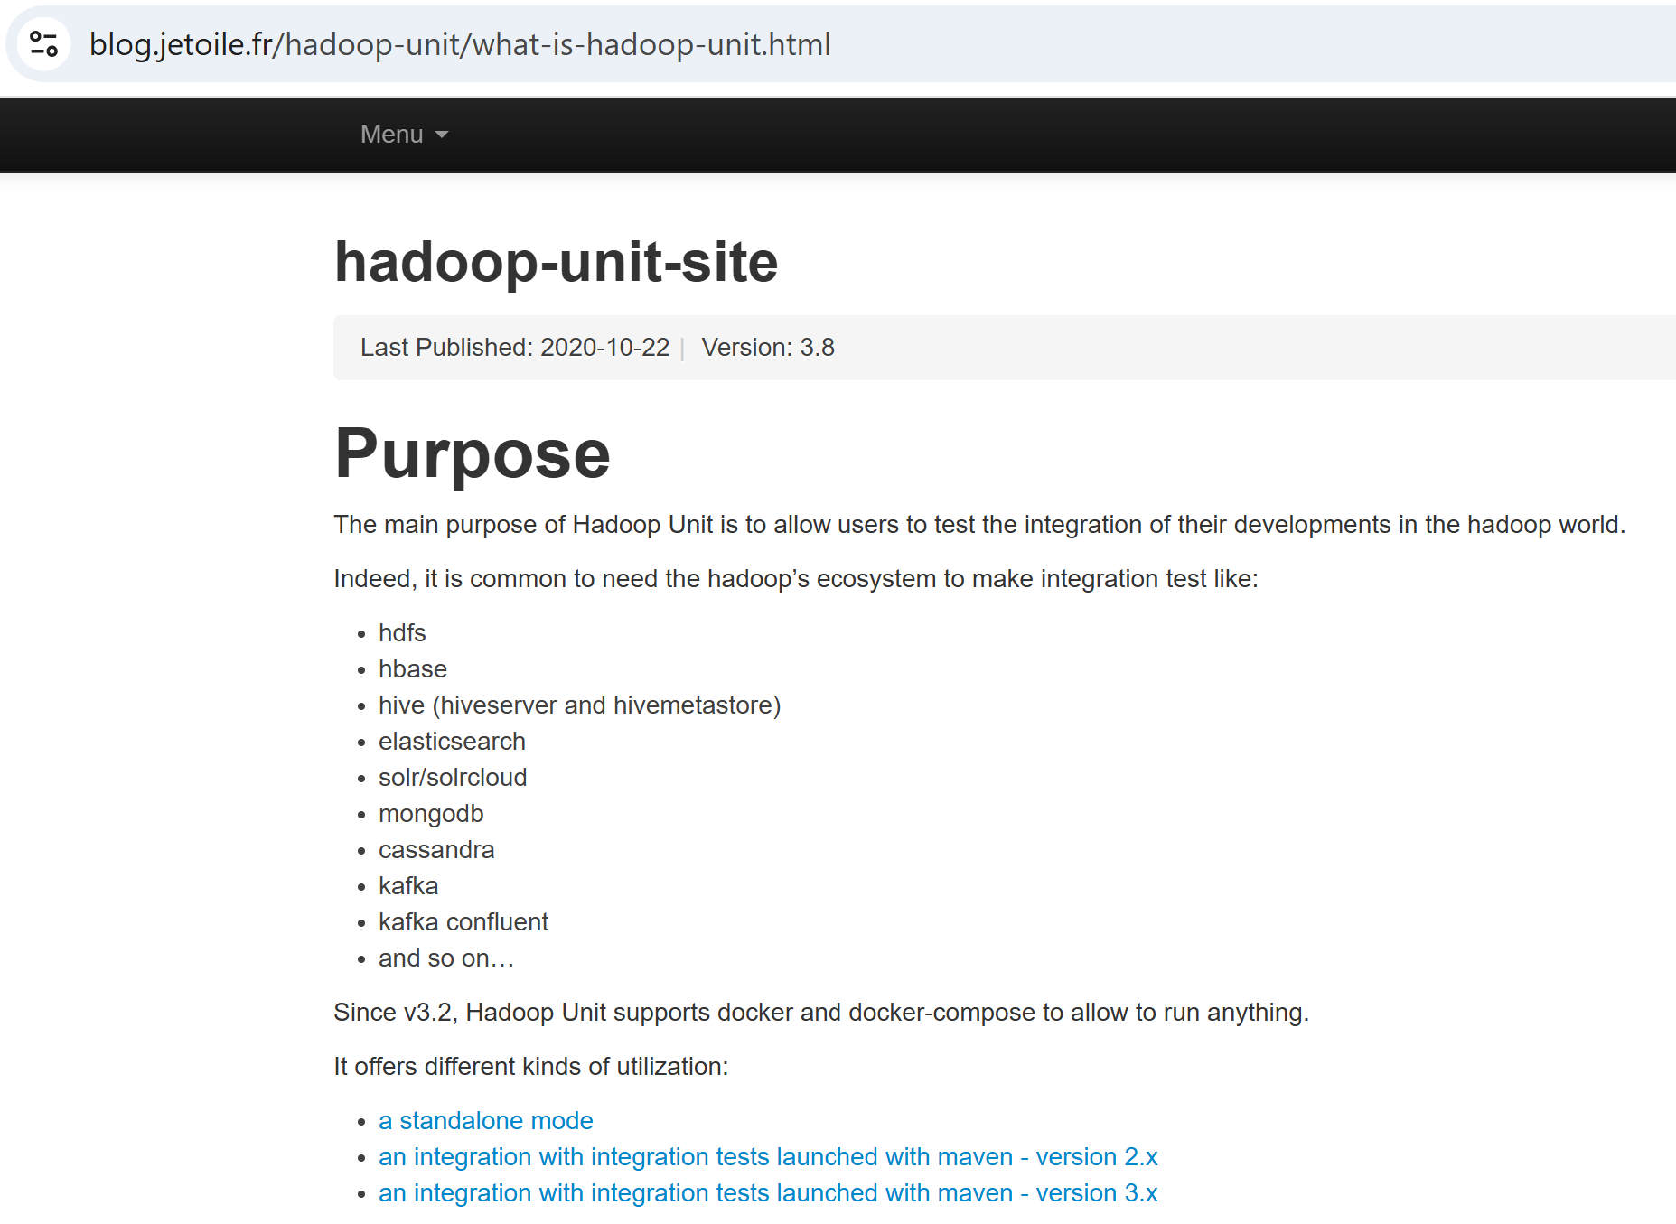
What is Hadoop-Unit

Slide 5
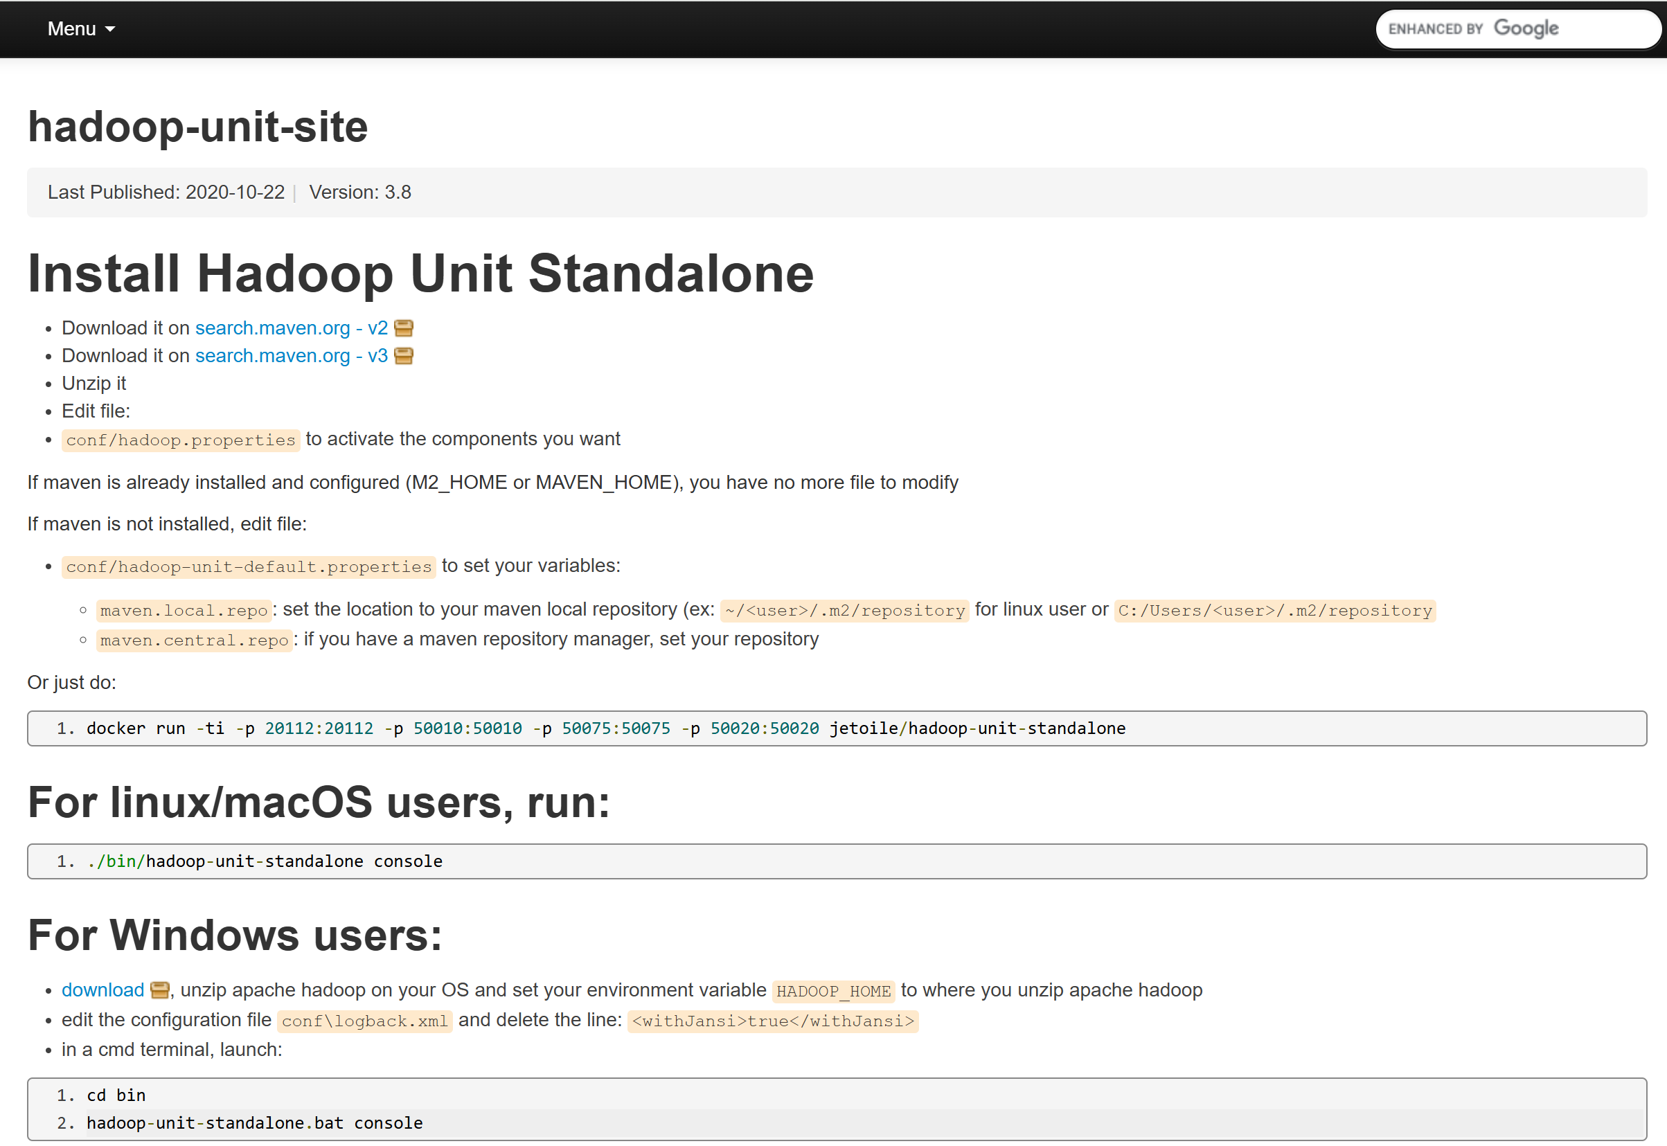
Install Standalone:
/install-hadoop-unit-standalone.html

Slide 6
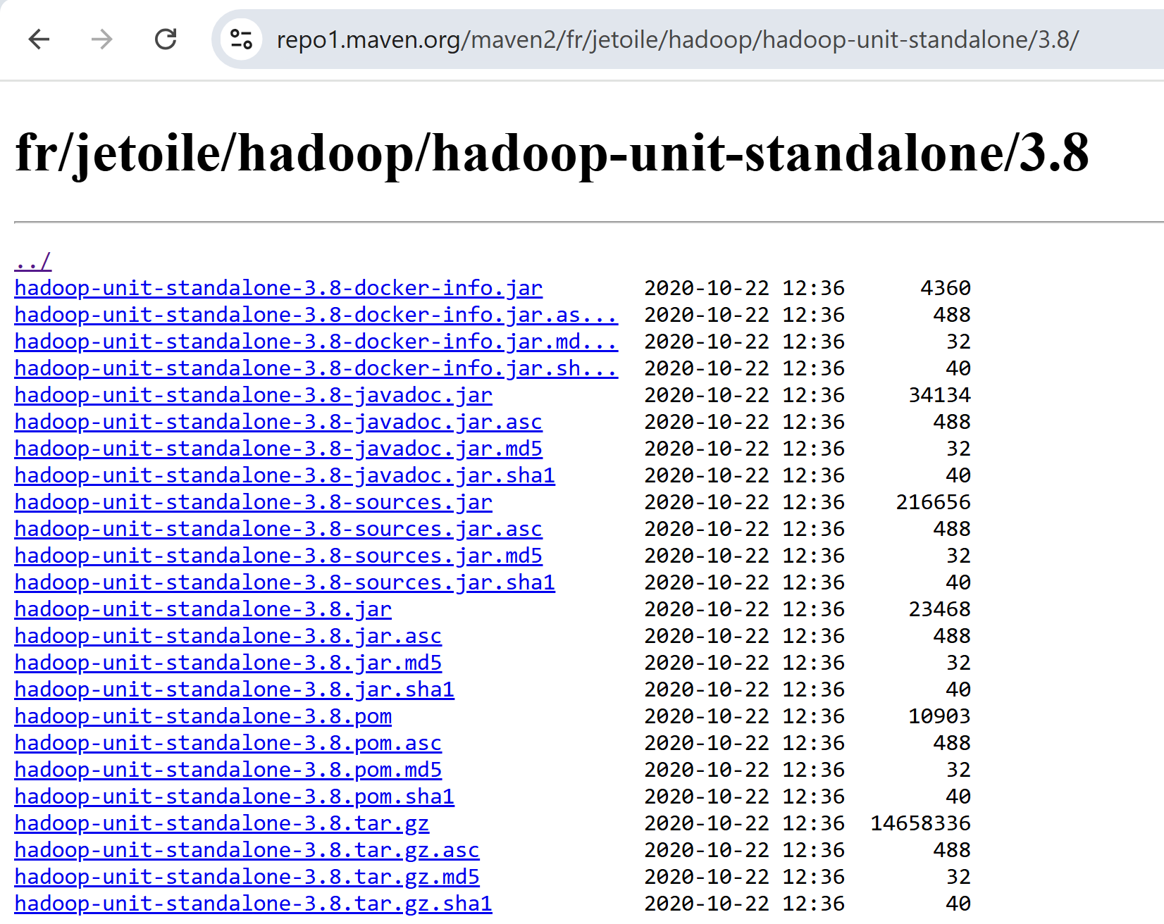
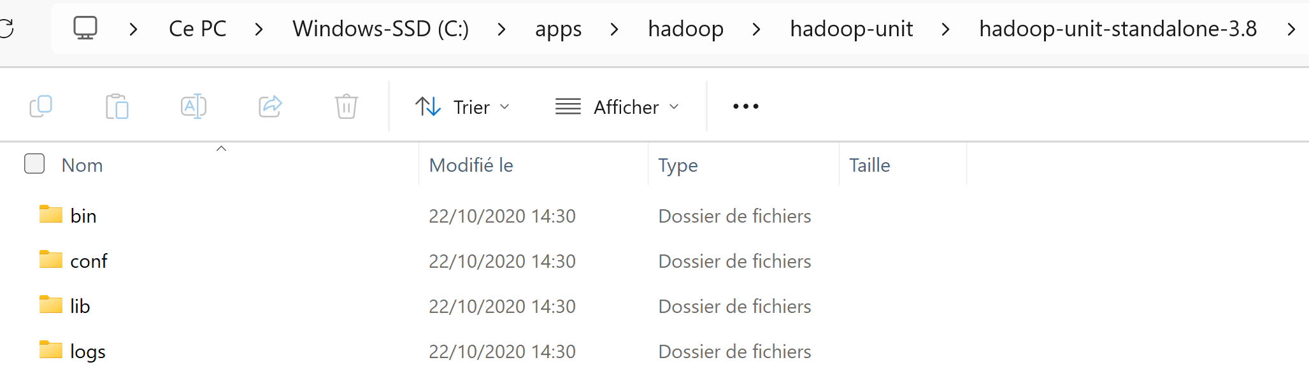
Download + extract .tar.gz

Slide 7
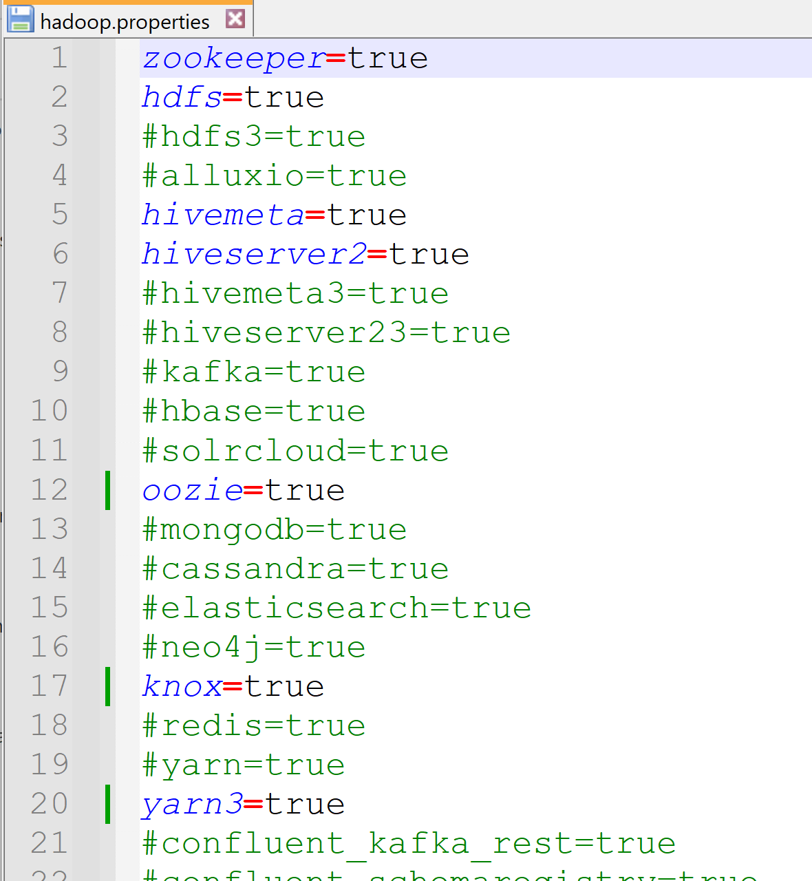
Edit conf\hadoop.properties choose component

Slide 8
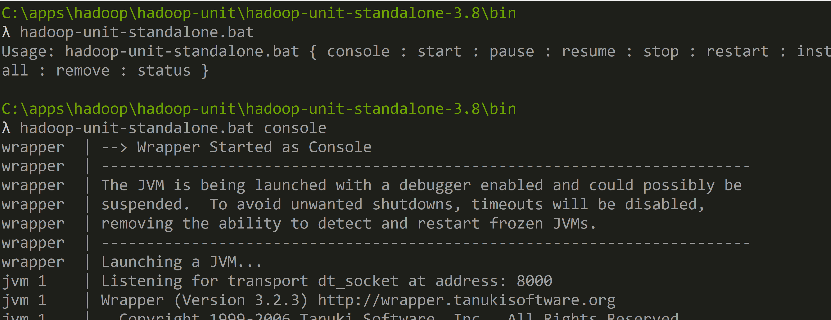
cd bin hadoop-unit-standalone.bat console

Slide 9
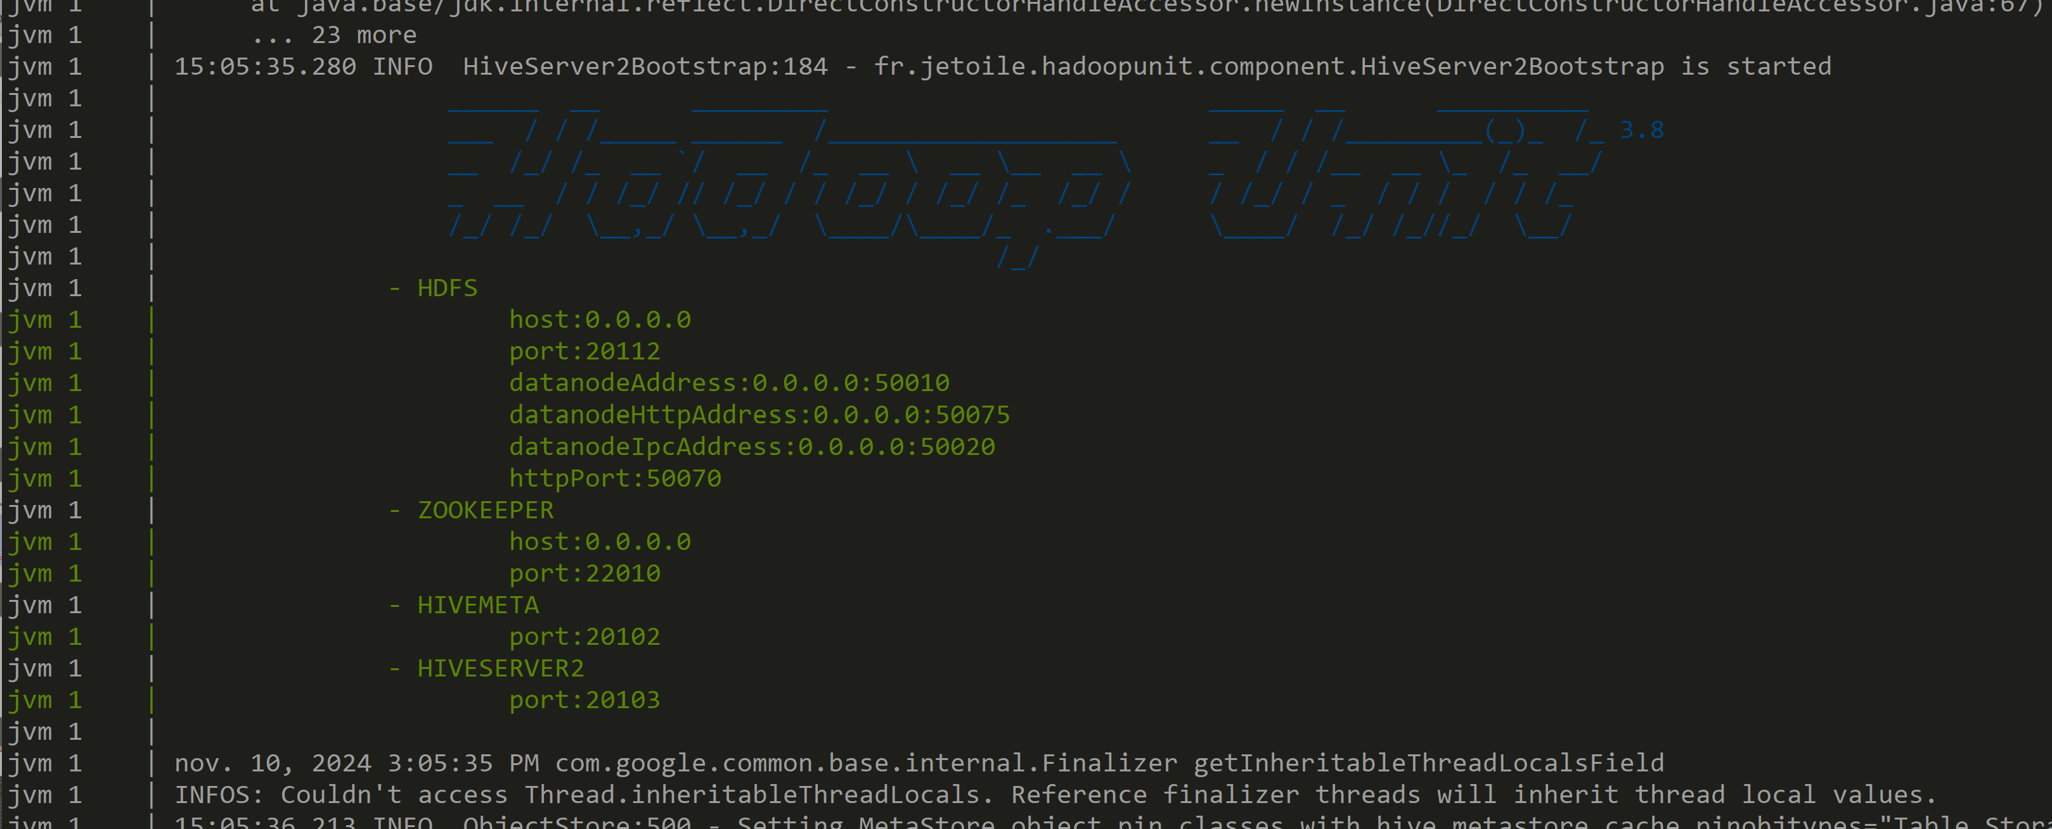
Running

Slide 10
Testing Hdfs "NameNode" Server http://localhost:50070

Slide 11
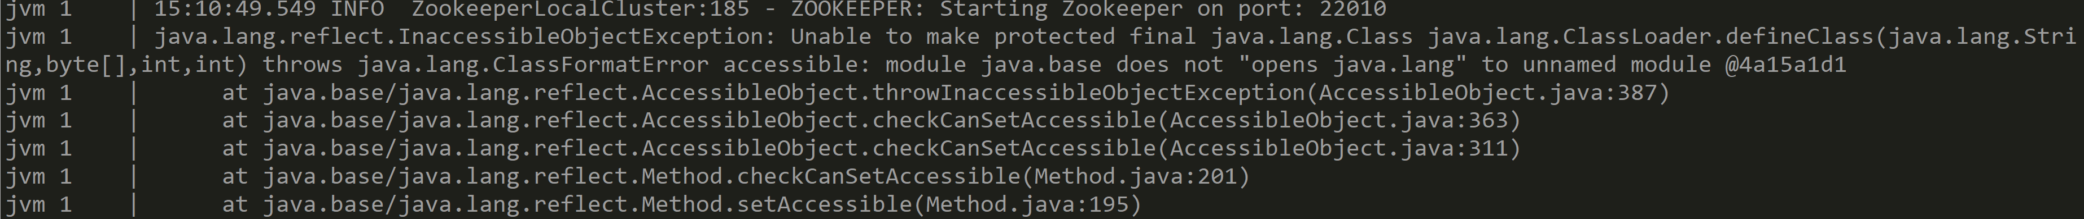
ERROR with jdk too recent (> 11 ?)

