Slide 1
Workshop 1 - Web
java springboot Http Rest Api + Http Client(s)

Slide 2
TD Outline
TD Goals = code & debug yourself a basic Http client-server
1/ install "Java JDK"
2/ install IDE : "IntelliJ IDEA"
3/ setup your app, using spring "initializr" click+download
4/ run your app
5/ open http://localhost:8080
6/ inspect network requests
7/ test Http requests

Slide 3
TD Outline
TD Goals = code & debug yourself a basic http client-server
1/ install "Java JDK"
2/ install IDE : "IntelliJ IDEA"
3/ setup your app, using spring "initializr" click+download
4/ run your app
5/ open http://localhost:8080
6/ inspect network requests
7/ test Http requests

Slide 4
Pre-Requisite 1 : Install Java JDK
JDK is Open-Source, but pre-built binaries may be licenced if downloading from oracle.com
on linux => "apt-get install default-jdk"
on Mac => "brew install openjdk"
on Windows => download adoptium temurin .msi installer
+ execute (see next slides)

Slide 5
Step 1 : Install Java JDK, download (~170 Mo)
JDK is Open-Source, but pre-built binaries may be licenced if downloading from oracle.com
Download from « adoptium » (previously « adoptOpenJdk »)
https://adoptium.net/

Slide 6
Installing ...
You may change defaults ... see next

Slide 7
Optional : defining env variable JAVA_HOME

Slide 8
Optional
Changing directory "c:\apps\jdk"
(avoid long names, and space in dir name so avoid "Program & Files\...")

Slide 9
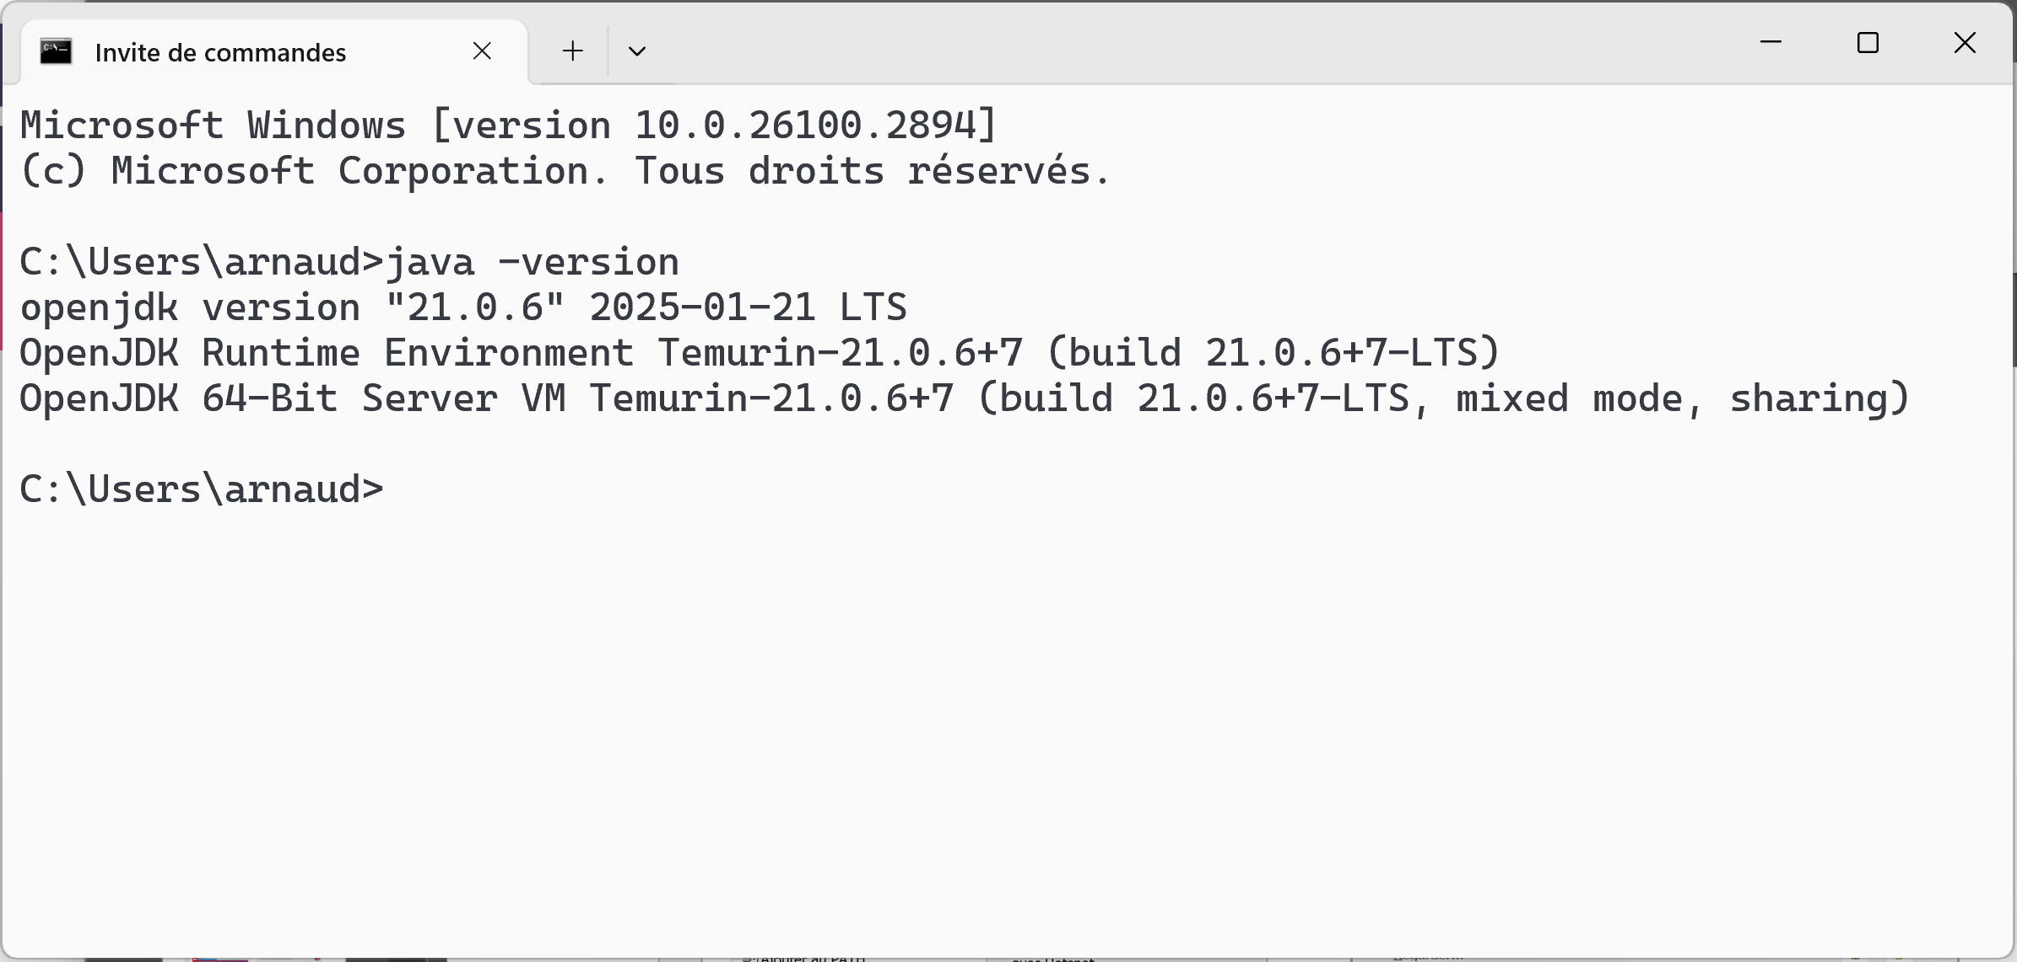
Check Java installation OK
C:> java -version

Slide 10
TD Outline
TD Goals = debug yourself a basic Http client-server
1/ install "Java JDK"
2/ install IDE : "IntelliJ IDEA"
3/ setup your app, using spring "initializr" click+download
4/ run your app
5/ open http://localhost:8080
6/ inspect network requests
7/ test Http requests

Slide 11
Pre-Requisite 2 : Install IDE "IntelliJ IDEA"
IntelliJ IDEA is the recommended IDE to use
it is the mostly used IDE in the world
100% ready and easy to use for java+maven+http+web+...

Slide 12
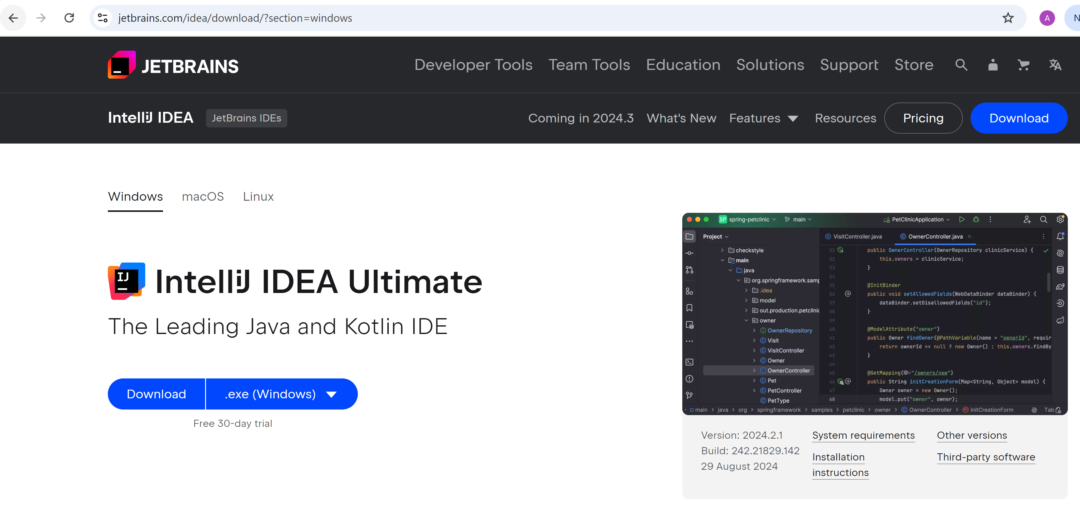
Download IntelliJ IDEA
https://www.jetbrains.com/idea/download

Slide 13
Free 30-days trial -OR- register free 1 year
version "Community" is FREE (but supports only java)
version "Ultimate" is much more complete
... and is FREE for students
... is paid by most companies for all developpers who ask
For doing today TD, you can just use "30-day trial"
if you have time (or later at home), you can fill the registration page
with your "@esilv" email (see next slides)

Slide 14
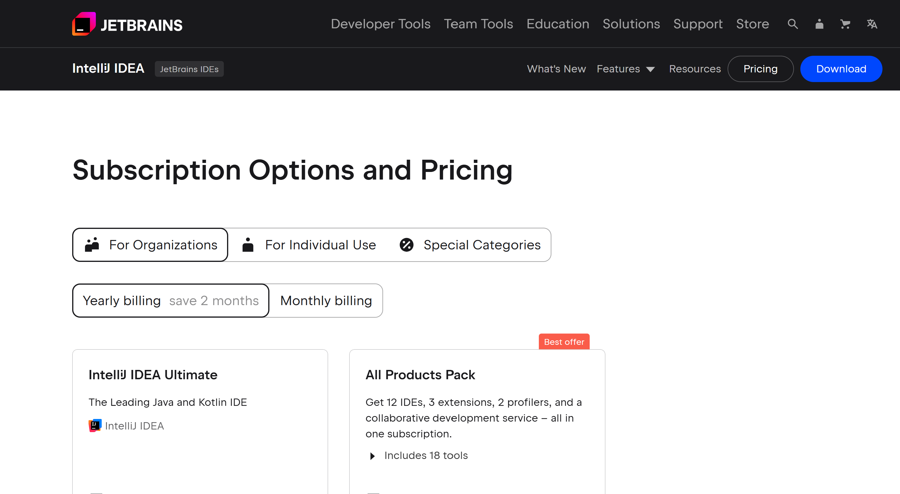
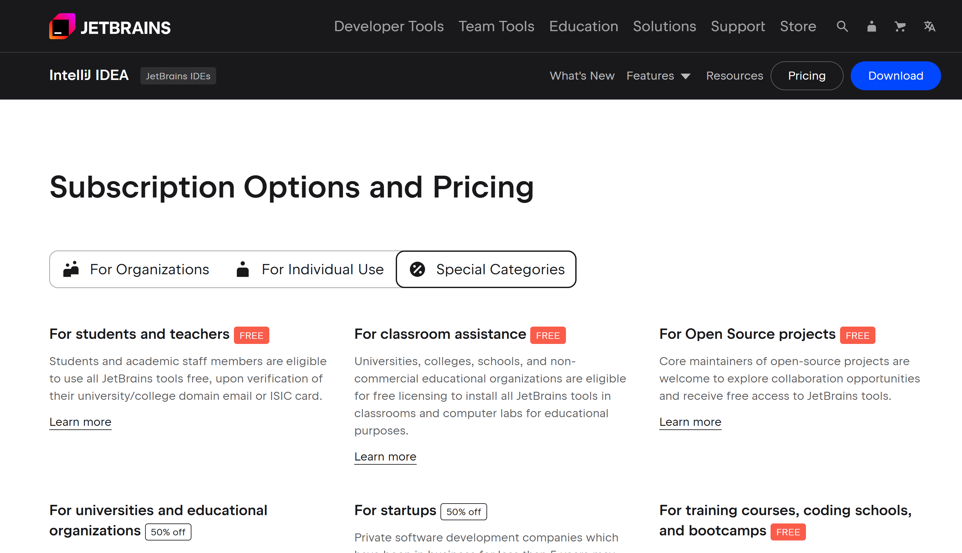
Register IntelliJ IDEA "Ultimate" as Student

Slide 15
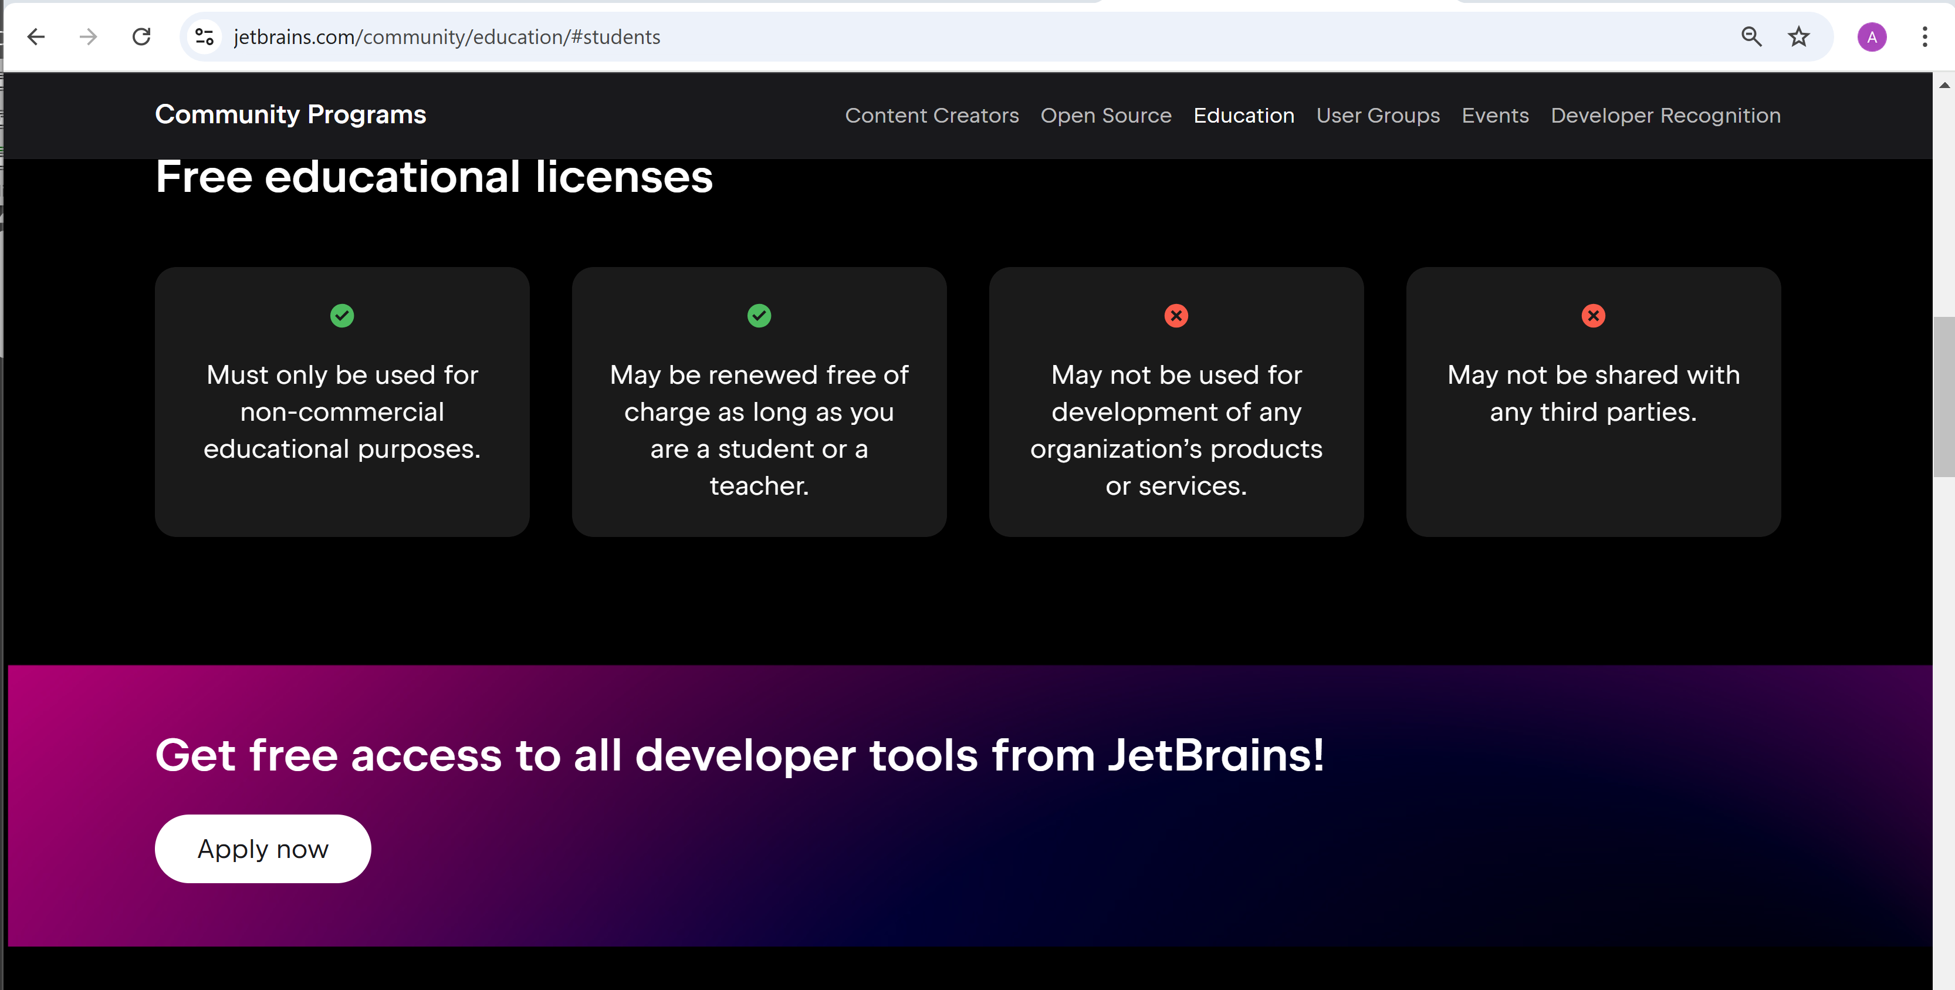
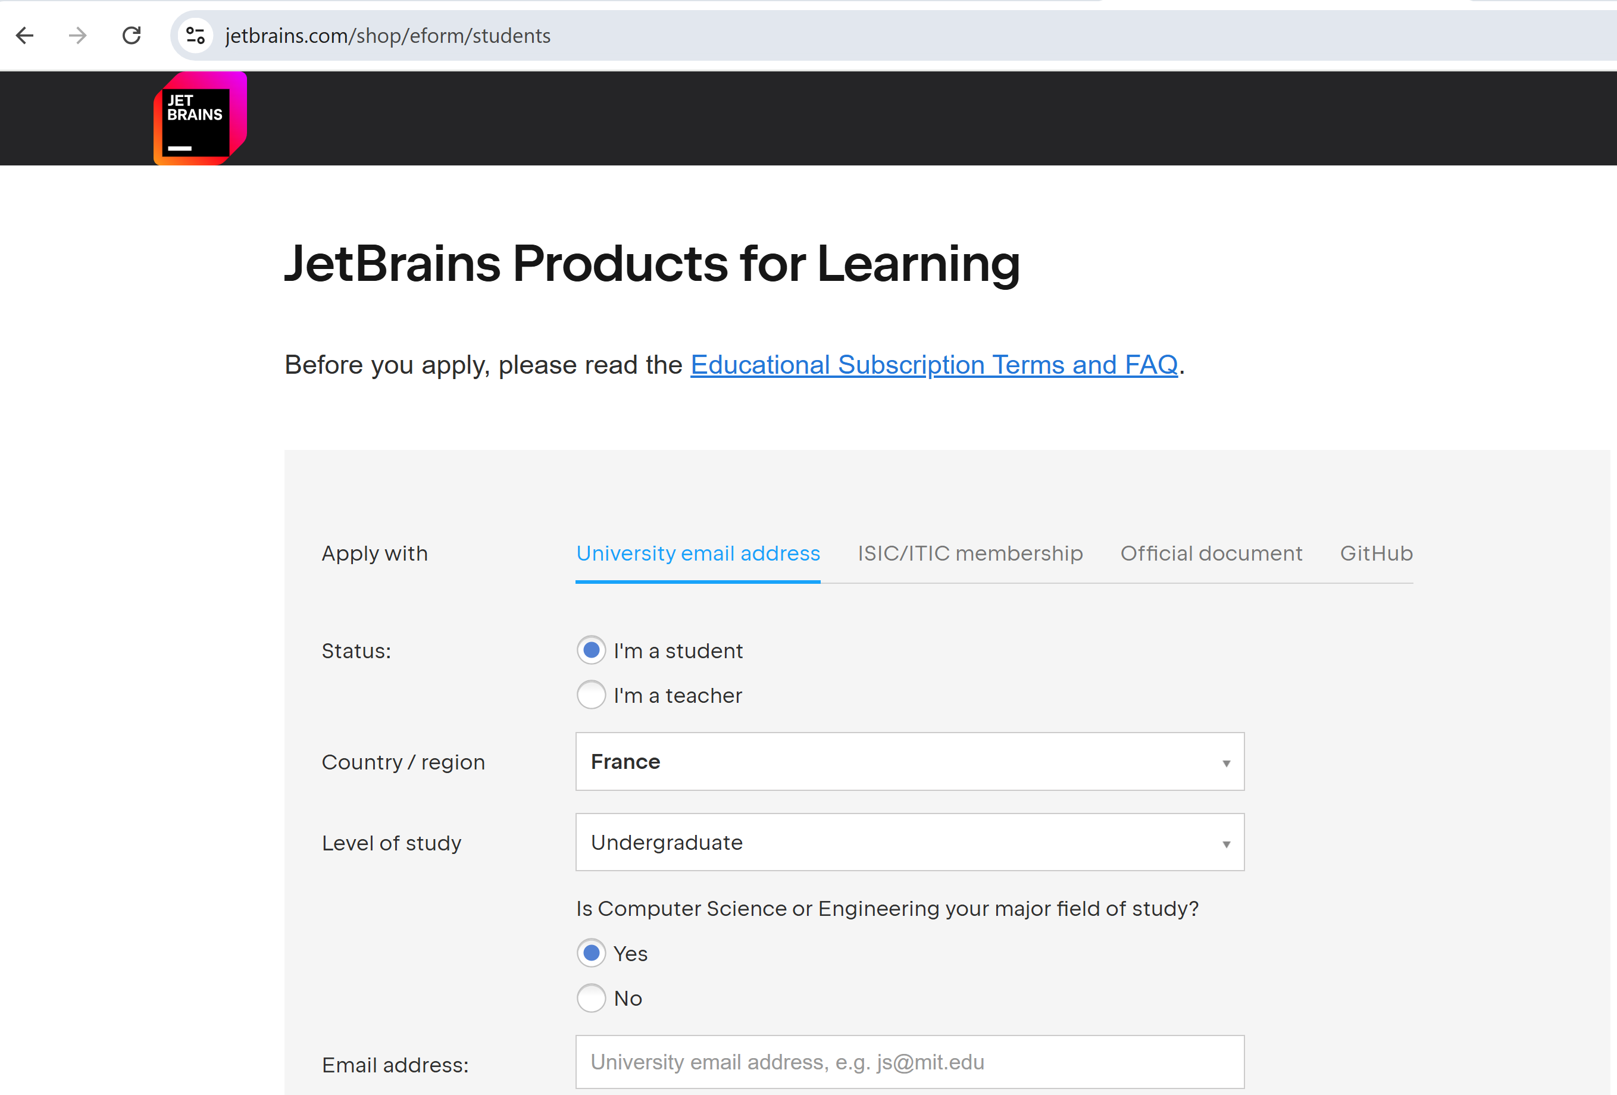
Steps ...
@ esilv

Slide 16
TD Outline
TD Goals = debug yourself a basic Http client-server
1/ install "Java JDK"
2/ install IDE : "IntelliJ IDEA"
3/ setup your app, using spring "initializr" click+download
4/ run your app
5/ open http://localhost:8080
6/ inspect network requests
7/ test Http requests

Slide 17
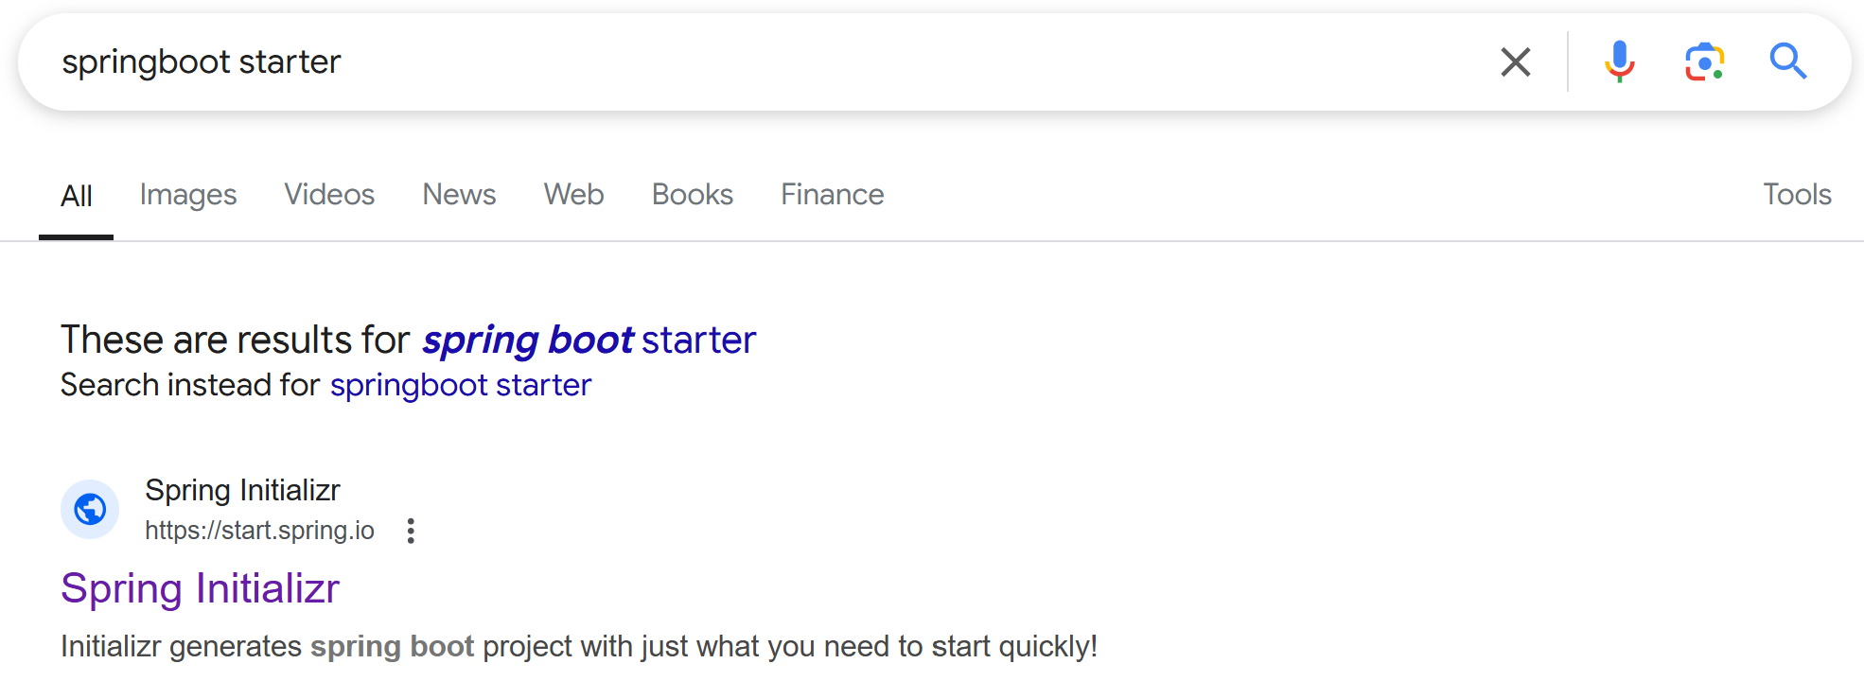
Using springboot starter aka "Spring Initializr" https://start.spring.io

Slide 18
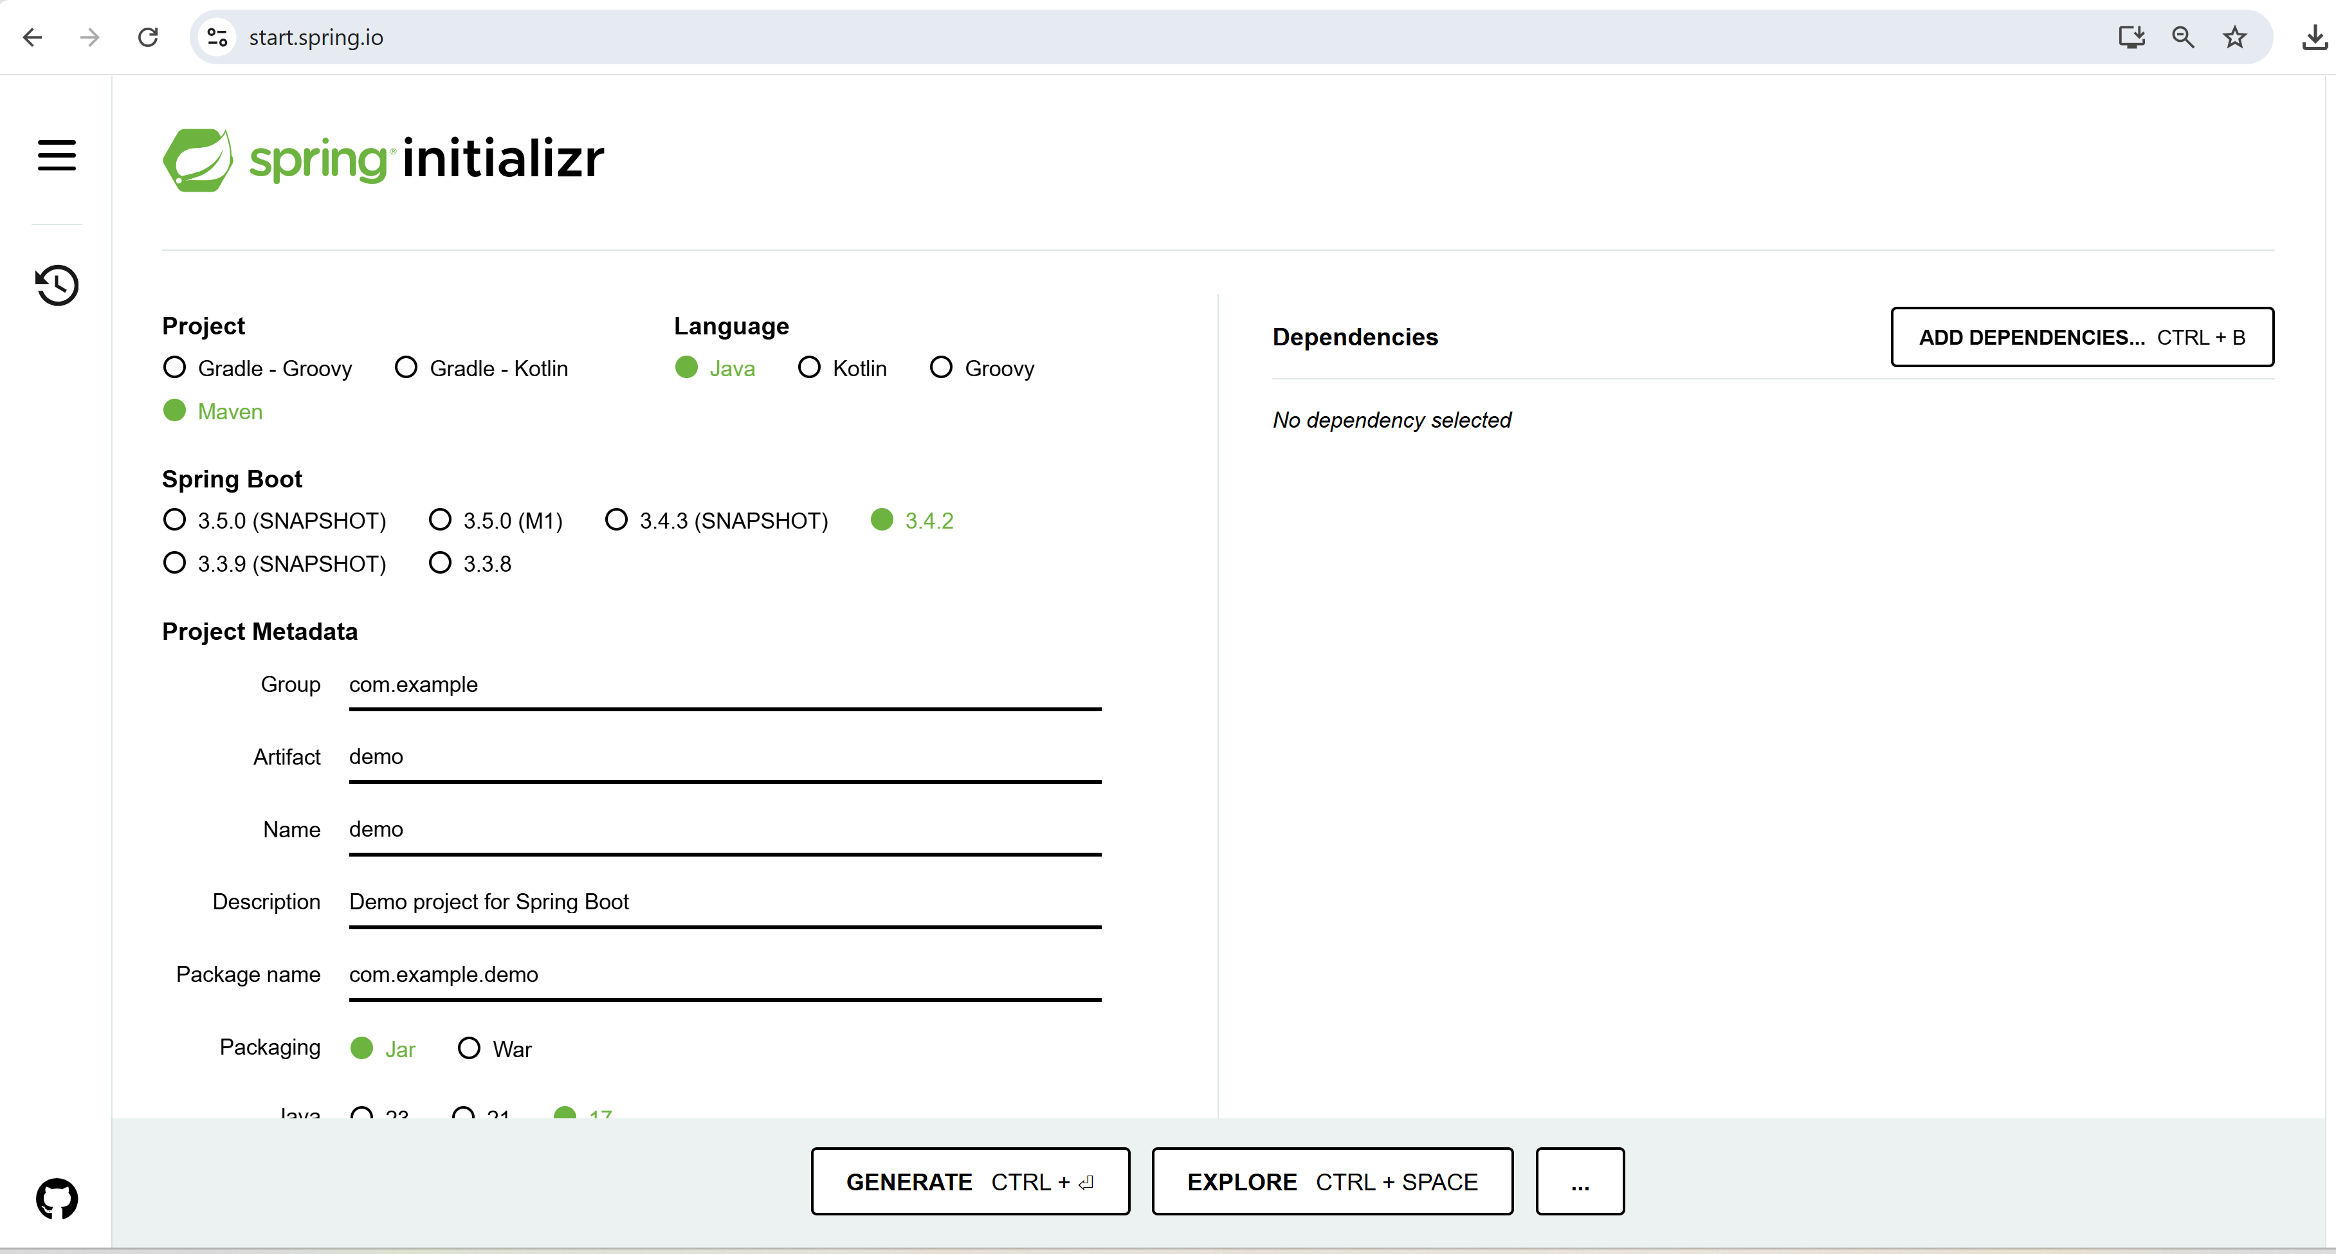
Open Springboot Initializr https://start.spring.io

Slide 19
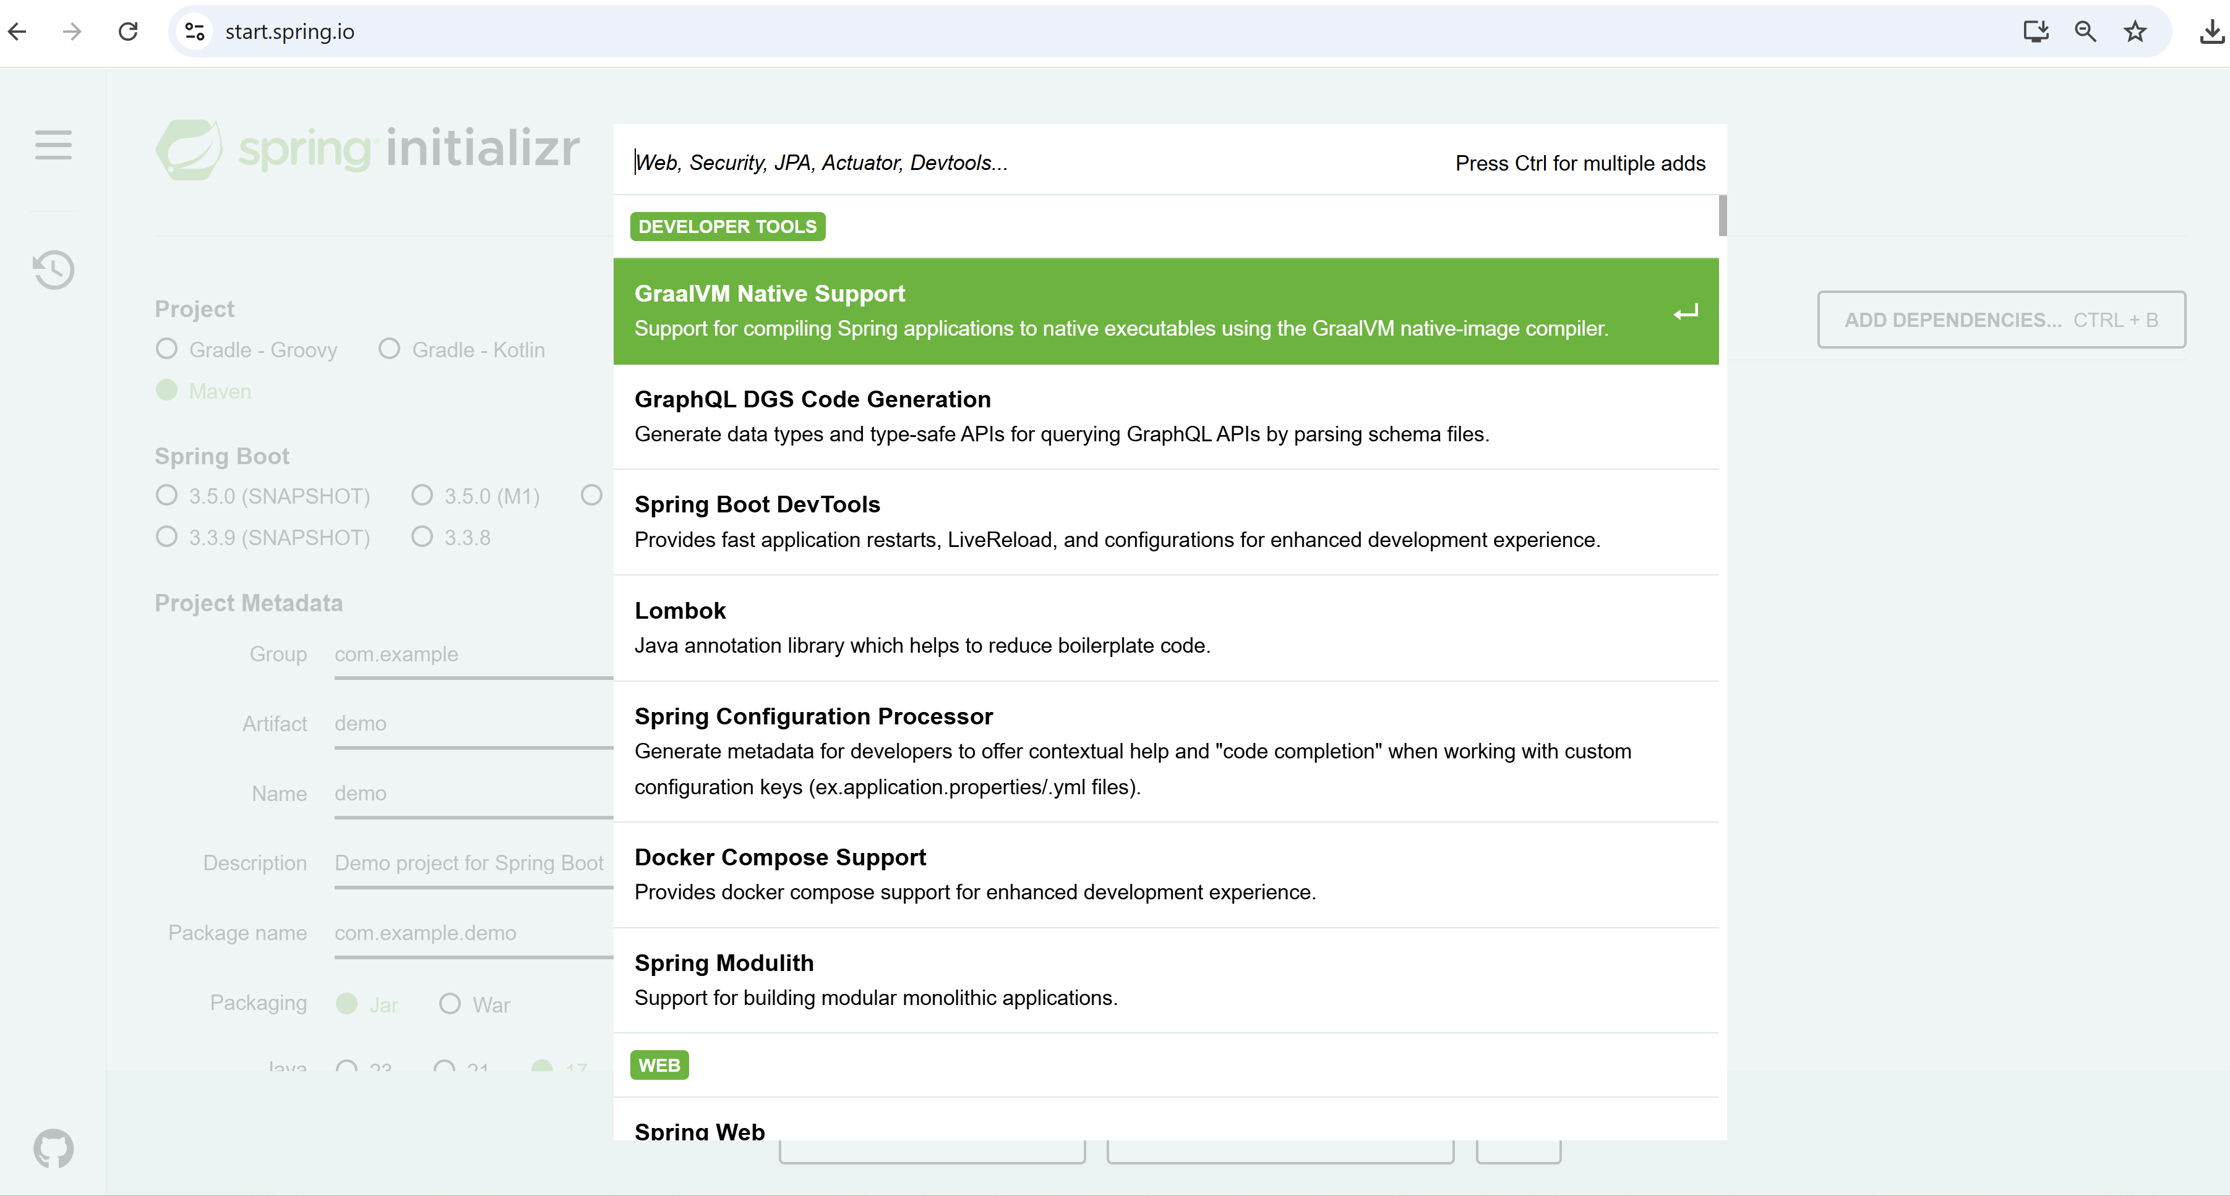
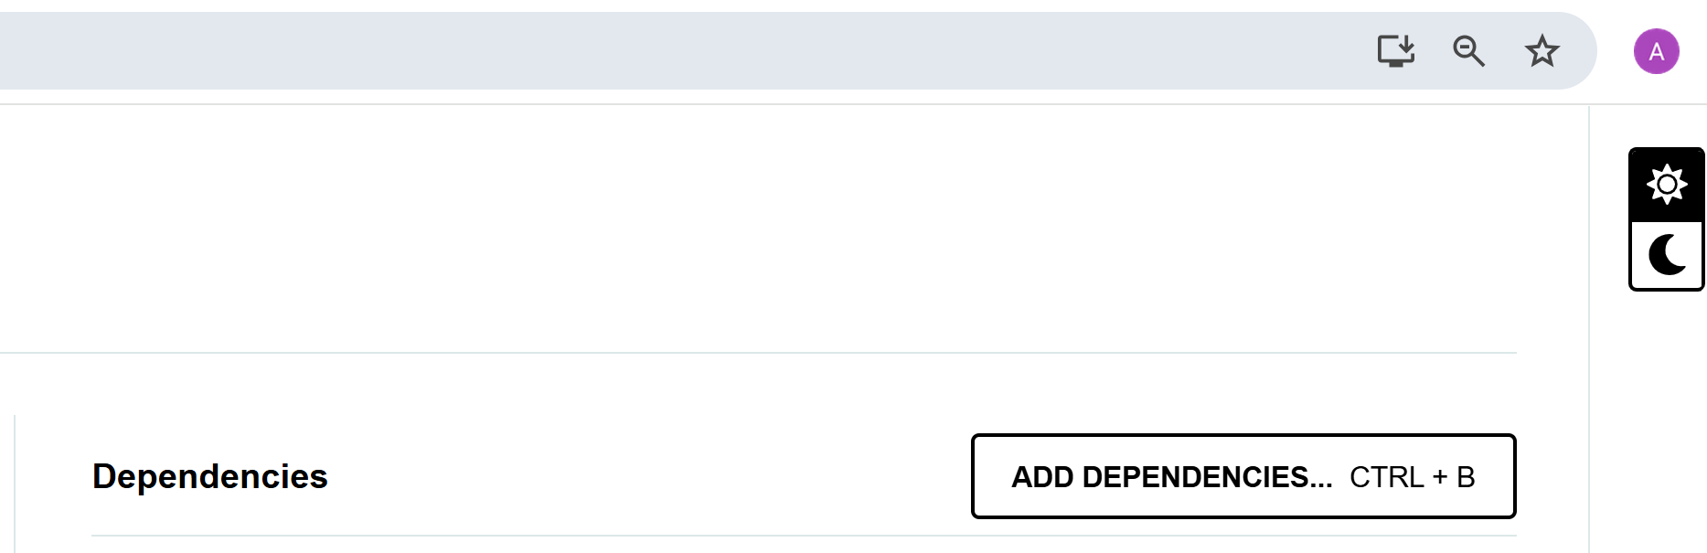
Click "ADD DEPENDENCIES..."

Slide 20
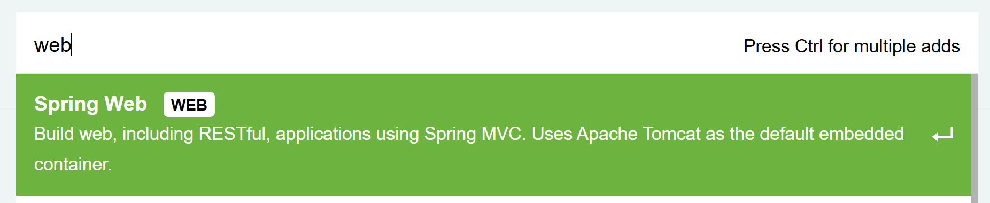
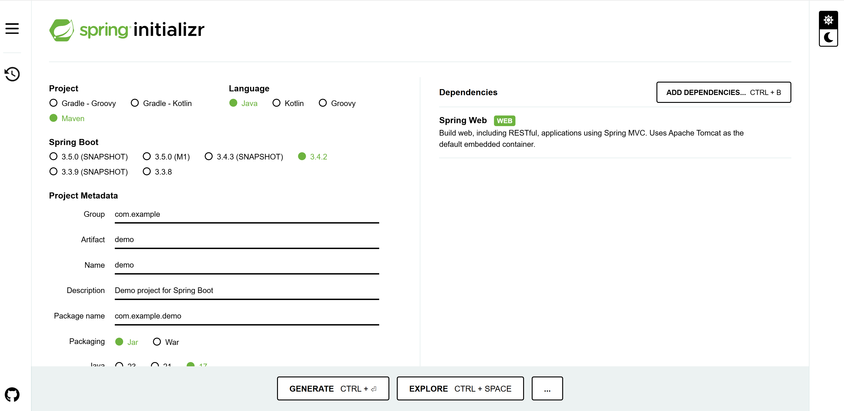
Add "web"

Slide 21
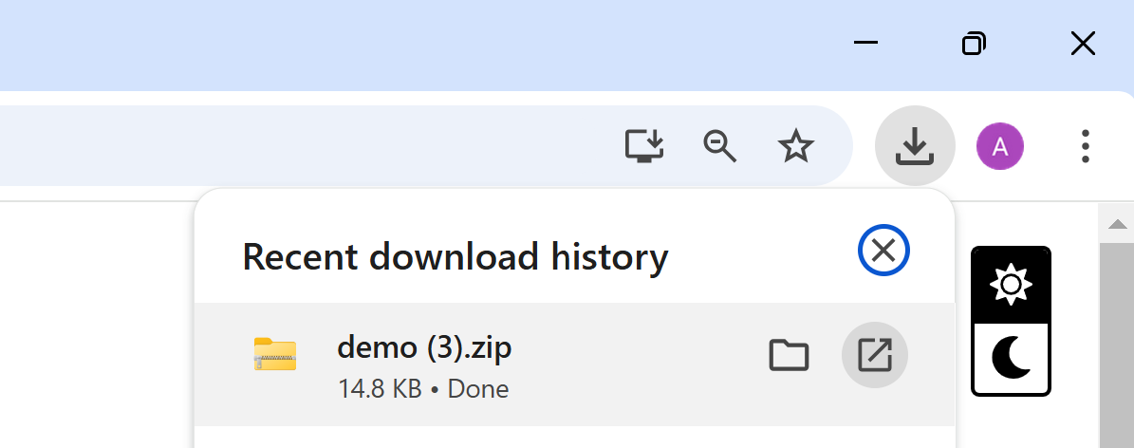
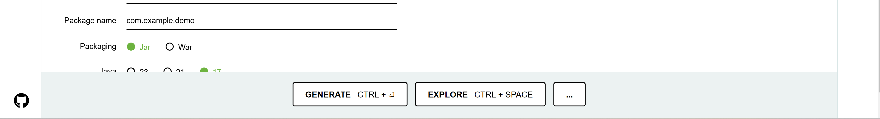
Then Click "GENERATE", open downloaded zip

Slide 22
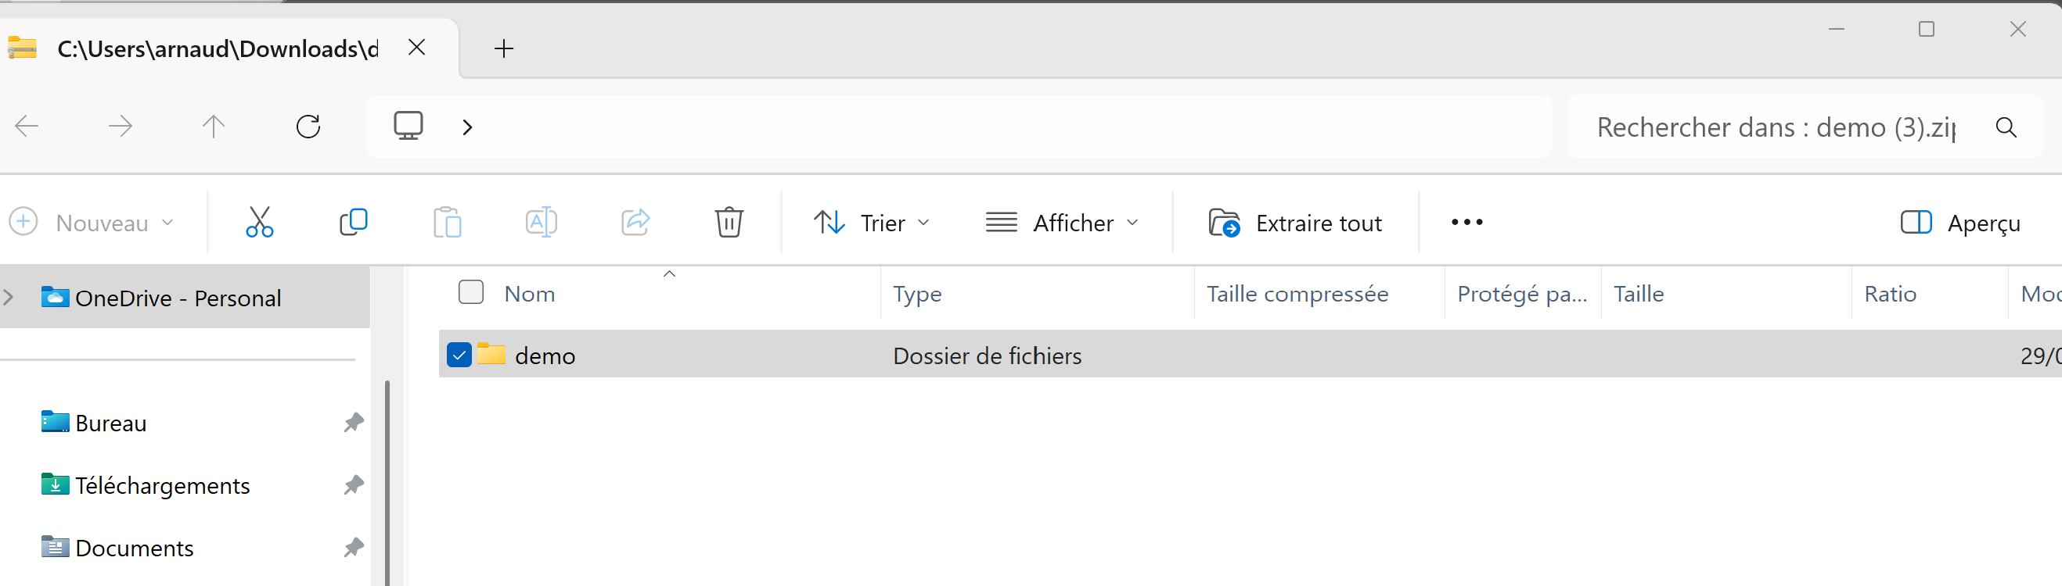
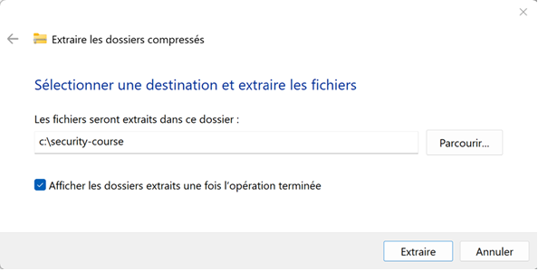
Extract All in a local dir
(example in c:\security-course)

Slide 23
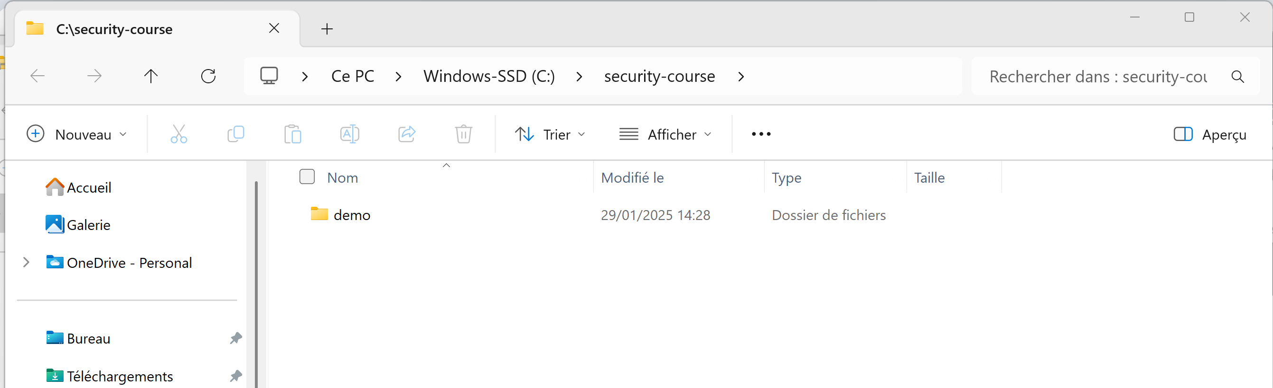
Explore Dir & Files
Basically 2 interresting files:
"pom.xml" => maven description of the java project
"src/main/java/com/example/demo/DemoApplication.java" => the main program (= the web app)

Slide 24
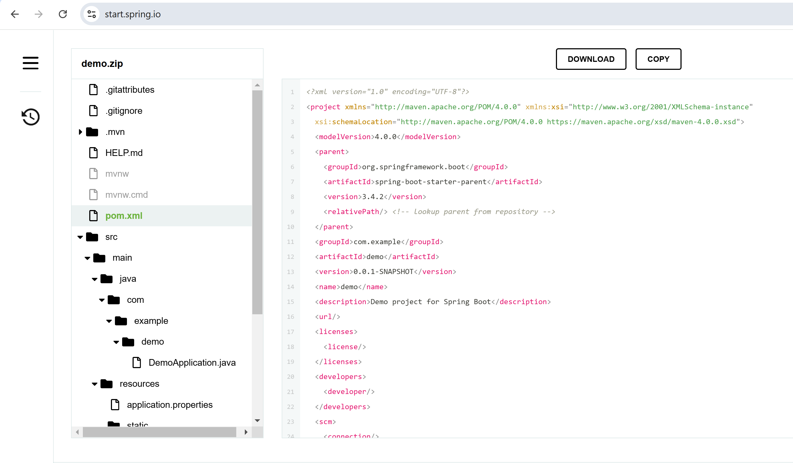
Explore Dir & Files from initializr "EXPLORE"

Slide 25
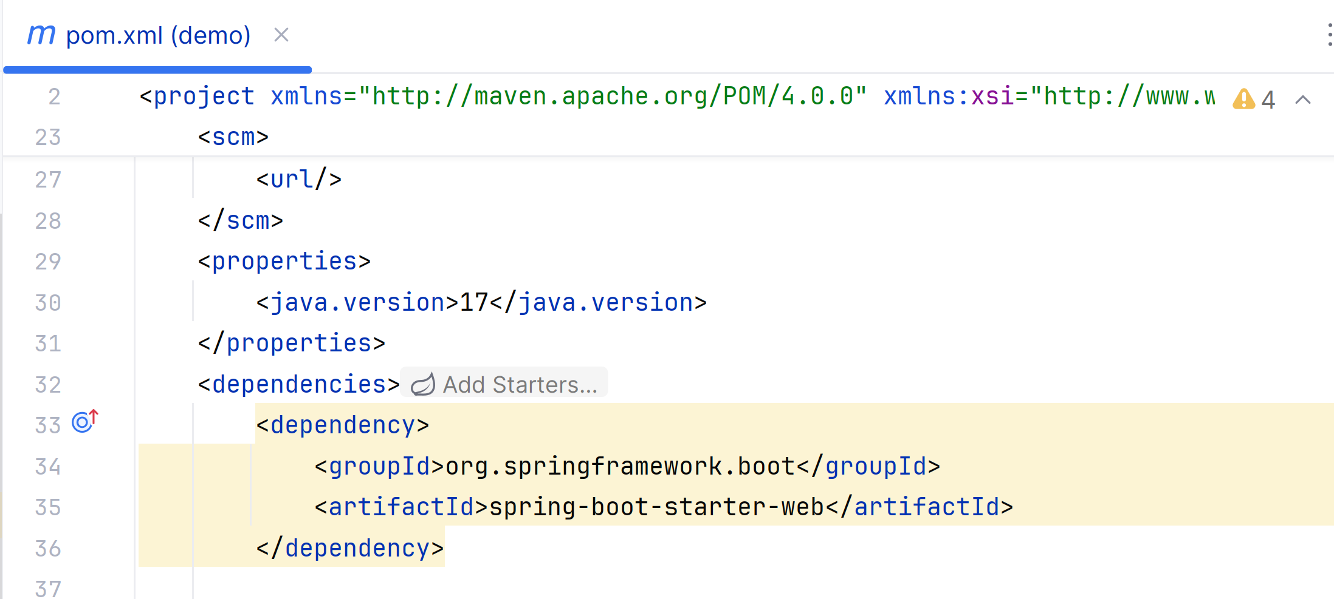
pom.xml contains basic information
+ springboot dependencies: starter-web

Slide 26
TD Outline
TD Goals = debug yourself a basic Http client-server
1/ install "Java JDK"
2/ install IDE : "IntelliJ IDEA"
3/ setup your app, using spring "initializr" click+download
4/ run your app
5/ open http://localhost:8080
6/ inspect network requests
7/ test Http requests

Slide 27

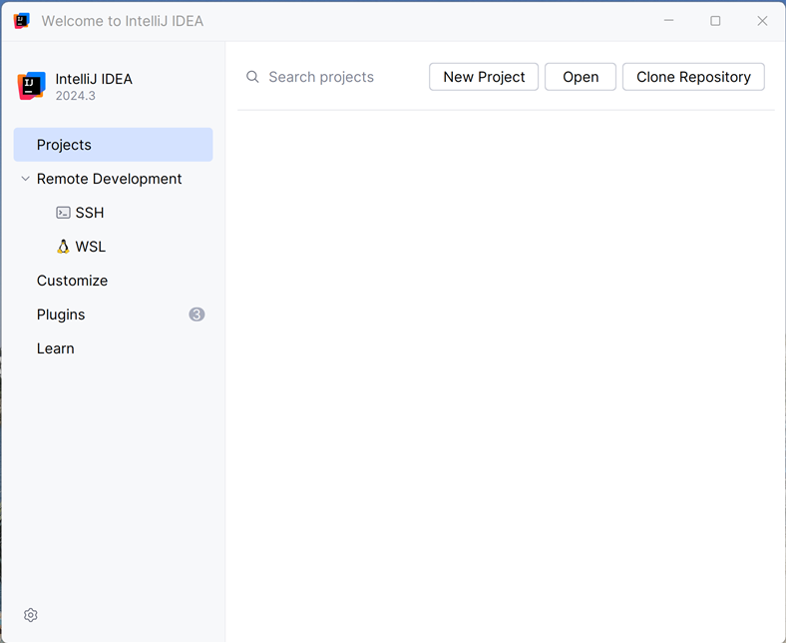
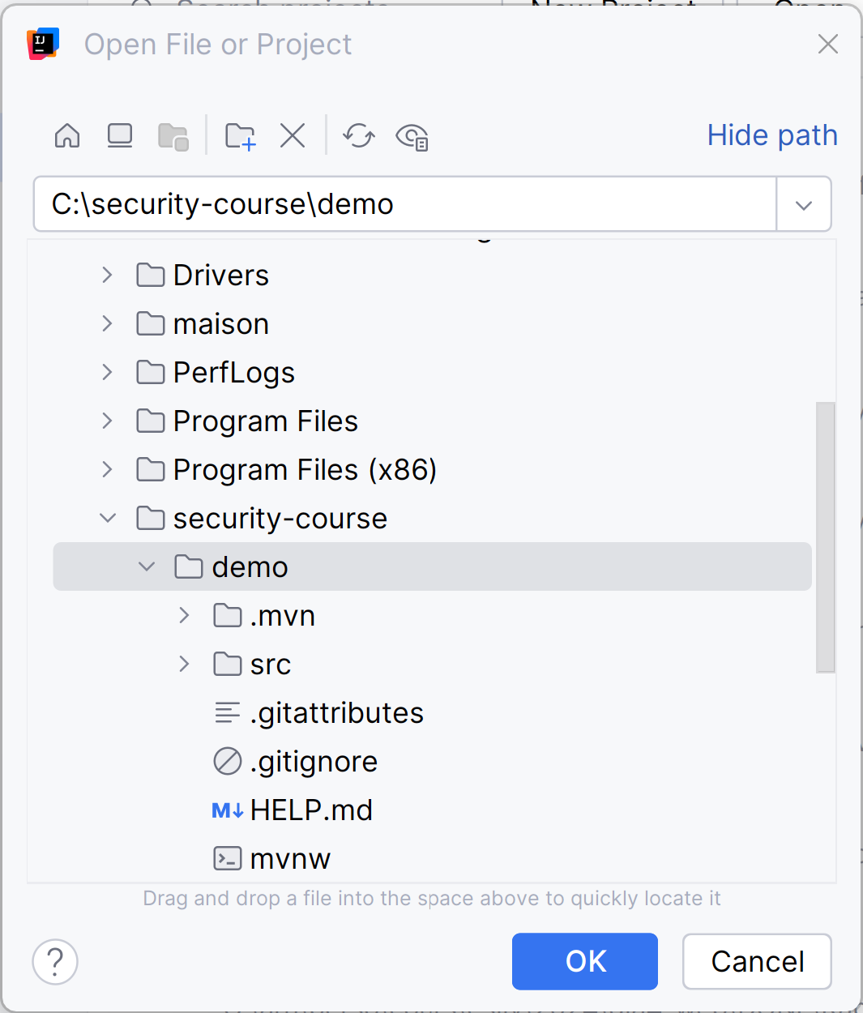
Launch your IDEA IntelliJ
Open Project

Slide 28
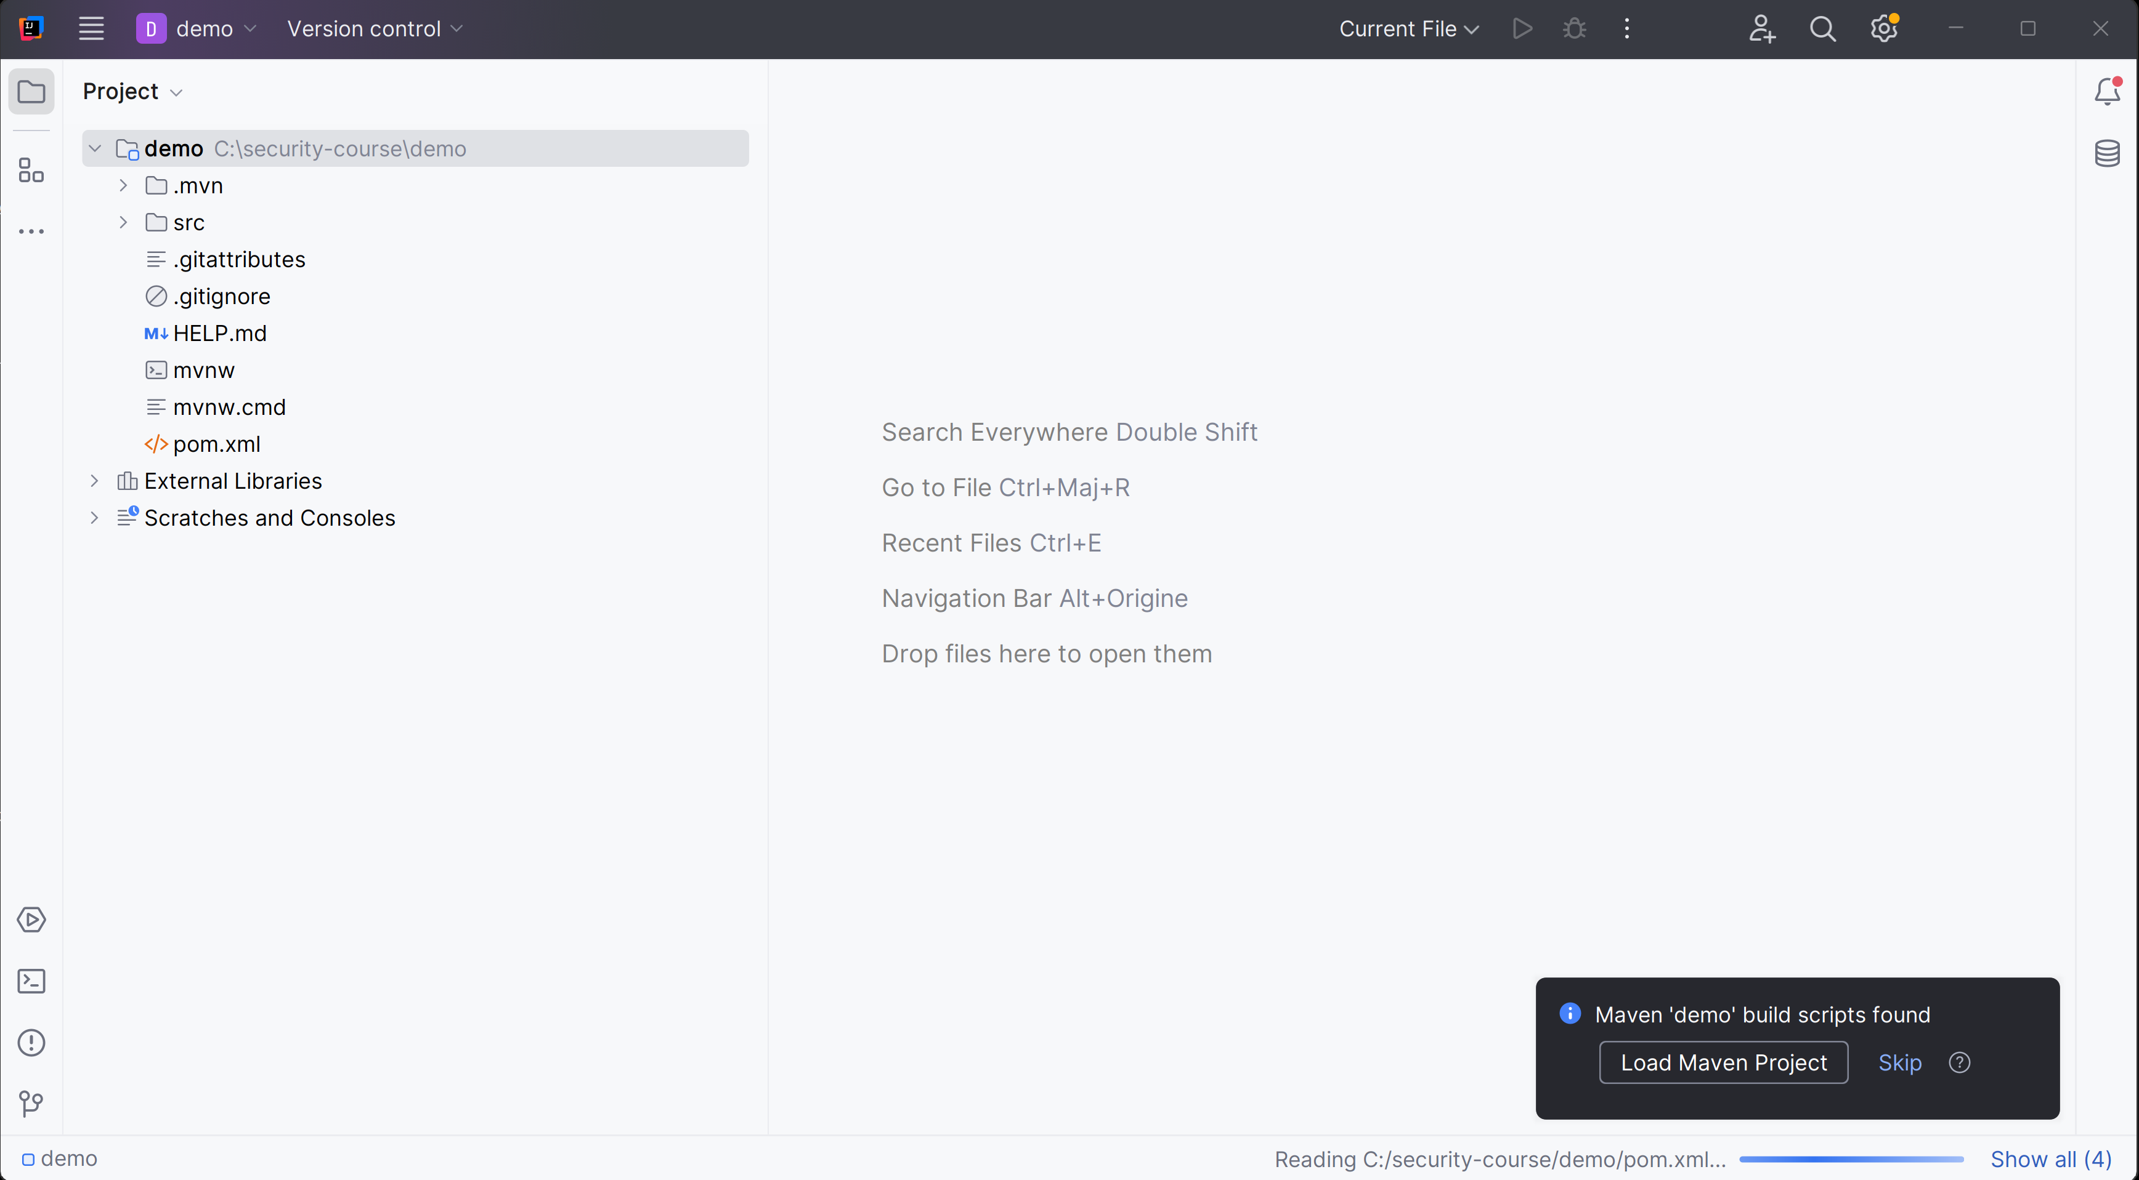
Click default "Load Maven Project"

Slide 29
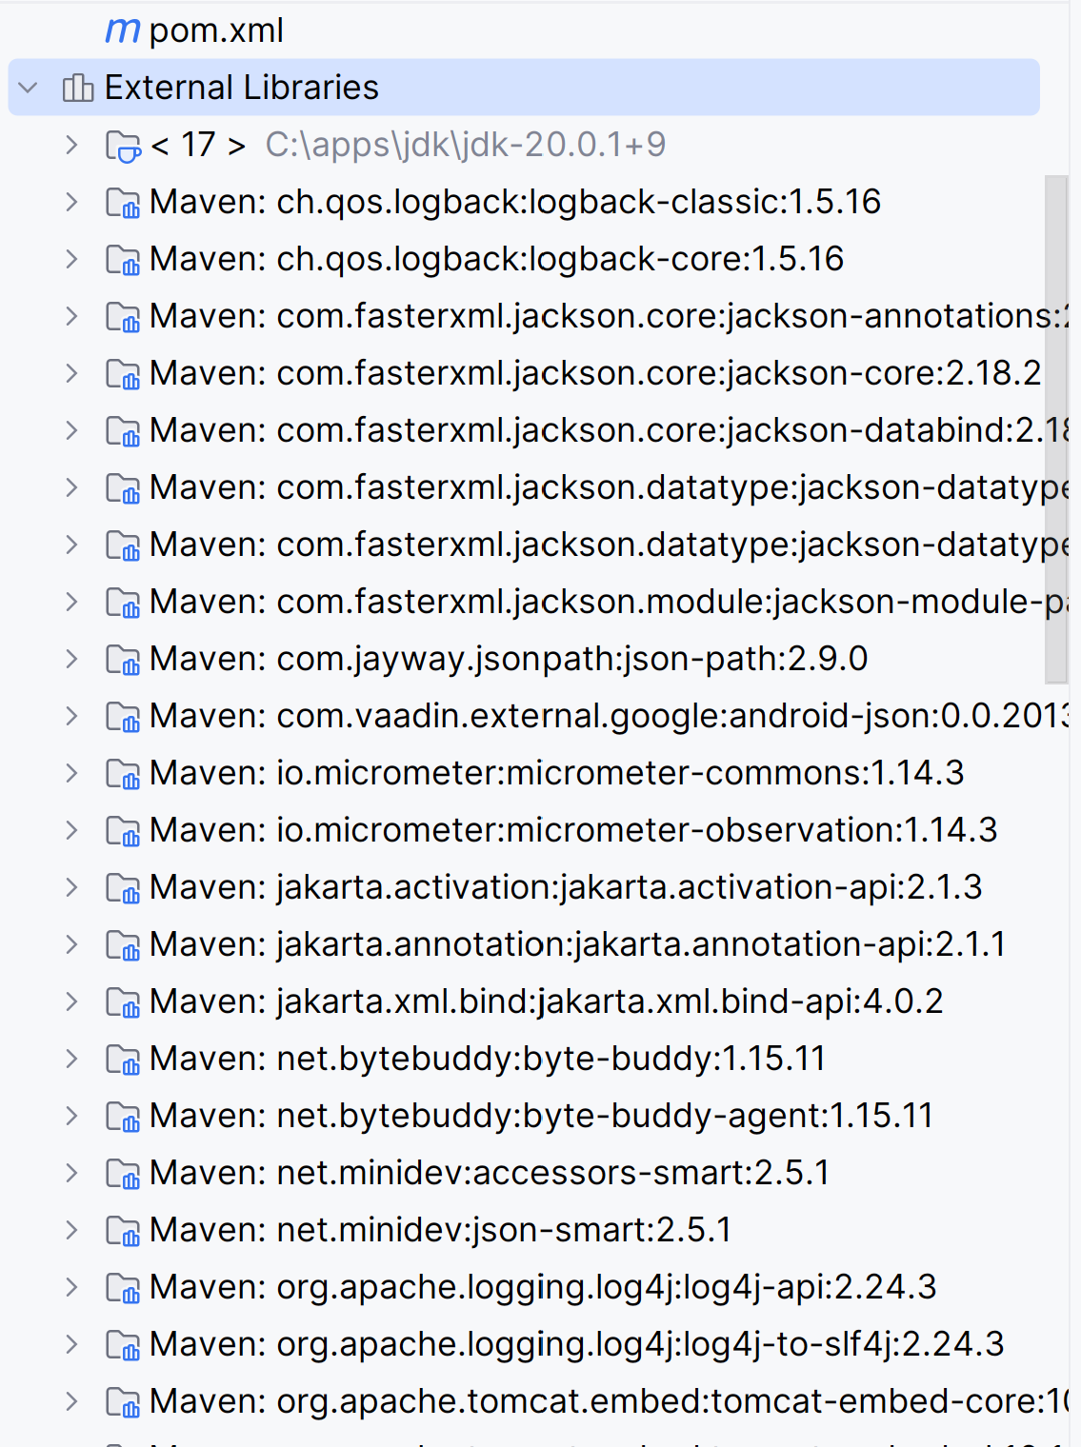
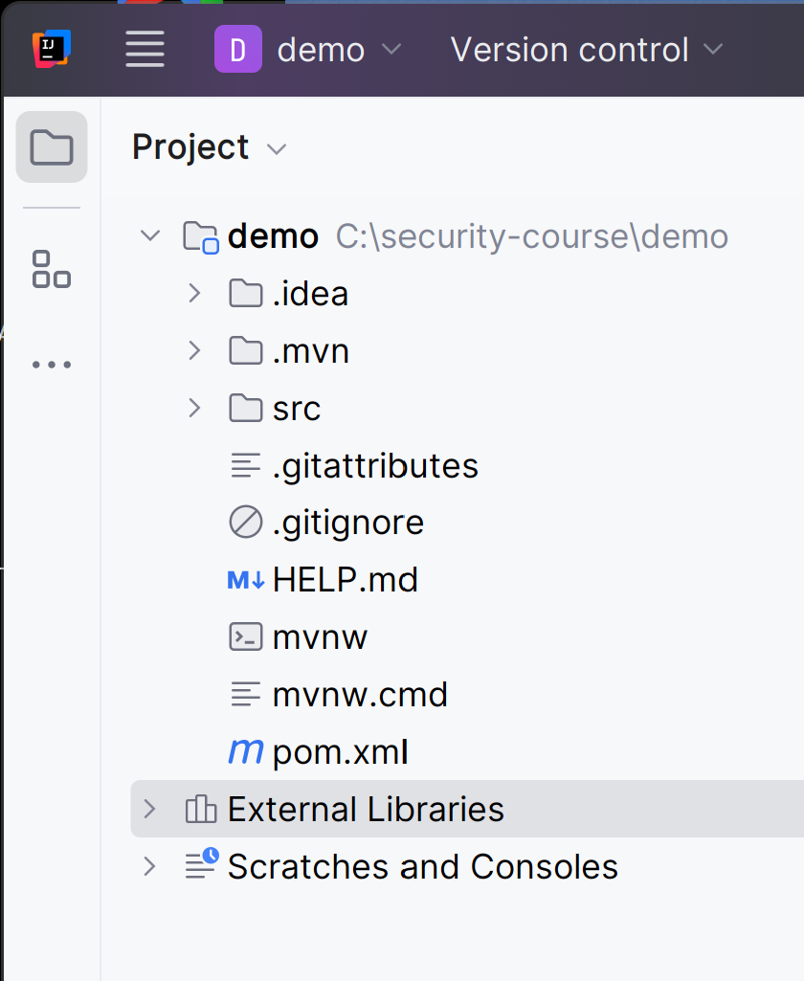
Wait few minutes
(downloading dependencies ...)
when finished
All dependencies
are automatically
downloaded
spring -> tomcat -> ...

Slide 30
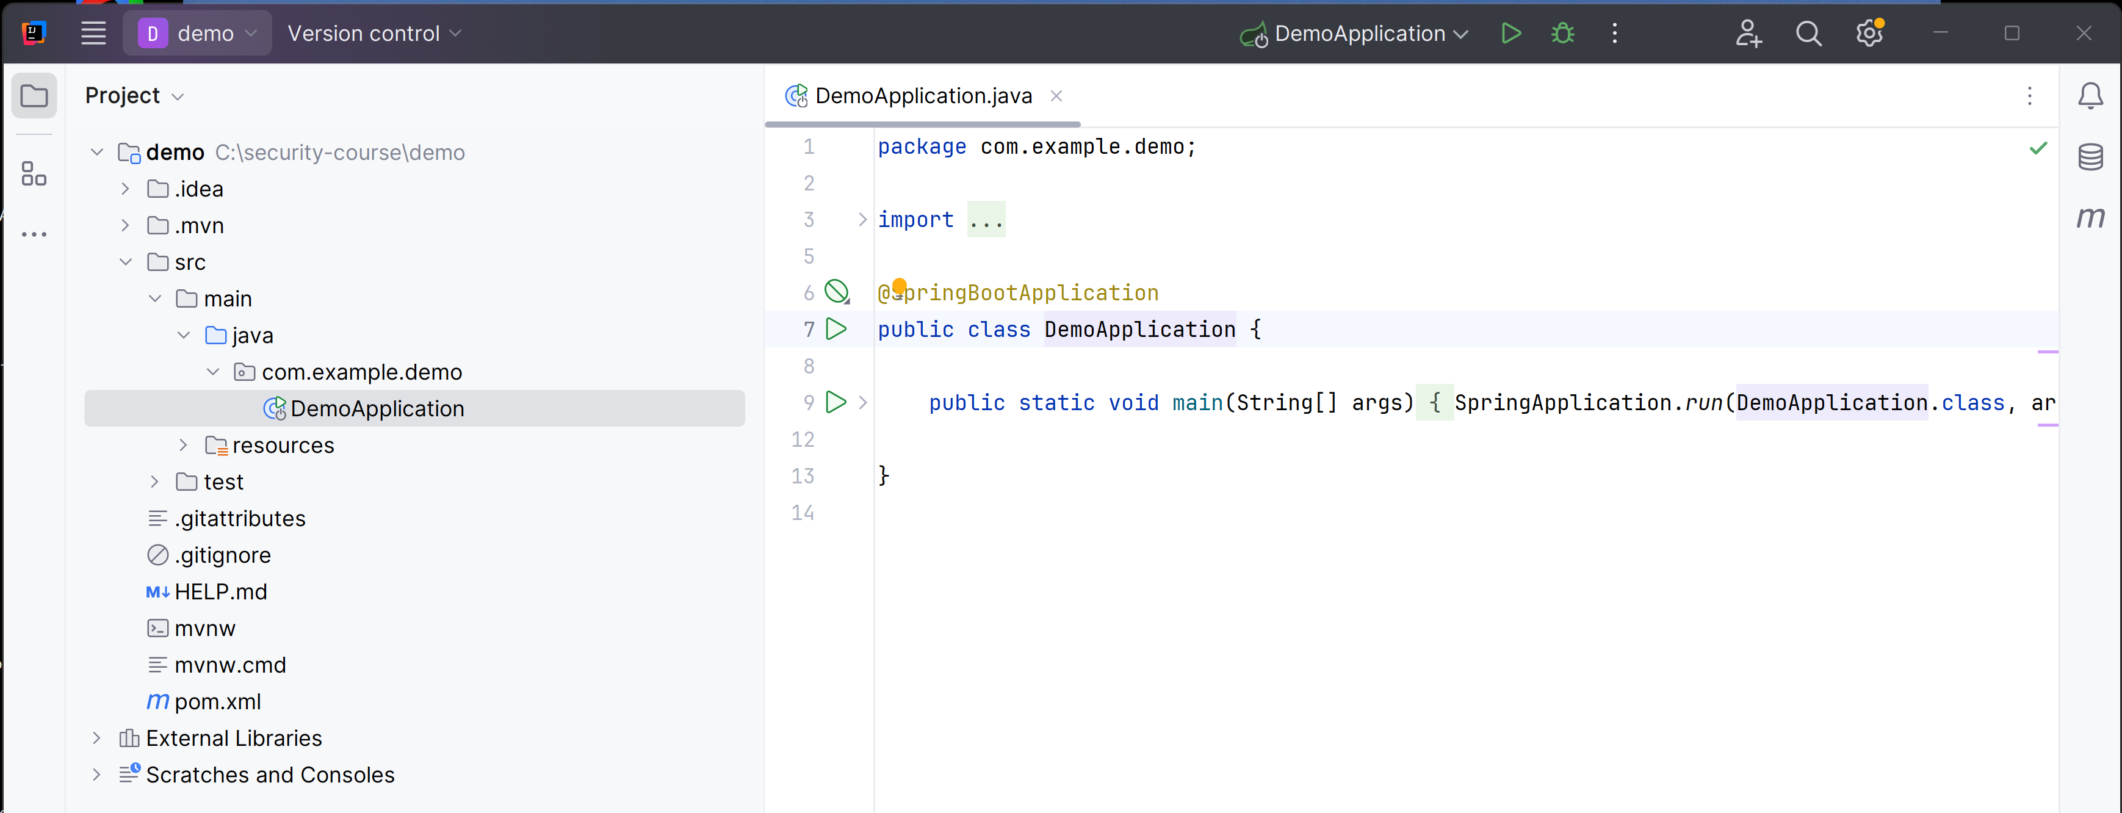
Open the main class "DemoApplication" in src/main/java/com.example.demo/

Slide 31
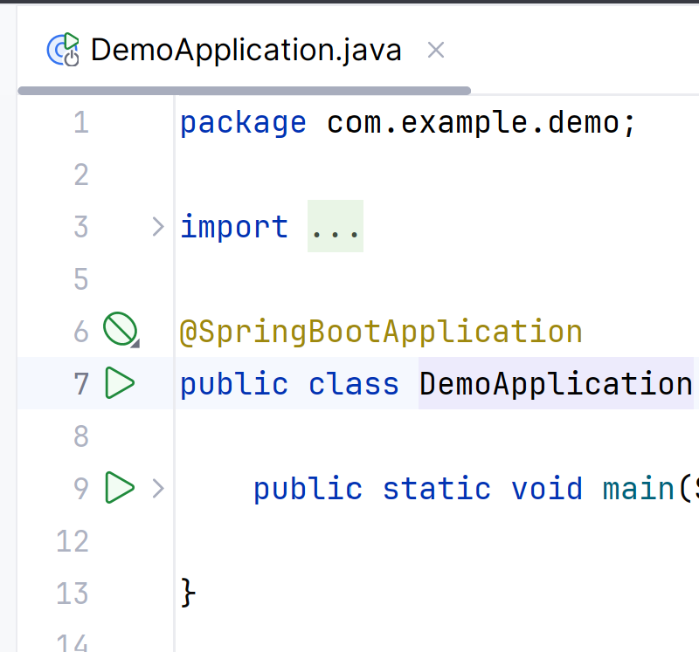
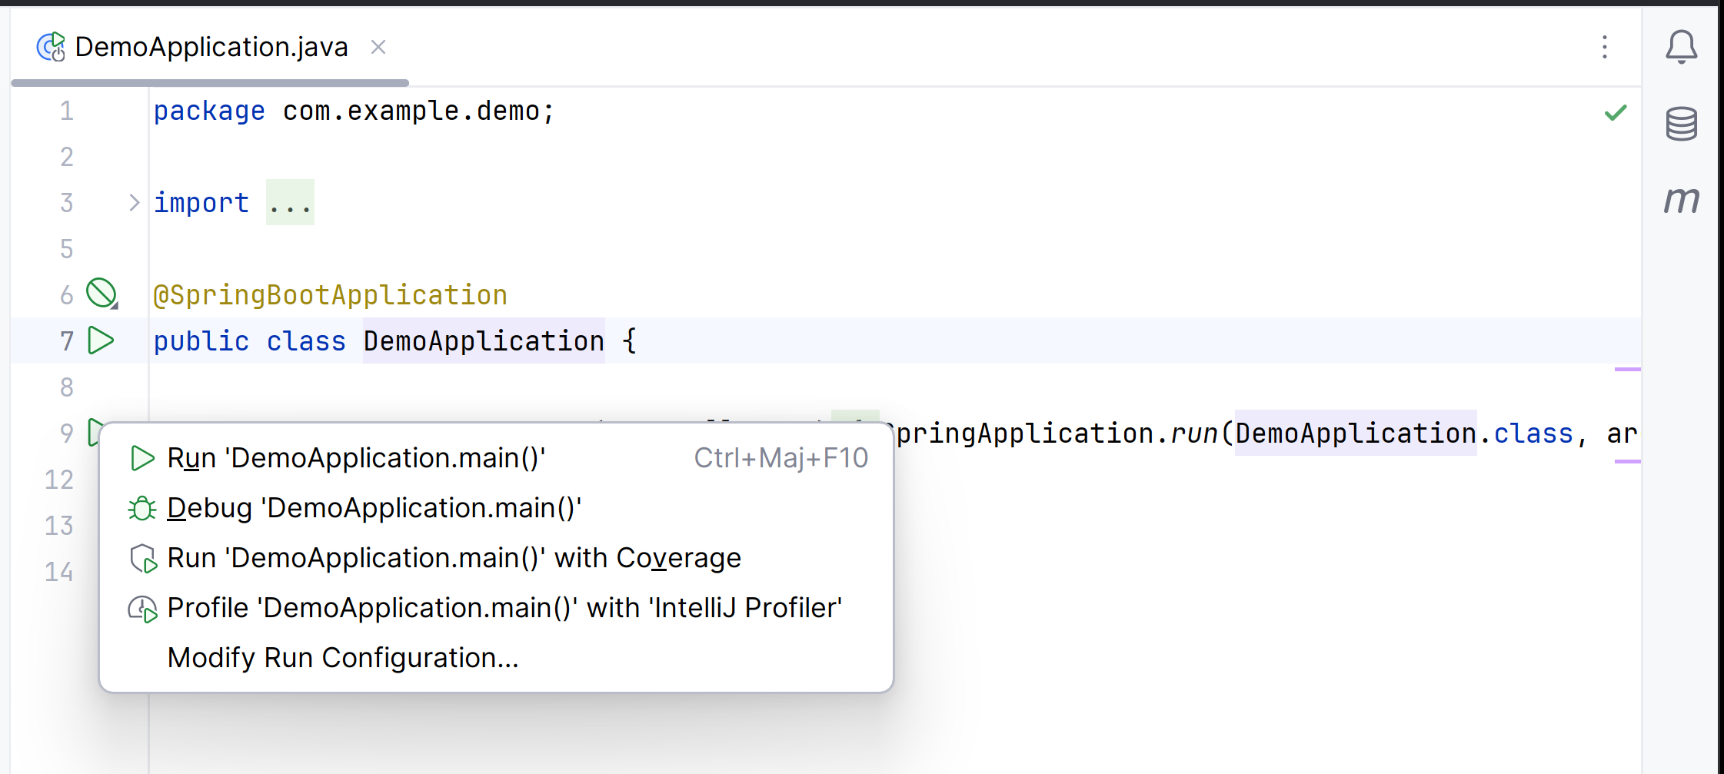
Click on "Run" Debug button

Slide 32
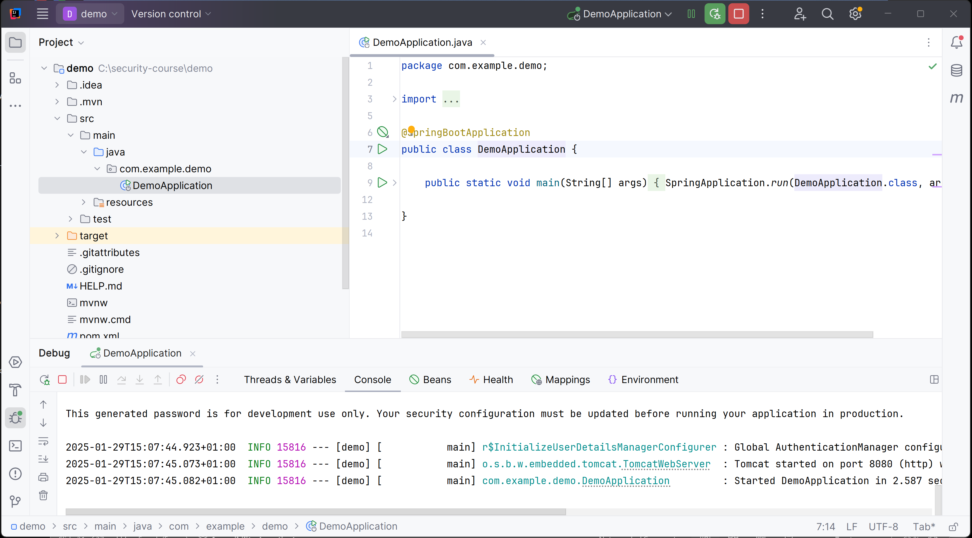
See Debug "Console" logs...
Tomcat started on port 8080 (http)

Slide 33
TD Outline
TD Goals = debug yourself a basic Http client-server
1/ install "Java JDK"
2/ install IDE : "IntelliJ IDEA"
3/ setup your app, using spring "initializr" click+download
4/ run your app
5/ open http://localhost:8080
6/ inspect network requests
7/ test Http requests

Slide 34
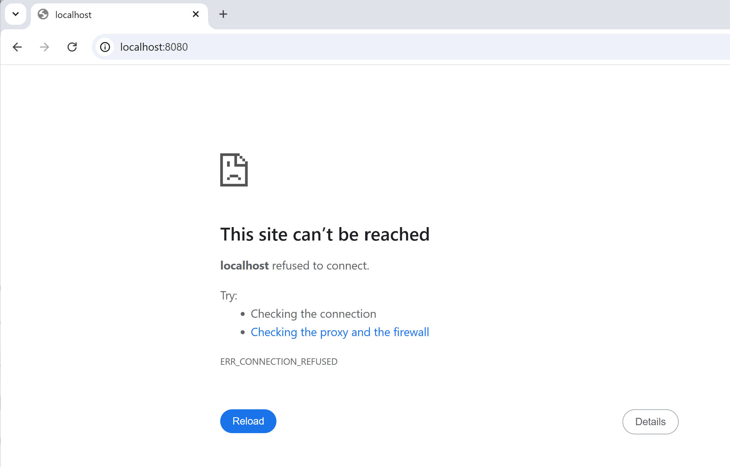
If server not running (or different port)

Slide 35
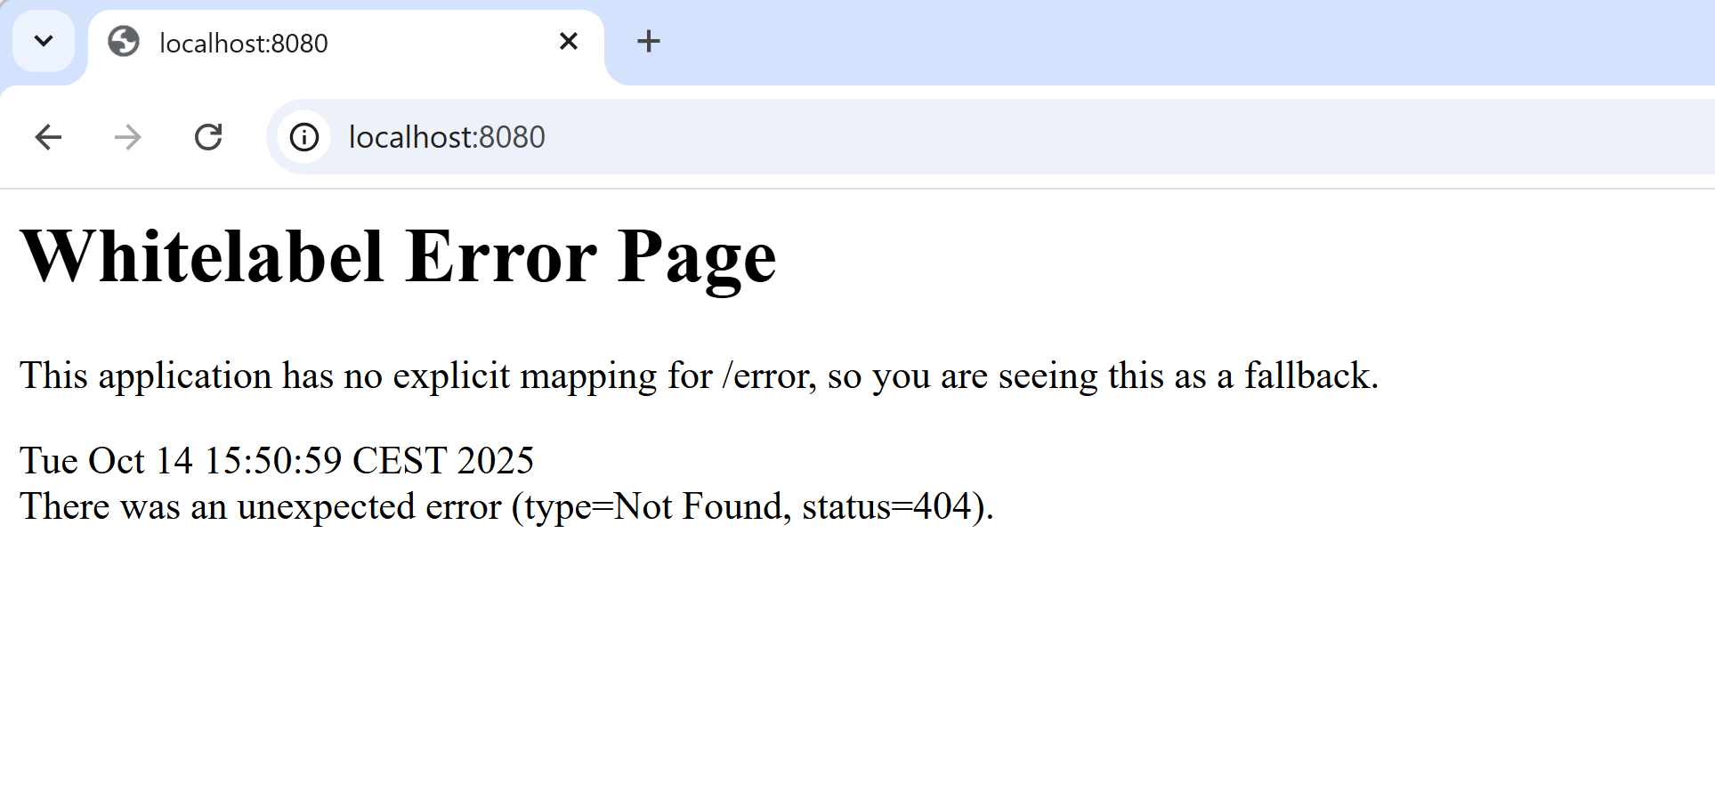
404 … page not found

Slide 36
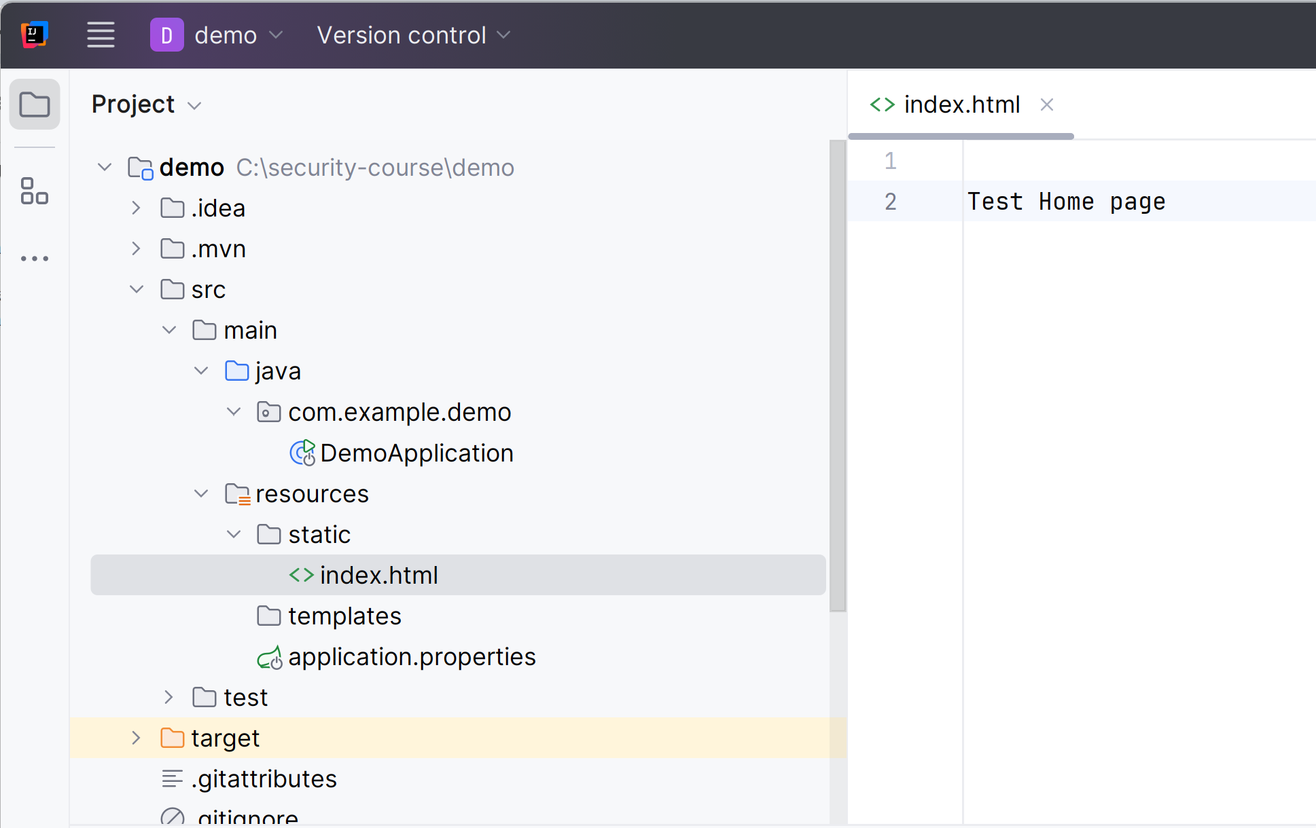
Adding new file "src/main/resource/static/index.html"

Slide 37
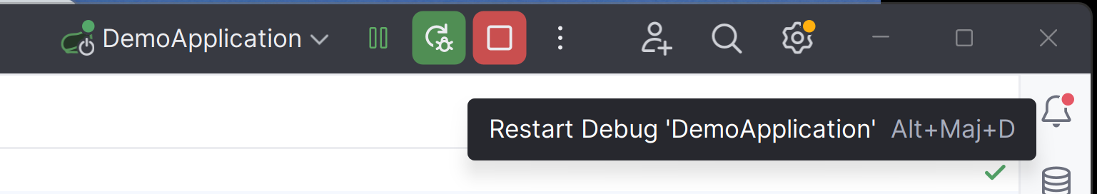
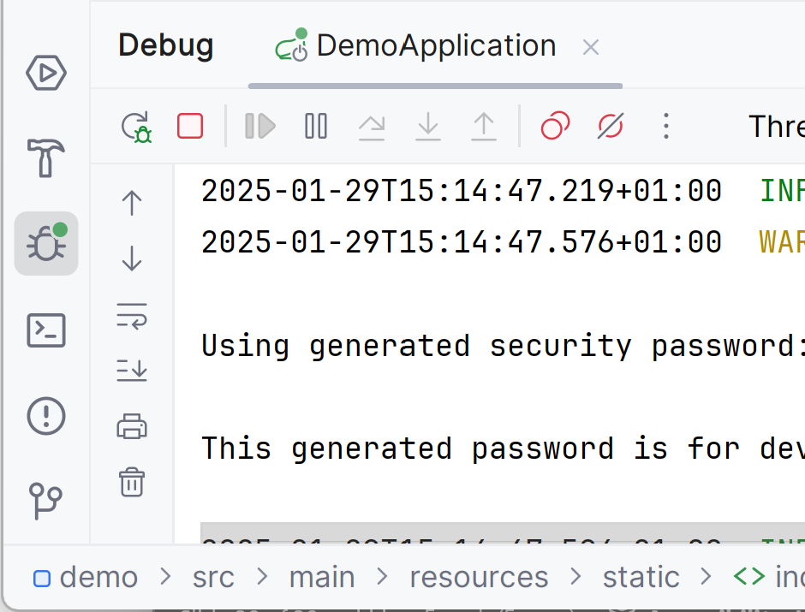
Relaunch

Slide 38
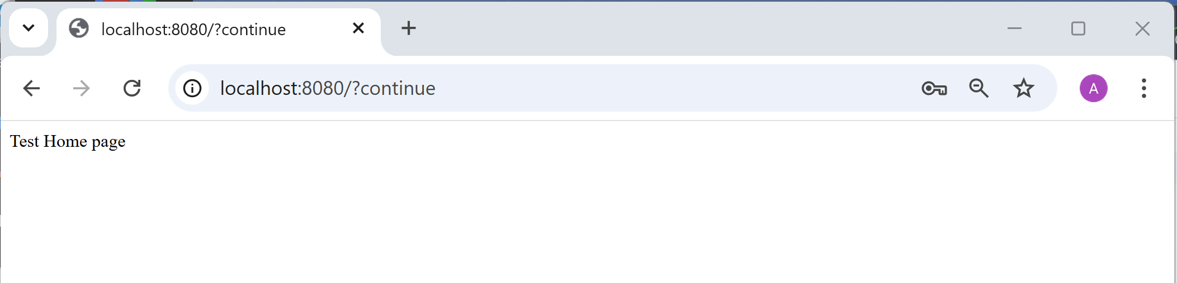
Retry ...
Resfresh (F5) Web page login user / (new) generated password

Slide 39
Add binding Java Code for http Requests
Create java class: « TodoRestController » and copy following…
package com.example.demo;
import org.springframework.http.HttpStatus;
import org.springframework.http.ResponseEntity;
import org.springframework.web.bind.annotation.*;
import java.util.ArrayList;
import java.util.List;
@RestController @RequestMapping(path = "/api/todo")
public class TodoRestController {
public static class Todo {
public int id; public String title; public String description; public int priority;
public Todo() { }
public Todo(int id, String title, String description, int priority) {
this.id = id; this.title = title; this.description = description;
this.priority = priority;
}
}
private int idGenerator = 1;
private int newId() {
return idGenerator++;
}
protected List<Todo> todos = new ArrayList<>(List.of(
new Todo(newId(), "Learn Java", "", 1),
new Todo(newId(), "Learn SpringBoot", "", 2),
new Todo(newId(), "Learn Rest Spring-Web", "", 3)
));
// UPDATE - Update existing todo
@PutMapping()
public ResponseEntity<Todo> update(
@RequestBody Todo updatedTodo) {
if (updatedTodo == null) {
return ResponseEntity.badRequest().build();
}
int id = updatedTodo.id;
boolean removed = todos.removeIf(t -> t.id == id);
if (!removed) {
return ResponseEntity.notFound().build();
}
todos.add(updatedTodo);
return ResponseEntity.ok(updatedTodo);
}
// DELETE - Delete todo by ID
@DeleteMapping("/{id}")
public ResponseEntity<Void> delete(@PathVariable int id) {
boolean removed = todos.removeIf(t -> t.id == id);
if (removed) {
return ResponseEntity.noContent().build();
}
return ResponseEntity.notFound().build();
}
// DELETE - Delete all todos
@DeleteMapping
public ResponseEntity<Void> deleteAll() {
todos.clear();
return ResponseEntity.noContent().build();
}
}
// READ - Get all todos
@GetMapping
public List<Todo> getAll() {
return todos;
}
// READ - Get todo by ID
@GetMapping("/{id}")
public ResponseEntity<Todo> getById(@PathVariable int id) {
Todo todo = todos.stream().filter(t -> t.id == id).findFirst().orElse(null);
if (todo == null) {
return ResponseEntity.notFound().build();
}
return ResponseEntity.ok(todo);
}
// CREATE - Add new todo
@PostMapping
public ResponseEntity<Todo> create(@RequestBody Todo todo) {
if (todo == null) {
return ResponseEntity.badRequest().build();
}
todo.id = newId(); // Assign new ID
todos.add(todo);
return ResponseEntity.status(HttpStatus.CREATED).body(todo);
}

Slide 40
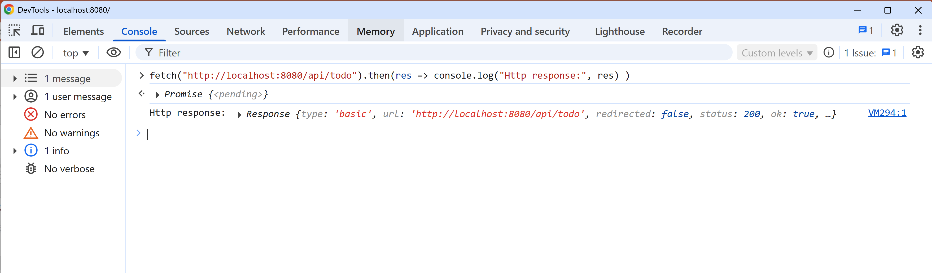
Test Using Web Browser DevTool « fetch() »
Open browser page « http://localhost:8080/ »
Then Open DevTool « F12 »
Then go in « Console » TAB
Type fetch("http://localhost:8080/api/todo").then(res => console.log("Http response:", res) )

Slide 41
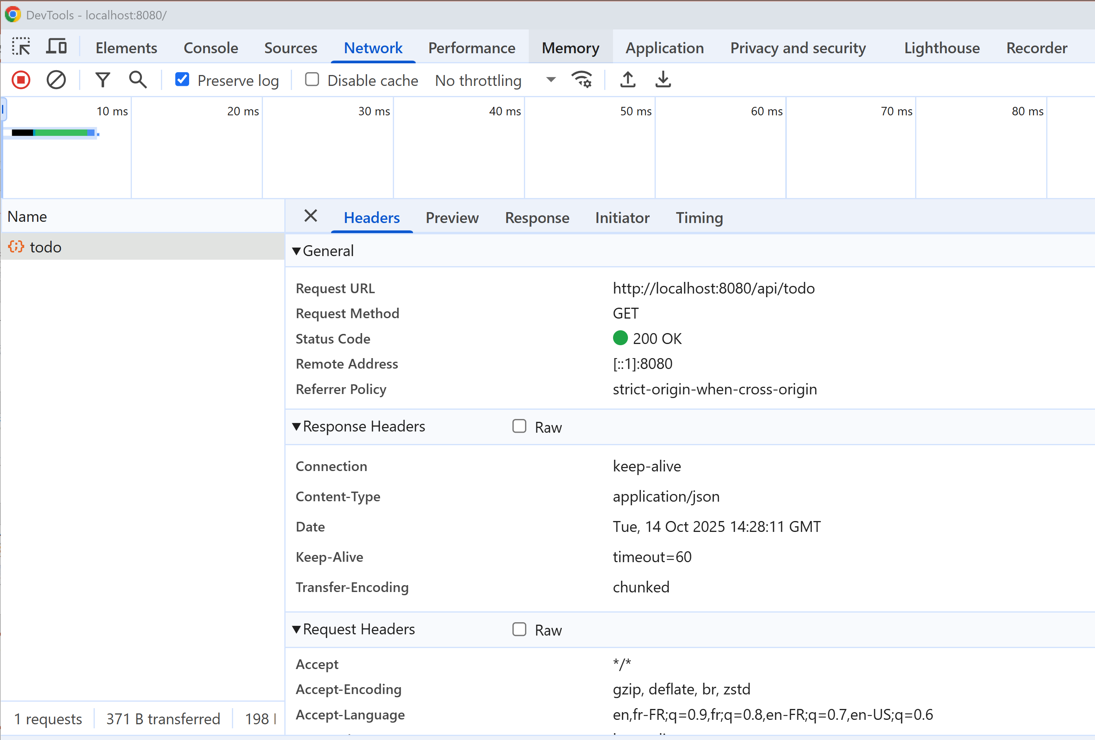
Open DevTools Tab « Network »

Slide 42
DevTool Console LOG INFO
Difficult to read the « Response Body » (ReadableStream)

Slide 43
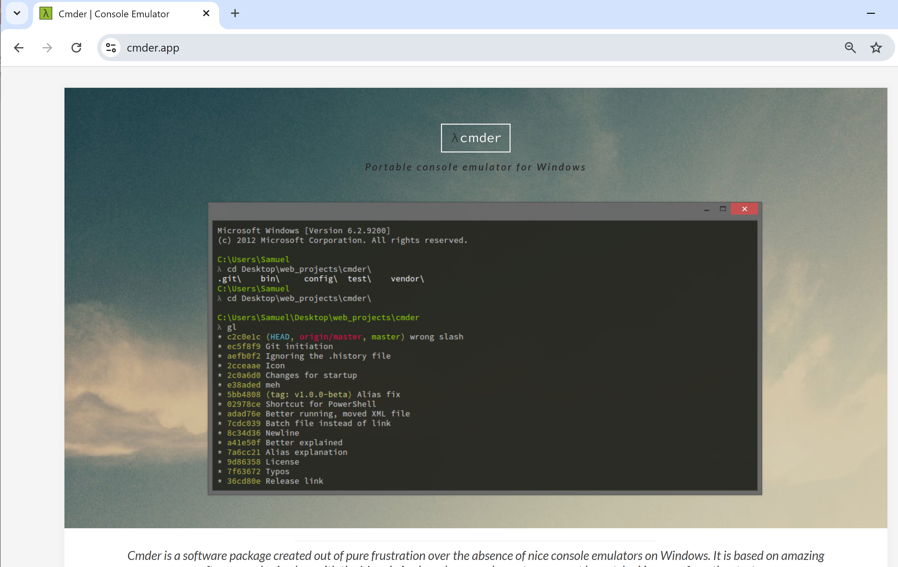
Testing Using CURL … need install Cmder https://cmder.app

Slide 44
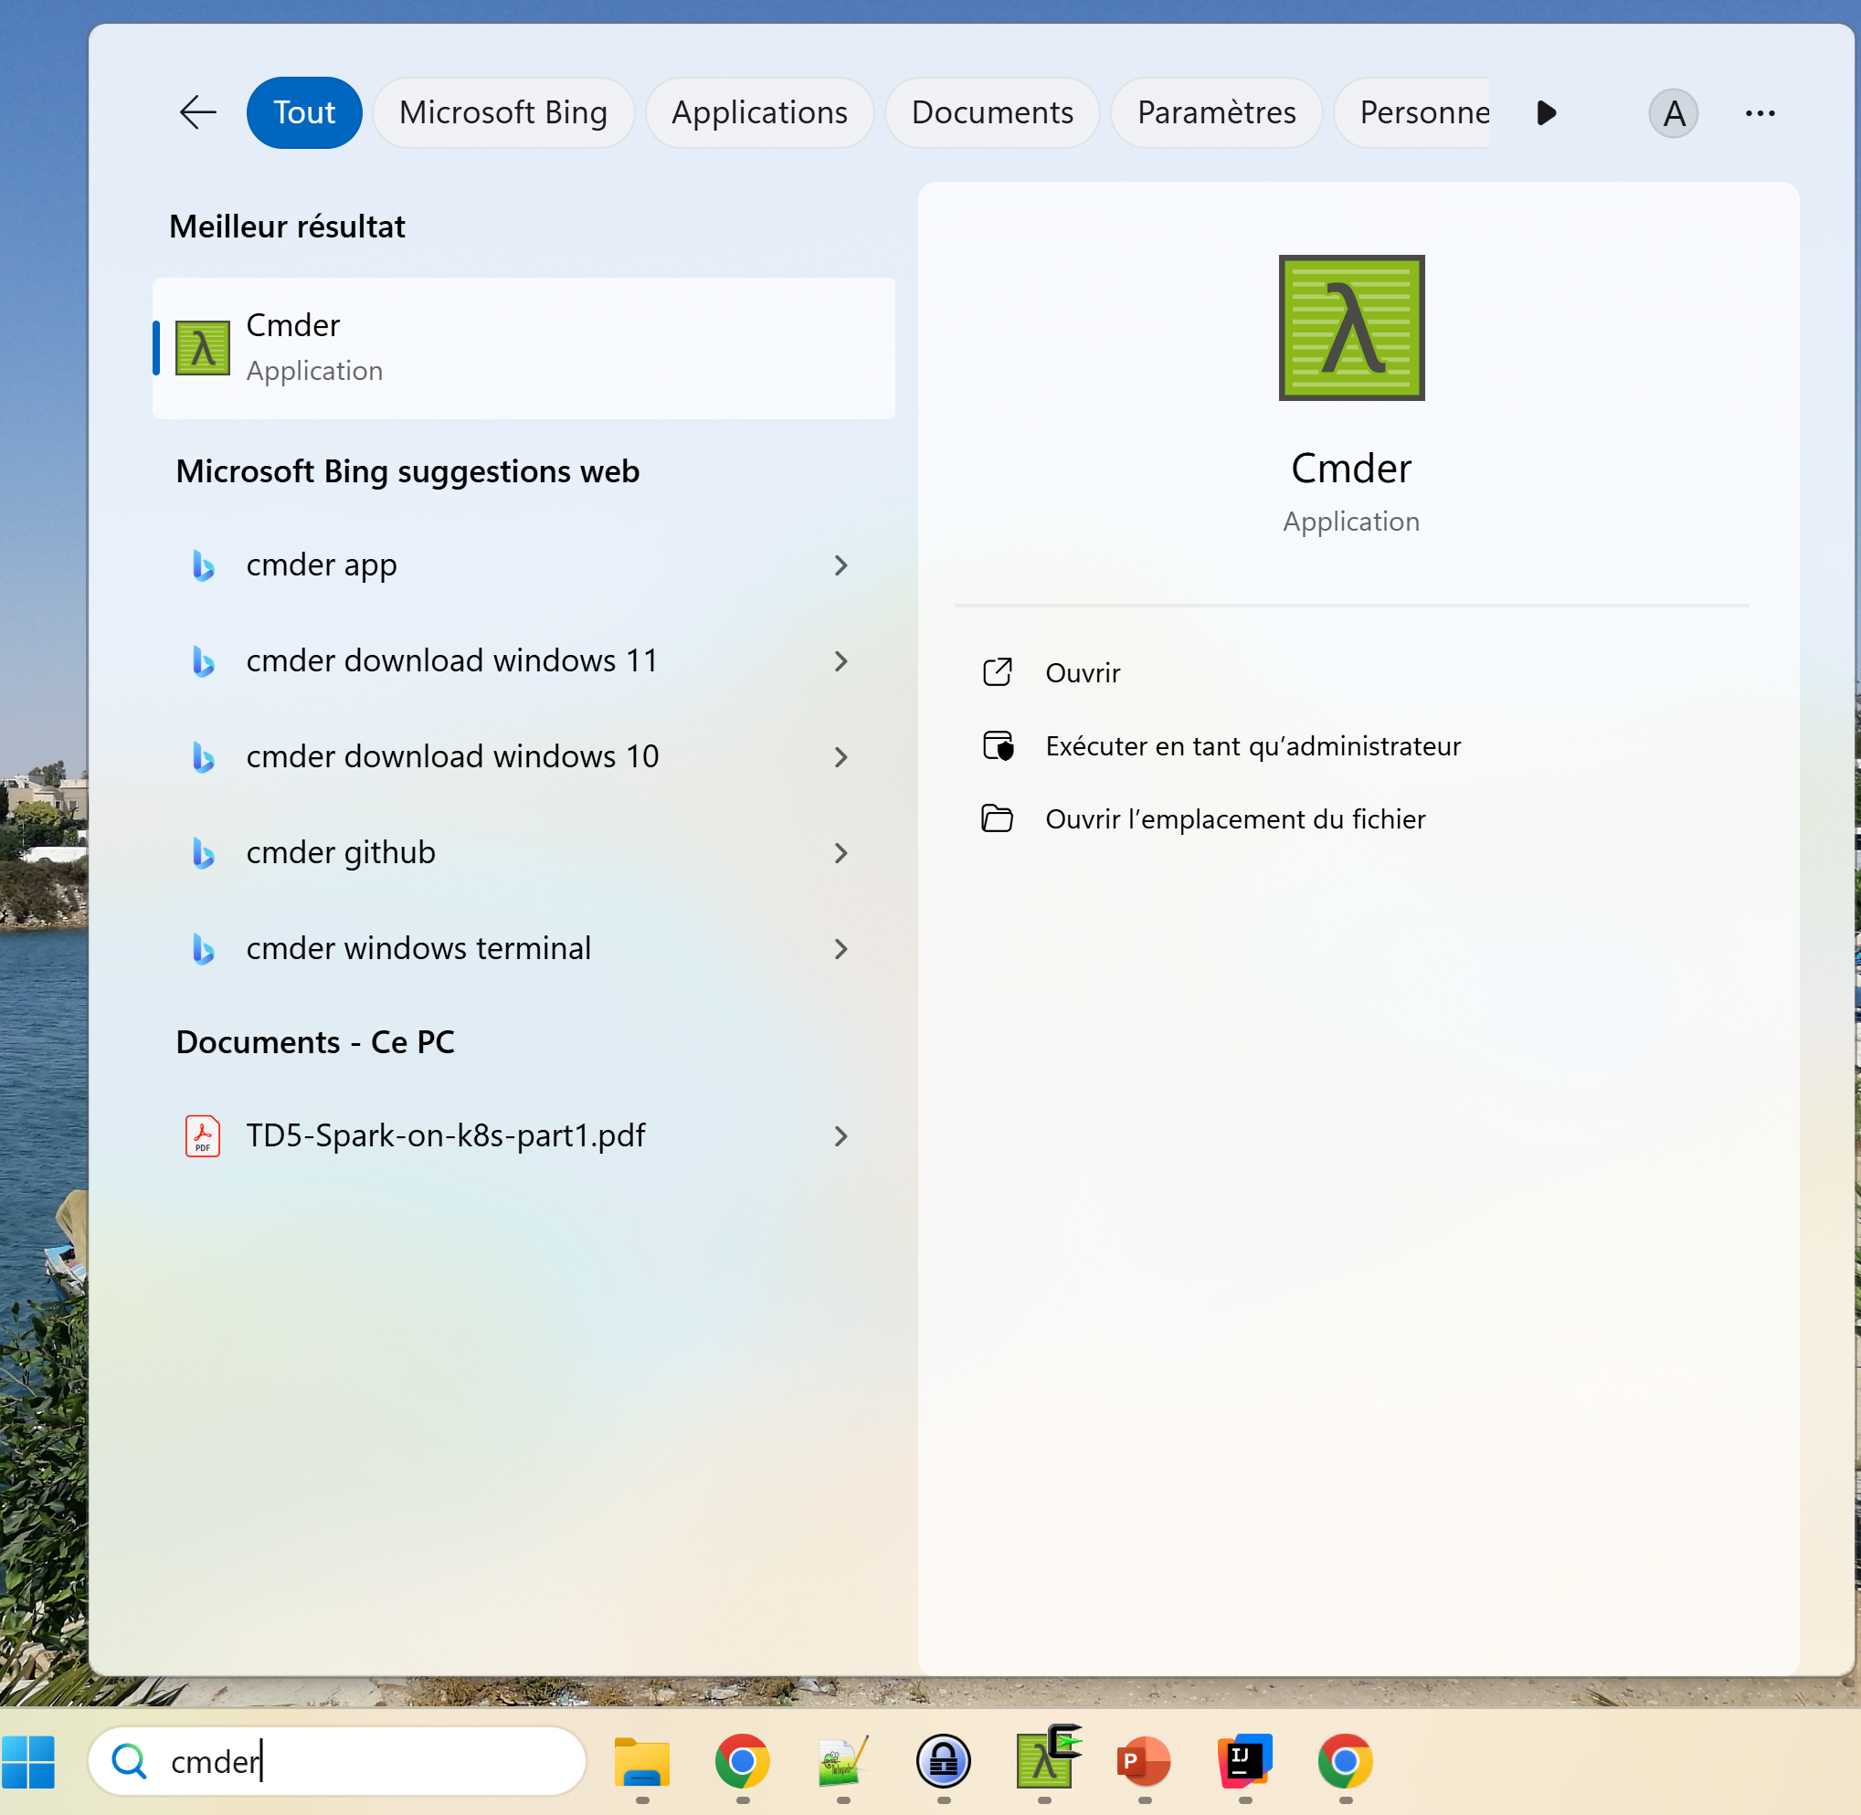
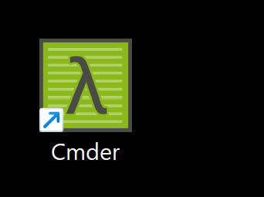
Open Terminal for Cmder

Slide 45
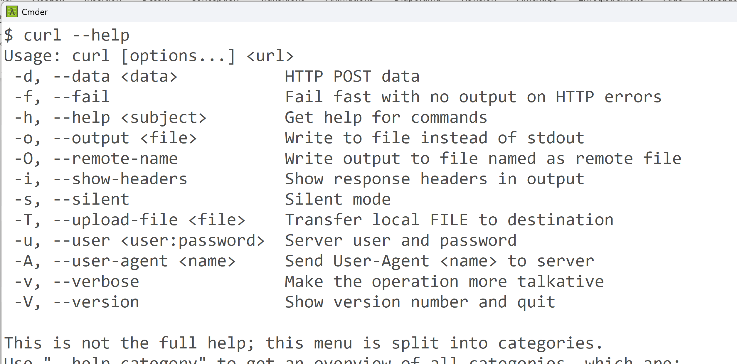
$ curl command

Slide 46
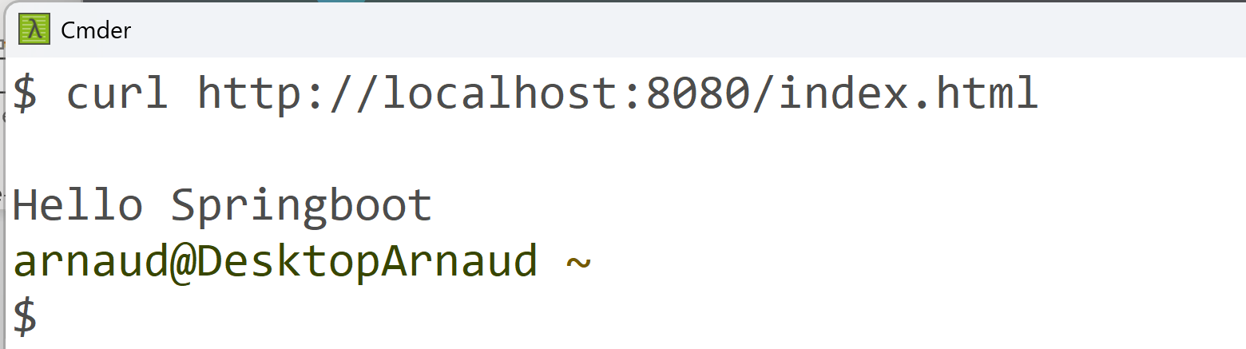
Example curl GET

Slide 47
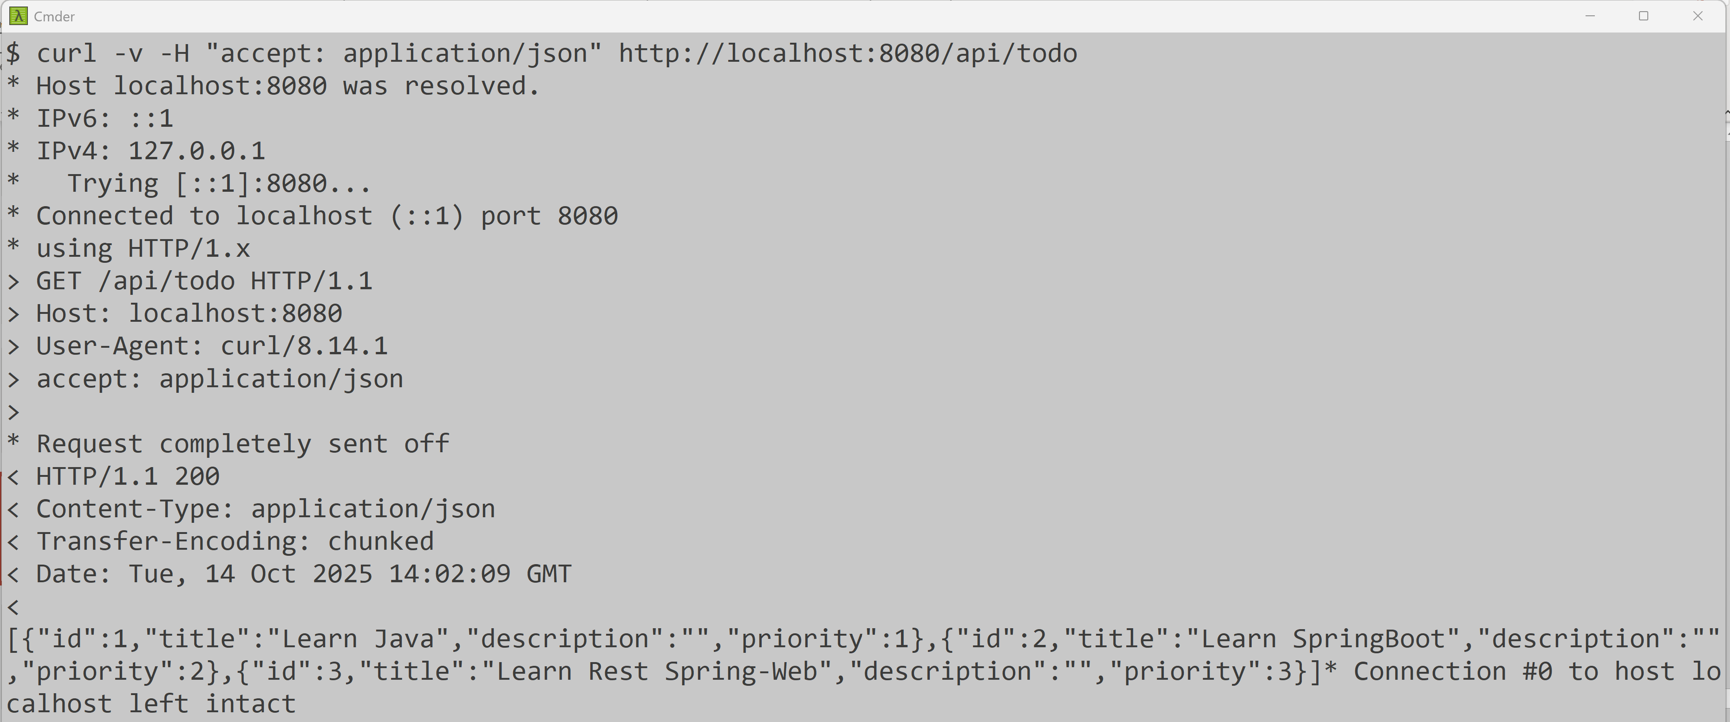
Using Curl, with Headers « -H ‘key: value’ »

Slide 48
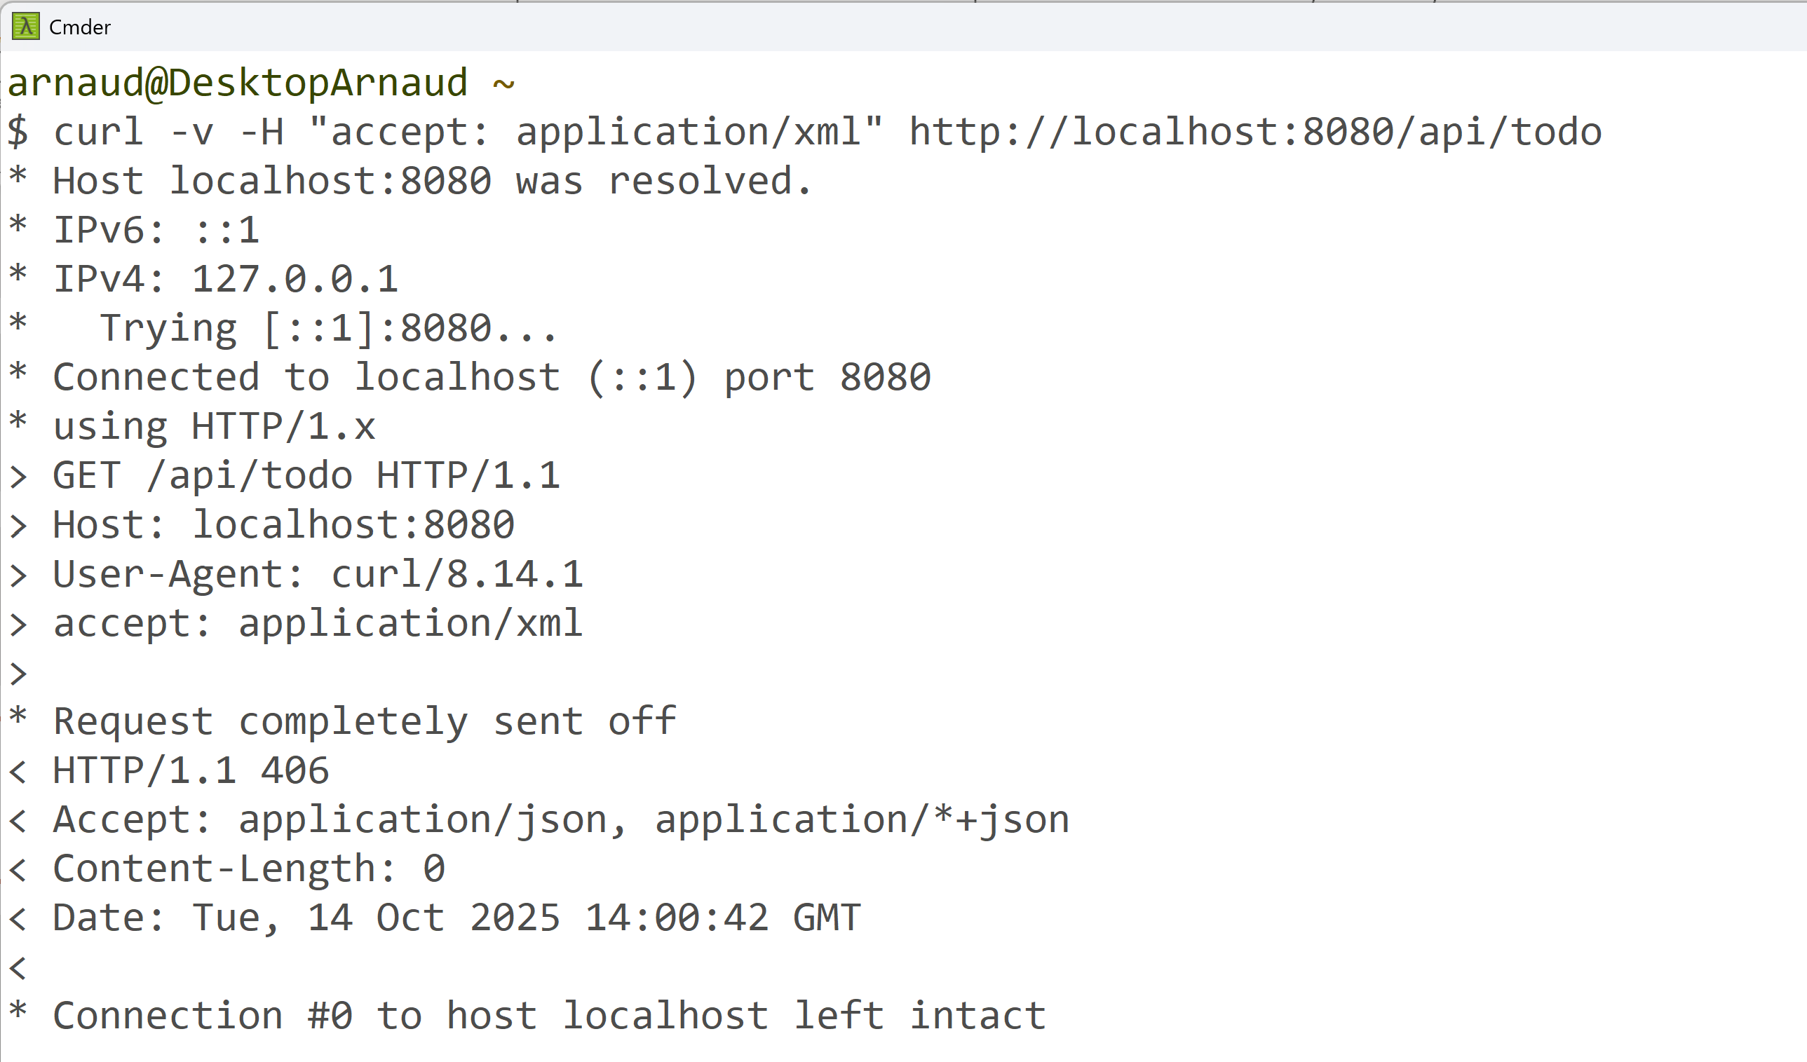
Example http 406 (bad media)

Slide 49
Test Using IntelliJ « test.http » file

Slide 50
Edit « test.http » file
### GET request
GET http://localhost:8080/api/todo
Accept: application/json
### POST request
POST http://localhost:8080/api/todo
Content-Type: application/json
{
"title": "Learn SpringBoot",
"description": "Learn SpringBoot",
"priority": 2
}
###

Slide 51

Test.http … request are executable

Slide 52
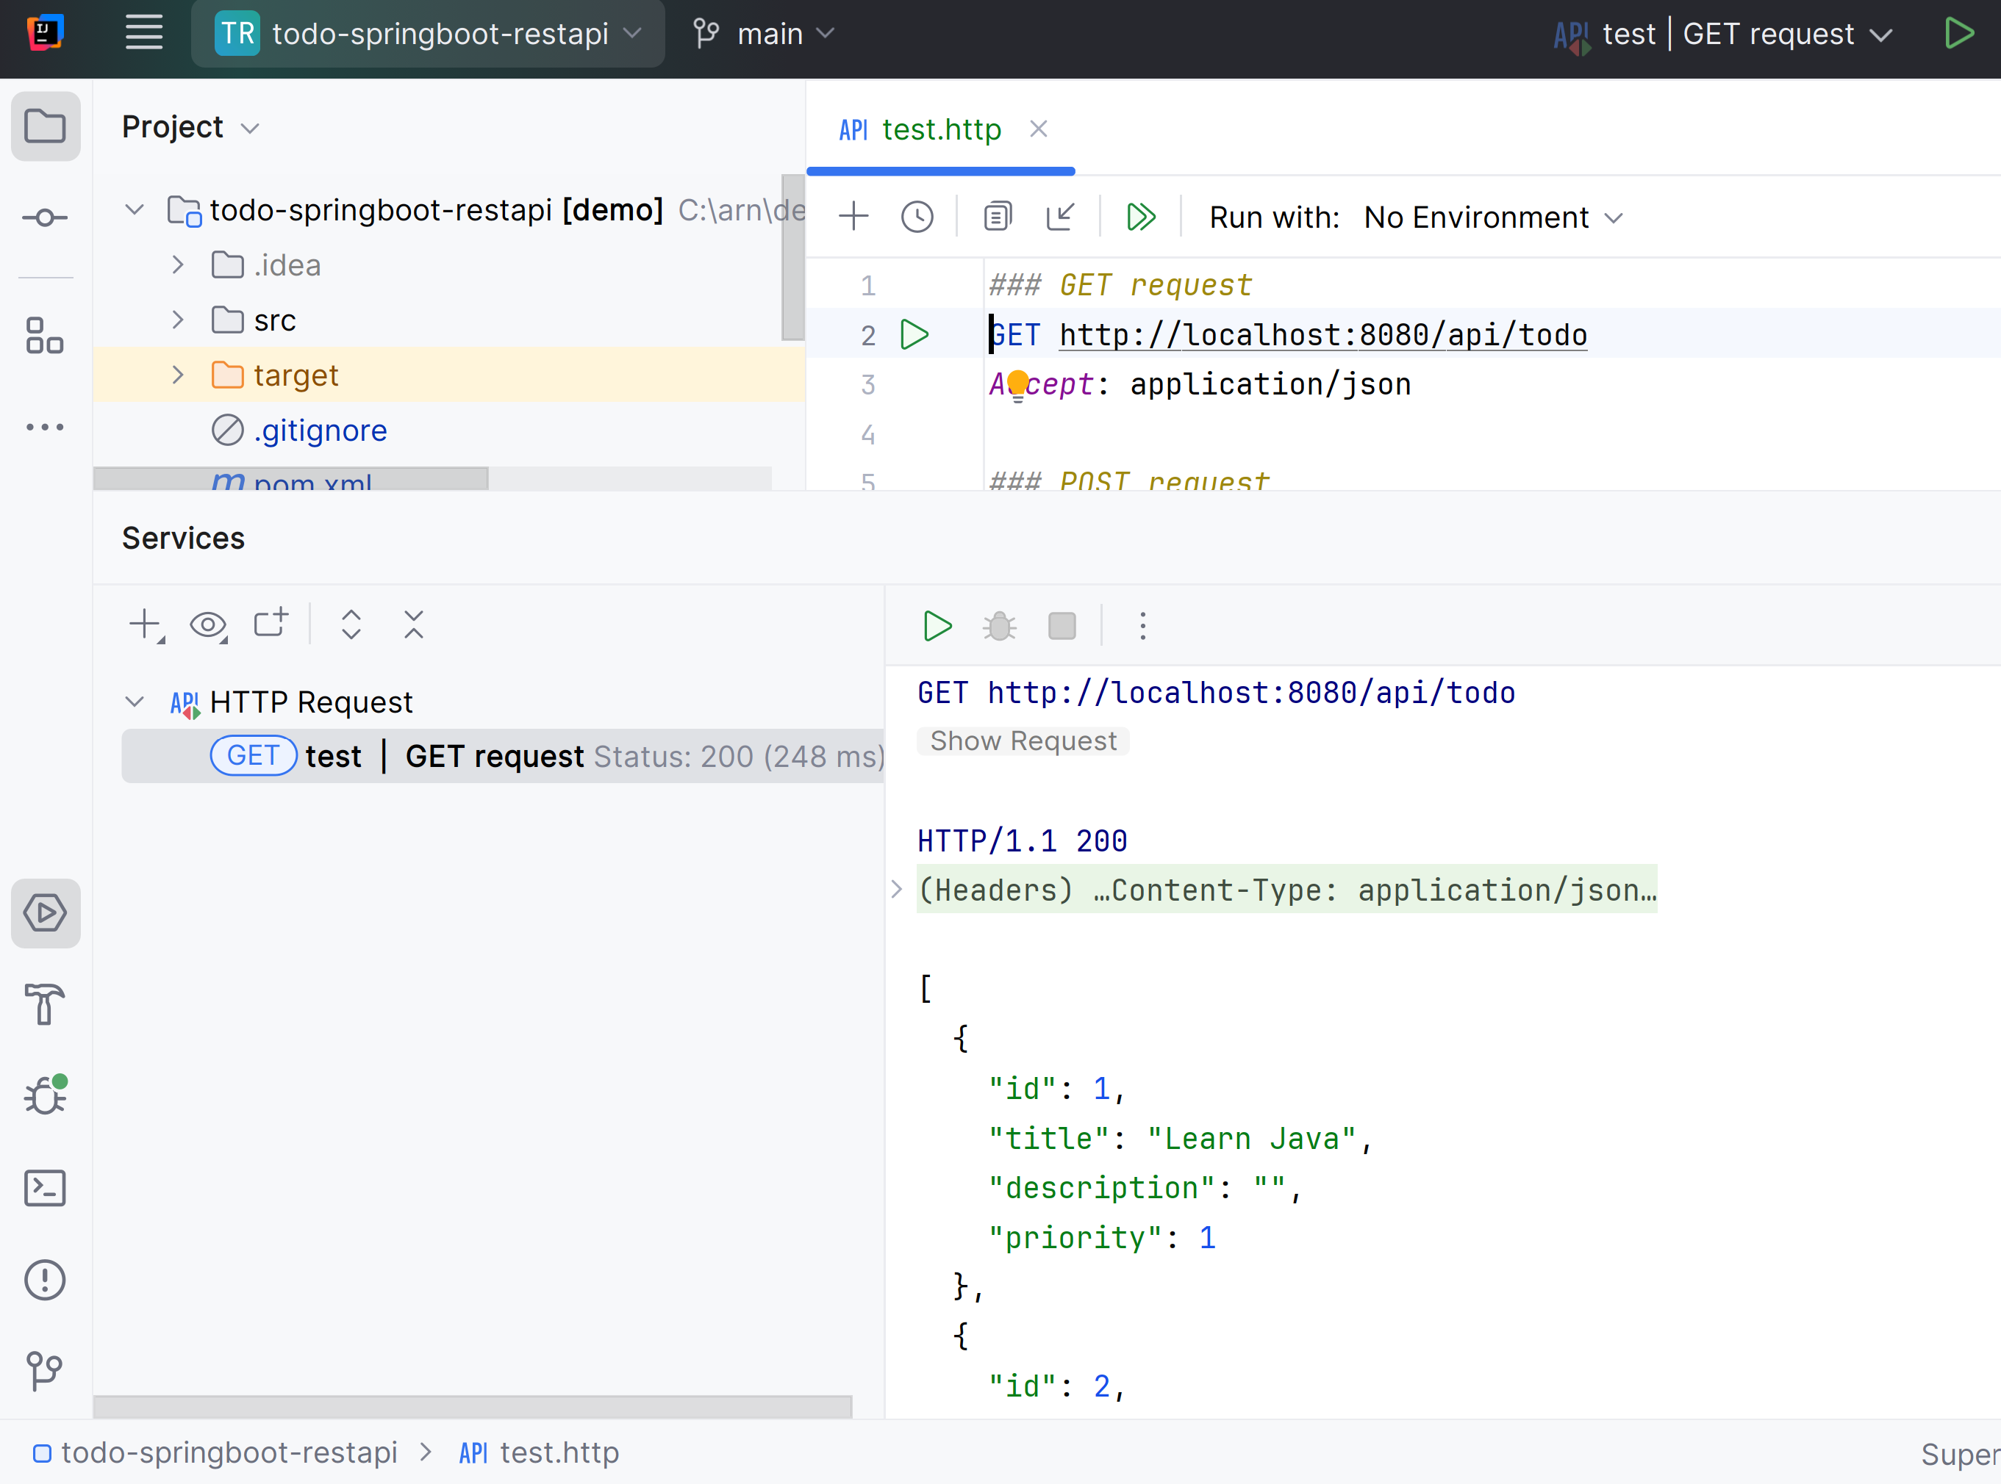
Execute..

Slide 53
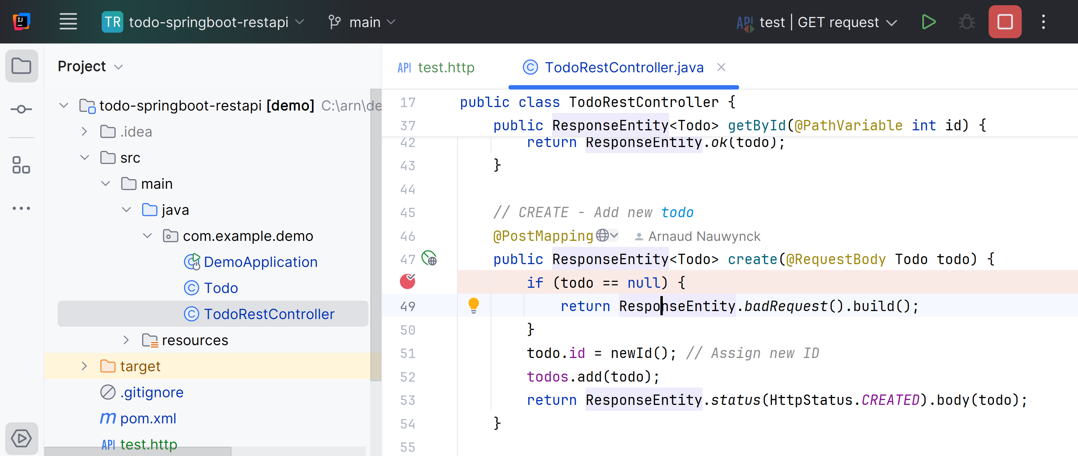
Put Debug Breakpoints in Server

Slide 54
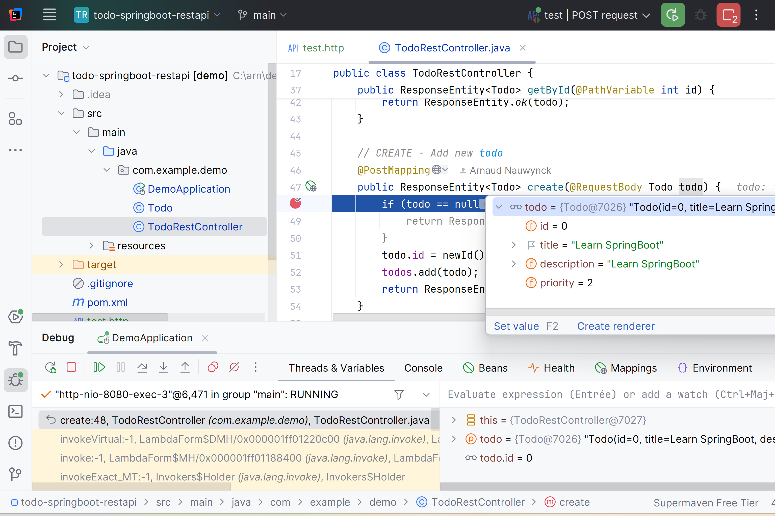
Debug..

Slide 55
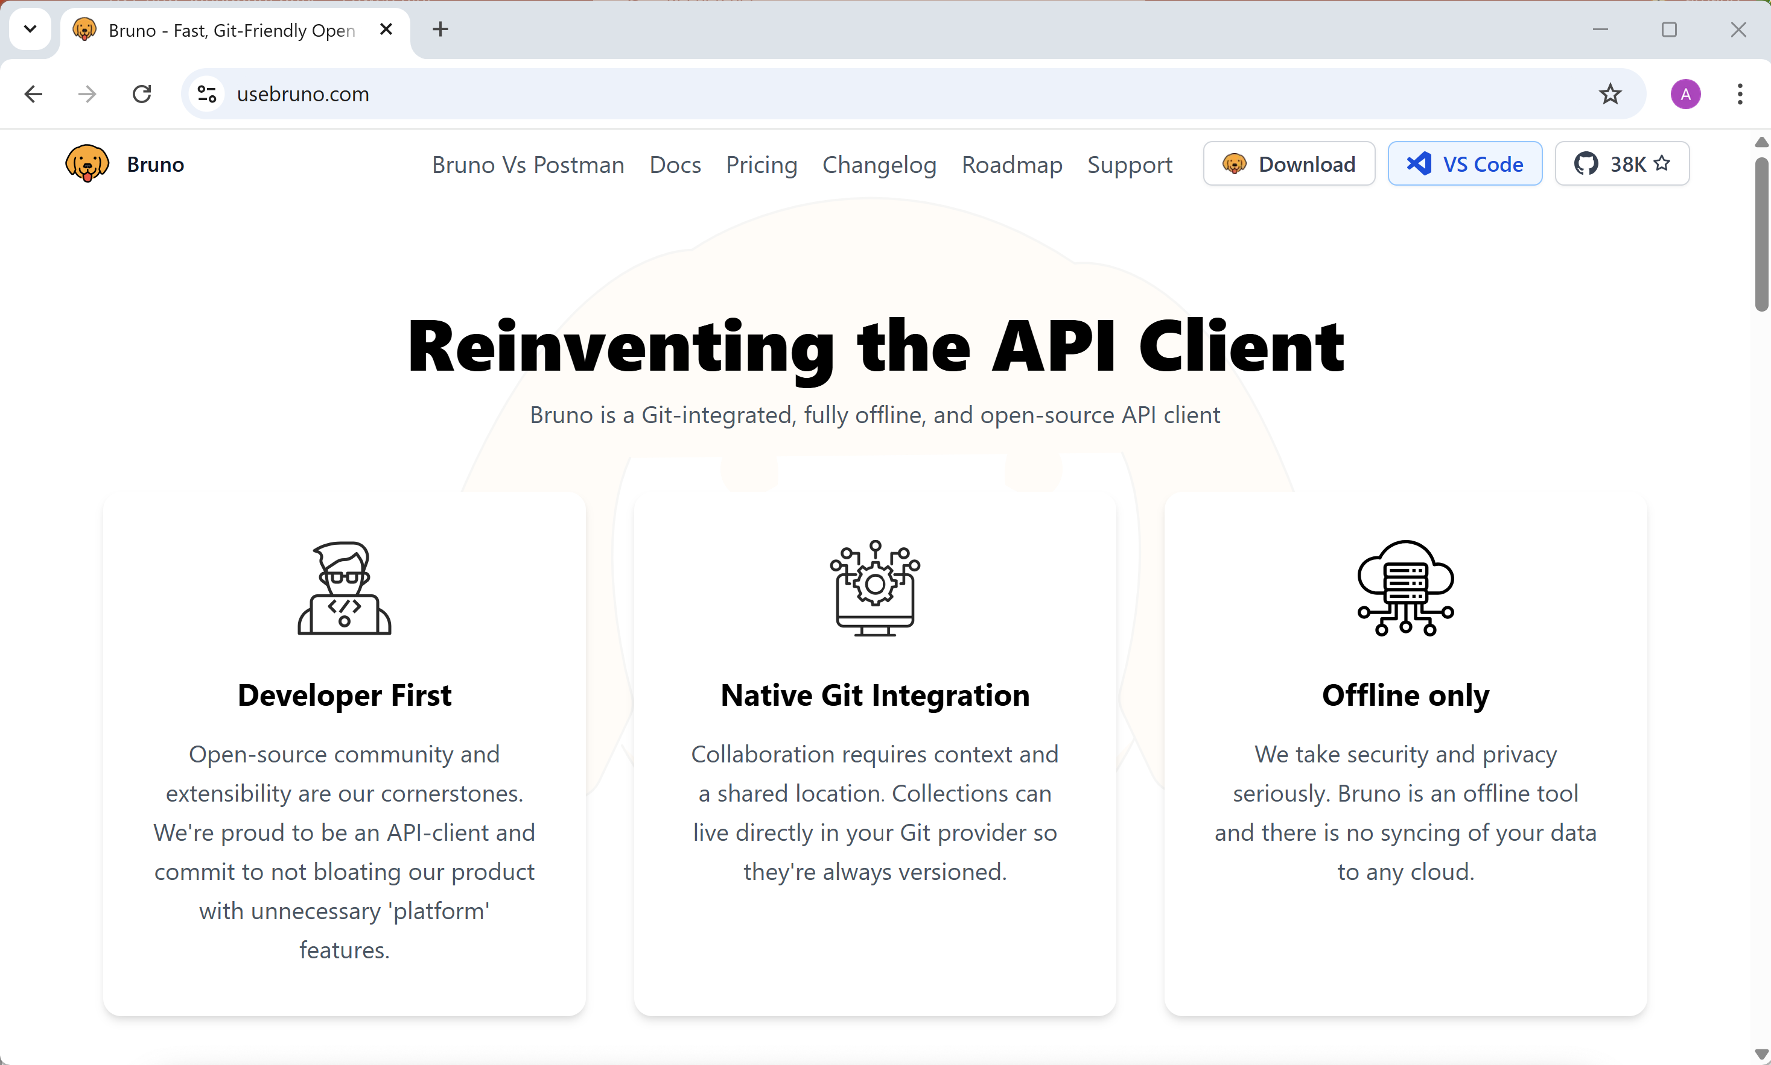
Test Using Bruno (or Postman) https://usebruno.com

Slide 56
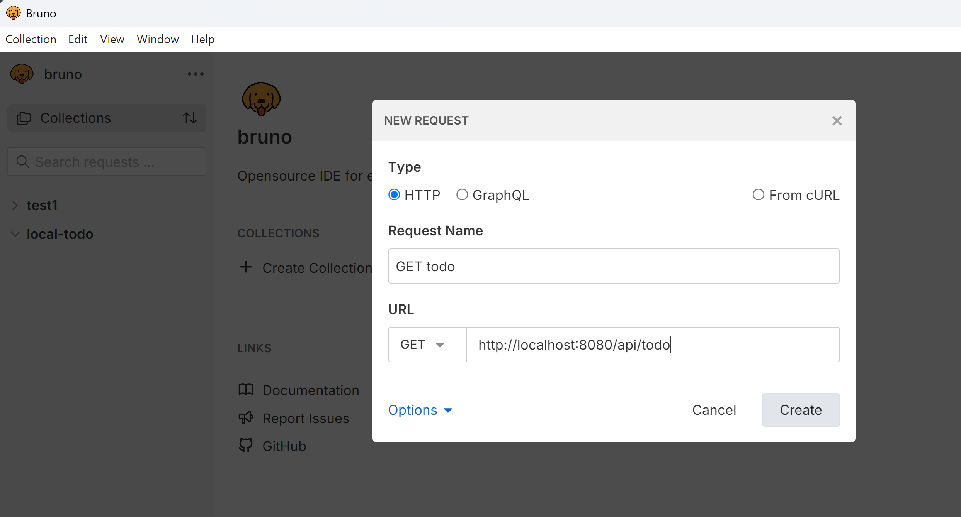
Bruno – Create Request

Slide 57
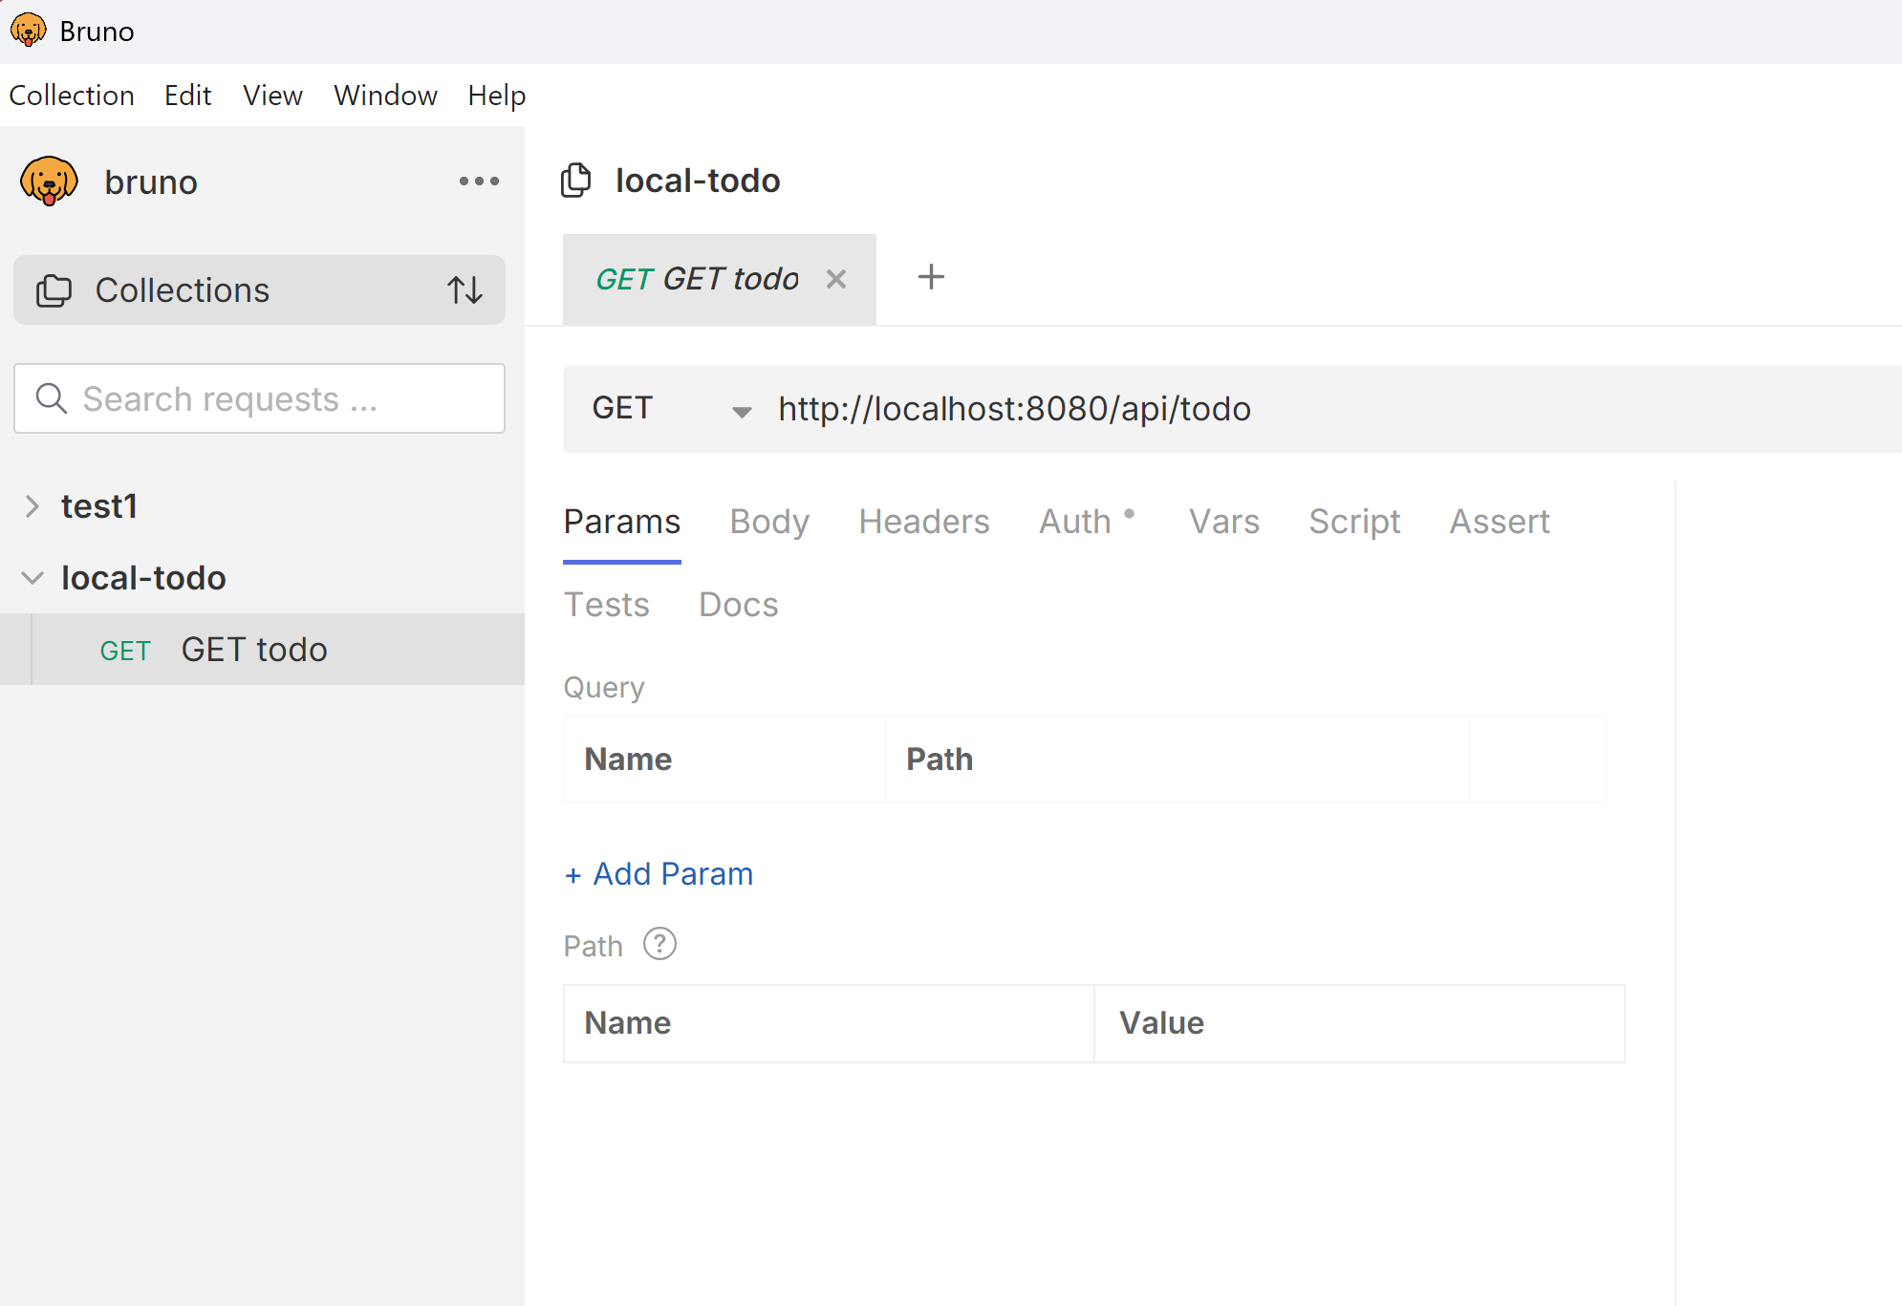
Bruno – Request

Slide 58
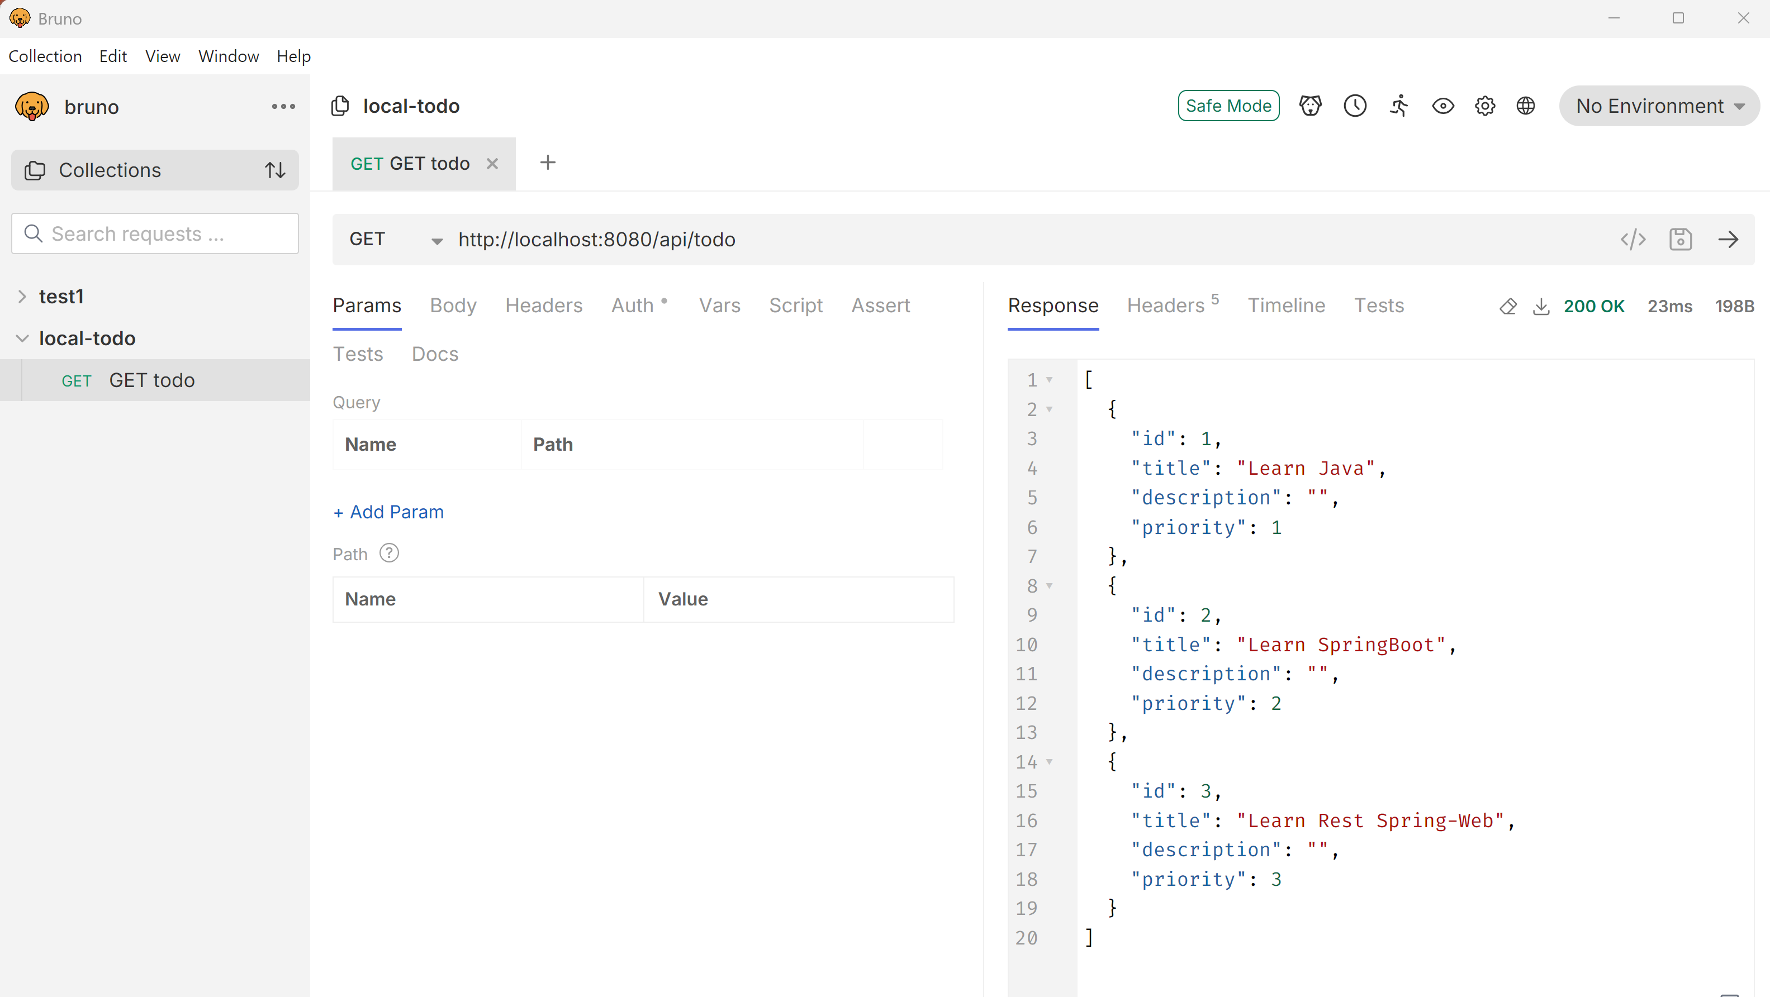
Execute Request

Slide 59
OpenAPI – Swagger
Add OpenAPI and swagger-ui maven dependencies to your pom.xml
Relaunch
Open « http://localhost:8080/swagger-ui.html »

