Slide 1
Architecture Design Part1 : Entity (Domain)
arnaud.nauwynck@gmail.com
DTO – Entity – Model classes
& RestController/GraphQL – Service – Repository classes
This document:
http://github.com/arnaud-nauwynck/Presentations/java/ Architecture-Design-part1-Entity.pdf

Slide 2
Step1 :
Analysis the objectives
Define the « Ubiquituous Langage »
Same langage for end-users & IT

Slide 3
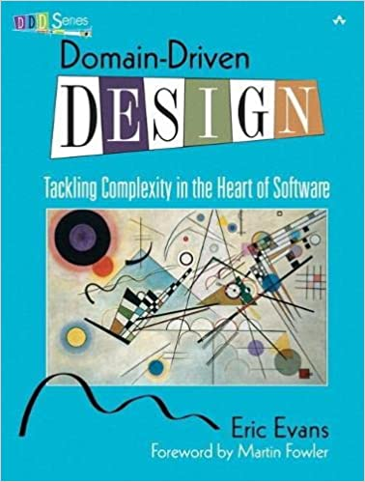

« Domain Driven Design » book
Author: Eric Evans
« DDD » : THE Reference
after introduction to UML modelisation in « Gof » = « Design Pattern » book

Slide 4
« THE » Domain : fit your « Bounded Context »
There is NOT a perfect Domain for matching all applications
1 Domain is specific to 1 App
Focus on the « kernel » / « fundamentals» of your app
In DDD book : « Bounded Contexts »

Slide 5
Step 2 : Classes for Domain
Handwritten Drawings in UML
… share knowledge with team
0..1
XEntity
YEntity
1
0..*
Id: IdType
field1: Type
field2: Type
…
Id: IdType
field1: Type
field2: Type
…
1
0..*

Slide 6
UML … classes hierarchies? interfaces ?
Start simple …
NO interface
NO « diamond » inheritance NO sub-class without new fields
NOT focusing on « behaviour » … focusing only on « data »
Favor delegation: « has » rather than inheritance: « is »
XEntity
Id: IdType
field1: Type
…
SubAXEntity
SubBXEntity
fieldForSubAX: Type
…
fieldForSubXB: Type
…
SubCBXEntity
fieldForSubXB: Type
…

Slide 7
Focus on (Persistence) Data vs Behavior
An Entity is unique via its « ID »
And completely defined via all its state data
Not focusing (yet) on behavior methods on Entity
Assume only Getter/Setters
+ Add/Remove relations to other Entities
Behavior will be handle by Service classes or corresponding Model class

Slide 8
Step 3 : … Your Database Technology
Focus on
Out of scope here
Document database
(Mongodb, CouchDb..)
Key-Value database
(HBase, Redis, ..)
Graph DB
(Neo4j..)
Plain Old « OLTP »
Transaction - Relational Database
Example: Postgresql, Mysql, Oracle
Object-Oriented DB
(Versant, Db4O, ? ..)
… would be fine, but not viable/mature/widespread

Slide 9
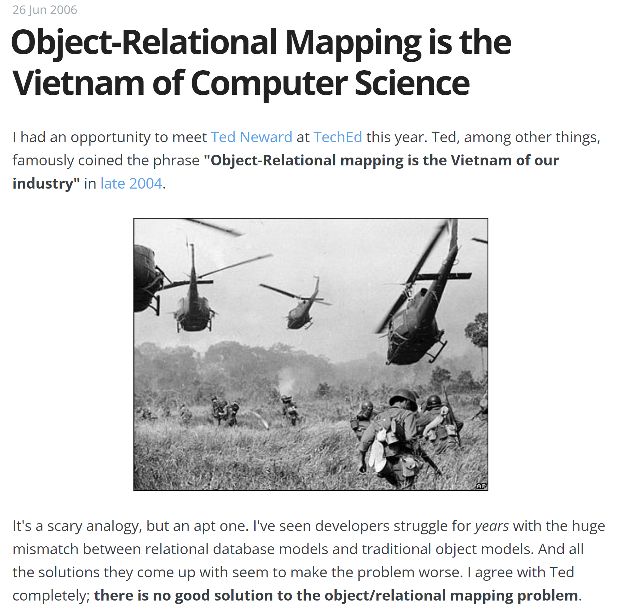
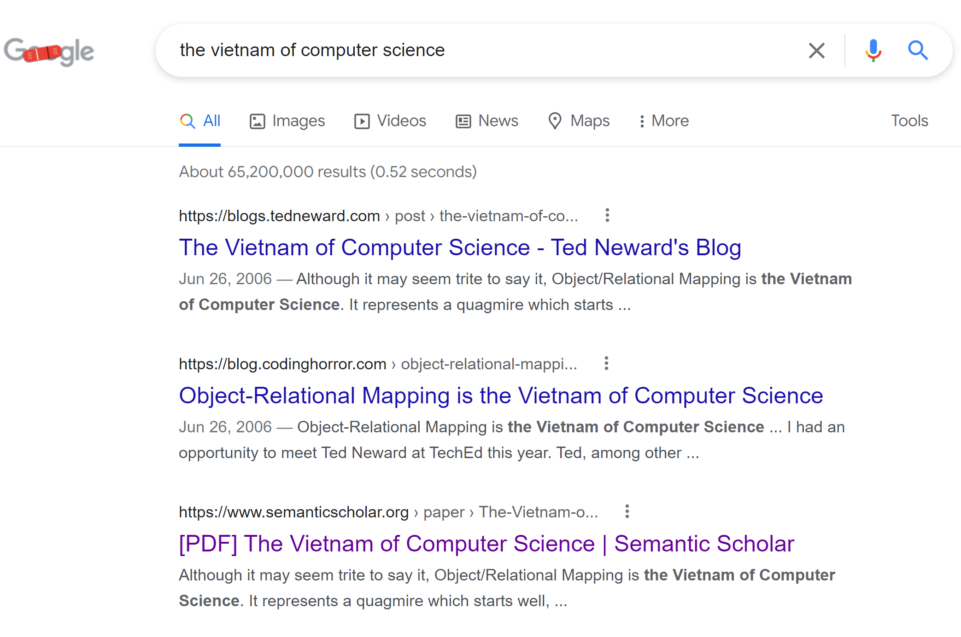
Object<-> Relational Mapping … « The Vietnam of Computer Science »

Slide 10
Mismatch in Object (Class Hierarchy) <-> Table Storage
Implicit
upcast
Table X
Join by id
XEntity
Explicit instanceof
Or virtual method
Table AX
Table BX
AXEntity
BXEntity
Relational DB
= FLAT TABULAR structure
… with some Foreign Key->PK relations
Querying « X » … including « AX » & « BX »
How to select « X » union « join A » union « join B » ??
How to efficiently search with index on table »X »
and simultaneoulsy use index on table « A » .. with join ??
Querying « AX » … where fieldX = … and fieldAX=…

Slide 11
Performances Mismatch … Object with nested Child List <-> Join global table List
NOSql (ex:PARQUET),
or Document oriented DB
Relational DB: storage by type
Car : 2
Car : 1
Car : 1
Car : 2
{ carId: "abc« , engine: { type: "xx", … } wheels: [ { pos:"front-left", .. }, { pos: "front-right"}, .. ] }
Engine
Wheel
Engine: 3
Engine: 4
Wheel: 1
Wheel: 2
…load all in 1 Query:
Select car, car.engine,car.wheel
From car
where id=?
… Load in several Queries (several index lookups + physical IOs)
1/ Select car … where id=?
2/ select engine… where car_id=?
3/ select wheel .. where car_ id=?
…
Or LEFT JOIN

Slide 12
Relations (Graph) between Entity
Relations: maybe cyclic / lazy loaded:
in-memory pointers for @ManyToOne
+
List<> pointers for @OneToMany
XEntity
YEntity
ZEntity
FooEntity

Slide 13
Relations (Graph) between Entity restrict to kernel « domain »
Lifecycle managed by
JPA Transaction
Domain (self-contained package)
XEntity
YEntity
ZEntity
FooEntity
Any Class
Lifecycle bigger than JPA Transaction

Slide 14
Entity – Model … same managed Lyfecycle
model (self-contained package)
Lifecycle managed by
JPA Transaction
Domain (self-contained package)
OK to Create Model from Entity
(model contain NO extra data)
YModel
XEntity
OK to point to Entity
(same lifecycle than Entity)
YEntity
ZEntity
FooEntity
Any Class
Lifecycle bigger than JPA Transaction

Slide 15
DTO - Entity – Model – Service … different managed Lyfecycle
model (self-contained package)
Lifecycle managed by
JPA Transaction
Domain (self-contained package)
OK to Create Model from Entity
(model contain NO extra data)
YModel
XEntity
OK to point to Entity
(same lifecycle than Entity)
YEntity
ZEntity
dtos (self-contained package)
NO CYCLIC dependencies
NO managed Lifecycle(only GC)
FooEntity
service (self-contained package)
Lifecycle managed by spring
ApplicationContext
XDTO
Service1
YDTO
Any Class
Lifecycle bigger
than JPA Transaction
Service2
ZDTO
Component1

Slide 16
Relations Cardinality OneToMany & ManyToOne
ManyToOne
ClassX
0..1
ClassY
Id: IdType
@ManyToOne
ClassY y;
@OneToMany
List<ClassY> yList;
Id: IdType
field1: Type
field2: Type
…
1
0..*
OneToMany

Slide 17
Split (materialize) ManyToMany relations
ManyToMany
XEntity
YEntity
0..*
0..*
Id: IdType
Id: IdType
1
Replace by
1
ManyToOne
ManyToOne
*
*
XYRelationEntity
// id or composite {x_id, y_id}
@ManyToOne XEntity x;
@ManyToOne YEntity y;

Slide 18
ManyToOne = pointer/reference/ Foreign Key
XEntity
(in-memory lazy pointer)
YEntity
IdType Id;
@ManyToOne
YEntity y;
YEntity getY()
void setY(YEntity y)
0..1
Id: IdType
…
Table X
Foreign Key constraint
Table Y
Id, y_id, …
id, …
column « Y_ID »: Foreign Key to « Y.ID »
can be nullable, but valid y when set
Column « ID » : Primary Key
( + unique index « PK_ID » )

Slide 19
ManyToOne => always(?) use non default fetch = FetchType.LAZY
AEntity
Id: IdType
@ManyToOne( fetch=FetchType.LAZY)
BEntity b;
BEntity
Id: IdType
@ManyToOne( fetch=FetchType.LAZY)
CEntity c;
CEntity
DEntity
EEntity
Otherwise… findAById(id) => load all the database in-memory
=> either using 1+1+1+1+… N selects
or using 1+1+1+…N LEFT JOIN + deduplications
ZEntity

Slide 20

Lazy Loading: load only ONCE, on first access ( instrumented code )
@ManytoOne( fetch = FetchType.LAZY )
private B Bentity b;
// code you write
// standard @Getter + @Setter
// != real code INSTRUMENTED by JPA
private Long $bId; private EntityManager $em;
public BEntity getB() {
if (this.b == null && this.$bId != null) {
this.b = this.$em.findById(BEntity.class, this.$bId);
}
return this.b;
}
GENERATED CODE

Slide 21
findById() remote « select » calls … only if caches 1+2 miss
Level1Cache
(=Session )
Read-Write, single-thread
Level2Cache
(=Global)
Read-Only, multi-threads
Thread
XA (Transaction)
a.getB()
lookup in Level2Cache
Perform jdbc « select … where id=? »
If ! already
lazy fetched
b = brepo.findById(id)
Clone read-only cached to (read-write) Entity
Fill Entity from Jdbc
+ put in cache
Lookup in Level2Cache
If found => return pointer

Slide 22
OneToMany : List with mappedBy relation
XEntity
YEntity
IdType id;
@OneToMany(mappedBy=« x »)
List<YEntity> yList;
List<YEntity> getYList()
void addY(YEntity y)
void removeY(YEntity y)
Id: IdType
@ManyToOne XEntity x;
XEntity getX()
// private setX(XEntity x)
// cf… x.add/removeY(this)
0..1
0..*
Table X
Foreign Key constraint
Table Y
Id, …
id, x_id, …
Column « ID »: Primary Key Standard table
… no constraint relation with « Y »
Column « ID » : Primary Key ( + unique index « PK_ID » )
Column « X_ID »: Foreign Key to « X.ID » (nullable)

Slide 23
Unmapped « Hidden » OneToMany .. Same DB, different JPA mapping
XEntity
Y Repository (DAO)
YEntity
IdType id;
// no « getYList()
// but can query:
// List<YEntity> findAllYByX(x)
Id: IdType
@ManyToOne
XEntity x;
XEntity getX()
setX(XEntity x)
0..*
0..1
Table X
Foreign Key constraint
Table Y
Id, …
id, x_id, …
Column « ID »: Primary Key Standard table
… no constraint relation with « Y »
Column « ID » : Primary Key ( + unique index « PK_ID » )
Column « X_ID »: Foreign Key to « X.ID » (nullable)

Slide 24
Owner.List <-> Element.owner redundant data to be consistent
addY(YEntity y) {
if (y.getXOwner() != null)
throw new Ex (« already in list »);
this.yList.add(y);
y._inv_setXOwner(this);
}
a « Y » object can only be in 0..1 « X list »
y._inv_setXOwner(x) … should not be called directly
( redundant with x.addY(this) )
removeY(YEntity y) {
if (y.getXOwner() != this)
throw new Ex (« not in list »);
this.yList.remove(y);
y._inv_setXOwner(null);
}

Slide 25
Caching Invalidations for Mapped @OneToMany
Entity « x » is modified
: field « yList » contains 1 more element
( if already lazy Loaded)
… on commit,
must broascast change
for invalidating cached « X »
Or change in-memory « X »
x.addY(y);
2 side-effects:
… on commit,
must broascast change
for invalidating cached « Y »
Or change in-memory « Y »
Entity « y » is modified
: field « xOwner » is changed null -> « x »
( if already lazy Loaded)

Slide 26
Caching Invalidation Difference between mapped @OneToMany / inverse @ManyToOne
@ManyToOne
Inverse @OneToMany
Cache Y
when changing Y
Need to invalidate both caches « X » and « Y »
Cache Y
when changing « Y »
… referential data « X » do not change
=> Can cache « X », no need invalidation
Cache X
Cache X
No « x.getYList() » method
.. So no field caching for get « Y list »
Need to perform many queries « dao.findAllYByX(x) »
cache
X
X.yList (in X)
Y
Can use « x.getYList() » method
.. So caching for get « Y list »
cache
X (no yList)
Y
REPEAT sql select y .. xhere x_id=?

Slide 27
Multiple (Fixed) List1,List2 for same Entities ?
XEntity
Id: IdType
@OneToMany(
mappedBy=owner1X)
List<YEntity> yList1;
@OneToMany( mappedBy=owner2X)
List<YEntity> yList2;
1
YEntity
0..*
Id: IdType
ClassX owner1X;
ClassX owner2X;
1
0..*
Foreign Key constraint X1
+ Foreign Key constraint X2
Table X
Table Y
Id, …
id, x1_id, x2_id, …
Column « ID »: Primary Key Standard table
… no constraint relation with « Y »
Column « ID » : Primary Key ( + unique index « PK_ID » )
Column « X1_ID »: Foreign Key to « X.ID » (nullable)
Column « X2_ID »: Foreign Key to « X.ID » (nullable)

Slide 28
« List » Entity
YListEntity
Id
@OneToMany
List<Yentity> yList
YEntity
0..*
Id: IdType
Table YList
Table Y
id, …
id, …
FK Ylist
Table YElement
FK Y
list_id, y_id, …

Slide 29
Notice.. IOT Tables for « list elements »
Heap
… NOT needed
IOT = Indexed Organized Table
Contains only a single B-Tree Index, but no Head allocation
(… all columns contained in index)
B-tree
Table YElement
Lookup by rowid
… NOT needed
list_id, y_id
INDEX: (list_id, y_id)
(col1..colN, rowid)
IOT Table: take ~1 / 2 of disk space, perform ~2x faster
FAST query: « select y_id from ylist_element where list_id=? »
Find first list_id
Index range scan y_id

Slide 30
Notice.. Reverse INDEX for fast lookup « Y » are in « lists » : memberships
IOT = Indexed Organized Table
+ extra index..
Table YElement
list_id, y_id
Pk INDEX: (list_id, y_id)
Secondary INDEX: (y_id, list_id)
FAST query: « select list_id from ylist_element where y_id=? »
Find first y_id
Index range scan list_id

Slide 31
Multiple (Dynamic) Lists for same Entities ?
XEntity
Id: IdType
@OneToMany
List<YListEntity> yListList;
YListEntity
0..*
Id
@OneToMany
List<Yentity> yList
YEntity
0..*
Id: IdType
FK X
Table Y
Table X
Table YList
Id, …
id, (x_id)…
id, …
FK Ylist
Table YElement
FK Y
list_id, y_id, …

Slide 32
Mapping for List allow Duplicates? preserve Order? Composite PK?
Table YElement
// composite embedded @Id
// .. See next
long list_id;
Set<Yentity> y;
No duplicate (Set instead of List)
No order
PK is composite {list_id,y_id}
list_id, y_id
@Id @GenereatedValue long id; // useless in DB !!
long list_id;
Set<Yentity> y;
Idem… but extra useless « technical » ID
No duplicate (Set instead of List)
No order
Id, list_id, y_id
long list_id;
List<Yentity> y;
List with order .. Possibly duplicates
PK is composite {list_id,order}
list_id, order, y_id

Slide 33
Importance of correct Database Model
Database performs well when early deployed to PROD
(contains ~100 rows)
Doing « FULL SCAN » of few rows is OK, database fit in-memory
Problems arise late when >= 100 000 000 rows

Slide 34
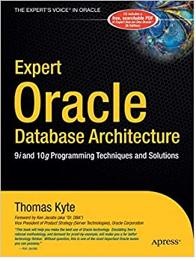

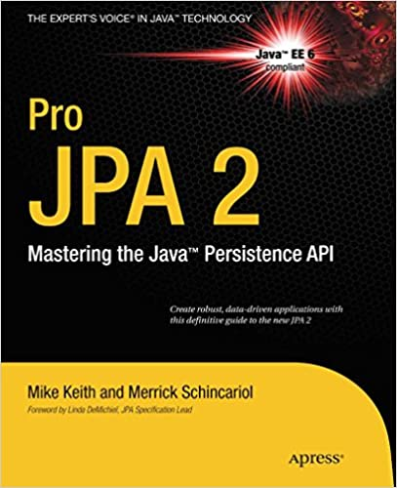

Good Architecture = Optimized Database Architecture AND Correct JPA Mapping AND Correct Config (Cache/Invalidation) AND Correct Code

Slide 35
Next parts
Part 1 : Entity (Domain UML, Database, JPA mapping )
Part 2 : extra Model class for Entity ?
Part 3 : DTO classes for Entity
Part 4 : Rest Controller, GraphQL, Service

