Slide 1

arnaud.nauwynck@gmail.com
Spark UI, Optimizer
& Internal concepts
(PhysicalPlan, Jobs, Stages, Tasks)
This document:
https://github.com/Arnaud-Nauwynck/presentations/ /pres-bigdata/12-sparkui-internals-plan-job-stage-task

Slide 2
Outline
What’s visible from Spark-ui
The concepts behinds Dataset/RDD execution : Job, Stage, Task
The architecture of deployment : Client, Driver, Executor

Slide 3
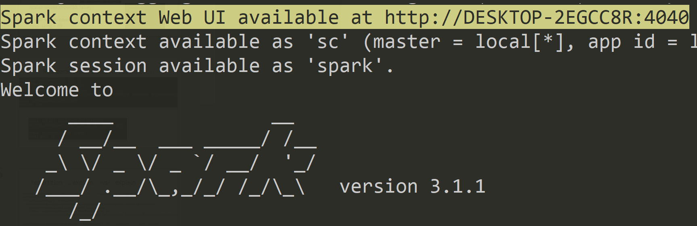
Spark-ui
http://localhost:4040

Slide 4
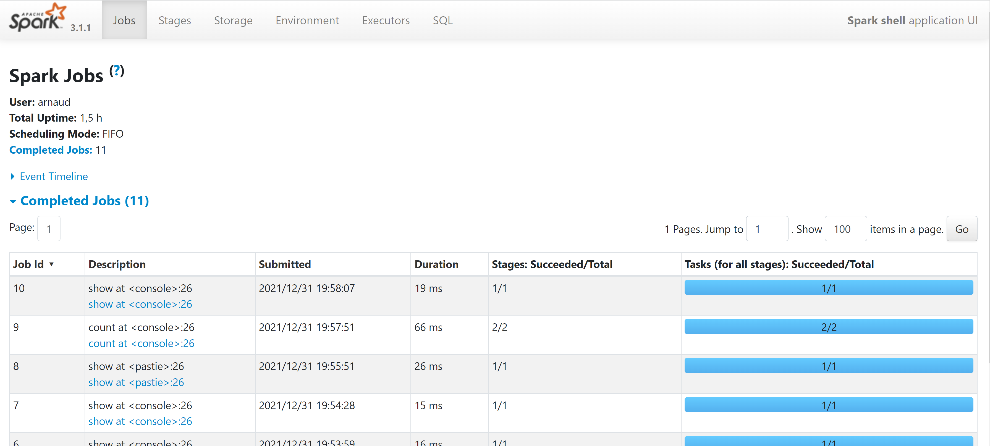
spark-ui [1/6]: Jobs

Slide 5
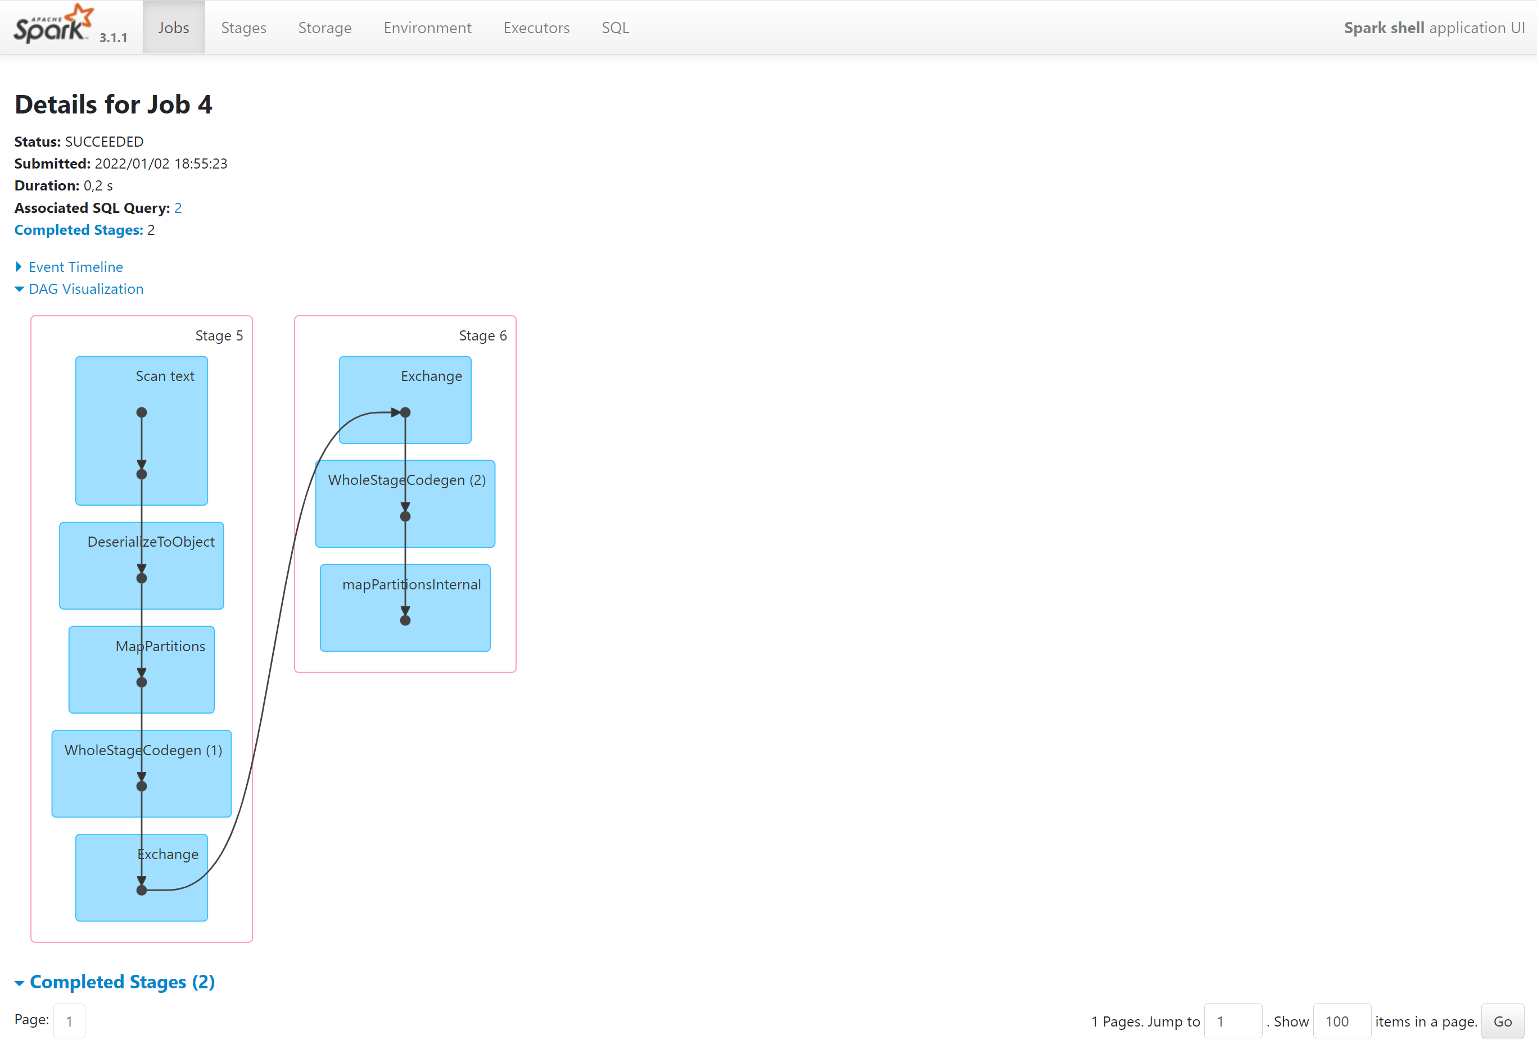
Spark-ui [1/6]: Job details DAG

Slide 6
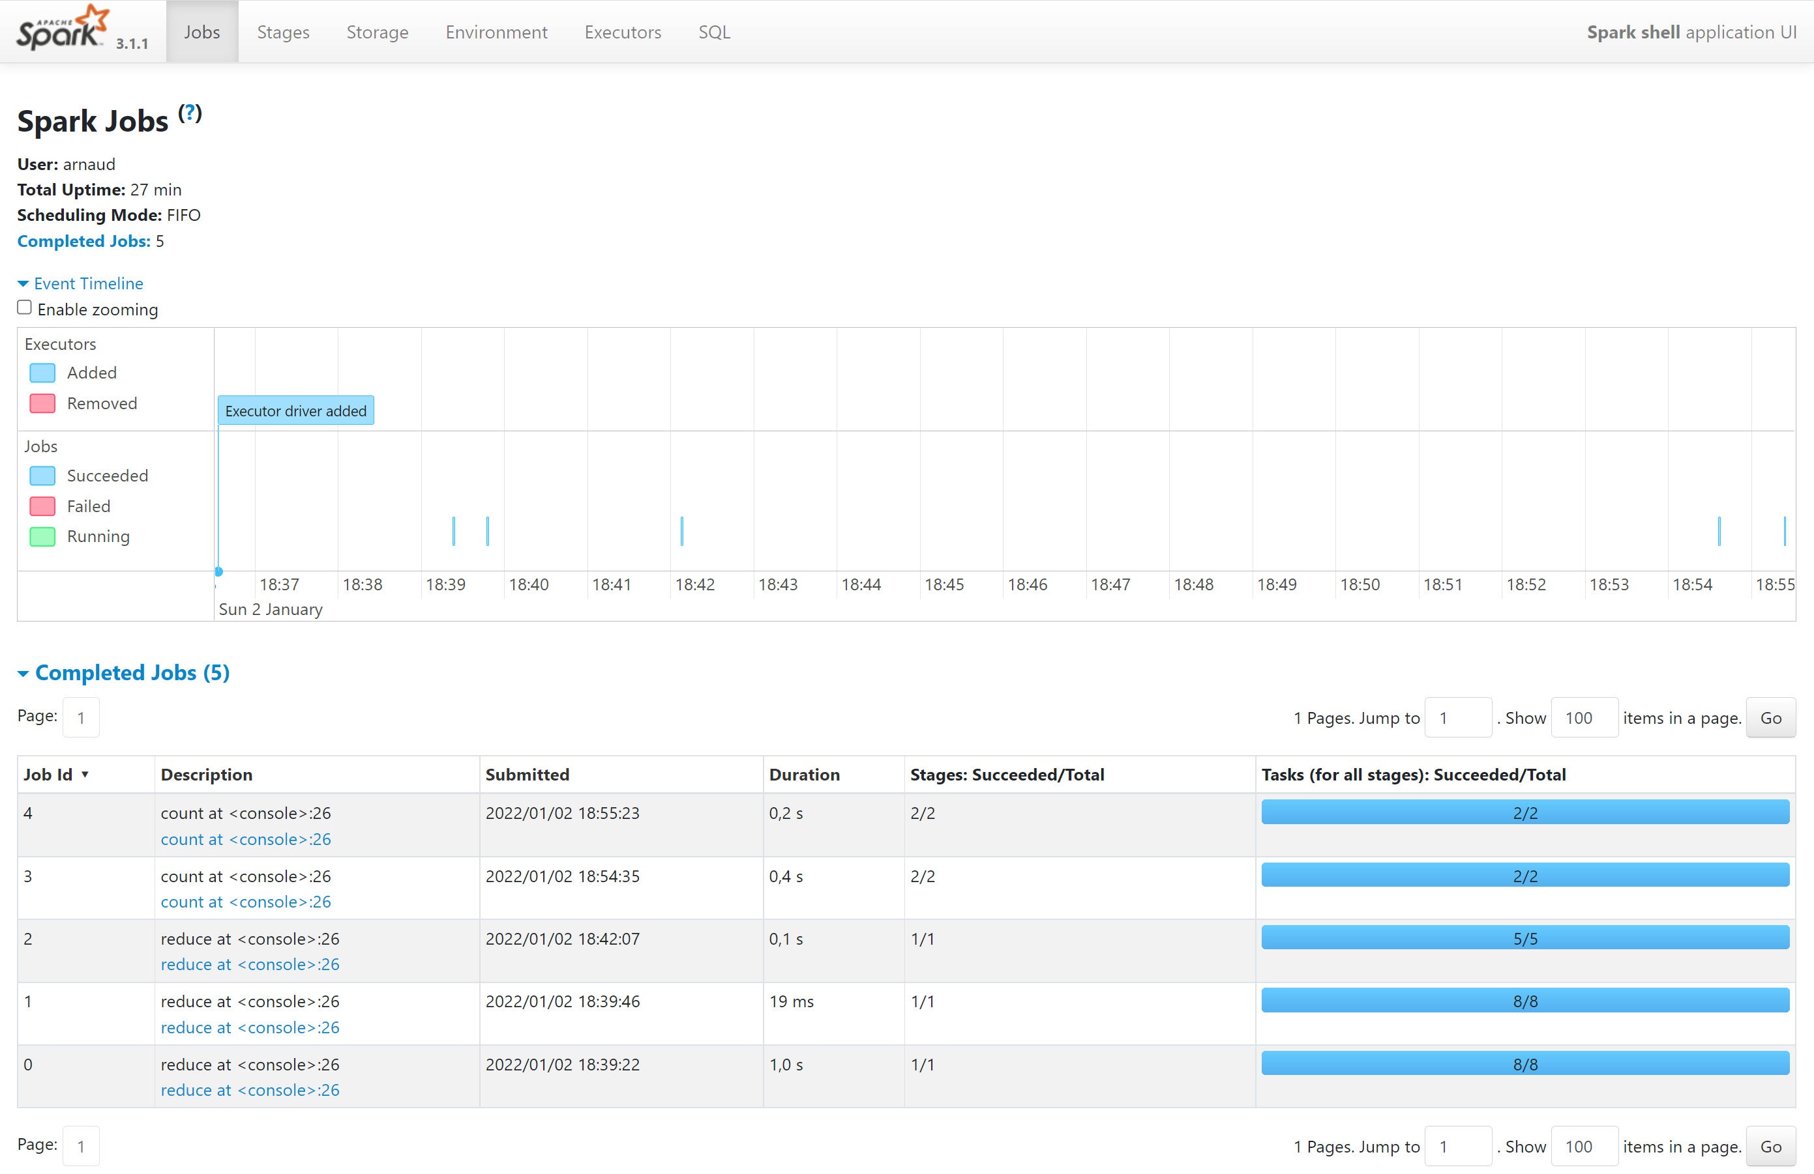
Spark-ui [1/6] detail Job timeline + statistics

Slide 7
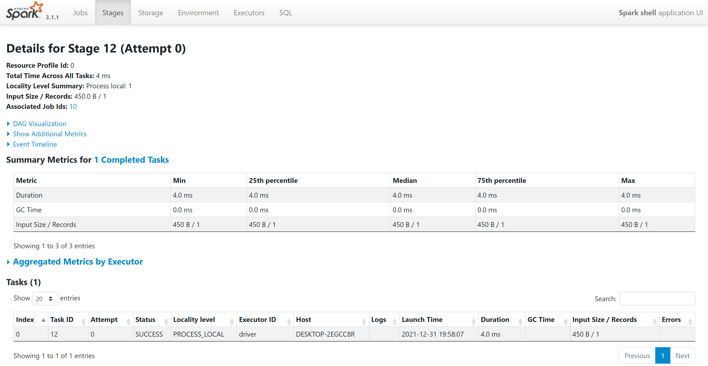
Spark-ui [2/6]: detail Job > Stage > Task

Slide 8
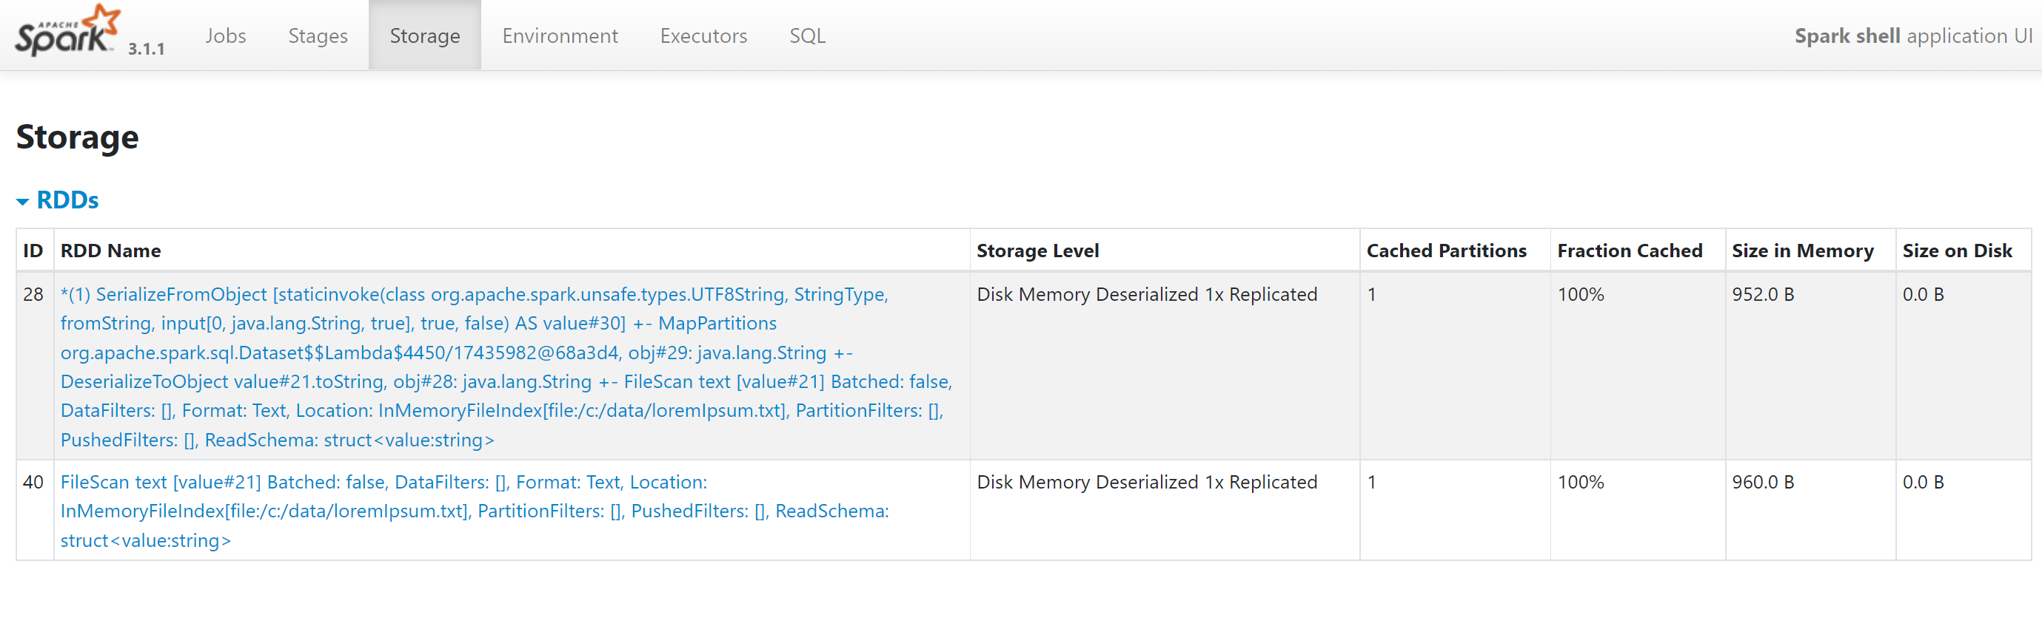
Spark-ui [3/6] Storage (cache, persist)

Slide 9
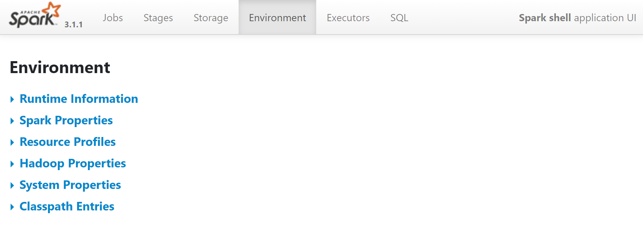
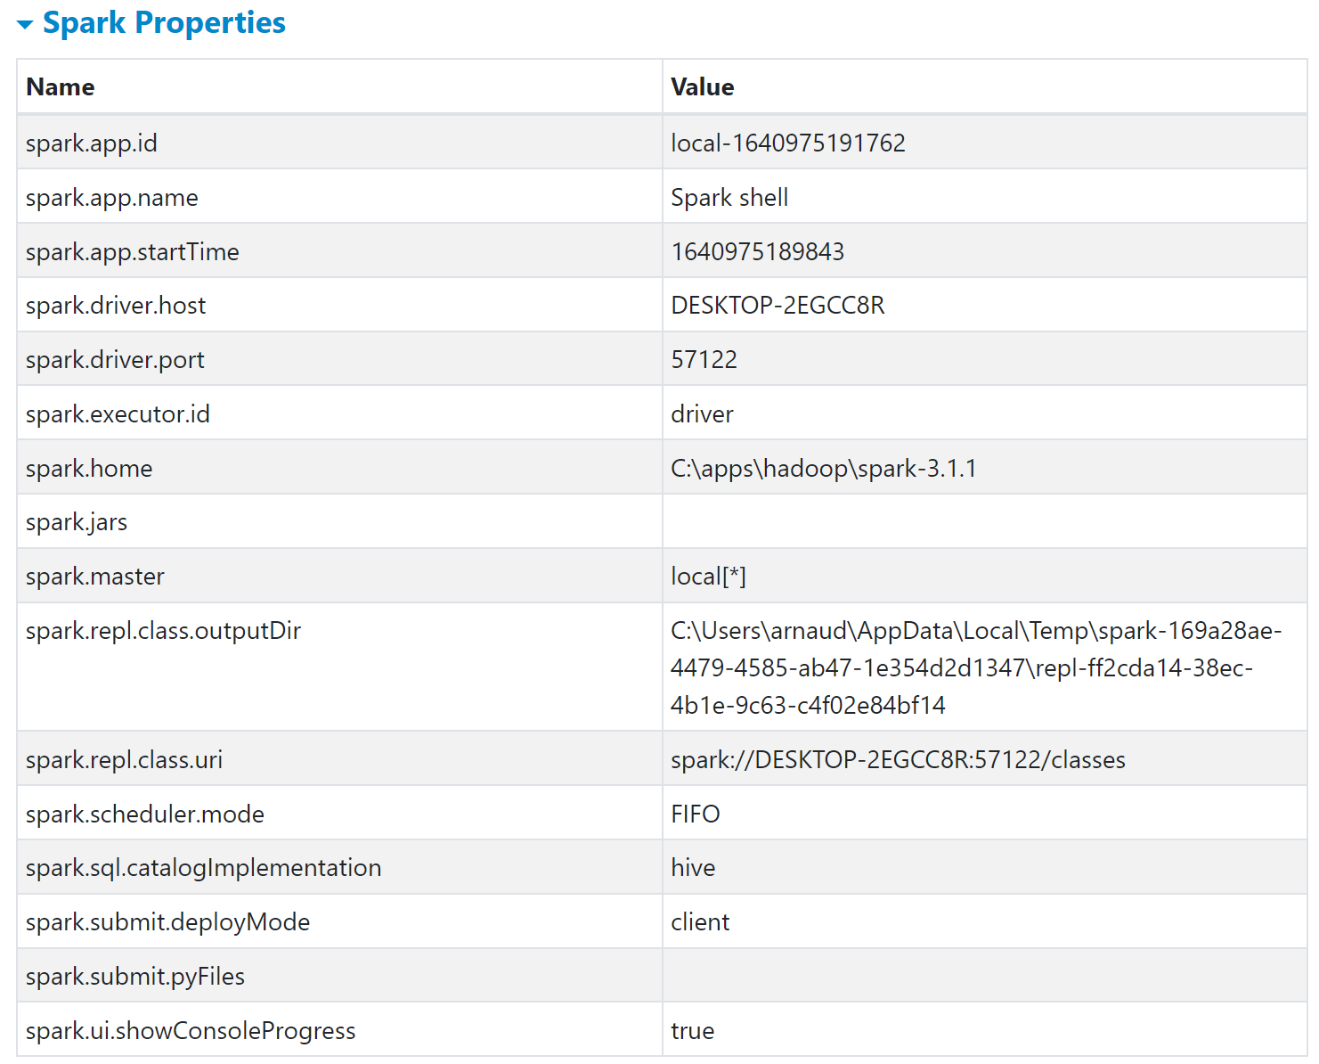
Spark-ui [4/6] Environment: jvm+spark+hadoop+..

Slide 10
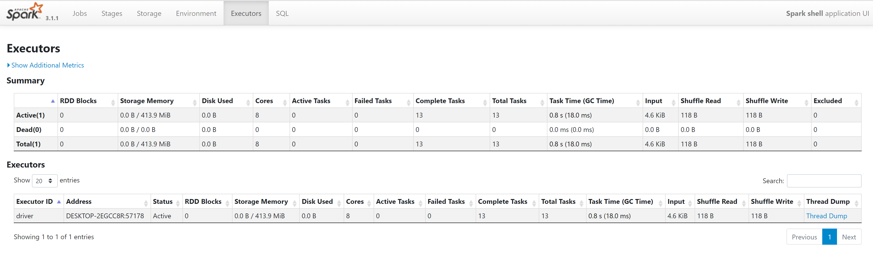
Spark-ui [5/6]: Executors / Driver

Slide 11
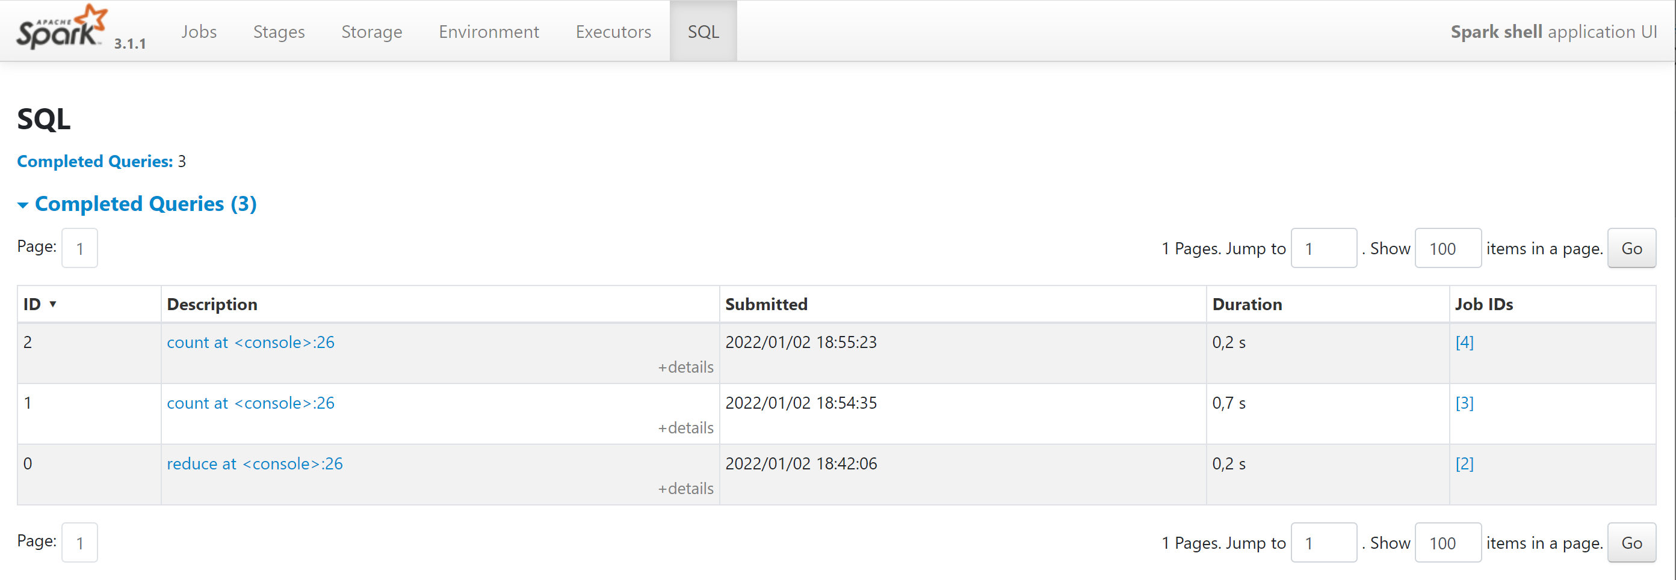
Spark-ui [6/6] SQL

Slide 12
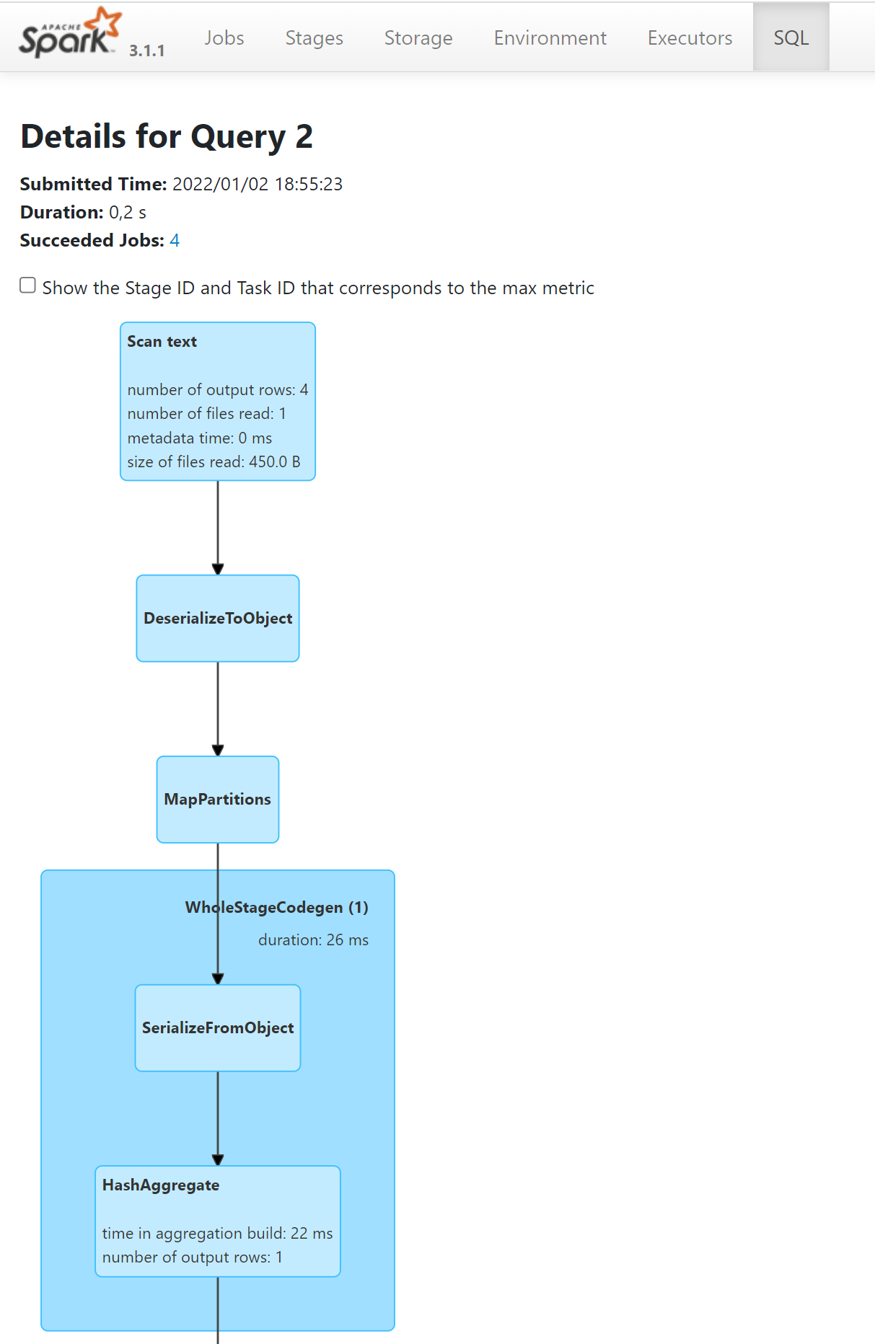
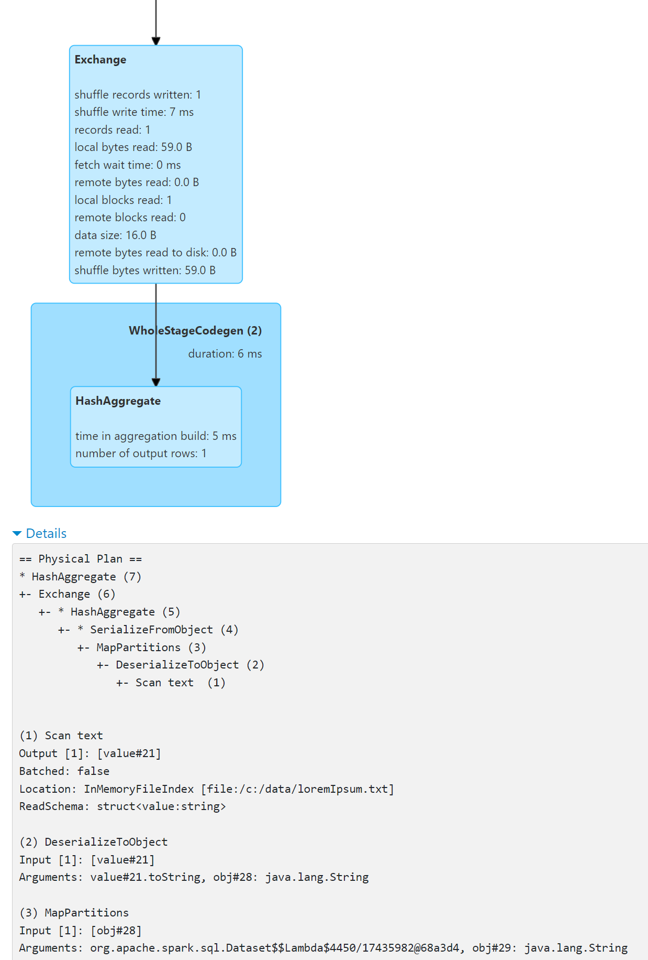
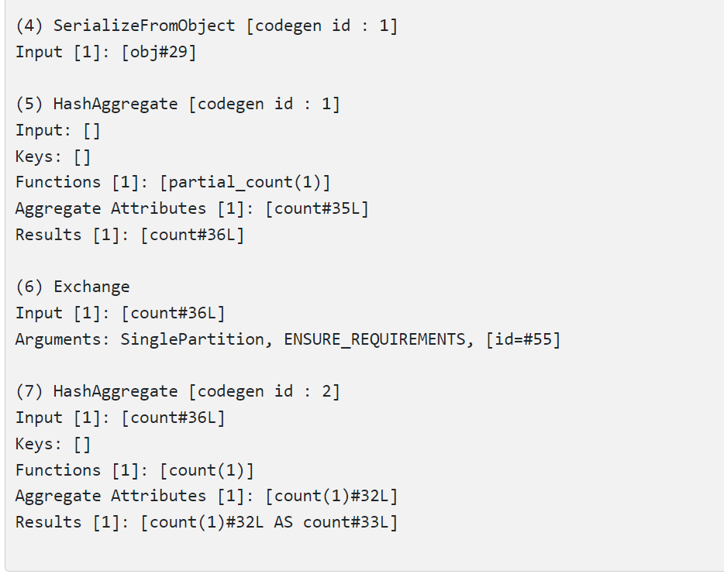
Spark-ui [6/6] Sql detail for query

Slide 13
Spark Internals Logical/PhysicalPlan Jobs - Stage - Tasks

Slide 14
Sql -> parsed AST -> Dataset + expression API Optimisation: re-write from LogicalPlan to PhysicalPlan

Slide 15
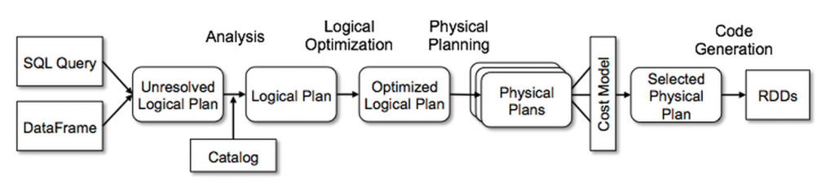
SQL / DataSet -> AST -> Catalyst -> Code + RDD

Slide 16
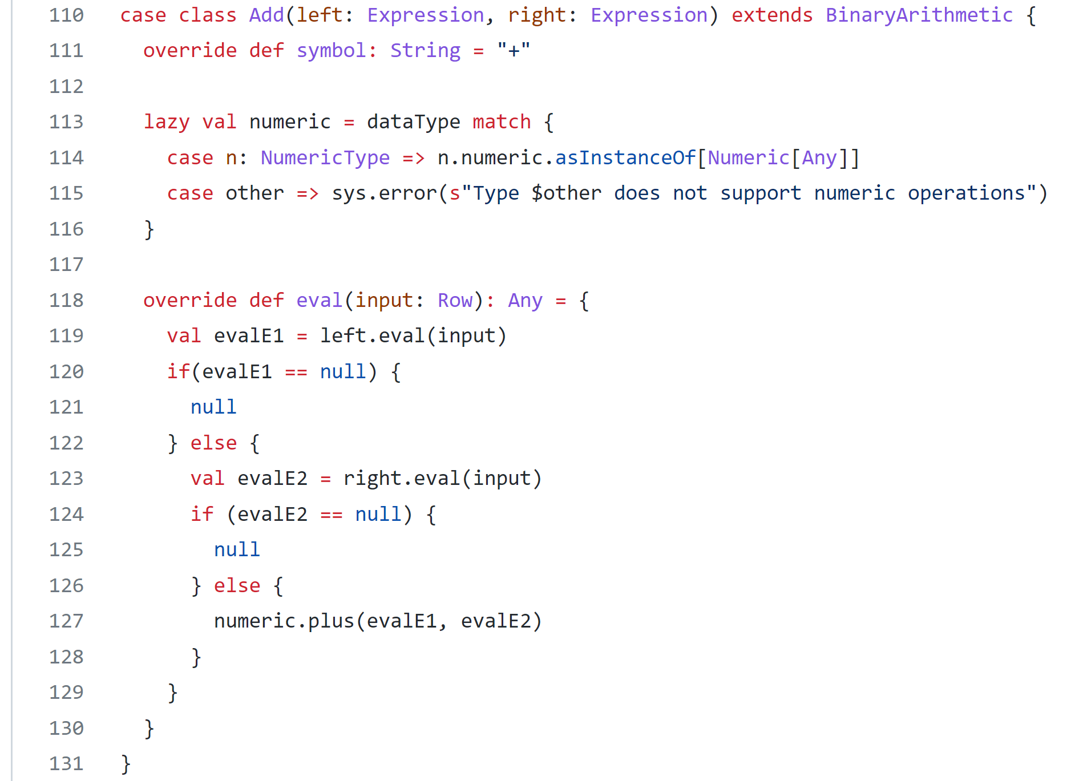
Compiler chain: Parser -> AST -> ..
Sql> select (a+1) from …
Projection
Add
Field
Literal
name: « a »
value: « 1 »

Slide 17
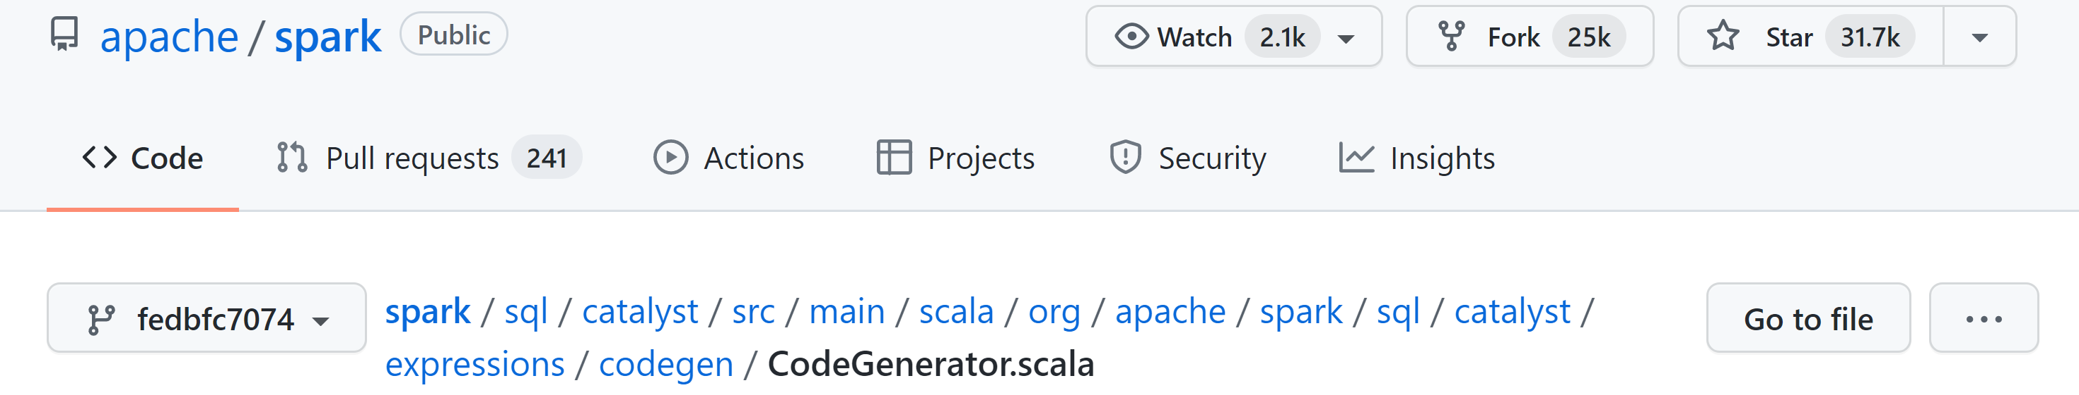
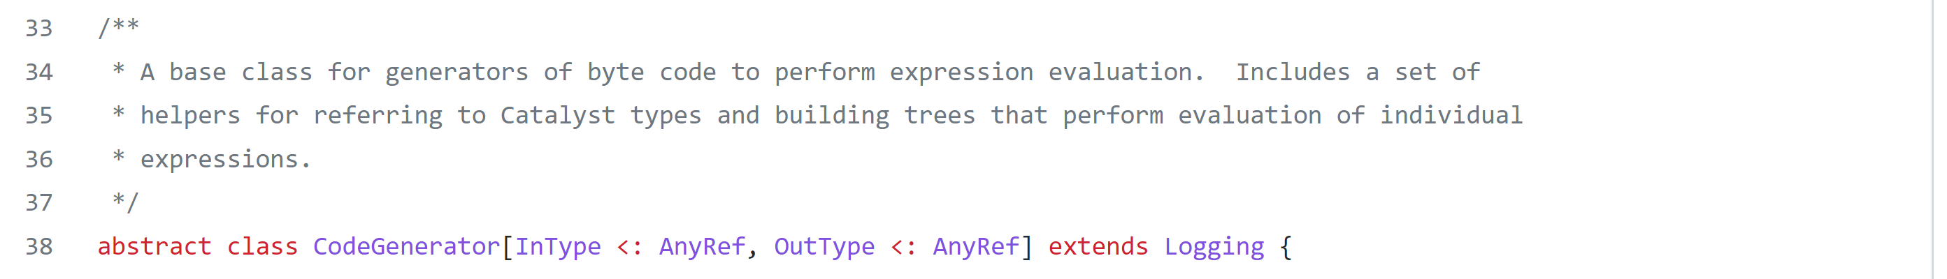
Catalyst AST -> CodeGenerator

Slide 18
Runtime Execution: Dataset -> RDD -> Dag Scheduler -> Jobs,Stages,Tasks

Slide 20
Spark-core Internal Concepts… RDD, Job, Stage, Task
using only low-level spark-core "RDD.eval()"
=> trigger 1 Job, with 1 or several Stages
RDD lineage dependency
Job
RDD
Stage
RDD
*
*
Task
Partition
*
1
TaskAttempt
1 (or 2,3?)

Slide 21
Spark-sql Internal Concepts… SQLExecution, Job, Stage, Task
lineage dependency
DataSet
using high-level spark-sql "Dataset.<action>()"
=> trigger 1 or Several Jobs, with 1 or several Stages
DataSet
SQLExecution
RDD lineage dependency
*
Job
RDD
1
Stage
RDD
*
*
Task
Partition
*
1
TaskAttempt
1 (or 2,3?)

Slide 22
Spark Internal Concepts… SQL, Job, Stage, Task
1..* input
SQLExecution
Dataset
Transformation
Analyzer
DataSet
1 output
LogicalPlan
1 input
Job
DataSet Action
Optimizer
Stage
1..* input
RDD
RDD
Transformation
1 output
PhysicalPlan
1 input
Task
RDD Action
Scheduler
DAG

Slide 23
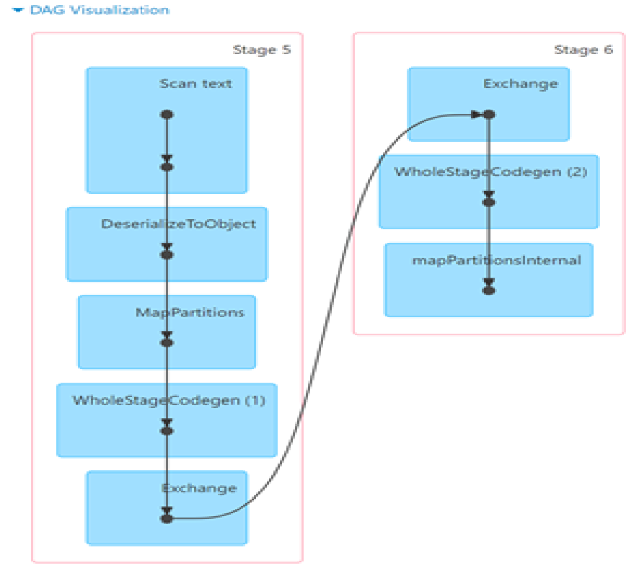
DAG Job = list of Stages each Stage = N "narrow" transformations between Stages = Exchange Shuffle ("Wide" transfo.)
1 stage =
Successive Narrow transformations
Bytecode generated
… executed within same Thread/Process
Exchange
Input
Job =
Full DAG of Stages
Exchange
Output
Wide transformation … separation between successive Stages

Slide 24
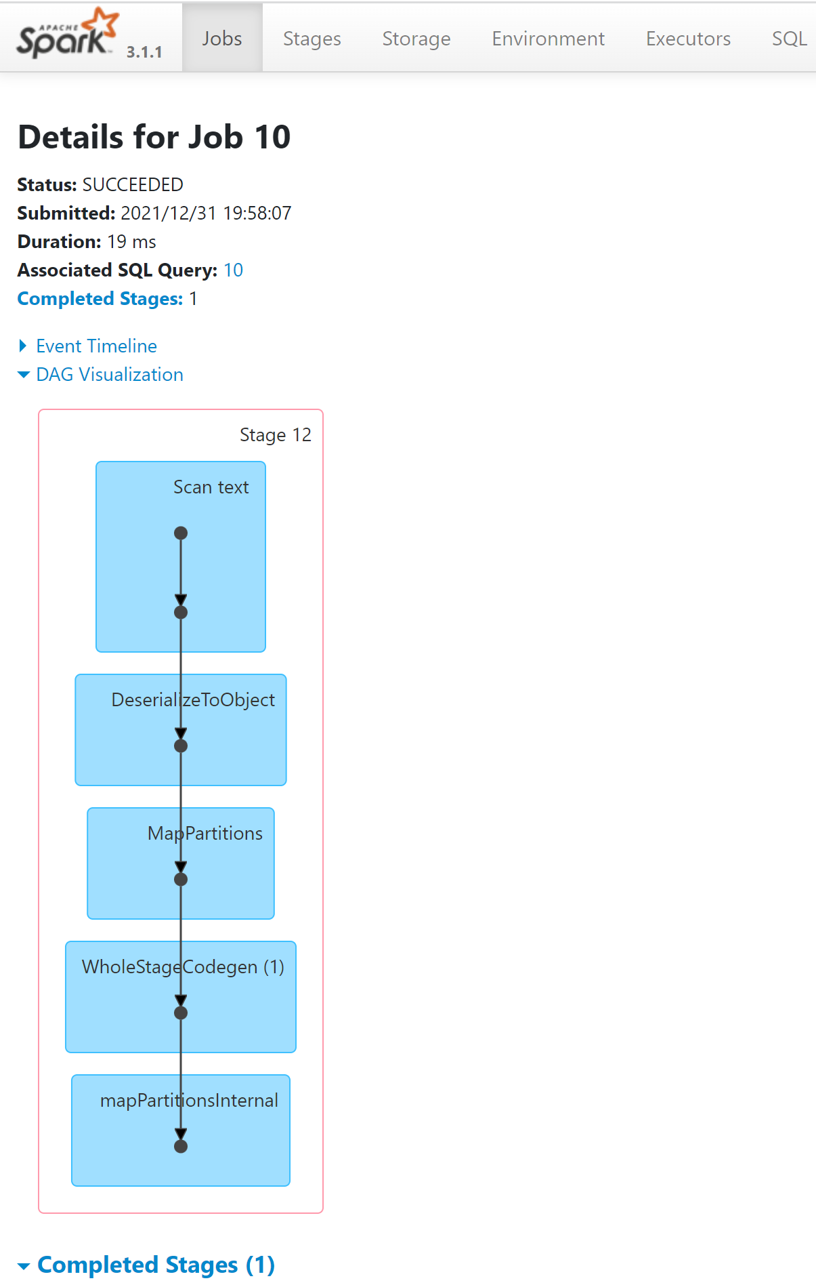
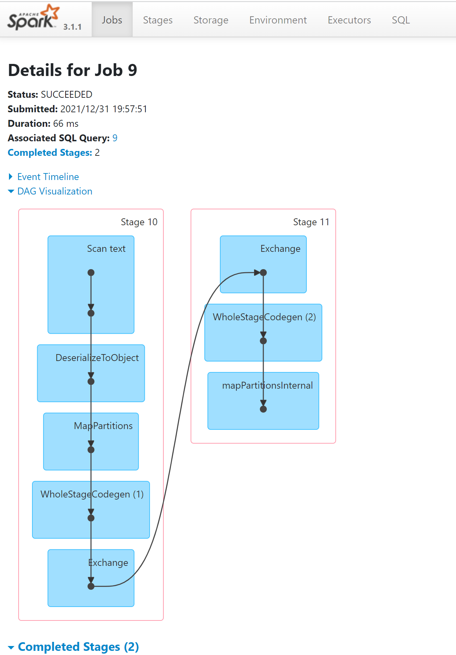
example Word Count DAGs simple -vs- repartition()

Slide 25
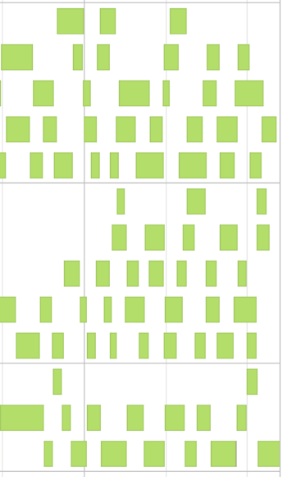
Stage = list of Tasks : 1 per Partition ... each scheduled on an executor
Tasks "eventTimeline" for stage
Tasks executed on executor 1
Tasks executed on executor 2
Tasks executed on executor 3

Slide 26
Tasks may fail, Retry individually
Tasks errors are automatically retryed (rescheduled)
By default,
spark.task.maxFailures = 4

Slide 27
Stage Retry
"Stage" failures, are also retryed
By default
spark.stage.maxConsecutiveAttempts = 4
stage 6 (retry 1)
stage 6 (retry 2)
stage 6 (retry 3)
throw Job Failure

Slide 28
Architecture Components Client-Cluster … Driver & Executors program/library/servers

Slide 29
Cluster Client -> Driver (-> SparkContext) -> Executor
Case 1/ Lauch directly java.. main(String[] args) {
SparkContext.getOrCreate()..
}
Spark Executor
Spark Driver
Java spark-submit
-master yarn -mode client
Java CoarseGrainExecutor
Case 2/ spark-submit –mode client
Cache
Task
SparkContext
Case 3/
Yarn launch spark –mode cluster
+ relaunch if failed
ClusterManager
OS WorkerNode
( + YarnNodeManager)
SparkSession
Java spark-submit
-master yarn -mode cluster
Spark Executor
OS WorkerNode
( + YarnNodeManager)
Java CoarseGrainExecutor
Cache
OS
Task
OS WorkerNode
( + YarnNodeManager)

Slide 30
Questions ? ... Next Steps ?

