Slide 1
Datalake File Format: Parquet
arnaud.nauwynck@gmail.com
Course Esilv 2024
This document: https://github.com/Arnaud-Nauwynck/presentations/pres-bigdata/ Datalake-File-Format-Parquet

Slide 2
Outline
Parquet Caracteristics
Structured, with Schema
Data – Metadata (footer)
Columnar ... Column Pruning
Splittable ... spark Dataset Partitions
Compression
Encoding
Statistics, Bloom ... spark Predicate-Push-Down
Optimize write once, read many ... spark dataset.repartition().sortWithinPartition().write

Slide 3
Parquet is a Structured Format Strongly Typed (Schema)

Slide 4
File Formats
Unstructured
Semi-Structured
Structured
Serialization Structured
Text
Json
Avro,Thrift,Protobuf
text line 1 \n text line 2 \n
{"a":"a1","b":"b1"} \n {"a":"a2","b":"b2"} \n
schema:XX,
value:0101010101
Csv
Xml
Columnar Structured
Col1;Col2;Col3\n a1;b1;c1\n
a2;b2;c2\n
<elt> <a>a1</a> <b>b1</b>
Orc, Parquet

Slide 5
Structured : struct<>, array<>, map<>
Scalar Value
(= terminal element in grammar)
= primitive data-type
Composite Value
struct<a:Type1, b:Type2, ...>
String
boolean
int
double
Date
...
array<ElementType>
map<KeyType,ValueType>

Slide 6
Type constraint = Schema
{ JSON }
JSON Schema (optional)
semi-structured
schema is optional
<xml>
XSD Schema (optional)
.avro
.avsc = avro schema
included in avro datafile format header
implicit in avro client-server exchanges
thrift
protobuf
structured
schema is strict
.parquet
included in parquet file footer (= metadata)

Slide 7
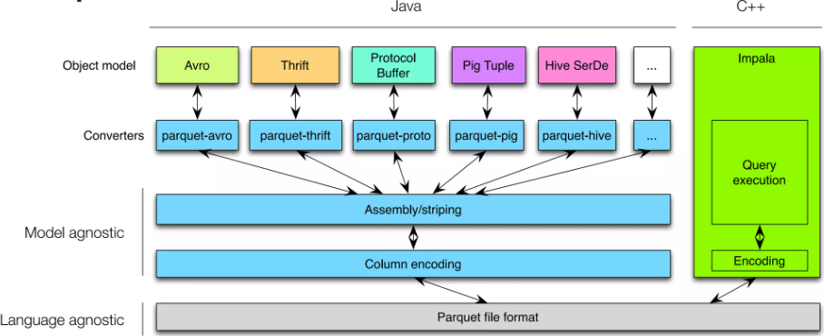
Parquet SDK / Converter / ObjectModel

Slide 8
Parquet separates Data and MetaData

Slide 9
Parquet Schema : in metadata footer
file.parquet
data part
(usually N x blocks of 128 Mo)
SCHEMA: struct<a:int, b: string, c:map<int,array<...>> .. >
footer: metadata part
(usually <= 50 ko )

Slide 10
Parquet for Small Files ?
small file.parquet
data part can be small (even empty)
parquet files ALWAYS have an
uncompressable footer,
containing SCHEMA
SCHEMA: struct<a:int, b: string, c:map<int,array<...>> .. >
Parquet for small data is NOT efficient
bad ratio of "data / metadata" size

Slide 11
Read Parquet footer only
1/ query File length => len
file.parquet
3/ read footer [len-F, len]
SCHEMA: struct<a:int, b: string, c:map<int,array<...>> .. >
2/ read last bytes [len-4, len] => F
last bytes: <<footer size>>

Slide 12
Why Footer instead of Header?
For reader : not a big overhead, ONLY 3 calls to read
For writer : MUCH more practical to "stream" write Nx rows, keep in-memory only few metadata, to flush write at end

Slide 13
Parquet is Columnar

Slide 14
Parquet : Columnar File Format
Logical view: rows - columns
On Disk Row Serialization: like CSV, JSON, AVRO,
a1
b1
c1
d1
a2
b2
c2
d2
a1
c1
a2
b2
c2
c3
a4
c4
b1
d1
d2
a3
b3
d3
b4
d4
a3
b3
c3
d3
a4
b4
c4
d4
On Disk: Columnar
a1
a2
a3
a4
b1
b2
b3
b4
c1
c2
c3
c4
d1
d2
d3
d4

Slide 15
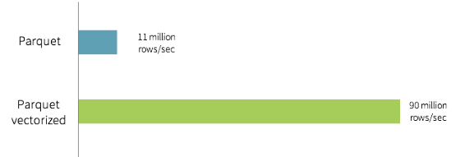
Columnar => better memory aligned, Vectorized CPU pipeline
struct A {
boolean f1; // <= 1 bit (on 1 byte)
// in-memory padding 3 bytes
int f2; // 4 bytes, aligned on multiple of 4
// in-memory padding 4 bytes long f3 // 8 bytes
}
array[struct<..>] <=>
Vectorized Reader ~9x Faster
array[boolean]
array[int] array[long]

Slide 16
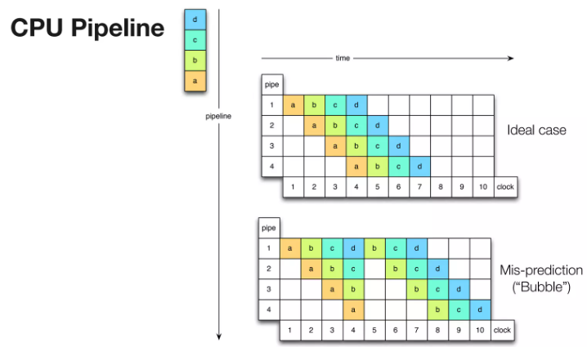
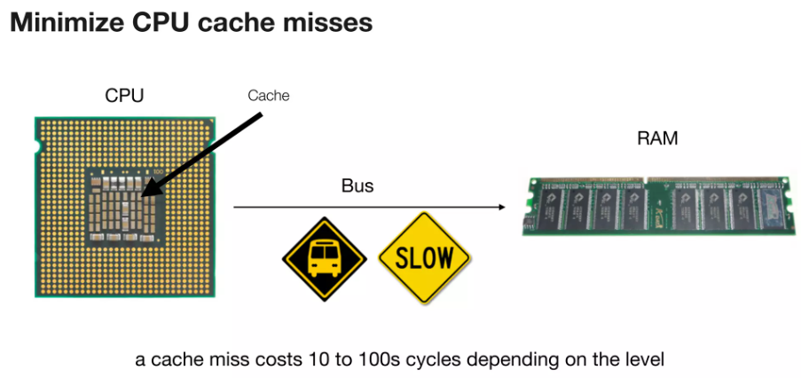
Vectorized code ... fewer "If", "Loop", "calls"
Better CPU Pipeline
Better Memory Cache

Slide 17
Column Pruning Optimization
Logical view: rows - columns
a1
b1
c1
d1
SELECT , -- ONLY 2 columns
FROM table
WHERE ..
a2
b2
c2
d2
b
d
a3
b3
c3
d3
a4
b4
c4
d4
On Disk READ: columnar
a1
a2
a3
a4
b1
b2
b3
b4
c1
c2
c3
c4
d1
d2
d3
d4
IO read for b values
IO read for d(s)

Slide 18

Compare IO Reads with JSON, CSV, Avro, ..
SELECT , -- ONLY 2 columns
FROM table
WHERE ..
b
d
a1
b1
c1
d1
a2
b2
c2
d2
a3
b3
c3
d3
a4
b4
c4
d4
force sequential READ ALL
a1
c1
= IO waste + CPU decoding waste
b1
d1

Slide 19
Parquet is Splitteable

Slide 20
Parquet split rows by RowGroups
Logical view: rows - columns
a1
b1
c1
a2
b2
c2
RowGroup 0
a3
b3
c3
On Disk: columnar
split
row group
a4
b4
c4
a1..3
b1..3
c1..3
a4..6
b4..6
c4..6
c7..9
a5
b5
c5
RowGroup 1
a6
b6
c6
RowGroup 0
RowGroup 1
RowGroup N
RowGroup N
a9
b9
c9

Slide 21

RowGroup ~ Spark Partition ~ Executor Thread
3/ read (rg0) file at offset
a1
b1
c1
Spark Executor(s)
RowGroup 0
a2
b2
c2
task0 = read rg0 (read at offset ..)
2/ Driver send Tasks to Executors
a3
b3
c3
task0
read (rg1) file at offset
task1
Dataset<> ds =
a4
b4
c4
partition 0
= rg0 at offset ..
RowGroup 1
a5
b5
c5
Spark Executor
partition 1
= rg1 at offset..
a6
b6
c6
partition 2
= rg2 at offset..
taskN
file (rgN) file at offset
Spark Driver
RowGroup N
a9
b9
c9
Footer Metadata
RowGroup Metadatas=[ offset 0, offset 1, ... offset N ]
1/ Driver read Metadata => get rowgroup offsets

Slide 22
1 Parquet RowGroup(s) -> default to 1 Spark DataSet partition
by default,
parquet.block.size = 128 Mo
=
spark.files.maxPartitionBytes = 128 Mo
=
spark.sql.files.maxPartitionBytes = 128 Mo

Slide 23
N Parquet RowGroups -> FileSplit to P (<=N) Spark Partitions
split positions
= k x 128Mo, k={1,2,3..}
parquet file
mid point
=(start+end)/2
parquet.block.size
RowGroup 0
spark.sql.files.maxPartitionBytes
Dataset<> ds =
partition 0 = rg0+rg1
RowGroup 1
partition 1 = rg2
partition 2 = rgN
RowGroup 2
ds = spark.sql(..)
or
ds=spark.read .format("parquet") .load(..)
RowGroup N

Slide 24
{Texts,CSV,Json} formats FileSplit
each spark executor reader Thread at split start => ignore first chars until '\n'
at split end => read extra chars until '\n
{ json line 1 } \n
{ json line 2 } \n
{ json line ...
line N } \n { line N+1
.. line N+1}\n
{ json line ...
line P} \n { line P+1 ..
spark.files.maxPartitionBytes
Dataset<> ds =
partition 0
partition 1
partition 2
ds = spark.sql(..)
or
ds=spark.read .format("json") .load(..)

Slide 25
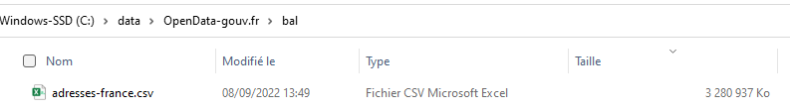
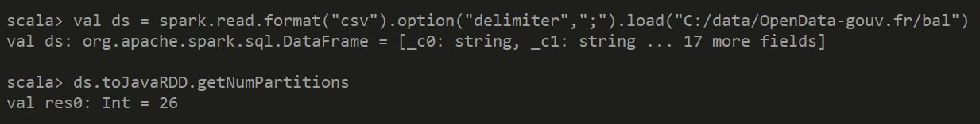
Example : Reading 1 CSV of 3.2 Go => 26 splits = 25 (~128 Mo) + 1 very small
3 280 937 / (128*1024) = 25.03

Slide 26
Parquet is Compressable { snappy | gz }

Slide 27
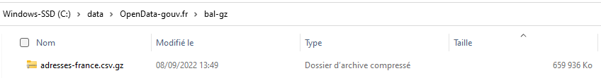
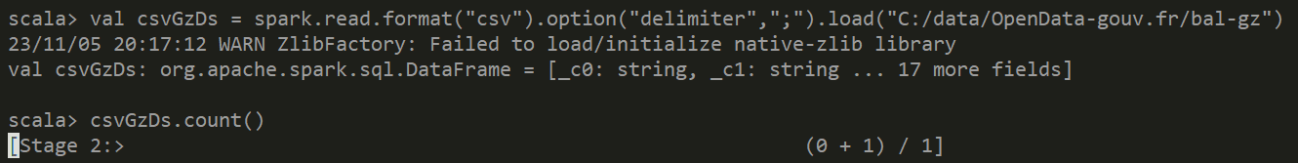
*.gz is NOT Splitteable !
CSV file was 3.2 Go, now 660 Mo in .gz
but NOT Splitteable => 1 spark partition, reading (CPU intensive) by 1 Thread only !
~8 times slower on a 8 cores PC

Slide 28
Compressions Algorithm
data
.snappy
fast compression/decompression
(focus on speed)
0101010101001
010101
.gz (gzip)
slower-compression,
better compression ratio
(focus on size)
01101
.lz4
compromise between
fast / compression ratio
010101

Slide 29
PARQUET.{snappy | gz}
Logical view: rows - columns
a1
b1
c1
d1
On Disk: Columnar NO compression
a2
b2
c2
d2
a1
a2
a3
a4
b1
b2
b3
b4
c1
c2
c3
c4
d1
d2
d3
d4
a3
b3
c3
d3
a4
b4
c4
d4
On Disk: Columnar parquet.{snappy | gz }
snappy(Chunk)
snappy(Chunk)
snappy(Chunk)
snappy(Chunk)
a1
a2
a3
a4
b1
b2
b3
b4
c1
c2
c3
c4
d1
d2
d3
d4
every "Chunk" of column data are compressed INDEPENDENTLY
=> file is STILL Splitteable

Slide 30
Parquet use Encodings

Slide 31
Run-length encoding (RLE)
a
a
a
bb
bb
bb
bb
bb
bb
c
c
c
c
repeated x3 times
Var Length Encoder:
3 a
6 bb
4 c
repeated x6 times
repeated x4 times

Slide 32
Size of Adding "Constant" Column
adding a column with only "0" for Billions of rows
=> take only ~100 bytes per RowGroup

Slide 33
Dictionary Encoding
Distinct Dictionary Values:
1=Manchester City
2=Arsenal
3=FC Barcelone
4=Newcastle
5..
Manchester City,
Arsenal,
Manchester City,
FC Barcelone,
Arsenal,
Newcastle,
Manchester United,
Newcastle,
FC Barcelone,
Arsenal,
Manchester United,
...
Dictionary Encoder:
Value Indexes:
1, 2, 1, 3, 4, 5 ..

Slide 34
Dictionary Size Limit
By default, Dictionary size = max 1 Mega (per RowGroup - Column Chunk )
When using
Huge RowGroup (> 128Mo) => less Dictionaries used
Small RowGroup (32M, 64Mo) => more Dictionaries
Parameters:
parquet.enable.dictionary=true (default)
parquet.dictionary.page.size=1M

Slide 35
Delta Encoding
BaseValue=10007
MinDelta=-7
Delta
Delta-MinDelta (>=0)
10007
10003
10005
10002
10009
10002
10008
+7
-4
+2
-3
+7
-7
+6
..
3
9
4
14
0
13
..
Delta Encoding
10007, -7, 3,9,4,14,0,13
+7
example size when fitting "int"(4 bytes)
7 x 4 = 28 bytes
when fitting 2 bytes
4 + 6 x 2 = 28 bytes
when fitting 1 bytes
4 + 2 + 6 x 1 = 12 bytes

Slide 36
Parquet use Statistics

Slide 37
Column Statistics: min/max Value per RowGroup
Logical view: rows - columns
a1
b1
c1
a2
b2
c2
RowGroup 0
a3
b3
c3
On Disk: columnar
a4
b4
c4
a1..3
b1..3
c1..3
a4..6
b4..6
c4..6
c7..9
a5
b5
c5
RowGroup 1
a6
b6
c6
RowGroup 0
RowGroup 1
RowGroup N
RowGroup N
a9
b9
c9
Schema: {a int, b string, c }
RowGroups:
rg0: {offset, a(min,max), b(min,max),c(min,max)}
rg1: { offset, a(min,max) ..}
a min = min (a1,a2,..a3)
a max = max(a1,a2,..a3)
a min = min (a4,a5,..a6)
a max = max(a4,a5,..a6)

Slide 38
Reading Metadata => read schema + offset + statistics
data part
(usually N x blocks of 128 Mo)
footer: metadata part
(usually <= 50 ko )

Slide 39
Parquet use Bloom Filter

Slide 40
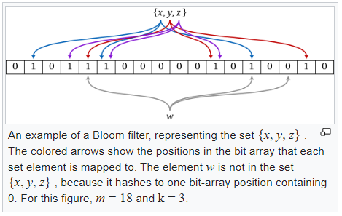
Bloom Filter
Probably Yes ...
Firm NO
is W in the set {x,y,z} ?
hash(W) = 0000100...10100
https://en.wikipedia.org/wiki/Bloom_filter

Slide 41
Parquet Predicate-Push-Down

Slide 42
Push-Down : from Spark -> Parquet Lib -> IO Storage
Your App, high level SQL
Spark Core - Spark SQL
Parquet MR lib
Hadoop Virtual FileSystem IO
AWS S3
Azure Datalake Storage
Hadoop HDFS

Slide 43
Statistics for skip read RowGroup SELECT .. WHERE column=value
a1
RG 0
a2
a3
a4
RG 1
SELECT ...
WHERE a = 250
a5
a6
RG 2
a9
RG 0 "a" min = 100, max = 200
NO match max < a
RG 1 "a" min = 201, max =300
OK min <= a <= max (maybe false positive)
RG 2 "a" min = 301, max =400
NO match a < min

Slide 44
Column Pruning + RowGroup Pruning(PPD) = minimal Reads
RG 0
a4
c4
SELECT c
WHERE a = 250
RG 1
c5
a5
a6
c6
RG 2
RG 0 "a" min = 100, max = 200
RG 1 "a" min = 201, max =300
RG 2 "a" min = 301, max =400

Slide 45
Badly sorted files => Bad min/max statistics => False positives
read ALL RGs !
RG 0
SELECT c
WHERE a = 250
RG 1
RG 2
RG 0 "a" min = 1, max = 9998
maybe false positive min <= a <= max
RG 1 "a" min = 0, max =9996
maybe false positive min <= a <= max
RG 2 "a" min = 2, max =9997
maybe false positive min <= a <= max

Slide 46
Optim Write Once / Read Many
when writing Parquet files ... think how file might be read later ! spend CPU when writing to save CPU / IO later reading

Slide 47
dataset
.repartition(nRepartitionCount) // or .repartition("col1", nRepartitionHash) .sortWithinPartitions("colA", "colB") .write .option("parquet.block.size", 32*MEGA)
.format("parquet") .save("file://some-dir")
// or
// .format("hive").insertInto("hiveDb.hiveTableName")

Slide 48
avoid many small files dataset.repartition(1) or .coalesce(1)
dataset
.repartition(nRepartitionCount) // or .coalesce(nRepartitionCount)
N spark in-memory Partitions
distributed over N executors
1 spark in-memory Partition
(should fit in spark.executor.memory !!)
write 1 parquet file

Slide 49
Does not fit in memory.. compromise to .repartition(smallN)
typically 200 partitions
default
spark.shuffle.size=200
n spark in-memory Partition
n "small", example: {2,3,4 } should fit in spark.executor.memory !!

Slide 50
.repartition("column")
typical usage:
column "a" has FEW distinct values { 1, 2, 3, 4 }
ds = dataset.repartition("a")
if a=1
if a=2
if a=3
partition
contains only a=1
if a=4
partition contains only a=2
partition contains only a=3
partition contains only a=4

Slide 51
.repartition("column", nHashCount)
partition
contains only a%15==0 i.e. {0, 15, 30, 45, ..}
example ... having many distinct values
col "a" values in [ 1, 2, 3, .... 500000]
=> h = hash(a) % 15 in [0, 1, .. 14 ]
partition contains only a%15==1 i.e. {1, 16, 31, 46, ..}
partition contains only a%15==2 i.e. {2, 12, 32, 47, ..}
partition contains only a%15==14 i.e. {14, 29, 44, ..}

Slide 52
.sortWithinPartitions("a", "b", ...)
local sort
(no shuffle)

Slide 53
.sortWithinPartitions => RowGroups stats more "compact"
a
a
b
b
b
b
c
c
d
d
z
blockSize =128Mo
RowGroup 0
min=a max=b
RowGroup 1
min=b max=c
RowGroup 2
min=c max=e
RowGroup 3
min=x max=z

Slide 54
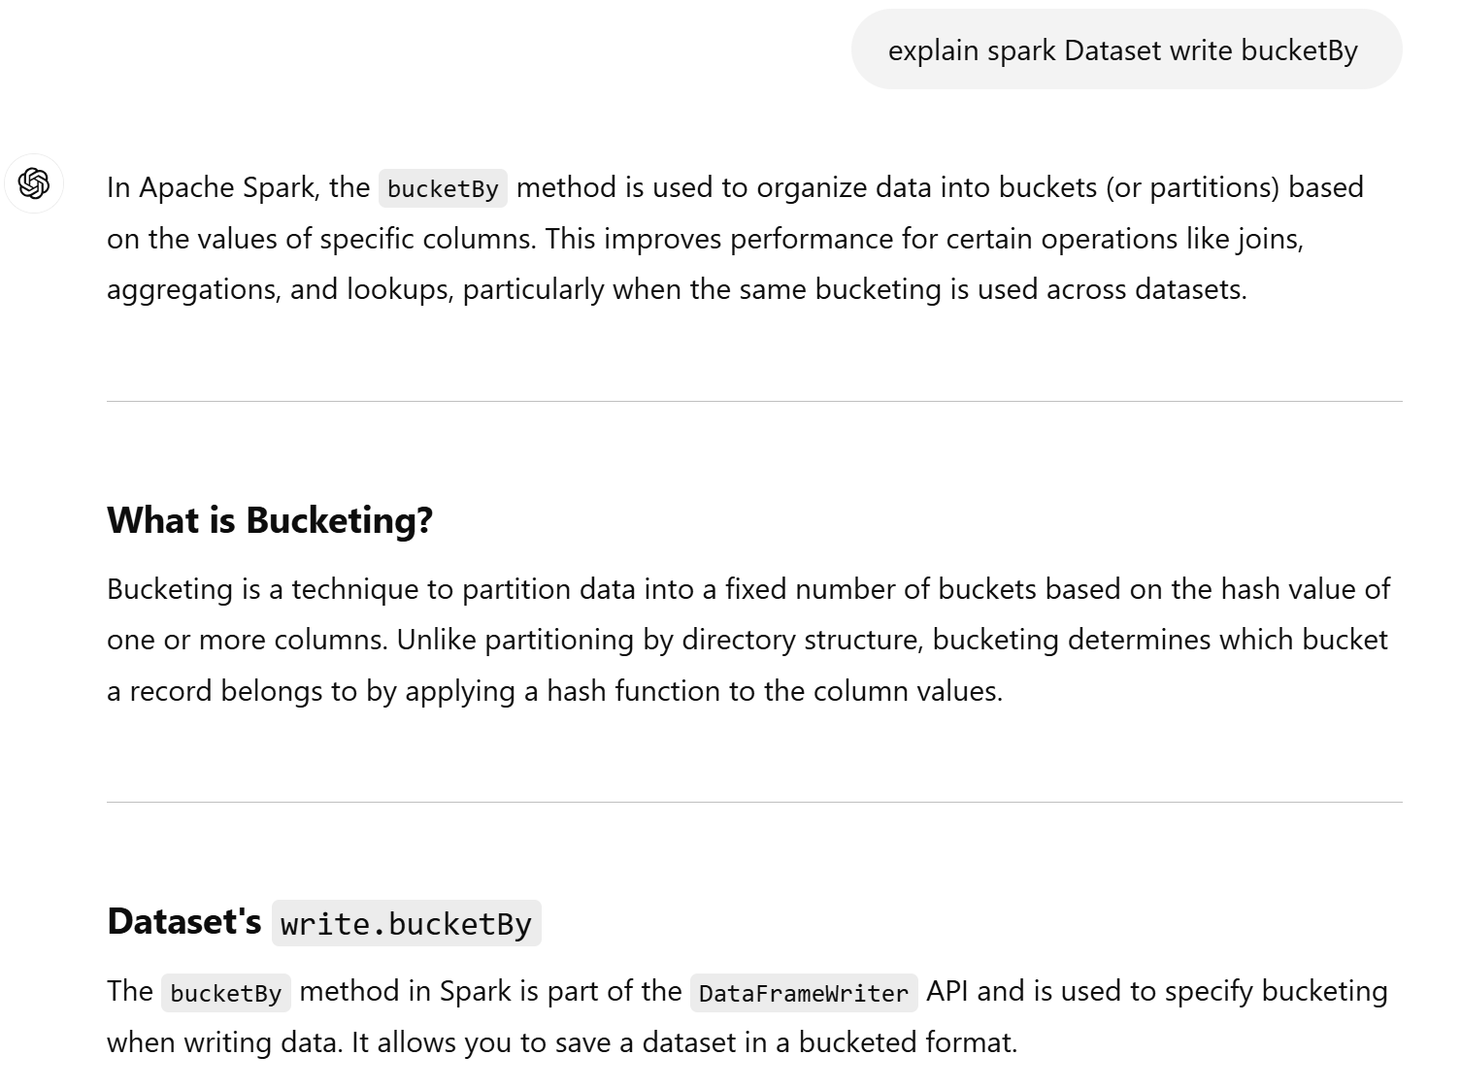
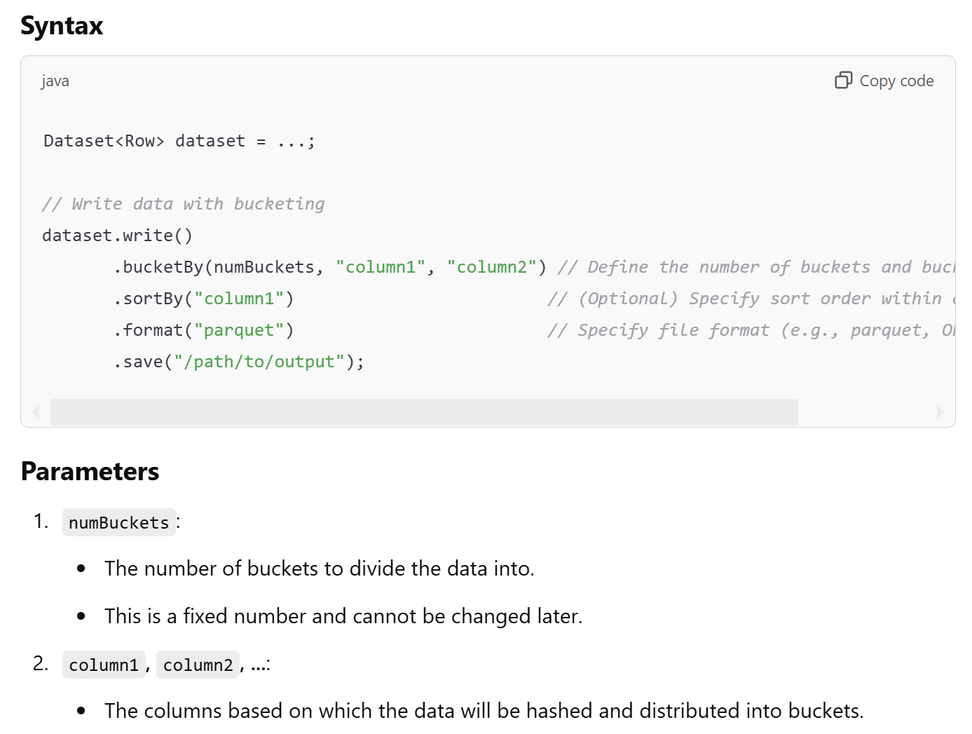
see also Dataset.write .bucketBy( .. )

Slide 55
Analyzing Parquet Files, using "parquet-cli"

Slide 56
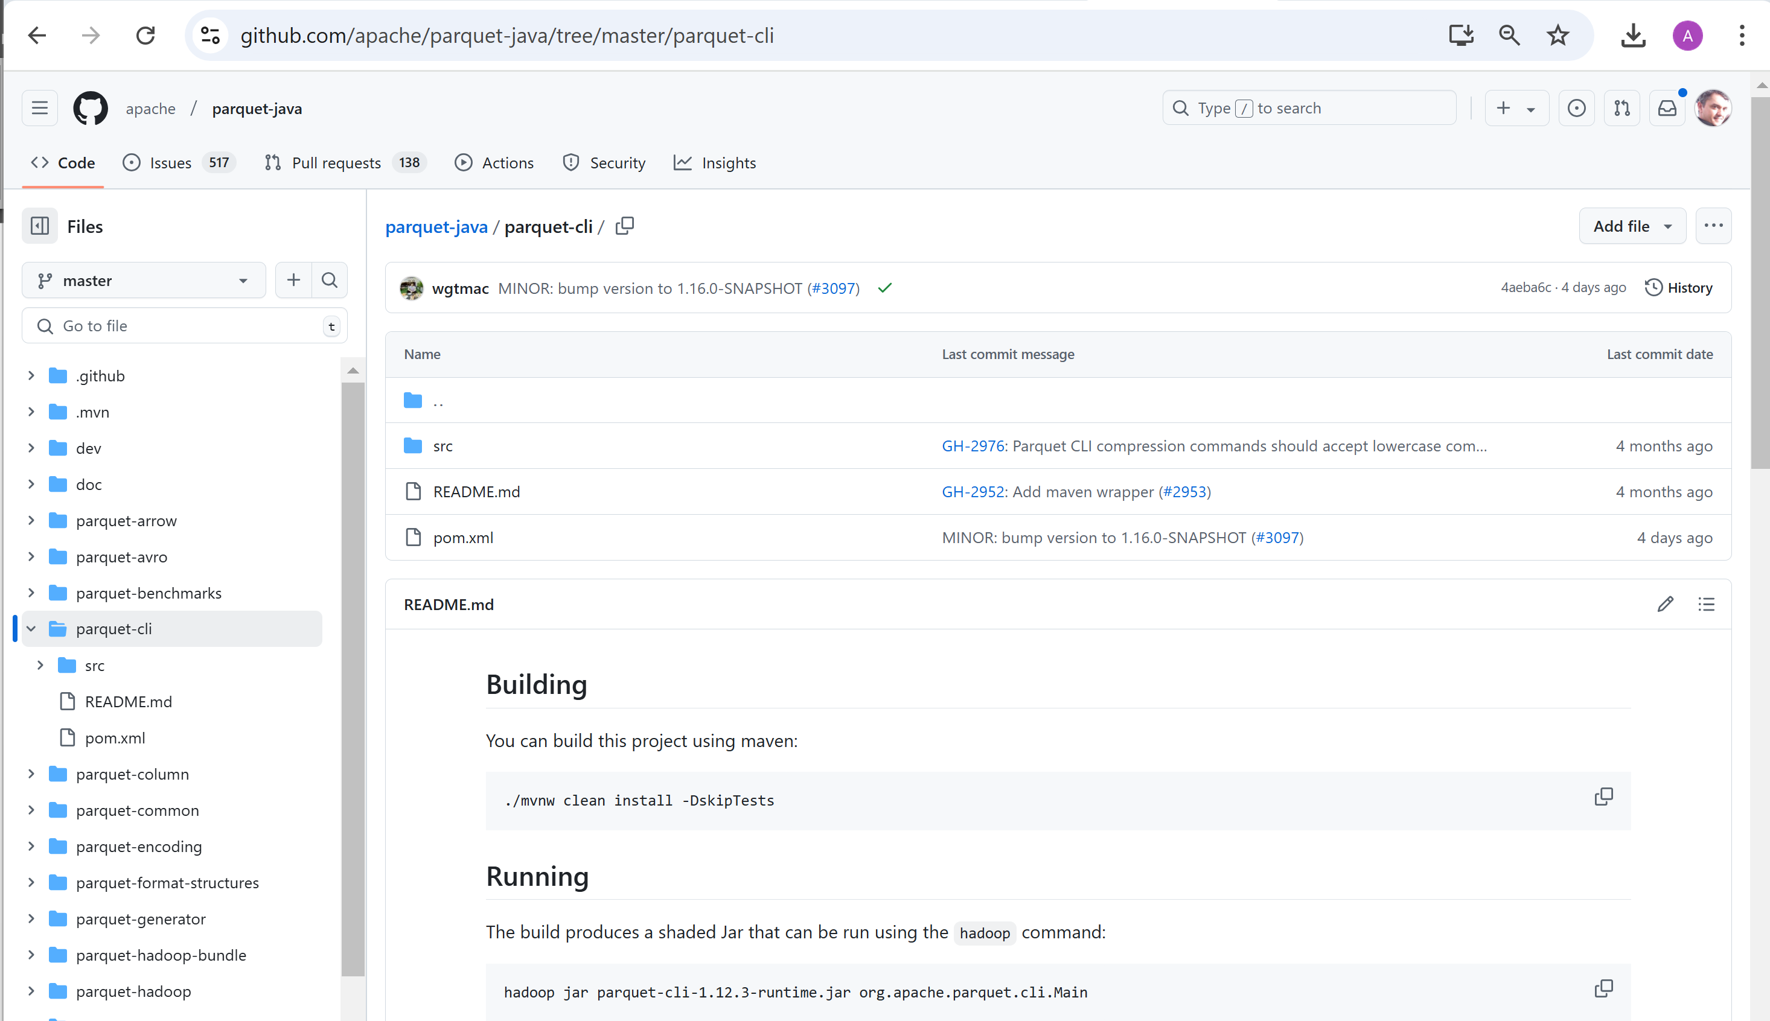
Analysing Parquet File, using "parquet-cli"

Slide 57
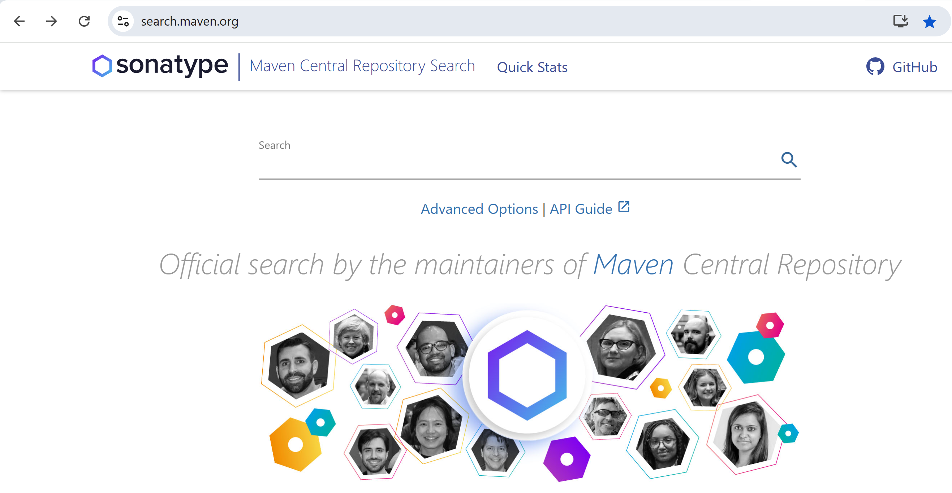
Search jar in maven repo: https://search.maven.org

Slide 58
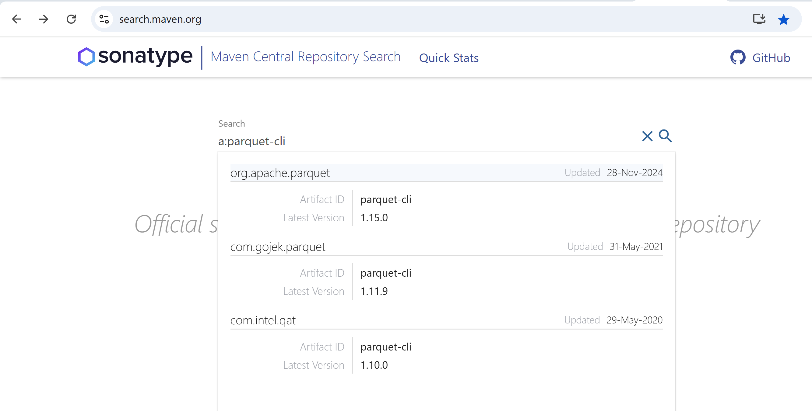
type search "a:parquet-cli" g:org.apache.parquet

Slide 59
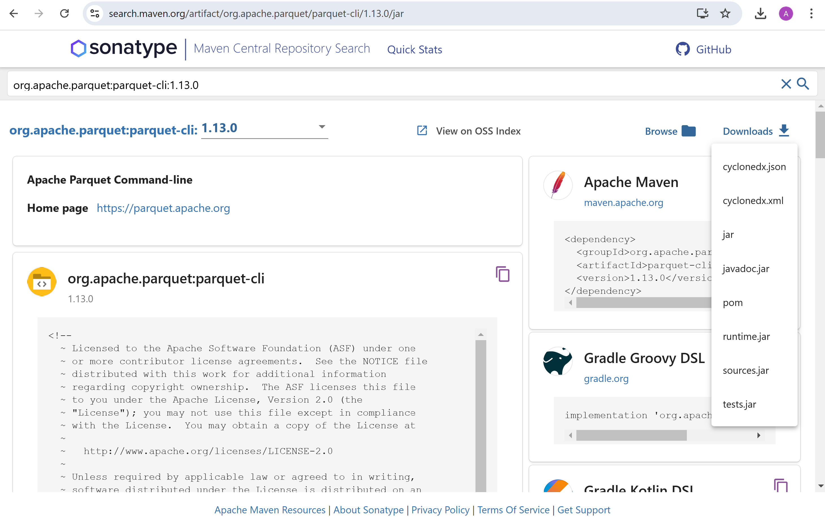
Downloading "parquet-cli" runtime.jar for same version 1.13.0 (same as spark/jars/*.jar)

Slide 60
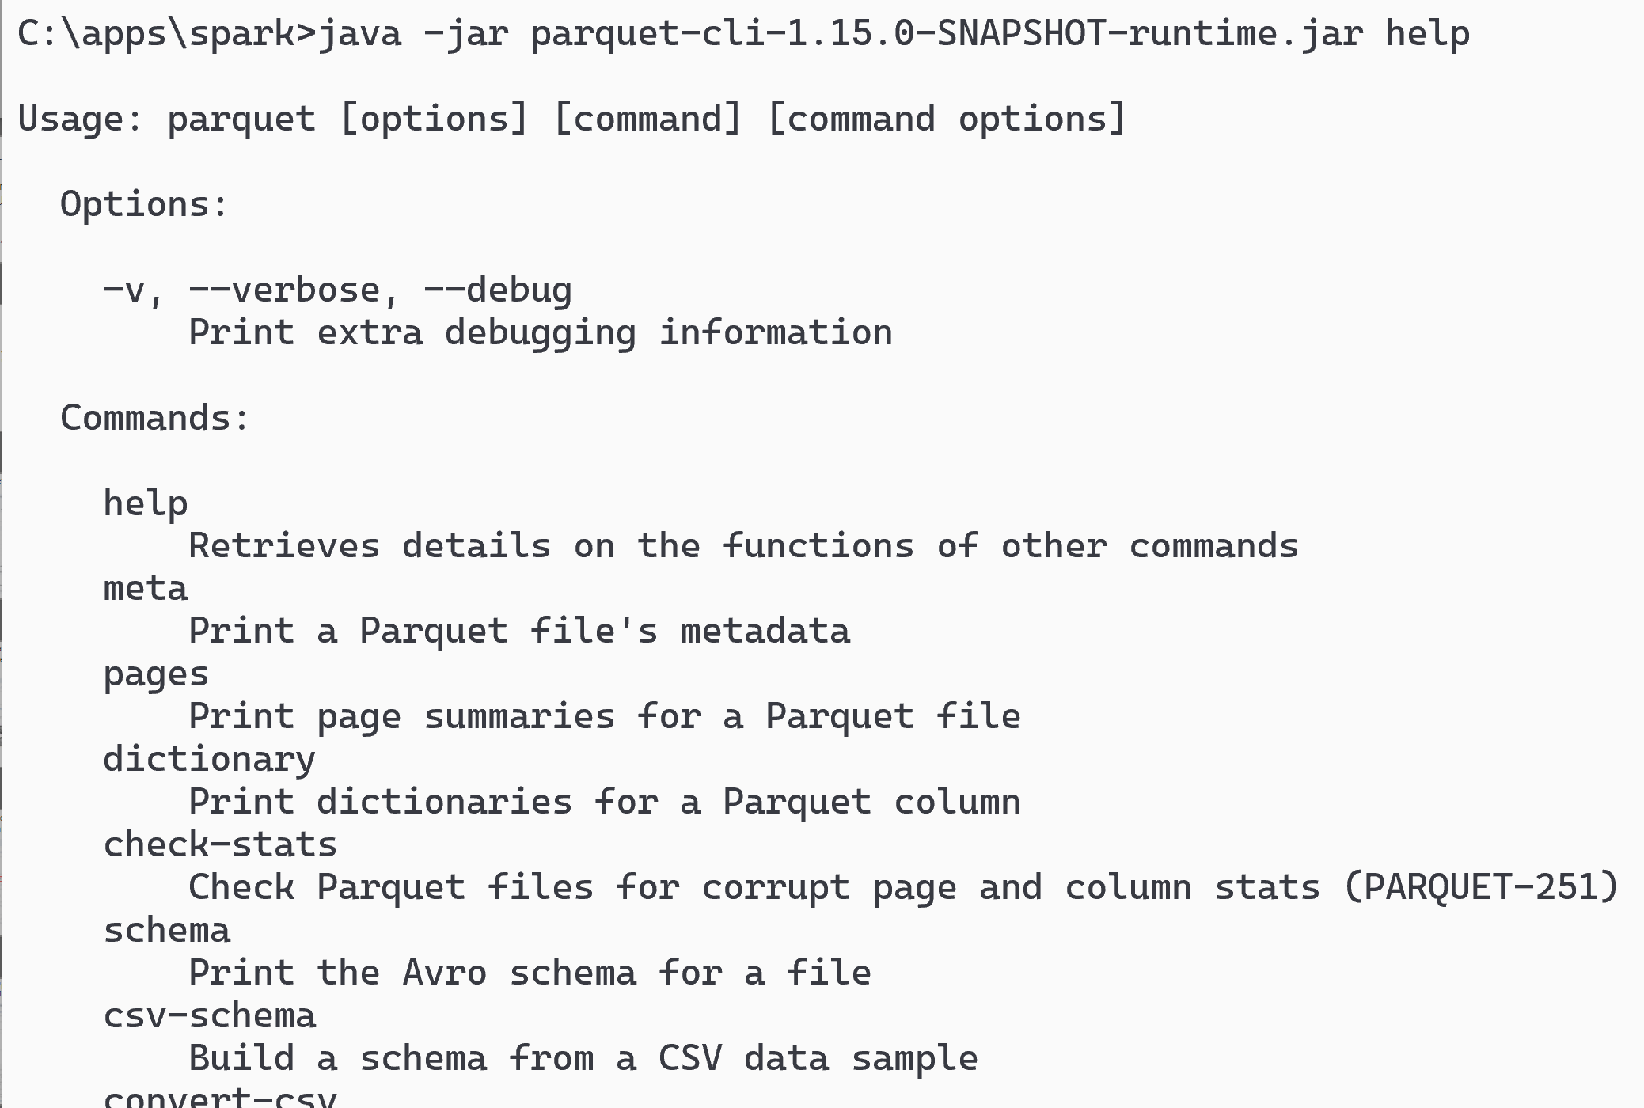
Launching parquet-cli
java -jar parquet-cli-runtime.jar help
(using shaded jar, otherwise may need to add hadoop classpath)

Slide 61
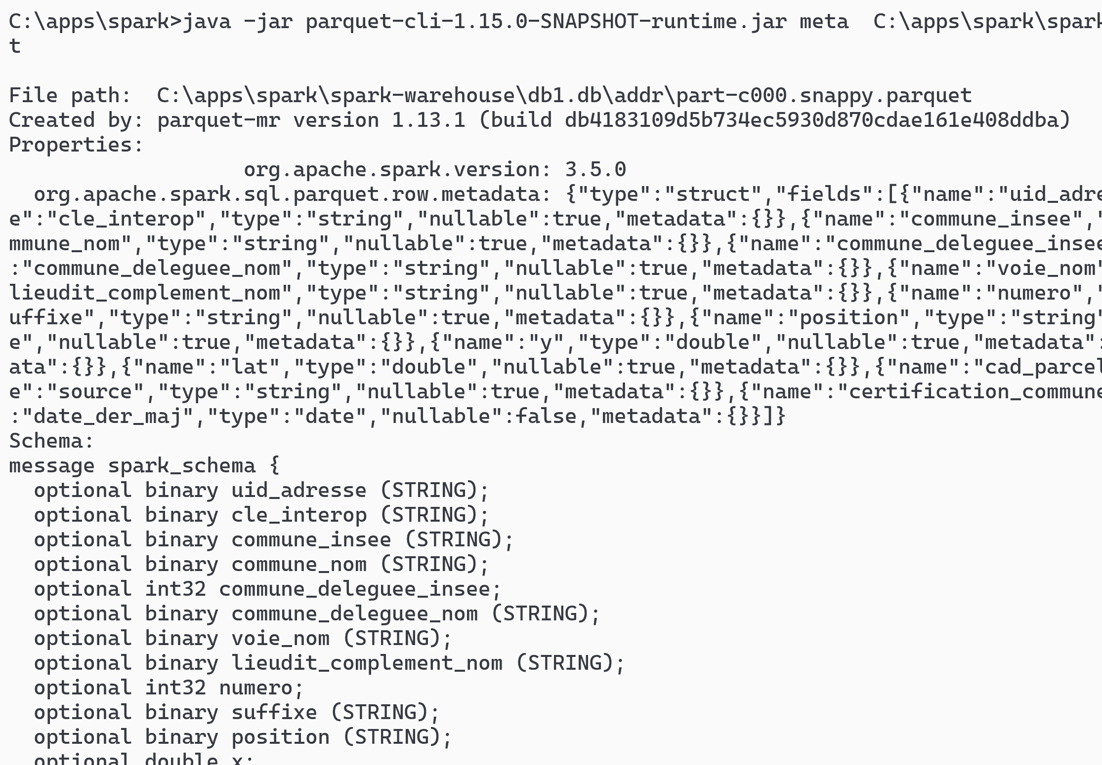
parquet-cli meta [1/2]
java -jar parquet-cli-runtime.jar meta file.parquet

Slide 62
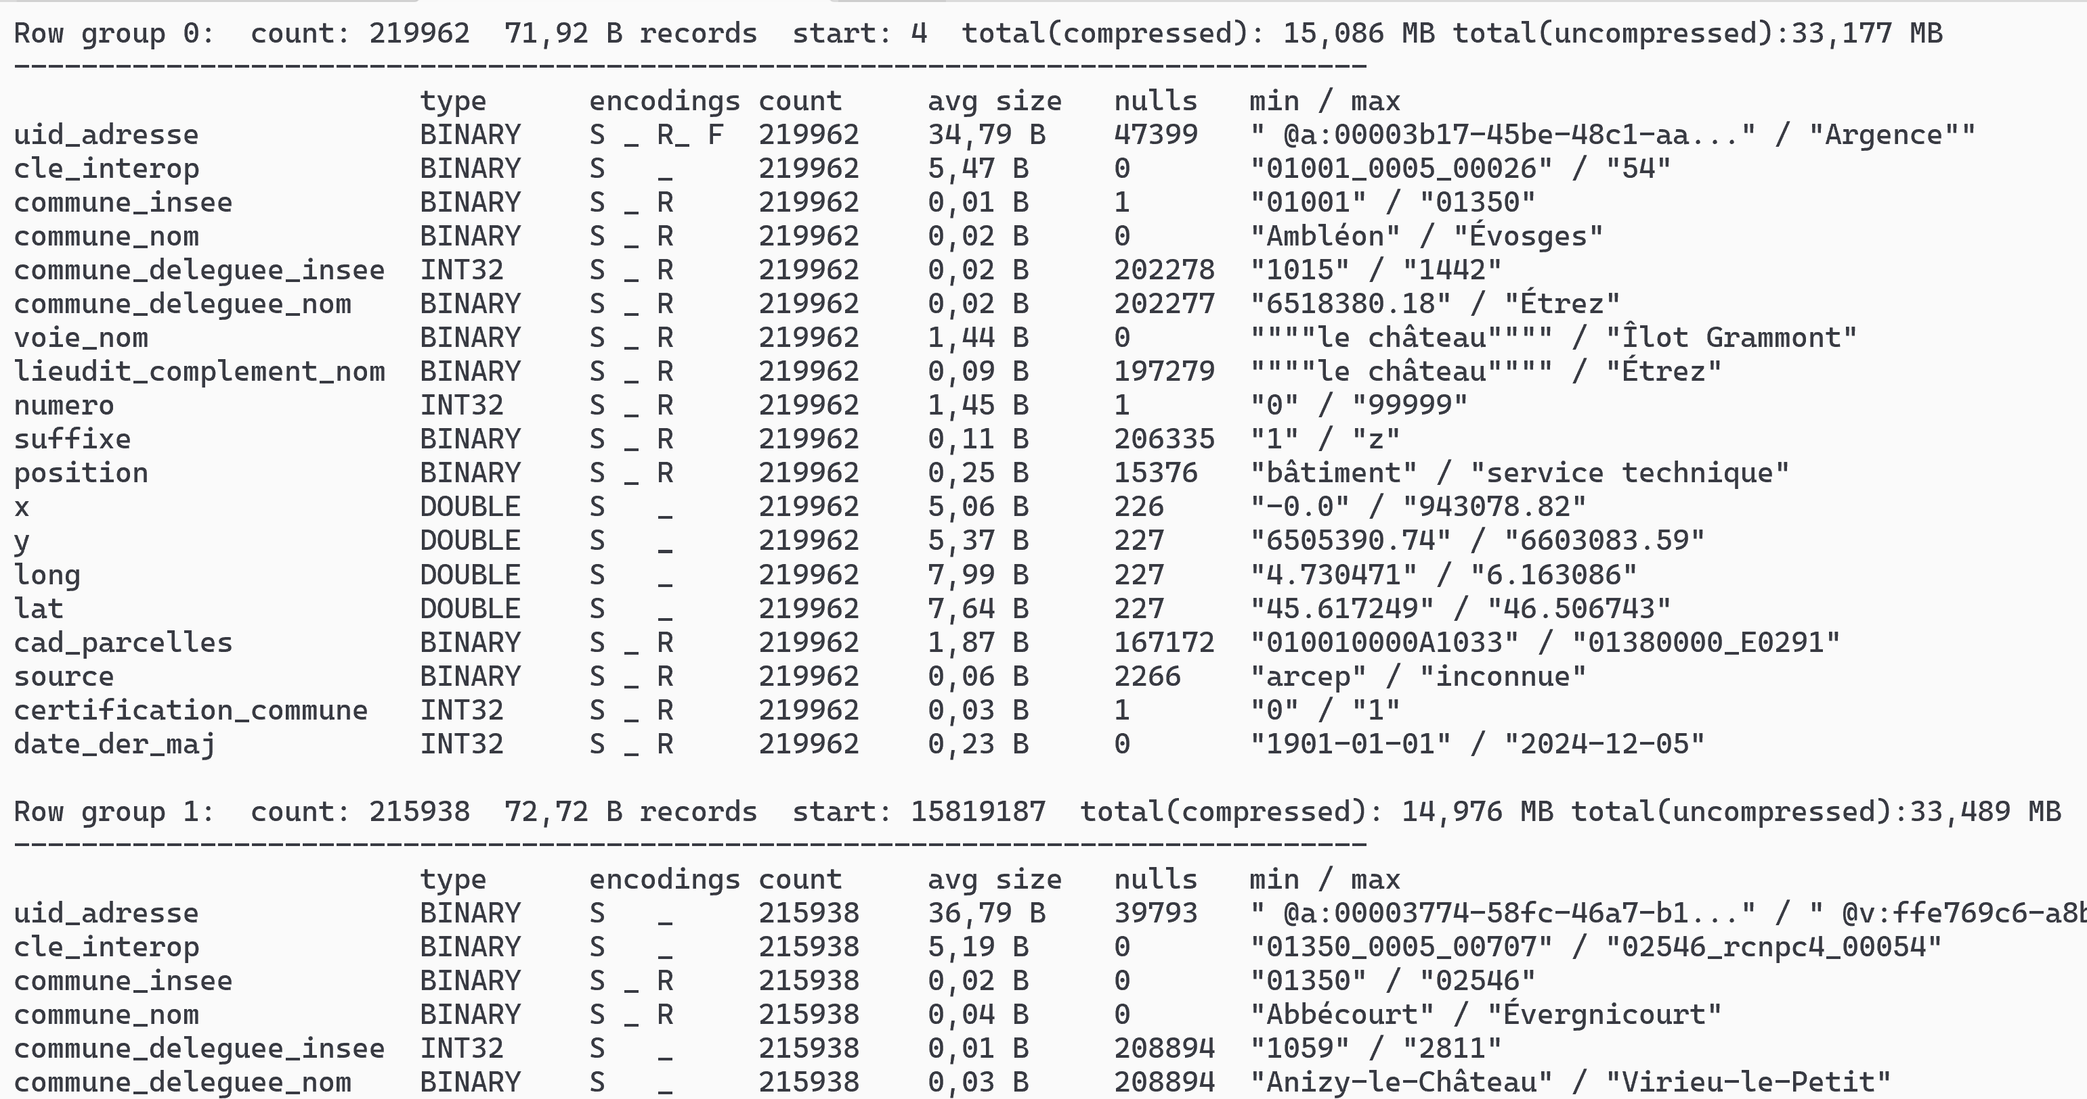
parquet-cli meta [2/2]

Slide 63
parquet-cli meta | grep "Row group"
java -jar parquet-cli-runtime.jar meta file.parquet > meta.txt
grep "Row group" meta.txt | head
Row group 0: count: 219962 71,92 B records start: 4 total(compressed): 15,086 MB total(uncompressed):33,177 MB
Row group 1: count: 215938 72,72 B records start: 15819187 total(compressed): 14,976 MB total(uncompressed):33,489 MB
Row group 2: count: 213992 73,68 B records start: 31523114 total(compressed): 15,036 MB total(uncompressed):33,821 MB
Row group 3: count: 233199 70,29 B records start: 47289138 total(compressed): 15,631 MB total(uncompressed):34,232 MB
Row group 4: count: 231558 69,04 B records start: 63679653 total(compressed): 15,246 MB total(uncompressed):33,383 MB
Row group 5: count: 219962 74,89 B records start: 79665824 total(compressed): 15,710 MB total(uncompressed):34,531 MB
Row group 6: count: 218409 73,91 B records start: 96138854 total(compressed): 15,394 MB total(uncompressed):33,957 MB
Row group 7: count: 199907 75,02 B records start: 112281114 total(compressed): 14,301 MB total(uncompressed):31,914 MB
Row group 8: count: 218409 69,87 B records start: 127277278 total(compressed): 14,552 MB total(uncompressed):34,174 MB
Row group 9: count: 272568 65,80 B records start: 142536439 total(compressed): 17,104 MB total(uncompressed):35,616 MB
grep "Row group" meta.txt | tail
Row group 108: count: 252150 64,55 B records start: 1719335249 total(compressed): 15,522 MB total(uncompressed):34,027 MB
Row group 109: count: 215240 71,68 B records start: 1735611436 total(compressed): 14,715 MB total(uncompressed):34,014 MB
Row group 110: count: 219962 68,48 B records start: 1751040857 total(compressed): 14,365 MB total(uncompressed):32,978 MB
Row group 111: count: 219962 68,18 B records start: 1766103960 total(compressed): 14,302 MB total(uncompressed):32,914 MB
Row group 112: count: 234887 64,52 B records start: 1781100645 total(compressed): 14,454 MB total(uncompressed):33,355 MB
Row group 113: count: 236624 66,44 B records start: 1796256273 total(compressed): 14,993 MB total(uncompressed):37,495 MB
Row group 114: count: 234063 65,95 B records start: 1811977242 total(compressed): 14,722 MB total(uncompressed):33,626 MB
Row group 115: count: 213992 73,42 B records start: 1827414634 total(compressed): 14,983 MB total(uncompressed):34,526 MB
Row group 116: count: 230100 69,58 B records start: 1843125866 total(compressed): 15,269 MB total(uncompressed):36,039 MB
Row group 117: count: 152925 67,36 B records start: 1859136956 total(compressed): 9,823 MB total(uncompressed):26,622 MB

Slide 64
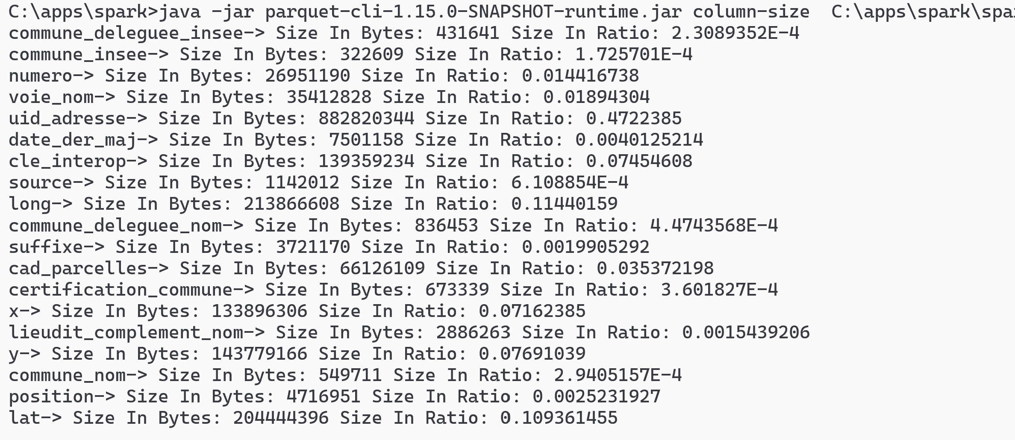
parquet-cli column-size
java -jar parquet-cli-runtime.jar column-size file.parquet

Slide 65
Column Sizes ... sorting
cat column-size | sed 's/-> Size In Bytes//g' | sed 's/ Size In Ratio//g' | sed 's/: /;/g' > column-size.csv
Column | Size | Ratio | Size in Mo
uid_adresse | 882820344 | 47,22% | 841,9
long | 213866608 | 11,44% | 204,0
lat | 204444396 | 10,94% | 195,0
y | 143779166 | 7,69% | 137,1
cle_interop | 139359234 | 7,45% | 132,9
x | 133896306 | 7,16% | 127,7
cad_parcelles | 66126109 | 3,54% | 63,1
voie_nom | 35412828 | 1,89% | 33,8
numero | 26951190 | 1,44% | 25,7
date_der_maj | 7501158 | 0,40% | 7,2
position | 4716951 | 0,25% | 4,5
suffixe | 3721170 | 0,20% | 3,5
lieudit_complement_nom | 2886263 | 0,15% | 2,8
source | 1142012 | 0,06% | 1,1
commune_deleguee_nom | 836453 | 0,04% | 0,8
certification_commune | 673339 | 0,04% | 0,6
commune_nom | 549711 | 0,03% | 0,5
commune_deleguee_insee | 431641 | 0,02% | 0,4
commune_insee | 322609 | 0,02% | 0,3
total | 1869437488 | 100,00% | 1782,8

Slide 66
Parquet Column Sizes Summary
zipcode ("commun_insee") : 0.3 Mo
+
city name ("commun_nom") : 0.5 Mo
+
street name ("voie_nom") : 33.8 Mo
+
numero : 25.7 Mo
=> 60 Mega (3% of file)
+ longitude, latitude : 204 Mo + 195 Mo
=> 459 Mo
most of the column size is
uid_address : 840 Mo (47.2%)
+
x, y ... redundant with longitude,lattitude
+
cle_interop : 132 Mo (7.4%)
... we will see parquet "column-pruning" in action : skipping unnecessary columns !

Slide 67
Conclusion
Parquet File Format is AMAZING
Spark is great using Parquet
Doing BigData processing = doing Spark + Parquet with good .repartition( ... ) .bucketBy( ... )
.sortWithinPartitions( ... )

Slide 68
Mind Map
Protobuf
Thrift
PARQUET
RowGropup ~spark Partition (FileSplit)
Avro
orc
text
csv
nd-json
xml
Serial
(Row)
RowGroup
Unstructured
Columnar
text files = splittable
(csv,nd-json)
Predicate-Push-Down
Semi-structured
.gz = unsplittable
Splitteable
Structured
Types of files
snappy (fast)
schema
lz4 (compromise)
Compression
.gz(comp. ratio)
Parquet File Format
Datatype
Run-Length Encoder
( RLE )
Column Chunk Encoders
data / metadata split
Scalar Value
Composite Value
Dictionary
Columnar
String
struct<f1:T1,f2:T2..>
Delta Encoder
RowGroup page offsets
footer
bool
int,long
array<T>
Column Pruning
CPU/Memory efficient
float,double
map<K,V>
schema
rowGroups Metadata
Datetime
rg-columns statistics
faster Vectorized reader
min/max value
fileOffset
bloomFilter

Slide 69
Questions?
arnaud.nauwynck@gmail.com

