Slide 1
Hand-on 4 Design Patterns
April 2023

Slide 2
Outline
Reminder on previous session: Design of a Drawing App
1/ Model-View-Controller pattern
2/ Publish&Subscribe pattern
3/ core domain classes (Text, Line, Rectangle, Circle, ..)
4/ extension classes: Composite, Proxy, Adapter (example: Img)
5/ Visitor pattern on domain classes.. Model to View
6/ State pattern for mouse click handler
7/ Command pattern for undo-redo..

Slide 3
Objective of this Hands-On
Implements the patterns
Obtain a minimalist running application
Easy:
Fully Guided
& Using code snippets

Slide 4
Step 0 : Create/import a project with maven pom.xml with javafx <dependency> with a public static void main(String[] args) with a javafx App … cf next

Slide 5
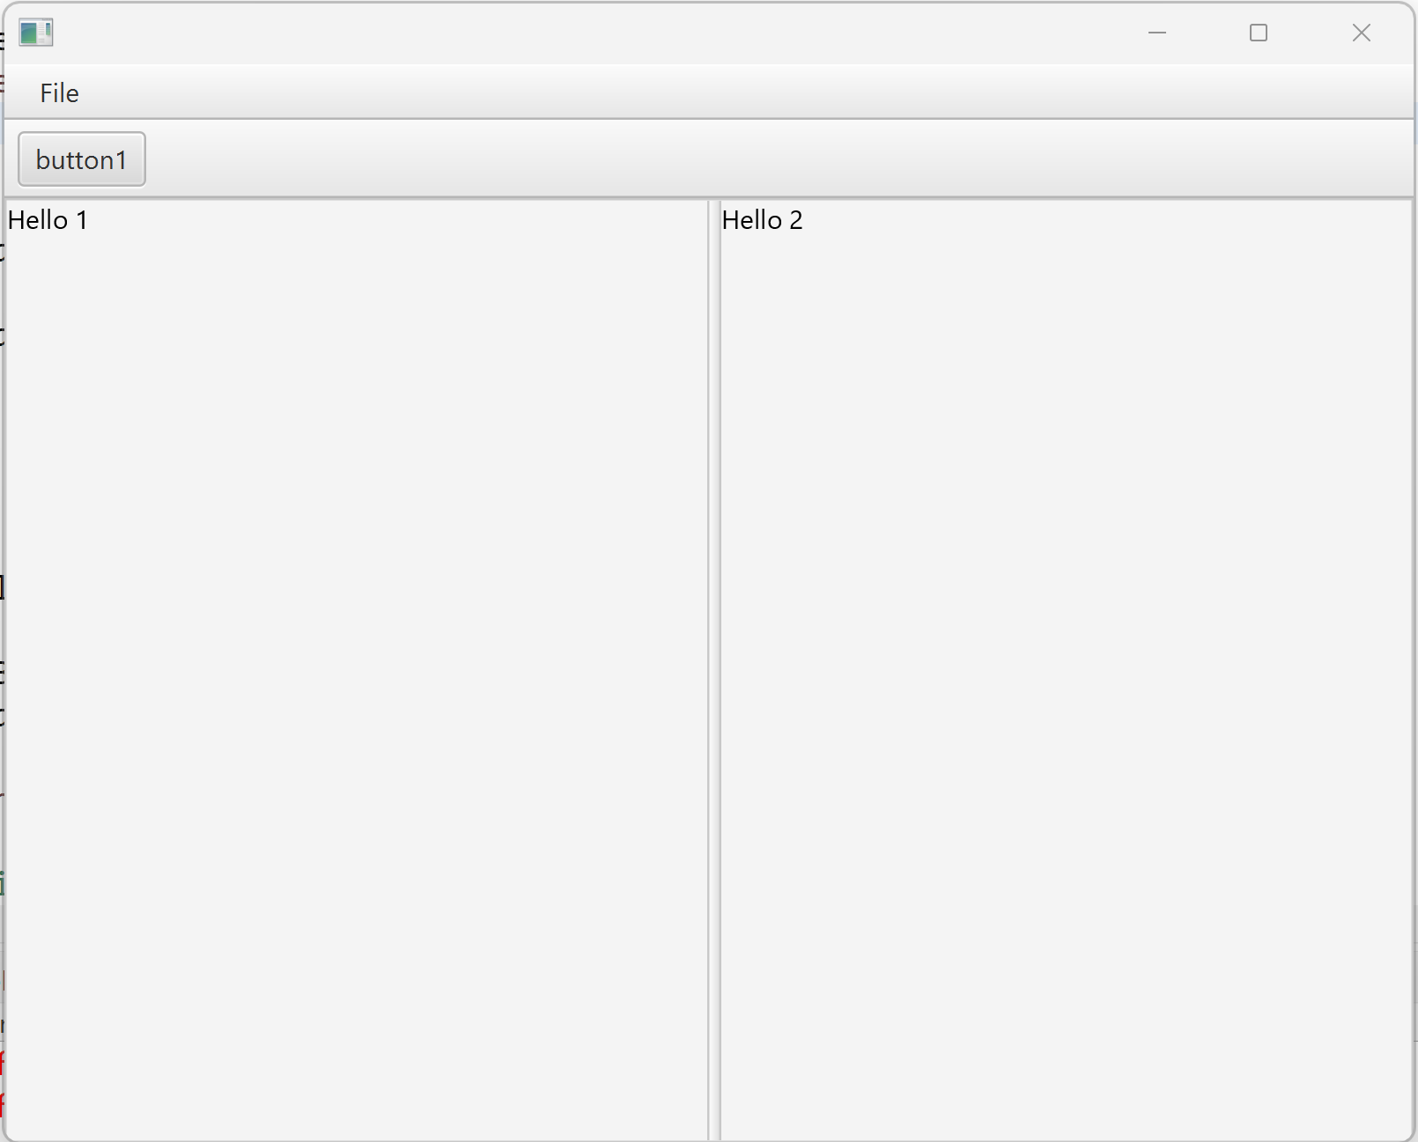
Step 0: Run … Expected GUI Result

Slide 6
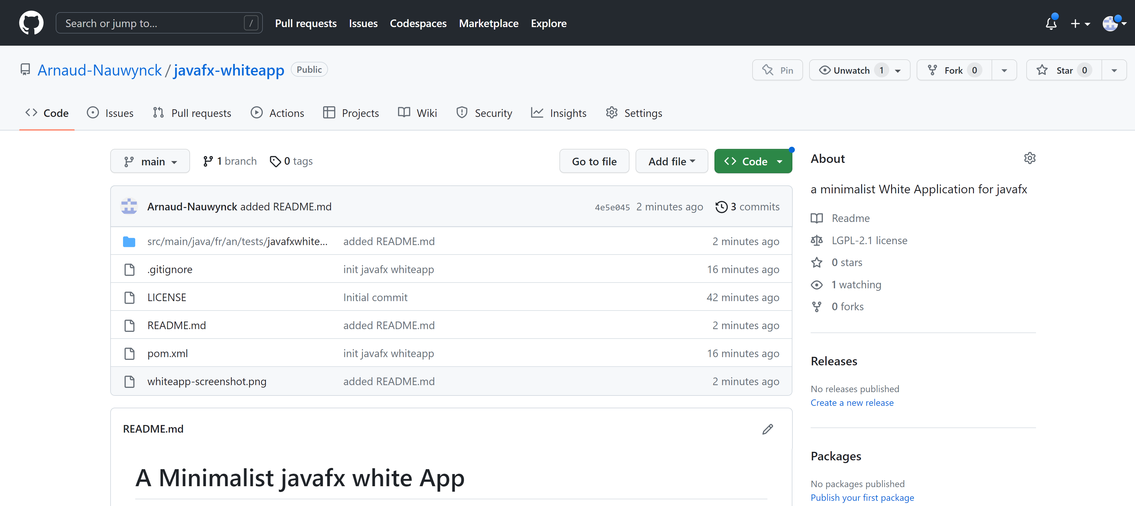
Step 0 : clone/download https://github.com/Arnaud-Nauwynck/javafx-whiteapp

Slide 7
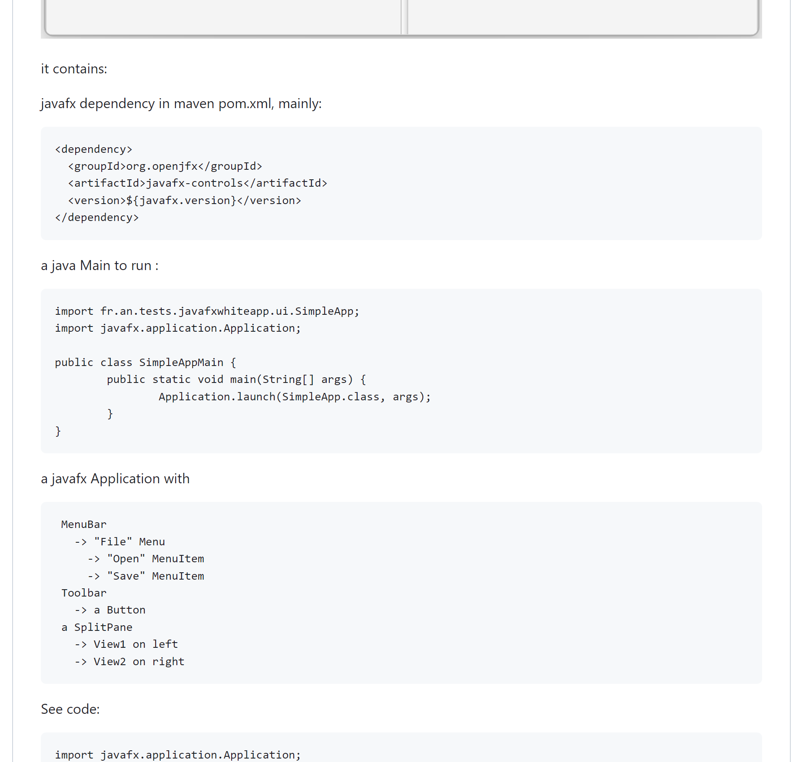
README.md

Slide 8
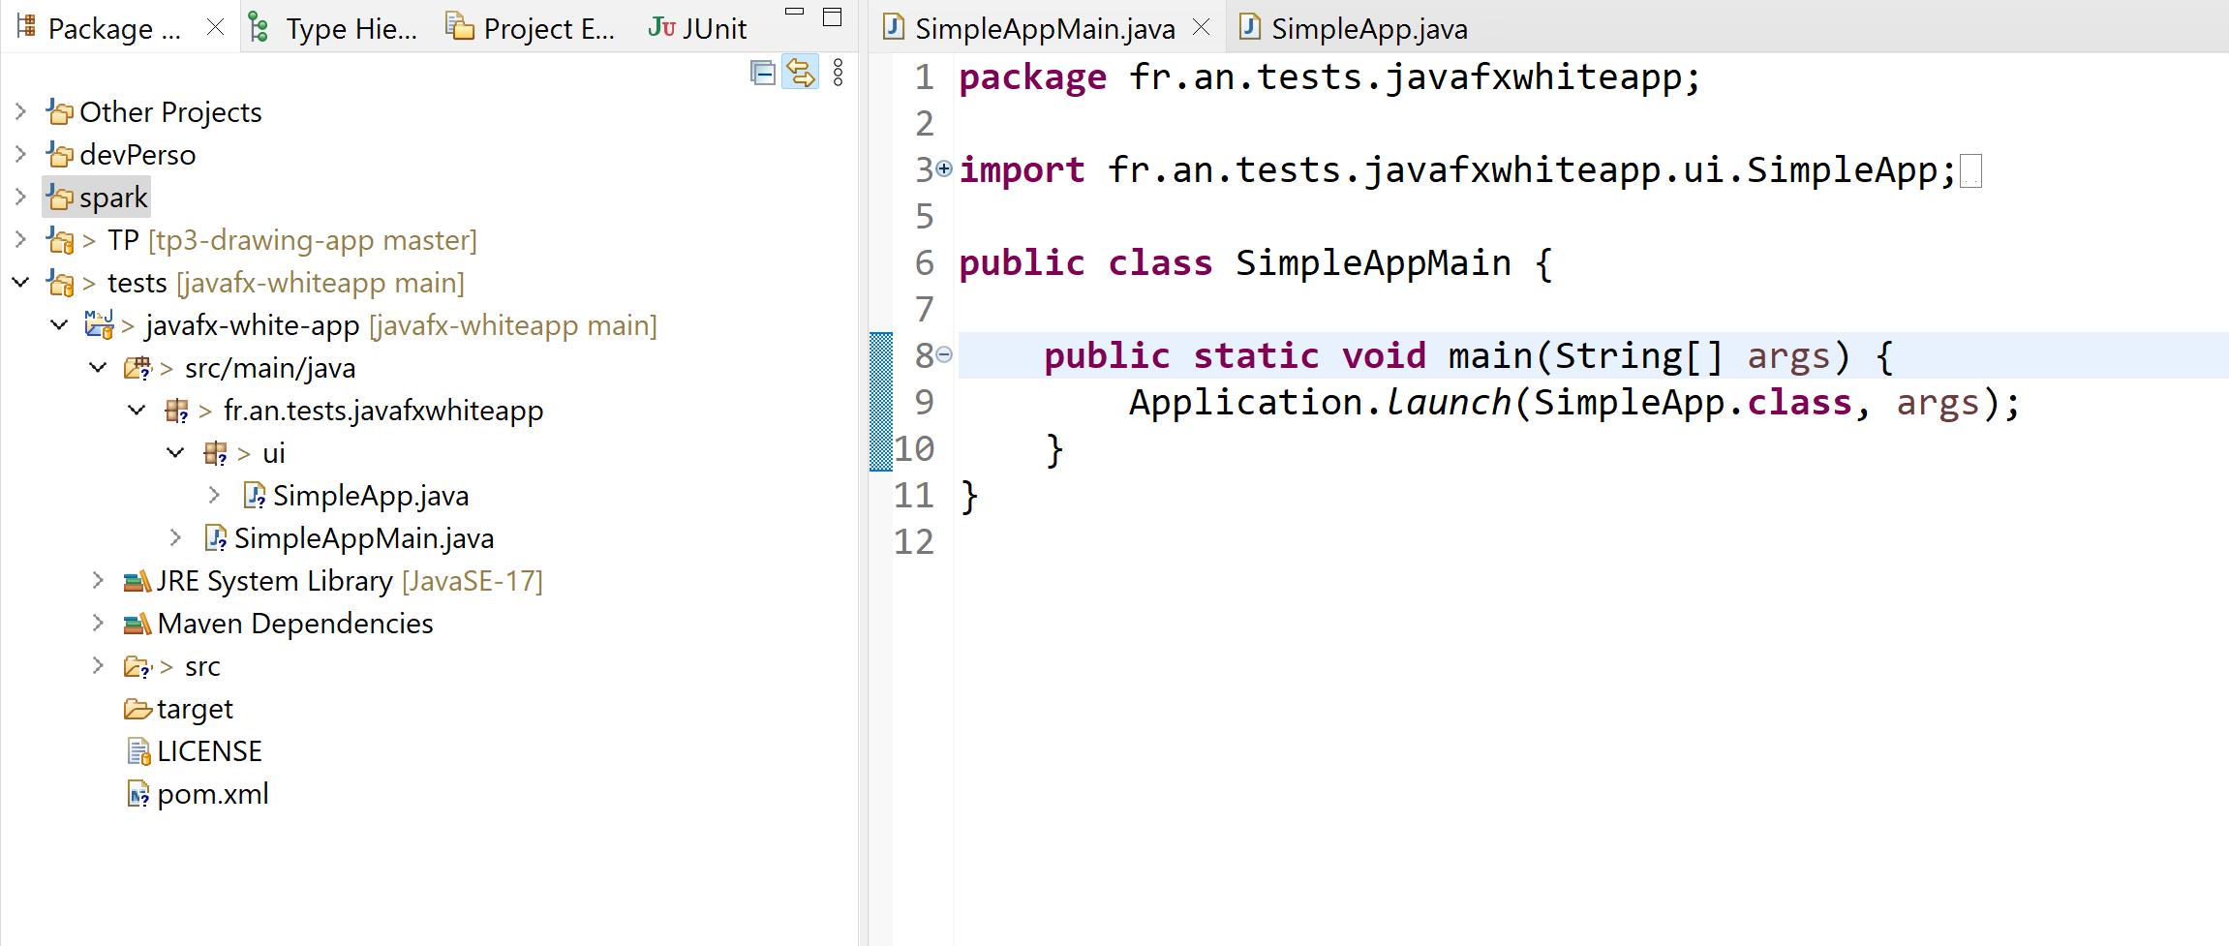
Step 1: Import in Eclipse/Idea + Run It

Slide 9
Step 1 : MVC Design Pattern Model-View-(Controler)
Drawing
Document
Model
Drawing View
component
content
DomainClass
1
Javafx.Node
1
1

Slide 10
Step 1 : code ..
public class DrawingDocModel {
public String documentName;
// to be replaced next
// by Drawing AST classes
public String content;
// more later: Publisher design-pattern
}
public abstract class DrawingView {
protected DrawingDocModel model;
public DrawingView(DrawingDocModel model) {
this.model = model;
}
public abstract javafx.scene.Node getComponent();
// more later: Subscriber design-pattern
}

Slide 11
Step 2: create a simple (text) DrawingView sub-class
Drawing View
BorderPane
Text Drawing View
center
1
TextArea
bottom
Button
Button

Slide 12
Step 2 code
public class TextDrawingView extends DrawingView {
protected BorderPane component;
protected TextArea textArea;
protected Button applyButton;
public TextDrawingView(DrawingDocModel model) {
super(model);
this.component = new BorderPane();
this.textArea = new TextArea();
component.setCenter(textArea);
this.applyButton = new Button("Apply");
component.setBottom(applyButton);
refreshModelToView();
}
@Override
public Node getComponent() {
return component;
}
public void refreshModelToView() {
String text = model.getContent();
textArea.setText(text);
}

Slide 13
Step 3: in main app instanciate 1 model and bind 2 Views model = new Model() view1 = new TextDrawingView1(model) view2 = new TextDrawingView1(model) add views

Slide 14
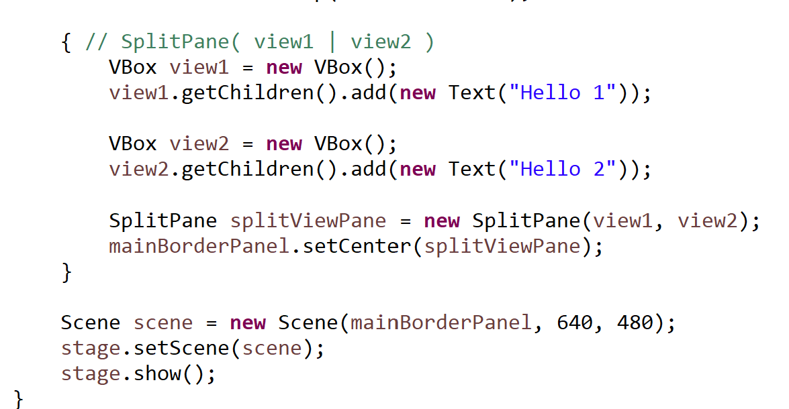
Step 3 code
DrawingDocModel model = new DrawingDocModel();
model.setContent("drawing content will go here later");
{ // SplitPane( view1 | view2 )
TextDrawingView view1 = new TextDrawingView(model);
Node view1Comp = view1.getComponent();
TextDrawingView view2 = new TextDrawingView(model);
Node view2Comp = view2.getComponent();
SplitPane splitViewPane = new SplitPane(view1Comp, view2Comp);
mainBorderPanel.setCenter(splitViewPane);
}

Slide 15
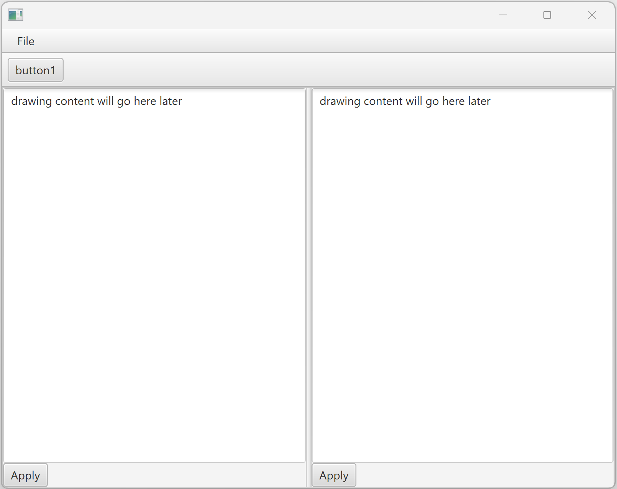
Step 3 Expected Result

Slide 16
Step 4 : Publish & Subscribe Design Pattern
Declare « interface DrawingModelListener »
Add on model-side
« List< DrawingModelListener> listeners = new ArrayList<>(); » methods addListener / removeListener / fireListenerChange()
Add « implements DrawingModelListener » on view-side + model.addListener(this)
Drawing Model
listeners
Drawing Model
Listener
*
Text Drawing View

Slide 17
Step 4 code (1/3)
protected List<DrawingModelListener> listeners = new ArrayList<>();
public void setContent(String content) {
this.content = content;
fireModelChange();
}
public void addListener(DrawingModelListener p) {
this.listeners.add(p);
}
public void removeListener(DrawingModelListener p) {
this.listeners.remove(p);
}
protected void fireModelChange() {
for(DrawingModelListener listener : listeners) {
listener.onModelChange();
}
}
public interface DrawingModelListener {
public void onModelChange();
}

Slide 18
Step 4 : Code (2/3)
public class TextDrawingView extends DrawingView implements DrawingModelListener {
public TextDrawingView(DrawingDocModel model) {
…
model.addListener(this); // publish&subscribe design pattern
}
protected void refreshModelToView() {
String text = model.getContent();
textArea.setText(text);
}
@Override
public void onModelChange() {
System.out.println("(from subscribe): model to view change");
refreshModelToView();
}

Slide 19
Step 4 : Alternative Code (3/3) … do not expose « public » Listener
public class TextDrawingView extends DrawingView {
protected DrawingModelListener innerListener = new DrawingModelListener() {
@Override
public void onModelChange() {
System.out.println("(from subscribe): model to view change");
refreshModelToView();
}
};
public TextDrawingView(DrawingDocModel model) {
…
model.addListener(this.innerListener); // publish&subscribe design pattern
}
protected void refreshModelToView() {
String text = model.getContent();
textArea.setText(text);
}

Slide 20
Step 5 : MVC… C=Controller
User-defined « View » class = javafx View + Controller
button.setOnAction( e -> onClickApply() );
(javafx) View
Javafx.control.Button
Model
On Click button
Controler
onClickApply() {
// view to model update
}

Slide 21
Step 5: code
public TextDrawingView(DrawingDocModel model) {
…
this.applyButton = new Button("Apply");
applyButton.setOnAction(e -> onClickApply());
}
private void onClickApply() {
System.out.println("apply view to model update");
String text = textArea.getText();
model.setContent(text); // => fireModelChange ..
}

Slide 22
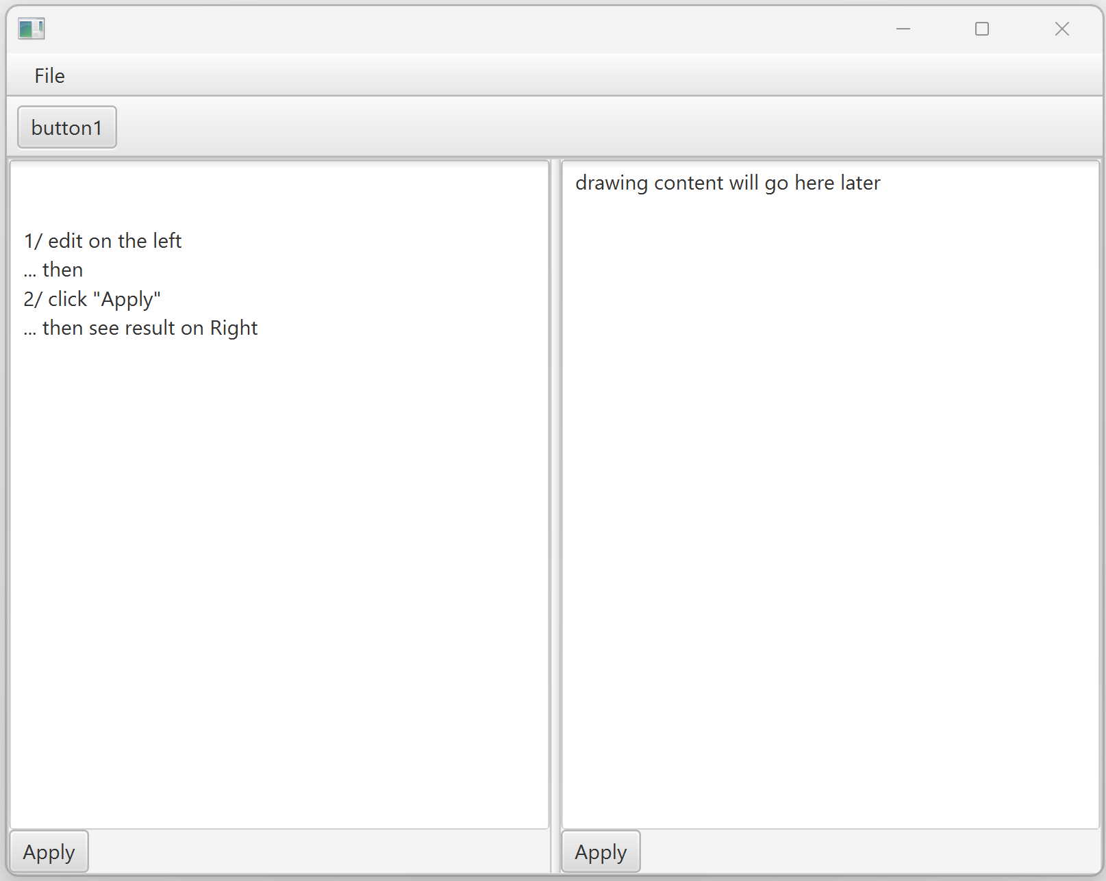
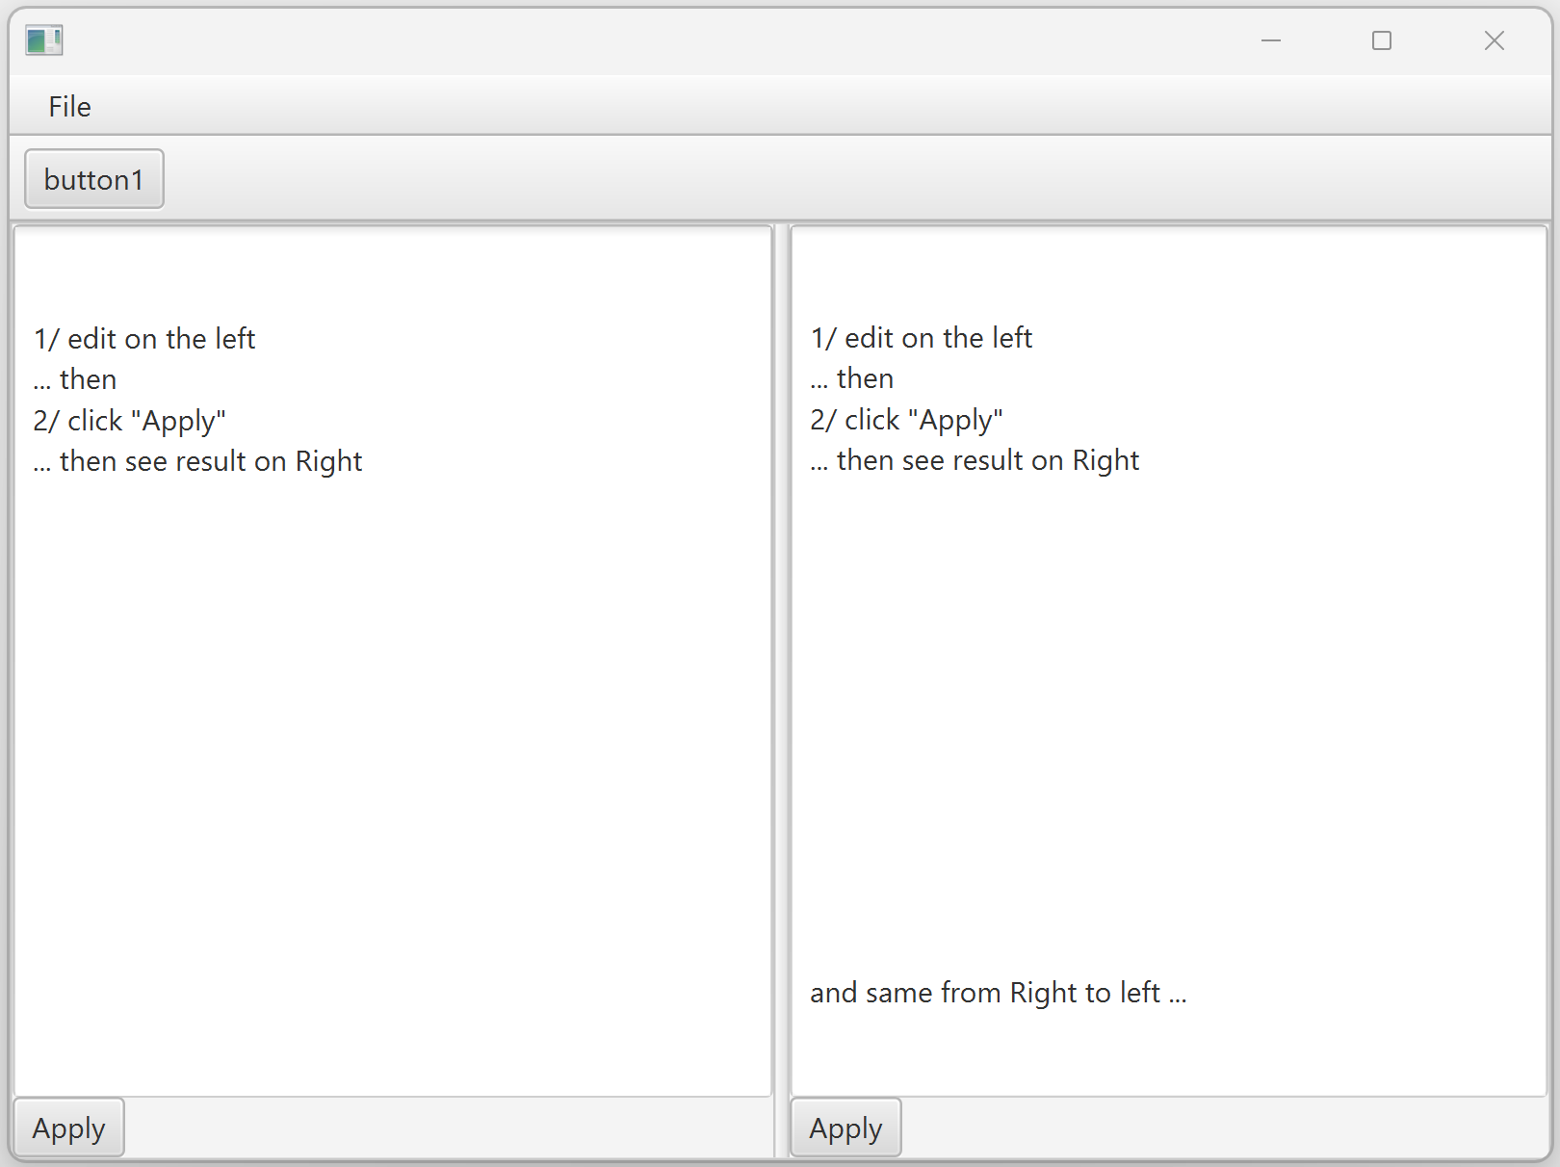
Step 5 : Expected Result

Slide 23
Step 6 : core domain classes design pattern… AST class hierarchy, Interpreter
(abstract) DrawingElement
Text DrawingElement
Line DrawingElement
Rectangle DrawingElement
Circle DrawingElement
Group DrawingElement
Image DrawingElement
Proxy DrawingElement
AffineTransformed DrawingElement
Other..
Other..
Other..
(Composite design pattern)
(Adapter design pattern)
(Proxy design pattern)
(Decorator design pattern)

Slide 24
Step 6: code (1/4)
/**
* abstract base class for Drawing element
* AST class hierarchy
* see sub-classes:
* <ul>
* <li> TextDrawingElement </li>
* <li> LineDrawingElement </li>
* <li> RectanleDrawingElement </li>
* <li> CircleDrawingElement </li>
* <li> ImageDrawingElement (adapter design pattern, to image: png/jpg/gif/.. )</li>
* <li> GroupDrawingElement (composite design-pattern) </li>
* <li> other.. </li>
* </ul>
*/
public abstract class DrawingElement {
// nothing except
// TOADD: visitor design pattern
}

Slide 25
Step 6 : code(2/4)
public class BaseDrawingElements {
public static class TextDrawingElement extends DrawingElement {
public String text;
public DrawingPt pos;
public Map<String,Object> properties; // font, size, color,
}
public static class LineDrawingElement extends DrawingElement {
public DrawingPt start;
public DrawingPt end;
public Map<String,Object> properties; // width, stroke, color, ..
}
public static class RectangleDrawingElement extends DrawingElement {
public DrawingPt upLeft;
public DrawingPt downRight;
public Map<String,Object> properties; // width, stroke, color, ..
}
public static class CircleDrawingElement extends DrawingElement {
public DrawingPt center;
public double radius;
public Map<String,Object> properties; // width, stroke, color, ..
}
}
public class DrawingPt {
public double x;
public double y;
public DrawingPt() {
}
public DrawingPt(
double x,
double y) {
this.x = x;
this.y = y;
}
}

Slide 26
Step 6 code (3/4)
/**
* Composite design pattern
*/
public static class GroupDrawingElement extends DrawingElement {
public List<DrawingElement> elements = new ArrayList<>();
}
/**
* Adapter design pattern, for javafx.scene.image.Image
*/
public static class ImageDrawingElement extends DrawingElement {
public javafx.scene.image.Image image; // => url, mimeType, data
}

Slide 27
Step 6 code (4/4)
/**
* Proxy design pattern
* example: including part from another document
*/
public static class ProxyDrawingElement extends DrawingElement {
public DrawingElement underlying;
}
/**
* Decorator design pattern
* For geometrical affine transformation
*/
public static class AffineTransformedDrawingElement extends DrawingElement {
public DrawingElement underlying;
public DrawingPt translate;
public double rotateAngle;
public double scale;
}

Slide 28
Step 7 : instanciate a simple Drawing Text + Line + Rectangle + Circle
public GroupDrawingElement createSimpleDrawing() {
TextDrawingElement text = new TextDrawingElement("Hello", new DrawingPt(100, 100));
LineDrawingElement line = new LineDrawingElement(new DrawingPt(100, 130),
new DrawingPt(200, 230));
RectangleDrawingElement rectangle = new RectangleDrawingElement( new DrawingPt(100, 300), new DrawingPt(200, 350));
CircleDrawingElement circle = new CircleDrawingElement(new DrawingPt(150, 400), 45);
GroupDrawingElement res = new GroupDrawingElement();
res.addAll(text, line, rectangle, circle);
return res;
}

Slide 29
Step 8 : change Model-> to use DrawingElement + naive code for model to text ( cf next … using Visitor )
public class DrawingDocModel {
protected String documentName;
protected DrawingElement content; // was String before step8
// in main:
DrawingDocModel model = new DrawingDocModel();
DrawingElement content = createSimpleDrawing();
model.setContent(content);

Slide 30
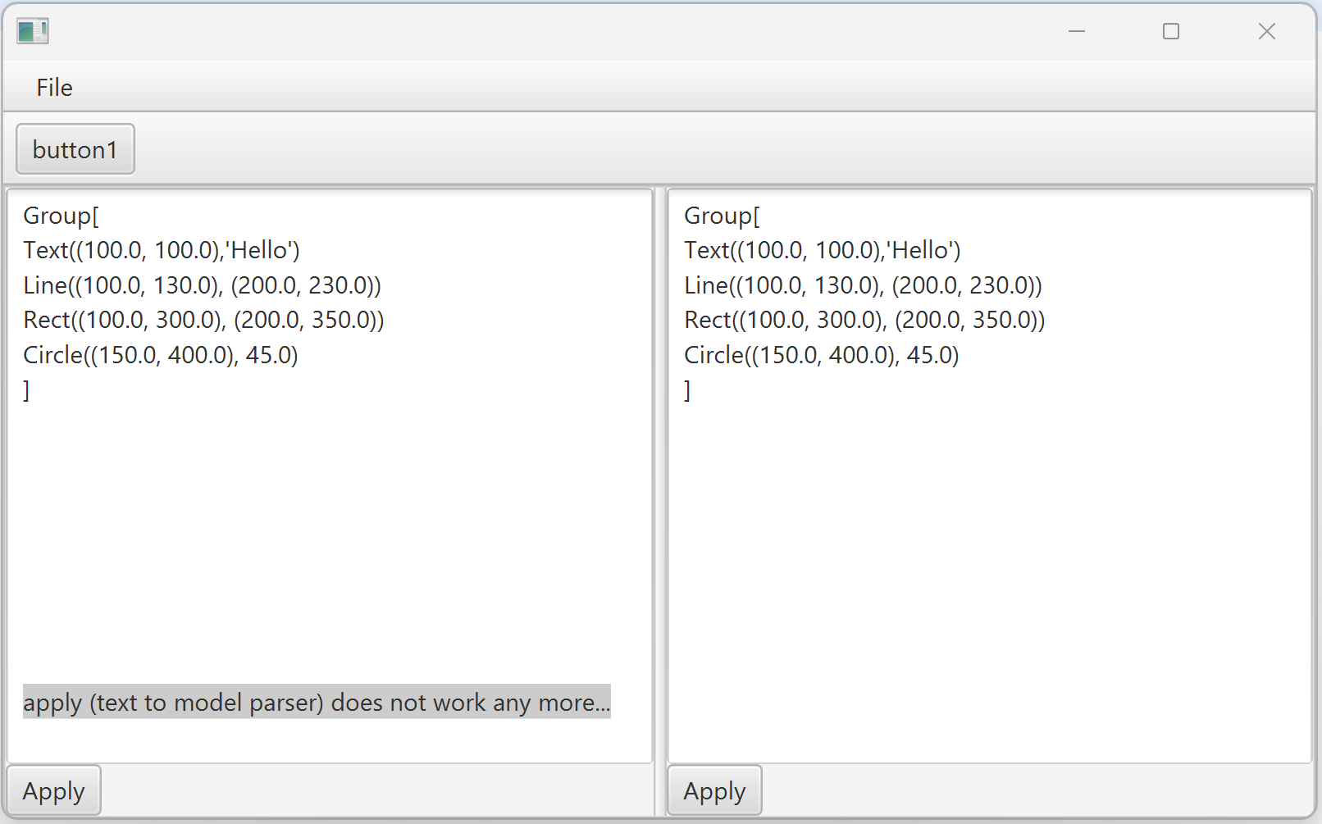
Step 8 : expected Result

Slide 31
Step 8 : code (1/3)
protected void refreshModelToView() {
DrawingElement content = model.getContent();
String text = recursiveElementToText(content);
textArea.setText(text);
}
private String recursiveElementToText(DrawingElement drawingElement) {
if (drawingElement instanceof TextDrawingElement) {
TextDrawingElement p = (TextDrawingElement) drawingElement;
return "Text(" + p.pos + ",'" + p.text + "')";
} else if (drawingElement instanceof LineDrawingElement) {
LineDrawingElement p = (LineDrawingElement) drawingElement;
return "Line(" + p.start + ", " + p.end + ")";
// } else .. Cf next page

Slide 32
Step 8 code (2/3)
} else if (drawingElement instanceof RectangleDrawingElement) {
RectangleDrawingElement p = (RectangleDrawingElement) drawingElement;
return "Rect(" + p.upLeft + ", " + p.downRight + ")";
} else if (drawingElement instanceof CircleDrawingElement) {
CircleDrawingElement p = (CircleDrawingElement) drawingElement;
return "Circle(" + p.center + ", " + p.radius + ")";
} else if (drawingElement instanceof GroupDrawingElement) {
GroupDrawingElement p = (GroupDrawingElement) drawingElement;
StringBuilder sb = new StringBuilder();
sb.append("Group[\n");
for(DrawingElement child: p.elements) {
// *** recurse ***
sb.append(recursiveElementToText(child));
sb.append("\n");
}
sb.append("]");
return sb.toString();
} else {
return "not implemented/recognized drawingElement "+
drawingElement.getClass().getName();
}
}

Slide 33
Step 9: introduce the Visitor design-pattern instead of ugly « if (instanceof ..) downcast ..else »

Slide 34
Step 9 : code (1/2)
public abstract class DrawingElementVisitor {
public abstract void caseText(TextDrawingElement p);
public abstract void caseLine(LineDrawingElement p);
public abstract void caseRect(RectangleDrawingElement p);
public abstract void caseCircle(CircleDrawingElement p);
public abstract void caseGroup(GroupDrawingElement p);
public abstract void caseOther(DrawingElement p);
}
public abstract class DrawingElement {
/**
* Visitor design pattern
* implement in sub-class, to call <code> visitor.caseXX(this); </code>
*/
public abstract void accept(DrawingElementVisitor visitor);
}

Slide 35
Step 9 : code (2/2)
class TextDrawingElement ...
@Override
public void accept(DrawingElementVisitor visitor) {
visitor.caseText(this);
}
}
class LineDrawingElement ...
@Override
public void accept(DrawingElementVisitor visitor) {
visitor.caseLine(this);
}
}
... class <<XX>>DrawingElement ...
@Override
public void accept(DrawingElementVisitor visitor) {
visitor.case<<XX>>(this);
}

Slide 36
Step 10 : refactor «String recursiveElementToText(DrawingElement e) » to use Visitor design-pattern

Slide 37
Step 10 : code (1/2)
private String recursiveElementToText(DrawingElement drawingElement) {
TextDrawingElementVisitor visitor = new TextDrawingElementVisitor();
drawingElement.accept(visitor);
return visitor.result;
}
protected static class TextDrawingElementVisitor extends DrawingElementVisitor {
String result;
@Override
public void caseText(TextDrawingElement p) {
result = "Text(" + p.pos + ",'" + p.text + "')";
}
@Override
public void caseLine(LineDrawingElement p) {
result = "Line(" + p.start + ", " + p.end + ")";
}

Slide 38
Step 10 : code (2/2)
@Override
public void caseRect(RectangleDrawingElement p) {
result = "Rect(" + p.upLeft + ", " + p.downRight + ")";
}
@Override
public void caseCircle(CircleDrawingElement p) {
result = "Circle(" + p.center + ", " + p.radius + ")";
}
@Override
public void caseGroup(GroupDrawingElement p) {
StringBuilder sb = new StringBuilder();
sb.append("Group[\n");
for(DrawingElement child: p.elements) {
// *** recurse ***
child.accept(this);
sb.append(result);
sb.append("\n");
}
sb.append("]");
result = sb.toString();
}
}
@Override
public void caseOther(DrawingElement p) {
result = "not implemented/recognized drawingElement " + p.getClass().getName();
}

Slide 39
Step 11 : implement a graphical DrawingElementView sub-class (copy&paste from TextDrawingView) using javafx shape objects use in application right View (keep left as Text)

Slide 40
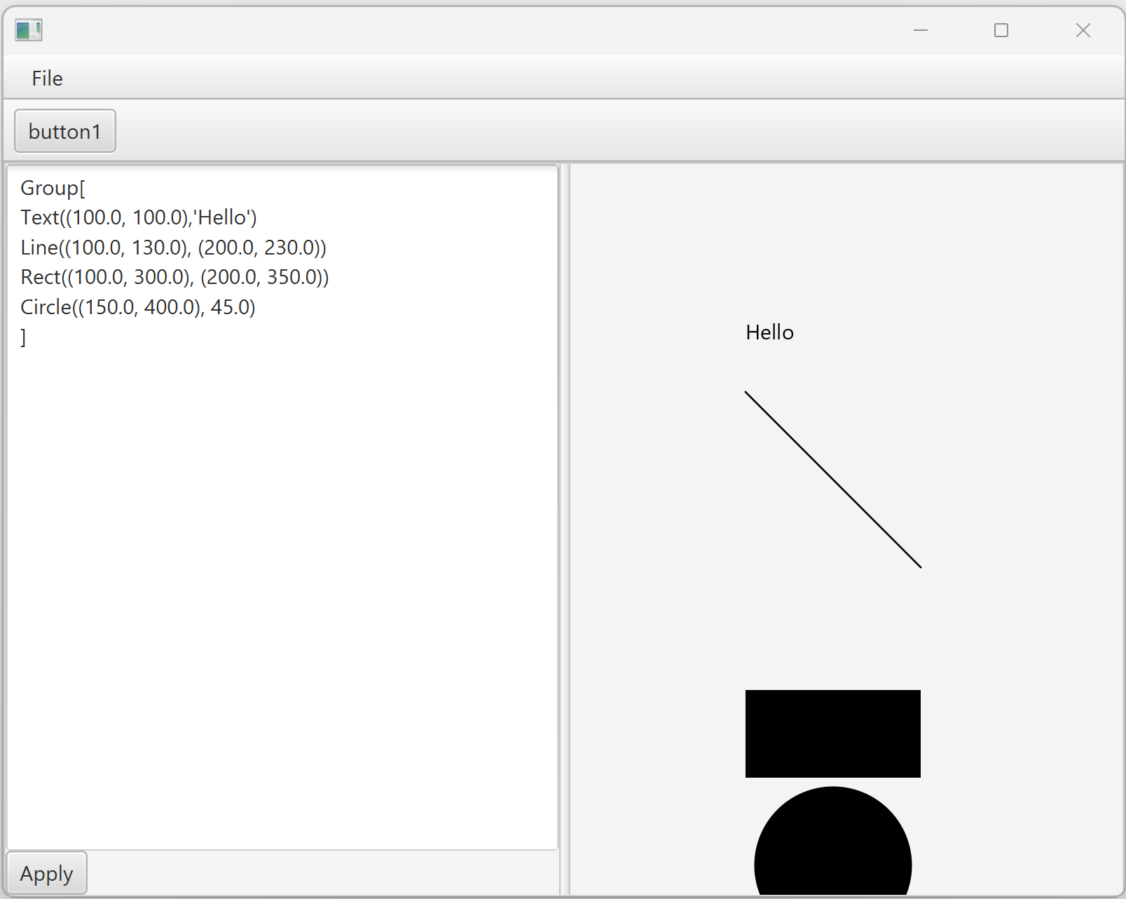
Step 11 : expected Result

Slide 41
Step 11 : code (1/3)
{ // SplitPane( view1 | view2 )
TextDrawingView view1 = new TextDrawingView(model);
Node view1Comp = view1.getComponent();
CanvasDrawingView view2 = new CanvasDrawingView(model);
Node view2Comp = view2.getComponent();
SplitPane splitViewPane = new SplitPane(view1Comp, view2Comp);
mainBorderPanel.setCenter(splitViewPane);
}
public class CanvasDrawingView extends DrawingView {
protected BorderPane component;
// to add javafx.scene.shape.* objects converted from model
protected Pane drawingPane;

Slide 42
Step 11 : code (2/3)
protected void refreshModelToView() {
DrawingElement content = model.getContent();
drawingPane.getChildren().clear();
JavafxDrawingElementVisitor visitor = new JavafxDrawingElementVisitor();
content.accept(visitor);
}
protected class JavafxDrawingElementVisitor extends DrawingElementVisitor {
protected void add(Node node) {
drawingPane.getChildren().add(node);
}
@Override
public void caseText(TextDrawingElement p) {
add(new javafx.scene.shape.Text(p.pos.x, p.pos.y, p.text));
}
@Override
public void caseLine(LineDrawingElement p) {
add(new new javafx.scene.shape.Line(p.start.x, p.start.y, p.end.x, p.end.y));
}

Slide 43
Step 11 : code (3/3)
@Override
public void caseRect(RectangleDrawingElement p) {
add(new javafx.scene.shape.Rectangle(p.upLeft.x, p.upLeft.y,
p.downRight.x-p.upLeft.x, p.downRight.y-p.upLeft.y);
}
@Override
public void caseCircle(CircleDrawingElement p) {
add(new javafx.scene.shape.Circle(p.center.x, p.center.y, p.radius);
}
@Override
public void caseGroup(GroupDrawingElement p) {
for(DrawingElement child: p.elements) {
// *** recurse ***
child.accept(this);
}
}
@Override
public void caseOther(DrawingElement p) {
// "not implemented/recognized drawingElement "+ p.getClass().getName();
}

Slide 44
Step 12 : recover Full Edit capabilities … using XStream library for formatting model -> text (xml) and parsing text (xml) -> model

Slide 45
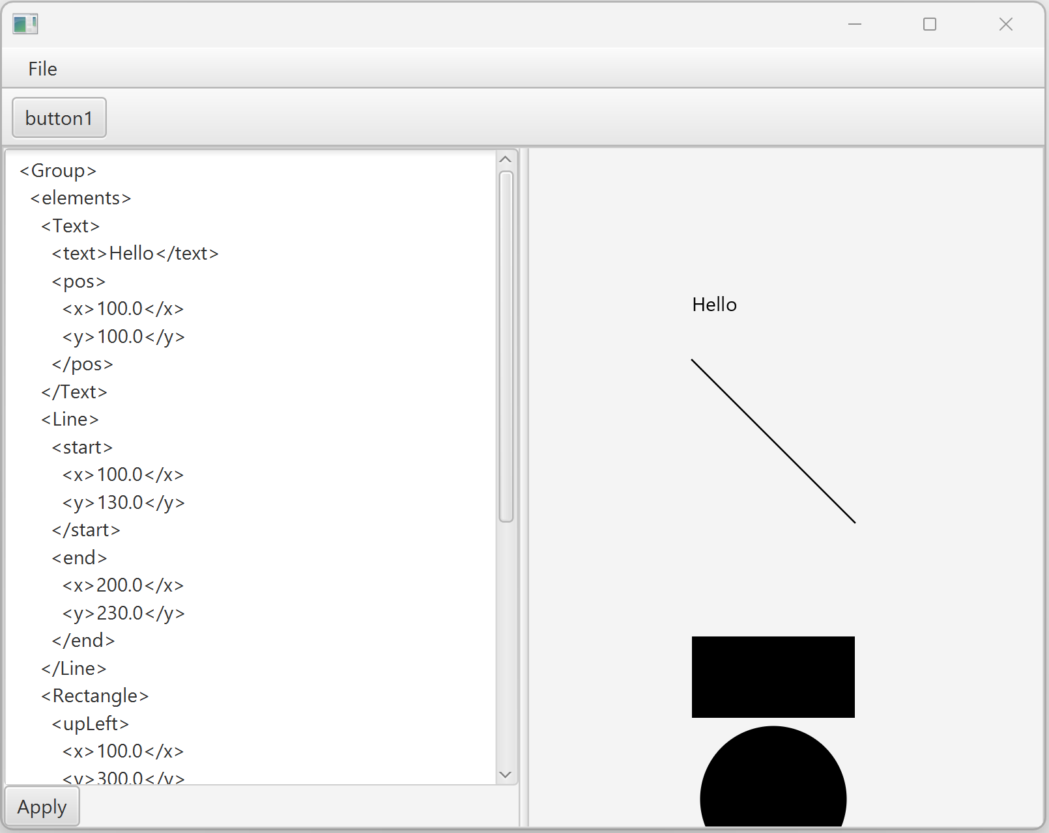
Step 12 : expected result

Slide 46
Step 12 : code (1/3)
<dependency>
<groupId>com.thoughtworks.xstream</groupId>
<artifactId>xstream</artifactId>
<version>1.4.20</version>
</dependency>

Slide 47
Step 12 : code (2/3)
XStream xstream = createXStream();
static XStream createXStream() {
XStream xstream = new XStream();
xstream.addPermission(AnyTypePermission.ANY);
xstream.alias("Pt", DrawingPt.class);
xstream.alias("Text", TextDrawingElement.class);
xstream.alias("Line", LineDrawingElement.class);
xstream.alias("Circle", CircleDrawingElement.class);
xstream.alias("Rectangle", RectangleDrawingElement.class);
xstream.alias("Group", GroupDrawingElement.class);
return xstream;
}

Slide 48
Step 12 : code (3/3)
protected void refreshModelToView() {
DrawingElement content = model.getContent();
String text = xstream.toXML(content);
textArea.setText(text);
}
private void onClickApply() {
System.out.println("apply view to model update");
String text = textArea.getText();
DrawingElement content = (DrawingElement) xstream.fromXML(text);
model.setContent(content); // => fireModelChange ..
}

Slide 49
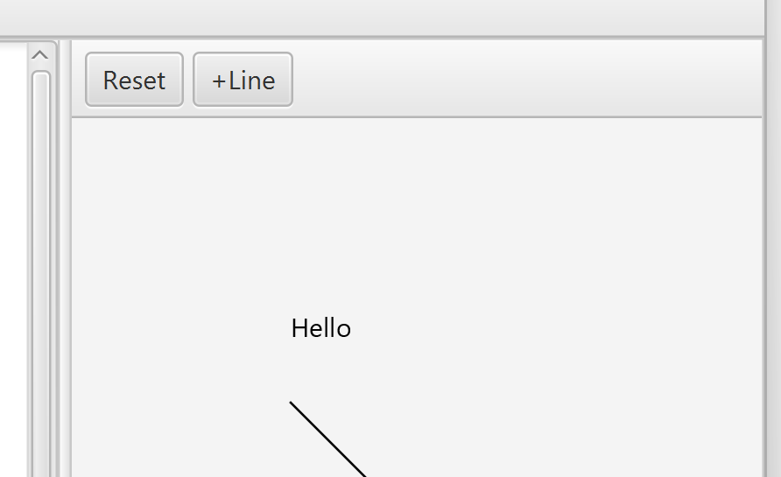
Step 13 : Add Button Toolbar for editing new « Line »
{ // button Toolbar
ToolBar toolBar = new ToolBar();
component.setTop(toolBar);
Button resetToolButton = new Button("Reset");
resetToolButton.setOnAction(e -> onClickToolReset());
toolBar.getItems().add(resetToolButton);
Button newLineButton = new Button("+Line");
newLineButton.setOnAction(e -> onClickToolNewLine());
toolBar.getItems().add(newLineButton);
}

Slide 50
Step 14 : Tool State Handler
public abstract class ToolStateHandler {
public abstract void onMouseEntered();
public abstract void onMouseMove(MouseEvent event);
public abstract void onMouseClick(MouseEvent event);
}
drawingPane.setOnMouseEntered(e -> currToolStateHandler.onMouseEnter());
drawingPane.setOnMouseMoved(e -> currToolStateHandler.onMouseMoved(e));
drawingPane.setOnMouseClicked(e -> currToolStateHandler.onMouseClicked(e));

Slide 51
Step 14
protected class DefaultSelectToolStateHandler extends DefaultToolStateHandler {
@Override
public void onMouseEnter() {
drawingPane.setCursor(Cursor.DEFAULT);
}
}

Slide 52
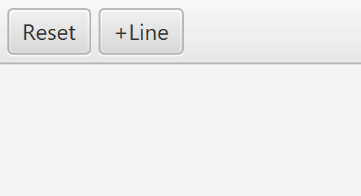
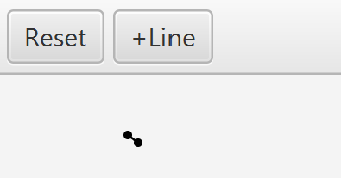
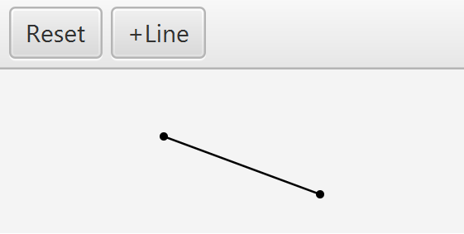
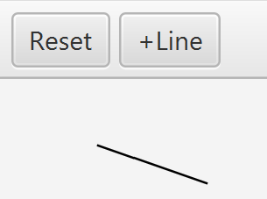
Step 15 : State Automaton for « new Line »
State1Pt
Default
Init
onMouseClicked
onMouseClicked
onMouseMoved
onMouseMoved
Model side-effect:
Add Line to model

Slide 53
Step 15: code
protected ToolStateHandler currToolStateHandler = new DefaultSelectToolStateHandler();
protected ObservableList<Node> currToolShapes = FXCollections.observableArrayList();
protected CircleDrawingElement currEditLineStartPt;
protected CircleDrawingElement currEditLineEndPt;
protected LineDrawingElement currEditLine;
protected void updateCurrEditTool() {
drawingPane.getChildren().removeAll(currToolShapes);
currToolShapes.clear();
JavafxDrawingElementVisitor visitor = new JavafxDrawingElementVisitor(currToolShapes);
if (currEditLineStartPt != null) { currEditLineStartPt.accept(visitor); }
if (currEditLineEndPt != null) { currEditLineEndPt.accept(visitor); }
if (currEditLine != null) { currEditLine.accept(visitor); }
drawingPane.getChildren().addAll(currToolShapes);
}

Slide 54
Step 15
private void onClickToolReset() {
this.currToolStateHandler = new DefaultToolStateHandler();
currEditLineStartPt = null;
currEditLineEndPt = null;
currEditLine = null;
refreshModelToView();
}
private void onClickToolNewLine() {
this.currToolStateHandler = new StateInit_LineToolStateHandler();
}
protected void setToolHandler(ToolStateHandler p) {
currToolStateHandler = p;
updateCurrEditTool();
}

Slide 55
Step 15
protected class StateInit_LineToolStateHandler extends DefaultToolStateHandler {
@Override
public void onMouseEnter() {
drawingPane.setCursor(Cursor.CROSSHAIR);
}
@Override
public void onMouseClicked(MouseEvent event) {
double x = event.getX(), y = event.getY();
DrawingPt pt = new DrawingPt(x, y);
currEditLineStartPt = new CircleDrawingElement(pt, 2);
currEditLineEndPt = new CircleDrawingElement(pt, 2);
currEditLine = new LineDrawingElement(pt, pt);
updateCurrEditTool();
setToolHandler(new StatePt1_LineToolStateHandler());
}

Slide 56
Step 15
protected class StatePt1_LineToolStateHandler extends DefaultToolStateHandler {
@Override
public void onMouseEnter() {
drawingPane.setCursor(Cursor.CROSSHAIR);
}
@Override
public void onMouseMoved(MouseEvent event) {
double x = event.getX(), y = event.getY();
currEditLineEndPt.center = currEditLine.end = new DrawingPt(x, y);
updateCurrEditTool();
}
@Override
public void onMouseClicked(MouseEvent event) {
LineDrawingElement addToModel = currEditLine;
GroupDrawingElement content = (GroupDrawingElement) model.getContent();
content.elements.add(addToModel);
model.setContent(content);
currEditLine = null; currEditLineStartPt = null; currEditLineEndPt = null;
updateCurrEditTool();
setToolHandler(new DefaultSelectToolStateHandler());
}

Slide 57
..

Slide 58
..

Slide 59
..

Slide 60
Using « Expression » instead of « Double » … advanced feature
ANNEXE

Slide 61
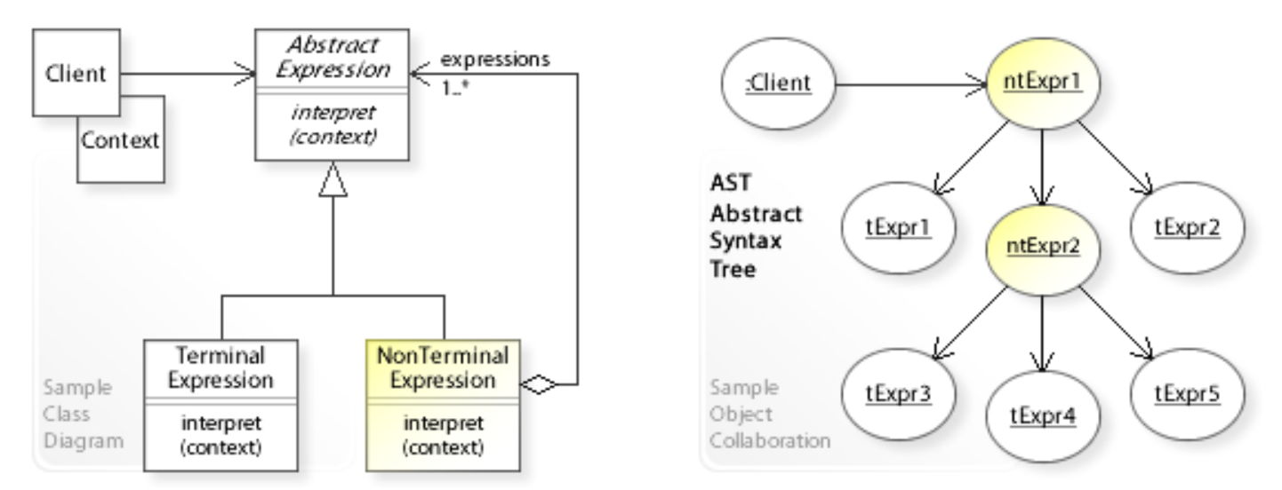
Interpreter
Given a language, define a representation for its grammar
along with an interpreter that uses the representation
to interpret sentences in the language.
REMINDER

Slide 62
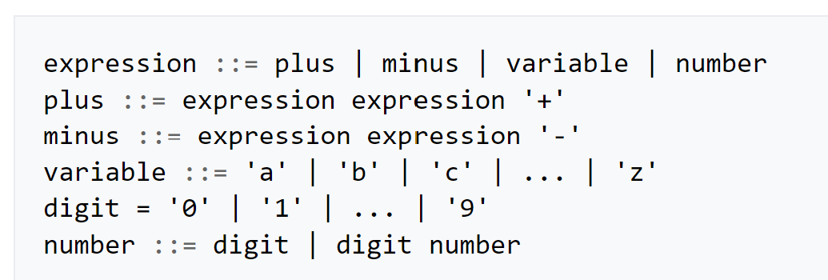
Example of Interpreter : Math Expression
abstract class Expression {}
class NumberExpression extends Expression {
double value;
}
class VariableExpression extends Expression {
String name;
}
class BinaryOperationExpression extends Expression {
Expression leftOperand;
String operator;
Expression rightOperand;
}
REMINDER

Slide 63
Example, using JEP library
<dependency>
<groupId>org.scijava</groupId>
<artifactId>jep</artifactId>
<version>2.4.2</version>
</dependency>
ANNEXE
JEP jep = new JEP();
jep.addVariable("x", 123);
Node expr = jep.parseExpression("x+2");
Double eval = (Double) jep.evaluate(expr);
System.out.println("x=123, x+2 => " + eval);

Slide 64

Reminder … « Bridge » design-pattern
StableApi
public class DrawingExprContext {
protected Map<String,Object> values;
protected org.nfunk.jep.JEP internalImpl;
..
public class DrawingExpr {
protected String text;
protected org.nfunk.jep.Node internalImpl;
..
InternalImpl
ANNEXE
May changes
.. Should not impact

