Slide 1
BigData Spark – Hands-On SQL, Temporary View Hive MetaStore, ExternalCatalog, Table Partitions
Arnaud Nauwynck
Nov 2023

Slide 2

Objectives of Hands-On
Reminders:
Local Install, spark-shell Spark File IO
1/ CreateTempView, use Dataset from SQL
2/ Configure HiveMetastore DB
3/ connect Spark External Catalog to MetaStore
4/ Create Table
5/ (Directory) Partitioned Table

Slide 3
Reminder Hands-On 1
Set JAVA_HOME
Set SPARK_HOME set PATH
JVM
WinUtils
Transform, filter
Setenv.bat
DataFrame=Dataset[Row]
Pre-Requisite
Val ds = spark.createDataset()
Spark.tar.gz embedded Hadoop
ds.show(10, true)
DataSet
Installation
User-defined
Hadoop.tar.gz
Immutable
Spark-Shell
Interactive
Windows error?
avoid
for () {} loop
Functionnal
Code Style
History
Seq
.map
lambda
Up / Down
Scala>
Repl
:help
TAB TAB autocompletion
Line compiled to scala
Eval on <enter>
val i =
var i =
Seq()
Tuple
On JVM
~Java
Numbered result « res0,res1,.. »

Slide 4
Reminder Hands-On 2
partitions
compression
parquet
dictionaries
UUID Files Write Dir
csv
Combine Read dir
Spark File I/O
json
ND-json
PostProcessing
text
Schema
xml ?

Slide 5
Objectives of Hands-On 3
1/ CreateTempView, use Dataset from SQL
2/ Configure HiveMetastore DB
3/ connect Spark External Catalog to MetaStore
4/ Create Table
5/ (Directory) Partitioned Table

Slide 6
Exercise 1: check spark conf spark.sql.catalogImplementation=in-memory … not « hive »
a/ execute line
scala> spark.sharedState.sparkContext.getConf.get("spark.sql.catalogImplementation")
Res1: String = in-memory
b/ expecting for now to have «in-memory» .. not « hive » (not configured / running yet !)
c/ If not correct, relaunch spark-shell using
spark-shell --conf spark.sql.catalogImplementation=in-memory

Slide 7
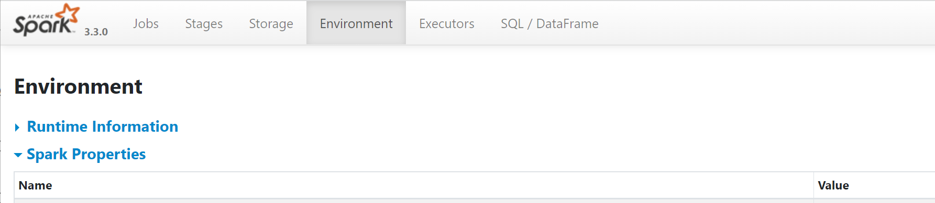
Checking from Spark-UI
a/ Open Spark-UI http://localhost:4040 … more on this later
b/ browse to Environment > Spark Properties >
c/ ensure you have « in-memory »
WRONG for now..

Slide 8
Re-Checking Second Time …
println(spark.sharedState.externalCatalog.unwrapped)
Else, even this will fail …

Slide 9
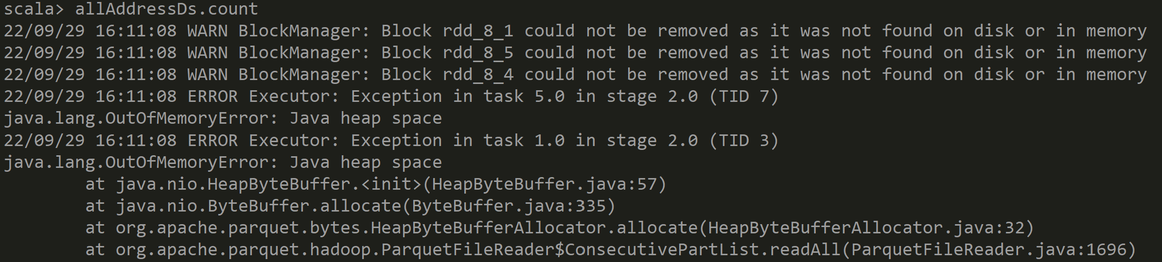
Exercise 2: reload address DataSet ensure no OutOfMemoryError
a/ Load the Dataset of addresses from previous hands-on.
scala> val allAddressDs = spark.read.parquet("C:/data/OpenData-gouv.fr/bal/adresses-parquet")
b/ check the data… using « .count » and « .show(2, false) »
c/ if encountering OutOfMemory Error .. Then increase memory (cf next)

Slide 10
Dataset… read CSV / write Parquet / load
Reminder
val csvDs = spark.read.format("csv").option("delimiter", ";").option("header",true)
.schema("""
uid_adresse string, cle_interop string NOT NULL, commune_insee string NOT NULL, commune_nom string,
commune_deleguee_insee integer, commune_deleguee_nom string,
voie_nom string, lieudit_complement_nom string, numero integer NOT NULL,
suffixe string, position string, x double, y double, long double, lat double, cad_parcelles string, source string,
date_der_maj string, certification_commune integer NOT NULL
""")
.load("C:/data/OpenData-gouv.fr/bal")
csvDs.printSchema
csvDs.show(1, false)
val csvDsNoXY = csvDs.drop("x", "y").sortWithinPartitions("commune_insee", "voie_nom", "numero")
csvDsNoXY.write.format("parquet").save("C:/data/OpenData-gouv.fr/bal-parquet")
val ds = spark.read.format("parquet").load("C:/data/OpenData-gouv.fr/bal-parquet")
ds.cache()

Slide 11
Ensure Memory JVM Argument –Xmx3g
Details
spark-shell --conf spark.sql.catalogImplementation=in-memory --driver-memory=3g

Slide 12
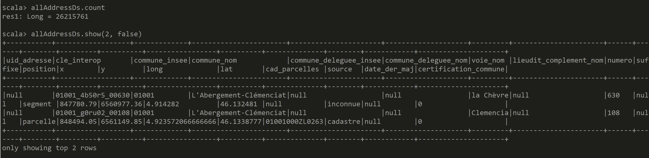
Answer Exercise 2

Slide 13
Exercise 3: createTempView … then SQL
Execute following
allAdressDs.createTempView("tmp_address")
spark.sql("SELECT count(*) FROM tmp_address").show
spark.sql("SELECT * FROM tmp_address").show(2, false)
spark.sql("SELECT * FROM tmp_address WHERE commune_nom='Paris'").show(2, false)

Slide 14
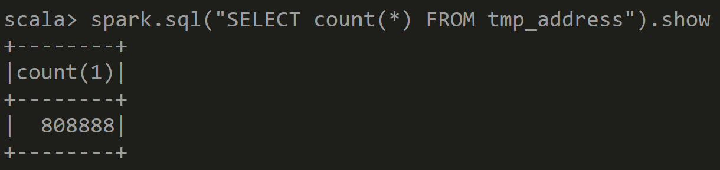
Answer Exercise 3

Slide 15
Exercise 4: list Tables
spark.sql("SHOW TABLES").show spark.catalog.listTables.show(false)

Slide 16
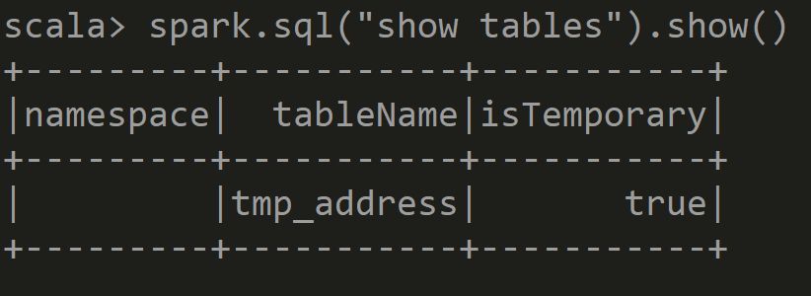
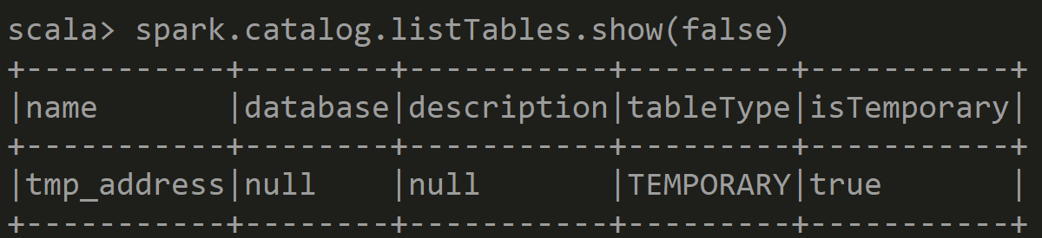
Answer Exercise 4: List Tables

Slide 17
Exercise 5: Describe Table / printSchema
Execute
a/ spark.sql("select * from tmp_address").printSchema
b/ spark.sql("describe table tmp_address").show(false)
c/ spark.sql("show create table tmp_address").show(false) // …. WILL FAIL … no Sql DDL for it
// error: not a « table » (but describe ok!)

Slide 18
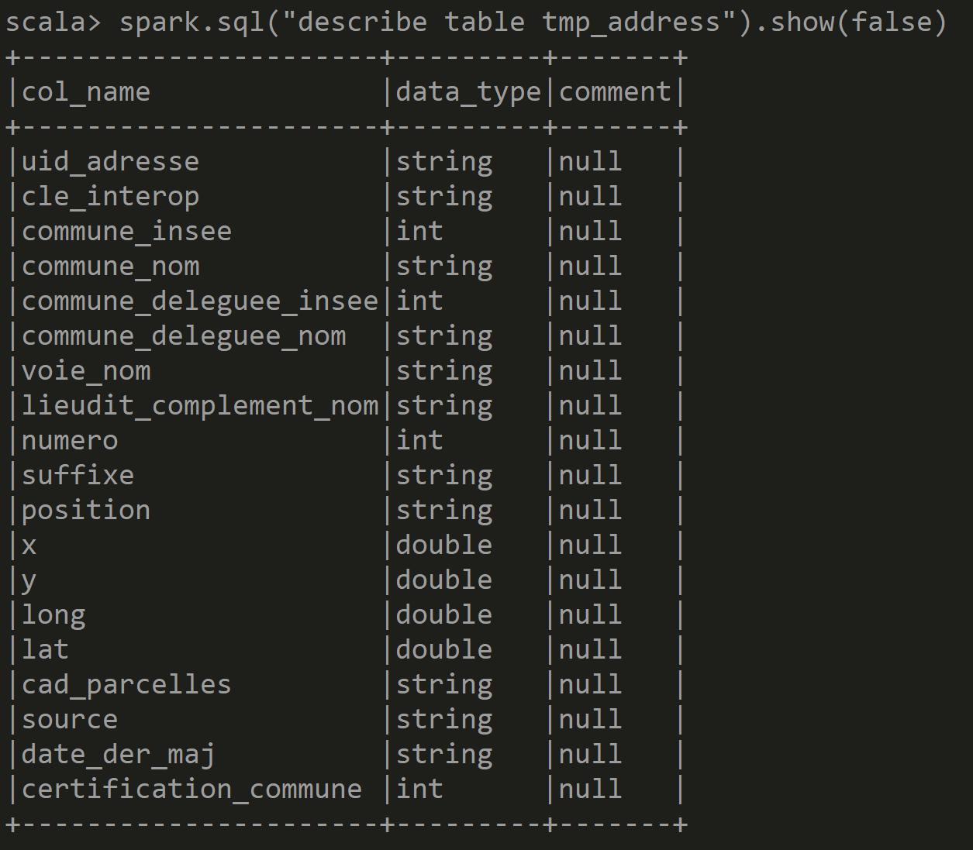
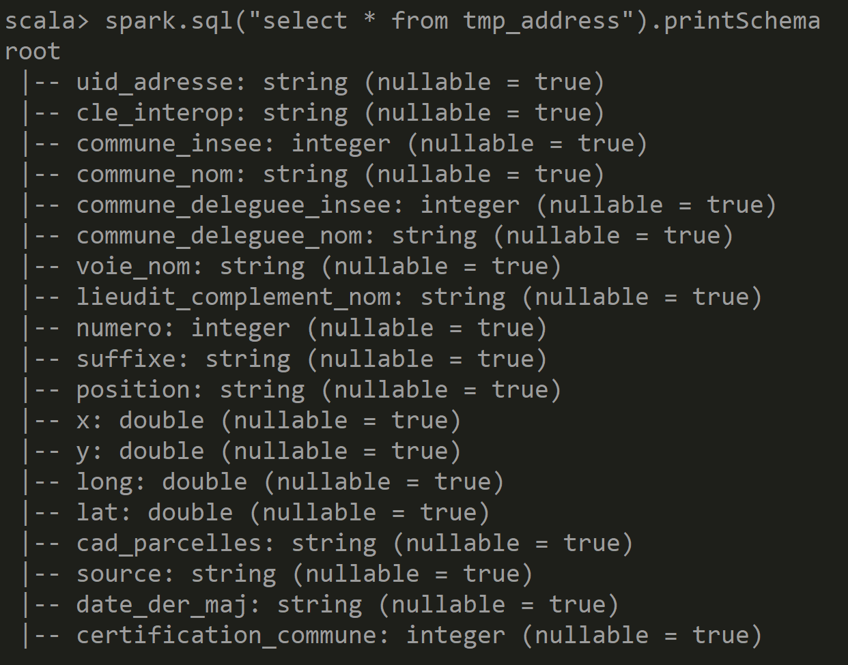
Answer Exercise 5 : describe Table / table DS schema

Slide 19
Exercise 6: stop + restart .. temporary
a/ stop spark-shell
b/ restart spark-shell
c/ list tables … Check temporary tables have disapeared !

Slide 20
Optional Exercise 7: createGlobalTemporaryView
Optional
https://spark.apache.org/docs/latest/sql-getting-started.html#global-temporary-view
a/ similar to Exercise 3, « createGlobalTemporaryView » from your dataset instead of a « createTempView »
b/ forget about finding it from default spark catalog ( … confusing ) list explicitly from: spark.catalog.listTables(« global_temp »).show(false)
c/ execute SQL query on « global_temp.address »
select count(*) from global_temp.address
d/ explain difference between global temp and temp

Slide 21
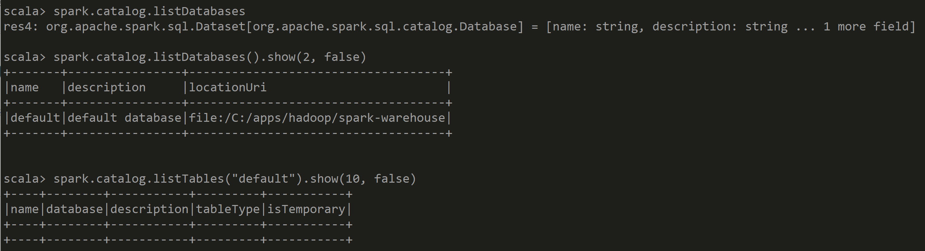
Answer Exercise 7 … Confusing: Where is my global temp table?

Slide 22
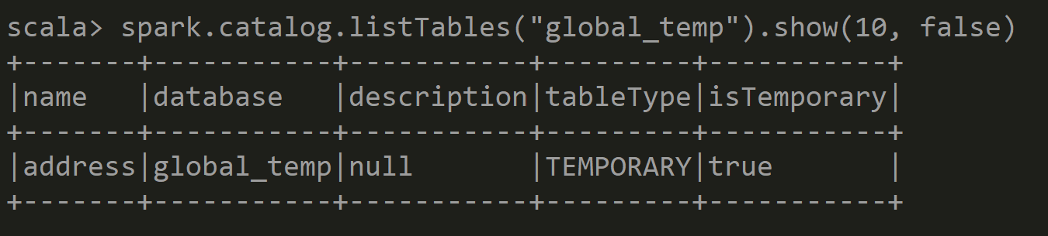
Answer Exercise 7 ask explicitly in « global_temp »

Slide 23
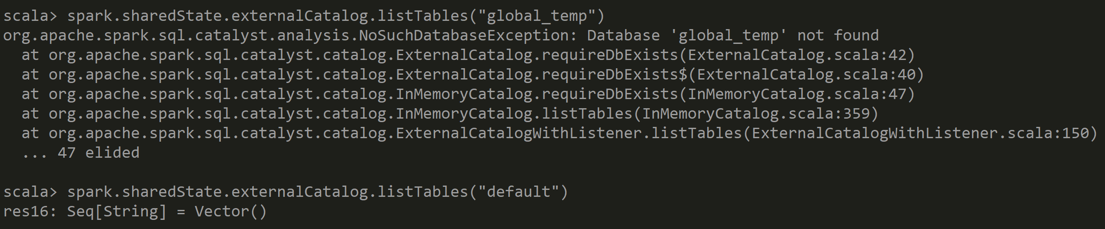
Answer Exercise 7 … Even more Confusing using spark.sharedState.externalCatalog

Slide 24
Answer Exercise 7
Global Temporary Table is Multi-Threaded, for all Spark Sessions
Temporary Table is for the current Session only
Both are temporary : for the JVM – SparkContext

Slide 25
Objectives of Hands-On
1/ CreateTempView, use Dataset from SQL
2/ Configure HiveMetastore DB
3/ connect Spark External Catalog to MetaStore
4/ Create Table
5/ (Directory) Partitioned Table

Slide 26
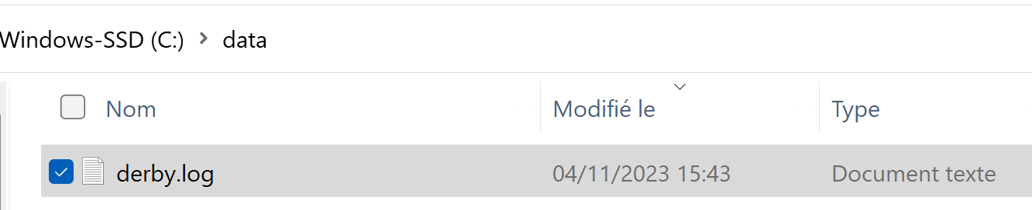
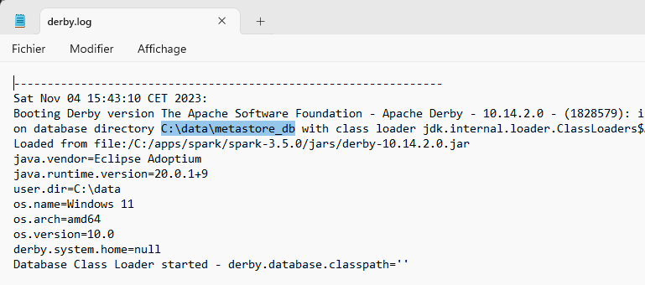
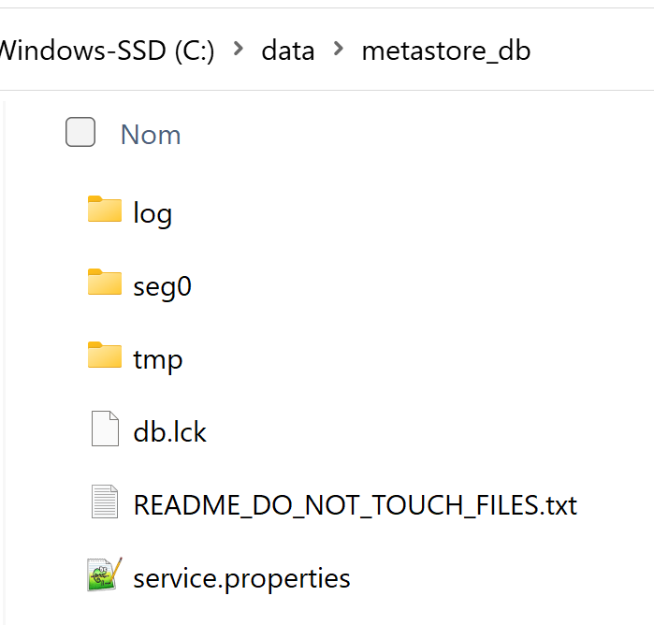
Default hive… using Derby metastore_db cf next slides if explicitly using Postgresql DB
Optional

Slide 27
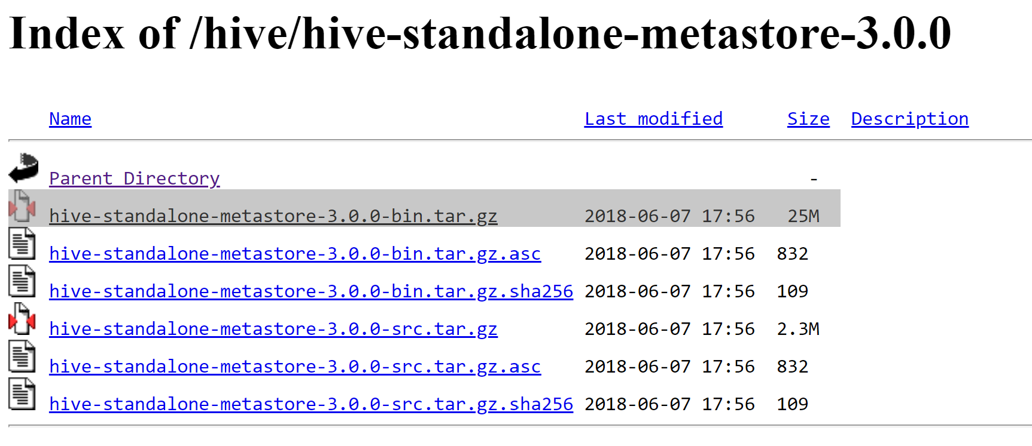
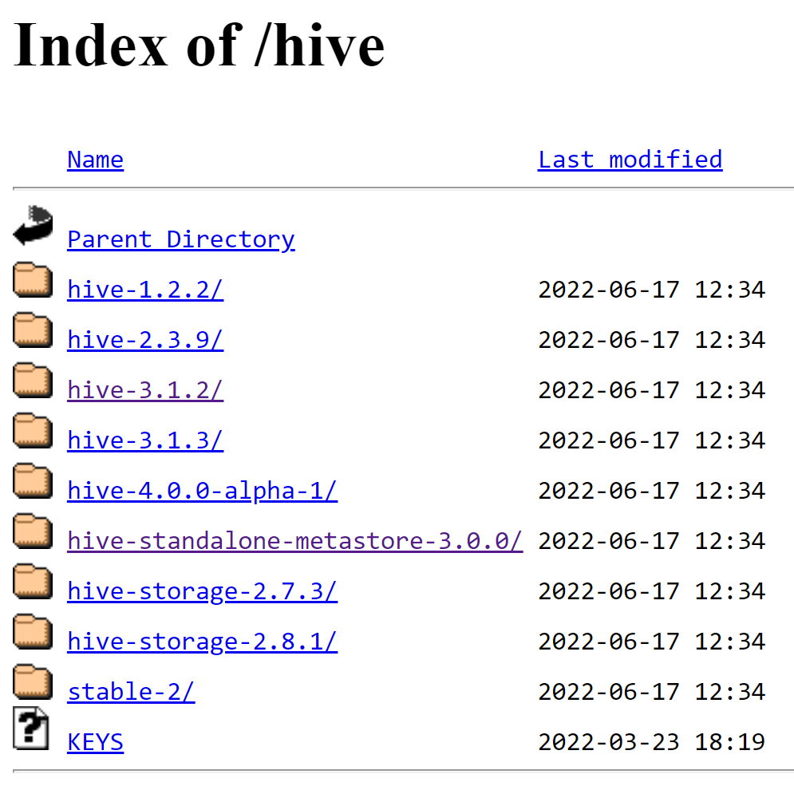
Install Hive Standalone Metastore
Optional
https://downloads.apache.org/hive/hive-standalone-metastore-3.0.0/
https://downloads.apache.org/hive/

Slide 28
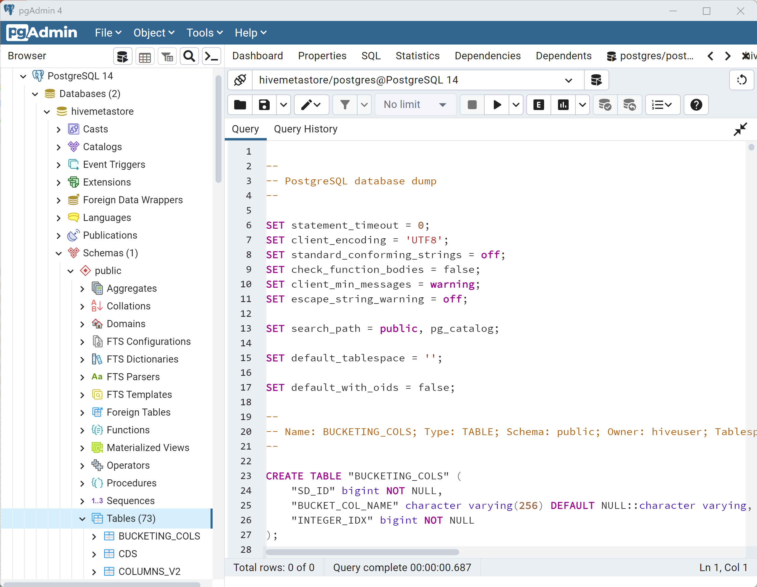
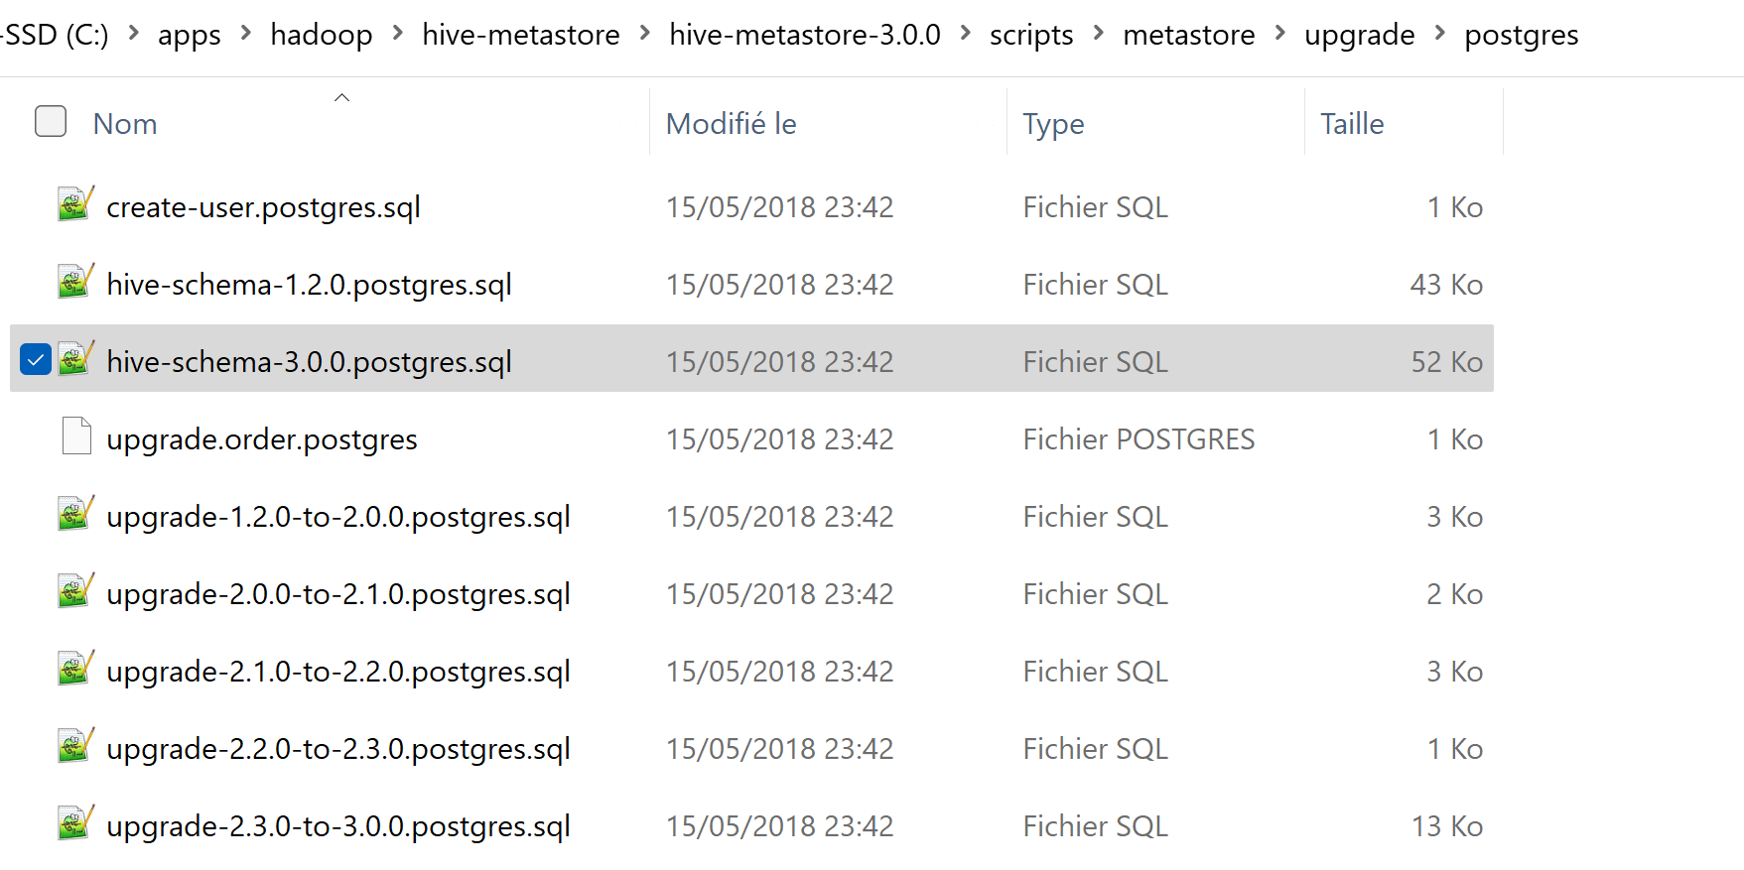
Example using Postgres : Create Hive Schema
Optional
1/ Open PgAdmin
2/ Create a « Database »
3/ execute SQL script « hive-schema-<dbType>.sql »
copied from <downloadedHiveDir>/scripts/metastore/upgrade/<dbType>

Slide 29
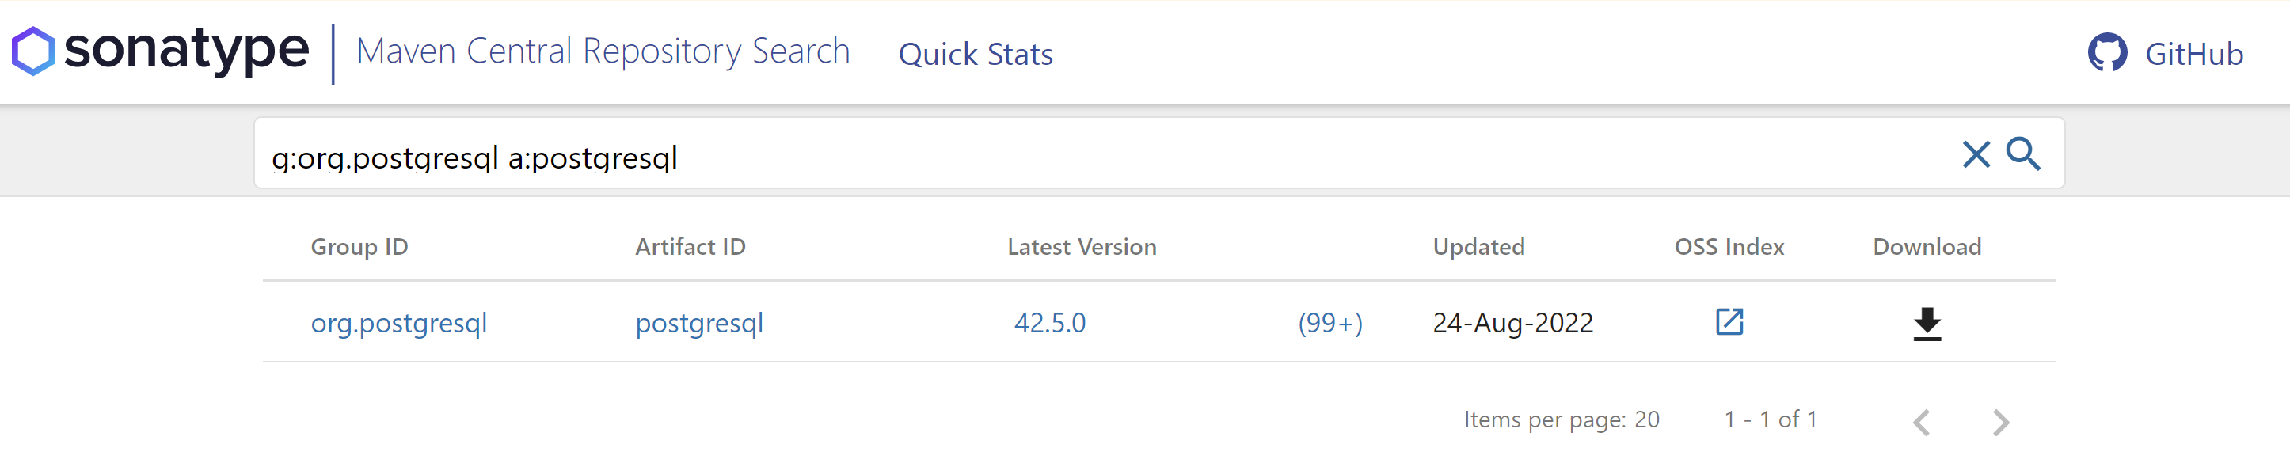
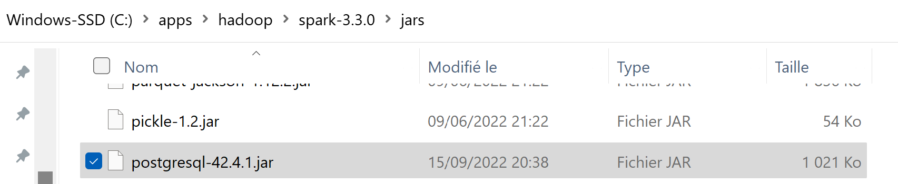
Copy Jar .. Example using Postgresql
Optional
Step 1/ find g:org.postgresql a:postgresql
https://search.maven.org/search?q=g:org.postgresql%20a:postgresql
Step 2/ copy jar to SPARK_HOME/jars

Slide 30
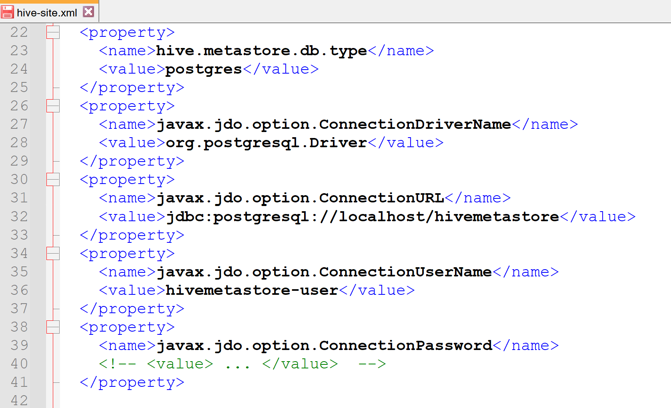
Configure hive metastore in HADOOP_CONF_DIR (or HADOOP_HOME) /conf/hive-site.xml
Optional

Slide 31
Objectives of Hands-On
1/ CreateTempView, use Dataset from SQL
2/ Configure HiveMetastore DB
3/ connect Spark External Catalog to MetaStore
4/ Create Database, Table
5/ (Directory) Partitioned Table

Slide 32
Restart spark-shell + Check externalCatalog
relaunch spark-shell
spark-shell --driver-memory 5g --conf spark.sql.catalogImplementation=hive
Check in sparkContext
spark.sharedState.sparkContext.getConf.get("spark.sql.catalogImplementation")
res1: String = "hive" println(spark.sharedState.externalCatalog.unwrapped)
Check in Spark UI

Slide 33
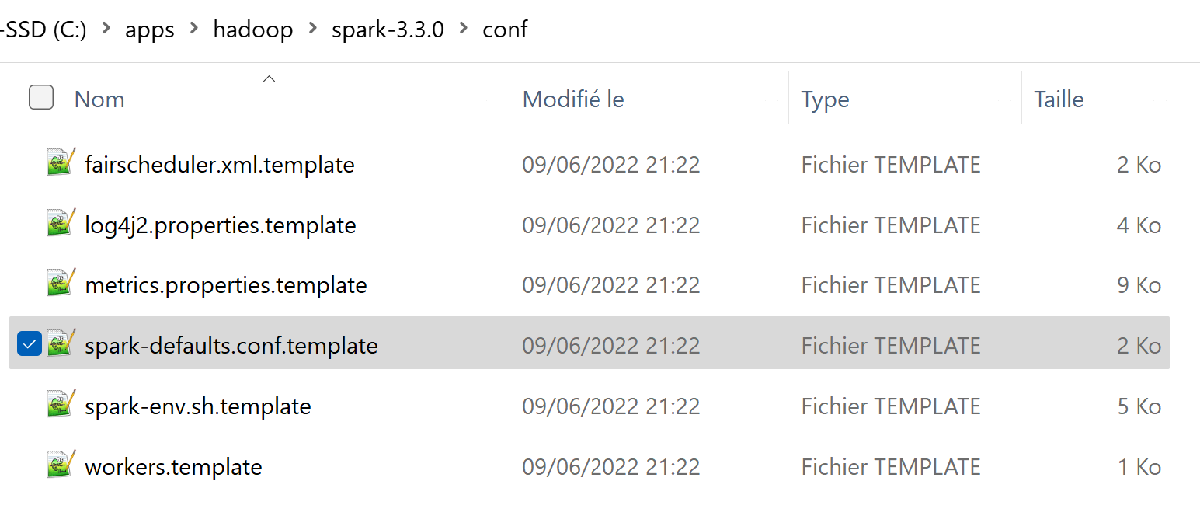
Optional Exercise 8: View/Change spark-defaults.conf
a/ Copy file, and rename without suffix « .template »
Edit to add line
spark.sql.catalogImplementation hive
Check conf can still be overloadded by « --conf key=value »
check conf at runtime: spark.sharedState.sparkContext.getConf.get(« key »)
Or in Spark UI

Slide 34
Objectives of Hands-On
1/ CreateTempView, use Dataset from SQL
2/ Configure HiveMetastore DB
3/ connect Spark External Catalog to MetaStore
4/ Create Database, Table
5/ (Directory) Partitioned Table

Slide 35
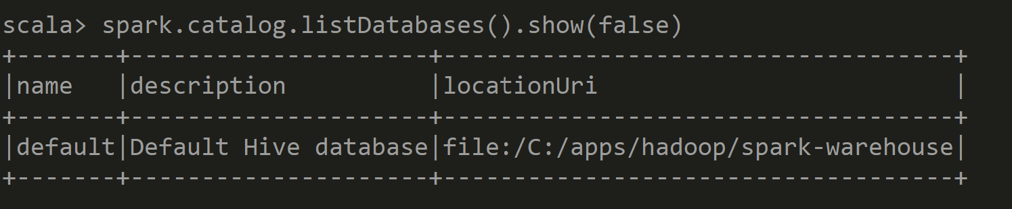
List Databases

Slide 36
Exercise 9: Create Database, Create if not exists
Execute:
spark.sql("CREATE DATABASE db1").show(false)
spark.sql("CREATE DATABASE IF NOT EXISTS db1").show(false)
Then, search created database

Slide 37
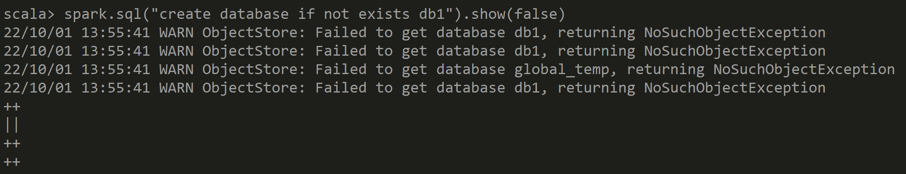
Answer Exercise 9: Create Database

Slide 38
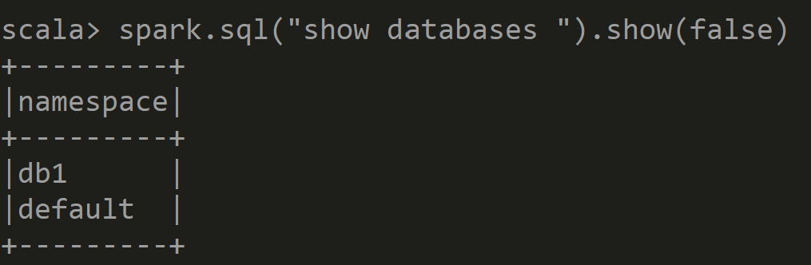
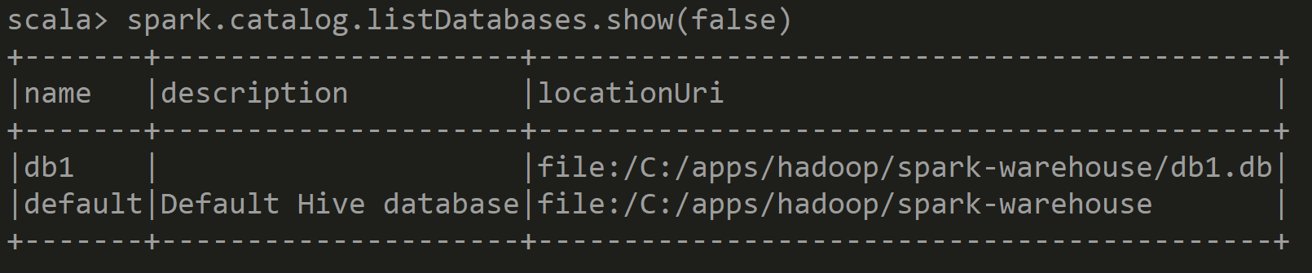
Answer Exercise 9: Show Databases

Slide 39
10 mn pause

Slide 40
Exercise 10: saveAsTable
Try some variations:
// val ds = spark.read.format("parquet").load("C:/data/OpenData-gouv.fr/bal-parquet")
ds.write.saveAsTable("addr")
ds.write.saveAsTable("db1.addr")
ds.write.format("parquet").saveAsTable("db1.addr")

Slide 41
Answer Exercise 10:

Slide 42
Exercise 10 : CTAS CREATE TABLE <db>.<table> AS SELECT
CREATE TABLE … => STUPID default format « text »
CREATE TABLE … STORED AS PARQUET => OK
Anyway… it is only to do next « show create table » ..
CTAS => can NOT create EXTERNAL tables / can NOT create PARTITIONED tables !!!

Slide 43
Exercise 11 : SHOW CREATE TABLE
a/ Execute SQL
spark.sql("SHOW TABLES in db1").show(false)
spark.sql("DESCRIBE TABLE db1.addr").show(false) spark.sql("SHOW CREATE TABLE db1.addr").show(false)
b/ check you can RE-Execute the result SQL DDL script (ensure modify table name)
c/ compare difference with « dataset.printSchema » or Sql « DESCRIBE TABLE »
(ASCII table vs Sql)

Slide 44
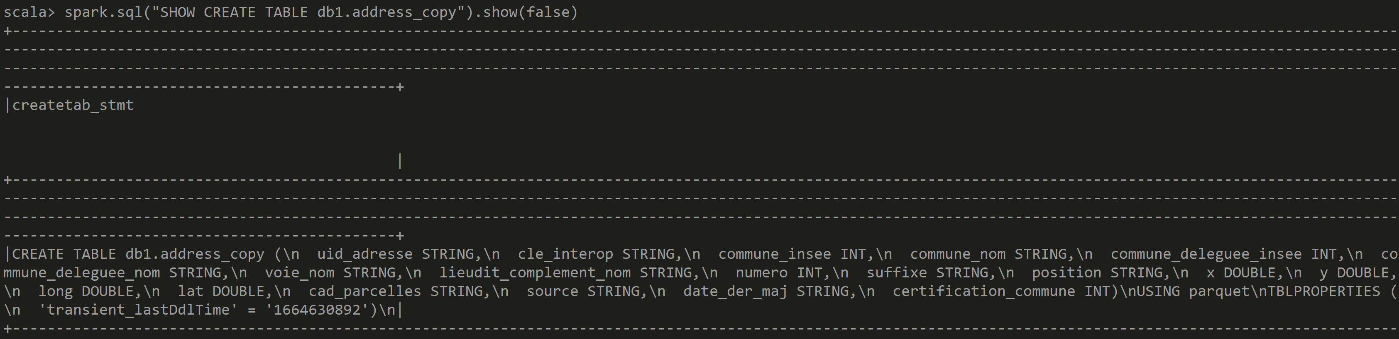
Answer Exercise 11: SHOW CREATE TABLE

Slide 45
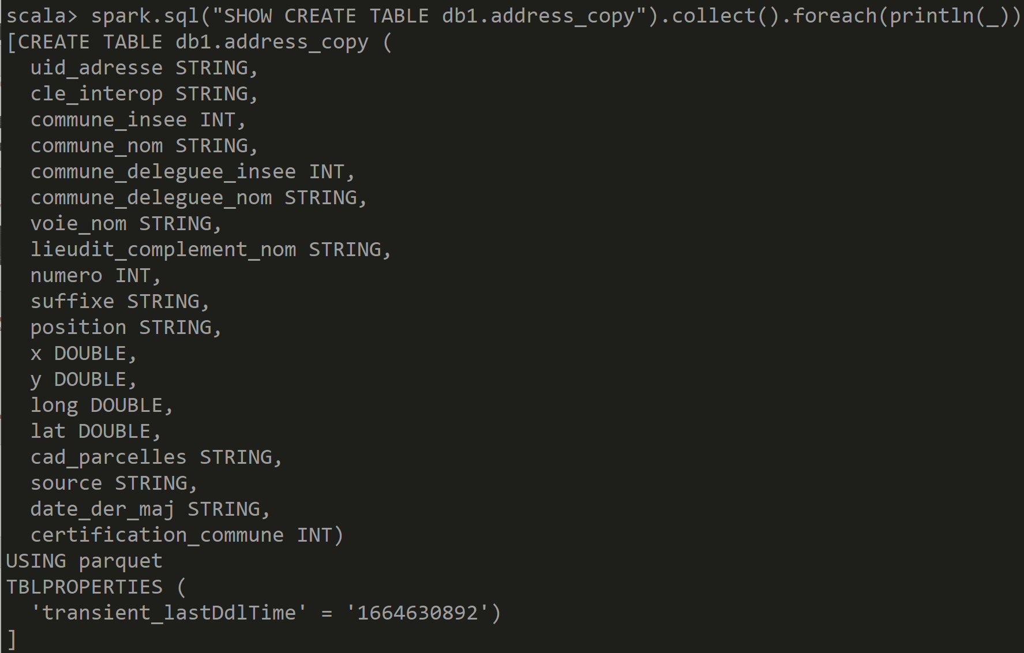
Answer Exercise 11: SHOW CREATE TABLE ..
Windows display error « \n » ??
Hint… instead of « .show() » use « .foreach( println(_) ) »

Slide 46
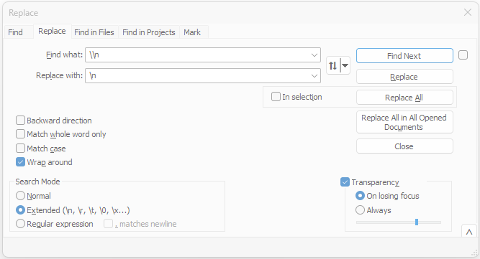
Hint Exercise 11: Replacing \\n by \n

Slide 47
SHOW CREATE TABLE
CREATE TABLE spark_catalog.db1.addr (
uid_adresse STRING,
cle_interop STRING, commune_insee STRING,
commune_nom STRING,
commune_deleguee_insee INT,
commune_deleguee_nom STRING,
voie_nom STRING,
lieudit_complement_nom STRING,
numero INT, suffixe STRING, position STRING, x DOUBLE, y DOUBLE,
long DOUBLE, lat DOUBLE, cad_parcelles STRING, source STRING,
date_der_maj STRING, certification_commune INT
)
USING parquet

Slide 48
Exercise 12: Create « EXTERNAL » TABLE instead of default «MANAGED » Table
a/ Execute Sql « DROP TABLE db1.address »
b/ Verify that it has deleted all Directories and Files !
c/ recreate your table, but using « CREATE EXTERNAL TABLE .. LOCATION .. »
d/ fill your table using « INSERT OVERWRITE … SELECT .. »)
e/ Execute « DROP TABLE » on the external table Verify that Dir/Files are NOT affected !
f/ RE-Create EXTERNAL TABLE … adding « LOCATION ‘c:/data/your-dir’ » (cf next slide) Verify it still has data « select count(*) from .. »

Slide 49
CREATE EXTERNAL TABLE .. STORED AS .. LOCATION …
spark.sql("""
CREATE EXTERNAL TABLE spark_catalog.db1.addr2 (
uid_adresse STRING,
cle_interop STRING, commune_insee STRING,
commune_nom STRING, commune_deleguee_insee INT, commune_deleguee_nom STRING,
voie_nom STRING, lieudit_complement_nom STRING, numero INT, suffixe STRING,
position STRING, x DOUBLE, y DOUBLE, long DOUBLE, lat DOUBLE, cad_parcelles STRING,
source STRING, date_der_maj STRING, certification_commune INT
)
STORED AS parquet
LOCATION 'C:/data/OpenData-gouv.fr/bal-table-addr2'
""").show()

Slide 50
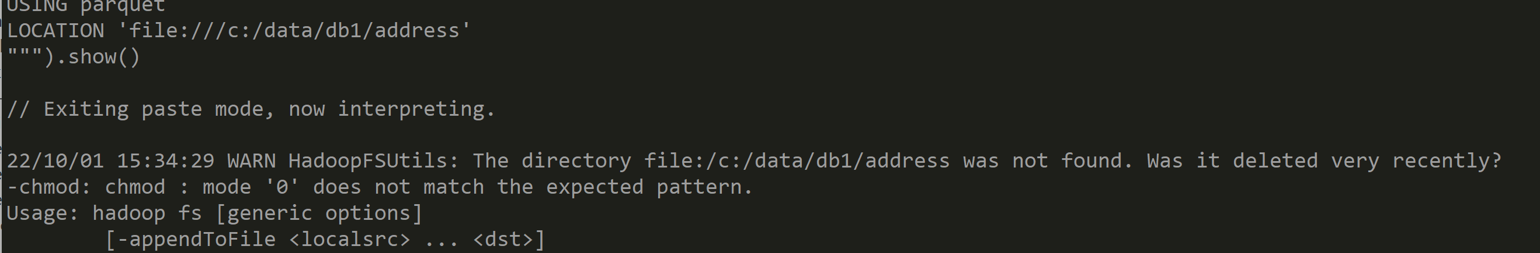
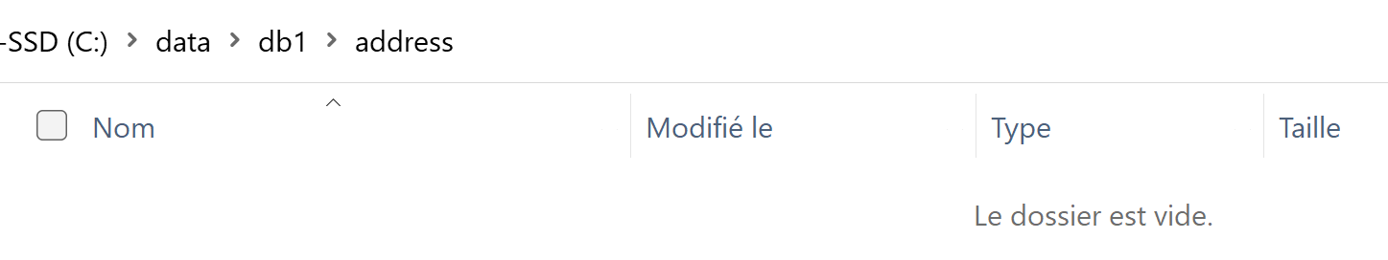
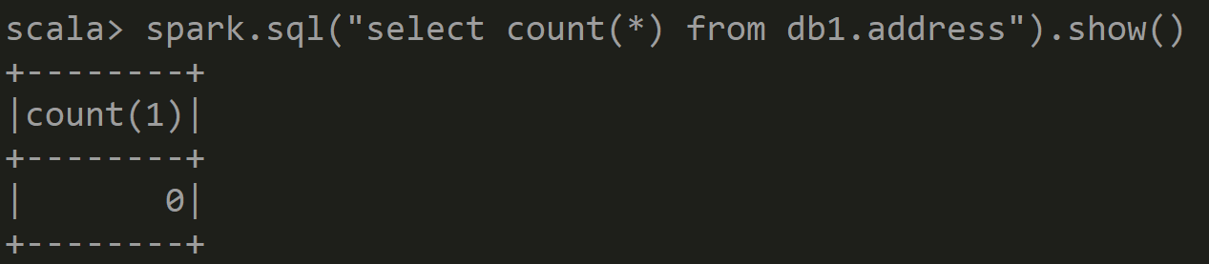
Answer Exercise 12: Create EXTERNAL Table … WARN if directory not already exists
Works anyway …
but table is empty yet

Slide 51
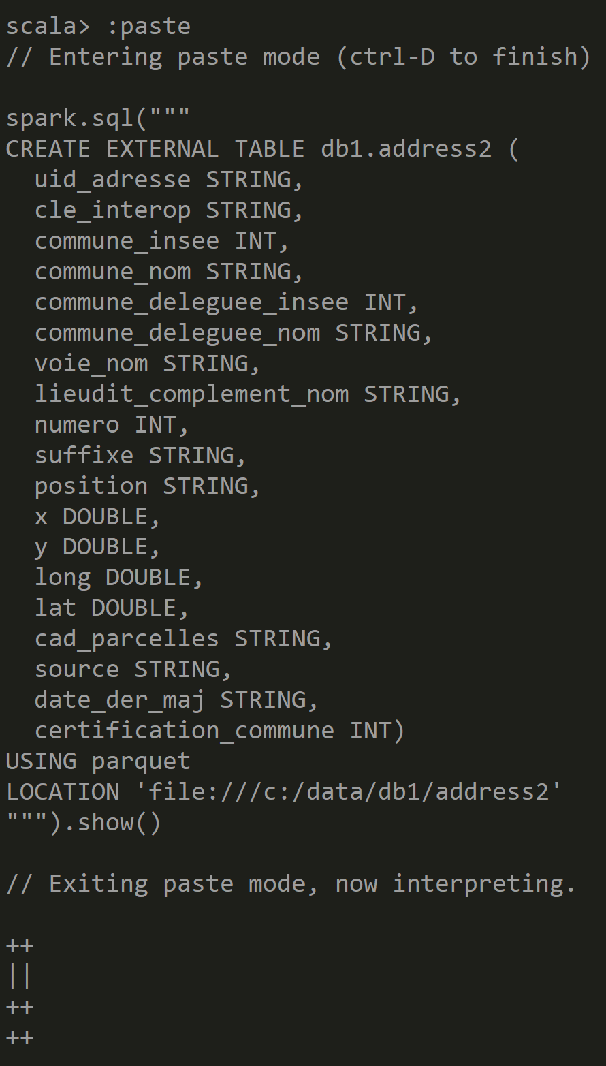
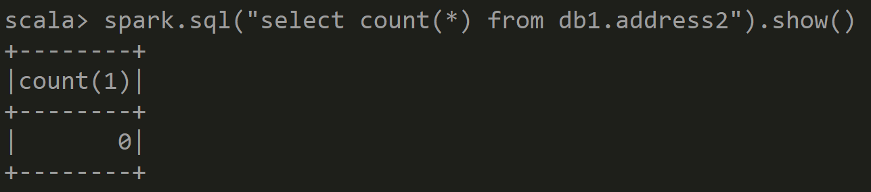
Answer Exercise 12: Create EXTERNAL Table ( directory already existed)

Slide 52
Exercise 13: INSERT INTO ..VALUES … result created File(s)
a/ Execute SQL
spark.sql("""
INSERT INTO db1.addr2 (commune_insee,commune_nom,numero,voie_nom) VALUES ('75000', 'PARIS', 1, 'rue de la paix')
""").show()
check that it has created 1 new File (containing only 1 line)
b/ .. Repeat 10 times … “for(i <- 0 to 10)”, check it has created 10 additional files

Slide 53
Exercise 13(next): INSERT INTO SELECT.. … result created File(s)
c/ Execute SQL
spark.sql("""
INSERT INTO db1.addr2 SELECT * FROM db1.addr """).show()
Check how many files are inserted, comparing to the parallelism of the SELECT
spark.sql("SELECT * FROM db1.addr").toJavaRDD.getNumPartitions
d/ redo with
spark.sql("""
INSERT INTO db1.addr2 SELECT /*+REPARTITION(25)*/ * FROM db1.addr
""").show()

Slide 54
Exercise 14: INSERT OVERWRITE ( difference with INSERT INTO )
a/ Question: if you reapeat several time the same « INSERT INTO », do you have duplicate rows ? Can you have unicity with Primary Key constraint ?
can you do sql “UPDATE” ?
b/ Execute SQL, replacing « INTO » by « OVERWRITE »
INSERT OVERWRITE db1.address SELECT * FROM tmp_address
c/ what are the files remaining/created after ? d/ if you repeat several times « INSERT OVERWRITE », what happens ?

Slide 55
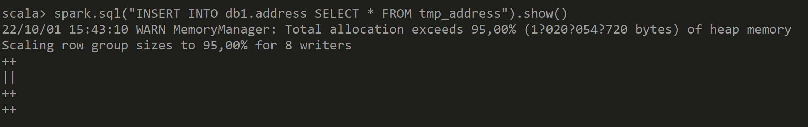
Answer Exercise 14: INSERT INTO .. SELECT ..

Slide 56
Objectives of Hands-On
1/ CreateTempView, use Dataset from SQL
2/ Configure HiveMetastore DB
3/ connect Spark External Catalog to MetaStore
4/ Create Database, Table
5/ (Directory) Partitioned Table

Slide 57
Exercise 15: enrich Dataset / table address by computing column « dept » from column « commune_insee »
We want to partition by department : only 99 values … instead of by 50 000 cities
Use column « commune_insee »: it is a String of 5 chars,
padding with « 0 » on left,
and ignore the 3 chars on right (city code within department)
Create a column to extract the numeric value of dept
Recreate your table (or dataset) with this extra column
HINT: use « .withColumn(« dept », regexp_replace( col(srcCol), pattern, replacement) ) »
Example:
« 75100 » => « 75 » => 75
« 01200 » => « 01 » => « 1 » => 1

Slide 58
Answer Exercise 15: computing « dept »
Cast String to Int
val allAdressDept = allAdressDs.withColumn("dept", regexp_replace(col("commune_insee"), "0*(.*)...", "$1").cast("int") )
From this column
Capture regexp block « (.*) »
So ignore «0» on left,
and 3 chars « … » on right
Use « $1 » captured block

Slide 59
Exercise 16 : Create PARTITIONED Table
a/ do « show create table » on UN-partitioned table
b/ edit SQL + execute to change to a new table « address_by_dept », partitioned by column « dept Int »
CREATE EXTERNAL TABLE db1.address_by_dept ( … <all columns except dept column> … ) PARTITIONED BY ( dept Int)
STORED AS PARQUET
LOCATION ‘file:///c/data/db1/address_by_dept’
c/ execute allAdressDept.write.format("parquet").saveAsTable("db1.tmp_addr_with_dept") or..
INSERT OVERWRITE db1.address_by_dept SELECT * FROM db1. tmp_addr_with_dept

Slide 60
Exercise 17: Dirs for Partitioned Table
a/ explore directory / files for partitioned table
b/ check the partitioned column does not exist in the sub-files content, only in directory names
HINT: reload an individual parquet file using « spark.read.parquet(« … »)

Slide 61
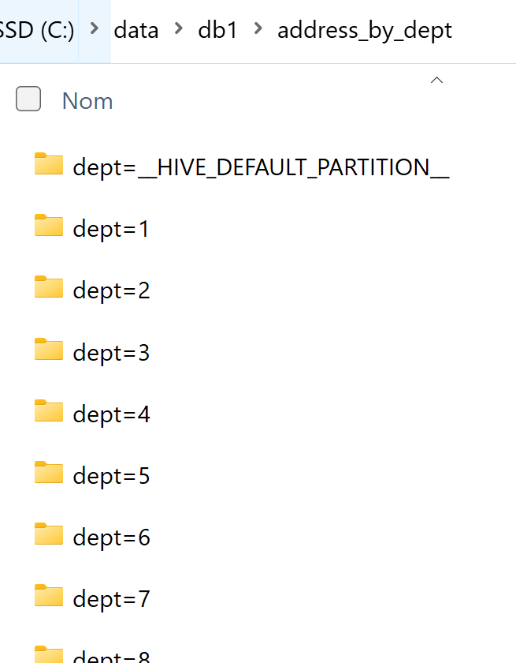
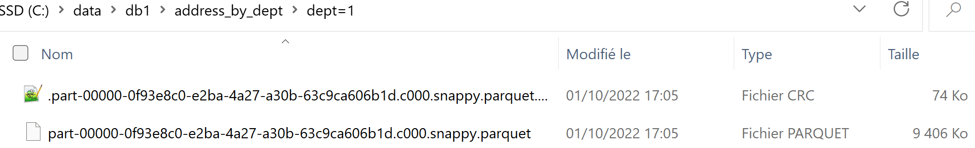
Answer Exercise 17 : Dirs for Partitioned Table

Slide 62
10 mn pause

Slide 63
Exercise 18: Query a Partitioned Table … optim « Partition Pruning »
a/ do a SQL query using a « WHERE dept=92 »
b/ do a SQL query using a « WHERE dept in (75, 78, 91, 92) »
c/ do a SQL query without partition column condition
d/ Can you measure that Query a/ is ~4x faster than Query b/ (1 part << 4 parts)
Query a/ is ~99x faster than Query c/ (1 part << 99 parts)
e/ check that Spark prunes the unnecessary partitions dirs from scanning

Slide 64
Exercise 19: SQL Explain plan: SQL « EXPLAIN select … from .. Where ..»
a/ Execute SQL prefixed by “EXPLAIN”
spark.sql("""
EXPLAIN select count(*) FROM db1.address_by_dept WHERE dept=92
""").foreach(println(_))
b/ Check that Spark has read ONLY files within directory « …/dept=92/*.parquet »

Slide 65
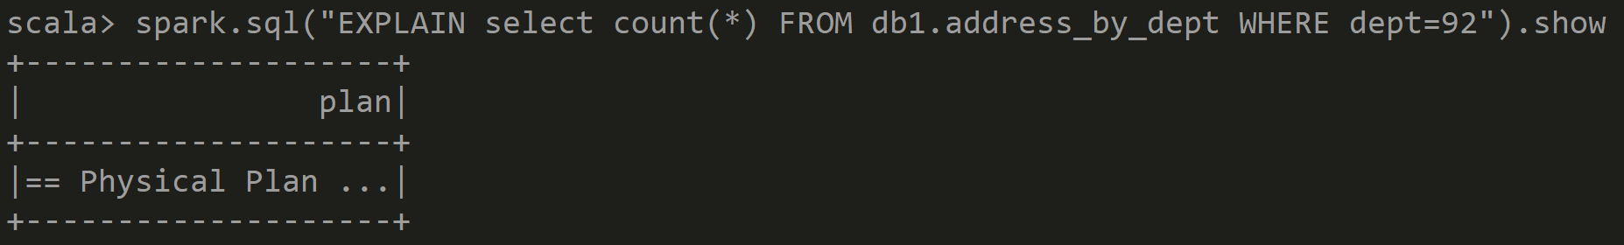
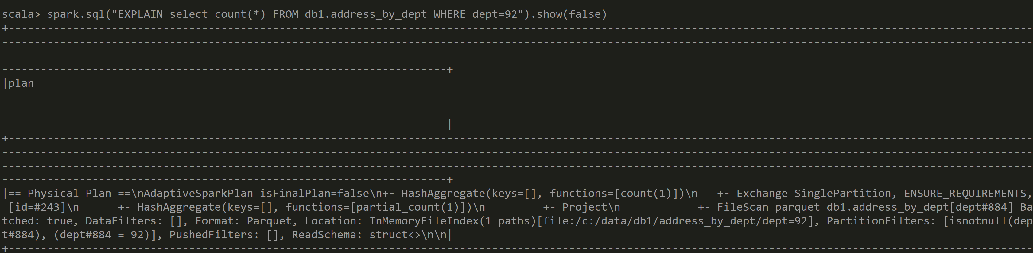
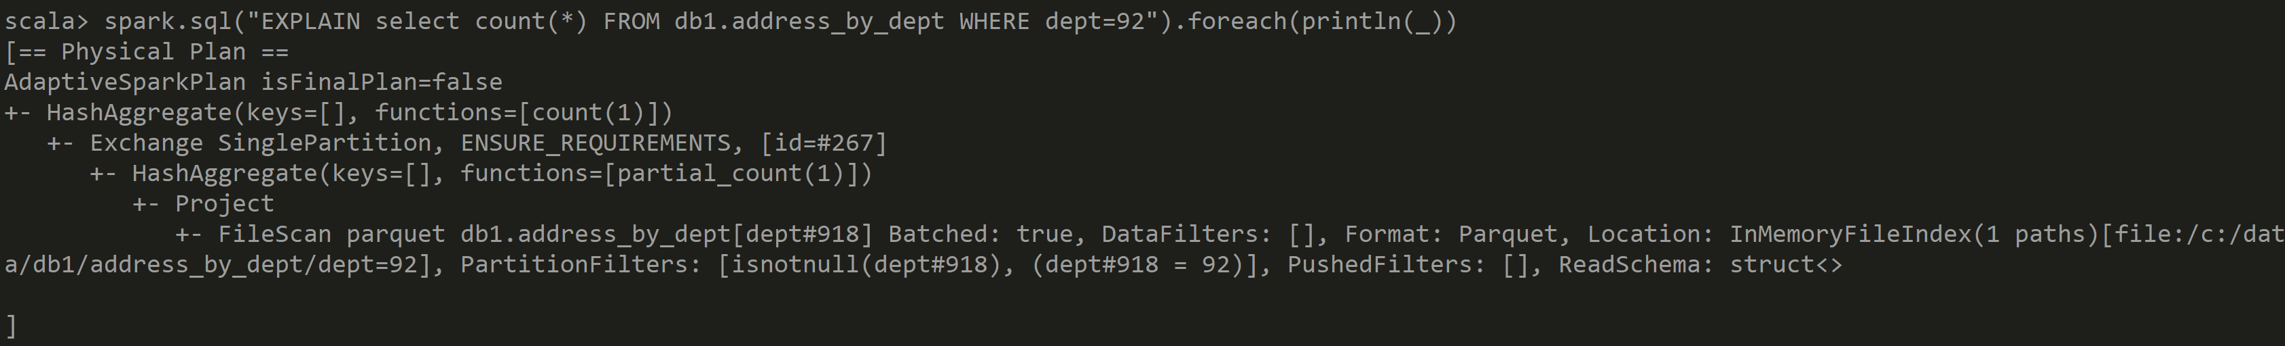
Answer Exercise 19: SQL Explain Plan

Slide 66
Exercise 20: Query by condition, NOT by partition column
a/ Execute SQL with any condition but not on column “dept” SELECT .. WHERE … somethingElse …
b/ Execute SQL: EXPLAIN SELECT …
b/ Check that Spark has read ALL directories/files … Check that is is slower than the unpartitioned table

Slide 67
Exercise 21: INSERT OVERWRITE… partitioned
a/ Execute SQL INSERT OVERWRITE address_by_dept SELECT .. FROM .. WHERE … commune=‘Nanterre’
b/ check that ALL files from directory /dept=92/* have been deleted… and rewritten with partial new results
c/ .. check that all cities != ‘Nanterre’ from dept=92 have been deleted (not re-created).
an “INSERT OVERWRITE” can INSERT+UPDATE+DELETE rows !
d/ check that ALL other directories dept != 92 are unmodified

Slide 68
Exercise 22: SAME insert overwrite … on 2 differently partitioned tables
Execute twice the same SQL, on 2 different tables, containing the same data
a/ compare select count(*) on both tables
b/ execute SQL on first (partitioned) table: INSERT OVERWRITE address_by_dept SELECT .. FROM .. WHERE … dept=92
c/ execute Same SQL on second (un-partitioned) table
INSERT OVERWRITE address SELECT .. FROM .. WHERE … dept=92
d/ compare counts, Explain

Slide 69
Exercise 23: INSERT OVERWRITE… for fully « UPDATING » partition(s)
a/ Execute SQL: INSERT OVERWRITE address_by_dept SELECT * FROM address WHERE … dept=92
b/ check that counts are same: select count(*) from address where dept=92
select count(*) from address_by_dept where dept=92
c/ Explain that you can replay safely an « UPDATE » batch for any dept .. NO duplicate, NO delete Update fully the expected result but no side effect elsewhere

Slide 70
Exercise 24: ACID Update / Delete in Spark ?
Questions
a/ Does Spark support SQL Update or Delete per rows?
b/ Can you « insert overwrite » data in Spark ? With which granularity ?
c/ can you emulate applicative updates or deletes on rows by append-only events ?
d/ Do you know « DeltaLake » or « Iceberg » ? (google it)

Slide 71
Exercise 25: Question on Partition.. What for ?
Questions
a/ Are partitions improving performances ?
b/ is it true that same SQL INSERT OVERWRITE
can have different results on tables with different partitionning ?
c/ Why/How should you use partitions ?
d/ Is is advisable to have deep sub-sub-sub partitioning ?

Slide 72
Optionnal Exercise 26 – DeltaLake / Iceberg …
Have a look to DeltaLake
https://docs.delta.io/latest/quick-start.html
spark-shell --packages io.delta:delta-core_2.12:2.2.0 \ --conf spark.sql.extensions=io.delta.sql.DeltaSparkSessionExtension \ --conf spark.sql.catalog.spark_catalog=org.apache.spark.sql.delta.catalog.DeltaCatalog CREATE TABLE … USING DELTA … (instead of STORED AS PARQUET … )

Slide 73
Exercise 27 : MindMap
Draw a MindMap to summarize
what you did and learn from this Hands-On session
Your MindMap should
start with word « Spark Catalog - Metastore» in the middle
Then draw star edges to other word chapters and sub-chapters

Slide 74
Answer Exercise 27: MindMap
*/Files per dir
1…N new file per insert
No SQL Update/ Delete
STORED AS..
LOCATION
Insert overwrite
.. By partition
SQL on java Dataset
SQL on Files
Read Optim: part-pruning
List Tables
CREATE EXTERNAL TABLE IF NOT EXISTS
Describe table .OK show Create Table KO
TABLE PARTITIONED BY(col type)
createTempView
SQL DDL
SHOW CREATE TABLE
SHOW TABLES
Spark Catalog - Metastore
Configure Spark
ExternalCatalog
createGlobalTempView
« global_temp » hidden Database
--conf spark.sql. catalogImplementation=..
Config
HADOOP_CONFIG_DIR
(or HADOOP_HOME)
/hive-site.xml
temporary
Global=Multi Sessions (SparkContext)
in-memory
HiveMetaStore
hive
Search + Download jar
(postgres,derby..)
Do not use!
HiveServer2
Plain old server, with relational DB

Slide 75
Questions ?

Slide 76
Take-Away What You learned ?

Slide 77
Next Steps
More Lessons
More Hands-On
Spark concepts:
Spark UI, DAG, Optimisation, Predicate-Push-Down
Spark Clustering
Java binding, UDF, map
Spark Streaming
…

