Slide 1
http://arnaud-nauwynck.github.io
arnaud.nauwynck@gmail.com
Big Data – Part 3
Hadoop Ecosystem
Main Components Explained

Slide 2
Outline
ZooKeeper
Hdfs
Yarn / Kubernetes
Oozie
Hive MetaStore

Slide 3
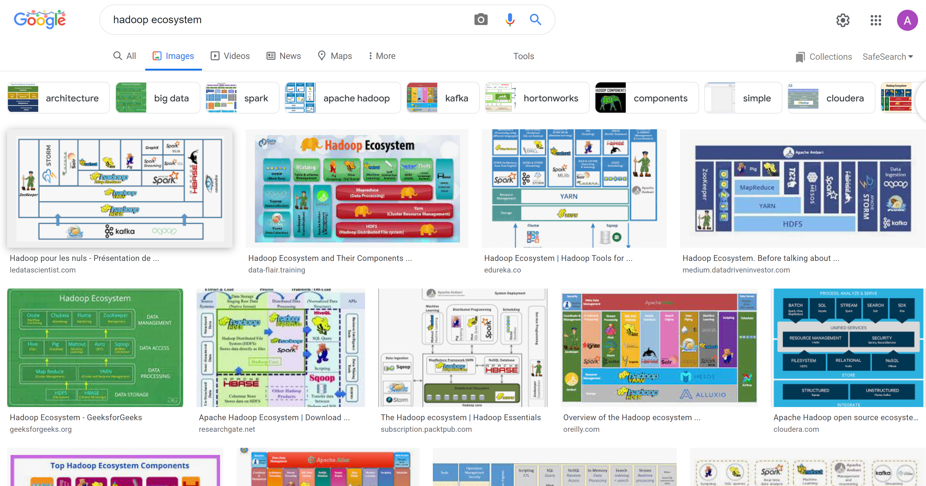
Google image ”Hadoop ecosystem”

Slide 4
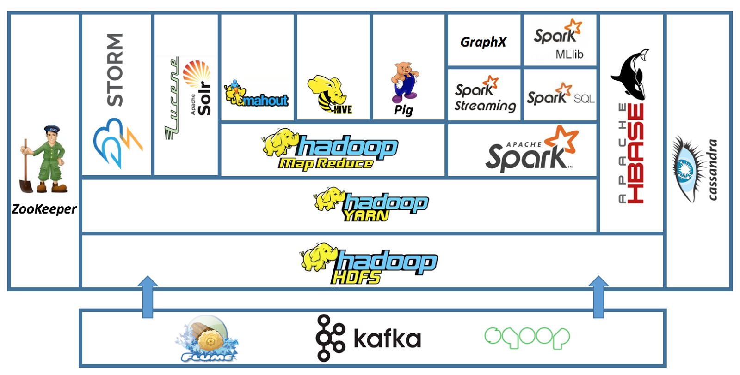
Hadoop Ecosystem..

Slide 5


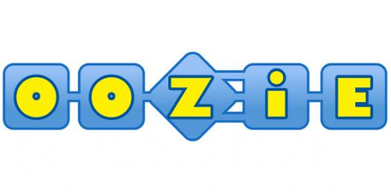

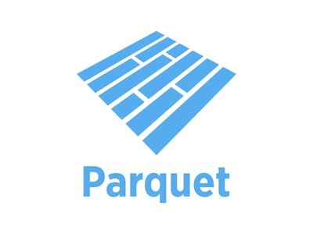



Low-Level Focus
ZooKeeper, HDFS, Yarn, oozie, Metastore
metastore

Slide 6
Spark RDD : MetaStore Dir partition
+ File + File-Block
MetaStore
HDFS dirs
part1-file1
Table1
List dirs
+ list Files
+ list File blocks
part2-file1, part2-file2
partitions
File
(block1)(block2)(block3)
List partitions
add/remove
partitions
RDD partition1
Spark Driver
RDD partition2
RDD partition3
RDD partition4
Spark Executor1
RDD partition5
Spark Executor2
RDD partition6
Spark ExecutorN
Assign 1 RDD partition to 1 executor

