Slide 1
BigData – Spark Hands-On : File IO
Arnaud Nauwynck Nov 2022

Slide 2
Outline
Reminder on TD1
Questions ? Problems on TD1 ?
Objective of TD2: mostly Files Input-Output
Pre-requisistes: same as TD1: « spark-shell »

Slide 3
Reminder TD1 : Mind Map
Set JAVA_HOME
Set SPARK_HOME set PATH
JVM
WinUtils
Transform, filter
Setenv.bat
DataFrame=Dataset[Row]
Pre-Requisite
Val ds = spark.createDataset()
Spark.tar.gz embedded Hadoop
ds.show(10, true)
DataSet
Installation
User-defined
Hadoop.tar.gz
Immutable
Spark-Shell
Interactive
avoid
for () {} loop
Functionnal
Code Style
History
Seq
.map
lambda
Up / Down
Scala>
Repl
:help
TAB TAB autocompletion
Line compiled to scala
Eval on <enter>
val i =
var i =
Seq()
Tuple
On JVM
~Java
Numbered result « res0,res1,.. »

Slide 4
Objectives of Hands-On
1/ read CSV files, convert options
2/ read combine several files
3/ others file format: json, nd-json, xml, text
4/ write to PARQUET files dir repartitionning
5/ Discover PARQUET format optimisations

Slide 5
Exercise 1: edit a csv file with few lines + Header
Edit a CSV file, with columns « id, text, boolean, date, doubleValue, .. »
Use either a text editor: Notepad++, SublimeText, IntelliJ / Eclipse, …
First line should be « header » : columns names
All other lines = values, separated by « ; »
Strings may contain special ‘;’ character, but should be wrapped with double quotes
Save as file « c:\data\sample-data1.csv »

Slide 6
Exercise 1..
id;text;boolean;date;doubleValue
1;hello 1;true;2020/01/24;3.1415926
2;hello 2;false;2020/01/25;2.71828
3;hello 3;true;2020/01/26;1.4142135
4;"hello multi-lines\n line 2..\n line 3";false;2020/01/27;0.0
5;"hello line containing ;;; chars";false;2020/01/28;1.0

Slide 7
Exercise 2 : Read CSV file from spark-shell
val sample1Ds = spark.read. ….
use
spark.read .option( … ) .format(« csv ») .load ( path )
OR equivalent spark.read .option( … ) .csv( path )
CHECK :
1/ correct path
2/ option to set the field delimiter
3/ option to interpret the first header line correctly
4/ cast or interpret types correctly
5/ use sample1Ds.show(20, false) to check lines
6/ use sample1Ds.printSchema to check types
… string,boolean,int should be OK for date .. Cf Exercise 3 or 5 !

Slide 8
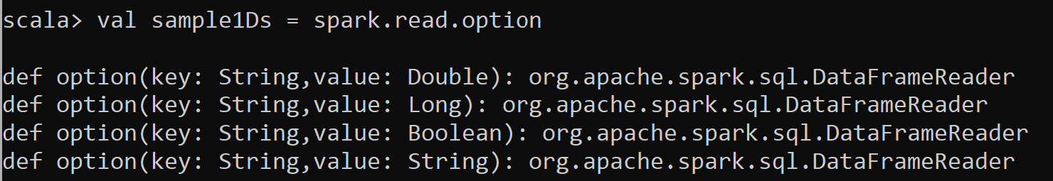
Hint Exercise 2
You can type spark.read. <TAB> to autocomplete
For option parameters … type: spark.read.option <TAB> <TAB>

Slide 9
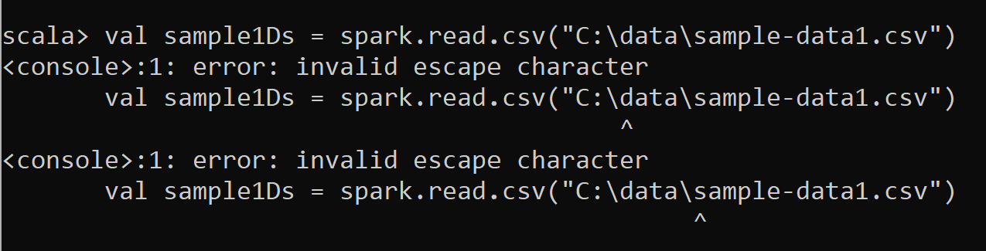
Hint Exercise 2
« C:\data\sample-data1.csv » does not work ! … « \ » is a special character

Slide 10
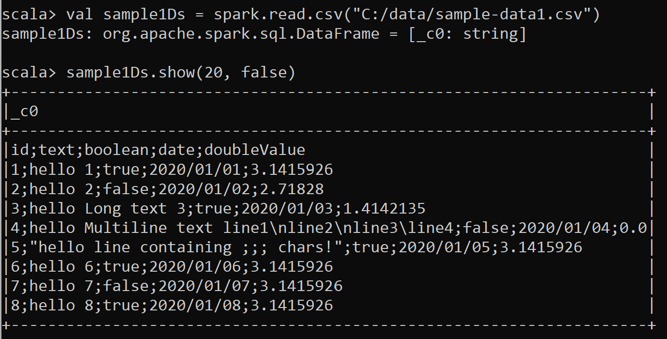
Exercise 2 … wrong delimiter + wrong header

Slide 11
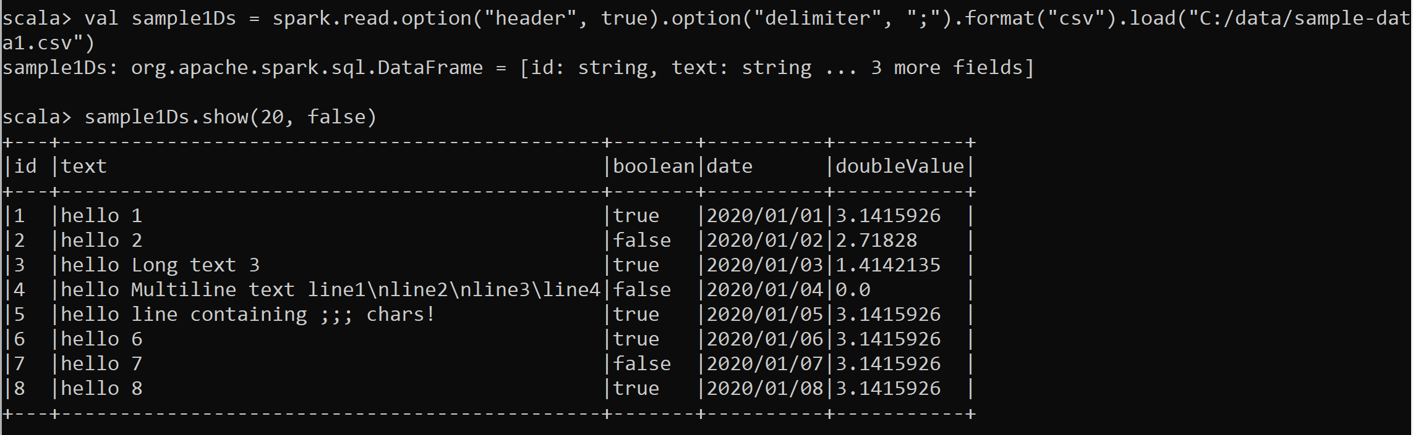
Hint Exercise 2 … almost correct ? But bad infered types

Slide 12
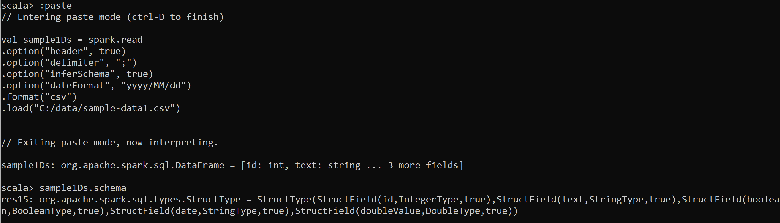
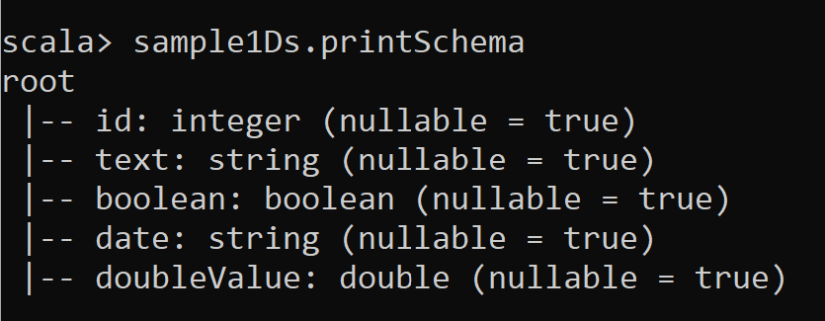
Almost Correct, still problem on Date … OK, cf Exercise 3

Slide 13
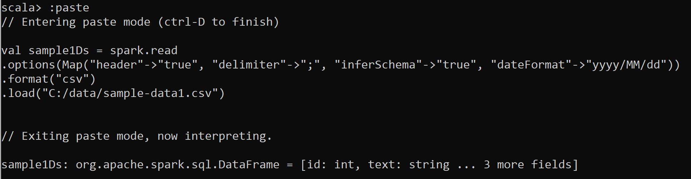
Alternative Answer Exercise 2 Using .options( Map(…) ) instead of .option().option() … .option()
WARNING: wrap all options as strings, to use Map[String,String] … not Map[String,Any]
.. Otherwise get error

Slide 14
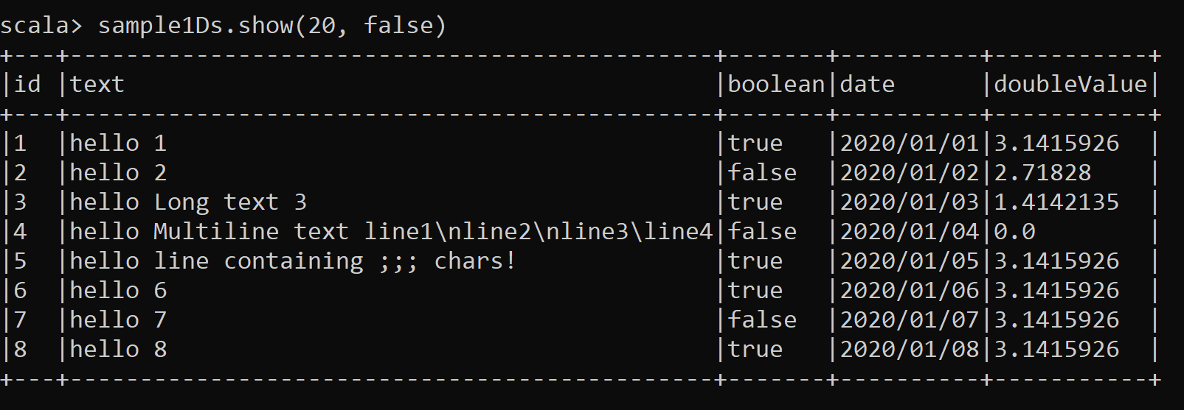
Answer Exercise 2

Slide 15
Exercise 3: use .option(« schema », ..)
Add spark.read .. .option(« schema », « name1 type1, name2 type2….. »)
to force column types
(but maybe not date columns that may need explicit parsing .. cf next !)

Slide 16
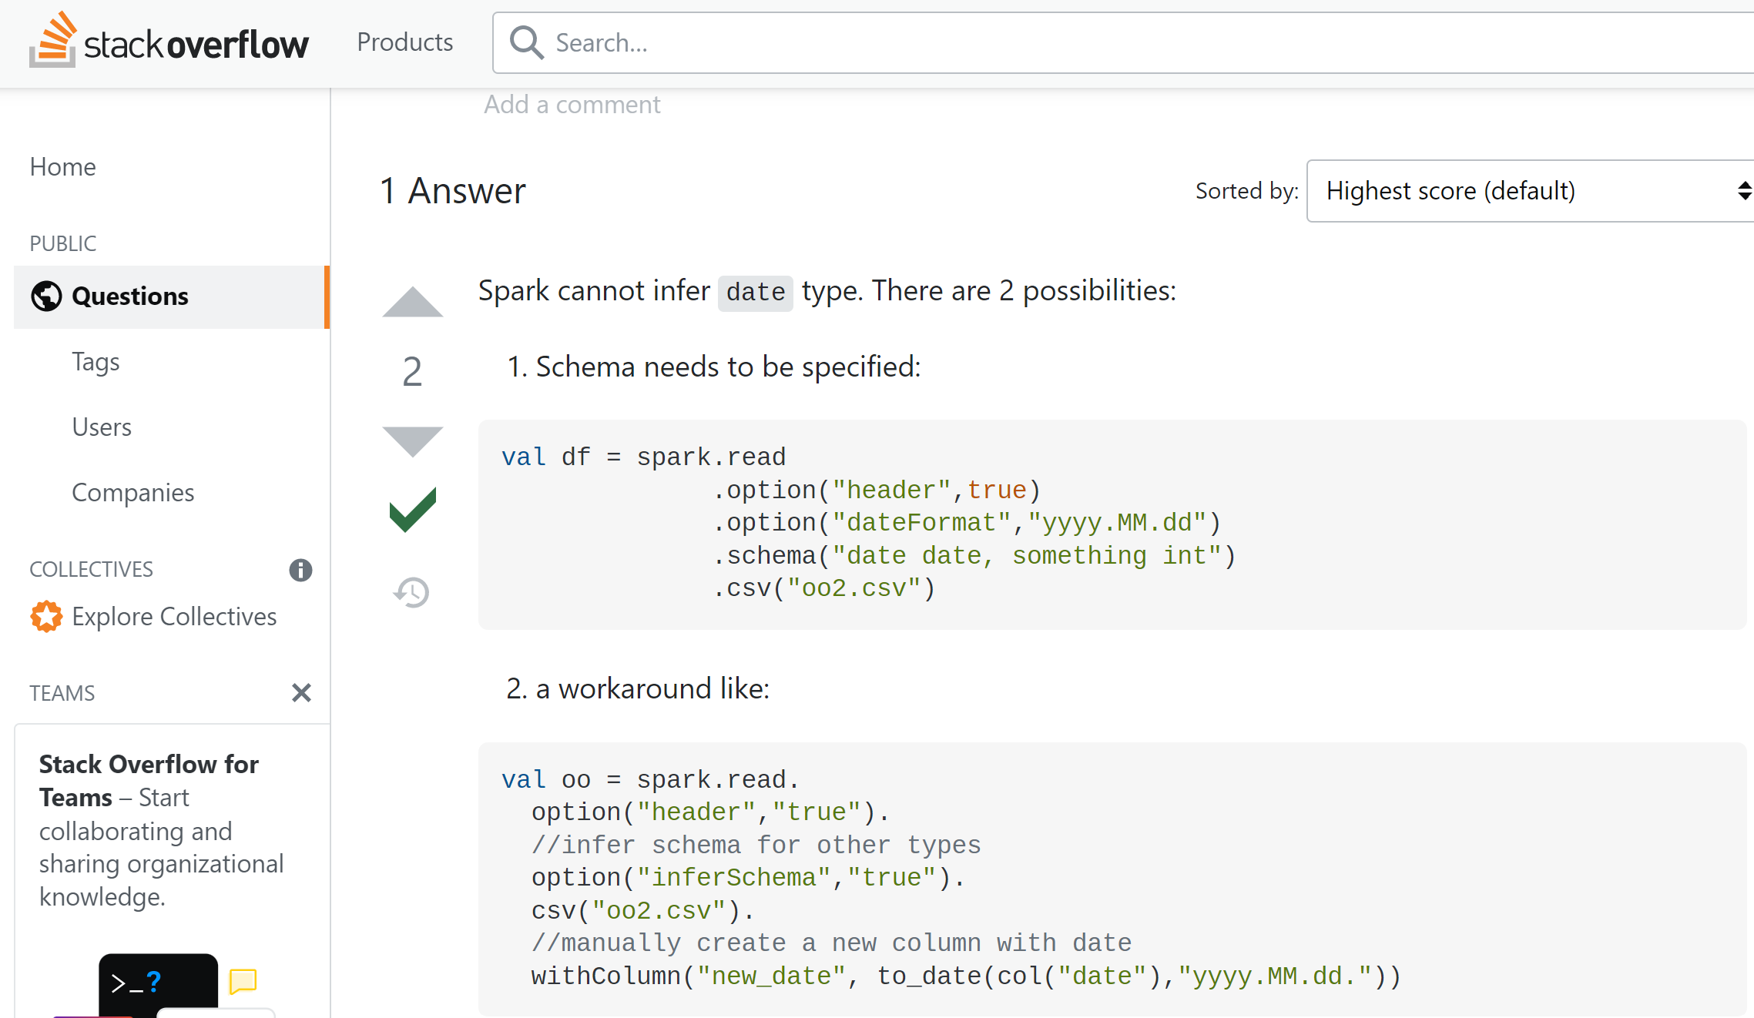
Exercise 3: Spark can not inferSchema for date …
https://stackoverflow.com/questions/66935214/spark-reading-csv-with-specified-date-format

Slide 17
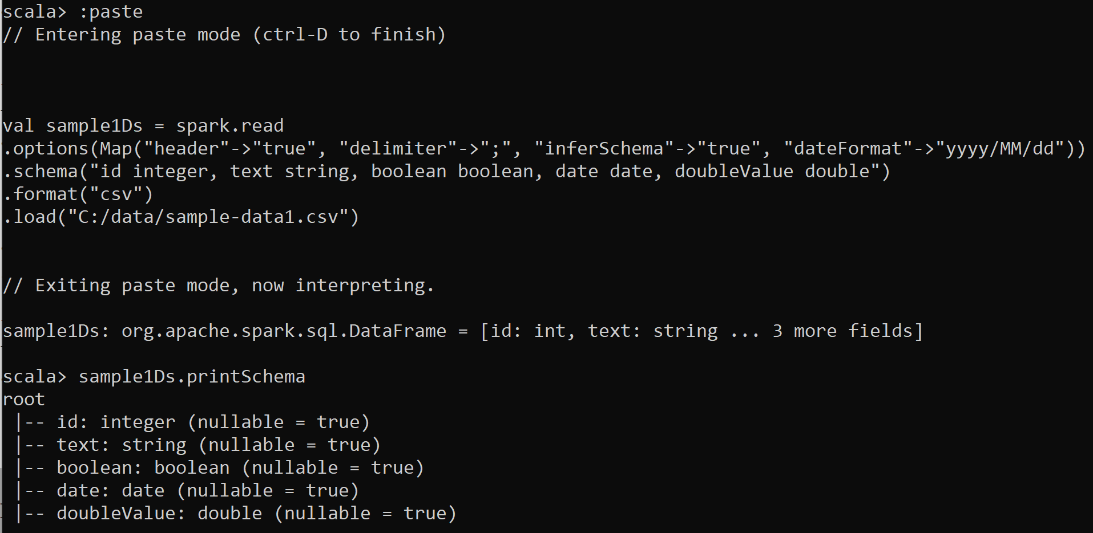
Answer Exercise 3

Slide 18
Exercise 4: use schema for file with no Header line
copy file « sample-data1.csv » without the header line save as « sample-data1-no-header.csv »
Read CSV file using option(« schema », « ….. »)

Slide 19
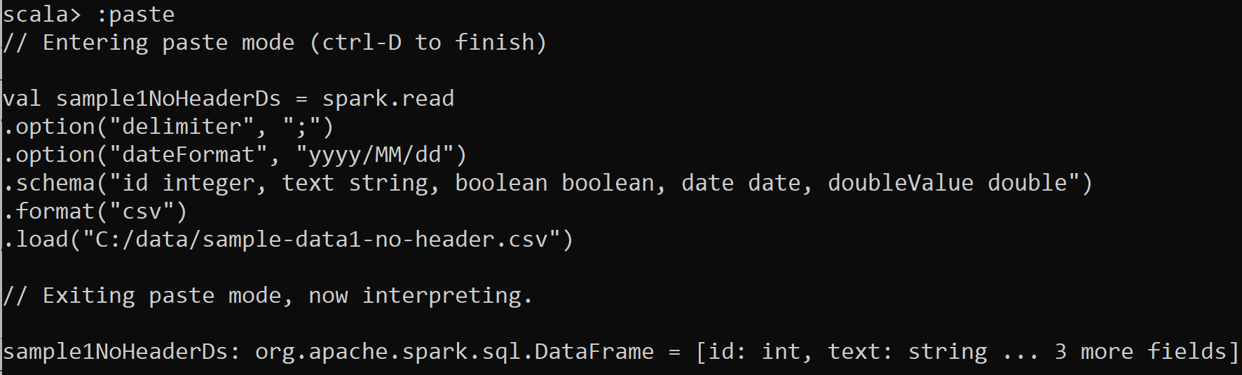
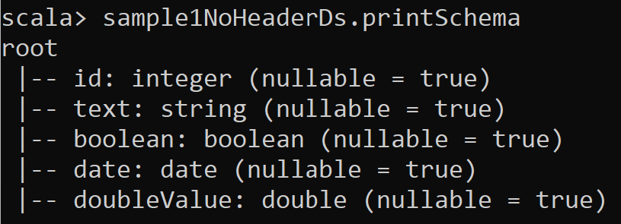
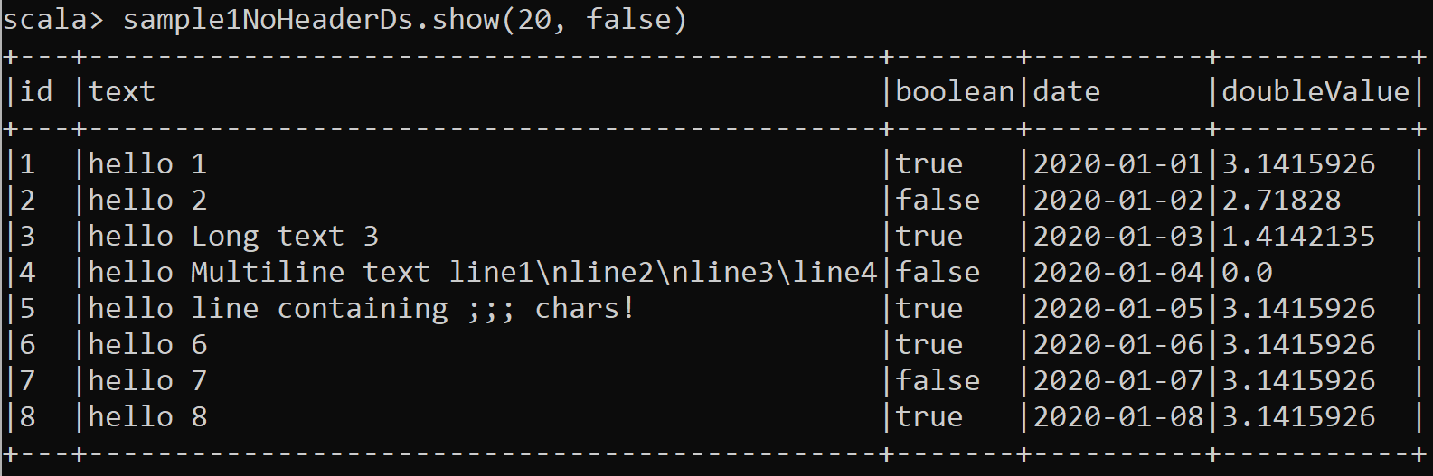
Answer Exercise 4

Slide 20
Exercise 5: post processing conversion String->Date
From Dataset sample1Ds (from exercise3/) … with date as String
Define new column « parsed_date » with typed date, then drop previous « date » text column, then rename column

Slide 21
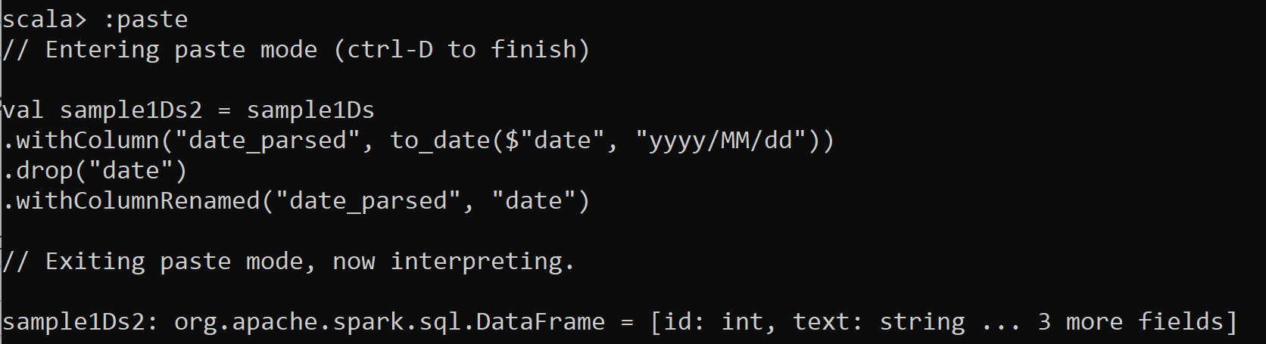
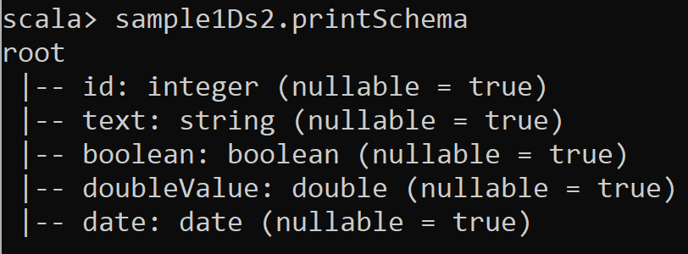
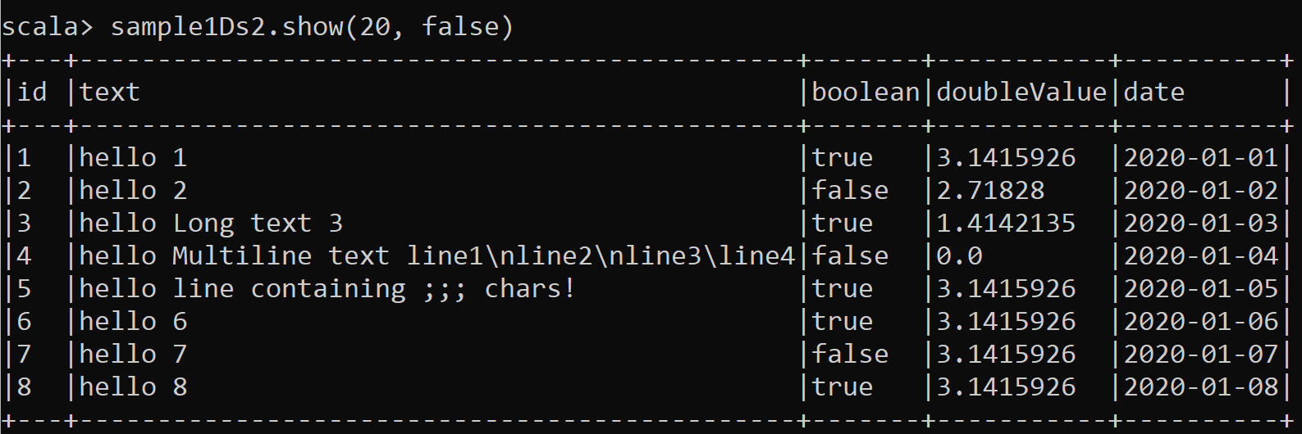
Answer Exercise 5
Added Column « date » is now the last column .. OK

Slide 22
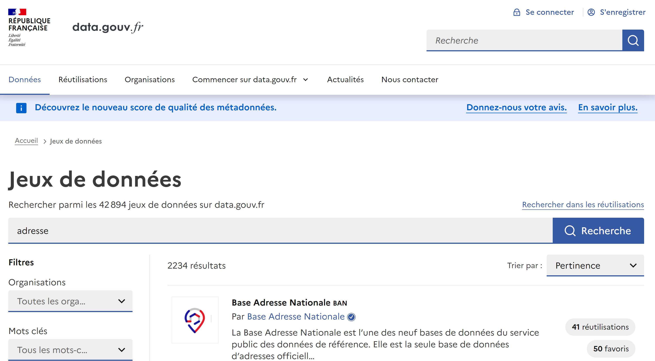
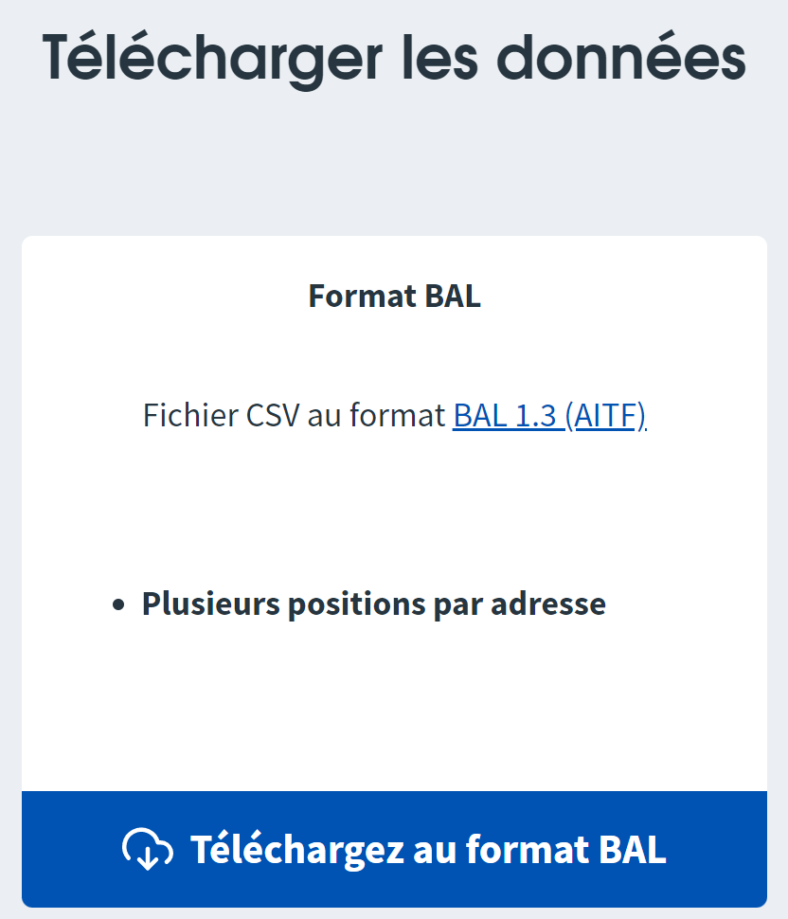
Exercise 6: real CSV Files, example of Open Data
https://www.data.gouv.fr
https://www.data.gouv.fr/fr/datasets/base-adresse-nationale/
Base Addresse Nationale:
number, street, city, zipCode, latitude, longitude …
1 CSV file 3.3 Go .. Or split by 990 files x 33 Ko

Slide 23
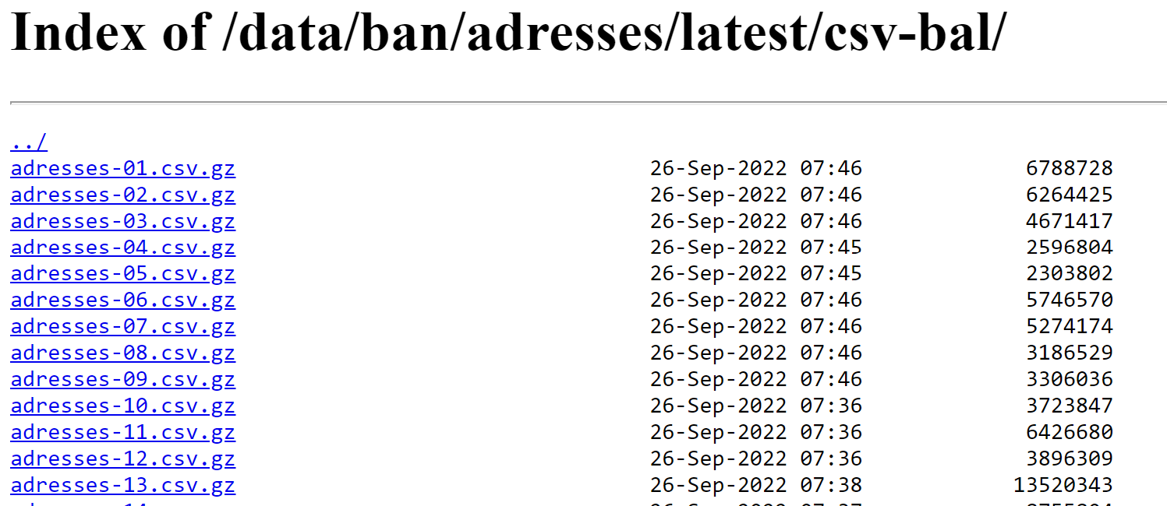
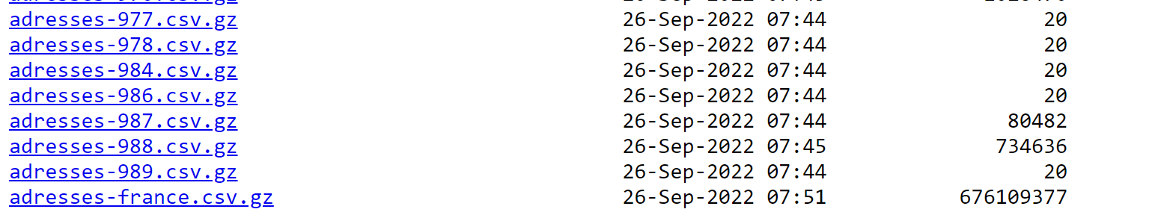
Exercise 6 … download + uncompress files
https://adresse.data.gouv.fr/data/ban/adresses/latest/csv-bal/
Exercise: Download few files 01, 02, … 04
990 x small csv.gz files
ALL in ONE = 1 x Big csv.gz files

Slide 24
Exercise 6: load individual CSV files, then do union of DataSets
a/ load files:
address-01.csv -> in dataset01 address-02.csv -> in dataset02 .. address-03 .csv -> in dataset03
b/ do union of datasets: dataset01.union(dataset02) .. .union(dataset04)
c/ check that count of union = sum of count of individual files

Slide 25
Answer Exercise 6 … naive hand-written for files {1,2,3,4}
val balDir = "C:/data/OpenData-gouv.fr/bal/bal-split-files"
def parseCsvAddress(fn: String) = spark.read .options(Map("header" -> "true", "delimiter" -> ";", "inferSchema" -> "true")) .format("csv").load(balDir + "/" + fn)
val address1Ds = parseCsvAddress("adresses-01.csv")
val address2Ds = parseCsvAddress("adresses-02.csv")
val address3Ds = parseCsvAddress("adresses-03.csv")
val address4Ds = parseCsvAddress("adresses-04.csv")
println(s"addressDs counts: ${address1Ds.count} + ${address2Ds.count} + ${address3Ds.count} + ${address4Ds.count}")
val addressDs = address1Ds.union(address2Ds).union(address3Ds).union(address4Ds)
addressDs.count

Slide 26
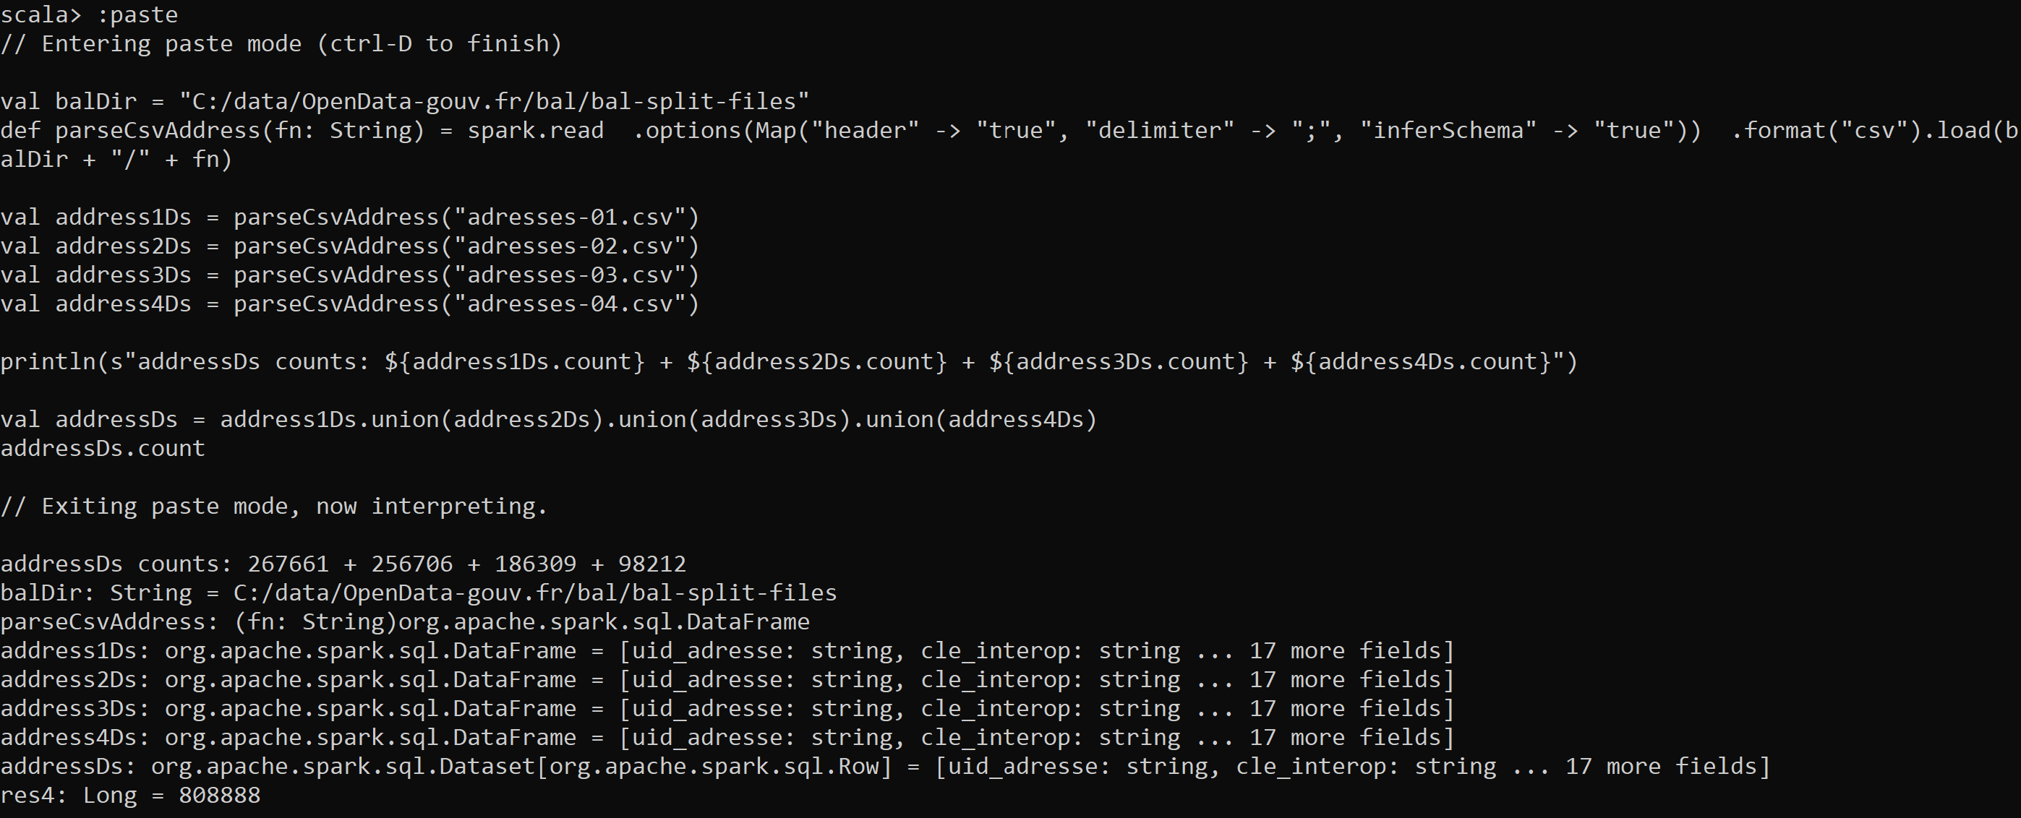
Answer Exercise 6

Slide 27
Answer Exercise 6 .. Using functional code-style
val balDir = "C:/data/OpenData-gouv.fr/bal/bal-split-files"
def parseCsvAddress(fn: String) = spark.read .options(Map("header" -> "true", "delimiter" -> ";", "inferSchema" -> "true")) .format("csv").load(balDir + "/" + fn)
val fileNameArray = new java.io.File(balDir).list()
import scala.collection.JavaConverters._
val scalaFileNameList = fileNameArray.toList
val addressDsList = scalaFileNameList.map(fn => parseCsvAddress(fn) )
val addressDs = addressDsList.reduce( (ds1,ds2) => ds1.union(ds2) )
val addressDsCounts = addressDsList.map( (ds) => ds.count )
val addressDsSumCount = addressDsCounts.reduce( (c1,c2) => c1+c2 )
println(s" counts ${addressDsSumCount} = sum ${addressDsCounts} = ${addressDs.count}")

Slide 28
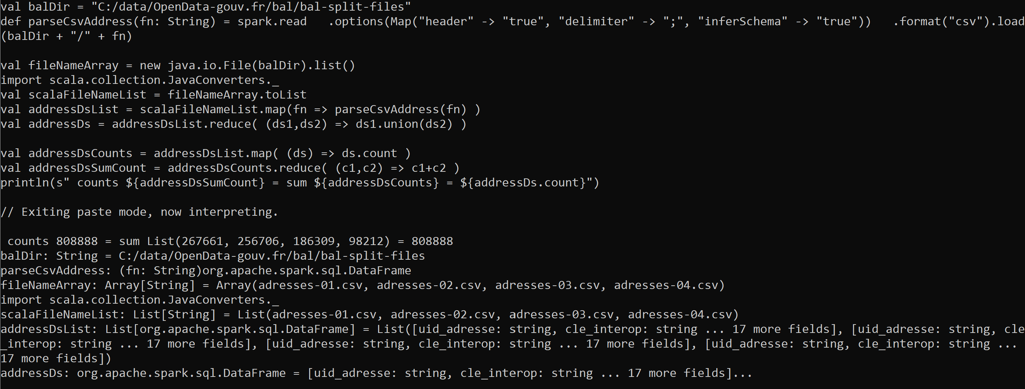
Answer Exercise 6

Slide 29
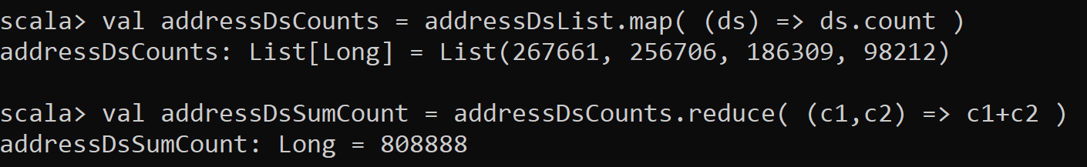
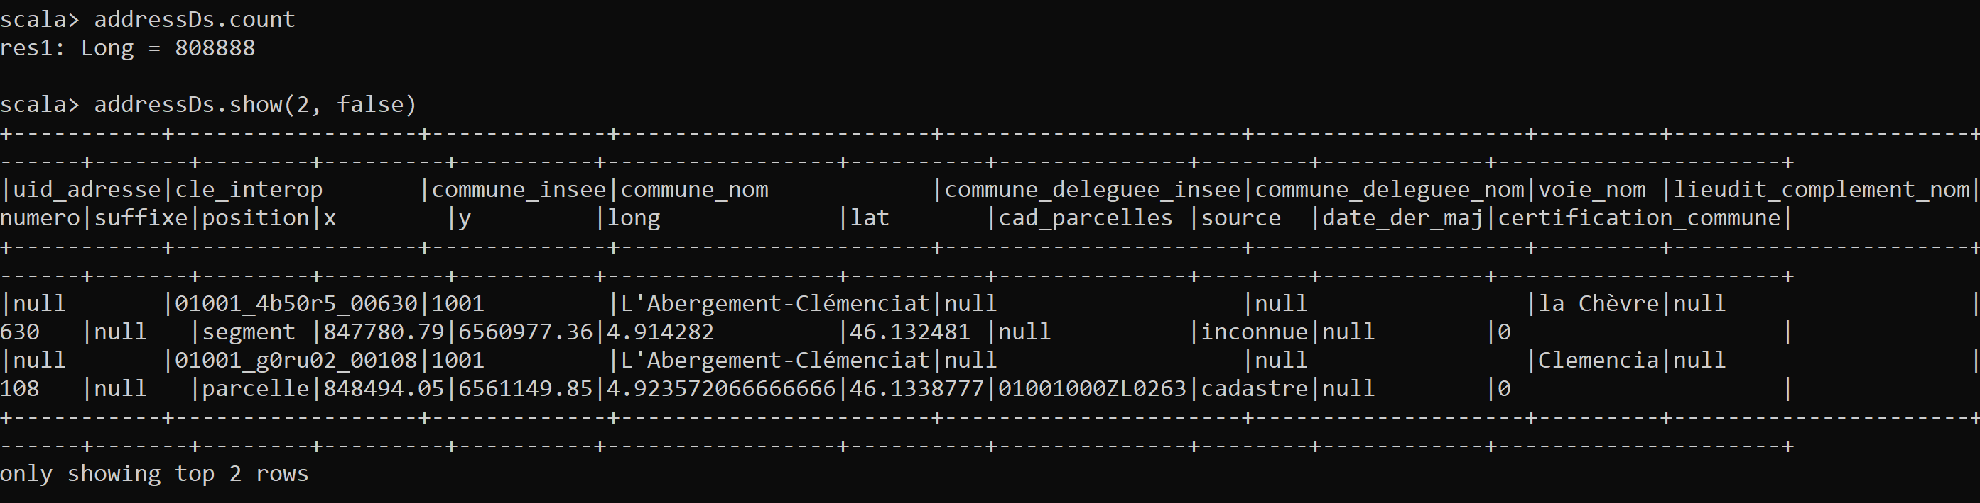
Answer Exercise 6

Slide 30
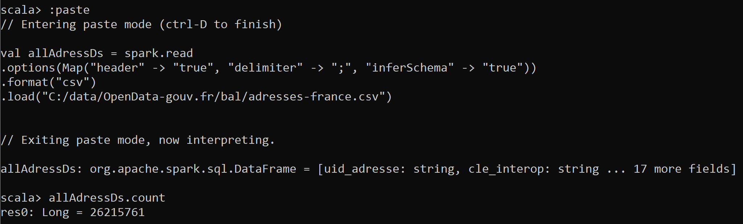
Loading all-in-one file … slow to download But OK, not « Big » Data
Uncompressed CSV = 3 Go, 26 Millions rows
Load in spark = ~1 minute
.. No problem to load in Spark JVM (default –Xmx1g ) … used only 453 Mo

Slide 31
Exercise 7: load multiple CSV files from 1 directory
a/ create an empty directory, for example « C:\data\OpenData-gouv.fr\bal\bal-split-files »
b/ put your few address files in it (adress-01.csv, -02, ..-03, -04 ) ensure you have NO other csv files in it c/ read all files using 1 command: spark.read … taking path of directory (instead of path of file)
d/ check that count is similar to exercise 7/

Slide 32
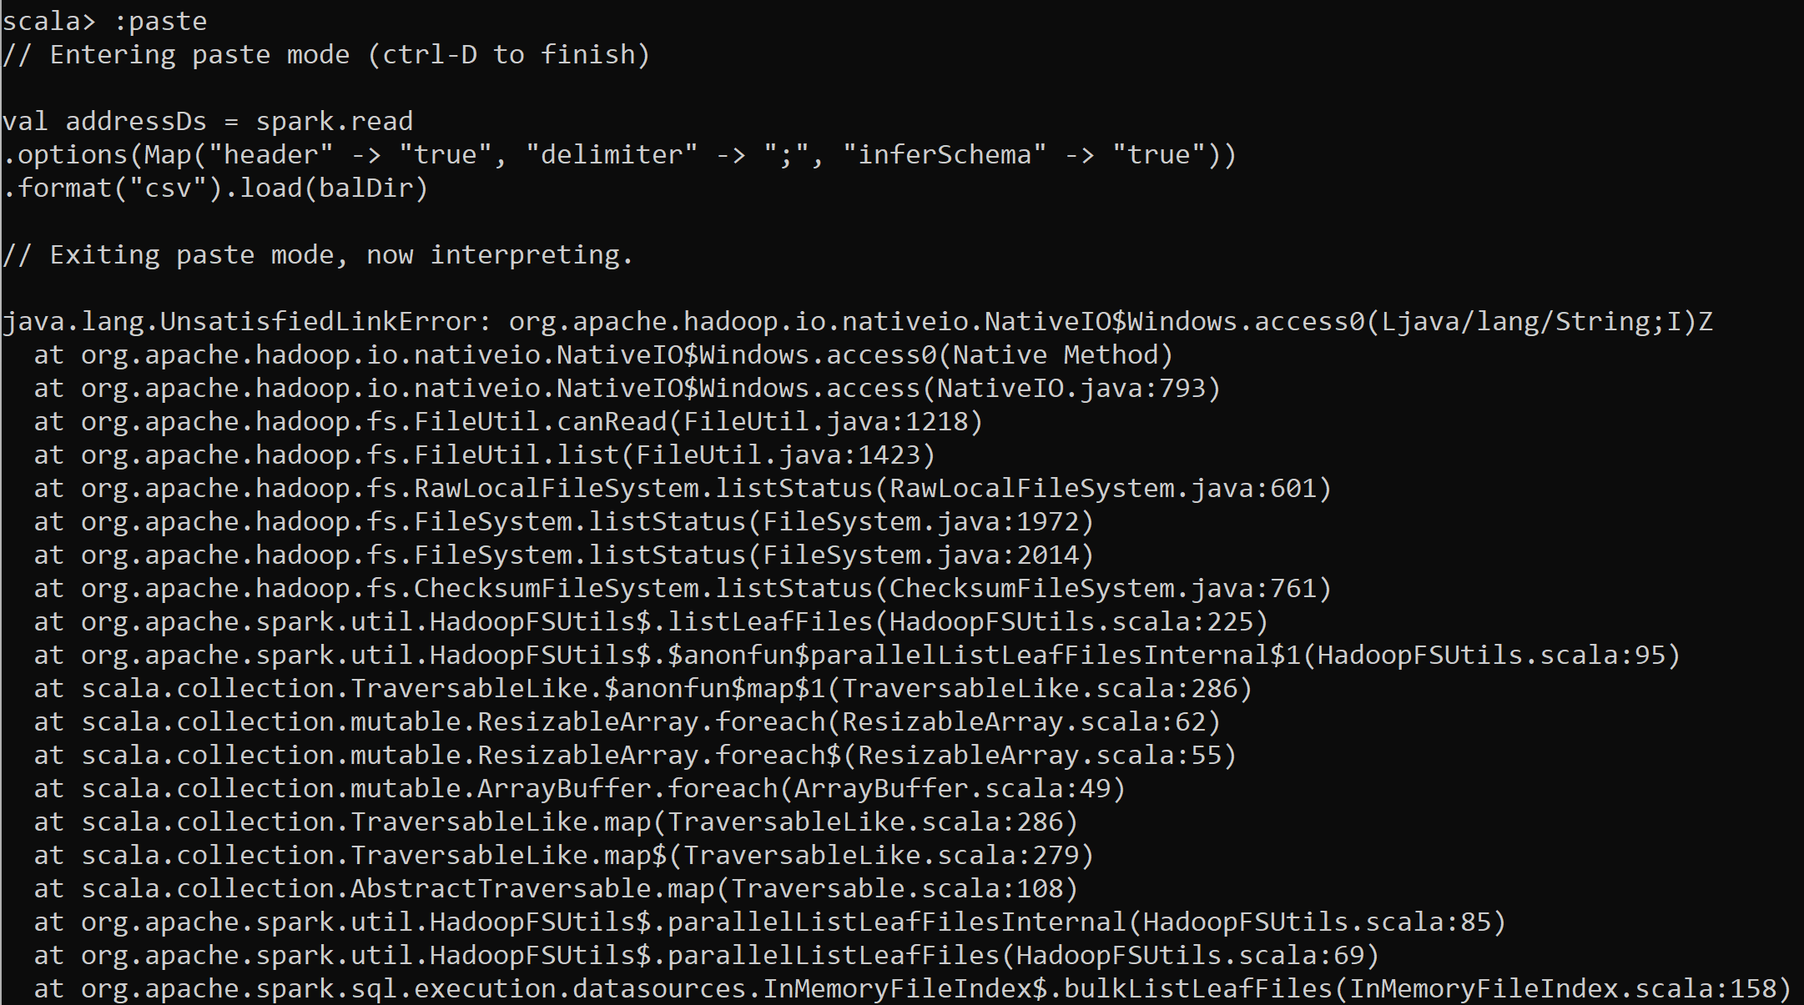
Exercise 7 … Error if HADOOP_HOME or WinUtils.exe is missing !

Slide 33
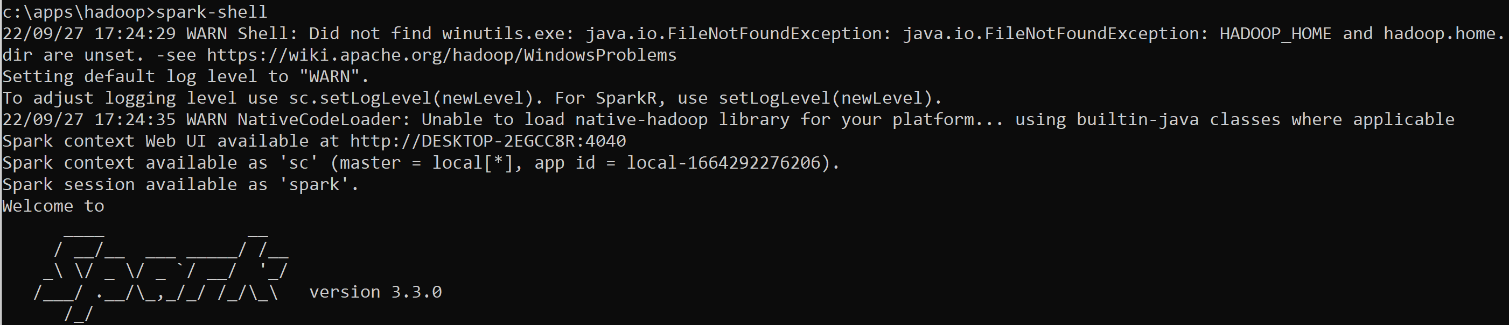
Exercise 7 … ERROR HADOOP_HOME not set => WARNING at startup

Slide 34
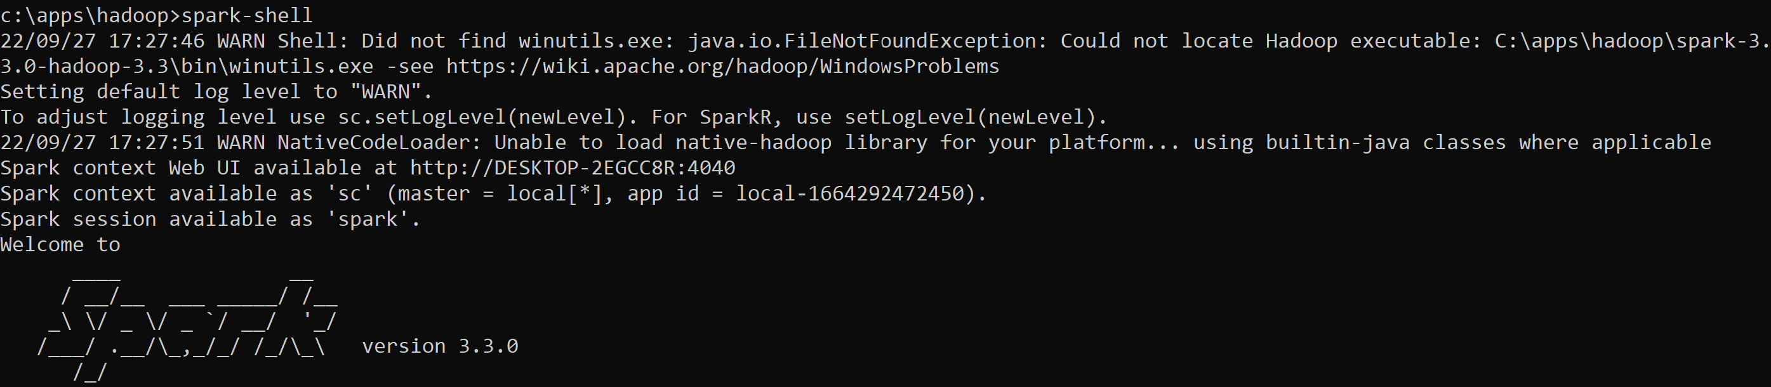
Exercise 7 .. ERROR HADOOP_HOME set, but file WinUtils.exe + hadoop.dll not copied!

Slide 35
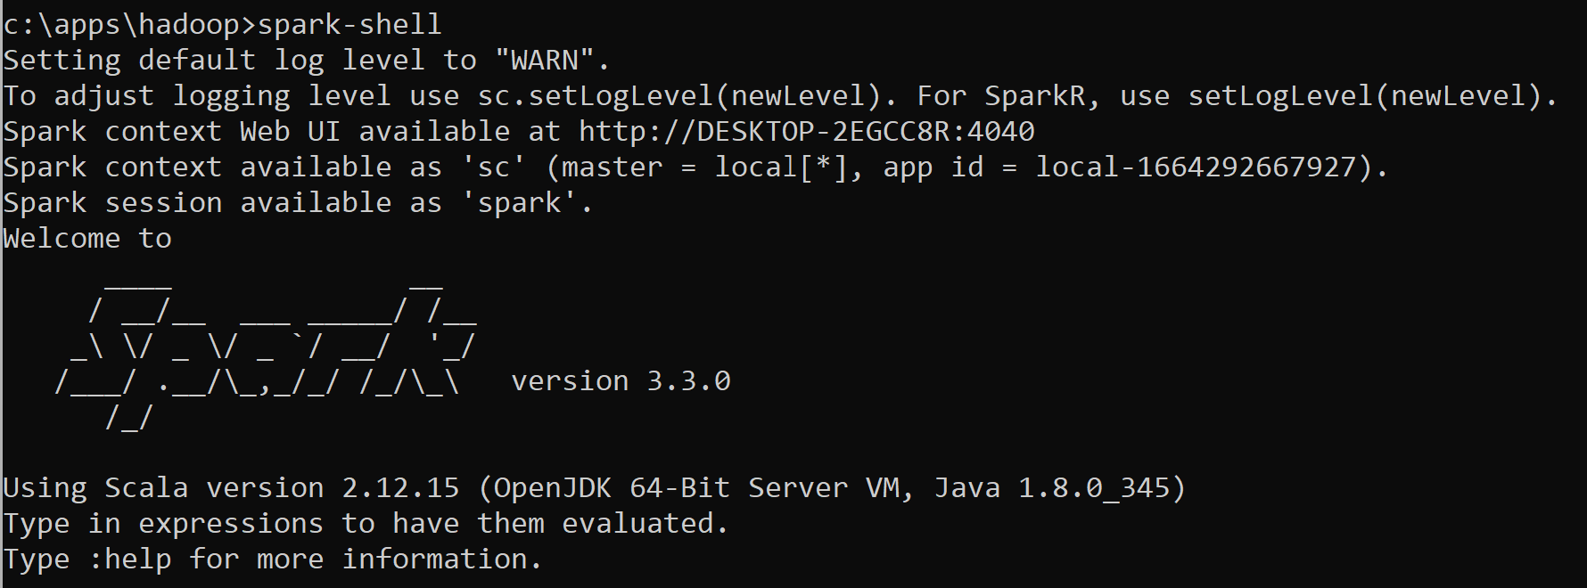
Answer Exercise 7 NO WARNING at startup

Slide 36
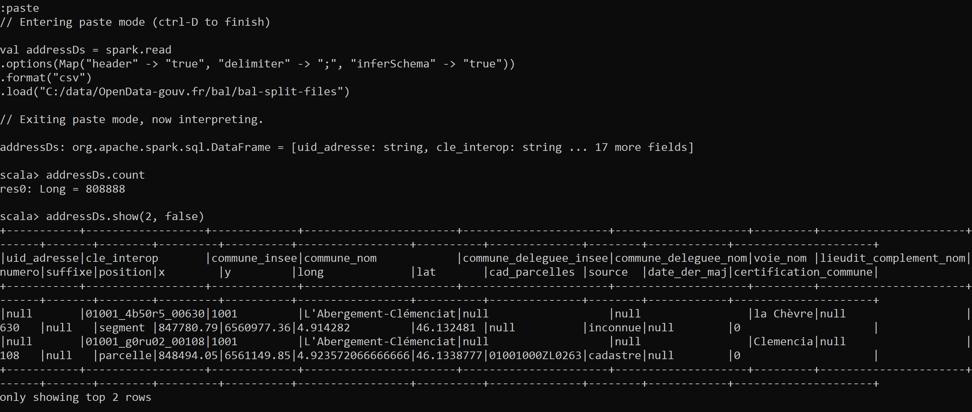
Answer Exercise 7

Slide 37
Exercise 8 … repeat query before/after .cache() explain which query a/b/c/.. perform IO reads
a/ Read? … for schema/statistics, but data not retained in memory
scala> spark.read. … « infer »true
scala> allAdressCsvDs.count
scala> allAdressCsvDs.count
scala> allAdressCsvDs.cache
scala> allAdressCsvDs.count
scala> allAdressCsvDs.count
scala> allAdressCsvDs.count
b/ Read ?
c/ Read ?
d/ Read ?
e/ Read ?
f/ Read ?

Slide 38
Answer Exercise 8 … cache => lazy then 1 read … then no more read
a/ Read: Yes … for schema/statistics, but data not retained in memory
scala> spark.read. … « infer »true
scala> allAdressCsvDs.count
scala> allAdressCsvDs.count
scala> allAdressCsvDs.cache
scala> allAdressCsvDs.count
scala> allAdressCsvDs.count
scala> allAdressCsvDs.count
b/ Read: Yes
c/ Read: Yes
d/ Read: No
e/ Read: Yes (first query after cache)
f/ Read: No

Slide 39

Objectives of Hands-On
1/ read CSV files, convert options
2/ read combine several files
3/ others file format: json, nd-json, xml, text
4/ write to PARQUET files dir repartitionning
5/ Discover PARQUET format optimisations

Slide 40
10 mn pause

Slide 41
APPENDIX … If you have finished exercises 1-8, but your friends are still struggling ?
Idea 1 / help your struggling friends
Idea 2/ imagine processing queries on OpenData addresses ( see next )

Slide 42
APPENDIX 1: Exercise 6 was loading « addresses » …
What could you process out of this ?
Suggestions:
Extract all city names with zipCode, average latitude/longitude
Extract all distinct street names
Extract number of addresses and number of streets per city
Detect all street named to a person « firstname Lastname » given a list of known firstname
Count how many times « Victor Hugo » is present
Count cities having neither « Victor Hugo », nor « Balzac », or « Picasso »
Detect cities having one of « Leningrad », « Stalingrad », « Maurice Thorez »
…

Slide 43
Objectives of Hands-On
1/ read CSV files, convert options
2/ read combine several files
3/ others file format: json, nd-json, xml, text
4/ write to PARQUET files dir repartitionning
5/ Discover PARQUET optimisations
6/ Discover Spark UI

Slide 44
Exercise 9: save as json, load json file
a/ write addresses Dataset (from CSV) to JSON
b/ look at written files is it a valid « .json » file, containing 1 array of objects ? Or ND-json = New-lines Delimited Json
compare file size of csv and nd-json
c/ load dataset from ND-json file

Slide 45
Answer Exercise 9
allAdressDs.write.format("json").save("C:/data/OpenData-gouv.fr/bal/adresses-json2")
More on this later… spark has split into 26 partitions
More on this later… retry with force spark « repartition » to write 1 file
allAdressDs.repartition(1).write.format("json").save("C:/data/OpenData-gouv.fr/bal/adresses-json")

Slide 46
Exercise 10 : analyze written json files
Repeat the same operation twice, and notice that
1/ you can not specify the file names .. Only an empty directory name !
2/ the file names are generated with a unique UUID part-00{partNumber}-{UUID}-c000.json
3/ during write time… spark write to « _temporary » sub dir, then rename at the end
4/ spark has written several files … If using the full dataset of 3Giga .. Spark write 26 json files

Slide 47
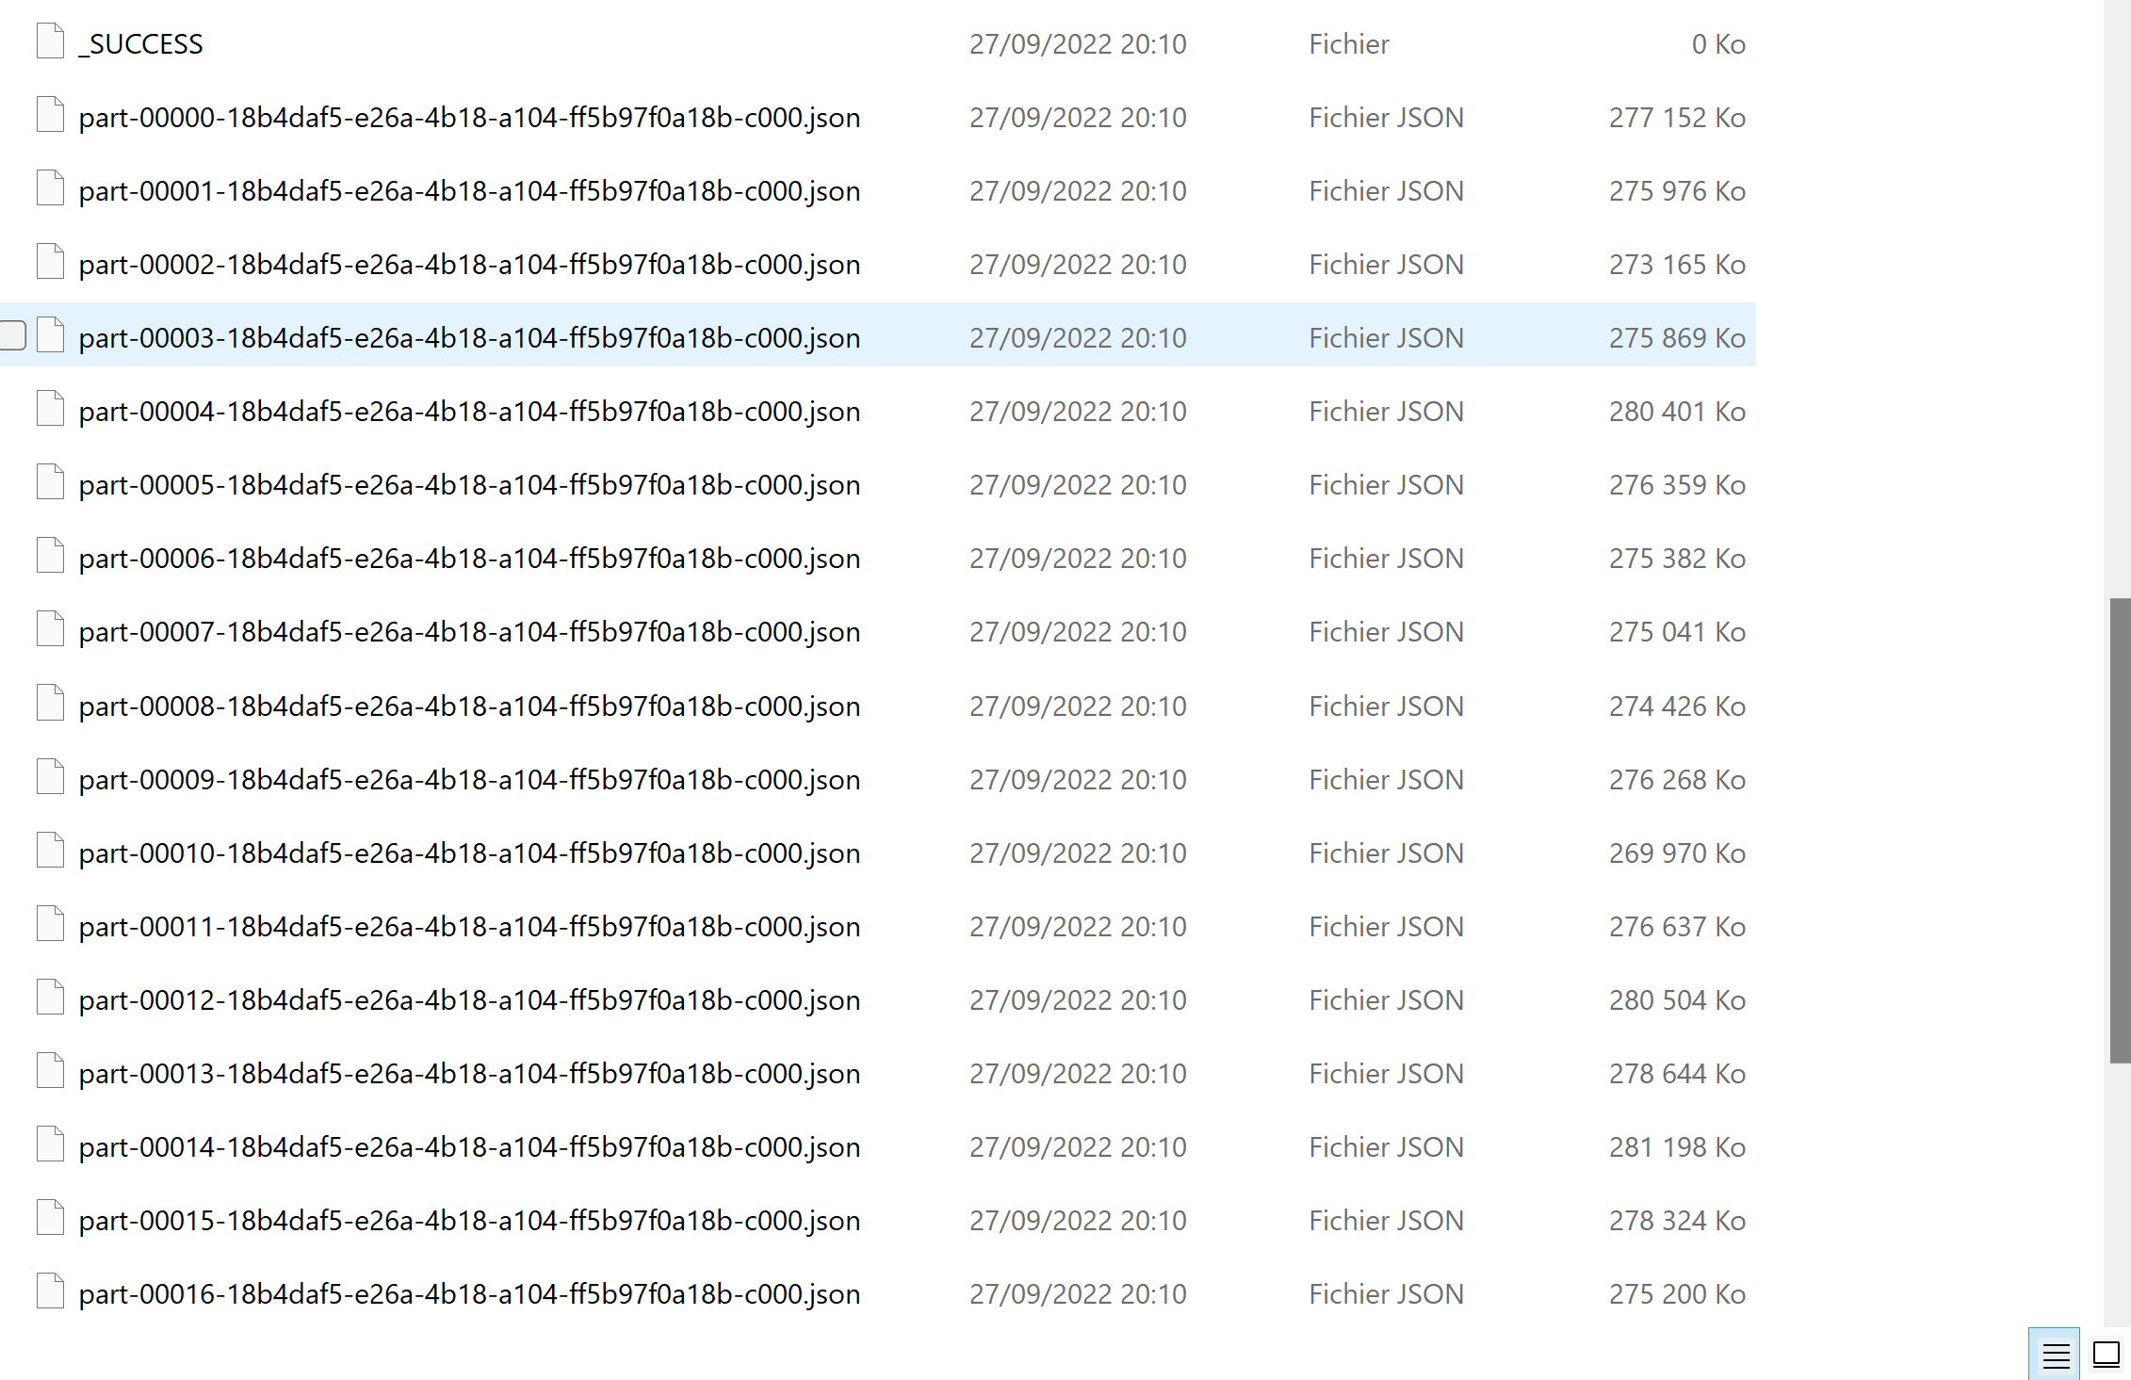
Answer Exercise 10 …

Slide 48
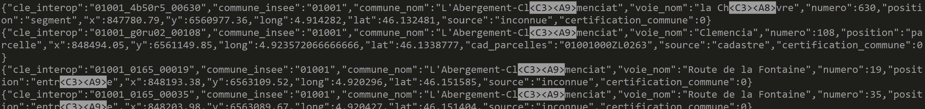
Answer Exercise 10
The ND-JSON File format is : { object1 }
{ object2 }
{ object3 }
..
Corresponding valid Json File would be: [ { object1 },
{ object2 },
{ object3 },
.. ]

Slide 49
(Optional) Exercise 11 : convert ND-json to valid JSON array File … then load from spark
To convert … you need to
add a START_ARRAY delimiter at line 1 : char « [«
finish all lines with char « , » … except the last line !!
finish END_ARRAY at last line : char « ] »
a/ edit manually a little file (~10 lines) / use regexp / or write a program(?)
b/ load this real json « multiline » file from spark

Slide 50
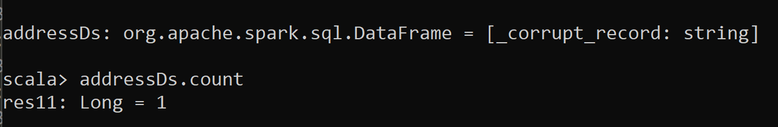
Hint Exercise 11
If you get this error …
Probably you have put an extra « , » at the last line ? … not valid json

Slide 51
Answer Exercise 11
val dir = "C:/data/OpenData-gouv.fr/bal/"
import java.io._
val out = new PrintStream(new BufferedOutputStream(new FileOutputStream(new File(dir + "/part.json"))))
val in = new BufferedInputStream(new FileInputStream(new File(dir + "/adresses-json2/part-00000-18b4daf5-e26a-4b18-a104-ff5b97f0a18b-c000.json")))
val lineReader = new BufferedReader(new InputStreamReader(in))
var line: String = null
out.print("[\n")
var more: Boolean = true
line = lineReader.readLine()
out.print(line) // print first line without comma separator
while(more) {
line = lineReader.readLine();
if (line != null) {
out.print(",\n"); // print separator, then line
out.print(line) ;
} else { more = false; } // no « break » in scala loop ?!
}
out.print("]\n")
out.close(); in.close()

Slide 52
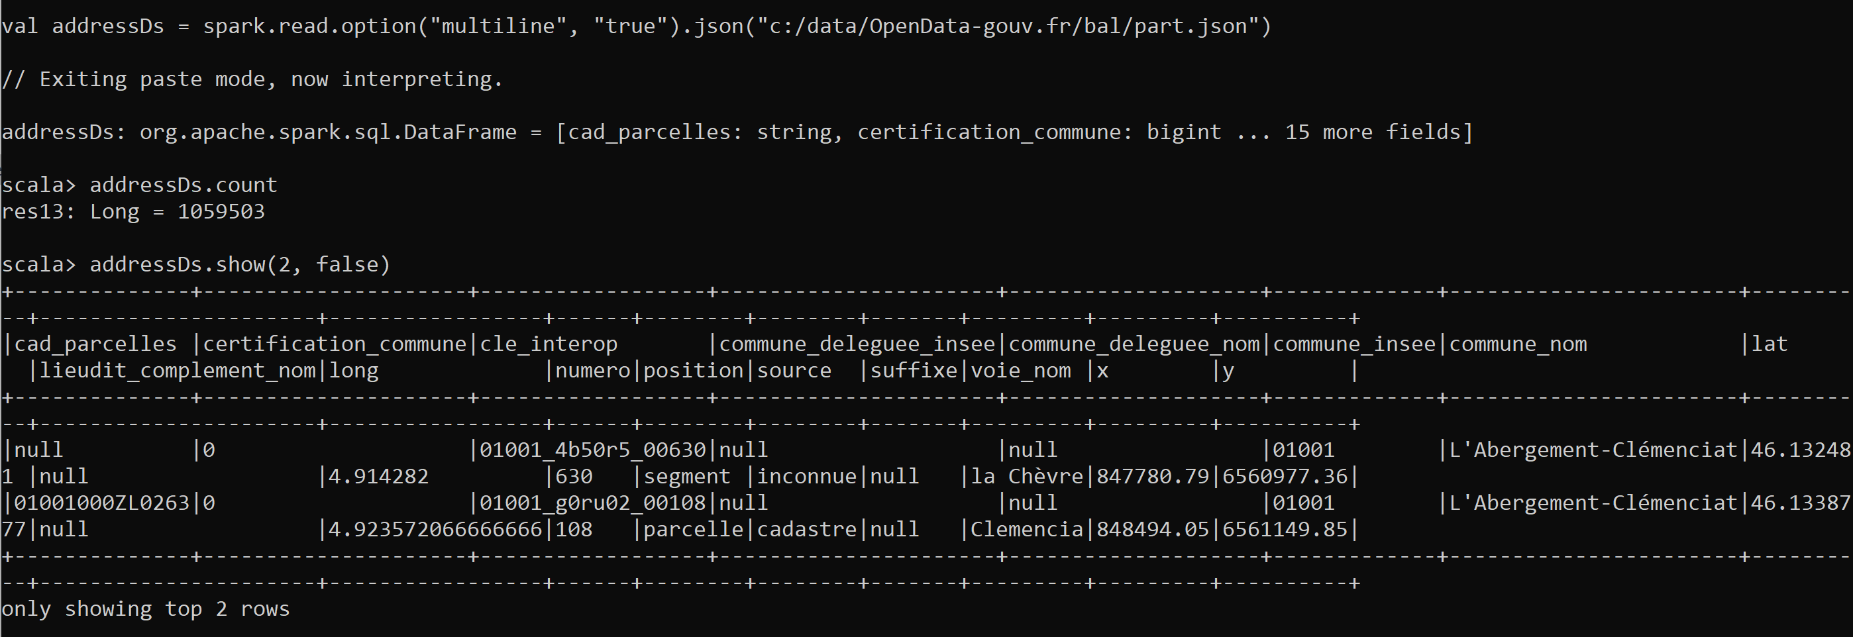
Answer Exercise 11
val addressDs = spark.read .option("multiline", "true")
.json("c:/data/OpenData-gouv.fr/bal/part.json")

Slide 53
Exercise 12 : Read plain « Text » lines from file
a/ edit a file containing many lines of text
b/ load this text file from spark c/ count number of lines
d/ what is the difference between spark.read.textFile() and spark.read.text() ?

Slide 54
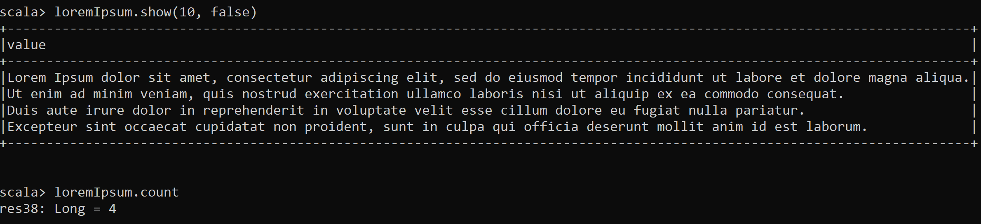
Answer Exercise 12
val loremIpsum = spark.read.textFile("c:/data/loremIpsum.txt")
loremIpsum.show(10, false)
loremIpsum.count

Slide 55
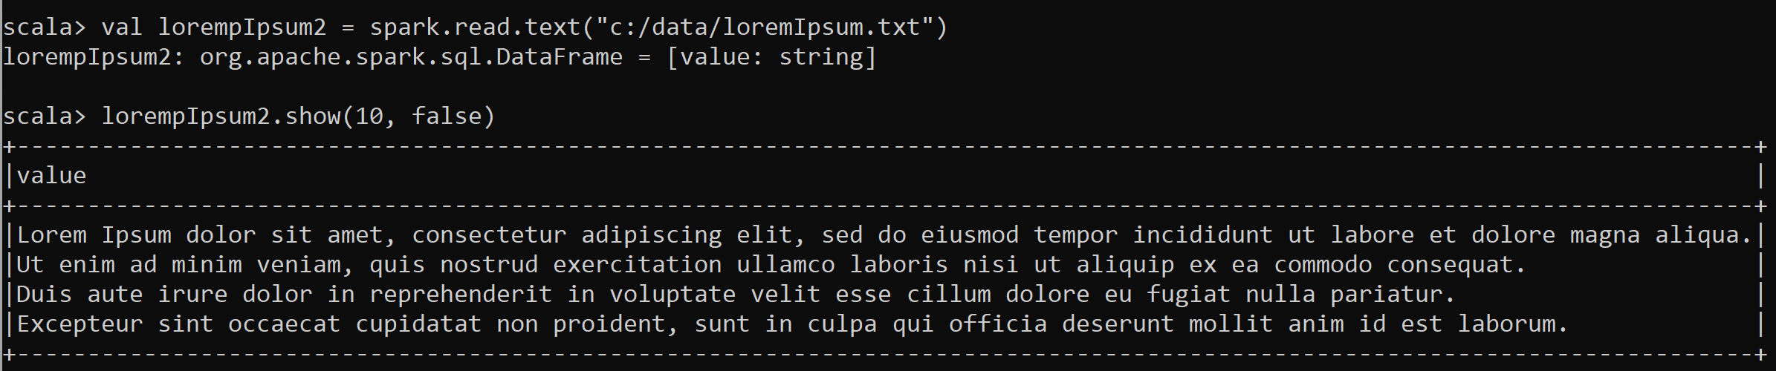
Answer Exercise 12 : difference between .text() and .textFile()
.textFile() => return Dataset[String] each element is a String
.text() => return DataFrame = Dataset[Row] … each element is a Row, containing 1 column « value », of type string

Slide 56
Exercise 13 : What about xml format ?
Questions
a/ do you see a « xml() » method in spark.read. ?
b/ why ?
c/ suppose you want to extract known <element>..</element> from a <root>..</root> … How would you convert to a Dataset ?

Slide 57
Answer Exercise 13
a/ There is NO spark xml method to parse xml … but java has standard xml parser (SAX or DOM) and XPath
b/ xml is not practical to define a standard list of rows. you need to interpret child elements of a given root element
c/ it is possible, but not practical .. Use map() and java code to parse. You may also use XPath UDF functions and explode lateral views.

Slide 58
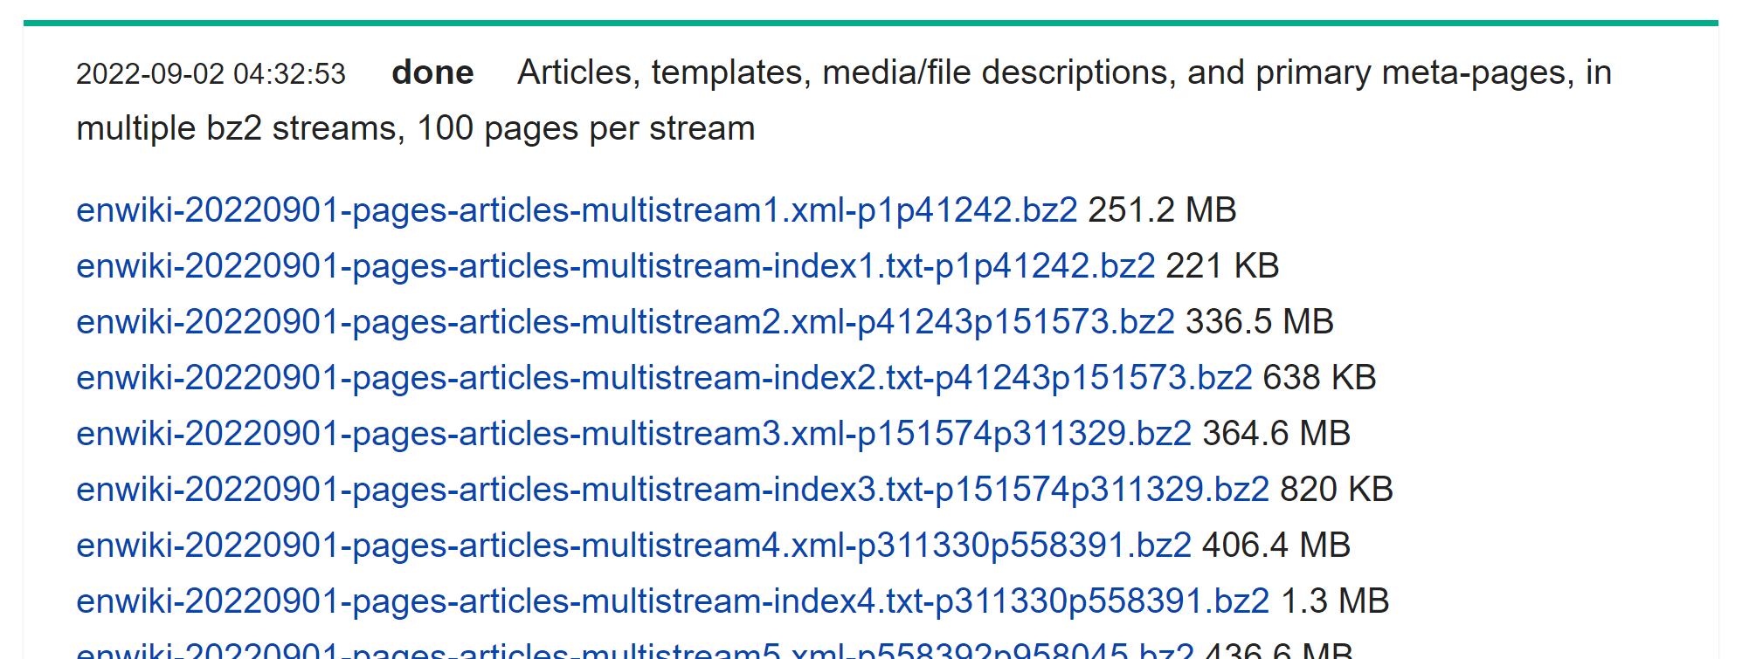
Exercise 13 … Example of « Big » Xml dump files
https://dumps.wikimedia.org/enwiki/20220901/
More than 100 Gigas of Xml files

Slide 59
Objectives of Hands-On
1/ read CSV files, convert options
2/ read combine several files
3/ others file format: json, nd-json, xml, text
4/ write to PARQUET files dir repartitionning
5/ Discover PARQUET format optimisations

Slide 60
APPENDIX … If you have finished exercises 9-13, but your friends are still struggling ?
Idea 1 / help your struggling friends
Idea 2/ bonus exercise 14 on textFile

Slide 61
Exercise 14 : the « World Count » Hello-World standard program of BigData
From dataset of text lines from exercise 12/ split all lines into words … For this, start by « map() » replacing all punctuation marks by a single space … Then replace 2 successive spaces by a single space
… Then split by space
… then use « flatMap() » instead of « map() »
Finally extract words count

Slide 62
Answer Exercise 14
spark.read.textFile("c:/data/loremIpsum.txt") .flatMap(line => line.replaceAll("[.,;:?!]", " ") .replace(" ", " ") .split(" ") )
.count

Slide 63
Answer Exercise 14 .. Explained
Return Dataset[String] .. 1 string per line
val loremIpsum = spark.read.textFile("c:/data/loremIpsum.txt")
loremIpsum.show(10, false)
val words = loremIpsum.flatMap(line => line.replaceAll("[.,;:?!]", " ") .replace(" ", " ") .split(" ") )
words.show(10, false)
words.count
Map + flatten all arrays
Regexp to replace punctuation
By single <space>
to replace 2 <space><space> By single <space>
String delimited by <space>
to Array

Slide 64
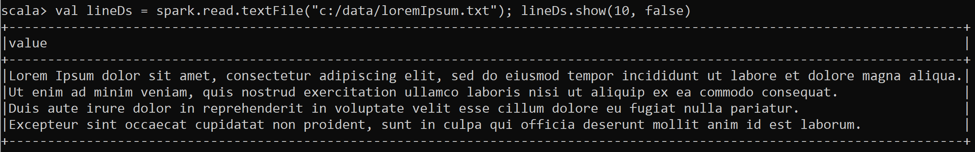
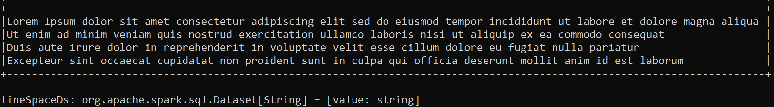
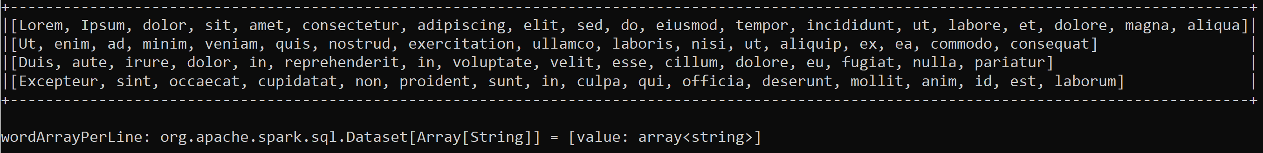
Answer Exercise 14
val lineDs = spark.read.textFile("c:/data/loremIpsum.txt") ; lineDs.show(10, false)
val lineSpaceDs = lineDs.map( line => line.replaceAll("[.,;:?!]", " ") .replace(" ", " ") ); lineSpaceDs.show(10, false)
val wordArrayPerLine = lineSpaceDs.map( line => line.split(" ") ) ; wordArrayPerLine.show(10, false)

Slide 65
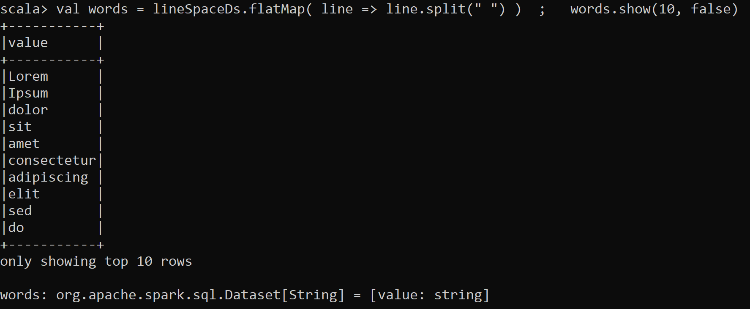
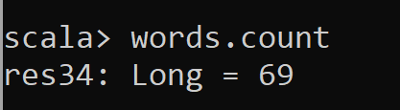
Answer Exercise 14 ..
val words = lineSpaceDs.flatMap( line => line.split(" ") ) ; words.show(10, false)
words.count

Slide 66
10 mn pause

Slide 67
Continue… Please open next document: Part2 TD2-Part2 (PARQUET)

