Slide 2
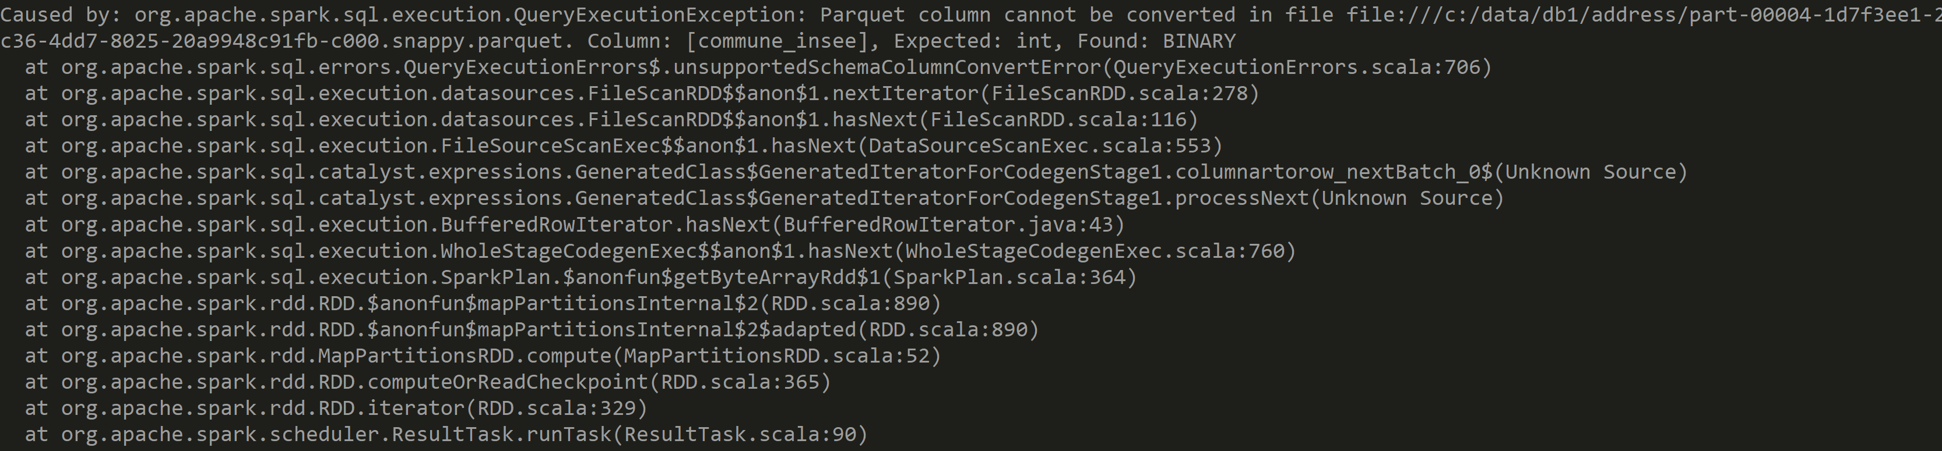
ERROR: convert Parquet <-> Column Metastore Type
Workarounds ? --conf spark.sql.parquet.enableVectorizedReader=false

Slide 3
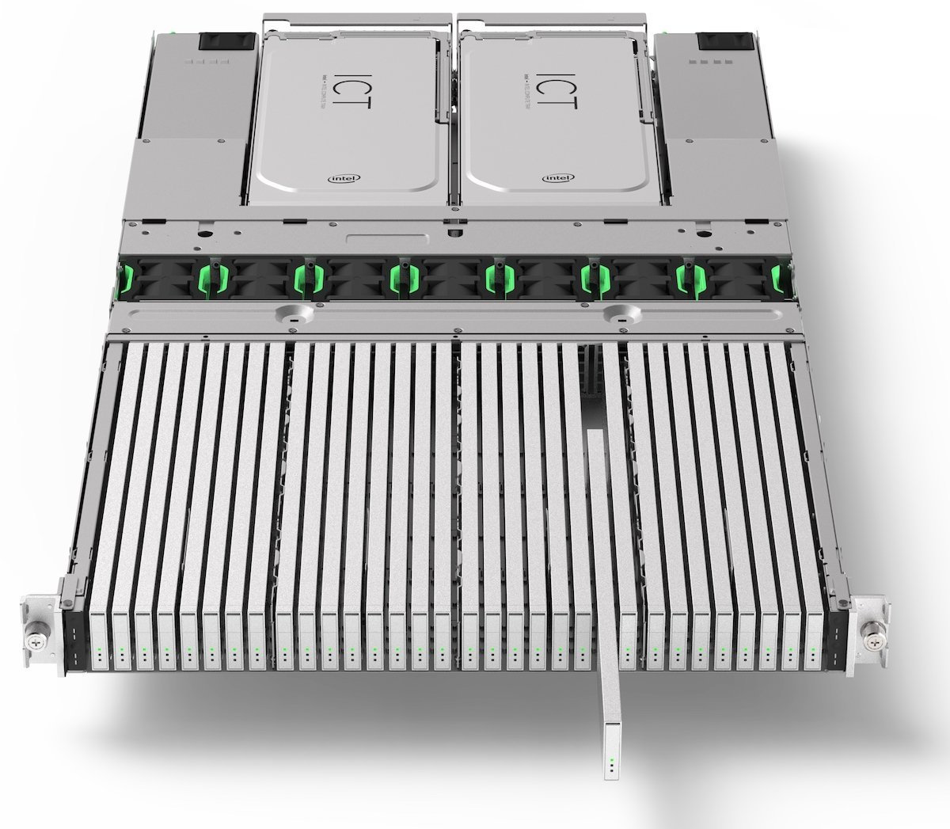
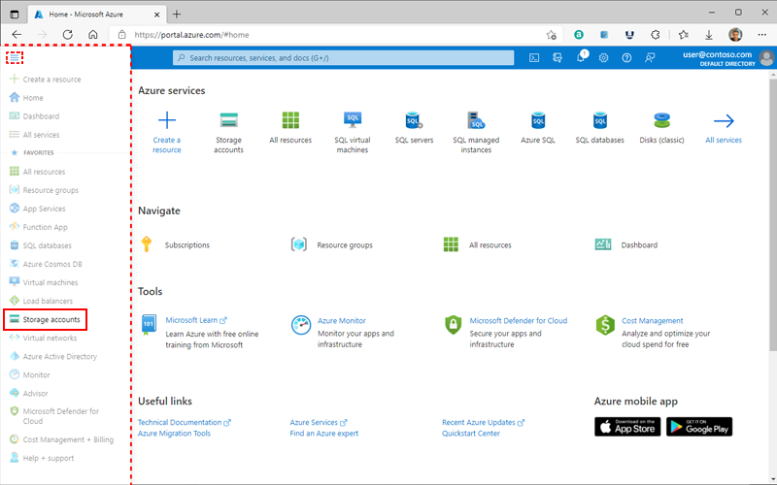
Difficult to Store 2 Petas?
4 x
or Click

