Slide 1
Basic Data-Structures & Algorithms Complexity
This document:
https://github.com/Arnaud-Nauwynck/presentations/blob/main/java/Basic-Data-Structures.pdf

Slide 2
Outline
ArrayList
add / indexOf / remove
resize
LinkedList
Arrays.sort, Tim Sort
HashMap
hashCode, modulo or power 2, collisions
resize
Put, get, remove, iterate
TreeMap
balanced tree, red-black tree
Put, get, remove, iterate
PriorityQueue
Offer, poll
All with Schemas
+ Algorithms
+ Associated Complexity
O(1), O(log N), O(N), O(N log N), O(n2)..

Slide 3
ArrayList<T>

Slide 4
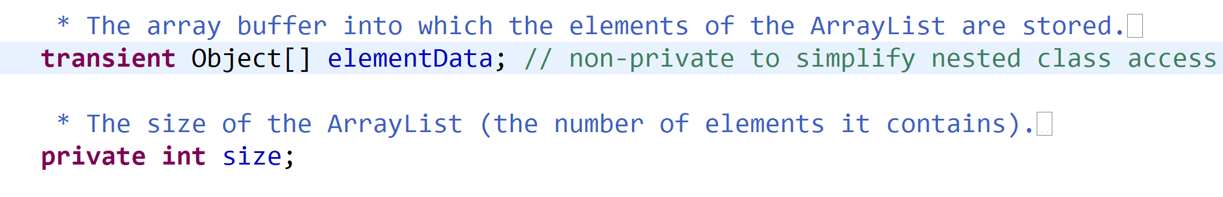
ArrayList
data.length
( > size)
ArrayList
elementData
[0] [1] [2] [3] … [size-1]
size
Free count =
data.length- size
elementI
element0
element1
element2

Slide 5
ArrayList.add(element) If Fast case : enough allocated length
elementData[size] = element
ArrayList
elementData
[0] [1] [2] [3] … [size-1]
[size]
size
Free count =
data.length- size
size++
element
Complexity = O(1) … 1 logical operation

Slide 6
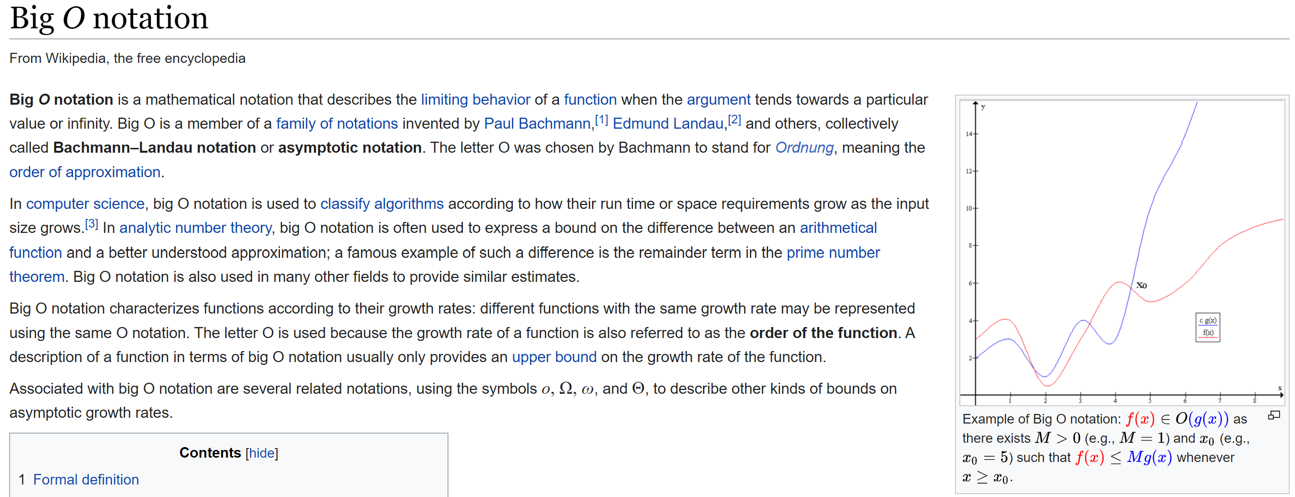
Big O Notation
f(x) is O(g(x)) means: f(x) < M g(x) for x > x0 and M>0

Slide 7
ArrayList.add(element) If Slow case : NOT enough allocated length
[0] [1] [2] [3] … [size-1]
ArrayList
arrayCopy(elementData, 0,
newData, 0, size)
newData[size] = element
new T[newSize]
elementData
size
[0] [1] [2] [3] … [size-1]
[size]
elementData=newData
New Free count =
newData.length- size
size++
element
Complexity = O(size) … need copy all existing element pointers

Slide 8
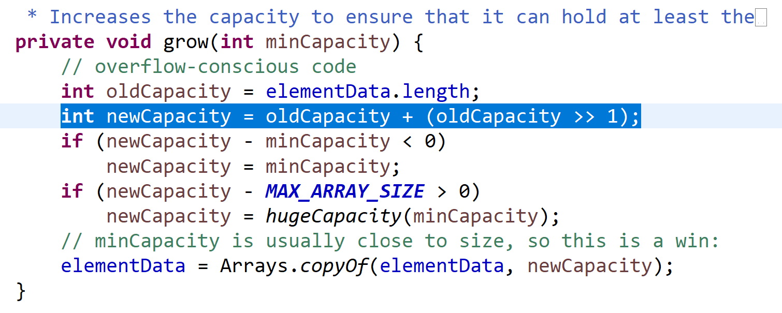
How much to allocate in advance?
compromize
+1 +2 +3 … +size/2 +… ???
Bad compromize:
Need copy every time adding
Bad compromize:
Lot of wasted memory if no more add
Memory preference
Compute preference

Slide 9
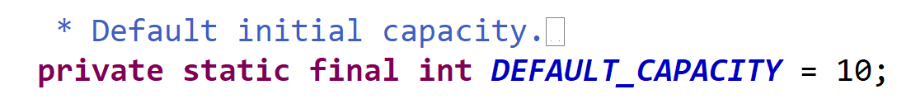
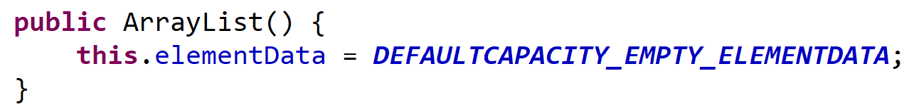
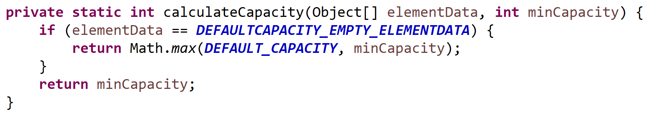
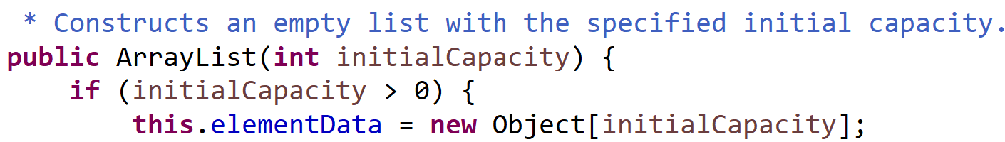
ArrayList initialCapacity : 0 .. then 10
Use explicit if known size

Slide 10
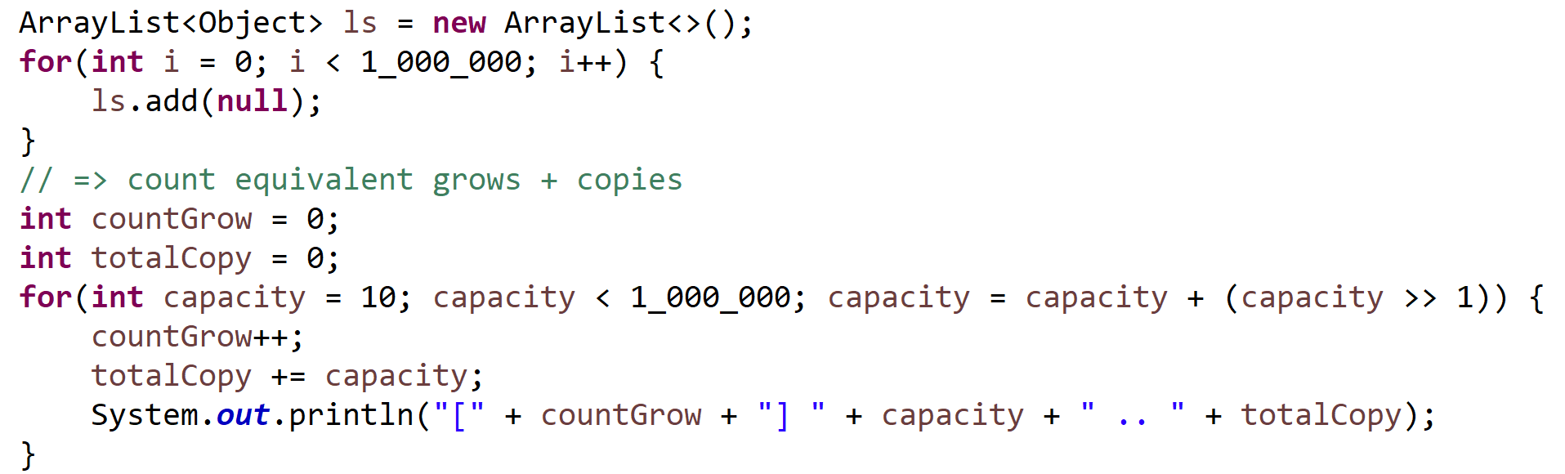
Loop … add(element) => How many waste copies / times ?
Grow capacity occcured at:
Count : 1 2 3 4 5 6 28 29
Capacity : 10 15 22 33 49 73 …. 540217 810325
Total Copies: 10 10+15= 25 25+22=47 80 129 202 1620647 2430972
Total : 2.4 Million copies
To add 1 Million values

Slide 11
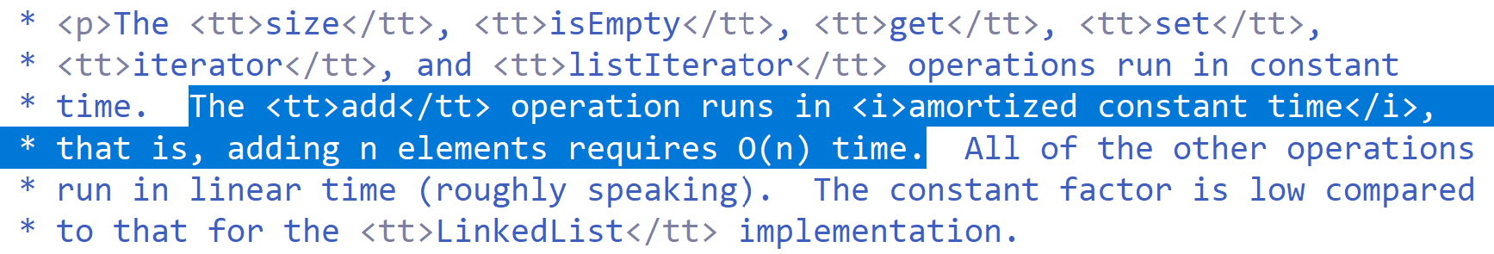
Average Cost
Total copies = O(N) …. 2.4 * N for 1M
Number of reallocations: O(log N)

Slide 12
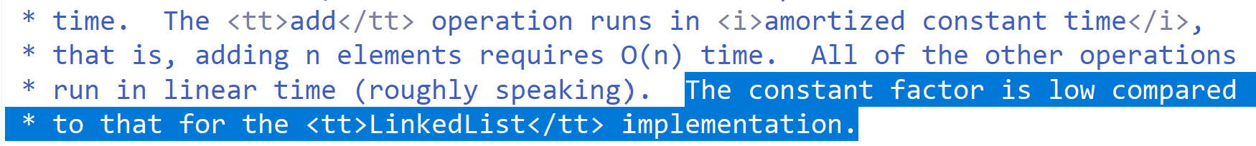
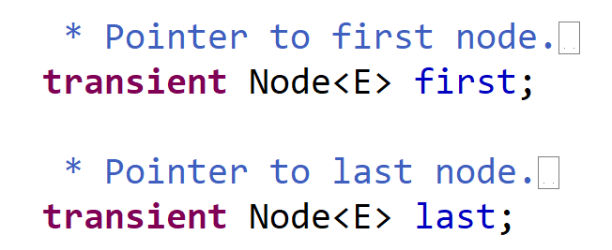
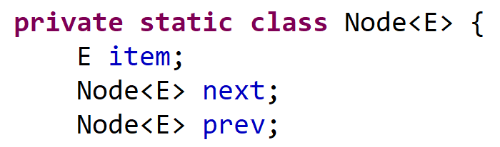
LinkedList … even worse !
LinkedList
Node
Node
Node
first
item
item
item
last

Slide 13
Problem … « RAM » Random Access Memory … cache L1, L2
Typical access time :
RAM is ~100 nanos … 1000 x SLOWER than L1
But Typical capacity :
L1 is ~15 Ko … 1M x SMALLER than Ram ( ~100 Go)
Algorithm cost is driven by Cache misses + Look Aheads

Slide 14
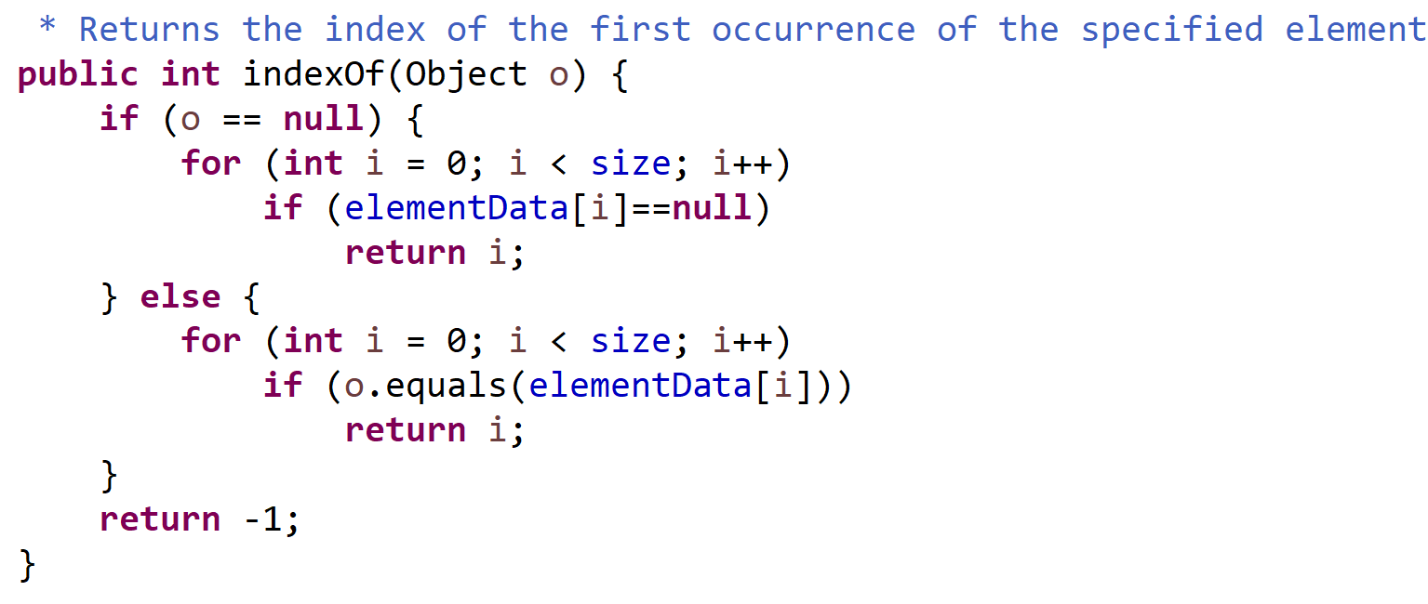
ArrayList.indexOf(element)

Slide 15
Average Cost indexOf()
Positive find => … return break loop maybe at position 1, or 2, … or N
1+2+3+ … + N
(N+1) * N
N+1
= half scan in average
N
=
2 N
=
2
Negative find => … always full scan
=
N

Slide 16
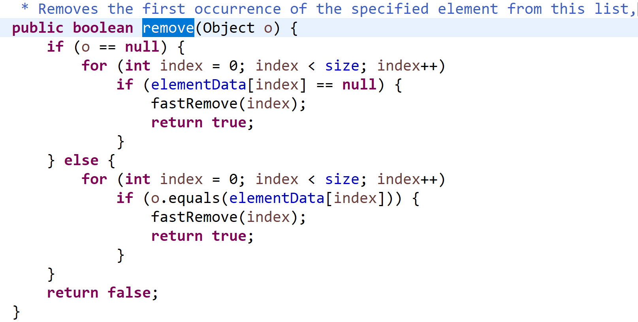
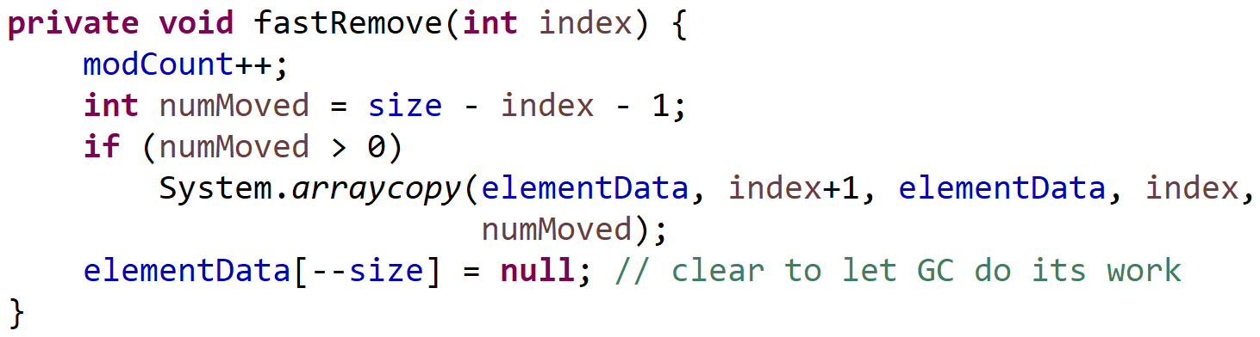
ArrayList.remove(element) = indexOf + fastRemove by index
arrayCopy(…)
data[--size] = null
ArrayList
elementData
[0] [1].. [index-1] [index] … [size-1]
[size]
size
Average : O(size/2 + size / 2) = O(N)
Size--
search
remove

Slide 17
ArrayList.remove(index)
list.remove(0)
WORSE CASE !!! O(N)
Need shifting ALL elements
list.remove(list.size()- 1)
OK… O(1)
Always prefer treating « removing »
elements at end

Slide 18
HashMap<K,V>

Slide 19
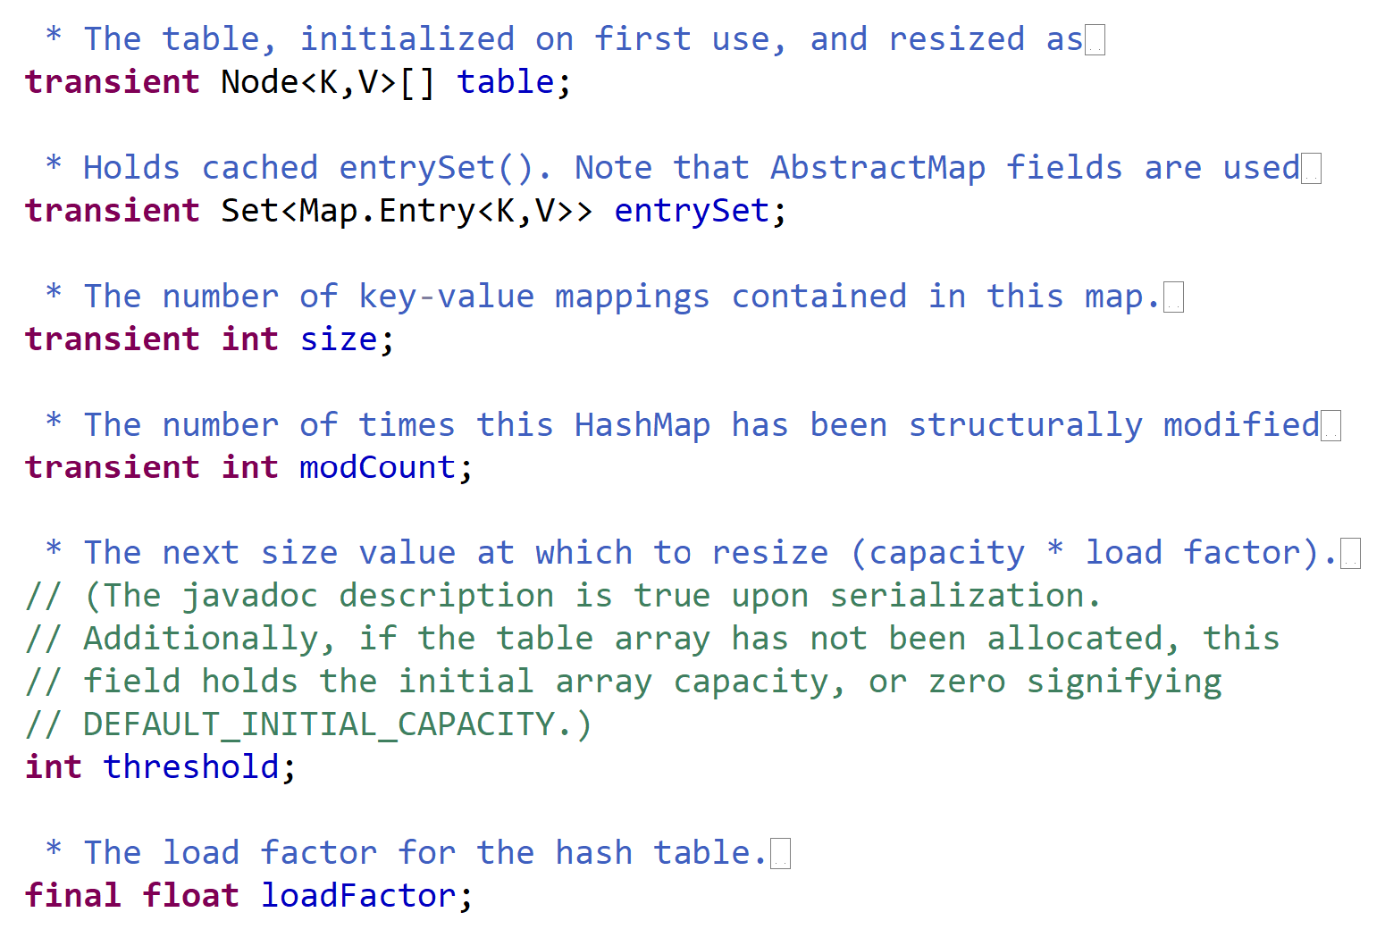
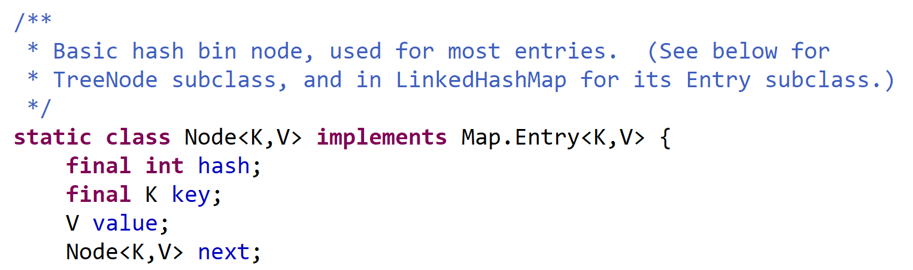
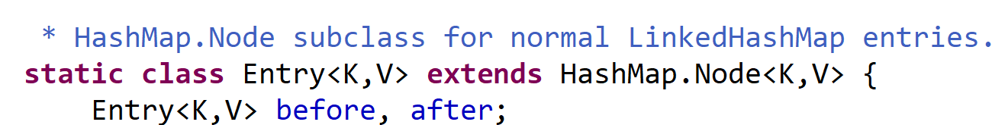
HashMap<K,V>
… LinkedHashMap<K,V>

Slide 20
hashCode() injective function for Key -> int
Key
field1
field2
..
Mix all bits information
Example using « ^ » (xor) :
int x,int y => x ^ y
long value => (value ^ (value>>>32))
Example using prime: x*31+y
int
Expected properties:
1/ repeatable (same object => same result .. No time or address dependent)
2/ when key1.equals(key2) => same hashCode
3/ when different key => expect BUT NOT mandatory to have different hashCode
4/ use all bits information on key (no naive return 123, even if legal)
5/ try to reach all possible values of « int » range: [-2^31… +2^31]

Slide 21
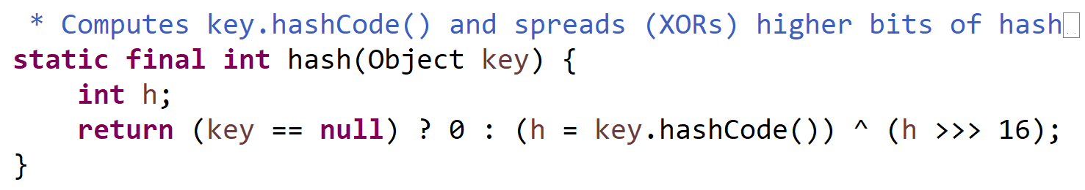
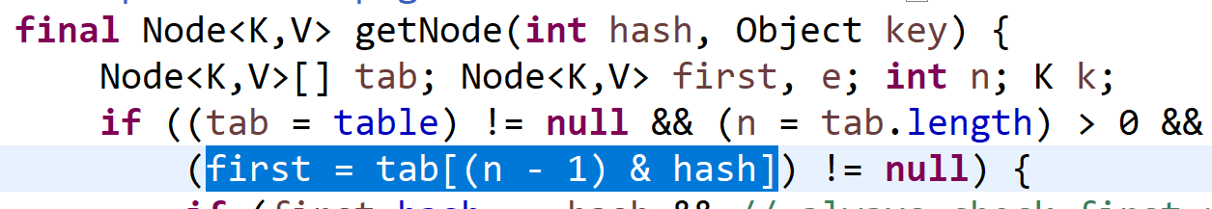
Hashing Function, then Modulo « % » or Bitwise « & »

Slide 22
.. Mostly equivalent to « modulo »
hash = Key.hashCode()
… « int » in range [-2^31, +2^31]
hash2 = Math.abs(hash)
… in [0, +2^31] .. Lost 1 bit
index = hash2 % M
Randomly distributed when M is Prime
… in range [ 0, size-1 ]
OK to lookup in array « table[size] »

Slide 23
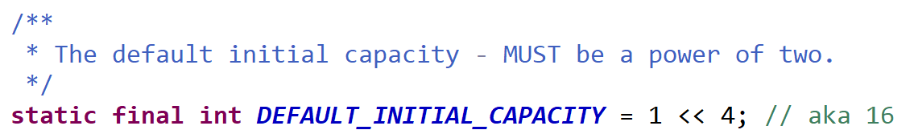
Jdk .. Use capacity=2^power
Example: (in base 2)
N =32 = (1 << 5) = 0 0 0 1 0 0 0 0 0
n-1 = 31 = 0 0 0 0 1 1 1 1 1
Hash = y y y y x x x x x
Hash&(n-1)= 0 0 0 0 x x x x x
Hash to index .. using « hash & (n-1) »
Resize: capacity *2 .. using « capacity << 1 »
(jdk : no decrease capacity )
Re-hash after resize => index change to index or index*2

Slide 24
hashCode() … lookup index for finding value by key if present
index = abs(key.hashCode()) % M
HashMap
table
[0] [1] [2] … [index] … [length-1]
size
FAST return null
If no Node for hash
Test same hashCode
Node
hash
Key
value
next
Key1
Test key.equals(key1)
Value1
Return value1 if equals key
Else if has next « collision »
(same hash)
… loop linked list
Node
hash
Key
value
next
Key2
Test key.equals(key2)
Value2

Slide 25
Strategy to Reduce Collisions Occurrences
1/ use « GOOD » hashCode() function …. With hopefully equally distributed values
2/ use « BIG » M allocated tables length (example: M > 2 * N ) … wasting memory, but improving selectivity (avoid %M collisions)
3/ if using « hashCode % M » … prefer M as Prime number ( NOT the implementation of jdk )

Slide 26
Same « hashCode()%M » : collisions
index = Key.hashCode() % M
HashMap
table
[0] [1] … [index] … [length-1]
size
Node
Node
Node
hash,key,value
next
hash,key,value
next
hash,key,value
next
Node
hash,key,value
next
Empty slot
Key not found
Key uniquely found
(no collision)
Collision :
2 different keys
with same hash%M
Too many collisions !!
Cf next ( Tree )

Slide 27
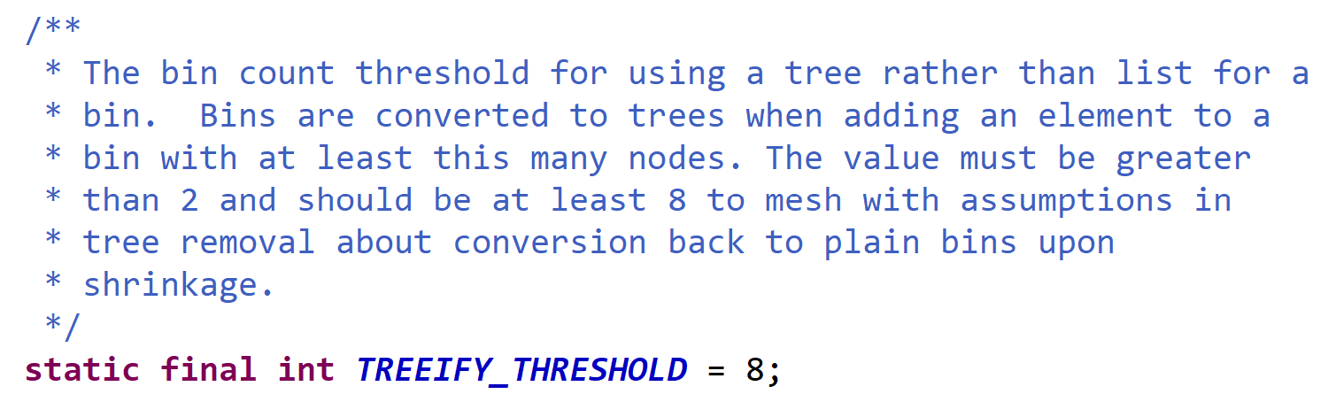
LinkedList to Tree … >= 8

Slide 28
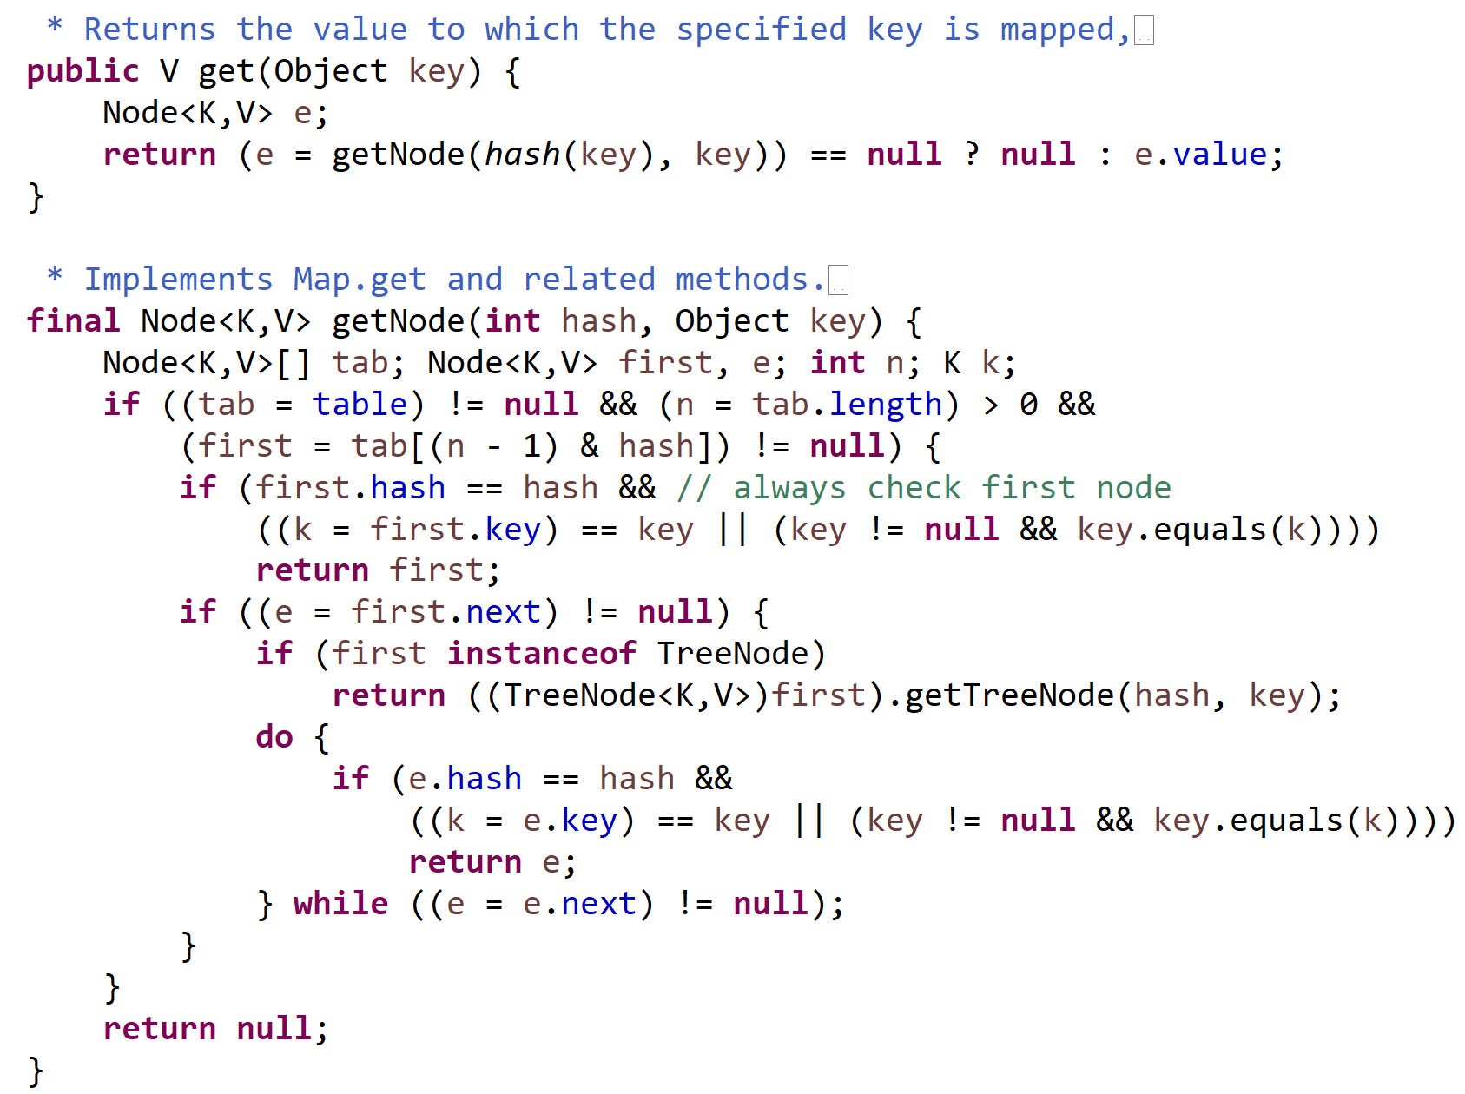
HashMap.get(key) … O(1)
Fast path
O(1) …no collision
many collisions
O(log(C)) …
medium path
O(8/2) …few collision(s)

Slide 29
HashMap.put() … may resize
Hash size « M » should be adapted to number of element « N »
greater (but not too much)
.. Sometime re-copy all ! … reduce collisions
General rehash when using %M
HashMap
table
size
FAST rehash
Using power of 2
Rehash is FAST … (not recomputed, and index unchanged OR *2)

Slide 30
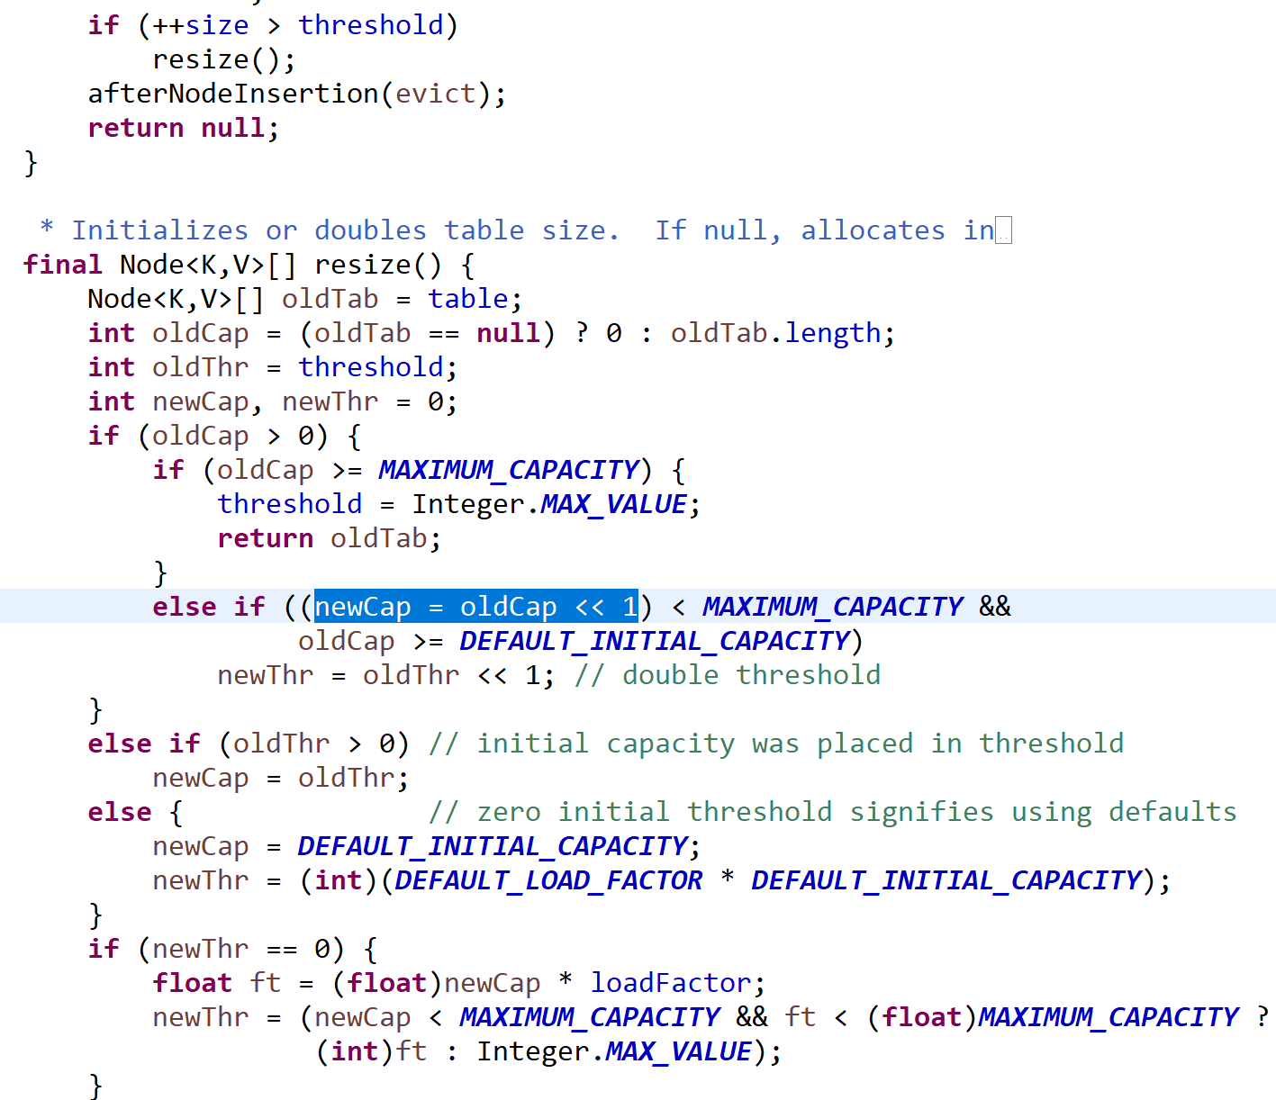
HashMap.resize(): ?>threshold and capacity*2
May resize after put()
capacity*2, threshold*2
Init : capacity=16,
loadFactor=0.75
..threshold=12

Slide 31
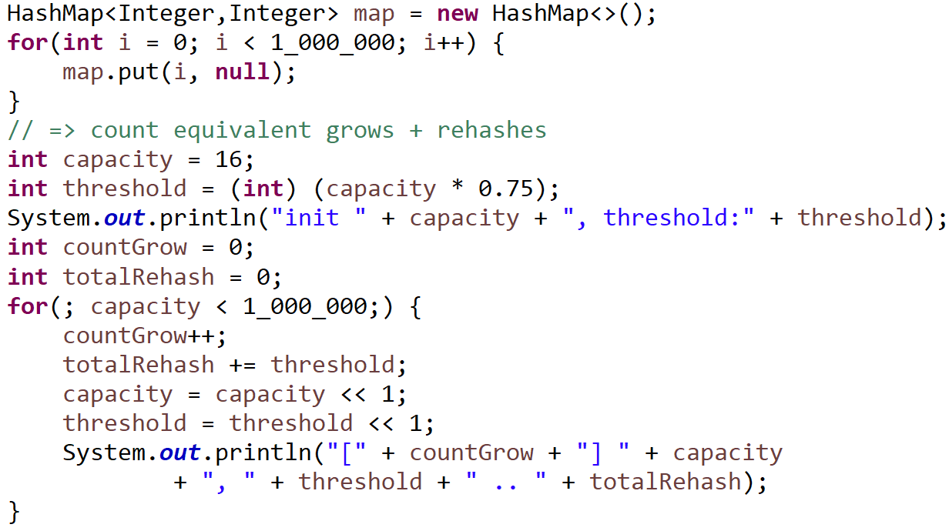
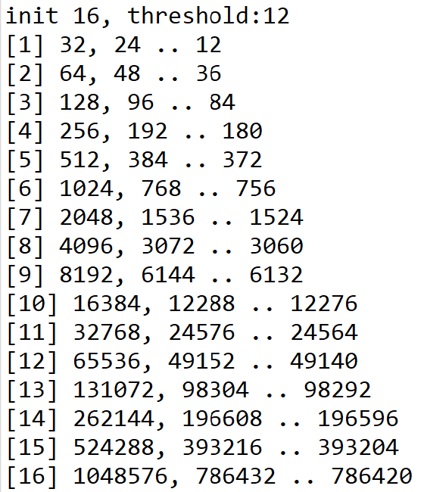
Loop put(k,v) … how many resize() + total Re-hashes?
Put 1 Million values => 16 resizes … 700k total rehashes
~ 0.8 N … O(N)

Slide 32
TreeMap<K,V>

Slide 33
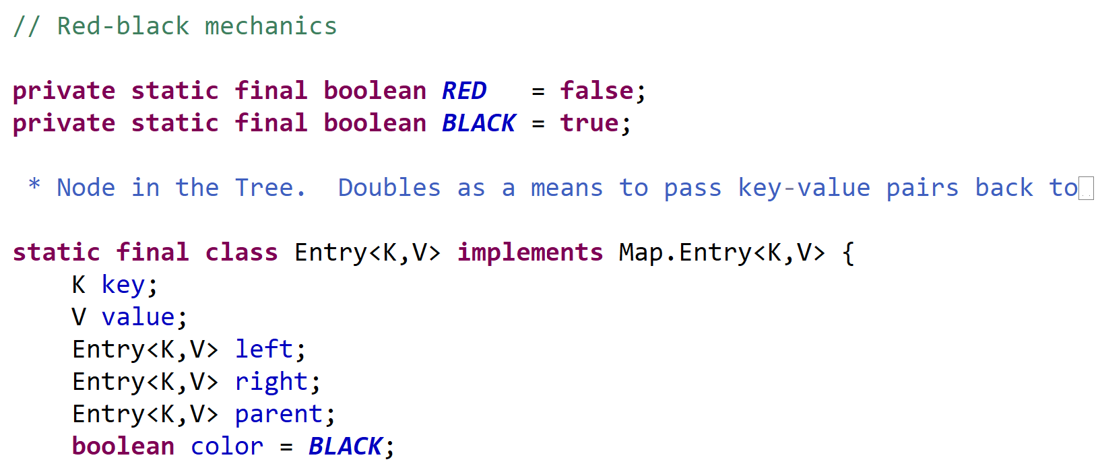
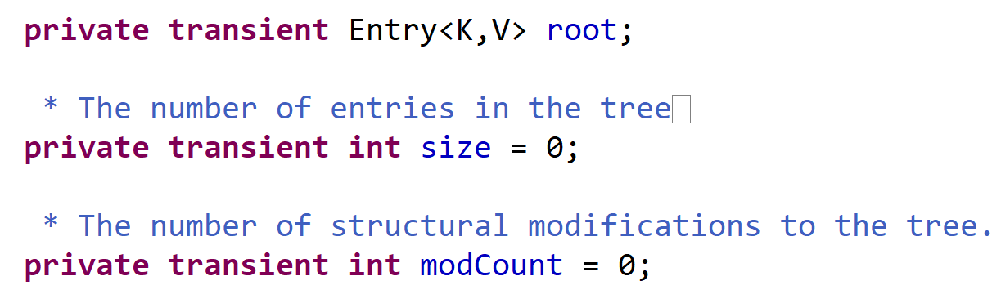
TreeMap<K,V>
TreeMap
root
Entry
size
key,value
color
Entry
Entry
key,value
color
key,value
color

Slide 34
Balanced / Un-balanced Trees
tree depth
= O(log N)
tree depth
= O( N)
null
intermediate
levels:
Hopefully
Entierly filled
null
null
null
null
null
null
leaf levels
may be empty
(not multiple of 2^N)
Weight Left SubTree ~= Weight Right Sub Tree
All path = depth-1 or depth

Slide 35
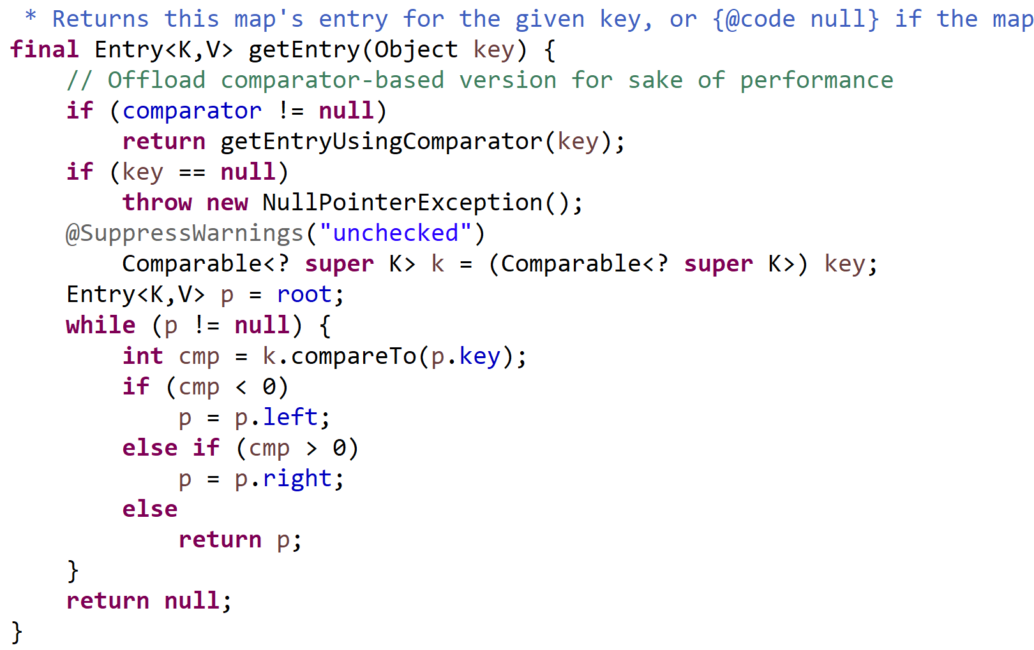
TreeMap.get(key)
Level 0: root
Compare rootKey <-> key
Compare : > 0 => go right
Max operations
= tree depth
= O(log N)
Compare < 0 => go left
Compare = 0
=> found
OR no more child => stop
N=2^depth

Slide 36
Red-Black Rules
1 Every node is either red or black.
2 All NIL nodes (figure 1) are considered black.
3 A red node does not have a red child.
4 Every path from a given node to any of its descendant NIL nodes goes through the same number of black nodes.
or
black
black
=> the path from the root to the farthest leaf is no more than twice as long as the path from the root to the nearest leaf
n1 black = n2 back

Slide 37
Rotations
Left to Right Rotation
n1
n2
n2
n1
T3
T1
Right to Left Rotation
T1
T2
T2
T3

Slide 38
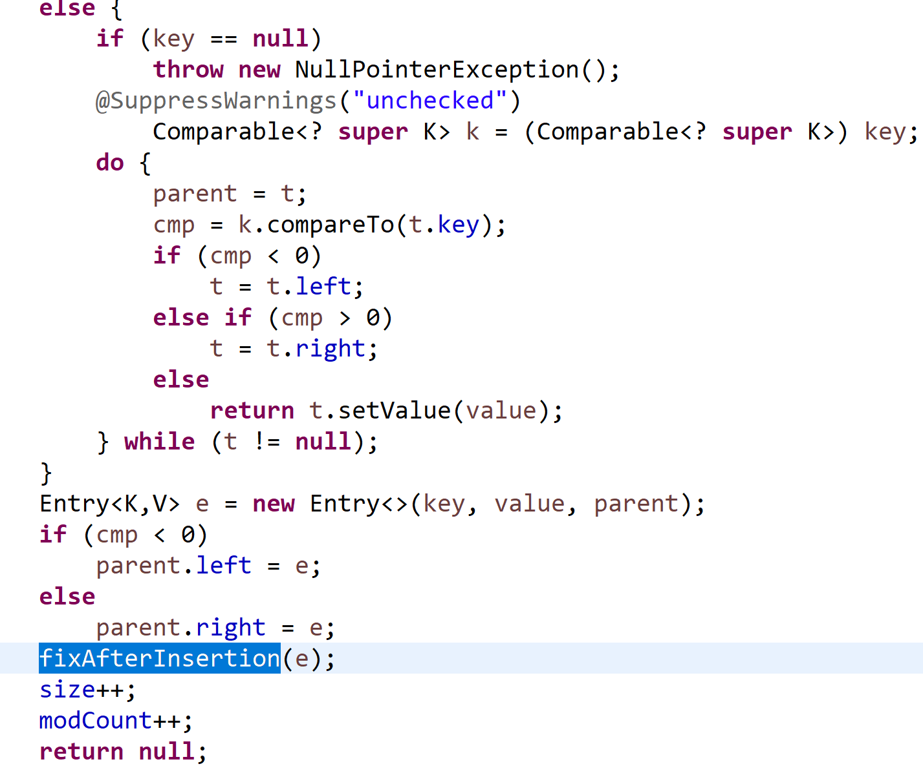
TreeMap.put(key, value) .. [1/2] find down insert point
…..
Level 0: root
Compare rootKey <-> key
Compare : > 0 => go right
Compare < 0 => go left
Compare = 0
=> setValue .. END
OR no more child => insert + fix

Slide 39
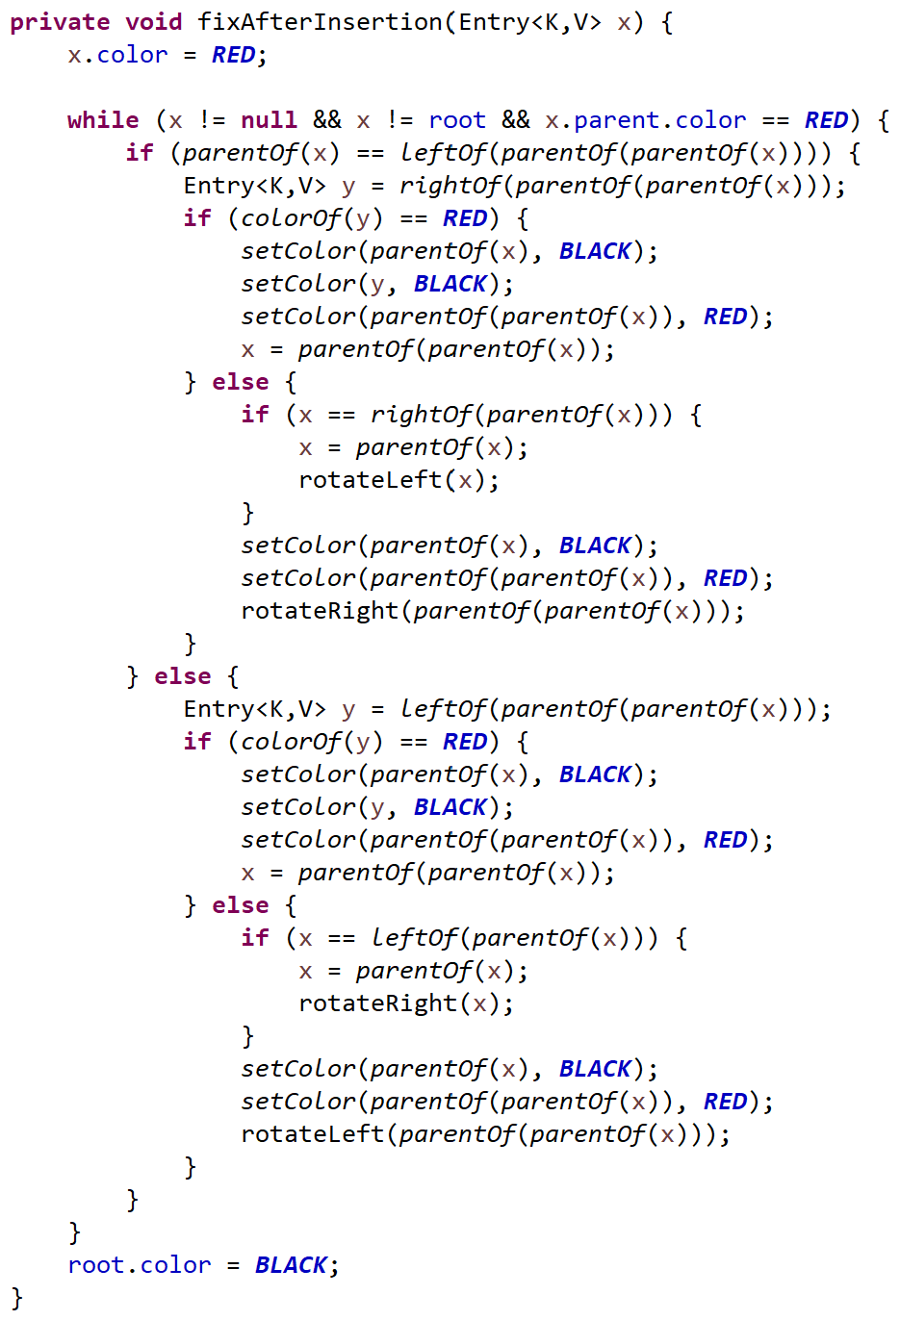
TreeMap.put(key, value) .. [2/2] fix up color+rotate
Finished on black parent node
( or root)
Maybe fix color + maybe rotate
Maybe fix color + maybe rotate

Slide 40
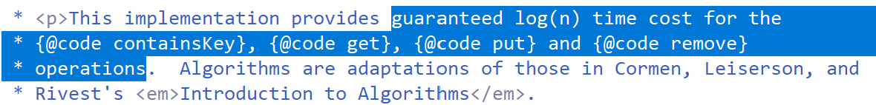
Time cost … O(log N)
.get(key) .containsKey(key)
.put(key, value)
.remove(key)
Read-only
Unitary write
Idempotent
(not atomic, need synchronize)
.put() and .remove() slightly slower than get
: need fixup .. But still very fast

Slide 41
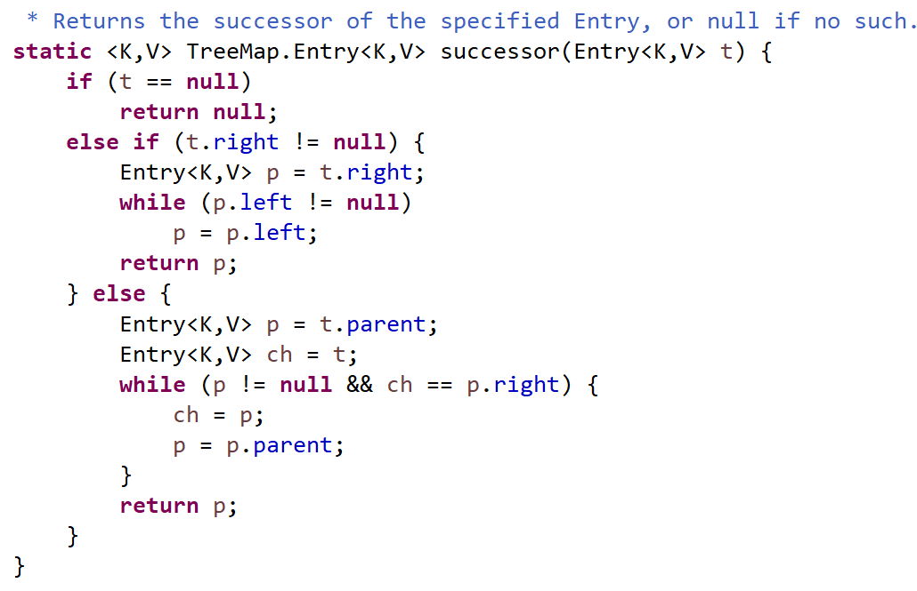
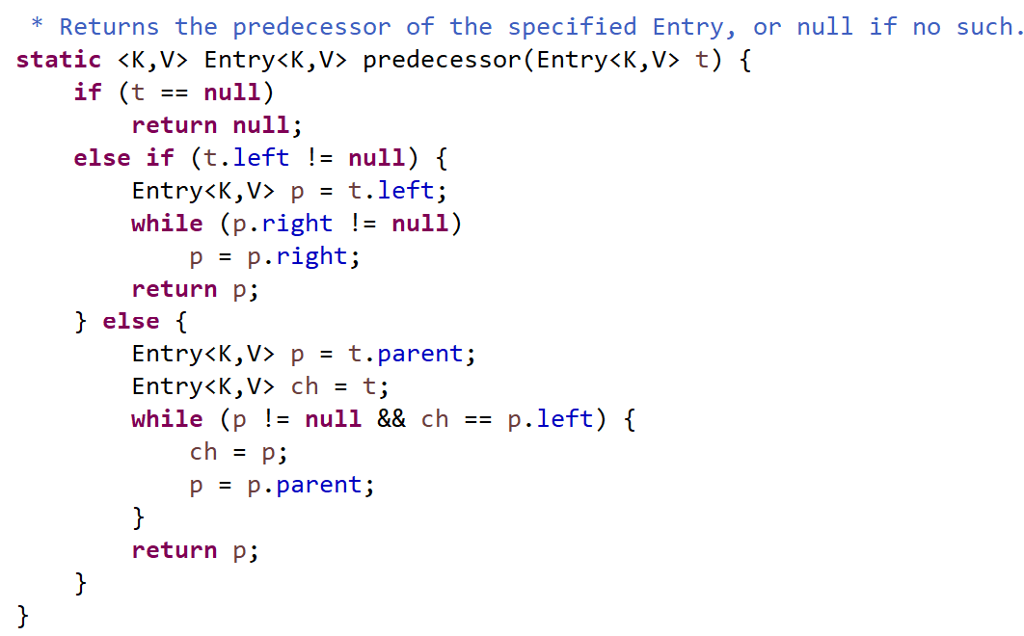
TreeMap.iterator / subMap / headMap / tailMap
Unitary successor() and predecessor() run in O(log N)
… scanning all TreeMap runs in O(N log N)
not optimal compared to Arrays.sort() + scanning in ArrayList

Slide 42
Arrays.sort()

Slide 43
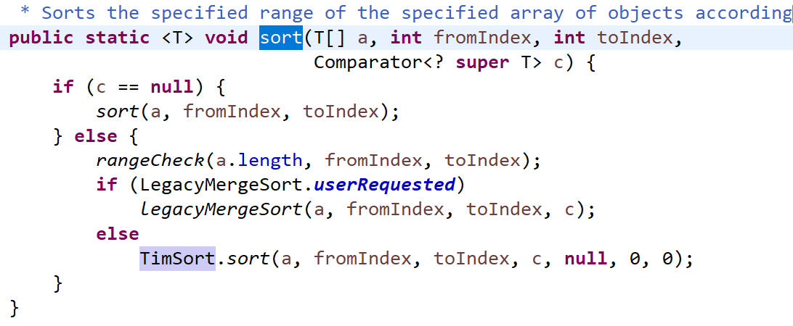
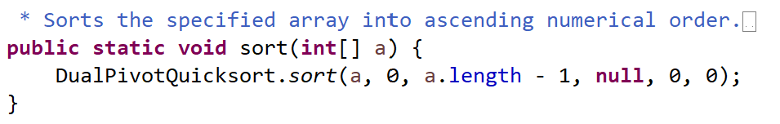
Arrays.sort() … O( N log N )
Many algorithms
Buble Sort (..bad O(N^2)) / Insert Sort / Quick Sort / Merge Sort … not used in java
ParallelSort .. => using common ForkJoinPool + Dual Pivot Quick Sort
Dual Pivot Quick Sort (called from Arrays.sort() … on primitive types)
Tim Sort … default in ArrayList and Arrays.sort(.. Comparator)

Slide 44
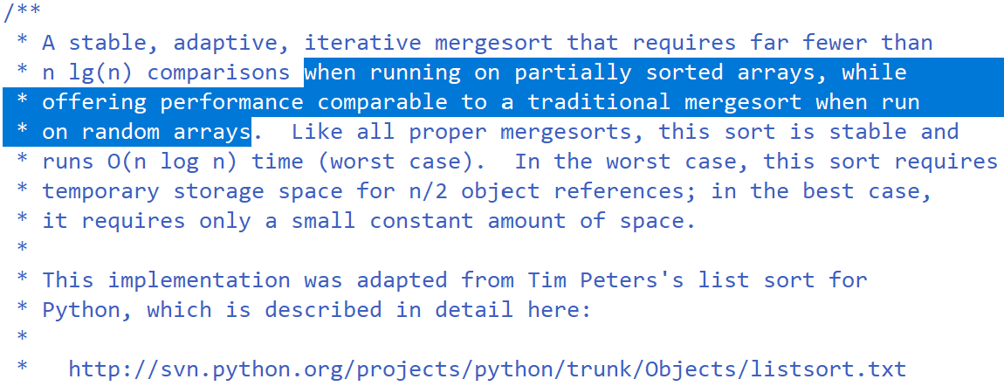
Tim Peter’s Sort

Slide 45
PriorityQueue<T>

Slide 46
PriorityQueue Property: for all node, parent value <= child value
Compared to TreeMap … no constraint between left child and right child
Root contains the min value
… all others looks « unordered »
1
Example for 1, 2, 3, 4, 5, 6
4
2
6
3
5

Slide 47
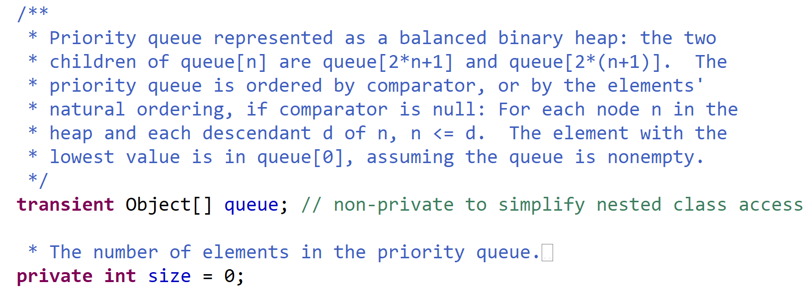
PriorityQueue … Balanced Binary Heap as Array

Slide 48
Tree as Array
Root [0]
0
[0]
Root Left child=0*2+1=1
1
Root Right child=0*2+2=2
2
3
2*1+1
4
2*1+2
5
2*2+1
6
2*2+2
7
8
Last insertion point
Fast arithmetic base 2:
« i *2 » : i << 1
« i /2 » : i >>> 1

Slide 49
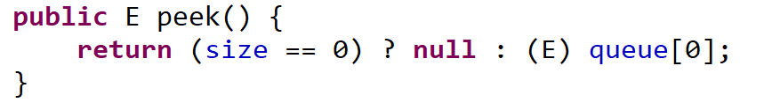
PriorityQueue.peek() … O(1)
peek() : return but do not consume (no remove) min value
… simply look at root !

Slide 50
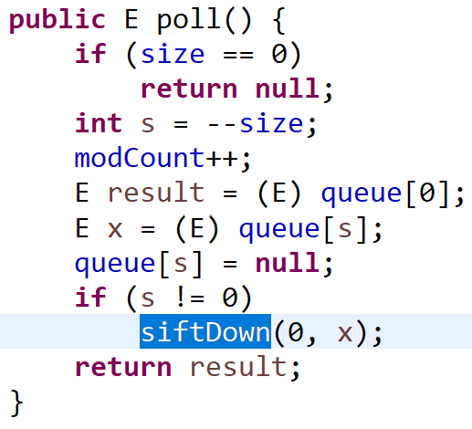
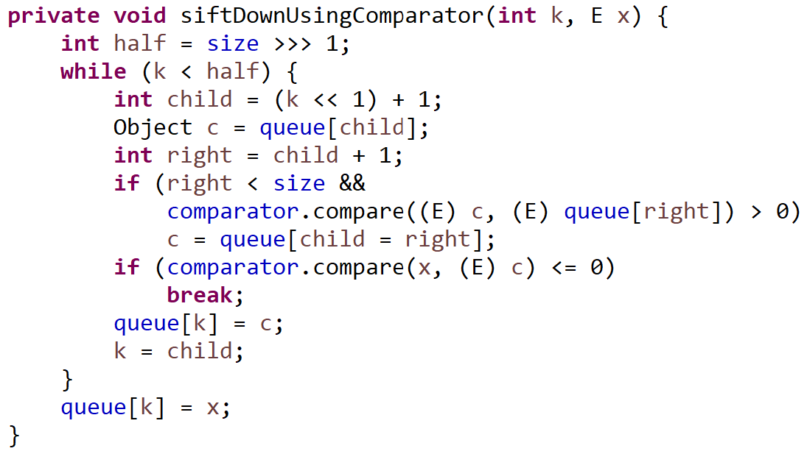
PriorityQueue.poll() … O(log N)
Poll root
Fix order
Down until ok
Compare to child right,
then child left
remove last,
put at root

Slide 51
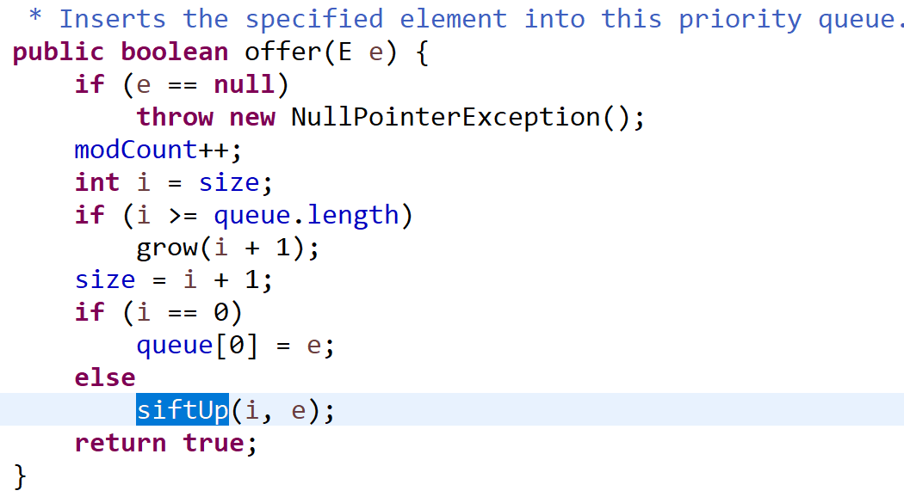
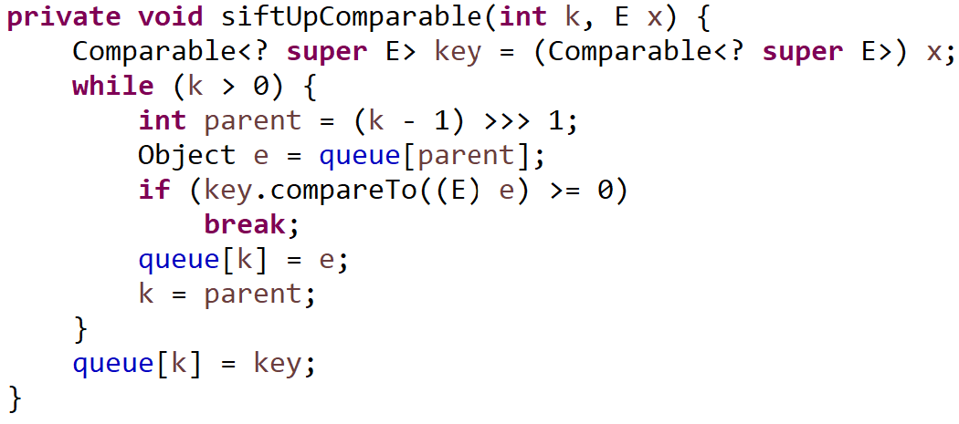
PriorityQueue.add(v) / .offer(v) … O(log N)
Loop Swap parent
until lower
insert last

Slide 52
Typical PriorityQueue Usages … Shortest Path Finding
Starting Point
Destination Point
Current shortest
Neighboors
to consider
Shortest Distances already analyzed
All points have their « shortest distance »
and « shortest predecessor direction»
Points not yet reachable from analyzed part

Slide 53
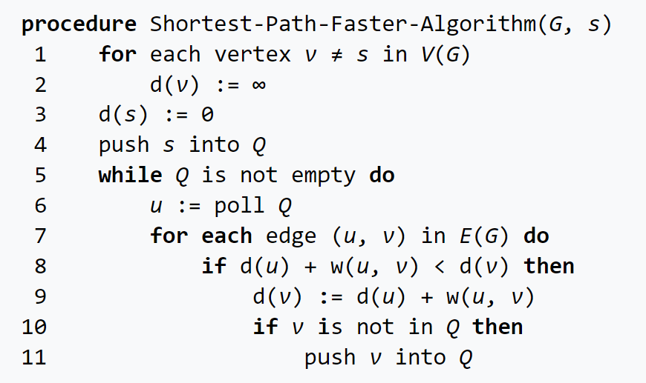
Shortest Path Finding Algorithms Bellman-Ford, Dijkstra, ..
Q is « queue »
Works with FIFO queue
… but optimal with PriorityQueue (Dijkstra)

Slide 54
Libraries for Collection & Algorithms big ecosystem, but jdk is often enough
Libraries of Interrest :
Guava (for Immutable Types )
Specialized data structures for native types « ListInt » instead of « List<Integer> »
Specialized « Off-Heap Memory » collections … for huge in-memory collections, but no GC problems with big jvm heap
Disitributed collection … Spark Datasets
Specialized persistent collections (save to File ~Database )

Slide 55



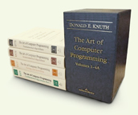
More Links: Books, Google, SourceCode, StackOverflow, …

Slide 56
Questions ?

