Slide 1
BigData Spark – HandsOn 3
SQL, Temporary View
Hive MetaStore, ExternalCatalog, Table
Partitions
arnaud.nauwynck@gmail.com
Esilv 2025

Slide 2

Objectives of Hands-On
Reminders:
Local Install, spark-shell
Spark File IO
1/ CreateTempView, use Dataset from SQL
2/ Configure HiveMetastore DB
3/ connect Spark External Catalog to MetaStore
4/ Create Table
5/ (Directory) Partitioned Table

Slide 3
Reminder Hands-On 1
Set JAVA_HOME
Set SPARK_HOME
set PATH
JVM
WinUtils
Transform, filter
Setenv.bat
DataFrame=Dataset[Row]
Pre-Requisite
Val ds = spark.createDataset()
Spark.tar.gz
embedded Hadoop
ds.show(10, true)
DataSet
Installation
User-defined
Hadoop.tar.gz
Immutable
Spark-Shell
Interactive
Windows error?
avoid
for () {} loop
Functionnal
Code Style
History
Seq
.map
lambda
Up / Down
Scala>
Repl
:help
TAB TAB autocompletion
Line compiled to scala
Eval on <enter>
val i =
var i =
Seq()
Tuple
On JVM
~Java
Numbered result « res0,res1,.. »

Slide 4
Reminder Hands-On 2
partitions
compression
parquet
dictionaries
UUID Files
Write Dir
csv
Combine
Read dir
Spark File I/O
json
ND-json
PostProcessing
text
Schema
xml ?

Slide 5
Objectives of Hands-On 3
1/ CreateTempView, use Dataset from SQL
2/ Configure HiveMetastore DB
3/ connect Spark External Catalog to MetaStore
4/ Create Table
5/ (Directory) Partitioned Table

Slide 6
PRE-REQUISITES : Redo from previous TD
val df = spark.read.option("header", "true").option("delimiter", ";").
option("dateFormat", "yyyy/MM/dd").
schema("""
uid_adresse STRING, cle_interop STRING,
commune_insee STRING, commune_nom STRING,
commune_deleguee_insee INT, commune_deleguee_nom STRING,
voie_nom STRING, lieudit_complement_nom STRING, numero INT, suffixe STRING,
position STRING, x STRING, y DOUBLE, long DOUBLE, lat DOUBLE, cad_parcelles STRING,
source STRING, date_der_maj TIMESTAMP, certification_commune INT
""").
csv("C:/data/OpenData-gouv.fr/bal-csv-all").
drop("x", "y", "date_der_maj") // drop big & redundant columns x,y (cf longitude,latitude), invalid dates
df.repartition(3).
sortWithinPartitions("commune_insee", "voie_nom", "numero", "'suffixe", "position").
write.format("parquet").save("c:/data/OpenData-gouv.fr/bal-parquet")

Slide 7
REMINDER..
Columns « x », « y » are big & redundant with « longitude », « latitude » (french coordinate system)
Columns « date_der_maj » contained some invalid dates … some with 1111-01-01
(before year 1534, so invalid in GregorianCalendar system)
Therefore, using « . drop("x", "y", "date_der_maj") »
Saving with both « .repartition() » and « .sortWithinPartitions() » produces better quality parquet files
(same data, but better organized, so better compressed and with better blocks statistics)

Slide 8
ERROR on column "date_der_maj"
("date dernière mise à jour", in english: last update date)
Caused by: org.apache.spark.SparkUpgradeException: [INCONSISTENT_BEHAVIOR_CROSS_VERSION.WRITE_ANCIENT_DATETIME]
You may get a different result due to the upgrading to Spark >= 3.0:
writing dates before 1582-10-15 or timestamps before 1900-01-01T00:00:00Z
into Parquet files can be dangerous, as the files may be read by Spark 2.x
or legacy versions of Hive later, which uses a legacy hybrid calendar that
is different from Spark 3.0+'s Proleptic Gregorian calendar. See more
details in SPARK-31404. You can set "spark.sql.parquet.datetimeRebaseModeInWrite" to "LEGACY" to rebase the
datetime values w.r.t. the calendar difference during writing, to get maximum
interoperability. Or set the config to "CORRECTED" to write the datetime
values as it is, if you are sure that the written files will only be read by
Spark 3.0+ or other systems that use Proleptic Gregorian calendar.
at org.apache.spark.sql.errors.QueryExecutionErrors$.sparkUpgradeInWritingDatesError(QueryExecutionErrors.scala:759)
at org.apache.spark.sql.execution.datasources.DataSourceUtils$.newRebaseExceptionInWrite(DataSourceUtils.scala:187)
at org.apache.spark.sql.execution.datasources.DataSourceUtils$.$anonfun$createDateRebaseFuncInWrite$1(DataSourceUtils.scala:207

Slide 9
Gregorian Calendar Dates : after 1582-10-15 so check invalid dates before
ds.select("date_der_maj").distinct().orderBy($"date_der_maj".asc).show(10)
+-----------------+
|date_der_maj|
+-----------------+
| NULL|
| 0023-04-12|
| 1111-11-01|
| 1900-01-01|
| 1901-01-01|
| 1904-09-30|
| 1930-02-21|
| 1935-04-17|
| 1936-11-27|
| 1944-10-13|
+----------------+
only showing top 10 rows

Slide 10
Alternative to Fix invalid dates, replace by min date (or NULL)
val min_date = to_date(lit("1901-01-01"));
val ds_fixdate = ds.withColumn("date_der_maj2", greatest(col("date_der_maj"), min_date));
ds_fixdate.select("date_der_maj2").distinct().orderBy($"date_der_maj2".asc).show(10)
val ds = ds_fixdate.drop("date_der_maj").withColumnRenamed("date_der_maj2", "date_der_maj")

Slide 11
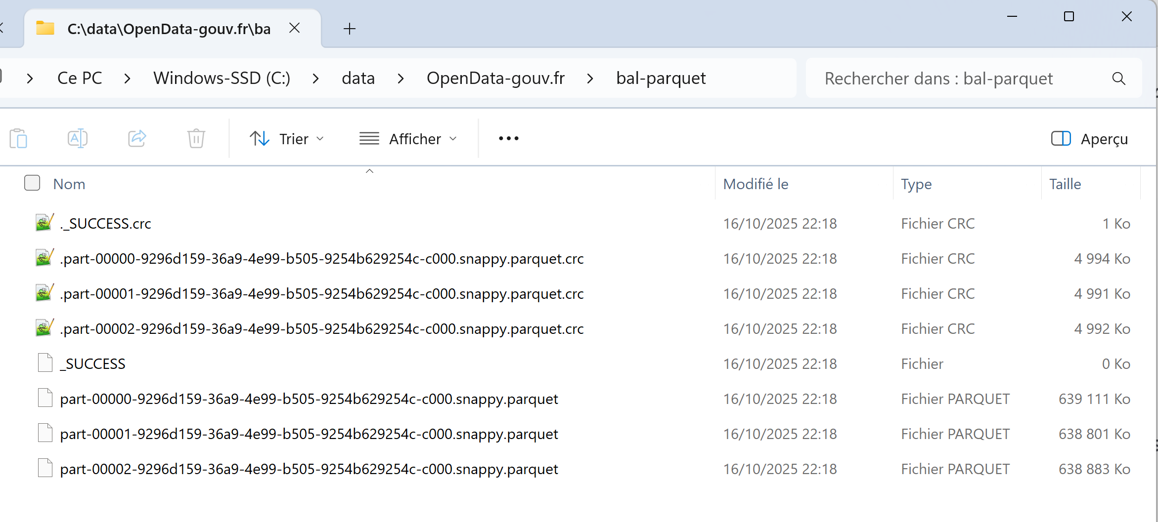
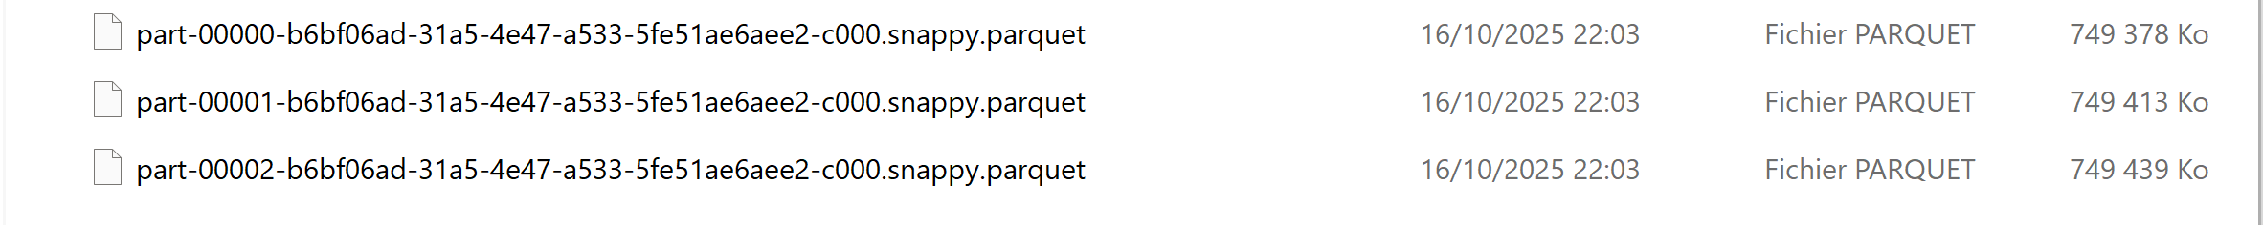
Parquet Files … ~3 x 640 Mo
If keeping columns x, y, date_der_maj => ~3 x 750 Mo ( that is + ~3 x 110M for the 3 useless columns)

Slide 12
Objectives of Hands-On 3
0/ Check spark backward compatibility (spark <=3)
1/ CreateTempView, use Dataset from SQL
2/ Configure HiveMetastore DB
3/ connect Spark External Catalog to MetaStore
4/ Create Table
5/ (Directory) Partitioned Table

Slide 13
Spark Changes version <= 3 … then >= 4
Before version <= 3, you needed to explicitly configure spark for Hive
Since >=4, spark comes with HiveMetastore pre-configured
(using Derby embedded database)
Conclusion: It is easier to use for beginners, without re-configuring

Slide 14
Exercise 1: check spark conf spark.sql.catalogImplementation=
« hive » or « in-memory » ?
a/ execute line
scala> spark.sharedState.sparkContext.getConf.get("spark.sql.catalogImplementation")
Res1: String = in-memory
b/ expecting for now to have «in-memory» .. not « hive »
( … to work similarly even on old spark version <=3)
c/ If not correct, relaunch spark-shell using
spark-shell --driver-memory 5g --conf spark.sql.catalogImplementation=in-memory

Slide 15
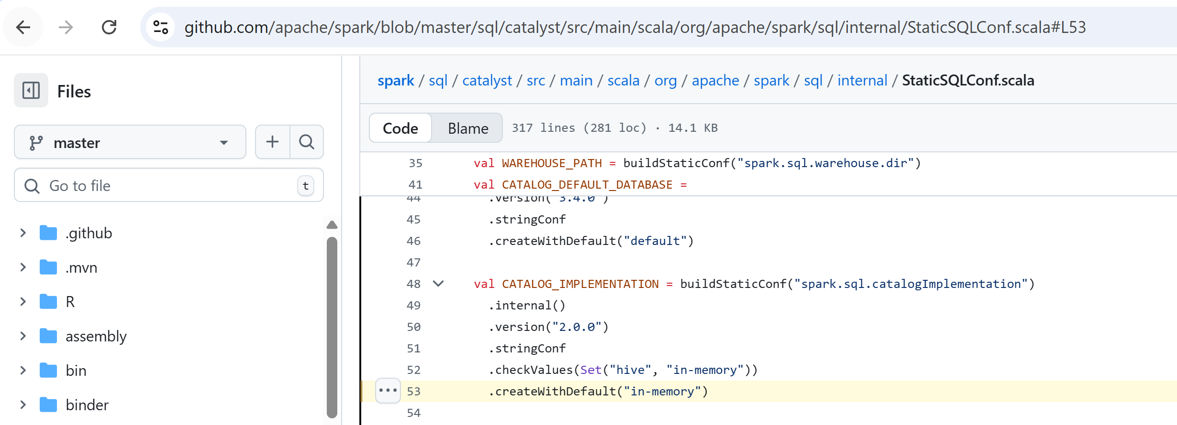
Check Source Code
https://github.com/apache/spark/blob/master/sql/catalyst/src/main/scala/org/apache/spark/sql/internal/StaticSQLConf.scala#L53

Slide 16
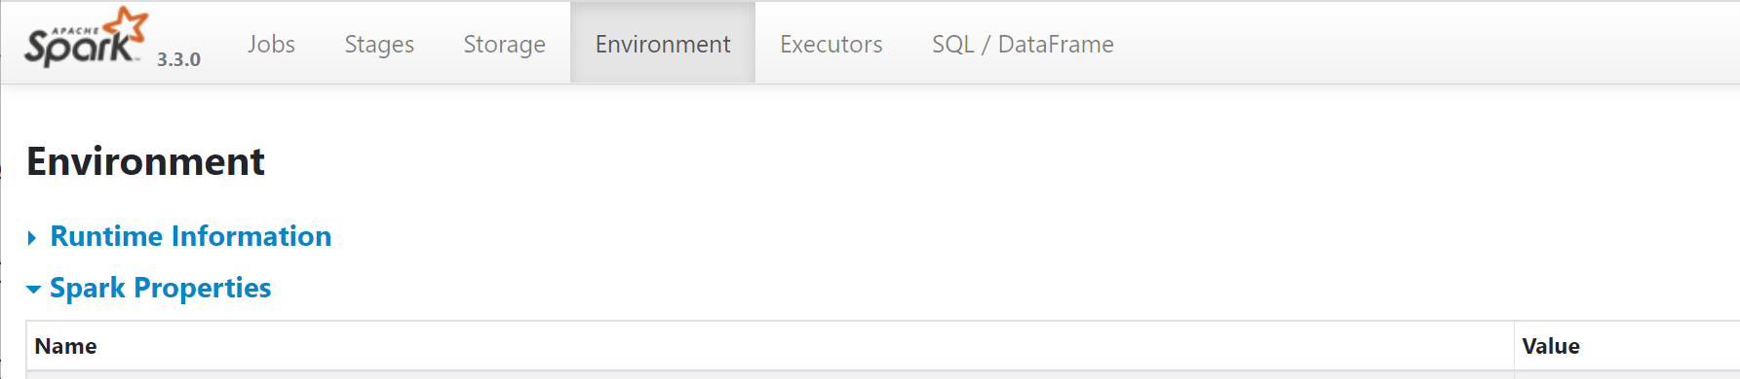
Checking from Spark-UI
a/ Open Spark-UI http://localhost:4040 … more on this later
b/ browse to Environment > Spark Properties >
c/ check spark.sql.catalogImplementation
WRONG for now..

Slide 17
Re-Checking Second Time …
println(spark.sharedState.externalCatalog.unwrapped)
Else, even this will fail in spark version <= 3 … but OK in spark version >= 4

Slide 18
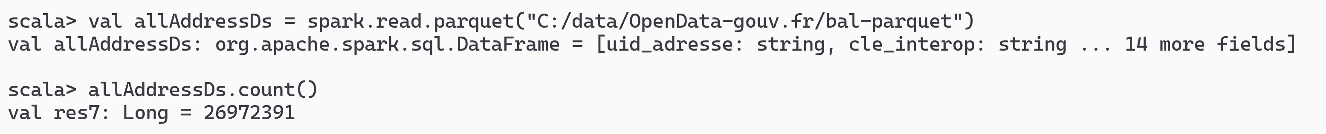
Exercise 2: reload address DataSet ensure no OutOfMemoryError
a/ Load the Dataset of addresses from previous hands-on.
scala> val allAddressDs = spark.read.parquet("C:/data/OpenData-gouv.fr/bal-parquet")
b/ check the data… using « .count » and « .show(2, false) »
You must have ~27 Millions rows

Slide 19
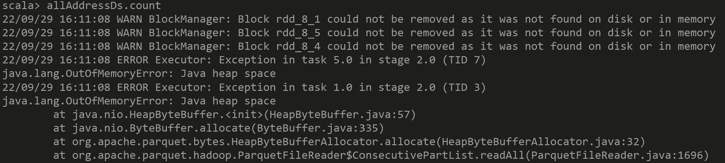
OutOfMemoryError ?
Details
if encountering OutOfMemory Error .. Then increase memory (cf next):
« spark-shell --driver-memory 5g »

Slide 20
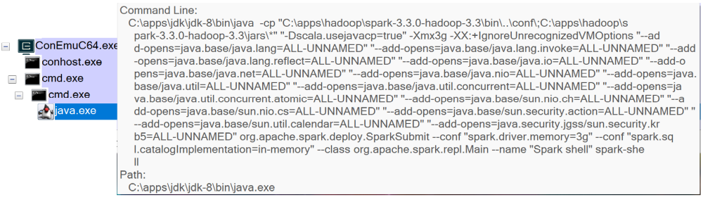
Ensure Memory JVM Argument –Xmx3g add arg --driver-memory=3g
Details
spark-shell --conf spark.sql.catalogImplementation=in-memory --driver-memory=3g

Slide 21
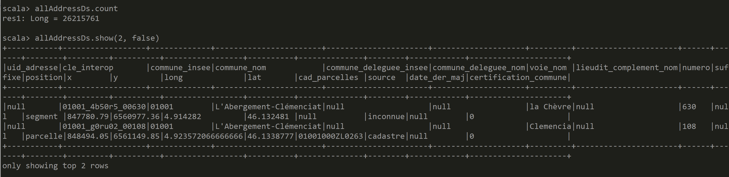
Answer Exercise 2

Slide 22
Exercise 3: createTempView … then SQL
Execute following
allAddressDs.createTempView("tmp_address")
spark.sql("SELECT count(*) FROM tmp_address").show()
spark.sql("SELECT * FROM tmp_address").show(2, false)
spark.sql("SELECT * FROM tmp_address WHERE commune_nom='Paris'").show(2, false)

Slide 23
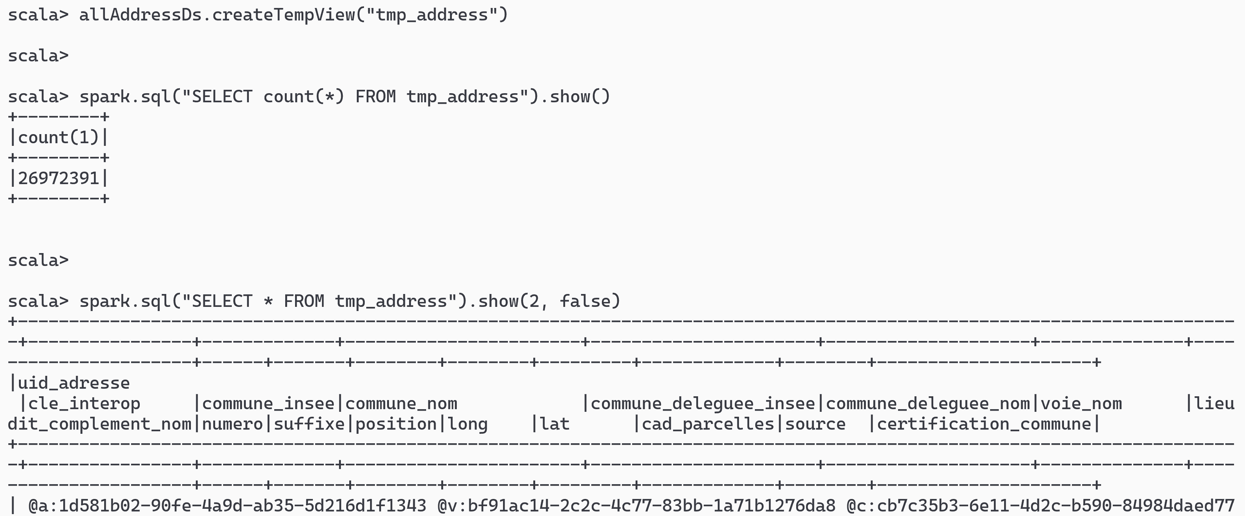
Answer Exercise 3

Slide 24
Exercise 4: list Tables
spark.sql("SHOW TABLES").show()
spark.catalog.listTables().show(false)

Slide 25
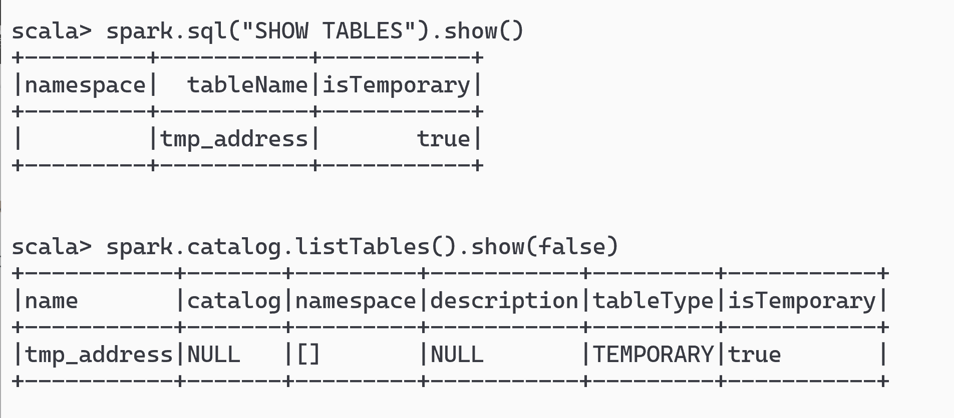
Answer Exercise 4: List Tables

Slide 26
Exercise 5: Describe Table / printSchema
Execute
spark.sql("select * from tmp_address").printSchema()
spark.sql("describe table tmp_address").show(false)
spark.sql("show create table tmp_address").show(false)
// …. WILL FAIL … no Sql DDL for it
// error: not a « table » (but describe ok!)

Slide 27
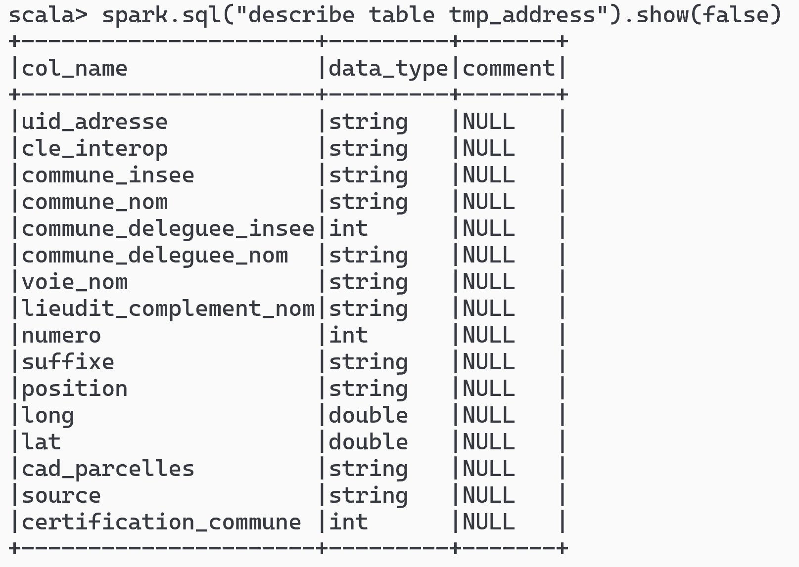
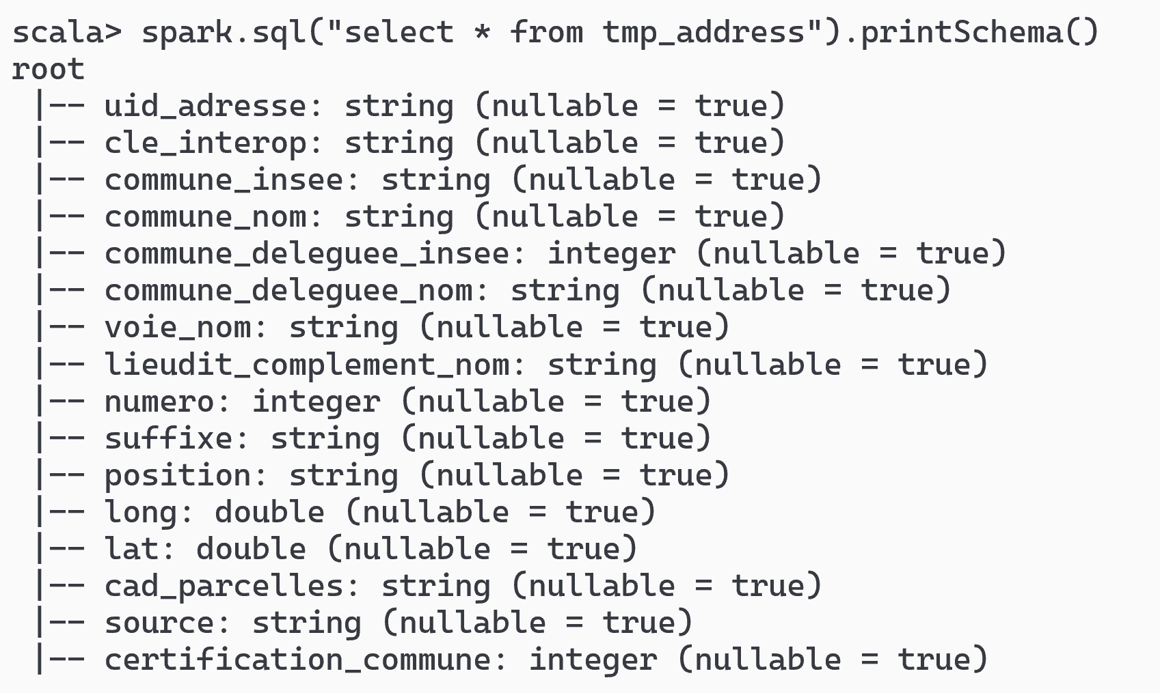
Answer Exercise 5 : describe Table / table DS schema

Slide 28
Exercise 6: stop + restart .. temporary
a/ stop spark-shell
b/ restart spark-shell
c/ list tables …
Check temporary tables have disapeared !

Slide 29
Optional Exercise 7: createGlobalTemporaryView
Optional
https://spark.apache.org/docs/latest/sql-getting-started.html#global-temporary-view
a/ similar to Exercise 3,
« createGlobalTemporaryView » from your dataset
instead of a « createTempView »
b/ forget about finding it from default spark catalog ( … confusing )
list explicitly from:
spark.catalog.listTables(« global_temp »).show(false)
c/ execute SQL query on « global_temp.address »
select count(*) from global_temp.address
d/ explain difference between global temp and temp

Slide 30
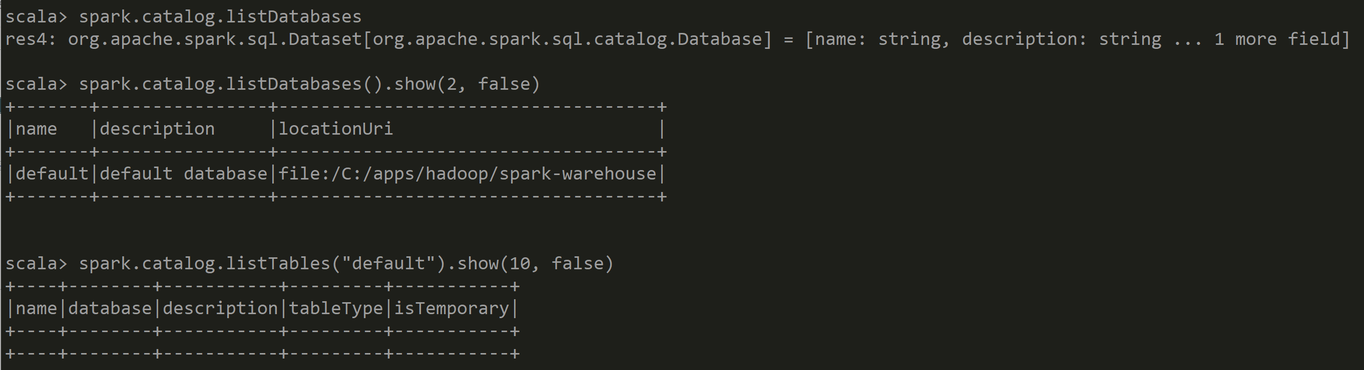
Answer Exercise 7
… Confusing: Where is my global temp table?

Slide 31
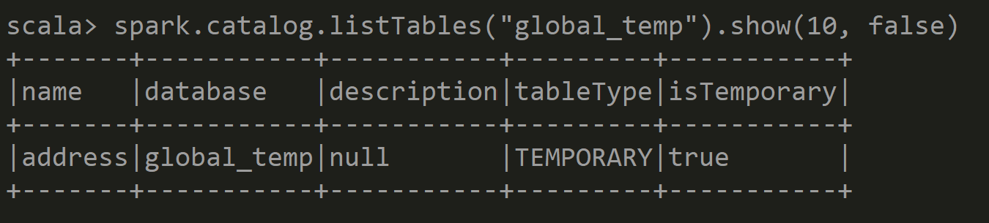
Answer Exercise 7 ask explicitly in « global_temp »

Slide 32
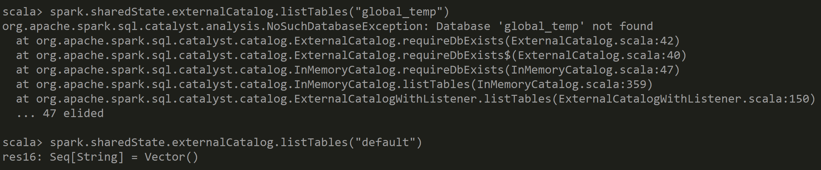
Answer Exercise 7
… Even more Confusing using spark.sharedState.externalCatalog

Slide 33
Answer Exercise 7
Global Temporary Table is Multi-Threaded, for all Spark Sessions
Temporary Table is for the current Session only
Both are temporary : for the JVM – SparkContext

Slide 34
Objectives of Hands-On
1/ CreateTempView, use Dataset from SQL
2/ Configure HiveMetastore DB
3/ connect Spark External Catalog to MetaStore
4/ Create Table
5/ (Directory) Partitioned Table

Slide 35
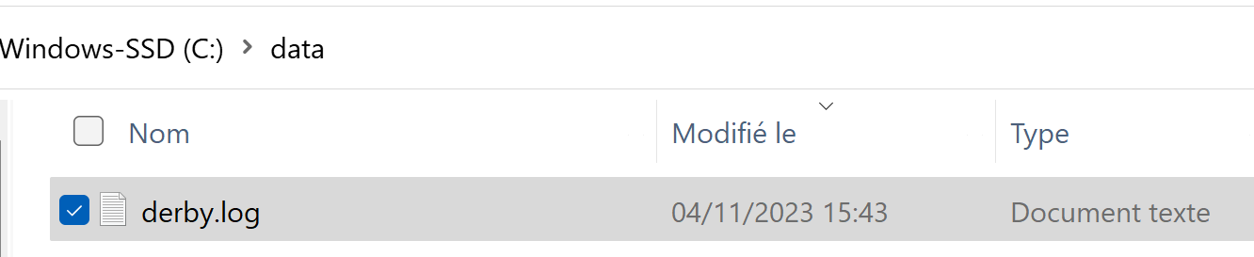
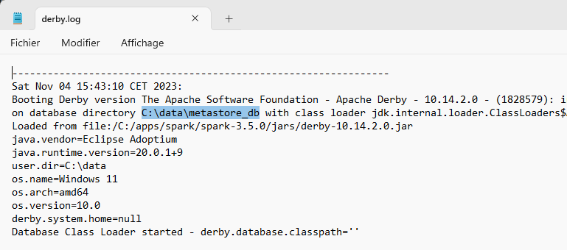
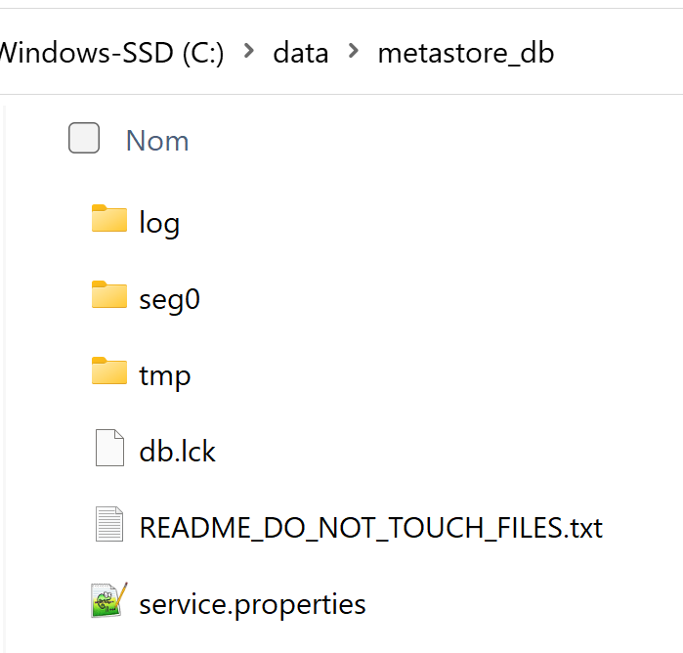
Default hive… using Derby metastore_db cf next slides if explicitly using Postgresql DB
Optional

Slide 36
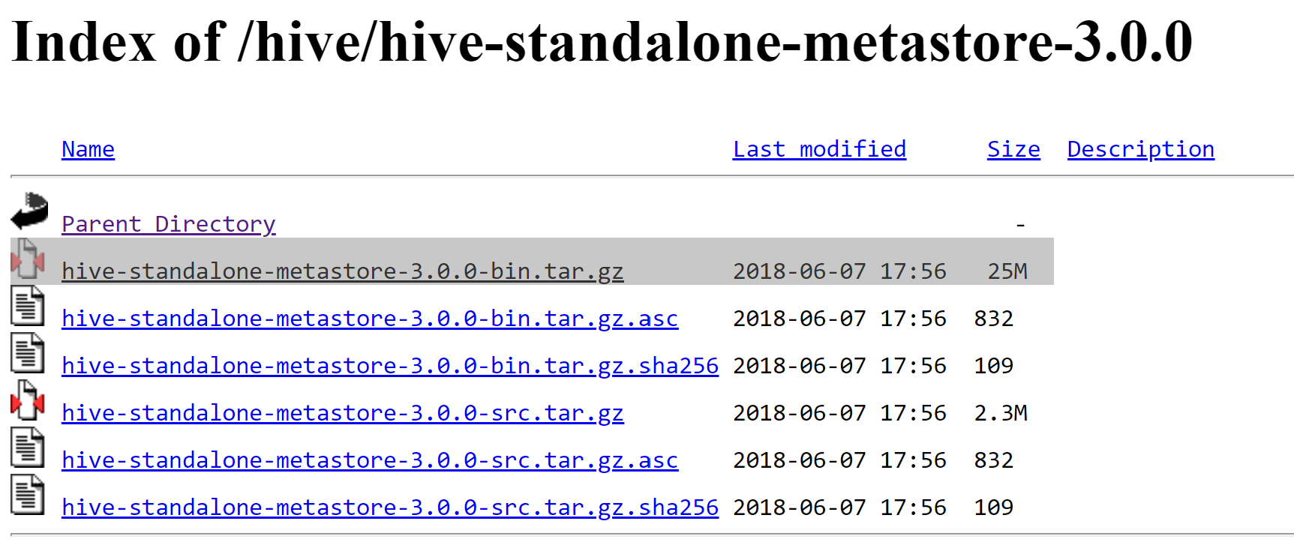
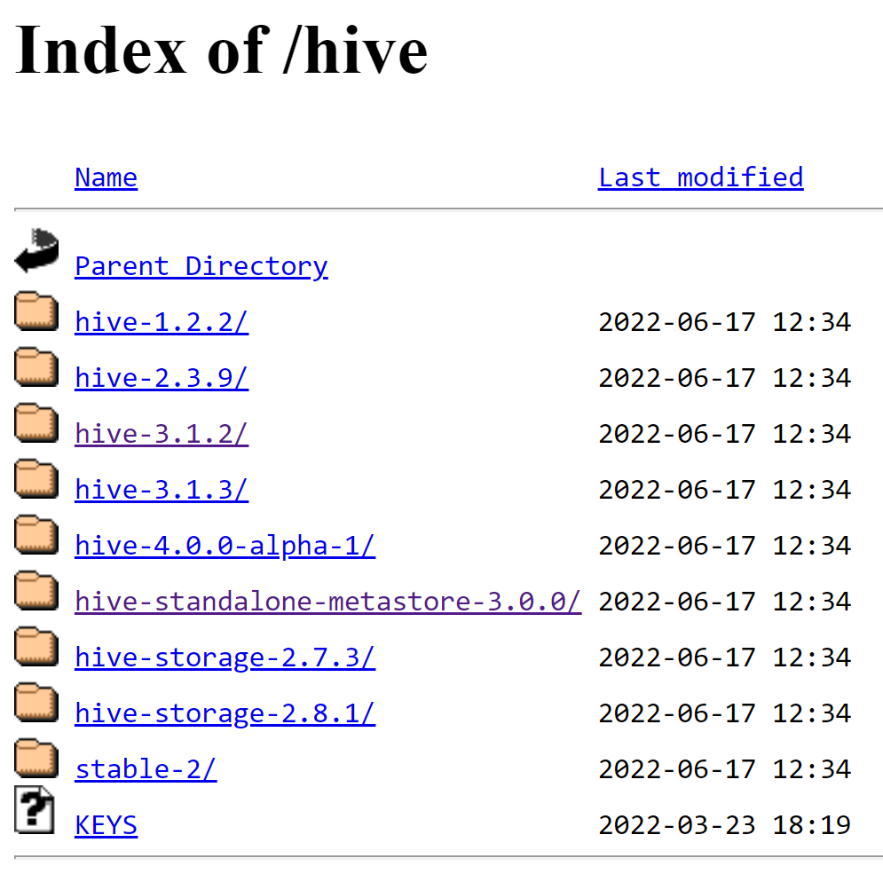
Install Hive Standalone Metastore
Optional
https://downloads.apache.org/hive/hive-standalone-metastore-3.0.0/
https://downloads.apache.org/hive/

Slide 37
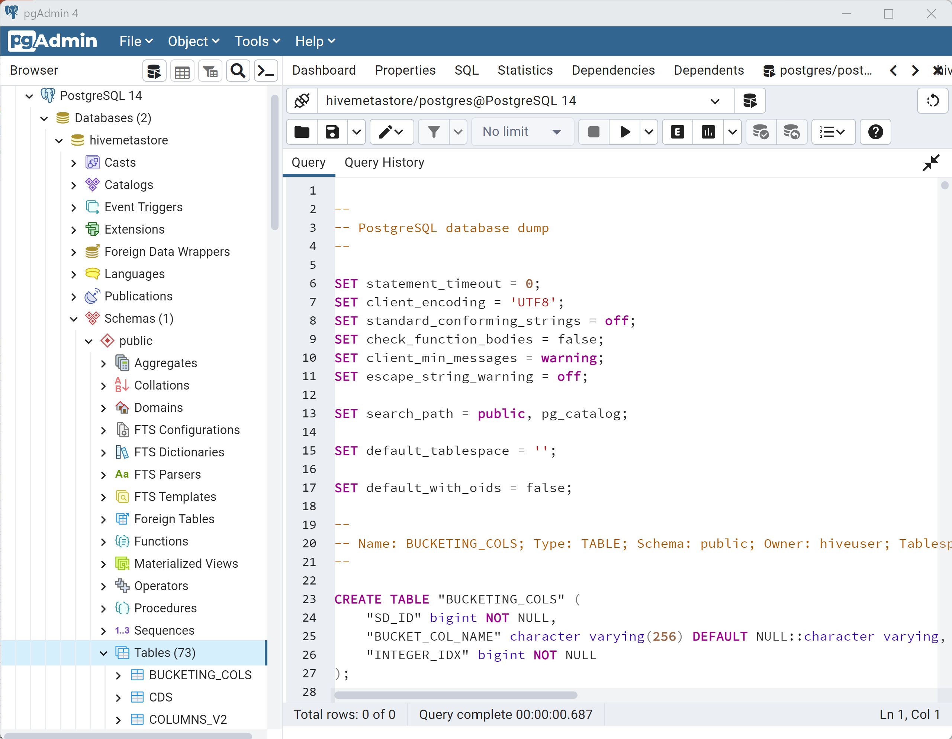
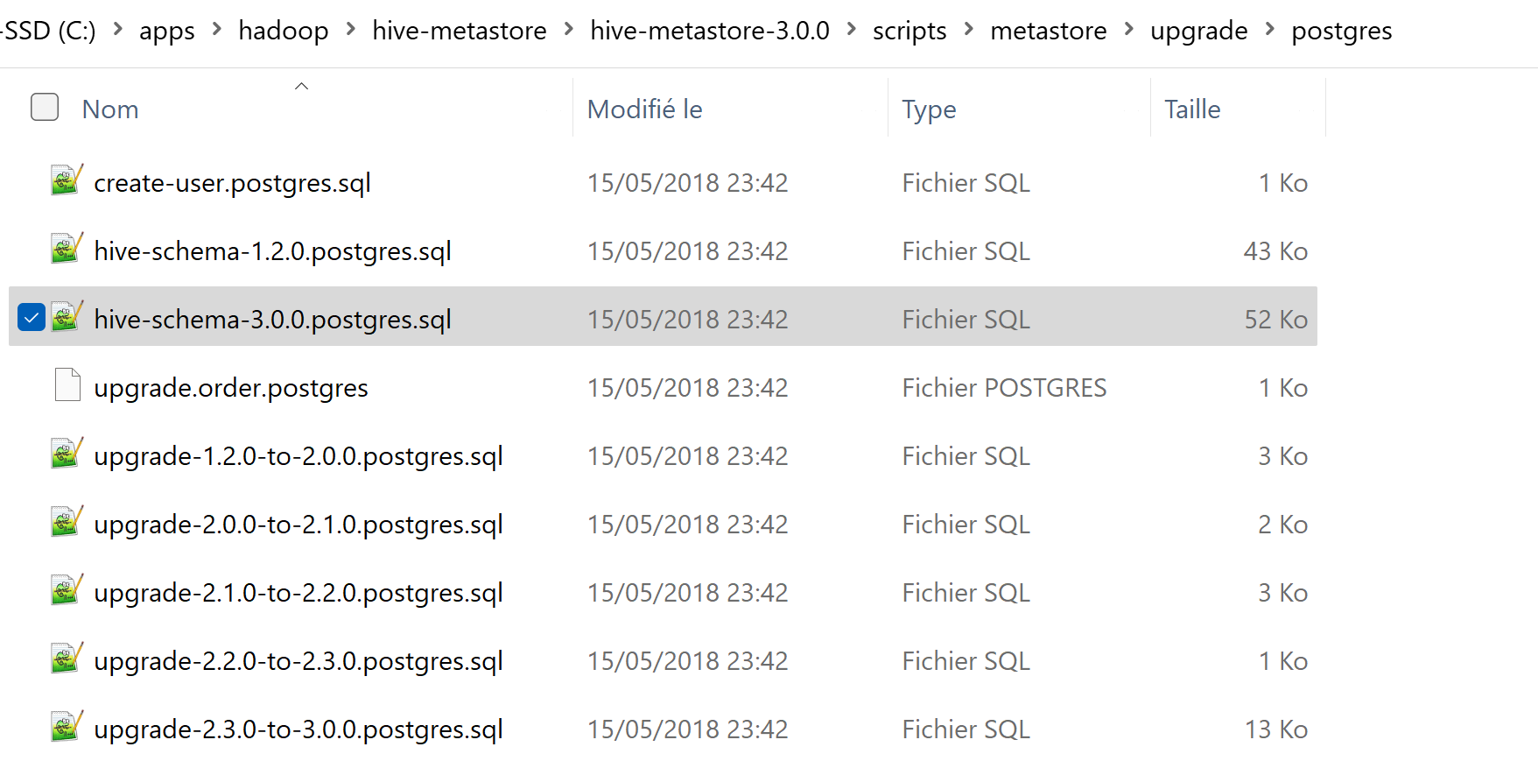
Example using Postgres : Create Hive Schema
Optional
1/ Open PgAdmin
2/ Create a « Database »
3/ execute SQL script « hive-schema-<dbType>.sql »
copied from <downloadedHiveDir>/scripts/metastore/upgrade/<dbType>

Slide 38
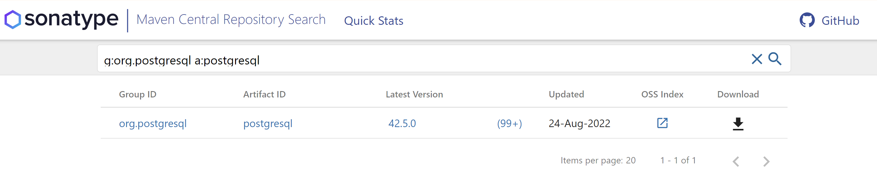
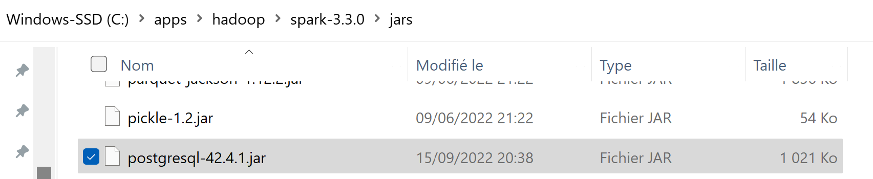
Copy Jar .. Example using Postgresql
Optional
Step 1/ find g:org.postgresql a:postgresql
https://search.maven.org/search?q=g:org.postgresql%20a:postgresql
Step 2/ copy jar to SPARK_HOME/jars

Slide 39
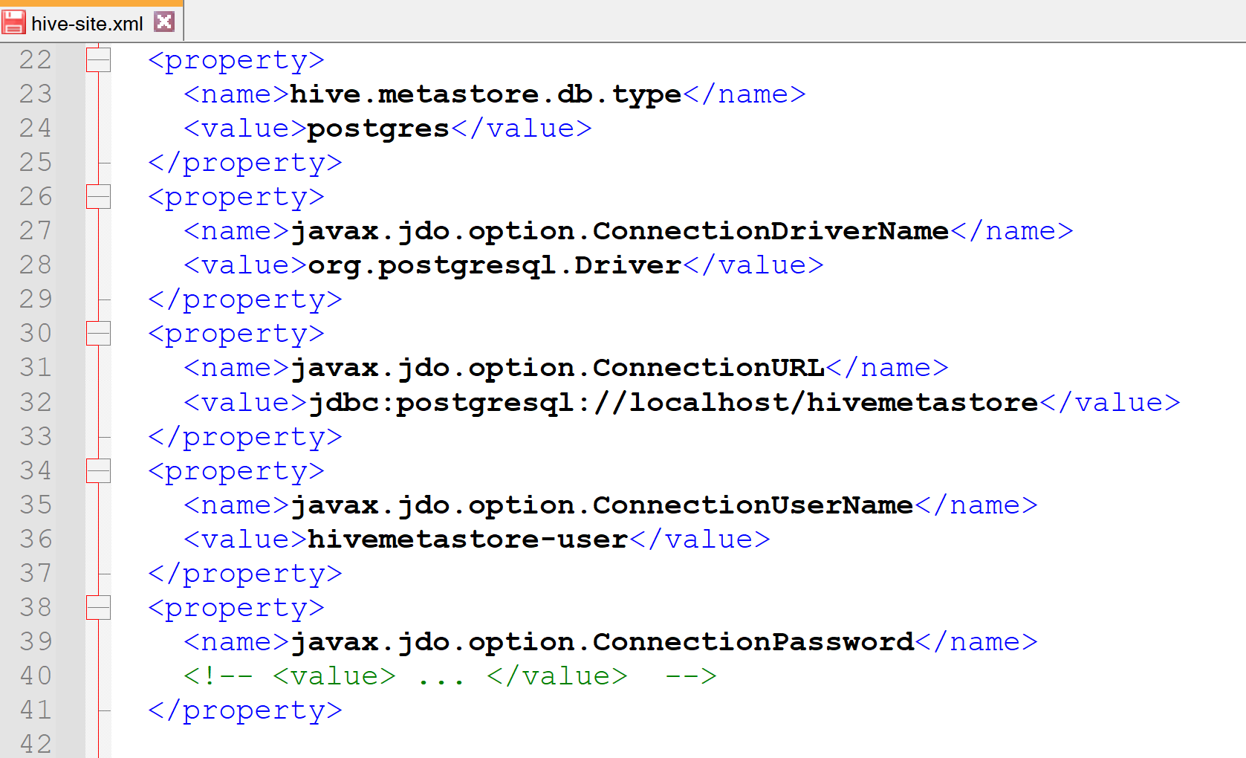
Configure hive metastore in HADOOP_CONF_DIR (or HADOOP_HOME)
/conf/hive-site.xml
Optional

Slide 40
Objectives of Hands-On
1/ CreateTempView, use Dataset from SQL
2/ Configure HiveMetastore DB
3/ connect Spark External Catalog to MetaStore
4/ Create Database, Table
5/ (Directory) Partitioned Table

Slide 41
Restart spark-shell + Check externalCatalog
relaunch spark-shell
spark-shell --driver-memory 5g --conf spark.sql.catalogImplementation=hive
Check in sparkContext
spark.sharedState.sparkContext.getConf.get("spark.sql.catalogImplementation")
res1: String = "hive"
println(spark.sharedState.externalCatalog.unwrapped)
Check in Spark UI

Slide 42
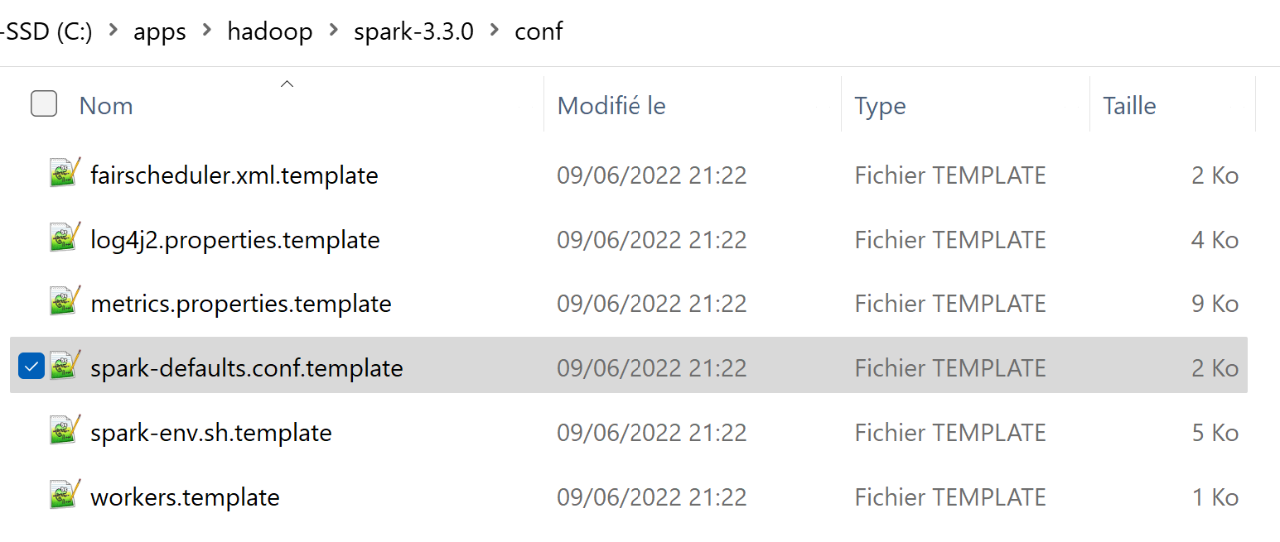
Optional Exercise 8: View/Change spark-defaults.conf
a/ Copy file, and rename without suffix « .template »
Edit to add line
spark.sql.catalogImplementation hive
Check conf can still be overloadded by « --conf key=value »
check conf at runtime:
spark.sharedState.sparkContext.getConf.get(« key »)
Or in Spark UI

Slide 43
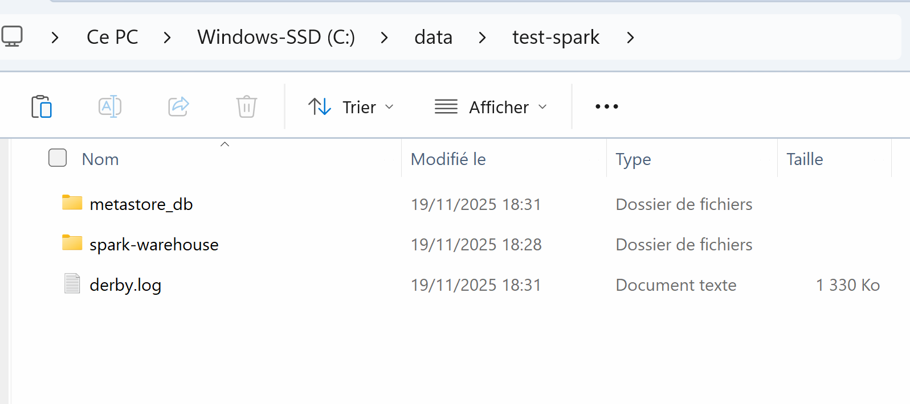
Spark 4 …
=> embedded Derby « Metastore_db » for Hive
+ « spark_warehouse » (default LOCATION for HDFS)
Example:
Launching spark-shell from dir
« c:/data/test-spark »
cd c:/data/test-spark
spark-shell
… spark.sql(« CREATE DATABASE db1 »).

Slide 44
Objectives of Hands-On
1/ CreateTempView, use Dataset from SQL
2/ Configure HiveMetastore DB
3/ connect Spark External Catalog to MetaStore
4/ Create Database, Table
5/ (Directory) Partitioned Table

Slide 45
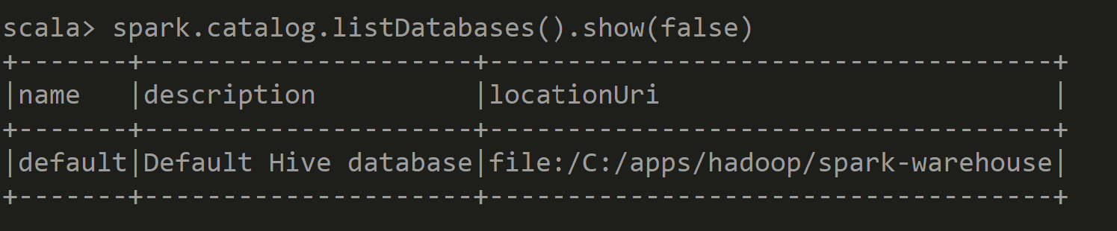
List Databases

Slide 46
Exercise 9: Create Database, Create if not exists
Execute:
spark.sql("CREATE DATABASE db1").show(false)
spark.sql("CREATE DATABASE IF NOT EXISTS db1").show(false)
Then, search created database

Slide 47
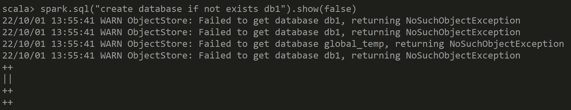
Answer Exercise 9: Create Database

Slide 48
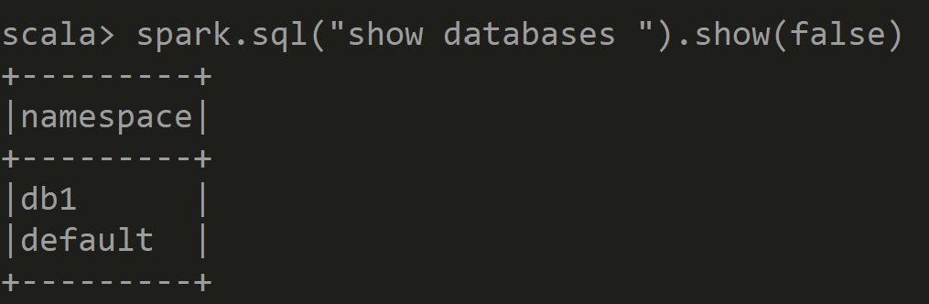
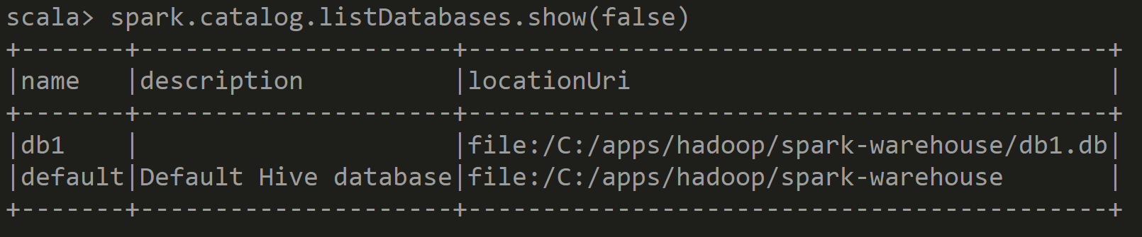
Answer Exercise 9: Show Databases

Slide 49
10 mn pause

Slide 50
Exercise 10: saveAsTable
Try some variations:
// val ds = spark.read.format("parquet").load("C:/data/OpenData-gouv.fr/bal-parquet")
ds.write.saveAsTable("addr")
ds.write.saveAsTable("db1.addr")
ds.write.format("parquet").saveAsTable("db1.addr")

Slide 51
Answer Exercise 10:

Slide 52
Exercise 10 : CTAS
CREATE TABLE <db>.<table> AS SELECT
CREATE TABLE … => STUPID default format « text »
CREATE TABLE … STORED AS PARQUET => OK
Anyway… it is only to do next « show create table » ..
CTAS => can NOT create EXTERNAL tables / can NOT create PARTITIONED tables !!!

Slide 53
Exercise 11 : SHOW CREATE TABLE
a/ Execute SQL
spark.sql("SHOW TABLES in db1").show(false)
spark.sql("DESCRIBE TABLE db1.addr").show(false)
spark.sql("SHOW CREATE TABLE db1.addr").show(false)
b/ check you can RE-Execute the result SQL DDL script
(ensure modify table name)
c/ compare difference with « dataset.printSchema » or Sql « DESCRIBE TABLE »
(ASCII table vs Sql)

Slide 54
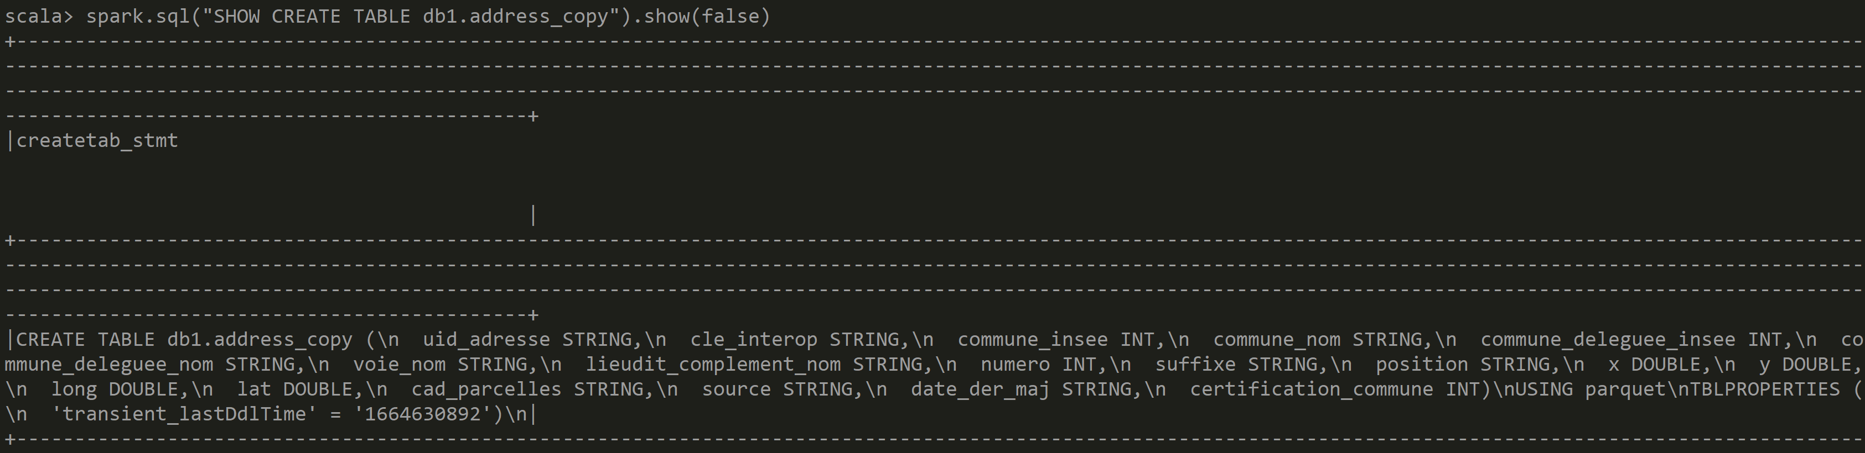
Answer Exercise 11: SHOW CREATE TABLE

Slide 55
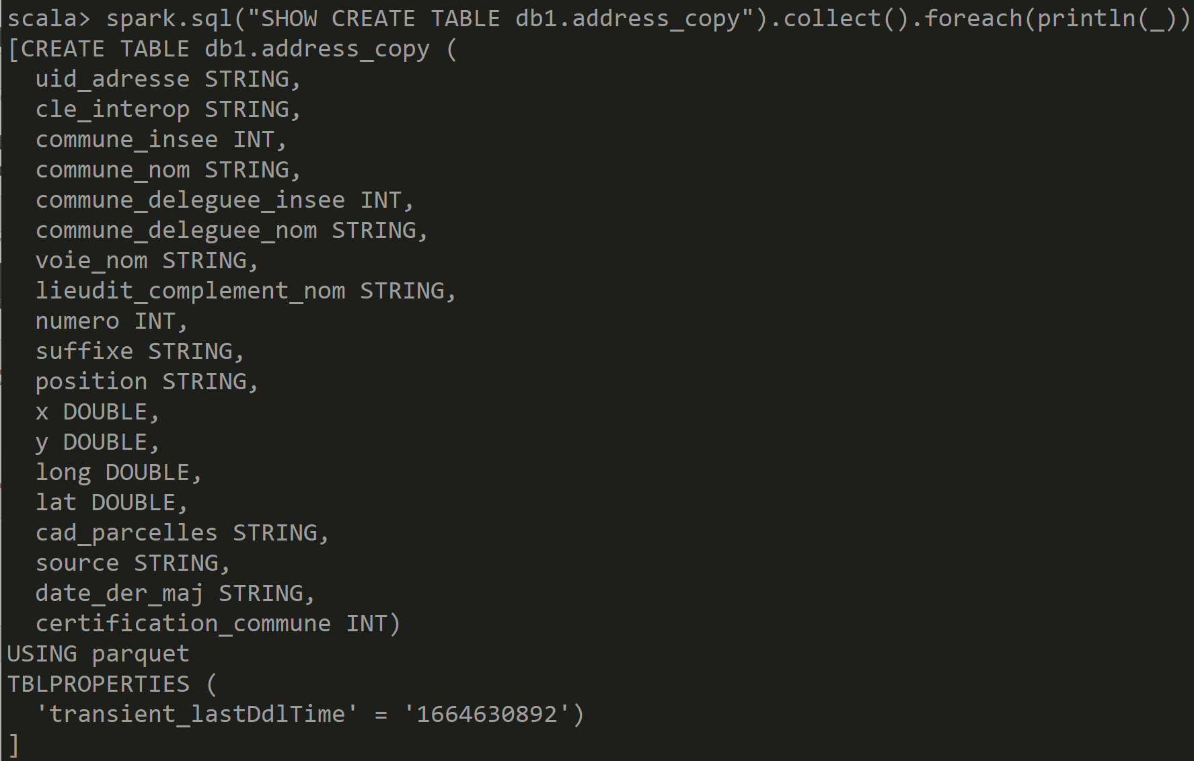
Answer Exercise 11: SHOW CREATE TABLE ..
Windows display error « \n » ??
Hint… instead of « .show() » use « .foreach( println(_) ) »

Slide 56
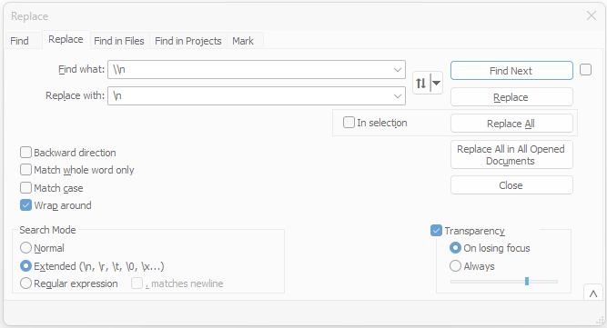
Hint Exercise 11: Replacing \\n by \n

Slide 57
SHOW CREATE TABLE
CREATE TABLE spark_catalog.db1.addr (
uid_adresse STRING,
cle_interop STRING, commune_insee STRING,
commune_nom STRING,
commune_deleguee_insee INT,
commune_deleguee_nom STRING,
voie_nom STRING,
lieudit_complement_nom STRING,
numero INT, suffixe STRING, position STRING, x DOUBLE, y DOUBLE,
long DOUBLE, lat DOUBLE, cad_parcelles STRING, source STRING,
date_der_maj STRING, certification_commune INT
)
USING parquet

Slide 58
Exercise 12: Create « EXTERNAL » TABLE instead of default «MANAGED » Table
a/ Execute Sql « DROP TABLE db1.address »
b/ Verify that it has deleted all Directories and Files !
c/ recreate your table, but using « CREATE EXTERNAL TABLE .. LOCATION .. »
d/ fill your table using « INSERT OVERWRITE … SELECT .. »)
e/ Execute « DROP TABLE » on the external table
Verify that Dir/Files are NOT affected !
f/ RE-Create EXTERNAL TABLE … adding « LOCATION ‘c:/data/your-dir’ » (cf next slide)
Verify it still has data « select count(*) from .. »

Slide 59
CREATE EXTERNAL TABLE .. STORED AS .. LOCATION …
spark.sql("""
CREATE EXTERNAL TABLE spark_catalog.db1.addr2 (
uid_adresse STRING,
cle_interop STRING, commune_insee STRING,
commune_nom STRING, commune_deleguee_insee INT, commune_deleguee_nom STRING,
voie_nom STRING, lieudit_complement_nom STRING, numero INT, suffixe STRING,
position STRING, x DOUBLE, y DOUBLE, long DOUBLE, lat DOUBLE, cad_parcelles STRING,
source STRING, date_der_maj STRING, certification_commune INT
)
STORED AS parquet
LOCATION 'C:/data/OpenData-gouv.fr/bal-table-addr2'
""").show()

Slide 60
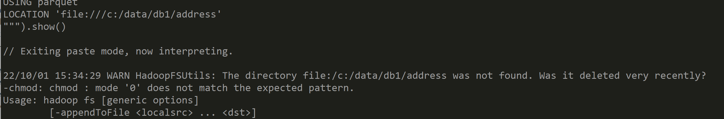
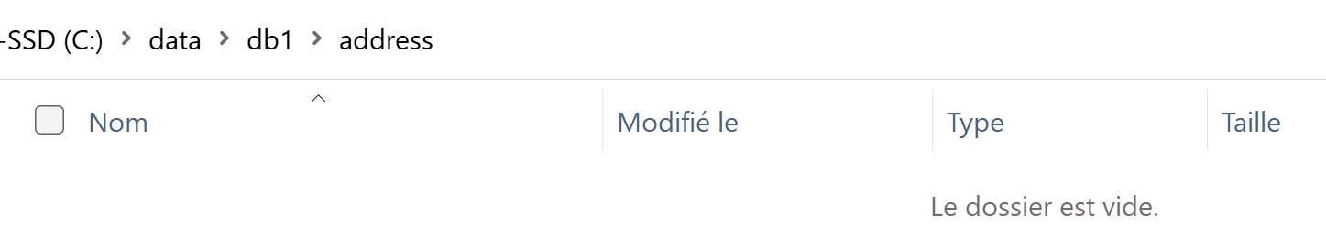
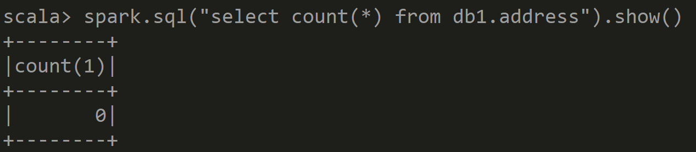
Answer Exercise 12: Create EXTERNAL Table
… WARN if directory not already exists
Works anyway …
but table is empty yet

Slide 61
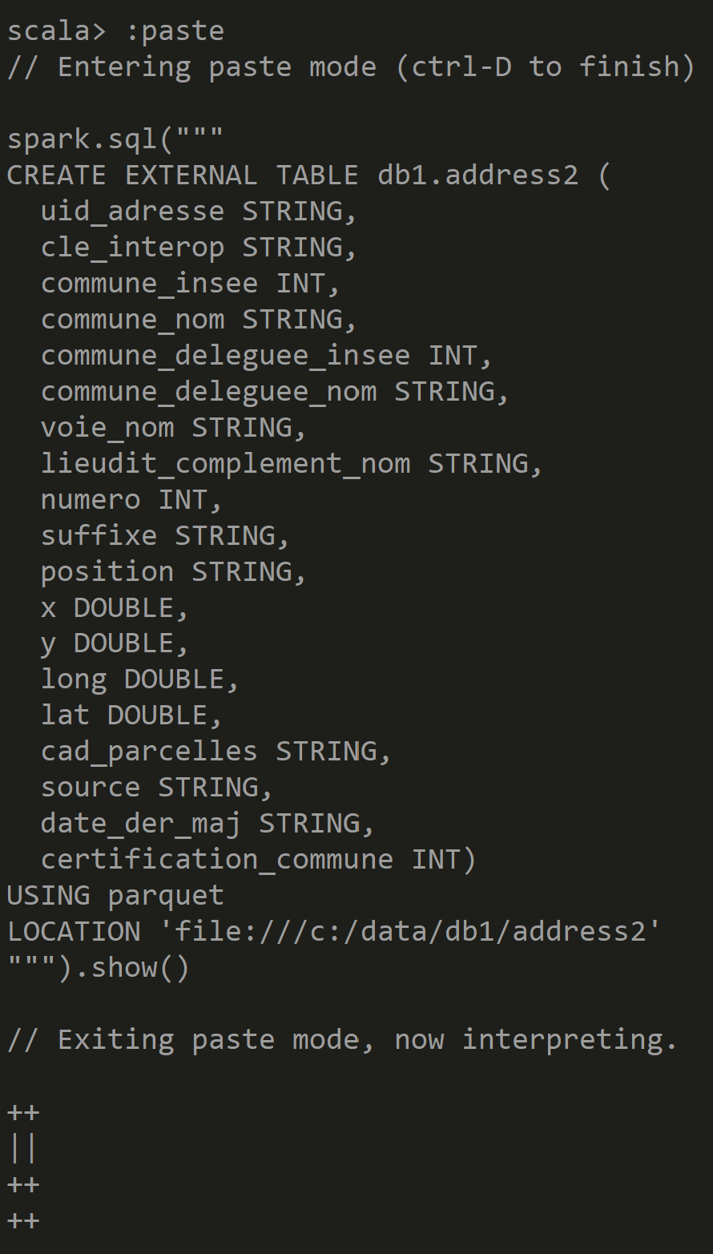
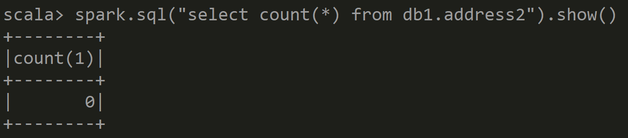
Answer Exercise 12: Create EXTERNAL Table
( directory already existed)

Slide 62
Exercise 13: INSERT INTO ..VALUES
… result created File(s)
a/ Execute SQL
spark.sql("""
INSERT INTO db1.addr2
(commune_insee,commune_nom,numero,voie_nom)
VALUES ('75000', 'PARIS', 1, 'rue de la paix')
""").show()
check that it has created 1 new File (containing only 1 line)
b/ .. Repeat 10 times … “for(i <- 0 to 10)”,
check it has created 10 additional files

Slide 63
Exercise 13(next): INSERT INTO SELECT..
… result created File(s)
c/ Execute SQL
spark.sql("""
INSERT INTO db1.addr2
SELECT * FROM db1.addr
""").show()
Check how many files are inserted, comparing to the parallelism of the SELECT
spark.sql("SELECT * FROM db1.addr").toJavaRDD.getNumPartitions
d/ redo with
spark.sql("""
INSERT INTO db1.addr2 SELECT /*+REPARTITION(2)*/ * FROM db1.addr
""").show()

Slide 64
Exercise 14: INSERT OVERWRITE
( difference with INSERT INTO )
a/ Question: if you reapeat several time the same « INSERT INTO »,
do you have duplicate rows ?
Can you have unicity with Primary Key constraint ?
can you do sql “UPDATE” ?
b/ Execute SQL, replacing « INTO » by « OVERWRITE »
INSERT OVERWRITE db1.address SELECT * FROM tmp_address
c/ what are the files remaining/created after ?
d/ if you repeat several times « INSERT OVERWRITE »,
what happens ?

Slide 65
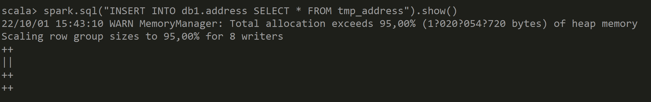
Answer Exercise 14: INSERT INTO .. SELECT ..

Slide 66
Objectives of Hands-On
1/ CreateTempView, use Dataset from SQL
2/ Configure HiveMetastore DB
3/ connect Spark External Catalog to MetaStore
4/ Create Database, Table
5/ (Directory) Partitioned Table

Slide 67
Exercise 15: enrich Dataset / table address by computing column « dept » from column « commune_insee »
We want to partition by department : only 99 values … instead of by 50 000 cities
Use column « commune_insee »: it is a String of 5 chars,
padding with « 0 » on left,
and ignore the 3 chars on right (city code within department)
Create a column to extract the string value of dept
Recreate your table (or dataset) with this extra column
HINT: use « .withColumn(« dept », regexp_replace( col(srcCol), pattern, replacement) ) »
Example:
« 75100 » => « 75 »
« 01200 » => « 01 » => « 1 »

Slide 68
Answer Exercise 15: computing « dept »
( Cast String to Int …
does not work for Corsica: 2A 2B)
.cast("int")
val allAdressDept = allAdressDs.withColumn("dept",
regexp_replace(col("commune_insee"), "0*(.*)...", "$1") )
From this column
Capture regexp block « (.*) »
So ignore «0» on left,
and 3 chars « … » on right
Use « $1 »
captured block

Slide 69
Exercise 16 : Create PARTITIONED Table
a/ do « show create table » on UN-partitioned table
b/ edit SQL + execute to change to a new table « address_by_dept »,
partitioned by column « dept Int »
//?? allAdressDept.write.writePartitioned("dept").format("parquet").saveAsTable("db1.tmp_addr_with_dept")
CREATE EXTERNAL TABLE db1.address_by_dept (
… <all columns except dept column> … )
PARTITIONED BY ( dept String)
STORED AS PARQUET
LOCATION ‘file:///c/data/db1/address_by_dept’
ds.write.format("hive").insertInto("db1.tmp_addr_with_dept")
ds.write.partitionBy(« dept »).saveAsTable("db1.addr_with_dept")
or..
INSERT OVERWRITE db1.address_by_dept SELECT * FROM db1. tmp_addr_with_dept

Slide 70
Exercise 17: Dirs for Partitioned Table
a/ explore directory / files for partitioned table
b/ check the partitioned column does not exist in the sub-files content,
only in directory names
HINT: reload an individual parquet file using « spark.read.parquet(« … »)

Slide 71
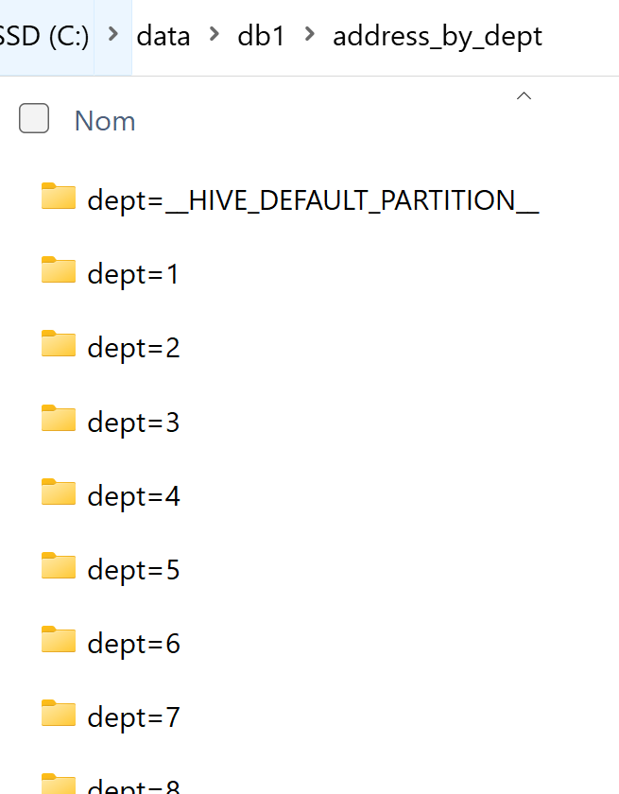
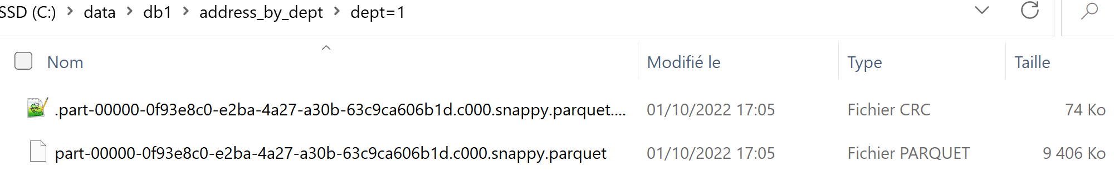
Answer Exercise 17 : Dirs for Partitioned Table

Slide 72
10 mn pause

Slide 73
Exercise 18: Query a Partitioned Table
… optim « Partition Pruning »
a/ do a SQL query using a « WHERE dept=’92’ »
b/ do a SQL query using a « WHERE dept in (’75’, ’78’, ’91’, ’92’) »
c/ do a SQL query without partition column condition
d/ Can you measure that
Query a/ is ~4x faster than Query b/ (1 part << 4 parts)
Query a/ is ~99x faster than Query c/ (1 part << 99 parts)
e/ check that Spark prunes the unnecessary partitions dirs from scanning

Slide 74
Exercise 19: SQL Explain plan:
SQL « EXPLAIN select … from .. Where ..»
a/ Execute SQL prefixed by “EXPLAIN”
spark.sql("""
EXPLAIN select count(*) FROM db1.address_by_dept WHERE dept=92
""").foreach(println(_))
b/ Check that Spark has read ONLY files within directory « …/dept=92/*.parquet »

Slide 75
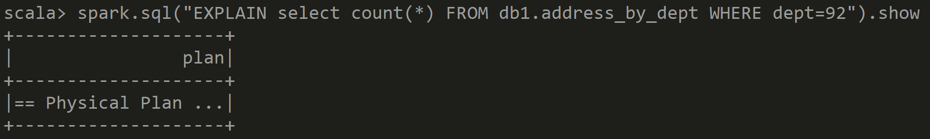
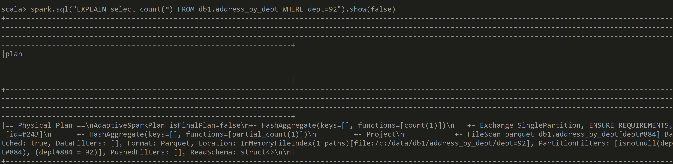
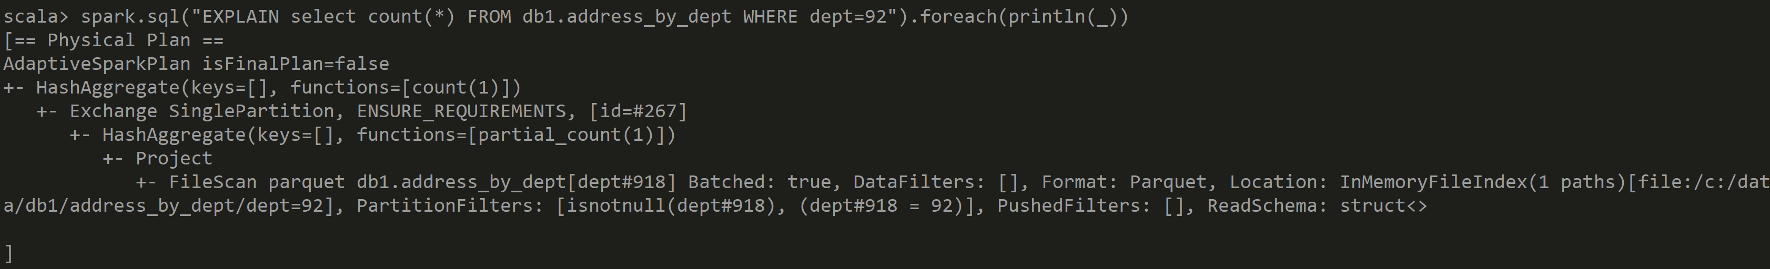
Answer Exercise 19: SQL Explain Plan

Slide 76
Exercise 20: Query by condition,
NOT by partition column
a/ Execute SQL with any condition but not on column “dept”
SELECT .. WHERE … somethingElse …
b/ Execute SQL:
EXPLAIN SELECT …
b/ Check that Spark has read ALL directories/files
… Check that is is slower than the unpartitioned table

Slide 77
Exercise 21… relaunch spark, with params
spark-shell --driver-memory=10g \
--conf spark.sql.dynamicPartitionMode=nonstrict \
--conf spark.sql.sources.partitionOverwriteMode=dynamic

Slide 78
Exercise 21: INSERT OVERWRITE… partitioned
a/ Execute SQL
INSERT OVERWRITE address_by_dept PARTITION(dept)
SELECT .. FROM .. WHERE … commune=‘Nanterre’
b/ check that ALL files from directory /dept=92/*
have been deleted… and rewritten with partial new results
c/ .. check that all cities != ‘Nanterre’ from dept=92 have been deleted
(not re-created).
an “INSERT OVERWRITE .. PARTITION()” can INSERT+UPDATE+DELETE rows,
But fortunately ONLY in the impacted partitions!
d/ check that ALL other directories dept != 92 are unmodified

Slide 79
Exercise 21 : … WARN …
The following Conf and SQLs look similar, and both can be executed succesfully … BUT make different result !!
With conf param « spark.sql.sources.partitionOverwriteMode=dynamic »
INSERT OVERWRITE address_by_dept PARTITION(dept)
SELECT .. FROM .. WHERE … dept=‘92’ and commune=‘Nanterre’
TRUNCATE only the partitions impacted
With partitioned data « where dept=‘92’… »
then fill some values
=> truncate +fill ONLY partition dept=92
INSERT OVERWRITE address_by_dept PARTITION(dept)
SELECT .. FROM .. WHERE … commune=‘Nanterre’
Same… but discovered by spark at runtime !!
BUT Without conf param « spark.sql.sources.partitionOverwriteMode=dynamic » (or with default =« static »)
INSERT OVERWRITE address_by_dept PARTITION(dept)
SELECT .. FROM .. WHERE … commune=‘Nanterre’
Completely TRUNCATE all partitions
then fill some values
in partition dept=92 for ‘Nanterre’
INSERT OVERWRITE address_by_dept
SELECT .. FROM .. WHERE … dept=‘92’

Slide 80
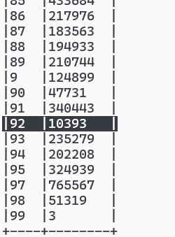
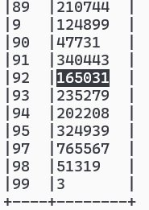
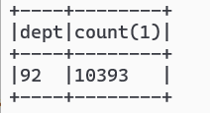
Exercise 21… Check
SELECT dept, COUNT(*)
FROM db2.addr_with_dept1
GROUP BY dept
ORDER BY dept
OK … only /dept=92
impacted !!
Retain 10393 out of 165031 rows
Values before update
(99 distinct depts)
FAILED !!!
All partitions DELETED…
And /dept=92 updated

Slide 81
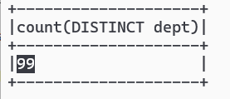
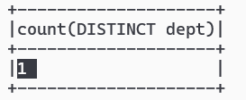
Exercise 21 … Check
SELECT COUNT(DISTINCT dept)
FROM db2.addr_with_dept
OK
FAILED !!!
All partitions DELETED…
And /dept=92 updated

Slide 82
Exercise 22: SAME insert overwrite
… on 2 differently partitioned tables
Execute twice the same SQL, on 2 different tables, containing the same data
a/ compare select count(*) on both tables
b/ execute SQL on first (partitioned) table:
INSERT OVERWRITE address_by_dept PARTITION(dept)
SELECT .. FROM .. WHERE … dept=92
c/ execute Same SQL on second (un-partitioned) table
INSERT OVERWRITE address
SELECT .. FROM .. WHERE … dept=92
d/ compare counts, Explain

Slide 83
Exercise 23: INSERT OVERWRITE… for fully « UPDATING » partition(s)
a/ Execute SQL:
INSERT OVERWRITE address_by_dept PARTITION(dept)
SELECT * FROM address WHERE … dept=92
b/ check that counts are same:
select count(*) from address where dept=92
select count(*) from address_by_dept where dept=92
c/ Explain that you can replay safely an « UPDATE » batch for any dept
.. NO duplicate, NO delete
Update fully the expected result but no side effect elsewhere

Slide 84
Exercise 24: ACID Update / Delete in Spark ?
Questions
a/ Does Spark support SQL Update or Delete per rows?
b/ Can you « insert overwrite » data in Spark ? With which granularity ?
c/ can you emulate applicative updates or deletes on rows
by append-only events ?
d/ Do you know « DeltaLake » or « Iceberg » ? (google it)

Slide 85
Exercise 25: Question on Partition.. What for ?
Questions
a/ Are partitions improving performances ?
b/ is it true that same SQL INSERT OVERWRITE
can have different results on tables with different partitionning ?
c/ Why/How should you use partitions ?
d/ Is is advisable to have deep sub-sub-sub partitioning ?

Slide 86
Optionnal Exercise 26 – DeltaLake / Iceberg …
Have a look to DeltaLake (legacy system, now switching to Iceberg standard)
https://docs.delta.io/latest/quick-start.html
spark-shell --packages io.delta:delta-core_2.12:2.2.0 \
--conf spark.sql.extensions=io.delta.sql.DeltaSparkSessionExtension \
--conf spark.sql.catalog.spark_catalog=org.apache.spark.sql.delta.catalog.DeltaCatalog
CREATE TABLE … USING DELTA … (instead of STORED AS PARQUET … )

Slide 87

Exercise 27 – Iceberg…
https://iceberg.apache.org/docs/latest/spark-getting-started/

Slide 88
Spark + Iceberg
spark-shell --packages org.apache.iceberg:iceberg-spark-runtime-3.5_2.12:1.10.0

Slide 89
Self Exploration (or HomeWork)
Create Iceberg Table for your dataset
Execute SQL query on it
Execute an UPDATE Sql query on it !

Slide 90
Check Read-Consistency
Open 2 spark-shells
In terminal 1/ launch spark-shell…. start working (reading) with an Iceberg Table
In Terminal 2/ launch another spark-shell …. Do an UPDATE on the Table
Then, go back on Terminal 1/
do again a Query on Table (or continue a long query)
… Check that it still works, with read isolation (you don’t see the updates & it does not fail ?)

Slide 91
Compare with legacy Hive (Partitioned) Table
On Legacy Hive (Partitioned) Table
You can ONLY fully overwrite (~ « Update ») a partition
If a Table is NOT partitioned => yuo can only fully overwrite the full table
… This is not an Atomic update
And not READ ISOLATED !
Check that 2 concurrent sessions of spark will FAIL :
After an Update, the Spark session that try to read the (old files of ) the table FAIL miserably

Slide 92
Exercise 28 : MindMap
Draw a MindMap to summarize
what you did and learn from this Hands-On session
Your MindMap should
start with word « Spark Catalog - Metastore» in the middle
Then draw star edges to other word chapters and sub-chapters

Slide 93
Answer Exercise 27: MindMap
*/Files per dir
1…N new file per insert
No SQL
Update/ Delete
STORED AS..
LOCATION
Insert overwrite
.. By partition
SQL on java Dataset
SQL on Files
Read Optim:
part-pruning
List Tables
CREATE EXTERNAL TABLE
IF NOT EXISTS
Describe table .OK
show Create Table KO
TABLE PARTITIONED
BY(col type)
createTempView
SQL DDL
Iceberg
SHOW CREATE TABLE
SHOW TABLES
Spark Catalog - Metastore
Configure Spark
ExternalCatalog
createGlobalTempView
« global_temp »
hidden Database
--conf spark.sql.
catalogImplementation=..
Config
HADOOP_CONFIG_DIR
(or HADOOP_HOME)
/hive-site.xml
temporary
Global=Multi Sessions
(SparkContext)
in-memory
HiveMetaStore
hive
Search +
Download
jar
(postgres,derby..)
Do not use!
HiveServer2
Plain old server,
with relational DB

Slide 94
Questions ?

Slide 95
Take-Away
What You learned ?

Slide 96
Next Steps
More Lessons
More Hands-On
Spark concepts:
Spark UI, DAG, Optimisation, Predicate-Push-Down
Spark Clustering
Java binding, UDF, map
Spark Streaming
…

