Slide 1
Workshop Https Certificate
Esilv 2026

Slide 2
Outline
Part 1 : Https Certificate on Client-Side
  A/ using Web Browser
  B/ using Command Line
Part 2 : Trusted Certificates
  Trusted on OS-system (Chrome -> in Windows)
  Trusted by application, ex: java
Part 3 : Https Certificate on Server-Side
  Generating a Self-signed certificate (KeyStore Explorer UI)
  Generating a Self-signed certificate (command line)
  Certificate Chain & Issuer
  Exposing https in springboot web server

Slide 3
Part 1 … Https Certificate on Client-Side
(using Web Browser)

Slide 4
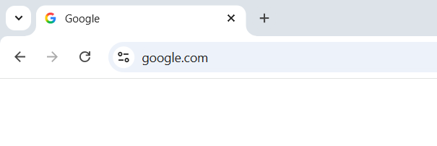
Open a Https:// web site
example: https://www.google.com
( equivalent to https://www.google.com:443/ )
Other example: https://my.devinci.fr/

Slide 5
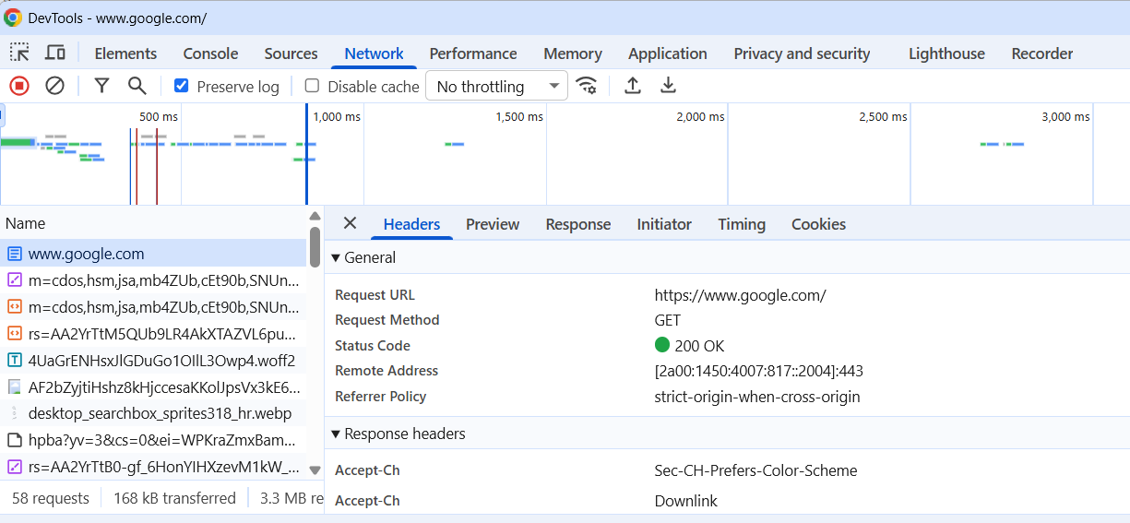
Using ChromeDev tool, check the TCP port is 443
(http => 80, or 8080 / https => 443)

Slide 6
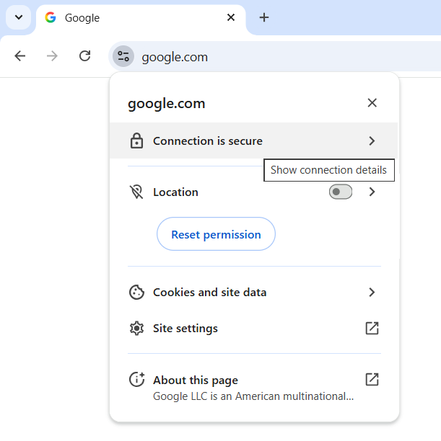
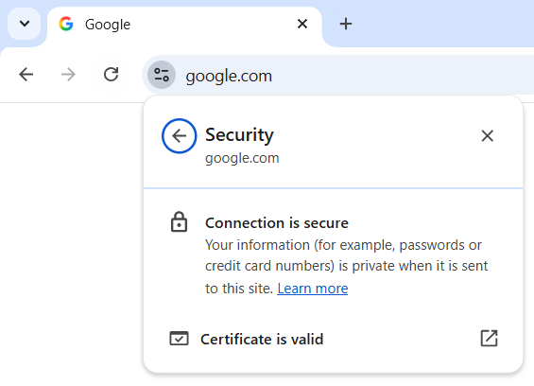
View the Certificate

Slide 7
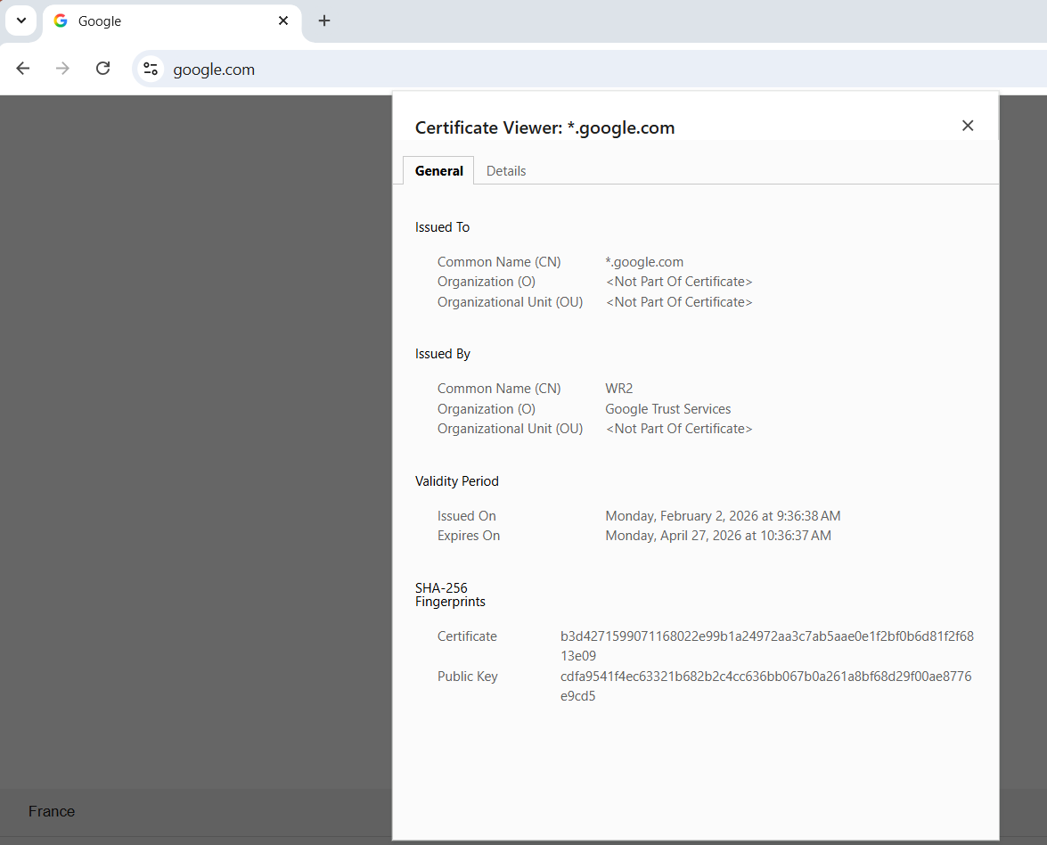
Certificate View (Tab: General)

Slide 8
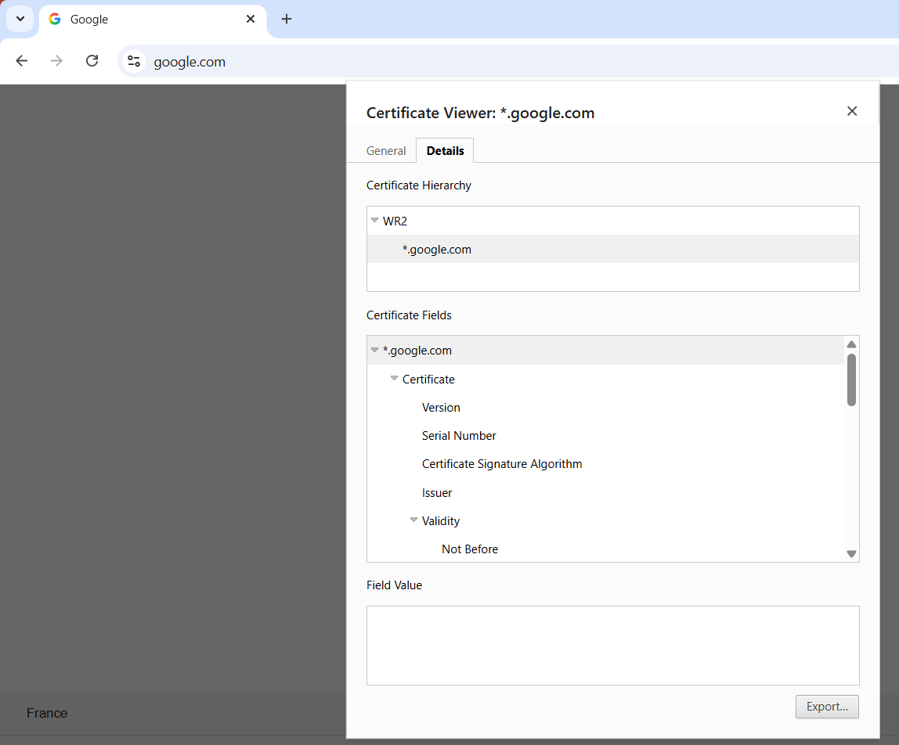
Certificate Details

Slide 9
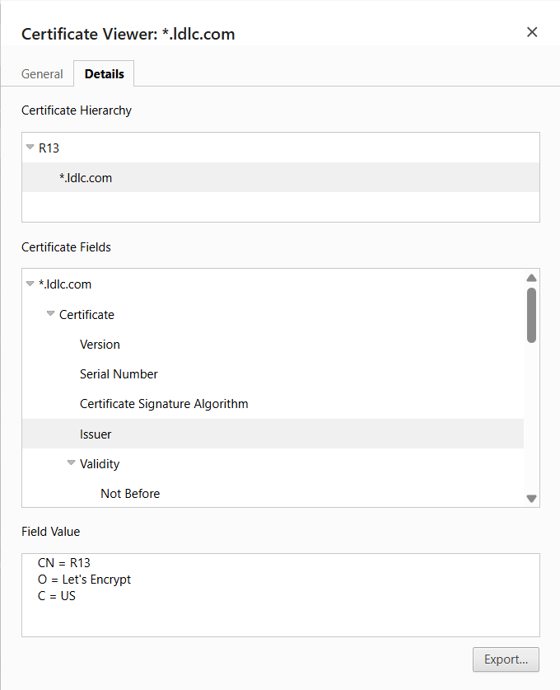
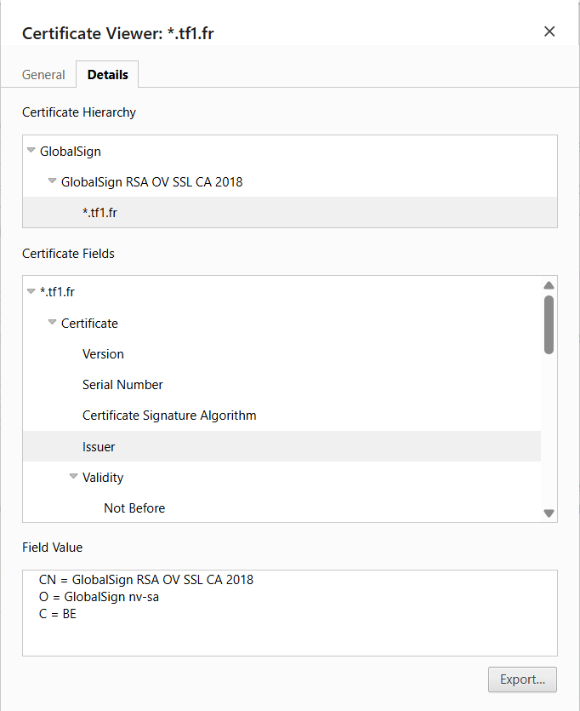
Certificate Hierarchy
Look at other web sites… Hierarchy of 1 / 2 / 3 Issuers
Example of Issuers: « Google Trust Services », « Let’s Encrypt », « GlobalSign RSA », …

Slide 10
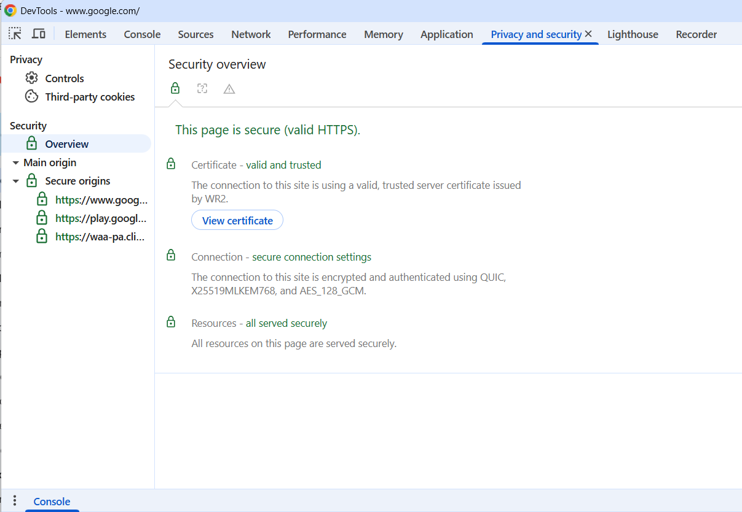
Remark: Can also view certificate from
DevTool > Privacy and security > View Certificate

Slide 11
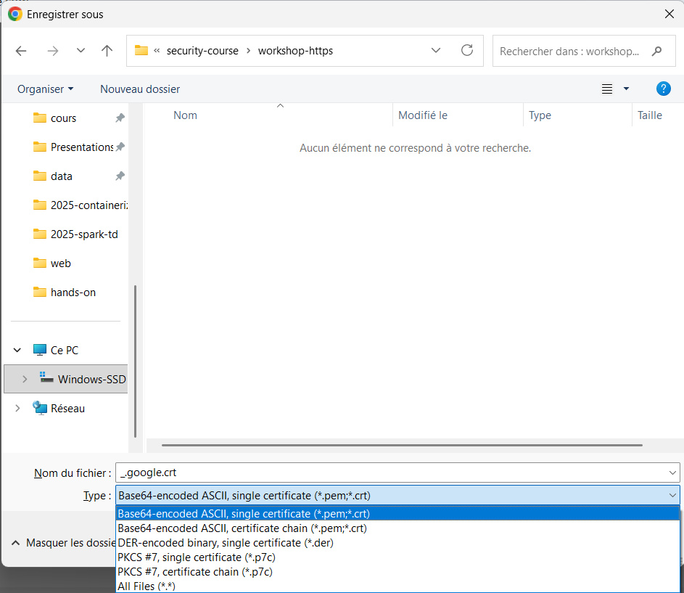
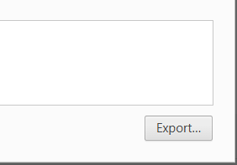
Export the Certificate as a single certificate *.pem file

Slide 12
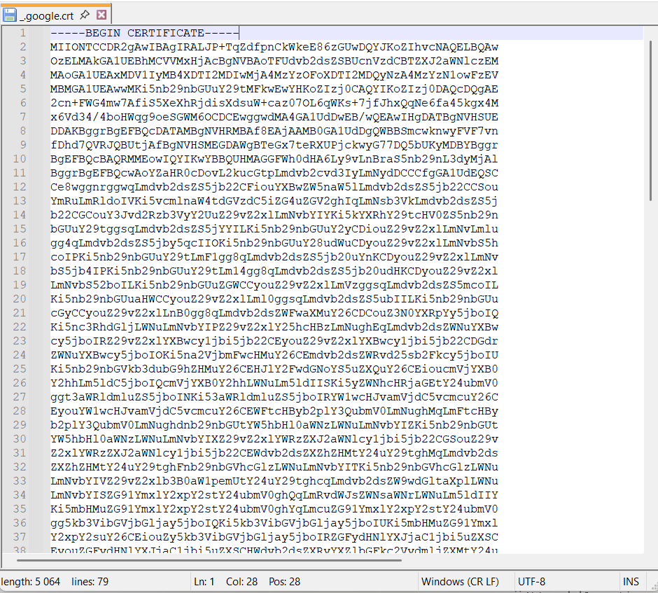
View (base64 = text file)
Check that it is a single section of text, wrapped with
-----BEGIN CERTIFICATE-----
<<base64>>
-----END CERTIFICATE-----

Slide 13
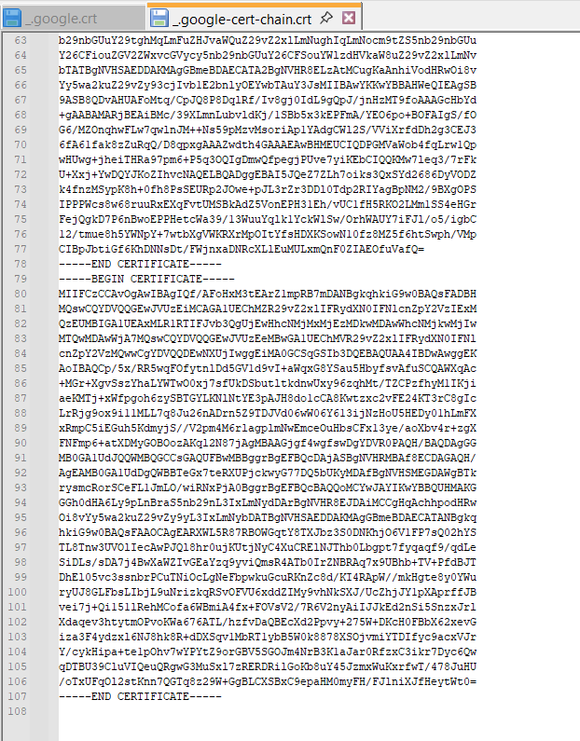
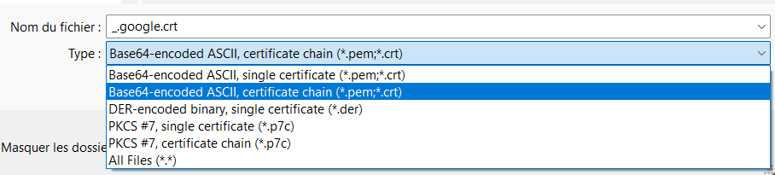
Compare with full certificate Chain
Check that it is
(written is reverse order compared to UI)
-----BEGIN CERTIFICATE-----
<<base64>>
-----END CERTIFICATE-----
-----BEGIN CERTIFICATE-----
<<base64>> (parent… root certificate)
-----END CERTIFICATE-----

Slide 14
Part 1 b/ … Https Certificate on Client-Side
(using Shell Commands Line)

Slide 15
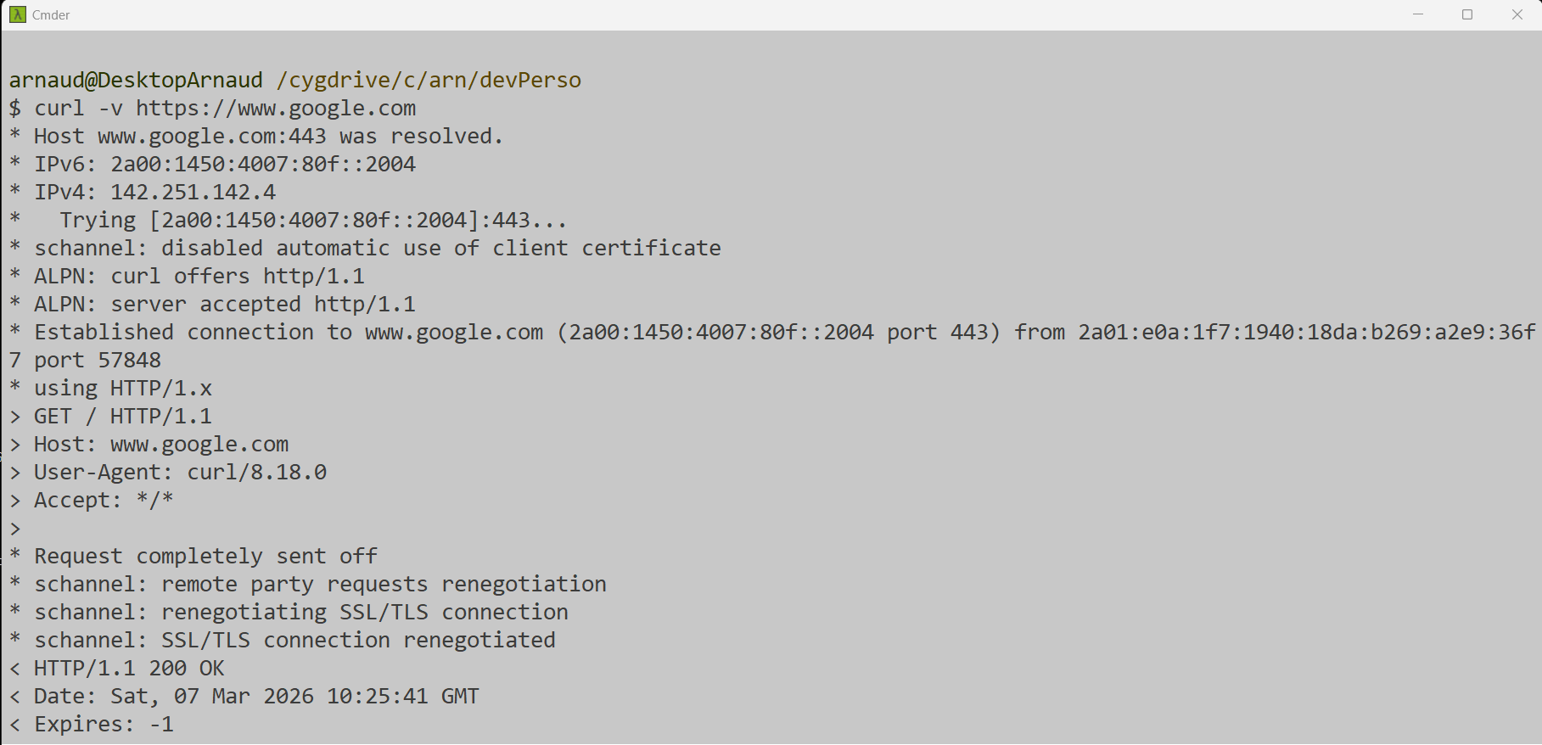
Https connection from Shell Command Line(curl)

Slide 16
Https From Curl -vv
curl –vv https://www.google.com
10:27:07.638000 [0-0] * Host www.google.com:443 was resolved.
10:27:07.654000 [0-0] * IPv6: 2a00:1450:4007:80f::2004
10:27:07.654000 [0-0] * IPv4: 142.251.142.4
10:27:07.662000 [0-0] * [HTTPS-CONNECT] adding wanted h2
10:27:07.662000 [0-0] * [HTTPS-CONNECT] added
10:27:07.662000 [0-0] * [HTTPS-CONNECT] connect, init
10:27:07.669000 [0-0] * Trying [2a00:1450:4007:80f::2004]:443...
10:27:07.669000 [0-0] * [HTTPS-CONNECT] connect -> 0, done=0
10:27:07.669000 [0-0] * [HTTPS-CONNECT] Curl_conn_connect(block=0) -> 0, done=0
10:27:07.669000 [0-0] * [HTTPS-CONNECT] adjust_pollset -> 0, 1 socks
10:27:07.685000 [0-0] * schannel: disabled automatic use of client certificate
10:27:07.693000 [0-0] * ALPN: curl offers http/1.1
10:27:07.693000 [0-0] * [HTTPS-CONNECT] connect -> 0, done=0
10:27:07.701000 [0-0] * [HTTPS-CONNECT] Curl_conn_connect(block=0) -> 0, done=0
10:27:07.706000 [0-0] * [HTTPS-CONNECT] adjust_pollset -> 0, 1 socks
10:27:07.708000 [0-0] * [HTTPS-CONNECT] connect -> 0, done=0
10:27:07.708000 [0-0] * [HTTPS-CONNECT] Curl_conn_connect(block=0) -> 0, done=0
10:27:07.717000 [0-0] * [HTTPS-CONNECT] adjust_pollset -> 0, 1 socks
10:27:07.717000 [0-0] * ALPN: server accepted http/1.1
10:27:07.717000 [0-0] * [HTTPS-CONNECT] connect+handshake h2: 60ms, 1st data: 40ms
10:27:07.733000 [0-0] * [HTTPS-CONNECT] connect -> 0, done=1
10:27:07.733000 [0-0] * [HTTPS-CONNECT] Curl_conn_connect(block=0) -> 0, done=1
10:27:07.733000 [0-0] * Established connection to www.google.com (2a00:1450:4007:80f::2004 port 443) from 2a01:e0a:1f7:1940:18da:b269:a2e9:36f7 port 57855
10:27:07.749000 [0-0] * [HTTPS-CONNECT] query ALPN
10:27:07.749000 [0-0] * using HTTP/1.x
10:27:07.749000 [0-0] > GET / HTTP/1.1
10:27:07.749000 [0-0] > Host: www.google.com

Slide 17
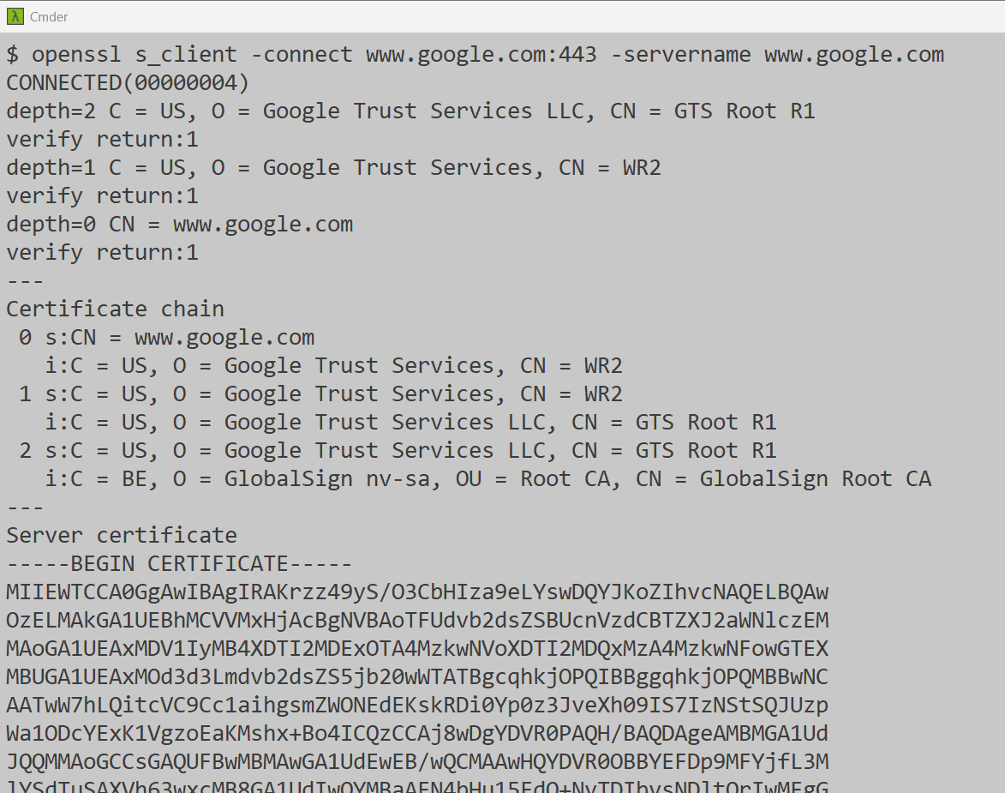
Certificate From OpenSSL command
openssl s_client -connect www.google.com:443 -servername www.google.com
Certificate chain has 3 levels ??
We saw 2 in Chrome ??

Slide 18
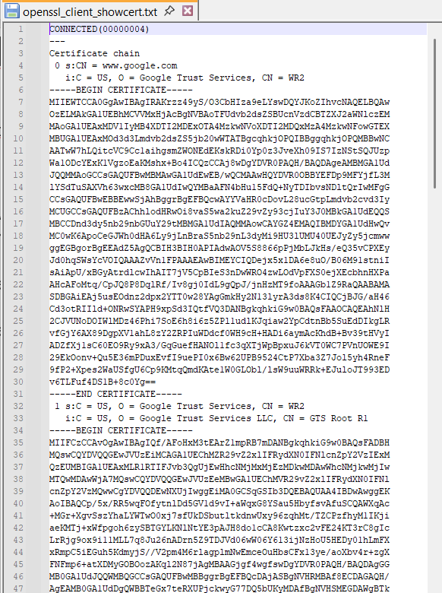
Openssl … see also option « -showcerts »
echo | openssl s_client -connect www.google.com:443 -servername www.google.com -showcerts
$ echo | openssl s_client -connect www.google.com:443 -servername www.google.com -showcerts \
> /cygdrive/c/security-course/workshop-https/openssl_client_showcert.txt
depth=2 C = US, O = Google Trust Services LLC, CN = GTS Root R1
verify return:1
depth=1 C = US, O = Google Trust Services, CN = WR2
verify return:1
depth=0 CN = www.google.com
verify return:1
DONE

Slide 19
Saving Certificate From openssl
echo \
| openssl s_client -connect www.google.com:443 -servername www.google.com 2>/dev/null \
| openssl x509 -outform pem \
> /cygdrive/c/security-course/workshop-https/cert.pem
Explanation notes:
« echo | » to force non interactive connect then close
« openssl s_client -connect» to establish TLS handshake 2>/dev/null ignore other logs
« openssl x509… » to convert to PEM file
… Strangely, it is not exactly the same file (format/encoding?) as exported from Chrome ?!
Chrome export in « DER »

Slide 20
Converting between DER <-> PEM ..
openssl x509 -in cert.pem -outform der -out cert.der
openssl x509 -in cert.der -inform der -out cert.pem

Slide 21
Part 2 : Trusted Certificate

Slide 22
Converting *.pem to Java « trustore » JKS format
&& Running java with Trust Store
keytool -importcert -alias mycert -file cert.pem -keystore truststore.jks
java \
-Djavax.net.ssl.trustStore=truststore.jks \
-Djavax.net.ssl.trustStorePassword=changeit \
-jar app.jar
If the http Certificate Chain is not trusted by java => You get error
javax.net.ssl.SSLHandshakeException: sun.security.validator.ValidatorException: PKIX path building failed:
sun.security.provider.certpath.SunCertPathBuilderException:
unable to find valid certification path to requested target

Slide 23
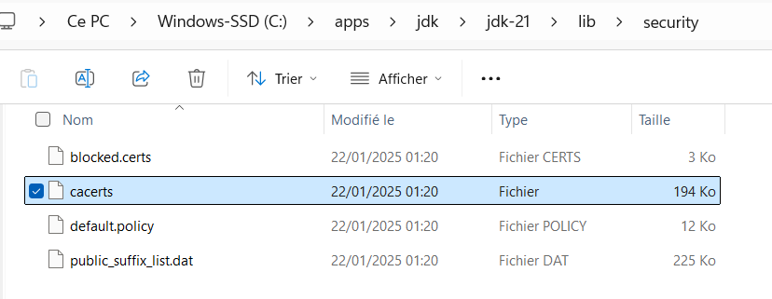
Certificate/Issuers Trusted by default in Java
By default, java trust all certificates from built-in trust store :
{java.home}/lib/security/cacerts

Slide 24
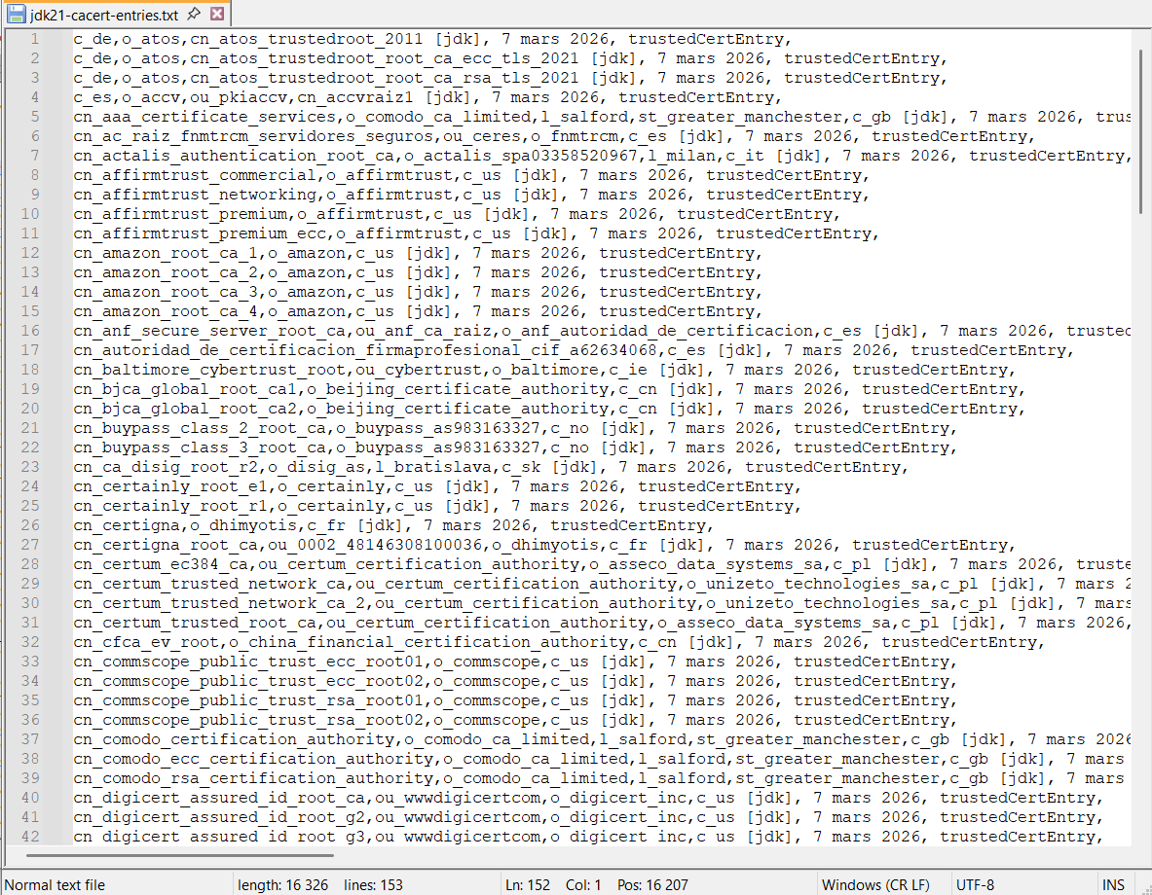
Listing all Trusted Certs (=> 152 in jdk 21)
keytool -list -keystore ${JAVA_HOME}/lib/security/cacerts
keytool -list -keystore ${JAVA_HOME}/lib/security/cacerts | grep trustedCertEntry | wc -l

Slide 25
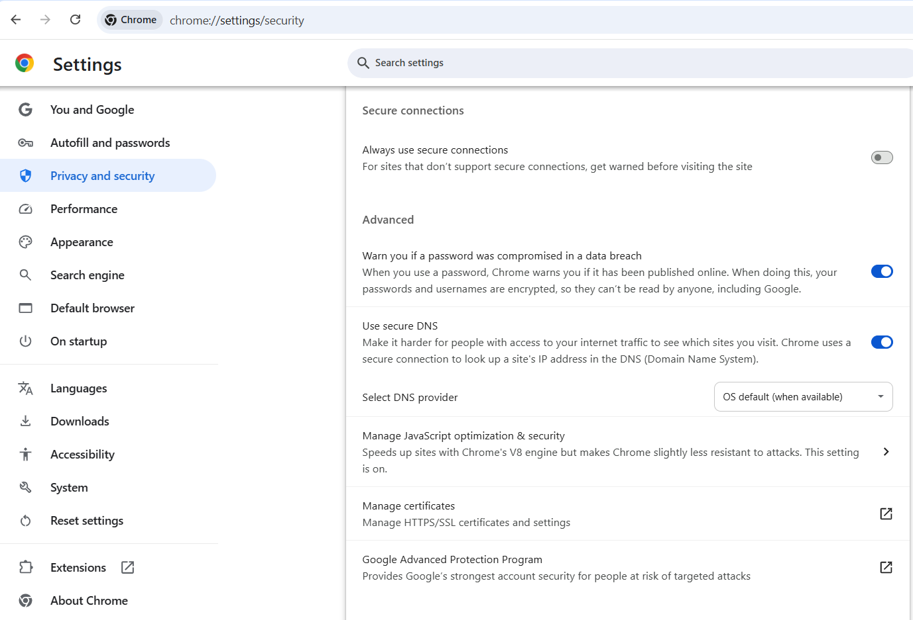
Trusted Certificate by Your Browser
chrome://settings/security

Slide 26
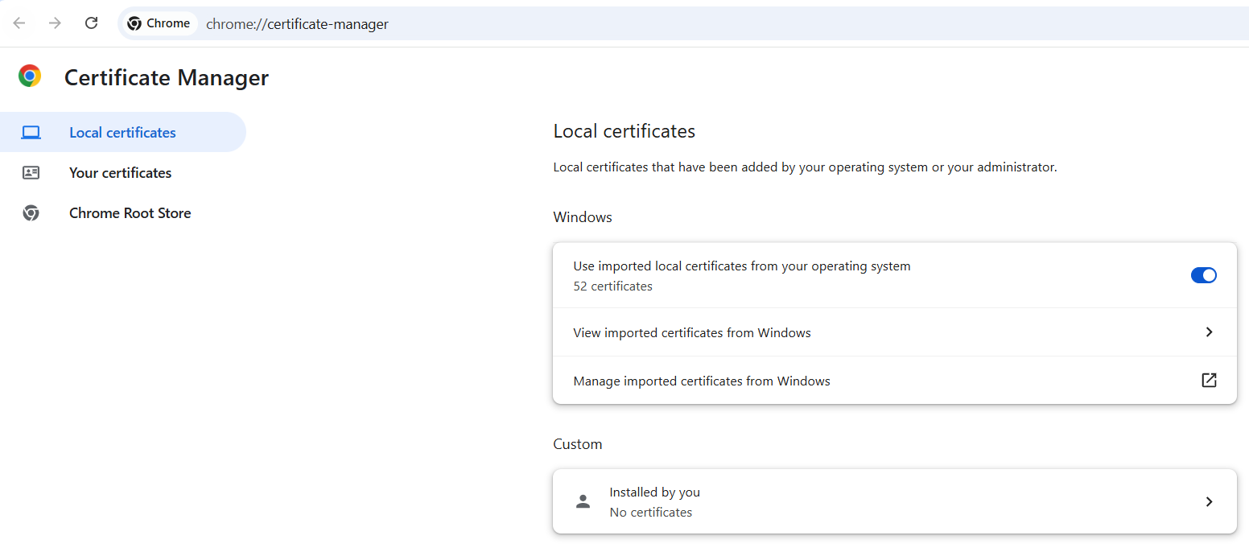
=> rely on your OS (Windows / Mac / …)
52 Certificates

Slide 27
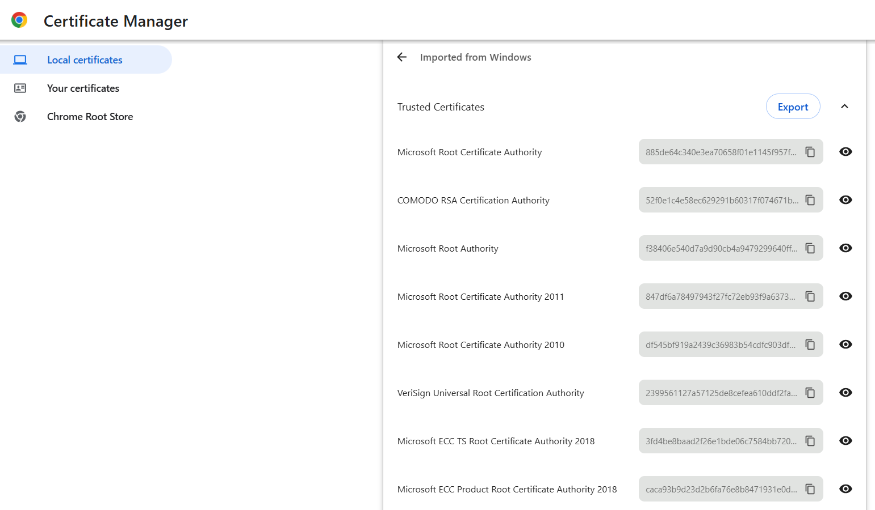
Trusted Certificates …

Slide 28
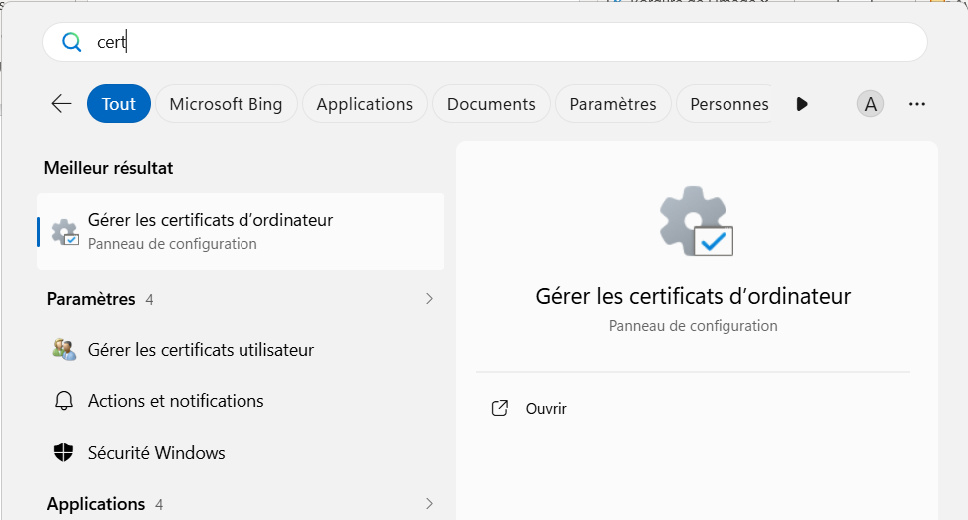
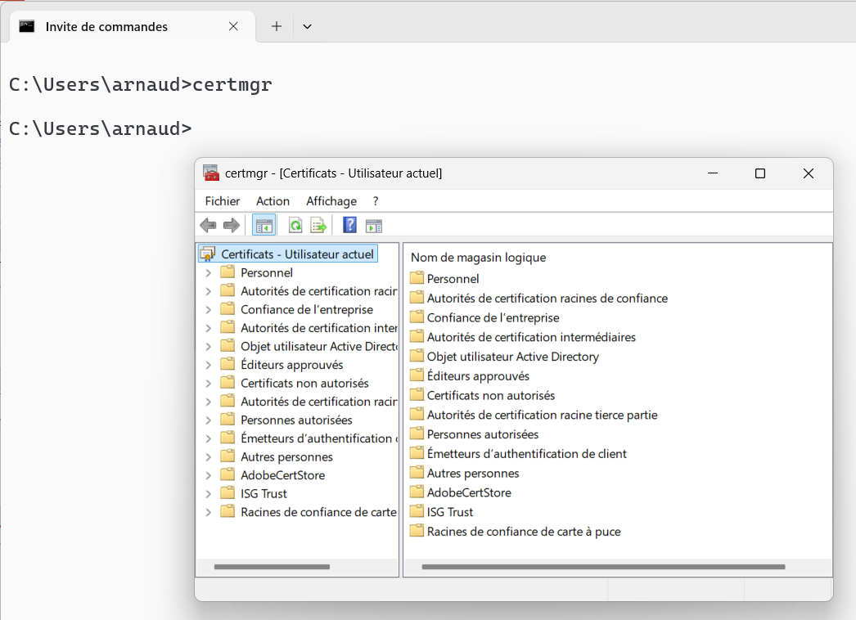
Open Windows Trusted Cert « certmgr »

Slide 29
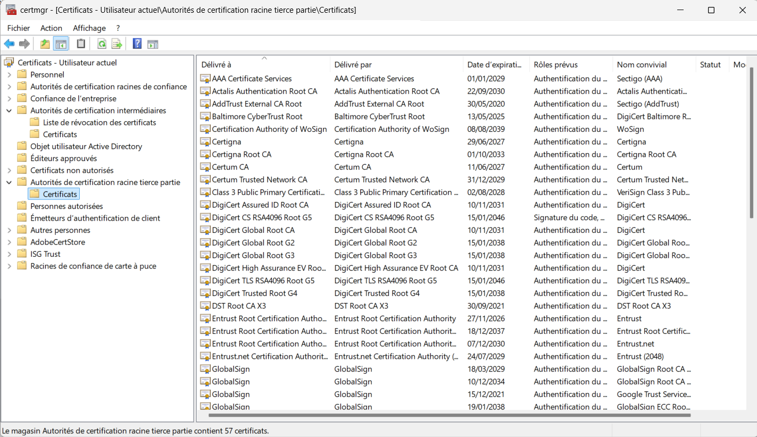
Windows CertMgr (57 certs)

Slide 30
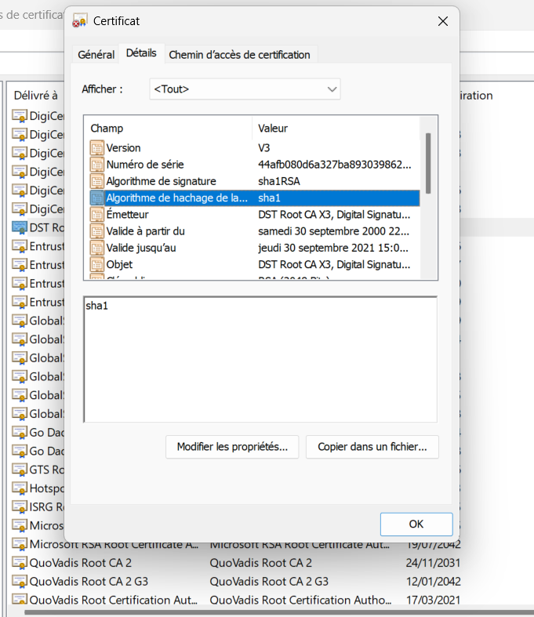
Certificate Details
See next…
certificate is stupid ! (expired)

Slide 31

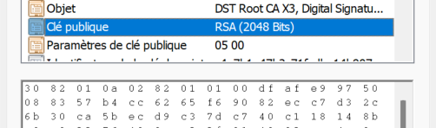
Example of a Deprecated/Unsafe Certificate …
Using SHA-1 ???!!!!!
Recommandation as-of 2026: SHA-256
Using only 2028 bits ???!!!!!
Recommandation as-of 2026: >= 4096 bits
Fortunatly… is is expired !! (but 3 years ago, it was already stupid)

Slide 32
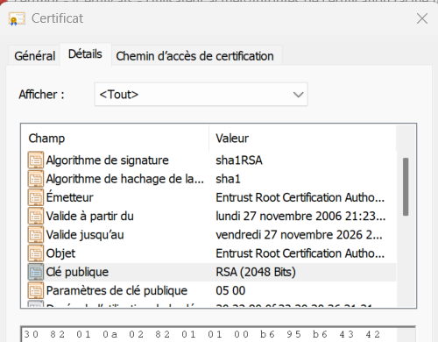
Find a valid (as-of 2026), but still stupid:
2048 bits and using SHA-1 ???
Windows, Chrome, Firefox, and Java reject SHA-1 signed certificates issued after 2016–2017.
So why is it still present?

Slide 33
Part 3 … Https Certificate on Server-Side

Slide 34
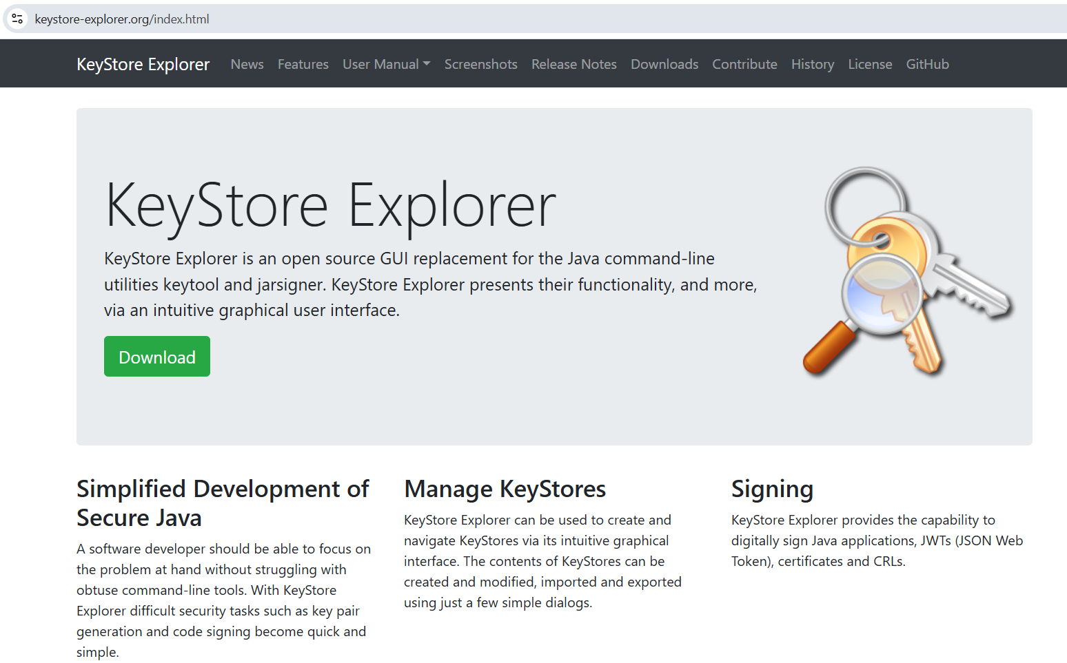
Generate your Https Self-signed certificate
Using KeyStore Explorer UI app
https://keystore-explorer.org/

Slide 35
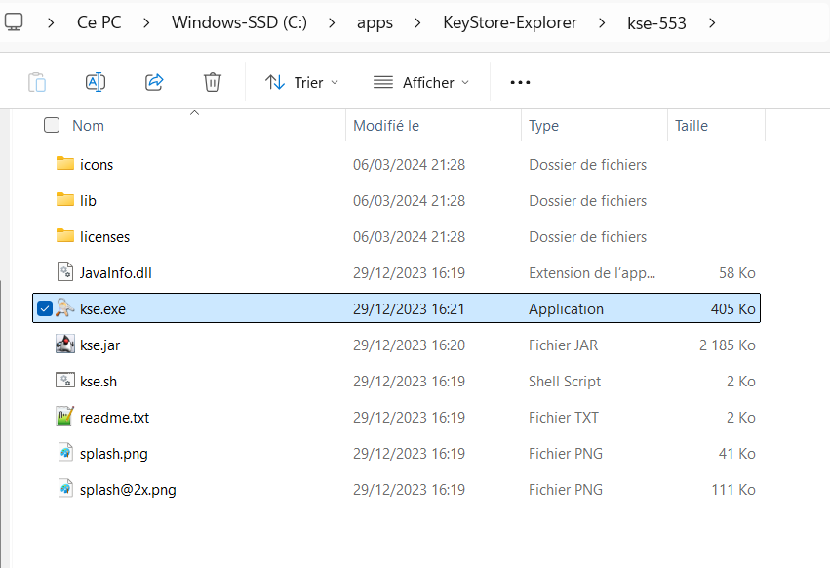
Install, Launch kse.exe

Slide 36
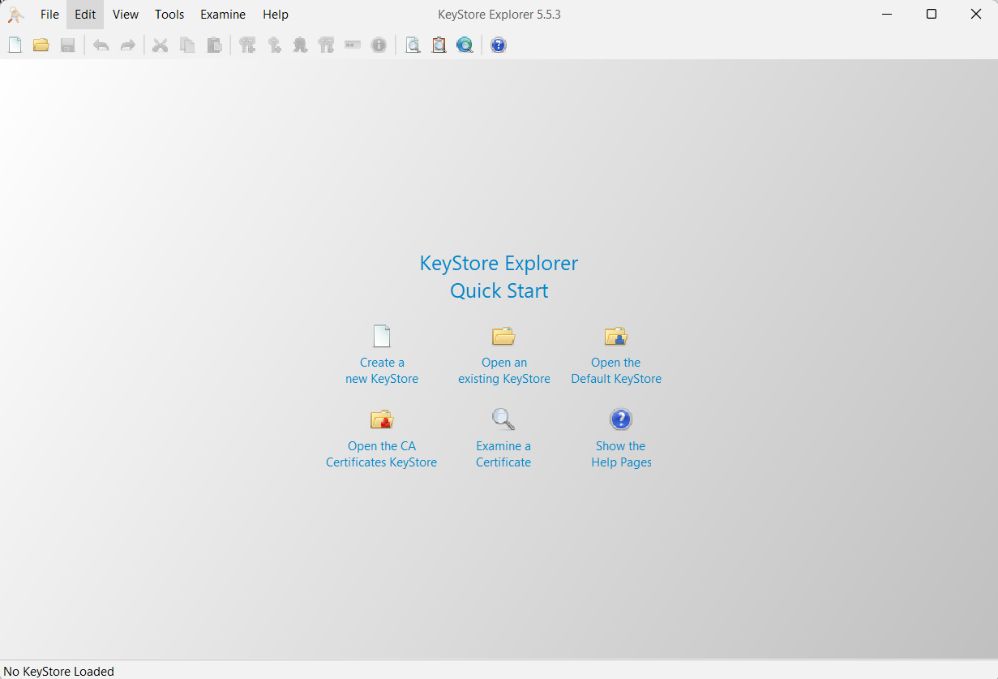
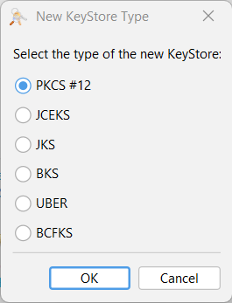
Step 1: Create a New KeyStore
Choose default PKCS#12
(else « JKS » for very old java version <=8 )

Slide 37
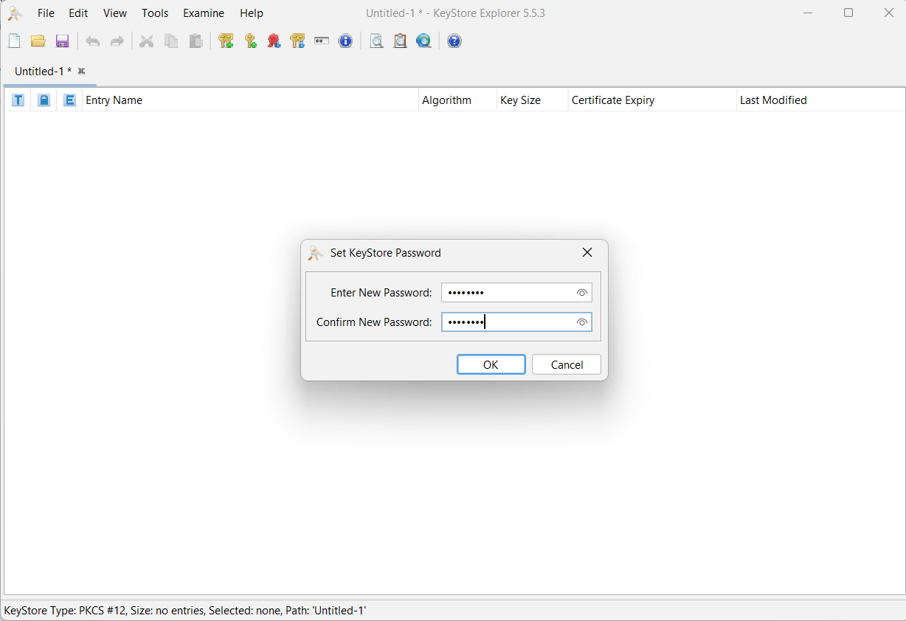
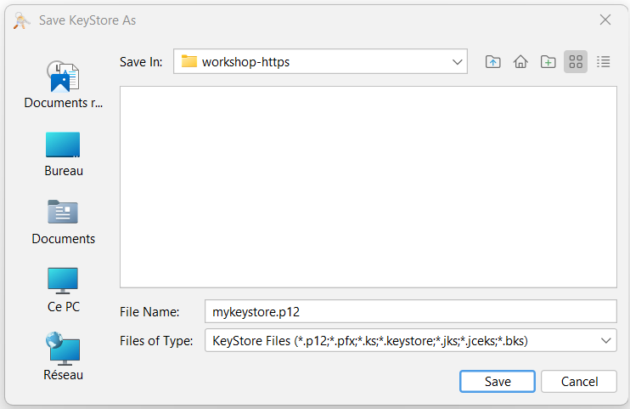
Save your PKCS#12 file
(prompt for password, example: changeit »

Slide 38
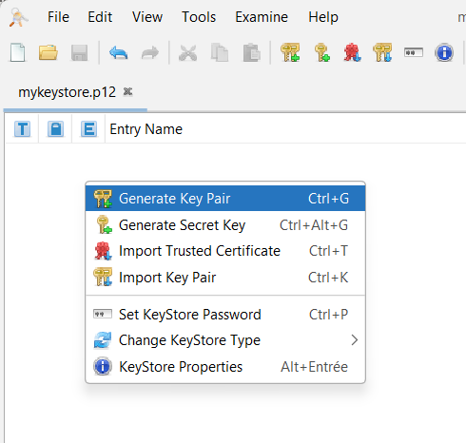
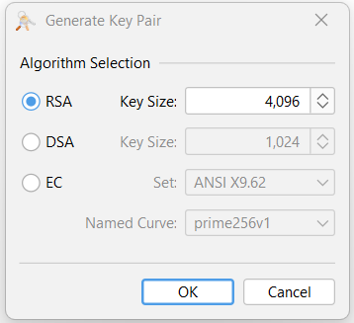
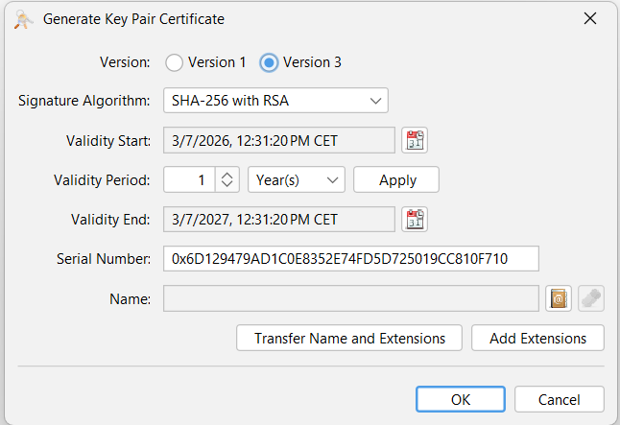
Generate a New KeyPair
(private + public part of Certificate)

Slide 39
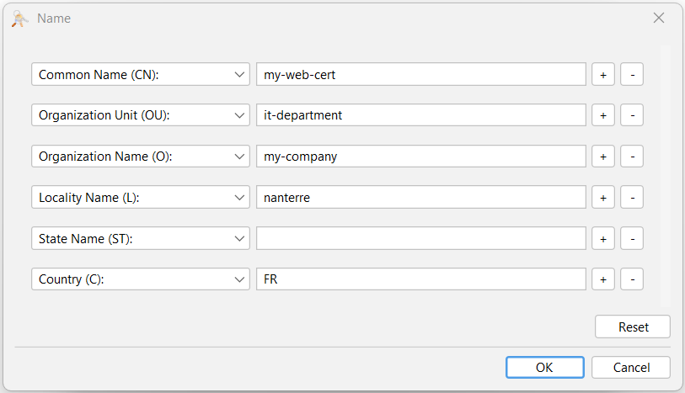
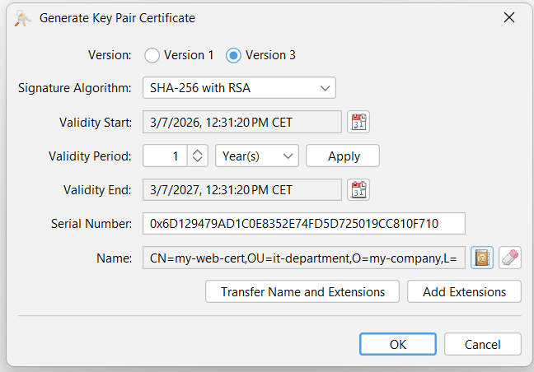
Edit « Names »

Slide 40
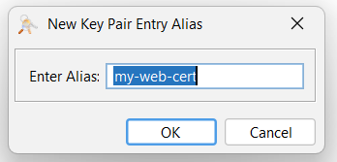
Enter « alias »
(name of KeyPair entry in KeyStore)

Slide 41
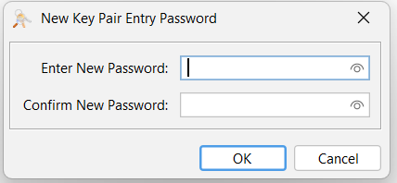
Optional… Enter a passphrase for this Entry

Slide 42
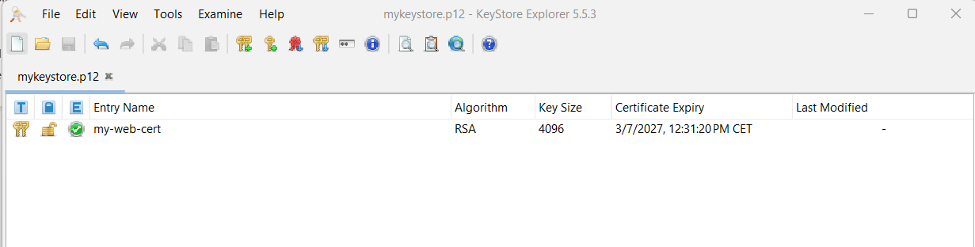
KeyStore now contains a RSA KeyPair Entry

Slide 43
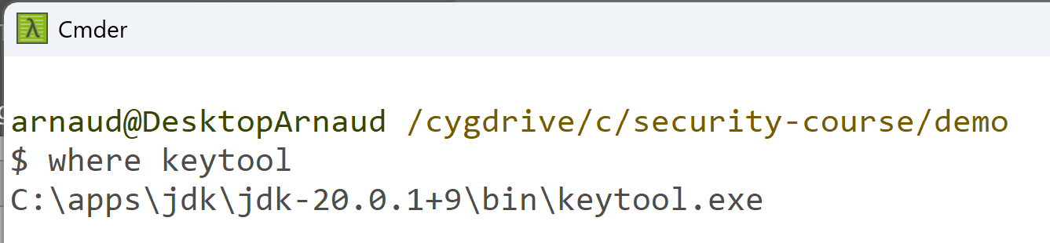
Alternative:
Generate self-signed certificate
From java KeyTool Command Line
keytool -genkeypair -alias mycert -keyalg RSA -keysize 2048 -storetype PKCS12 -keystore mycert.p12
-validity 3650
Troubleshooting ?
"keytool" is a tool in your jdk/bin directory
check "where keytool" => it should be found in your "PATH" environment variable
check "echo $PATH"
... to fix, use windows "env" to edit your environement variables, or export PATH="$PATH:$JAVA_HOME/bin"

Slide 44
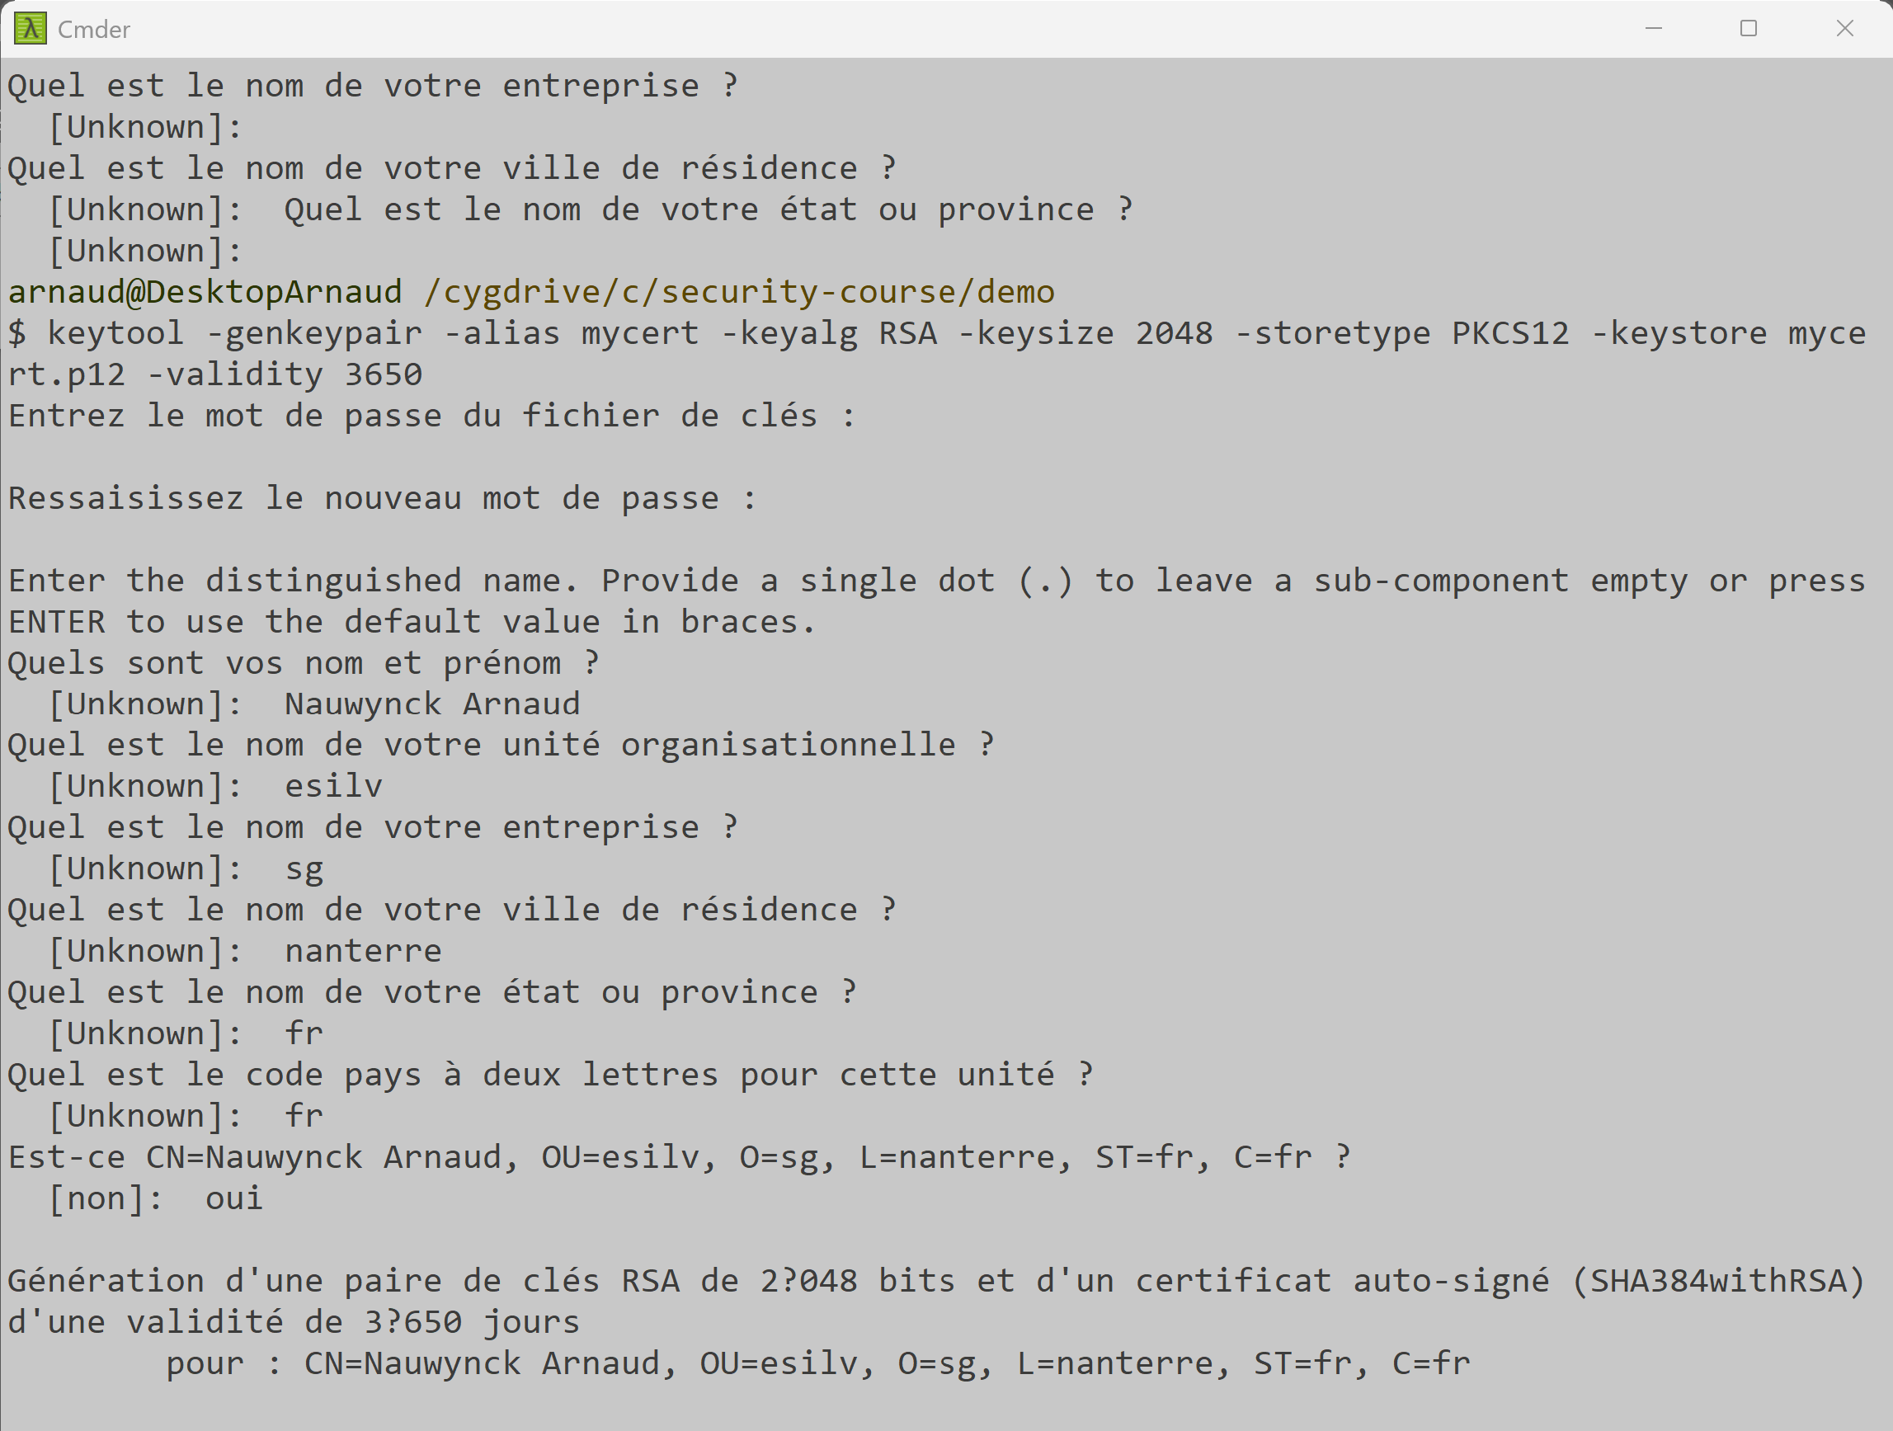
interactive answer to prompt (any is ok) lastly "Is it CN=.... ? " [no]: type yes !!

Slide 45
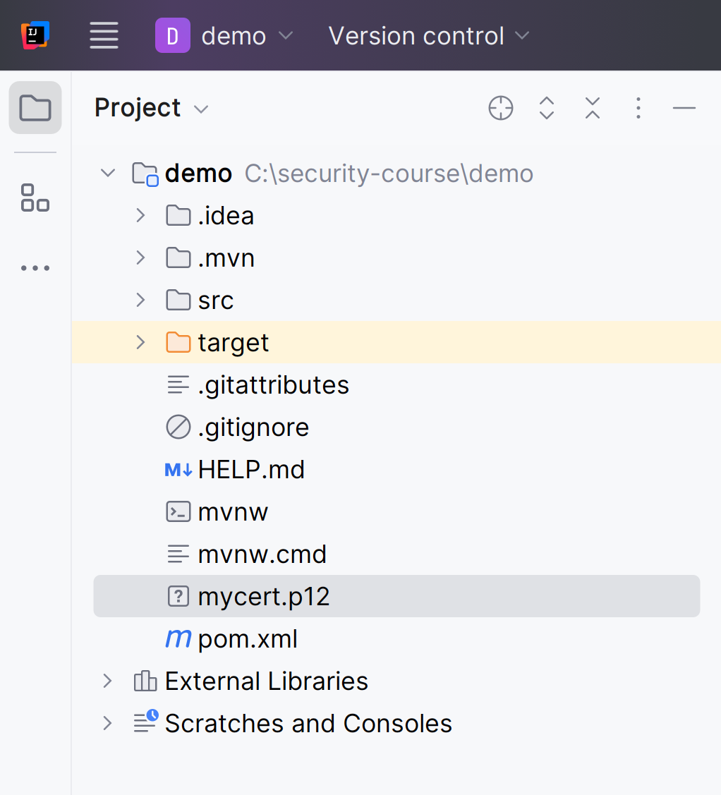
Copy file "mycert.p12" in project

Slide 46
Notice… Certificate (self-signed) => Chain
More complex… Not studied here
For curious students :
Step 1/ generate a CA = « Certificate Authority »
openssl genrsa -out ca.key 4096
Step 2/ Generate a « CA Certificate » (self-signed … chicken & egg problem)
openssl req -x509 -new -nodes -key ca.key -sha256 -days 3650 -out ca.crt
Step 3/ Generate a CSR = « Certificate Signing Request »
openssl req -new -key server.key -out server.csr
Step 4/ Sign the CSR With the CA, with Alternate Subject Names => CRT
openssl x509 -req -in server.csr -CA ca.crt -CAkey ca.key -CAcreateserial -out server.crt -days 365 -sha256 -extfile san.cnf

Slide 47
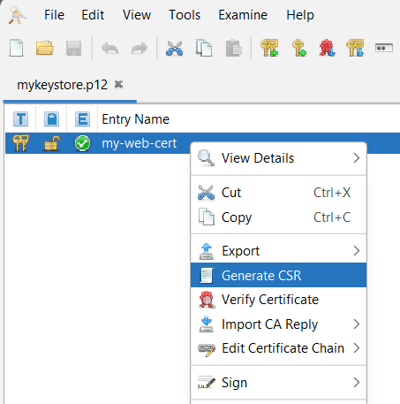
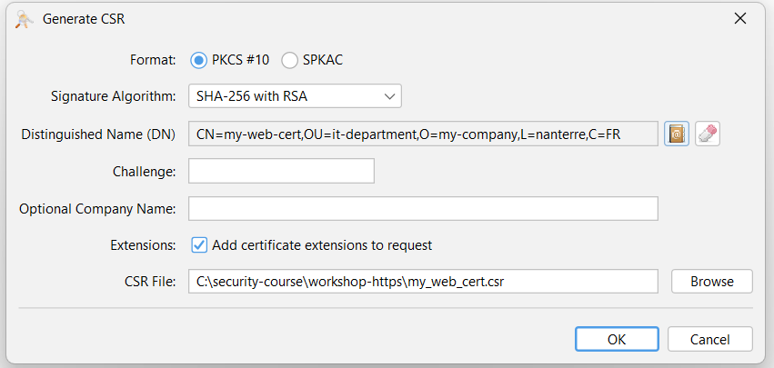
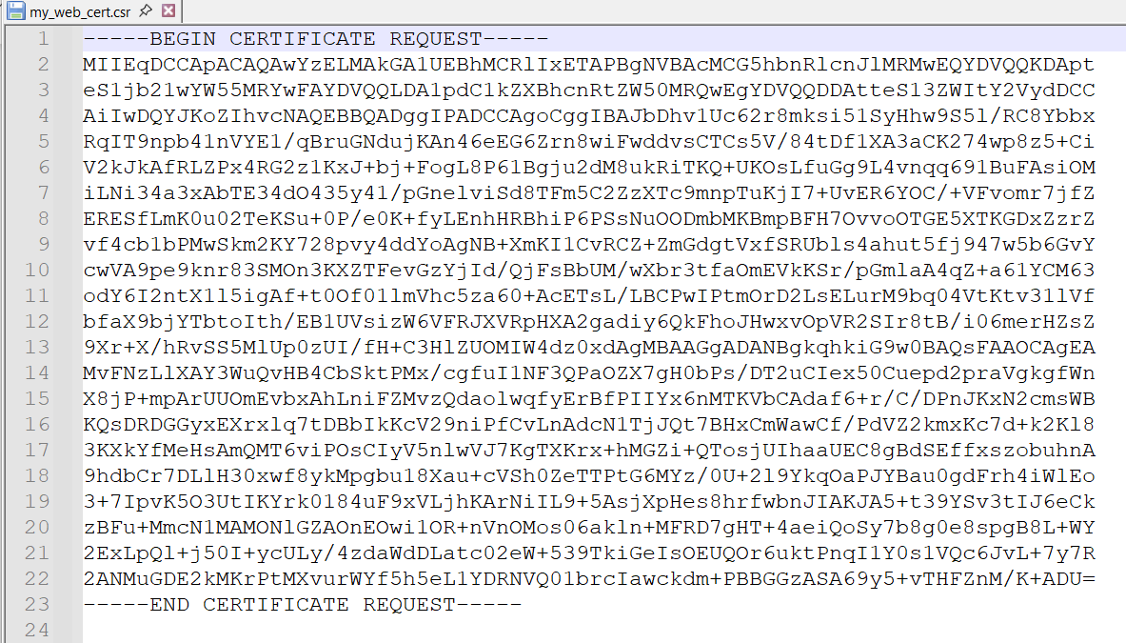
Manual Interactive CA + CSR + Sign with KeyStoreExplorer?

Slide 48
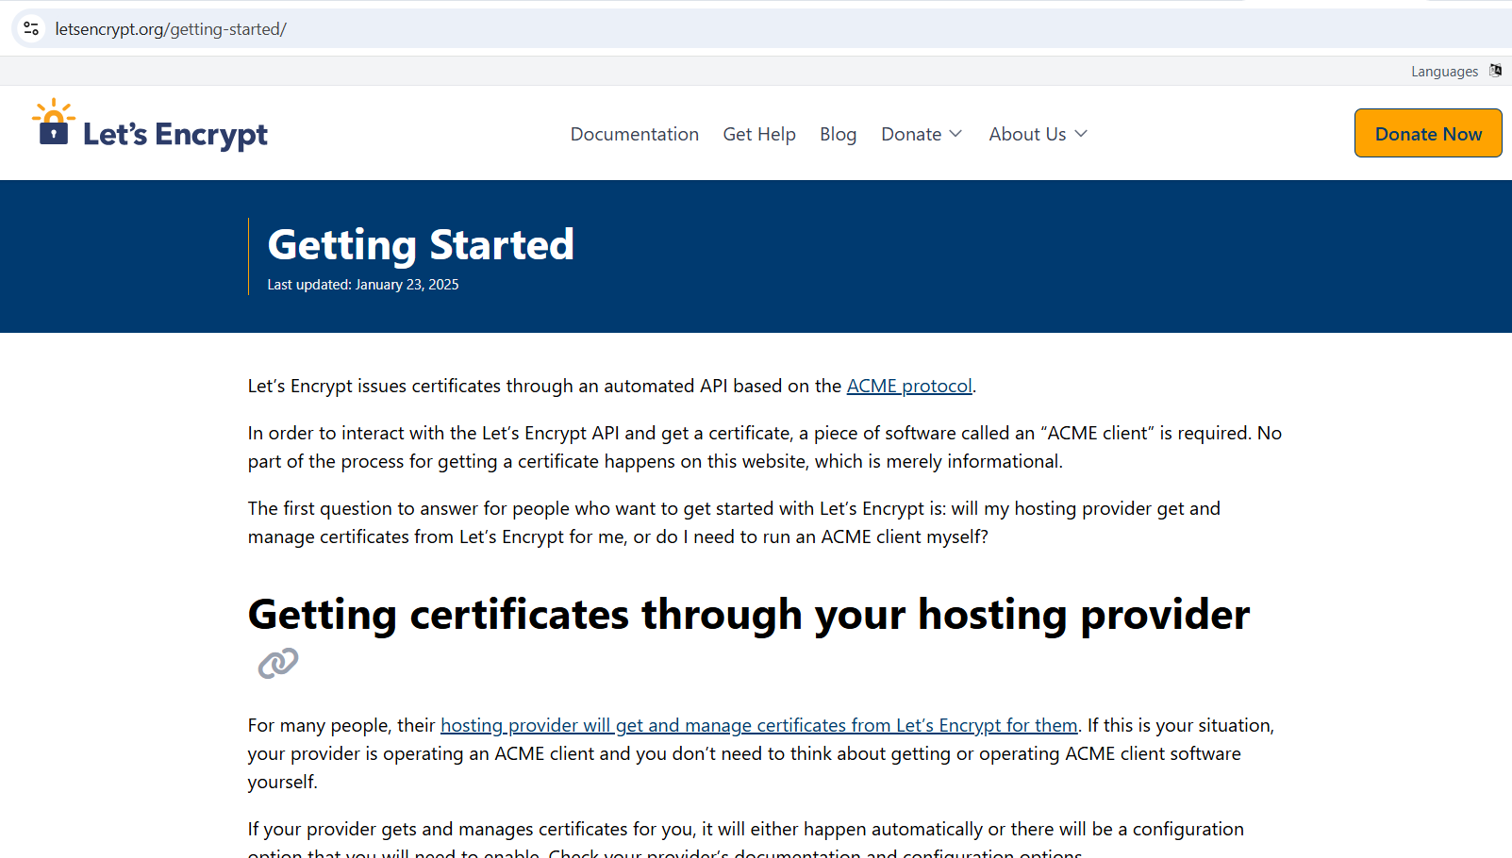
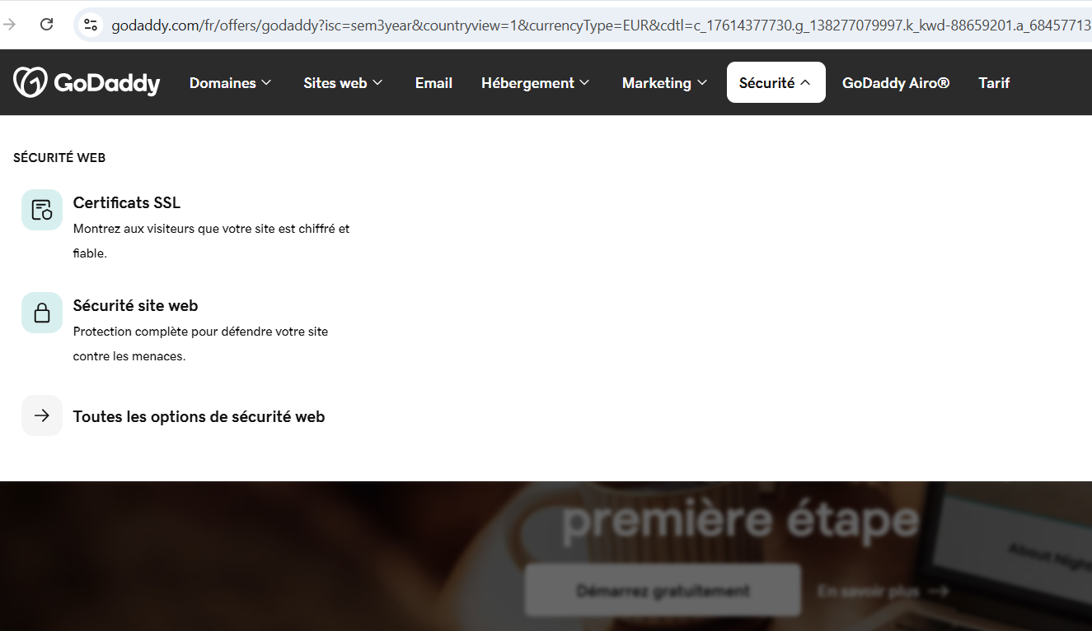
Example of Issuers:
« Let’s Encrypt », « Go Daddy », etc.
https://letsencrypt.org/
https://www.godaddy.com/

Slide 49
Re-Open your springboot
« web » demo project

Slide 50

Edit src/main/resources/application.properties to configure SSL
server.port=8443
server.ssl.enabled=true
server.ssl.key-store-type=PKCS12
server.ssl.key-store=mycert.p12
server.ssl.key-store-password=password
server.ssl.key-alias=mycert

Slide 51

Relaunch server, check new console log

Slide 52

port changed 8080 (default for http)
-> 8443 (default for https)
on previous port 8080
=> "ERROR Connection refused"
OK, Normal !!

Slide 53

https://localhost:8443 (self-signed certificate)
CERT_AUTHORITY_INVALID ... OK

Slide 54
Why ?
... because of self-signed certificate
NOT built-in recognized in your Chrome
Alternatives ?
=> click on "ADVANCED" button to accept self-signed certificate
=> Add in Windows (CertMgr) User-defined certificates
=> pay 200 EURO/year to have a valid certificate ?
=> use GO-DADDY or other signing Authority on internet (recognized by Chrome)

Slide 55


Advanced > Proceed to (unsafe)

Slide 56

Chrome DevTools Network requests
... same on "https://"

Slide 57

Chrome DevTools "Security" tab

Slide 58

See Also Chrome -> Certificate Details
Suggestion ...
open view on a real web-site, "https://www.google.fr"
to see a valid signed certificate

Slide 59


Importing your Self-Signed Cert in Windows
(Using KeyStore Explorer)

Slide 60
Alternative… Importing directly in Windows
( 20 Clicks)
Notice old versions of Windows used to support only « *.pfx » file
(need to do conversion PEM / PKCS12 -> .pfx )
Now OK, can import directly from PKCS12 (but not jks)

Slide 61

Importing Certificate in Windows

Slide 62



Importing …

Slide 63



Importing…

Slide 64

Imported !

Slide 65
… Check Your web page is now « Secured »
Relaunch your Web Browser (re-import Windows->Chrome??)
Re-open https://localhost:443
Check that Web site is « Secured » … take screenshot

Slide 66

Questions ?

