Slide 1
Web Architecture
Network Components
arnaud.nauwynck@gmail.com
Esilv 2026

Slide 2
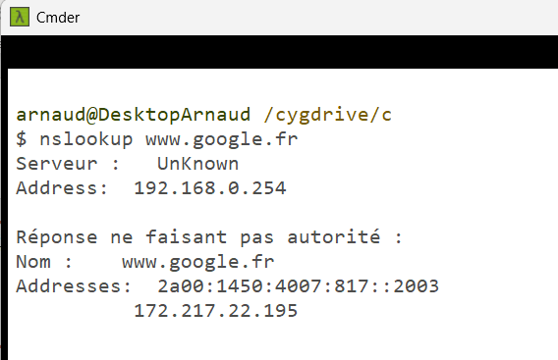
DNS
Domain Name Service
Example: resolving with « nslookup »

Slide 3
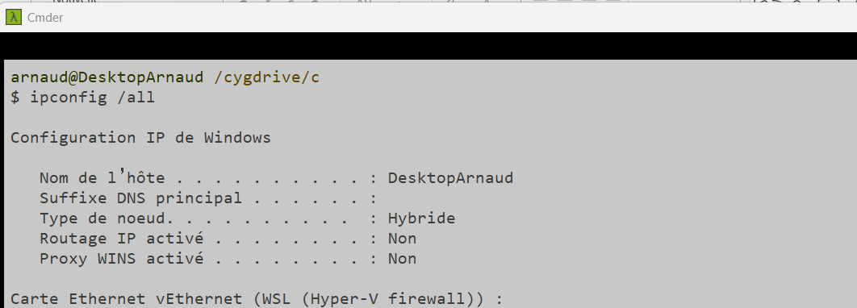
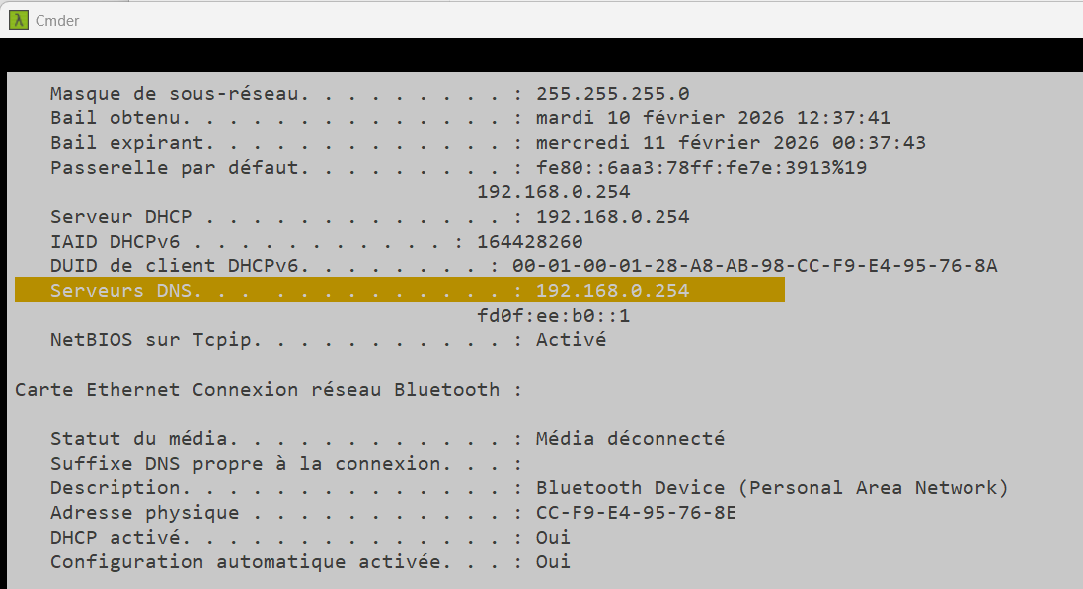
DNS Server…
Example: « ipconfig /all»

Slide 4
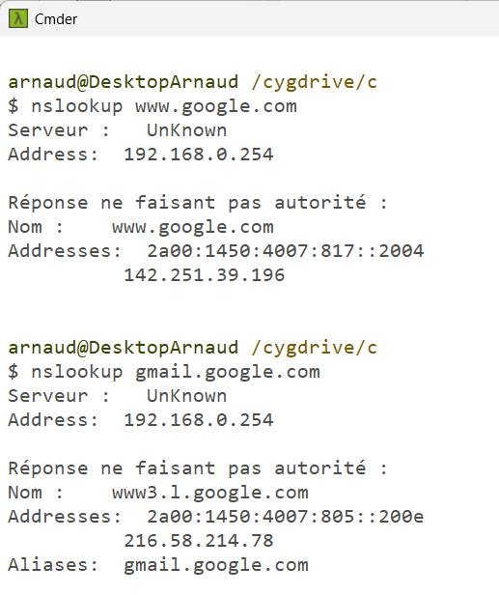
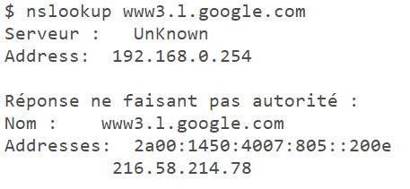
FQDN = hostName + domainName
example … « www.google.com »
Hostname server1 = « www »
On internet Domain = «*.google.com »
TCP-IP: IPv4=142.251.39.196, IPv6=..
Hostname server « gmail »
CNAME Alias to « www3.l.google.com »
…
=> TCP-IP: IPv4=…

Slide 5
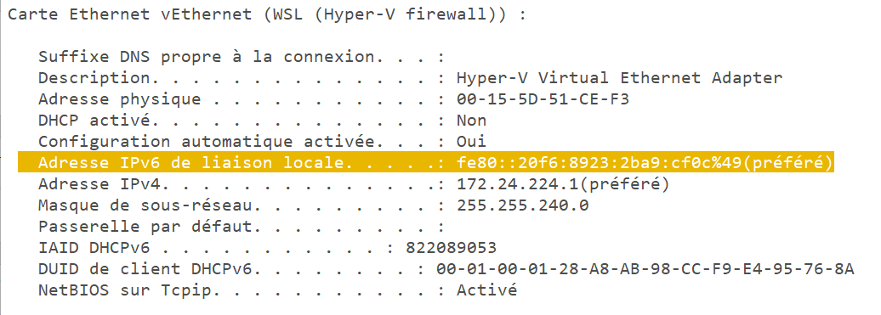
TCP-IP => Network Gateway
Local network: 255.255.240.0/20
pc1
pc2

Slide 6
CIDR, Network Mask
255.255.240.0
255 = 8 bits set to 1
240 = 11110000 = 4 bits set to 1
12 (=8+4) bits in local networks out of 2^32
i.e. « /20 » mask

