Slide 1
Java Langage & JRE Internal Basics Compile – (Link -) Runtime
This document:
https://github.com/Arnaud-Nauwynck/presentations/blob/main/java/Java-Langage-JRE-Internal-Basics.pdf

Slide 2
Outline
Overview compile – runtime chain
Compiler basics: grammar, parser to AST
Declaration-Statement-Expression
Bytecode, stack
Langage Class Symbol resolution
Class.forName() / ClassLoader
First reference, Hot swap code
Method Symbol resolution + call
Invokestatic, invokespecial
Invokevirtual
Invokeinterface
invokedynamic

Slide 3
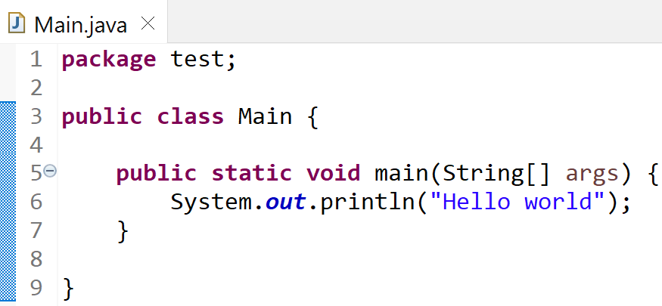
Compile – Runtime Chain
UTF-8 files
src/main/java/*.java
Bytecode (binary) files
target/classes/*.class
jar file = zip of *.class
target/*.jar
javac
jar
*.jar or .class
In CLASSPATH
+ main FQN
java
JRE
Symbols
C0 bytecode interpreter
C1 assembly langage
C2 assembly … optimized
.. bytecode link resolved
On first use

Slide 4
Compile (+Extension) – Runtime(+JVM Agent) Chain
UTF-8 files
src/main/java/*.java
Bytecode (binary) files
target/classes/*.class
target/*.jar
( jar = zip file
of *.class)
javac
jar
Compiler Extensions
(ex: Lombok)
JRE
*.jar or .class
In CLASSPATH
+ main FQN
java
Symbols
C0 bytecode interpreter
C1 assembly langage
C2 assembly … optimized
.. bytecode link resolved
On first use
javaagent Extensions
(ex: glowroot profiler)

Slide 5
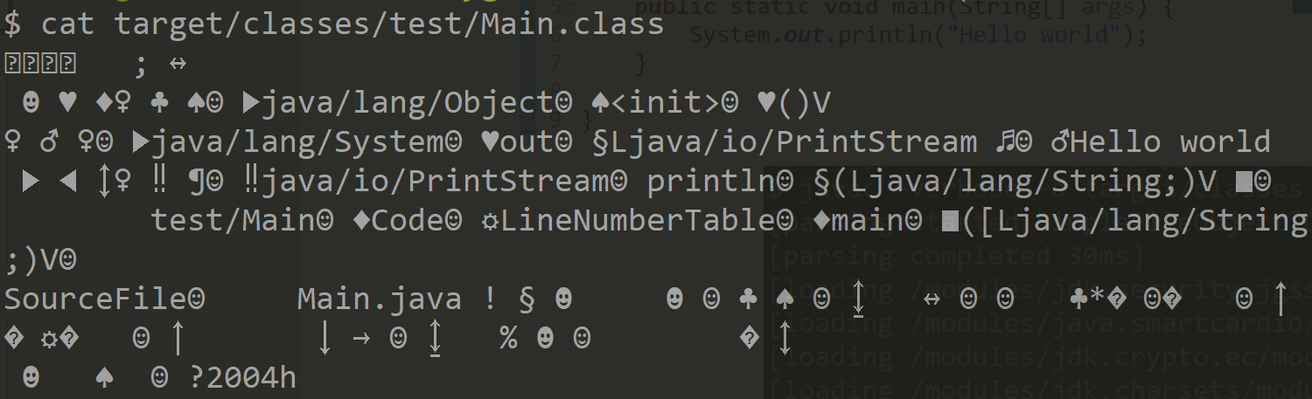
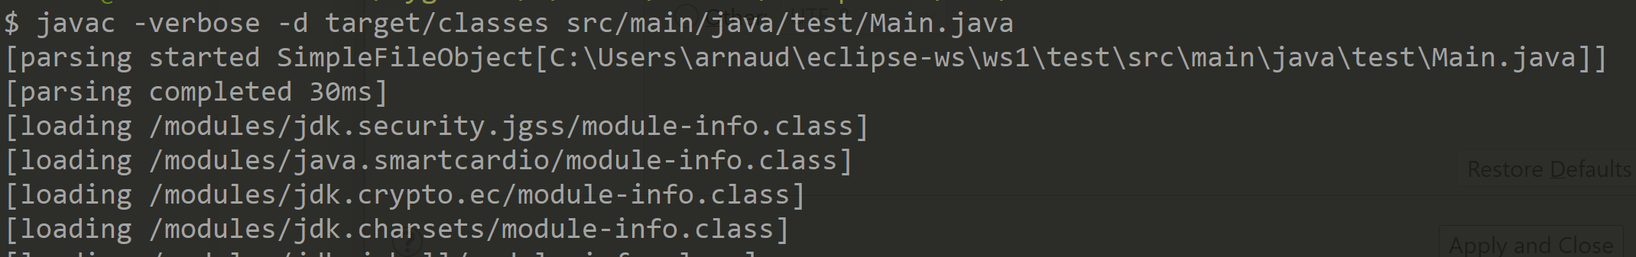

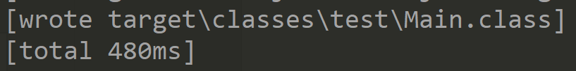
Compile steps
UTF-8 files
src/main/java/*.java
Bytecode (binary) files
target/classes/*.class
Zip file
target/*.jar
javac
jar
mvn package

Slide 6
Javac .. steps
*.java
Bytecode generator
Read char(s)
lexer
parser
builder
Token(s)
Grammar rules
shift-reduce
Tree
( AST )
Resolved
Typed Tree
Attributed Tree
( AAST )
Bytecode
AAST =
Attributed Abstract Syntaxic Tree
Stack Operator
CST = Concrete Syntaxic Tree
AST = Abstract Syntaxic Tree
contain « ; » and parenthesis « () »

Slide 7
Example.. Compiling « (1+x)*3.1 » from source to bytecode
push 1
push x
fadd
push 3.1
dmult
( 1 + x ) * 3.1
??

Slide 8
Javac .. steps
*.java
Bytecode generator
Read char(s)
lexer
parser
builder
Token(s)
Grammar rules
shift-reduce
Tree
( AST )
Resolved
Typed Tree
Attributed Tree
( AAST )
Bytecode
AAST =
Attributed Abstract Syntaxic Tree
Stack Operator
CST = Concrete Syntaxic Tree
AST = Abstract Syntaxic Tree
contain « ; » and parenthesis « () »
*
Type: double
push 1
push x
fadd
push 3.1
dmult
« (1 + x) * 3.1 »
*
+
3.1
Type: float
+
3.1
1
Name « x »
Type: int
1
«x »
Resolved var..
type: f

Slide 9
Lexer to Tokens
« ( 1 + x ) * 3.1 »
(
Literal number
op
Name
)
op
Literal number
UTF-8 source file
API to read char file:
reader = ..
for(;;) {
char c = reader.read();
..
}
API to read tokens:
tokenLexer = ..
for(;;) {
token tk = lexer.readToken();
..
}

Slide 10
Grammar Rule
Expression ::= LitteralNumberExpr | VariableExpr | ParenthesisExpr | UnaryOpExpr | BinaryOp | FunctionCallExpr
LitteralNumberExpr ::= <number>
VariableExpr ::= <name>
ParenthesisExpr ::= « ( » Expression « ) »
UnaryOpExpr ::= unoperator Expression
+, -, !
BinaryOpExpr ::= Expression binayOperator Expression
+, -, *, /, %, &, |, ^, && ..

Slide 11
Grammar Rule Parsed
« ( 1 + x ) * 3.1 »
Literal number
Name
Literal number
Binary Op
Parenthesis Expression
Binary Op

Slide 12
Tree (in-memory) Representation
Binary Op ..’*’
Expression parsedExpression =
BinaryOpExpression
Parenthesis Expression
left
right
Op: ‘*’
Binary Op .. ‘+’
Literal number
BinaryOpExpression
LiteralExpression
left
right
Op: ‘+’
value: double 3.1
Literal number
Name
LiteralExpression
NamedExpression
value: int 1
name: « x »
« ( 1 + x ) * 3.1 »

Slide 13
Concrete -> Abstract Syntaxic Tree lost parenthesis, « ; », indentation, comment…
AST is NOT ambiguous, no need parenthesis
( parser need handling operator precendence )
(1 + 2) * 3
1 + (2 * 3) = 1 + 2 * 3
*
+
+
3
1
*
1
2
2
3

Slide 14
Expression classes Abstract Syntaxic Tree (AST)
(abstract) Expression
1
LiteralExpression
NamedExpression
UnaryOpExpression
1 left
1 right
BinaryOpExpression
* params
FunctionExpression
Terminal classes (rule with token only)
intermediate Composite classes (recursive grammar rule)

Slide 15
.. Not only Expressions need Procedural (Statement) + Declarations
AbstractNode
Declaration
Statement
Expression
For program structure
package, class, method, ..
For procedural parts
« if », « for », « switch »..
For values, and operators

Slide 16
Abstract Syntaxic Tree
AbstractNode
DeclarationNode
StatementNode
ExprNode
CompilationUnit
BlockStmt
ExpressionStmt
UnaryOpExpr
IfStmt
BinaryOpExpr
ClassDeclaration
ClassSymbol
ForStmt
TernaryOpExpr
SwitchStmt
LocalVarDeclStmt
…
MethodDeclaration
MethodSymbol
ApplyExpr
FieldDeclaration
FieldSymbol
FieldAccess

Slide 17
Correspondance Grammar Rule <-> AST Classes
1 grammar Rule ~ 1 AST sub-class
Parse 1 grammar rule => build 1 AST sub tree
Example
Rule XYZ::= <expr1> token <expr2> .. token <exprN> // => trigger AST builder code:
{ return new AstXYZ (expr1, expr2, .. exprN); }

Slide 18
Parser
Example tools:
« lex & yacc » (origin C)
« Antlr », « JavaCC », ..
Using Code Generated
from Grammar Rule
?
Using « hand-coded »
Recursive parser
… example « javac »

Slide 19
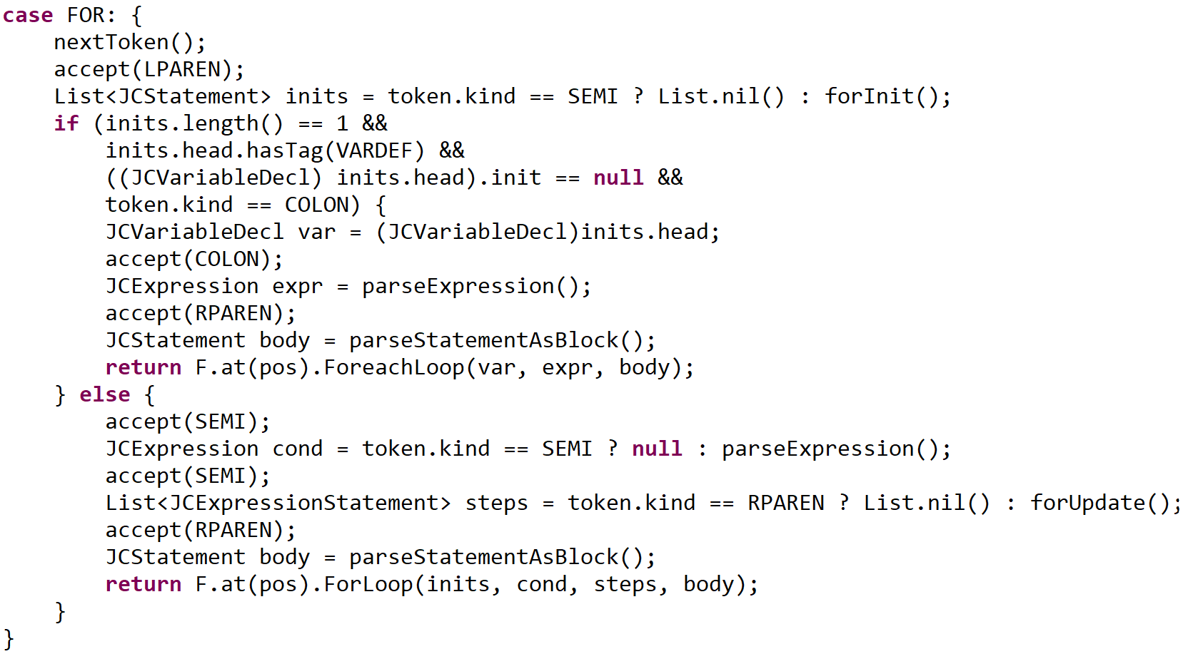
Detailed JDK extract.. JavacParser.java
// <=Rule for
for( Type var : collection ) stmt
// <=Rule for
for( init ; cond ; update ) stmt

Slide 20
Full AST « Hello World »
parser
builder
Grammar rules
shift-reduce
Tree
( AST )
CompilationUnit
Public class « Main »
ClassDeclaration
Public static void « main(String[] args) »
MethodDeclaration
{.. ; .. ; }
StatementBlock
ExpressionStatement
ApplyExpr
lhs: « System.out »
params: [« Hello world» ]
« . »
FieldAccess
MethodSymbol
StringLiteral
« println(String)»
«Hello world»
ClassSymbol
FieldSymbol
« java.lang.System »
« out»

Slide 21
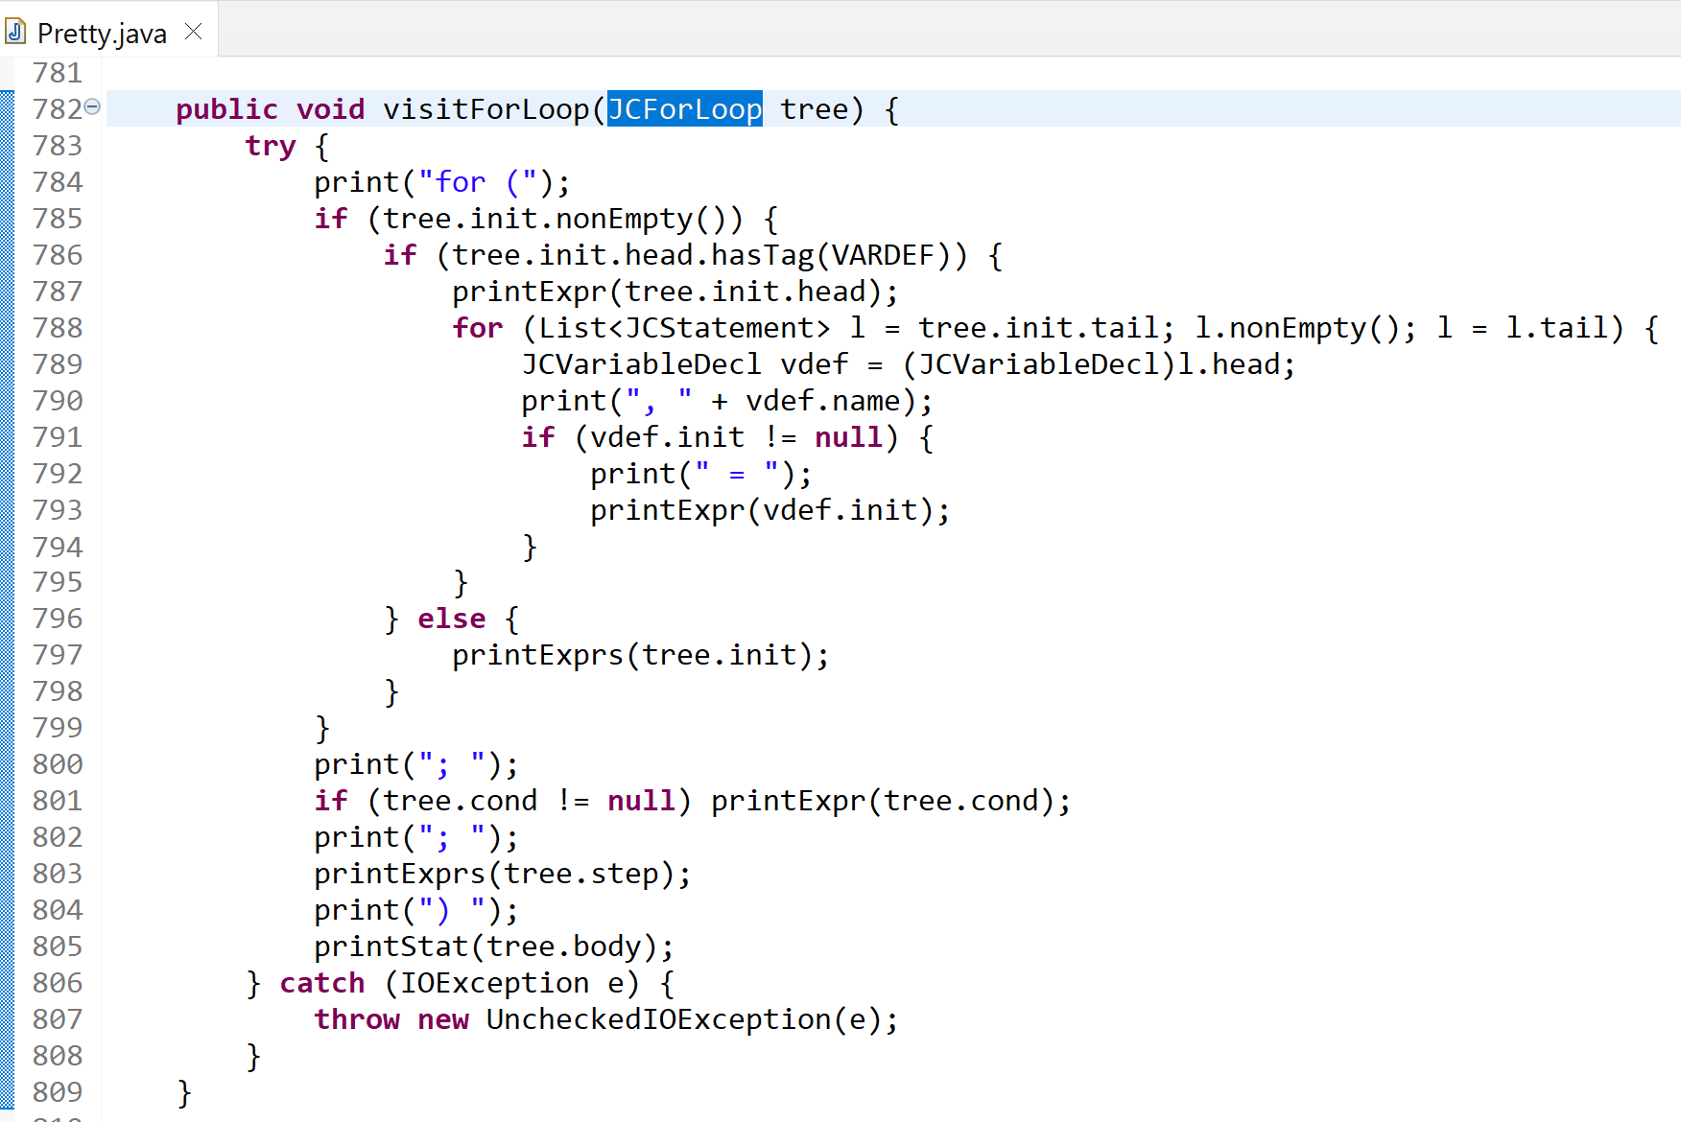
AST to Text … Pretty.java read easy code to understand AST

Slide 22
Declaration
Something that can be prefixed with access modifier
« public|protected|private » « static » « final »
A declaration produces a « symbol », that can be imported / used

Slide 23
Statement
Something that can be suffixed by « ; »
or wrapped in « { ; ; } »
A statement has no type
No push/pop values on stack … statement need expressions

Slide 24
Expression
Something that can be wrapped by « ( .. ) »
A statement has a type amoung
- Primitive type
- Pointer to class/enum/interface/..
- Array
Evaluating an expression => pop arguments + eval + push result value on stack

Slide 25
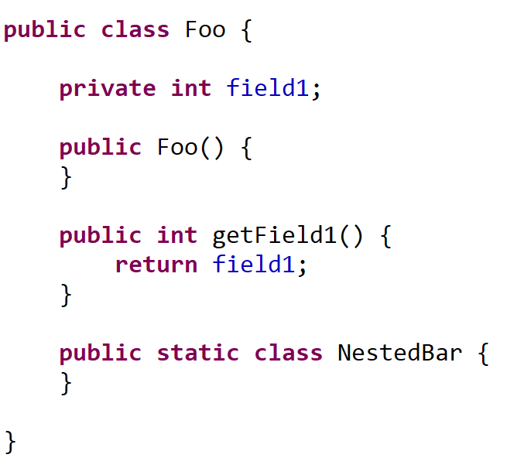
Declaration examples
Class Declaration
Field Declaration
Constructor Declaration
Method Declaration
Nested class Declaration

Slide 26
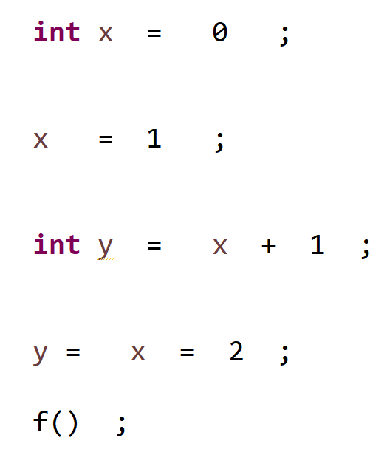
Statement / Expression Examples
LocalVariableDeclaration … statement, initializer: expression
ExpressionStatement … statement containing Expression

Slide 27
Symbol
.jar / .class library
Contains Symbol Tables
By [index] internally in bytecode
By [name] externally
Java (Source Code File)
At Compile-Time
Import
+ resolve (ambiguous names)
+ type-check
... use in AST
produce
Compile/link
Declaration
Symbol
load
At Runtime
Resolve by unique symbol name
+ redo type-check
… use in bytecode

Slide 28
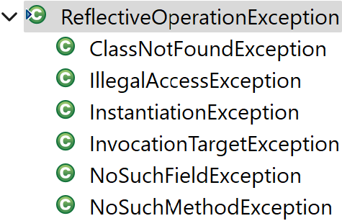
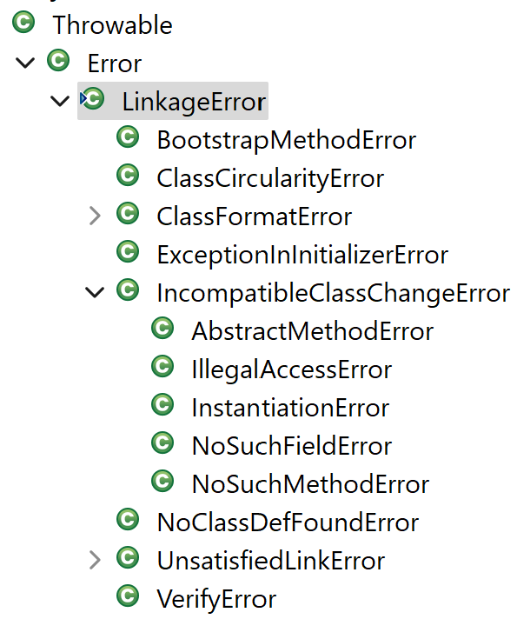
Explicit Reflection Loading / Implicit Link for bytecode
Explicit from reflect code:
Class.forName()
/ ClassLoader.load() / .define()
/ Class.getMethod() / .getField()
May throw ReflectiveOperationException
load
At Runtime
Resolve by unique symbol name
+ redo type-check
Symbol
Implicit Link For bytecode
Resolved at first usage
May throw LinkageError

Slide 29
Type Descriptor & Symbol Name Mangling
Primitive Type => V, Z(boolean), B(byte), I(int),J(long), F(float),D(double),..
Array Type => « [ » typeName
Class => type descriptor: « L » « pack »/ « subpack » /« ClassName » « ; »
symbol name : « pack » . « subpack » . « ClassName » FQN (Fully Qualified Name)
Field => FQN « $ » « fieldName »
Method => type descriptor: « (type1 type2 ..typeN) returnType »
symbol name : «methodName(type1 type2 ..typeN) »

Slide 30
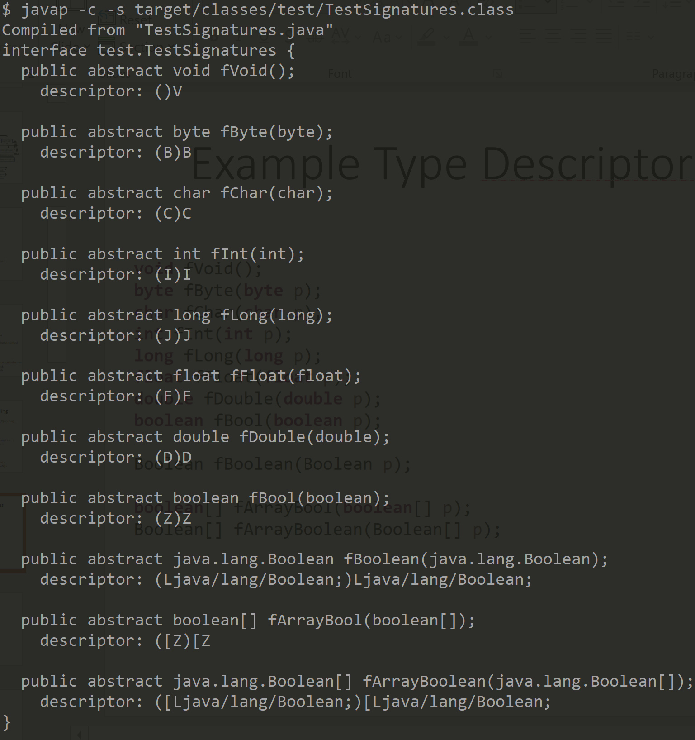
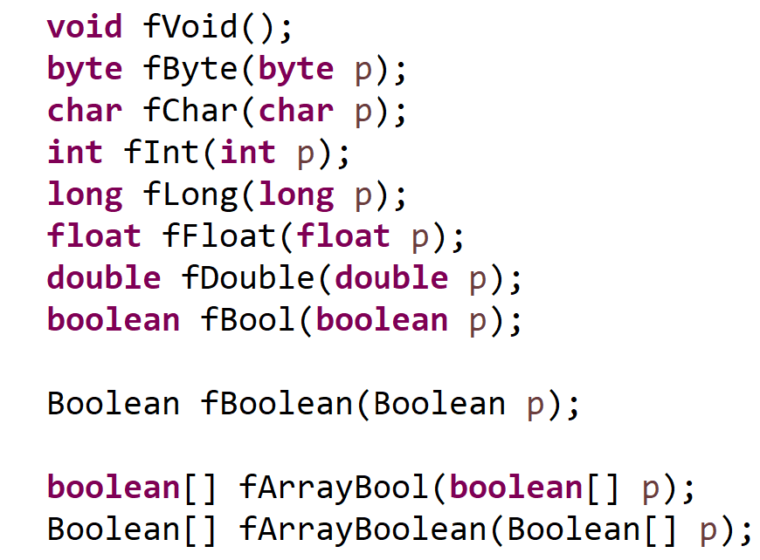
Example Type Descriptor & Symbol Names

Slide 31
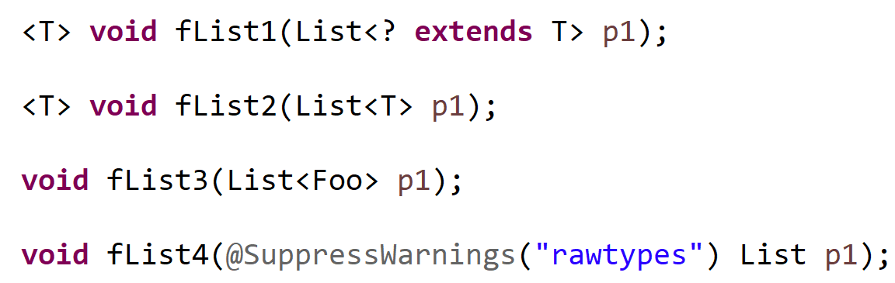
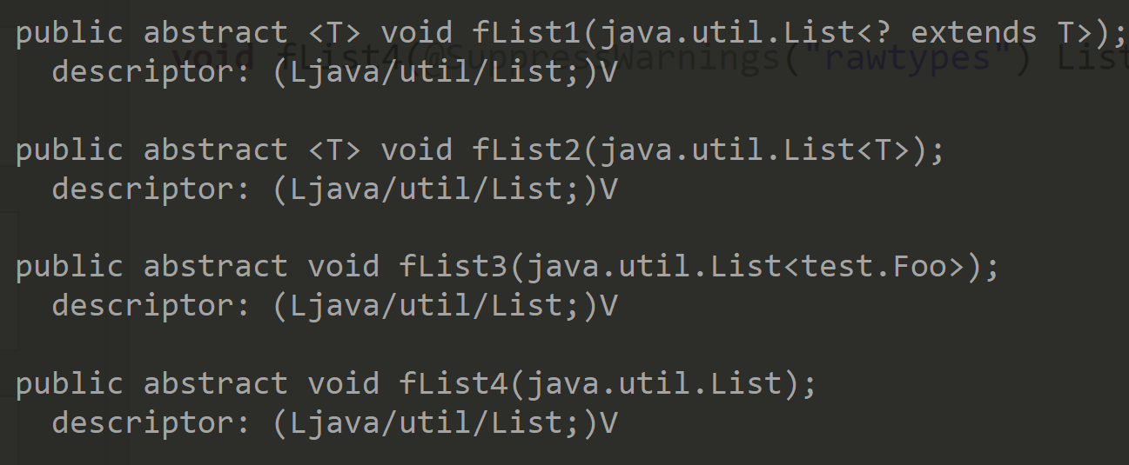
Notice: Generic Types => same as <Object> exact Type Erased in Descriptor « Type Erasure »

Slide 32
Overload method signatures
Can not have 2 methods overload
differing only by template type
( not an error in other langages like C++)

Slide 33
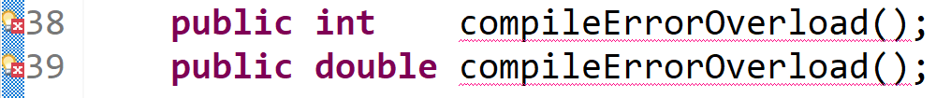
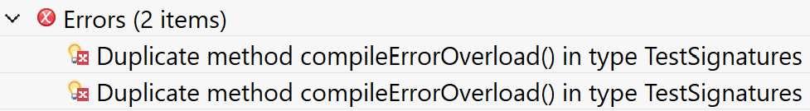
Notice 2 : return type not in symbol name
Can not have 2 methods overload
differing only by return type or template type

Slide 34
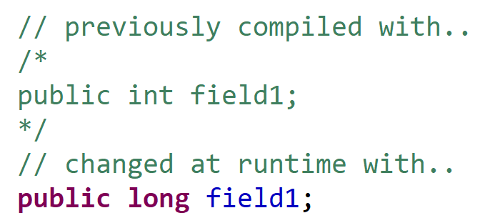
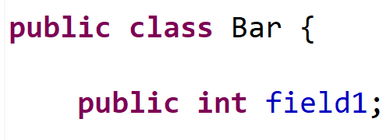
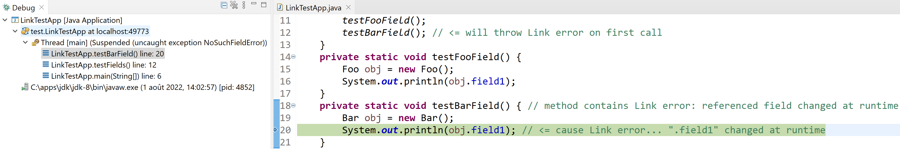
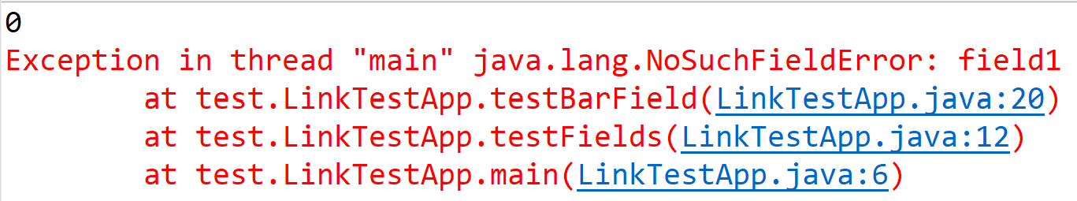
Compiled OK … BUT change in CLASSPATH => LinkError
Program start OK
Error method partially execute .. OK !
but fail on first bytecode Link error

Slide 35
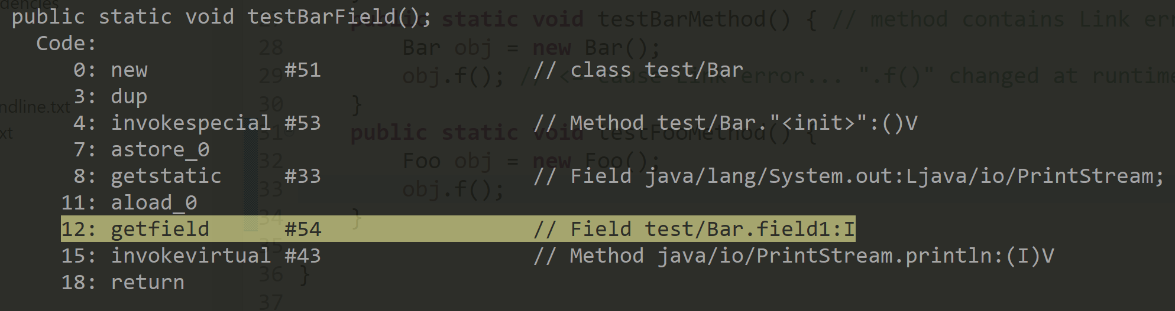
Internally … « getfield » => « _fast_*getfield »
On First use….
Resolve Bytecode « getfield #fieldIdx»
Load + type-check
Class c = .. Class.forName(« test.Bar »)
f = c.getField(« field1 »);
assert f.getType().equals(int.class);
Bytecode instruction
« getfield #idx»
HOT REPLACED BY internal
« _fast_getfield offset»
Code replaced (?) or re-executed
with « throw new …Error() »
«fast_getfield» on next uses

Slide 36
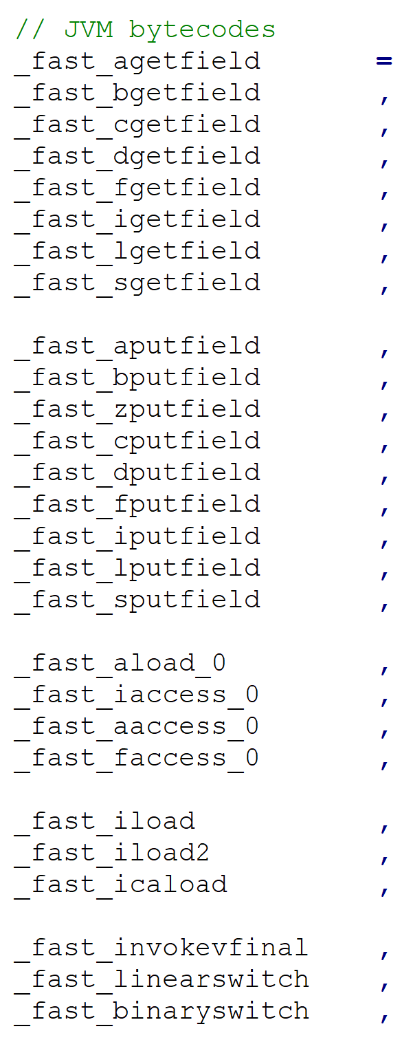
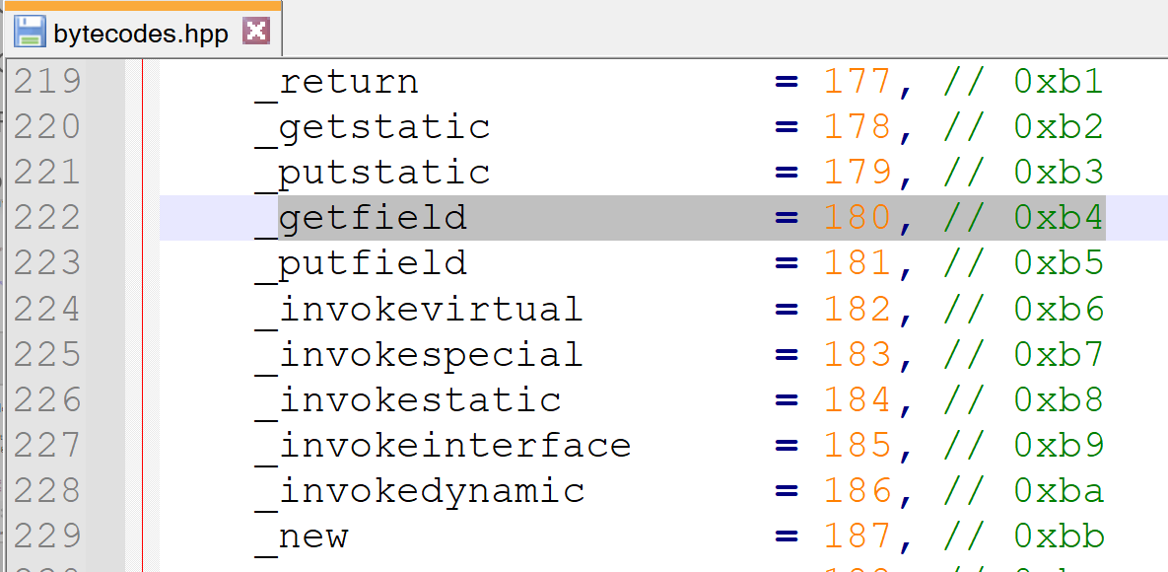
Cf OpenJdk .. src/hotspot/share/interpreter/bytecodes.hpp
bytecodes
Internal Reserved
fast_* bytecodes

Slide 37
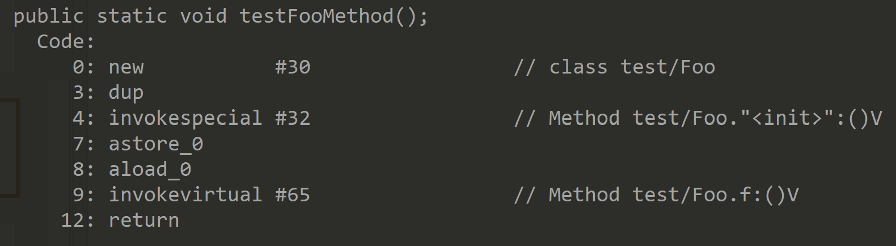
Idem « invoke* » => « fast_invoke* »
On First use….
Resolve Bytecode « invoke* #methIdx»
Load + type-check
Class c = .. Class.forName(« test.Bar »)
m = c.getMethod(« field1(type1..typeN »);
assert m.getType().equals(…);
Bytecode instruction
« invoke* #idx»
HOT REPLACED BY internal
« _fast_invoke* offset»
Code replaced (?) or re-executed
with « throw new …Error() »
«fast_invoke*» on next uses

Slide 38
Different « invoke* » : {static|special|virtual|interface|dynamic}
static => … to call fixed (known) function, and update stack
special => … idem … call fixed (known) function, and update stack after « new »: « <init> » method, or « super() » method
virtual => … need array access to object class « virtual table », to determine exact method
interface => … need lookup interfaces table … then virtual table, to determine method
dynamic => … internal for JRE, allowing type evolution

Slide 39
invokestatic
next Thread
stack pointer
« stack += .. »
Current Thread
stack pointer
« stack[..] = return addr
Current method
Bytecode index
Resolved meth
next method
Bytecode index
« goto address »
Invokestatic #methIdx

Slide 40
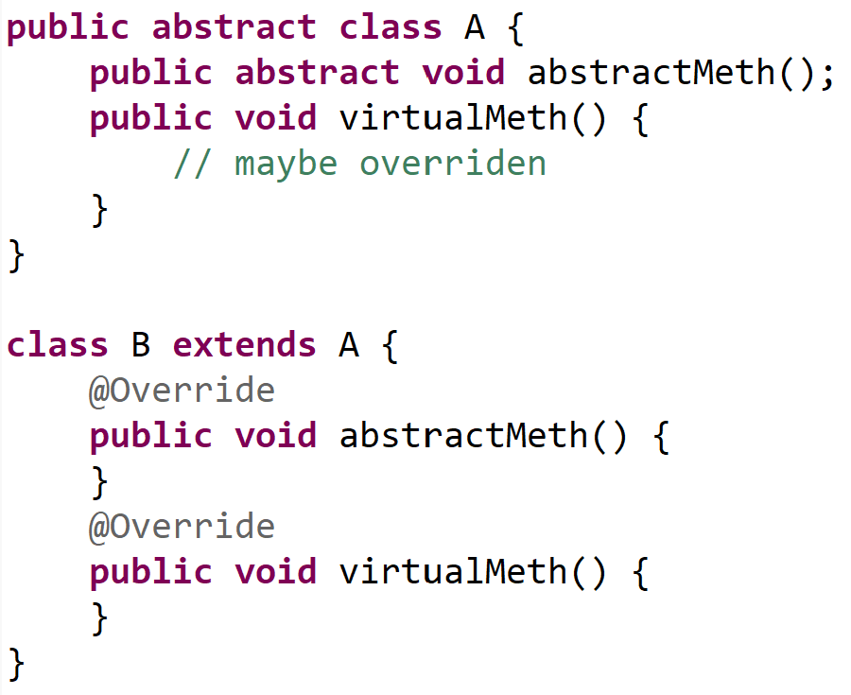
invokevirtual
obj.class
Class XYZ … extends A
Virtualtable: [0] [1] … [i] … [N]
Virtual method symbols
next Thread
stack pointer
« stack += .. »
obj
type: ? extends A
Call i-th method
Current Thread
stack pointer
Resolved meth
« stack[..] = return addr
invokevirtual [i]

Slide 41
invokevirtual .. slower than invokestatic
Invokestatic …. O( 1 call )
Invokevirtual …. O( 1 array access + push 1 extra param « this » + 1 call )

Slide 42
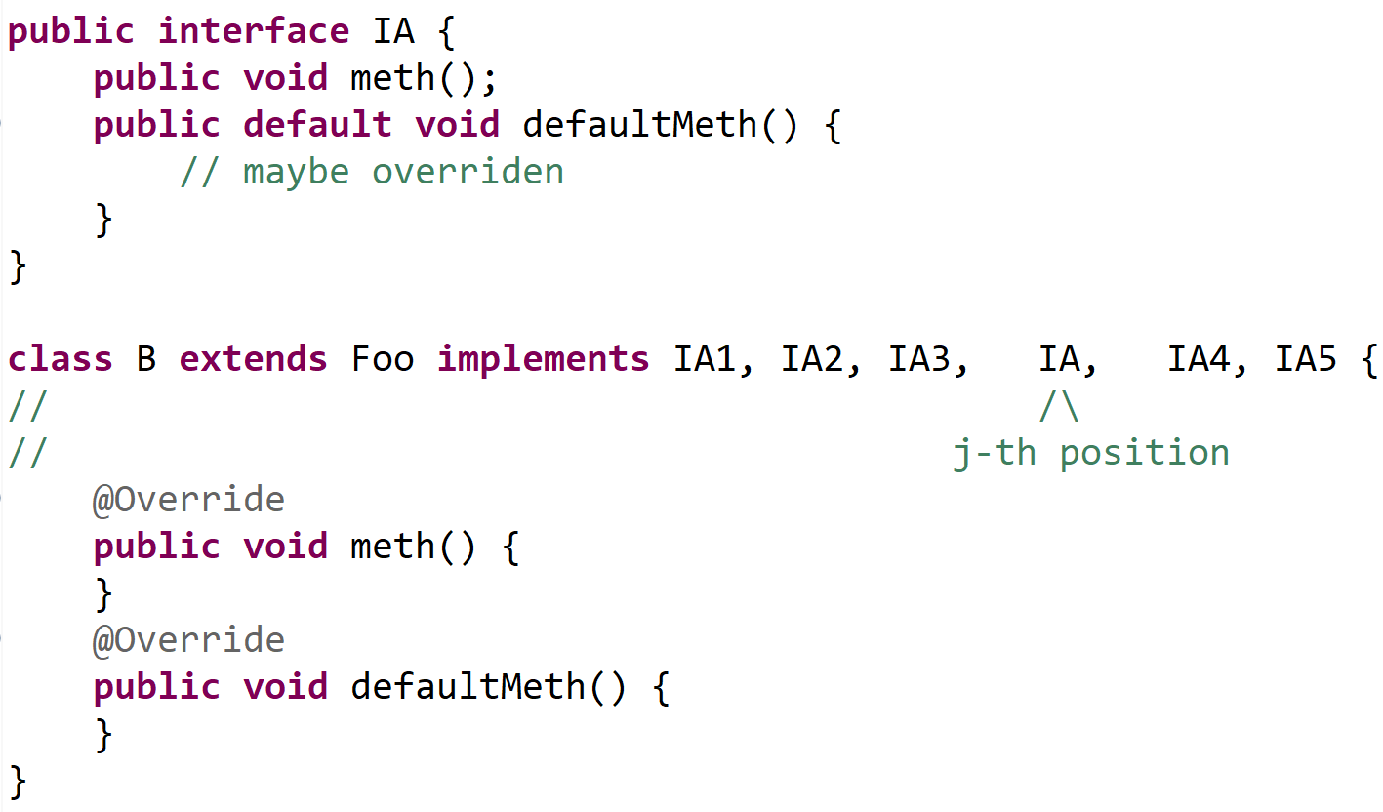
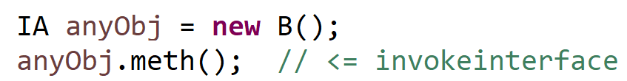
invokeinterface
Performance Problem :
no relation between interface « IA » and extends class (here: « Foo »)
.. can not use virtualtable directly

Slide 43
invokeinterface
Interface IA2
Interface IA1
Class XYZ … implements …. IA …
Interface IA
interfacetable: [0] [1] … [j] … [NI]
(binary or linear search
for interface)
Interface IA3
Interface IA4
Virtualtable: [0] [1] … [i] … [N]
obj.class
Virtual method symbols
Current Thread
stack pointer
next Thread
stack pointer
« stack += .. »
obj
type: ? implements IA
Call method by interface fqn
Resolved meth
« stack[..] = return addr
Invokeinterface « fqn »

Slide 44
invokeinterface .. slower than invokevirtual
Invokestatic …. O( 1 call )
Invokevirtual …. O( 1 array access + push 1 extra param « this » + 1 call )
Invokeinterface …. O( 1 pointer access + J linear OR log(J) binary search interface tables + 1 virtual table array access + push 1 extra param « this » + 1 call )

Slide 45
Remark: abstract class vs interface
For performance (with millions of calls…):
1/ Prefer declare virtual method in abstract class
Rather than method in interface
2/ do not use too many interfaces
3/ sort « implements » interfaces by most frequent usage first
(? .. If linear search )
Example: cf in JDK …
public abstract class InputStream { public abstract int read(); }
public abstract class OutputStream { public abstract void write(int data); }

Slide 46
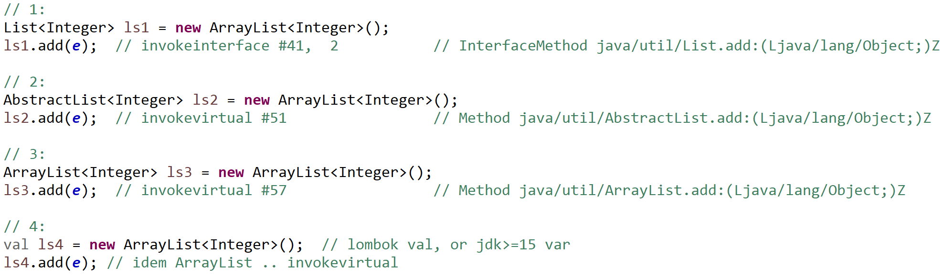
ArrayList extends AbstractList (..AbstractCollection) implement List
1: Slower than 2:,3:,4:
2: & 3: same perf (both invokevirtual, not same type)
4: idem 3:
HOTSPOT may optimize all as invokespecial !!

Slide 47
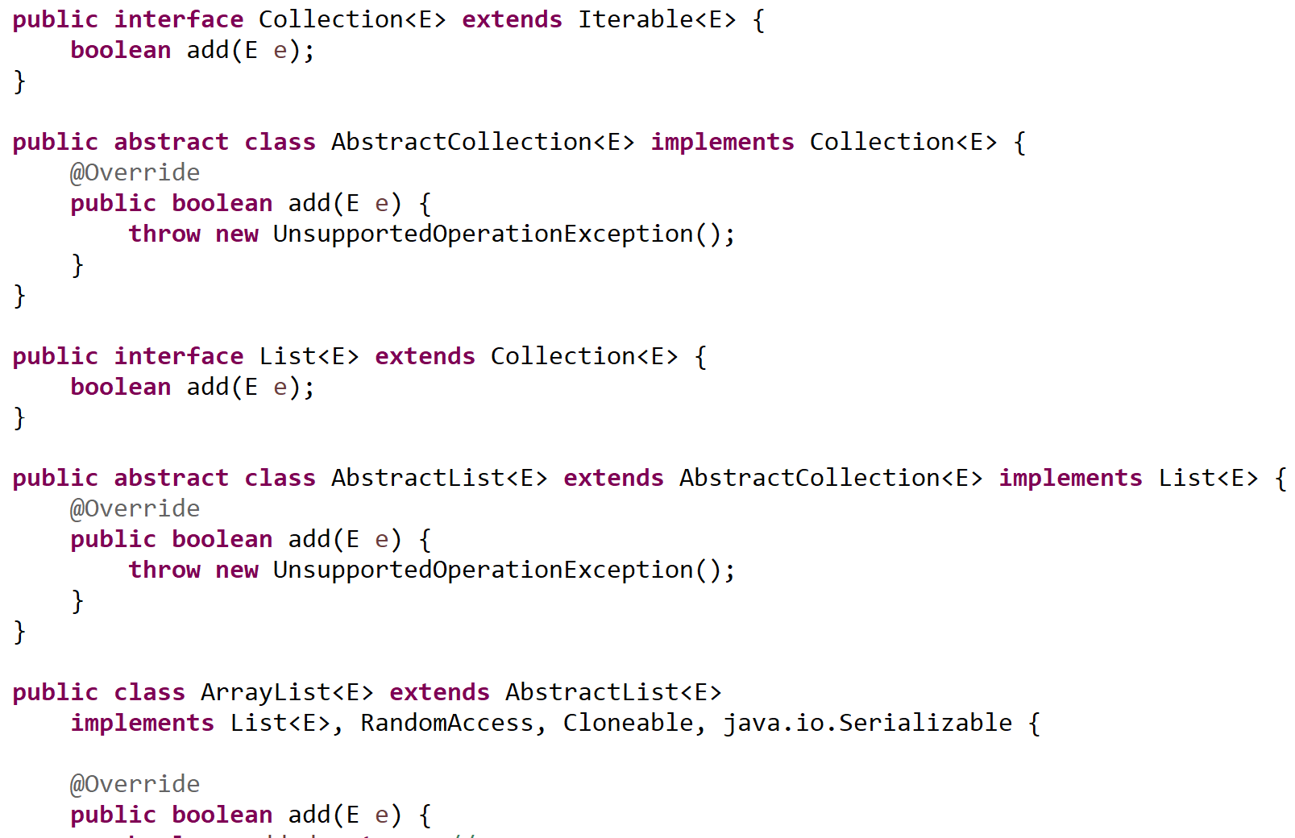
Declarations List, ArrayList, ..

Slide 48
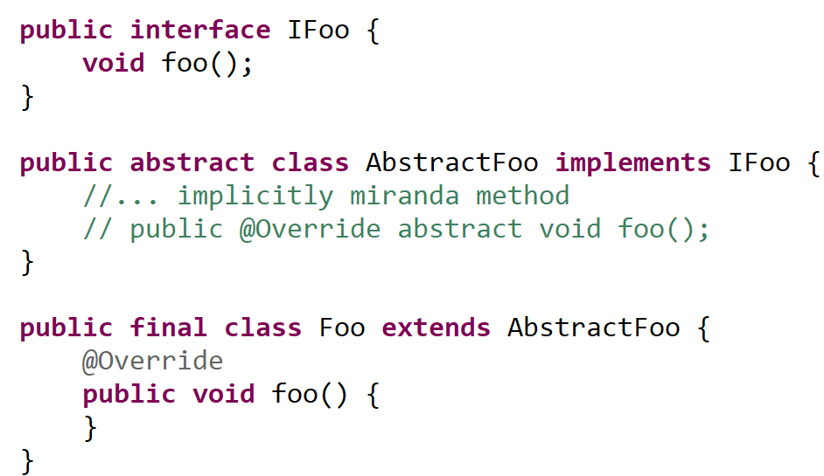
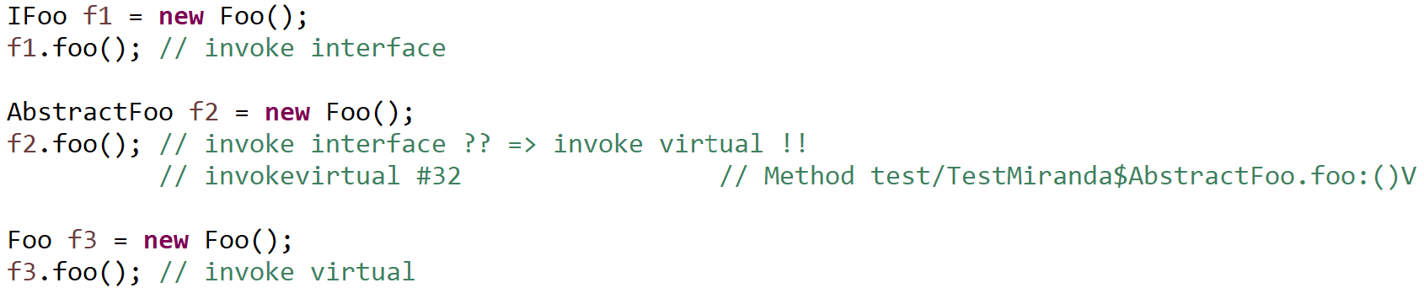
Miranda Methods (implicit abstract methods from interface)

Slide 49
Questions ?

