Slide 1
Hands-On 2 - Design Patterns
February 2023
arnaud.nauwynck@gmail.com
This document: https://github.com/Arnaud-Nauwynck/presentations /tree/main/java/TP-design-patterns/handson-2-design-patterns.pptx

Slide 2
Outline
The goal of this Hands-On is to recognize and model as UML Classes
many Design Patterns, for FileFormat / Grammar / Compiler / Math
Composite,
Proxy,
Adapter,
Interpreter,
Visitor,
…

Slide 3
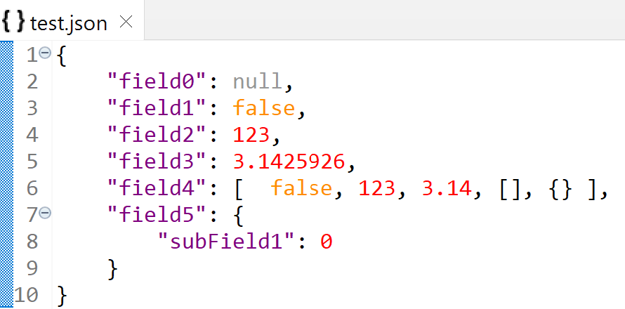
Exercise 1 : model JSON schema in UML classes
JsonNode
??
??
??
??
JSON grammar:
« json element » are called « JsonNode »
null is a valid element
There are terminal elements with values « Number », « Text », « Boolean »
Elements can be combined in array: [ element1, element2, … elementN ]
Elements can be combined in Object: { name1: element1, name2: element2, … }

Slide 4
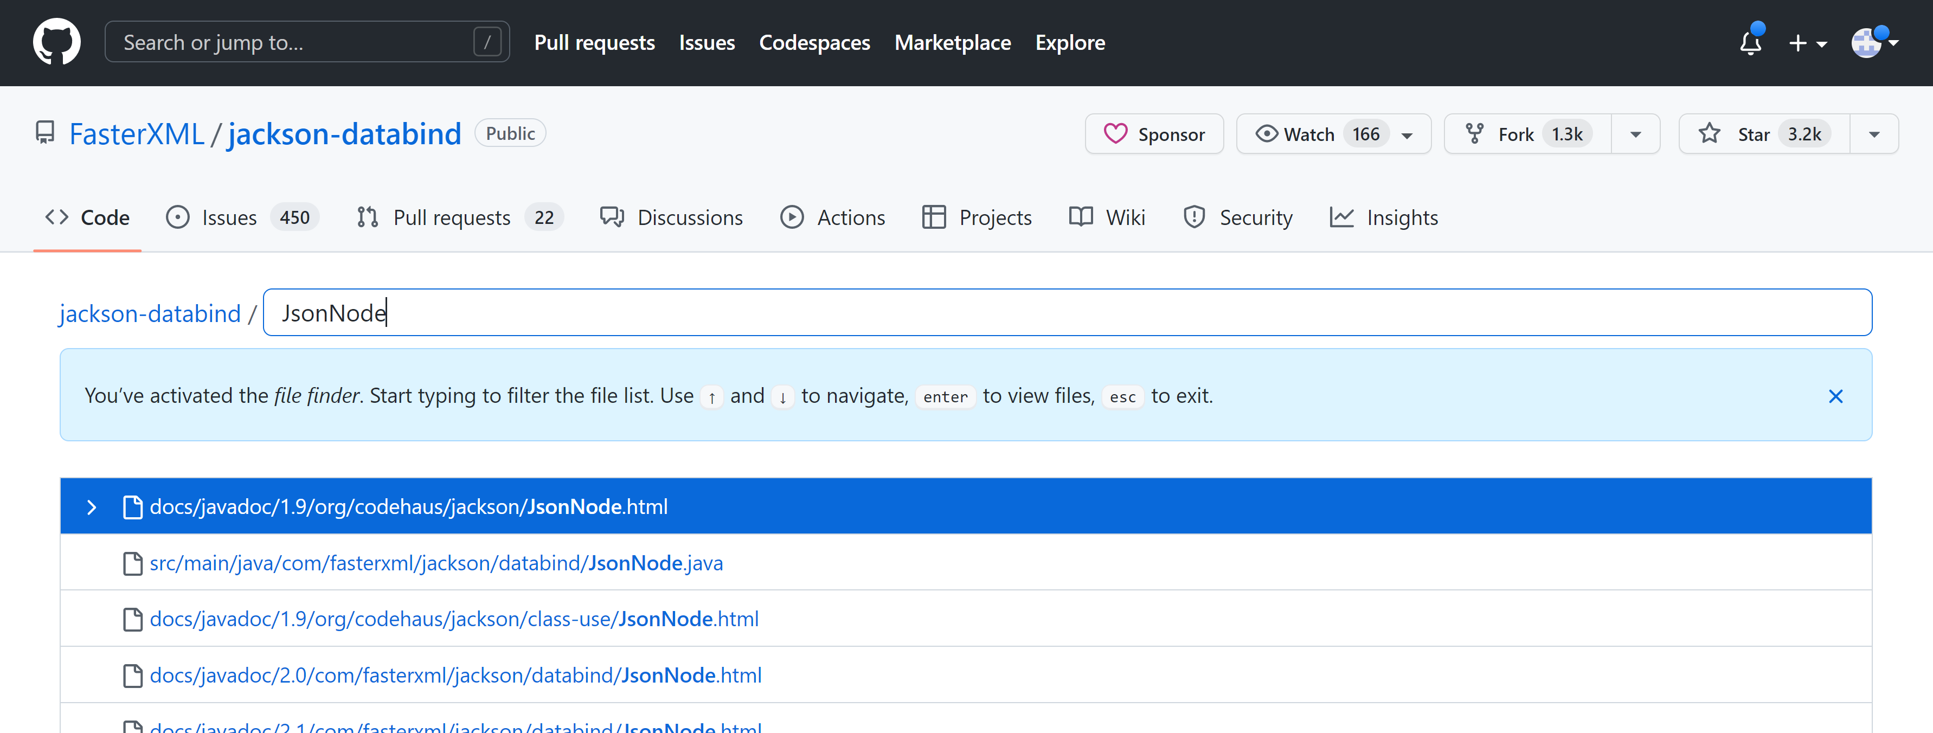
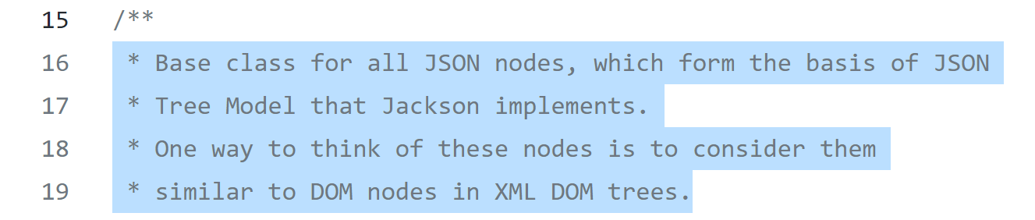
Exercise 2: Source code of Java Json library: « Jackson »
a/ open url https://github.com/FasterXML/jackson-databind
b/ type « T » (github search for file) .. Then type « JsonNode »
c/ read first javadoc lines

Slide 5
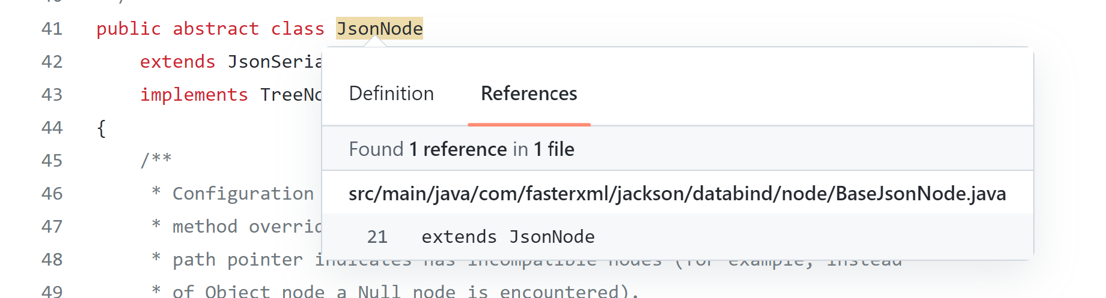
Exercise 3 : search sub-classes hierarchy of JsonNode in jackson
In github directly
Or download source-code
cd src/main/java
grep -R "extends BaseJsonNode"
grep -R "extends ContainerNode"
grep -R "extends ValueNode"

Slide 6
Exercise 4: create a Java Project, + Re-implement a minimal JsonNode class and sub-classes
public abstract class JsonNode {
// nested static classes: all known sub-classes of JsonNode
public static class NullJsonNode extends JsonNode {}
public static class TextJsonNode extends JsonNode { public String value; }
public static class NumericJsonNode extends JsonNode { public double value; }
public static class BooleanJsonNode extends JsonNode { public boolean value; }
public static class ArrayJsonNode extends JsonNode { public List<JsonNode> child; }
public static class ObjectJsonNode extends JsonNode { public Map<String,JsonNode> fields; }
}

Slide 7
Exercise 5: abstract methods…
Declare abstract method to « clone » any JsonNode, and recursively
=> Override all sub-classes, to implement correctly
Declare another abstract method to « dump as text » any JsonNode, and recursively
=> Override all sub-classes, to implement correctly

Slide 8
Exercise 6 : check code caracteristics
Characteristic 1: the model AST classes are polluted with any applicative code
Characteristic 2: each model AST class contains many methods, the code become intrinsically complex (many features)
Characteristic 3: each features is split between several classes

Slide 9
Exercise 5 : add the Visitor design-pattern (to ex 4)
public abstract class JsonNode {
public abstract void visit(JsonNodeVisitor visitor);
// nested static classes: all known sub-classes of JsonNode // for all XXXX sub-class
public static class XXXXJsonNode extends JsonNode {
@Override public void visit(JsonNodeVisitor visitor) { visitor.caseXXXX(this);
}
}
}
public abstract class JsonNodeVisitor {
public abstract caseNull(NullJsonNode p);
public abstract caseText(TextJsonNode p);
public abstract caseNumber(NumberJsonNode p);
….
}

Slide 10
Exercise 6: implement a concrete JsonNodeVisitor to clone (recursively) a Node
public class JsonNodeCloner extends JsonNodeVisitor {
public JsonNode result;
@Override
public caseNull(NullJsonNode p) { .. }
@Override
public abstract caseText(TextJsonNode p) { .. }
@Override
public abstract caseNumber(NumberJsonNode p) { .. }
….
}

Slide 11
Exercise 7 : call the visitor, write Junit test(s)
public class JsonNodeClonerTest {
// sut = System Under Test
JsonCloner sut = new JsonCloner();
@Test
public void testClone() {
// given
JsonNode node = … // when
sut.visit(node);
// then JsonNode clonedRes = sut.result;
Assert.assertEquals(…, clonedRes…);
}
}

Slide 12
Exercise 8 : write another Visitor, to dump as indented Json text
public class JsonNodeDumper extends JsonNodeVisitor {
private final PrintStream out;
private int indentLevel = 0;
public JsonNodeDumper(PrintStream out) { this.out = out; }
protected void incrIndent() { this.indentLevel++; }
protected void decrIndent() { this.indentLevel--; }
protected void printIndent() { for(int i = 0; i < indentLevell; i++) out.print(« »); }
protected void printIndentedLine(String text) { printIndent(); out.print(text); out.print(«\n»); }
@Override
public caseNull(NullJsonNode p) { printIndentedLine(«null») ; }
@Override
public abstract caseText(TextJsonNode p) { .. }
…
}

Slide 13
Exercise 9: … check code caracteristics
Characteristic 1: the model AST classes are not polluted with any applicative code
Characteristic 2: the model AST class contains only getter/setter/constructor + Visitor
Characteristic 3: different features are written in separated Visitor classes, 1 feature = 1 Visitor
Characteristic 4: each Visitor has his own private utility method, encapsulated (example: indentation logic)

