Slide 1
Hands-On Analyzing Parquet Files, using "parquet-cli"
Esilv 2024

Slide 2
Exercise : Analyzing Parquet Files, using "parquet-cli"

Slide 3
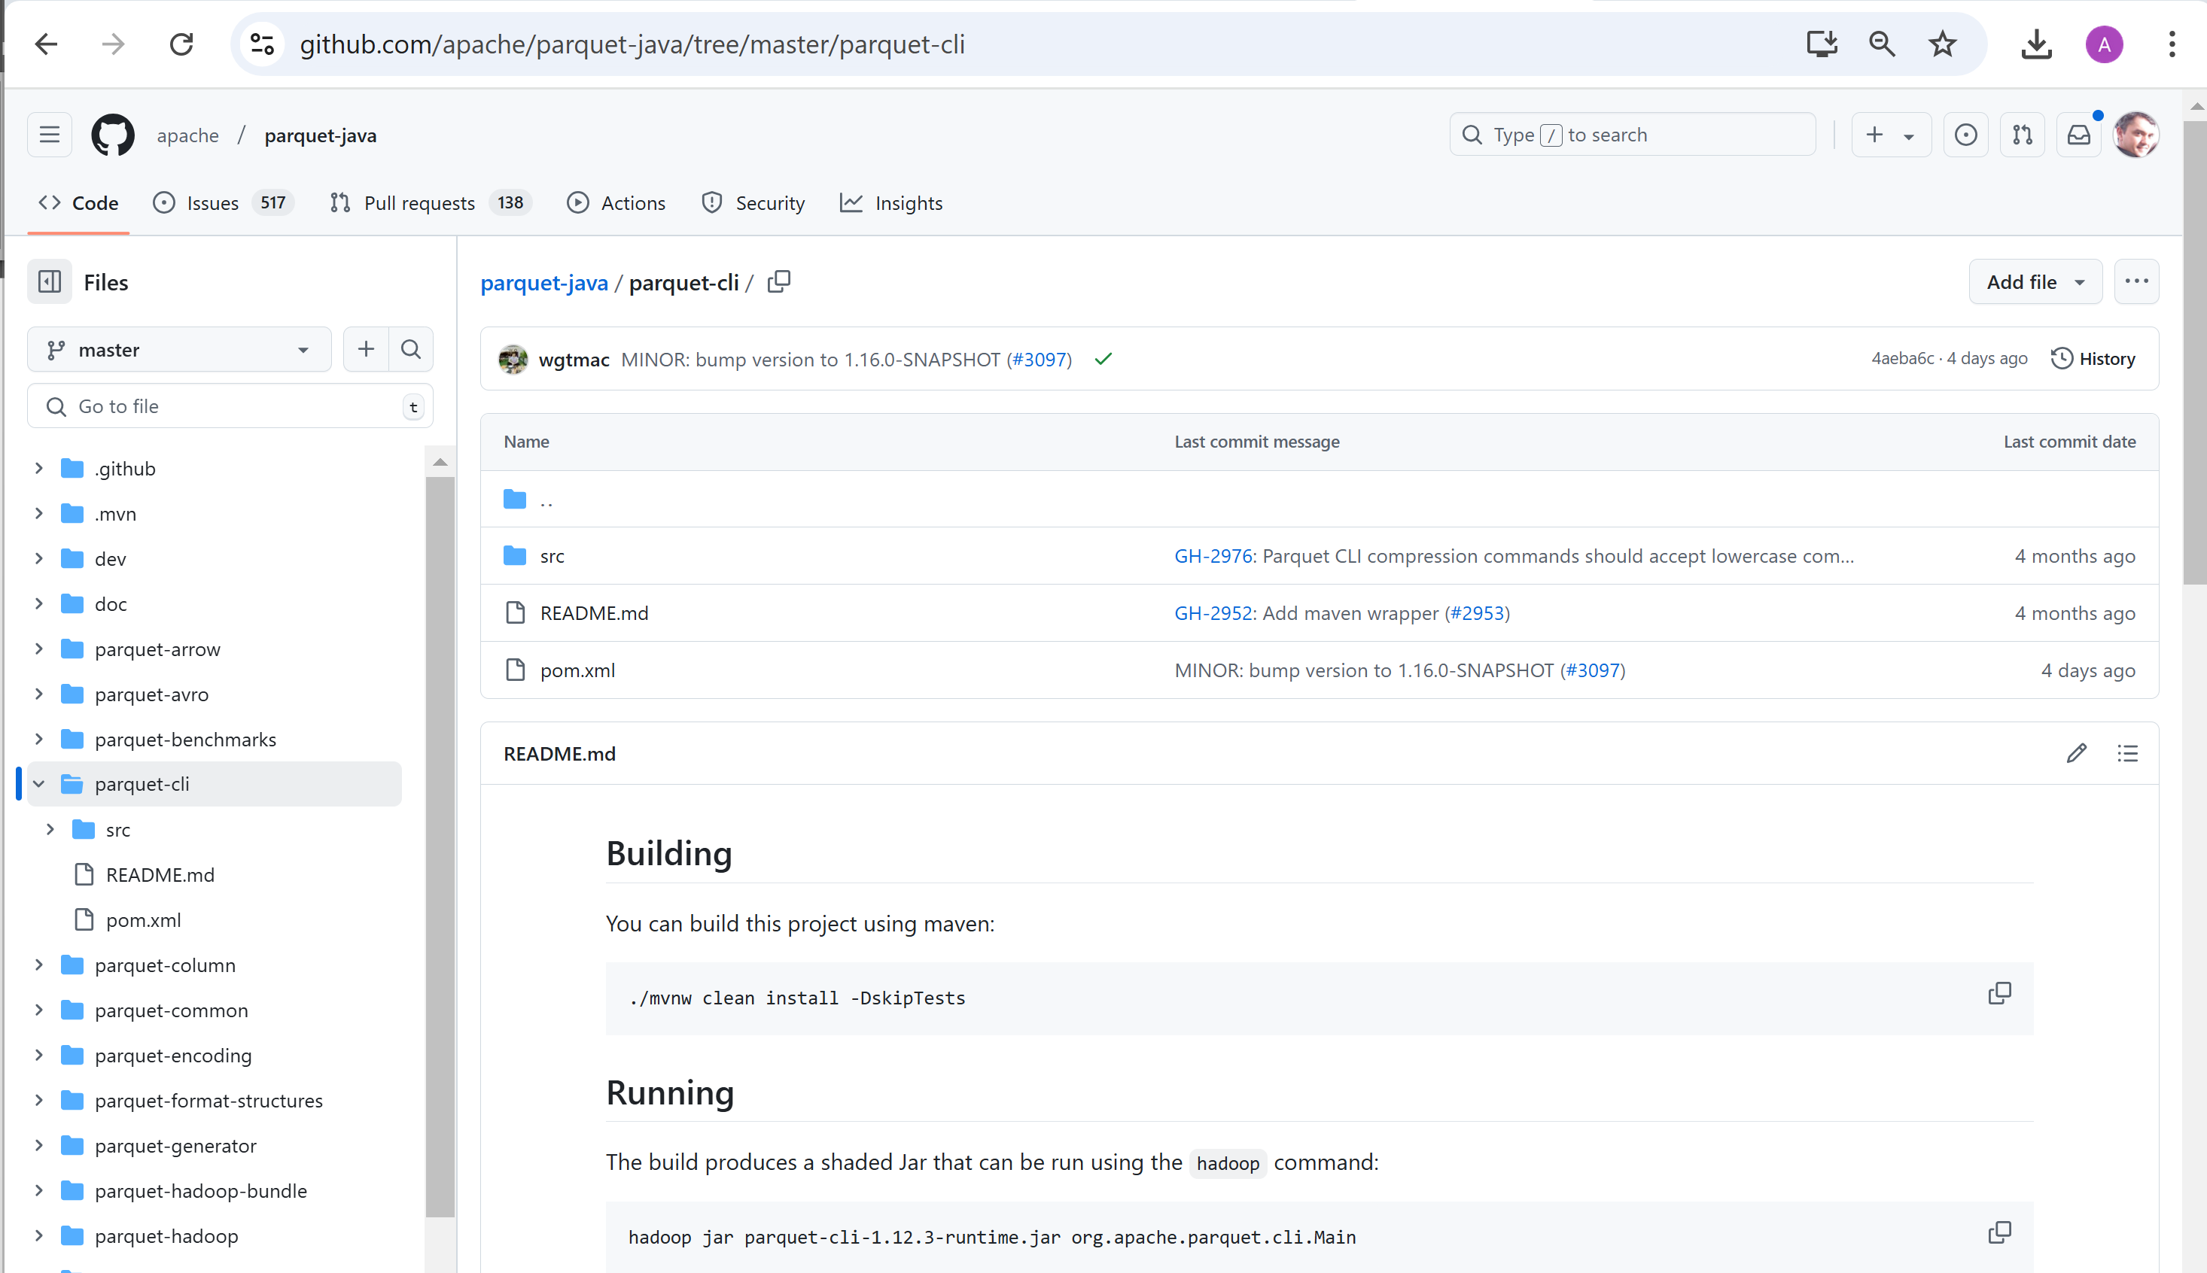
Analysing Parquet File, using "parquet-cli"

Slide 4
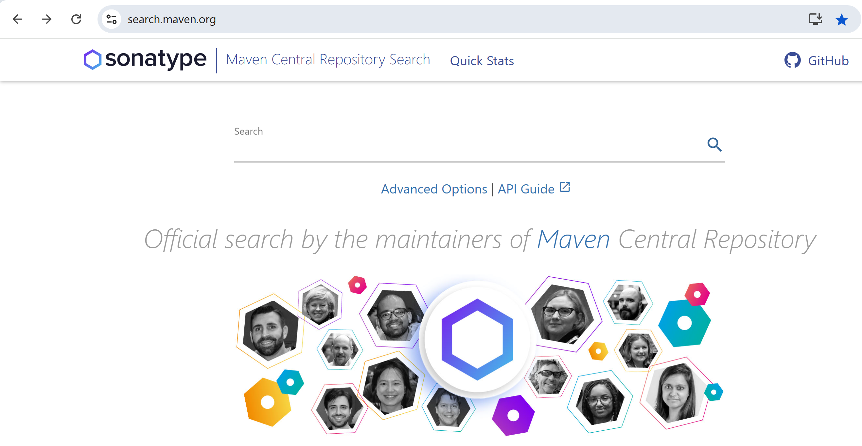
Search jar in maven repo: https://search.maven.org

Slide 5
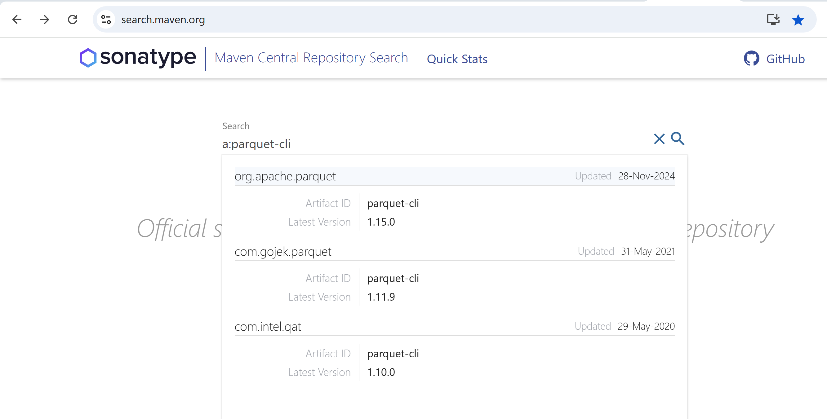
type search "a:parquet-cli" g:org.apache.parquet

Slide 6
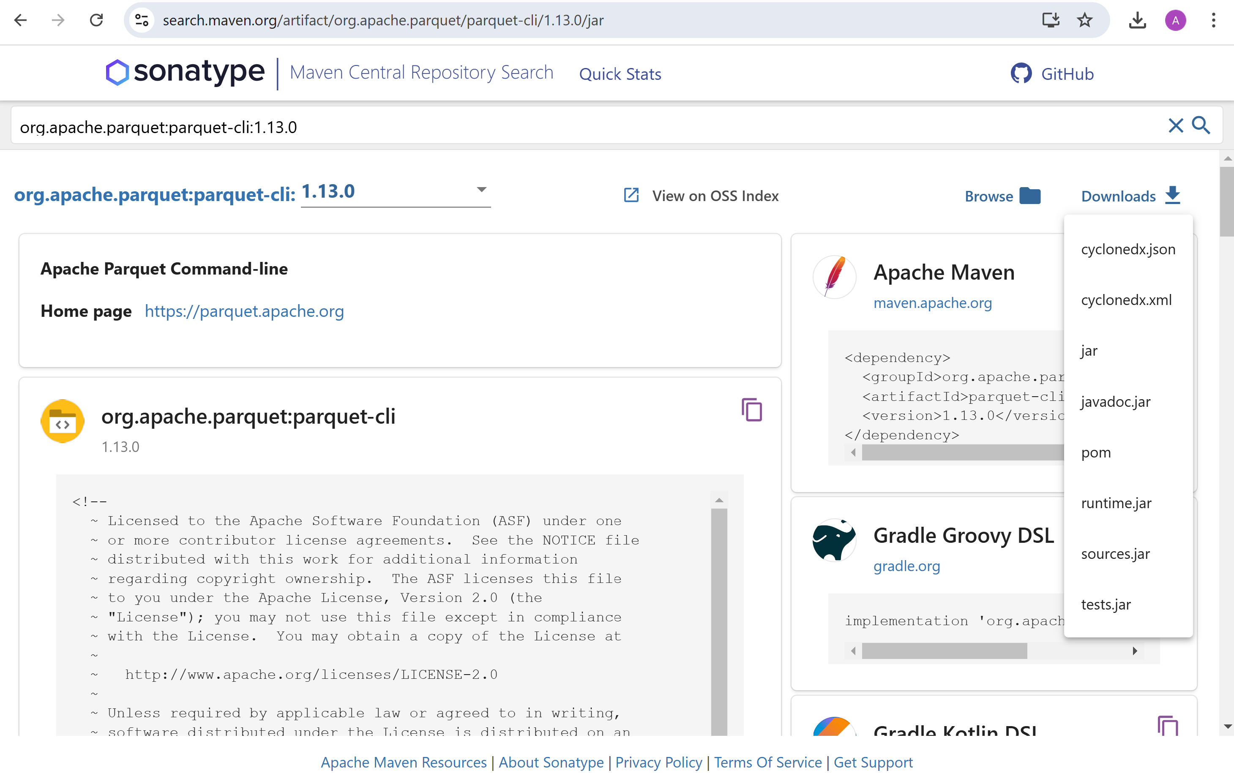
Downloading "parquet-cli" runtime.jar for same version 1.13.0 (same as spark/jars/*.jar)

Slide 7
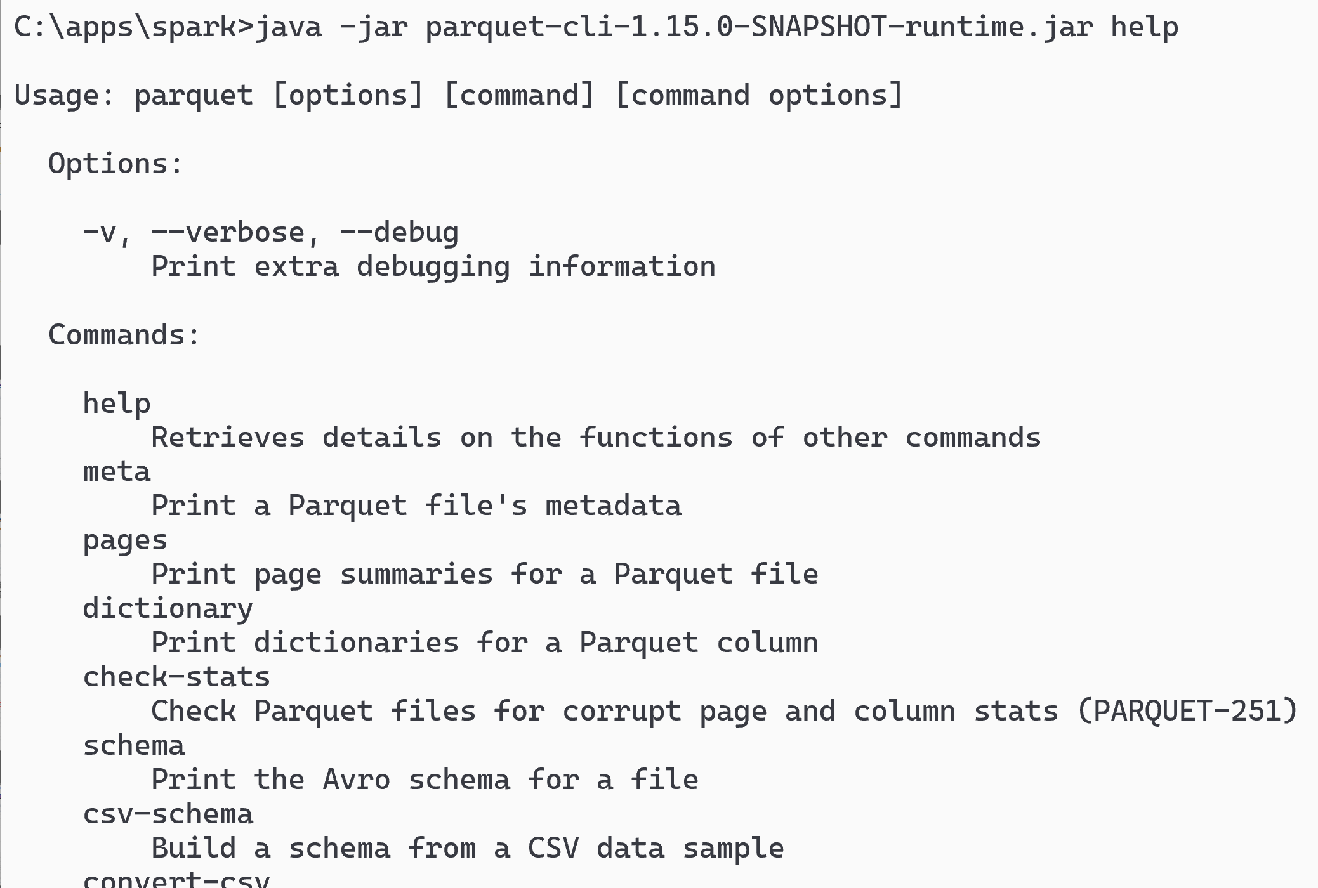
Launching parquet-cli
java -jar parquet-cli-runtime.jar help
(using shaded jar, otherwise may need to add hadoop classpath)

Slide 8
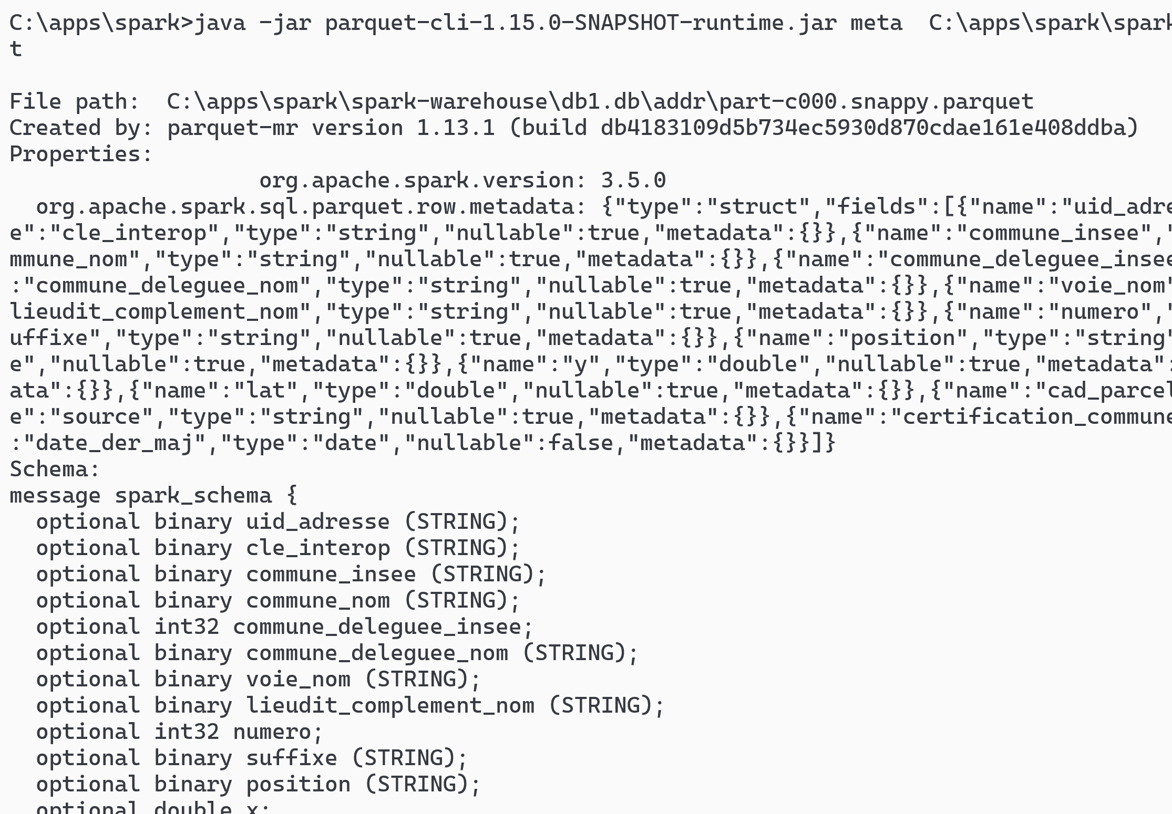
parquet-cli meta [1/2]
java -jar parquet-cli-runtime.jar meta file.parquet

Slide 9
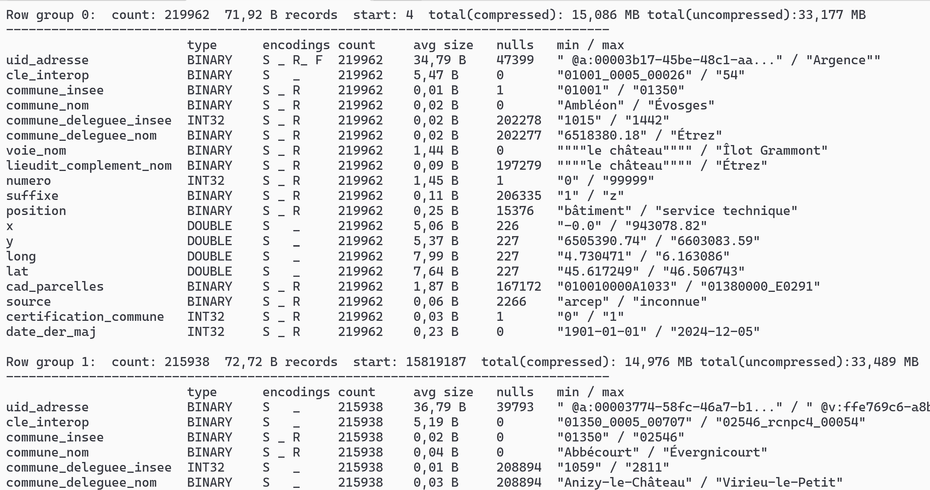
parquet-cli meta [2/2]

Slide 10
parquet-cli meta | grep "Row group"
java -jar parquet-cli-runtime.jar meta file.parquet > meta.txt
grep "Row group" meta.txt | head
Row group 0: count: 219962 71,92 B records start: 4 total(compressed): 15,086 MB total(uncompressed):33,177 MB
Row group 1: count: 215938 72,72 B records start: 15819187 total(compressed): 14,976 MB total(uncompressed):33,489 MB
Row group 2: count: 213992 73,68 B records start: 31523114 total(compressed): 15,036 MB total(uncompressed):33,821 MB
Row group 3: count: 233199 70,29 B records start: 47289138 total(compressed): 15,631 MB total(uncompressed):34,232 MB
Row group 4: count: 231558 69,04 B records start: 63679653 total(compressed): 15,246 MB total(uncompressed):33,383 MB
Row group 5: count: 219962 74,89 B records start: 79665824 total(compressed): 15,710 MB total(uncompressed):34,531 MB
Row group 6: count: 218409 73,91 B records start: 96138854 total(compressed): 15,394 MB total(uncompressed):33,957 MB
Row group 7: count: 199907 75,02 B records start: 112281114 total(compressed): 14,301 MB total(uncompressed):31,914 MB
Row group 8: count: 218409 69,87 B records start: 127277278 total(compressed): 14,552 MB total(uncompressed):34,174 MB
Row group 9: count: 272568 65,80 B records start: 142536439 total(compressed): 17,104 MB total(uncompressed):35,616 MB
grep "Row group" meta.txt | tail
Row group 108: count: 252150 64,55 B records start: 1719335249 total(compressed): 15,522 MB total(uncompressed):34,027 MB
Row group 109: count: 215240 71,68 B records start: 1735611436 total(compressed): 14,715 MB total(uncompressed):34,014 MB
Row group 110: count: 219962 68,48 B records start: 1751040857 total(compressed): 14,365 MB total(uncompressed):32,978 MB
Row group 111: count: 219962 68,18 B records start: 1766103960 total(compressed): 14,302 MB total(uncompressed):32,914 MB
Row group 112: count: 234887 64,52 B records start: 1781100645 total(compressed): 14,454 MB total(uncompressed):33,355 MB
Row group 113: count: 236624 66,44 B records start: 1796256273 total(compressed): 14,993 MB total(uncompressed):37,495 MB
Row group 114: count: 234063 65,95 B records start: 1811977242 total(compressed): 14,722 MB total(uncompressed):33,626 MB
Row group 115: count: 213992 73,42 B records start: 1827414634 total(compressed): 14,983 MB total(uncompressed):34,526 MB
Row group 116: count: 230100 69,58 B records start: 1843125866 total(compressed): 15,269 MB total(uncompressed):36,039 MB
Row group 117: count: 152925 67,36 B records start: 1859136956 total(compressed): 9,823 MB total(uncompressed):26,622 MB

Slide 11
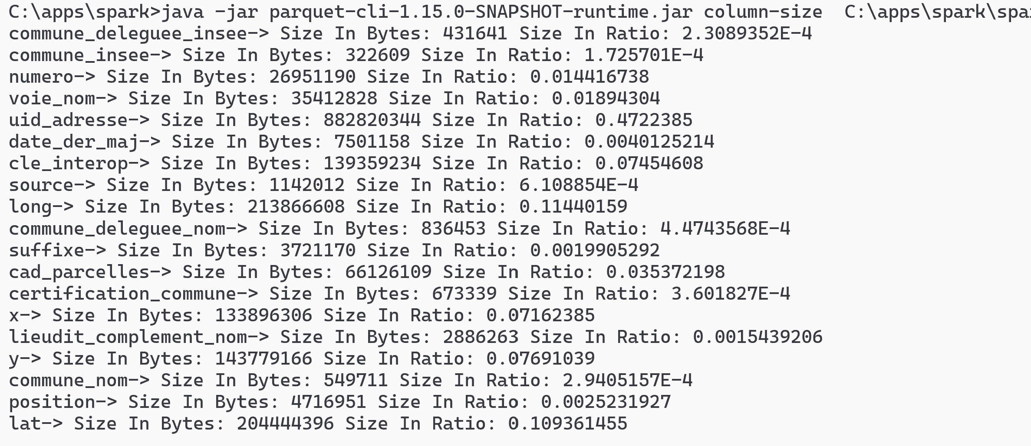
parquet-cli column-size
java -jar parquet-cli-runtime.jar column-size file.parquet

Slide 12
Column Sizes ... sorting
cat column-size | sed 's/-> Size In Bytes//g' | sed 's/ Size In Ratio//g' | sed 's/: /;/g' > column-size.csv
Column | Size | Ratio | Size in Mo
uid_adresse | 882820344 | 47,22% | 841,9
long | 213866608 | 11,44% | 204,0
lat | 204444396 | 10,94% | 195,0
y | 143779166 | 7,69% | 137,1
cle_interop | 139359234 | 7,45% | 132,9
x | 133896306 | 7,16% | 127,7
cad_parcelles | 66126109 | 3,54% | 63,1
voie_nom | 35412828 | 1,89% | 33,8
numero | 26951190 | 1,44% | 25,7
date_der_maj | 7501158 | 0,40% | 7,2
position | 4716951 | 0,25% | 4,5
suffixe | 3721170 | 0,20% | 3,5
lieudit_complement_nom | 2886263 | 0,15% | 2,8
source | 1142012 | 0,06% | 1,1
commune_deleguee_nom | 836453 | 0,04% | 0,8
certification_commune | 673339 | 0,04% | 0,6
commune_nom | 549711 | 0,03% | 0,5
commune_deleguee_insee | 431641 | 0,02% | 0,4
commune_insee | 322609 | 0,02% | 0,3
total | 1869437488 | 100,00% | 1782,8

Slide 13
Parquet Column Sizes Summary
zipcode ("commun_insee") : 0.3 Mo
+
city name ("commun_nom") : 0.5 Mo
+
street name ("voie_nom") : 33.8 Mo
+
numero : 25.7 Mo
=> 60 Mega (3% of file)
+ longitude, latitude : 204 Mo + 195 Mo
=> 459 Mo
most of the column size is
uid_address : 840 Mo (47.2%)
+
x, y ... redundant with longitude,lattitude
+
cle_interop : 132 Mo (7.4%)
... we will see parquet "column-pruning" in action : skipping unnecessary columns !

