Slide 1
http://arnaud-nauwynck.github.io
arnaud.nauwynck@gmail.com
Big Data
Principles of Distributed Computing

Slide 2
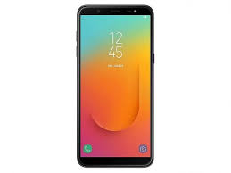
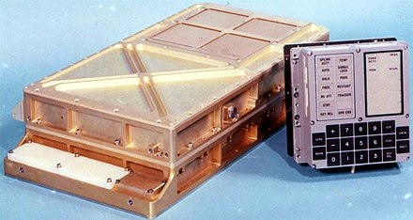
Big Data ...
Big? is Time-relative
cell phone (in 2021) >= 1000x "more"
than Appolo moon
guidance computer (1968)

