Slide 1

Why Websites Never Save Your Passwords
How authentication works in the backend
> Author: Arnaud Gomes

Slide 2
The Plaintext Problem
Username | Password
admin | admin67
charlie | cats123
Exact input = Exact database record
One breach = Total Database Compromise
NEVER leave passwords in plaintext

Slide 3
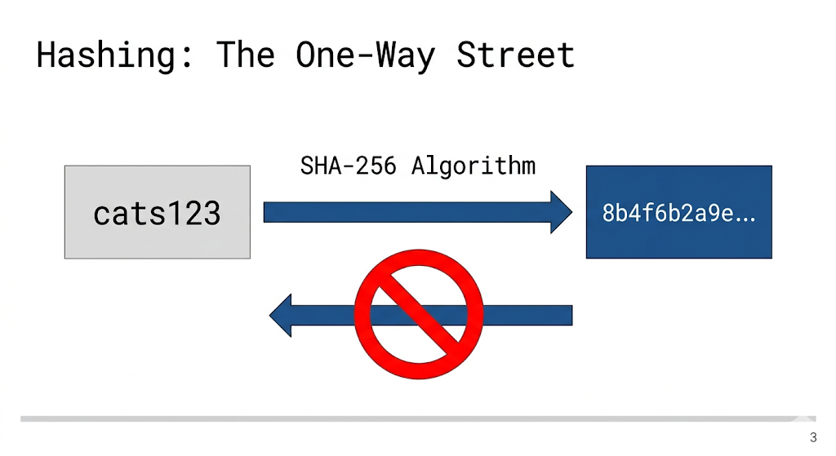
Hashing Algorithms
One-way mathematical function
Fixed-length, chaotic string
Compare hashes, never see the password

Slide 4
Hashing: The Database View
RAM ONLY
Username | Password (Plaintext) | Password (Hashed)
admin | admin67 | 5897cfa...
charlie | cats123 | f6d4692...
alice | cats123 | f6d4692...
bob | p@ssword | 0fd2059...
Plaintext exists ONLY in RAM
Database stores ONLY the hash
Match input hash vs. stored hash

Slide 5
Hashing Limitations
Username | Password (Plaintext) | Password (Hashed)
admin | admin67 | 5897cfa...
charlie | cats123 | f6d4692...
alice | cats123 | f6d4692...
bob | p@ssword | 0fd2059...
Deterministic, Same input = Same output
Identical passwords are exposed
"Rainbow Tables", dictionaries with common passwords and their hashes

Slide 6
Salting Implementation
Username | Password (Plaintext) | Salt | Password (Hashed)
admin | admin67 | 8xF2 | b3664aba...
charlie | cats123 | a7d9 | 34b60fbf...
alice | cats123 | 1yZ5 | 46346c13...
bob | p@ssword | 3mK8 | 4e00b7af...
Password + Unique Random Salt
= Hash
Salt saved alongside the hash
Identical passwords, different hashes

Slide 7
Summary
Never store raw passwords
Hashing: One-way mathematical signature
Salting: Guarantees unique values for every user
MFA: Mandatory secondary layer of security
Questions?

