Slide 1


Development of a
fsATI mutation search tool
Julie GORSE BOGOIN
M2 BIB
2019-2020

Slide 2
What is a fsATI mutation?
1. Framshift → deletion or insertion of a number of base pair <= 2
WT
AGTAGGA TG TGT TCA TCA AAA TGA
Insertion
ATG TAG GAT GTG TTC ATC AAA ATG A
AGTAGGA*GTGTTCATCAAAATGA
Deletion

Slide 3
What is a fsATI mutation?
2. ATI: Alternative transcription initiation
AGTAGGA TG TGT TCA TGA AAA TGA ACG TCA
Case 1
AGTAGGATGTGTTCA TG AAA ATG AAC GTC A
Case 2

Slide 4
What is a fsATI mutation?
frameshift mutation-induced Alternative Translation Initiation
ATI
fs
fsATI
ATI
fs
5’
WT
3’

Slide 5
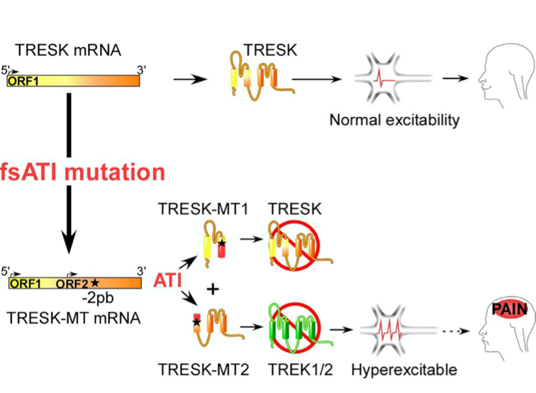
How fsATi can be involved in diseases?
Based on Royal et al paper (2018)
TRESK channel heteromerizes with TREK1 and TREK2
TRESK-MT mutant induces formation of MT1 and MT2
MT2 is produced by fsATI
MT2 inhibits TREK to increase neuronal excitability
→ induce a migraine phenotype

Slide 6
Strategy
Based on Whiffin et al. paper (2019)
Same goal on a different mutation: Upstream open reading frames (uORFs)
Systematic genome-wide study of variants that create and disrupt human uORFs
Explore their role in human disease
15708 whole genome sequences collected by the Genome Aggregation Database (gnomAD) project

Slide 7
Workflow
Mutation screening method evaluation
Generation of _{m}RNA sequences from ANNOVAR
ORFs sens
and antisens
Potentiel fsATI selection
Scores validation
in silico
Experimental validation
Kosak strenght
PhyloP score

Slide 8
Scripts
Language: Phyton3 using BioPhyton and Pandas modules
mRNA_to_ORF.py
→ generate ORF from mRNA sequences generated by ANNOVAR.
find_fsATI.py
→ find wich sequence could be a fsATI
Molecular definition
Calculation of Kosak Strenght and PhyloP score
validate_fsATI.py
→ Select only sequences with a Kosak strenght = 3 and a PhyloP score >=2

Slide 9
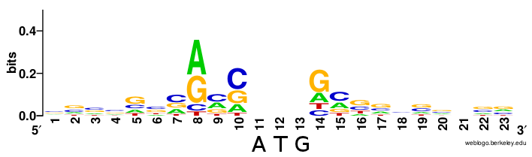
Kosak sequence 5'-gccRccATGG-3
a nucleic acid motif that functions as the protein translation initiation site in most eukaryotic mRNA transcripts
ensures that a protein is correctly translated from the genetic message, mediating ribosome assembly and translation initiation
-3
+4
Sequence logo showing the most conserved bases around the initiation codon from over 10 000 human mRNAs.
Source: Wikipedia

Slide 10
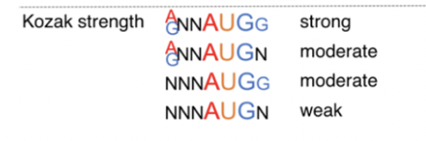
Kosak sequence strenght
refers to the favoribility of initiation, affecting how much protein is synthesized from a given mRNA
Scoring method of Kosak strenght.
Source: Whiffin et al., 2019

Slide 11
PhyloP score
Measure evolutionary conservation at individual alignment sites
Scores are compared to the evolution that is expected under neutral drift.
Positive scores: conservation,
→ slower evolution than expected
sites are predicted to be conserved
Negative scores: acceleration,
→ faster evolution than expected
→ sites are predicted to be fast-evolving

Slide 12
Results
5 gènes
→ KCNQ1, KCNQ2, KCNQ3, KCNQ4, KCNQ5
143 _{m}RNA
507 ORF
94 supposed fsATI
6 fsATI validated

Slide 13
Results

Slide 14
Conclusion and persective
Success in developing a method of fsATI mutation determination and validation
Code should be review to simplify and decrease complexity
Phylop scoring method has to be rethough
→ to find a way of collecting genes base genomique position
→to avoid parsing of the massive score file
Would be continued by using more genes from gnomAD, SNPedia et dbSNP databases to discut quality of strategy and code.

Slide 15
Thank you for your attention !

