Slide 1


Development of a
fsATI mutation search tool
Julie GORSE BOGOIN
M2 BIB
2019-2020

Slide 2
What is a fsATI mutation?
1. framshift→ deletion or insertion of a number of base pair <= 2
WT
AGTAGGA TG TGT TCA TCA AAA TGA
Insertion
ATG TAG GAT GTG TTC ATC AAA ATG A
AGTAGG*AGTGTTCATCAAAATGA
Deletion

Slide 3
What is a fsATI mutation?
2. ATI Alternative transcription initiation
Transciption 1
AGTAGGA TG TGT TCA TGA AAA TGA ACG TCA
Transciption 2
AGTAGGATGTGTTCA TG AAA ATG AAC GTC A

Slide 4
What is a fsATI mutation?
frameshift mutation-induced Alternative Translation Initiation
ATI
fs
fsATI
ATI
fs
5’
WT
3’

Slide 5
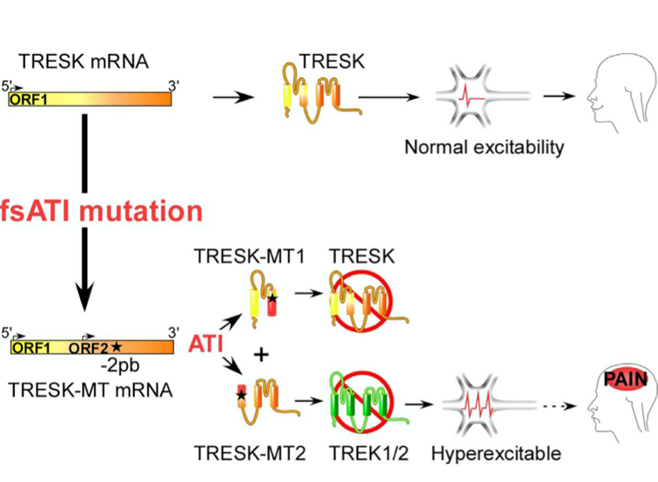
How fsATi can be involved in diseases?
Based on Royal et al paper (february 2019)
TRESK heteromerizes with
TREK1 and TREK2
TRESK-MT mutant induces formation of MT1 and MT2
MT2 is produced by fsATI
MT2 inhibits TREK to increase neuronal excitability
→ induce a migraine phenotype

Slide 6
Strategy
Based on Whi

Slide 7
Workflow
Evaluation des méthodes de ciblage des variants
Récupération des séquences ARN_{m}
Génération des ORFs sens
et antisens
Sélection des fsATI potentielles
Validation des scores
in silico
Validation expérimentale
Force des séquences de Kosak
Score PhyloP

Slide 8
Scripts
Language Phyton 3 using BioPhyton and Pandas module
mRNA_to_ORF.py → generate ORF from mRNA sequences generated by ANNOVAR.
find_fsATI.py → find wich sequence could be fsATI
Molecular definition
Calculation of Kosak Strenght and PhyloP score
validate_fsATI.py → Select only sequences with a Kosak strenght à 3 et un score de PhyloP >=2

Slide 9
Kosak Strenght
Based on Whi

Slide 10
PhyloP
Based on Whi

Slide 11
Results
5 gènes used for testing:
→ KCNQ1, KCNQ2, KCNQ3, KCNQ4, KCNQ5
143 RNA_{m} sequences
507 ORF
94 supposed fsATI
6 fsATI validated

Slide 12
Results

Slide 13
Conclusion

Slide 14
Thanks for your attention !

