Slide 1

About the CODE

Slide 2

Why JAVA ?
Portability
  UNIX, WINDOWS...
Simplicity
  Graphical user interface, Server...
University
  OOP, Team sync...
Notes:
So we used the java language for our simulation, why ?
You all have once updated java on your computer and seen all the different system using java. It means that our simulator can be run on all those system !
It's also because of the simplicity, server tools and graphic tools are both directly included in Java !
And of course, because this year we studied the java language and more precisely object oriented programing and also how to work in team with tools like github, but I'll speak about that later

Slide 3
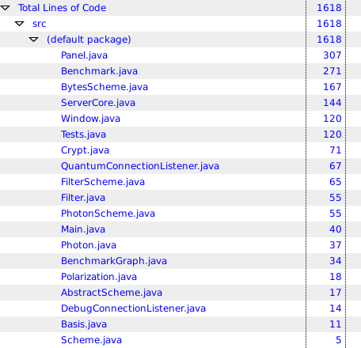
Our project :
Implementation :
Server
Graphical User Interface
Quantum Physics
Cryptography/BB84

Slide 4




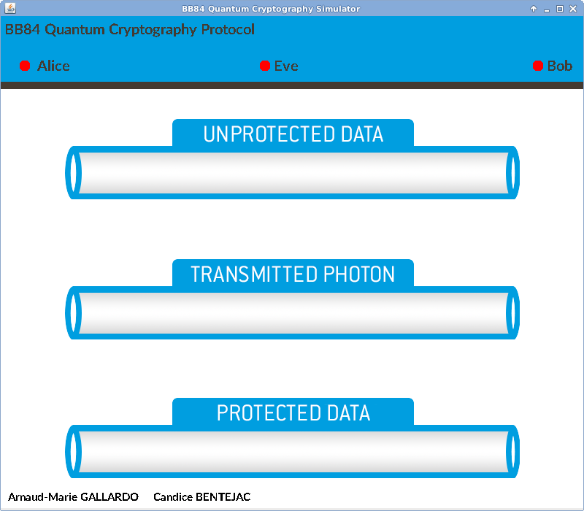

Quick explanation
ALICE
Client/Server
We used a library named JEXXUS, based on the Java Sockets API
EVE
SERVER
BOB
GUI (Graphical User Interface)
We used the Java Swing API

Slide 5
Quantum physics implementation
FAKE TUNA
(pun intended)
Photons.java
POLARIZATION
Polarization.java
FILTER
Filters.java
POLARIZED PHOTON

Slide 6


Team work
www.github.com/ArnaudGallardo/BB84
www.github.com/ArnaudGallardo/BB84-client

Slide 7

Benchmark
Apache POI - the Java API for Microsoft Documents
Creating spreadsheets files
Automatic simulation (21000 tests in 80 minutes with at the end more than 16 millions photons simulated) and writing

Slide 8
Benchmark

Slide 9
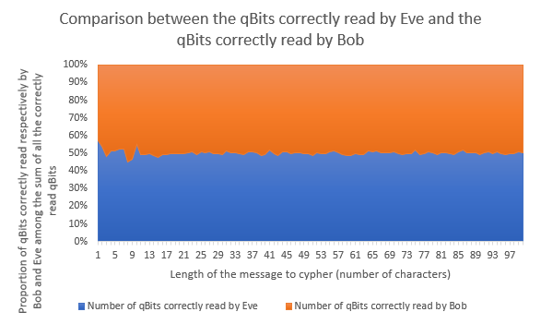
Benchmark

Slide 10
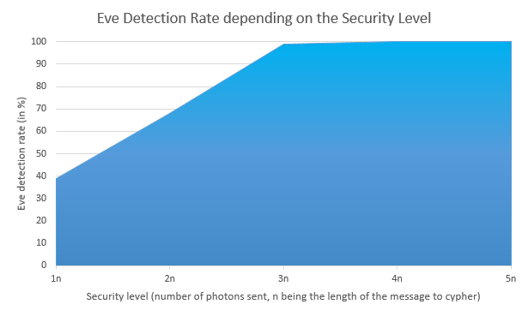
Benchmark

Slide 11
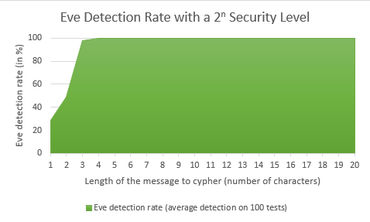
Benchmark

