Slide 1

Thesis defense : Project 7 Solve Problems Using Algorithms in Python

Slide 2
Table of contents
Global Project Presentation
Algorithms Presentation
Side by Side Comparison

Slide 3
Global Project Presentation
Mission : Write and propose an algorithm in python to suggest the best investment while respecting some limitations :
Each share can only be bought once.
We cannot buy a fraction of a share.
We can spend at most 500 euros per client.

Slide 4
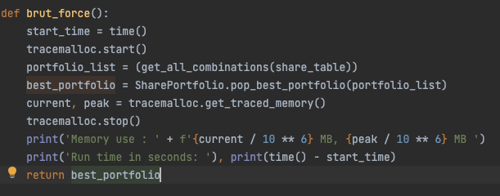
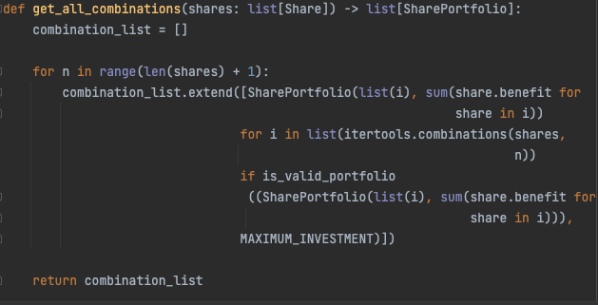
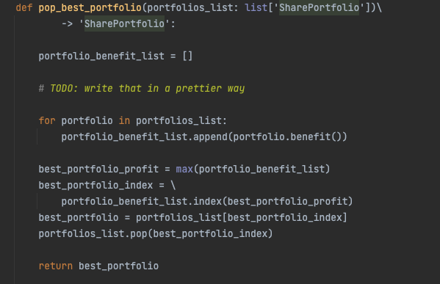
Algorithms presentation: Brut_force algorithm
Step 1: Create a list of combination from the list of shares previously taken from the database
Step 2: Find the combination of shares with the highest profit and return it.

Slide 5
Brut force result
Share Portfolio::
name : Share-4, price : 70, profit : 20
name : Share-5, price : 60, profit : 17
name : Share-6, price : 80, profit : 25
name : Share-8, price : 26, profit : 11
name : Share-10, price : 34, profit : 27
name : Share-11, price : 42, profit : 17
name : Share-13, price : 38, profit : 23
name : Share-18, price : 10, profit : 14
name : Share-19, price : 24, profit : 21
name : Share-20, price : 114, profit : 18
Total cost is: 498$
Total profit is: 99.08$
Global portfolio efficiency : 19.9
Share Portfolio value after 2 years is: 597.08$
Run time in seconds: 8.412
Memory use : 258.102746 MB
Peak: 266.601122 MB
Algorithm complexity : O(2^n)

Slide 6
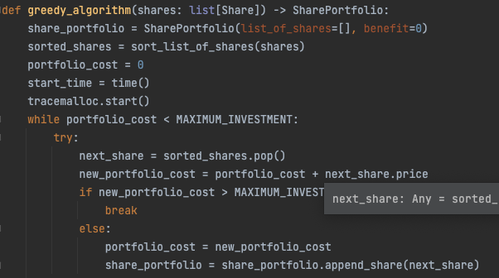
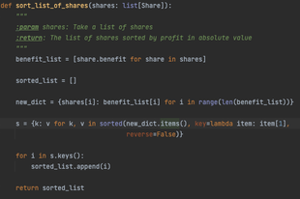
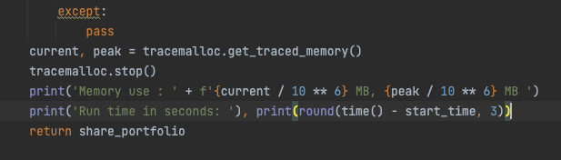
Algorithm presentation Greedy
Step 1:Sort the list of shares based on the profit in absolute value
Step 2 : Add the first share of the list to the shareportfolio until the maximum investment amount is reached.

Slide 7
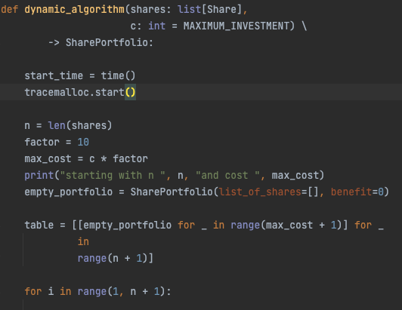
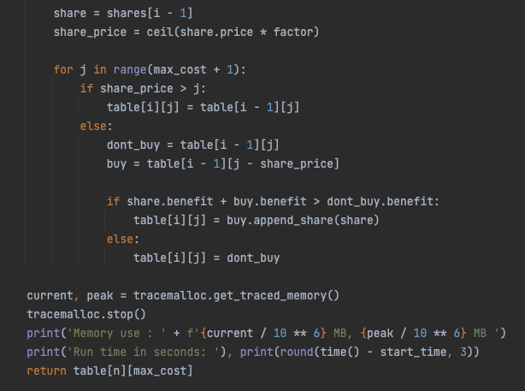
Algorithm presentation: Dynamic algorithm based on Knapsack problem
Step 1: We create a double table within the range of len(shares) and the maximum investment amount previsouly factored (here by 10) to get a more precise result
Step 2: We fill the table at each index [i][j] for i the number of shares and j the maximum weight, based on the the previous cell with the best Share Portfolio.
Step 3: We return the last cell of the table which contains the best Share Portfolio for the global list of shares and the maximum investment amount

Slide 8
Side by side comparison: Greedy Algorithm Dataset 1
Sienna bought:
Share portfolio :
Share-GRUT
Total cost is: 498.76 $
Total profit is: 196.61$
Global portfolio efficiency : 39.42 %
Share Portfolio value after 2 years is : 695,37 $
We bought:
Share portfolio:
name : Share-GRUT, price : 498.76, profit : 39.42
Total cost is: 498.76$
Total profit is: 196.61$
Global portfolio efficiency : 39.4 %
Share Portfolio value after 2 years is: 695.37$

Slide 9
Side by side comparison: Greedy Algorithm Dataset 2
Sienna bought:
Share Portfolio :
Share-ECAQ
Share-IXCI
Share-FWBE
Share-ZOFA
Share-PLLK
Share-YFVZ
Share-ANFX
Share-PATS
Share-NDKR
Share-ALIY
Share-JWGF
Share-JGTW
Share-FAPS
Share-VCAX
Share-LFXB
Share-DWSK
Share-XQII
Share-ROOM
Total cost is: 489.24$
Total profit is: 193.78$
Global portfolio efficiency : 39.61 %
Share Portfolio value after 2 years is : 683.02 $
We bought:
Share Portfolio :
name : Share-JWGF, price : 48.69, profit : 39.93
name : Share-MBQU, price : 51.46, profit : 35.78
name : Share-QEVK, price : 49.77, profit : 34.38
name : Share-DLNE, price : 44.06, profit : 36.74
name : Share-IJFT, price : 40.91, profit : 38.89
name : Share-ANFX, price : 38.55, profit : 39.72
name : Share-MALJ, price : 46.37, profit : 32.88
name : Share-OPBR, price : 39.0, profit : 38.95
name : Share-FWMV, price : 41.68, profit : 35.8
name : Share-HATC, price : 43.45, profit : 34.14
name : Share-XGNC, price : 41.86, profit : 35.14
Total cost is: 485.8$
Total profit is: 177.28$
Global portfolio efficiency : 36.49 %
Share Portfolio value after 2 years is: 663.08$

Slide 10
Side by side comparison: Dynamic Algorithm Dataset 1 Factor 10
We bought:
Share Portfolio:
name : Share-IFCP, price : 29.23, profit : 39.88
name : Share-QSPX, price : 0.6, profit : 35.15
name : Share-LRBZ, price : 32.9, profit : 39.95
name : Share-XJMO, price : 9.39, profit : 39.98
name : Share-GIAJ, price : 10.75, profit : 39.9
name : Share-QQTU, price : 33.19, profit : 39.6
name : Share-SKKC, price : 24.87, profit : 39.49
name : Share-ZSDE, price : 15.11, profit : 39.88
name : Share-LGWG, price : 31.41, profit : 39.5
name : Share-WPLI, price : 34.64, profit : 39.91
name : Share-QLMK, price : 17.38, profit : 39.49
name : Share-FKJW, price : 21.08, profit : 39.78
name : Share-GTQK, price : 15.4, profit : 39.95
name : Share-USSR, price : 25.62, profit : 39.56
name : Share-MTLR, price : 16.49, profit : 39.97
name : Share-LPDM, price : 39.35, profit : 39.73
name : Share-UEZB, price : 24.87, profit : 39.43
name : Share-NHWA, price : 29.18, profit : 39.77
name : Share-GHIZ, price : 28.0, profit : 39.89
name : Share-KMTG, price : 23.21, profit : 39.97
name : Share-CAEQ, price : 36.56, profit : 39.17
Total cost is: 499.23$
Total profit is: 198.22$
Global portfolio efficiency : 39.7 %
Share Portfolio value after 2 years is: 697.45$
Sienna bought:
Share portfolio :
Share-GRUT
Total cost is: 498.76 $
Total profit is: 196.61$
Global portfolio efficiency : 39.42 %
Share Portfolio value after 2 years is : 695,37 $

Slide 11
Side by side comparison: Dynamic Algorithm Dataset 1 Factor 1
Sienna bought:
Share portfolio :
Share-GRUT
Total cost is: 498.76 $
Total profit is: 196.61$
Global portfolio efficiency : 39.42 %
Share Portfolio value after 2 years is : 695,37 $
We bought:
Share portfolio:
name : Share-HITN, price : 0.67, profit : 33.49
name : Share-GRUT, price : 498.76, profit : 39.42
Total cost is: 499.43$
Total profit is: 196.84$
Global portfolio efficiency : 39.41 %
SharePortfolio value after 2 years is: 696.27$

Slide 12
Run time and memory cost Data set 1 Factor 10 vs Factor 1
Factor 10
Run time in seconds: 4.606
Memory use : 141.473962 MB, Peak : 141.47419 MB
Algorithm complexity : Linear O(n*w)
Factor 1
Run time in seconds: 0.454
Memory use : 12.985986 MB, Peak : 12.986186 MB
Algorithm complexity : Linear O(n*w)

Slide 13
Side by side comparison: Dynamic Algorithm Dataset 2 Factor 1
Sienna bought:
Share Portfolio :
Share-ECAQ
Share-IXCI
Share-FWBE
Share-ZOFA
Share-PLLK
Share-YFVZ
Share-ANFX
Share-PATS
Share-NDKR
Share-ALIY
Share-JWGF
Share-JGTW
Share-FAPS
Share-VCAX
Share-LFXB
Share-DWSK
Share-XQII
Share-ROOM
Total cost is: 489.24$
Total profit is: 193.78$
Global portfolio efficiency : 39.61 %
Share Portfolio value after 2 years is : 683.02 $
We bought:
Share portfolio:
name : Share-GEBJ, price : 5.87, profit : 37.95
name : Share-DWSK, price : 29.49, profit : 39.35
name : Share-LFXB, price : 14.83, profit : 39.79
name : Share-IJFT, price : 40.91, profit : 38.89
name : Share-ZKSN, price : 22.83, profit : 38.63
name : Share-FAPS, price : 32.57, profit : 39.54
name : Share-JGTW, price : 35.29, profit : 39.43
name : Share-JWGF, price : 48.69, profit : 39.93
name : Share-ALIY, price : 29.08, profit : 39.93
name : Share-NDKR, price : 33.06, profit : 39.91
name : Share-PATS, price : 27.7, profit : 39.97
name : Share-ANFX, price : 38.55, profit : 39.72
name : Share-OPBR, price : 39.0, profit : 38.95
name : Share-PLLK, price : 19.94, profit : 39.91
name : Share-ZOFA, price : 25.32, profit : 39.78
name : Share-FWBE, price : 18.31, profit : 39.82
name : Share-ECAQ, price : 31.66, profit : 39.49
Total cost is: 493.1$
Total profit is: 194.9$
Global portfolio efficiency : 39.53 %
Share Portfolio value after 2 years is: 688.0$

Slide 14
Side by side comparison: Dynamic Algorithm Dataset 2 Factor 10
Sienna bought:
Share Portfolio :
Share-ECAQ
Share-IXCI
Share-FWBE
Share-ZOFA
Share-PLLK
Share-YFVZ
Share-ANFX
Share-PATS
Share-NDKR
Share-ALIY
Share-JWGF
Share-JGTW
Share-FAPS
Share-VCAX
Share-LFXB
Share-DWSK
Share-XQII
Share-ROOM
Total cost is: 489.24$
Total profit is: 193.78$
Global portfolio efficiency : 39.61 %
Share Portfolio value after 2 years is : 683.02 $
We bought:
Share Portfolio:
name : Share-UPCV, price : 32.45, profit : 38.9
name : Share-DWSK, price : 29.49, profit : 39.35
name : Share-LFXB, price : 14.83, profit : 39.79
name : Share-FAPS, price : 32.57, profit : 39.54
name : Share-JGTW, price : 35.29, profit : 39.43
name : Share-JWGF, price : 48.69, profit : 39.93
name : Share-ALIY, price : 29.08, profit : 39.93
name : Share-NDKR, price : 33.06, profit : 39.91
name : Share-VCXT, price : 29.19, profit : 39.22
name : Share-PATS, price : 27.7, profit : 39.97
name : Share-ANFX, price : 38.55, profit : 39.72
name : Share-YFVZ, price : 22.55, profit : 39.1
name : Share-LXZU, price : 4.24, profit : 39.54
name : Share-PLLK, price : 19.94, profit : 39.91
name : Share-ZOFA, price : 25.32, profit : 39.78
name : Share-FWBE, price : 18.31, profit : 39.82
name : Share-IXCI, price : 26.32, profit : 39.4
name : Share-ECAQ, price : 31.66, profit : 39.49
Total cost is: 499.24$
Total profit is: 197.69$
Global portfolio efficiency : 39.6 %
Share Portfolio value after 2 years is: 696.93$

Slide 15
Run time and memory cost Data set 2 Factor 10 vs Factor 1
Factor 10
Run time in seconds: 2.548 seconds
Memory use : 104.250442 MB, Peak : 104.250642 MB
Algorithm complexity : Linear O(n*w)
Factor 1
Run time in seconds: 0.203 seconds
Memory use : 9.84073 MB, Peak : 9.84093 MB
Algorithm complexity : Linear O(n*w)

