Slide 1
Project: IEEE P802.15 Working Group for Wireless Personal Area Networks (WPANs)
Submission Title: [IEEE 802.15.4 MAC Overview]
Date Submitted: [10 May, 2004]
Source: [Marco Naeve] Company [Eaton Corporation]
Address [4201 North 27th Street, Milwaukee, WI 53216, USA]
Voice:[414-449-7270], FAX: [414-449-6131], E-Mail:[marconaeve@eaton.com]
Re: [Reflector discussions.
References: IEEE 802.15.4-2003 standard, 03036r0P802-15_WG-802-15-4-TG4-Tutorial.ppt by Jose Gutierrez, and 03057r0P802-15_TG4-Specification_summary.ppt by Pat Kinney, Paul Gorday, Phil Jamieson]
Abstract: [This document presents an overview of the IEEE 802.15.4 MAC sub-layer as currently specified in the 2003 version of the standard.]
Purpose: [For informative purpose for the IEEE 802.15.4a task group.]
Notice: This document has been prepared to assist the IEEE P802.15. It is offered as a basis for discussion and is not binding on the contributing individual(s) or organization(s). The material in this document is subject to change in form and content after further study. The contributor(s) reserve(s) the right to add, amend or withdraw material contained herein.
Release: The contributor acknowledges and accepts that this contribution becomes the property of IEEE and may be made publicly available by P802.15.

Slide 2
Content
Overview
Topologies
Superframe structure
Frame formatting
Data service
Management service
Interframe spacing
CSMA procedure

Slide 3
802.15.4 Architecture
Upper Layers
IEEE 802.2
IEEE 802.15.4 SSCS
LLC, Type I
IEEE 802.15.4 MAC
IEEE 802.15.4
IEEE 802.15.4
868/915 MHz
2400 MHz
PHY
PHY
Notes:
Page <number>

Slide 4
Protocol Drivers
Extremely low cost
Ease of installation
Reliable data transfer
Short range operation
Reasonable battery life

Slide 5
MAC Overview
Star and peer-to-peer topologies
Optional frame structure
Association
CSMA-CA channel access mechanism
Packet validation and message rejection
Optional guaranteed time slots
Guaranteed packet delivery
Facilitates low-power operation
Security

Slide 6
IEEE 802.15.4 Device Classes
Full function device (FFD)
  Any topology
  PAN coordinator capable
  Talks to any other device
  Implements complete protocol set
Reduced function device (RFD)
  Limited to star topology or end-device in a peer-to-peer network.
  Cannot become a PAN coordinator
  Very simple implementation
  Reduced protocol set

Slide 7
IEEE 802.15.4 Definitions
Network Device: An RFD or FFD implementation containing an IEEE 802.15.4 medium access control and physical interface to the wireless medium.
Coordinator: An FFD with network device functionality that provides coordination and other services to the network.
PAN Coordinator: A coordinator that is the principal controller of the PAN. A network has exactly one PAN coordinator.

Slide 8

Low-Power Operation
Duty-cycle control using superframe structure
  Beacon order and superframe order
  Coordinator battery life extension
Indirect data transmission
Devices may sleep for extended period over multiple beacons
Allows control of receiver state by higher layers

Slide 9
Star Topology
PAN
coordinator
Master/slave
FFD
RFD
Communications flow

Slide 10
Peer-Peer Topology
PAN
coordinators
Point to point
Cluster tree
FFD
Communications flow
RFD

Slide 11
Combined Topology
Clustered stars - for example,
cluster nodes exist between rooms
of a hotel and each room has a
star network for control.
FFD
Communications flow
RFD

Slide 12
Optional Frame Structure
Battery life extension
GTS 3
GTS 2
GTS 1
Contention Access Period
Contention Free Period
Slot
15ms * 2^{n}
where 0 ≥ n ≥ 14
Network beacon
Transmitted by PAN coordinator. Contains network information,
frame structure and notification of pending node messages.
Beacon
extension
period
Space reserved for beacon growth due to pending node messages
Contention
period
Access by any node using CSMA-CA
Guaranteed
Time Slot
Reserved for nodes requiring guaranteed bandwidth [n = 0].

Slide 13
Optional Frame Structure
Inactive Period
15ms * 2^{SO}
where 0 ≥ SO ≥ 14
15ms * 2^{BO}
where SO ≥ BO ≥ 14
SO = Superframe order
BO = Beacon order
Superframe may have inactive period

Slide 14
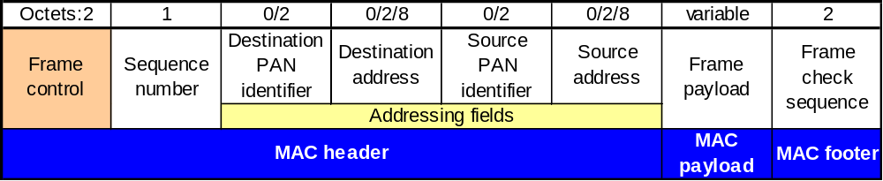
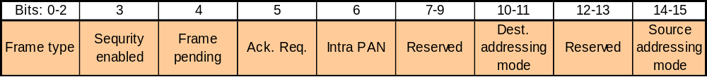
General MAC Frame Format
Frame control field

Slide 15
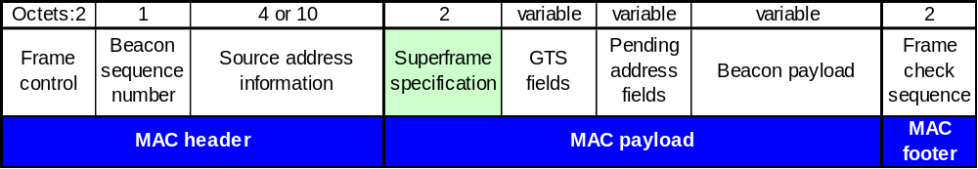
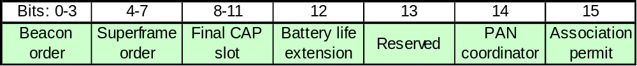
Beacon Frame Format

Slide 16
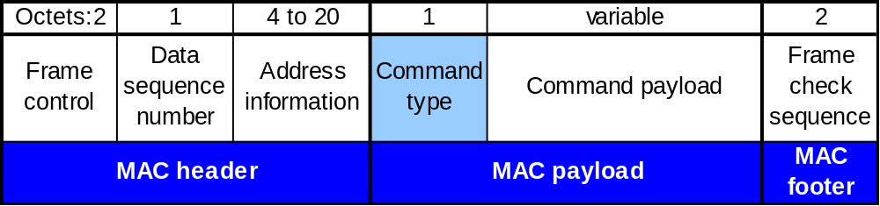
MAC Command Frame
Command Frame Types
  Association request
  Association response
  Disassociation notification
  Data request
  PAN ID conflict notification
  Orphan Notification
  Beacon request
  Coordinator realignment
  GTS request

Slide 17
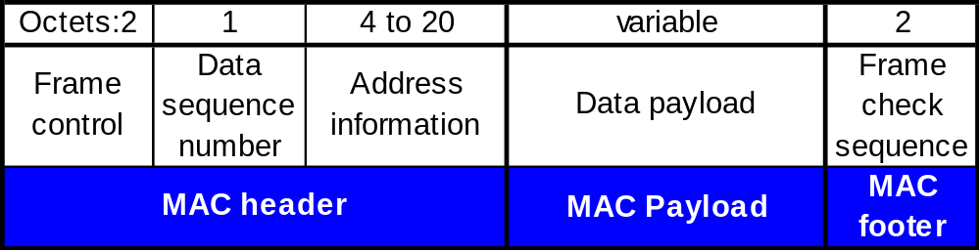
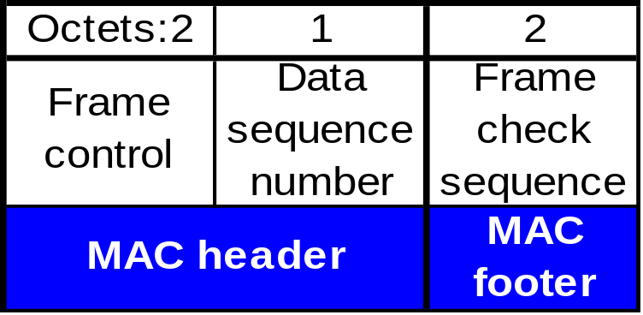
Data Frame Format
Acknowledgement Frame Format

Slide 18
Data Service
Data transfer to neighboring devices
  Acknowledged or unacknowledged
  Direct or indirect
  Using GTS service
Maximum data length (MSDU) aMaxMACFrameSize (102 bytes)

Slide 19
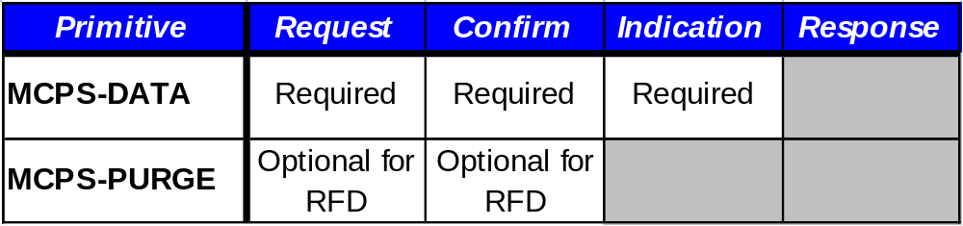
MAC Data Primitives

Slide 20
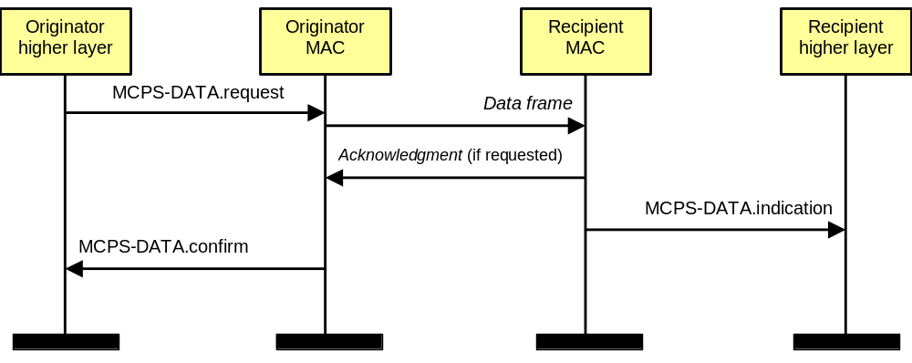
Data Transfer
Message Sequence Diagram

Slide 21
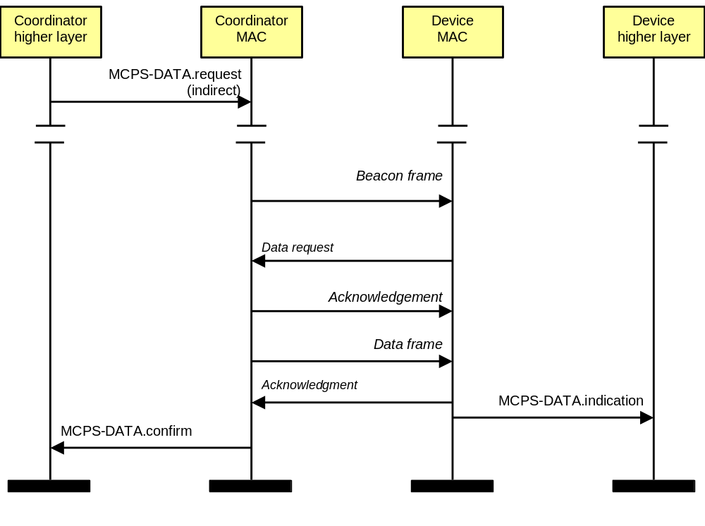
Indirect Data Transfer
Message Sequence Diagram

Slide 22
Management Service
Access to the PIB
Association / disassociation
GTS allocation
Message pending
Node notification
Network scanning/start
Network synchronization/search

Slide 23
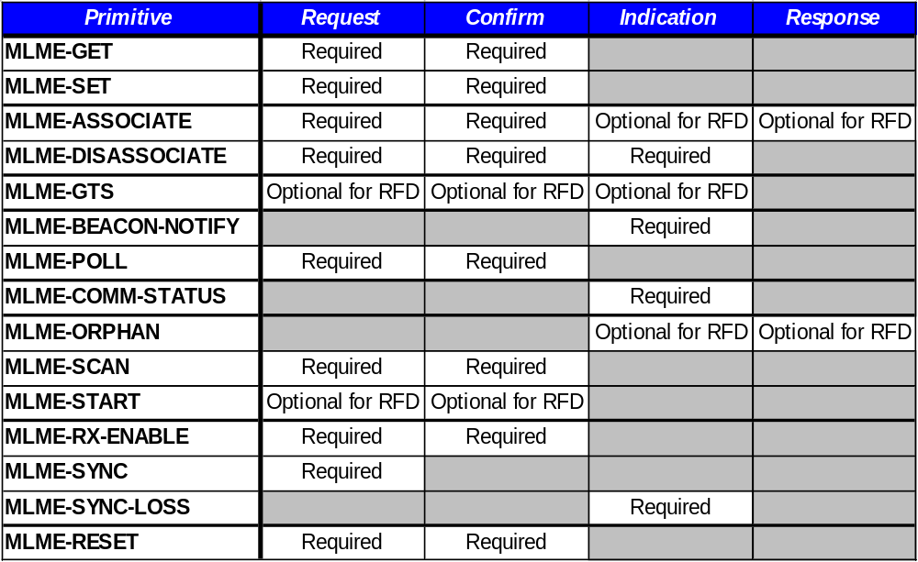
MAC Management Primitives

Slide 24
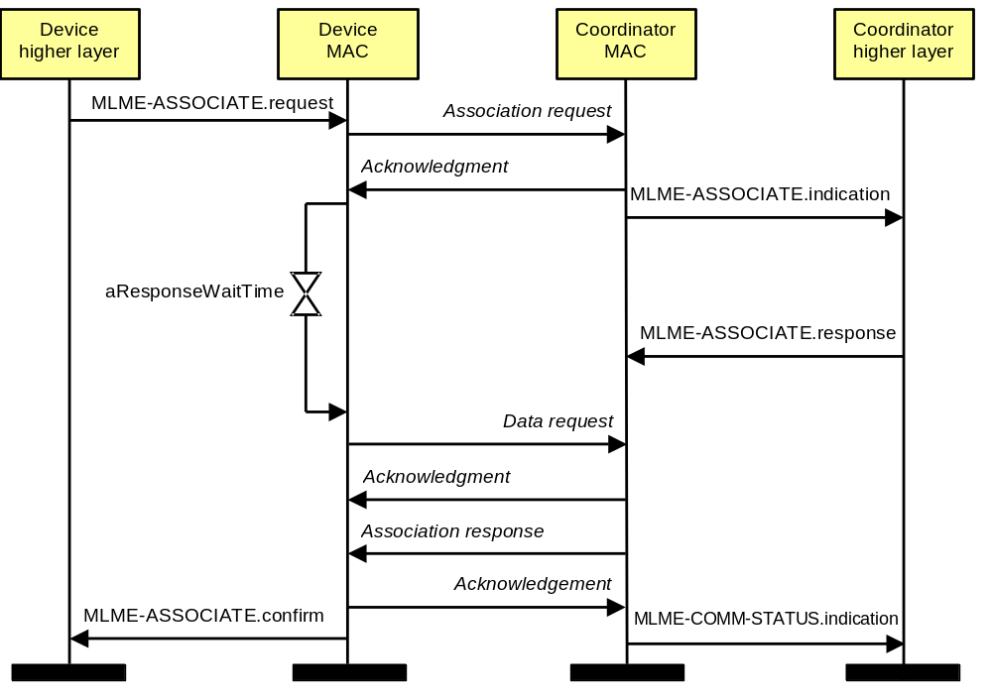
Association
Message Sequence Diagram

Slide 25
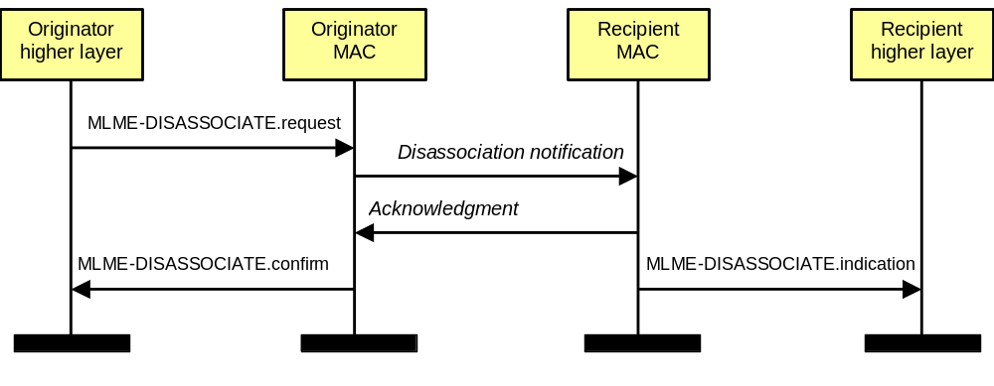
Disassociation
Message Sequence Diagram

Slide 26
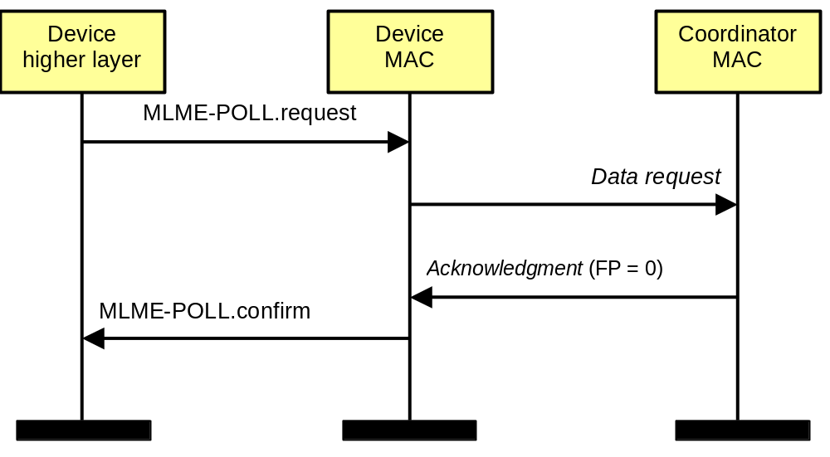
Data Polling
Message Sequence Chart
No data pending at the coordinator

Slide 27
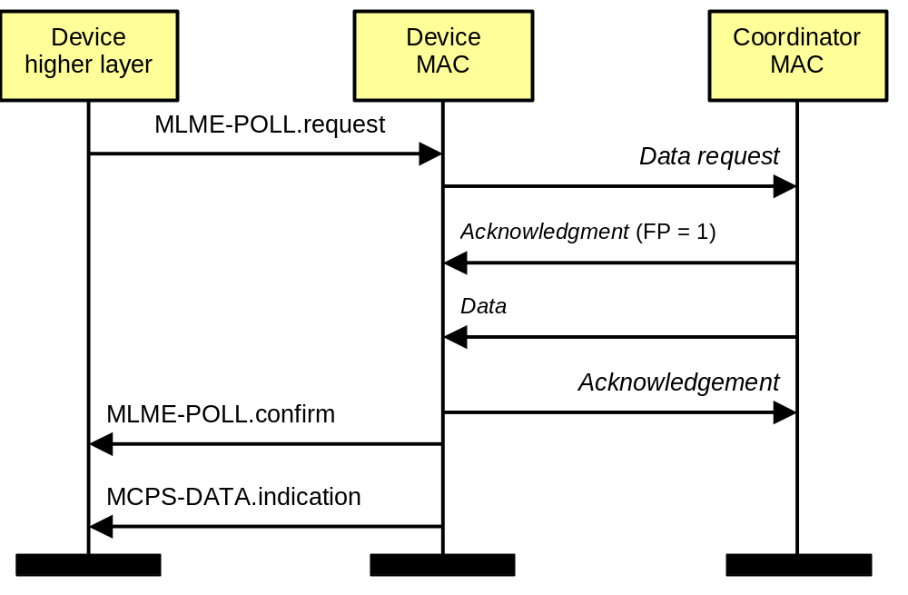
Data Polling
Message Sequence Chart
Data pending at the coordinator

Slide 28
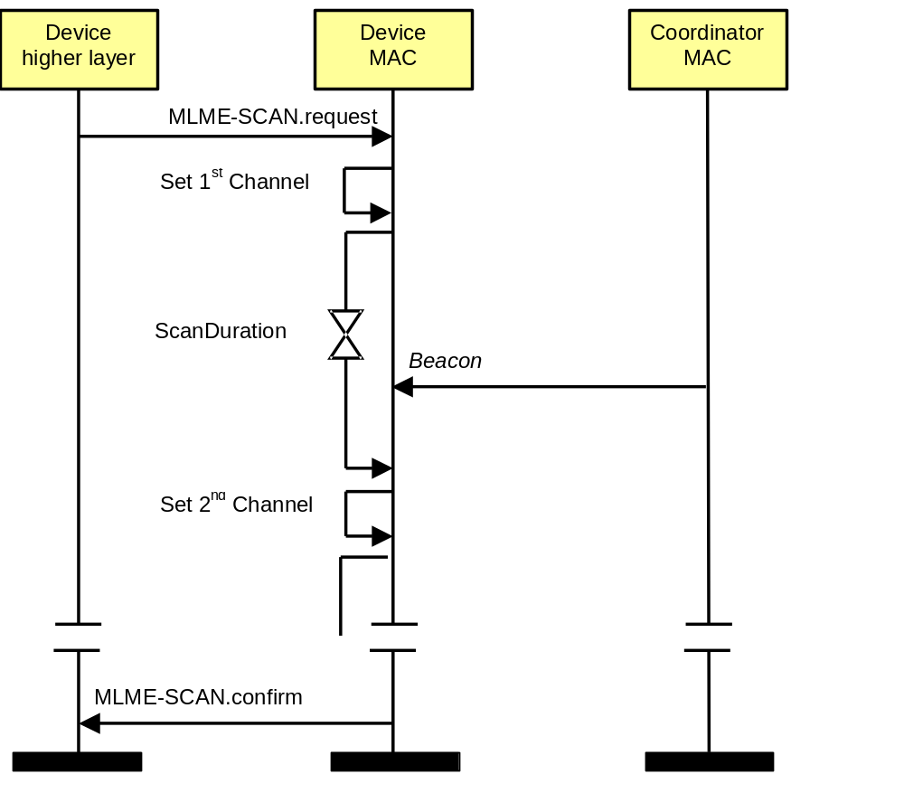
Passive Scan

Slide 29
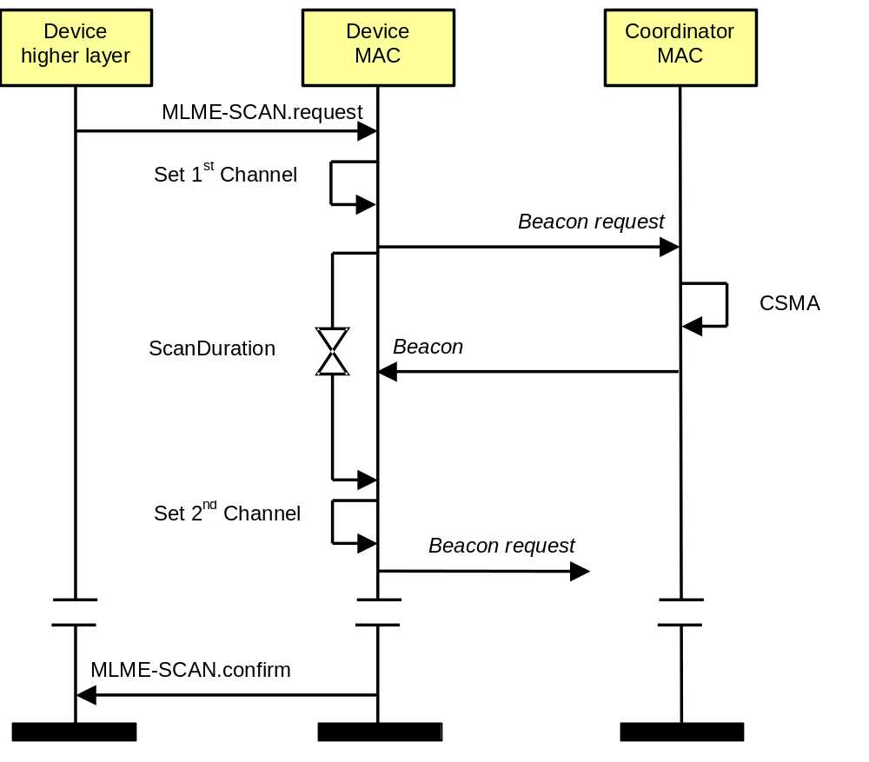
Active Scan

Slide 30
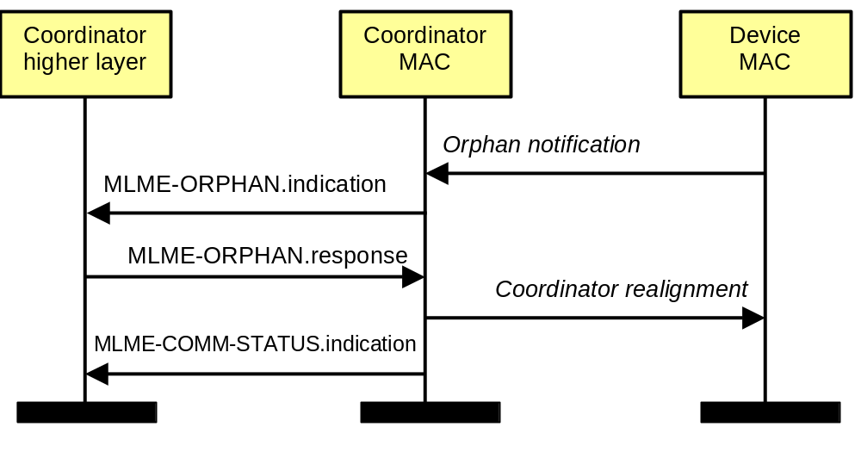
Orphaning
Message Sequence Diagram

Slide 31
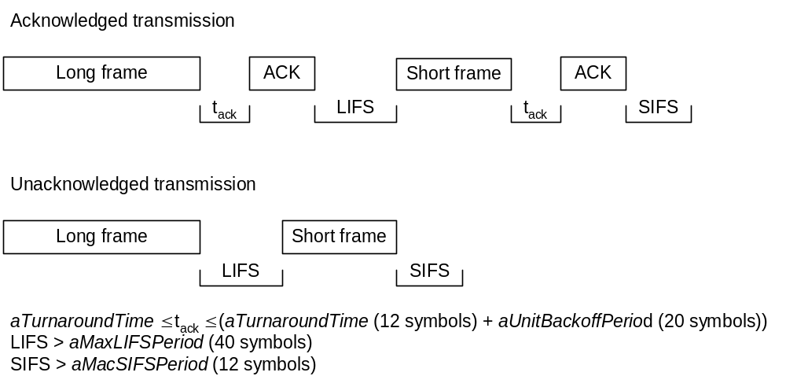
Inter-frame Spacing
For frames ≤ aMaxSIFSFrameSize use short inter-frame spacing (SIFS)
For frames > aMaxSIFSFrameSize use long inter-frame spacing (LIFS)

Slide 32
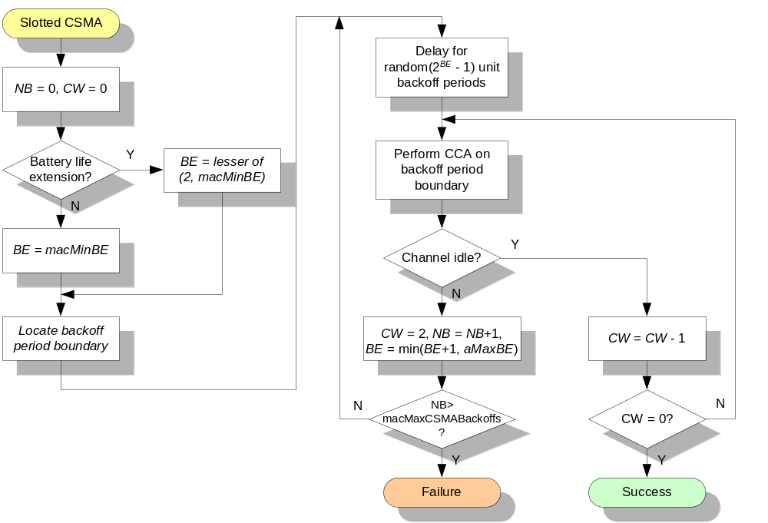
Slotted CSMA Procedure
Used in beacon enabled networks.

Slide 33
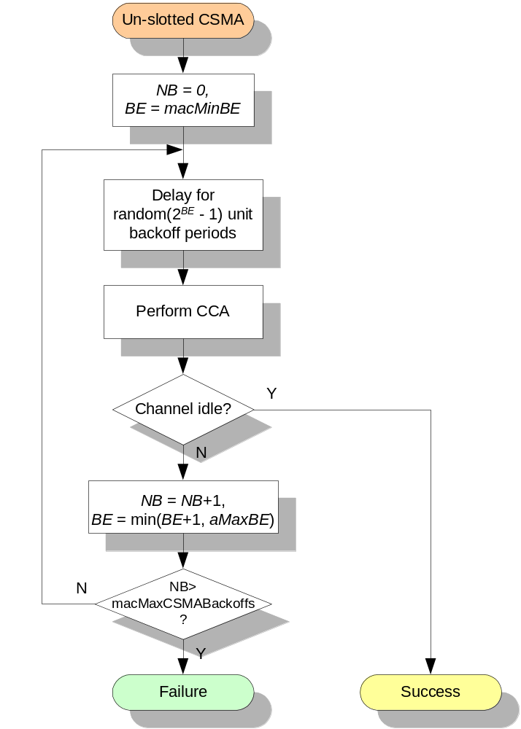
Un-slotted CSMA Procedure
Used in non-beacon networks.

Slide 34

Thank you!
Questions

