Slide 1
Project: IEEE P802.15 Working Group for Wireless Personal Area Networks (WPANs)
Submission Title: IEEE 802.15.4 PHY Capabilities
Date Submitted: May 2004
Source: Frederick Martin, Motorola, Inc., Paul Gorday, Motorola, Inc., Jon Adams, Freescale, Inc., Hans van Leeuwen, STS-wireless.
Contact: F. Martin, Motorola, Inc., 8000 W. Sunrise Blvd. Plantation, FL 33322
Hans van Leeuwen, STS, +1 858 344 5120
Voice: +1 954-723-6395, FAX: +1 954-723-3712, E-Mail: f.martin@motorola.com
Re: Technical Contribution to TG4A
Abstract: The 802.15.4 PHY and a typical hardware implementation are described.
Purpose: Tutorial information on capabilities of current 15.4 hardware.
Notice: This document has been prepared to assist the IEEE P802.15. It is offered as a basis for discussion and is not binding on the contributing individual(s) or organization(s). The material in this document is subject to change in form and content after further study. The contributor(s) reserve(s) the right to add, amend or withdraw material contained herein.
Release: The contributor acknowledges and accepts that this contribution becomes the property of IEEE and may be made publicly available by P802.15.

Slide 2
Outline
IEEE 802.15.4 PHY Overview
Freescale 802.15.4 IC Characteristics
Summary

Slide 3
IEEE 802.15.4 PHY Overview
Operating Frequency Bands
868MHz/
915MHz
PHY
Channel 0
Channels 1-10
2 MHz
868.3 MHz
902 MHz
928 MHz
2.4 GHz
PHY
Channels 11-26
5 MHz
2.4 GHz
2.4835 GHz

Slide 4
IEEE 802.15.4 PHY Overview
Packet Structure (Both PHY’s)
PHY Packet Fields
Preamble (32 bits) – Symbol synchronization
Start of Packet Delimiter (8 bits) – Frame synchronization
PHY Header (8 bits) – Specifies PSDU length
PSDU (up to 127 bytes) – Data field
Start of
Packet
Delimiter
PHY
Header
PHY Service
Data Unit (PSDU)
Preamble
6 Bytes
≤ 127 Bytes
(0.2 ms @ 250 kbps)
(1.2 ms @ 40 kbps)
(< 4.1 ms @ 250 kbps)
(< 50.8 ms @ 40 kbps)

Slide 5
IEEE 802.15.4 PHY Overview
Modulation/Spreading
2.4 GHz PHY
Data rate is 250 kbps (4 bits/symbol, 62.5 ksymbols/s)
Data modulation is 16-ary orthogonal modulation
16 symbols are ~orthogonal set of 32-chip PN codes
Chip modulation is O-QPSK with half-sine pulse shape
Chip rate is 2.0 Mchip/s
868MHz/915MHz PHY
Data rate is 20 kbps @ 868 MHz, 40 kbps @ 915 MHz
Data modulation is BPSK with differential encoding
Spreading code is a 15-chip m-sequence
Chip modulation is BPSK with raised-cosine pulse shape (α=1.0)
Chip rate is 0.3 Mchip/s at 868 MHz, 0.6 Mchip/s at 915 MHz

Slide 6
IEEE 802.15.4 PHY Overview
Common Parameters
Transmit Power
Capable of at least -3 dBm
Maximum set by regulatory limits
Transmit Center Frequency Tolerance
± 40 ppm
Receiver Sensitivity
-85 dBm (2.4 GHz PHY)
-92 dBm (868/915 MHz PHY)
Features
Packet strength indication (for location, routing)
Clear channel assessment (for CSMA)
Dynamic channel selection (for coexistence)

Slide 7
2.4 GHz Implementation – Freescale Semiconductor
HC08
uP
SPI CEB
MC13192 IC
SPI CLK
2.0-3.6 V
SPI DATA IN
SPI DATA OUT
INT
REF CLK
EXTERNAL COMPONENTS
-- 1 Crystal (16 MHz AT-cut)
-- 2 RF tuning caps
-- 4 Compensation caps (0.22 uF)
-- 2 RF bypass caps
-- 2 low-freq bypass caps (0.22 uF)
TOTAL 11 COMPONENTS
FEATURES
-- typical sensitivity: -90 dBm
-- RSSI resolution: < 0.5 dB
-- TX Output: 0 dBm
-- CMOS 0.18 um

Slide 8
0.9 GHz Implementation – STS
8bit,
32kB flash
uP
SPI CEB
SSTAR
SPI CLK
2.0-3.6 V
SPI DATA IN
SPI DATA OUT
INT
REF CLK
EXTERNAL COMPONENTS
-- 1 Crystal (12 MHz AT-cut)
TOTAL 1 COMPONENTS
FEATURES
-- RX sensitivity: -103 dBm
-- TX Output: +3 dBm
-- CMOS 0.35 um

Slide 9
802.15.4 Active Die Area
mm² | 0.35um (actual 900MHz) | 0.18 um (actual 2400MHz) | 0.13 um (estimated) | 0.09 um (estimated)
Analog/RF |  | 1.4 | 1.3 | 1.2
Digital |  | 1.2 | 0.8 | 0.6
Total | 12 ~ 16 | 2.6 | 2.1 | 1.8

Slide 10
802.15.4 Power Dissipation
 | 900MHz 0.35um 2.2 volt (estimated) | 2400MHz 0.18 um, 1.8 volts (actual) | 2400MHz 0.13 um 1.5 volts (estimated) | 2400MHz 0.09 um 1.2 volts (estimated)
RX | 50mW -103dBm | 60 mW -92dBm | 40 mW | 30 mW
TX | 50mW +3dBm | 60 mW 0dBm | 50 mW | 40 mW
Standby | 4uW | 4 uW | 4 uW | 4 uW

Slide 11
Battery Life Case Study –Peel ‘N Stick Security Sensors
Battery Operation
  2 AA Alkaline or 1 Li-AA cell
802.15.4/ZigBee Mode
  Non-beacon network environment
Sensor process
  RC Oscillator waking up MCU and doing network check-in at some interval
    Many security systems have between ~10 second and ~15 minute requirement
  On a sensor event, device immediately awakens and reports in to network
802.15.4
XCVR
Vcc
SPI
MCU
4
SPI
Vcc
3Vdc
CLK
OSC1
IRQ
16.000MHz
Security
Sensor

Slide 12
Battery Life Case Study –Peel ‘N Stick Security Sensors
Battery-Powered Sensor
Mains-Powered Router
Interval timer expires: Wake Up
256µs
CCAx2
192µs
RX>TX
~650µs
TX
RX
192µs
TX>RX
RX>TX
Check-in only ~1640µs
~350µs
ACK RX
ACK TX OPT: Pending ON
Event and Get Data ~2300µs
~650µs
RX Data
TX Data
Set Interval timer
Sleep

Slide 13
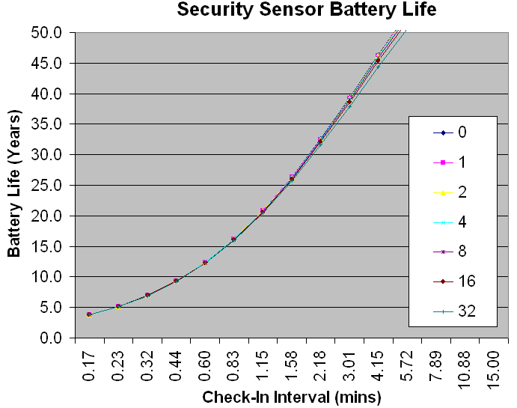
Battery Life Case Study –Peel ‘N Stick Security Sensors
Any check-in interval exceeding ~14 sec allows sensor to surpass alkaline battery shelf life
2 AA Alkaline Batteries!
Events/day

Slide 14
Battery Life Case Study – Body-Worn Medical Sensor
Heartbeat Sensor
  Battery-operated using CR2032 Li-Coin cell
802.15.4/ZigBee Mode
  Network environment using Guaranteed Time Slot (GTS)
  Network beacons occurring either every
    960ms or 61.44s (closest values to 1 and 60 s)
Sensor has two ongoing processes
  Heartbeat time logging
  Transmit heartrate and other information (8 bytes total)
    Instantaneous and average heart rate
    Body temperature and battery voltage
heartbeat
GTS
Beacon
time
802.15.4
XCVR
Vcc
MCU
Vcc
3Vdc
SPI
4
SPI
IRQ/
INT
IRQ
RESET
OSC1
OSC2
Heartbeat
Sensor
16.000MHz
32.768kHz

Slide 15
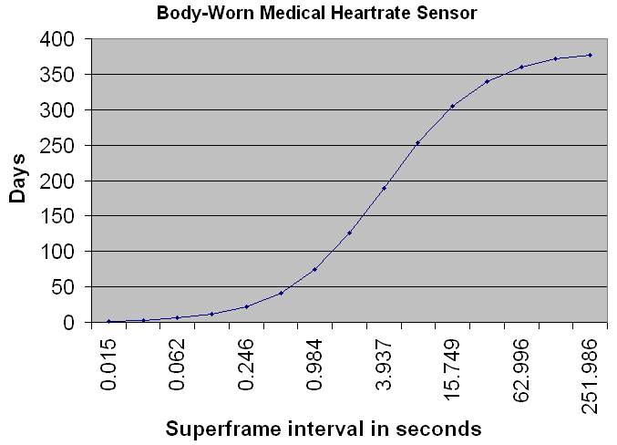
Battery Life Case Study – Body-Worn Medical Sensor
Single CR2032 Li Coin Cell

Slide 16
Indoor Propagation Model
Assume typical home/office indoor environment
free space LOS propagation to 4 meters
additional 0.7 dB/meter loss beyond 4 meters
fading margin is dependent on bandwidth
UWB: 5 dB
802.11a/b: 8 dB
802.15.4: 16 dB
Shadowing (not included):
sigma 3 dB @ 8 meters increases to 9 dB @ 100 meters
Distance curves include fading margin, do not include shadowing.
K. Siwiak, A. Petroff, "A Path Link Model for Ultra Wide Band Pulse Transmissions," Proc. IEEE VTC2001 Spring Conf., vol. 2, pp. 1173-1175.
0.00
-20.00
-40.00
-60.00
-80.00
Path Loss (dB)
-100.00
-120.00
-140.00
-160.00
1
10
100
Range (m)
Path loss for UWB 3-5 GHz channel in indoor environment with 4 meter LOS.

Slide 17
Indoor Range Comparison
Indoor Range Comparison
802.11B
Kbit/s
802.15.4 2400 LC
1000
802.15.4 900 LC
802.15.4 900 HP
802.15.4 2400 HP
100
10
1
0.1
0.01
1
10
100
meters
802.11B: 2.4 GHz frequency, 20 dBm TX power, 6 dB NF, 8 dB loss for fading.
802.15.4 (2400 LC): 2.4 GHz frequency, 0 dBm TX, 16 dB NF, 16 dB loss for fading.
802.15.4 (2400 HP): 2.4 GHz frequency, 20 dBm TX, 6 dB NF, 16 dB loss for fading.
802.15.4 (900 LC): 900 MHz frequency, 0 dBm TX, 16 dB NF, 16 dB loss for fading.
802.15.4 (900 HP): 900 MHz frequency, 20 dBm TX, 6 dB NF, 16 dB loss for fading.

Slide 18
Outdoor LOS Propagation
Transmitting
antenna
Receiving
Direct wave
antenna
h_{T}
Reflected
h_{R}
Planar ground
wave
d
For narrowband two-path LOS model at 2.4 GHz, breakpoint between
1/d² and 1/d⁴ path loss occurs near [1]
2
π
h
h
2
π
(
=
=
10
m
)(
1
m
)
≈
d
T
R
500
m
B
λ
(
0
.
0125
m
)
[1] Sato and Kobayashi, “Path-Loss Exponents of Ultra Wideband Signals in Line-of-Sight Environments”,
Document # IEEE802.15-04-0111-00-004a, March 14, 2004.

Slide 19
Outdoor LOS Propagation Estimates
Bits/s
1.0E+08
802.11B
802.15.4 2.4GHz LC
802.15.4 2.4 GHz HP
1.0E+07
802.15.4 900 MHz LC
802.15.4 900 MHz HP
1.0E+06
1.0E+05
1.0E+04
10
100
1000
10000
meters
802.11B: 2.4 GHz frequency, 20 MHz bandwidth, 20 dBm TX power, 6 dB NF, 8 dB loss for fading.
802.15.4 2.4 GHz LC: 2.4 GHz frequency, 250 kbit/s, 0 dBm TX, 16 dB NF, 16 dB loss for fading.
802.15.4 2.4 GHz LC: 2.4 GHz frequency, 250 kbit/s, 20 dBm TX, 6 dB NF, 16 dB loss for fading
802.15.4 900 MHz LC: 900 MHz frequency, 20 kbit/s, 0 dBm TX, 16 dB NF, 16 dB loss for fading
802.15.4 900 MHz HP: 900 MHz frequency, 20 kbit/s, 20 dBm TX, 6 dB NF, 16 dB loss for fading

Slide 20
Outdoor LOS Propagation -- Multipath
Multipath for the 2.4 GHz PHY:
  Narrow-band DSSS signal (T_{SYMB} = 16 μs, T_{CHIP} = 0.5 μs)
  Capable of withstanding high delay spread (> 1 μs)
  Assume flat Rayleigh fading (conservative):
    10% outage ⇒ 10 dB margin
    5% outage ⇒ 13 dB margin
    1% outage ⇒ 20 dB margin
[1] Sato and Kobayashi, “Path-Loss Exponents of Ultra Wideband Signals in Line-of-Sight Environments”,
Document # IEEE802.15-04-0111-00-004a, March 14, 2004.

Slide 21
Summary
Current 802.15.4 PHY
-- 20 to 250 kbit/s
-- 900 MHz, 2.4 GHz
Current Implementations for 15.4
-- simple
-- low silicon area
-- low power
Range
-- 20-50m, 2.4 GHz indoor model
--300 to 1000+, 2.4 GHz, 900 MHz, LOS outdoor model
Power
-- multi-year life

