Slide 1
OCLScribe
Integrating Modelio and USEOCL
modelio.org
sourceforge.net/projects/useocl/

Slide 2
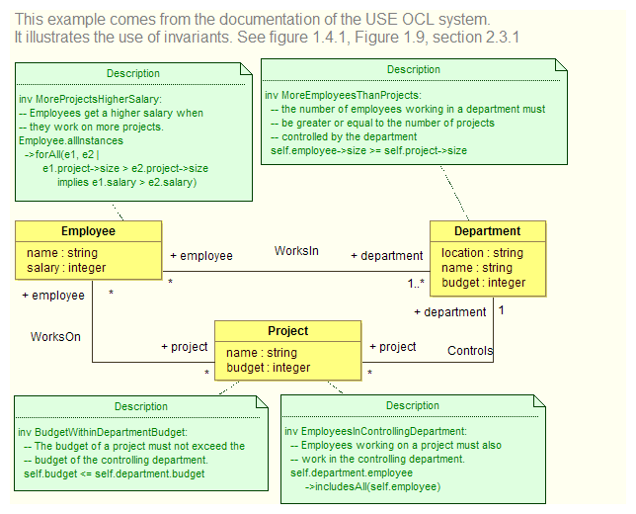
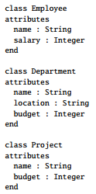
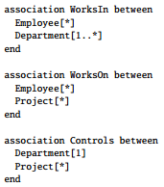
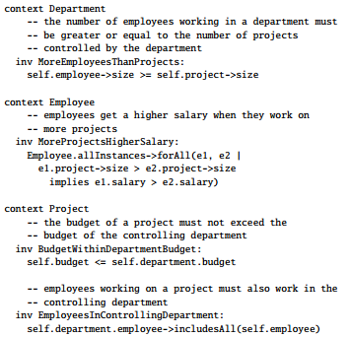
Overview
OCLScribe
Modelio
USEOCL

Slide 3
Objectives
Integration of OCL contraints into Modelio
use of a simple profile defined on Notes
<<Invariant>>,<<Precondition>>,<<Postcondition>>
Generation of the "Structural" model
Copy of the OCL constraints

Slide 4
Current limitations
Limited to the generation of the model
Possible extensions:
launching the OCLUSE and error reporting
generating instances (.soil) from object models
reverse engineering instances (.soil)

Slide 5
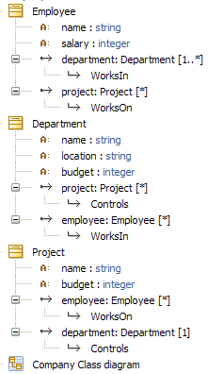
"Company" Example – Modelio
Structure
Constraints
Structure

Slide 6
"Company" Example – USEOCL
Structure
Constraints
See section 2.3.1 of USEOCL manual for comments and reference to the full version

Slide 7
Modelio vs USEOCL – Structure

Slide 8
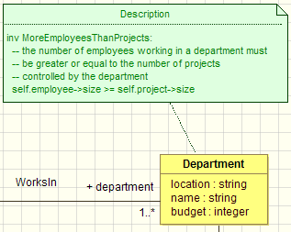

Modelio vs USEOCL – Constraints

Slide 9
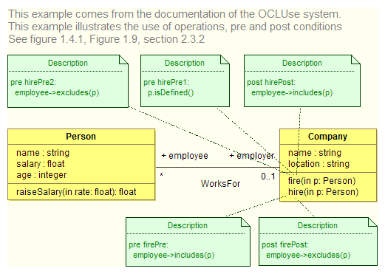
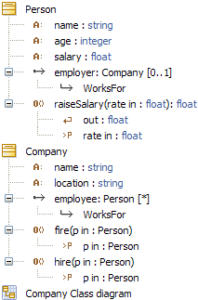
"Employee" Example – Modelio

