Slide 1

HACK THE BOX
Group 12

Slide 2
Description
HackTheBox can be described as a learning platform to develop your cybersecurity and pentesting skills.
“You can start by learning the foundational fundamentals, transition into hands-on training that forces you to compromise realistic environments, compete in Capture The Flag events, and even land your first cybersecurity job.”
¿ HTB Academy vs. HTB Labs vs. HTB CTFs ?

Slide 4
Differences between Academy, Labs & CTFs
HTB Academy: Provides you with guided theoretical training and interactive exercises on live targets to reinforce your skills
HTB Labs: Pool of hackable environments that simulate up-to-date security vulnerabilities and misconfigurations.
HTB CTFs: Capture the flag events, excellent for experienced hackers looking to develop, test, and prove their skills because they gamify hacking concepts.

Slide 5
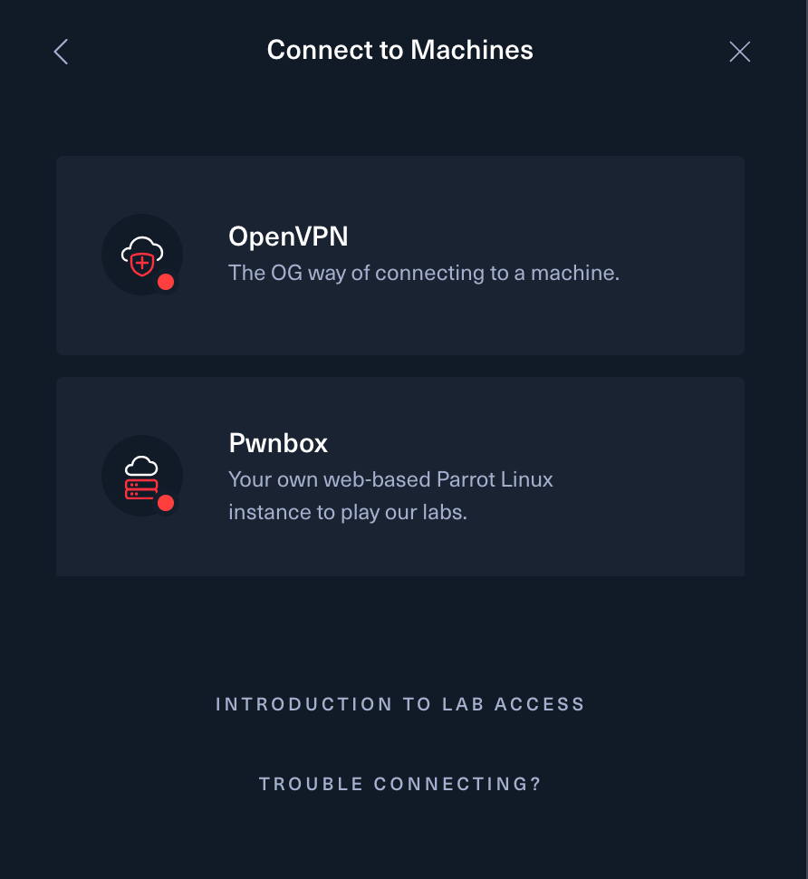
How to play? [HTB Labs]
There are 2 supported ways to connect and exploit the machines:
> OpenVPN
> Pwnbox

Slide 6
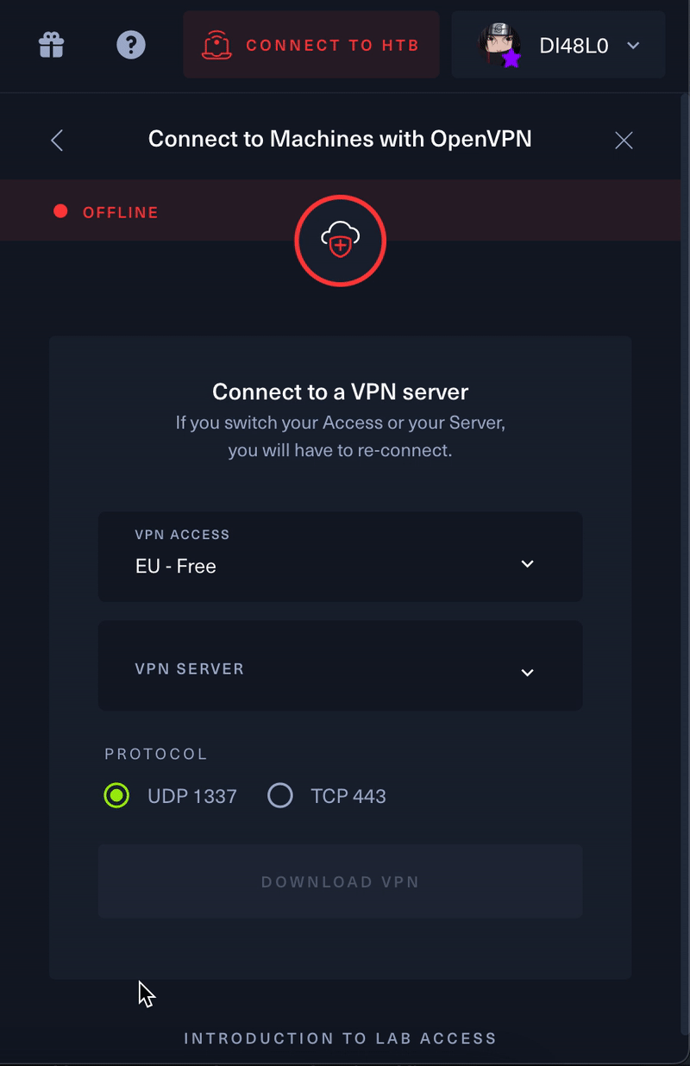
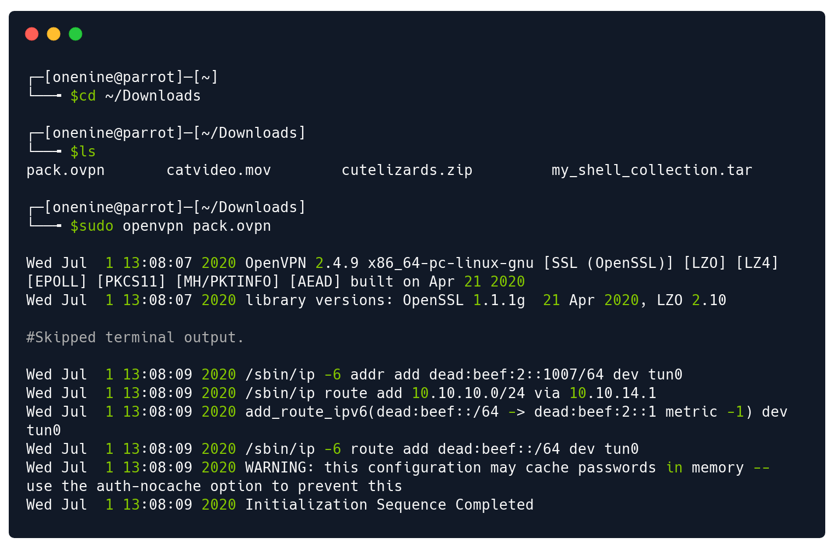
OpenVPN Connection [HTB Labs]
1. Download openvpn configuration file.
2. Connect to the VPN using the given config.
3. Exploit the machine using your own tools.

Slide 7
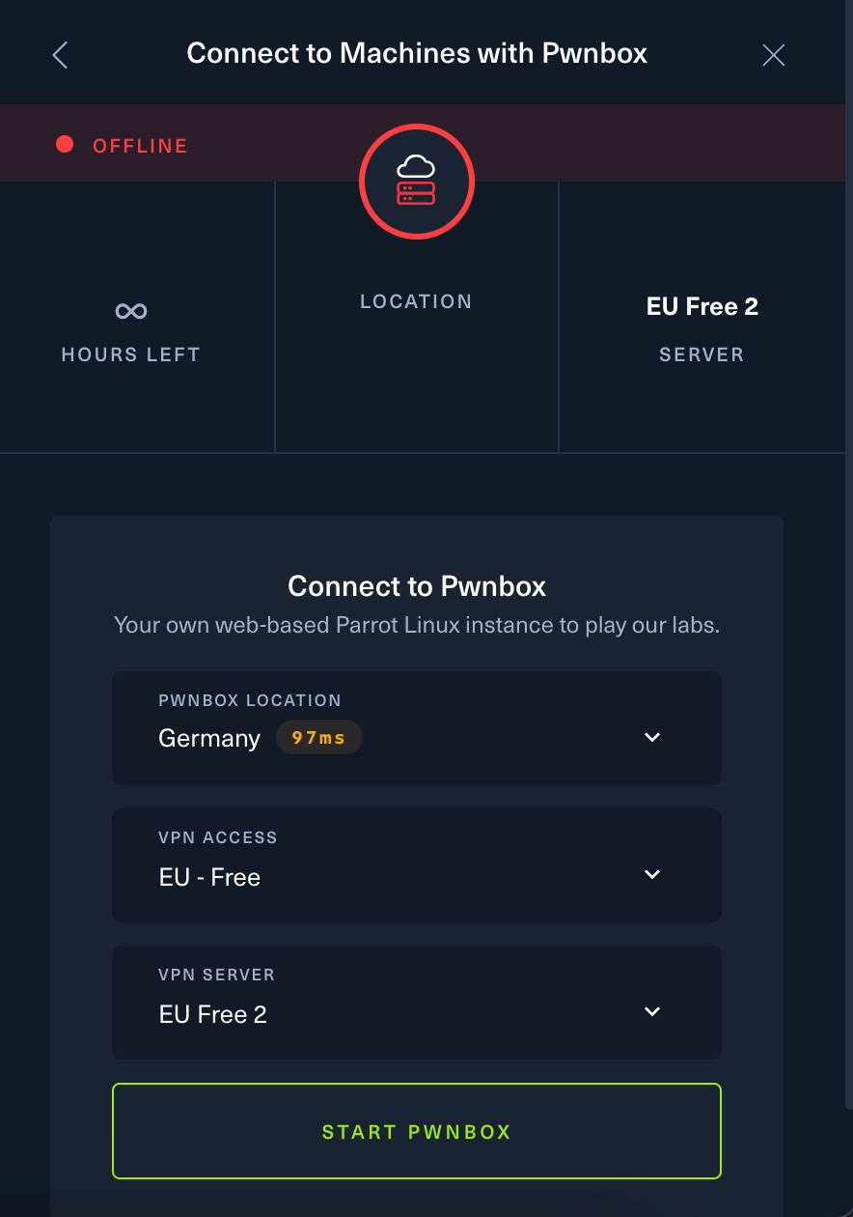
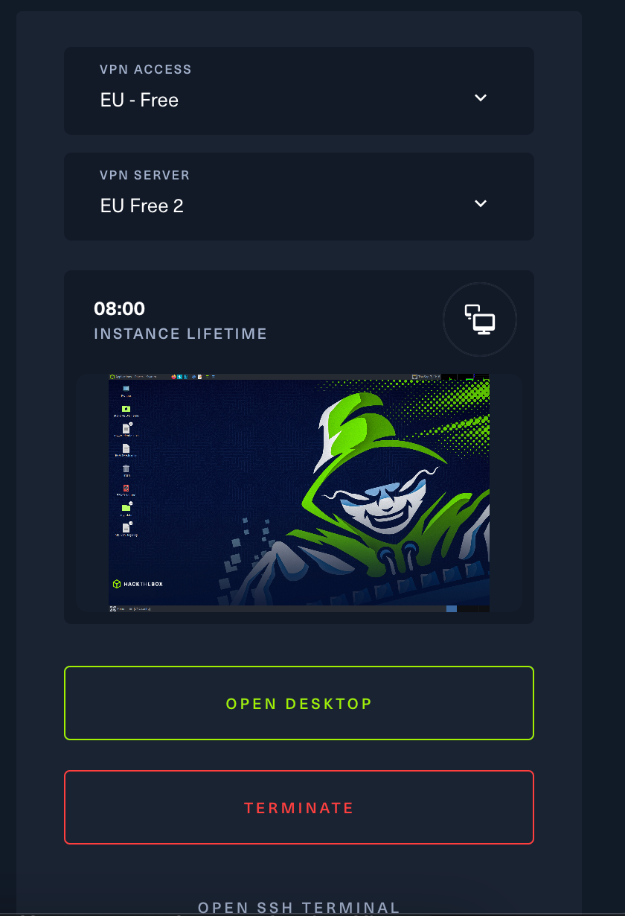
Pwnbox Connection [HTB Labs]
You can use a VM accessible through you internet browser.
Start Pwnbox > Open Desktop

Slide 8
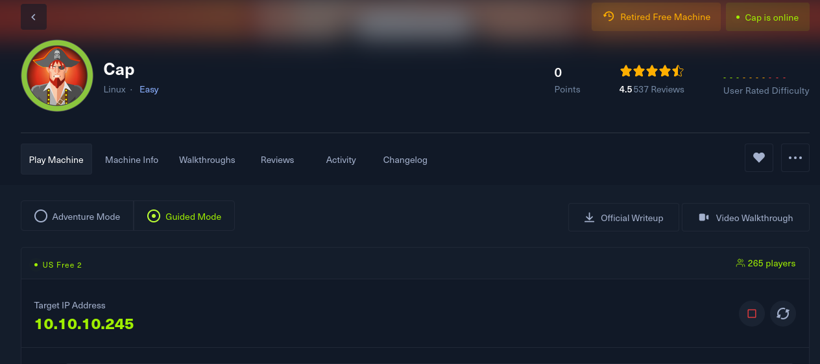
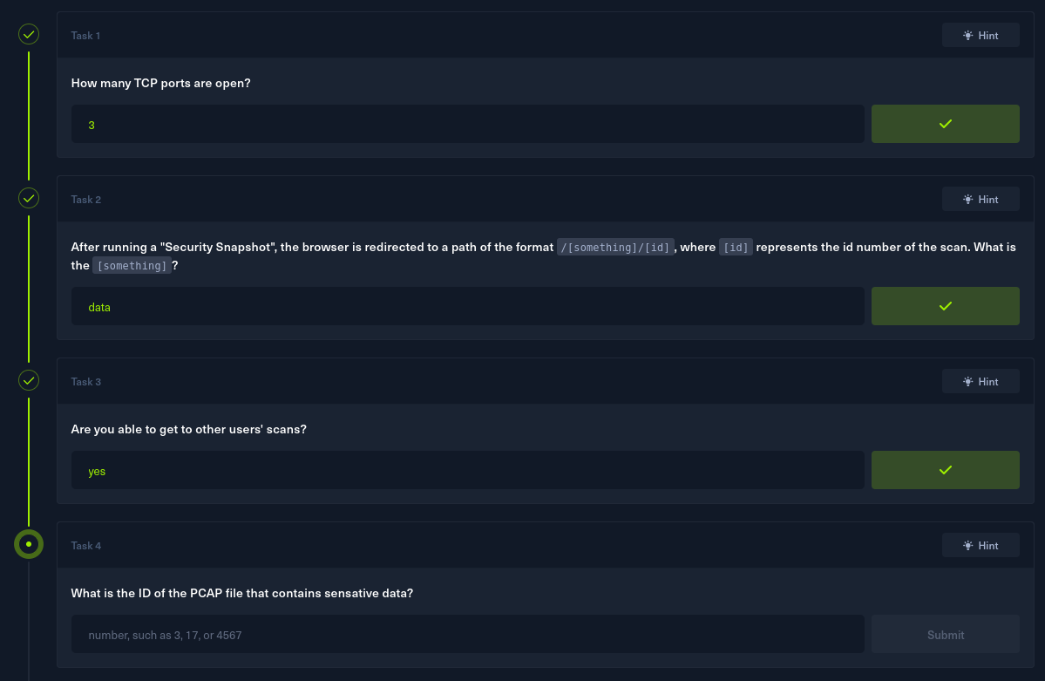
How to play? [HTB Labs]
Example machine & Questions/Answers

Slide 9
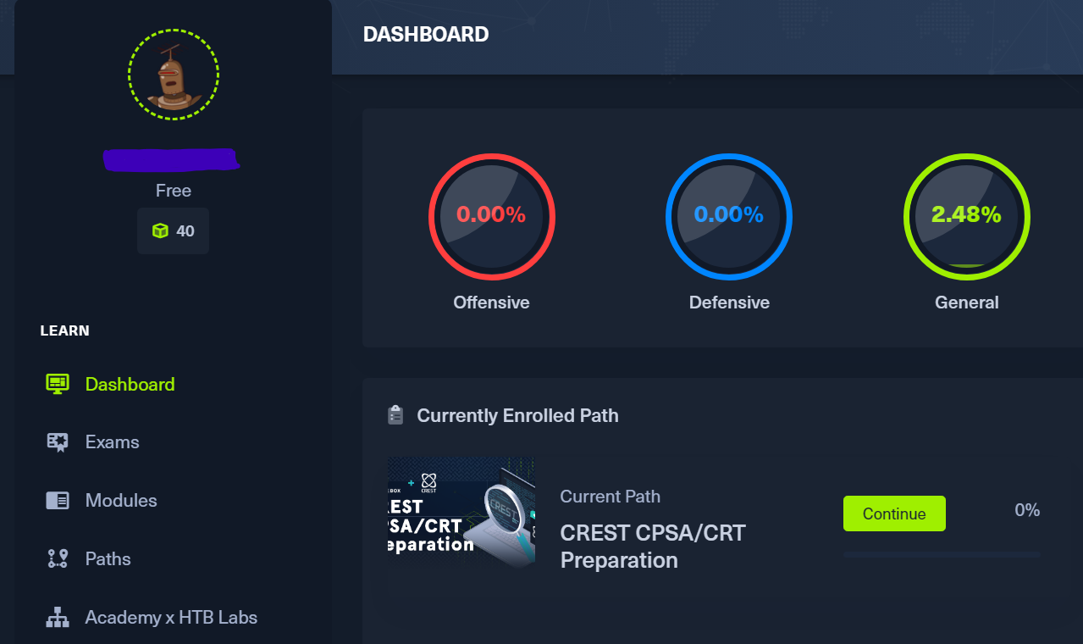
How to play? [HTB Academy]

Slide 10
Cybersecurity concepts that are explored
Penetration Testing - Evaluates the candidates’ penetration testing skills
Bug Bounty
Evaluates the candidates’ bug bounty hunting and web application pentesting skills
Defensive Security:
- Evaluates the candidates’ security analysis and incident handling skills
Web Exploitation:
- Evaluates candidates' skills in identifying advanced and hard-to-find web vulnerabilities.
Notes:
BUG BOUNTY: certifies intermediate-level skills in bug bounty hunting and web application penetration testing, with the ability to assess risks and produce actionable reports.

Slide 11
Strengths and weaknesses of the game
Strengths:
Real challenges
Variety of topics and challenges
Competition and streak
Weaknesses:
Requires a lot of time
Pay to play

Slide 12
Target profiles
Students in Cybersecurity Courses: Perfect for gaining experience in a controlled environment.
Penetration Testers: Those wanting to improve their skills in offensive security.
IT skilled staff: Gain insight into how their systems can be attacked and learn defense strategies.
IT non-skilled staff: Those entering in the world of cybersecurity.

Slide 13
Can it be useful for cybersecurity training purposes?
Practical learning: Simulates real-world situations to practice penetration testing and vulnerability exploitation.
Adaptable for all skill levels: Offers challenges from beginner to advanced, making it useful for a wide range of users.

Slide 14
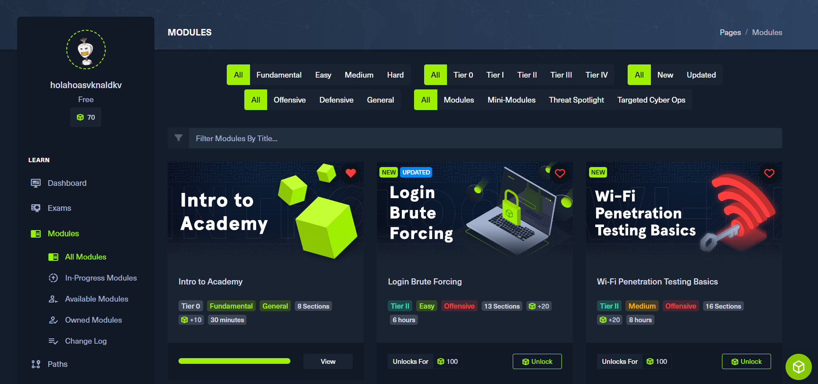
Can it be useful for cybersecurity training purposes?

