Slide 1
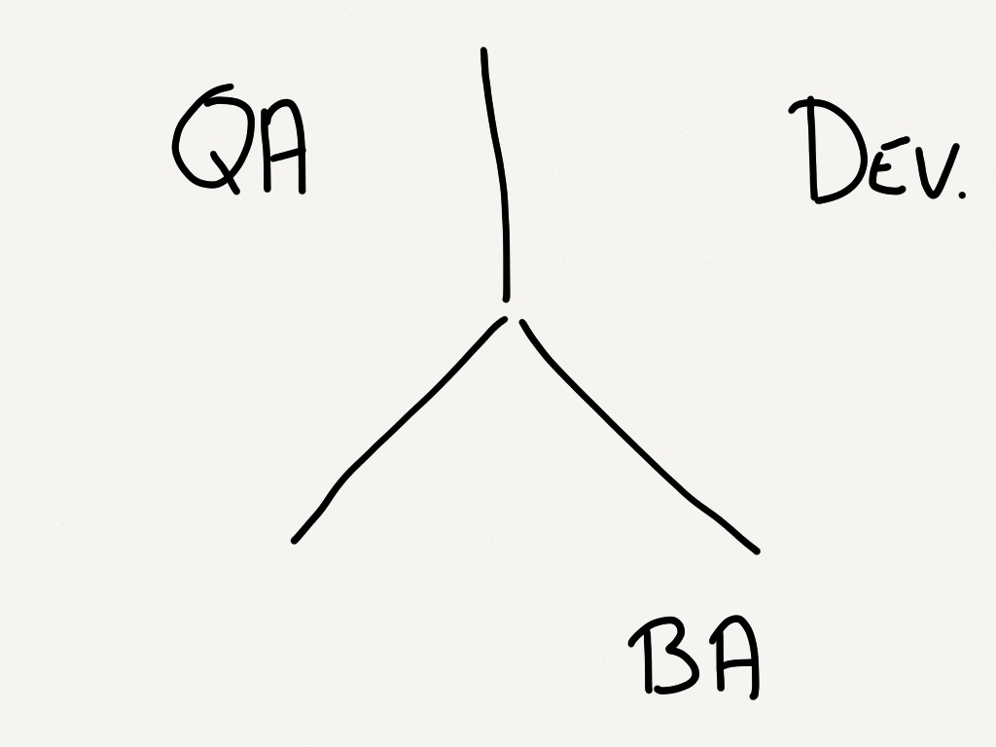

Slide 2
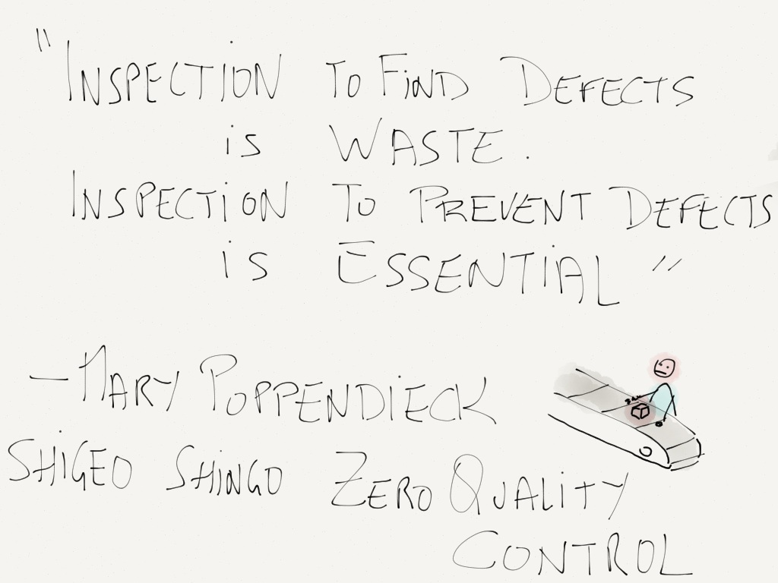

Slide 3


Slide 4
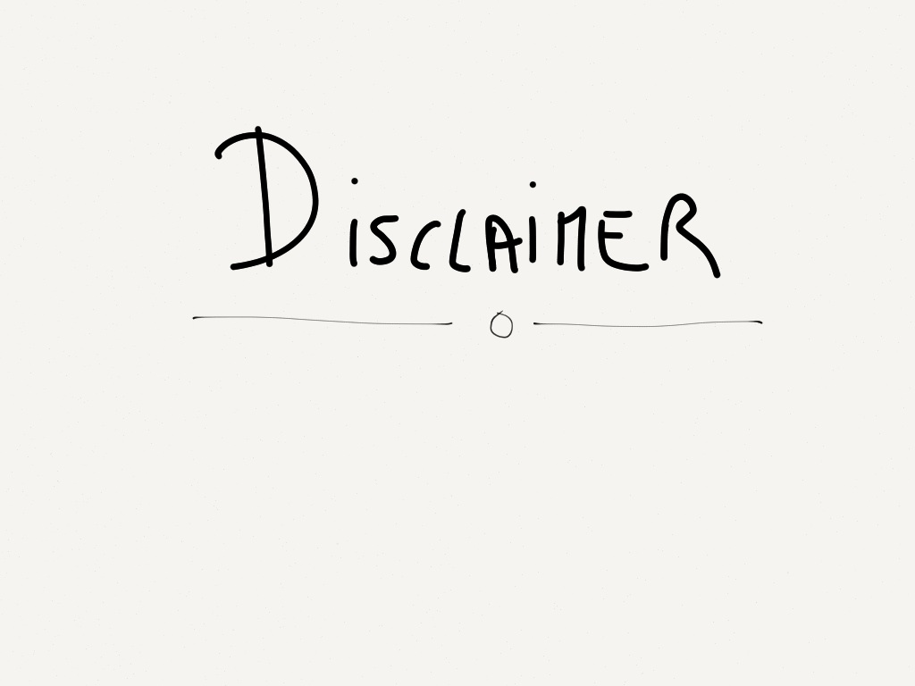

Slide 5
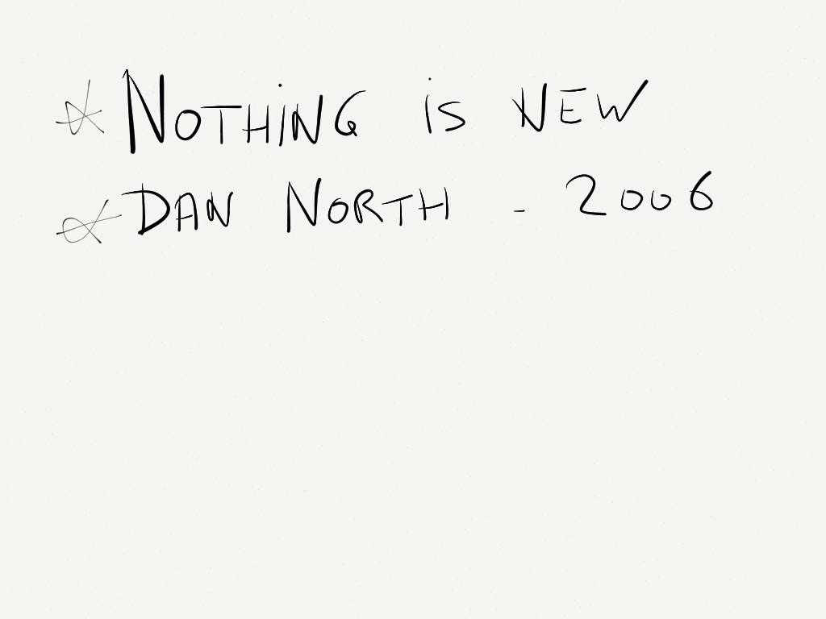

Slide 6
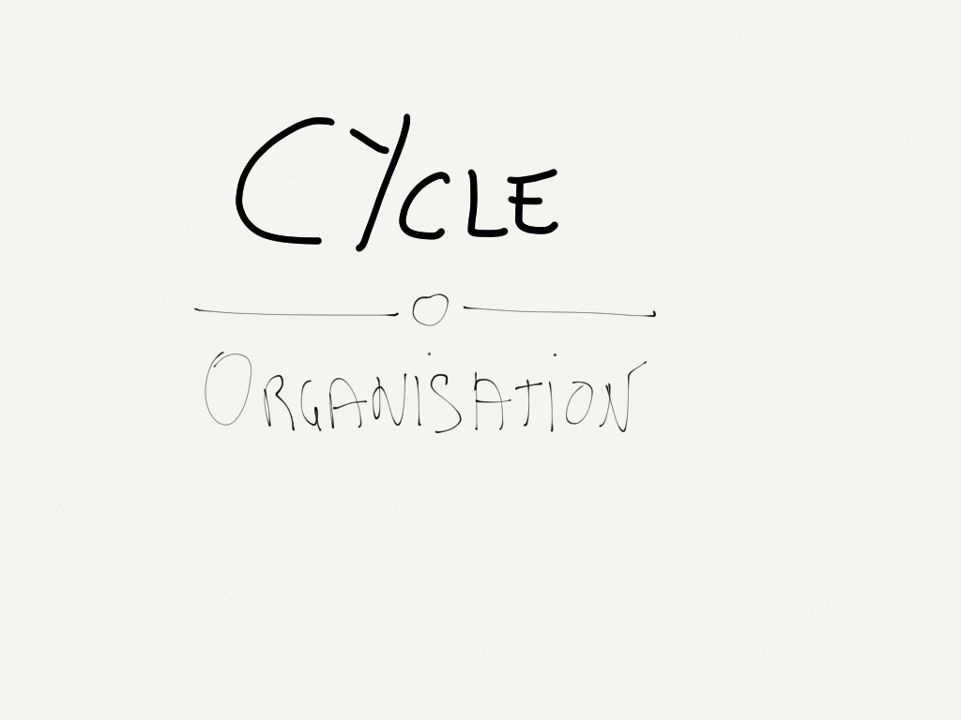

Slide 7
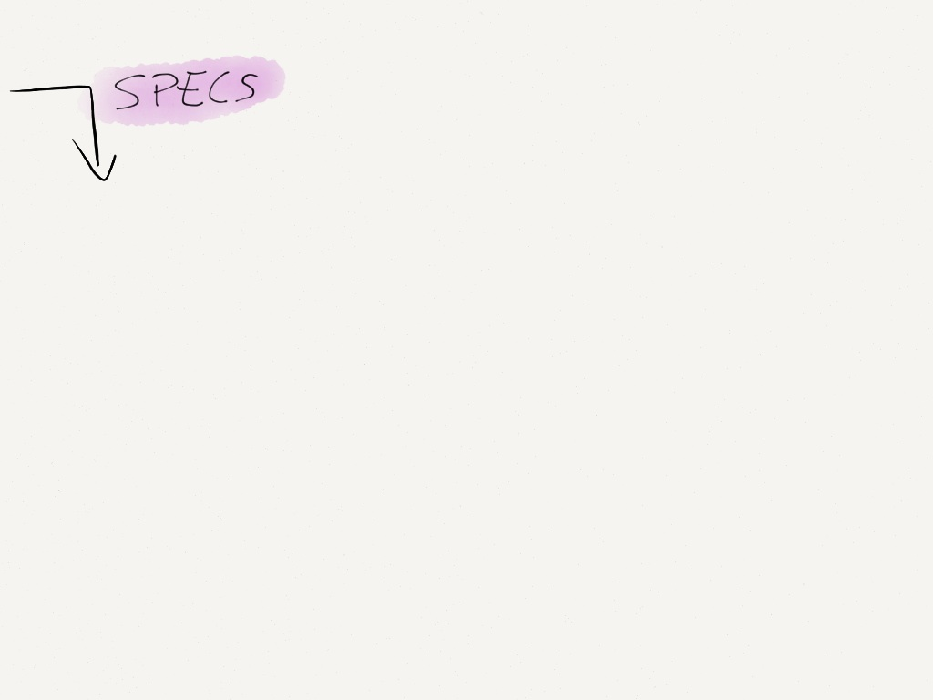

Slide 8
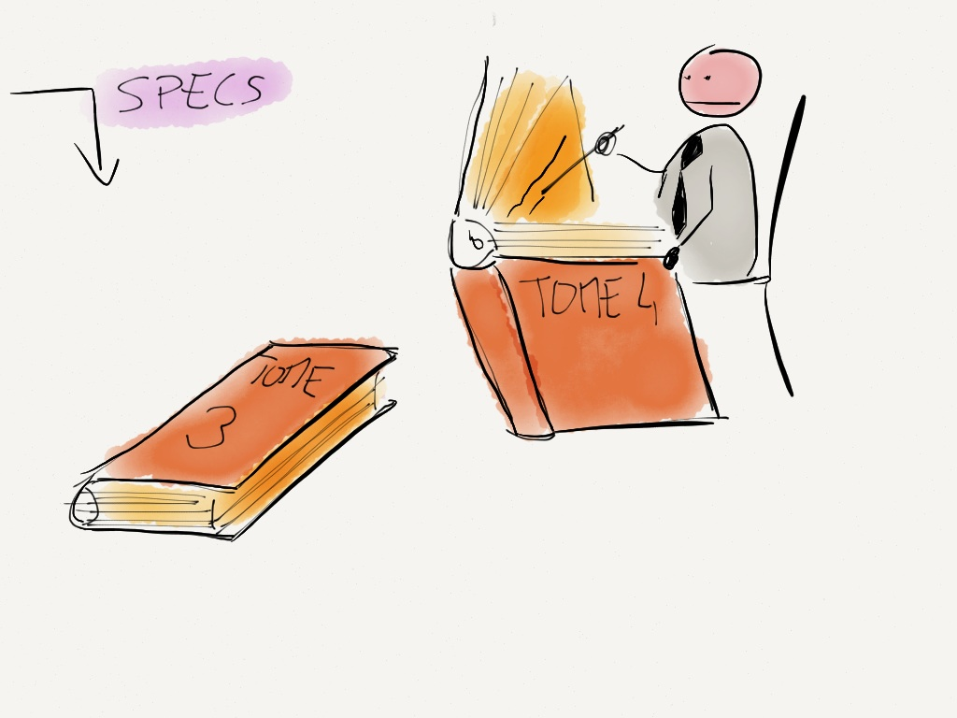

Slide 9
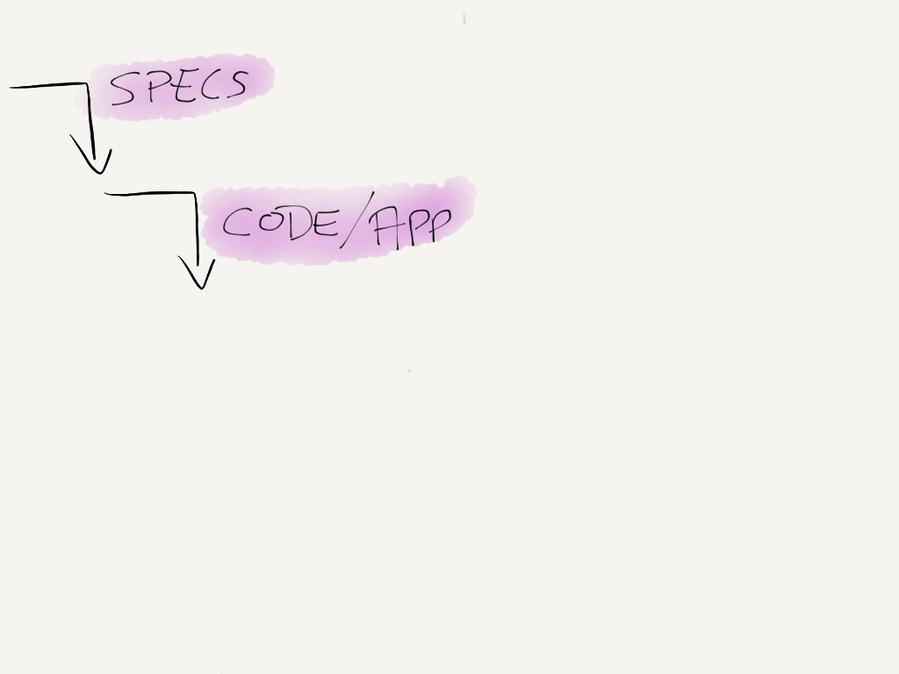

Slide 10
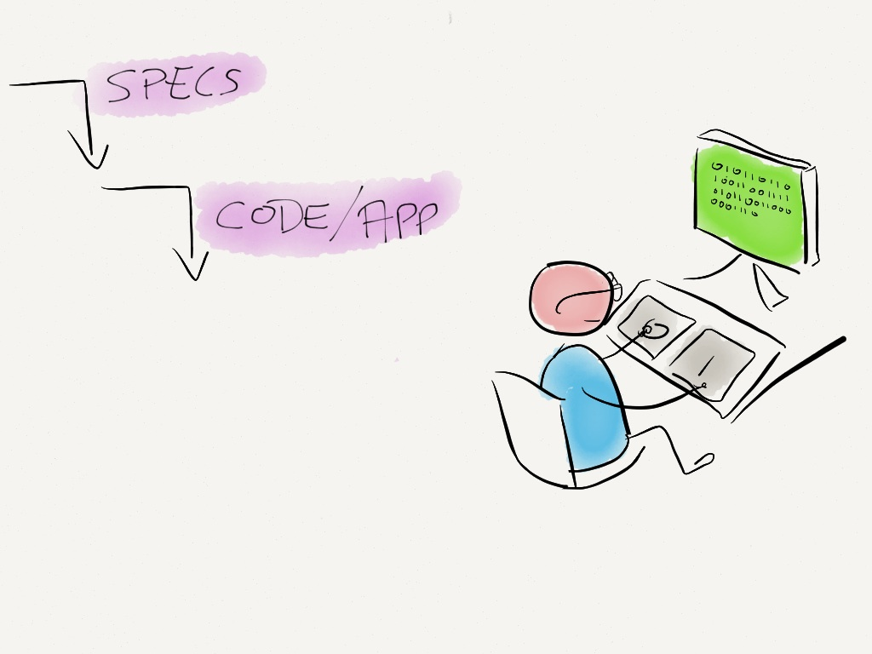

Slide 11
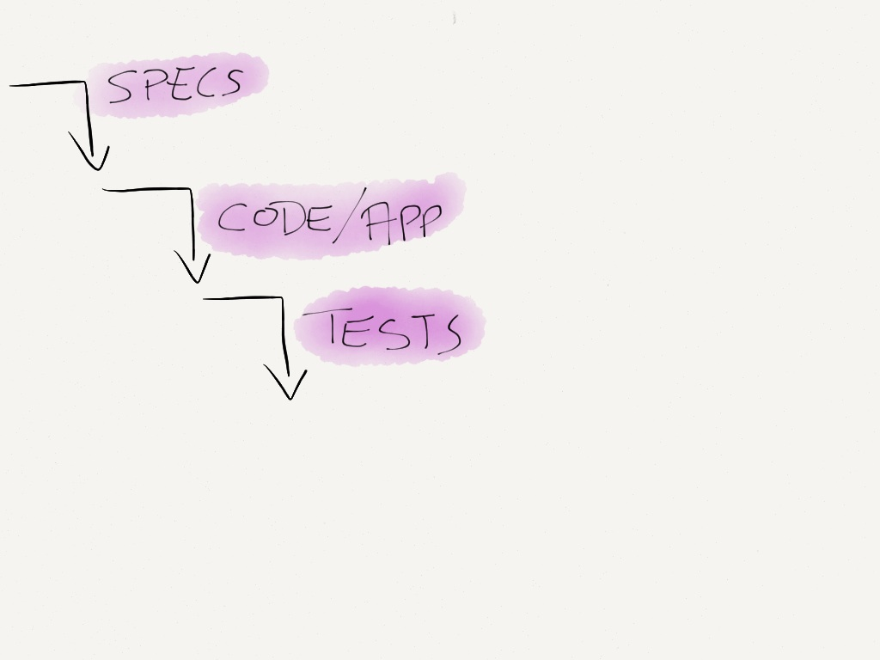

Slide 12
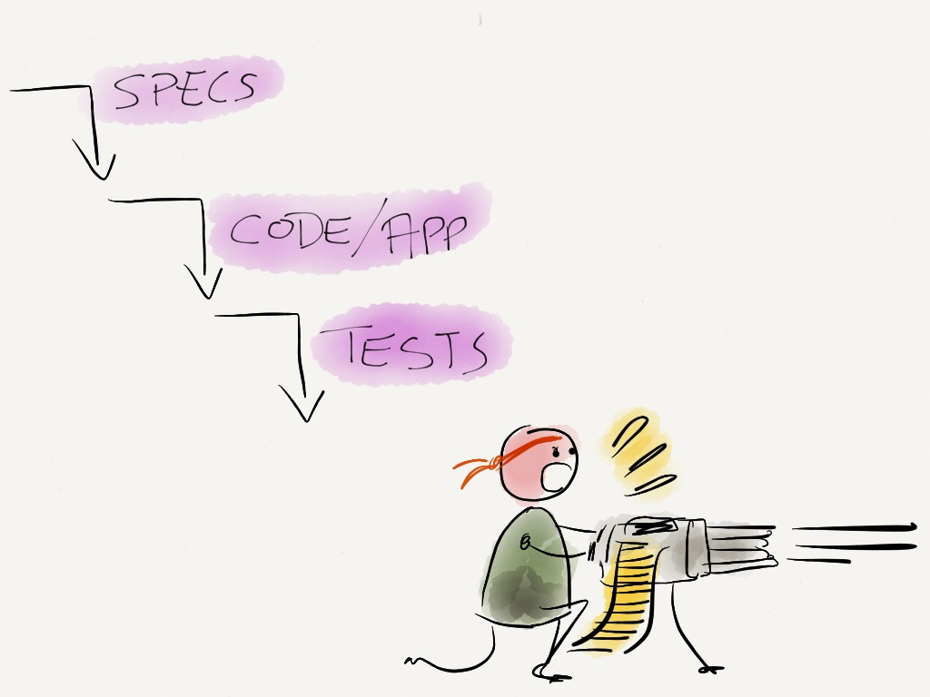

Slide 13
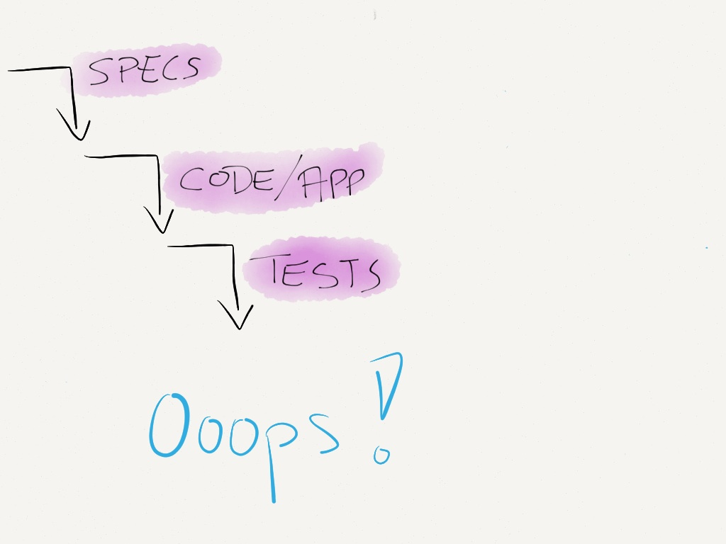

Slide 14
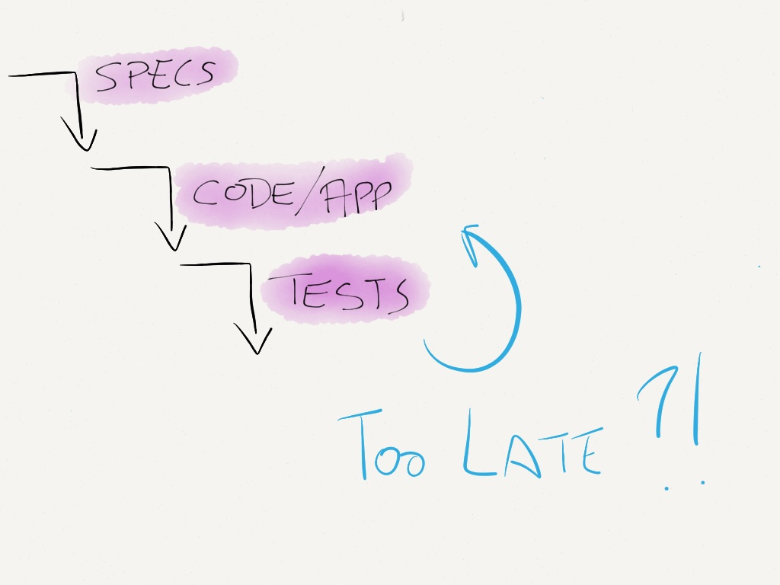

Slide 15
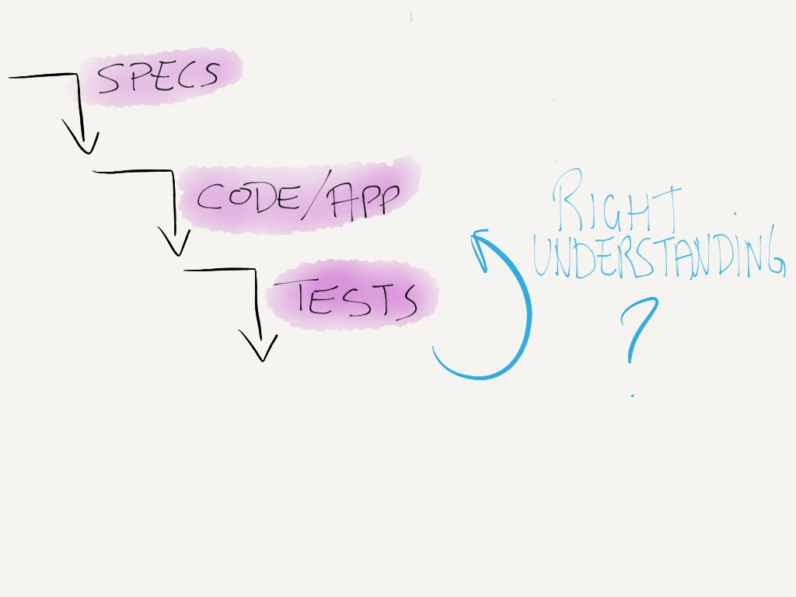

Slide 16
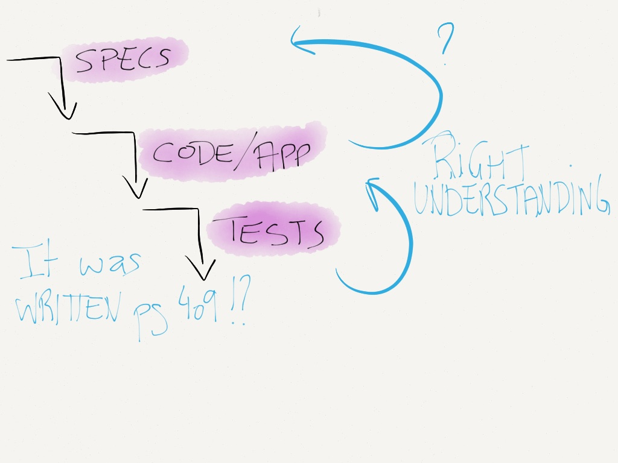

Slide 17
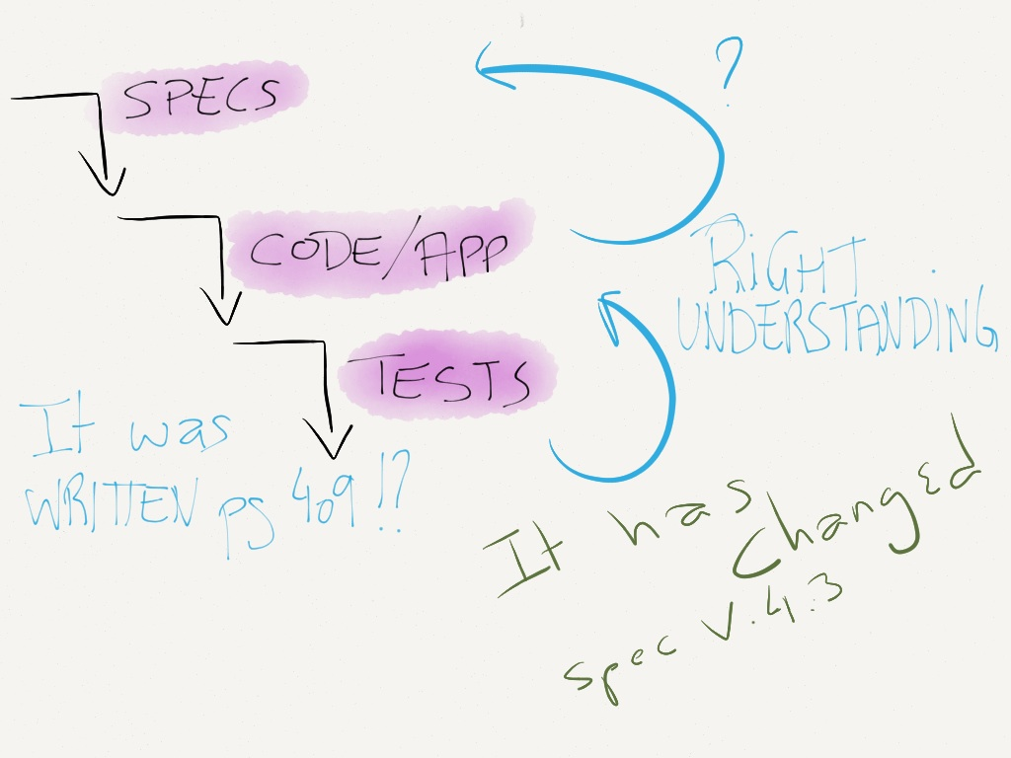

Slide 18
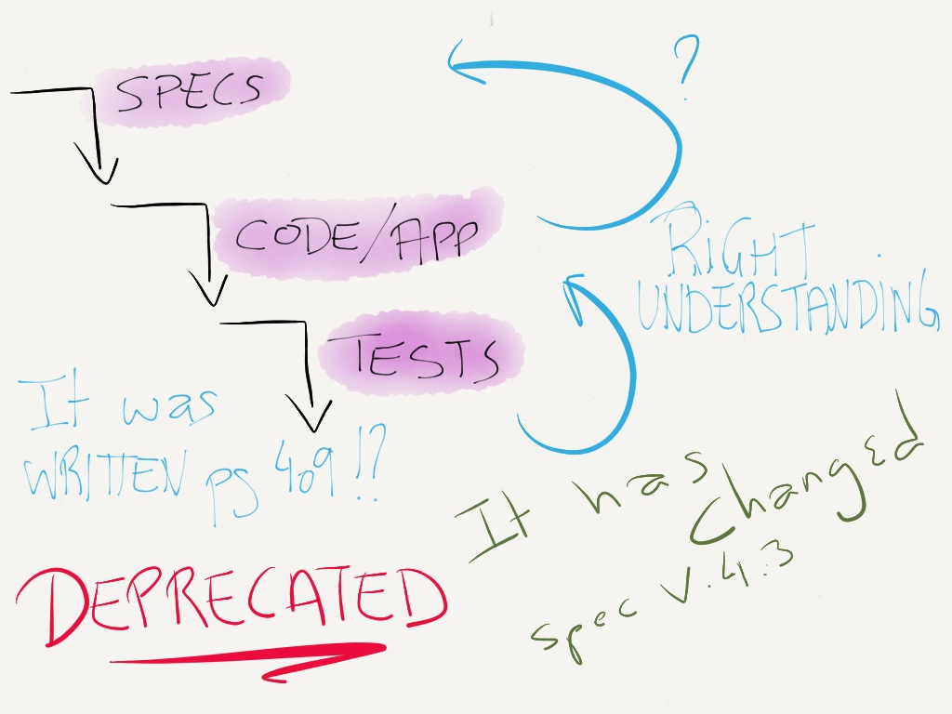

Slide 19
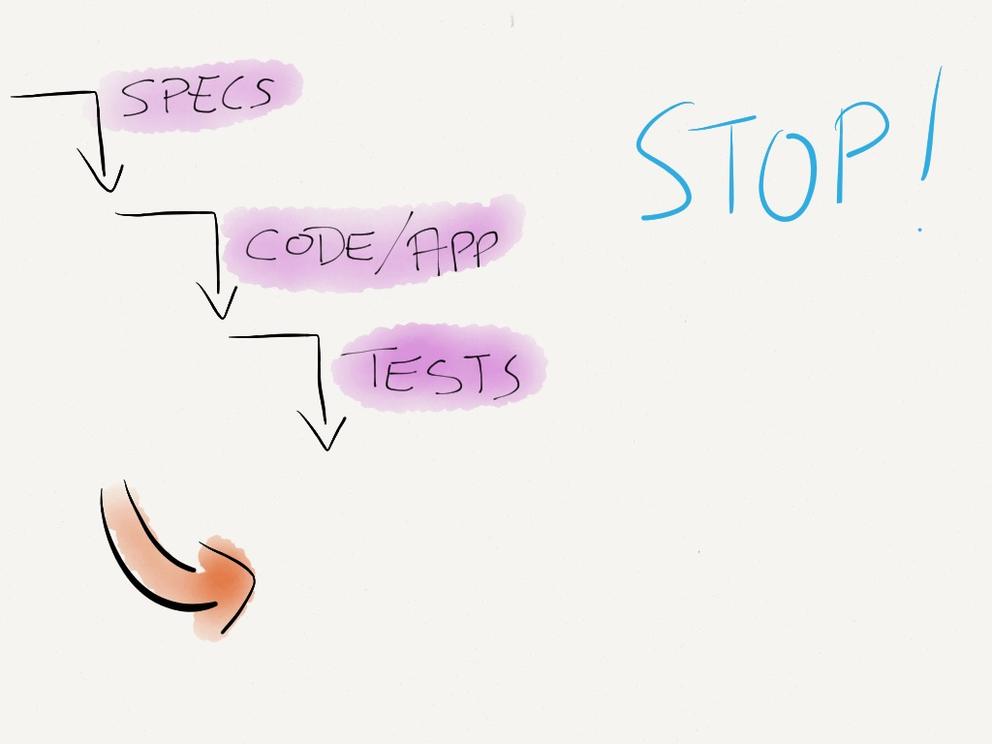

Slide 20
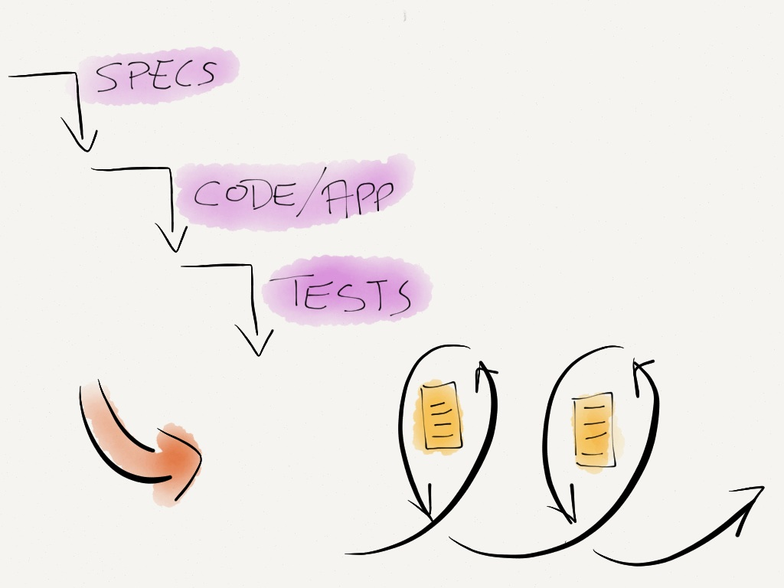

Slide 21
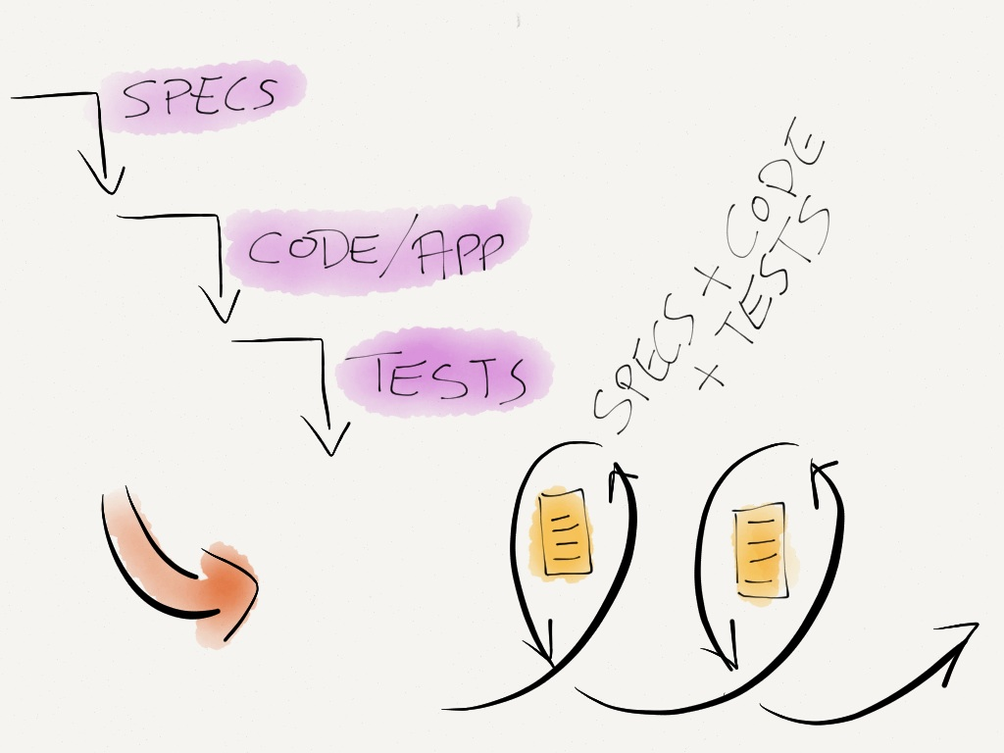

Slide 22
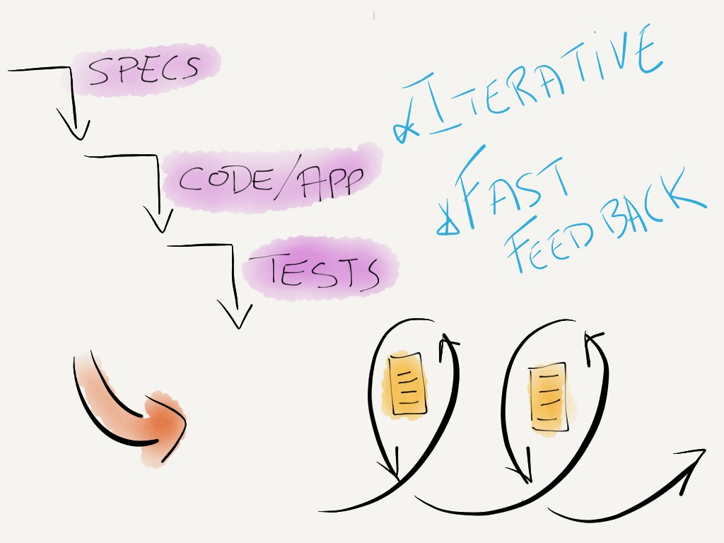

Slide 23
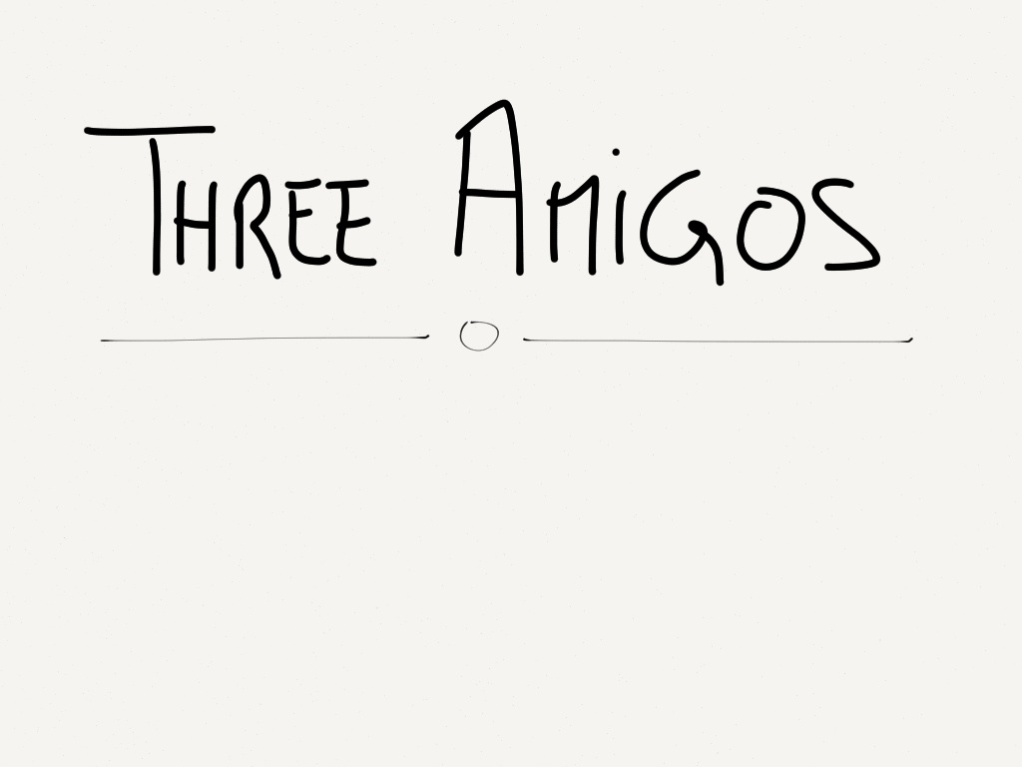

Slide 24
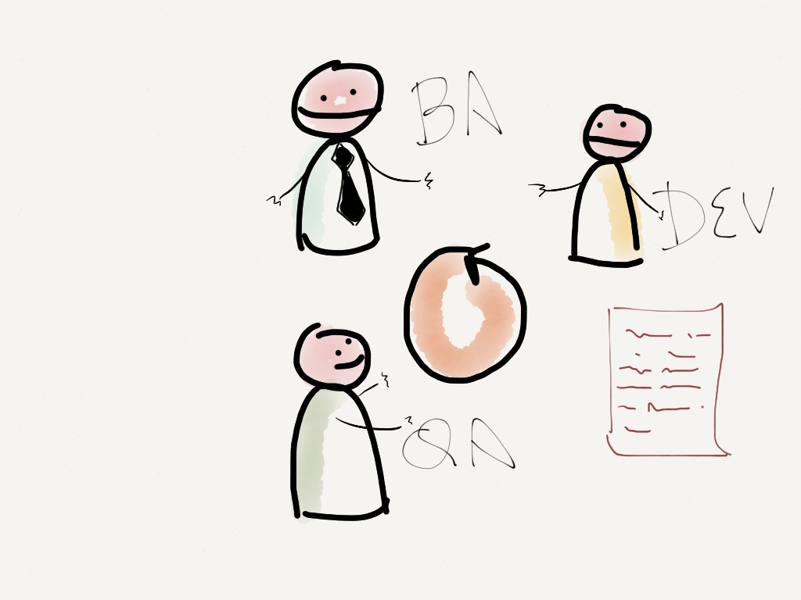

Slide 25
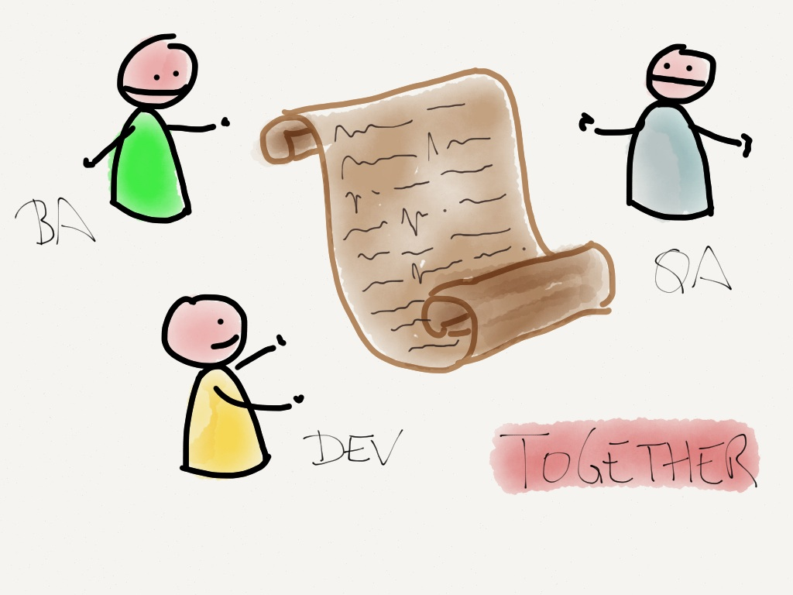

Slide 26


Slide 27
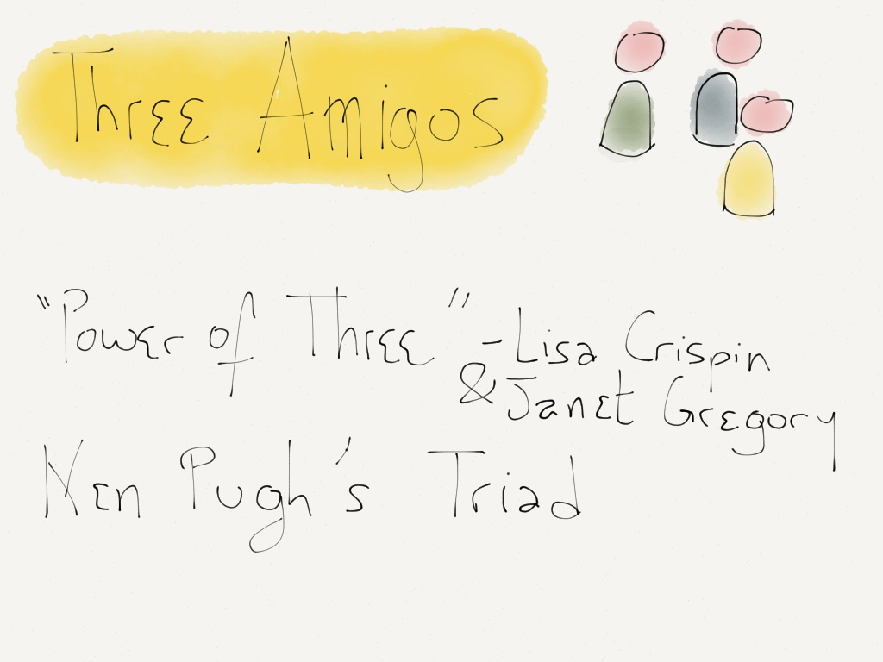

Slide 28
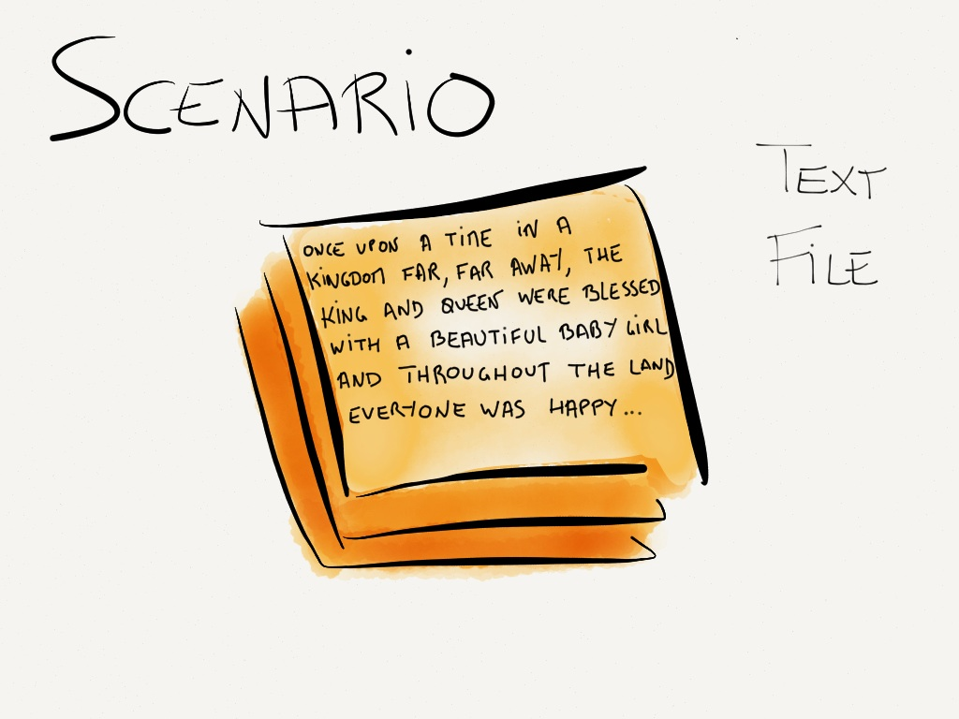

Slide 29
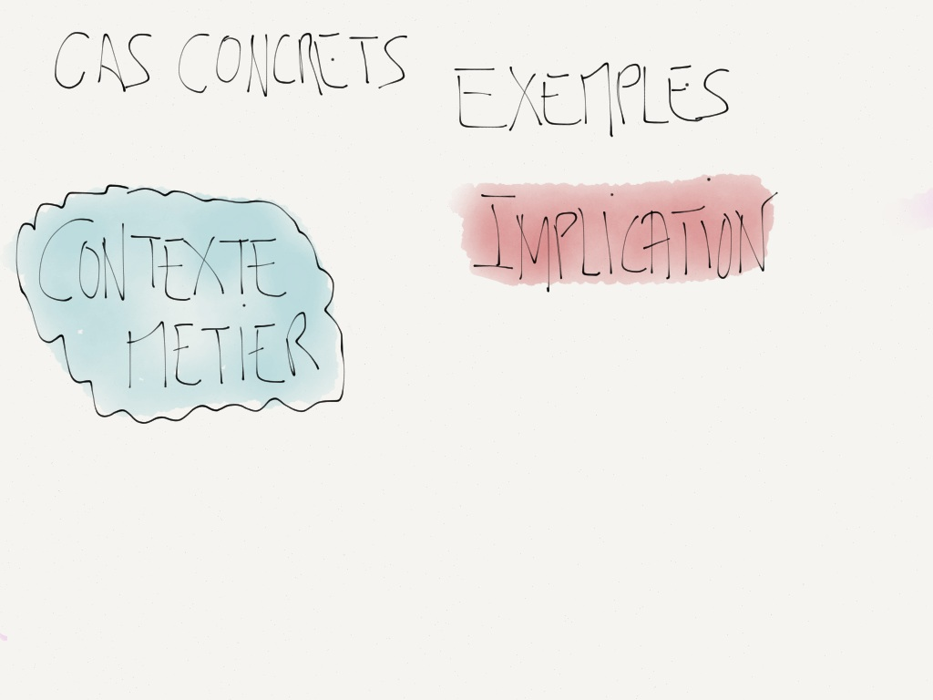

Slide 30
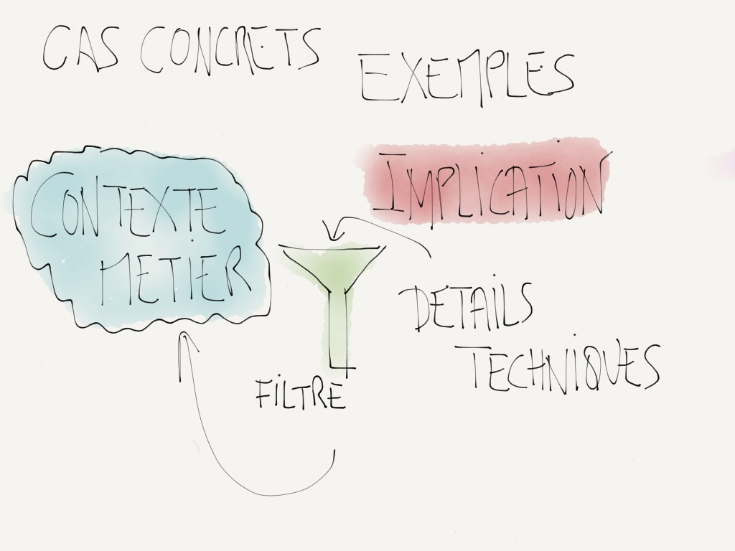

Slide 31
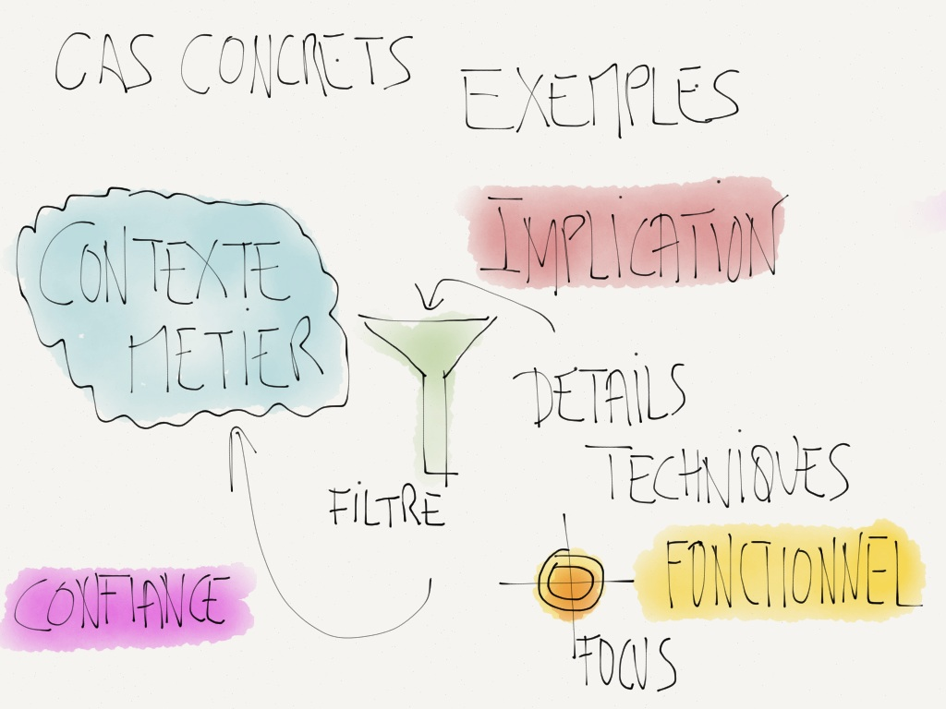

Slide 32
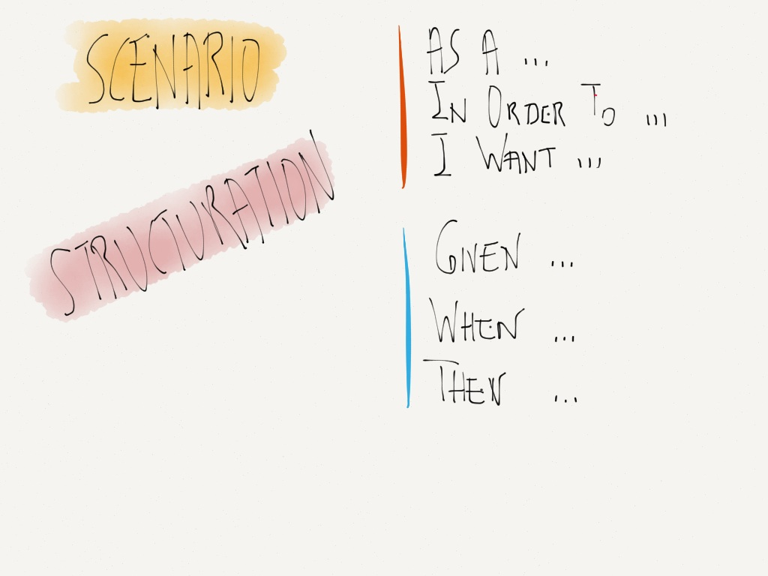

Slide 33
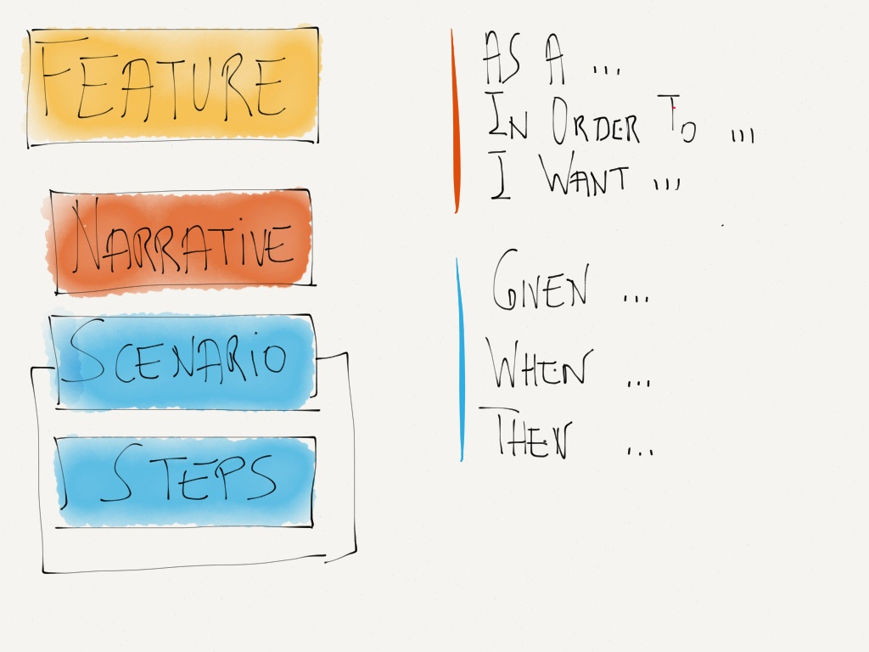

Slide 34
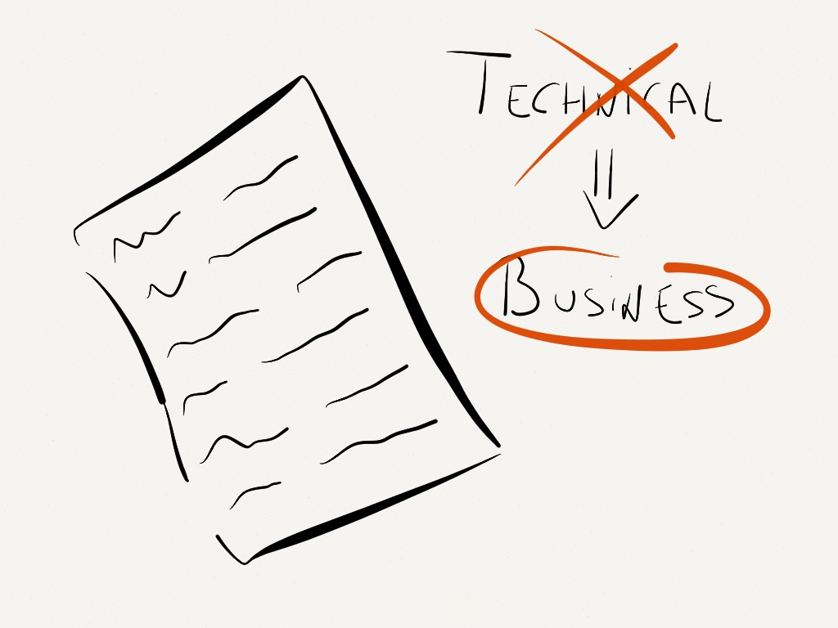

Slide 35
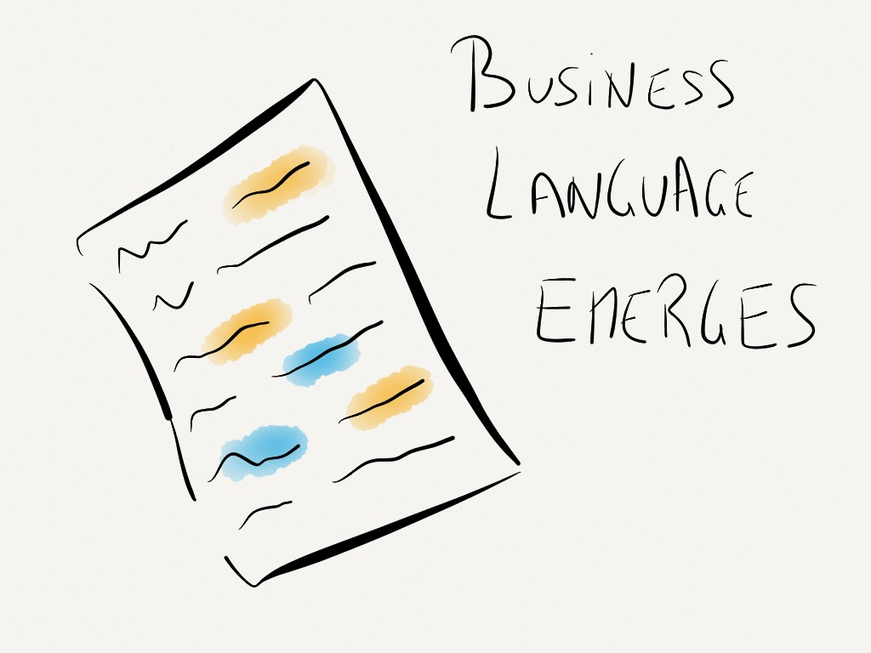

Slide 36
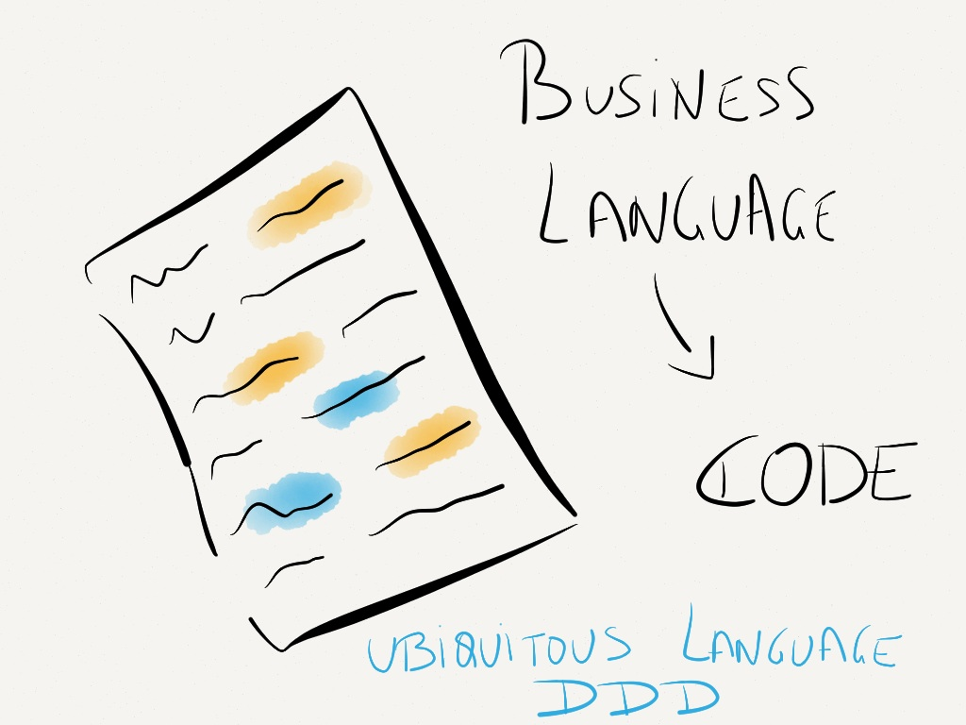

Slide 37
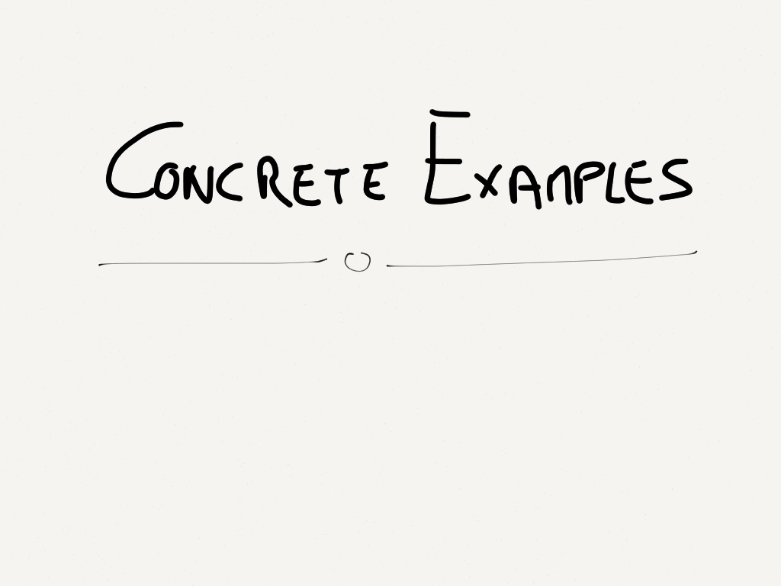

Slide 38
Feature: Account Holder withdraws cash
As an Account Holder
I want to withdraw cash from an ATM
So that I can get money when the bank is closed

Slide 39
Scenario: Account has sufficient funds
Given the account balance is 100€
And the card is valid
And the machine contains enough money
When the Account Holder requests 20€
Then the ATM should dispense 20€
And the account balance should be 80€
And the card should be returned

Slide 40
Scenario: The ATM has insufficient funds
Given the account balance is 100€
And the card is valid
And the machine contains only 20€
When the Account Holder requests 30€
Then the ATM should say it has insufficient funds
And the account balance should be 100€
And the card should be returned

Slide 41


Slide 42
Scenario: Account has insufficient funds
Given the account balance is 10€
And the card is valid
And the machine contains enough money
When the Account Holder requests 30€
Then the ATM should not dispense any money
And the ATM should say there are insufficient funds
And the account balance should still be 10€
And the card should be returned

Slide 43
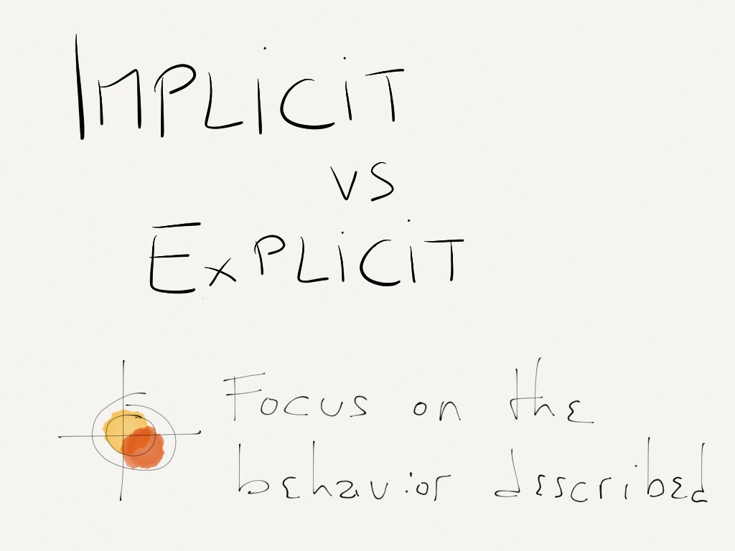

Slide 44
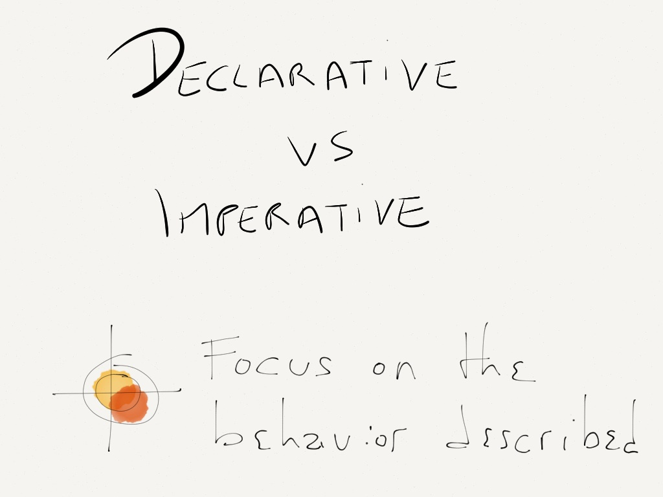

Slide 45
Scenario: Wrong PIN
Given the card is valid
And its PIN number is "0000"
When the Account Holder enters "1234"
Then the ATM should say the PIN number is wrong

Slide 46
Scenario: Wrong PIN three times
Given the card is valid
And its PIN number is "0000"
When the Account Holder enters "1234"
And the Account Holder enters "4321"
And the Account Holder enters "2341"
Then the ATM should retain the card
And the ATM should say the card has been retained

Slide 47
Scenario: Card has been disabled
Given the card is disabled
When the Account Holder requests 30€
Then the ATM should retain the card
And the ATM should say the card has been retained

Slide 48
Scenario: Card has been disabled
Given the card is disabled
When the Account Holder requests 30€
Then the ATM should retain the card
And the ATM should say the card has been retained

Slide 49


Slide 50
Why this feature ?
Feature: Interpolate
In order to interpolate values
As an Trader
I want to interpolate values in a range of Market data

Slide 51

Why this feature ?
Feature: Interpolate
In order to interpolate values
As an Trader
I want to interpolate values in a range of Market data

Slide 52
Why this feature ?
Feature: Linear Interpolation
In order to fill the gaps and provide a value for any maturity
As a trader responsible for market-marking
I want to interpolate linearly values within a range of points
And I want a flat extrapolation outside of the range of points

Slide 53
What about this scenario
Scenario: Change the negotiation price from positive to negative => soulte cashflow appears and premium cashflow is modified
Given an FUNKY_EXOTIC
And deal way is sell
And deal nature is TOMATO
And trade value date is 2012/07/01
And nominal is 100 JPY
And negotiation price is 0.20 JPY
When I validate the deal
Then there are 1 Price cashflows
And there are 0 fee cashflows
When I change the negotiation price to -0.3 JPY
And I validate the deal
Then there are 1 Price cashflows
And there are 1 fee cashflows
And the trade cashflow's payment date is 2012/07/01
And the trade cashflow's way is receive
And the trade cashflow's amount is 30 JPY
And the fee cashflow's payment date is 2012/07/01
And the fee cashflow's way is give
And the fee cashflow's amount is 60 JPY

Slide 54
What about this scenario
Scenario: Change the negotiation price from positive to negative => soulte cashflow appears and premium cashflow is modified
Given an FUNKY_EXOTIC
And deal way is sell
And deal nature is TOMATO
And trade value date is 2012/07/01
And nominal is 100 JPY
And negotiation price is 0.20 JPY
When I validate the deal
Then there are 1 Price cashflows
And there are 0 fee cashflows
When I change the negotiation price to -0.3 JPY
And I validate the deal
Then there are 1 Price cashflows
And there are 1 fee cashflows
And the trade cashflow's payment date is 2012/07/01
And the trade cashflow's way is receive
And the trade cashflow's amount is 30 JPY
And the fee cashflow's payment date is 2012/07/01
And the fee cashflow's way is give
And the fee cashflow's amount is 60 JPY
d = new Deal();
d.SetWay(Sell);
d.SetNature(Tomato); d.SetValueDate(new Date(...)); d.SetNominal(100, JPY); d.SetNegotiationPrice(0.20, JPY);
cf = d.GetCashFlows(); AssertThat(IsEqual(...);
...

Slide 55
What about this scenario
Scenario: Fee and Price cashflows when the negotiation price is set to a negative value
Given a sell for a nominal 100 JPY on FUNKY_EXOTIC TOMATO negotiation price 0.20 JPY traded on 2012/07/01
When the middle officer validates the deal
Then the trade has one Price cashflow and no Fee cashflow
When the middle officer changes the negotiation price to -0.3 JPY
And the middle officer validates the deal
Then the trade has the following cashflows:
| FlowType| Way | Amount | Currency | PaymentDate | Remarks |
| Price | Receive| 30 | JPY | 2012/07/01 | 100*abs(-0.3) |
| Fee | Give | 60 | JPY | 2012/07/01 | 100*2*abs(-0.3)|
Communicate With the Business People !!!

Slide 56
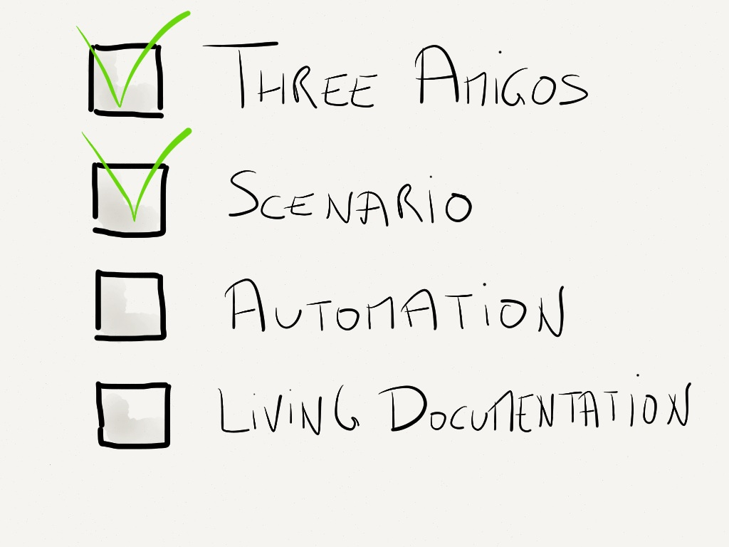

Slide 57
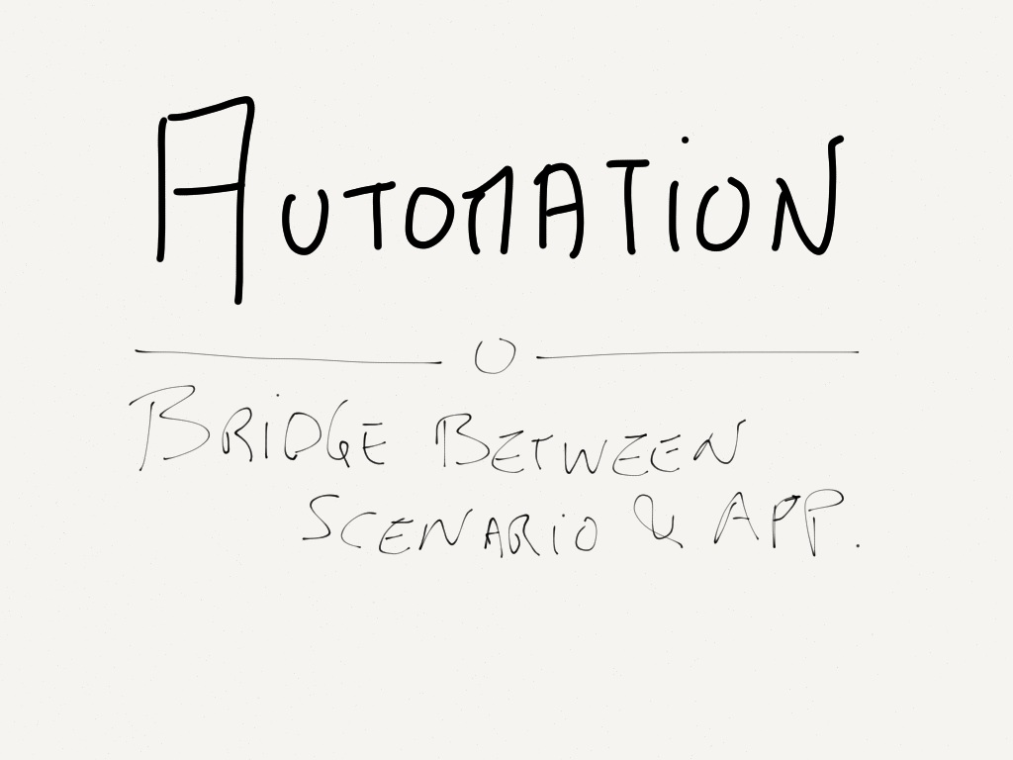

Slide 58


Slide 59
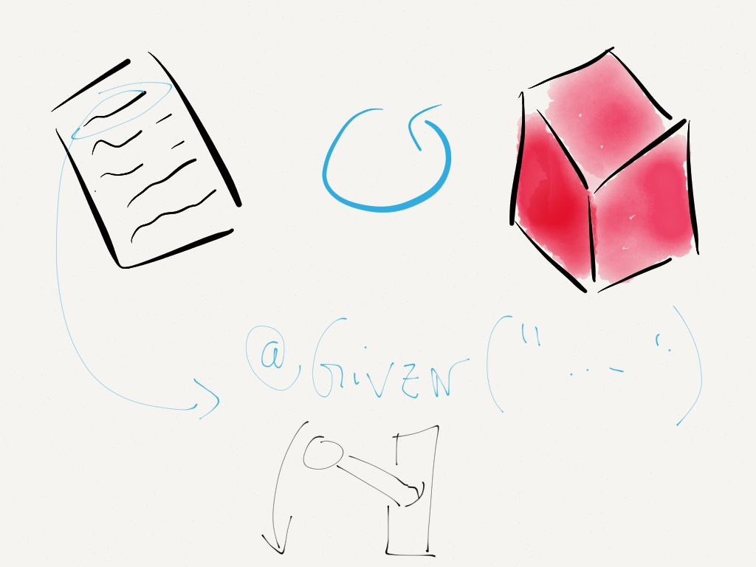

Slide 60


Slide 61
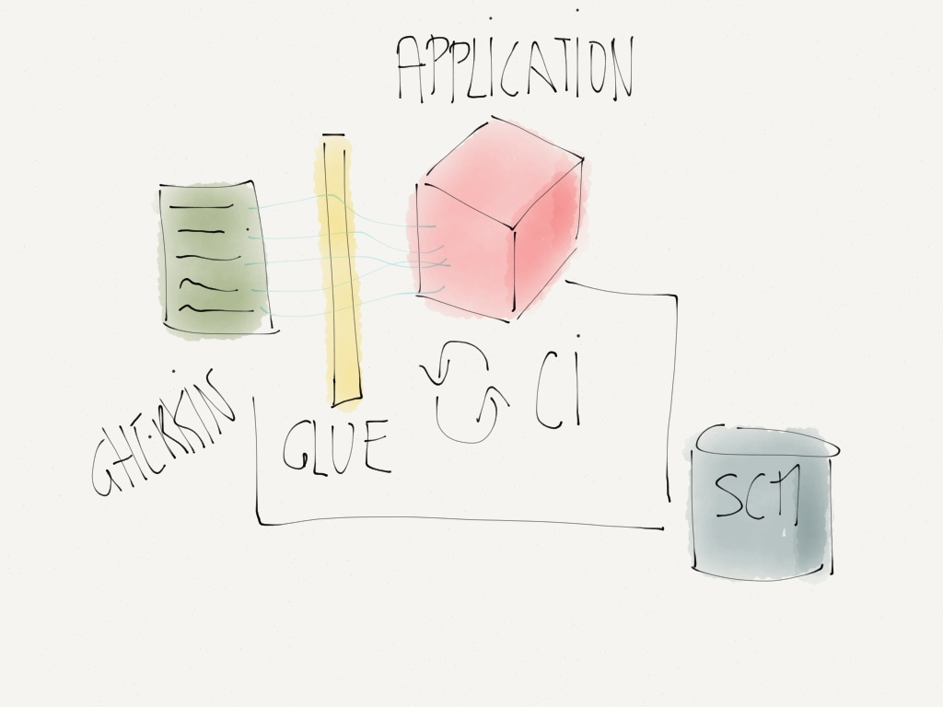

Slide 62
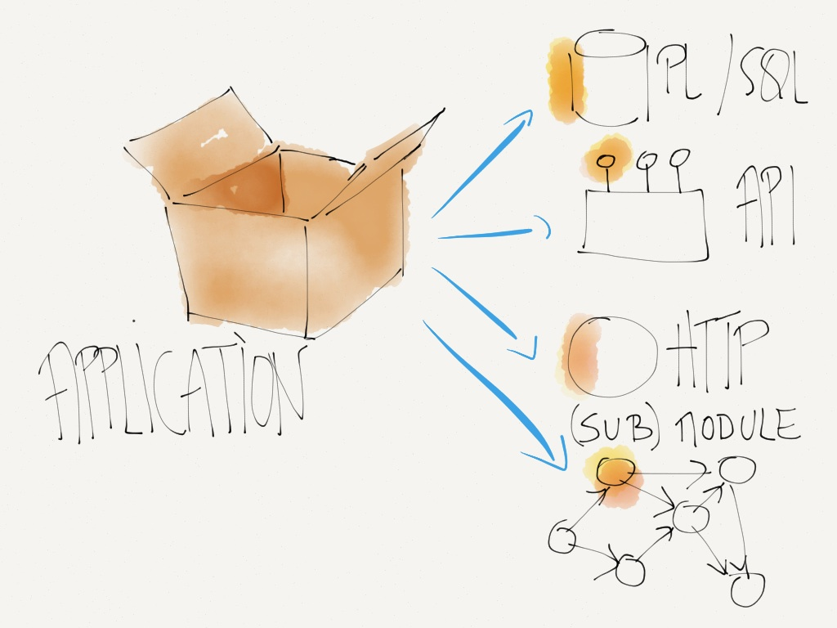

Slide 63
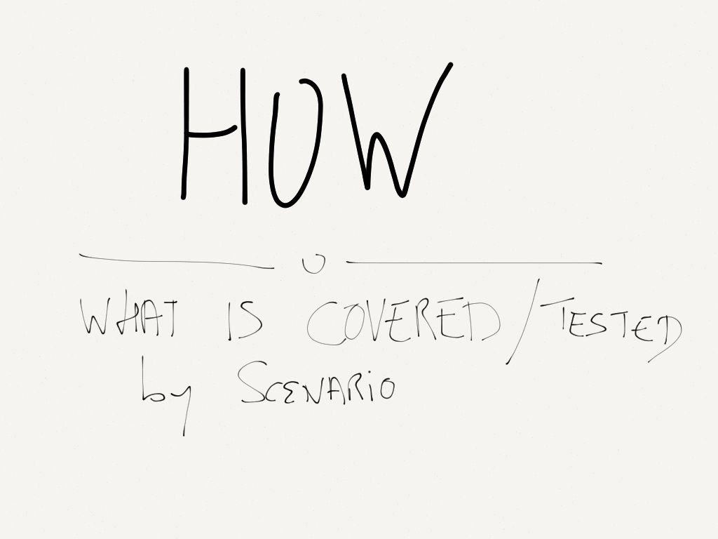

Slide 64
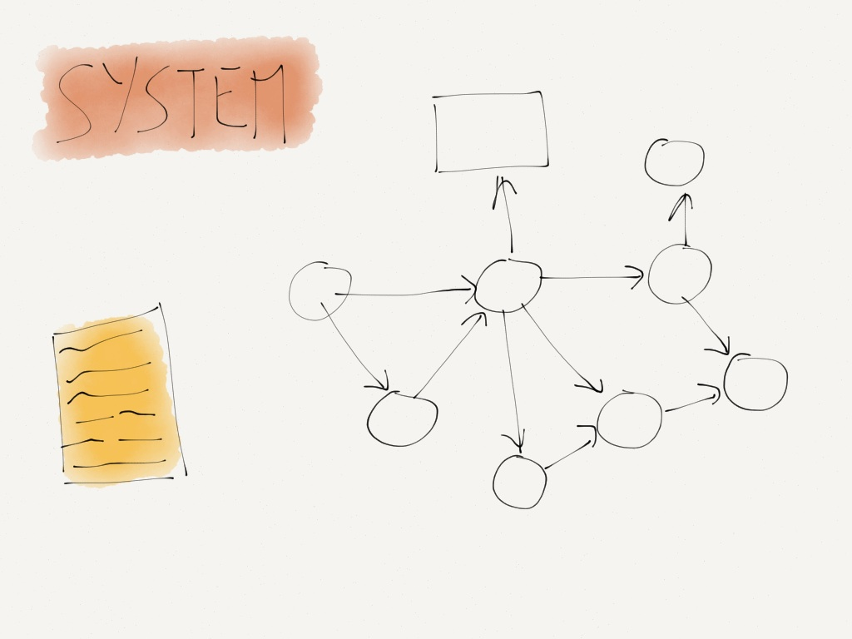

Slide 65
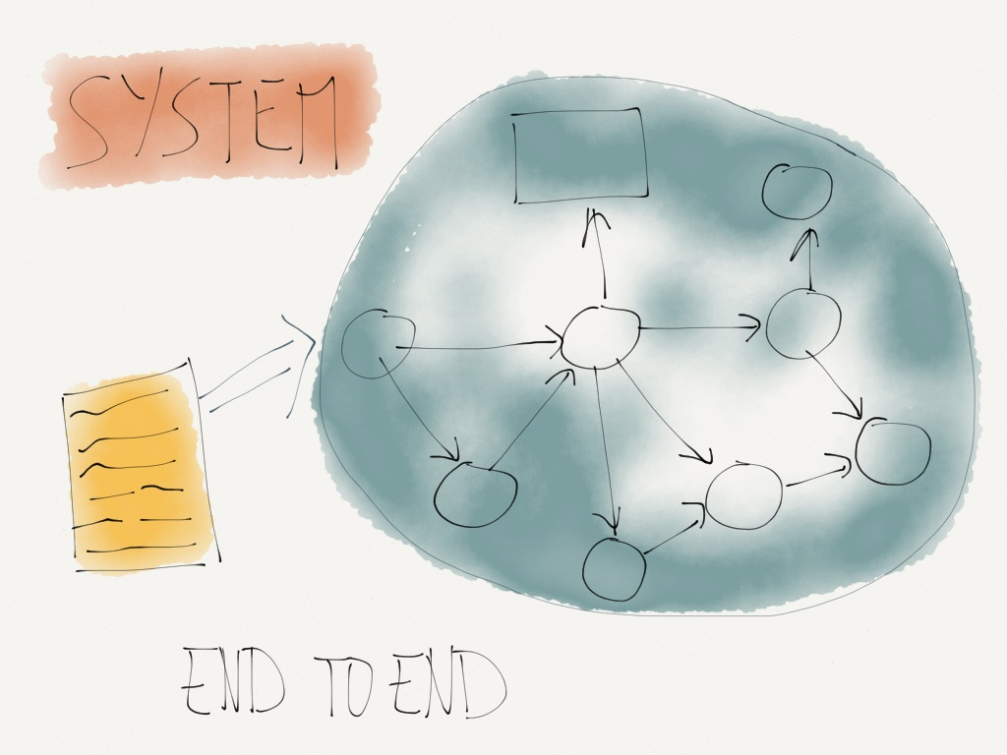

Slide 66
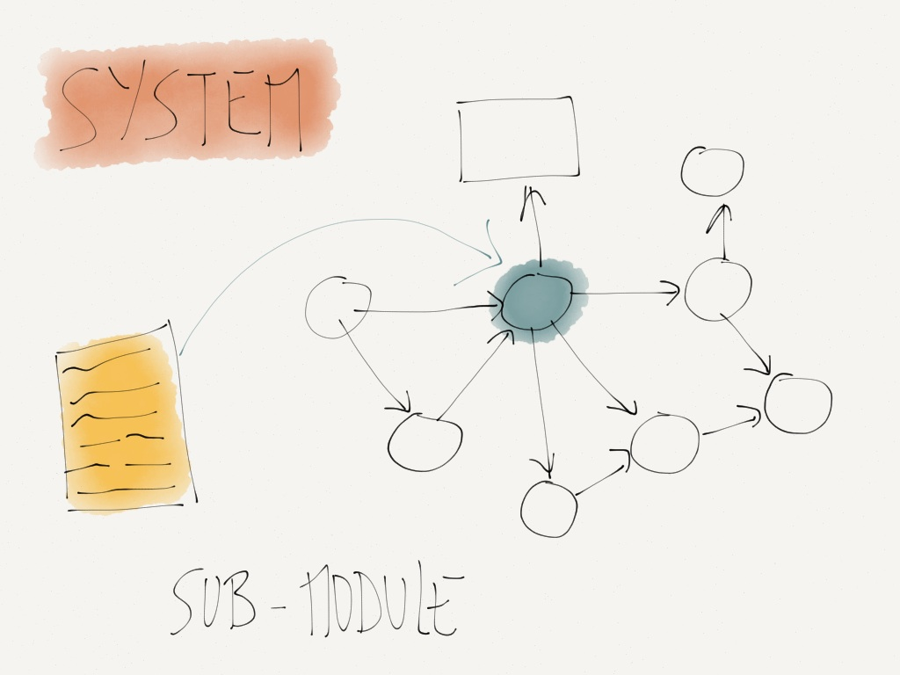

Slide 67
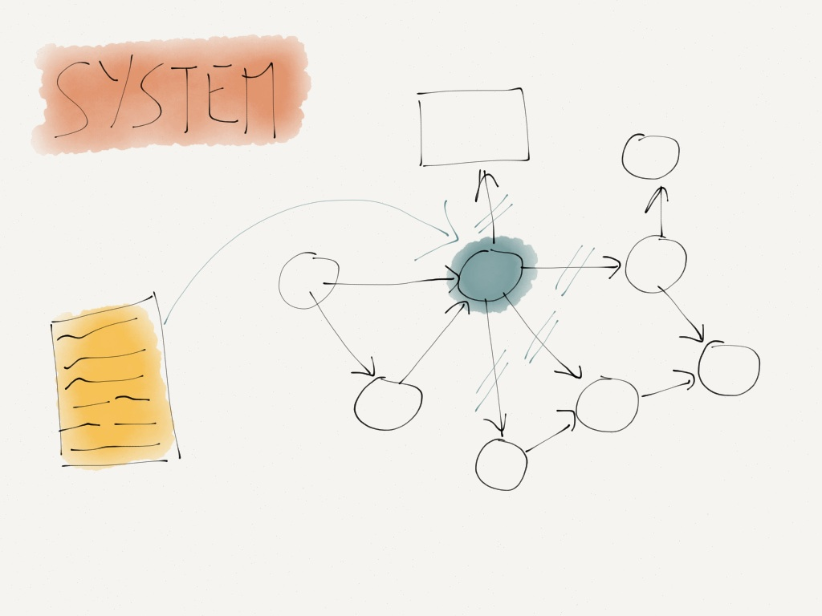

Slide 68


Slide 69
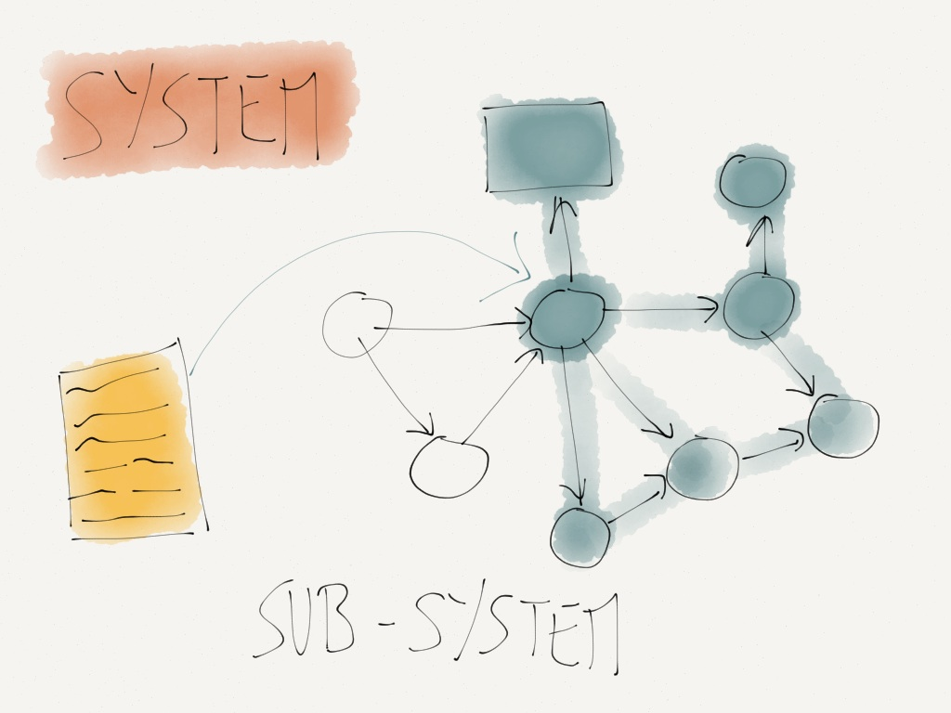

Slide 71
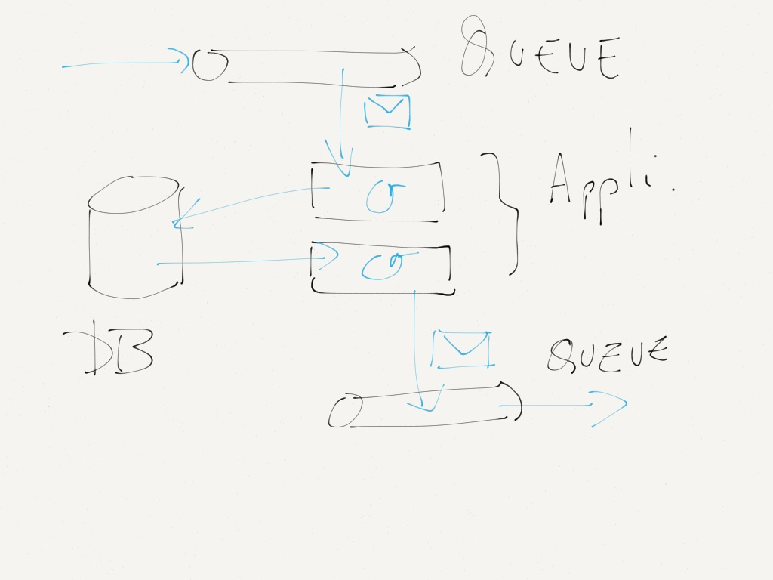

Slide 72
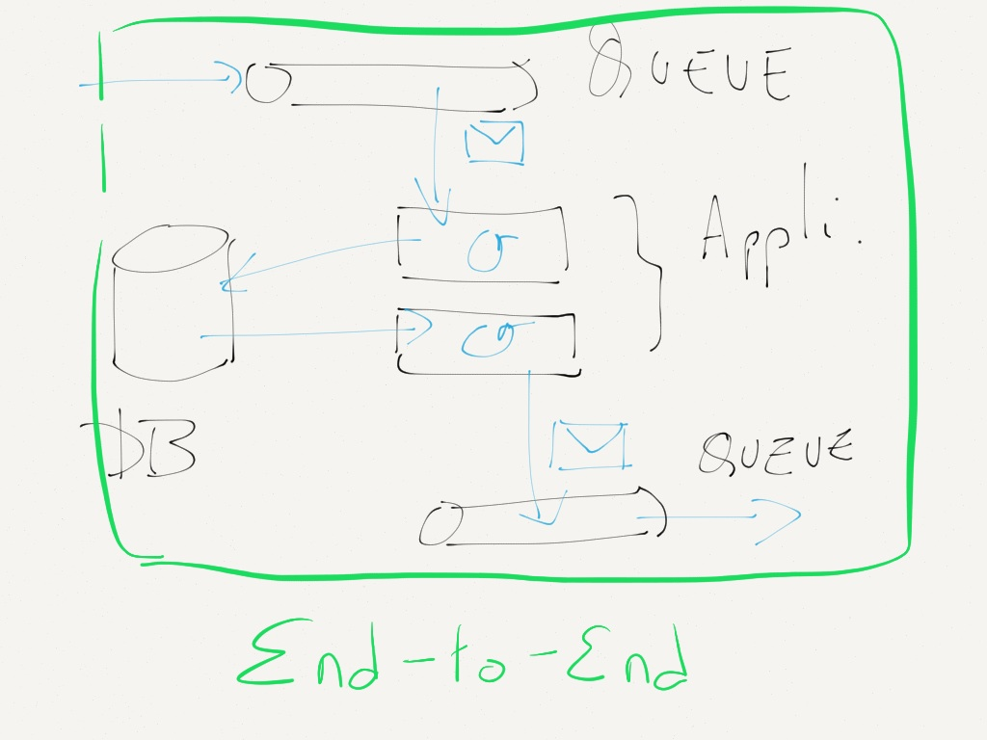

Slide 73


Slide 74


Slide 75


Slide 76


Slide 77


Slide 78


Slide 79


Slide 80


Slide 81





Slide 82
You will learn to think of automated tests as executable specification that become living documentation
– Mary Poppendieck

Slide 83



Slide 84





Slide 85



Slide 86


Slide 87


Slide 88


Slide 89


Slide 90


