Slide 1




CQRS with Erlang
presented by Bryan Hunter Firefly Logic
Twitter #erlang #cqrs
#strangeloop
@bryan_hunter
@fireflylogic

Slide 2
The case for CQRS with Erlang
Why CQRS?
DDD seems right, but is hard
The “layered architecture” is ridiculous.
Keep privates private
Return focus to business
Vendor relationships should be consensual
Scale out
Simplify conflicts
Return decision making to business
Tunable CAP
Explicit & tunable staleness
Vary SLA to the business value
The perfect audit
Captures intent (fortune telling)
CQRS is Heresy
Division of labor
Why Erlang?
Concurrency is simple
Distribution is simple
Fault-tolerance is simple
Why together?
What we demonstrate
Task based UI
Commands
Bus
Command Handlers
Aggregates
Events
Event Store
Event Handlers
Projections

Slide 3
Lifecycle notes
Task based UI
Each client will have a client process
Commands
Created by client process to capture user intent from task-based UI.
Client process sends command to the bus
Bus
Created at application start
As commands come in route them to the appropriate command handler.
If command has no handler, or multiple handlers store the command and notify ops.
Command Handlers
Who news these up?
One process per command sent?
Repository
Library module called to either create or load Aggregate processes from events store.
Called to save events to store?
Aggregates
Each Aggregate instance is a dedicated process
Events
Created by aggregates to capture mutations.
Aggregate publishes Events to the bus.
How are events stored to the Event Store?
Event Store
Persistence of Events from Aggregates
Event Handlers
Who news these up?
Projections

Slide 4
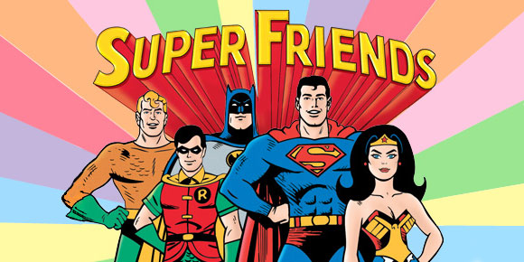
Notes:
http://www.dccomics.com/tv/super-friends-1973-1974

