Slide 1
Credit Card Fraud Detection
UOA MS DS Capstone -2
Arnav Munshi

Slide 2
Table of contents
Problem statement
Business Problem Overview
Project Pipeline
Insights from the data
Model selection and build
Conclusion to Model Selection
Cost Benefit Analysis
Summary to the Business

Slide 3
Problem Statement
The problem statement chosen for this project is to predict fraudulent credit card transactions with the help of machine learning models.
In this project, you will analyze customer-level data that has been collected and analyzed during a research collaboration between Worldline and Machine Learning Group.
The data set is taken from the Kaggle website and has a total of 284,807 transactions; out of these, 492 are fraudulent. Since the data set is highly imbalanced, it needs to be handled before model building.

Slide 4
Business Problem Overview
It has been estimated by Nilson Report that by 2020, banking frauds would account for $30 billion worldwide. With the rise in digital payment channels, fraudulent transactions are occurring in new and different ways. This number is increasing rapidly.
In the banking industry, credit card fraud detection using machine learning is not just a trend. It is necessary for players in the industry to put proactive monitoring and fraud prevention mechanisms in place. Machine learning is helping them reduce time-consuming manual reviews, costly chargebacks and fees, and denials of legitimate transactions.

Slide 5
Project Pipeline
The Project Pipeline has been summarized into below steps:
Data Understanding and Data Preparation
Exploratory Data Analysis(EDA)
Model Building / Hyper-parameter Tuning
Evaluation of each models

Slide 6
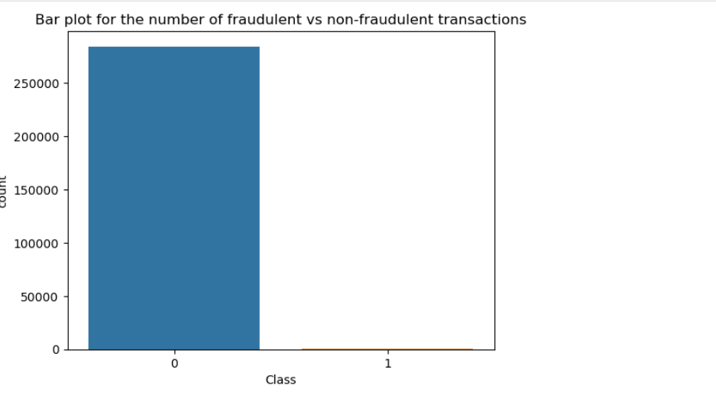
Insights from the Dataset using EDA
As we had executed the missing values from the dataset ,we founded that no missing values were present in the whole dataset
Then we had ran a bar plot to get the difference between fraudulent and non-fraudulent transactions and we could see a huge difference

Slide 7
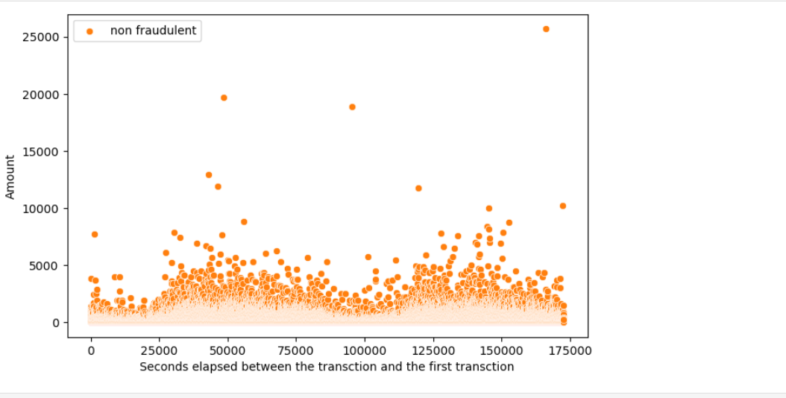
Insights from the Dataset using EDA
We had also checked the scatter plot to get the data distribution of the dataset with seconds elapsed from one transaction to other transactions

Slide 8
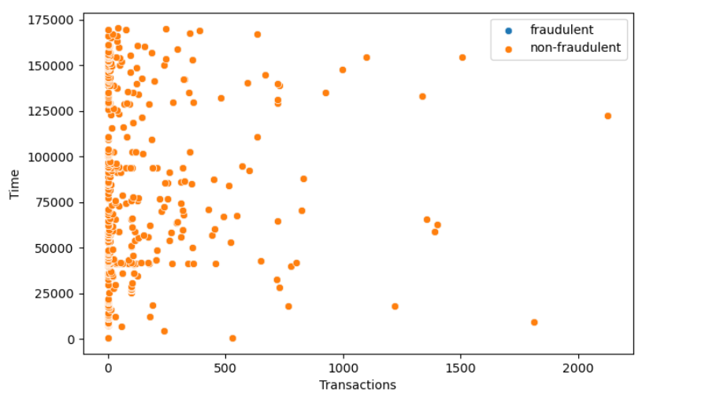
Insights from the Dataset using EDA
Outlier distribution of the dataset with respect to Amount

Slide 9
Model selection and Build
For this Business problem , we had using below Machine Learning Algorithms to get executed against the dataset :
Logistics Regression
Decision Trees
XGBoost
KNN
Support Vector Machines(SVM)

Slide 10
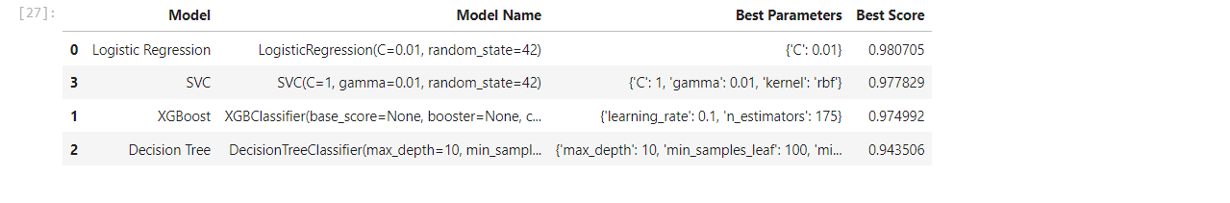
Model selection and Build
We had executed the dataset against the imbalanced classes against the below models and this is their best scores :

Slide 11
Model Selection and Build
Once the model against the imbalanced classes were executed , we choose XGBOOST as the best model as it worked best on the class with the high ROC AUC scores along with Logistics Regression.
Next we had to handle the imbalanced classes for which below techniques were used:
1. Under-sampling :- Here for balancing the class distribution, the non-fraudulent transactions count will be reduced to 396 (similar count of fraudulent transactions)-
2. Oversampling :- Here we will make the same count of non-fraudulent transactions as fraudulent transactions.
3. SMOTE :- Synthetic minority oversampling technique. It is another oversampling technique, which uses nearest neighbor algorithm to create synthetic data.
4. Adasyn:- This is similar to SMOTE with minor changes that the new synthetic data is generated on the region of low density of imbalanced data points.

Slide 12
Model Selection and Build
Model Comparison and Selection:
Various data balancing techniques used: Under-sampling, Oversampling, SMOTE, Adasyn.
Under-sampling models performed well but led to information loss.
SMOTE and Adasyn models showed promising results without information loss.
Best Model Choice:
Among SMOTE and Adasyn models, Logistic regression stood out.
Logistic regression achieved:
ROC score of 0.99 on train set.
ROC score of 0.97 on test set.
Simplicity and lower resource requirements make Logistic regression ideal for fraud detection.

Slide 13
Conclusion to Model Selection
Logistic regression with SMOTE identified as best model.
Ideal for credit card fraud detection due to:
Simplicity of interpretation.
Strong performance with ROC scores of 0.99 (train) and 0.97 (test).
Efficient use of resources.

Slide 14
Cost Benefit Analysis
Model Performance:
Most models perform well based on ROC score, Precision, and Recall.
These metrics are crucial for evaluation.
Infrastructure and Costs:
Heavy models like Random Forest, SVM, XGBoost require substantial computational resources.
Building infrastructure for these models increases deployment costs.
Simpler models like Logistic Regression are more resource-efficient and cost-effective.
Financial Implications:
Assess potential financial loss or gain for the bank due to model choice.
Evaluate cost-effectiveness of each model considering:
Cost of infrastructure.
Ongoing operational expenses.
Ultimate Decision:
Select the model based on a balance of:
Performance metrics.
Infrastructure availability.
Cost implications and potential financial gains.

Slide 15
Summary to Business
Smaller Transaction Value Banks:
High Precision Preferred:
Want to label only relevant transactions as fraudulent.
Adding human verification for flagged transactions.
Low precision increases burden of human verification.
Larger Transaction Value Banks:
High Recall Necessary:
Low recall risks missing high-value fraudulent transactions.
Losses could be significant if high-value frauds go undetected.
Model Choice:
Balanced Dataset with SMOTE:
Logistic Regression:
Good ROC score and high Recall.
Easier interpretation and explanation for business.
Suitable for saving banks from high-value fraudulent transactions.

Slide 16
END OF THE PRESENTATION
Thank you

