Slide 1
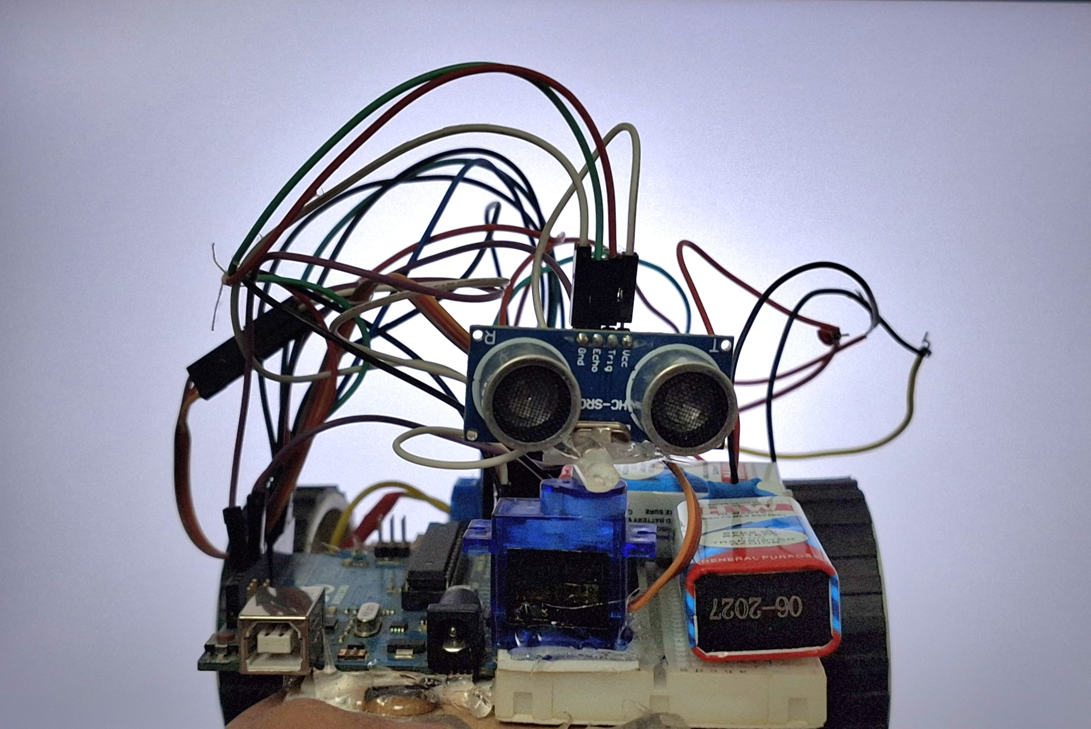
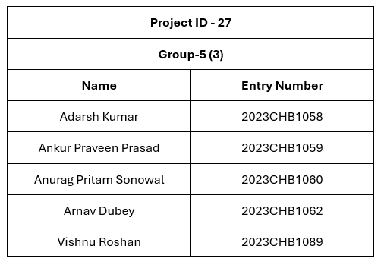
GE-107
Tinkering Lab
Maze Solving Robot
2023CHB1058

Slide 2
Overview
Autonomous Navigation
Right-Hand Wall Following
The robot is designed to navigate a maze autonomously, using sensor data and pre-programmed logic to make decisions about its movement.
The robot employs a right-hand wall following strategy to ensure efficient pathfinding, allowing it to systematically explore the maze.
Ultrasonic Sensors
Servo Motors
Ultrasonic sensors are used for obstacle detection, providing the robot with real-time information about its surroundings.
Servo motors are used for directional sensing, enabling the robot to scan its environment and detect walls effectively.

Slide 3
Motivation
1
Robotics Applications
2
Rescue Missions
Autonomous navigation is a critical aspect of robotics, finding application in various fields such as rescue missions, exploration, and automation.
Maze solving robots can assist in disaster relief efforts by navigating complex environments to locate victims and deliver aid.
3
Exploration
4
Automation
These robots can be deployed in uncharted territories for exploration, mapping new areas, and gathering data.
Maze solving robots can automate tasks in industrial settings, navigating warehouses, factories, and other environments with obstacles.

Slide 4
Objective
1
Autonomous Maze Navigation
Develop a robot capable of navigating a maze without human intervention.
2
Wall-Following Logic
Implement a right-hand wall following algorithm to ensure efficient and systematic maze exploration.
3
Obstacle Avoidance
Ensure the robot can detect and avoid obstacles within the maze, preventing collisions and maintaining a safe path.

Slide 5
Problem Statement
Maze Navigation
Obstacle Avoidance
Right-Hand Wall Following
Design a robot capable of traversing a maze from a starting point to a designated goal.
The robot must be able to detect and avoid obstacles throughout the maze, ensuring a safe and successful navigation path.
Implement a right-hand wall-following strategy to ensure the robot effectively navigates the maze and reaches the goal.

Slide 6

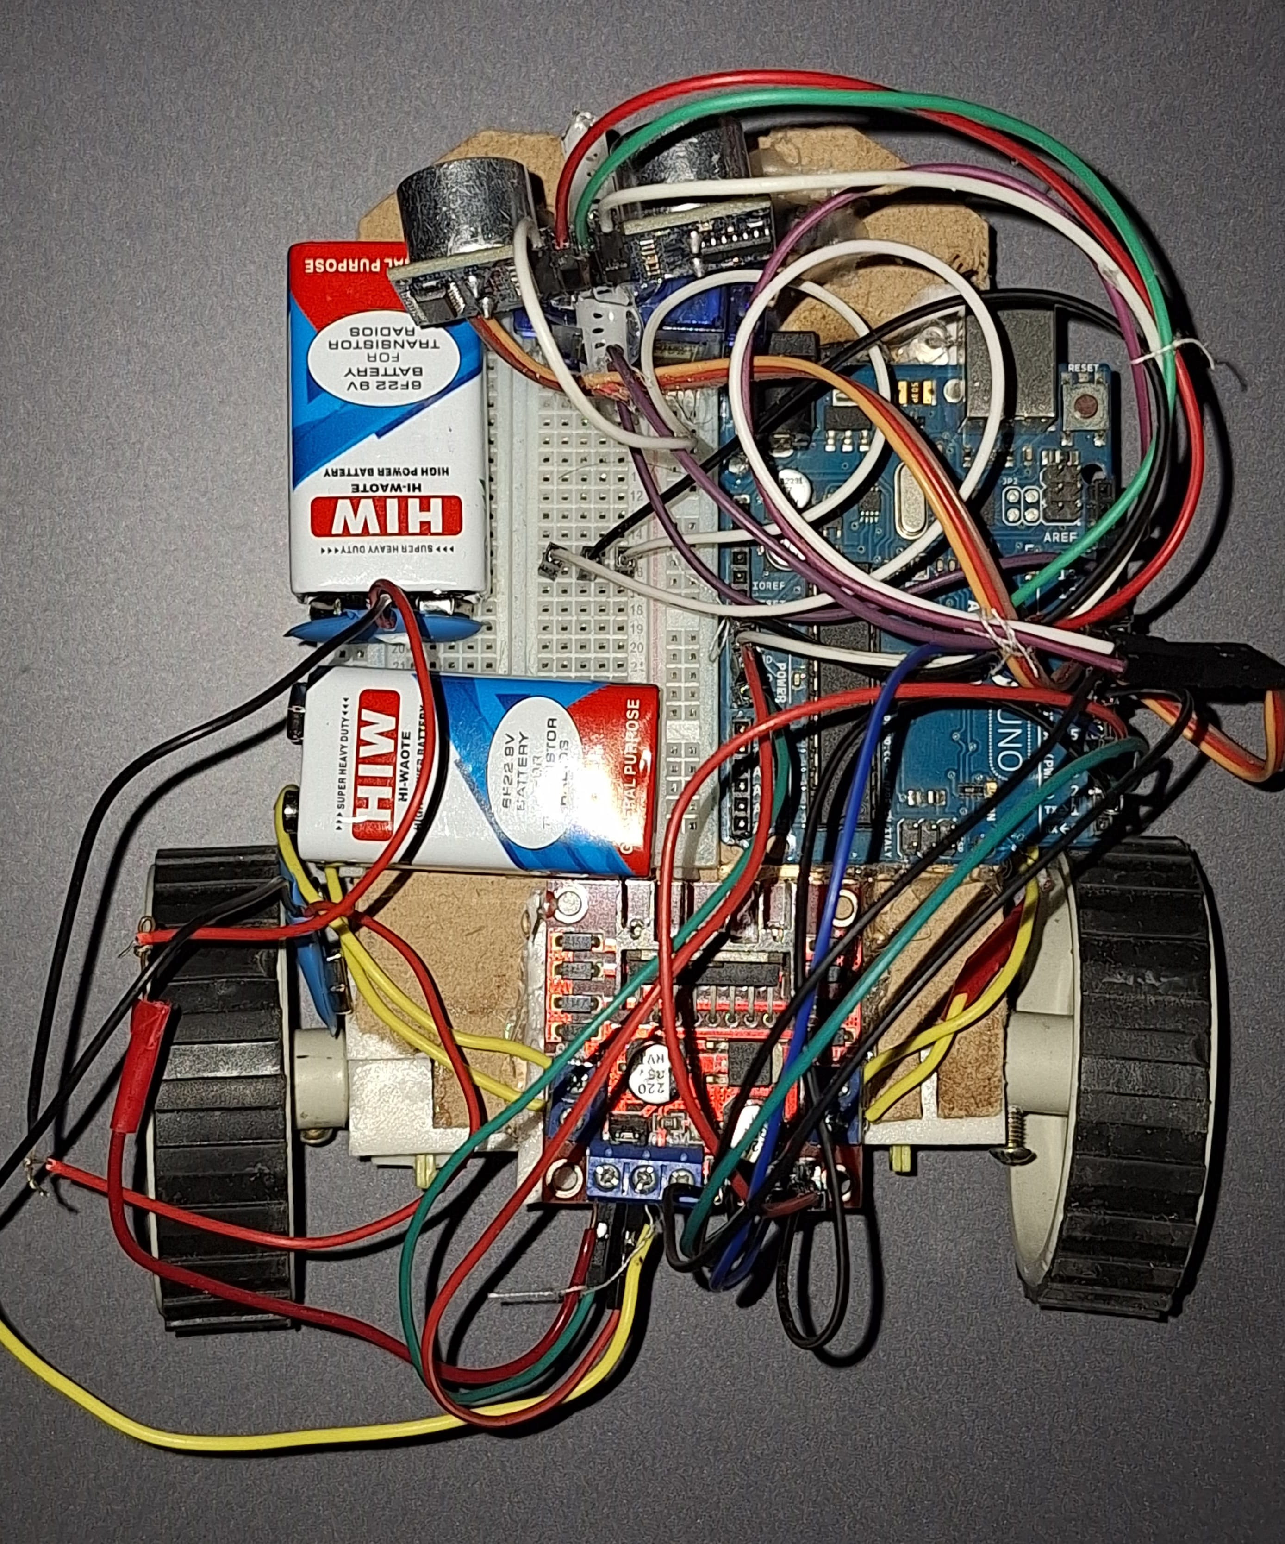
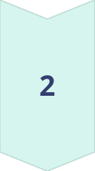
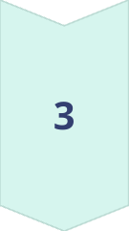
System Model and Workflow
Sensor Data Acquisition
The robot uses ultrasonic sensors to gather distance information about its surroundings, detecting obstacles and wall positions.
Decision-Making Logic
A microcontroller processes sensor data and implements predefined logic to determine the robot's next movement based on obstacle distances and wall presence.
Motor Control
Control signals are generated by the microcontroller and sent to the motor driver, which controls the speed and direction of the robot's wheels.

Slide 7
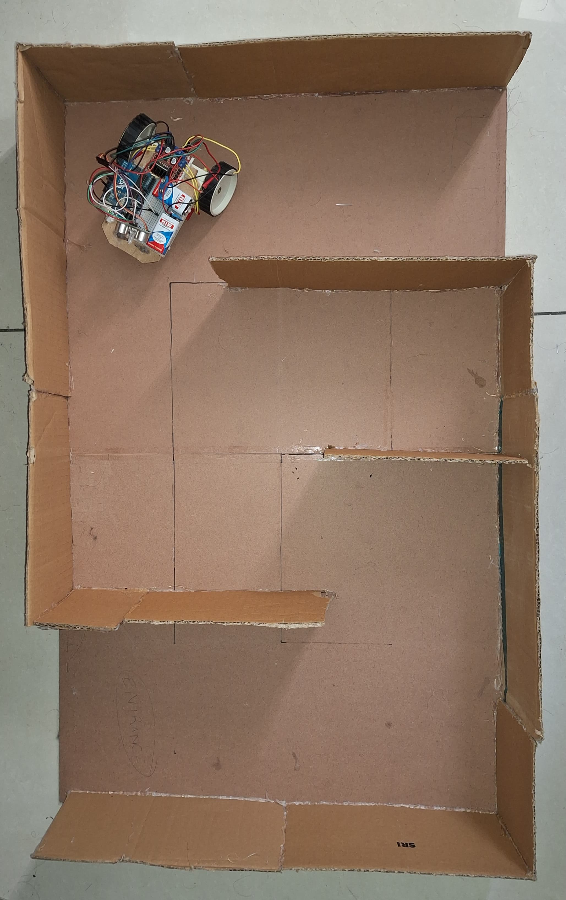
Working Principle
Step
Action
Conditions
1
Scan Surrounding
Robot reads distances ahead and to the right using the ultrasonic sensor.
2
Decision-Making
Based on predefined thresholds, the robot decides on the next movement.
3
Move Forward
If no obstacle ahead and right wall is present, the robot moves forward.
4
Turn Left
If no wall is detected on the right, the robot turns left to search for a wall.
5
Turn Right
If the front is blocked but the right wall is detected, the robot turns right to follow the wall.
6
Servo Adjustment
The servo motor adjusts the ultrasonic sensor's direction for precise distance measurements and accurate wall detection.

Slide 8
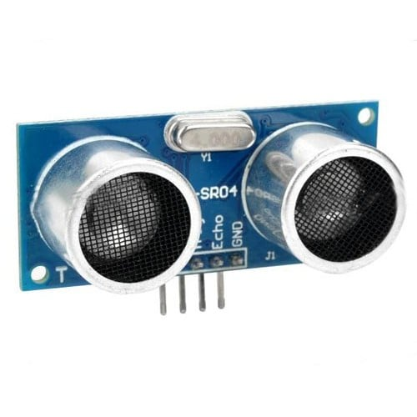
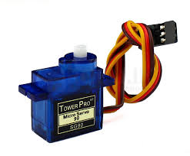
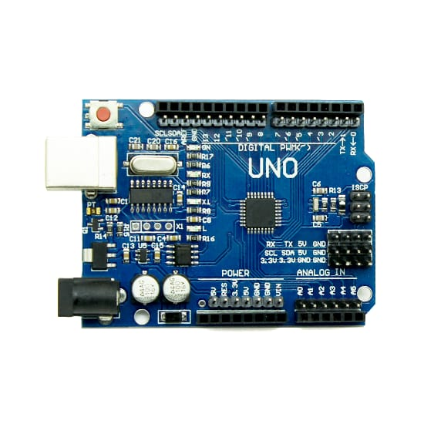
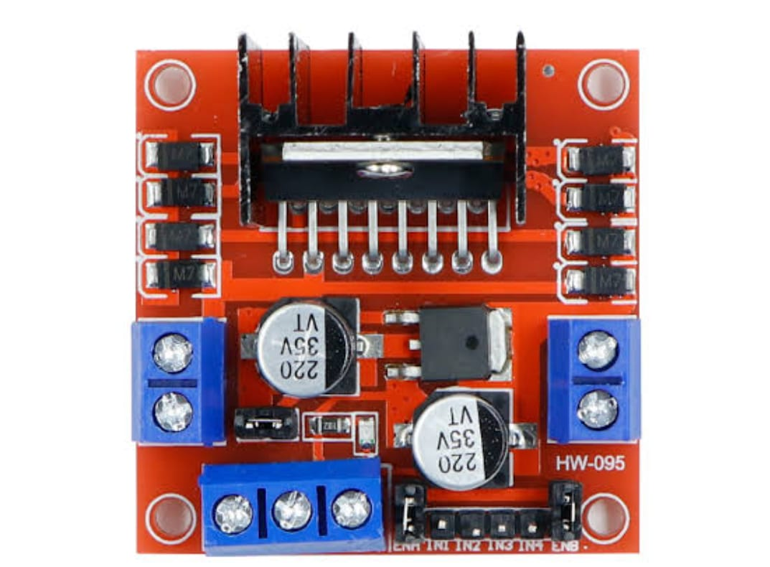
Major Components Used
Ultrasonic Sensor
Servo Motor
Motor Driver
Microcontroller (Arduino)
Used to measure distances to objects, allowing the robot to detect obstacles and walls in its surroundings.
Used for directional sensing, allowing the robot to control the angle of the ultrasonic sensor for accurate wall detection.
Function is to control the speed, direction, and torque of a motor, and to ensure its safe and efficient operation
Acts as the robot's brain, processing sensor data, implementing decision-making logic, and controlling the motors.

Slide 9
Results
The results we achieved were not entirely satisfactory, as the robot was unable to complete the entire maze autonomously.
While it demonstrated the ability to navigate certain sections of the maze, it faced difficulties in handling more complex turns, dead ends, or adapting to unforeseen obstacles.
Despite these limitations, the project was a valuable learning experience, even if the performance fell short of full autonomy.
These challenges have provided insights into areas that need improvement, such as refining algorithms, enhancing sensor accuracy, and optimizing decision-making processes.
Although the robot didn’t fully meet our expectations, it represents a meaningful foundation for future iterations and advancements.

Slide 10
Challenges
Fine-Tuning Sensor Thresholds
Handling Narrow Pathways and Sharp Turns
Adjusting Motor Speeds
Adjusting sensor thresholds to accurately detect walls and avoid false positives or misses is crucial for reliable navigation.
Finding the optimal motor speeds to ensure smooth and stable movement without excessive overshoot or stalling is crucial for navigating the maze effectively.
Navigating narrow pathways and sharp turns presents a challenge for the robot's movement and sensor readings.

Slide 11
Conclusion
The maze-solving robot could not demonstrate efficient autonomous navigation.
Right-hand wall-following logic was not able ensure a simple yet effective approach to maze solving.
Future improvements could include dynamic path optimization and multi-sensor integration.

